Slide 1


ITM 540
Data Networks
The Network Layer
Layer 3
Ping and Tracert
Professor: Carol Davids
Email: davids@iit.edu
Carol Davids © 2014

Slide 2
Generating ICMP messages
Two important utilities that can be used to generate ICMP messages.
Ping
Tracert
Carol Davids © 2014

Slide 3
ICMP Type 0 and Type 8
ICMP message type 0 is an echo reply.
ICMP message type 8 is an echo request.
The Ping Utility causes these two ICMP messages to be sent.
Carol Davids © 2014

Slide 4
Ping Utility
Ping is a basic troubleshooting tool
Verifies that machine is active
Verifies that machine is reachable
Carol Davids © 2014

Slide 5
Ping Functions
Ping utility causes the ICMP process to send an ICMP echo request message
The body of the echo request message contains some kind of data that the distant machine is requested to send back (echo) to the sender
Carol Davids © 2014

Slide 6
Ping Functions
The ping utility waits up to one second to receive the echoed data
The ping utility then prints the number of packets it sent and it received.
The utility checks that the data that was echoed back is the same as the data that was sent.
Carol Davids © 2014

Slide 7
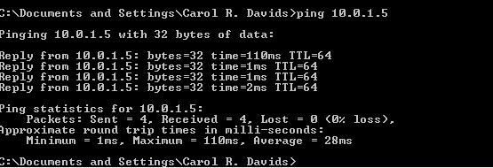
Ping Example 1
Ping another host on my wireless home network.
Notice that 32 bytes of data were sent.
Notice that 4 replies are listed, and each reply tells the round trip time and the TTL
Carol Davids © 2014

Slide 8
Ping Example 1
Notice the ping statistics:
They provide information about the round trip times: The first echo took 110 ms. The second and third took 1 ms. The last one took 2 ms.
Statistics gave a max, min and average time.
Carol Davids © 2014

Slide 9
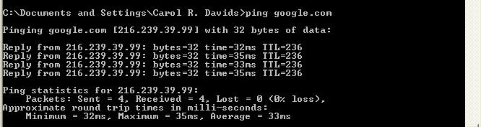
Ping Example 2
Ping Google from home.
Max round trip time is 35 ms
Min round trip time is 32 ms
Average round trip time is 33 ms
Carol Davids © 2014

Slide 10
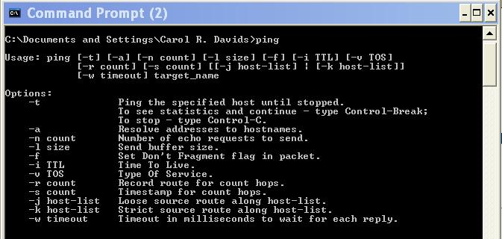
Ping Options for Windows
You can use the ping options to learn about the network topology and the network conditions.
Carol Davids © 2014

Slide 11
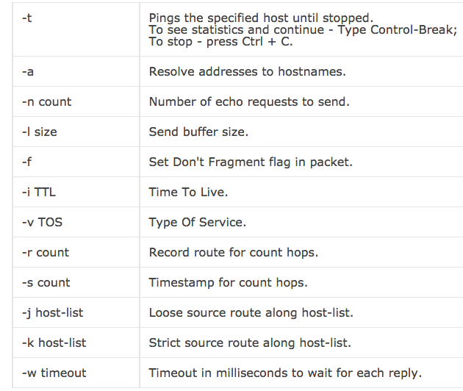
Ping Options – for Windows
Carol Davids © 2014

Slide 12
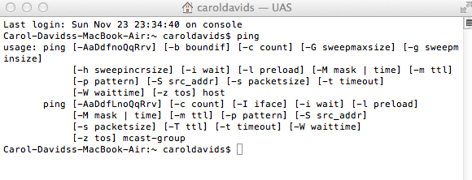
Ping Options – for Mac
Carol Davids © 2014

Slide 13
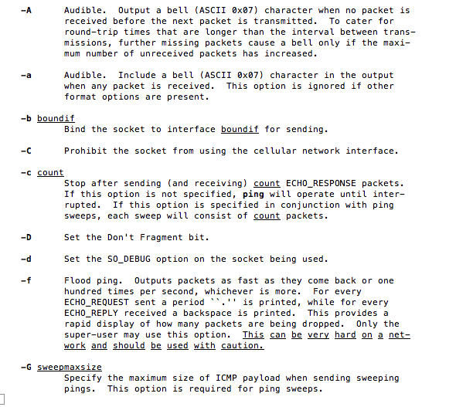
Ping Options – for Mac
Carol Davids © 2014

Slide 14
Ping Sweep
A ping sweep is a type of network probe.
You input a list of IP addresses and the sweep sends a ping request to each one.
fping is a utility that can be used to implement a ping sweep.
Carol Davids © 2014

Slide 15
Ping Exercise – with answers for Mac
Use the ping command to do the following. Take a separate trace of the result of issuing each trace.
Send a 180 byte ping 5 times
  ping –c 5 – s 180
Send a 180 byte ping 5 times with TTL set to 60
  ping –c 5 –m 600 –s 180
Carol Davids © 2014

Slide 16
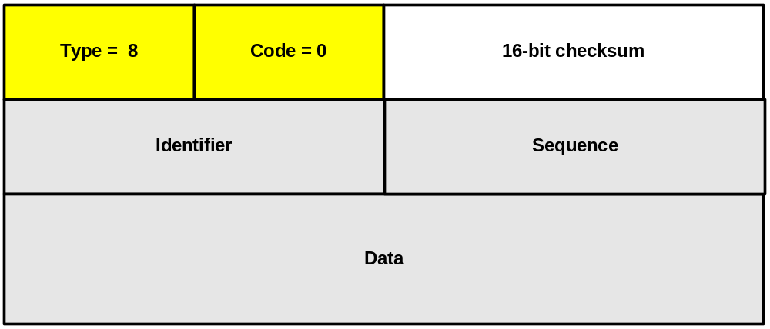
Ping Request Message Structure
Type =8; Code= 0; checksum
Identifier; Sequence; Data
Carol Davids © 2014

Slide 17
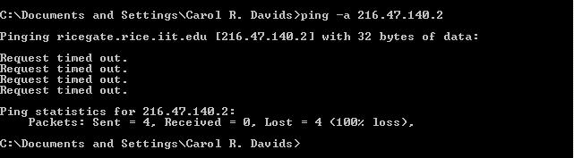
Ping -a: Pinging the unpingable
Ping -a : Resolves an IP address to a host name.
In this example I pinged the Rice Campus gateway router.
The router is provisioned not to respond to pings.
Carol Davids © 2014

Slide 18
Ping -a: Pinging the unpingable
But the ping -a utility caused a DNS lookup to be launched which resulted in my receiving the FQDN of the IP address, even though the ping itself failed.
Carol Davids © 2014

Slide 19
Wireshark trace of first ping request
Internet Protocol, Src Addr: 10.0.1.3 (10.0.1.3), Dst Addr: 216.47.140.2 (216.47.140.2)
Version: 4
Header length: 20 bytes
Differentiated Services Field: 0x00 (DSCP 0x00: Default; ECN: 0x00)
Total Length: 60
Identification: 0x6b98 (27544)
Flags: 0x00
Fragment offset: 0
Time to live: 128
Protocol: ICMP (0x01)
Header checksum: 0x5ff4 (correct)
Source: 10.0.1.3 (10.0.1.3)
Destination: 216.47.140.2 (216.47.140.2)
Internet Control Message Protocol
Type: 8 (Echo (ping) request)
Code: 0
Checksum: 0x3d5c (correct)
Identifier: 0x0300
Sequence number: 0x0d00
Data (32 bytes)
0000 61 62 63 64 65 66 67 68 69 6a 6b 6c 6d 6e 6f 70 abcdefghijklmnop
0010 71 72 73 74 75 76 77 61 62 63 64 65 66 67 68 69 qrstuvwabcdefghi
Carol Davids © 2014

Slide 20
Wireshark trace of second ping request
Internet Protocol, Src Addr: 10.0.1.3 (10.0.1.3), Dst Addr: 216.47.140.2 (216.47.140.2)
Version: 4
Header length: 20 bytes
Differentiated Services Field: 0x00 (DSCP 0x00: Default; ECN: 0x00)
Total Length: 60
Identification: 0x6b9b (27547)
Flags: 0x00
Fragment offset: 0
Time to live: 128
Protocol: ICMP (0x01)
Header checksum: 0x5ff1 (correct)
Source: 10.0.1.3 (10.0.1.3)
Destination: 216.47.140.2 (216.47.140.2)
Internet Control Message Protocol
Type: 8 (Echo (ping) request)
Code: 0
Checksum: 0x3c5c (correct)
Identifier: 0x0300
Sequence number: 0x0e00
Data (32 bytes)
0000 61 62 63 64 65 66 67 68 69 6a 6b 6c 6d 6e 6f 70 abcdefghijklmnop
0010 71 72 73 74 75 76 77 61 62 63 64 65 66 67 68 69 qrstuvwabcdefghi
Carol Davids © 2014

Slide 21
Wireshark trace of fourth ping request
Internet Protocol, Src Addr: 10.0.1.3 (10.0.1.3), Dst Addr: 216.47.140.2 (216.47.140.2)
Version: 4
Header length: 20 bytes
Differentiated Services Field: 0x00 (DSCP 0x00: Default; ECN: 0x00)
Total Length: 60
Identification: 0x6b9f (27551)
Flags: 0x00
Fragment offset: 0
Time to live: 128
Protocol: ICMP (0x01)
Header checksum: 0x5fed (correct)
Source: 10.0.1.3 (10.0.1.3)
Destination: 216.47.140.2 (216.47.140.2)
Internet Control Message Protocol
Type: 8 (Echo (ping) request)
Code: 0
Checksum: 0x3a5c (correct)
Identifier: 0x0300
Sequence number: 0x1000
Data (32 bytes)
0000 61 62 63 64 65 66 67 68 69 6a 6b 6c 6d 6e 6f 70 abcdefghijklmnop
0010 71 72 73 74 75 76 77 61 62 63 64 65 66 67 68 69 qrstuvwabcdefghi
Carol Davids © 2014

Slide 22
Trace of whole transaction frames 1-4
Frame 1 (42 bytes on wire, 42 bytes captured)
Ethernet II, Src: 00:0c:41:2b:a2:a6, Dst: ff:ff:ff:ff:ff:ff
Address Resolution Protocol (request)
Frame 2 (42 bytes on wire, 42 bytes captured)
Ethernet II, Src: 00:03:93:e5:13:52, Dst: 00:0c:41:2b:a2:a6
Address Resolution Protocol (reply)
Frame 3 (85 bytes on wire, 85 bytes captured)
Ethernet II, Src: 00:0c:41:2b:a2:a6, Dst: 00:03:93:e5:13:52
Internet Protocol, Src Addr: 10.0.1.3 (10.0.1.3), Dst Addr: 10.0.1.1 (10.0.1.1)
User Datagram Protocol, Src Port: 1044 (1044), Dst Port: domain (53)
Domain Name System (query)
Frame 4 (120 bytes on wire, 120 bytes captured)
Ethernet II, Src: 00:03:93:e5:13:52, Dst: 00:0c:41:2b:a2:a6
Internet Protocol, Src Addr: 10.0.1.1 (10.0.1.1), Dst Addr: 10.0.1.3 (10.0.1.3)
User Datagram Protocol, Src Port: domain (53), Dst Port: 1044 (1044)
Domain Name System (response)
Carol Davids © 2014

Slide 23
Trace of whole transaction frames 5-8
Frame 5 (74 bytes on wire, 74 bytes captured)
Ethernet II, Src: 00:0c:41:2b:a2:a6, Dst: 00:03:93:e5:13:52
Internet Protocol, Src Addr: 10.0.1.3 (10.0.1.3), Dst Addr: 216.47.140.2 (216.47.140.2)
Internet Control Message Protocol
Frame 6 (81 bytes on wire, 81 bytes captured)
Ethernet II, Src: 00:0c:41:2b:a2:a6, Dst: 00:03:93:e5:13:52
Internet Protocol, Src Addr: 10.0.1.3 (10.0.1.3), Dst Addr: 10.0.1.1 (10.0.1.1)
User Datagram Protocol, Src Port: 1163 (1163), Dst Port: domain (53)
Domain Name System (query)
Frame 7 (81 bytes on wire, 81 bytes captured)
Ethernet II, Src: 00:03:93:e5:13:52, Dst: 00:0c:41:2b:a2:a6
Internet Protocol, Src Addr: 10.0.1.1 (10.0.1.1), Dst Addr: 10.0.1.3 (10.0.1.3)
User Datagram Protocol, Src Port: domain (53), Dst Port: 1163 (1163)
Domain Name System (response)
Frame 8 (81 bytes on wire, 81 bytes captured)
Ethernet II, Src: 00:0c:41:2b:a2:a6, Dst: 00:03:93:e5:13:52
Internet Protocol, Src Addr: 10.0.1.3 (10.0.1.3), Dst Addr: 10.0.1.1 (10.0.1.1)
User Datagram Protocol, Src Port: 1163 (1163), Dst Port: domain (53)
Domain Name System (query)
Carol Davids © 2014

Slide 24
Trace of whole transaction frames 9 - 12
Frame 9 (81 bytes on wire, 81 bytes captured)
Ethernet II, Src: 00:03:93:e5:13:52, Dst: 00:0c:41:2b:a2:a6
Internet Protocol, Src Addr: 10.0.1.1 (10.0.1.1), Dst Addr: 10.0.1.3 (10.0.1.3)
User Datagram Protocol, Src Port: domain (53), Dst Port: 1163 (1163)
Domain Name System (response)
Frame 10 (74 bytes on wire, 74 bytes captured)
Ethernet II, Src: 00:0c:41:2b:a2:a6, Dst: 00:03:93:e5:13:52
Internet Protocol, Src Addr: 10.0.1.3 (10.0.1.3), Dst Addr: 216.47.140.2 (216.47.140.2)
Internet Control Message Protocol
Frame 11 (74 bytes on wire, 74 bytes captured)
Ethernet II, Src: 00:0c:41:2b:a2:a6, Dst: 00:03:93:e5:13:52
Internet Protocol, Src Addr: 10.0.1.3 (10.0.1.3), Dst Addr: 216.47.140.2 (216.47.140.2)
Internet Control Message Protocol
Frame 12 (74 bytes on wire, 74 bytes captured)
Ethernet II, Src: 00:0c:41:2b:a2:a6, Dst: 00:03:93:e5:13:52
Internet Protocol, Src Addr: 10.0.1.3 (10.0.1.3), Dst Addr: 216.47.140.2 (216.47.140.2)
Internet Control Message Protocol
Carol Davids © 2014

Slide 25
Wireshark trace of this ‘ping -a’ example
Host sends an ARP to determine where my router is on my wireless LAN.
Router supplies its MAC address.
Host sends an ICMP echo request to ricegate
Host sends two DNS queries to my router which responds
Host sends three more ICMP echo requests to ricegate
Ping times out (silently)
Carol Davids © 2014

Slide 26
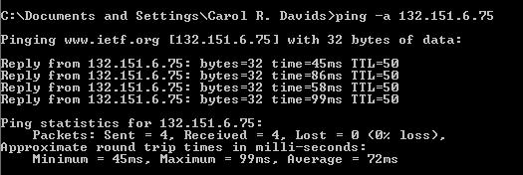
Ping -a IETF Web Site
Issue ping -a of ietf.org
The –a resolves the IP address to 132.151.6.75
Carol Davids © 2014

Slide 27
Ping -a IETF
The pings do not time out - IETF allows the echo reply.
Minimum round trip time was 45 ms, maximum was 99 ms and average was 72 ms.
Carol Davids © 2014

Slide 28
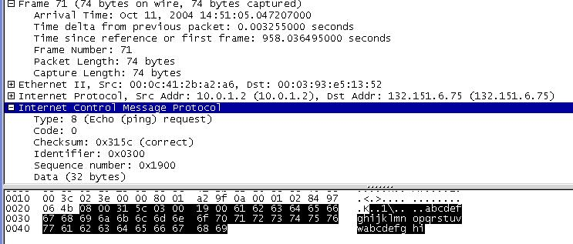
Carol Davids © 2014

Slide 29
In the first ping request:
  Type = 8, Code = 0.
  Identifier = hex 0300
  Sequence number = hex 1900
  There are 32 bytes of data
  The data is abcdefghijklmnopqrstuvwabcdefghi
Carol Davids © 2014

Slide 30
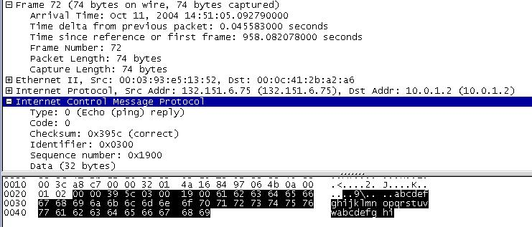
Carol Davids © 2014

Slide 31
In the first ping reply:
  Type = 0, Code = 0.
  Identifier = hex 0300
  Sequence number = hex 1900
  There are 32 bytes of data
  The data is abcdefghijklmnopqrstuvwabcdefghi
  Notice that the time since the previous packet is ~46 ms
Carol Davids © 2014

Slide 32
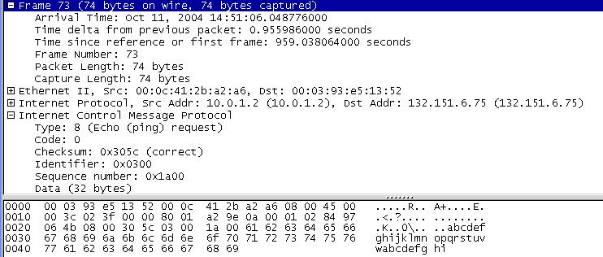
Carol Davids © 2014

Slide 33
In the second ping request:
  Type = 8, Code = 0.
  Identifier = hex 0300
  Sequence number = hex 1a00
  There are 32 bytes of data
  The data is abcdefghijklmnopqrstuvwabcdefghi
Carol Davids © 2014

Slide 34
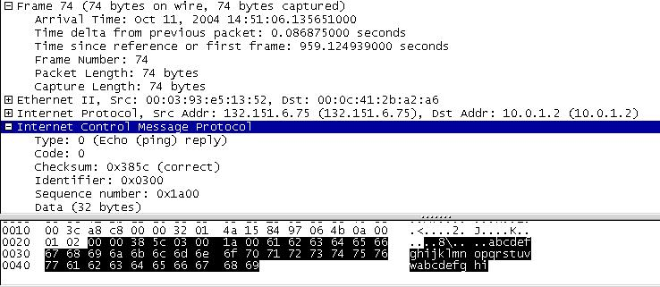
Carol Davids © 2014

Slide 35
In the second ping reply:
  Type = 0, Code = 0.
  Identifier = hex 0300
  Sequence number = hex 1a00
  There are 32 bytes of data
  The data is abcdefghijklmnopqrstuvwabcdefghi
  Notice time delta from last packet is ~ 87 ms
Carol Davids © 2014

Slide 36
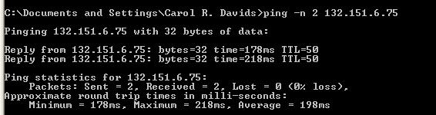
Ping -n (count )
Ping -n (count) (IP Address) tells the utility to ping the IP Address ‘count’ times.
ping -n 2 132.151.6.75
Carol Davids © 2014

Slide 37
Ping -n (count)
Round trip minimum time was 178 ms
maximum RTT was 218 ms
average RTT was 198 ms.
Carol Davids © 2014

Slide 38
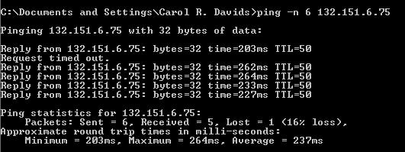
Ping -n 6 132.151.6.75
Carol Davids © 2014

Slide 39
Ping -n 6 132.151.6.75
Round trip minimum time was 203 ms
maximum was 264 ms
average was 237 ms.
Packet loss was 16%
Carol Davids © 2014

Slide 40
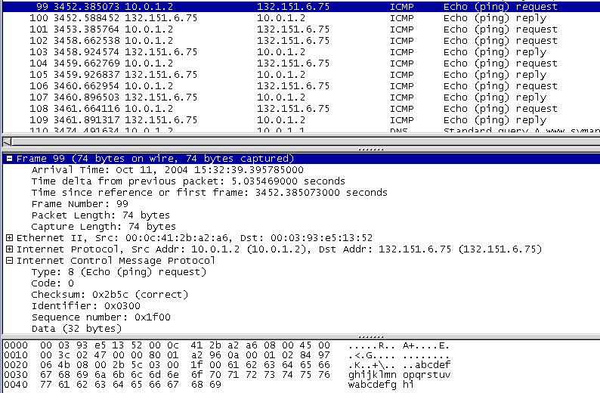
Test 2: Ping -n 6
Carol Davids © 2014

Slide 41
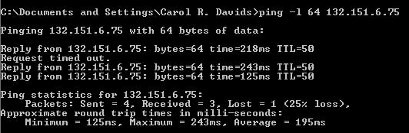
Ping -l (size)
You may select the size of the data that ping will send
In the example below ping -l 64 132.151.6.75 64 bytes of data are sent.
Carol Davids © 2014

Slide 42
Ping -l (size)
Round trip minimum time was 125 ms
maximum was 243 ms
average was 195 ms.
Packet loss was 25%
Carol Davids © 2014

Slide 43
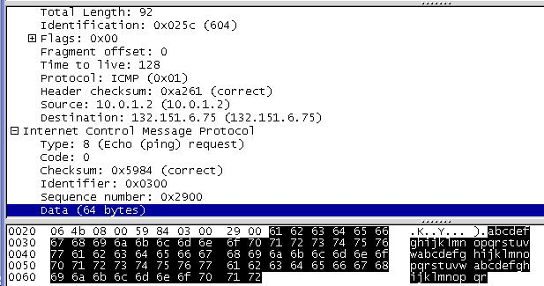
Below is the Wireshark trace of the first echo request with a 64 byte data packet.
Notice that the data is abcdefghijklmnopqrstuvwabcdefghijklmnopqrstuvwabcdefghijklmnopqr
Carol Davids © 2014

Slide 44
Below is the ethereal trace of the first echo request with a 64 byte data packet.
Carol Davids © 2014

Slide 45
Ping -l 64
Notice that the data sent in the ping is abcdefghijklmnopqrstuvwabcdefghijklmnopqrstuvwabcdefghijklmnopqr
This is 64 ascii characters - 64 bytes of data
Carol Davids © 2014

Slide 46
Ping -f
Ping -f causes the DF bit to be set in the IP header of the echo requests and replies.
Carol Davids © 2014

Slide 47
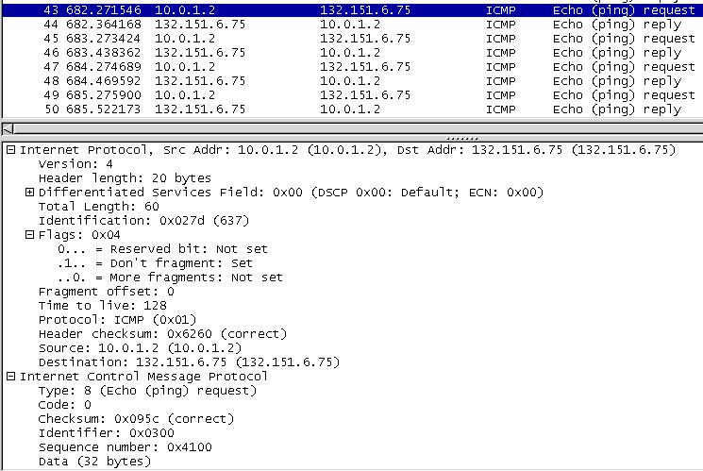
Carol Davids © 2014

Slide 48
Ping -i TTL
Ping -i TTL causes the TTL hop count to be set in the IP header of the echo requests and replies.
In the following examples the hop count is set to 2 and 3 respectively using the ping -I command.
Carol Davids © 2014

Slide 49
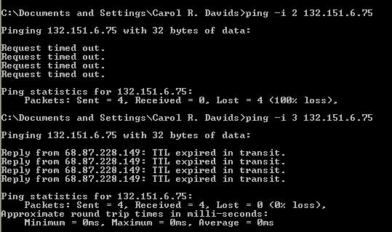
Carol Davids © 2014

Slide 50
Ping -i TTL
In the next example, the hop count is set to 14 and 15 respectively.
TTL expired in transit for 14 but not for a hop count of 15 so we know there are 15 devices between my host and the destination.
This is the method used by the tracert utility to identify the set of routers traversed to get an ip datagram between its source and destination.
Carol Davids © 2014

Slide 51
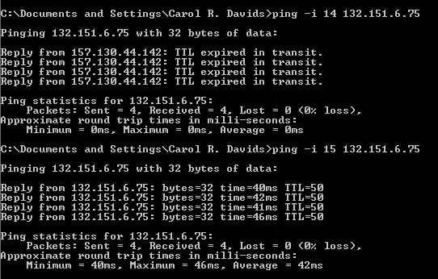
Carol Davids © 2014

Slide 52
Other options for the ping request
Ping -v allows you to set the type of service field
Ping -r count allows you to record the route taken for the count hops
Ping -s count allows you to receive a time stamp for each count hop
Carol Davids © 2014

Slide 53
Other options for the ping request
Ping -j host-list forces the echo message to pass through all the hosts in host-list
Ping -k host-list forces the echo message to pass through exactly the route identified in host-list
Ping -w allows you to set the time that the ping utility will wait before timing out waiting for an echo reply message.
Carol Davids © 2014

Slide 54
Record Route ( Ping -r )
Ping -r acts to add a Record-Route Option field to the IP header of ping request.
Each router that handles the echo request and the echo reply adds its IP Address to a list in the options field.
The usefulness of this request is limited by the size of the IP header length.
4 bits -> maximum value can be 15
Carol Davids © 2014

Slide 55
Reminder about IP header length
Remember this field represents the length of the IP header, in 32-bit words.
The normal value of this field when no options are used is 5
(5 32-bit words = 5*4 = 20 bytes).
Carol Davids © 2014

Slide 56
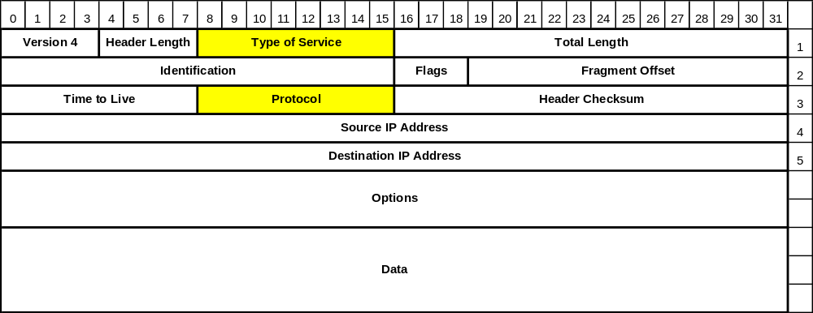
Review IP header length field
Carol Davids © 2014

Slide 57
Ping -r
The maximum header length is 15 32-bit words (15 “lines” in this drawing or 60 bytes.
Carol Davids © 2014

Slide 58
Ping -r
The Record Route Option fields are as shown below.
Limiting factors are:
The entire IP header must be less than or equal to 60 bytes long
The required fields in the IP header take up 20 bytes.
Carol Davids © 2014

Slide 59
Ping -r
This leaves 40 bytes for options.
The Record Route Option has 3 bytes of overhead in the code, len and ptr fields.
This leaves 37 bytes to identify the IP Addresses along the route.
Each address uses 4 bytes.
There are 9 groups of 4 in 37, so no more than 9 IP addresses can be recorded using the Record Route Option.
Carol Davids © 2014

Slide 60
Ping -r
This leaves 40 bytes for options.
The Record Route Option has 3 bytes of overhead in the code, len and ptr fields.
This leaves 37 bytes to identify the IP Addresses along the route.
Carol Davids © 2014

Slide 61
Ping -r
Each address uses 4 bytes.
There are 9 groups of 4 in 37
so no more than 9 IP addresses can be recorded using the Record Route Option.
Carol Davids © 2014

Slide 62
Ptr field
Ptr =4
Ptr =8
Ptr =12
The ptr field in the reply tells where the next ip address starts
The ptr field will have values that are multiples of 4.
These values represent the number of bytes from the start of the Option header.
Carol Davids © 2014

Slide 63
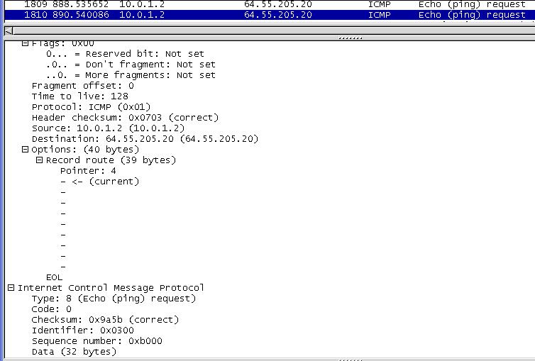
Carol Davids © 2014

Slide 64
Tracert Utility
The Tracert utility uses ICMP echo requests and responses with varying TTL values to deduce the route an IP datagram takes from source to destination.
Carol Davids © 2014

Slide 65
Tracert Function
Tracert sends an ICMP ‘Echo’ packet with a TTL of 1.
The device that receives an IP datagram with TTL value of 1, decrements the hop count by 1, checks and observes that the hop count is now 0.
Carol Davids © 2014

Slide 66
Tracert Function
It discards the datagram and sends an ICMP error message back to the sender telling the sender that the TTL was exceeded.
The IP address of the receiving device is included in that error message.
Carol Davids © 2014

Slide 67
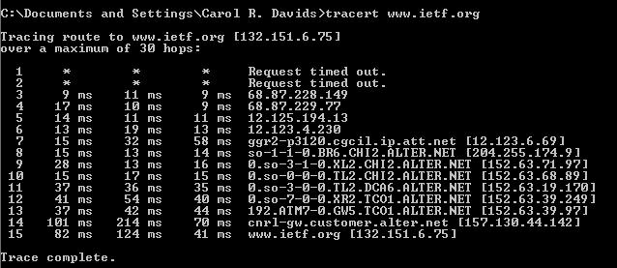
Tracert Example
Tracert www.ietf.org
Results in 15 lines of output in this example.
Carol Davids © 2014

Slide 68
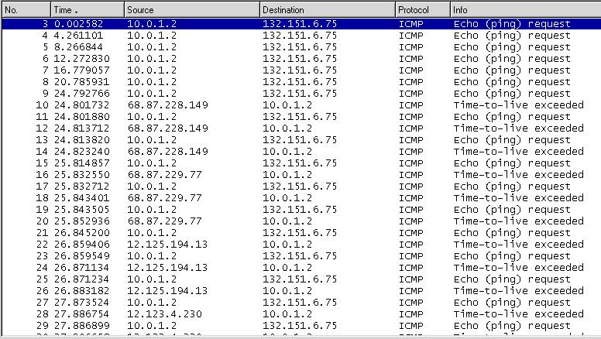
A Wireshark trace taken while tracert was executing.
Carol Davids © 2014

Slide 69
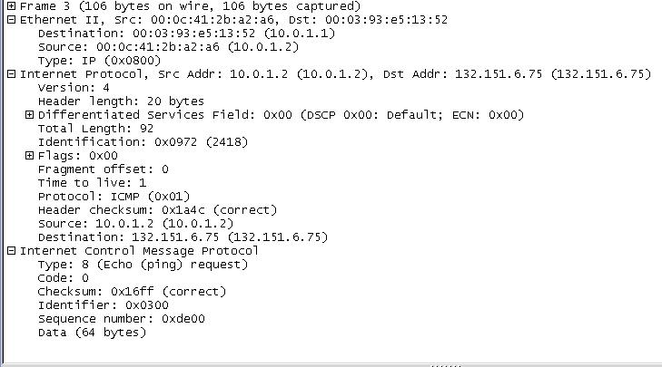
Frame ID 3
Carol Davids © 2014

Slide 70
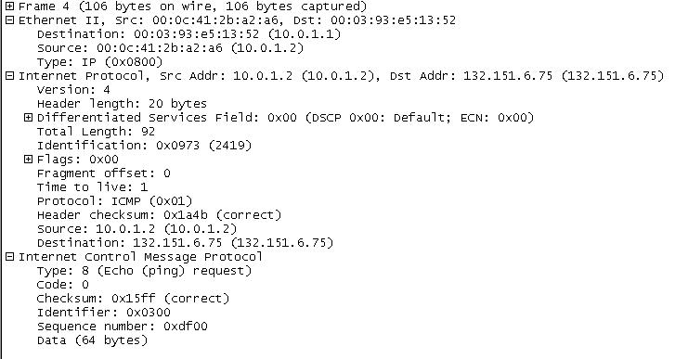
Frame ID 4
Carol Davids © 2014

Slide 71

Frame ID 9
Carol Davids © 2014

Slide 72
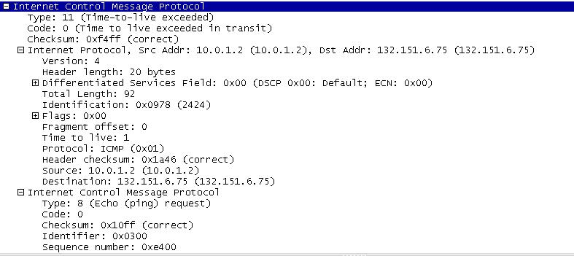
Frame ID 10 - Time to live exceeded (ICMP type 11)
Body of this ICMP message contains the IP header and the first 8 bytes of data in the ip datagram that caused the error message to be generated.
Carol Davids © 2014

Slide 73
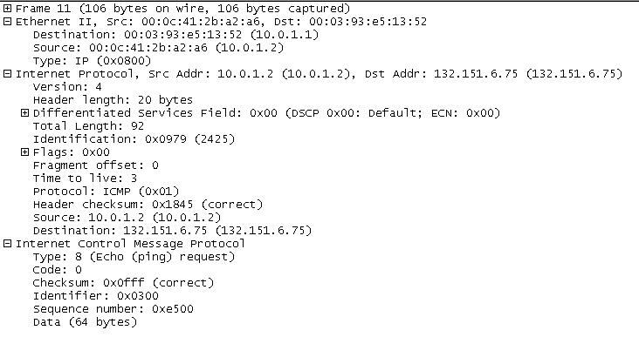
Frame ID 11
Frame 11 is protocol type 1 (ICMP) and the ICMP message is type 8 code 0, an echo request whose Sequence Number is hex e500.
Carol Davids © 2014

Slide 74
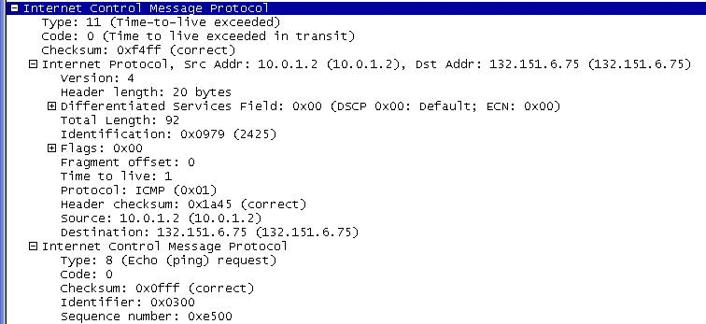
Frame ID 12
Frame 12 is an ICMP error message of type 11 (ttl exceeded) and code 0 (ttl exceeded in transit).
Error messages contain the IP header and first 8 bytes of data of the IP datagram that caused the error. Note that the Sequence number is hex e500. So frame 11 contained the datagram in question.
Carol Davids © 2014

Slide 75
Tracert* Utility Syntax and Options
tracert [-d] [-h maximum_hops] [-j host-list] [-w timeout] target_name
  -d :Do not resolve addresses to hostnames.
  -h (maximum_hops): Maximum number of hops to search for target.
  -j (host-list): Loose source route along host-list.
  -w (timeout): Wait timeout milliseconds for each reply.
  * traceroute is the command in Mac or Linux
Carol Davids © 2014

Slide 76
Tracert options that can limit processing time
tracert -h 15 -- limits the number of echo messages sent to 15 and so cuts down processing time.
tracert -d -- cuts down processing time
Tracert -w 30 -- limits the time to 30 ms that your system will wait before timing out on a request
Carol Davids © 2014

Slide 77
Tracert and Loose Source Routing Options
Source Routing refers to routing information that is supplied by the source of the datagram.
This is distinct from routing that is provided in routing tables or is hard coded.
Carol Davids © 2014

Slide 78
Tracert and Loose Source Routing Options
Loose Source Routing refers to a list of devices through which you want your datagrams to travel.
Your datagrams may travel through other routers that are not listed in a loose source routing list.
Carol Davids © 2014

Slide 79
Tracert and Loose Source Routing Options
Tracert -j <router name> <host computer>
This command would require the IP datagram carrying the ICMP echo request to travel through <router name>
This can be used to discover why a remote host can’t be reached.
Carol Davids © 2014

Slide 80
Traceroute –I <FQDN or IP address>
Use Traceroute – I <address or name> on Linux or Mac
See the man page for the options
See examples next page
Carol Davids © 2014

Slide 81
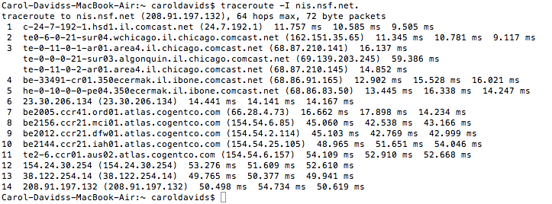
Traceroute –I <FQDN or IP address>
This screen dump corresponds to the Wireshark trace, traceroute –I nis.nsf.net.
Carol Davids © 2014

Slide 82
The End
Carol Davids © 2014

