Slide 1


ITM 540
Data Networks
The Network Layer
Layer 3
Introduction to Routing
Professor: Carol Davids
Email: davids@iit.edu
Carol Davids © 2015

Slide 2
Reading Assignment
Forouzan :
Network Layer: Delivery, Forwarding and Routing
Carol Davids © 2015

Slide 3
Delivery, Forwarding, Routing
The Internet is a network of networks.
Computing devices of various kinds are identified on this concatenation of networks by means of their IP addresses.
The computing devices also have MAC addresses or other kinds of data-link addresses.
But we do not use datalink addresses to route packets between different LANs.
Carol Davids © 2015

Slide 4
Delivery, Forwarding, Routing
We distinguish between three distinct terms used in connection with sending packets from source to destination IP address:
Delivery
Forwarding
Routing
Carol Davids © 2015

Slide 5
Delivery
Delivery is the responsibility of lower layers under the supervision of the network layer
When an IP datagram arrives at a LAN it arrives at the LAN’s gateway router
The router needs to hand the datagram over to the datalink layer to deliver it.
For this, it needs to resolve the IP address to a MAC address or other datalink address.
The device on which the router function runs, uses ARP to resolve the MAC address
Carol Davids © 2015

Slide 6
Forwarding
Forwarding is the responsibility of the network layer (layer 3.)
It is the act of placing the IP datagram onto the correct link so that it can arrive at the next hop on its journey across the networks that lie between it and its destination host.
Carol Davids © 2015

Slide 7
Routing
Routing is also the responsibility of the network layer (layer 3.)
It involves calculating and recording the ‘best’ route.
The decision as to what is ‘best’ will depend on the requirements of the network administration.
Different types of network choose different metrics to determine what is best.
Carol Davids © 2015

Slide 8
IP Address use for delivery, forwarding and routing
The IP address is used in Delivery process, as the input to the ARP process.
The router sends an ARP message that contains the IP address of the destination in order to learn the MAC address to which the datagram must be delivered.
Carol Davids © 2015

Slide 9
IP Address use for delivery, forwarding and routing
The Forwarding process uses the destination IP address as input to the Routing process.
Carol Davids © 2015

Slide 10
IP Address use for delivery, forwarding and routing
The Routing process operates on the IP address to
  Learn the next hop network router to which the datagram will be sent
  Identify the interface out of which the datagram will be sent to get to that next hop
Carol Davids © 2015

Slide 11
IP Address use for delivery, forwarding and routing
The IP address is used in routing to calculate the best routes
Carol Davids © 2015

Slide 12
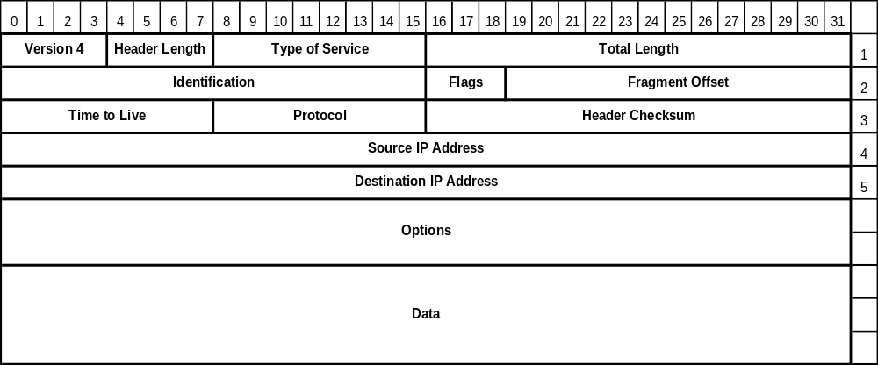
IP Datagram
Carol Davids © 2015

Slide 13
Routing Basics
Some hosts have more than one IP Address or interface.
All routers have more than one interface and usually more than one IP Address.
Which Interface will the router or host send a particular datagram out?
Carol Davids © 2015

Slide 14
Where to keep routes?
The hosts and routers cannot keep a list of all the nodes in the Internet.
There are just too many nodes
  too much memory would be needed
  the search would take too long.
Carol Davids © 2015

Slide 15
Best Routes will vary
Even if we could keep this list, the best route would change over time as links become more and less congested and as nodes fail and new nodes are brought on line.
Carol Davids © 2015

Slide 16
How do you define ‘best’?
How we define the “best” when seeking the best route?
Some administrations may require packets to take the route that involves hopping between the fewest nodes.
Others may want to take the route that has the most bandwidth.
Others may need the one with the shortest queues in their exit buffers.
Carol Davids © 2015

Slide 17
Routing Table
Identifies the interface to which a datagram will be sent.
Identifies the next hop router to which the datagram will be sent
Carol Davids © 2015

Slide 18
Router uses routing table
The router learns the next hop and the interface out which to send the datagram by consulting the routing table
Carol Davids © 2015

Slide 19
Router uses routing table
Datagram enters
Router operates on the destination address in the datagram to determine the destination network or host
Router checks if destination network address matches information in first row.
If it matches, then it puts the datagram onto the identified interface toward the next hop
Carol Davids © 2015

Slide 20
Router uses routing table
If it does not match, then it checks if there is a match on the second row
In each row, the router must operate on the same destination IP address using the network mask in that row to determine if there is a match.
Carol Davids © 2015

Slide 21
Contents of the Routing Table
We consider two types of routing
  Route-based
  Next-Hop
Carol Davids © 2015

Slide 22
Route vs. Next Hop
For Route based routing, the routing table contains the entire route from source to destination – like mapquest
For Next Hop routing, the routing table contains the identify of the next router or network the packet
Carol Davids © 2015

Slide 23
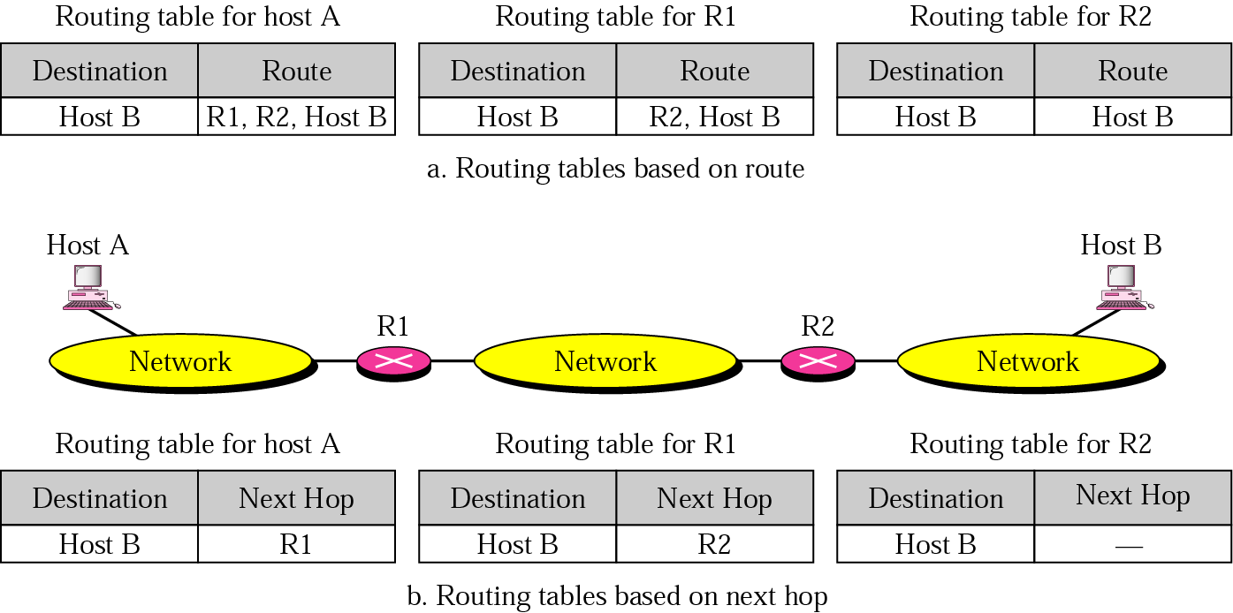
Route vs. Next-Hop
In the top illustration, the routing tables contain the full route.
At the bottom, the routing tables contain only the next hop.
Carol Davids © 2015

Slide 24
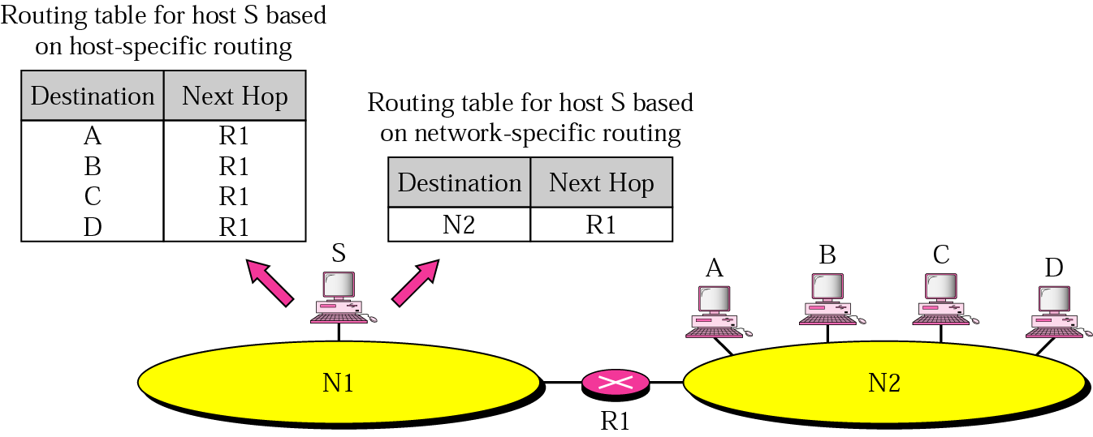
Network-Specific Forwarding
Treats all hosts on a network as a single entity.
Destination column elements are networks
Next Hop column can contain routers
Carol Davids © 2015

Slide 25
Network-Specific Forwarding
This method saves table entries since all the hosts on a network are reached using the network address.
Carol Davids © 2015

Slide 26
Host-Specific Forwarding
The destination column of the routing table contains the address of an individual host.
The next hop column contains the identification of the next hop router that will carry the datagram to that host.
Carol Davids © 2015

Slide 27
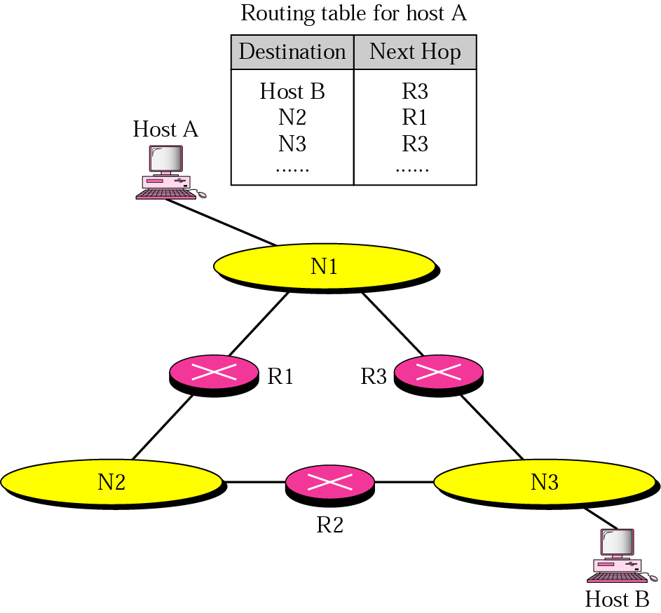
Host-Specific Forwarding
Routing table whose first list contains a host specific entry.
This forces all packets destined for B to travel through R3
Carol Davids © 2015

Slide 28
Host-Specific Forwarding
This gives the administrator greater control over routing.
Could be used as a Security Measure; to route all the IP datagrams destined for a particular network to pass through a particular Firewall.
Carol Davids © 2015

Slide 29
Default Routing
The destination column of the routing table contains the address 0.0.0.0.
By definition this means the default network address.
If the router has not found the destination address anywhere else the destination column, it will send the IP datagram to the Next Hop Router indicated.
Carol Davids © 2015

Slide 30
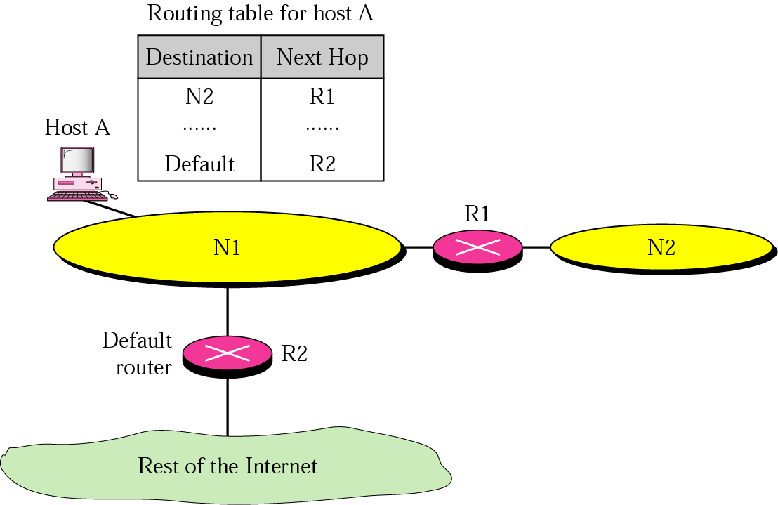
Default Routing
Host A is on N1, and N1 has two routers.
R1 gets you to N2
R2 gets you to the rest of the Internet
Carol Davids © 2015

Slide 31
Routing Table - Updates
The routing table can be updated by several methods including:
  Manual entry of routes (static routing)
  Receipt of ICMP messages
  Routing processes
Carol Davids © 2015

Slide 32
Manual Updates
A static routing table has information entered manually.
Does not scale well
  labor intensive
  time-consuming.
  error-prone - either due to failures to enter changes at all or due to the latency between when the physical change is made and when the change is entered.
Carol Davids © 2015

Slide 33
ICMP Updates
The ICMP messages that can trigger changes in the Routing table include:
  ‘Redirect’
  ‘Advertisement’
  ‘Solicitation’
Carol Davids © 2015

Slide 34
Source Routing by-passing the routing table
Source routing allows the source IP host to specify a route through the IP network.
It is specified as an option in the IP header.
If source routing is specified, the software forwards the packet according to the specified source route.
The routing table is not consulted
Carol Davids © 2015

Slide 35
Dynamic Routing Protocol Updates
Dynamic Routing tables are updated periodically and automatically.
A dynamic routing protocol sends information between routing processes.
We will study three dynamic routing protocols
Carol Davids © 2015

Slide 36
Dynamic Routing Protocols
  RIP - Routing Information Protocol
  OSPF - Open Shortest Path First
  BGP - Border Gateway Protocol
Carol Davids © 2015

Slide 37
Routing Application
Dynamic routing methods involve an application - a routing application
The application (layer 5):
  Receives information from routing protocol messages
  Processes that information
  Writes information to the routing table
Carol Davids © 2015

Slide 38
Classless Routing
The routing table requires a minimum of 4 columns:
  Network mask
  Destination address
  Next-hop address
  Interface
Carol Davids © 2015

Slide 39
Classless Routing
Classless routing process is as follows:
  Datagram arrives at routing process
  Router applies mask of first entry in its routing table to the destination address of the arriving datagram
  If the result is the entry’s destination address, the datagram is sent to the corresponding interface and from there to the next-hop address.
Carol Davids © 2015

Slide 40
Classless Routing
If the routing process exhausts all rows in the routing table without finding a match, it delivers the packet to the default interface which takes the packet to the default router.
Carol Davids © 2015

Slide 41
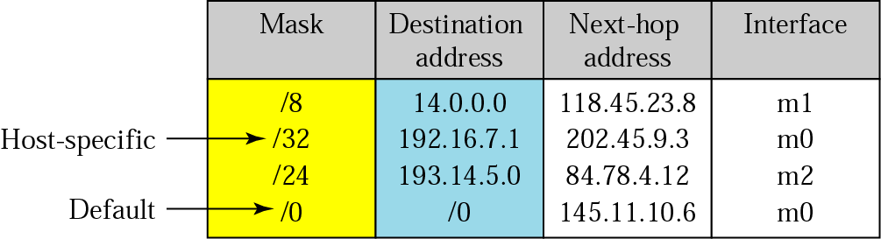
Examples
Row 1, network mask is /8 and destination address is a network address
Row 2, network mask is /32, this means that you need to match every bit of the destination address to use that row
Row 3, network mask is /24 and destination address is also a network address
Carol Davids © 2015

Slide 42
Examples
Out which interface will packet be sent?
(Ex 1 ) packet destined for 192.16.7.1
(Ex 2) packet destined for 193.14.5.22
(Ex 3) packet destined for 200.34.12.34
Carol Davids © 2015

Slide 43
Example 1
(Ex 1) packet destined for 192.16.7.1
Match is made in second row:
Place /32 over 192.16.7.1 to get 192.16.7.1
Next hop is 202.45.9.3
Interface is m0
Carol Davids © 2015

Slide 44
Example 2
(Ex 2) packet destined for 193.14.5.22
Match is made in third row:
Place /24 over 193.14.5.22 to get 193.14.5.0
Next hop is 84.78.4.12
Interface is m2
Carol Davids © 2015

Slide 45
Example 3
(Ex 3) packet destined for 200.34.12.34
Match is made in fourth row:
Place /0 over 200.34.12.34 to get 0.0.0.0
Next hop is 145.11.10.6
Interface is m0
Carol Davids © 2015

Slide 46
Classless Routing
Classless routing allows us to consolidate a number of Class C networks into a single larger network.
More commonly, it allows us to divide Class A and Class B networks into smaller networks.
In both cases the subnet mask is used to determine whether the destination address of the datagram matches the destination in the table.
Carol Davids © 2015

Slide 47

Classless Routing
Figure 22.5 : forwarding in classless address routing
Carol Davids © 2015

Slide 48

Make the routing table for R1
Figure 22.5 Edition 4: forwarding in classless address roiuting
m3
Carol Davids © 2015

Slide 49

Table 22.1 Example 22.1
Routing table created from diagram on previous page.
Place the longest network mask at the top.
Note that next hop field is blank since the network address denotes the network on which the host resides. So no further hops are needed.
Carol Davids © 2015

Slide 50
Example using R1 Routing Table
A packet arrives at R1 with destination address 180.70.65.140.
What is the next hop network and the interface out which the packet will be sent?
Carol Davids © 2015

Slide 51
Classless routing -> longer routing tables
When Class A and Class B networks are subdivided using classless addressing, the number of lines in the routing tables will grow.
Two mechanisms are used to reduce the size of the routing tables:
  Address aggregation
  Longest mask matching
Carol Davids © 2015

Slide 52
Hierarchical routing
In hierarchical routing the internet has been divided into International and National ISPs; Regional and Local ISPs
The result is that routers in each area or region need to know how to reach all the networks below them in the hierarchy, rather than needing to know how to reach every host in every network.
Carol Davids © 2015

Slide 53
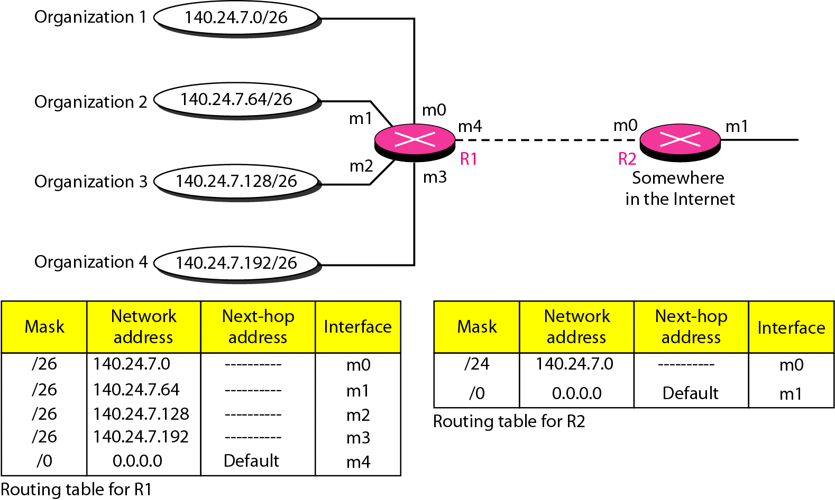
Address Aggregation
The address aggregation method is illustrated in Figure 22.7 of Forouzan,edition 4.
Carol Davids © 2015

Slide 54
Address Aggregation
R2 routes packets to any of the 4 networks to R1. R1 sorts them out.
Carol Davids © 2015

Slide 55
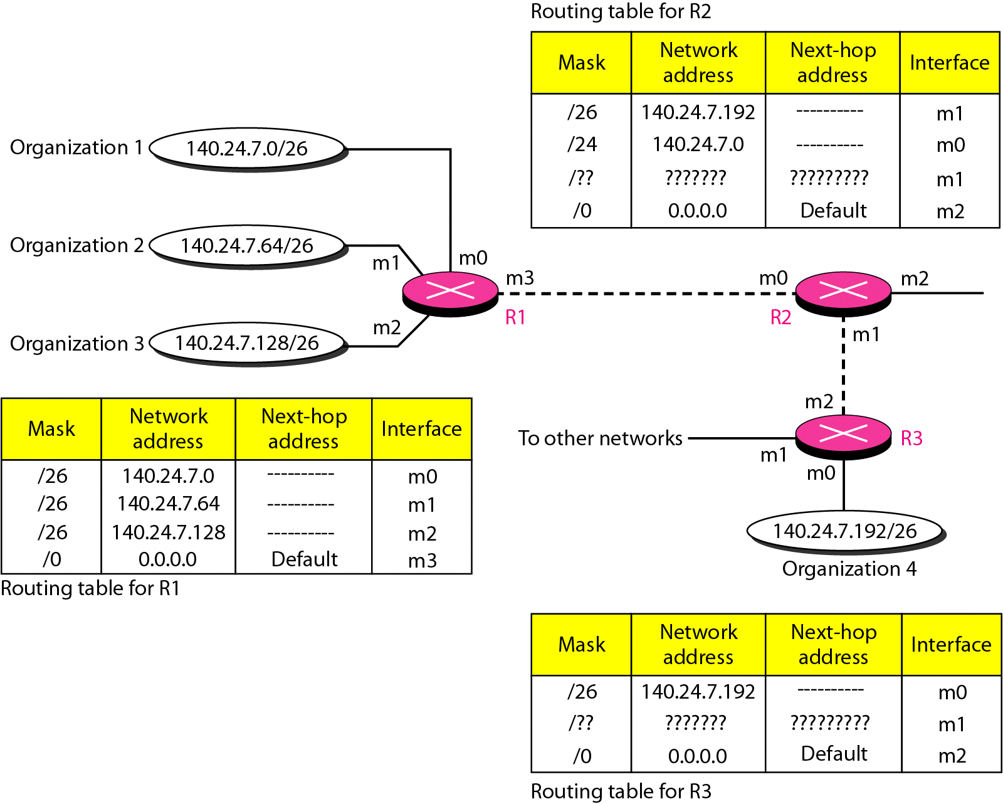
Longest Mask Matching
Illustrated in Figure 22.8 of Forouzan, edition 4
Carol Davids © 2015

Slide 56
Longest Mask Matching
Sort the routing table by longest mask to shortest mask
Carol Davids © 2015

Slide 57
Forwarding Tables vs. Routing Tables
Switches and Routers both need to keep a table in memory where they store information about the interfaces out of which to send the frames or datagrams that they are called upon to forward.
Carol Davids © 2015

Slide 58
Forwarding Tables vs. Routing Tables
The table that the switch keeps is called a Forwarding table.
The table that the router keeps is called a Routing Table.
Carol Davids © 2015

Slide 59
Switches vs. Routers
The spanning tree protocol is used by the bridges on a network to identify a loop-free route over which frames will be sent.
The goal on a LAN is to have only one path for the frame to follow to a destination.
Carol Davids © 2015

Slide 60
Switches vs. Routers
The Internet is a mesh of nodes and there are multiple possible paths between source and destination.
Various methods of identifying the best path are provided.
Carol Davids © 2015

Slide 61
Router Architecture
Physically - the architecture looks like a Star since several cables come into one central node.
Logically - the architecture is also a Star since there is logic in the router that enables it to forward datagrams to particular destinations .
Carol Davids © 2015

Slide 62
Simple Routing Table
To view your host’s Routing Table:
netstat-r
Carol Davids © 2015

Slide 63
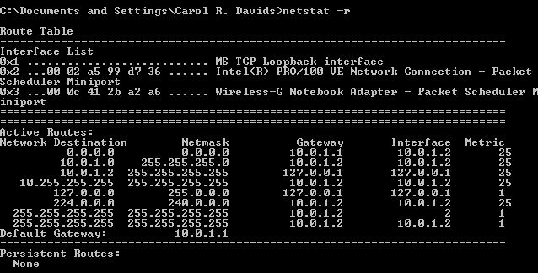
Carol Davids © 2015

Slide 64
Detail from Simple Routing Table
In this example, there are three interfaces listed above the Active Routes.
  Interface 0x1 is the TCP loopback interface
  Interface 0x2 is the MAC address of the internal network interface card
  Interface 0x3 is the MAC address of the wireless network interface card
Carol Davids © 2015

Slide 65
Detail from Simple Routing Table
Top line says for the destination “This host”, the gateway (router) is 10.0.1.1 and the interface is 10.0.1.2 which is the IP Address of my computer.
Second line says for the destination 10.0.1.0 (which is my home network address) the gateway is 10.0.1.2 and the interface is also 10.0.1.2.
Carol Davids © 2015

Slide 66
Simple Routing Table
The third line says for the destination 10.0.1.2 (my computer) the gateway (router) is the loopback address 127.0.0.1 and the interface is 127.0.0.1 as well.
The fourth line says for the destination 10.255.255.255 (which is the broadcast address for the network 10.0.0.0) uses gateway is 10.0.1.2 and interface 10.0.1.2.
Carol Davids © 2015

Slide 67
Simple Routing Table
The fifth line says for destination 127.0.0.0 use gateway 127.0.0.1 and interface 127.0.0.1.
The sixth line says for destination 224.0.0.0 (a multicast address) use gateway 10.0.1.2 and interface 10.0.1.2.
Carol Davids © 2015

Slide 68
Simple Routing Table
The seventh line says for destination 255.255.255.255 the broadcast address, use gateway 10.0.1.2 and interface 2.
The eighth line says for destination 255.255.255.255 the broadcast address, use gateway 10.0.1.2 and interface 10.0.1.2.
Carol Davids © 2015

Slide 69
Simple Routing Table
The default gateway on this network is 10.0.1.1 which is the address of my wireless router on my network.
Carol Davids © 2015

Slide 70
Netstat - Syntax and Usage
NETSTAT [-a] [-e] [-n] [-s] [-p proto] [-r] [interval]
-a : Displays all connections and listening ports.
-e : Displays Ethernet statistics. This may be combined with the -s option.
-n : Displays addresses and port numbers in numerical form.
Carol Davids © 2015

Slide 71
Netstat - Syntax and Usage
NETSTAT [-a] [-e] [-n] [-s] [-p proto] [-r] [interval]
-p proto : Shows connections for the protocol specified by proto
proto may be TCP or UDP.
If used with the -s option to display per-protocol statistics, proto may be TCP, UDP or IP.
-r : Displays the routing table.
Carol Davids © 2015

Slide 72
Netstat - Syntax and Usage
NETSTAT [-a] [-e] [-n] [-s] [-p proto] [-r] [interval]
-s : Displays per-protocol statistics.
By default, statistics are shown for TCP, UDP and IP
the -p option may be used to specify a subset of the default.
Carol Davids © 2015

Slide 73
Netstat - Syntax and Usage
NETSTAT [-a] [-e] [-n] [-s] [-p proto] [-r] [interval]
interval: Redisplays selected statistics, pausing ‘interval’ seconds between each display.
Press CTRL+C to stop redisplaying statistics.
If omitted, netstat will print the current configuration information once.
Carol Davids © 2015

Slide 74
The End
Carol Davids © 2015

Slide 75
References
http://computer.howstuffworks.com/lan-switch16.htm
http://computer.howstuffworks.com/router.htm
TCP/IP Illustrated, Volume 1 , Stevens
Carol Davids © 2015

