Slide 1


ITM 540
Data Networks
The Network Layer
Layer 3
Dynamic Routing - OSPF
Professor: Carol Davids
Email: davids@iit.edu
Carol Davids © 2013

Slide 2
  Link State Routing
Link State Routing is the second category of interior routing protocols.
Link State routing involves a different kind of information sharing between routers than is used in Distance Vector Routing.
Carol Davids © 2013

Slide 3
  Info sent is State of the Neighborhood
  Each router sends the state of the neighborhood to every other router in the neighborhood
Carol Davids © 2013

Slide 4
  Flooding method is used
  Flooding is the name of process by which the sharing is accomplished
Carol Davids © 2013

Slide 5
  When Link state info is sent
  Each router shares the state of its neighborhood only when there is a change.
  This results in less network traffic than is generated using distance vector.
Carol Davids © 2013

Slide 6
  Link State Routing
In Link State Routing every node creates a complete map of the network.
The nodes do this using information provided to them in Link State packets .
The specification refers to these as LSAs or Link State Advertisements (LSAs)
Carol Davids © 2013

Slide 7
  Link State Routing
Link state protocols rely on two mechanisms:
  Reliable dissemination of link state information.
  Calculation of routes from the sum of all the accumulated link state knowledge.
Carol Davids © 2013

Slide 8
  Reliable Flooding
Reliable Flooding means that each node sends a copy of the link state packet to all directly-connected links.
Each node that receives a copy of the LSA sends a copy to all of its directly-connected links.
  And so on and so on…
  The process continues until all nodes in the network have received the LSA.
Carol Davids © 2013

Slide 9
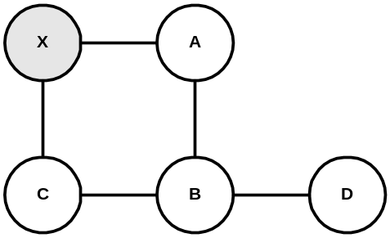
  Reliable Flooding
A new LSA is generated at node X.
X sends it to directly connected nodes A and C.
A sends it to B (but not back to X)
C sends it to B (but not back to X)
Carol Davids © 2013

Slide 10
  Reliable Flooding
B has received two identical LSAs - one from A and one from C.
It knows they are identical because they have the same sequence number and source.
So it throws out the one it received second.
Carol Davids © 2013

Slide 11
  Reliable Flooding
B sends the LSA on to the only directly connected network left, D.
Now the flooding process is complete.
All nodes have the same picture of the network configuration.
Carol Davids © 2013

Slide 12
  Generation of LSAs
LSAs are generated under two different circumstances:
  The expiration of a periodic timer.
  A change in the network topology.
Carol Davids © 2013

Slide 13
  Generation of LSAs
A node will generate an LSA if :
  A directly connected links goes down.
  A neighboring node goes down.
Carol Davids © 2013

Slide 14
  Generation of LSAs
If a directly connected link goes down, the node detects that via a link-layer (layer 2) protocol.
Carol Davids © 2013

Slide 15
  Generation of LSAs
If a neighboring node goes down, it will stop generating periodic “hello” messages.
The “hello” messages are generated by the routing protocol – at the application layer.
The node will observe this and issue a new LSA reflecting the fact that the node in question is unreachable.
Carol Davids © 2013

Slide 16
  Contents of an LSA
A LSA contains the following information:
  ID of the node that created the LSA
  List of directly connected nodes and the cost of the link to each node
  Sequence number
  Time to Live for this packet
Carol Davids © 2013

Slide 17
  Routing Database
Once a node has received a copy of the LSA from every other node, it has a routing data base.
It uses that database as a map of the network topology.
Then it uses that map to decide the best route to each destination.
Carol Davids © 2013

Slide 18
  Route Calculation
Calculating the best route is done using an algorithm from graph theory.
The algorithm is called Dijkstra’s shortest-path algorithm.
Carol Davids © 2013

Slide 19
  Routing Table
After the routes are calculated, they are stored in the routing table
Carol Davids © 2013

Slide 20
  Route Calculation
Two lists are set up - ‘Temporary’ and ‘Confirmed’.
The algorithm is repeatedly applied and the shortest paths are tested and moved from the Temporary to the Confirmed list.
The final Confirmed list is used to build the routing table.
Carol Davids © 2013

Slide 21
  Summary of two types of routing
Distance Vector and Link State are two different routing types.
Distance vector makes decisions based on the hop count or distance between source and destination. The metric used to rank routes is the hop count. All hops have the value 1.
Link State makes decisions based on a calculated metric. Inputs to the calculation include the speed of the link, the media type, whether the link is up or down, and other factors that may be set by the system administrator.
Carol Davids © 2013

Slide 22
  Summary
Distance vector requires relatively little processing and memory.
Link State requires much more processing and memory.
Distance vector might choose a very slow route over a very fast one if the hop count of the slow route were low.
Carol Davids © 2013

Slide 23
  Creating the Link State Database
Every router in an Area receives LSAs from every other router in the Area.
The router uses the information in the LSAs to create a link state database.
The result is that all the routers in the Area have the same information in their respective link state databases.
Carol Davids © 2013

Slide 24
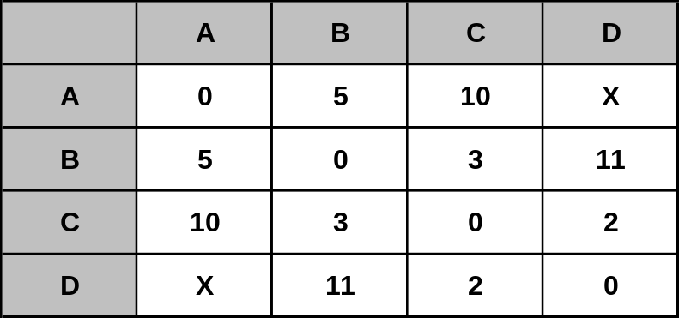
  Link State Database
The routing database is shared by all the routers in a given area.
In the example below, read the rows as follows: A’s link to A costs 0; A’s link to B costs 5; A’s link to C costs 10; A’s link to D costs X.
Carol Davids © 2013

Slide 25
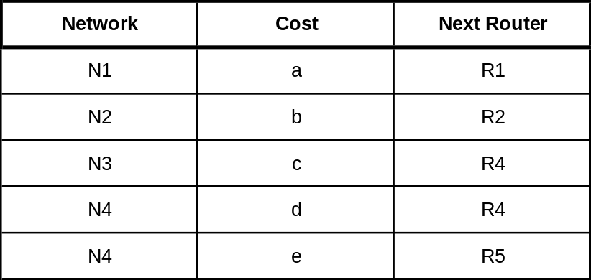
  Routing table is different from database
Example of a routing table in a router implementing Link State Routing.
Carol Davids © 2013

Slide 26
  Calculating the Routing Table
Dijkstra Algorithm is used to calculate the routing table using the routing data base.
The algorithm is applied to the routing data base to produce the routing table.
The algorithm is used to calculate the shortest path between two points using a graph made up of nodes and edges.
The algorithm categorizes the potetial nodes as ‘temporary’ and ‘confirmed’.
Carol Davids © 2013

Slide 27
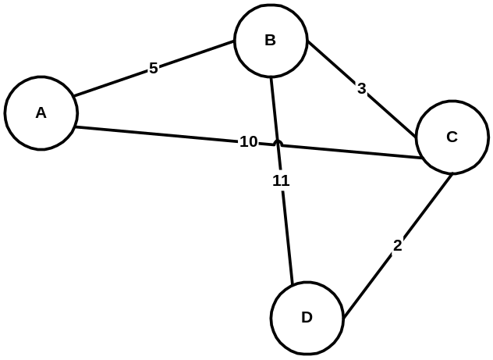
  Example of route calculation for link status routing
We will now walk through creation of the routing table for node D in the network below.
This example is adapted from Peterson and Davie, Computer Networks, A System Approach.
Carol Davids © 2013

Slide 28
The routing database for this internet looks like this.
Carol Davids © 2013

Slide 29
  Calculating the routing table for Node D
Initialize the ‘confirmed’ list with the entry for the router doing the calculation.
Give this entry a cost of 0.
Now node D has been added to the confirmed list.
Call the node you just added to the confirmed list ‘next’.
Now calculate the cost of getting to each ‘neighbor’ of ‘next’ using the information in the routing database.
Carol Davids © 2013

Slide 30
  Calculating the routing table for Node D
This cost is calculated as the sum of:
  The cost of getting from myself (the router doing the calculation, in this example, D) to ‘next’
  The cost of getting from ‘next’ to ‘next’s neighbors.
  Notice that you have just confirmed the cost of getting from yourself to ‘next’ and have put this value into the ‘confirmed’ column.
Carol Davids © 2013

Slide 31
  Calculating the routing table for Node D
Step 1:
D is the only new member of the confirmed list.
So examine its neighbors and the routing database.
Carol Davids © 2013

Slide 32
  Calculating the routing table for Node D
Step 2:
D has two neighbors, B and C.
Consider neighbor B:
  D can reach B via B at a cost of 11.
  B is not on the tentative or the confirmed list, so put this information on the tentative list.
Consider neighbor C:
  D can reach C via C at a cost of 2.
  C is not on the tentative or the confirmed list, so put this information on the tentative list.
Carol Davids © 2013

Slide 33
  Calculating the routing table for Node D
Step 3:
Put the lowest cost member of the tentative list onto the confirmed list.
This is (C,2,C)
C is now ‘next’
Examine the routes from ‘next’ = C to C’s neighbors.
Carol Davids © 2013

Slide 34
  Calculating the routing table for Node D
Step 4:
C has three neighbors, D, A, and B.
Consider neighbor D:
  D is on the confirmed list, so don’t worry about it.
Consider neighbor A:
  D can get to A at a cost of 12 via C.
  A is on neither list so put (A,12,C) onto ‘tentative’ list
Carol Davids © 2013

Slide 35
  Calculating the routing table for Node D
Step 4:
Consider neighbor B:
  D can get to B at a cost of 5 via C.
  B is already on the tentative list, but at a higher cost.
  So replace the entry (B,11,B) with the entry (B,5,C)
Carol Davids © 2013

Slide 36
  Calculating the routing table for Node D
Step 5:
Move the lowest cost member of the tentative list to the confirmed list.
This means move (B,5,C) to the confirmed list.
Call B ‘next’ and now examine routes from B to its neighbors.
Carol Davids © 2013

Slide 37
  Calculating the routing table for Node D
Step 6:
B has 3 neighbors, A,D and C.
C and D are already in the confirmed column, so don’t need to consider them.
Cost to A from D is 10 via C
  Put this information in the ‘tentative’ column
  Since this value is lower than the current cost from D to A in the tentative column, replace the tentative value.
  Now the tentative list contains (A,10,C).
Carol Davids © 2013

Slide 38
  Calculating the routing table for Node D
Step 7:
Move the lowest cost member of the tentative list to the confirmed list.
This means move the only entry in the tentative column, (A,10,C) to the confirmed column.
Since there are no more entries in the tentative column, we are done.
Carol Davids © 2013

Slide 39
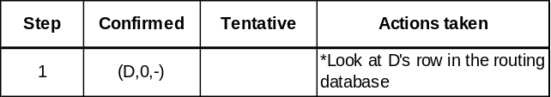
  Step 1:
Put the shortest path in D’s routing database into the Confirmed column.
Note:
( A, 12, C ) means, “ I can get to node A at a cost of 12 via node C.”
Carol Davids © 2013

Slide 40
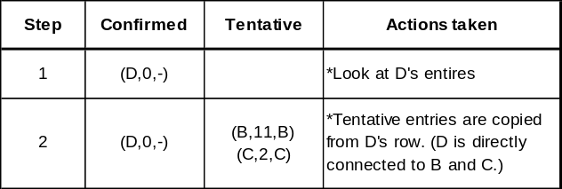
  Step 2:
Put the information in D’s LSP into the Tentative column.
Carol Davids © 2013

Slide 41
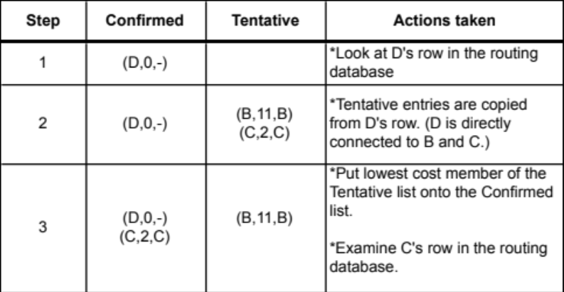
  Step 3:
Put the lowest cost member of the Tentative list into the Confirmed list.
Now examine the LSP of the member you just moved. ( C )
Carol Davids © 2013

Slide 42
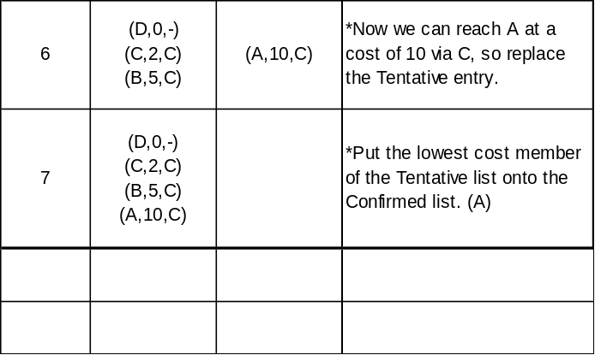
  Step 3:
C can get to B for a cost of 3
C can get to A for a cost of 10
It currently costs 11 to get to B via B, whereas if we went to B via C it would cost 5 (2+3)
So we will change the tentative list entry…
Carol Davids © 2013

Slide 43
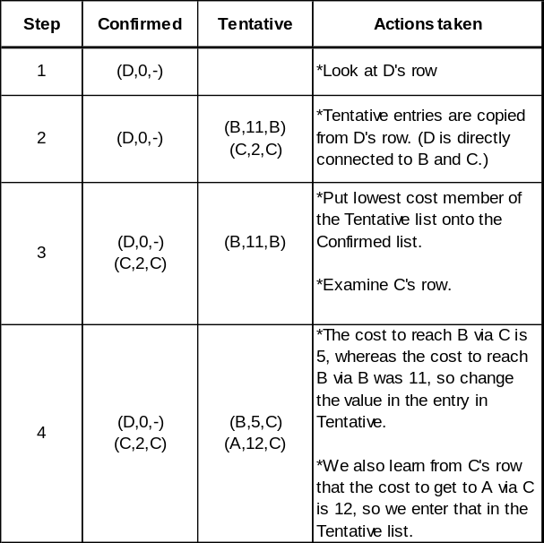
  Step 4:
Change the value in the Tentative column for the route to B.
Carol Davids © 2013

Slide 44
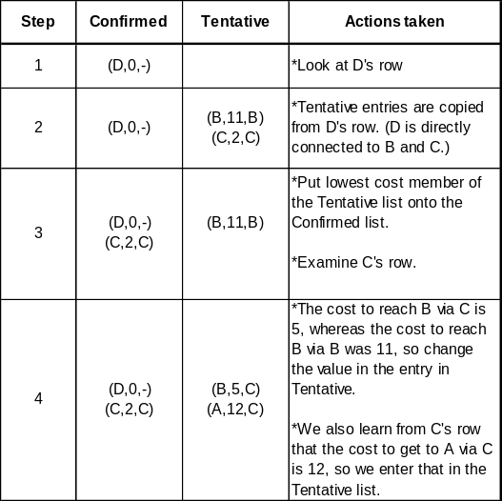
  Step 4:
Incorporate the fact that you can get from C to A for a cost of 10 and we can get to C from D at a cost of 2 to give (A,12,C) in the Tentative column.
Carol Davids © 2013

Slide 45
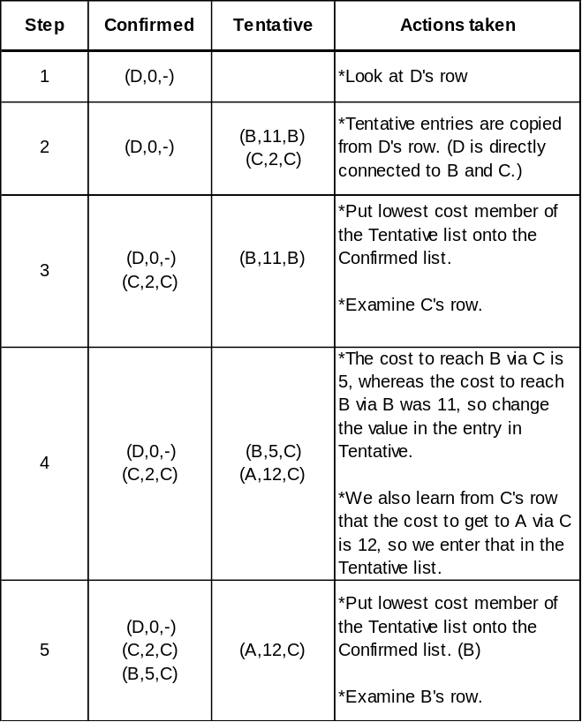
  Step 5:
Put lowest cost member of the Tentative list into the Confirmed list.
Look at B’s LSP
Carol Davids © 2013

Slide 46
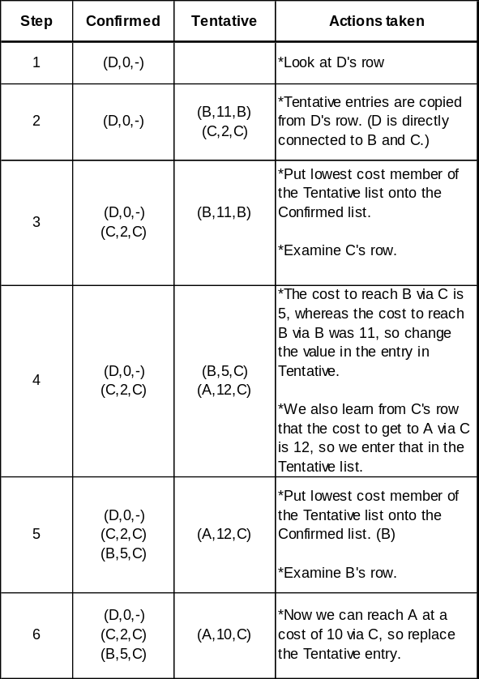
  Step 6:
We now learn that we can reach A at a cost of 5 via B.
Carol Davids © 2013

Slide 47
  Step 6:
We previously learned when we examined C’s LSP that we can reach B at a cost of 3 via C.
Carol Davids © 2013

Slide 48
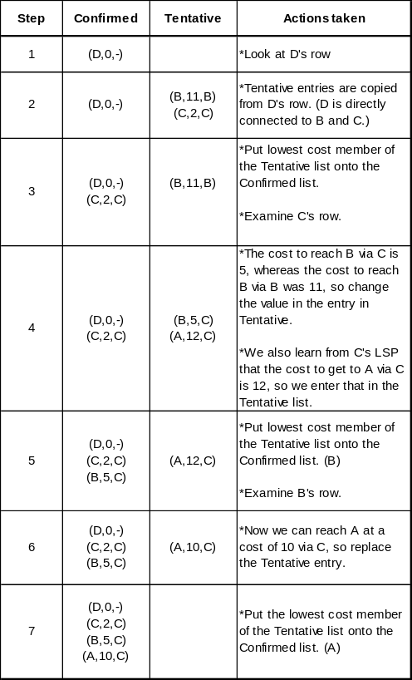
  Step 7:
Put the lowest cost member of the Tentative list onto the Confirmed list.
Carol Davids © 2013

Slide 49

  Step 7:
Now all directly connected nodes have a route in the Confirmed column so we are done.
Carol Davids © 2013

Slide 50
The End
Carol Davids © 2013

Slide 51
References
http://homepages.uel.ac.uk/u0217358/main%20Routing%20protocols.htm
http://www.inetdaemon.com/tutorials/internet/ip/routing/dv_vs_ls.html
http://www.informit.com/articles/article.asp?p=27267
http://www.informit.com/articles/article.asp?p=27267&seqNum=4 (Test Your Knowledge)
http://www.rhyshaden.com/eigrp.htm (EIGRP)
Carol Davids © 2013

Slide 52
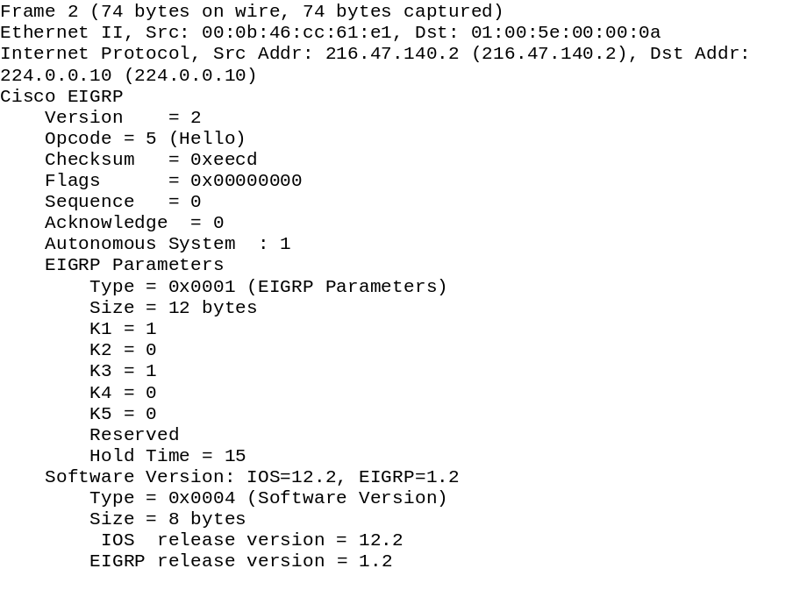
  Hello packet - sent by a Cisco Router using a Cisco proprietary protocol EIGRP*
*Enhanced Interior Gateway Routing Protocol
Carol Davids © 2013

Slide 53
OSPF Traces
This example illustrates how OSPF tracing allows for monitoring the HELLO messages sent and received by a router.
From http://www.riverstonenetworks.com/support/ospf/tracing.htm
RS1#
-05-04 22:59:40 OSPF SEND: 10.0.0.1 -> 224.0.0.5: Version 2, Type Hello (1), Length 48
-05-04 22:59:40 Router ID 1.1.1.1, Area 0.0.0.0, Authentication <None> (0)
-05-04 22:59:40 Authentication data: 00000000 00000000
-05-04 22:59:40 Mask 255.255.255, Options <E> (2), Priority 1, Neighbours 1
-05-04 22:59:40 Intervals: Hello 10s, Dead Router 40s, Designated Router 10.0.0.2, Backup 10.0.0.1
-05-04 22:59:40 Neighbours: 2.2.2.2
Carol Davids © 2013

Slide 54
OSPF Traces
This example illustrates how OSPF tracing allows for monitoring the HELLO messages sent and received by a router.
From http://www.riverstonenetworks.com/support/ospf/tracing.htm
-05-04 22:59:40 OSPF RECV: 10.0.0.2 -> 224.0.0.5: Version 2, Type Hello (1), Length 48
-05-04 22:59:40 Router ID 2.2.2.2, Area 0.0.0.0, Authentication <None> (0)
-05-04 22:59:40 Authentication data: 00000000 00000000
-05-04 22:59:40 Mask 255.255.255, Options <E> (2), Priority 1, Neighbours 1
-05-04 22:59:40 Intervals: Hello 10s, Dead Router 40s, Designated Router 10.0.0.2, Backup 10.0.0.1
-05-04 22:59:40 Neighbours: 1.1.1.1
-
Carol Davids © 2013

Slide 55
OSPF Traces
This example illustrates how OSPF tracing allows for monitoring the HELLO messages sent and received by a router.
From http://www.riverstonenetworks.com/support/ospf/tracing.htm
--05-04 22:59:50 OSPF SEND: 10.0.0.1 -> 224.0.0.5: Version 2, Type Hello (1), Length 48
-05-04 22:59:50 Router ID 1.1.1.1, Area 0.0.0.0, Authentication <None> (0)
-05-04 22:59:50 Authentication data: 00000000 00000000-05-04 22:59:50 Mask 255.255.255, Options <E> (2), Priority 1, Neighbours 1
-05-04 22:59:50 Intervals: Hello 10s, Dead Router 40s, Designated Router 10.0.0.2, Backup 10.0.0.1
-05-04 22:59:50 Neighbours: 2.2.2.2
Carol Davids © 2013

Slide 56
OSPF Traces
This example illustrates how OSPF tracing allows for monitoring the HELLO messages sent and received by a router.
From http://www.riverstonenetworks.com/support/ospf/tracing.htm
-05-04 22:59:50 OSPF RECV: 10.0.0.2 -> 224.0.0.5: Version 2, Type Hello (1), Length 48
-05-04 22:59:50 Router ID 2.2.2.2, Area 0.0.0.0, Authentication <None> (0)
-05-04 22:59:50 Authentication data: 00000000 00000000
-05-04 22:59:50 Mask 255.255.255, Options <E> (2), Priority 1, Neighbours 1
-05-04 22:59:50 Intervals: Hello 10s, Dead Router 40s, Designated Router 10.0.0.2, Backup 10.0.0.1
-05-04 22:59:50 Neighbours: 1.1.1.1
Carol Davids © 2013

Slide 57
OSPF Traces
Visit http://www.riverstonenet.com/support/ospf/stuckexstart.htm to see how an MTU mismatch can cause a router not to accept an LSA - which is too long
“Background
The “Exchange” phase is the beginning of adjacency formation between two neighbors. It follows the “2-Way” state for neighbors that have decided to proceed and establish full adjacency. During the “ExStart” state, the two neighbors decide who will be the “Master” and who will be the “Slave” in the conversation between them. During the “Exchange” state the two neighbors exchange their databases by sending and acknowledging Database Description (DD) packets.
“ExStart” and “Exchange” are short-lived states. Once a router enters one of these states with a neighbor, it should proceed to Full state within several seconds (depending on the size of the LSDB and the network type).
Possible Causes
Mismatched MTU sizes between the neighbors”
Carol Davids © 2013

Slide 58
OSPF Traces
Visit http://www.riverstonenet.com/support/ospf/stuckexstart.htm to see how an MTU mismatch can cause a router not to accept an LSA - which is too long
“If one of the neighbors has a large LSDB to transmit to the other neighbor, when it reaches the Exchange state with that neighbor, it will pack an MTU-worth of LSAs in a DD packet and will attempt to send them to the neighbor. If the neighbor is incapable of processing a packet this large, it will drop it and fail to acknowledge it. Which will lead to infinite repetitive attempts from the originating router to re-send the DD packet. While doing that the routers will be in “Exchange” state.”
Carol Davids © 2013

Slide 59
OSPF Traces
Visit http://www.riverstonenet.com/support/ospf/stuckexstart.htm to see how an MTU mismatch can cause a router not to accept an LSA - which is too long
-05-08 12:43:49 OSPF SEND: 10.0.0.2 -> 224.0.0.5: Version 2, Type Hello (1), Length 48
-05-08 12:43:49 Router ID 2.2.2.2, Area 0.0.0.0, Authentication <None> (0)
-05-08 12:43:49 Authentication data: 00000000 00000000
-05-08 12:43:49 OSPF SEND: 10.0.0.2 -> 10.0.0.1: Version 2, Type Database Desciption (2), Length 32
-05-08 12:43:49 Router ID 2.2.2.2, Area 0.0.0.0, Authentication <None> (0)
-05-08 12:43:49 Authentication data: 00000000 00000000
-05-08 12:43:49 Options <E> (2), Flags <MS M I> (7), Sequence 9
Carol Davids © 2013

Slide 60
OSPF Traces
Visit http://www.riverstonenet.com/support/ospf/stuckexstart.htm to see how an MTU mismatch can cause a router not to accept an LSA - which is too long
-05-08 12:43:49 OSPF RECV: 10.0.0.1 -> 224.0.0.5: Version 2, Type Hello (1), Length 48
-05-08 12:43:49 Router ID 1.1.1.1, Area 0.0.0.0, Authentication <None> (0)
-05-08 12:43:49 Authentication data: 00000000 00000000
-05-08 12:43:49 OSPF RECV: 10.0.0.1 -> 10.0.0.2: Version 2, Type Database Desciption (2), Length 32
-05-08 12:43:49 Router ID 1.1.1.1, Area 0.0.0.0, Authentication <None> (0)
-05-08 12:43:49 Authentication data: 00000000 00000000
-05-08 12:43:49 Options <E> (2), Flags <MS M I> (7), Sequence 10
-05-08 12:43:49 OSPF: invalid DD packet: Confusing Master/Initial flags (21)
Carol Davids © 2013

Slide 61
OSPF Traces
Visit http://www.riverstonenet.com/support/ospf/stuckexstart.htm to see how an MTU mismatch can cause a router not to accept an LSA - which is too long
-05-08 12:43:54 OSPF SEND: 10.0.0.2 -> 10.0.0.1: Version 2, Type Database Desciption (2), Length 32
-05-08 12:43:54 Router ID 2.2.2.2, Area 0.0.0.0, Authentication <None> (0)
-05-08 12:43:54 Authentication data: 00000000 00000000
-05-08 12:43:54 Options <E> (2), Flags <MS M I> (7), Sequence 9
-05-08 12:43:54 OSPF RECV: 10.0.0.1 -> 10.0.0.2: Version 2, Type Database Desciption (2), Length 32
-05-08 12:43:54 Router ID 1.1.1.1, Area 0.0.0.0, Authentication <None> (0)
-05-08 12:43:54 Authentication data: 00000000 00000000
-05-08 12:43:54 Options <E> (2), Flags <MS M I> (7), Sequence 10
-05-08 12:43:54 OSPF: invalid DD packet: Confusing Master/Initial flags (21)
Carol Davids © 2013

Slide 62
OSPF Traces
Visit http://www.riverstonenet.com/support/ospf_index.shtml for more information about the implementation of ospf on riverstone routers
Carol Davids © 2013

Slide 63
RFC 2328 (OSPF)
“A.1 Encapsulation of OSPF packets
OSPF runs directly over the Internet Protocol's network layer. OSPF packets are therefore encapsulated solely by IP and local data-link
headers.
OSPF does not define a way to fragment its protocol packets, and depends on IP fragmentation when transmitting packets larger than the network MTU. ..
Carol Davids © 2013

Slide 64
RFC 2328 (OSPF)
The OSPF packet types that are likely to be large (Database Description Packets, Link State Request, Link State Update, and Link State Acknowledgment
packets) can usually be split into several separate protocol packets, without loss of functionality.
This is recommended;
IP fragmentation should be avoided whenever possible. …..“
Carol Davids © 2013

Slide 65
RFC 2328 (OSPF)
OSPF is IP protocol number 89. This number has been registered with the Network Information Center. IP protocol number assignments are documented in [Ref11].
All OSPF routing protocol packets are sent using the normal service TOS value of binary 0000 defined in [Ref12]. ….
Carol Davids © 2013

Slide 66
RFC 2328 (OSPF)
Routing protocol packets are sent with IP precedence set to Internetwork Control.
OSPF protocol packets should be given precedence over regular IP data traffic, in both sending and receiving.
Setting the IP precedence field in the IP header to Internetwork Control [Ref5] may help implement this objective….”
Carol Davids © 2013

Slide 67
  OSPF Routing Protocol
Like RIP, OSPF is also an interior gateway protocol.
It uses a different routing technique than does RIP.
Whereas RIP exchanges distance vectors.
OSPF exchanges link state protocol messages.
Typo on page 548 - ‘dissipating’ should probably be ‘disseminating’.
Carol Davids © 2013

Slide 68
Link State Protocol (LSA) messages provide a map of the entire area overseen by the router.
Carol Davids © 2013

Slide 69
  Area
An area is a collection of networks, hosts and routers all contained in an Autonomous System (AS).
Or, another way of looking at it is, Autonomous Systems can be divided into a number of different areas.
Each Area in an Autonomous System has an Area Identification.
The areas in an Autonomous System must be connected.
Carol Davids © 2013

Slide 70
  Area Border Routers
Area Border Routers are routers located at the edge of an Area.
They are connected to at least two areas.
Carol Davids © 2013

Slide 71
  Backbone Area
Each Autonomous System has a Backbone Area.
The Area Identification of the Backbone Area is ‘0’.
The Backbone Area has a connection to every Area in the AS.
Areas within an Autonomous System MAY be connected to each other, but they MUST be connected to the Backbone Area.
Carol Davids © 2013

Slide 72
  Backbone Routers
Routers inside a Backbone Area are called Backbone Routers.
Carol Davids © 2013

Slide 73
  Virtual Links
If a backbone router loses its connection to an Area within its AS, the administrator of the AS must create a virtual link to that area.
The link is necessary if the backbone router is to fulfill its function within the AS.
Carol Davids © 2013

Slide 74
  Virtual Links (from RFC 2328)
The single backbone area (Area ID = 0.0.0.0) cannot be disconnected, or some areas of the Autonomous System will become unreachable.
To establish/maintain connectivity of the backbone, virtual links can be configured through non-backbone areas.
Virtual links serve to connect physically separate components of the backbone.
Carol Davids © 2013

Slide 75
  Virtual Links
The two endpoints of a virtual link are area border routers.
The virtual link must be configured in both routers.
The configuration information in each router consists of the other virtual endpoint (the other area border router), and the non-backbone area the two routers have in common (called the Transit area).
Virtual links cannot be configured through stub areas.
Carol Davids © 2013

Slide 76
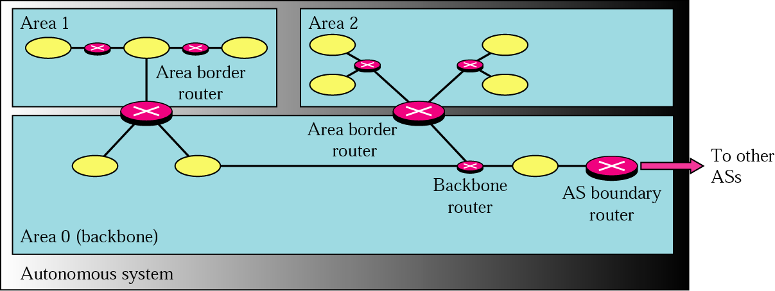
  Areas in Autonomous Systems
Figure 21.7, Forouzan
Area 1 contains networks connected by routers – and an area border router connecting that area to Area 0, the backbone.
Carol Davids © 2013

Slide 77
  Choice of Metric
The administrator of a network assigns a cost - called a metric - to each route
The administrator can decide which metric to use. This is different than distance vector.
The metric selected might be based on a type of service such as Minimum delay or Maximum throughput.
Routers may keep multiple routing tables, one for each type of service.
Carol Davids © 2013

Slide 78
  Links
In OSPF terminology a connection is called a link.
Four types of link are identified:
  Point-to-point
  Transit
  Stub
  Virtual
Carol Davids © 2013

Slide 79
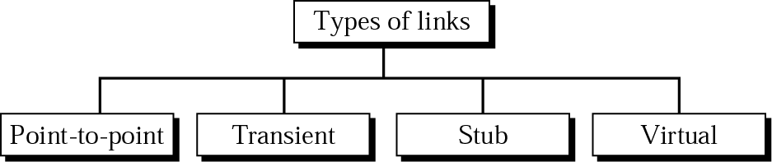
  Types of Links
Forouzan, Figure 22.25
Carol Davids © 2013

Slide 80
  Point-to-point Link
Connects two routers without any other host or router in between.
The link is a network.
  Example is two routers connected by a T1 telephone line.
  It is not necessary to assign a network address to this type of link.
  Each router has only one neighbor at the other end of the link.
Carol Davids © 2013

Slide 81
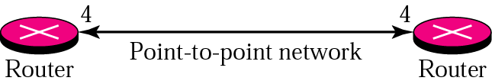
  Point-to-point Link
  Each router has only one neighbor at the other end of the link.
Carol Davids © 2013

Slide 82
  Transit Link
A transit link is a network with several routers attached to it.
  All LANs are transit links.
  WANs with two or more routers are also transit links.
  Each router in a Transit link has several neighbors.
Carol Davids © 2013

Slide 83
  Transit Links
Transit links are represented by designating one router amongst the routers to be the ‘designated’ router.
Carol Davids © 2013

Slide 84
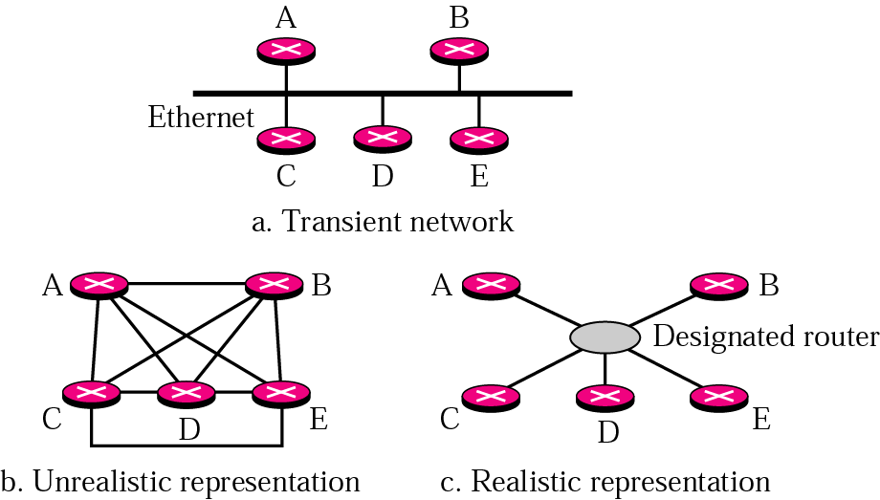
  Transit Link - illustration page 551
One router represents the whole network. This cuts down the number of LSPs that must be exchanged.
In the mesh, each router exchanges LSPs with every other router on the network. (Fig 21.10 below)
Carol Davids © 2013

Slide 85
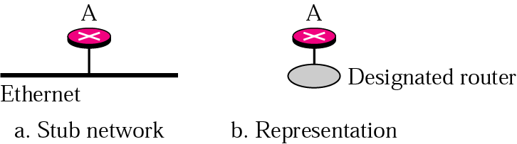
  Stub Link
A network connected to only one router.
Data packets enter and leave the network through this one router.
Carol Davids © 2013

Slide 86
  Virtual Link
A path created by an administrator that connects two routers when the link between them is not working.
This path may go through several routers, as the more direct link is broken or out of service.
Carol Davids © 2013

Slide 87
  From RFC 2328
The Autonomous System's link-state database describes a directed graph.
The vertices of the graph consist of routers and networks.
A graph edge connects two routers when they are attached via a physical point-to-point network.
An edge connecting a router to a network indicates that the router has an interface on the network.
Carol Davids © 2013

Slide 88
  From RFC 2328
Networks can be either transit or stub networks.
Transit networks are those capable of carrying data traffic that is neither locally originated nor locally destined.
A transit network is represented by a graph vertex having both incoming and outgoing edges.
A stub network's vertex has only incoming edges.
Carol Davids © 2013

Slide 89
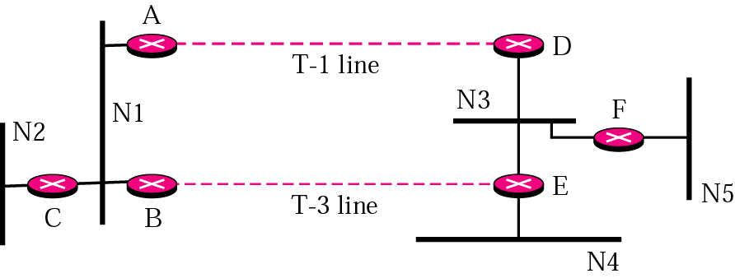
  Representation of small internet
Figure 21.12, page 553.
Seven networks are shown, although the point-to-point links, T-1 line and T-3 line, are not given network identifiers
Carol Davids © 2013

Slide 90
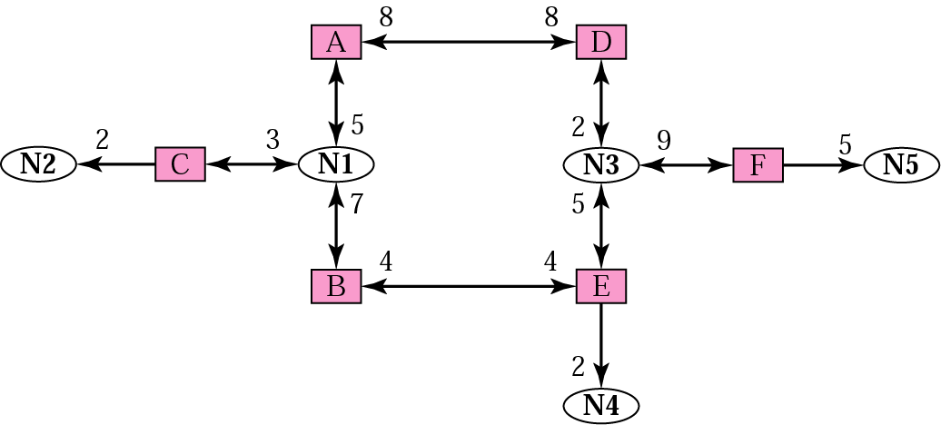
  Graphical Representation of small internet
Figure 21.13, page 553.
Squares represent routers; ovals represent networks; numbers on links represent cost.
Carol Davids © 2013

Slide 91
  OSPF Messages
Routers exchange Link State Advertisements (LSAs) to share their view of the network.
There are 5 different types of LSAs:
  Router Link
  Network Link
  Summary Link to network
  Summary Link to AS boundary router
  External Link
Carol Davids © 2013

Slide 92
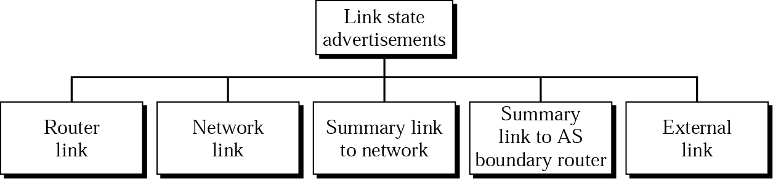
  Types of LSA
Routers exchange Link State Advertisements (LSAs) to share their view of the network.
Carol Davids © 2013

Slide 93
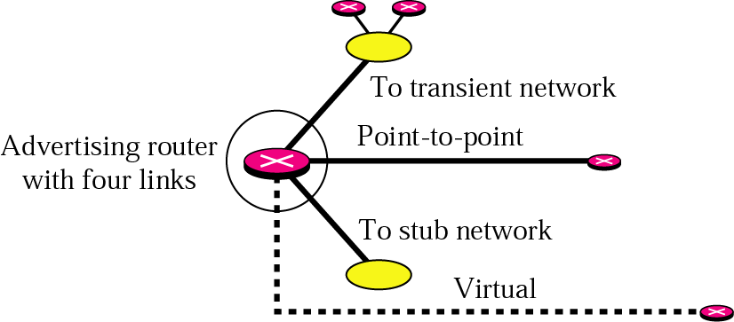
  Router Link LSA
Router announces information about all its links and the neighbors connected to those links
Carol Davids © 2013

Slide 94
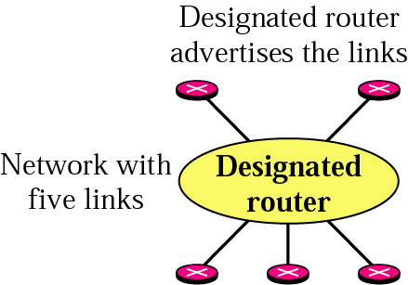
  Network Link LSA
Defines the links of a network
Sent by the designated router on behalf of its transit network
Identifies all the routers connected to the network
Carol Davids © 2013

Slide 95
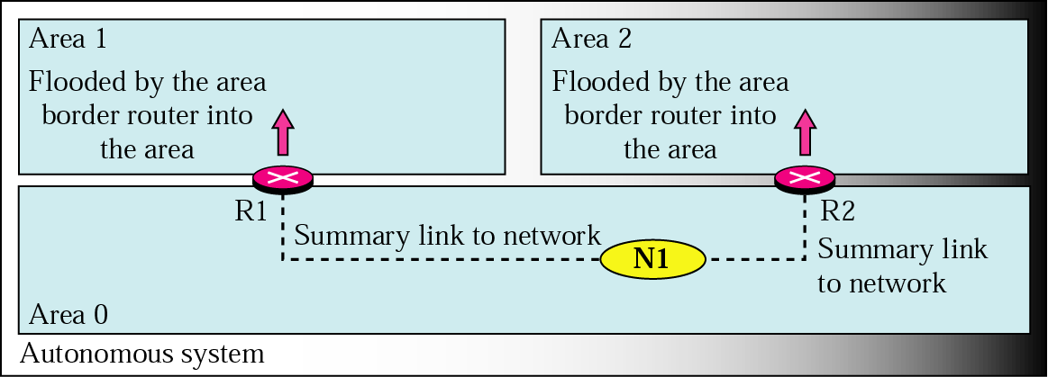
  Summary Link to Network LSA
Sent by an Area Border Router
Area Border Routers are active in more than one area
Provides information about the cost to reach any network inside the autonomous area.
Figure 21.17
Carol Davids © 2013

Slide 96
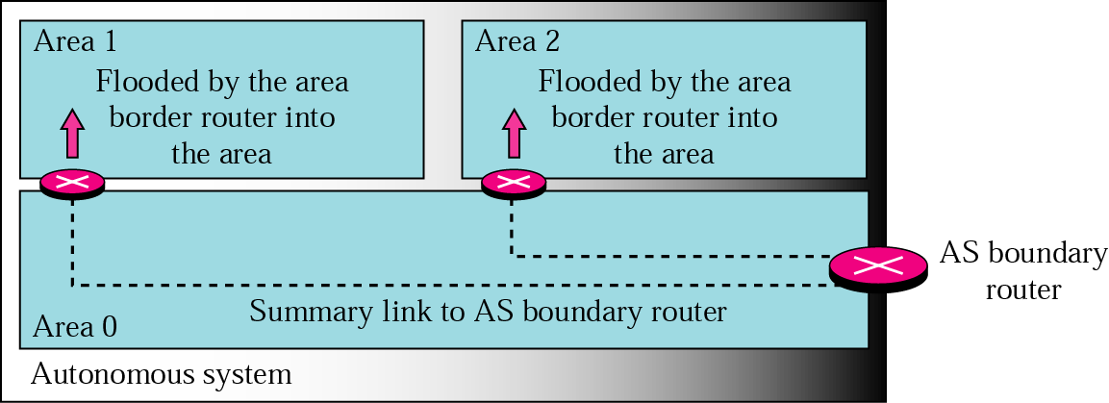
  Summary Link to AS Boundary LSA
Sent by an Area Border Router
Provides information about the route to an autonomous boundary router
Figure 21.18
Carol Davids © 2013

Slide 97
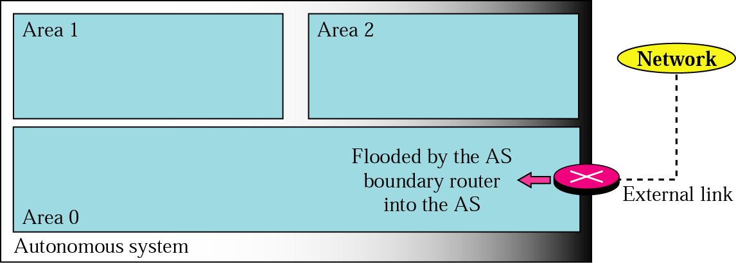
  External Link LSA
Sent by an AS Boundary Router
Tells which networks are available outside the autonomous system and the cost of each network outside the autonomous system
Each advertisements contains one single network
Carol Davids © 2013

