Slide 1


ITM 540
Data Networks
The Transport Layer
Layer 4
UDP
Professor: Carol Davids
Email: davids@iit.edu
Carol Davids © 2014

Slide 2
Reading Assignment
Forouzan, ed 4: Chapter 23
Carol Davids © 2014

Slide 3
Transport Layer
We have now reached the Transport Layer - which the OSI model also refers to as Layer 4.
The transport layer acts as the interface between the higher application-oriented layers and the underlying network-dependent protocol layers
Carol Davids © 2014

Slide 4
Transport Layer
Layer 4 hides the network layer from the application layer.
It enables the application layer to use different network layers without alteration of the application layer code.
Carol Davids © 2014

Slide 5
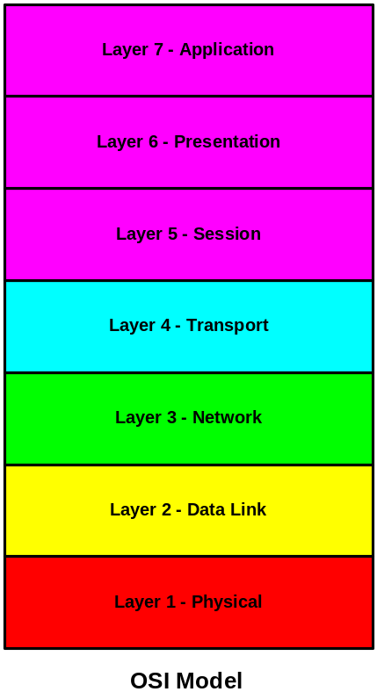
Transport Layer
OSI Model
Layer 4 - Transport Layer - Enables process to process communication across different networks.
Carol Davids © 2014

Slide 6
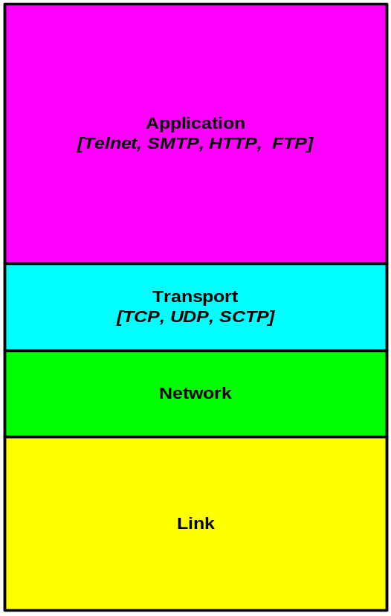
Transport Layer
IP Model
Layer 4 - Transport Layer - Enables process-to-process communication across different networks.
Carol Davids © 2014

Slide 7
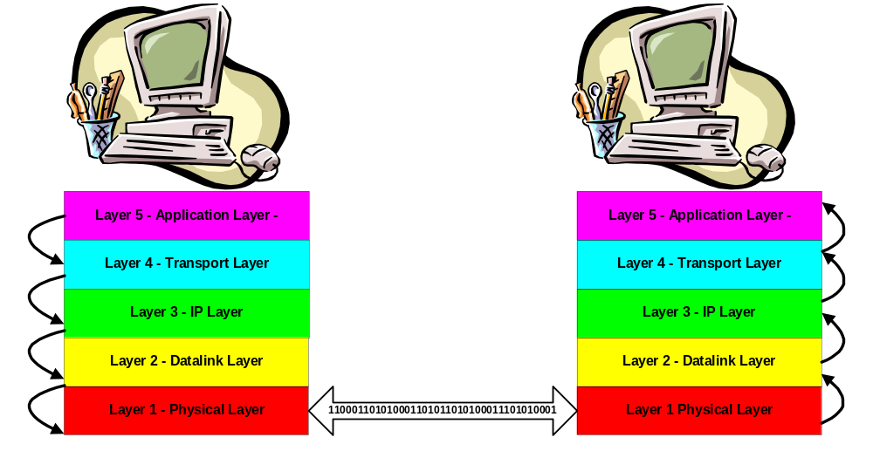
Layered communication
Applications use a UDP port or a TCP port to send or receive application data down or up the stack.
Carol Davids © 2014

Slide 8
Transport Layer
The transport layer allows an application program in one computer to send and receive input and output to/from application programs in other computers.
This is an important part of the distributed computing that data networks enable.
The two transport layer protocols we study do this by defining Ports and Sockets.
Carol Davids © 2014

Slide 9
TCP/UDP Ports and Sockets
A Port is a point at which data from the application enters and leaves the transport layer.
  Think of it as the door to the application layer
A Socket is the combination of an IP address and a port number.
Carol Davids © 2014

Slide 10
Multiplexing using ports
Ports allow a computer to use its single IP Address as a point of entry for many different application requests and responses.
Carol Davids © 2014

Slide 11
Distributed Processes
Distributed process can have different relationships to one another.
  Client / Server
  Master / Slave
  Peer to peer
Carol Davids © 2014

Slide 12
Client/Server
In a Client-Server relationship the processes are defined as Client tasks and Server tasks.
Client tasks send requests to Server tasks by means of some well defined protocol.
Carol Davids © 2014

Slide 13
Client-Server Processes
The Server tasks can all reside in one physical device or they can be distributed in a number of different physical devices.
Clients can also reside in different physical devices.
Carol Davids © 2014

Slide 14
Client - Server Examples
Domain Name Service (DNS):
The Name-server is the server and Name-resolver is the client in the DNS distributed application.
Carol Davids © 2014

Slide 15
Client - Server Examples
Web Browsing:
The Web browser is the client and the Web server ( HTTP server) is the server in the distributed application we call the World Wide Web.
Carol Davids © 2014

Slide 16
Client - Server Examples
File Transfer:
File Transfer Protocol (FTP) servers allow you to make FTP requests from your PC which functions as an FTP client.
Carol Davids © 2014

Slide 17
Master - Slave
Client Server is only one of several relationships that can exist between parts of distributed applications.
In a Master/Slave relationship, one program is in charge of all other programs.
Carol Davids © 2014

Slide 18
Peer-to-peer
In a peer-to-peer relationship, either of two programs is able to initiate a transaction.
Carol Davids © 2014

Slide 19
User Datagram Protocol - UDP
Protocol type 17
UDP is specified in IETF RFC 768 (adopted in 1980).
It is referred to as a connectionless protocol, as distinct from TCP which is connection-oriented.
In the IP datagram it is identified by the Protocol Type 17.
Carol Davids © 2014

Slide 20
User Datagram Protocol - UDP
Protocol 17
The services provided by UDP are :
  Port numbers
  Checksum over the whole datagram
Carol Davids © 2014

Slide 21
Port Numbers
Layer 4 addresses are called Port Numbers
The layer 4 address is described using 16 bits
For this reason, port numbers can take on values between 0 and 65,535
Carol Davids © 2014

Slide 22
Port Numbers: Ephemeral vs. Well-known
Port numbers can be assigned dynamically , at the time they are needed
These are called ephemeral ports
OR
Port numbers can be assigned by convention to be the default ports always used by a particular application
These are called well-known ports
Carol Davids © 2014

Slide 23
Applications using UDP
Applications that use UDP as their transport layer include
  DNS
  BOOTP
  DHCP
  TFTP
  VoIP protocols: SIP, MGCP, RTP
Carol Davids © 2014

Slide 24
User Datagram Protocol - UDP
UDP operates by passing pieces of data down from an application process to the IP process.
The IP process routes the application data encapsulated in the UDP header to the corresponding application process at the far end.
The receiving UDP simply passes pieces of incoming data from IP to the appropriate application.
Carol Davids © 2014

Slide 25
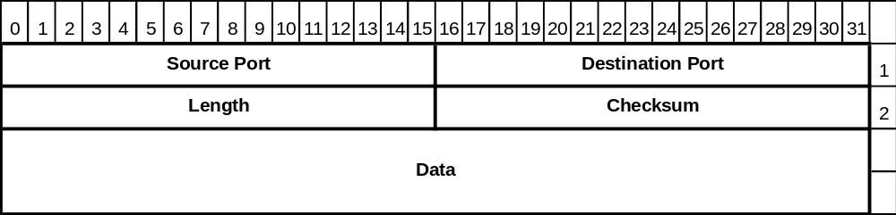
User Datagram Protocol - UDP
UDP operates like an elevator – taking application data between layer 5 and layer 3.
It provides very few functions or services and so needs very few bytes in its header.
UDP has an 8-byte header
Carol Davids © 2014

Slide 26
User Datagram Functions
UDP doesn't split data into multiple packets.
UDP doesn't keep track of what it has sent so it can resend if necessary.
Carol Davids © 2014

Slide 27
User Datagram Functions
UDP provides port numbers, so that several programs can use UDP at once.
This process is also known as multiplexing.
The UDP process is handling requests for a number of different applications
It assigns each application client and each application server its own UDP port
Carol Davids © 2014

Slide 28
Checksum is Optional
UDP provides an optional checksum.
The checksum is over the UDP header and payload as well as over 12 bytes of the IP header.
These twelve bytes of the IP header are called the Pseudo header. (pronounced soo dough)
Carol Davids © 2014

Slide 29
Checksum
The checksum field is the 16 bit one's complement of the one's complement sum of all 16 bit words in the :
  UDP header
  UDP body
  UDP pseudo header (12 additional bytes of the IP header - bytes that are not changed by routers.)
Carol Davids © 2014

Slide 30
Why use the pseudo-header
The Pseudo-header includes a set of IP Parameters that are recorded by UDP.
UDP uses the pseudo-header in the checksum to ensure that segments reach the right destination.
Carol Davids © 2014

Slide 31
Checksum and pseudo-header
This pseudo header contains the following values from the IP header:
  Source IP Address
  Destination IP Address
  Protocol value (PT)
  UDP length (total length minus header length)
UDP learns these values by means of function calls made by the UDP process to the IP process.
Carol Davids © 2014

Slide 32
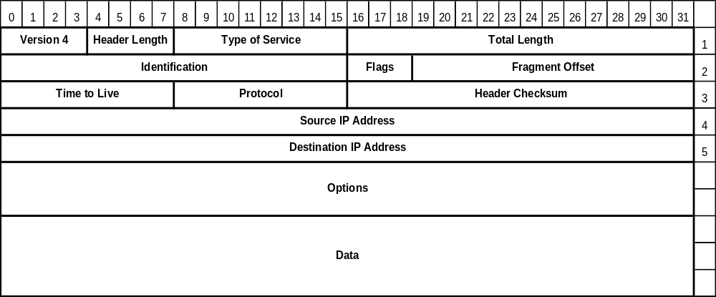
IP fields used in pseudo-header
Carol Davids © 2014

Slide 33
User Datagram Protocol Functions
There are well-known port numbers for servers that use UDP.
The UDP header contains a source and destination port number and a checksum.
There is no sequence number in a UDP header.
Carol Davids © 2014

Slide 34
Connectionless service
Connectionless service
  The datagrams sent by the same process to the same destination process are not related to each other
  Contrast connectionless to connection-oriented service (see next page)
Carol Davids © 2014

Slide 35
Connection-oriented service
Connection-oriented service
  The datagrams sent by the same process to the same destination process are related to each other
  The relationship is maintained at the cost of memory allocated in participating nodes AND processing cycles in participating nodes
Carol Davids © 2014

Slide 36
Connection-oriented service
Memory must be allocated in which the connection parameters are stored
Connection parameters such as connection id, sequence number, timers, encryption keys, must be stored in memory
Processing time must be used to read and use these connection parameters
Carol Davids © 2014

Slide 37
Flow and error control
UDP does not provide flow control - there is no window mechanism, such as we will study in TCP
The only error control is provided by the checksum
This error control mechanism does not prevent lost packets or duplicate packets
Carol Davids © 2014

Slide 38

How UDP operates
Fig 23.12 illustrates how UDP operates to receive data from the application process at the sending side and to deliver data to the application process at the receiving side.
Carol Davids © 2014

Slide 39

Operation - UDP
Client process starts
The client requests a UDP port from the Operating System
Incoming and outgoing queues are associated with the process
Client ports are usually ephemeral
When the process terminates, queues are destroyed
Carol Davids © 2014

Slide 40
Operation – UDP - Sending
At sender side, UDP takes application layer information from the sender’s queue, adds UDP header, and delivers it to IP
If outgoing queue overflows, the Operating System can ask the sending process to wait
Carol Davids © 2014

Slide 41
Operation – UDP - receiving
When client side receives a message, UDP checks to see if the destination port exists
If it does exist, UDP puts the message at the end of the queue
Carol Davids © 2014

Slide 42
Operation - UDP
If the port does not exist, UDP discards the message and tells ICMP to send a port unreachable message
Carol Davids © 2014

Slide 43
Operation - UDP
If the incoming queue overflows, UDP discards the message and tells ICMP to send a port unreachable message
Carol Davids © 2014

Slide 44
Applications encapsulated in UDP
DNS - UDP port 53
BOOTP server - UDP port 67
BOOTP client - UDP port 68
Find these at : http://www.iana.org/assignments/port-numbers
Carol Davids © 2014

Slide 45
Applications encapsulated in UDP
DHCP
dhcpv6-client 546/tcp DHCPv6 Client
dhcpv6-client 546/udp DHCPv6 Client
dhcpv6-server 547/tcp DHCPv6 Server
dhcpv6-server 547/udp DHCPv6 Server
These port numbers found at : http://www.iana.org/assignments/port-numbers
Carol Davids © 2014

Slide 46
Applications encapsulated in UDP
TFTP
tftp 69/tcp Trivial File Transfer
tftp 69/udp Trivial File Transfer
These port numbers found at : http://www.iana.org/assignments/port-numbers
Carol Davids © 2014

Slide 47
SIP trace with UDP
In this trace, the application layer protocol is SIP, a VoIP signaling application. It usually uses UDP as its transport layer.
Frame 4 (663 bytes on wire, 663 bytes captured)
Ethernet II, Src: 00:14:bf:24:e6:c3, Dst: 00:0b:46:cc:61:e1
Internet Protocol, Src Addr: 216.47.140.33 (216.47.140.33), Dst Addr: 216.115.25.171 (216.115.25.171)
User Datagram Protocol, Src Port: 10000 (10000), Dst Port: 5061 (5061)
Session Initiation Protocol
Request-Line: REGISTER sip:bspgroup1.bsp.vonage.net;transport=UDP SIP/2.0
Carol Davids © 2014

Slide 48
NTP trace with UDP
In the trace on the next page, the application layer protocol is NTP, the Network Time Protocol.
It usually uses UDP as its transport layer.
Carol Davids © 2014

Slide 49
Frame 33 (90 bytes on wire, 90 bytes captured)
Ethernet II, Src: 192.168.0.121 (00:0c:30:52:91:17), Dst: 192.168.0.8 (00:d0:b7:2e:9e:77)
Internet Protocol, Src: 192.168.0.121 (192.168.0.121), Dst: 192.5.41.40 (192.5.41.40)
User Datagram Protocol, Src Port: 6763 (6763), Dst Port: ntp (123)
Source port: 6763 (6763)
Destination port: ntp (123)
Length: 56
Checksum: 0x1a40 [correct]
Network Time Protocol
Flags: 0xe3
Peer Clock Stratum: unspecified or unavailable (0)
………
Carol Davids © 2014

Slide 50
DHCP trace with UDP
In the trace on the next page, the application layer protocol is DHCP, the Dynamic Host Configuration Protocol.
It usually uses UDP as its transport layer.
Carol Davids © 2014

Slide 51
Ethernet II, Src: CompaqCo_d9:01:ce (00:50:8b:d9:01:ce), Dst: Broadcast (ff:ff:ff:ff:ff:ff)
Internet Protocol, Src: 192.168.0.6 (192.168.0.6), Dst: 255.255.255.255 (255.255.255.255)
User Datagram Protocol, Src Port: bootpc (68), Dst Port: bootps (67)
Source port: bootpc (68)
Destination port: bootps (67)
Length: 256
Checksum: 0x0d2c [correct]
Bootstrap Protocol
Message type: Boot Request (1)
Hardware type: Ethernet
Hardware address length: 6
Hops: 0
…….
Carol Davids © 2014

Slide 52
DNS trace with UDP
In the trace on the next page, the application layer protocol is DNS, the Domain Name Service. It usually uses UDP as its transport layer.
Carol Davids © 2014

Slide 53
Frame 3 (71 bytes on wire, 71 bytes captured)
Ethernet II, Src: 10.0.1.3 (00:0c:41:2b:a2:a6), Dst: 10.0.1.1 (00:03:93:e5:13:52)
Internet Protocol, Src: 10.0.1.3 (10.0.1.3), Dst: 10.0.1.1 (10.0.1.1)
User Datagram Protocol, Src Port: 1060 (1060), Dst Port: domain (53)
Source port: 1060 (1060)
Destination port: domain (53)
Length: 37
Checksum: 0x6cd1 [correct]
Domain Name System (query)
Transaction ID: 0x2527
Flags: 0x0100 (Standard query)
Questions: 1
……..
Queries
?.attbi.com: type A, class IN
Name: ?.attbi.com
Type: A (Host address)
Class: IN (0x0001)
Note: The application is numbering its requests since it can’t depend on the transport layer to do so.
Carol Davids © 2014

Slide 54
The End
Carol Davids © 2014

