Slide 1


ITM 540
Data Networks
The Network Layer
Layer 4
TCP
Professor: Carol Davids
Email: davids@iit.edu

Slide 2
Reading Assignment
Forouzan, ed 4 : Chapter 23

Slide 3
Transmission Control Protocol - TCP Protocol 6
TCP is a transport layer protocol specified in the IETF RFC 793.
Date published is 1981.

Slide 4
Transmission Control Protocol - TCP Protocol 6
A connection-oriented protocol.
The only real option specified in RFC 793 is the maximum segment size.
It indicates the maximum amount of data that the receiving system can accept.

Slide 5
Connection Oriented
Goal is to create the effect of putting an imaginary pipe between the sender and receiver processes
The sender produces bytes
The receiver consumes bytes

Slide 6
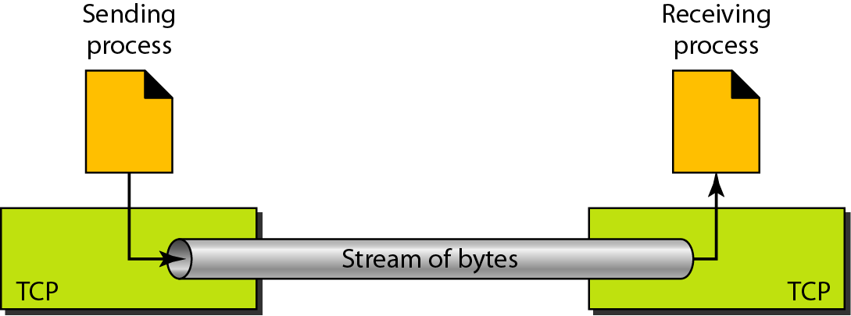
Connection Oriented
Consider a stream of bytes being produced by the sender and a stream of bytes being consumed by the receiver

Slide 7
How TCP creates the illusion
The bytes from the sender application are placed into a send buffer
They are numbered sequentially starting with a randomly generated number

Slide 8
How TCP creates the illusion
TCP takes segments out of this send buffer
TCP decides how many bytes to take
Different situations result in different size segments

Slide 9
How TCP creates the illusion
TCP identifies the segments by the number of the first byte in the segment.

Slide 10
Transmission Control Protocol - TCP
Applications it supports include:
E-mail
File transfer
Web browsing

Slide 11
Transmission Control Protocol - TCP
20 byte header when no options are present

Slide 12
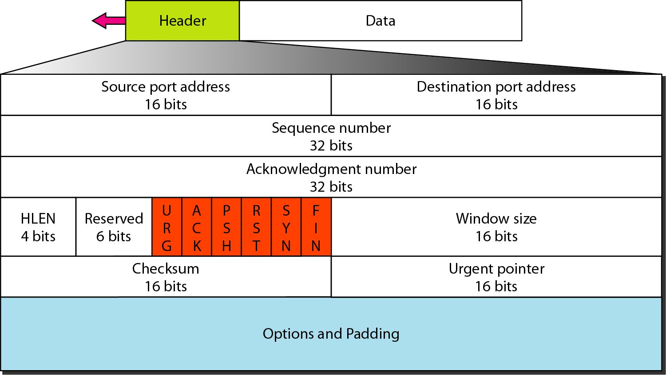
Transmission Control Protocol - TCP
Figure 23.16 ed 4

Slide 13
TCP Wireshark Trace
Frame 15 (619 bytes on wire, 619 bytes captured)
Ethernet II, Src: 00:0c:41:2b:a2:a6, Dst: 00:03:93:e5:13:52
Internet Protocol, Src Addr: 10.0.1.3 (10.0.1.3), Dst Addr: 66.102.7.104 (66.102.7.104)
Transmission Control Protocol, Src Port: 1585 (1585), Dst Port: http (80), Seq: 3683161283, Ack: 3973483453, Len: 565
Source port: 1585 (1585)
Destination port: http (80)
Sequence number: 3683161283
Acknowledgement number: 3973483453
Header length: 20 bytes
Flags: 0x0018 (PSH, ACK)
Window size: 16343
Checksum: 0x76e4 (correct)
Hypertext Transfer Protocol

Slide 14
Ports
The source port and the destination port are each identified by a 16 bit number.
This means that TCP Ports values can range between 0 to 2¹⁶ - 1 .

Slide 15
Ports
Ports are bound to ( associated with ) processes within computing devices.
The devices are identified by their IP Address.
The processes are identified by their port numbers.

Slide 16
Binding ports to Processes
Frequently-used processes such as HTTP or E-mail are assigned fixed sockets which are made known to the public.

Slide 17
Binding ports to Processes
These services can then be accessed through the well-known ports.
The IANA site where the well-known ports are found is http://www.iana.org/assignments/port-numbers .

Slide 18
Excerpt from http://www.iana.org/assignments/port-numbers
PORT NUMBERS (last updated 2007-11-20)
The port numbers are divided into three ranges: the Well Known Ports, the Registered Ports, and the Dynamic and/or Private Ports.
The Well Known Ports are those from 0 through 1023. …….
The Registered Ports are those from 1024 through 49151 ……..
The Dynamic and/or Private Ports are those from 49152 through 65535 A value of 0 in the port numbers registry below indicates that no port has been allocated. ….

Slide 19
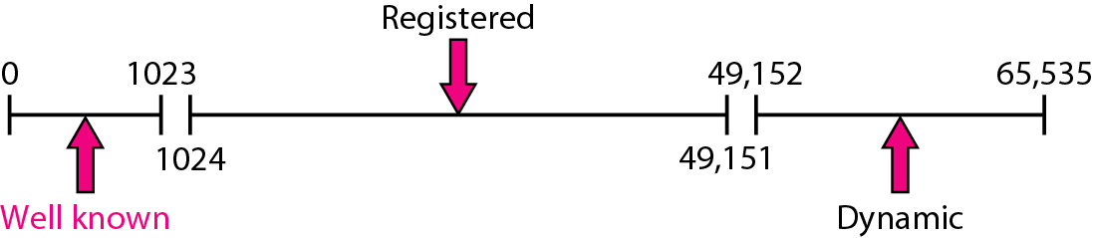
Classification of Ports
Figure 23.4 in the text book illustrates the information in the excerpt on the previous page.

Slide 20
Sequence Number
The Sequence number is the number of the byte in the stream of bytes being sent
The sequence number of the first byte in a segment of bytes is used to identify the segment
The field that identifies the sequence number is 32 bits long, so the value of the sequence number can range between 0 and 2³² -1

Slide 21
Sequence Number
The Sequence number is used to alert the receiver of four types of transmission errors:
Lost
Duplicate
Out of sequence delivery
Corrupted
It is a 32 bit integer and so can take on values between 0 and 2³² - 1.

Slide 22
Acknowledgement Number
The Acknowledgement Number is the next sequence number that the sender is expecting to receive.
It has the same format that a sequence number has.

Slide 23
HLEN – (Data Offset Number)
Header Length indicates where the data begins.
For this reason, this field is also referred to as the data offset number.
It is the number of 32 bit words (4 byte words) in the TCP Header.
You can also think of this as the number of ‘rows’ we use in the standard diagram of a data packet.

Slide 24
HLEN - data offset
Its value is given in a 4-bit field, so that the maximum value possible for this offset is 2⁴ - 1 or 15.
The header length is a number between 5 and 15.
This represents a header length between 20 bytes and 60 bytes.
The TCP header is always an integral number of ‘rows’ in our standard data packet diagram.

Slide 25
Reserved Field
Set to 0.

Slide 26
TCP Flags
The flags provide information about the data in the packet.
The flags are:
URG
ACK
PSH
RST
SYN
FIN

Slide 27
Two flags for processing
Two of these flags are used to tell the receiving TCP process how to handle the data packet.
URG
PSH

Slide 28
Two flags for processing
URG – When set to 1 this flag tells the receiver to read the urgent pointer field. The urgent pointer field tells the TCP process how many bytes to allow to go to the front of the buffer - to “jump the line.”
PSH – When set to 1 this flag indicates that the data in the buffer should be delivered promptly, without waiting for the normal algorithm for passing data to the application. (Ignore normal procedures.)

Slide 29
Urgent
Urgent data is sent out of sequence.
The urgent data might be a control character for example, and the sending device wants this information to “jump to the front of the line” so that the receiving device can act on it before acting on the things already in its receive buffer.

Slide 30
PUSH
A push causes TCP to promptly forward and deliver data that has arrived to the receiver without waiting for the receive buffer to reach a certain level of fullness for example.

Slide 31
Four flags for creating and removing connections
Three of these flags are used to create and delete connections under normal conditions.
ACK
SYN
FIN
These are the ones we use in the TCP Three-Way Handshake

Slide 32
Flags for connections
ACK – This flag is set to 1 in all but the first segment during the process of establishing a connection.
SYN – This flag is set to 1 in the initial messages when setting up a data transfer.
FIN – This flag is set to 1 to close a session gracefully.

Slide 33
Reset
RST - This flag is set to 1 to indicate that the connection needs to be reset.
Reset destroys the current connection, flushing the buffers and resetting all parameters to their null or default values
It is different from FIN. FIN indicates a normal disconnection.
RST indicates that there was trouble with the connection.

Slide 34
Reset
Reset might be used if:
Requesting TCP asks the receiving TCP to create a connection to a non-existent port
Either TCP encounters an abnormal condition
One TCP observes that the other has not sent during some time period that exceeds some “idle” threshold

Slide 35
Window Size
The maximum number of octets that the far end may transmit before receiving further permission.
The “window size” field enables the receiver to control the amount of data sent by the far end.

Slide 36
Window Size
This enables a method of flow control.
The TCP receiving process reports a "window" to the TCP sending process.
This window specifies the number of octets, starting with the acknowledgment number, that the receiving TCP process is currently prepared to receive.

Slide 37
Window Size enables Flow Control
The far end's sending TCP process then knows that it may send “window” number of bytes starting with byte “ack."
Thus it has already sent some bytes that have not been acknowledged, it must include them in the count as to how many more it is allowed to send before receiving a new "ack."

Slide 38
Checksum
The checksum field is the 16 bit one's complement of the one's complement sum of all 16 bit words in the :
TCP header
TCP body
TCP pseudo header (12 additional bytes of the IP header - bytes that are not changed by routers.)

Slide 39
Why use the pseudo-header
The pseudo header includes a set of IP Parameters that are recorded by TCP.
TCP uses the pseudo-header in the checksum to ensure that segments reach the right destination.

Slide 40
Checksum and pseudo-header
This pseudo header contains the following values from the IP header:
Source Address
Destination Address
Protocol value
TCP length (total length minus header length)
TCP learns these values by means of function calls made by the TCP process to the IP process.

Slide 41
IP fields used in pseudo-header

Slide 42
Urgent Pointer
TCP keeps a variable called the urgent pointer.
The value of the urgent pointer tells TCP where the urgent information ends.
This field is only read in a segment whose URG flag is set.

Slide 43
Options
There are only a few options defined for TCP.
Option 0
Option 1
Option 2
There is a newer option, called SACK, defined in a separate RFC

Slide 44
Option 0
End of Option List
This option code indicates the end of the option list.
This is used at the end of all options, not the end of each option
It only needs to be used if the end of the options would not otherwise coincide with the end of the TCP header.

Slide 45
Option 1
No-Operation (NOOP).
Can serve to align the beginning of the next option on a word boundary.
Not all senders will use this option, however.

Slide 46
Option 2
Maximum Segment Size
This is a TLV type of option (Type-Length-Value).
Type = 1 byte with a value of 2
Length = 1 byte with a value of 4
Value = 2 bytes that identify the maximum segment size

Slide 47
Option 2
Maximum Segment Size
The maximum receive segment size at the TCP which sends this segment.
Only sent in the initial connection request - that is, in segments with the SYN flag is set.
If this option is not used, any segment size is allowed.

Slide 48
Frame 27 (62 bytes on wire, 62 bytes captured)
Ethernet II, Src: 00:0c:41:2b:a2:a6, Dst: 00:03:93:e5:13:52
Internet Protocol, Src Addr: 10.0.1.3 (10.0.1.3), Dst Addr: 205.188.180.118 (205.188.180.118)
Transmission Control Protocol, Src Port: 1587 (1587), Dst Port: http (80), Seq: 2313141255, Ack: 0, Len: 0
Source port: 1587 (1587)
Destination port: http (80)
Sequence number: 2313141255
Header length: 28 bytes
Flags: 0x0002 (SYN)
Window size: 16384
Checksum: 0x697f (correct)
Options: (8 bytes)
Maximum segment size: 1460 bytes
NOP
NOP
SACK permitted

Slide 49
SACK - RFC 2018
Selective Acknowledgment (SACK) is a strategy that improves TCP performance in the face of multiple dropped segments.
With selective acknowledgments, the data receiver can inform the sender about all segments that have arrived successfully, so the sender only needs to retransmit the segments that have actually been lost.

Slide 50
Padding
The TCP header padding is used to ensure that the TCP header ends, and data begins, on a 32 bit boundary.
The padding is composed of zeros.

Slide 51
Data
Some TCP messages contain data, others do not.
A TCP message that does not contain data is used to manage the connection in some way.
It might be used to establish the connection, or to acknowledge the receipt of segments, or to tear down the connection.

Slide 52
TCP Operation
The connection needs to be established before the payload or data can be sent.
TCP first breaks a data stream into segments
Then attaches a TCP header to each segment
Then sends the segment - including its header - down the stack to IP
IP attaches its own header and sends the datagram to the destination IP Address.

Slide 53
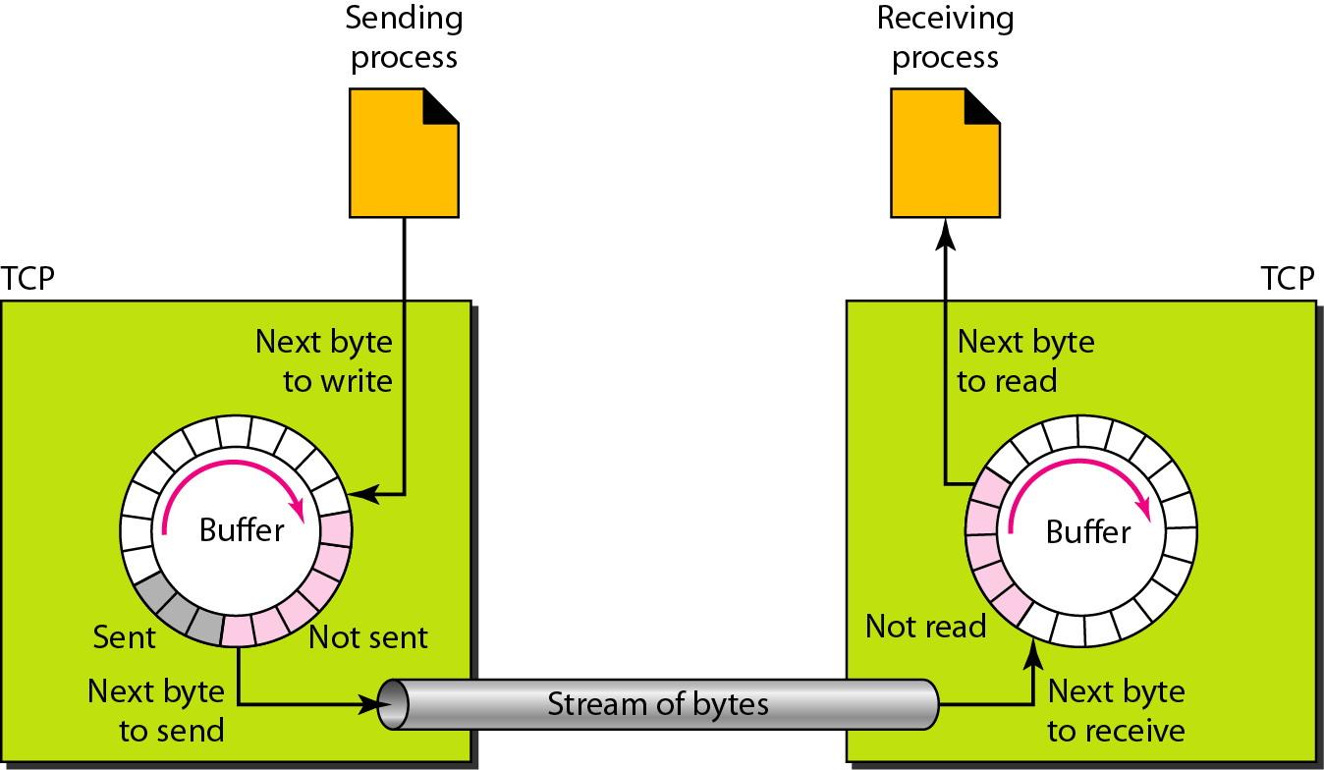
TCP creates streams of bytes. Imagine a tube carrying bytes across the Internet. (Fig 23.14 below.)

Slide 54

The sending process writes (produces) bytes to be added to the stream
The receiving process reads (consumes) bytes from the stream of bytes

Slide 55
The illusion is created using data structures called ‘sending buffers’ and ‘receiving buffers.’

Slide 56
These buffers can be implemented as circular arrays of elements that are one-byte locations

Slide 57
Send buffer and Receive buffer
TCP uses a send buffer and a receive buffer to create streams of bytes.
TCP numbers the bytes
TCP does not actually number the segments – it numbers the bytes.

Slide 58
SEQ and ACK numbers
TCP assigns the number of the first byte in a segment ‘I am sending to you’ to be the SEQ, the Sequence Number.
TCP assigns the number of the first byte ‘I expect to receive from you’ to be the ACK, the acknowledgement number.
Note that the receiver numbers the bytes that it just received, starting with the sequence number in the packet. Then it adds 1 to the highest byte number it received and sends that in the ACK.

Slide 59
SEQ and ACK numbers
Note that the receiver numbers the bytes that it just received, starting with the sequence number in the packet. Then it adds 1 to the highest byte number it received and sends that in the ACK.

Slide 60
TCP sends Segments
The segments that TCP sends are of varying lengths.
TCP decides how many bytes to put into a segment based on information in the header fields of TCP messages it received from the far end
That information can include the window size that the distant TCP announced.

Slide 61
TCP operation continued
At the destination, the segment is received by IP
IP passes the segment to TCP.
TCP checks the header for bit errors using the checksum
TCP only delivers the message to the application layer when all the segments are arranged in order
TCP uses the SEQ and ACK numbers to determine if the segments are in order

Slide 62
TCP operation continued
If it finds no bit errors, it sends an acknowledgement to the originating TCP.
If it finds errors, no ACK for that segment is sent
If the originator does not receive an ACK after a specified time-out period, it resends the segment.

Slide 63
TCP operation continued
The ACK lets the originating TCP know the sequence number of the next byte that the receiving TCP expects to receive.
(That is, what is the SEQ that it expects to see in the next TCP message.)

Slide 64
TCP Connections from the specification…
“When two processes wish to communicate, their TCP's must first establish a connection (initialize the status information on each side).
When their communication is complete, the connection is terminated or closed to free the resources for other uses.”

Slide 65
Establishing a TCP Connection

Slide 66
Establishing a TCP Connection
The Server tells its TCP that it is ready to receive requests.
This causes the server's TCP to enter the Passive Open state and the process is called a passive open.

Slide 67
Establishing a TCP Connection .. step 1
When the application's client side needs to exchange data with the application's server side,
The Client’s application sends data to TCP.
TCP buffers the data.
TCP constructs a segment.

Slide 68
Establishing a TCP Connection .. step 1
The TCP segment includes :
source and destination port numbers
initial sequence number (chosen at random)
a window size
an optional maximum segment length.

Slide 69
Establishing a TCP Connection .. step 1
TCP sets the SYN flag to 1.
TCP sends the segment.

Slide 70
Establishing a TCP Connection .. step 2
The TCP on the application's server side, responds to the SYN with a TCP message of its own.
The TCP on the server side sets the SYN and the ACK flags to 1 in this segment.

Slide 71
Establishing a TCP Connection .. step 2
The server side's TCP segment includes :
window size
maximum segment size
its own sequence number – (also chosen at random)
an ACK number 1 greater than the value of the sequence number it received.

Slide 72
Establishing a TCP Connection .. step 3
The TCP process on the client side issues another segment.
Its sequence number is the old sequence number plus 1.
Its ACK number is the received sequence number plus 1.
It sets the ACK flag and sends this segment.

Slide 73
Establishing a TCP Connection ..3
This completes the three-way handshake.
Now the TCP connection is open and both ends are ready to exchange data.

Slide 74
Three way handshake from the RFC

Slide 75
Closing a TCP Connection

Slide 76
Closing the TCP connection
The entity that wants to close the connections sends a segment with the FIN flag set.
The far end sends a segment whose ACK flag is set.
The far end sends a segment whose FIN flag is set.
The first entity sends a segment whose ACK flag is set.
At this point the connection is closed.

Slide 77
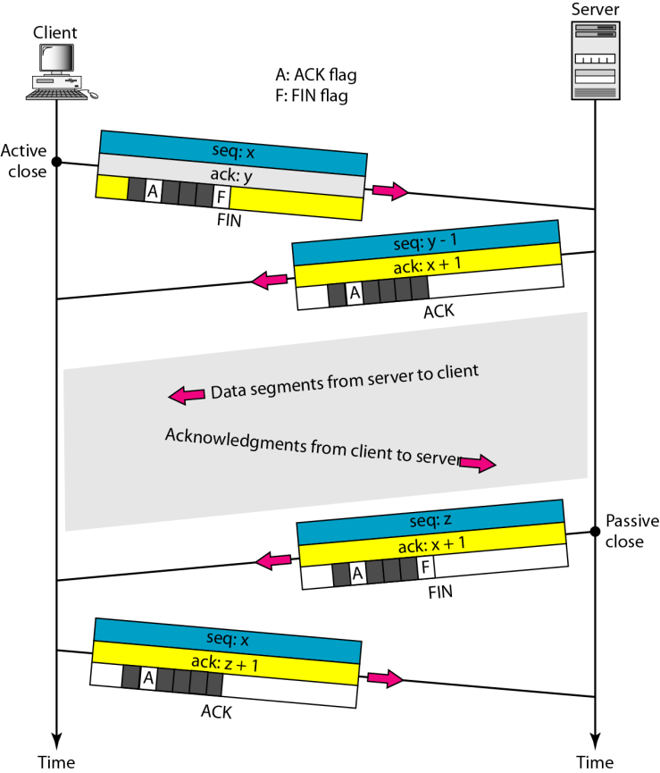
Half close
Here, the client is done sending.
Client closes its sending portion
Client continues to receive from server
Server closes when it is done sending.

Slide 78
Examples
The following pages include examples of TCP messages.

Slide 79
Example 1: A browser calls an HTTP server in lab
Notice
There is no relationship between the sequence numbers sent by the client and those sent by the server.
The acknowledgement numbers sent are the next numbers that the sender expects to receive in the sequence number field of the next TCP message it receives on this connection.
Sometimes TCP messages contain no body or payload. They are used to signal information about the connection.

Slide 80
Browser causes TCP to send a SYN to establish the connection
Frame 48 (62 bytes on wire, 62 bytes captured)
Ethernet II, Src: 00:0b:cd:cd:77:f6, Dst: 00:0f:24:4e:d0:d0
Internet Protocol, Src Addr: 192.168.123.1 (192.168.123.1), Dst Addr: 192.168.123.8 (192.168.123.8)
Transmission Control Protocol, Src Port: 1761 (1761), Dst Port: http (80), Seq: 1364394887, Ack: 0, Len: 0
Source port: 1761 (1761)
Destination port: http (80)
Sequence number: 1364394887
Header length: 28 bytes
Flags: 0x002 (SYN)
Window size: 64240
Checksum: 0xb4c8 (correct)
Options: (8 bytes)
Note: There is no ACK flag in the first SYN segment.

Slide 81
Server causes TCP to send a SYN/ACK
Frame 49 (60 bytes on wire, 60 bytes captured)
Ethernet II, Src: 00:0f:24:4e:d0:d0, Dst: 00:0b:cd:cd:77:f6
Internet Protocol, Src Addr: 192.168.123.8 (192.168.123.8), Dst Addr: 192.168.123.1 (192.168.123.1)
Transmission Control Protocol, Src Port: http (80), Dst Port: 1761 (1761), Seq: 3637881877, Ack: 1364394888, Len: 0
Source port: http (80)
Destination port: 1761 (1761)
Sequence number: 3637881877
Acknowledgement number: 1364394888
Header length: 24 bytes
Flags: 0x012 (SYN, ACK)
Window size: 4128
Checksum: 0x2fa4 (correct)
Options: (4 bytes)
The TCP server side expects to receive sequence number 1364394888
because the last sequence number it received was 1364394887.

Slide 82
Browser causes TCP to send an ACK - thus completing the 3-way handshake
Frame 50 (60 bytes on wire, 60 bytes captured)
Ethernet II, Src: 00:0b:cd:cd:77:f6, Dst: 00:0f:24:4e:d0:d0
Internet Protocol, Src Addr: 192.168.123.1 (192.168.123.1), Dst Addr: 192.168.123.8 (192.168.123.8)
Transmission Control Protocol, Src Port: 1761 (1761), Dst Port: http (80), Seq: 1364394888, Ack: 3637881878, Len: 0
Source port: 1761 (1761)
Destination port: http (80)
Sequence number: 1364394888
Acknowledgement number: 3637881878
Header length: 20 bytes
Flags: 0x010 (ACK)
Window size: 64240
Checksum: 0x5c90 (correct)
The TCP client side expects to receive sequence number 3637881878
because the last sequence number it received was 3637881877.

Slide 83
Browser causes TCP to send application data (HTTP)
Frame 51 (418 bytes on wire, 418 bytes captured)
Ethernet II, Src: 00:0b:cd:cd:77:f6, Dst: 00:0f:24:4e:d0:d0
Internet Protocol, Src Addr: 192.168.123.1 (192.168.123.1), Dst Addr: 192.168.123.8 (192.168.123.8)
Transmission Control Protocol, Src Port: 1761 (1761), Dst Port: http (80), Seq: 1364394888, Ack: 3637881878, Len: 364
Source port: 1761 (1761)
Destination port: http (80)
Sequence number: 1364394888
Acknowledgement number: 3637881878
Header length: 20 bytes
Flags: 0x018 (PSH, ACK)
Window size: 64240
Checksum: 0x04c0 (correct)
Hypertext Transfer Protocol
The sequence number is the same as the sequence number of the ACK since the message that carried the ACK did not carry any application data.

Slide 84
Server causes TCP to send application data
Frame 52 (614 bytes on wire, 614 bytes captured)
Ethernet II, Src: 00:0f:24:4e:d0:d0, Dst: 00:0b:cd:cd:77:f6
Internet Protocol, Src Addr: 192.168.123.8 (192.168.123.8), Dst Addr: 192.168.123.1 (192.168.123.1)
Transmission Control Protocol, Src Port: http (80), Dst Port: 1761 (1761), Seq: 3637881878, Ack: 1364395252, Len: 560
Source port: http (80)
Destination port: 1761 (1761)
Sequence number: 3637881878
Acknowledgement number: 1364395252
Header length: 20 bytes
Flags: 0x0010 (ACK)
Window size: 3764
Checksum: 0x7afa (correct)
Hypertext Transfer Protocol
Line-based text data: text/html
Server side acknowledges it received the segment whose sequence number was 1364395251 and so is expecting to receive 1364395252.

Slide 85
Server causes TCP to send more application data
Frame 53 (614 bytes on wire, 614 bytes captured)
Ethernet II, Src: 00:0f:24:4e:d0:d0, Dst: 00:0b:cd:cd:77:f6
Internet Protocol, Src Addr: 192.168.123.8 (192.168.123.8), Dst Addr: 192.168.123.1 (192.168.123.1)
Transmission Control Protocol, Src Port: http (80), Dst Port: 1761 (1761), Seq: 3637882438, Ack: 1364395252, Len: 560
Source port: http (80)
Destination port: 1761 (1761)
Sequence number: 3637882438
Acknowledgement number: 1364395252
Header length: 20 bytes
Flags: 0x0010 (ACK)
Window size: 3764
Checksum: 0x3aee (correct)
Hypertext Transfer Protocol
Server side acknowledges it received the segment whose sequence number was 1364395251 and so is still expecting to receive 1364395252.

Slide 86
Server causes TCP to send still more application data
Frame 54 (144 bytes on wire, 144 bytes captured)
Ethernet II, Src: 00:0f:24:4e:d0:d0, Dst: 00:0b:cd:cd:77:f6
Internet Protocol, Src Addr: 192.168.123.8 (192.168.123.8), Dst Addr: 192.168.123.1 (192.168.123.1)
Transmission Control Protocol, Src Port: http (80), Dst Port: 1761 (1761), Seq: 3637882998, Ack: 1364395252, Len: 90
Source port: http (80)
Destination port: 1761 (1761)
Sequence number: 3637882998
Acknowledgement number: 1364395252
Header length: 20 bytes
Flags: 0x0010 (ACK)
Window size: 3764
Checksum: 0xc295 (correct)
Hypertext Transfer Protocol
Server side acknowledges it received the segment whose sequence number was 1364395251 and so is still expecting to receive 1364395252.

Slide 87
Browser causes TCP to send an ACK
Frame 55 (60 bytes on wire, 60 bytes captured)
Ethernet II, Src: 00:0b:cd:cd:77:f6, Dst: 00:0f:24:4e:d0:d0
Internet Protocol, Src Addr: 192.168.123.1 (192.168.123.1), Dst Addr: 192.168.123.8 (192.168.123.8)
Transmission Control Protocol, Src Port: 1761 (1761), Dst Port: http (80), Seq: 1364395252, Ack: 3637882998, Len: 0
Source port: 1761 (1761)
Destination port: http (80)
Sequence number: 1364395252
Acknowledgement number: 3637882998
Header length: 20 bytes
Flags: 0x0010 (ACK)
Window size: 63120
Checksum: 0x5b24 (correct)
Browser side acknowledges it received the segment whose sequence number was 3637882997and so is expecting to receive 3637882998.
Notice that the Len: is 0, so there is no application data being sent by the browser.

Slide 88
Browser sends application - HTTP - data
Frame 56 (614 bytes on wire, 614 bytes captured)
Ethernet II, Src: 00:0f:24:4e:d0:d0, Dst: 00:0b:cd:cd:77:f6
Internet Protocol, Src Addr: 192.168.123.8 (192.168.123.8), Dst Addr: 192.168.123.1 (192.168.123.1)
Transmission Control Protocol, Src Port: http (80), Dst Port: 1761 (1761), Seq: 3637883088, Ack: 1364395252, Len: 560
Source port: http (80)
Destination port: 1761 (1761)
Sequence number: 3637883088
Acknowledgement number: 1364395252
Header length: 20 bytes
Flags: 0x0010 (ACK)
Window size: 3764
Checksum: 0x8982 (correct)
Hypertext Transfer Protocol

Slide 89
Example 2: Google search from home PC
Frame 5 (62 bytes on wire, 62 bytes captured)
Ethernet II, Src: 00:0c:41:2b:a2:a6, Dst: 00:03:93:e5:13:52
Internet Protocol, Src Addr: 10.0.1.3 (10.0.1.3), Dst Addr: 66.102.7.104 (66.102.7.104)
Transmission Control Protocol, Src Port: 1585 (1585), Dst Port: http (80), Seq: 3683160795, Ack: 0, Len: 0
Source port: 1585 (1585)
Destination port: http (80)
Sequence number: 3683160795
Header length: 28 bytes
Flags: 0x0002 (SYN)
Window size: 16384
Checksum: 0x7969 (correct)
Options: (8 bytes)
Maximum segment size: 1460 bytes
NOP
NOP
SACK permitted

Slide 90
Google responds to my SYN with a SYN,ACK
Frame 6 (58 bytes on wire, 58 bytes captured)
Ethernet II, Src: 00:03:93:e5:13:52, Dst: 00:0c:41:2b:a2:a6
Internet Protocol, Src Addr: 66.102.7.104 (66.102.7.104), Dst Addr: 10.0.1.3 (10.0.1.3)
Transmission Control Protocol, Src Port: http (80), Dst Port: 1585 (1585), Seq: 3973482275, Ack: 3683160796, Len: 0
Source port: http (80)
Destination port: 1585 (1585)
Sequence number: 3973482275
Acknowledgement number: 3683160796
Header length: 24 bytes
Flags: 0x0012 (SYN, ACK)
Window size: 8190
Checksum: 0x3a67 (correct)
Options: (4 bytes)
Maximum segment size: 1460 bytes

Slide 91
I respond with ACK - completing the 3-way handshake
Frame 7 (54 bytes on wire, 54 bytes captured)
Ethernet II, Src: 00:0c:41:2b:a2:a6, Dst: 00:03:93:e5:13:52
Internet Protocol, Src Addr: 10.0.1.3 (10.0.1.3), Dst Addr: 66.102.7.104 (66.102.7.104)
Transmission Control Protocol, Src Port: 1585 (1585), Dst Port: http (80), Seq: 3683160796, Ack: 3973482276, Len: 0
Source port: 1585 (1585)
Destination port: http (80)
Sequence number: 3683160796
Acknowledgement number: 3973482276
Header length: 20 bytes
Flags: 0x0010 (ACK)
Window size: 17520
Checksum: 0x2db2 (correct)

Slide 92
I send application data …
Frame 8 (541 bytes on wire, 541 bytes captured)
Ethernet II, Src: 00:0c:41:2b:a2:a6, Dst: 00:03:93:e5:13:52
Internet Protocol, Src Addr: 10.0.1.3 (10.0.1.3), Dst Addr: 66.102.7.104 (66.102.7.104)
Transmission Control Protocol, Src Port: 1585 (1585), Dst Port: http (80), Seq: 3683160796, Ack: 3973482276, Len: 487
Source port: 1585 (1585)
Destination port: http (80)
Sequence number: 3683160796
Next sequence number: 3683161283
Acknowledgement number: 3973482276
Header length: 20 bytes
Flags: 0x0018 (PSH, ACK)
Window size: 17520
Checksum: 0xffc0 (correct)
Hypertext Transfer Protocol
………>

Slide 93
….. application data
Hypertext Transfer Protocol
GET / HTTP/1.1\r\n
Host: www.google.com\r\n
User-Agent: Mozilla/5.0 (Windows; U; Windows NT 5.1; en-US; rv:1.7.2) Gecko/20040804 Netscape/7.2 (ax)\r\n
Accept: text/xml,application/xml,application/xhtml+xml,text/html;q=0.9,text/plain;q=0.8,image/png,*/*;q=0.5\r\n
Accept-Language: en-us,en;q=0.5\r\n
Accept-Encoding: gzip,deflate\r\n
Accept-Charset: ISO-8859-1,utf-8;q=0.7,*;q=0.7\r\n
Keep-Alive: 300\r\n
Connection: keep-alive\r\n
Cookie: PREF=ID=591aa73a0af3d098:TM=1008817899:LM=1033049829:S=1mnjXUNaKaFz9kbt\r\n
\r\n

Slide 94
Google sends data …..
Frame 9 (1231 bytes on wire, 1231 bytes captured)
Ethernet II, Src: 00:03:93:e5:13:52, Dst: 00:0c:41:2b:a2:a6
Internet Protocol, Src Addr: 66.102.7.104 (66.102.7.104), Dst Addr: 10.0.1.3 (10.0.1.3)
Transmission Control Protocol, Src Port: http (80), Dst Port: 1585 (1585), Seq: 3973482276, Ack: 3683161283, Len: 1177
Source port: http (80)
Destination port: 1585 (1585)
Sequence number: 3973482276
Next sequence number: 3973483453
Acknowledgement number: 3683161283
Header length: 20 bytes
Flags: 0x0018 (PSH, ACK)
Window size: 14544
Checksum: 0x2ace (correct)
Hypertext Transfer Protocol
…….>

Slide 95
Hypertext Transfer Protocol
HTTP/1.1 200 OK\r\n
Cache-Control: private\r\n
Content-Type: text/html\r\n
Content-Encoding: gzip\r\n
Server: GWS/2.1\r\n
Content-Length: 1009\r\n
Date: Sat, 20 Nov 2004 20:59:40 GMT\r\n
\r\n
Data (1009 bytes)
0000 1f 8b 08 00 00 00 00 00 02 ff 8d 55 6d 6f db 36 ...........Umo.6
0010 10 fe 9e 5f c1 aa 9b 67 af 96 65 07 71 16 c4 a2 ..._...g..e.q
………………………………………………………………………..
………………………………………………………………………..

Slide 96
I respond to Google with ACK and no data
Frame 10 (54 bytes on wire, 54 bytes captured)
Ethernet II, Src: 00:0c:41:2b:a2:a6, Dst: 00:03:93:e5:13:52
Internet Protocol, Src Addr: 10.0.1.3 (10.0.1.3), Dst Addr: 66.102.7.104 (66.102.7.104)
Transmission Control Protocol, Src Port: 1585 (1585), Dst Port: http (80), Seq: 3683161283, Ack: 3973483453, Len: 0
Source port: 1585 (1585)
Destination port: http (80)
Sequence number: 3683161283
Acknowledgement number: 3973483453
Header length: 20 bytes
Flags: 0x0010 (ACK)
Window size: 16343
Checksum: 0x2bcb (correct)

Slide 97
Example Calculations using trace II:
In frame 8, the sequence number announced by the client is 3683160796
In frame 9, the acknowledgement number announced by the server is 3683161283
This means that the server consumed 487 bytes (3683161283 - 3683160796)

Slide 98
Example Calculations using trace II:
Check if this is true by looking at the ‘bytes on the wire’ in frame 8.
It is 541
Add the size of the headers associated with frame 8:
Ethernet II -> 14 bytes
IP -> 20 bytes
TCP -> 20 bytes
__________________
Total -> 54 bytes
541 - 54 = 487 payload of data sent to TCP

Slide 99
Example Calculations using trace II:
In frame 9, the server sends data to the client.
The sequence number of the segment is 3973482276
In frame 10, the client acknowledges the receipt of this segment.
The acknowledgement number in frame 10 is 3973483453.
The amount of data received by the client is 3973483453 - 3973482276 = 1177 bytes

Slide 100
Example Calculations using trace II:
Now look at the window size advertised by the client in frame 8.
It is 17520 bytes
Look at the window size advertised by the client in frame 10 (ACK)
It is 16343 bytes
Take the difference between these two window sizes:
17520 - 16343 = 1177 bytes
This is the same as the size of the data the client has just received from the server.
It appears that the client has not yet pushed this data out of its receive queue and up to the application.

Slide 101
The End

Slide 102
SACK - RFC 2018
Selective Acknowledgment (SACK) is a strategy which improves tcp performance in the face of multiple dropped segments.
With selective acknowledgments, the data receiver can inform the sender about all segments that have arrived successfully, so the sender only needs to retransmit the segments that have actually been lost.

Slide 103
Note on the 3-way handshake from RFC 793
“The synchronization requires each side to send it's own initial sequence number and to receive a confirmation of it in acknowledgment from the other side.
Each side must also receive the other side's initial sequence number and send a confirming acknowledgment….

Slide 104
Note on the 3-way handshake from RFC 793
1) A --> B SYN my sequence number is X
2) A <-- B ACK your sequence number is X
3) A <-- B SYN my sequence number is Y
4) A --> B ACK your sequence number is Y
Because steps 2 and 3 can be combined in a single message this is called the three way (or three message) handshake. .”

Slide 105
Note on the 3-way handshake from RFC 793
“For a connection to be established or initialized, the two TCPs must synchronize on each other's initial sequence numbers.
This is done in an exchange of connection establishing segments carrying a control bit called "SYN" (for synchronize) and the initial sequence numbers.
As a shorthand, segments carrying the SYN bit are also called "SYNs".
Hence, the solution requires a suitable mechanism for picking an initial sequence number and a slightly involved handshake to exchange the ISN's. .”

Slide 106
Note on the 3-way handshake from RFC 793
“A three way handshake is necessary because sequence numbers are not tied to a global clock in the network, and TCPs may have different mechanisms for picking the ISN's.
The receiver of the first SYN has no way of knowing whether the segment was an old delayed one or not, unless it remembers the last sequence number used on the connection (which is not always possible), and so it must ask the sender to verify this SYN.”

Slide 107
The cost of creating connections
Creating connections uses up resources
The cost of connections includes:
Sockets
Memory bytes in which to store information about the connection – including the sequence numbers, ack numbers and state information
Processing time needed to process the messages related to the connection

Slide 108
Connections are pairs of sockets
Remember that a TCP port is bound to a process in order that the process may receive data at that port.
The combination of the IP Address and this TCP port number is called a Socket.
(Remember that UDP also defined sockets this way.)

Slide 109
TCP Connections
A pair of sockets identifies a Connection.
The relationships between ports, sockets and connections is illustrated on the next pages.

Slide 110
Process A uses TCP Port 2000.
Process A uses TCP Socket 216.47.140.25:2000.
The connection between Process A and Process B is identified by the pair of sockets 216.47.140.25:2000 , 192.168.24.32:6001

Slide 111
Memory - Transmission Control Block
The maintenance of a TCP connection requires the remembering of several variables.
We conceive of these variables being stored in a connection record called a Transmission Control Block or TCB.

Slide 112
Transmission Control Block is a portion of memory in the device containing information about the connection.

Slide 113
TCB variables
local socket number
remote socket number
security of the connection
precedence of the connection
pointer to the user's send buffer
pointer to the user’s receive buffer
pointer to the retransmit queue
pointer to the current segment.
variables relating to the send sequence number
variables relating to the receive sequence number

Slide 114
TCP Multiplexing
Notice that one socket can be used in multiple connections.
The socket is the combination of IP Address and TCP port.
The connection is identified by a combination of 2 sockets - this socket and the distant socket.

Slide 115
TCP Multiplexing
This means that many different connections - each identified by a different distant socket - can be associated with a single local socket.
This is illustrated on the next page.

Slide 117
Example of multiplexing on a socket …
Process A is bound to TCP port 2000 in the device whose IP Address is 216.47.140.25.
The socket used by Process A is 216.47.140.25:2000

Slide 118
Example of multiplexing on a socket …
Process B is bound to TCP port 6001 in the device whose IP Address is 192.168.24.32.
The socket used by Process B is 192.168.24.32:6001.

Slide 119
The connection between Process A and Process B is identified by the pair of sockets :
216.47.140.25:2000 , 192.168.24.32:6001
There is a different connection between Process A and Process C, identified by the pair of sockets:
216.47.140.25:2000 , 192.168.24.32:7000
And a different connection between Process A and Process D, identified by the pair of sockets:
216.47.140.25:2000 , 192.168.24.32:9000

Slide 120
All three of these connections use the same socket on the device 216.47.140.25.
In this way, Process A can have multiple connections using only one TCP port.
This process of using one facility for multiple connections is called Multiplexing.

Slide 121
Multiplexing is made possible in this case by the fact that the thing being multiplexed - the connection - has an additional piece of identifying information - the other socket - that distinguishes it from other connections that share the same port.

Slide 122
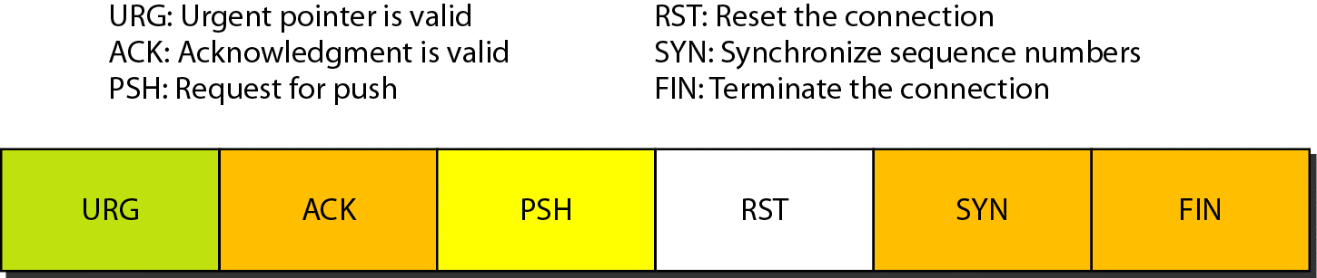
Note on Flag Encoding
Flags: 0x012 (SYN, ACK)
Hex 12 = 0001 0010 since 1 == 0001 and 2 == 0010
Now reading from right to left:
the FIN bit is 0;
the SYN bit is set to 1;
the RST and PSH bits are 0;
the ACK bit is set to 1;
the URG bit is 0.

Slide 123
encoding of the flags…
HLEN (data offset) uses 4 bits
Reserved uses 6 bits
Flags use 6 bits
Flags: 0x02 (SYN) : Hex 02 = 0000 0010; red indicates these are not flag bits
the FIN bit is 0;
the SYN bit is set to 1;
the RST and PSH bits are 0;
the ACK bit is set to 0;
the URG bit is 0.

Slide 124
Encoding the flags…
HLEN (data offset) uses 4 bits
Reserved uses 6 bits
Flags use 6 bits
Flags: 0x12 (SYN,ACK) : Hex 12 = 0001 0010; red indicates these are not flag bit. When you read the hex read the 0001 as 1 and the 0010 as 2. You are not changing it to decimal.
the FIN bit is 0;
the SYN bit is set to 1;
the RST and PSH bits are 0;
the ACK bit is set to 1;
the URG bit is 0.

Slide 125
Note on flag encoding
Flags: 0x0010 (ACK) Hex 10 = 0001 0000;
the FIN bit is 0;
the SYN bit is set to 0;
the RST and PSH bits are 0;
the ACK bit is set to 1;
the URG bit is 0.

Slide 126
Note on flag encoding
Flags: 0x0018 (PSH, ACK) Hex 18 = 0001 1000;
the FIN bit is 0;
the SYN bit is set to 0;
the RST bit is 0;
PSH bit is set to 1
the ACK bit is set to 1;
the URG bit is 0.

Slide 127
References
http://www.iana.org/assignments/port-numbers
http://www.informit.com/articles/article.asp?p=30662&seqNum=2
http://www.thinkingsecure.com/docs/TCPIP-Illustrated-1/tcp_bulk.htm#20_8

