Slide 1


ITM 540
Data Networks
Layer 4: Transport Layer
TCP Flow Control
Professor: Carol Davids
Email: davids@iit.edu
Carol Davids © 2015

Slide 2
Reading
Forouzan, ed 4, Chapter 23
Carol Davids © 2015

Slide 3
Flow Control uses ‘ack’ and ‘window’ fields
TCP provides a means for the destination side of a TCP connection to govern the amount of data sent by the source side.
The destination side of a TCP transmission sends a value in the "window" field.
The value in the “window” field tells the source how much data it may send before it needs to wait to get an acknowledgement.
Carol Davids © 2015

Slide 4
TCP provides a virtual full-duplex connection
That means, each end of the connection has a source and a sink.
At each side, the source is the buffer filled with data to be sent, the sink is the buffer filled with received data.
Carol Davids © 2015

Slide 5
TCP provides a virtual full-duplex connection
Side A
Side B
Sink
A
Source
A
Sink
B
Source
B
Carol Davids © 2015

Slide 6
Segment
The unit of data transfer between two devices using TCP is called a Segment.
The Sequence number of a segment is the number assigned to the first byte of data contained in the segment.
Each byte in the TCP stream is numbered, but we only ‘see’ the sequence and acknowledgement numbers.
Carol Davids © 2015

Slide 7
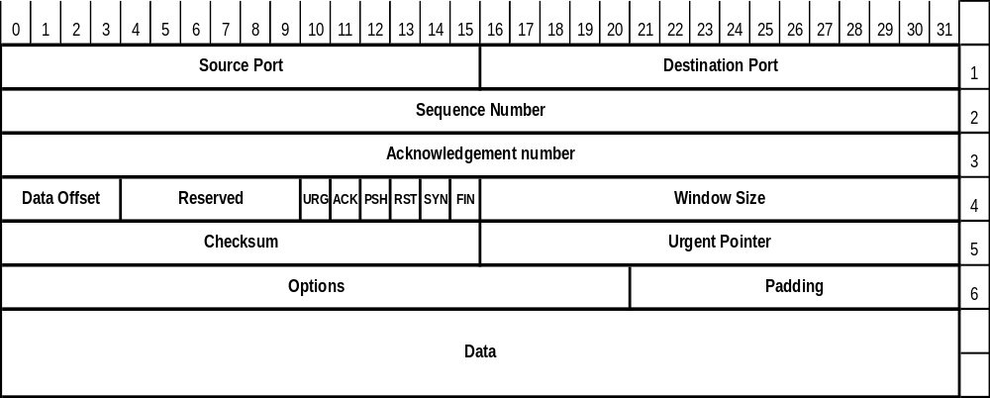
TCP message
Here the acknowledgement number indicates the sequence number of the next message the receiver expects.
The window size indicates how many bytes after that one the receiver will accept.
Carol Davids © 2015

Slide 8
Sliding Window
The flow control method used by TCP is called a sliding window method.
It enables TCP to send many segments before receiving an ACK.
The sliding window protocol is much more efficient than a Stop and Wait protocol.
Carol Davids © 2015

Slide 9
Sequence Number
Sequence Number: 32 bit field, so sequence number values can range from 0 to 2³² -1
If SYN flag is set, the sequence number is the Initial Sequence Number (ISN)
Then, the first data octet is ISN+1.
Carol Davids © 2015

Slide 10
Sequence Number
If SYN flag is not set, the sequence number is the number of the first data octet in this segment
Carol Davids © 2015

Slide 11
Acknowledgement Number
The value of the acknowledgement field is the number of the next byte of data the sender of this message expects to receive.
Carol Davids © 2015

Slide 12
Sequence- and Octet Numbering
The first data octet immediately following the header is the lowest numbered, and the following octets are numbered consecutively.
In the example below, if the bytes through 508 were already sent, the sequence number of the next segment would be 509.
Carol Davids © 2015

Slide 13
Window Size
Window: 16 bits
The number of data octets, beginning with the one indicated in the acknowledgment field, which the sender of this message is willing to accept.
Since the window size can be described using 16 bits, the largest possible window size is (2¹⁶ -1) (65,535) bytes.
Carol Davids © 2015

Slide 14
Sliding Window Flow Control
Flow control is a method for defining the amount of data a source can send before receiving an acknowledgement from the destination.
Sliding Window is a particular method of flow control.
Carol Davids © 2015

Slide 15
TCP Sliding Window Method
TCP uses a sliding window method of flow control
TCP keeps a send buffer and a receive buffer
It uses information provided in the Acknowledgement field and in the Window field to identify which bytes in the send buffer are eligible to be sent
Carol Davids © 2015

Slide 16

TCP send buffer
Send buffer is divided into three parts:
  Sent but not acknowledged
  Not sent
  Not written to by sending process yet
Carol Davids © 2015

Slide 17
TCP send buffer
Note that the sending process is a layer 5 process.
It will write data into the “not written to yet” part of the send buffer
Carol Davids © 2015

Slide 18

TCP receive buffer
Receive buffer is divided into two parts:
  Not written to yet (has not received data from the byte stream)
  Not read by the application process yet
Carol Davids © 2015

Slide 19

TCP receive buffer
Note that the receiving process is a layer 5 process. It removes bytes from the “not read yet” portion of the receive buffer.
The byte stream sent from the far end is written into the empty memory locations in the receive buffer.
Carol Davids © 2015

Slide 20
TCP Sliding Window Method
TCP uses a byte oriented sliding window method.
Sliding window refers to the fact that the method can be visualized as putting a window over a buffer full of data.
The bytes of data covered by the window are candidates for being transmitted.
We are visualizing this as a ruler with markings that correspond to one byte. We place the first byte of the ruler over the byte whose number == the acknowledgement value in the TCP message we just received.
Carol Davids © 2015

Slide 21
TCP Sliding Window Method
We are visualizing this as a ruler with markings that correspond to one byte.
We place the first byte of the ruler over the byte whose number equals the "acknowledgement" value in the TCP message we just received.
Then we measure to right the number of bytes indicated in the "window" field of the TCP message we just received.
The last byte that is covered by the ruler is the last byte that we are allowed to send until we receive a new "acknowledgement" value.
Carol Davids © 2015

Slide 22
TCP Sliding Window Method
Notice that this method does not tell us how large a segment we can send.
It simply tells us the last byte that we would be allowed to send right now.
Notice that we may have sent additional segments that the far end has not acknowledged yet.
So we have to keep track of the last byte that we sent as well as the last byte we are allowed to send.
It is the difference between THOSE two values that would tell us the maximum number of bytes we COULD send.
Carol Davids © 2015

Slide 23
TCP Sliding Window Method
Notice that we may have sent additional segments that the far end has not acknowledged yet.
So we have to keep track of the last byte that we sent as well as the last byte we are allowed to send.
It is the difference between those two values that would tell us the maximum number of bytes we could send.
Carol Davids © 2015

Slide 24

Example
In this example, bytes 199, 200, 201, and 202 have been sent.
A pointer containing the value 203 is set in the memory allocated to the connection indicating the next byte to be sent
Carol Davids © 2015

Slide 25
Example
Suppose a TCP message is received with ACK=200 and window =9
This means that bytes 200, 201..through 208 may be sent. (The next 9 bytes starting with 200.)
200, 201 and 202 were already sent and so will not be sent again at this time.
Carol Davids © 2015

Slide 26
Example
But, since the near end has already sent bytes 200, 201 and 202, its ‘send pointer’ is pointing at byte 203.
The next segment it will send will have sequence number 203.
The sender is not allowed to send bytes beyond byte 208
Carol Davids © 2015

Slide 27
Example Note
The sender is not required to send all the bytes in its send buffer.
Carol Davids © 2015

Slide 28
rwind and cwind explained
The text book defines two parameters, Receiver Window, "rwind" and also the Congestion Window, "cwind."
The only parameter we have considered in this example is the "rwind."
Carol Davids © 2015

Slide 29
rwind and cwind
"rwind" is a parameter that each TCP calculates, using the information it receives in the ack and window size fields from the far end
"cwind" is a parameter that each TCP calculates based on information about other parameters of the communication. In our problems we will ignore this parameter.
Carol Davids © 2015

Slide 30
Receiver Window - rwind
In today's discussion we only consider rwind
We get rwind by reading the “window” value from the other side of the connection.
Carol Davids © 2015

Slide 31
Using rwind and ack
Visualize that you place a ruler 9 (window size) bytes long so that its left edge covers the ack value 200
Then the right edge covers the highest numbered byte in the send buffer that you are allowed to send
Carol Davids © 2015

Slide 32

Generalizing the example
Below, the red portion indicates the bytes in the send buffer that TCP is free to send at this point in time.
Carol Davids © 2015

Slide 33
Closing, opening, shrinking
The producer's window can close, open or shrink.
The window closes, opens or shrinks depending upon the values in the ACK and Window fields of the message it receives from the consumer.
Carol Davids © 2015

Slide 34
Closing the Window
The left hand wall represents the number of the ACK
The window closes as the left hand wall moves right
So, as the consumer sends ACKs, the window closes.
Carol Davids © 2015

Slide 35
Opening the window
The right hand wall represents the highest numbered byte you are allowed to send at this time.
The window opens when the right hand wall moves further right.
The value of the right wall byte is (ack + window – 1.)
Carol Davids © 2015

Slide 36
Shrinking the window
Shrinking the window means moving the right wall to the left.
The sum (ack + window -1) would then be a smaller number than that sum was in the past.
This is dangerous, since some bytes that are now outside of the window may have already been sent.
Carol Davids © 2015

Slide 37
Send Window - Review
In this discussion and example we have been creating a “send window” (or the producer's window)
We have been using information we received from the consumer about its receive window.
The information is the ACK value and the Receive Window size.
Carol Davids © 2015

Slide 38
Send Window - review
We put the send window's left edge over the byte whose number is the value in the “ack number” field.
We make the window stretch to the same number of bytes as the value in the “window” field.
We read the value of the byte number under the right edge of the send window.
That is the highest numbered byte we may send at this moment.
Carol Davids © 2015

Slide 39
Receiver Window
The value “rwind”, the receiver window size (or the consumer's window size), is the number that the consumer places in the “window” field when it sends a TCP message with the ACK flag raised.
The receiver window size reflects the difference between the rate of ‘consumption’ of application bytes and the rate at which bytes are being received in the sink's receive buffer.
Carol Davids © 2015

Slide 40
Receiver Window
The green areas represent the bytes received from the source.
The next byte to be consumed by the receiving application is 194.
The receiver's TCP buffer has not yet received byte 200.
From illustration 22.20
Ready to receive
Occupied part of buffer
Consumed
Carol Davids © 2015

Slide 41
Receiver Window
In this illustration, the total length of the receive buffer is 13 bytes.
There are 6 bytes of data in the buffer now.
That means the window size is 7, since 7 more bytes can be received before the buffer overflows.
Ready to receive
Occupied part of buffer
Consumed
Carol Davids © 2015

Slide 42
Receiver Window
The receiver would put the value 7 into the window field of the TCP header.
This corresponds to the fact that there are 7 spaces to receive data in the receive buffer.
Ready to receive
Occupied part of buffer
Consumed
Carol Davids © 2015

Slide 43
Enlarging the Sender Window
If the receiver consumes bytes more quickly than it receives them, it can enlarge the receive buffer.
It acknowledges receiving all the bytes it has placed in the receive buffer, and it sends a new larger window size.
Carol Davids © 2015

Slide 44
Shrinking the Sender Window
If the receiver consumes bytes more slowly than it receives them, it needs to shrink the receive buffer.
It acknowledges receiving all the bytes it has placed in the receive buffer, but it sends a new reduced window size.
Carol Davids © 2015

Slide 45
Closing the Sender Window
When the receiver buffer is completely full, the receiver must advertise a window size of 0.
Carol Davids © 2015

Slide 46
Operations with the TCP Window
Source is not required to send a full window's worth of data
Destination controls the size of the sender's window
Destination can send an ACK at any time
Carol Davids © 2015

Slide 47
Scenarios using TCP windows
The following material relates to scenarios that are not well supported by the sliding window algorithm alone.
These scenarios need additional algorithmic support in order to prevent “silly”, inefficient behaviors.
Carol Davids © 2015

Slide 48
TCP Interactive Data Flow
About half of all TCP segments contain bulk data:
Bulk data includes:
  FTP
  Electronic Mail
  Newsgroups
Carol Davids © 2015

Slide 49
TCP Interactive Data Flow
The other half of TCP data is called interactive data:
  Telnet
  Rlogin
We have seen how to use the sliding window method to improve performance of bulk data transfer.
Now we look at techniques for optimizing interactive data flows.
Carol Davids © 2015

Slide 50
Silly window syndrome
What if TCP sent one byte at a time.
  The IP header would use 20 bytes
  The TCP header would use 20 bytes
  The data would be a single byte
  The total IP datagram would be 41 bytes long.
  The ratio of ‘overhead’ to ‘payload’ would be 41/1
  This is very inefficient use of network bandwidth! It is called the “silly window”
Carol Davids © 2015

Slide 51
If Source produces Silly window
The source could produce the silly window syndrome if it were sending interactive data – like keystrokes from a PC.
The sender needs to be instructed to wait until a lot of these bytes are collected before it creates a segment.
But how many bytes should it accumulate before it sends a segment?
Carol Davids © 2015

Slide 52
Nagle’s Algorithm solves sender silly window
Nagle’s algorithm states:
The source sends the first piece of data it receives from the application, regardless if it is only one byte long.
The source then accumulates data in the output buffer until one of two things happens:
  Either it receives an Acknowledgement
  Or the output buffer contains Maximum Segment Size of data
Carol Davids © 2015

Slide 53
Nagle’s Algorithm gives the answer
  In either case, the source TCP sends the data it has accumulated in the send buffer.
  Repeat step 2 until the sending application is done.
Carol Davids © 2015

Slide 54
Nagle Algorithm described in RFC 896
Network Working Group
John Nagle
Request For Comments: 896
6 January 1984
Ford Aerospace and Communications Corporation
Congestion Control in IP/TCP Internetworks
This memo discusses some aspects of congestion control in IP/TCP Internetworks. It is intended to stimulate thought and further discussion of this topic. While some specific suggestions are made for improved congestion control implementation, this memo does not specify any standards.
Carol Davids © 2015

Slide 55
If Destination produces silly window
If the receiving application consumes data one byte at a time, and if, after filling its receive buffer, it consumes one byte and then acknowledges with a 1 byte window size, we can produce the same network inefficiency as before.
The 41/1 overhead to payload ratio.
Carol Davids © 2015

Slide 56
If Destination produces silly window
It is now necessary to control the behavior of the receiver process.
Two methods are described:
  Clark’s solution
  Delayed Acknowledgement
Carol Davids © 2015

Slide 57
If Destination produces silly window
Clark’s Solution:
  Send an acknowledgement as soon as the data arrive
  Announce a window size of 0 until one of the following is true:
    There is enough buffer space to hold a MSS amount of data
    One half the buffer is empty
Carol Davids © 2015

Slide 58
If Destination produces silly window
Delayed Acknowledgement solution:
  Accumulate the data without sending an acknowledgement
  This causes the sender not to slide its send window
  After all the data in the sender’s window has been sent, the sender stops sending and so ends the silly syndrome
Carol Davids © 2015

Slide 59
Advantage of delayed acknowledgement
Delayed acknowledgement reduces network traffic.
Remember that Clark’s method required us to acknowledge as the receive buffer is consumed.
Each acknowledgement uses bandwidth
Carol Davids © 2015

Slide 60
Delayed Acknowledgement
Normally implementations use a 200 ms delay.
The Host Requirements RFC mandates that TCP provide a delayed acknowledgement .
The RFC sets an upper limit of 500 ms delay.
Carol Davids © 2015

Slide 61
TCP Error Control
The following section discusses the type of errors that can exist and the methods that TCP uses to control errors.
Carol Davids © 2015

Slide 62
Retransmission
When the TCP transmits a segment containing data, it puts a copy on a retransmission queue and starts a timer
When the acknowledgment for that data is received, the segment is deleted from the queue.
If the acknowledgment is not received before the timer runs out, the segment is retransmitted.
Carol Davids © 2015

Slide 63
Error control
TCP provides reliable transport service to the application layer
It delivers the application’s stream of data to the receiver in the same order in which it was sent, no loss of data, no duplications of data, no errors in the data
Carol Davids © 2015

Slide 64
TCP’s three techniques for error detection
To do this TCP needs error detection techniques
The three techniques used by TCP are:
  Checksum
  Acknowledgement
  Time-out
Carol Davids © 2015

Slide 65
Checksum
If checksum indicates that the segment is corrupted, TCP discards the segment
Carol Davids © 2015

Slide 66
Acknowledgement
TCP acknowledges the sender by announcing the next byte it expects to receive
TCP does not send a NAK (No Acknowledge)
Carol Davids © 2015

Slide 67
Time-out
If the send timer for a particular segment expires before the sender receives an acknowledgement, then the segment will be re-sent.
Note that each segment has its own timer.
Carol Davids © 2015

Slide 68
Lost Segments
Lost or corrupted segments are handled as shown in the illustration, next page.
Sender sends segments 1201, 1401 and 1601 before receiving an ACK that acknowledges segments 1201 and 1401
Segment 1601 gets lost
So the send-timer for segment 1601 expires
After it expires, the sending TCP sends segment 1601 again
The receiver sends an ACK of 1801
Carol Davids © 2015

Slide 69
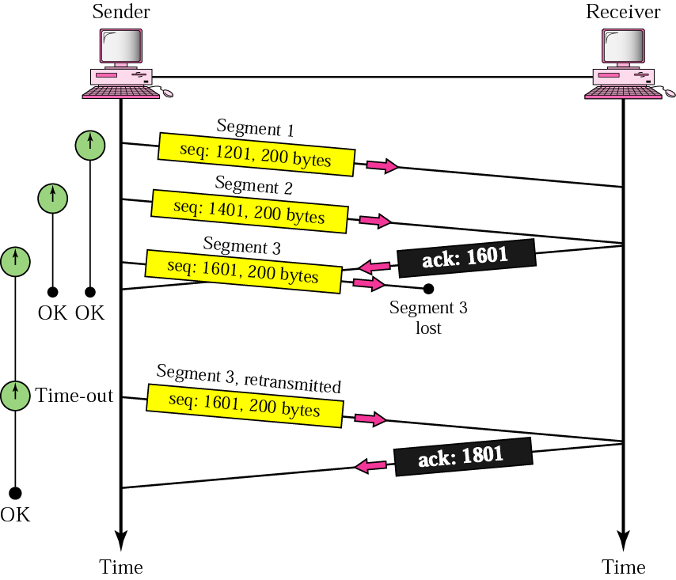
Lost Segments
Carol Davids © 2015

Slide 70
Duplicate Segment
What happens if the receiver got segment 1401 and ACKed segment 1601, but the ACK got delayed causing the send-timer for segment 1601 to expire?
Then the sender would send segment 1601 again.
When the receiver gets segment 1601 it discards the segment
Carol Davids © 2015

Slide 71
Out of Order Segment
What if the segment whose sequence number is 1801 arrives before the segment whose sequence number is 1601?
The receiver TCP will save the segment with sequence number 1801 and wait to receive the segment with sequence number 1601 before ACKing 1801
If 1801’s send-timer expires before the ACK is received, the sender will re-transmit it.
The receiving TCP is holding this sequence however, so it will discard the second copy of it.
Carol Davids © 2015

Slide 72
Lost Acknowledgement
Illustration on next page shows what happens when an ACK gets lost
Here, Segments 1201, 1401 and 1601 are sent, and the receiver ACKS 1201 and 1401, by saying, I am ready to receive 1601 (ACK 1601)
The ACK of 1601 is lost.
The receiver next receives Segment 1601, so it ACKs 1801.
The sender never knows that the first ACK was lost.
Carol Davids © 2015

Slide 73
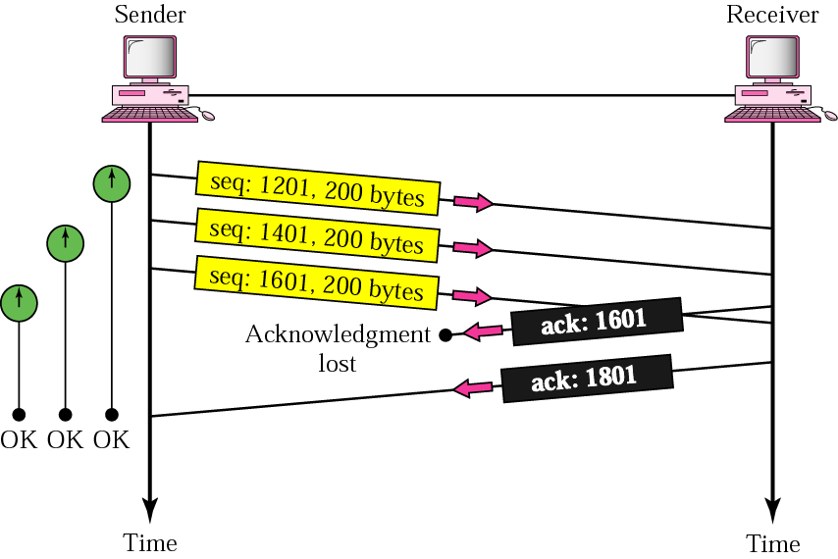
Lost Acknowledgement
Carol Davids © 2015

Slide 74
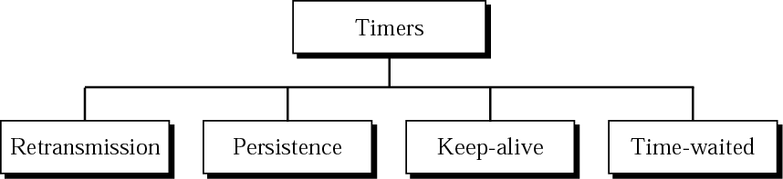
TCP Timers
TCP defines four timers.
Carol Davids © 2015

Slide 75
Retransmission
The retransmission timer is set dynamically for each connection
Even within each connection its value is not static, but is recalculated during the life of the connection
Commonly the retransmission timer is 2 times the round-trip time.
Carol Davids © 2015

Slide 76
Retransmission
Two methods are described for how to calculate the RTT
The first uses a TCP Option called Timestamp
The second records the time between the sending of a segment and the receipt of its acknowledgement and keeps this data over time.
Then uses a weighted average of previous and current RTTs to come up with a new RTT
Carol Davids © 2015

Slide 77
Retransmission
Karn’s algorithm prevents bad data from getting into that weighted sum.
It does not save RTT information that is based on re-transmitted segments
Carol Davids © 2015

Slide 78
Persistence Timer
ACKs are not acknowledged in TCP
Suppose the window size was set to 0
The sender is waiting to receive a non-zero window size in an ACK but the ACK gets lost
This could result in a stale-mate where sender and receiver are each waiting for the other to act
Carol Davids © 2015

Slide 79
Persistence Timer
To break the stalemate a new timer - the persistence timer is set after receiving a 0 window size ACK
When the persistence timer expires, a probe segment consisting of a single byte of data is sent
Carol Davids © 2015

Slide 80
Persistence Timer
The probe has a sequence number which is ignored in the calculation of subsequent segments
The probe alerts the receiving TCP that the ACK was lost
The persistence timer is usually set to the RTT and doubled each time it is resent
After the persistence timer reaches 60 seconds, probes are sent every 60 seconds until ACK is received
Carol Davids © 2015

Slide 81
Keep-Alive Timer
Prevents long idle connections between two TCPs
It is set by the Server after the Client initiates a TCP connection
It prevents the situation in which the Client asks for the connection, but then crashes so the application never tells the TCP client that it is through with the connection
Carol Davids © 2015

Slide 82
Keep-Alive Timer
Server sets the Keep-Alive timer for 2 hours normally
It resets the timer each time the client sends
If the server does not hear from the client for 2 hours, the server sends a probe
After 10 probes, 75 seconds apart with no response from the client, the server terminates the connection
Carol Davids © 2015

Slide 83
Time-Waited Timer
Before TCP allows sockets to be reused it waits to be sure that there are no duplicate FIN messages coming from the other end.
If there were such duplicate FINs they might unintentionally close newly opened TCP connections
So, the Time-Waited timer is set after receipt of a FIN
The Time-waited timer is usually 2 times the lifetime of a segment on the network.
Carol Davids © 2015

Slide 84
References
http://www.iana.org/assignments/port-numbers
http://www.informit.com/articles/article.asp?p=30662&seqNum=2
http://www.thinkingsecure.com/docs/TCPIP-Illustrated-1/tcp_bulk.htm#20_8
Carol Davids © 2015

Slide 85
The End
Carol Davids © 2015

