Slide 1
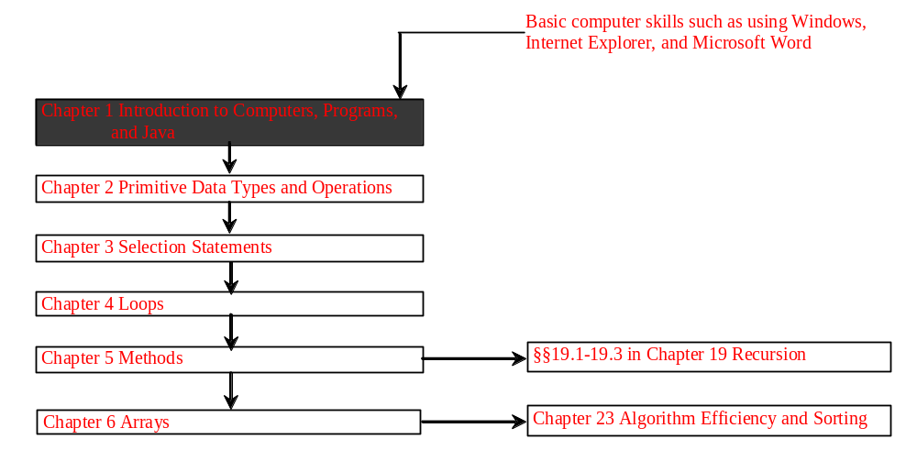
Chapter 1 Introduction to Computers, Programs, and Java

Slide 2
Objectives
To review computer basics, programs, and operating systems (§1.2-1.4).
To represent numbers in binary, decimal, and hexadecimal (§1.5 Optional).
To understand the relationship between Java and the World Wide Web (§1.6).
To know Java’s advantages (§1.7).
To distinguish the terms API, IDE, and JDK (§1.8).
To write a simple Java program (§1.9).
To create, compile, and run Java programs (§1.10).
To understand the Java runtime environment (§1.10).
To know the basic syntax of a Java program (§1.11).
To display output on the console and on the dialog box (§1.12).

Slide 3

What is a Computer?
A computer consists of a CPU, memory, hard disk, floppy disk, monitor, printer, and communication devices.

Slide 4

CPU
The central processing unit (CPU) is the brain of a computer. It retrieves instructions from memory and executes them. The CPU speed is measured in megahertz (MHz), with 1 megahertz equaling 1 million pulses per second. The speed of the CPU has been improved continuously. If you buy a PC now, you can get an Intel Pentium 4 Processor at 3 gigahertz (1 gigahertz is 1000 megahertz).

Slide 5

Memory
Memory is to store data and program instructions for CPU to execute. A memory unit is an ordered sequence of bytes, each holds eight bits. A program and its data must be brought to memory before they can be executed. A memory byte is never empty, but its initial content may be meaningless to your program. The current content of a memory byte is lost whenever new information is placed in it.

Slide 6

How Data is Stored?
Data of various kinds, such as numbers, characters, and strings, are encoded as a series of bits (zeros and ones). Computers use zeros and ones because digital devices have two stable states, which are referred to as zero and one by convention. The programmers need not to be concerned about the encoding and decoding of data, which is performed automatically by the system based on the encoding scheme. The encoding scheme varies. For example, character ‘J’ is represented by 01001010 in one byte. A small number such as three can be stored in a single byte. If computer needs to store a large number that cannot fit into a single byte, it uses a number of adjacent bytes. No two data can share or split a same byte. A byte is the minimum storage unit.

Slide 7

Storage Devices
Memory is volatile, because information is lost when the power is off. Programs and data are permanently stored on storage devices and are moved to memory when the computer actually uses them. There are three main types of storage devices:Disk drives (hard disks and floppy disks), CD drives (CD-R and CD-RW), and Tape drives.

Slide 8

Output Devices: Monitor
The monitor displays information (text and graphics). The resolution and dot pitch determine the quality of the display.

Slide 9
Monitor Resolution and Dot Pitch
resolution
The resolution specifies the number of pixels per square inch. Pixels (short for “picture elements”) are tiny dots that form an image on the screen. The resolution can be set manually. The higher the resolution, the sharper and clearer the image is. However, the image may be very small if you set high resolution on a small screen monitor. PC monitors are usually 15-inch, 17-inch, 19-inch, or 21-inch. For a 15-inch monitor, a comfortable resolution setting would be 640×480 (307,200 pixels).
dot pitch
The dot pitch is the amount of space between pixels. The smaller the dot pitch, the better the display.
For example iphone.

Slide 10

Communication Devices
A regular modem uses a phone line and can transfer data in a speed up to 56,000 bps (bits per second). A DSL (digital subscriber line) also uses a phone line and can transfer data in a speed 20 times faster than a regular modem. A cable modem uses the TV cable line maintained by the cable company. A cable modem is as fast as a DSL. Network interface card (NIC) is a device to connect a computer to a local area network (LAN). The LAN is commonly used in business, universities, and government organizations. A typical type of NIC, called 10BaseT, can transfer data at 10 mbps (million bits per second).

Slide 11
Programs
Computer programs, known as software, are instructions to the computer.
You tell a computer what to do through programs. Without programs, a computer is an empty machine. Computers do not understand human languages, so you need to use computer languages to communicate with them.
Programs are written using programming languages.

Slide 12
Programming Languages
Machine Language Assembly Language High-Level Language
Machine language is a set of primitive instructions built into every computer. The instructions are in the form of binary code, so you have to enter binary codes for various instructions. Program with native machine language is a tedious process. Moreover the programs are highly difficult to read and modify. For example, to add two numbers, you might write an instruction in binary like this:
  1101101010011010

Slide 13
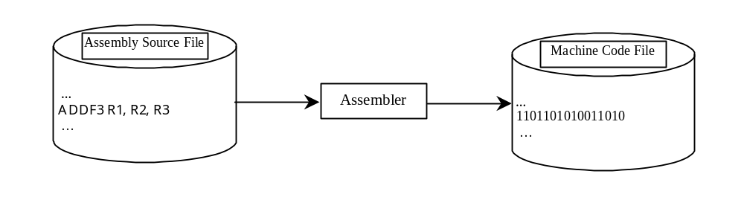
Programming Languages
Machine Language Assembly Language High-Level Language
Assembly languages were developed to make programming easy. Since the computer cannot understand assembly language, however, a program called assembler is used to convert assembly language programs into machine code. For example, to add two numbers, you might write an instruction in assembly code like this:
ADDF3 R1, R2, R3

Slide 14
Programming Languages
Machine Language Assembly Language High-Level Language
The high-level languages are English-like and easy to learn and program. For example, the following is a high-level language statement that computes the area of a circle with radius 5:
area = 5 * 5 * 3.1415;

Slide 15
Popular High-Level Languages
COBOL (COmmon Business Oriented Language)
FORTRAN (FORmula TRANslation)
BASIC (Beginner All-purpose Symbolic Instructional Code)
Pascal (named for Blaise Pascal)
Ada (named for Ada Lovelace)
C (whose developer designed B first)
Visual Basic (Basic-like visual language developed by Microsoft)
Delphi (Pascal-like visual language developed by Borland)
C++ (an object-oriented language, based on C)
Java (We use it in the book)

Slide 16
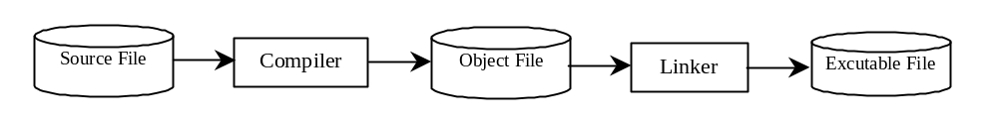
Compiling Source Code
A program written in a high-level language is called a source program. Since a computer cannot understand a source program. Program called a compiler is used to translate the source program into a machine language program called an object program. The object program is often then linked with other supporting library code before the object can be executed on the machine.

Slide 17
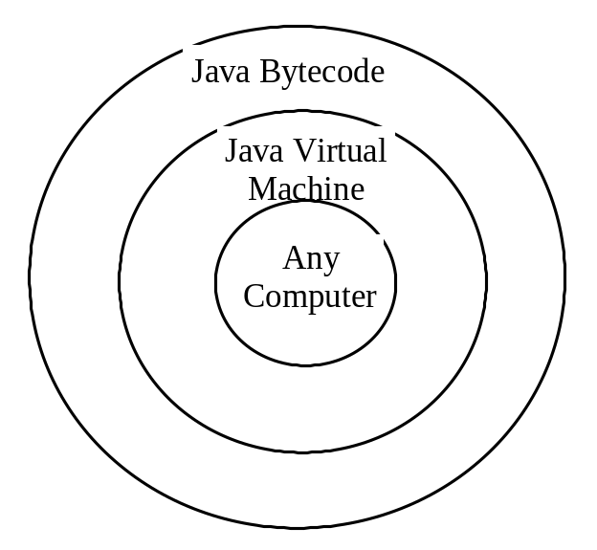
Compiling Java Source Code
You can port a source program to any machine with appropriate compilers. The source program must be recompiled, however, because the object program can only run on a specific machine. Nowadays computers are networked to work together. Java was designed to run object programs on any platform. With Java, you write the program once, and compile the source program into a special type of object code, known as bytecode. The bytecode can then run on any computer with a Java Virtual Machine, as shown in Figure 1.5. Java Virtual Machine is a software that interprets Java bytecode.

Slide 18
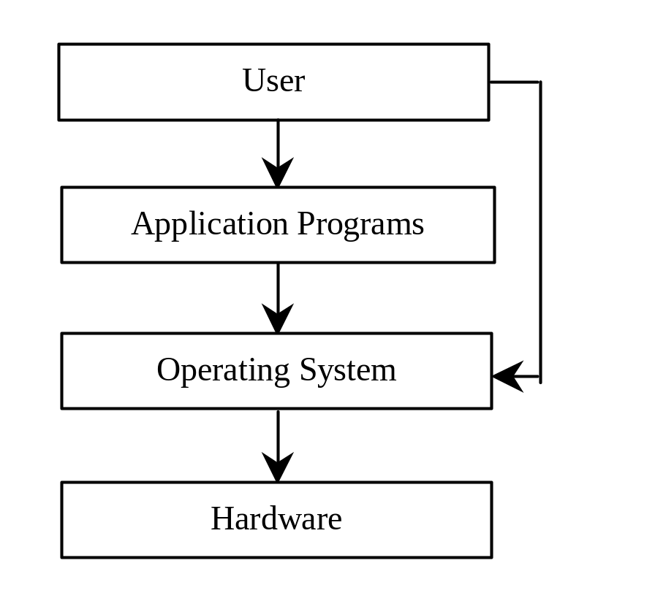
Operating Systems
The operating system (OS) is a program that manages and controls a computer’s activities. You are probably using Windows 98, NT, 2000, XP, or ME. Windows is currently the most popular PC operating system. Application programs such as an Internet browser and a word processor cannot run without an operating system.

Slide 19
Number Systems(跳过)
NOTE: You can skip this section and use it as reference when you have questions regarding binary and hexadecimal numbers.
binary
0, 1
0, 1, 2, 3, 4, 5, 6, 7
0, 1, 2, 3, 4, 5, 6, 7, 8, 9
0, 1, 2, 3, 4, 5, 6, 7, 8, 9, A, B, C, D, E, F
octal
decimal
hexdecimal

Slide 20
Number Systems
Computers use binary numbers internally because storage devices like memory and disk are made to store 0s and 1s. A number or a text inside a computer is stored as a sequence of 0s and 1s. Each 0 and 1 is called a bit, short for binary digit. The binary number system has two digits, 0 and 1.
Binary numbers are not intuitive, since we use decimal numbers in our daily life. When you write a number like 20 in a program, it is assumed to be a decimal number. Internally, computer software is used to convert decimal numbers into binary numbers, and vice versa.

Slide 21
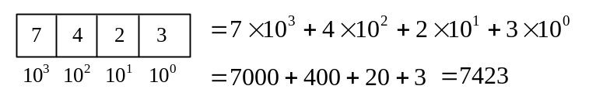
Number Systems, cont.
The digits in the decimal number system are 0, 1, 2, 3, 4, 5, 6, 7, 8, and 9. A decimal number is represented using a sequence of one or more of these digits. The value that each digit in the sequence represents depends on its position. A position in a sequence has a value that is an integral power of 10. For example, the digits 7, 4, 2, and 3 in decimal number 7423 represent 7000, 400, 20, and 3, respectively, as shown below:
The decimal number system has ten digits and the position values are integral powers of 10. We say that 10 is the base or radix of the decimal number system. Similarly, the base of the binary number system is 2 since the binary number system has two digits and the base of the hex number system is 16 since the hex number system has sixteen digits.

Slide 22
Number Systems, cont.
Binary numbers tend to be very long and cumbersome. Hexadecimal numbers are often used to abbreviate binary numbers. The hexadecimal number system has 16 digits: 0, 1, 2, 3, 4, 5, 6, 7, 8, 9, A, B, C, D, E, and F. The letters A, B, C, D, E, and F correspond to the decimal numbers 10, 11, 12, 13, 14, and 15.

Slide 23

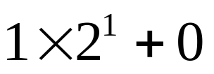

Binary Numbers => Decimals
Given a binary number
the equivalent decimal value is
10 in binary
= 2 in decimal
1000 in binary
= 8 in decimal
10101011 in binary
= 171 in decimal

Slide 24

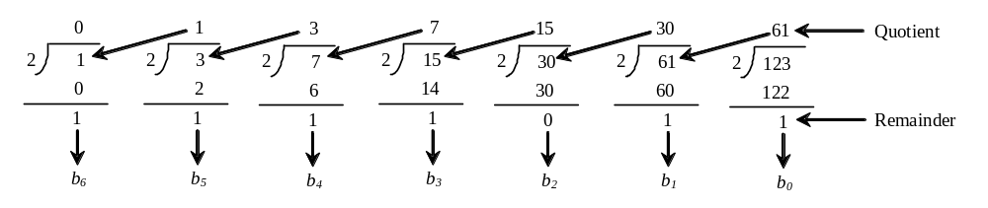
Decimals => Binary
To convert a decimal number d to a binary number is to find the binary digits.. such that
These numbers can be found by successively dividing d by 2 until the quotient is 0. The remainders are
For example, the decimal number 123 is 1111011 in binary. The conversion is conducted as follows:

Slide 25
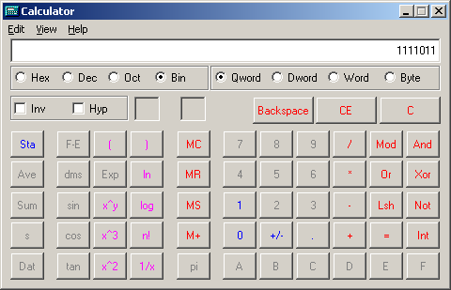
Windows Calculator
The Windows Calculator is a useful tool for performing number conversions. To run it, choose Programs, Accessories, and Calculator from the Start button.

Slide 26

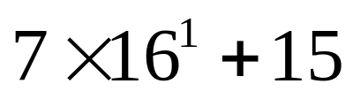

Hexadecimals => Decimals
The hexadecimal number system has sixteen digits: 0, 1, 2, 3, 4, 5, 6, 7, 8, 9, A, B, C, D, E, and F. The letters A, B, C, D, E, and F correspond to the decimal numbers 10, 11, 12, 13, 14, and 15. Given a hexadecimal number
The equivalent decimal value is
7F in hex
= 127 in decimal
FFFF in hex
= 65535 in decimal

Slide 27

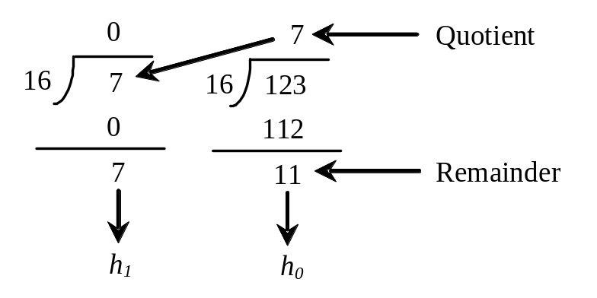

Decimals => Hexadecimal
To convert a decimal number d to a hexadecimal number is to find the hexadecimal digits hn, hn-1, hn-2, ... such that
These numbers can be found by successively dividing d by 16 until the quotient is 0. The remainders are
For example, the decimal number 123 is 7B in hexadecimal. The conversion is conducted as follows:

Slide 28
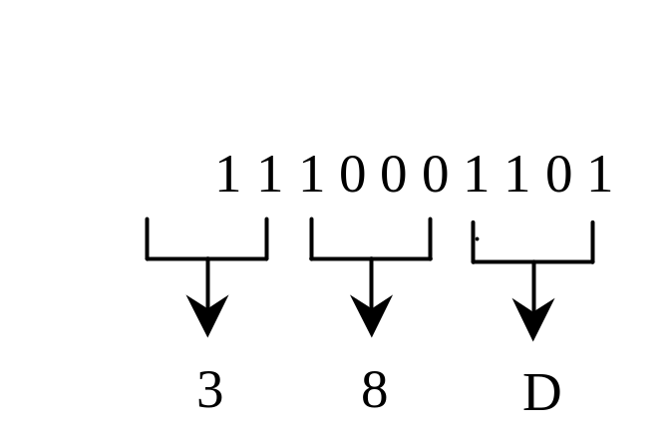
Hexadecimal ⬄ Binary
Binary Hex Decimal
To convert a hexadecimal number to a binary number, simply convert each digit in the hexadecimal number into a four-digit binary number.
0000 0 0
0001 1 1
0010 2 2
0011 3 3
0100 4 4
0101 5 5
0110 6 6
0111 7 7
1000 8 8
1001 9 9
1010 A 10
1011 B 11
1100 C 12
1101 D 13
1110 E 14
1111 F 15
To convert a binary number to a hexadecimal, convert every four binary digits from right to left in the binary number into a hexadecimal number. For example,

Slide 29
Why Java?
The answer is that Java enables users to develop and deploy applications on the Internet for servers, desktop computers, and small hand-held devices. The future of computing is being profoundly influenced by the Internet, and Java promises to remain a big part of that future. Java is the Internet programming language.
Java is a general purpose programming language.
Java is the Internet programming language.

Slide 30
Java, Web, and Beyond
Java can be used to develop Web applications.
Java Applets
Java Servlets and JavaServer Pages
Java can also be used to develop applications for hand-held devices such as Palm and cell phones

Slide 31
Examples of Java’s Versatility
Standalone Application: TicTacToe
Applet: TicTacToe
Servlets: SelfTest Web site
Mobile Computing: Cell phones

Slide 32
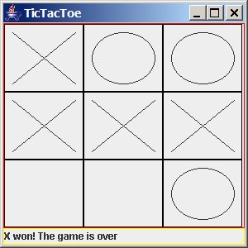
TicTacToe Standalone

Slide 33
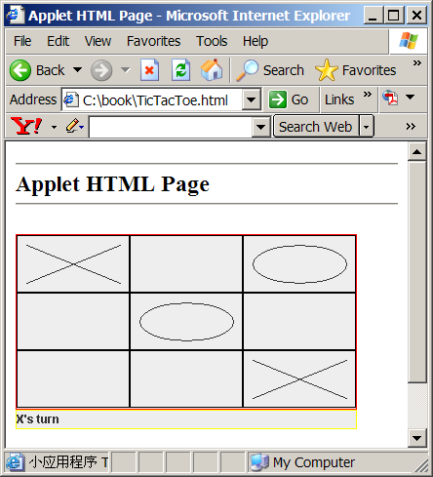
TicTacToe Applet

Slide 34
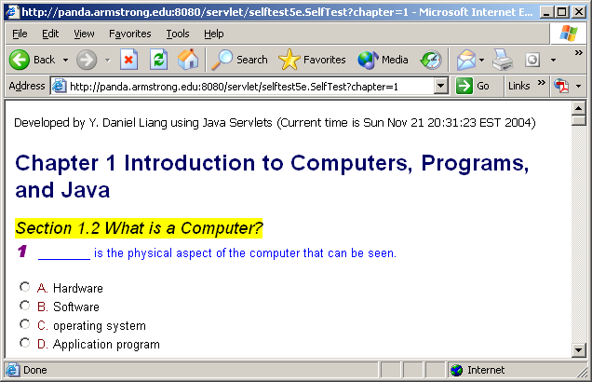
SelfTest Website (using Java Servlets)

Slide 35
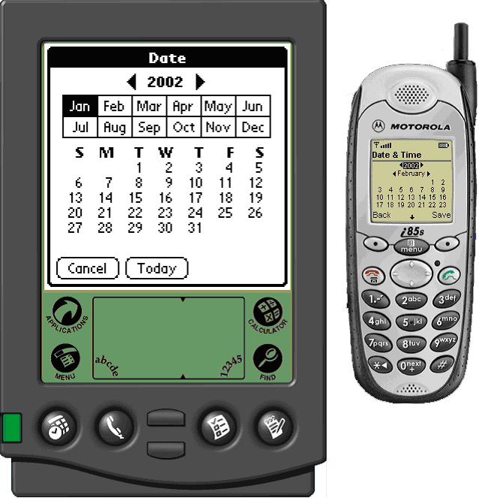
PDA and Cell Phone

Slide 36
Java’s History
James Gosling and Sun Microsystems
Oak
Java, May 20, 1995, Sun World
HotJava
  The first Java-enabled Web browser
Early History Website:
http://java.sun.com/features/1998/05/birthday.html

Slide 37
Characteristics of Java
Optional
Java Is Simple
Java Is Object-Oriented
Java Is Distributed
Java Is Interpreted
Java Is Robust
Java Is Secure
Java Is Architecture-Neutral
Java Is Portable
Java's Performance
Java Is Multithreaded
Java Is Dynamic
www.cs.armstrong.edu/liang/intro6e/JavaCharacteristics.pdf

Slide 38
Characteristics of Java
Optional
Java Is Simple
Java Is Object-Oriented
Java Is Distributed
Java Is Interpreted
Java Is Robust
Java Is Secure
Java Is Architecture-Neutral
Java Is Portable
Java's Performance
Java Is Multithreaded
Java Is Dynamic
Java is partially modeled on C++, but greatly simplified and improved. Some people refer to Java as "C++--" because it is like C++ but with more functionality and fewer negative aspects.

Slide 39
Characteristics of Java
Optional
Java Is Simple
Java Is Object-Oriented
Java Is Distributed
Java Is Interpreted
Java Is Robust
Java Is Secure
Java Is Architecture-Neutral
Java Is Portable
Java's Performance
Java Is Multithreaded
Java Is Dynamic
Java is inherently object-oriented. Although many object-oriented languages began strictly as procedural languages, Java was designed from the start to be object-oriented. Object-oriented programming (OOP) is a popular programming approach that is replacing traditional procedural programming techniques.
One of the central issues in software development is how to reuse code. Object-oriented programming provides great flexibility, modularity, clarity, and reusability through encapsulation, inheritance, and polymorphism.

Slide 40
Characteristics of Java
Optional
Java Is Simple
Java Is Object-Oriented
Java Is Distributed
Java Is Interpreted
Java Is Robust
Java Is Secure
Java Is Architecture-Neutral
Java Is Portable
Java's Performance
Java Is Multithreaded
Java Is Dynamic
Distributed computing involves several computers working together on a network. Java is designed to make distributed computing easy. Since networking capability is inherently integrated into Java, writing network programs is like sending and receiving data to and from a file.

Slide 41
Characteristics of Java
Optional
Java Is Simple
Java Is Object-Oriented
Java Is Distributed
Java Is Interpreted
Java Is Robust
Java Is Secure
Java Is Architecture-Neutral
Java Is Portable
Java's Performance
Java Is Multithreaded
Java Is Dynamic
You need an interpreter to run Java programs. The programs are compiled into the Java Virtual Machine code called bytecode. The bytecode is machine-independent and can run on any machine that has a Java interpreter, which is part of the Java Virtual Machine (JVM).

Slide 42
Characteristics of Java
Optional
Java Is Simple
Java Is Object-Oriented
Java Is Distributed
Java Is Interpreted
Java Is Robust
Java Is Secure
Java Is Architecture-Neutral
Java Is Portable
Java's Performance
Java Is Multithreaded
Java Is Dynamic
Java compilers can detect many problems that would first show up at execution time in other languages.
Java has eliminated certain types of error-prone programming constructs found in other languages.
Java has a runtime exception-handling feature to provide programming support for robustness.

Slide 43
Characteristics of Java
Optional
Java Is Simple
Java Is Object-Oriented
Java Is Distributed
Java Is Interpreted
Java Is Robust
Java Is Secure
Java Is Architecture-Neutral
Java Is Portable
Java's Performance
Java Is Multithreaded
Java Is Dynamic
Java implements several security mechanisms to protect your system against harm caused by stray programs.

Slide 44
Characteristics of Java
Optional
Java Is Simple
Java Is Object-Oriented
Java Is Distributed
Java Is Interpreted
Java Is Robust
Java Is Secure
Java Is Architecture-Neutral
Java Is Portable
Java's Performance
Java Is Multithreaded
Java Is Dynamic
Write once, run anywhere
With a Java Virtual Machine (JVM), you can write one program that will run on any platform.

Slide 45
Characteristics of Java
Optional
Java Is Simple
Java Is Object-Oriented
Java Is Distributed
Java Is Interpreted
Java Is Robust
Java Is Secure
Java Is Architecture-Neutral
Java Is Portable
Java's Performance
Java Is Multithreaded
Java Is Dynamic
Because Java is architecture neutral, Java programs are portable. They can be run on any platform without being recompiled.

Slide 46
Characteristics of Java
Optional
Java Is Simple
Java Is Object-Oriented
Java Is Distributed
Java Is Interpreted
Java Is Robust
Java Is Secure
Java Is Architecture-Neutral
Java Is Portable
Java's Performance
Java Is Multithreaded
Java Is Dynamic
Java’s performance Because Java is architecture neutral, Java programs are portable. They can be run on any platform without being recompiled.

Slide 47
Characteristics of Java
Optional
Java Is Simple
Java Is Object-Oriented
Java Is Distributed
Java Is Interpreted
Java Is Robust
Java Is Secure
Java Is Architecture-Neutral
Java Is Portable
Java's Performance
Java Is Multithreaded
Java Is Dynamic
Multithread programming is smoothly integrated in Java, whereas in other languages you have to call procedures specific to the operating system to enable multithreading.

Slide 48
Characteristics of Java
Optional
Java Is Simple
Java Is Object-Oriented
Java Is Distributed
Java Is Interpreted
Java Is Robust
Java Is Secure
Java Is Architecture-Neutral
Java Is Portable
Java's Performance
Java Is Multithreaded
Java Is Dynamic
Java was designed to adapt to an evolving environment. New code can be loaded on the fly without recompilation. There is no need for developers to create, and for users to install, major new software versions. New features can be incorporated transparently as needed.

Slide 49
JDK Versions
JDK 1.02 (1995)
JDK 1.1 (1996)
JDK 1.2 (1998)
JDK 1.3 (2000)
JDK 1.4 (2002)
JDK 1.5 (2004) a. k. a. JDK 5 or Java 5
JDK 1.6

Slide 50
JDK Editions
Java Standard Edition (J2SE)
  J2SE can be used to develop client-side standalone applications or applets.
Java Enterprise Edition (J2EE)
  J2EE can be used to develop server-side applications such as Java servlets and Java ServerPages.
Java Micro Edition (J2ME).
  J2ME can be used to develop applications for mobile devices such as cell phones.
This book uses J2SE to introduce Java programming.

Slide 51
Java IDE Tools
Borland JBuilder
NetBeans Open Source by Sun
Sun ONE Studio by Sun MicroSystems
Eclipse Open Source by IBM
JCreator

Slide 52
A Simple Java Program
Listing 1.1
//This program prints Welcome to Java!
public class Welcome {
public static void main(String[] args) {
System.out.println("Welcome to Java!");
}
}
Source
IMPORTANT NOTE: To run the program from the Run button, (1) set c:\Program Files\java\jdk1.5.0\bin for path, and (2) install slides from the Instructor Resource Website to a directory (e.g., c:\LiangIR) .
Run

Slide 53

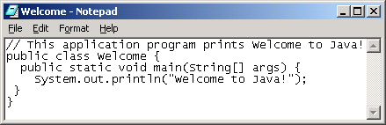
Creating and Editing Using NotePad
To use NotePad, type
  notepad Welcome.java
from the DOS prompt.

Slide 54

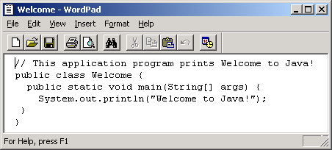
Creating and Editing Using WordPad
To use WordPad, type
  write Welcome.java
from the DOS prompt.

Slide 55
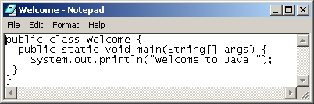
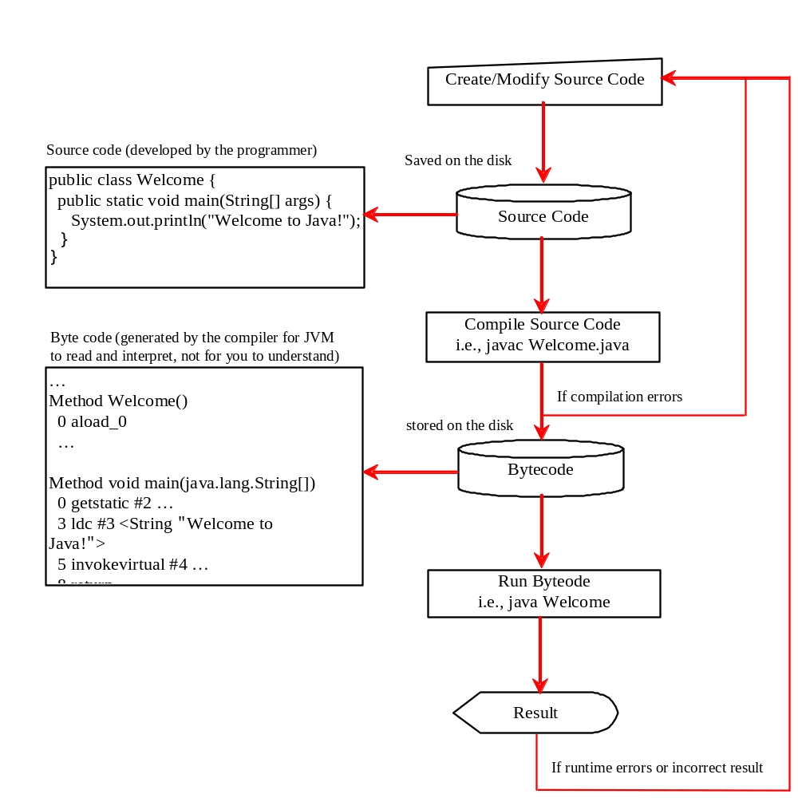
Creating, Compiling, and Running Programs

Slide 56
Trace a Program Execution
animation
Enter main method
//This program prints Welcome to Java!
public class Welcome {
public static void main(String[] args) {
System.out.println("Welcome to Java!");
}
}

Slide 57
Trace a Program Execution
animation
Execute statement
//This program prints Welcome to Java!
public class Welcome {
public static void main(String[] args) {
System.out.println("Welcome to Java!");
}
}

Slide 58

Trace a Program Execution
animation
//This program prints Welcome to Java!
public class Welcome {
public static void main(String[] args) {
System.out.println("Welcome to Java!");
}
}
print a message to the console

Slide 59
Supplements on the Companion Website
See Supplement A for installing and configuring JDK 1.5
See Supplement B for compiling and running Java from the command window for details
www.prenhall.com/liang
Direct link at
www.cs.armstrong.edu/liang/intro5e.html

Slide 60
JDK
Java Development Kit
  编译java程序
  执行java程序
  提供java程序所需的基本功能（类库）

Slide 61

Compiling and Running Java from the Command Window
Set path to JDK bin directory
  set path=c:\Program Files\java\jdk1.5.0\bin
Set classpath to include the current directory
  set classpath=.
Compile
  javac Welcome.java
Run
  java Welcome

Slide 62

Compiling and Running Java from TextPad
TextPad Optional
See Supplement B on the Website for details

Slide 63
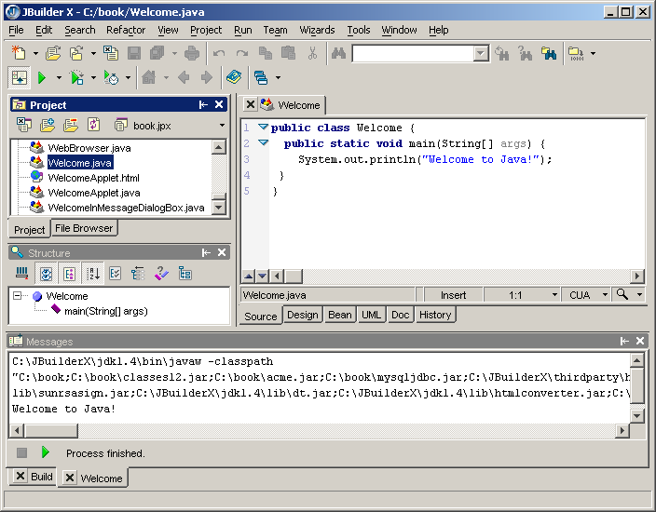
Compiling and Running Java from JBuilder
JBuilder Optional
See Supplement H on the Website for details

Slide 64
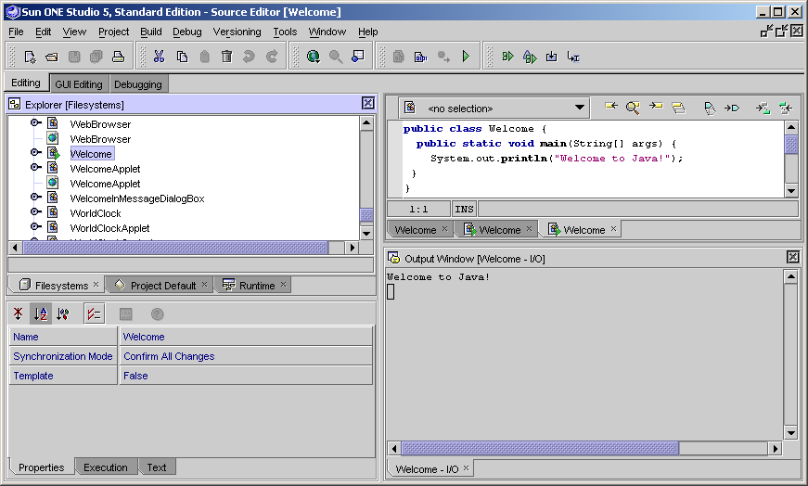
Compiling and Running Java from NetBeans
NetBeans Optional
See Supplement I on the Website for details

Slide 65
Anatomy of a Java Program
Comments
Package
Reserved words
Modifiers
Statements
Blocks
Classes
Methods
The main method

Slide 66
Comments(注释)
In Java, comments are preceded by two slashes (//) in a line, or enclosed between /* and */ in one or multiple lines. When the compiler sees //, it ignores all text after // in the same line. When it sees /*, it scans for the next */ and ignores any text between /* and */.

Slide 67
Package(包)
The second line in the program (package chapter1;) specifies a package name, chapter1, for the class Welcome. Forte compiles the source code in Welcome.java, generates Welcome.class, and stores Welcome.class in the chapter1 folder.

Slide 68
Reserved Words(保留字)
Reserved words or keywords are words that have a specific meaning to the compiler and cannot be used for other purposes in the program. For example, when the compiler sees the word class, it understands that the word after class is the name for the class. Other reserved words in Listing 1.1 are public, static, and void. Their use will be introduced later in the book.

Slide 69
Modifiers(修饰符)
Java uses certain reserved words called modifiers that specify the properties of the data, methods, and classes and how they can be used. Examples of modifiers are public and static. Other modifiers are private, final, abstract, and protected. A public datum, method, or class can be accessed by other programs. A private datum or method cannot be accessed by other programs. Modifiers are discussed in Chapter 6, “Objects and Classes.”

Slide 70
Statements(语句)
A statement represents an action or a sequence of actions. The statement System.out.println("Welcome to Java!") in the program in Listing 1.1 is a statement to display the greeting "Welcome to Java!" Every statement in Java ends with a semicolon (;).

Slide 71

Blocks(块)
A pair of braces in a program forms a block that groups components of a program.

Slide 72
Classes(类)
The class is the essential Java construct. A class is a template or blueprint for objects. To program in Java, you must understand classes and be able to write and use them. The mystery of the class will continue to be unveiled throughout this book. For now, though, understand that a program is defined by using one or more classes.

Slide 73
Methods(方法)
What is System.out.println? It is a method: a collection of statements that performs a sequence of operations to display a message on the console. It can be used even without fully understanding the details of how it works. It is used by invoking a statement with a string argument. The string argument is enclosed within parentheses. In this case, the argument is "Welcome to Java!" You can call the same println method with a different argument to print a different message.

Slide 74
main Method(main 方法)
The main method provides the control of program flow. The Java interpreter executes the application by invoking the main method.
The main method looks like this:
public static void main(String[] args) {
// Statements;
}

Slide 75
Displaying Text in a Message Dialog Box
you can use the showMessageDialog method in the JOptionPane class. JOptionPane is one of the many predefined classes in the Java system, which can be reused rather than “reinventing the wheel.”
Source
IMPORTANT NOTE: To run the program from the Run button, (1) set c:\jdk1.5.0\bin for path, and (2) install slides from the Instructor Resource Website to a directory (e.g., c:\LiangIR) .
Run

Slide 76
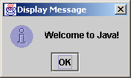
The showMessageDialog Method
JOptionPane.showMessageDialog(null,
"Welcome to Java!",
“Display Message",
JOptionPane.INFORMATION_MESSAGE));

Slide 77
Two Ways to Invoke the Method
There are several ways to use the showMessageDialog method. For the time being, all you need to know are two ways to invoke it.
One is to use a statement as shown in the example:
  JOptionPane.showMessageDialog(null, x,
  y, JOptionPane.INFORMATION_MESSAGE));
where x is a string for the text to be displayed, and y is a string for the title of the message dialog box.
The other is to use a statement like this:
  JOptionPane.showMessageDialog(null, x);
where x is a string for the text to be displayed.

Slide 78
The exit Method
Prior to JDK 1.5, you have to invoke System.exit() to terminate the program if the program uses JOptionPane dialog boxes. Since JDK 1.5, it is not necessary.

Slide 79

Jcreator（介绍）

Slide 80
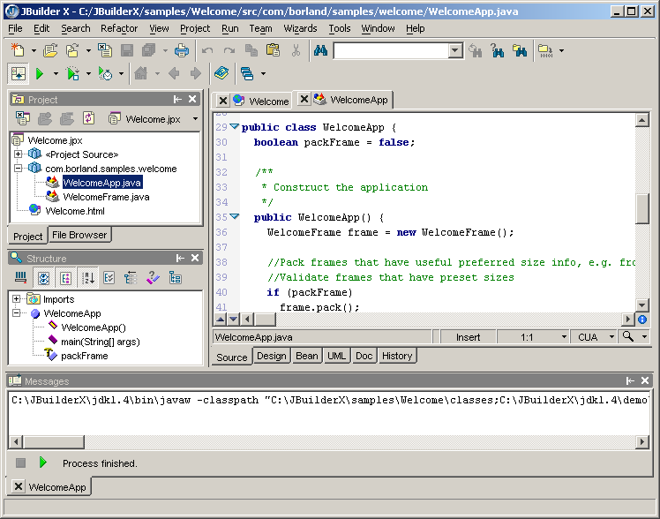
JBuilder IDE Interface
JBuilder Optional
file tab
content pane (showing the editor)
main menu
main toolbar
project toolbar
project pane
structure pane
message pane
execution status bar
status bar
file viewer tab
Resize editor font

Slide 81
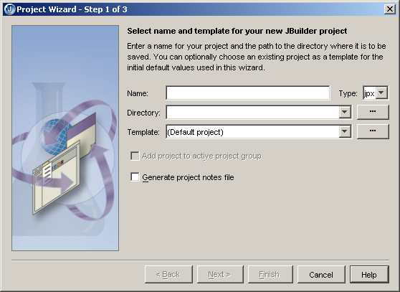
Creating a JBuilder project
JBuilder Optional
Choose File, New Project to display the project wizard
Enter a project name -- any descriptive of your choice
Enter a directory name where your project will be stored. If the directory does not exist, the wizard can create it automatically. All the files in the book are stored in c:\book.
book
C:\book
C:\book
You may optionally check this box to let the wizard generate a project description file. This is an HTML file, which is nonessential for the project.
You may optionally choose an existing project as template.

Slide 82
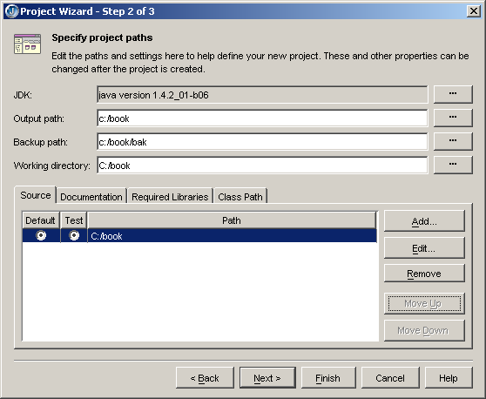
Creating a JBuilder project, cont.
JBuilder Optional
Set output path, backup path, working directory, and source path. There are many ways to set paths. I recommend you to follow the instructions from your instructor to set these paths. Creating projects incorrectly is a common problem for new JBuilder users, and can lead to frustrating mistakes.
You can choose any directory as output path. However, I recommend new JBuilder users to choose the project path as the output path.
The working directory is the starting directory that JBuilder gives a program when it is launched. Any directory may be configured as the working directory. By default, it has the same name as the project file.
The backup path is where the backup files are stored. I recommend you to enter outpath/bak.
The source directory is where the source files created using JBuilder’s wizards are stored. I recommend new JBuilder users to choose the project path as the output path.

Slide 83
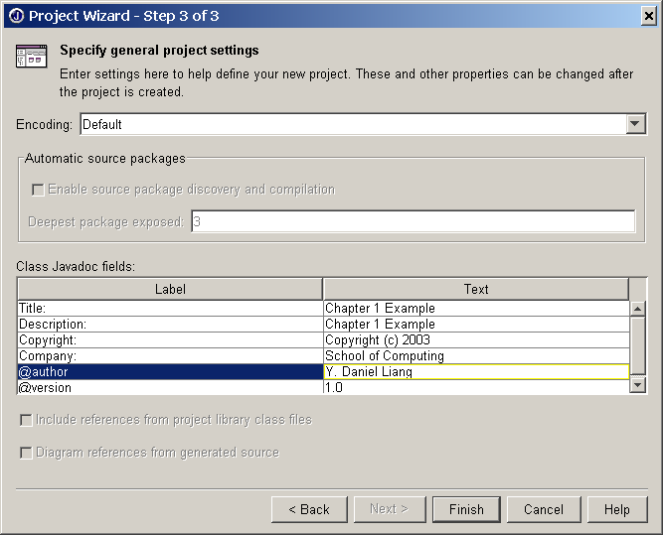
Creating a JBuilder project, cont.
JBuilder Optional
Optional project description

Slide 84
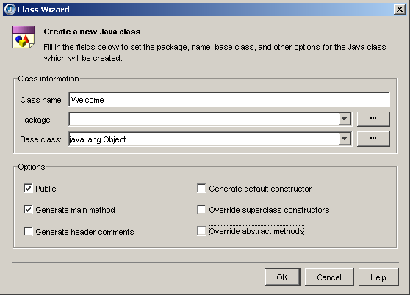
Creating a Java Program
JBuilder Optional
Choose File, New Class to display the class wizard
Enter the class name, e.g., Welcome.
All the examples in Introduction to Java Programming, 5E do not use the package statement. So leave this blank.
This is the default. Leave it as it is.
Leave these boxes unchecked.
Check these two boxes

