Slide 1
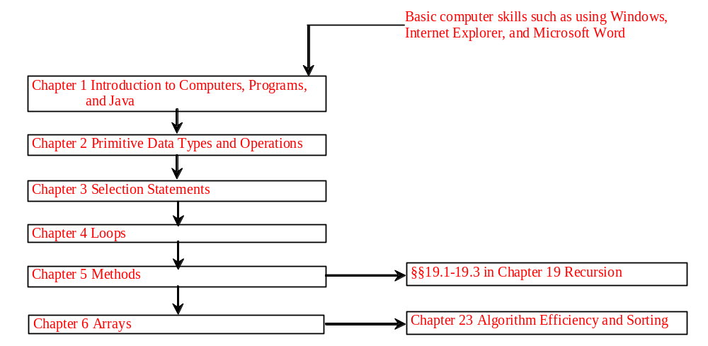
Chapter 2 Primitive Data Types and Operations(基本数据类型和操作符)

Slide 2
Objectives
To write Java programs to perform simple calculations (§2.2).
To use identifiers to name variables, constants, methods, and classes (§2.3).
To use variables to store data (§2.4-2.5).
To program with assignment statements and assignment expressions (§2.5).
To use constants to store permanent data (§2.6).
To declare Java primitive data types: byte, short, int, long, float, double, and char (§2.7 – 2.10).
To use Java operators to write expressions (§2.7 – 2.9).
To represent a string using the String type. (§2.10)
To obtain input using the JOptionPane input dialog boxes (§2.11).
(Optional) To obtain input from console (§2.13).
To become familiar with Java documentation, programming style, and naming conventions (§2.14).
To distinguish syntax errors, runtime errors, and logic errors (§2.15).
To debug logic errors (§2.16).

Slide 3
Introducing Programming with an Example
Listing 2.1 Computing the Area of a Circle
This program computes the area of the circle.
ComputeArea
IMPORTANT NOTE: To run the program from the Run button, (1) set c:\Program Files\java\jdk1.5.0\bin for path, and (2) install slides from the Instructor Resource Website to a directory (e.g., c:\LiangIR) .
Run

Slide 4
Trace a Program Execution
animation
allocate memory for radius
public class ComputeArea {
/** Main method */
public static void main(String[] args) {
double radius;
double area;
// Assign a radius
radius = 20;
// Compute area
area = radius * radius * 3.14159;
// Display results
System.out.println("The area for the circle of radius " +
radius + " is " + area);
}
}
radius
no value

Slide 5
Trace a Program Execution
animation
public class ComputeArea {
/** Main method */
public static void main(String[] args) {
double radius;
double area;
// Assign a radius
radius = 20;
// Compute area
area = radius * radius * 3.14159;
// Display results
System.out.println("The area for the circle of radius " +
radius + " is " + area);
}
}
memory
radius
no value
area
no value
allocate memory for area

Slide 6
Trace a Program Execution
animation
public class ComputeArea {
/** Main method */
public static void main(String[] args) {
double radius;
double area;
// Assign a radius
radius = 20;
// Compute area
area = radius * radius * 3.14159;
// Display results
System.out.println("The area for the circle of radius " +
radius + " is " + area);
}
}
assign 20 to radius
radius
20
area
no value

Slide 7
Trace a Program Execution
animation
public class ComputeArea {
/** Main method */
public static void main(String[] args) {
double radius;
double area;
// Assign a radius
radius = 20;
// Compute area
area = radius * radius * 3.14159;
// Display results
System.out.println("The area for the circle of radius " +
radius + " is " + area);
}
}
memory
radius
20
area
1256.636
compute area and assign it to variable area

Slide 8

Trace a Program Execution
animation
public class ComputeArea {
/** Main method */
public static void main(String[] args) {
double radius;
double area;
// Assign a radius
radius = 20;
// Compute area
area = radius * radius * 3.14159;
// Display results
System.out.println("The area for the circle of radius " +
radius + " is " + area);
}
}
memory
radius
20
area
1256.636
print a message to the console

Slide 9
Identifiers（标识符）
An identifier is a sequence of characters that consist of letters, digits, underscores (_), and dollar signs ($).
An identifier must start with a letter, an underscore (_), or a dollar sign ($). It cannot start with a digit.
  An identifier cannot be a reserved word. (See Appendix A, “Java Keywords,” for a list of reserved words).
An identifier cannot be true, false, or
null.
An identifier can be of any length.

Slide 10
Variables
// Compute the first area
radius = 1.0;
area = radius * radius * 3.14159;
System.out.println("The area is “ + area + " for radius "+radius);
// Compute the second area
radius = 2.0;
area = radius * radius * 3.14159;
System.out.println("The area is “ + area + " for radius "+radius);

Slide 11
Declaring Variables
int x; // Declare x to be an
// integer variable;
double radius; // Declare radius to
// be a double variable;
char a; // Declare a to be a
// character variable;

Slide 12
Assignment Statements
x = 1; // Assign 1 to x;
radius = 1.0; // Assign 1.0 to radius;
a = 'A'; // Assign 'A' to a;

Slide 13
Declaring and Initializing in One Step
int x = 1;
double d = 1.4;

Slide 14
Constants
final datatype CONSTANTNAME = VALUE;
final double PI = 3.14159;
final int SIZE = 3;

Slide 15
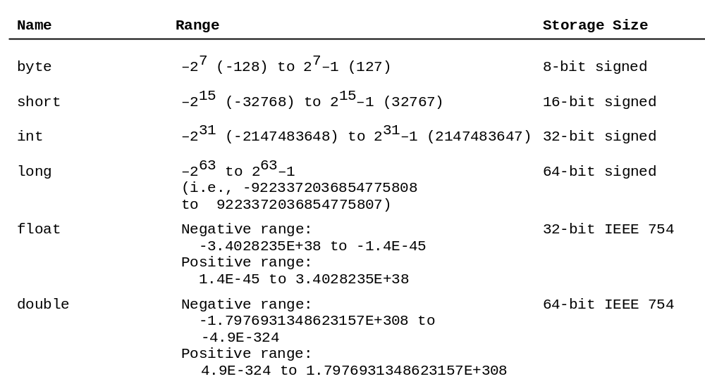
Numerical Data Types

Slide 16
TIP（跳过）
An excellent tool to demonstrate how numbers are stored in a computer was developed by Richard Rasala. You can access it at
http://www.ccs.neu.edu/jpt/jpt_2_3/bitdisplay/applet.htm

Slide 17

Numeric Operators（算数运算符）

Slide 18
Integer Division（整数除法）
+, -, *, /, and %
5 / 2 yields an integer 2.
5.0 / 2 yields a double value 2.5
5 % 2 yields 1 (the remainder of the division)

Slide 19

Remainder Operator（取余）
Remainder is very useful in programming. For example, an even number % 2 is always 0 and an odd number % 2 is always 1. So you can use this property to determine whether a number is even or odd. Suppose today is Saturday and you and your friends are going to meet in 10 days. What day is in 10 days? You can find that day is Tuesday using the following expression:

Slide 20
Example: Displaying Time
Write a program that obtains hours and minutes from seconds.
DisplayTime
Run

Slide 21
NOTE（浮点运算不能完全精确）
Calculations involving floating-point numbers are approximated because these numbers are not stored with complete accuracy. For example,
System.out.println(1.0 - 0.1 - 0.1 - 0.1 - 0.1 - 0.1);
displays 0.5000000000000001, not 0.5, and
System.out.println(1.0 - 0.9);
displays 0.09999999999999998, not 0.1. Integers are stored precisely. Therefore, calculations with integers yield a precise integer result.

Slide 22
Number Literals（直接量）
A literal is a constant value that appears directly in the program. For example, 34, 1,000,000, and 5.0 are literals in the following statements:
int i = 34;
long x = 1000000;
double d = 5.0;

Slide 23
Integer Literals
An integer literal can be assigned to an integer variable as long as it can fit into the variable. A compilation error would occur if the literal were too large for the variable to hold. For example, the statement byte b = 1000 would cause a compilation error, because 1000 cannot be stored in a variable of the byte type.
An integer literal is assumed to be of the int type, whose value is between -2³¹ (-2147483648) to 2³¹–1 (2147483647). To denote an integer literal of the long type, append it with the letter L or l. L is preferred because l (lowercase L) can easily be confused with 1 (the digit one).

Slide 24
Floating-Point Literals
Floating-point literals are written with a decimal point. By default, a floating-point literal is treated as a double type value. For example, 5.0 is considered a double value, not a float value. You can make a number a float by appending the letter f or F, and make a number a double by appending the letter d or D. For example, you can use 100.2f or 100.2F for a float number, and 100.2d or 100.2D for a double number.

Slide 25
Scientific Notation（科学计数法）
Floating-point literals can also be specified in scientific notation, for example, 1.23456e+2, same as 1.23456e2, is equivalent to 123.456, and 1.23456e-2 is equivalent to 0.0123456. E (or e) represents an exponent and it can be either in lowercase or uppercase.

Slide 26

Arithmetic Expressions
is translated to
(3+4*x)/5 – 10*(y-5)*(a+b+c)/x + 9*(4/x + (9+x)/y)

Slide 27

Example: Converting Temperatures
Write a program that converts a Fahrenheit degree to Celsius using the formula:
FahrenheitToCelsius
Run

Slide 28
Shortcut Assignment Operators
赋值运算符的简写方式
Operator Example Equivalent
+= i += 8 i = i + 8
-= f -= 8.0 f = f - 8.0
*= i *= 8 i = i * 8
/= i /= 8 i = i / 8
%= i %= 8 i = i % 8

Slide 29
Increment and
Decrement Operators
Operator Name Description
++var preincrement The expression (++var) increments var by 1 and evaluates
to the new value in var after the increment.
var++ postincrement The expression (var++) evaluates to the original value
in var and increments var by 1.
--var predecrement The expression (--var) decrements var by 1 and evaluates
to the new value in var after the decrement.
var-- postdecrement The expression (var--) evaluates to the original value
in var and decrements var by 1.

Slide 30
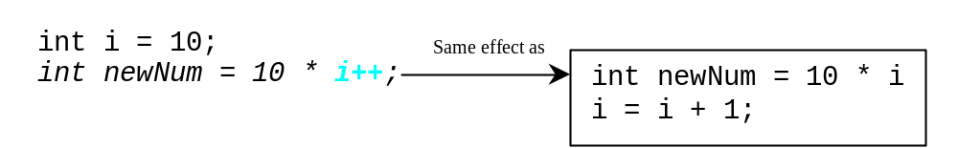
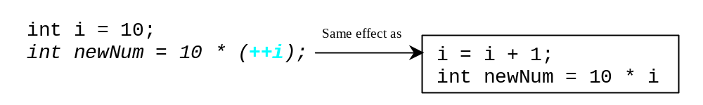
Increment and
Decrement Operators, cont.

Slide 31
Increment and
Decrement Operators, cont.
Using increment and decrement operators makes expressions short, but it also makes them complex and difficult to read. Avoid using these operators in expressions that modify multiple variables, or the same variable for multiple times such as this: int k = ++i + i.

Slide 32
Assignment Expressions and Assignment Statements
Prior to Java 2, all the expressions can be used as statements. Since Java 2, only the following types of expressions can be statements:
variable op= expression; // Where op is +, -, *, /, or %
++variable;
variable++;
--variable;
variable--;

Slide 33
Numeric Type Conversion
数据类型转换
Consider the following statements:
byte i = 100;
long k = i * 3 + 4;
double d = i * 3.1 + k / 2;

Slide 34
Conversion Rules
When performing a binary operation involving two operands of different types, Java automatically converts the operand based on the following rules:
容量大的数据类型优先。
1. If one of the operands is double, the other is converted into double.
2. Otherwise, if one of the operands is float, the other is converted into float.
3. Otherwise, if one of the operands is long, the other is converted into long.
4. Otherwise, both operands are converted into int.

Slide 35
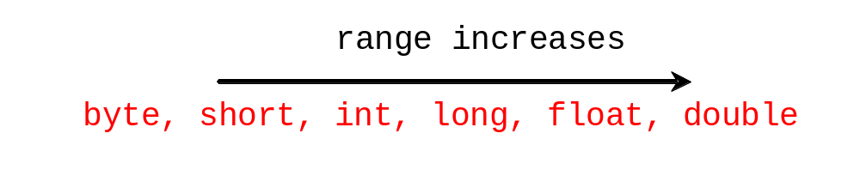
Type Casting
Implicit casting（隐性转换）
double d = 3; (type widening)
Explicit casting（显性转换）
int i = (int)3.0; (type narrowing)
int i = (int)3.9; (Fraction part is truncated)
What is wrong? int x = 5 / 2.0;

Slide 36
Example: Keeping Two Digits After Decimal Points
Write a program that displays the sales tax with two digits after the decimal point.
（显示有2位小数的数值）
SalesTax
Run

Slide 37
Character Data Type
Four hexadecimal digits.
char letter = 'A'; (ASCII)
char numChar = '4'; (ASCII)
char letter = '\u0041'; (Unicode)
char numChar = '\u0034'; (Unicode)
NOTE: The increment and decrement operators can also be used on char variables to get the next or preceding Unicode character. For example, the following statements display character b.
  char ch = 'a';
  System.out.println(++ch);

Slide 38

Unicode Format
Java characters use Unicode, a 16-bit encoding scheme established by the Unicode Consortium to support the interchange, processing, and display of written texts in the world’s diverse languages. Unicode takes two bytes, preceded by \u, expressed in four hexadecimal numbers that run from '\u0000' to '\uFFFF'. So, Unicode can represent 65535 + 1 characters.
Unicode \u03b1 \u03b2 \u03b3 for three Greek letters

Slide 39
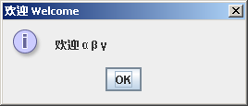
Example: Displaying Unicodes
Write a program that displays two Chinese characters and three Greek letters.
DisplayUnicode
Run

Slide 40
Escape Sequences for Special Characters
Description Escape Sequence Unicode
Backspace \b \u0008
Tab \t \u0009
Linefeed \n \u000A
Carriage return \r \u000D
Backslash \\ \u005C
Single Quote \' \u0027
Double Quote \" \u0022

Slide 41

Appendix B: ASCII Character Set
ASCII Character Set is a subset of the Unicode from \u0000 to \u007f

Slide 42

ASCII Character Set, cont.
ASCII Character Set is a subset of the Unicode from \u0000 to \u007f

Slide 43
Casting between char and Numeric Types
int i = 'a'; // Same as int i = (int)'a';
char c = 97; // Same as char c = (char)97;

Slide 44
The String Type（字符串）
The char type only represents one character. To represent a string of characters, use the data type called String. For example,
String message = "Welcome to Java";
String is actually a predefined class in the Java library just like the System class and JOptionPane class. The String type is not a primitive type. It is known as a reference type. Any Java class can be used as a reference type for a variable. Reference data types will be thoroughly discussed in Chapter 6, “Classes and Objects.” For the time being, you just need to know how to declare a String variable, how to assign a string to the variable, and how to concatenate strings.

Slide 45
String Concatenation（字符串连接）
// Three strings are concatenated
String message = "Welcome " + "to " + "Java";
// String Chapter is concatenated with number 2
String s = "Chapter" + 2; // s becomes Chapter2
// String Supplement is concatenated with character B
String s1 = "Supplement" + 'B'; // s becomes SupplementB

Slide 46
Obtaining Input（获取键盘输入）
This book provides three ways of obtaining input.
Using JOptionPane input dialogs (§2.15)
Using the JDK 1.5 Scanner class (§2.16)

Slide 47
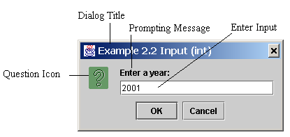
Getting Input from Input Dialog Boxes
String string = JOptionPane.showInputDialog(
null, “Prompting Message”, “Dialog Title”,
JOptionPane.QUESTION_MESSAGE));

Slide 48
Two Ways to Invoke the Method
There are several ways to use the showInputDialog method. For the time being, you only need to know two ways to invoke it.
One is to use a statement as shown in the example:
  String string = JOptionPane.showInputDialog(null, x,
  y, JOptionPane.QUESTION_MESSAGE));
where x is a string for the prompting message, and y is a string for the title of the input dialog box.
The other is to use a statement like this:
  JOptionPane.showInputDialog(x);
where x is a string for the prompting message.

Slide 49
Converting Strings to Integers
The input returned from the input dialog box is a string. If you enter a numeric value such as 123, it returns “123”. To obtain the input as a number, you have to convert a string into a number.
To convert a string into an int value, you can use the static parseInt method in the Integer class as follows:
int intValue = Integer.parseInt(intString);
（从字符串变为整数）
where intString is a numeric string such as “123”.

Slide 50
Converting Strings to Doubles
To convert a string into a double value, you can use the static parseDouble method in the Double class as follows:
double doubleValue =Double.parseDouble(doubleString);
从字符串变为浮点数。
where doubleString is a numeric string such as “123.45”.

Slide 51
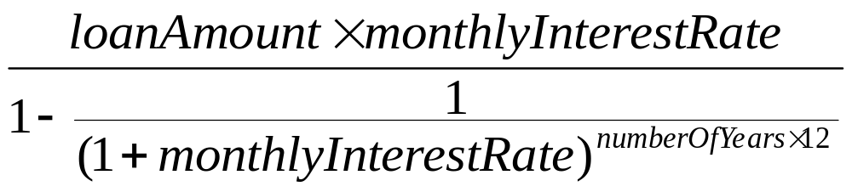
Example:
Computing Loan Payments
This program lets the user enter the interest rate, number of years, and loan amount and computes monthly payment and total payment.
ComputeLoan
Run

Slide 52
Example: Monetary Units
This program lets the user enter the amount in decimal representing dollars and cents and output a report listing the monetary equivalent in single dollars, quarters, dimes, nickels, and pennies. Your program should report maximum number of dollars, then the maximum number of quarters, and so on, in this order.
ComputeChange
Run

Slide 53
Trace ComputeChange
Suppose amount is 11.56
int remainingAmount = (int)(amount * 100);
// Find the number of one dollars
int numberOfOneDollars = remainingAmount / 100;
remainingAmount = remainingAmount % 100;
// Find the number of quarters in the remaining amount
int numberOfQuarters = remainingAmount / 25;
remainingAmount = remainingAmount % 25;
// Find the number of dimes in the remaining amount
int numberOfDimes = remainingAmount / 10;
remainingAmount = remainingAmount % 10;
// Find the number of nickels in the remaining amount
int numberOfNickels = remainingAmount / 5;
remainingAmount = remainingAmount % 5;
// Find the number of pennies in the remaining amount
int numberOfPennies = remainingAmount;
remainingAmount
1156
remainingAmount initialized

Slide 54
Trace ComputeChange
animation
Suppose amount is 11.56
int remainingAmount = (int)(amount * 100);
// Find the number of one dollars
int numberOfOneDollars = remainingAmount / 100;
remainingAmount = remainingAmount % 100;
// Find the number of quarters in the remaining amount
int numberOfQuarters = remainingAmount / 25;
remainingAmount = remainingAmount % 25;
// Find the number of dimes in the remaining amount
int numberOfDimes = remainingAmount / 10;
remainingAmount = remainingAmount % 10;
// Find the number of nickels in the remaining amount
int numberOfNickels = remainingAmount / 5;
remainingAmount = remainingAmount % 5;
// Find the number of pennies in the remaining amount
int numberOfPennies = remainingAmount;
remainingAmount
1156
numberOfOneDollars
11
numberOfOneDollars assigned

Slide 55
Trace ComputeChange
animation
Suppose amount is 11.56
int remainingAmount = (int)(amount * 100);
// Find the number of one dollars
int numberOfOneDollars = remainingAmount / 100;
remainingAmount = remainingAmount % 100;
// Find the number of quarters in the remaining amount
int numberOfQuarters = remainingAmount / 25;
remainingAmount = remainingAmount % 25;
// Find the number of dimes in the remaining amount
int numberOfDimes = remainingAmount / 10;
remainingAmount = remainingAmount % 10;
// Find the number of nickels in the remaining amount
int numberOfNickels = remainingAmount / 5;
remainingAmount = remainingAmount % 5;
// Find the number of pennies in the remaining amount
int numberOfPennies = remainingAmount;
remainingAmount
56
numberOfOneDollars
11
remainingAmount updated

Slide 56
Trace ComputeChange
animation
Suppose amount is 11.56
int remainingAmount = (int)(amount * 100);
// Find the number of one dollars
int numberOfOneDollars = remainingAmount / 100;
remainingAmount = remainingAmount % 100;
// Find the number of quarters in the remaining amount
int numberOfQuarters = remainingAmount / 25;
remainingAmount = remainingAmount % 25;
// Find the number of dimes in the remaining amount
int numberOfDimes = remainingAmount / 10;
remainingAmount = remainingAmount % 10;
// Find the number of nickels in the remaining amount
int numberOfNickels = remainingAmount / 5;
remainingAmount = remainingAmount % 5;
// Find the number of pennies in the remaining amount
int numberOfPennies = remainingAmount;
remainingAmount
56
numberOfOneDollars
11
numberOfOneQuarters
2
numberOfOneQuarters assigned

Slide 57
Trace ComputeChange
animation
Suppose amount is 11.56
int remainingAmount = (int)(amount * 100);
// Find the number of one dollars
int numberOfOneDollars = remainingAmount / 100;
remainingAmount = remainingAmount % 100;
// Find the number of quarters in the remaining amount
int numberOfQuarters = remainingAmount / 25;
remainingAmount = remainingAmount % 25;
// Find the number of dimes in the remaining amount
int numberOfDimes = remainingAmount / 10;
remainingAmount = remainingAmount % 10;
// Find the number of nickels in the remaining amount
int numberOfNickels = remainingAmount / 5;
remainingAmount = remainingAmount % 5;
// Find the number of pennies in the remaining amount
int numberOfPennies = remainingAmount;
remainingAmount
6
numberOfOneDollars
11
numberOfQuarters
2
remainingAmount updated

Slide 58
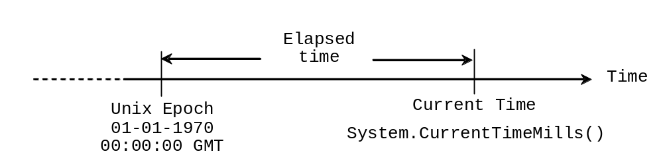
Example: Displaying Current Time
Write a program that displays current time in GMT in the format hour:minute:second such as 1:45:19.
The currentTimeMillis method in the System class returns the current time in milliseconds since the midnight, January 1, 1970 GMT. (1970 was the year when the Unix operating system was formally introduced.) You can use this method to obtain the current time, and then compute the current second, minute, and hour as follows.
ShowCurrentTime
Run

Slide 59
Getting Input Using Scanner
Optional
1. Create a Scanner object
  Scanner scanner = new Scanner(System.in);
2. Use the methods next(), nextByte(), nextShort(), nextInt(), nextLong(), nextFloat(), nextDouble(), or nextBoolean() to obtain to a string, byte, short, int, long, float, double, or boolean value. For example,
  System.out.print("Enter a double value: ");
  Scanner scanner = new Scanner(System.in);
  double d = scanner.nextDouble();
TestScanner
Run

Slide 60
Programming Style and Documentation
Appropriate Comments
Naming Conventions
Proper Indentation and Spacing Lines
Block Styles

Slide 61
Appropriate Comments
Include a summary at the beginning of the program to explain what the program does, its key features, its supporting data structures, and any unique techniques it uses.
Include your name, class section, instructor, date, and a brief description at the beginning of the program.

Slide 62
Naming Conventions
Choose meaningful and descriptive names.
Variables and method names:
  Use lowercase. If the name consists of several words, concatenate all in one, use lowercase for the first word, and capitalize the first letter of each subsequent word in the name. For example, the variables radius and area, and the method computeArea.

Slide 63
Naming Conventions, cont.
Class names:
  Capitalize the first letter of each word in the name. For example, the class name ComputeArea.
Constants:
  Capitalize all letters in constants, and use underscores to connect words. For example, the constant PI and MAX_VALUE

Slide 64
Proper Indentation and Spacing
Indentation
  Indent two spaces.
Spacing
  Use blank line to separate segments of the code.

Slide 65

Block Styles
Use end-of-line style for braces.

Slide 66
Programming Errors
Syntax Errors
  Detected by the compiler
Runtime Errors
  Causes the program to abort
Logic Errors
  Produces incorrect result

Slide 67
Syntax Errors
public class ShowSyntaxErrors {
public static void main(String[] args) {
i = 30;
System.out.println(i + 4);
}
}

Slide 68
Runtime Errors
public class ShowRuntimeErrors {
public static void main(String[] args) {
int i = 1 / 0;
}
}

Slide 69
Logic Errors
public class ShowLogicErrors {
// Determine if a number is between 1 and 100 inclusively
public static void main(String[] args) {
// Prompt the user to enter a number
String input = JOptionPane.showInputDialog(null,
"Please enter an integer:",
"ShowLogicErrors", JOptionPane.QUESTION_MESSAGE);
int number = Integer.parseInt(input);
// Display the result
System.out.println("The number is between 1 and 100, " +
"inclusively? " + ((1 < number) && (number < 100)));
System.exit(0);
}
}

Slide 70
Debugging
Logic errors are called bugs. The process of finding and correcting errors is called debugging. A common approach to debugging is to use a combination of methods to narrow down to the part of the program where the bug is located. You can hand-trace the program (i.e., catch errors by reading the program), or you can insert print statements in order to show the values of the variables or the execution flow of the program. This approach might work for a short, simple program. But for a large, complex program, the most effective approach for debugging is to use a debugger utility.

Slide 71
Debugger
Debugger is a program that facilitates debugging. You can use a debugger to
Execute a single statement at a time.
Trace into or stepping over a method.
Set breakpoints.
Display variables.
Display call stack.
Modify variables.

Slide 72
Debugging in JBuilder
JBuilder Optional
The debugger utility is integrated in JBuilder. You can pinpoint bugs in your program with the help of the JBuilder debugger without leaving the IDE. The JBuilder debugger enables you to set breakpoints and execute programs line by line. As your program executes, you can watch the values stored in variables, observe which methods are being called, and know what events have occurred in the program.

Slide 73
Setting Breakpoints
JBuilder Optional
A breakpoint is a stop sign placed on a line of source code that tells the debugger to pause when this line is encountered. The debugger executes every line until it encounters a breakpoint, so you can trace the part of the program at the breakpoint. Using the breakpoint, you can quickly move over the sections you know work correctly and concentrate on the sections causing problems.
There are several ways to set a breakpoint on a line. One quick way is to click the cutter of the line on which you want to put a breakpoint. You will see the line highlighted. You also can set breakpoints by choosing Run, Add Breakpoint. To remove a breakpoint, simply click the cutter of the line.

Slide 74
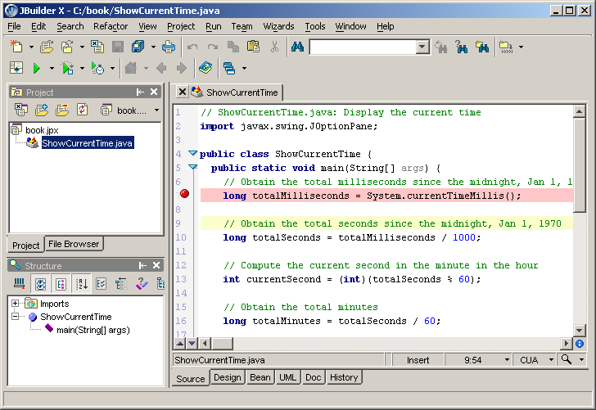
Setting Breakpoints, cont.
JBuilder Optional
Cutter area
As you debug your program, you can set as many breakpoints as you want, and can remove breakpoints at any time during debugging. The project retains the breakpoints you have set when you exit the project. The breakpoints are restored when you reopen it.
Breakpoint

Slide 75
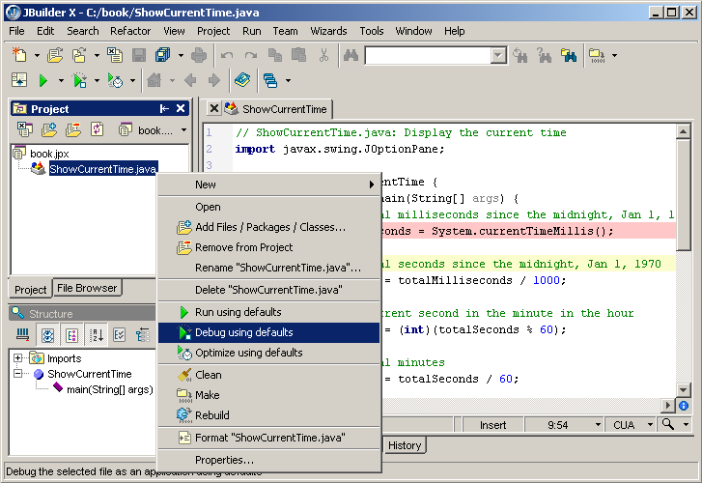
Starting the debugger
JBuilder Optional
Set breakpoints.
Choose the program (e.g., ShowCurrentTime.java in the project pane, and right-click the mouse button to display the context menu. Click Debug Using Defaults in the context menu to start debugging.

Slide 76
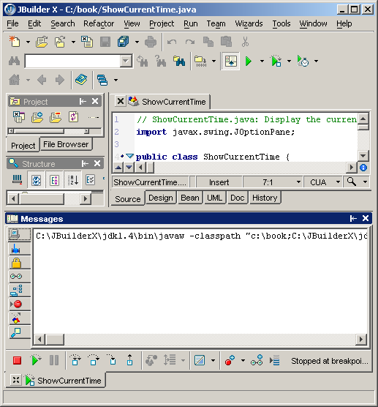
Console View
JBuilder Optional
Console view displays output and errors. You can also enter input from the console view.
Console view

Slide 77
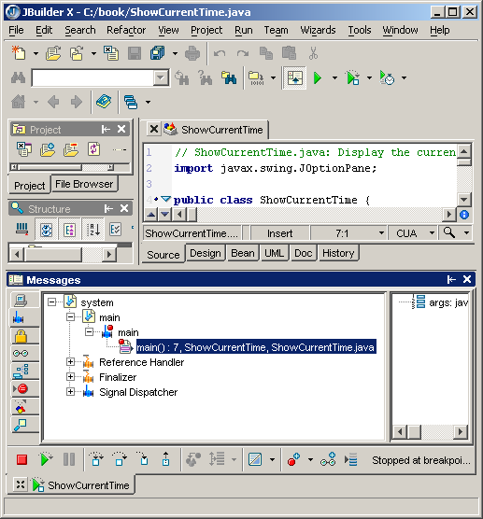
Stack View
JBuilder Optional
Stack view displays the methods and local variables in the call stack.
Call stacks

Slide 78
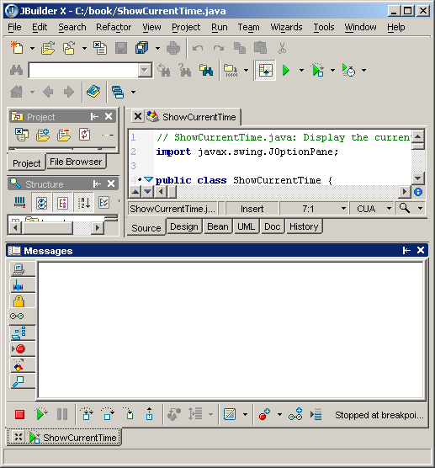
Watch View
JBuilder Optional
You can add variables to the watch view. Watch view displays the contents of the variables in the watch view.
Data watches

Slide 79
Adding Variables to Watch View
JBuilder Optional
There are several ways to add variables to the watch view. A simple way is to highlight the variable and then right-click the mouse to display the context menu. Choose Add Watch in the context menu to add the variable to the watch view.

Slide 80
Controlling Program Execution
JBuilder Optional
The program pauses at the first breakpoint line encountered. This line, called the current execution point, is highlighted and has a green arrow to the left. The execution point marks the next line of source code to be executed by the debugger.
When the program pauses at the execution point, you can issue debugging commands to control the execution of the program. You also can inspect or modify the values of variables in the program.
When JBuilder is in the debugging mode, the Run menu contains the debugging commands. Most of the commands also appear in the toolbar under the message pane. The toolbar contains additional commands that are not in the Run menu. Here are the commands for controlling program execution:

Slide 81
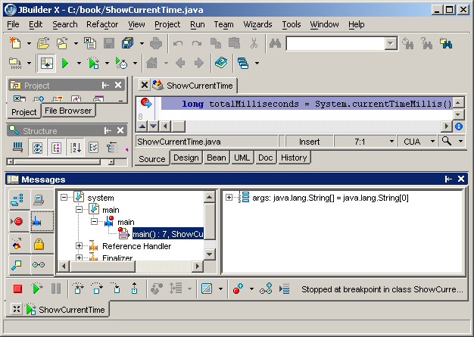
Debugger Commands in the Toolbar
JBuilder Optional
Reset program
Resume program
Pause program
Step over
Step into
Step out

Slide 82
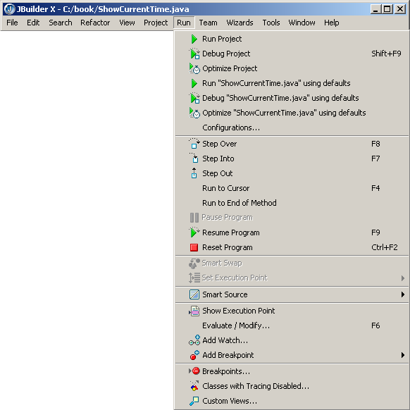
Debugger Commands in the Menu
JBuilder Optional

Slide 83
Debugger Commands
JBuilder Optional
Step Over executes a single statement. If the statement contains a call to a method, the entire method is executed without stepping through it.
Step Into executes a single statement or steps into a method.
Step Out executes all the statements in the current method and returns to its caller.
Run to Cursor runs the program, starting from the current execution point, and pauses and places the execution point on the line of code containing the cursor, or at a breakpoint.
Run to End of Method runs the program until it reaches the end of the current method or a breakpoint.
Resume Program continues the current debugging session or restarts one that has finished or been reset.
Reset Program ends the current program and releases it from memory. Use Reset to restart an application from the beginning, as when you make a change to the code and want to run again from the beginning, or if variables or data structures become corrupted with unwanted values. This command terminates debugging and returns to the normal editing session.
Show Execution Point positions the cursor at the execution point in the content pane.

Slide 84
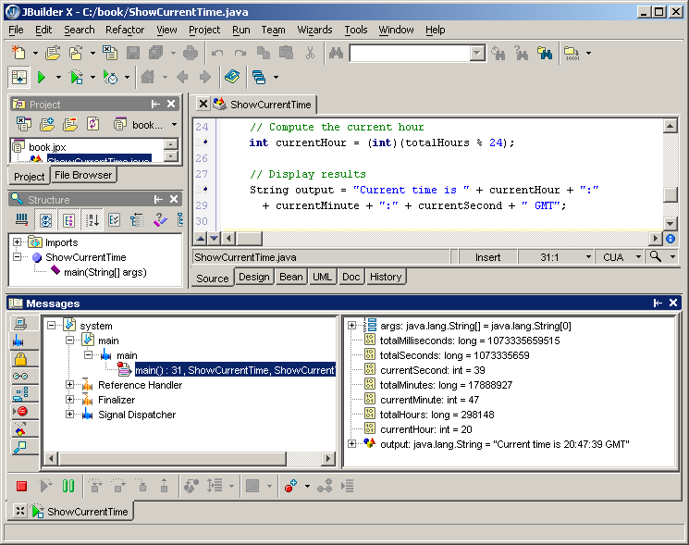
Tracing Execution
JBuilder Optional
You may trace the program line by line and see the contents of the variables in the stack view. This is most convenient.

