Slide 1
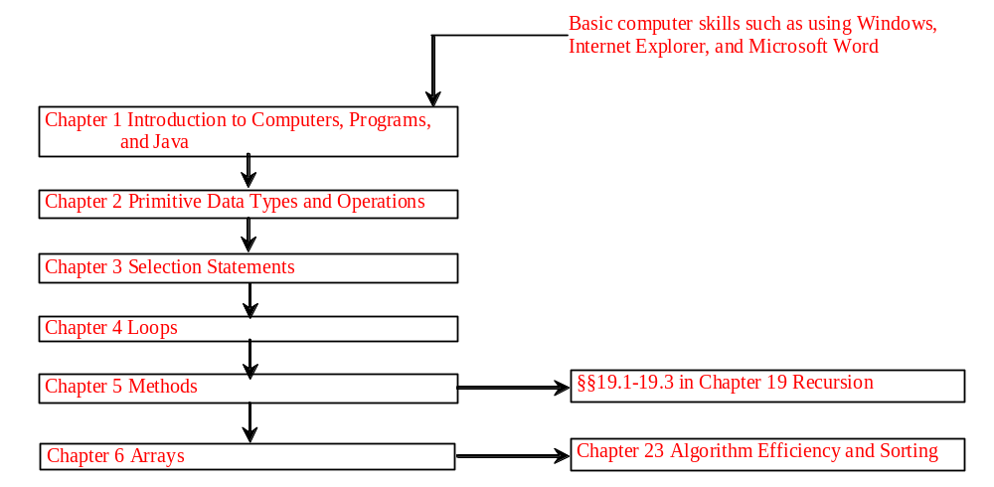
Chapter 3 Control Statements
Liang, Introduction to Java Programming, Sixth Edition, (c) 2007 Pearson Education, Inc. All rights reserved. 0-13-222158-6

Slide 2
Objectives
To declare boolean type and write Boolean expressions (§3.2).
To distinguish between conditional and unconditional && and || operators (§3.2.1).
To use Boolean expressions to control selection statements (§3.3-3.5).
To implement selection control using if and nested if statements (§3.3).
To implement selection control using switch statements (§3.4).
To write expressions using the conditional operator (§3.5) .
To display formatted output using the System.out.printf method and to format strings using the String.format method (§3.6).
To know the rules governing operand evaluation order, operator precedence, and operator associativity (§§3.7-3.8) .
Liang, Introduction to Java Programming, Sixth Edition, (c) 2007 Pearson Education, Inc. All rights reserved. 0-13-222158-6

Slide 3
The boolean Type and Operators
Often in a program you need to compare two values, such as whether i is greater than j. Java provides six comparison operators (also known as relational operators) that can be used to compare two values. The result of the comparison is a Boolean value: true or false.
boolean b = (1 > 2);

Slide 4
Comparison Operators
Operator Name
< less than
<= less than or equal to
> greater than
>= greater than or equal to
== equal to
!= not equal to

Slide 5
Boolean Operators
Operator Name
! not
&& and
|| or
^ exclusive or

Slide 6
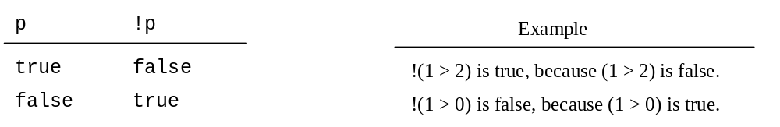
Truth Table for Operator !

Slide 7
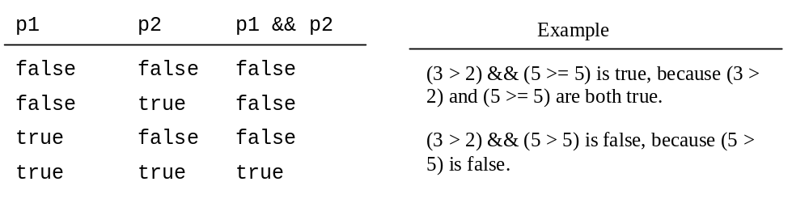
Truth Table for Operator &&

Slide 8
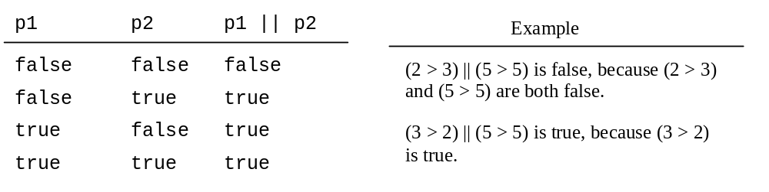
Truth Table for Operator ||

Slide 9
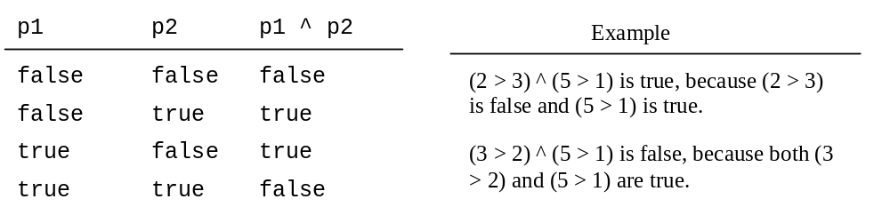
Truth Table for Operator ^

Slide 10
Examples
System.out.println("Is " + num + " divisible by 2 and 3? " +
((num % 2 == 0) && (num % 3 == 0)));
System.out.println("Is " + num + " divisible by 2 or 3? " +
((num % 2 == 0) || (num % 3 == 0)));
System.out.println("Is " + num +
" divisible by 2 or 3, but not both? " +
((num % 2 == 0) ^ (num % 3 == 0)));

Slide 11
Example: Determining Leap Year?
This program first prompts the user to enter a year as an int value and checks if it is a leap year.
A year is a leap year if it is divisible by 4 but not by 100, or it is divisible by 400.
(year % 4 == 0 && year % 100 != 0) || (year % 400 == 0)
LeapYear
Run

Slide 12
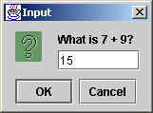
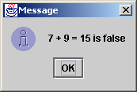
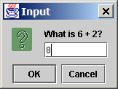
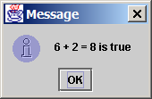
Example: A Simple Math Learning Tool
This example creates a program to let a first grader practice additions. The program randomly generates two single-digit integers number1 and number2 and displays a question such as “What is 7 + 9?” to the student, as shown below. After the student types the answer in the input dialog box, the program displays a message dialog box to indicate whether the answer is true or false.
AdditionTutor
Run

Slide 13
The & and | Operators
&&: conditional AND operator
&: unconditional AND operator
||: conditional OR operator
|: unconditional OR operator
exp1 && exp2
(1 < x) && (x < 100)
(1 < x) & (x < 100)

Slide 14
The & and | Operators
If x is 1, what is x after this expression?
(x > 1) & (x++ < 10)
If x is 1, what is x after this expression?
(1 > x) && ( 1 > x++)
How about (1 == x) | (10 > x++)?
(1 == x) || (10 > x++)?

Slide 15
Selection Statements
if Statements
switch Statements
Conditional Operators

Slide 16
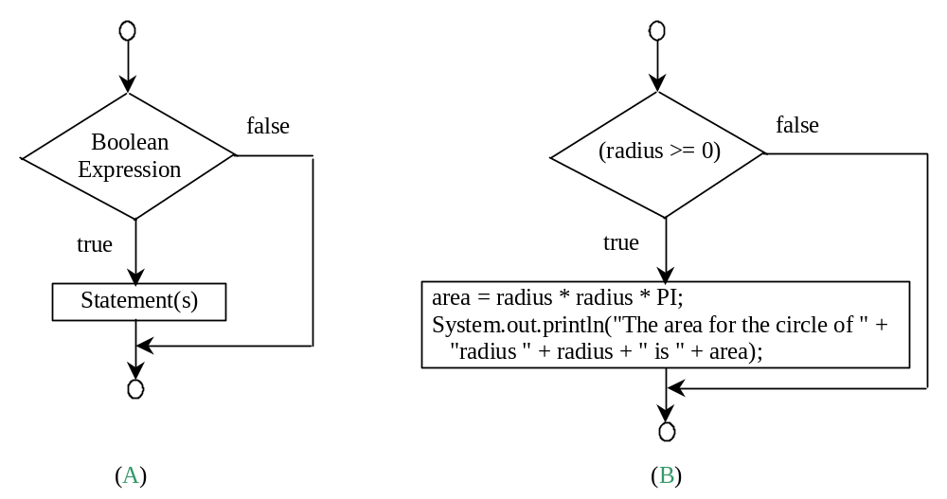
Simple if Statements
if (radius >= 0) {
area = radius * radius * PI;
System.out.println("The area"
+ " for the circle of radius "
+ radius + " is " + area);
}
if (booleanExpression) {
statement(s);
}

Slide 17
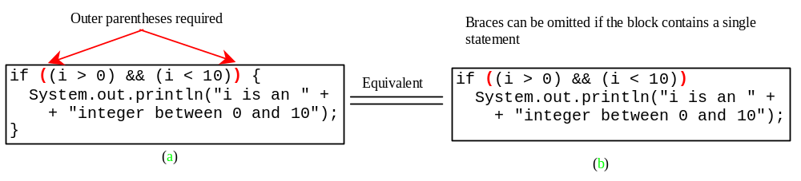
Note

Slide 18
Caution
Adding a semicolon at the end of an if clause is a common mistake.
if (radius >= 0);
{
area = radius*radius*PI;
System.out.println(
"The area for the circle of radius " +
radius + " is " + area);
}
This mistake is hard to find, because it is not a compilation error or a runtime error, it is a logic error.
This error often occurs when you use the next-line block style.
Wrong

Slide 19
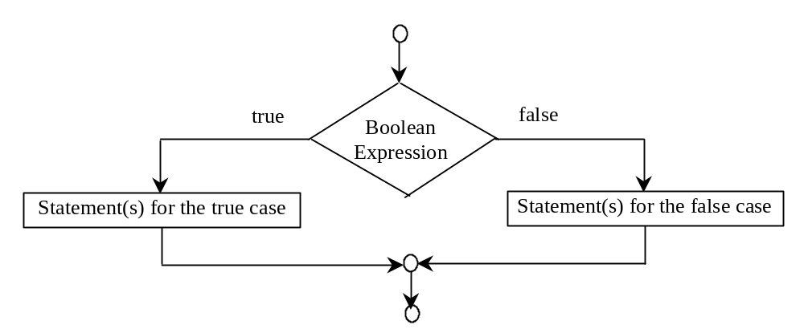
The if...else Statement
if (booleanExpression) {
statement(s)-for-the-true-case;
}
else {
statement(s)-for-the-false-case;
}

Slide 20
if...else Example
if (radius >= 0) {
area = radius * radius * 3.14159;
System.out.println("The area for the “
+ “circle of radius " + radius +
" is " + area);
}
else {
System.out.println("Negative input");
}

Slide 21
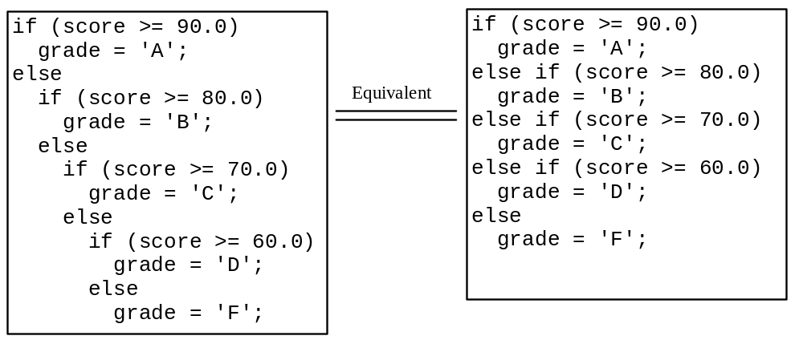
Multiple Alternative if Statements

Slide 22
Trace if-else statement
animation
Suppose score is 70.0
The condition is false
if (score >= 90.0)
grade = 'A';
else if (score >= 80.0)
grade = 'B';
else if (score >= 70.0)
grade = 'C';
else if (score >= 60.0)
grade = 'D';
else
grade = 'F';

Slide 23
Trace if-else statement
animation
Suppose score is 70.0
The condition is false
if (score >= 90.0)
grade = 'A';
else if (score >= 80.0)
grade = 'B';
else if (score >= 70.0)
grade = 'C';
else if (score >= 60.0)
grade = 'D';
else
grade = 'F';

Slide 24
Trace if-else statement
animation
Suppose score is 70.0
The condition is true
if (score >= 90.0)
grade = 'A';
else if (score >= 80.0)
grade = 'B';
else if (score >= 70.0)
grade = 'C';
else if (score >= 60.0)
grade = 'D';
else
grade = 'F';

Slide 25
Trace if-else statement
animation
Suppose score is 70.0
grade is C
if (score >= 90.0)
grade = 'A';
else if (score >= 80.0)
grade = 'B';
else if (score >= 70.0)
grade = 'C';
else if (score >= 60.0)
grade = 'D';
else
grade = 'F';

Slide 26
Trace if-else statement
animation
Suppose score is 70.0
Exit the if statement
if (score >= 90.0)
grade = 'A';
else if (score >= 80.0)
grade = 'B';
else if (score >= 70.0)
grade = 'C';
else if (score >= 60.0)
grade = 'D';
else
grade = 'F';

Slide 27
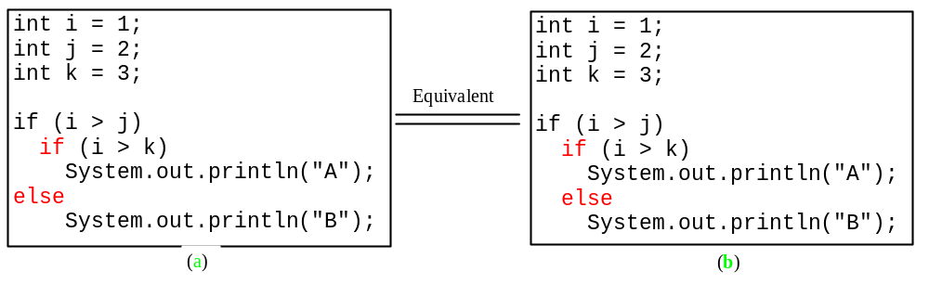
Note
The else clause matches the most recent if clause in the same block.

Slide 28
Note, cont.
Nothing is printed from the preceding statement. To force the else clause to match the first if clause, you must add a pair of braces:
int i = 1;
int j = 2;
int k = 3;
if (i > j) {
if (i > k)
System.out.println("A");
}
else
System.out.println("B");
This statement prints B.

Slide 29

TIP

Slide 30

CAUTION

Slide 31
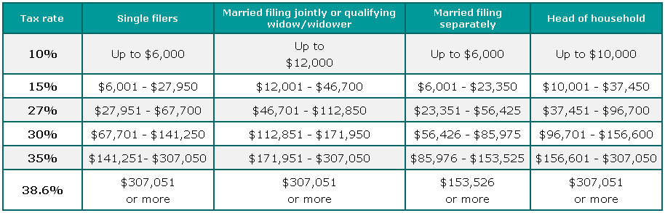
Example: Computing Taxes
The US federal personal income tax is calculated based on the filing status and taxable income. There are four filing statuses: single filers, married filing jointly, married filing separately, and head of household. The tax rates for 2002 are shown in Table 3.1.

Slide 32

Example: Computing Taxes, cont.
if (status == 0) {
// Compute tax for single filers
}
else if (status == 1) {
// Compute tax for married file jointly
}
else if (status == 2) {
// Compute tax for married file separately
}
else if (status == 3) {
// Compute tax for head of household
}
else {
// Display wrong status
}
ComputeTaxWithSelectionStatement

Slide 33
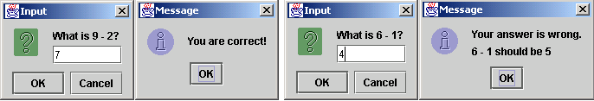
Example: An Improved Math Learning Tool
This example creates a program to teach a first grade child how to learn subtractions. The program randomly generates two single-digit integers number1 and number2 with number1 > number2 and displays a question such as “What is 9 – 2?” to the student, as shown in the figure. After the student types the answer in the input dialog box, the program displays a message dialog box to indicate whether the answer is correct, as shown in figure.
SubtractionTutor

Slide 34
Example: Guessing Birth Date
The program can guess your birth date. Run to see how it works.
GuessBirthDate

Slide 35
switch Statements
switch (status) {
case 0: compute taxes for single filers;
break;
case 1: compute taxes for married file jointly;
break;
case 2: compute taxes for married file separately;
break;
case 3: compute taxes for head of household;
break;
default: System.out.println("Errors: invalid status");
System.exit(0);
}

Slide 36
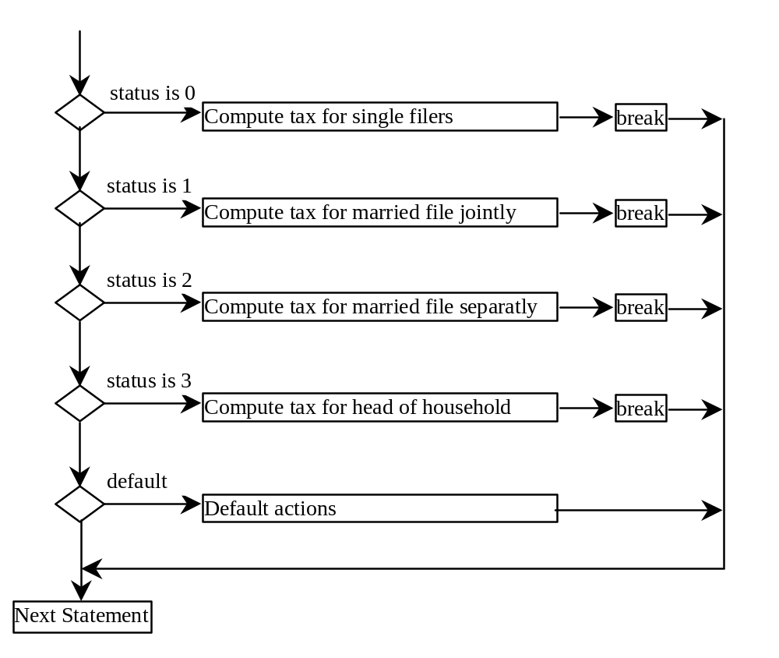
switch Statement Flow Chart

Slide 37
switch Statement Rules
The switch-expression must yield a value of char, byte, short, or int type and must always be enclosed in parentheses.
switch (switch-expression) {
case value1: statement(s)1;
break;
case value2: statement(s)2;
break;
…
case valueN: statement(s)N;
break;
default: statement(s)-for-default;
}
The value1, ..., and valueN must have the same data type as the value of the switch-expression. The resulting statements in the case statement are executed when the value in the case statement matches the value of the switch-expression. Note that value1, ..., and valueN are constant expressions, meaning that they cannot contain variables in the expression, such as 1 + x.

Slide 38
switch Statement Rules
The keyword break is optional, but it should be used at the end of each case in order to terminate the remainder of the switch statement. If the break statement is not present, the next case statement will be executed.
switch (switch-expression) {
case value1: statement(s)1;
break;
case value2: statement(s)2;
break;
…
case valueN: statement(s)N;
break;
default: statement(s)-for-default;
}
The default case, which is optional, can be used to perform actions when none of the specified cases matches the switch-expression.
The case statements are executed in sequential order, but the order of the cases (including the default case) does not matter. However, it is good programming style to follow the logical sequence of the cases and place the default case at the end.

Slide 39
Trace switch statement
animation
Suppose ch is 'a':
switch (ch) {
case 'a': System.out.println(ch);
case 'b': System.out.println(ch);
case 'c': System.out.println(ch);
}

Slide 40
Trace switch statement
animation
ch is 'a':
switch (ch) {
case 'a': System.out.println(ch);
case 'b': System.out.println(ch);
case 'c': System.out.println(ch);
}

Slide 41
Trace switch statement
animation
Execute this line
switch (ch) {
case 'a': System.out.println(ch);
case 'b': System.out.println(ch);
case 'c': System.out.println(ch);
}

Slide 42
Trace switch statement
animation
Execute this line
switch (ch) {
case 'a': System.out.println(ch);
case 'b': System.out.println(ch);
case 'c': System.out.println(ch);
}

Slide 43
Trace switch statement
animation
Execute this line
switch (ch) {
case 'a': System.out.println(ch);
case 'b': System.out.println(ch);
case 'c': System.out.println(ch);
}

Slide 44
Trace switch statement
animation
Execute next statement
switch (ch) {
case 'a': System.out.println(ch);
case 'b': System.out.println(ch);
case 'c': System.out.println(ch);
}
Next statement;

Slide 45
Trace switch statement
animation
Suppose ch is 'a':
switch (ch) {
case 'a': System.out.println(ch);
break;
case 'b': System.out.println(ch);
break;
case 'c': System.out.println(ch);
}

Slide 46
Trace switch statement
animation
ch is 'a':
switch (ch) {
case 'a': System.out.println(ch);
break;
case 'b': System.out.println(ch);
break;
case 'c': System.out.println(ch);
}

Slide 47
Trace switch statement
animation
Execute this line
switch (ch) {
case 'a': System.out.println(ch);
break;
case 'b': System.out.println(ch);
break;
case 'c': System.out.println(ch);
}

Slide 48
Trace switch statement
animation
Execute this line
switch (ch) {
case 'a': System.out.println(ch);
break;
case 'b': System.out.println(ch);
break;
case 'c': System.out.println(ch);
}

Slide 49
Trace switch statement
animation
Execute next statement
switch (ch) {
case 'a': System.out.println(ch);
break;
case 'b': System.out.println(ch);
break;
case 'c': System.out.println(ch);
}
Next statement;

Slide 50
Conditional Operator
if (x > 0)
y = 1
else
y = -1;
is equivalent to
y = (x > 0) ? 1 : -1;
(booleanExpression) ? expression1 : expression2
Ternary operator
Binary operator
Unary operator

Slide 51
Conditional Operator
if (num % 2 == 0)
System.out.println(num + “is even”);
else
System.out.println(num + “is odd”);
System.out.println(
(num % 2 == 0)? num + “is even” :
num + “is odd”);

Slide 52
Conditional Operator, cont.
(booleanExp) ? exp1 : exp2

Slide 53
Formatting Output
JDK 1.5
Feature
Use the new JDK 1.5 printf statement.
  System.out.printf(format, items);
Where format is a string that may consist of substrings and format specifiers. A format specifier specifies how an item should be displayed. An item may be a numeric value, character, boolean value, or a string. Each specifier begins with a percent sign.

Slide 54

Frequently-Used Specifiers
JDK 1.5
Feature
Specifier Output Example
%b a boolean value true or false
%c a character 'a'
%d a decimal integer 200
%f a floating-point number 45.460000
%e a number in standard scientific notation 4.556000e+01
%s a string "Java is cool"

Slide 55
Creating Formatted Strings
System.out.printf(format, item1, item2, ..., itemk)
String.format(format, item1, item2, ..., itemk)
String s = String.format("count is %d and amount is %f", 5, 45.56));

Slide 56
Operator Precedence
How to evaluate 3 + 4 * 4 > 5 * (4 + 3) – 1?

Slide 57
Operator Precedence
var++, var--
+, - (Unary plus and minus), ++var,--var
(type) Casting
! (Not)
*, /, % (Multiplication, division, and remainder)
+, - (Binary addition and subtraction)
<, <=, >, >= (Comparison)
==, !=; (Equality)
& (Unconditional AND)
^ (Exclusive OR)
| (Unconditional OR)
&& (Conditional AND) Short-circuit AND
|| (Conditional OR) Short-circuit OR
=, +=, -=, *=, /=, %= (Assignment operator)

Slide 58
Operator Precedence and Associativity
The expression in the parentheses is evaluated first. (Parentheses can be nested, in which case the expression in the inner parentheses is executed first.) When evaluating an expression without parentheses, the operators are applied according to the precedence rule and the associativity rule.
If operators with the same precedence are next to each other, their associativity determines the order of evaluation. All binary operators except assignment operators are left-associative.

Slide 59
Operator Associativity
When two operators with the same precedence are evaluated, the associativity of the operators determines the order of evaluation. All binary operators except assignment operators are left-associative.
a – b + c – d is equivalent to ((a – b) + c) – d
Assignment operators are right-associative. Therefore, the expression
a = b += c = 5 is equivalent to a = (b += (c = 5))

Slide 60

Example
Applying the operator precedence and associativity rule, the expression 3 + 4 * 4 > 5 * (4 + 3) - 1 is evaluated as follows:

Slide 61
Operand Evaluation Order
The precedence and associativity rules specify the order of the operators, but do not specify the order in which the operands of a binary operator are evaluated. Operands are evaluated from left to right in Java.
The left-hand operand of a binary operator is evaluated before any part of the right-hand operand is evaluated.

Slide 62
Operand Evaluation Order, cont.
If no operands have side effects that change the value of a variable, the order of operand evaluation is irrelevant. Interesting cases arise when operands do have a side effect. For example, x becomes 1 in the following code, because a is evaluated to 0 before ++a is evaluated to 1.
  int a = 0;
  int x = a + (++a);
But x becomes 2 in the following code, because ++a is evaluated to 1, then a is evaluated to 1.
  int a = 0;
  int x = ++a + a;

Slide 63
Rule of Evaluating an Expression
Rule 1: Evaluate whatever subexpressions you can possibly evaluate from left to right.
Rule 2: The operators are applied according to their precedence.
Rule 3: The associativity rule applies for two operators next to each other with the same precedence.

Slide 64
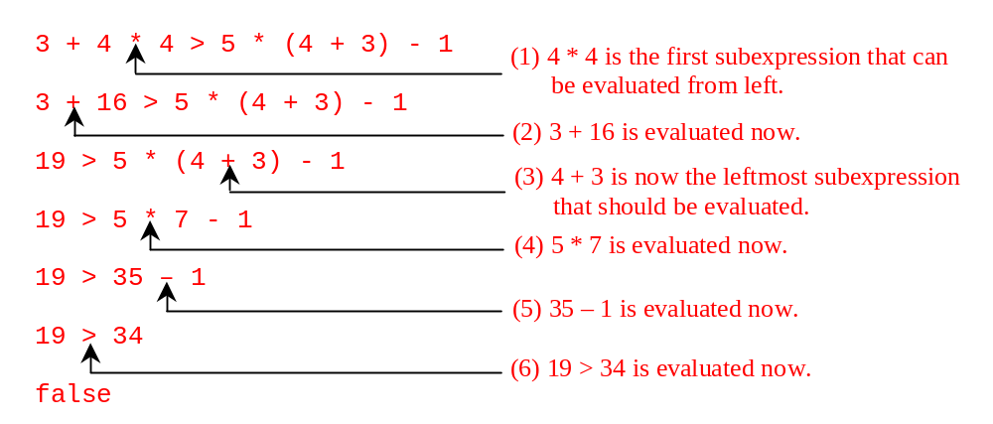
Rule of Evaluating an Expression
Applying the rule, the expression 3 + 4 * 4 > 5 * (4 + 3) - 1 is evaluated as follows:

