Slide 1
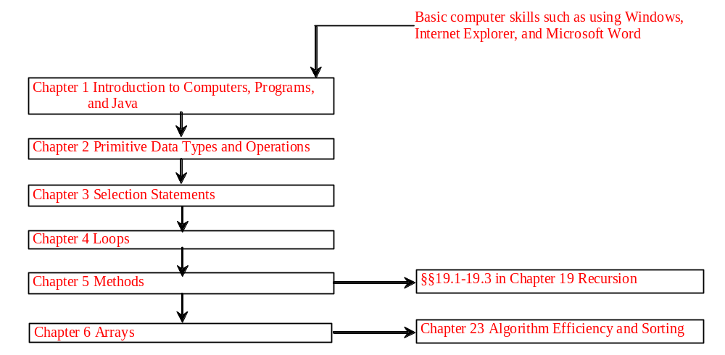
Chapter 4 Loops
Liang, Introduction to Java Programming, Sixth Edition, (c) 2007 Pearson Education, Inc. All rights reserved. 0-13-222158-6

Slide 2
Objectives
To use while, do-while, and for loop statements to control the repetition of statements (§§4.2-4.4).
To understand the flow of control in loop statements (§§4.2-4.4).
To use Boolean expressions to control loop statements (§§4.2-4.4).
To write nested loops (§4.5).
To know the similarities and differences of three types of loops (§4.6).
To implement program control with break and continue (§4.7).
Liang, Introduction to Java Programming, Sixth Edition, (c) 2007 Pearson Education, Inc. All rights reserved. 0-13-222158-6

Slide 3
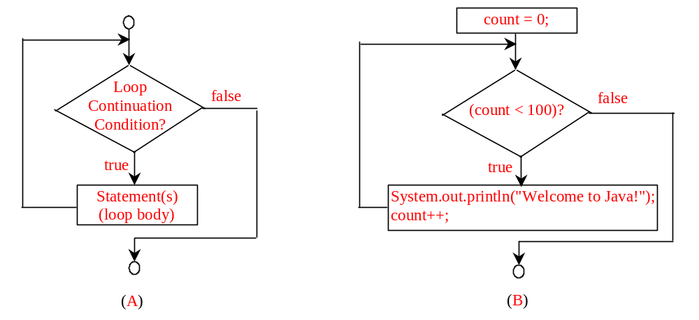
while Loop Flow Chart
int count = 0;
while (count < 100) {
System.out.println("Welcome to Java!");
count++;
}
while (loop-continuation-condition) {
// loop-body;
Statement(s);
}

Slide 4
Trace while Loop
animation
Initialize count
int count = 0;
while (count < 2) {
System.out.println("Welcome to Java!");
count++;
}

Slide 5
Trace while Loop, cont.
animation
(count < 2) is true
int count = 0;
while (count < 2) {
System.out.println("Welcome to Java!");
count++;
}

Slide 6
Trace while Loop, cont.
animation
Print Welcome to Java
int count = 0;
while (count < 2) {
System.out.println("Welcome to Java!");
count++;
}

Slide 7
Trace while Loop, cont.
animation
Increase count by 1
count is 1 now
int count = 0;
while (count < 2) {
System.out.println("Welcome to Java!");
count++;
}

Slide 8
Trace while Loop, cont.
animation
(count < 2) is still true since count is 1
int count = 0;
while (count < 2) {
System.out.println("Welcome to Java!");
count++;
}

Slide 9
Trace while Loop, cont.
animation
Print Welcome to Java
int count = 0;
while (count < 2) {
System.out.println("Welcome to Java!");
count++;
}

Slide 10
Trace while Loop, cont.
animation
Increase count by 1
count is 2 now
int count = 0;
while (count < 2) {
System.out.println("Welcome to Java!");
count++;
}

Slide 11
Trace while Loop, cont.
animation
(count < 2) is false since count is 2 now
int count = 0;
while (count < 2) {
System.out.println("Welcome to Java!");
count++;
}

Slide 12
Trace while Loop
animation
The loop exits. Execute the next statement after the loop.
int count = 0;
while (count < 2) {
System.out.println("Welcome to Java!");
count++;
}

Slide 13

Example: An Advanced Math Learning Tool
The Math subtraction learning tool program generates just one question for each run. You can use a loop to generate questions repeatedly. This example gives a program that generates ten questions and reports the number of the correct answers after a student answers all ten questions.
SubtractionTutorLoop
IMPORTANT NOTE: To run the program from the Run button, (1) set c:\jdk1.5.0\bin for path, and (2) install slides from the Instructor Resource Website to a directory (e.g., c:\LiangIR) .

Slide 14
Ending a Loop with a Sentinel Value
Often the number of times a loop is executed is not predetermined. You may use an input value to signify the end of the loop. Such a value is known as a sentinel value.
Write a program that reads and calculates the sum of an unspecified number of integers. The input 0 signifies the end of the input.
SentinelValue
IMPORTANT NOTE: To run the program from the Run button, (1) set c:\jdk1.5.0\bin for path, and (2) install slides from the Instructor Resource Website to a directory (e.g., c:\LiangIR) .

Slide 15
Caution
Don’t use floating-point values for equality checking in a loop control. Since floating-point values are approximations, using them could result in imprecise counter values and inaccurate results. This example uses int value for data. If a floating-point type value is used for data, (data != 0) may be true even though data is 0.
// data should be zero
double data = Math.pow(Math.sqrt(2), 2) - 2;
if (data == 0)
System.out.println("data is zero");
else
System.out.println("data is not zero");

Slide 16
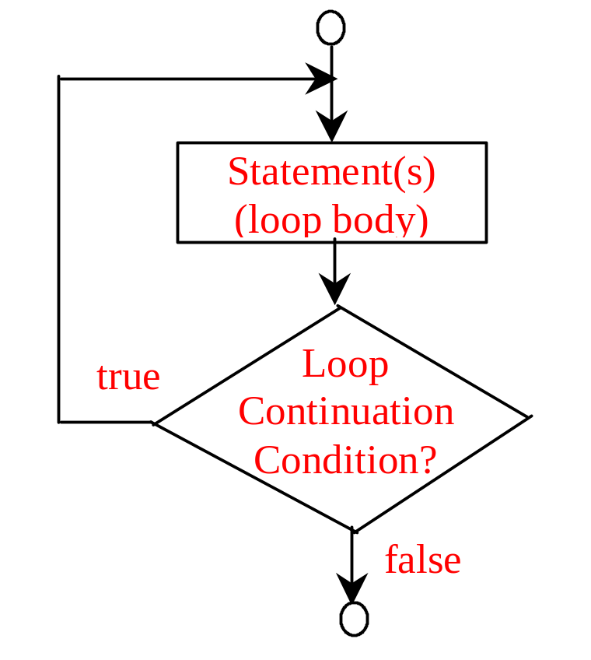
do-while Loop
do {
// Loop body;
Statement(s);
} while (loop-continuation-condition);

Slide 17
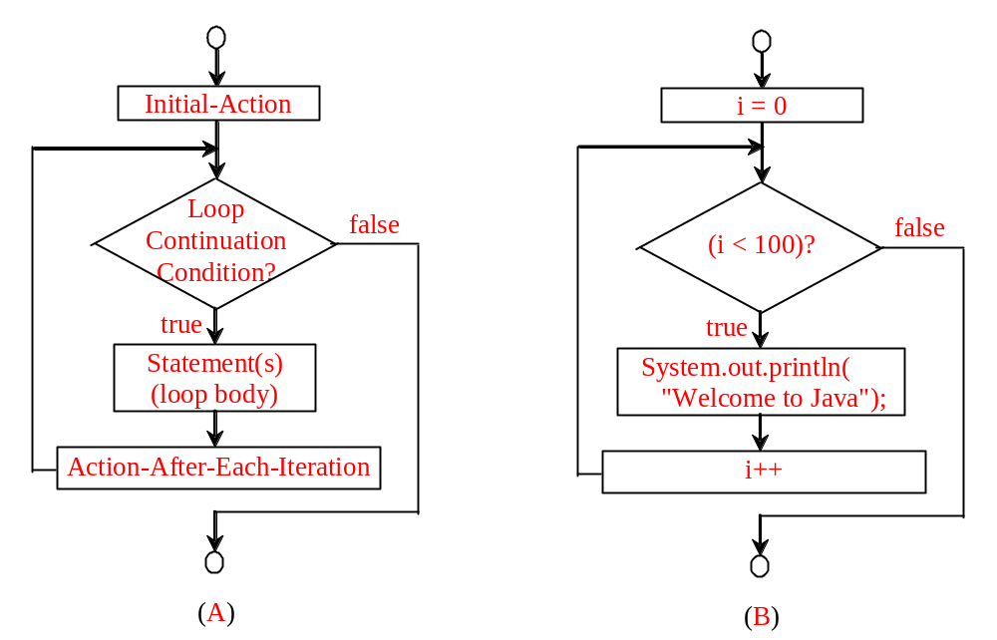
for Loops
for (initial-action; loop-continuation-condition; action-after-each-iteration) {
// loop body;
Statement(s);
}
int i;
for (i = 0; i < 100; i++) {
System.out.println(
"Welcome to Java!");
}

Slide 18
Trace for Loop
animation
Declare i
int i;
for (i = 0; i < 2; i++) {
System.out.println("Welcome to Java!");
}

Slide 19
Trace for Loop, cont.
animation
Execute initializer
i is now 0
int i;
for (i = 0; i < 2; i++) {
System.out.println("Welcome to Java!");
}

Slide 20
Trace for Loop, cont.
animation
(i < 2) is true
since i is 0
int i;
for (i = 0; i < 2; i++) {
System.out.println( "Welcome to Java!");
}

Slide 21
Trace for Loop, cont.
animation
Print Welcome to Java
int i;
for (i = 0; i < 2; i++) {
System.out.println("Welcome to Java!");
}

Slide 22
Trace for Loop, cont.
animation
Execute adjustment statement
i now is 1
int i;
for (i = 0; i < 2; i++) {
System.out.println("Welcome to Java!");
}

Slide 23
Trace for Loop, cont.
animation
(i < 2) is still true
since i is 1
int i;
for (i = 0; i < 2; i++) {
System.out.println("Welcome to Java!");
}

Slide 24
Trace for Loop, cont.
animation
Print Welcome to Java
int i;
for (i = 0; i < 2; i++) {
System.out.println("Welcome to Java!");
}

Slide 25
Trace for Loop, cont.
animation
Execute adjustment statement
i now is 2
int i;
for (i = 0; i < 2; i++) {
System.out.println("Welcome to Java!");
}

Slide 26
Trace for Loop, cont.
animation
(i < 2) is false
since i is 2
int i;
for (i = 0; i < 2; i++) {
System.out.println("Welcome to Java!");
}

Slide 27
Trace for Loop, cont.
animation
Exit the loop. Execute the next statement after the loop
int i;
for (i = 0; i < 2; i++) {
System.out.println("Welcome to Java!");
}

Slide 28
Note
The initial-action in a for loop can be a list of zero or more comma-separated expressions. The action-after-each-iteration in a for loop can be a list of zero or more comma-separated statements. Therefore, the following two for loops are correct. They are rarely used in practice, however.
  for (int i = 1; i < 100; System.out.println(i++));
  for (int i = 0, j = 0; (i + j < 10); i++, j++) {
  // Do something
  }

Slide 29

Note
If the loop-continuation-condition in a for loop is omitted, it is implicitly true. Thus the statement given below in (a), which is an infinite loop, is correct. Nevertheless, it is better to use the equivalent loop in (b) to avoid confusion:

Slide 30
Example: Using for Loops
Problem: Write a program that sums a series that starts with 0.01 and ends with 1.0. The numbers in the series will increment by 0.01, as follows: 0.01 + 0.02 + 0.03 and so on.
TestSum

Slide 31
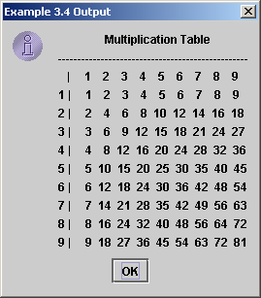
Nested Loops
Problem: Write a program that uses nested for loops to print a multiplication table.
TestMultiplicationTable

Slide 32


Which Loop to Use?
The three forms of loop statements, while, do-while, and for, are expressively equivalent; that is, you can write a loop in any of these three forms. For example, a while loop in (a) in the following figure can always be converted into the following for loop in (b):
A for loop in (a) in the following figure can generally be converted into the following while loop in (b) except in certain special cases (see Review Question 3.19 for one of them):

Slide 33
Recommendations
Use the one that is most intuitive and comfortable for you. In general, a for loop may be used if the number of repetitions is known, as, for example, when you need to print a message 100 times. A while loop may be used if the number of repetitions is not known, as in the case of reading the numbers until the input is 0. A do-while loop can be used to replace a while loop if the loop body has to be executed before testing the continuation condition.

Slide 34
Caution
Adding a semicolon at the end of the for clause before the loop body is a common mistake, as shown below:
Logic Error
for (int i=0; i<10; i++);
{
System.out.println("i is " + i);
}

Slide 35
Caution, cont.
Similarly, the following loop is also wrong:
int i=0;
while (i < 10);
{
System.out.println("i is " + i);
i++;
}
In the case of the do loop, the following semicolon is needed to end the loop.
int i=0;
do {
System.out.println("i is " + i);
i++;
} while (i<10);
Logic Error
Correct

Slide 36
Example:
Finding the Greatest Common Divisor
Problem: Write a program that prompts the user to enter two positive integers and finds their greatest common divisor.
Solution: Suppose you enter two integers 4 and 2, their greatest common divisor is 2. Suppose you enter two integers 16 and 24, their greatest common divisor is 8. So, how do you find the greatest common divisor? Let the two input integers be n1 and n2. You know number 1 is a common divisor, but it may not be the greatest commons divisor. So you can check whether k (for k = 2, 3, 4, and so on) is a common divisor for n1 and n2, until k is greater than n1 or n2.
GreatestCommonDivisor
Run

Slide 37
Example: Finding the Sales Amount
Problem: You have just started a sales job in a department store. Your pay consists of a base salary and a commission. The base salary is $5,000. The scheme shown below is used to determine the commission rate.
      Sales Amount Commission Rate
      $0.01–$5,000 8 percent
      $5,000.01–$10,000 10 percent
      $10,000.01 and above 12 percent
Your goal is to earn $30,000 in a year. Write a program that will find out the minimum amount of sales you have to generate in order to make $30,000.
FindSalesAmount
Run

Slide 38
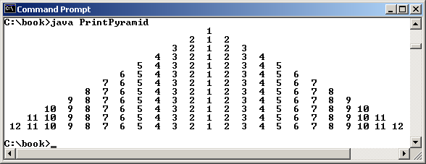
Example:
Displaying a Pyramid of Numbers
Problem: Write a program that prompts the user to enter an integer from 1 to 15 and displays a pyramid. For example, if the input integer is 12, the output is shown below.
PrintPyramid
Run

Slide 39
Using break and continue
Examples for using the break and continue keywords:
TestBreak.java
TestBreak
TestContinue.java
TestContinue

Slide 40
Example: Displaying Prime Numbers
Problem: Write a program that displays the first 50 prime numbers in five lines, each of which contains 10 numbers. An integer greater than 1 is prime if its only positive divisor is 1 or itself. For example, 2, 3, 5, and 7 are prime numbers, but 4, 6, 8, and 9 are not.
Solution: The problem can be broken into the following tasks:
  For number = 2, 3, 4, 5, 6, ..., test whether the number is prime.
  Determine whether a given number is prime.
  Count the prime numbers.
  Print each prime number, and print 10 numbers per line.
PrimeNumber
Run

Slide 41
Debugging Loops
JBuilder Optional
Programming errors often occur in loops. Debugger can help to locate the errors. You can examine the change of variables after each iteration by placing a breakpoint at the last statement inside the loop and executing the program using the Run to End of Method command.
Suppose you forgot to increment count in Line 27 in the preceding example, PrimeNumber.java. Let us trace the program using JBuilder, as follows:
1. Click the cutter of Line 41 to set a breakpoint in the last statement inside the while loop.
2. Right-click PrimeNumber.java in the project pane to display a context menu, and choose Debug Using Defaults to start the debugger. The execution is paused at the breakpoint.
3. Add variables number, count, and isPrime in the watch view. Choose Run, Run to End of Method to observe the change of variables in the watch view, as shown in the next slide. You will see that count is not changed after each iteration.

Slide 42
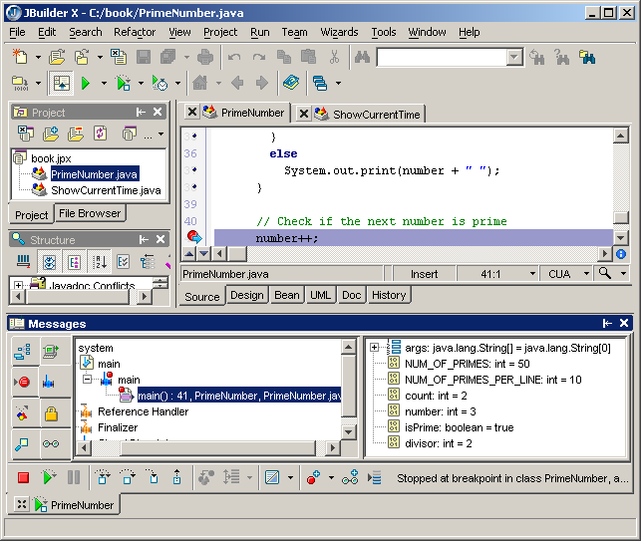
Debugging Loops
JBuilder Optional

