Slide 1
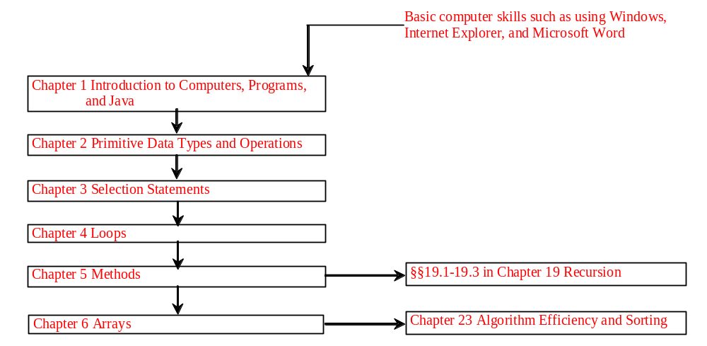
Chapter 5 Methods

Slide 2
Objectives
To declare methods, invoke methods, and pass arguments to a method (§5.2-5.4).
To use method overloading and know ambiguous overloading (§5.5).
To determine the scope of local variables (§5.6).
To learn the concept of method abstraction (§5.7).
To know how to use the methods in the Math class (§5.8).
To design and implement methods using stepwise refinement (§5.10).
To group classes into packages (§5.11 Optional).

Slide 3
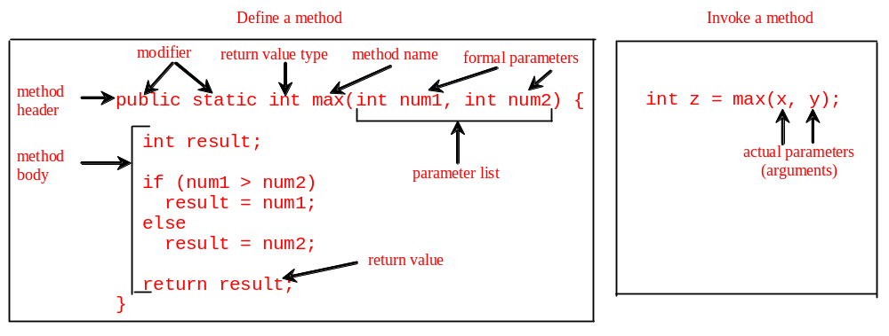
Introducing Methods
A method is a collection of statements that are grouped together to perform an operation.

Slide 4
Introducing Methods, cont.
Method signature is the combination of the method name and the parameter list.
The variables defined in the method header are known as formal parameters.
When a method is invoked, you pass a value to the parameter. This value is referred to as actual parameter or argument.

Slide 5
Introducing Methods, cont.
A method may return a value. The returnValueType is the data type of the value the method returns. If the method does not return a value, the returnValueType is the keyword void. For example, the returnValueType in the main method is void.

Slide 6

Calling Methods
Listing 5.1 Testing the max method
This program demonstrates calling a method max to return the largest of the int values
TestMax

Slide 7
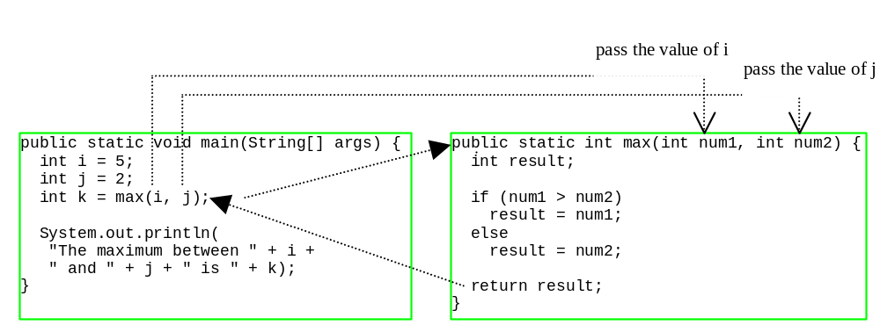
Calling Methods, cont.
animation

Slide 8

Trace Method Invocation
animation
i is now 5

Slide 9
Trace Method Invocation
animation
j is now 2

Slide 10
Trace Method Invocation
animation
invoke max(i, j)

Slide 11
Trace Method Invocation
animation
invoke max(i, j)
Pass the value of i to num1
Pass the value of j to num2

Slide 12
Trace Method Invocation
animation
declare variable result

Slide 13
Trace Method Invocation
animation
(num1 > num2) is true since num1 is 5 and num2 is 2

Slide 14
Trace Method Invocation
animation
result is now 5

Slide 15
Trace Method Invocation
animation
return result, which is 5

Slide 16
Trace Method Invocation
animation
return max(i, j) and assign the return value to k

Slide 17
Trace Method Invocation
animation
Execute the print statement

Slide 18
CAUTION
A return statement is required for a nonvoid method. The following method is logically correct, but it has a compilation error, because the Java compiler thinks it possible that this method does not return any value.
public static int sign(int n) {
if (n > 0) return 1;
else if (n == 0) return 0;
else if (n < 0) return –1;
}
To fix this problem, delete if (n<0) in the code.

Slide 19
Reuse Methods from Other Classes
NOTE: One of the benefits of methods is for reuse. The max method can be invoked from any class besides TestMax. If you create a new class Test, you can invoke the max method using ClassName.methodName (e.g., TestMax.max).

Slide 20
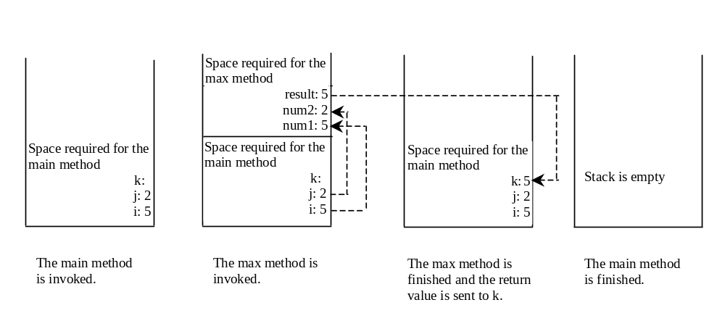
Call Stacks

Slide 21


Trace Call Stack
animation
i is declared and initialized

Slide 22
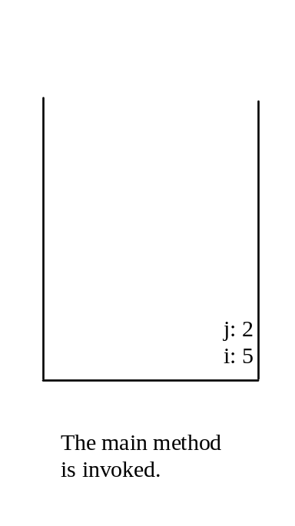
Trace Call Stack
animation
j is declared and initialized

Slide 23

Trace Call Stack
animation
Declare k

Slide 24
Trace Call Stack
animation
Invoke max(i, j)

Slide 25

Trace Call Stack
animation
pass the values of i and j to num1 and num2

Slide 26

Trace Call Stack
animation
pass the values of i and j to num1 and num2

Slide 27
Trace Call Stack
animation
(num1 > num2) is true

Slide 28

Trace Call Stack
animation
Assign num1 to result

Slide 29

Trace Call Stack
animation
Return result and assign it to k

Slide 30

Trace Call Stack
animation
Execute print statement

Slide 31
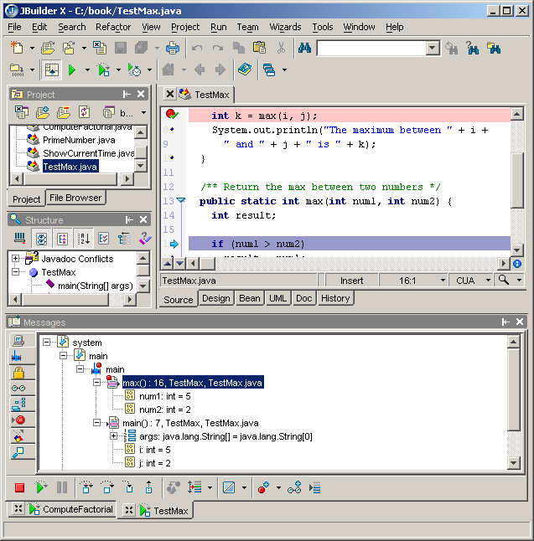
Call Stack in JBuilder Debugger
JBuilder Optional
You can see the chain of method invocations in the stack view of the JBuilder debugger.
Stack view
Invoke max
Invoke main

Slide 32
Passing Parameters
public static void nPrintln(String message, int n) {
for (int i = 0; i < n; i++)
System.out.println(message);
}
Suppose you invoke the method using
  nPrintln(“Welcome to Java”, 5);
What is the output?
Suppose you invoke the method using
  nPrintln(“Computer Science”, 15);
What is the output?

Slide 33
Pass by Value
Listing 5.2 Testing Pass by value
This program demonstrates passing values to the methods.
TestPassByValue

Slide 34
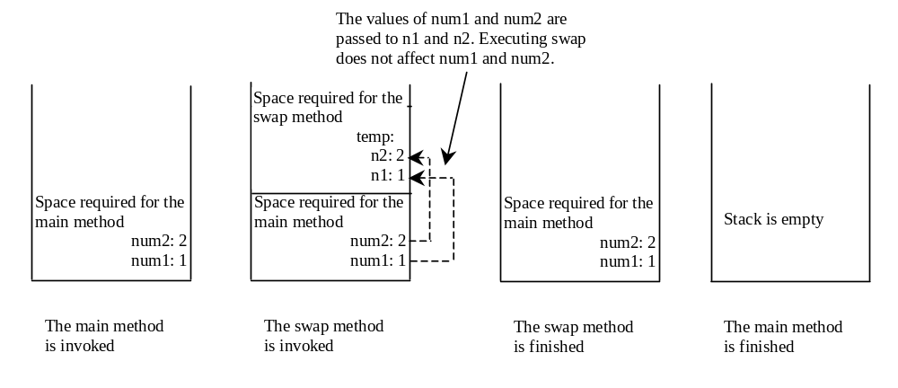
Pass by Value, cont.

Slide 35
Overloading Methods
Listing 5.3 Overloading the max Method
public static double max(double num1, double num2) {
if (num1 > num2)
return num1;
else
return num2;
}
TestMethodOverloading

Slide 36
Ambiguous Invocation
Sometimes there may be two or more possible matches for an invocation of a method, but the compiler cannot determine the most specific match. This is referred to as ambiguous invocation. Ambiguous invocation is a compilation error.

Slide 37
Ambiguous Invocation
public class AmbiguousOverloading {
public static void main(String[] args) {
System.out.println(max(1, 2));
}
public static double max(int num1, double num2) {
if (num1 > num2)
return num1;
else
return num2;
}
public static double max(double num1, int num2) {
if (num1 > num2)
return num1;
else
return num2;
}
}

Slide 38
Case Study: Computing Taxes with Methods
Listing 3.1, “Computing Taxes,” uses if statements to check the filing status and computes the tax based on the filing status. Simplify Listing 3.1 using methods. Each filing status has six brackets.
The code for computing taxes is nearly same for each filing status except that each filing status has different bracket ranges. For example, the single filer status has six brackets [0, 6000], (6000, 27950], (27950, 67700], (67700, 141250], (141250, 307050], (307050, ∞), and the married file jointly status has six brackets [0, 12000], (12000, 46700], (46700, 112850], (112850, 171950], (171950, 307050], (307050, ∞).

Slide 39
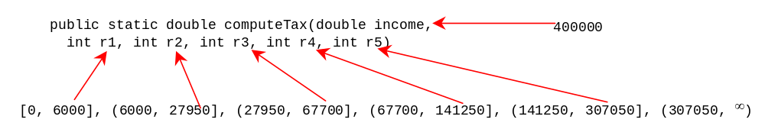
Case Study cont.
The first bracket of each filing status is taxed at 10%, the second 15%, the third 27%, the fourth 30%, the fifth 35%, and the sixth 38.6%. So you can write a method with the brackets as arguments to compute the tax for the filing status. The signature of the method is:
For example, you can invoke computeTax(400000, 6000, 27950, 67700, 141250, 307050) to compute the tax for single filers with $400,000 of taxable income:
ComputeTaxWithMethod

Slide 40
Scope of Local Variables
A local variable: a variable defined inside a method.
Scope: the part of the program where the variable can be referenced.
The scope of a local variable starts from its declaration and continues to the end of the block that contains the variable. A local variable must be declared before it can be used.

Slide 41
Scope of Local Variables, cont.
You can declare a local variable with the same name multiple times in different non-nesting blocks in a method, but you cannot declare a local variable twice in nested blocks.

Slide 42

Scope of Local Variables, cont.
A variable declared in the initial action part of a for loop header has its scope in the entire loop. But a variable declared inside a for loop body has its scope limited in the loop body from its declaration and to the end of the block that contains the variable.

Slide 43

Scope of Local Variables, cont.

Slide 44
Scope of Local Variables, cont.
// Fine with no errors
public static void correctMethod() {
int x = 1;
int y = 1;
// i is declared
for (int i = 1; i < 10; i++) {
x += i;
}
// i is declared again
for (int i = 1; i < 10; i++) {
y += i;
}
}

Slide 45
Scope of Local Variables, cont.
// With no errors
public static void incorrectMethod() {
int x = 1;
int y = 1;
for (int i = 1; i < 10; i++) {
int x = 0;
x += i;
}
}

Slide 46

Method Abstraction
You can think of the method body as a black box that contains the detailed implementation for the method.

Slide 47
Benefits of Methods
Write a method once and reuse it anywhere.
Information hiding. Hide the implementation from the user.
Reduce complexity.

Slide 48
The Math Class
Class constants:
  PI
  E
Class methods:
  Trigonometric Methods
  Exponent Methods
  Rounding Methods
  min, max, abs, and random Methods

Slide 49
Trigonometric Methods
sin(double a)
cos(double a)
tan(double a)
acos(double a)
asin(double a)
atan(double a)
Examples:
Math.sin(0) returns 0.0
Math.sin(Math.PI / 6) returns 0.5
Math.sin(Math.PI / 2) returns 1.0
Math.cos(0) returns 1.0
Math.cos(Math.PI / 6) returns 0.866
Math.cos(Math.PI / 2) returns 0
Radians
toRadians(90)

Slide 50
Exponent Methods
exp(double a)
  Returns e raised to the power of a.
log(double a)
  Returns the natural logarithm of a.
log10(double a)
  Returns the 10-based logarithm of a.
pow(double a, double b)
  Returns a raised to the power of b.
sqrt(double a)
  Returns the square root of a.
Examples:
Math.exp(1) returns 2.71
Math.log(2.71) returns 1.0
Math.pow(2, 3) returns 8.0
Math.pow(3, 2) returns 9.0
Math.pow(3.5, 2.5) returns 22.91765
Math.sqrt(4) returns 2.0
Math.sqrt(10.5) returns 3.24

Slide 51
Rounding Methods
double ceil(double x)
  x rounded up to its nearest integer. This integer is returned as a double value.
double floor(double x)
  x is rounded down to its nearest integer. This integer is returned as a double value.
double rint(double x)
  x is rounded to its nearest integer. If x is equally close to two integers, the even one is returned as a double.
int round(float x)
  Return (int)Math.floor(x+0.5).
long round(double x)
  Return (long)Math.floor(x+0.5).

Slide 52
Rounding Methods Examples
Math.ceil(2.1) returns 3.0
Math.ceil(2.0) returns 2.0
Math.ceil(-2.0) returns –2.0
Math.ceil(-2.1) returns -2.0
Math.floor(2.1) returns 2.0
Math.floor(2.0) returns 2.0
Math.floor(-2.0) returns –2.0
Math.floor(-2.1) returns -3.0
Math.rint(2.1) returns 2.0
Math.rint(2.0) returns 2.0
Math.rint(-2.0) returns –2.0
Math.rint(-2.1) returns -2.0
Math.rint(2.5) returns 2.0
Math.rint(-2.5) returns -2.0
Math.round(2.6f) returns 3
Math.round(2.0) returns 2
Math.round(-2.0f) returns -2
Math.round(-2.6) returns -3

Slide 53
min, max, and abs
max(a, b)and min(a, b)
  Returns the maximum or minimum of two parameters.
abs(a)
  Returns the absolute value of the parameter.
random()
  Returns a random double value
  in the range [0.0, 1.0).
Examples:
Math.max(2, 3) returns 3
Math.max(2.5, 3) returns 3.0
Math.min(2.5, 3.6) returns 2.5
Math.abs(-2) returns 2
Math.abs(-2.1) returns 2.1

Slide 54

The random Method
Generates a random double value greater than or equal to 0.0 and less than 1.0 (0 <= Math.random() < 1.0).
Examples:
In general,

Slide 55
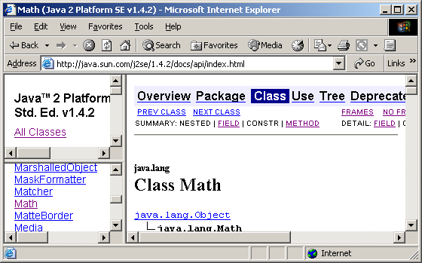
View java.lang.Math Documentation
JBuilder Optional
You can view the complete documentation for the Math class online from http://java.sun.com/j2se/1.5.2/docs/api/index.htm.

Slide 56
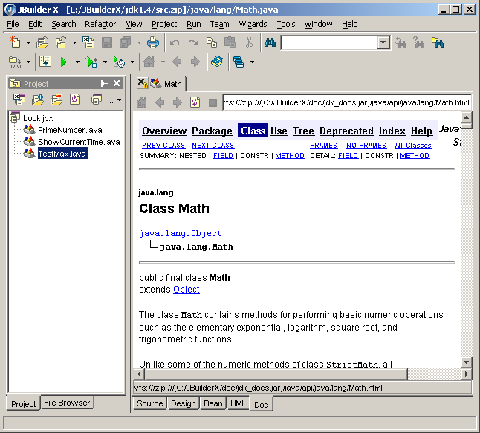
View java.lang.Math from JBuilder
JBuilder Optional
You can view the complete documentation for the Math class in JBuilder by choosing Search, Find Classes to display the Find Classes dialog box. Type java.lang.Math in the Class name field to display the documentation of the Math class in the content pane.

Slide 57
Case Study: Generating Random Characters
Computer programs process numerical data and characters. You have seen many examples that involve numerical data. It is also important to understand characters and how to process them.
As introduced in Section 2.9, each character has a unique Unicode between 0 and FFFF in hexadecimal (65535 in decimal). To generate a random character is to generate a random integer between 0 and 65535 using the following expression: (note that since 0 <= Math.random() < 1.0, you have to add 1 to 65535.)
  (int)(Math.random() * (65535 + 1))

Slide 58
Case Study: Generating Random Characters, cont.
Now let us consider how to generate a random lowercase letter. The Unicode for lowercase letters are consecutive integers starting from the Unicode for 'a', then for 'b', 'c', ..., and 'z'. The Unicode for 'a' is
  (int)'a'
So, a random integer between (int)'a' and (int)'z' is
  (int)((int)'a' + Math.random() * ((int)'z' - (int)'a' + 1)

Slide 59
Case Study: Generating Random Characters, cont.
Now let us consider how to generate a random lowercase letter. The Unicode for lowercase letters are consecutive integers starting from the Unicode for 'a', then for 'b', 'c', ..., and 'z'. The Unicode for 'a' is
  (int)'a'
So, a random integer between (int)'a' and (int)'z' is
  (int)((int)'a' + Math.random() * ((int)'z' - (int)'a' + 1)

Slide 60
Case Study: Generating Random Characters, cont.
As discussed in Section 2.9.4, all numeric operators can be applied to the char operands. The char operand is cast into a number if the other operand is a number or a character. So, the preceding expression can be simplified as follows:
  'a' + Math.random() * ('z' - 'a' + 1)
So a random lowercase letter is
  (char)('a' + Math.random() * ('z' - 'a' + 1))

Slide 61
Case Study: Generating Random Characters, cont.
To generalize the foregoing discussion, a random character between any two characters ch1 and ch2 with ch1 < ch2 can be generated as follows:
  (char)(ch1 + Math.random() * (ch2 – ch1 + 1))

Slide 62
The RandomCharacter Class
// RandomCharacter.java: Generate random characters
public class RandomCharacter {
/** Generate a random character between ch1 and ch2 */
public static char getRandomCharacter(char ch1, char ch2) {
return (char)(ch1 + Math.random() * (ch2 - ch1 + 1));
}
/** Generate a random lowercase letter */
public static char getRandomLowerCaseLetter() {
return getRandomCharacter('a', 'z');
}
/** Generate a random uppercase letter */
public static char getRandomUpperCaseLetter() {
return getRandomCharacter('A', 'Z');
}
/** Generate a random digit character */
public static char getRandomDigitCharacter() {
return getRandomCharacter('0', '9');
}
/** Generate a random character */
public static char getRandomCharacter() {
return getRandomCharacter('\u0000', '\uFFFF');
}
}

Slide 63
Stepwise Refinement (Optional)
The concept of method abstraction can be applied to the process of developing programs. When writing a large program, you can use the “divide and conquer” strategy, also known as stepwise refinement, to decompose it into subproblems. The subproblems can be further decomposed into smaller, more manageable problems.
PrintCalendar

Slide 64
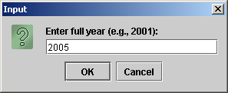
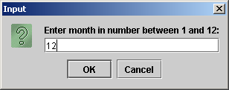
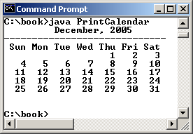
PrintCalender Case Study
Let us use the PrintCalendar example to demonstrate the stepwise refinement approach.

Slide 65

Design Diagram

Slide 66
Implementation: Top-Down
Top-down approach is to implement one method in the structure chart at a time from the top to the bottom. Stubs can be used for the methods waiting to be implemented. A stub is a simple but incomplete version of a method. The use of stubs enables you to test invoking the method from a caller. Implement the main method first and then use a stub for the printMonth method. For example, let printMonth display the year and the month in the stub. Thus, your program may begin like this:
A Skeleton for printCalendar

Slide 67
Implementation: Bottom-Up
Bottom-up approach is to implement one method in the structure chart at a time from the bottom to the top. For each method implemented, write a test program to test it. Both top-down and bottom-up methods are fine. Both approaches implement the methods incrementally and help to isolate programming errors and makes debugging easy. Sometimes, they can be used together.

Slide 68
Package
Optional
There are three reasons for using packages:
To avoid naming conflicts. When you develop reusable classes to be shared by other programmers, naming conflicts often occur. To prevent this, put your classes into packages so that they can be referenced through package names.
To distribute software conveniently. Packages group related classes so that they can be easily distributed.
To protect classes. Packages provide protection so that the protected members of the classes are accessible to the classes in the same package, but not to the external classes.

Slide 69
Package-Naming Conventions
Packages are hierarchical, and you can have packages within packages. For example, java.lang.Math indicates that Math is a class in the package lang and that lang is a package in the package java. Levels of nesting can be used to ensure the uniqueness of package names.
Choosing a unique name is important because your package may be used on the Internet by other programs. Java designers recommend that you use your Internet domain name in reverse order as a package prefix. Since Internet domain names are unique, this prevents naming conflicts. Suppose you want to create a package named mypackage on a host machine with the Internet domain name prenhall.com. To follow the naming convention, you would name the entire package com.prenhall.mypackage. By convention, package names are all in lowercase.

Slide 70

Package Directories
Java expects one-to-one mapping of the package name and the file system directory structure. For the package named com.prenhall.mypackage, you must create a directory, as shown in the figure. In other words, a package is actually a directory that contains the bytecode of the classes.
com.prenhall.mypackage
The com directory does not have to be the root directory. In order for Java to know where your package is in the file system, you must modify the environment variable classpath so that it points to the directory in which your package resides.

Slide 71
Setting classpath Environment
The com directory does not have to be the root directory. In order for Java to know where your package is in the file system, you must modify the environment variable classpath so that it points to the directory in which your package resides.
Suppose the com directory is under c:\book. The following line adds c:\book into the classpath:
  classpath=.;c:\book;
The period (.) indicating the current directory is always in classpath. The directory c:\book is in classpath so that you can use the package com.prenhall.mypackage in the program.

Slide 72
Setting Paths in JBuilder
Optional for JBuilder
An IDE such as JBuilder uses the source directory path to specify where the source files are stored and uses the class directory path to specify where the compiled class files are stored.
A source file must be stored in a package directory under the source directory path. For example, if the source directory is c:\mysource and the package statement in the source code is package com.prenhall.mypackage, then the source code file must be stored in c:\mysource\com\prenhall\mypackage.
A class file must be stored in a package directory under the class directory path. For example, if the class directory is c:\myclass and the package statement in the source code is package com.prenhall.mypackage, then the class file must be stored in c:\myclass\com\prenhall\mypackage.

Slide 73
Putting Classes into Packages
Every class in Java belongs to a package. The class is added to the package when it is compiled. All the classes that you have used so far in this book were placed in the current directory (a default package) when the Java source programs were compiled. To put a class in a specific package, you need to add the following line as the first noncomment and nonblank statement in the program:
  package packagename;

Slide 74
Listing 5.8 Putting Classes into Packages
Problem
This example creates a class named Format and places it in the package com.prenhall.mypackage. The Format class contains the format(number, numOfDecimalDigits) method that returns a new number with the specified number of digits after the decimal point. For example, format(10.3422345, 2) returns 10.34, and format(-0.343434, 3) returns –0.343.
Solution
1. Create Format.java as follows and save it into c:\book\com\prenhall\mypackage.
  // Format.java: Format number.
  package com.prenhall.mypackage;
  public class Format {
  public static double format(
  double number, int numOfDecimalDigits) {
  return Math.round(number * Math.pow(10, numOfDecimalDigits)) /
  Math.pow(10, numOfDecimalDigits);
  }
  }
2. Compile Format.java. Make sure Format.class is in c:\book\com\prenhall\mypackage.

Slide 75
Using Classes from Packages
There are two ways to use classes from a package.
One way is to use the fully qualified name of the class. For example, the fully qualified name for JOptionPane is javax.swing.JOptionPane. For Format in the preceding example, it is com.prenhall.mypackage.Format. This is convenient if the class is used a few times in the program.
The other way is to use the import statement. For example, to import all the classes in the javax.swing package, you can use
import javax.swing.*;
An import that uses a * is called an import on demand declaration. You can also import a specific class. For example, this statement imports javax.swing.JOptionPane:
  import javax.swing.JOptionPane;
The information for the classes in an imported package is not read in at compile time or runtime unless the class is used in the program. The import statement simply tells the compiler where to locate the classes.

Slide 76
Listing 5.9 Using Packages
Problem
This example shows a program that uses the Format class in the com.prenhall.mypackage.mypackage package.
Solution
1. Create TestFormatClass.java as follows and save it into c:\book.
The following code gives the solution to the problem.
  // TestFormatClass.java: Demonstrate using the Format class
  import com.prenhall.mypackage.Format;
  public class TestFormatClass {
  /** Main method */
  public static void main(String[] args) {
  System.out.println(Format.format(10.3422345, 2));
  System.out.println(Format.format(-0.343434, 3));
  }
  }

