Slide 1

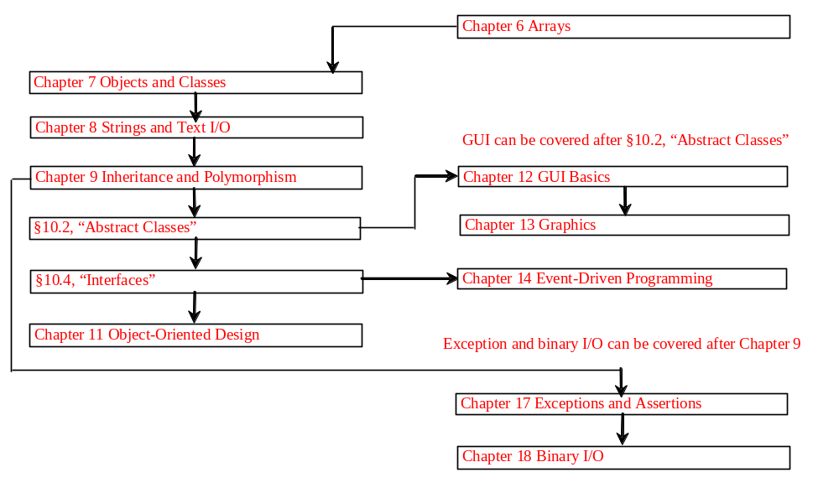
Chapter 8 Strings and Text I/O

Slide 2
Objectives
To use the String class to process fixed strings (§8.2).
To use the Character class to process a single character (§8.3).
To use the StringBuilder/StringBuffer class to process flexible strings (§8.4).
To know the differences between the String, StringBuilder, and StringBuffer classes (§8.2-8.4).
To learn how to pass strings to the main method from the command line (§8.5).
(Optional) To use the regular expressions to represent patterns for matching, replacing, and splitting strings (§8.6).
To discover file properties, delete and rename files using the File class (§8.7).
To write data to a file using the PrintWriter class (§8.8.1).
To read data from a file using the Scanner class (§8.8.2).
(Optional GUI) To add components to a frame (§8.9).

Slide 3
The String Class
Constructing a String:
  String message = "Welcome to Java“;
  String message = new String("Welcome to Java“);
  String s = new String();
Obtaining String length and Retrieving Individual Characters in a string
String Concatenation (concat)
Substrings (substring(index), substring(start, end))
Comparisons (equals, compareTo)
String Conversions
Finding a Character or a Substring in a String
Conversions between Strings and Arrays
Converting Characters and Numeric Values to Strings

Slide 4
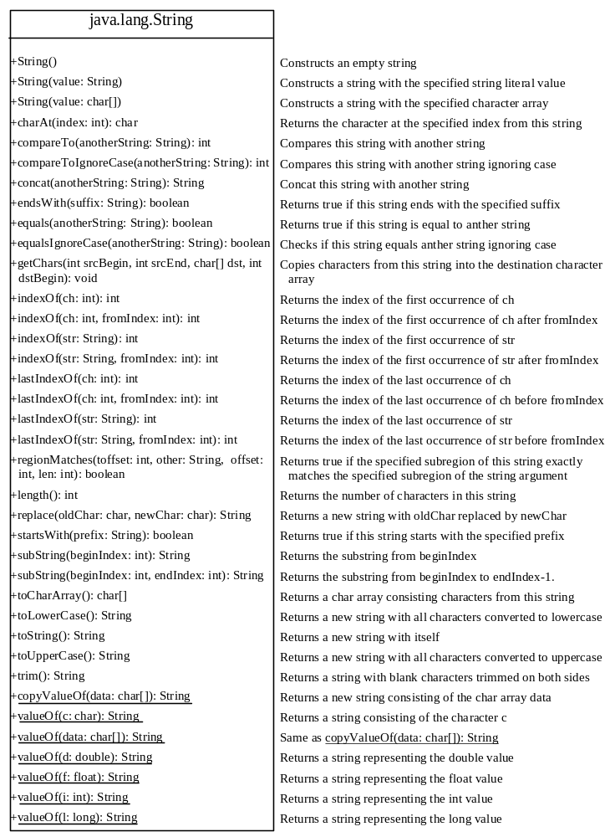

Slide 5
Constructing Strings
String newString = new String(stringLiteral);
String message = new String("Welcome to Java");
Since strings are used frequently, Java provides a shorthand initializer for creating a string:
String message = "Welcome to Java";

Slide 6
Strings Are Immutable
A String object is immutable; its contents cannot be changed. Does the following code change the contents of the string?
String s = "Java";
s = "HTML";

Slide 7

Trace Code
animation
String s = "Java";
s = "HTML";

Slide 8
Trace Code
animation
String s = "Java";
s = "HTML";

Slide 9
Interned Strings
Since strings are immutable and are frequently used, to improve efficiency and save memory, the JVM uses a unique instance for string literals with the same character sequence. Such an instance is called interned. You can also use a String object’s intern method to return an interned string. For example, the following statements:

Slide 10
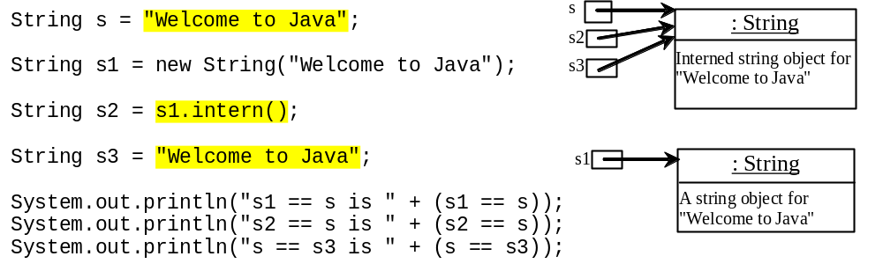
Examples
display
s1 == s is false
s2 == s is true
s == s3 is true
A new object is created if you use the new operator.
If you use the string initializer, no new object is created if the interned object is already created.

Slide 11
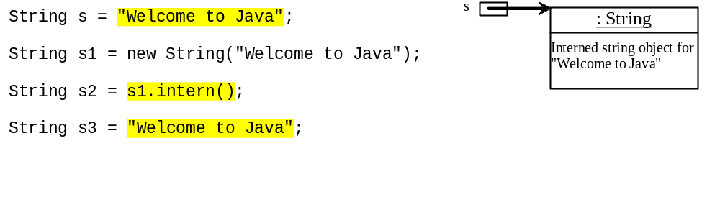
Trace Code
animation

Slide 12
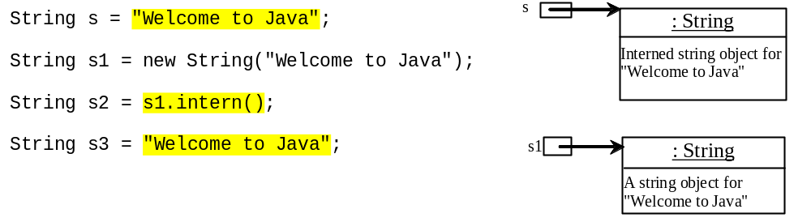
Trace Code

Slide 13
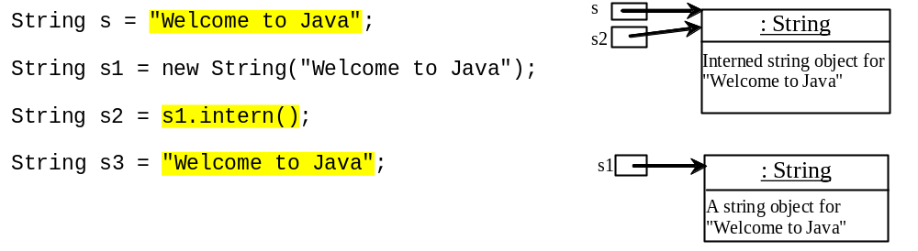
Trace Code

Slide 14
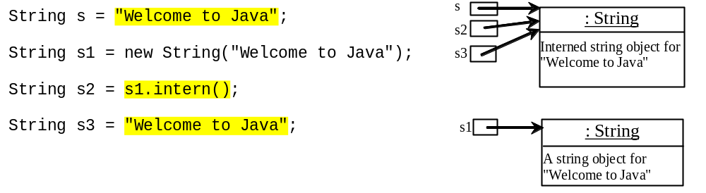
Trace Code

Slide 15
Finding String Length
Finding string length using the length() method:
message = "Welcome";
message.length() (returns 7)

Slide 16
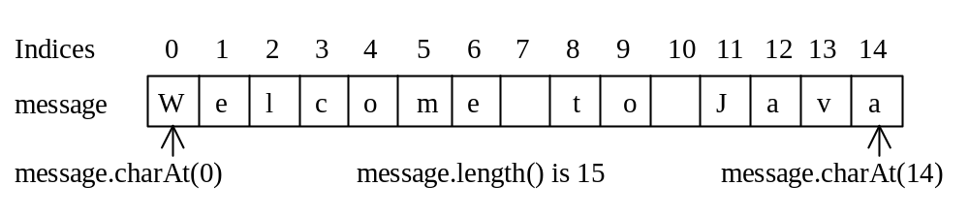
Retrieving Individual Characters in a String
Do not use message[0]
Use message.charAt(index)
Index starts from 0

Slide 17
String Concatenation
String s3 = s1.concat(s2);
String s3 = s1 + s2;
s1 + s2 + s3 + s4 + s5 same as
(((s1.concat(s2)).concat(s3)).concat(s4)).concat(s5);

Slide 18
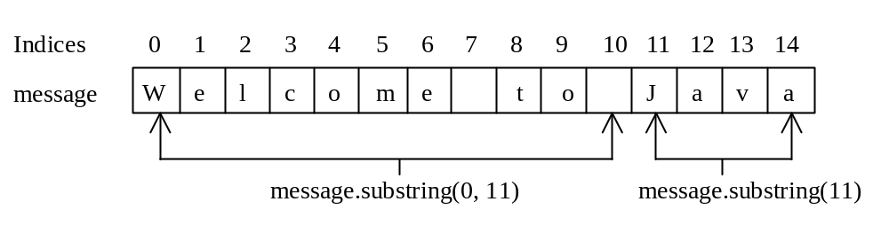
Extracting Substrings
You can extract a single character from a string using the charAt method. You can also extract a substring from a string using the substring method in the String class.
String s1 = "Welcome to Java";
String s2 = s1.substring(0, 11) + "HTML";

Slide 19
String Comparisons
equals
String s1 = new String("Welcome“);
String s2 = "welcome";
if (s1.equals(s2)){
// s1 and s2 have the same contents
}
if (s1 == s2) {
// s1 and s2 have the same reference
}

Slide 20
String Comparisons, cont.
compareTo(Object object)
String s1 = new String("Welcome“);
String s2 = "welcome";
if (s1.compareTo(s2) > 0) {
// s1 is greater than s2
}
else if (s1.compareTo(s2) == 0) {
// s1 and s2 have the same contents
}
else
// s1 is less than s2

Slide 21
String Conversions
The contents of a string cannot be changed once the string is created. But you can convert a string to a new string using the following methods:
toLowerCase
toUpperCase
trim
replace(oldChar, newChar)

Slide 22
Finding a Character or a Substring in a String
"Welcome to Java".indexOf('W') returns 0.
"Welcome to Java".indexOf('x') returns -1.
"Welcome to Java".indexOf('o', 5) returns 9.
"Welcome to Java".indexOf("come") returns 3.
"Welcome to Java".indexOf("Java", 5) returns 11.
"Welcome to Java".indexOf("java", 5) returns -1.
"Welcome to Java".lastIndexOf('a') returns 14.

Slide 23
Convert Character and Numbers to Strings
The String class provides several static valueOf methods for converting a character, an array of characters, and numeric values to strings. These methods have the same name valueOf with different argument types char, char[], double, long, int, and float. For example, to convert a double value to a string, use String.valueOf(5.44). The return value is string consists of characters ‘5’, ‘.’, ‘4’, and ‘4’.

Slide 24
Example:
Finding Palindromes
Objective: Checking whether a string is a palindrome: a string that reads the same forward and backward.
CheckPalindrome
Run

Slide 25
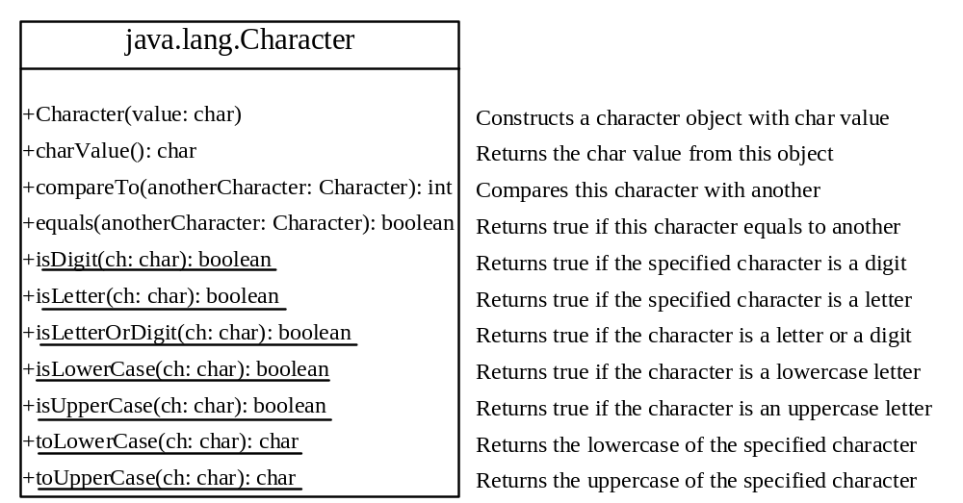
The Character Class

Slide 26
Examples
Character charObject = new Character('b');
charObject.compareTo(new Character('a')) returns 1
charObject.compareTo(new Character('b')) returns 0
charObject.compareTo(new Character('c')) returns -1
charObject.compareTo(new Character('d') returns –2
charObject.equals(new Character('b')) returns true
charObject.equals(new Character('d')) returns false

Slide 27
Example: Counting Each Letter in a String
This example gives a program that counts the number of occurrence of each letter in a string. Assume the letters are not case-sensitive.
CountEachLetter
Run

Slide 28
StringBuilder and StringBuffer
The StringBuilder/StringBuffer class is an alternative to the String class. In general, a StringBuilder/StringBuffer can be used wherever a string is used. StringBuilder/StringBuffer is more flexible than String. You can add, insert, or append new contents into a string buffer, whereas the value of a String object is fixed once the string is created.

Slide 29
StringBuilder vs. StringBuffer
The StringBuilder class, introduced in JDK 1.5, is similar to StringBuffer except that the update methods in StringBuffer are synchronized. Use StringBuffer if it may be accessed by multiple tasks concurrently. Using StringBuilder is more efficient if it is accessed by a single task. The constructors and methods in StringBuffer and StringBuilder are almost the same.
This book covers StringBuffer. You may replace StringBuffer by StringBuilder. The program can compile and run without any other changes.

Slide 30
The StringBuffer Class
The StringBuffer class is an alternative to the String class. In general, a string buffer can be used wherever a string is used.
StringBuffer is more flexible than String. You can add, insert, or append new contents
into a string buffer. However, the value of
a String object is fixed once the string is created.

Slide 31
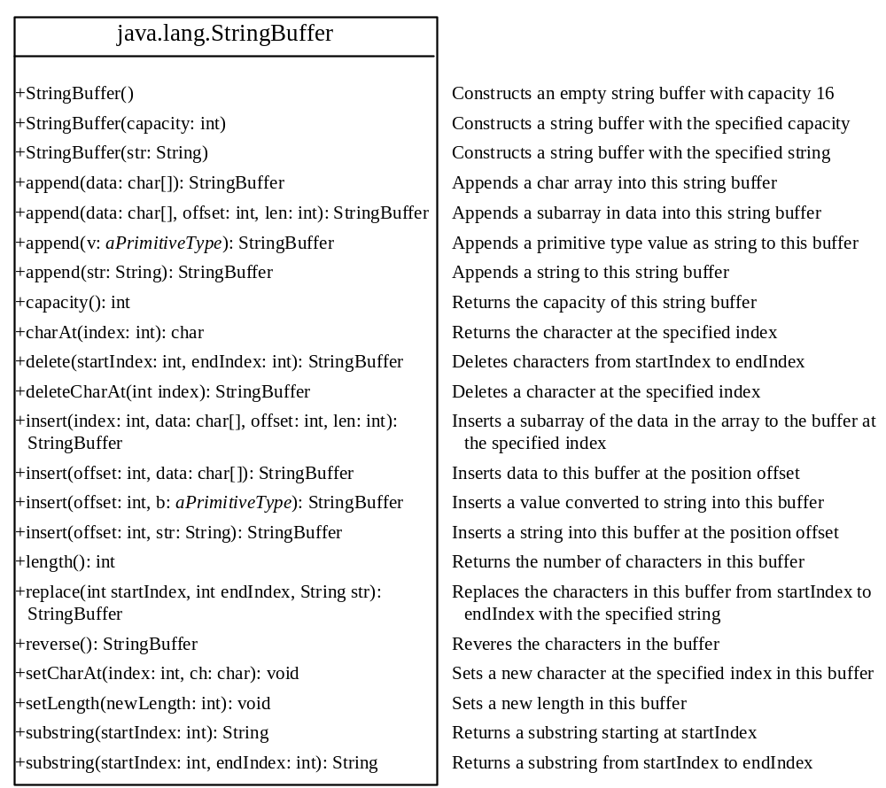

Slide 32
StringBuffer Constructors
public StringBuffer()
No characters, initial capacity 16 characters.
public StringBuffer(int length)
No characters, initial capacity specified by the length argument.
public StringBuffer(String str)
Represents the same sequence of characters
as the string argument. Initial capacity 16
plus the length of the string argument.

Slide 33
Appending New Contents into a String Buffer
StringBuffer strBuf = new StringBuffer();
strBuf.append("Welcome");
strBuf.append(' ');
strBuf.append("to");
strBuf.append(' ');
strBuf.append("Java");

Slide 34
Example:
Checking Palindromes Ignoring Non-alphanumeric Characters
This example gives a program that counts the number of occurrence of each letter in a string. Assume the letters are not case-sensitive.
PalindromeIgnoreNonAlphanumeric
Run

Slide 35
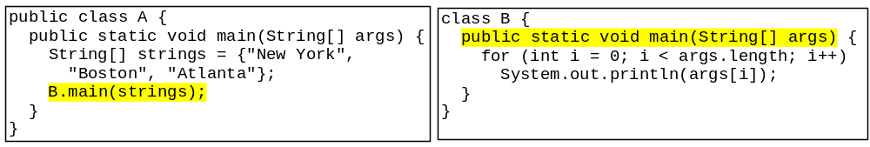
Main Method Is Just a Regular Method
You can call a regular method by passing actual parameters. Can you pass arguments to main? Of course, yes. For example, the main method in class B is invoked by a method in A, as shown below:

Slide 36
Command-Line Parameters
class TestMain {
public static void main(String[] args) {
...
}
}
java TestMain arg0 arg1 arg2 ... argn

Slide 37
Processing
Command-Line Parameters
In the main method, get the arguments from args[0], args[1], ..., args[n], which corresponds to arg0, arg1, ..., argn in the command line.
Notes:
Example 12.4

Slide 38
Example: Using Command-Line Parameters
Objective: Write a program that will perform binary operations on integers. The program receives three parameters: an operator and two integers.
java Calculator 2 + 3
Calculator
java Calculator 2 - 3
Run
java Calculator 2 / 3
java Calculator 2 “*” 3

Slide 39
Pedagogical NOTE
The previous edition of this book introduced the StringTokenizer class for extracting tokens from a string. Using regular expressions is more powerful and flexible than StringTokenizer for splitting strings. Therefore, StringTokenizer is obsolete.

Slide 40
Regular Expressions
Optional
A regular expression (abbreviated regex) is a string that describes a pattern for matching a set of strings. Regular expression is a powerful tool for string manipulations. You can use regular expressions for matching, replacing, and splitting strings.

Slide 41
Matching Strings
Optional
"Java".matches("Java");
"Java".equals("Java");
"Java is fun".matches("Java.*")
"Java is cool".matches("Java.*")
"Java is powerful".matches("Java.*")

Slide 42
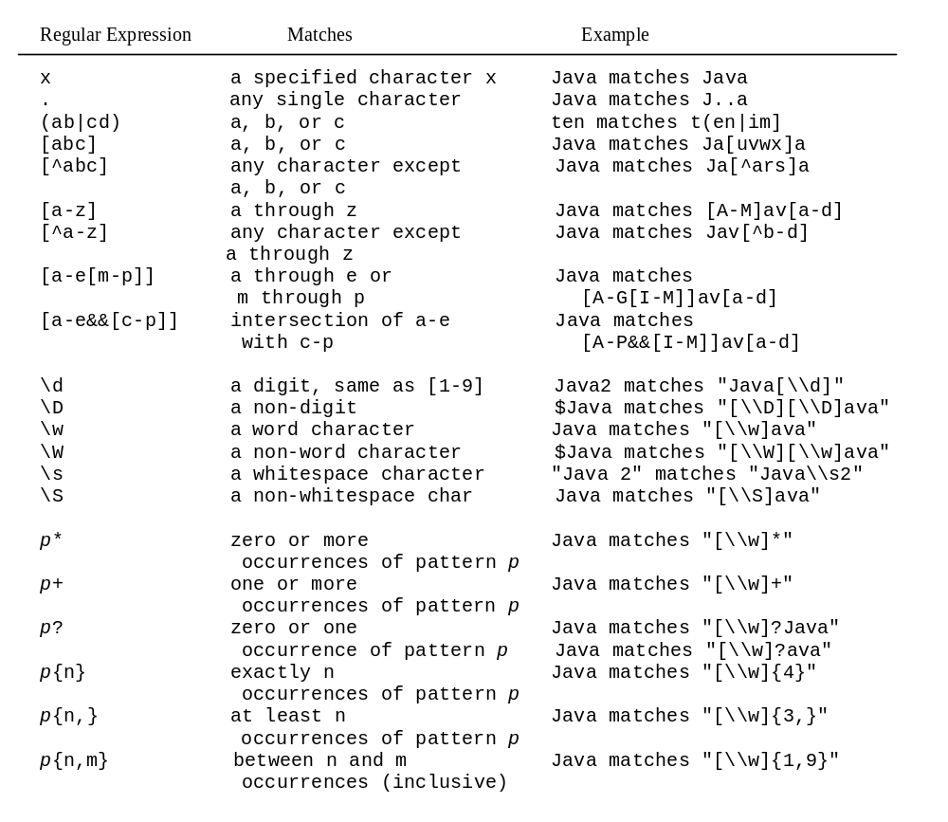
Regular Expression Syntax
Optional

Slide 43
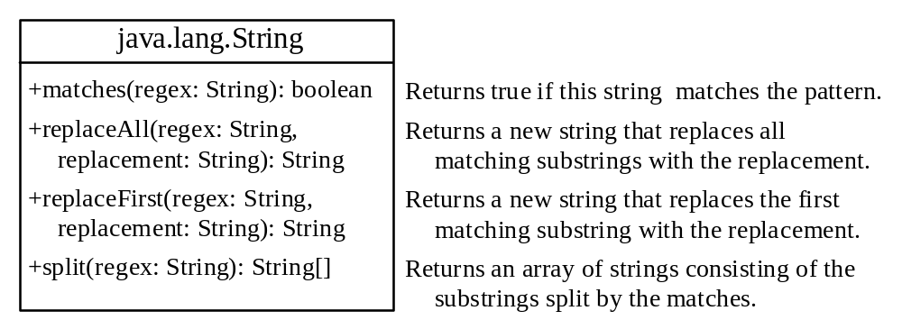
Replacing and Splitting Strings
Optional

Slide 44
Examples
String s = "Java Java Java".replaceAll("v\\w", "wi") ;
String s = "Java Java Java".replaceFirst("v\\w", "wi") ;
String[] s = "Java1HTML2Perl".split("\\d");

Slide 45
Pedagogical NOTE
The previous edition of this book introduced text I/O using many subclasses of java.io.Writer and java.io.Reader. These classes are lower-level and difficult to learn. The java.util.PrintWriter and java.util.Scanner classes are higher-level and easy to use. All the programs written using the lower-level text I/O classes can be revised using the PrintWriter and Scanner classes. Therefore, the PrintWriter and Scanner classes supersede the lower-level text I/O classes. If students need to know these lower-level text I/O classes, please refer to Supplement V.I, “Text I/O Using Reader and Writer.”

Slide 46
The File Class
The File class is intended to provide an abstraction that deals with most of the machine-dependent complexities of files and path names in a machine-independent fashion. The filename is a string. The File class is a wrapper class for the file name and its directory path.

Slide 47
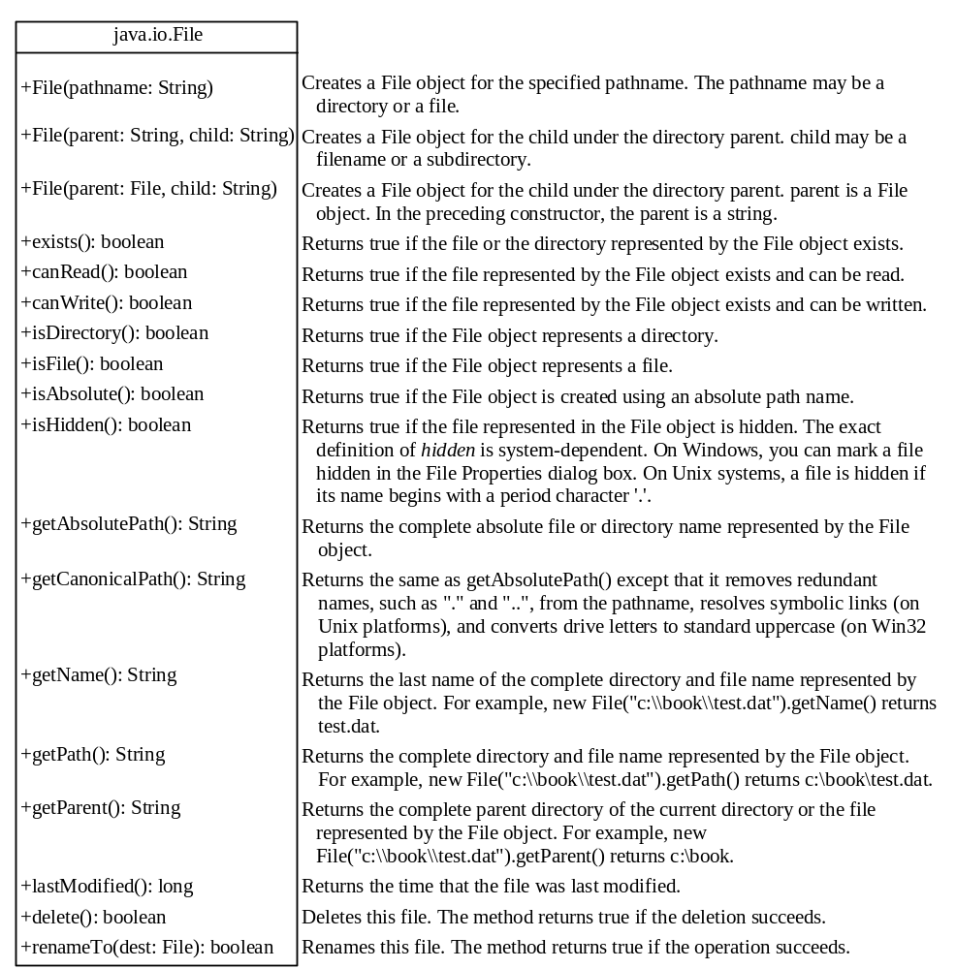
Obtaining file properties and manipulating file

Slide 48


Example: Using the File Class
Objective: Write a program that demonstrates how to create files in a platform-independent way and use the methods in the File class to obtain their properties. Figure 16.1 shows a sample run of the program on Windows, and Figure 16.2 a sample run on Unix.
TestFileClass
Run

Slide 49
Text I/O
A File object encapsulates the properties of a file or a path, but does not contain the methods for reading/writing data from/to a file. In order to perform I/O, you need to create objects using appropriate Java I/O classes. The objects contain the methods for reading/writing data from/to a file. This section introduces how to read/write strings and numeric values from/to a text file using the Scanner and PrintWriter classes.

Slide 50

Writing Data Using PrintWriter
WriteData
Run

Slide 51
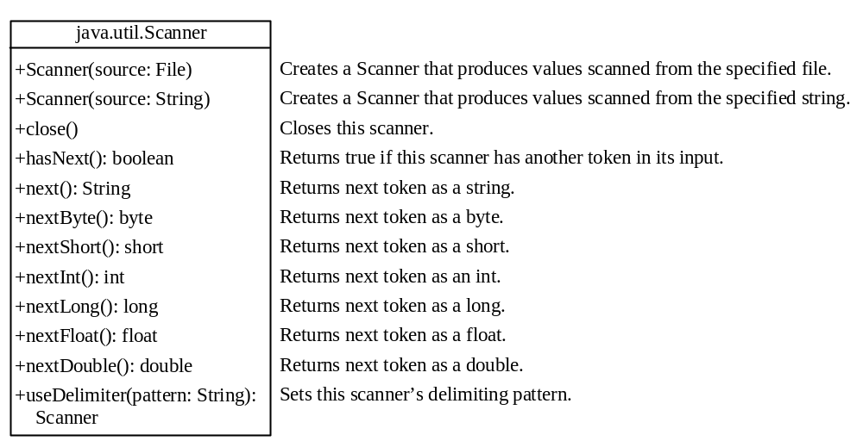
Reading Data Using Scanner
ReadData
Run

Slide 52
Example: Replacing Text
Write a class named ReplaceText that replaces a string in a text file with a new string. The filename and strings are passed as command-line arguments as follows:
  java ReplaceText sourceFile targetFile oldString newString
For example, invoking
  java ReplaceText FormatString.java t.txt StringBuilder StringBuffer
replaces all the occurrences of StringBuilder by StringBuffer in FormatString.java and saves the new file in t.txt.
ReplaceText
Run

Slide 53
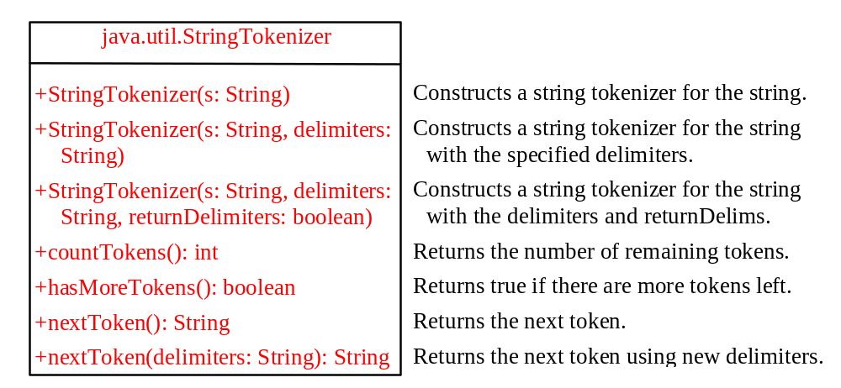
The StringTokenizer Class

Slide 54
Examples 1
  String s = "Java is cool.";
  StringTokenizer tokenizer = new StringTokenizer(s);
  System.out.println("The total number of tokens is " +
  tokenizer.countTokens());
  while (tokenizer.hasMoreTokens())
  System.out.println(tokenizer.nextToken());
The code displays
    The total number of tokens is 3
    Java
    is
    cool.

Slide 55
Examples 2
  String s = "Java is cool.";
  StringTokenizer tokenizer = new StringTokenizer(s, "ac");
  System.out.println("The total number of tokens is " +
  tokenizer.countTokens());
  while (tokenizer.hasMoreTokens())
  System.out.println(tokenizer.nextToken());
The code displays
    The total number of tokens is 4
    J
    v
    is
    ool.

Slide 56
Examples 3
  String s = "Java is cool.";
  StringTokenizer tokenizer = new StringTokenizer(s, "ac", ture);
  System.out.println("The total number of tokens is " +
  tokenizer.countTokens());
  while (tokenizer.hasMoreTokens())
  System.out.println(tokenizer.nextToken());
The code displays
    The total number of tokens is 7
    J
    a
    v
    a
    is
    c
    ool.

Slide 57
No no-arg Constructor in StringTokenizer
The StringTokenizer class does not have a no-arg constructor. Normally it is a good programming practice to provide a no-arg constructor for each class. On rare occasions, however, a no-arg constructor does not make sense. StringTokenizer is such an example. A StringTokenizer object must be created for a string, which should be passed as an argument from a constructor.

Slide 58
The Scanner Class
JDK 1.5
Feature
The delimiters are single characters in StringTokenizer. You can use the new JDK 1.5 java.util.Scanner class to specify a word as a delimiter.
String s = "Welcome to Java! Java is fun! Java is cool!";
Scanner scanner = new Scanner(s);
scanner.useDelimiter("Java");
while (scanner.hasNext())
System.out.println(scanner.next());
Creates an instance of Scanner for the string.
Sets “Java” as a delimiter.
hasNext() returns true if there are still more tokens left.
The next() method returns a token as a string.
Welcome to
!
is fun!
is cool!
Output

Slide 59
Scanning Primitive Type Values
JDK 1.5
Feature
If a token is a primitive data type value, you can use the methods nextByte(), nextShort(), nextInt(), nextLong(), nextFloat(), nextDouble(), or nextBoolean() to obtain it. For example, the following code adds all numbers in the string. Note that the delimiter is space by default.
String s = "1 2 3 4";
Scanner scanner = new Scanner(s);
int sum = 0;
while (scanner.hasNext())
sum += scanner.nextInt();
System.out.println("Sum is " + sum);

Slide 60
Console Input Using Scanner
JDK 1.5
Feature
Another important application of the Scanner class is to read input from the console. For example, the following code reads an int value from the keyboard:
System.out.print("Please enter an int value: ");
Scanner scanner = new Scanner(System.in);
int i = scanner.nextInt();
NOTE: StringTokenizer can specify several single characters as delimiters. Scanner can use a single character or a word as the delimiter. So, if you need to scan a string with multiple single characters as delimiters, use StringTokenizer. If you need to use a word as the delimiter, use Scanner.

Slide 61
Containers and Layout Managers
Optional
GUI
Objective: Add a button to the frame.
HoldComponents
Run

Slide 62
Using FlowLayout Manager
Optional
GUI
Objective: Add a button to the frame of FlowLayout.
UseFlowLayout
Run

Slide 63
Adding Multiple Components
Optional
GUI
Objective: Add two buttons to the frame of FlowLayout.
TwoButtons
Run

