Slide 1

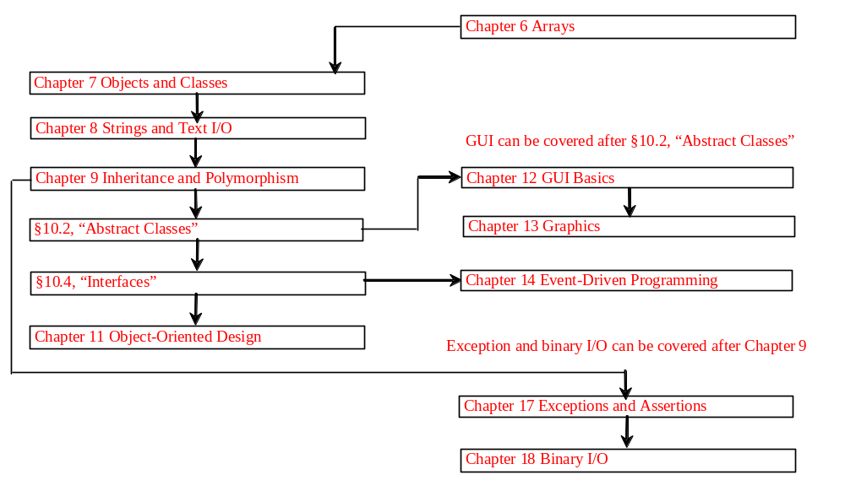

Chapter 9 Inheritance and Polymorphism

Slide 2
Objectives
    To develop a subclass from a superclass through inheritance (§9.2).
    To invoke the superclass’s constructors and methods using the super keyword (§9.3).
    To override methods in the subclass (§9.4).
    To distinguish differences between overriding and overloading (§9.5).
    To explore the useful methods (equals(Object), hashCode(), toString(), finalize(), clone(), and getClass()) in the Object class (§9.6, §9.13 optional).
    To comprehend polymorphism, dynamic binding, and generic programming (§9.7).
    To describe casting and explain why explicit downcasting is necessary (§9.8).
    To store, retrieve, and manipulates objects in an ArrayList (§9.9).
    To implement a Stack class using ArrayList (§9.10).
    To restrict access to data and methods using the protected visibility modifier (§9.11).
    To declare constants, unmodifiable methods, and nonextendable classes using the final modifier (§9.12).
    (Optional) To understand the effect of hiding data fields and static methods (§9.14).
    (Optional) To initialize data using initialization blocks and to distinguish between instance initialization and static initialization blocks (§9.15).
    (Optional GUI) To use inheritance in GUI programming (§9.16).

Slide 3
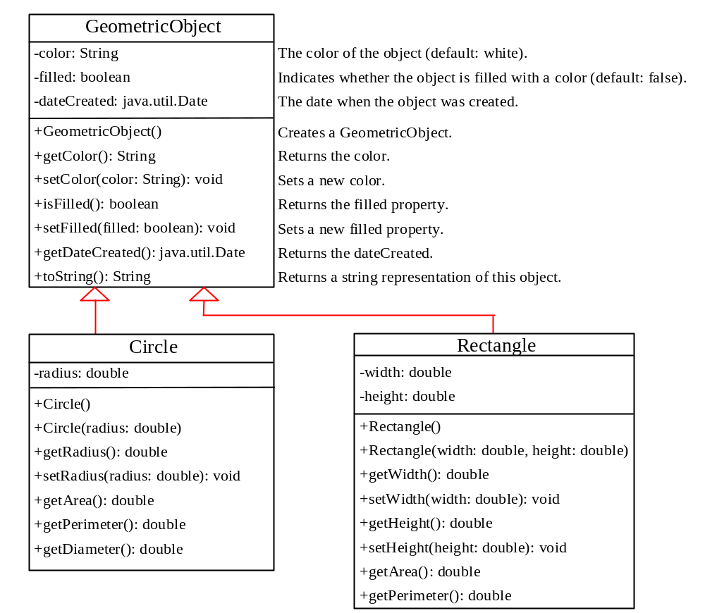
Superclasses and Subclasses
GeometricObject
Circle
Rectangle
TestCircleRectangle
Run

Slide 4
Are superclass’s Constructor Inherited?
No. They are not inherited.
They are invoked explicitly or implicitly.
Explicitly using the super keyword.
A constructor is used to construct an instance of a class. Unlike properties and methods, a superclass's constructors are not inherited in the subclass. They can only be invoked from the subclasses' constructors, using the keyword super. If the keyword super is not explicitly used, the superclass's no-arg constructor is automatically invoked.

Slide 5


Superclass’s Constructor Is Always Invoked
A constructor may invoke an overloaded constructor or its superclass’s constructor. If none of them is invoked explicitly, the compiler puts super() as the first statement in the constructor. For example,

Slide 6
Using the Keyword super
The keyword super refers to the superclass of the class in which super appears. This keyword can be used in two ways:
To call a superclass constructor
To call a superclass method

Slide 7
CAUTION
You must use the keyword super to call the superclass constructor. Invoking a superclass constructor’s name in a subclass causes a syntax error. Java requires that the statement that uses the keyword super appear first in the constructor.

Slide 8
Constructor Chaining
Constructing an instance of a class invokes all the superclasses’ constructors along the inheritance chain. This is called constructor chaining.
public class Faculty extends Employee {
public static void main(String[] args) {
new Faculty();
}
public Faculty() {
System.out.println("(4) Faculty's no-arg constructor is invoked");
}
}
class Employee extends Person {
public Employee() {
this("(2) Invoke Employee’s overloaded constructor");
System.out.println("(3) Employee's no-arg constructor is invoked");
}
public Employee(String s) {
System.out.println(s);
}
}
class Person {
public Person() {
System.out.println("(1) Person's no-arg constructor is invoked");
}
}

Slide 9
Trace Execution
animation
public class Faculty extends Employee {
public static void main(String[] args) {
new Faculty();
}
public Faculty() {
System.out.println("(4) Faculty's no-arg constructor is invoked");
}
}
class Employee extends Person {
public Employee() {
this("(2) Invoke Employee’s overloaded constructor");
System.out.println("(3) Employee's no-arg constructor is invoked");
}
public Employee(String s) {
System.out.println(s);
}
}
class Person {
public Person() {
System.out.println("(1) Person's no-arg constructor is invoked");
}
}
1. Start from the main method

Slide 10
Trace Execution
animation
public class Faculty extends Employee {
public static void main(String[] args) {
new Faculty();
}
public Faculty() {
System.out.println("(4) Faculty's no-arg constructor is invoked");
}
}
class Employee extends Person {
public Employee() {
this("(2) Invoke Employee’s overloaded constructor");
System.out.println("(3) Employee's no-arg constructor is invoked");
}
public Employee(String s) {
System.out.println(s);
}
}
class Person {
public Person() {
System.out.println("(1) Person's no-arg constructor is invoked");
}
}
2. Invoke Faculty constructor

Slide 11
Trace Execution
animation
public class Faculty extends Employee {
public static void main(String[] args) {
new Faculty();
}
public Faculty() {
System.out.println("(4) Faculty's no-arg constructor is invoked");
}
}
class Employee extends Person {
public Employee() {
this("(2) Invoke Employee’s overloaded constructor");
System.out.println("(3) Employee's no-arg constructor is invoked");
}
public Employee(String s) {
System.out.println(s);
}
}
class Person {
public Person() {
System.out.println("(1) Person's no-arg constructor is invoked");
}
}
3. Invoke Employee’s no-arg constructor

Slide 12
Trace Execution
animation
public class Faculty extends Employee {
public static void main(String[] args) {
new Faculty();
}
public Faculty() {
System.out.println("(4) Faculty's no-arg constructor is invoked");
}
}
class Employee extends Person {
public Employee() {
this("(2) Invoke Employee’s overloaded constructor");
System.out.println("(3) Employee's no-arg constructor is invoked");
}
public Employee(String s) {
System.out.println(s);
}
}
class Person {
public Person() {
System.out.println("(1) Person's no-arg constructor is invoked");
}
}
4. Invoke Employee(String) constructor

Slide 13
Trace Execution
animation
public class Faculty extends Employee {
public static void main(String[] args) {
new Faculty();
}
public Faculty() {
System.out.println("(4) Faculty's no-arg constructor is invoked");
}
}
class Employee extends Person {
public Employee() {
this("(2) Invoke Employee’s overloaded constructor");
System.out.println("(3) Employee's no-arg constructor is invoked");
}
public Employee(String s) {
System.out.println(s);
}
}
class Person {
public Person() {
System.out.println("(1) Person's no-arg constructor is invoked");
}
}
5. Invoke Person() constructor

Slide 14
Trace Execution
animation
public class Faculty extends Employee {
public static void main(String[] args) {
new Faculty();
}
public Faculty() {
System.out.println("(4) Faculty's no-arg constructor is invoked");
}
}
class Employee extends Person {
public Employee() {
this("(2) Invoke Employee’s overloaded constructor");
System.out.println("(3) Employee's no-arg constructor is invoked");
}
public Employee(String s) {
System.out.println(s);
}
}
class Person {
public Person() {
System.out.println("(1) Person's no-arg constructor is invoked");
}
}
6. Execute println

Slide 15
Trace Execution
animation
public class Faculty extends Employee {
public static void main(String[] args) {
new Faculty();
}
public Faculty() {
System.out.println("(4) Faculty's no-arg constructor is invoked");
}
}
class Employee extends Person {
public Employee() {
this("(2) Invoke Employee’s overloaded constructor");
System.out.println("(3) Employee's no-arg constructor is invoked");
}
public Employee(String s) {
System.out.println(s);
}
}
class Person {
public Person() {
System.out.println("(1) Person's no-arg constructor is invoked");
}
}
7. Execute println

Slide 16
Trace Execution
animation
public class Faculty extends Employee {
public static void main(String[] args) {
new Faculty();
}
public Faculty() {
System.out.println("(4) Faculty's no-arg constructor is invoked");
}
}
class Employee extends Person {
public Employee() {
this("(2) Invoke Employee’s overloaded constructor");
System.out.println("(3) Employee's no-arg constructor is invoked");
}
public Employee(String s) {
System.out.println(s);
}
}
class Person {
public Person() {
System.out.println("(1) Person's no-arg constructor is invoked");
}
}
8. Execute println

Slide 17
Trace Execution
animation
public class Faculty extends Employee {
public static void main(String[] args) {
new Faculty();
}
public Faculty() {
System.out.println("(4) Faculty's no-arg constructor is invoked");
}
}
class Employee extends Person {
public Employee() {
this("(2) Invoke Employee’s overloaded constructor");
System.out.println("(3) Employee's no-arg constructor is invoked");
}
public Employee(String s) {
System.out.println(s);
}
}
class Person {
public Person() {
System.out.println("(1) Person's no-arg constructor is invoked");
}
}
9. Execute println

Slide 18
Example on the Impact of a Superclass without no-arg Constructor
Find out the errors in the program:
public class Apple extends Fruit {
}
class Fruit {
public Fruit(String name) {
System.out.println("Fruit's constructor is invoked");
}
}

Slide 19
Declaring a Subclass
A subclass extends properties and methods from the superclass. You can also:
  Add new properties
  Add new methods
  Override the methods of the superclass

Slide 20
Calling Superclass Methods
You could rewrite the printCircle() method in the Circle class as follows:
public void printCircle() {
System.out.println("The circle is created " +
super.getDateCreated() + " and the radius is " + radius);
}

Slide 21
Overriding Methods in the Superclass
A subclass inherits methods from a superclass. Sometimes it is necessary for the subclass to modify the implementation of a method defined in the superclass. This is referred to as method overriding.
public class Circle extends GeometricObject {
// Other methods are omitted
/** Override the toString method defined in GeometricObject */
public String toString() {
return super.toString() + "\nradius is " + radius;
}
}

Slide 22
NOTE
An instance method can be overridden only if it is accessible. Thus a private method cannot be overridden, because it is not accessible outside its own class. If a method defined in a subclass is private in its superclass, the two methods are completely unrelated.

Slide 23
NOTE
Like an instance method, a static method can be inherited. However, a static method cannot be overridden. If a static method defined in the superclass is redefined in a subclass, the method defined in the superclass is hidden.

Slide 24
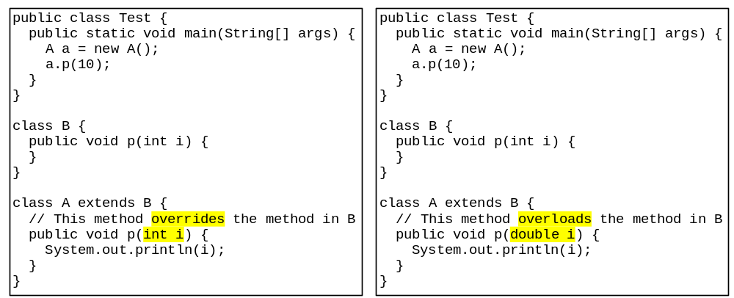
Overriding vs. Overloading

Slide 25

The Object Class
Every class in Java is descended from the java.lang.Object class. If no inheritance is specified when a class is defined, the superclass of the class is Object.

Slide 26
The toString() method in Object
The toString() method returns a string representation of the object. The default implementation returns a string consisting of a class name of which the object is an instance, the at sign (@), and a number representing this object.
Loan loan = new Loan();
System.out.println(loan.toString());
The code displays something like Loan@15037e5 . This message is not very helpful or informative. Usually you should override the toString method so that it returns a digestible string representation of the object.

Slide 27
Polymorphism, Dynamic Binding and Generic Programming
public class PolymorphismDemo {
public static void main(String[] args) {
m(new GraduateStudent());
m(new Student());
m(new Person());
m(new Object());
}
public static void m(Object x) {
System.out.println(x.toString());
}
}
class GraduateStudent extends Student {
}
class Student extends Person {
public String toString() {
return "Student";
}
}
class Person extends Object {
public String toString() {
return "Person";
}
}
Method m takes a parameter of the Object type. You can invoke it with any object.
An object of a subtype can be used wherever its supertype value is required. This feature is known as polymorphism.
When the method m(Object x) is executed, the argument x’s toString method is invoked. x may be an instance of GraduateStudent, Student, Person, or Object. Classes GraduateStudent, Student, Person, and Object have their own implementation of the toString method. Which implementation is used will be determined dynamically by the Java Virtual Machine at runtime. This capability is known as dynamic binding.
PolymorphismDemo
Run

Slide 28

Dynamic Binding
Dynamic binding works as follows: Suppose an object o is an instance of classes C₁, C₂, ..., C_{n-1}, and C_{n}, where C₁ is a subclass of C₂, C₂ is a subclass of C₃, ..., and C_{n-1} is a subclass of C_{n}. That is, C_{n} is the most general class, and C₁ is the most specific class. In Java, C_{n} is the Object class. If o invokes a method p, the JVM searches the implementation for the method p in C₁, C₂, ..., C_{n-1} and C_{n}, in this order, until it is found. Once an implementation is found, the search stops and the first-found implementation is invoked.

Slide 29
Method Matching vs. Binding
Matching a method signature and binding a method implementation are two issues. The compiler finds a matching method according to parameter type, number of parameters, and order of the parameters at compilation time. A method may be implemented in several subclasses. The Java Virtual Machine dynamically binds the implementation of the method at runtime. See Review Questions 9.7 and 9.9.

Slide 30
Generic Programming
public class PolymorphismDemo {
public static void main(String[] args) {
m(new GraduateStudent());
m(new Student());
m(new Person());
m(new Object());
}
public static void m(Object x) {
System.out.println(x.toString());
}
}
class GraduateStudent extends Student {
}
class Student extends Person {
public String toString() {
return "Student";
}
}
class Person extends Object {
public String toString() {
return "Person";
}
}
Polymorphism allows methods to be used generically for a wide range of object arguments. This is known as generic programming. If a method’s parameter type is a superclass (e.g., Object), you may pass an object to this method of any of the parameter’s subclasses (e.g., Student or String). When an object (e.g., a Student object or a String object) is used in the method, the particular implementation of the method of the object that is invoked (e.g., toString) is determined dynamically.

Slide 31
Casting Objects
You have already used the casting operator to convert variables of one primitive type to another. Casting can also be used to convert an object of one class type to another within an inheritance hierarchy. In the preceding section, the statement
  m(new Student());
assigns the object new Student() to a parameter of the Object type. This statement is equivalent to:
  Object o = new Student(); // Implicit casting
  m(o);
The statement Object o = new Student(), known as implicit casting, is legal because an instance of Student is automatically an instance of Object.

Slide 32
Why Casting Is Necessary?
Suppose you want to assign the object reference o to a variable of the Student type using the following statement:
  Student b = o;
A compilation error would occur. Why does the statement Object o = new Student() work and the statement Student b = o doesn’t? This is because a Student object is always an instance of Object, but an Object is not necessarily an instance of Student. Even though you can see that o is really a Student object, the compiler is not so clever to know it. To tell the compiler that o is a Student object, use an explicit casting. The syntax is similar to the one used for casting among primitive data types. Enclose the target object type in parentheses and place it before the object to be cast, as follows:
  Student b = (Student)o; // Explicit casting

Slide 33
Casting from
Superclass to Subclass
Explicit casting must be used when casting an object from a superclass to a subclass. This type of casting may not always succeed.
  Apple x = (Apple)fruit;
  Orange x = (Orange)fruit;

Slide 34
The instanceof Operator
Use the instanceof operator to test whether an object is an instance of a class:
  Object myObject = new Circle();
  ... // Some lines of code
  /** Perform casting if myObject is an instance of Circle */
  if (myObject instanceof Circle) {
  System.out.println("The circle diameter is " +
  ((Circle)myObject).getDiameter());
  ...
  }

Slide 35
TIP
To help understand casting, you may also consider the analogy of fruit, apple, and orange with the Fruit class as the superclass for Apple and Orange. An apple is a fruit, so you can always safely assign an instance of Apple to a variable for Fruit. However, a fruit is not necessarily an apple, so you have to use explicit casting to assign an instance of Fruit to a variable of Apple.

Slide 36
Example: Demonstrating Polymorphism and Casting
This example creates two geometric objects: a circle, and a rectangle, invokes the displayGeometricObject method to display the objects. The displayGeometricObject displays the area and diameter if the object is a circle, and displays area if the object is a rectangle.
TestPolymorphismCasting
Run

Slide 37
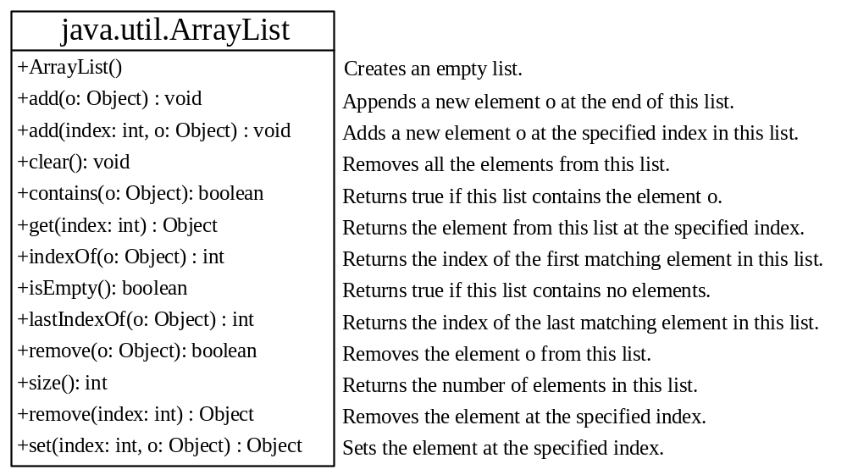
The ArrayList and Vector Classes
You can create an array to store objects. But the array’s size is fixed once the array is created. Java provides the ArrayList class that can be used to store an unlimited number of objects.

Slide 38
JDK 1.5 Warning
You will get a compilation warning “unchecked operation” in JDK 1.5. Ignore it. This warning can be fixed using generic types in Chapter 20.
TestArrayList
Run

Slide 39
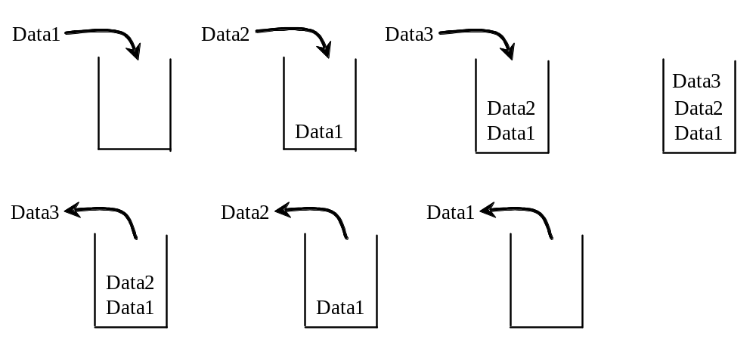
The MyStack Classes

Slide 40
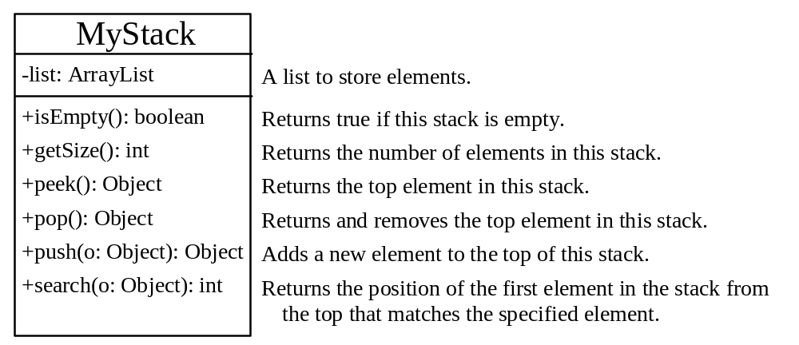
The MyStack Classes
A stack to hold objects.
MyStack

Slide 41

The protected Modifier
The protected modifier can be applied on data and methods in a class. A protected data or a protected method in a public class can be accessed by any class in the same package or its subclasses, even if the subclasses are in a different package.
private, default, protected, public

Slide 42

Accessibility Summary

Slide 43

Visibility Modifiers

Slide 44
A Subclass Cannot Weaken the Accessibility
A subclass may override a protected method in its superclass and change its visibility to public. However, a subclass cannot weaken the accessibility of a method defined in the superclass. For example, if a method is defined as public in the superclass, it must be defined as public in the subclass.

Slide 45
NOTE
The modifiers are used on classes and class members (data and methods), except that the final modifier can also be used on local variables in a method. A final local variable is a constant inside a method.

Slide 46
The final Modifier
The final class cannot be extended:
final class Math {
...
}
The final variable is a constant:
final static double PI = 3.14159;
The final method cannot be
overridden by its subclasses.

Slide 47
The equals() and hashCode() Methods in the Object Class
Optional
The equals() method compares the
contents of two objects.
The hashCode() method returns the hash code of the object. Hash code is an integer, which can be used to store the object in a hash set so that it can be located quickly.

Slide 48
The equals Method
Optional
The equals() method compares the
contents of two objects. The default implementation of the equals method in the Object class is as follows:
public boolean equals(Object obj) {
return (this == obj);
}
For example, the equals method is overridden in the Circle class.
public boolean equals(Object o) {
if (o instanceof Circle) {
return radius == ((Circle)o).radius;
}
else
return false;
}

Slide 49
NOTE
The == comparison operator is used for comparing two primitive data type values or for determining whether two objects have the same references. The equals method is intended to test whether two objects have the same contents, provided that the method is modified in the defining class of the objects. The == operator is stronger than the equals method, in that the == operator checks whether the two reference variables refer to the same object.

Slide 50
The hashCode() method
Optional
Invoking hashCode() on an object returns the hash code of the object. Hash code is an integer, which can be used to store the object in a hash set so that it can be located quickly. Hash sets will be introduced in Chapter 22, “Java Collections Framework.” The hashCode implemented in the Object class returns the internal memory address of the object in hexadecimal. Your class should override the hashCode method whenever the equals method is overridden. By contract, if two objects are equal, their hash codes must be same.

Slide 51
The finalize, clone, and getClass Methods
Optional
The finalize method is invoked by the garbage collector on an object when the object becomes garbage.
The clone() method copies an object.
The getClass() method returns an instance of the java.lang.Class class, which contains the information about the class for the object. Before an object is created, its defining class is loaded and the JVM automatically creates an instance of java.lang.Class for the class. From this instance, you can discover the information about the class at runtime.

Slide 52
The finalization Demo
Optional
The finalize method is invoked by the JVM. You should never write the code to invoke it in your program. For this reason, the protected modifier is appropriate.
FinalizationDemo
Run

Slide 53
Hiding Fields and Static Methods
Optional
You can override an instance method, but you cannot override a field (instance or static) or a static method. If you declare a field or a static method in a subclass with the same name as one in the superclass, the one in the superclass is hidden, but it still exists. The two fields or static methods are independent. You can reference the hidden field or static method using the super keyword in the subclass. The hidden field or method can also be accessed via a reference variable of the superclass’s type.

Slide 54
Hiding Fields and Static Methods, cont.
Optional
When invoking an instance method from a reference variable, the actual class of the object referenced by the variable decides which implementation of the method is used at runtime. When accessing a field or a static method, the declared type of the reference variable decides which method is used at compilation time.
HidingDemo
Run

Slide 55
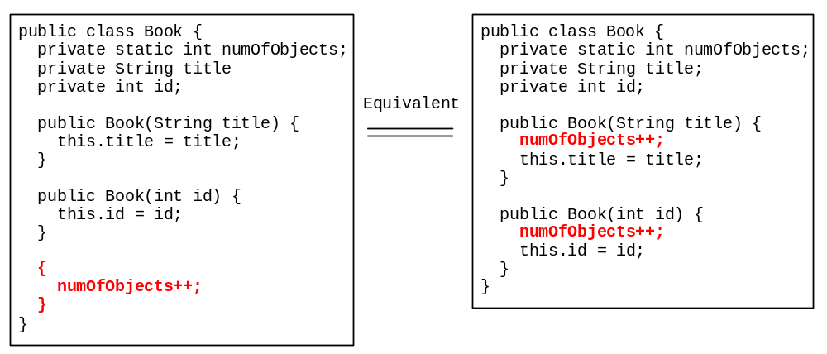
Initialization Block
Optional
Initialization blocks can be used to initialize objects along with the constructors. An initialization block is a block of statements enclosed inside a pair of braces. An initialization block appears within the class declaration, but not inside methods or constructors. It is executed as if it were placed at the beginning of every constructor in the class.

Slide 56
Static Initialization Block
Optional
A static initialization block is much like a nonstatic initialization block except that it is declared static, can only refer to static members of the class, and is invoked when the class is loaded. The JVM loads a class when it is needed. A superclass is loaded before its subclasses.
InitializationDemo
Run

Slide 57
Inheriting GUI Components
Optional
GUI
Objective: Create a custom frame by extending JFrame.
CustomFrame
Run

