Slide 1

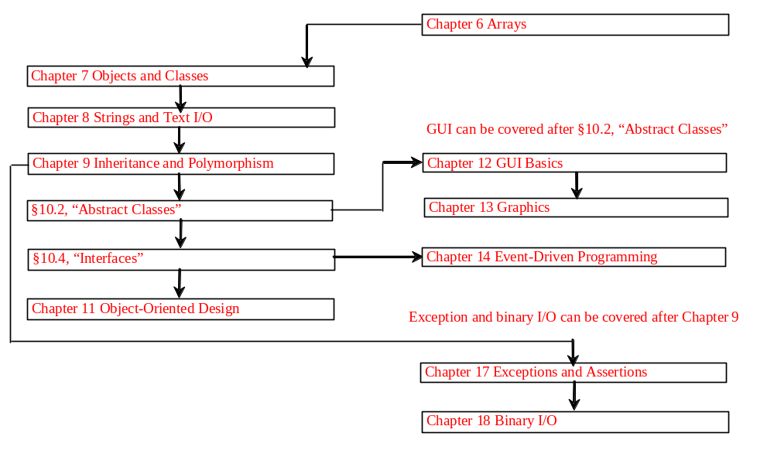
Chapter 11 Object-Oriented Design

Slide 2
Objectives
To become familiar with the process of program development (§11.2).
To the relationship types: association, aggregation, composition, strong inheritance, and weak inheritance (§11.3).
To declare classes to represent the relationships among the classes (§11.3).
To design systems by identifying the classes and discovering the relationships among these classes (§11.4).
To implement the Rational class and process rational numbers using this class (§11.5).
To design classes that follow the class-design guidelines (§11.6).
To model dynamic behavior using sequence diagrams and statechart diagrams (§11.7 Optional)
To know the concept of framework-based programming using Java API (§11.8).

Slide 3
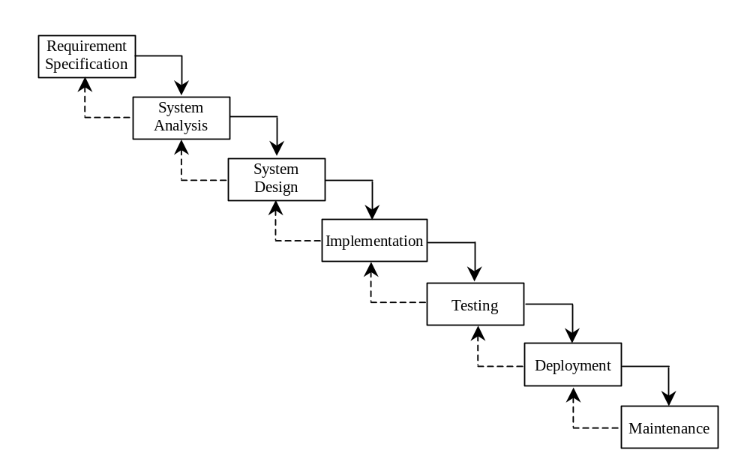
Software Development Process

Slide 4
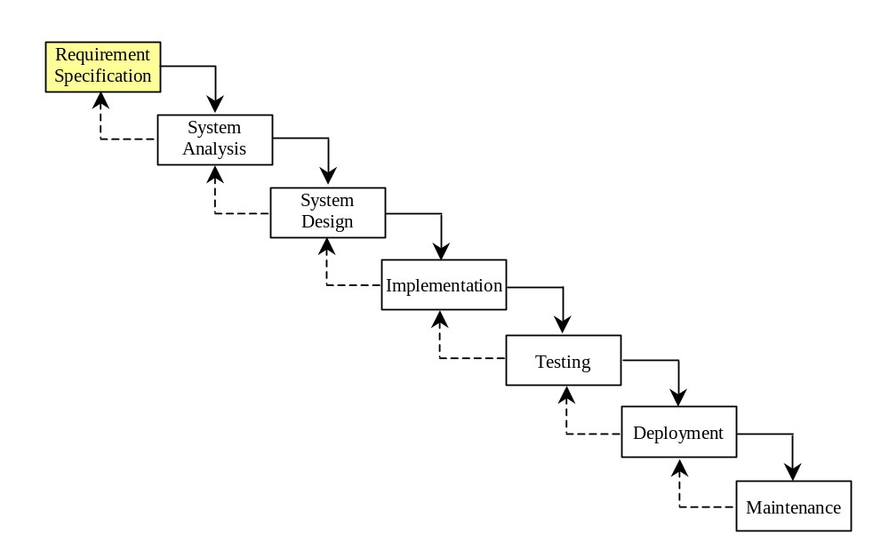
Requirement Specification
A formal process that seeks to understand the problem and document in detail what the software system needs to do. This phase involves close interaction between users and designers.
Most of the examples in this book are simple, and their requirements are clearly stated. In the real world, however, problems are not well defined. You need to study a problem carefully to identify its requirements.

Slide 5
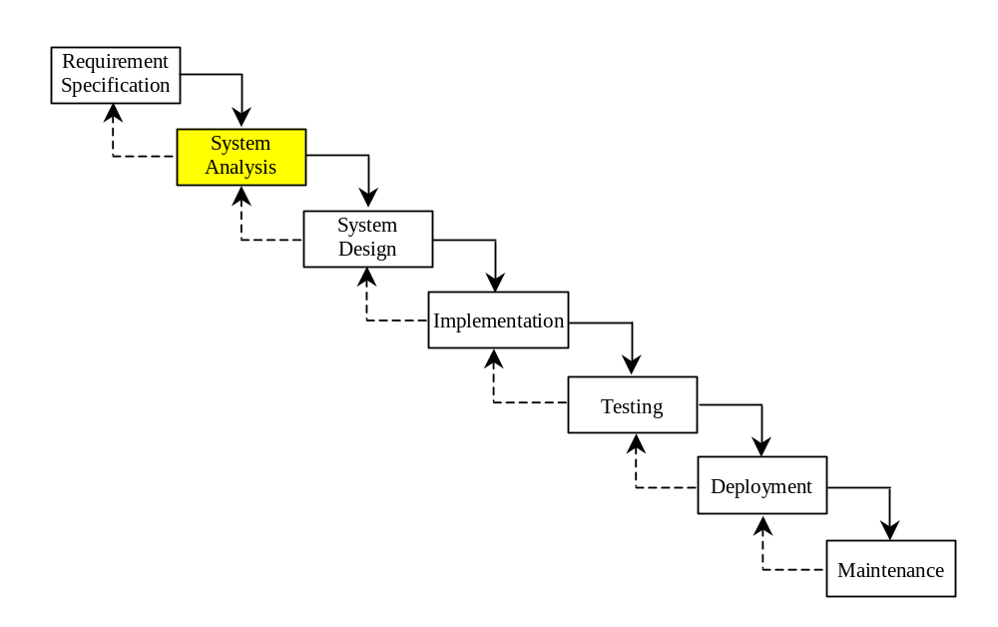
System Analysis
Seeks to analyze the business process in terms of data flow, and to identify the system’s input and output.
Part of the analysis entails modeling the system’s behavior. The model is intended to capture the essential elements of the system and to define services to the system.

Slide 6
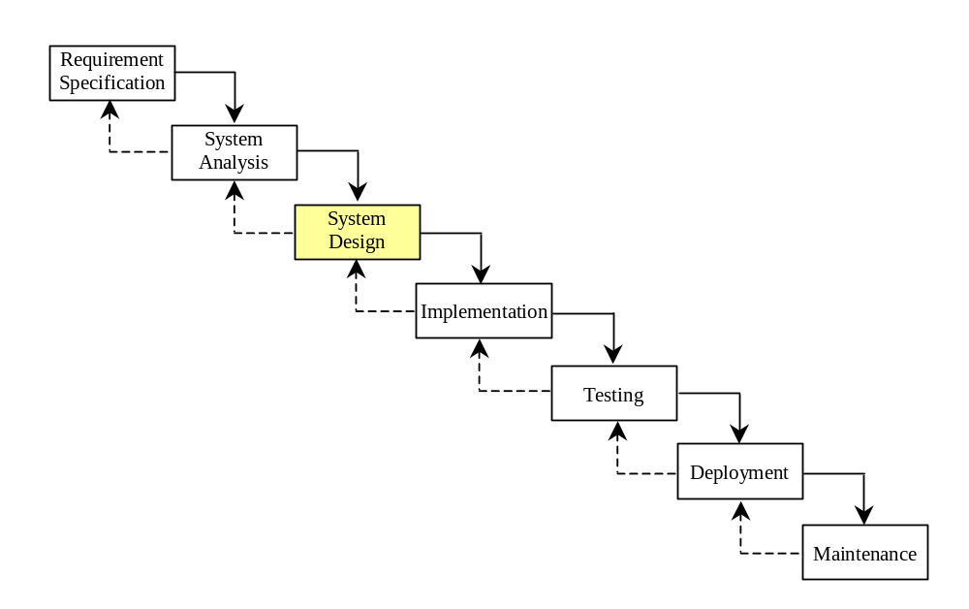
System Design
The process of designing the system’s components.
This phase involves the use of many levels of abstraction to decompose the problem into manageable components, identify classes and interfaces, and establish relationships among the classes and interfaces.

Slide 7
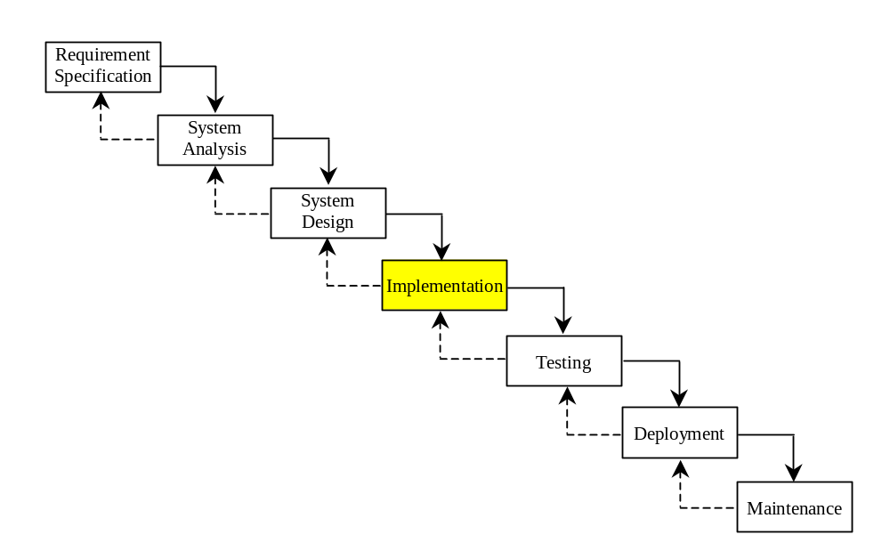
Implementation
The process of translating the system design into programs. Separate programs are written for each component and put to work together.
This phase requires the use of a programming language like Java. The implementation involves coding, testing, and debugging.

Slide 8
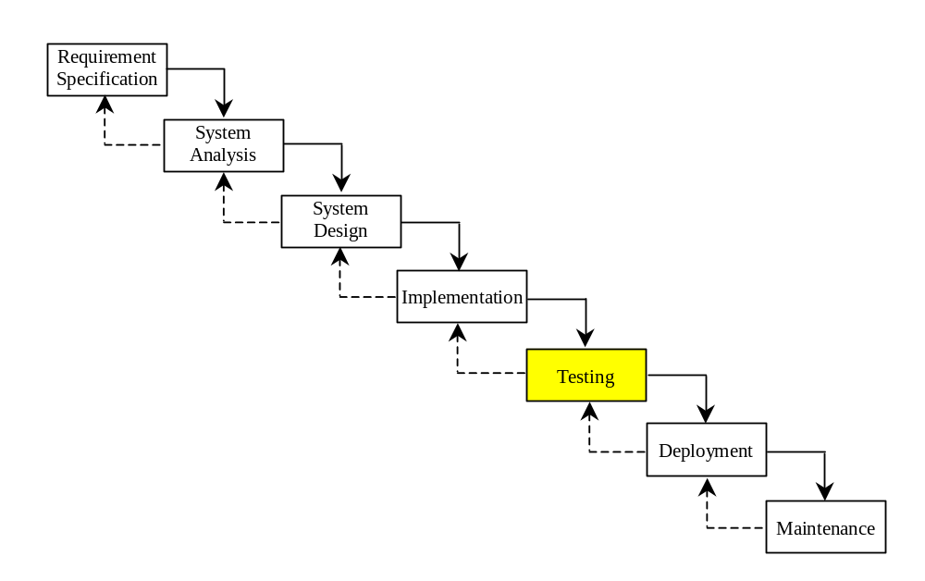
Testing
Ensures that the code meets the requirements specification and weeds out bugs.
An independent team of software engineers not involved in the design and implementation of the project usually conducts such testing.

Slide 9
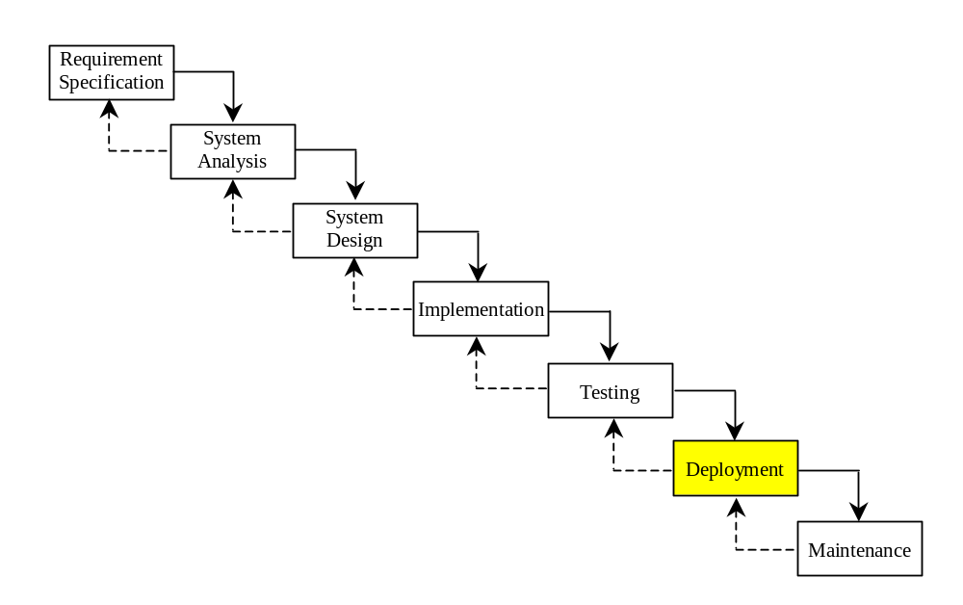
Deployment
Deployment makes the project available for use.
For a Java applet, this means installing it on a Web server; for a Java application, installing it on the client's computer.

Slide 10
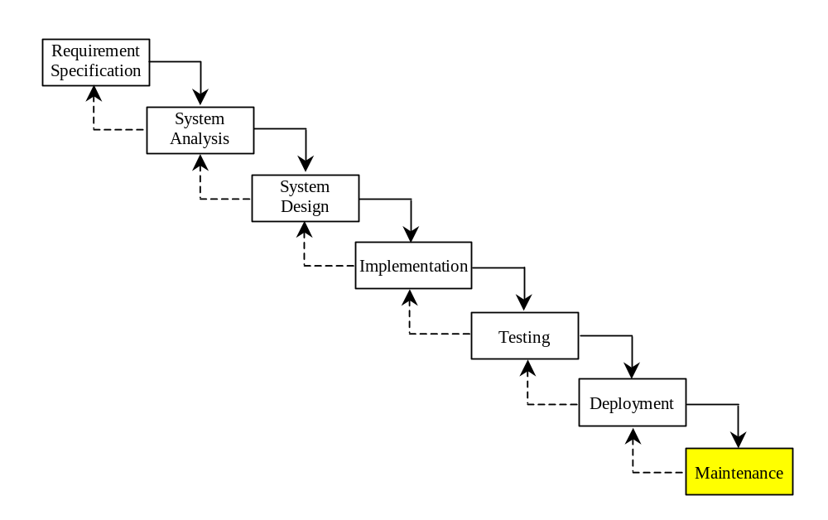
Maintenance
Maintenance is concerned with changing and improving the product.
A software product must continue to perform and improve in a changing environment. This requires periodic upgrades of the product to fix newly discovered bugs and incorporate changes.

Slide 11
Relationships among Classes
Association
Aggregation
Composition
Inheritance

Slide 12
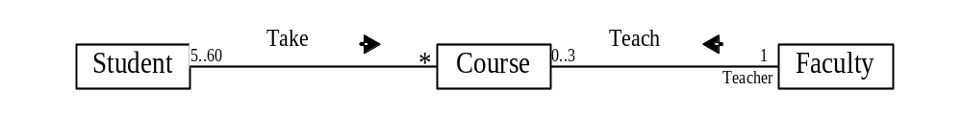
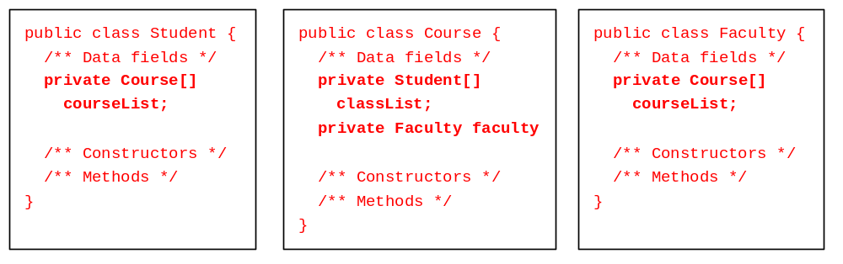
Association
Association represents a general binary relationship that describes an activity between two classes.
An association is usually represented as a data field in the class.

Slide 13
Translation is not Unique
NOTE: If you don’t need to know the courses a student takes or a faculty teaches, the data field coureList in Student or Faculty can be omitted.

Slide 14

Association Between Same Class
Association may exist between objects of the same class. For example, a person may have a supervisor.

Slide 15
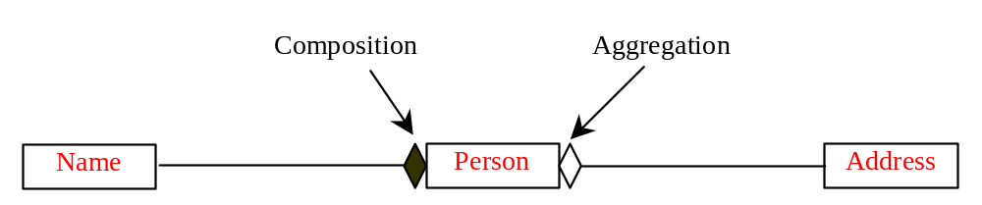
Aggregation and Composition
Aggregation is a special form of association, which represents an ownership relationship between two classes. Aggregation models the has-a relationship. If an object is exclusively owned by an aggregated object, the relationship between the object and its aggregated object is referred to as composition.

Slide 16
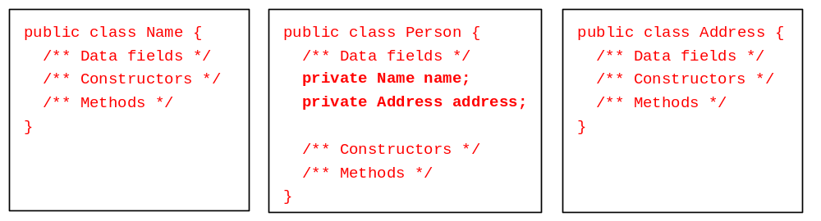
Representing Aggregation in Classes
An aggregation relationship is usually represented as a data field in the aggregated class.

Slide 17
Inner Classes Translation
If Name or Address is used in the Person class only, they can be declared as an inner class in Person. For example,
public class Person {
private Name name;
private Address address;
...
class Name {
...
}
class Address {
...
}
}

Slide 18
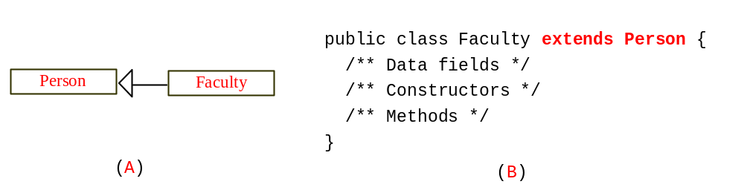
Inheritance
Inheritance models the is-an-extension-of relationship between two classes.

Slide 19
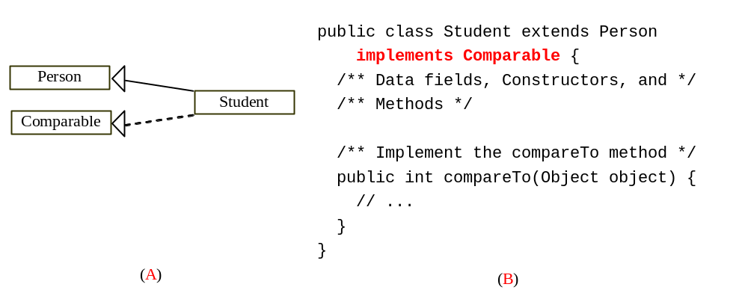
Weak Inheritance Relationship
A weak is-an-extension-of relationship can be represented using interfaces. For example, the weak is-an-extension-of relationship “students are comparable based on their grades” can be represented by implementing the Comparable interface, as follows:

Slide 20
Class Design
1. Identify classes for the system.
2. Describe attributes and methods in each class.
3. Establish relationships among classes.
4. Create classes.

Slide 21
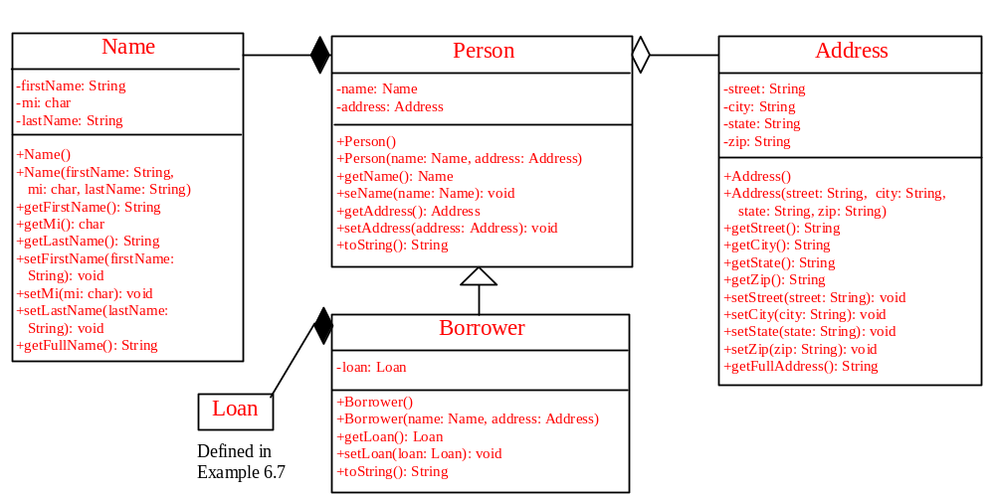
Example 11.1 Borrowing Loans
Name
Loan
Person
Borrower
Address

Slide 22
Example 11.1 Borrowing Loans, cont.
The following is a test program that uses the classes Name, Person, Address, Borrower, and Loan.
BorrowLoan
Run

Slide 23
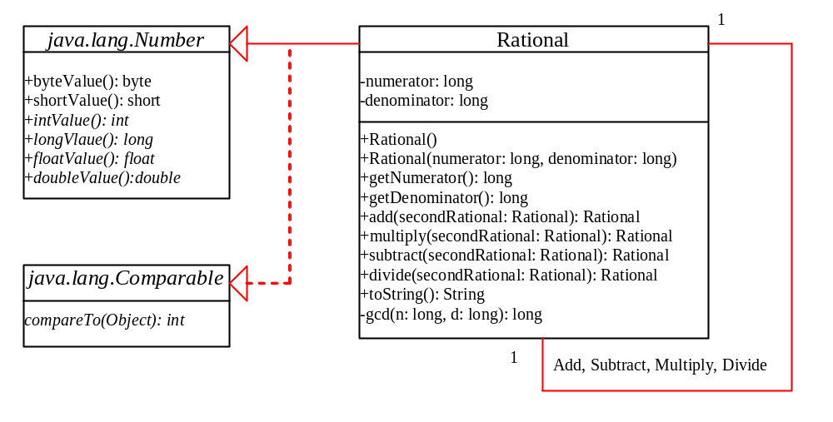
Example 11.2 The Rational Class
Rational
TestRationalClass
Run

Slide 24
Class Design Guidelines
Designing a Single Class.
Using Modifiers public, protected, private and static
Using Inheritance or Aggregation
Using Interfaces or Abstract Classes

Slide 25
Designing a Class
A class should describe a single entity or a set of similar operations. A single entity with too many responsibilities can be broken into several classes to separate responsibilities. The String class, StringBuffer class, and StringTokenizer class all deal with strings, for example, but have different responsibilities.

Slide 26
Designing a Class, cont.
Classes are usually designed for use by many different customers. To make a class useful in a wide range of applications, the class should provide a variety of ways for customization through properties and methods.

Slide 27
Designing a Class, cont.
Classes are designed for reuse. Users can incorporate classes in many different combinations, orders, and environments. Therefore, you should design a class that imposes no restrictions on what or when the user can do with it, design the properties to ensure that the user can set properties in any order, with any combination of values, and design methods to function independently of their order of occurrence.

Slide 28
Designing a Class, cont.
Provide a public no-arg constructor and override the equals method and the toString method defined in the Object class whenever possible.

Slide 29
Designing a Class, cont.
Follow standard Java programming style and naming conventions. Choose informative names for classes, data fields, and methods. Always place the data declaration before the constructor, and place constructors before methods. Always provide a constructor and initialize variables to avoid programming errors.

Slide 30
Using Visibility Modifiers
Each class can present two contracts – one for the users of the class and one for the extenders of the class. Make the fields private and accessor methods public if they are intended for the users of the class. Make the fields or method protected if they are intended for extenders of the class. The contract for the extenders encompasses the contract for the users. The extended class may increase the visibility of an instance method from protected to public, or change its implementation, but you should never change the implementation in a way that violates that contract.

Slide 31
Using Visibility Modifiers, cont.
A class should use the private modifier to hide its data from direct access by clients. You can use get methods and set methods to provide users with access to the private data, but only to private data you want the user to see or to modify. A class should also hide methods not intended for client use. The gcd method in the Rational class in Example 11.2, “The Rational Class,” is private, for example, because it is only for internal use within the class.

Slide 32
Using the static Modifier
A property that is shared by all the instances of the class should be declared as a static property.

Slide 33
Using Inheritance or Aggregation
In general, the difference between inheritance and aggregation is the difference between the is-an-extension-of relationship and the has-a relationship. For example, an apple is fruit; thus, you would use inheritance to model the relationship between the classes Apple and Fruit. A person has a name; thus, you would use aggregation to model the relationship between the classes Person and Name.

Slide 34
Using Inheritance or Aggregation, cont.
Sometimes, the choice between inheritance and aggregation is not obvious. For example, you have used inheritance to model the relationship between the classes Circle and Cylinder. One could argue that a cylinder consists of circles; thus, you might use aggregation to define the Cylinder class as follows:

Slide 35
Using Inheritance or Composition, cont.
public class Cylinder {
private Circle circle;
/** Constructors */
/** Methods */
}

Slide 36
Using Inheritance or Aggregation, cont.
Both designs are fine. Which one is preferred? If polymorphism is desirable, you need to use the inheritance design. If you don’t care about polymorphism, the aggregation design gives more flexibility because the classes are less dependent using aggregation than using inheritance.

Slide 37
Using Interfaces or Abstract Classes
Both interfaces and abstract classes can be used to generalize common features. How do you decide whether to use an interface or a class? In general, a strong is-an-extension-of relationship that clearly describes a parent-child relationship should be modeled using classes.

Slide 38
Using Interfaces or Abstract Classes, cont.
For example, since an orange is a fruit, their relationship should be modeled using class inheritance. A weak is-an-extension-of relationship, also known as an is-kind-of relationship, indicates that an object possesses a certain property. A weak is-an-extension-of relationship can be modeled using interfaces. For example, all strings are comparable, so the String class implements the Comparable interface. A circle or a rectangle is a geometric object, for example, so Circle can be designed as a subclass of GeometricObject. Circles are different and comparable based on their radius, for example, so Circle can implement the Comparable interface.

Slide 39
Using Interfaces or Abstract Classes, cont.
Interfaces are more flexible than abstract classes, because a subclass can extend only one superclass, but implement any number of interfaces. However, interfaces cannot contain concrete methods. You can combine the virtues of interfaces and abstract classes by creating an interface with a companion abstract class that implements the interface. So you can use the interface or its companion class whichever is more convenient.

Slide 40
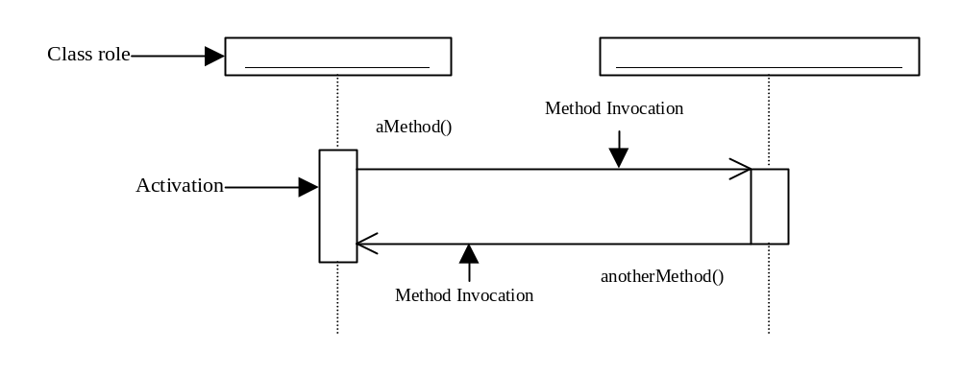
Sequence diagrams
Sequence diagrams describe interactions among objects by depicting the time ordering of method invocations.

Slide 41
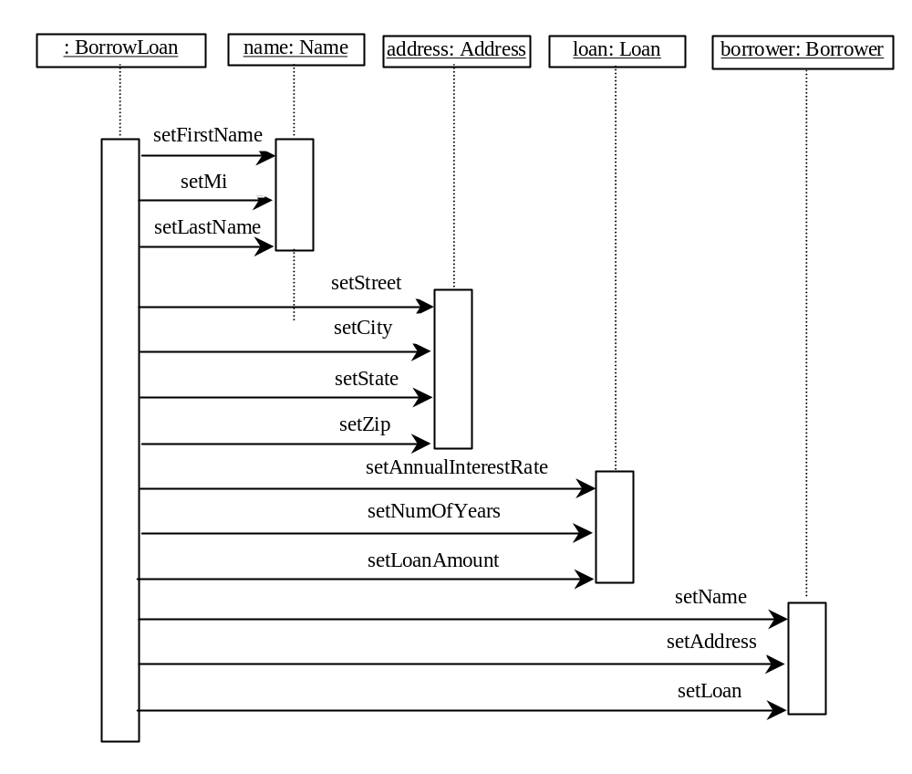
Sequence diagrams, cont.

Slide 42
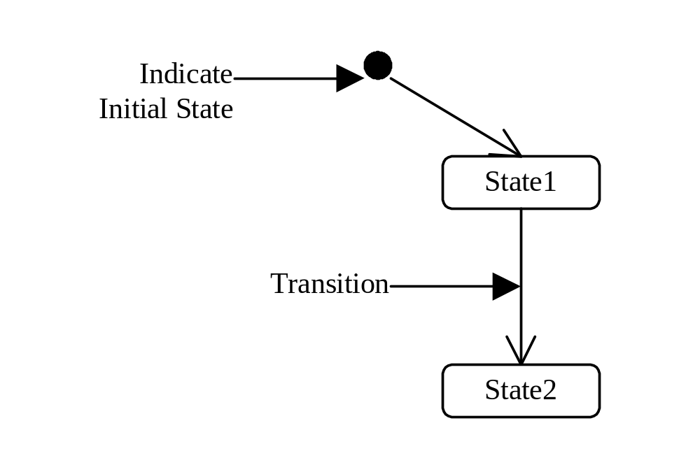
Statechart diagrams
Statechart diagrams describe flow of control of the object.

Slide 43
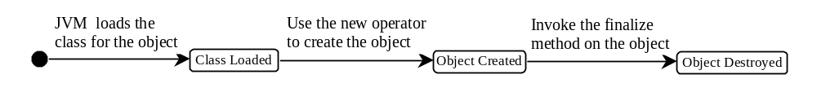
Statechart diagrams, cont.

Slide 44
The Java API
The Java API (Application Program Interface, Application Programming Interface, or Application Programmer interface) consists of numerous classes and interfaces grouped into more than a dozen of packages. You have used classes and interfaces in the java.lang, javax.swing, and java.util packages.

Slide 45
Framework-Based Programming
To create comprehensive projects, you have to use more classes and interfaces in the Java API. The classes and interfaces in the Java API establish a framework for programmers to develop applications using Java. For example, the classes and interfaces in the Java GUI API establish a framework for developing GUI programs. You have to use these classes and interfaces and follow their conventions and rules to create applications. This is referred to as framework-based programming.

Slide 46
Framework-Based Programming, cont.
Once you understand the concept of Java and object-orient programming, the most important lesson from now on is learning how to use the API to develop useful programs. The most effective way to achieve it is to imitate good examples. The book provides many carefully designed examples to demonstrate the concept of the framework-based programming using the Java API.

Slide 47
Framework-Based Programming, cont.
You will learn the Java GUI programming framework in Part III, the Java exception handling framework in Chapter 17, the Java IO framework in Chapter 18, the Java collections framework in Chapter 22, the Java multithreading framework in Chapter 24, Networking in Chapter 25, Internationalization in Chapter 26, and JDBC in Chapters 32-33, Servlets in Chapter 34and RMI in Chapter 36.

