Slide 1

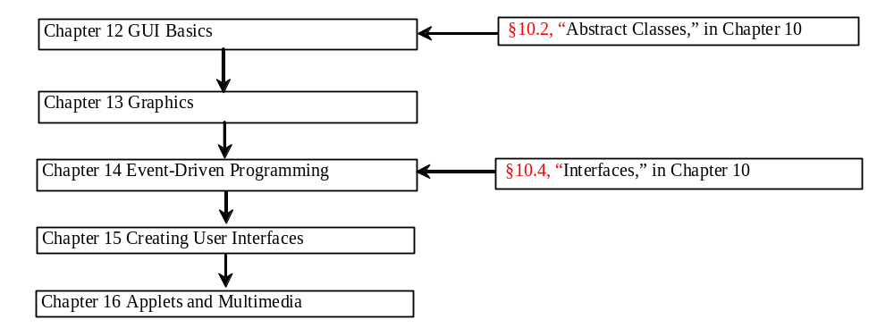
Chapter 13 Graphics

Slide 2
Objectives
To understand Java coordinate systems (§13.2).
To draw things using the methods in the Graphics class (§13.3).
To obtain a graphics context using the getGraphics() method (§13.3).
To override the paintComponent method to draw things on a graphical context (§13.4).
To use a panel as a canvas to draw things (§13.5).
To draw strings, lines, rectangles, ovals, arcs, and polygons (§§13.6, 13.8-13.9).
To obtain font properties using FontMetrics and know how to center a message (§13.10).
To display image in a GUI component (§13.13).
To develop reusable GUI components FigurePanel, MessagePanel, StillClock, and ImageViewer (§§13.7, 13.11, 13.12, 13.14).

Slide 3
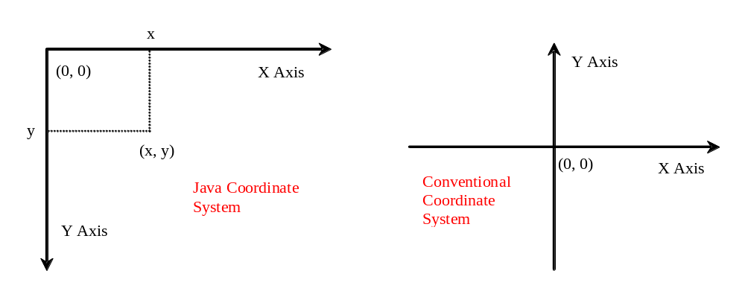
Java Coordinate System

Slide 4
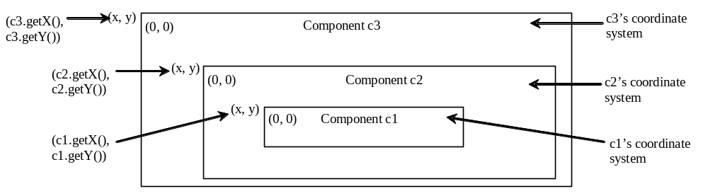
Each GUI Component Has its Own Coordinate System

Slide 5
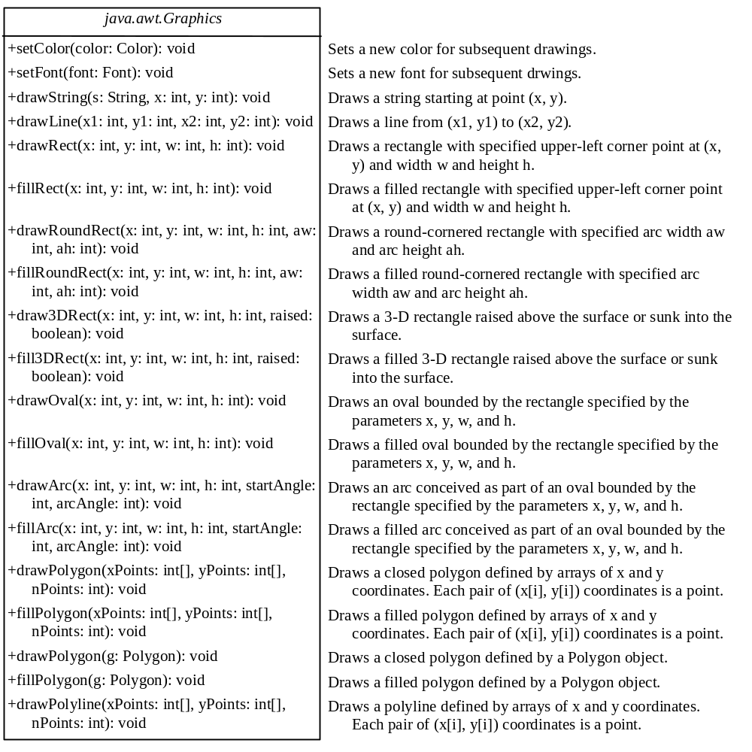
The Graphics Class
You can draw strings, lines, rectangles, ovals, arcs, polygons, and polylines, using the methods in the Graphics class.

Slide 6
Obtaining Graphics Object
The Graphics class is an abstract class that provides a device-independent graphics interface for displaying figures and images on the screen on different platforms. Whenever a component (e.g., a button, a label, a panel) is displayed, a Graphics object is created for the component on the native platform. This object can be obtained using the getGraphics() method. For example, the graphics context for a label object jlblBanner can be obtained using
  Graphics graphics = jlblBanner.getGraphics();
You can then apply the methods in the Graphics class to draw things on the label’s graphics context.

Slide 7
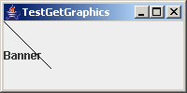
A Drawing Example
(0, 0)
(50, 50)
Draw a line and a text
TestGetGraphics
Run

Slide 8
Two Problems With the Preceding Example
If you resize the frame, the line is gone.
It is awkward to program because you have to make sure that the component to be displayed before obtaining its graphics context using the getGraphics() method. For this reason, Lines 20 and 21 are placed after the frame is displayed in Line 17.
To fix the first problem, you need to know its cause. When you resize the frame, the JVM invokes the paintComponent method of a Swing component (e.g., a label) to redisplay the graphics on the component. Since you did not draw a line in the paintComponent method, the line is gone when the frame is resized. To permanently display the line, you need to draw the line in the paintComponent method.

Slide 9
The paintComponent Method
The paintComponent method is defined in JComponent, and its header is as follows:
  protected void paintComponent(Graphics g)
This method, defined in the JComponent class, is invoked whenever the component is first displayed or redisplayed. The Graphics object g is created automatically by the JVM for every visible GUI component. The JVM obtains the Graphics object and passes it to invoke paintComponent.

Slide 10
paintComponent Example
In order to draw things on a component (e.g., a JLabel), you need to declare a class that extends a Swing GUI component class and overrides its paintComponent method to specify what to draw. The first program in this chapter can be rewritten using paintComponent.
TestPaintComponent
Run

Slide 11
Drawing on Panels
JPanel can be used to draw graphics (including text) and enable user interaction.
To draw in a panel, you create a new class that extends JPanel and override the paintComponent method to tell the panel how to draw things. You can then display strings, draw geometric shapes, and view images on the panel.
TestPanelDrawing
Run

Slide 12
Drawing Geometric Figures
Drawing Strings
Drawing Lines
Drawing Rectangles
Drawing Ovals
Drawing Arcs
Drawing Polygons

Slide 13
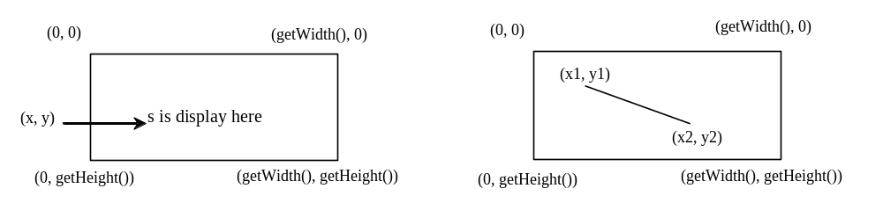
Drawing Strings
drawString(String s, int x, int y);
drawLine(int x1, int y1, int x2, int y2);

Slide 14
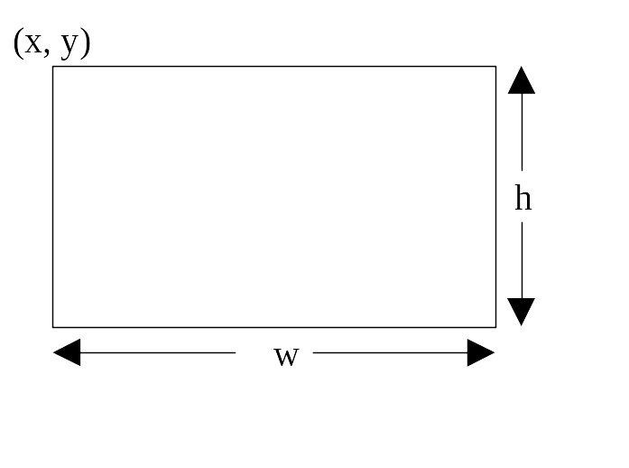
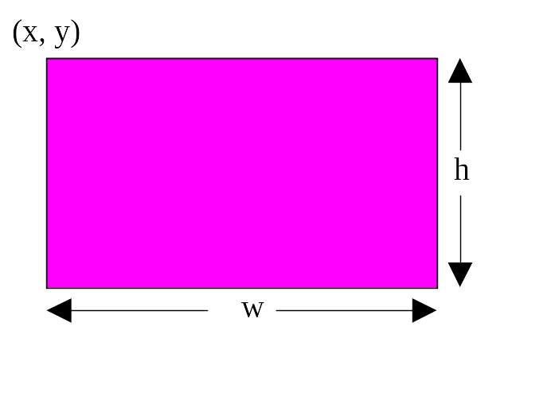
Drawing Rectangles
drawRect(int x, int y, int w, int h);
fillRect(int x, int y, int w, int h);

Slide 15
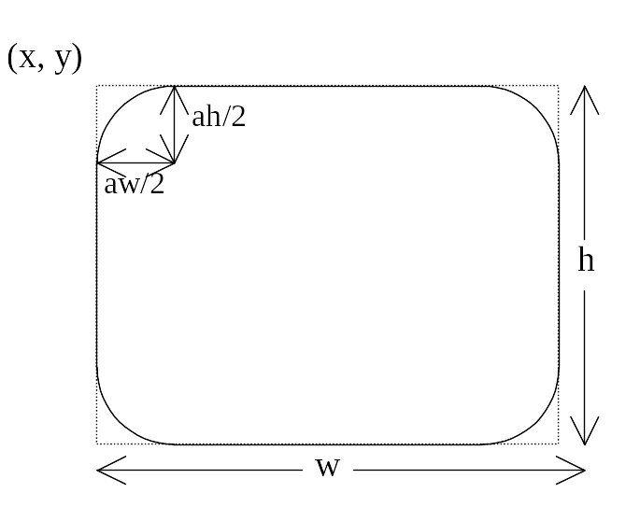
Drawing Rounded Rectangles
drawRoundRect(int x, int y, int w, int h, int aw, int ah);
fillRoundRect(int x, int y, int w, int h, int aw, int ah);

Slide 16
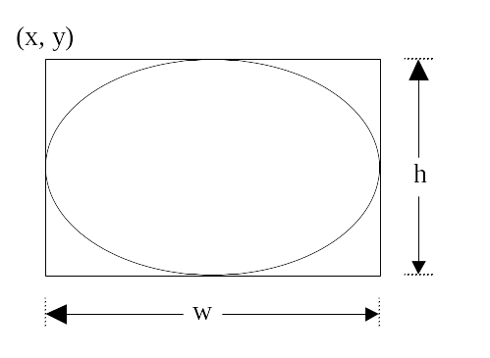
Drawing Ovals
drawOval(int x, int y, int w, int h);
fillOval(int x, int y, int w, int h);

Slide 17
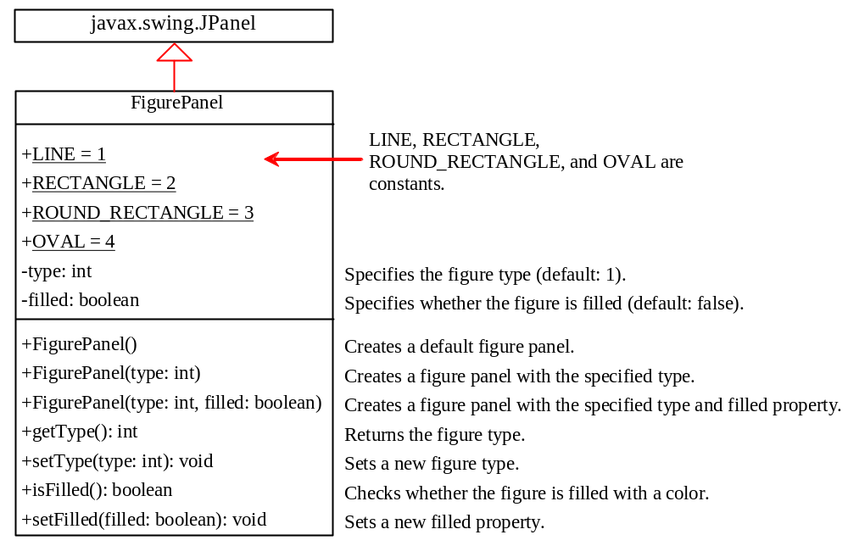
Case Study: The FigurePanel Class
This example develops a useful class for displaying various figures. The class enables the user to set the figure type and specify whether the figure is filled, and displays the figure on a panel.
FigurePanel

Slide 18
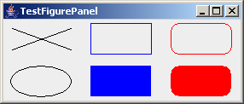
Test FigurePanel
This example develops a useful class for displaying various figures. The class enables the user to set the figure type and specify whether the figure is filled, and displays the figure on a panel.
TestFigurePanel
Run

Slide 19
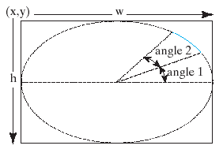
Drawing Arcs
drawArc(int x, int y, int w, int h, int angle1, int angle2);
fillArc(int x, int y, int w, int h, int angle1, int angle2);
Angles are in degree

Slide 20
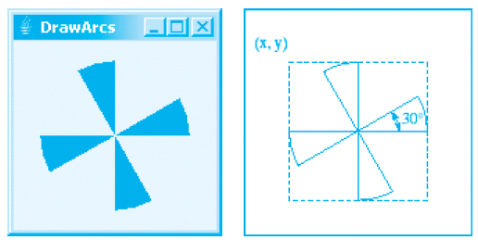
Drawing Arcs Example
DrawArcs
Run

Slide 21
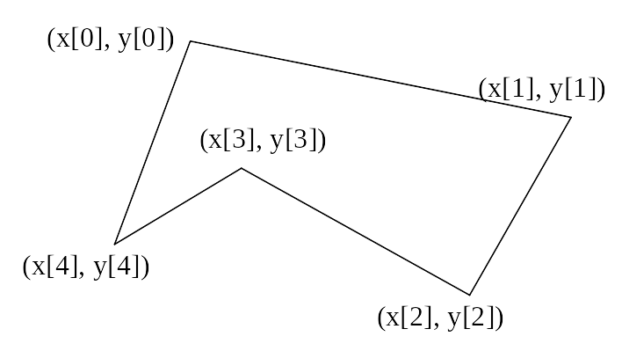
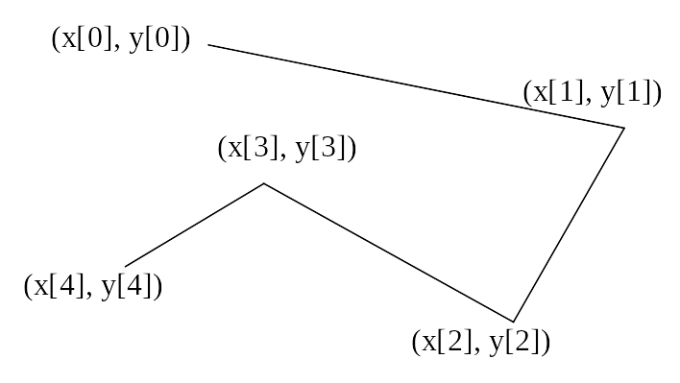
Drawing Polygons and Polylines
int[] x = {40, 70, 60, 45, 20};
int[] y = {20, 40, 80, 45, 60};
g.drawPolygon(x, y, x.length);
g.drawPolyline(x, y, x.length);

Slide 22
Drawing Polygons Using the Polygon Class
Polygon polygon = new Polygon();
polygon.addPoint(40, 59);
polygon.addPoint(40, 100);
polygon.addPoint(10, 100);
g.drawPolygon(polygon);

Slide 23
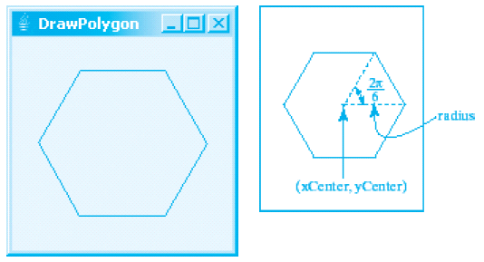
Drawing Polygons Example
DrawPolygon
Run

Slide 24
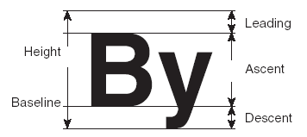
Centering Display Using the FontMetrics Class
You can display a string at any location in a panel. Can you display it centered? To do so, you need to use the FontMetrics class to measure the exact width and height of the string for a particular font. A FontMetrics can measure the following attributes:
public int getAscent()
public int getDescent()
public int getLeading()
public int getHeight()
public int stringWidth(String str)
getLeading()
getHeight()
getAscent()
getDescent()

Slide 25
The FontMetrics Class
FontMetrics is an abstract class. To get a FontMetrics object for a specific font, use the following getFontMetrics methods defined in the Graphics class:
  · public FontMetrics getFontMetrics(Font f)
Returns the font metrics of the specified font.
  · public FontMetrics getFontMetrics()
Returns the font metrics of the current font.

Slide 26
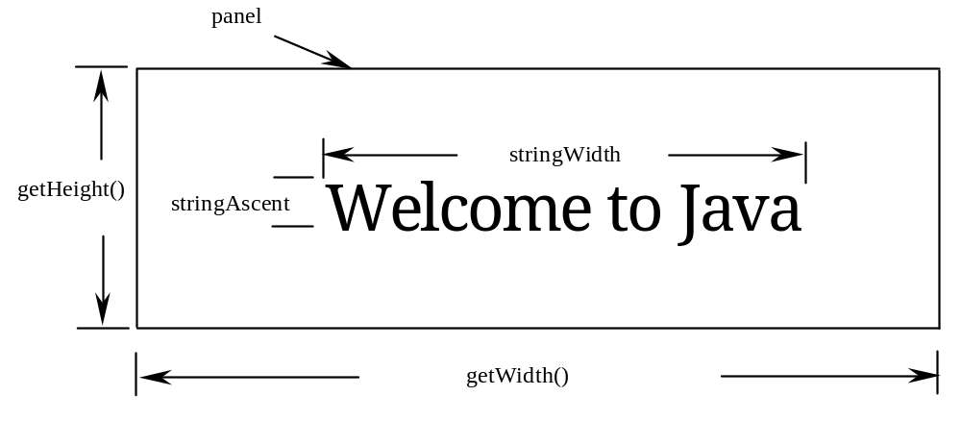
TestCenterMessage
Run

Slide 27
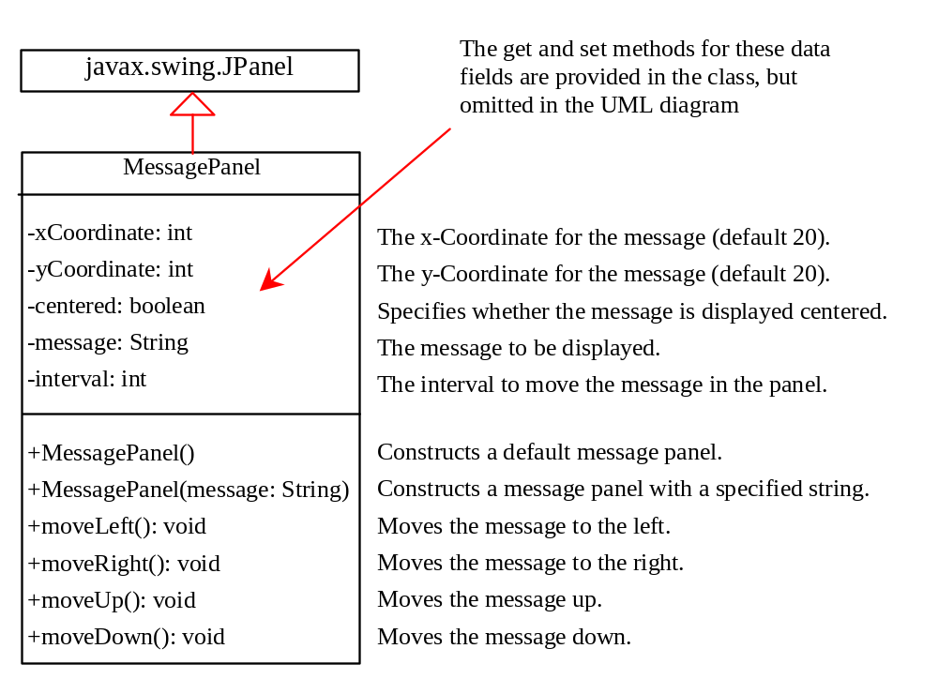
Case Study: MessagePanel
This case study develops a useful class that displays a message in a panel. The class enables the user to set the location of the message, center the message, and move the message with the specified interval.
MessagePanel
TestMessagePanel
Run

Slide 28
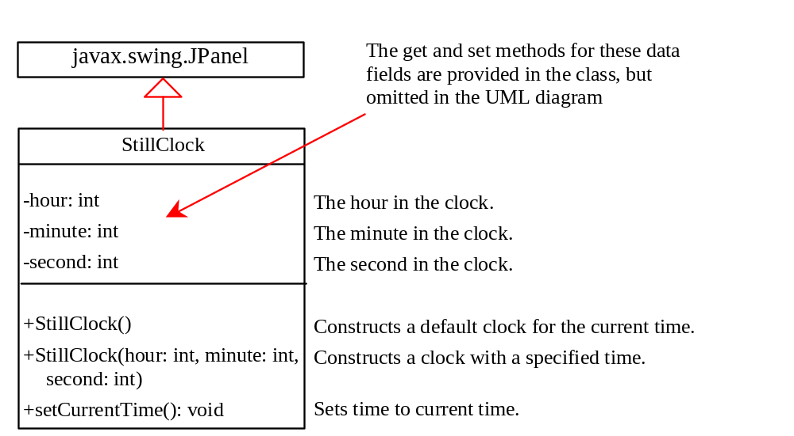
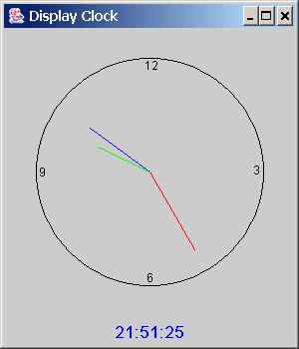
Case Study: StillClock
StillClock
DisplayClock
Run

Slide 29
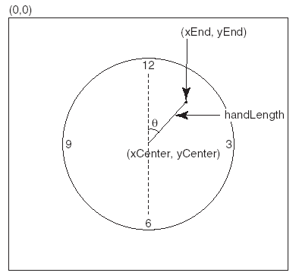
Drawing Clock
xEnd = xCenter + handLength × sin(θ)
yEnd = yCenter - handLength × cos(θ)
Since there are sixty seconds in one minute, the angle for the second hand is
second × (2π/60)

Slide 30
Drawing Clock, cont.
xEnd = xCenter + handLength × sin(θ)
yEnd = yCenter - handLength × cos(θ)
The position of the minute hand is determined by the minute and second. The exact minute value combined with seconds is minute + second/60. For example, if the time is 3 minutes and 30 seconds. The total minutes are 3.5. Since there are sixty minutes in one hour, the angle for the minute hand is
(minute + second/60) × (2π/60)

Slide 31
Drawing Clock, cont.
xEnd = xCenter + handLength × sin(θ)
yEnd = yCenter - handLength × cos(θ)
Since one circle is divided into twelve hours, the angle for the hour hand is
(hour + minute/60 + second/(60 × 60))) × (2π/12)

Slide 32
Displaying Image Icons
You learned how to create image icons and display image icons in labels and buttons. For example, the following statements create an image icon and display it in a label:
ImageIcon icon = new ImageIcon("image/us.gif");
JLabel jlblImage = new JLabel(imageIcon);
An image icon displays a fixed-size image. To display an image in a flexible size, you need to use the java.awt.Image class. An image can be created from an image icon using the getImage() method as follows:
Image image = imageIcon.getImage();

Slide 33
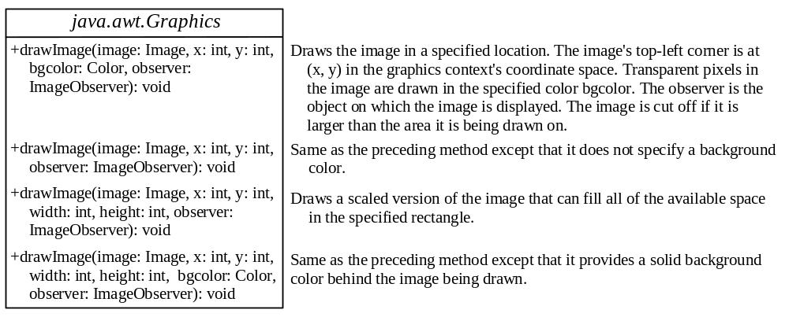
Displaying Images
Using a label as an area for displaying images is simple and convenient, but you don't have much control over how the image is displayed. A more flexible way to display images is to use the drawImage method of the Graphics class on a panel. Four versions of the drawImage method are shown here.

Slide 34

Displaying Images Example
This example gives the code that displays an image from image/us.gif. The file image/us.gif is under the class directory. The Image from the file is created in the program. The drawImage method displays the image to fill in the whole panel, as shown in the figure.
DisplayImage
Run

Slide 35
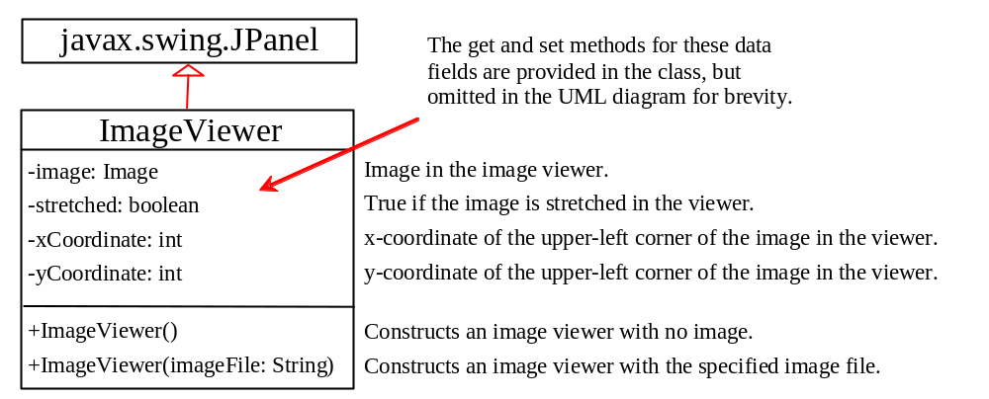
Case Study: ImageViewer Class
Displaying an image is a common task in Java programming. This case study develops a reusable component named ImageViewer that displays an image in a panel. The ImageViewer class contains the properties image, imageFilename, stretched, xCoordinate, and yCoordinate.

Slide 36
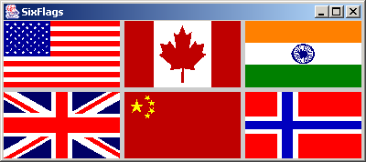
ImageView Example
This example gives an example that creates six images using the ImageViewer class.
SixFlags
Run

