Slide 2

What Happens When U.S. High-Technology Firms Move to China?
Learning Objectives
1.1 | Explain these three key economic ideas: People are rational. People respond to incentives. Optimal decisions are made at the margin.
1.2 | Discuss how an economy answers these questions: What goods and services will be produced? How will the goods and services be produced? Who will receive the goods and services?
1.3 | Understand the role of models in economic analysis.
1.4 | Distinguish between microeconomics and macroeconomics.
1.5 | Become familiar with important economic terms.
APPENDIX Review the use of graphs and formulas.
Many U.S., Japanese, and European firms have been moving the production of goods and services outside their home country …

Slide 3
Economics: Foundations and Models
In this book, we use economics to answer questions such as the following:
  • How are the prices of goods and services determined?
  • How does pollution affect the economy, and how should government policy deal with these effects?
  • Why do firms engage in international trade, and how do government policies affect international trade?
  • Why does government control the prices of some goods and services, and what are the effects of those controls?

Slide 4
Economics: Foundations and Models
4.1
Scarcity The situation in which unlimited wants exceed the limited resources available to fulfill those wants.
Economics The study of the choices people make to attain their goals, given their scarce resources.
Economic model A simplified version of reality used to analyze real-world economic situations.

Slide 5
Three Key Economic Ideas
Learning Objective 1.1
4.1
Market A group of buyers and sellers of a good or service and the institution or arrangement by which they come together to trade.
Throughout this book, as we study how people make choices and interact in markets, we will return to three important ideas:
1 People are rational.
2 People respond to economic incentives.
3 Optimal decisions are made at the margin.
Marginal analysis Analysis that involves comparing marginal benefits and marginal costs.

Slide 6
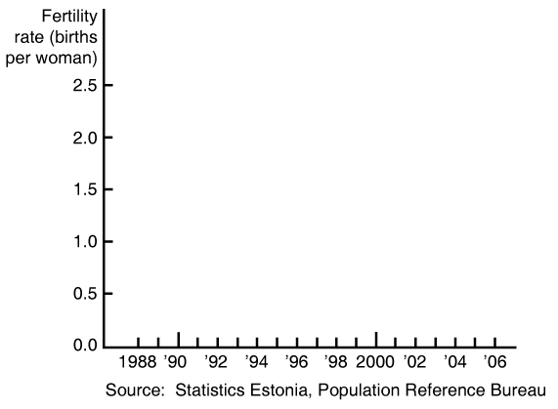

Learning Objective 1.1
Making
the
Connection
Will Women Have More Babies if the Government Pays Them To?

Slide 7
Learning Objective 1.1
Solved Problem
1-1
Apple Computer Makes a Decision at the Margin
Should Apple produce an additional 300,000 iPods?
In solving the problem, consider the following:
Optimal decisions are made at the margin.
An activity should be continued to the point where the marginal benefit is equal to the marginal cost.
In this case, the correct decision requires information about additional revenue and additional cost.

Slide 8
The Economic Problem That Every Society Must Solve
Learning Objective 1.2
Trade-off The idea that because of scarcity, producing more of one good or service means producing less of another good or service.
Opportunity cost The highest-valued alternative that must be given up to engage in an activity.
Trade-offs force society to make choices, particularly when answering the following three fundamental questions:
  1 What goods and services will be produced?
  2 How will the goods and services be produced?
  3 Who will receive the goods and services produced?

Slide 9
The Economic Problem That Every Society Must Solve
Learning Objective 1.2
Centrally Planned Economies versus Market Economies
Centrally planned economy An economy in which the government decides how economic resources will be allocated.
Market economy An economy in which the decisions of households and firms interacting in markets allocate economic resources.

Slide 10
The Economic Problem That Every Society Must Solve
Learning Objective 1.2
The Modern “Mixed” Economy
Mixed economy An economy in which most economic decisions result from the interaction of buyers and sellers in markets but in which the government plays a significant role in the allocation of resources.

Slide 11
The Economic Problem That Every Society Must Solve
Learning Objective 1.2
Efficiency and Equity
Productive efficiency The situation in which a good or service is produced at the lowest possible cost.
Allocative efficiency A state of the economy in which production is in accordance with consumer preferences; in particular, every good or service is produced up to the point where the last unit provides a marginal benefit to society equal to the marginal cost of producing it.

Slide 12
The Economic Problem That Every Society Must Solve
Learning Objective 1.2
Efficiency and Equity
Voluntary exchange The situation that occurs in markets when both the buyer and seller of a product are made better off by the transaction.
Equity The fair distribution of economic benefits.

Slide 13
Economic Models
Learning Objective 1.3
To develop a model, economists generally follow these steps:
  Decide on the assumptions to be used in developing the model.
  Formulate a testable hypothesis.
  Use economic data to test the hypothesis.
  Revise the model if it fails to explain well the economic data.
  Retain the revised model to help answer similar economic questions in the future.

Slide 14
Economic Models
Learning Objective 1.3
The Role of Assumptions in Economic Models
Economic models make behavioral assumptions about the motives of consumers and firms.
Forming and Testing Hypotheses in Economic Models
Economic variable Something measurable that can have different values, such as the wages of software programmers.

Slide 15

Learning Objective 1.3
Making
the
Connection
When Economists Disagree:
A Debate over Outsourcing
Does outsourcing by U.S. firms raise or lower incomes in the United States?

Slide 16
Economic Models
Learning Objective 1.3
Normative and Positive Analysis
Positive analysis Analysis concerned with what is.
Normative analysis Analysis concerned with what ought to be.
Don’t Let This Happen to YOU!
Don’t Confuse Positive Analysis with Normative Analysis

Slide 17
Microeconomics and Macroeconomics
Learning Objective 1.4
Microeconomics The study of how households and firms make choices, how they interact in markets, and how the government attempts to influence their choices.
Macroeconomics The study of the economy as a whole, including topics such as inflation, unemployment, and economic growth.

Slide 18
A Preview of Important Economic Terms
Learning Objective 1.5
Entrepreneur
Innovation
Technology
Firm, company, or business
Goods
Services
Revenue
Profit
Household
Factors of production or economic resources
Capital
Human capital

Slide 19
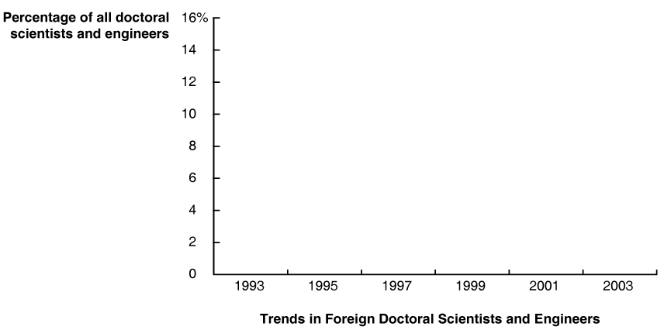
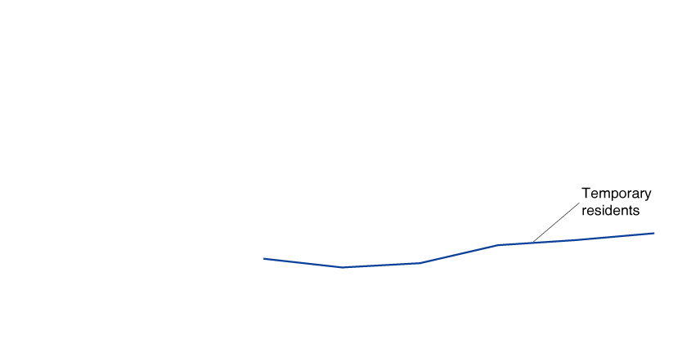
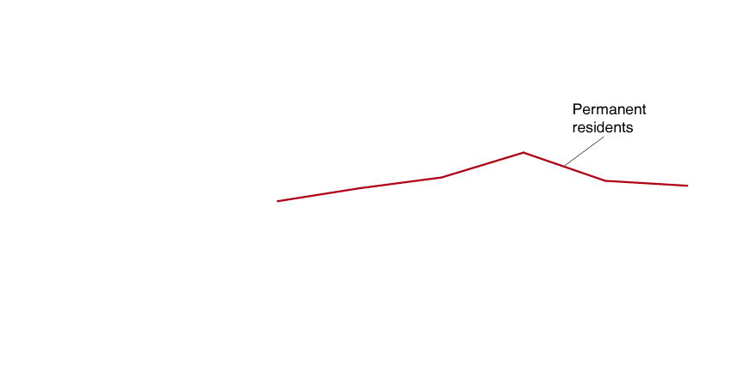
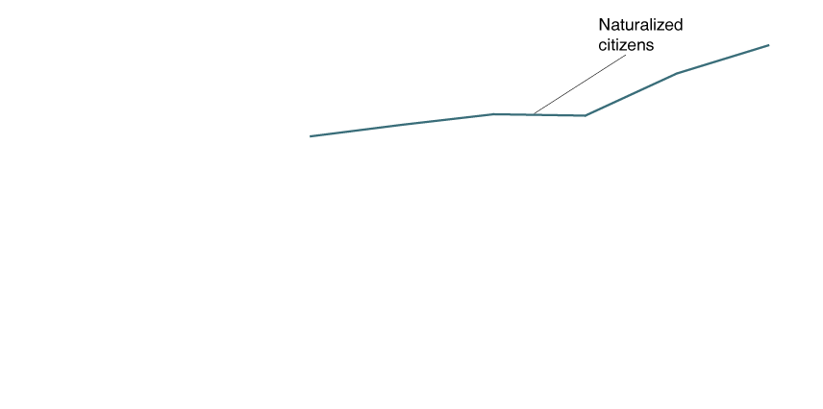
An Inside
LOOK
Should the United States Worry about High- Tech Competition from India and China?
Nightmare Scenarios

Slide 20
K e y T e r m s
Allocative efficiency
Centrally planned economy
Economic model
Economic variable
Economics
Equity
Macroeconomics
Marginal analysis
Market
Market economy
Microeconomics
Mixed economy
Normative analysis
Opportunity cost
Positive analysis
Productive efficiency
Scarcity
Trade-off
Voluntary exchange

Slide 21
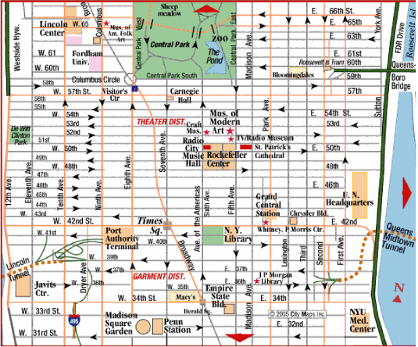
Appendix
Using Graphs and Formulas
A graph is like a street map—it is a simplified version of reality.

Slide 22
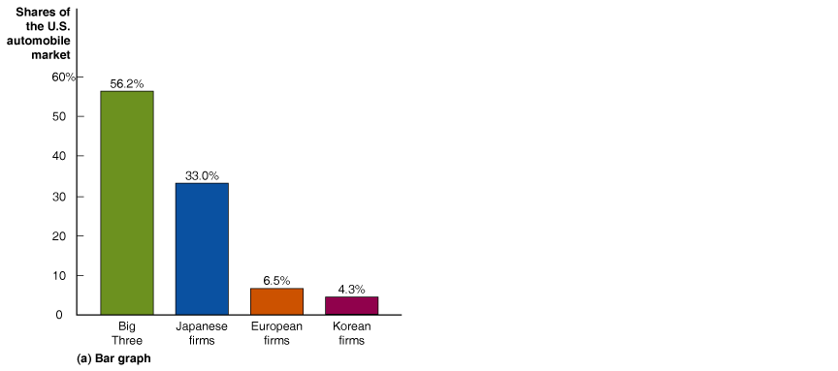
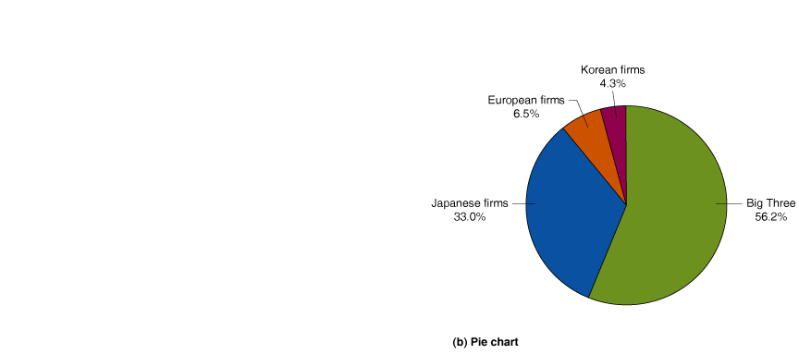
Appendix
Graphs of One Variable
FIGURE 1A-1
Bar Graphs and Pie Charts

Slide 23
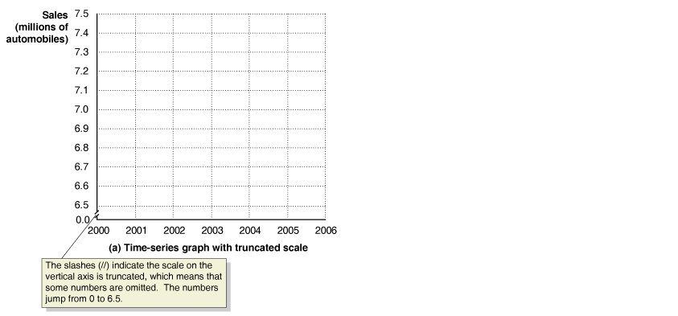

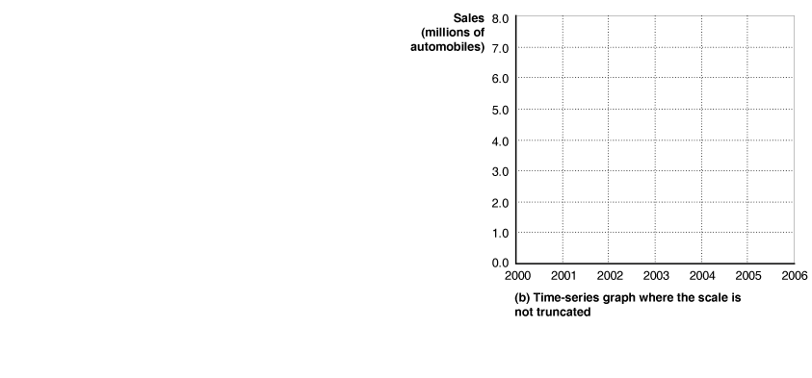

Appendix
Graphs of One Variable
FIGURE 1A-2
Time-Series Graphs

Slide 24
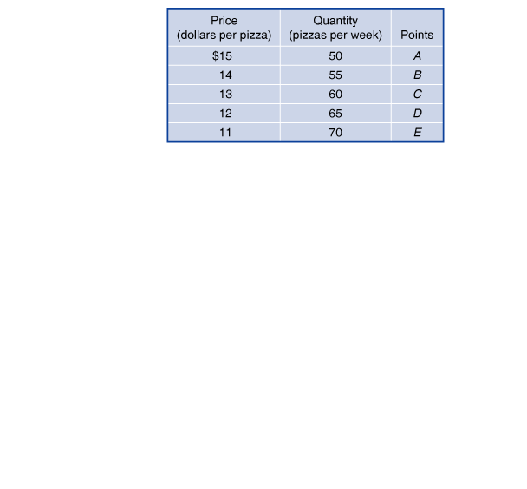
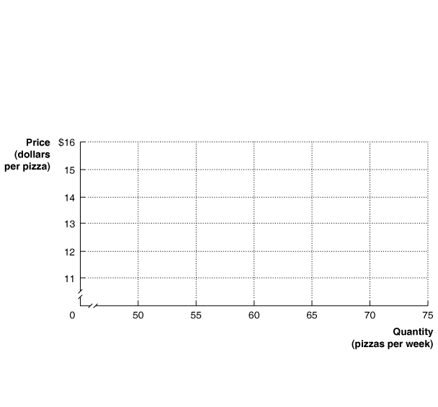

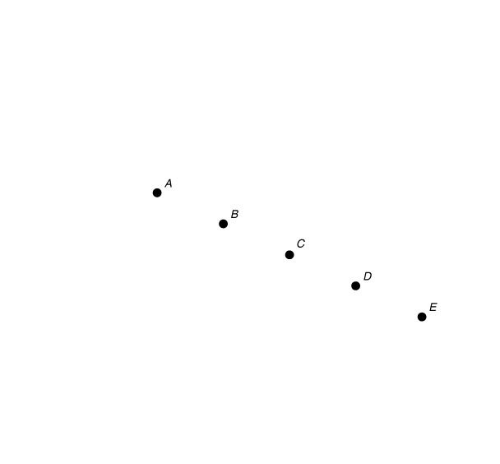
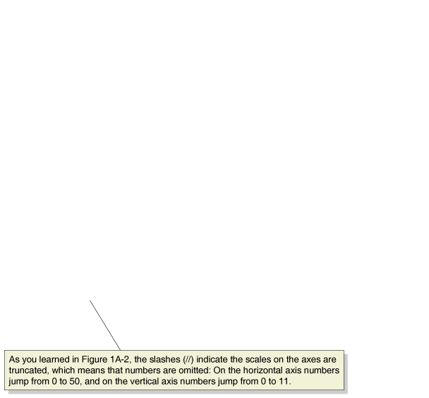
Appendix
Graphs of Two Variables
FIGURE 1A-3
Plotting Price and Quantity Points in a Graph

Slide 25
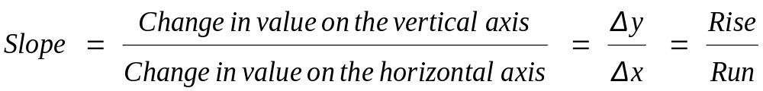
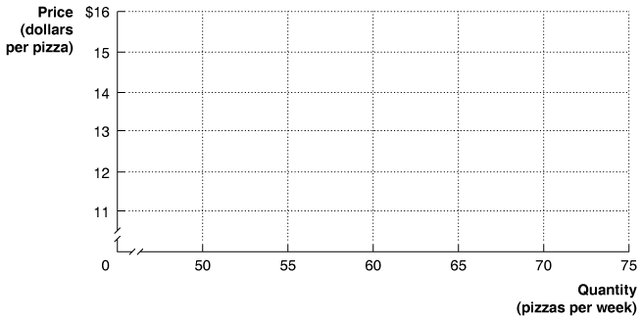
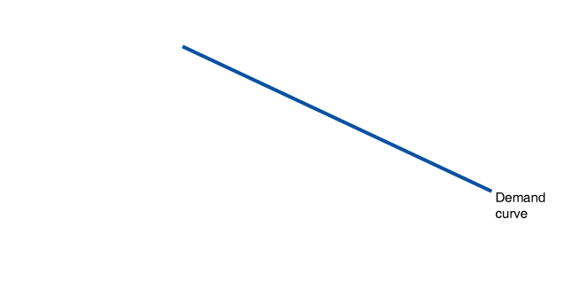
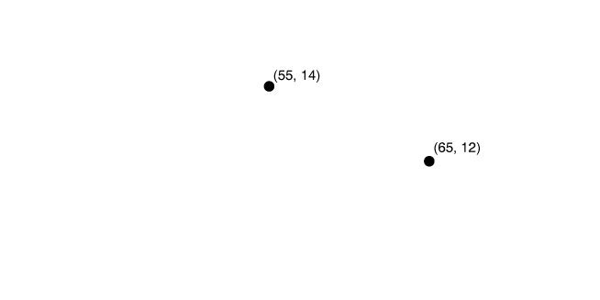
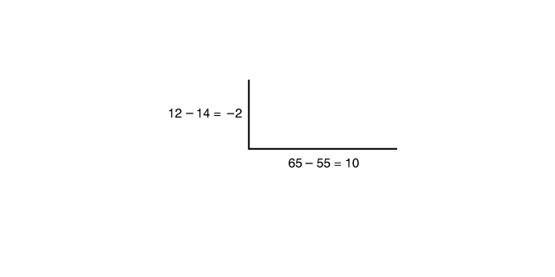
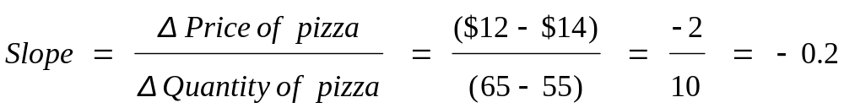
Appendix
Graphs of Two Variables
Slopes of Lines
FIGURE 1A-4
Calculating the Slope of a Line

Slide 26
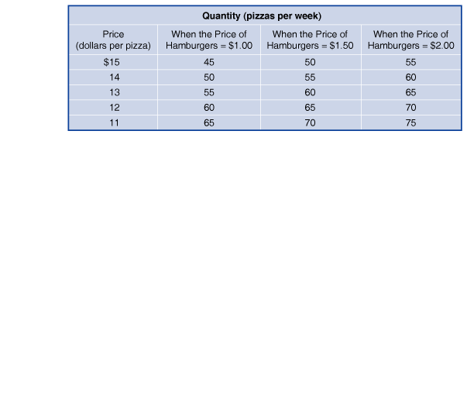
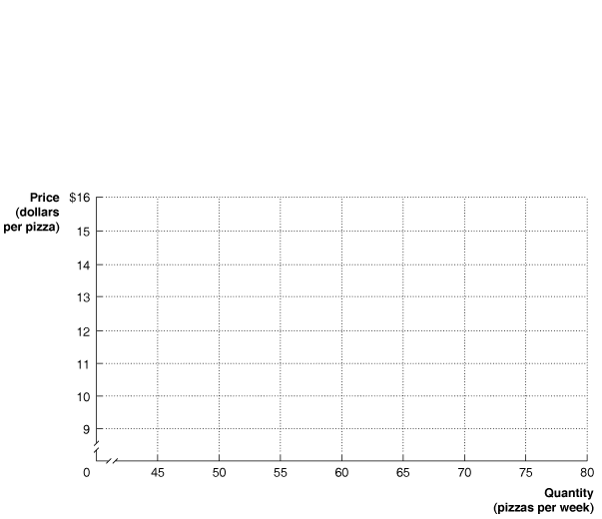
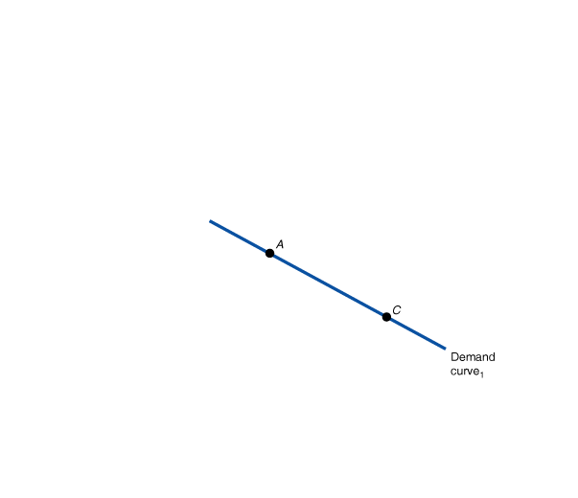
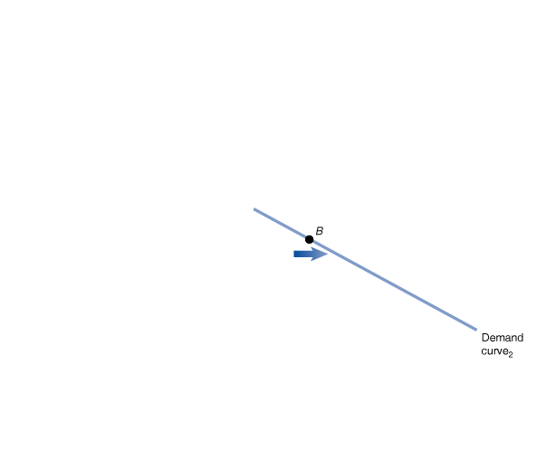
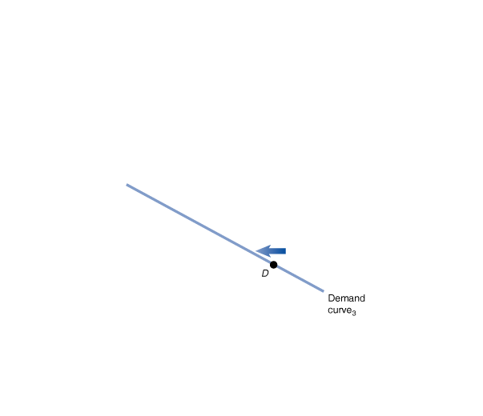
Appendix
Graphs of Two Variables
Taking into Account More Than Two Variables on a Graph
FIGURE 1A-5
Showing Three Variables on a Graph

Slide 27
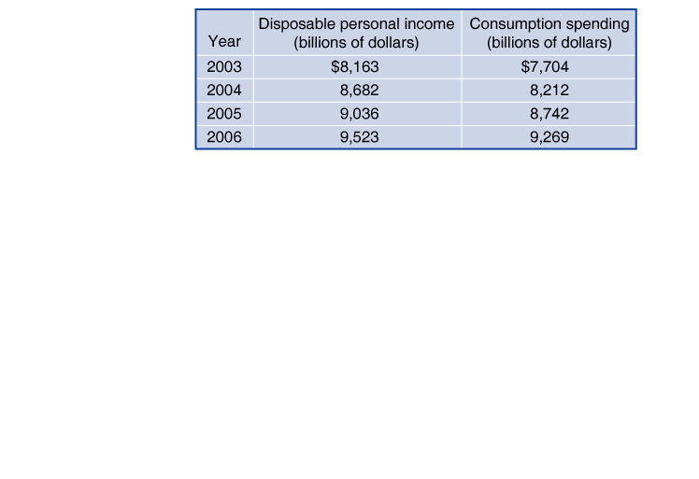
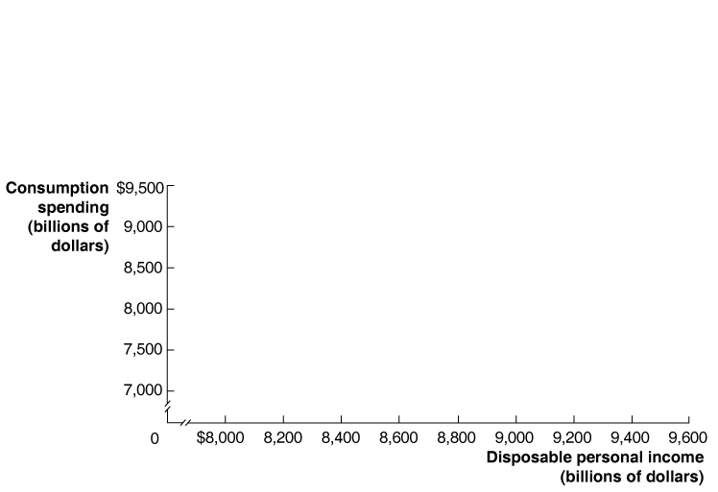
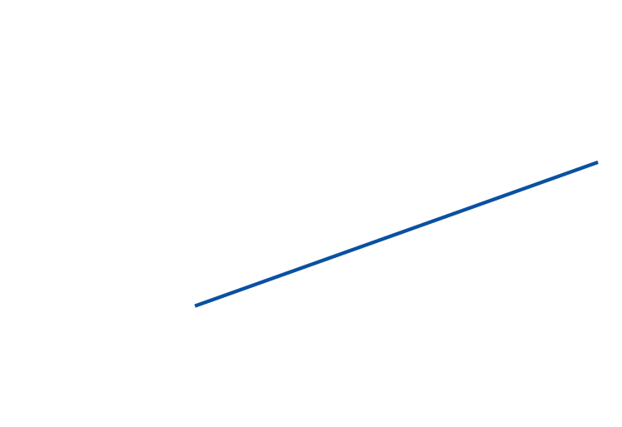
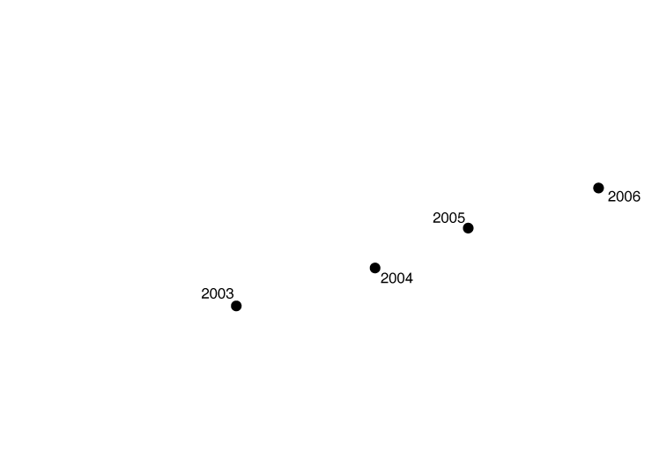
Appendix
Graphs of Two Variables
Positive and Negative Relationships
FIGURE 1A-6
Graphing the Positive Relationship between Income and Consumption

Slide 28
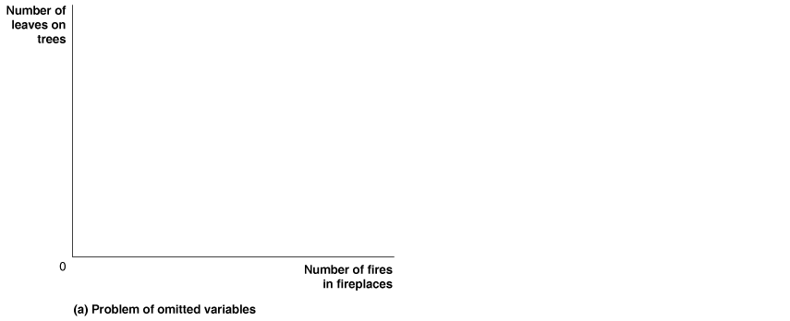

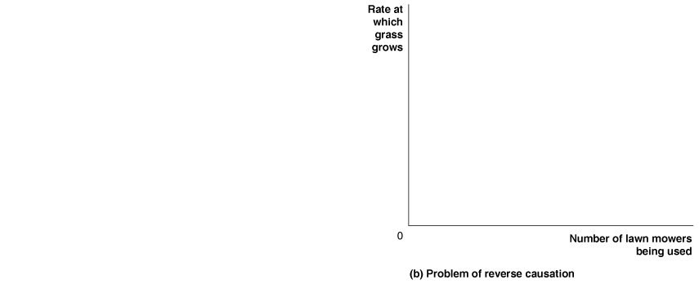

Appendix
Graphs of Two Variables
Determining Cause and Effect
FIGURE 1A-7
Determining Cause and Effect

Slide 29
Appendix
Graphs of Two Variables
Are Graphs of Economic Relationships Always Straight Lines?
The graphs of relationships between two economic variables that we have drawn so far have been straight lines.
The relationship between two variables is linear when it can be represented by a straight line.
Few economic relationships are actually linear.

Slide 30
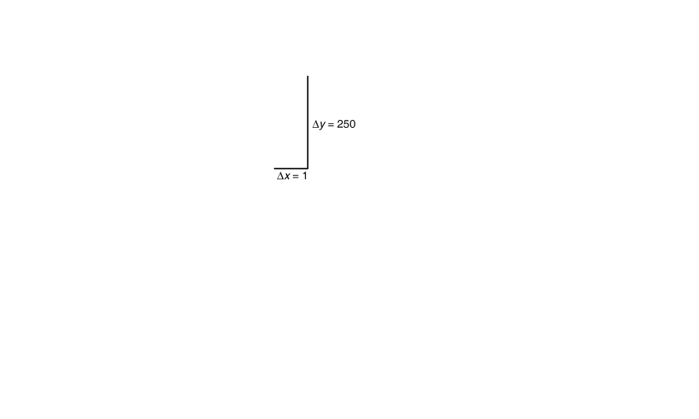
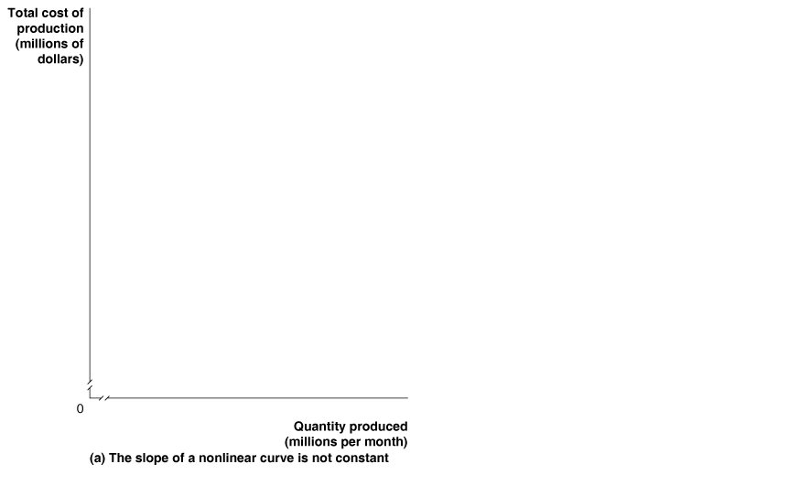
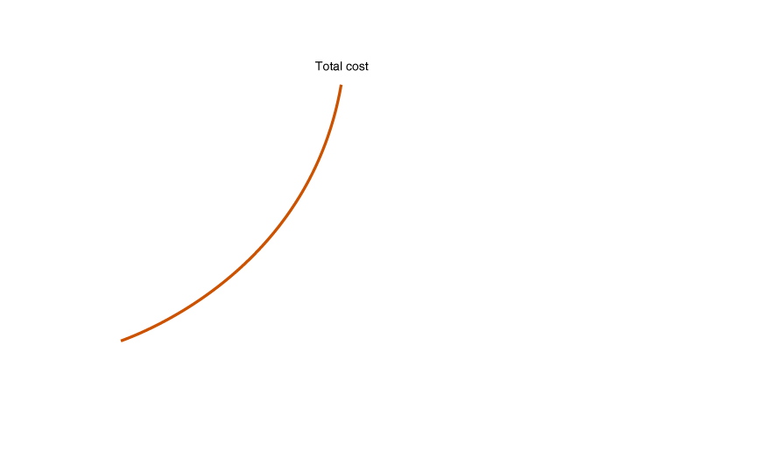
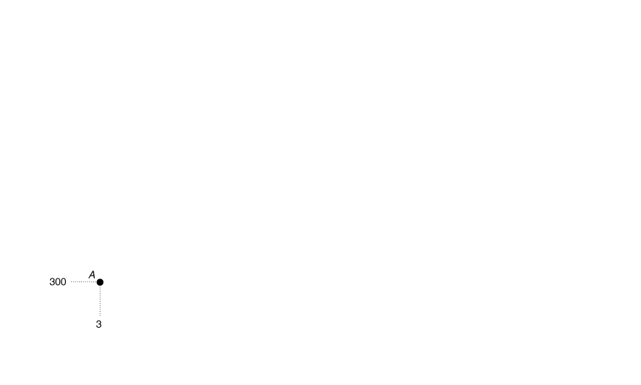
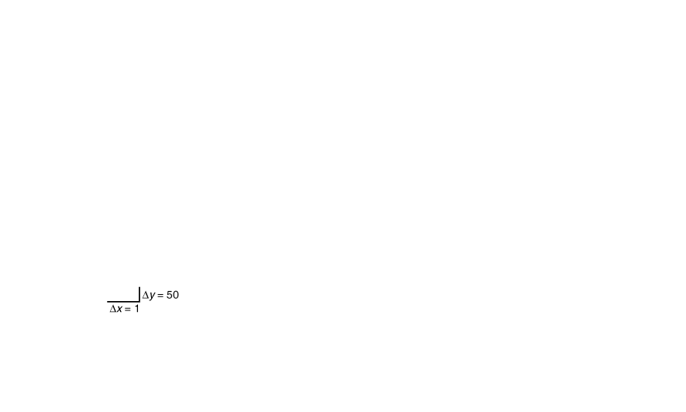
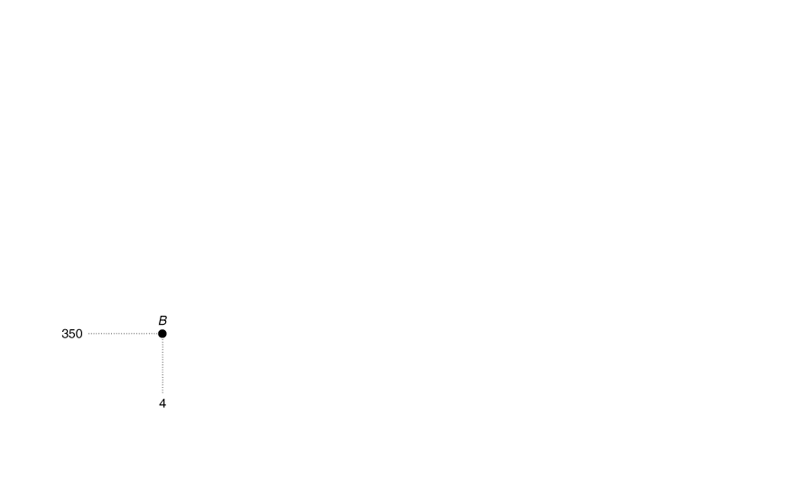
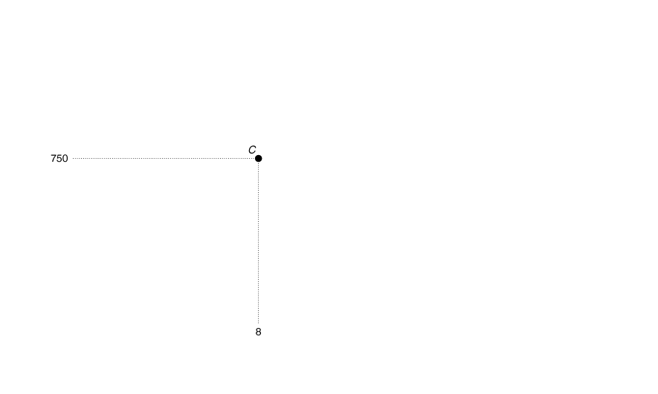
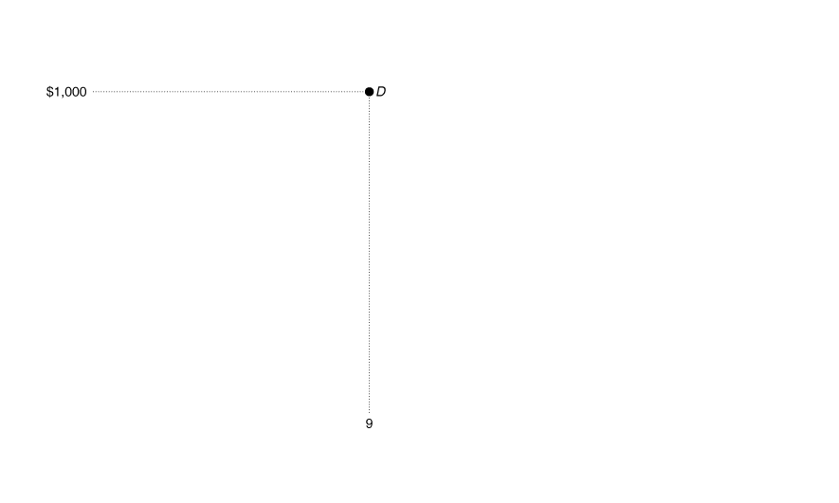
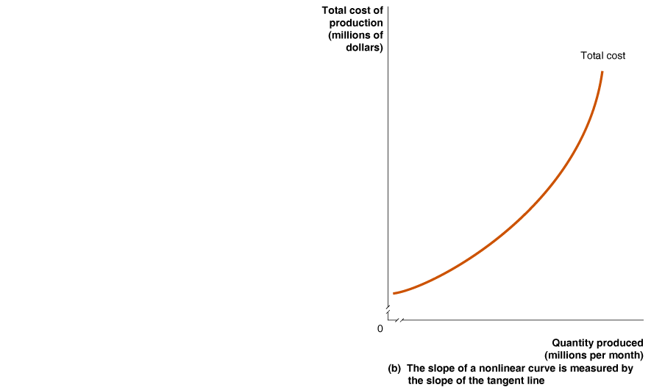
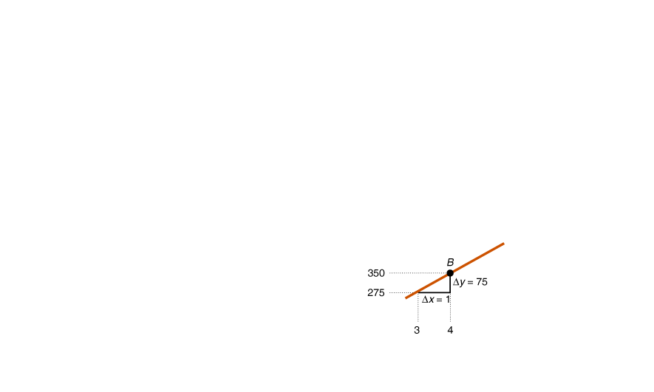
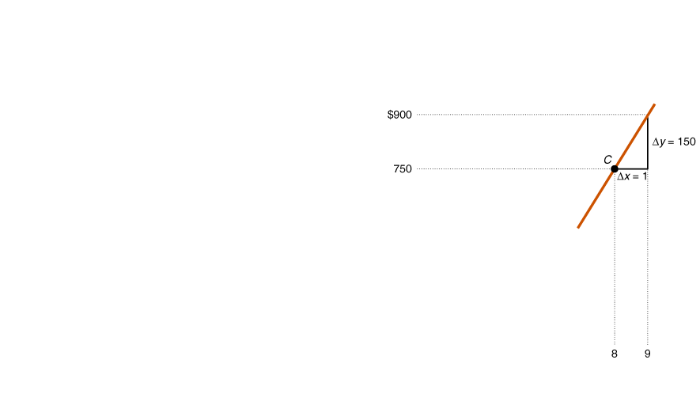
Appendix
Graphs of Two Variables
Slopes of Nonlinear Curves
FIGURE 1A-8
The Slope of a Nonlinear Curve

Slide 31
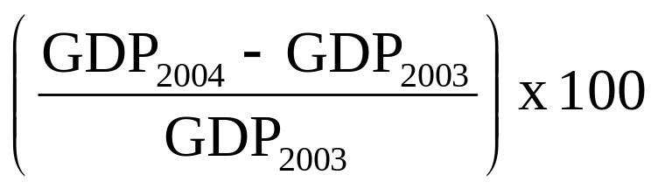
Appendix
Formulas
Formulas for a Percentage Change
One important formula is the percentage change.
The percentage change is the change in some economic variable, usually from one period to the next, expressed as a percentage.

Slide 32
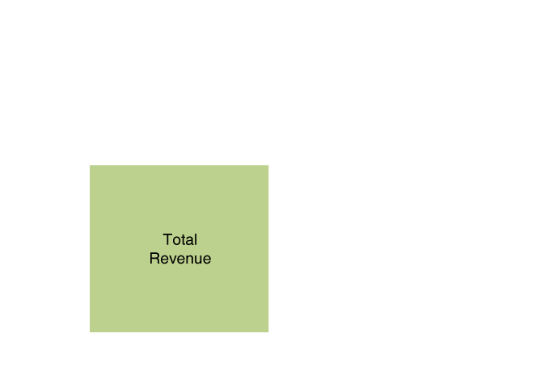
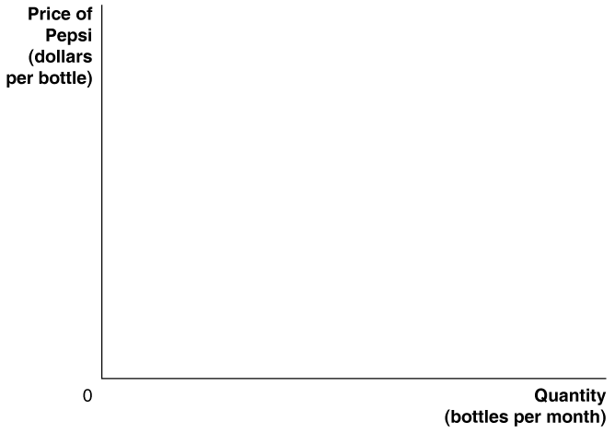
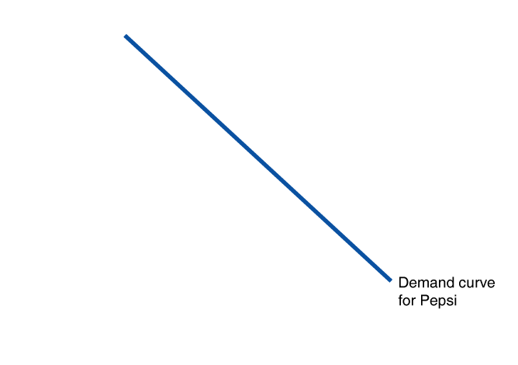
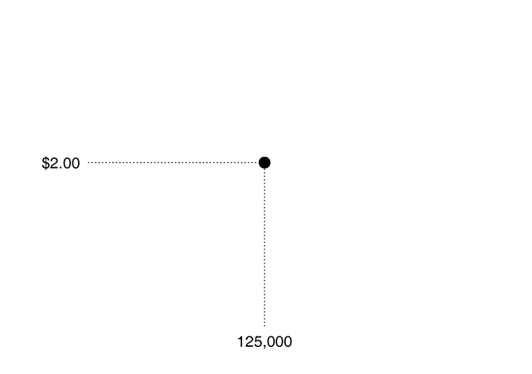
Appendix
Formulas
Formulas for the Areas of a Rectangle and a Triangle
FIGURE 1A-9
Showing a Firm’s Total Revenue on a Graph

Slide 33

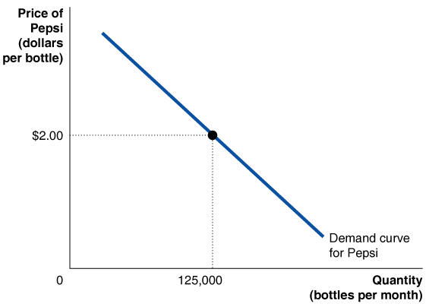
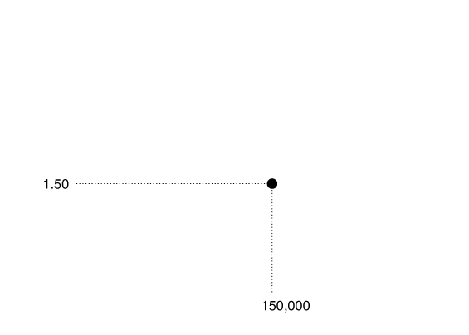
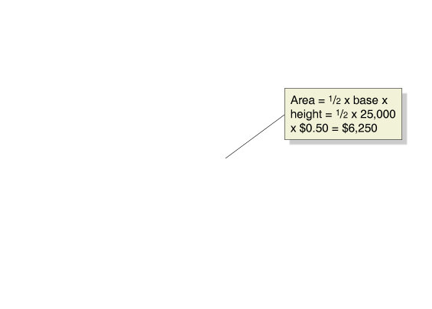
Appendix
Formulas
Formulas for the Areas of a Rectangle and a Triangle
FIGURE 1A-10
The Area of a Triangle

Slide 34
Appendix
Formulas
Summary of Using Formulas
Whenever you must use a formula, you should follow these steps:
1 Make sure you understand the economic concept that the formula represents.
2 Make sure you are using the correct formula for the problem you are solving.
3 Make sure that the number you calculate using the formula is economically reasonable. For example, if you are using a formula to calculate a firm’s revenue and your answer is a negative number, you know you made a mistake somewhere.

