Slide 1
GDP: Measuring Total
Production and Income

Slide 2

Increases in GDP Spur Hiring at Freightliner
After studying this chapter, you should be able to:
  Explain how total production is measured.
  Discuss whether GDP is a good measure of economic well-being.
  Discuss the difference between real variables and nominal variables.
  Become familiar with other measures of total production and total income.
1
2
3
LEARNING OBJECTIVES
4
Individual firms like Freightliner must pay attention to developments in the overall economy.

Slide 3
GDP
20世纪最重要的发现之一便是使用GDP.
萨缪尔森

Slide 4
GDP: Measuring Total Production and Income
Microeconomics The study of how households and businesses make choices, how they interact in markets, and how the government attempts to influence their choices.
Macroeconomics The study of the economy as a whole, including topics such as inflation, unemployment, and economic growth.
Business cycle Alternating periods of economic expansion and economic recession.

Slide 5

The use of macroeconomic analysis to help the federal government design policies that help the economy run more efficiently is:
a. An absolute necessity, according to economists.
b. A practice suggested by politicians but not by economists.
c. A controversial question among economists.
d. Ideal in theory but nonexistent in practice since our knowledge of the economy as a whole is in fact very limited.

Slide 6
The use of macroeconomic analysis to help the federal government design policies that help the economy run more efficiently is:
a. An absolute necessity, according to economists.
b. A practice suggested by politicians but not by economists.
c. A controversial question among economists.
d. Ideal in theory but nonexistent in practice since our knowledge of the economy as a whole is in fact very limited.

Slide 7
GDP: Measuring Total Production and Income
Expansion The period of a business cycle during which total production and total employment are increasing.
Recession The period of a business cycle during which total production and total employment are decreasing.
Economic growth The ability of an economy to produce increasing quantities of goods and services.
Inflation rate The percentage increase in the price level from one year to the next.

Slide 8
Gross Domestic Product Measures Total Production
1
LEARNING OBJECTIVE
Measuring Total Production:
Gross Domestic Product
Gross domestic product (GDP) The market value of all final goods and services produced in a country during a period of time.

Slide 9
Gross Domestic Product Measures Total Production
Measuring Total Production: Gross Domestic Product
GDP IS MEASURED USING MARKET VALUES, NOT QUANTITIES
GDP INCLUDES ONLY THE MARKET VALUE OF FINAL GOODS
Final good or service A good or service purchased by a final user.
Intermediate good or service A good or service that is an input into another good or service, such as a tire on a truck.
GDP INCLUDES ONLY CURRENT PRODUCTION

Slide 10
最终产品，增值和 GDP
1.1
定义: 国内生产总值是在某一既定时期一个国家内生产的所有最终物品与劳务的市场价值。
“……所有的……”：GDP要成为全面的衡量，它包括了经济中生产并在市场上合法出售的所有东西。GDP还包括了租金和佣金的收入。
“……最终……”：GDP只计算最终物品的价值，而不包括中间物品，避免对中间物品的重复计算。
“……物品和劳务……”：GDP既包括有形的物品，也包括无形的劳务。
Return

Slide 11
“……生产的……”：GDP包括现期生产的物品与劳务，并不包括涉及过去生产的东西的交易。二手货（used goods）出售并不包括在GDP中
“……一个国家之内……”：GDP衡量的生产价值是在一个国家的地理范围之内。国民生产总值（GNP）是在某一既定时期内由一国永久居民生产的所有最终物品和劳务的市场价值。
“……在某一既定时期内……”：GDP衡量某一既定时期内进行的生产的价值。通常这个时期是一年或一个季度。GDP衡量在这一段时期中经济收入与支出的流量。

Slide 12
Which of the following terms is the opposite of the term “final goods” in the definition of GDP?
a. Intangible goods.
b. Unfinished goods.
c. Partial goods.
d. Intermediate goods.

Slide 13
Which of the following terms is the opposite of the term “final goods” in the definition of GDP?
a. Intangible goods.
b. Unfinished goods.
c. Partial goods.
d. Intermediate goods.

Slide 14
7 - 1
1
LEARNING OBJECTIVE
Calculating GDP
PRODUCTION AND PRICE STATISTICS FOR 2007
(1) PRODUCT | (2) QUANTITY | (3) PRICE PER UNIT
Eye examinations | 100 | $50.00
Pizzas | 80 | 10.00
Textbooks | 20 | 100.00
Paper | 2,000 | 0.10
PRODUCT | (1) QUANTITY | (2) PRICE PER UNIT | (3) VALUE
Eye examinations | 100 | $50 | $5,000
Pizzas | 80 | 10 | 800
Textbooks | 20 | 100 | 2,000

Slide 15
Gross Domestic Product Measures Total Production
Production, Income, and the Circular Flow Diagram
Transfer payments Payments by the government to individuals for which the government does not receive a good or service in return.

Slide 16
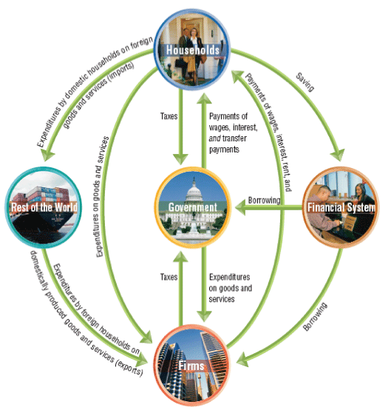
Gross Domestic Product Measures Total Production
Production, Income, and the Circular Flow Diagram
7 - 1
The Circular Flow and
the Measurement of GDP

Slide 17
收入-支出流程图
第一，家庭从厂商和和政府处获得收入，从厂商处购买商品即支出，并向政府交税。
第二，厂商向家庭和政府出售获得收入，向家庭支付工资、薪金、股息、利息和租
金，并向政府纳税。第三，政府收税取得收入，购买商品劳务并支付工作人员工资，
向家庭支付利息和转移收入。
工资，利息，股息，租金
税收
劳务购买和转移支付
厂商间投资品购买
家庭间劳务购买
厂商
政府
家庭
商品采购
税收
商品购买

Slide 18
In the circular-flow diagram, who supplies factors of production in exchange for income?
a. Households.
b. Firms.
c. The government.
d. All of the above.

Slide 19
In the circular-flow diagram, who supplies factors of production in exchange for income?
a. Households.
b. Firms.
c. The government.
d. All of the above.

Slide 20

Gross Domestic Product Measures Total Production
Components of GDP
PERSONAL CONSUMPTION EXPENDITURES, OR “CONSUMPTION”
Consumption Spending by households on goods and services, not including spending on new houses.
GROSS PRIVATE DOMESTIC INVESTMENT, OR “INVESTMENT”
Investment Spending by firms on new factories, office buildings, machinery, and inventories, and spending by households on new houses.
Remember What Economists Mean By “Investment”

Slide 21
Gross Domestic Product Measures Total Production
Components of GDP
GOVERNMENT CONSUMPTION AND GROSS INVESTMENT, OR “GOVERNMENT PURCHASES”
Government purchases Spending by federal, state, and local governments on goods and services.

Slide 22
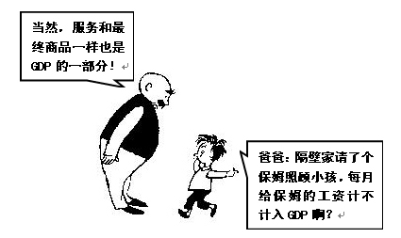


Slide 23
投资 (I)
1.2
定义1: 对资本[生产要素]的支出.
定义2: 对将来使用的商品的支出.
宏观经济学的投资是创造新资本，不包括债券和股票
张三购买了一套万科城市花园的3年前的小别墅（当年的呢？）、中国石化出售1000万元的股票，并用该收入建立几个加油站。
某同学购买甲同学的华能国际的股票
  企业固定资产投资，为生产其他产品或服务而购买的厂房和设备
  居民固定资产投资
  家庭和房东购买的新住房
  存货投资
  企业存货的变动
Notes:
In definition #1, note that aggregate investment equals total spending on newly produced capital goods. (If I pay $1000 for a used computer for my business, then I’m doing $1000 of investment, but the person who sold it to me is doing $1000 of disinvestment, so there is no net impact on aggregate investment.)
The housing issue
A consumer’s spending on a new house counts under investment, not consumption.
A tenant’s spending on rent counts under services -- rent is considered spending on “housing services.”
So what happens if a renter buys the house she had been renting? Conceptually, consumption should remain unchanged: just because she is no longer paying rent, she is still consuming the same housing services as before.
In national income accounting, (the services category of) consumption includes the imputed rental value of owner-occupied housing.
To help students keep all this straight, you might suggest that they think of a house as a piece of capital which is used to produce a consumer service, which we might call “housing services”. Thus, spending on the house counts in “investment”, and the value of the housing services that the house provides counts under “consumption” (regardless of whether the housing services are being consumed by the owner of the house or a tenant).
Inventories
If total inventories are $10 billion at the beginning of the year, and $12 billion at the end, then inventory investment equals $2 billion for the year.
Note that inventory investment can be negative (which means inventories fell over the year).

Slide 24


7 - 1
Spending on Homeland Security
Government spending on homeland security more than doubled between 2001 and 2004.

Slide 25
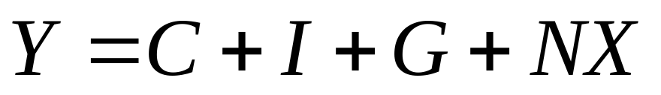
Gross Domestic Product Measures Total Production
Components of GDP
NET EXPORTS OF GOODS AND SERVICES, OR “NET EXPORTS”
Net exports Exports minus imports.
An Equation for GDP and Some Actual Values

Slide 26
When accounting for exports and imports in GDP, which of the following is correct?
a. Exports are added to the other categories of expenditures.
b. Imports are added to the other categories of expenditures.
c. Both exports and imports are added to the other categories of expenditures.
d. Both exports and imports are subtracted from the other categories of expenditures.

Slide 27
When accounting for exports and imports in GDP, which of the following is correct?
a. Exports are added to the other categories of expenditures.
b. Imports are added to the other categories of expenditures.
c. Both exports and imports are added to the other categories of expenditures.
d. Both exports and imports are subtracted from the other categories of expenditures.

Slide 28
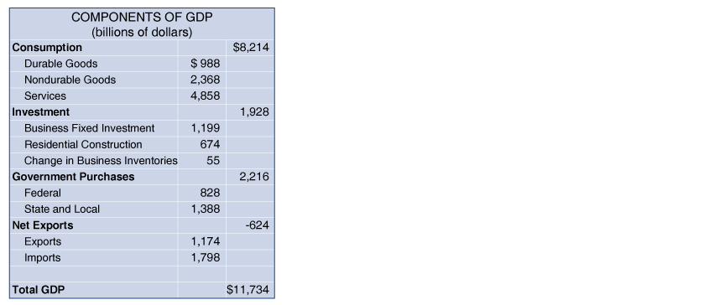
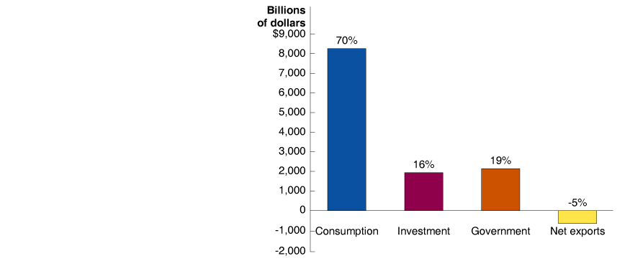
Gross Domestic Product Measures Total Production
An Equation for GDP and Some Actual Values
7 - 2
Components of GDP in 2004

Slide 29
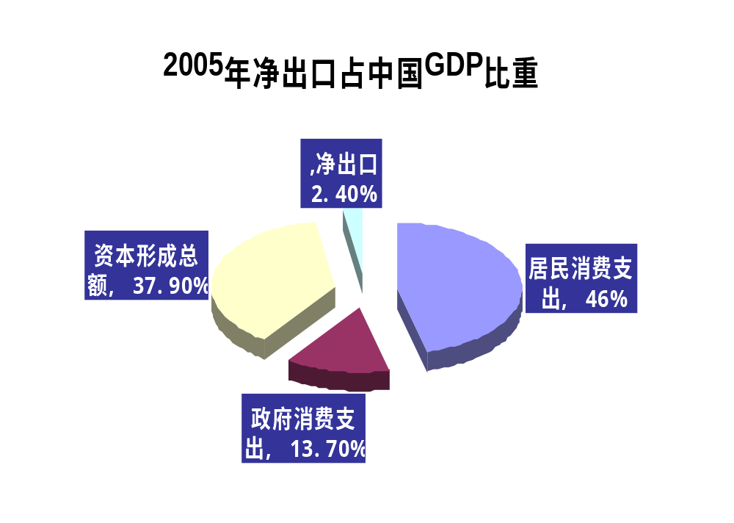

Slide 30
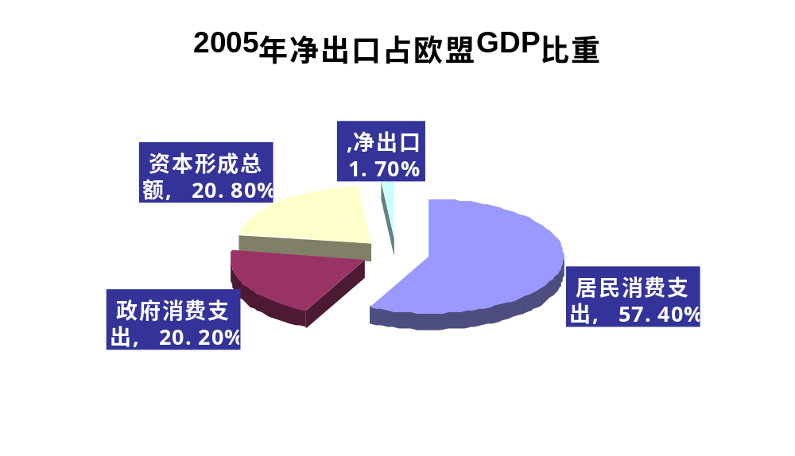

Slide 31
2005年世界各国国内生产总值构成比较
国家和地区 | 人均GDP | GDP支出构成（％）
 |  | 居民消费支出 | 政府消费支出 | 资本形成总额 | 净出口
中国 | 890 | 46.0 | 13.7 | 37.9 | 2.4
美国 | 34280 | 68.6 | 14.4 | 20.7 | －3.7
欧盟 | 20670 | 57.4 | 20.2 | 20.8 | 1.7
日本 | 35610 | 56.4 | 17.5 | 25.5 | 0.6
德国 | 23560 | 59.0 | 19.1 | 20.0 | 1.9
英国 | 25120 | 65.8 | 19.2 | 17.2 | －2.2
墨西哥 | 5530 | 70.1 | 11.6 | 20.7 | －2.4
印度尼西亚 | 690 | 67.0 | 7.4 | 17.0 | 8.5
马来西亚 | 3330 | 40.6 | 12.2 | 28.9 | 18.4
新加坡 | 21500 | 42.1 | 11.9 | 24.3 | 21.7
泰国 | 1940 | 58.3 | 11.6 | 24.0 | 6.1
韩国 | 9460 | 60.5 | 10.4 | 26.7 | 2.3

Slide 32
Gross Domestic Product Measures Total Production
An Equation for GDP and Some Actual Values
The table provides a more detailed breakdown and shows several interesting points:
  Consumer spending on services is greater than the sum of spending on durable and nondurable goods.
  Business fixed investment is the largest component of investment.
  Purchases by state and local governments are greater than purchases by the federal government.
  Imports are greater than exports, so net exports are negative.

Slide 33
Gross Domestic Product Measures Total Production
Measuring GDP by the Value Added Method
Value added The market value a firm adds to a product.
7 – 1
Calculating Value Added
FIRM | VALUE OF PRODUCT | VALUE ADDED
Cotton Farmer | Value of raw cotton = $1.00 | Value added by cotton farmer | = $1.00
Textile Mill | Value of raw cotton woven into cotton fabric = $3.00 | Value added by cotton textile mill = ($3.00 – $1.00) | = $2.00
Shirt Company | Value of cotton fabric made into a shirt = $15.00 | Value added by shirt manufacturer = ($15.00 –$3.00) | = $12.00
L.L. Bean | Value of shirt for sale on L.L. Bean’s Web site = $35.00 | Value added by L.L. Bean = ($35.00 – $15.00) | = $20.00
 | Total Value Added |  | = $35.00

Slide 34
Does GDP Measure What We Want It to Measure?
2
LEARNING OBJECTIVE
Shortcomings in GDP as a Measure of Total Production
HOUSEHOLD PRODUCTION
Household production Goods and services people produce for themselves.
THE UNDERGROUND ECONOMY
Underground economy Buying and selling of goods and services that is concealed from the government to avoid taxes or regulations or because the goods and services are illegal.

Slide 35
Household production and the underground economy:
a. Are fully accounted for in GDP figures gathered by the Commerce Department.
b. Are not considered formal production of goods and services; therefore, they are not included in GDP accounting.
c. Are important but unaccounted for in the Commerce Department’s estimate of GDP.
d. Are irrelevant because they constitute only a very small fraction of GDP for most countries.

Slide 36
Household production and the underground economy:
a. Are fully accounted for in GDP figures gathered by the Commerce Department.
b. Are not considered formal production of goods and services; therefore, they are not included in GDP accounting.
c. Are important but unaccounted for in the Commerce Department’s estimate of GDP.
d. Are irrelevant because they constitute only a very small fraction of GDP for most countries.

Slide 37

7 - 2
How the Underground Economy Hurts Developing Countries
In some developing countries, more than half the workers may be in the underground economy.

Slide 38
Does GDP Measure What We Want It to Measure?
Shortcomings of GDP as a Measure of Well-Being
THE VALUE OF LEISURE IS NOT INCLUDED IN GDP
GDP IS NOT ADJUSTED FOR POLLUTION OR OTHER NEGATIVE EFFECTS OF PRODUCTION
GDP IS NOT ADJUSTED FOR CHANGES IN CRIME AND OTHER SOCIAL PROBLEMS

Slide 39

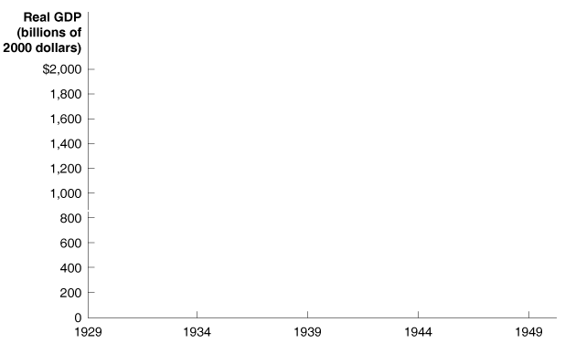
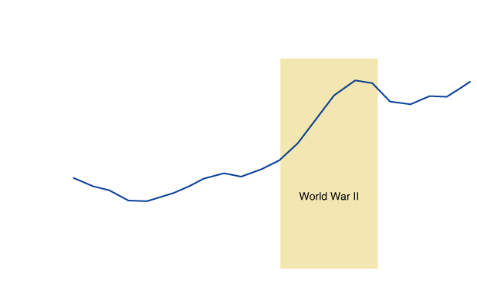
7 - 3
Did World War II Bring Prosperity?
Production of military goods soared during World War II, but production of consumption goods lagged.

Slide 40
Real GDP versus Nominal GDP
3
LEARNING OBJECTIVE
Calculating Real GDP
Real GDP The value of final goods and services evaluated at base year prices.
Nominal GDP The value of final goods and services evaluated at current year prices.

Slide 41
Which measure of GDP represents changes strictly in the quantity of goods and services produced in the economy, not the prices?
a. Nominal GDP.
b. Real GDP.
c. The GDP measure that sums up the value of goods and services evaluated at current year prices.
d. None of the above.

Slide 42
Which measure of GDP represents changes strictly in the quantity of goods and services produced in the economy, not the prices?
a. Nominal GDP.
b. Real GDP.
c. The GDP measure that sums up the value of goods and services evaluated at current year prices.
d. None of the above.

Slide 43
7 - 2
3
LEARNING OBJECTIVE
Calculating Real GDP
 | 2000 |  | 2005
PRODUCT | QUANTITY | PRICE | QUANTITY | PRICE
Eye examinations | 80 | $40 | 100 | $50
Pizzas | 90 | $11 | 80 | $10
Textbooks | 15 | $90 | 20 | $100
PRODUCT | QUANTITY | PRICE | VALUE
Eye examinations | 100 | $40 | $4,000
Pizzas | 80 | $11 | $880
Textbooks | 20 | $90 | $1,800

Slide 44
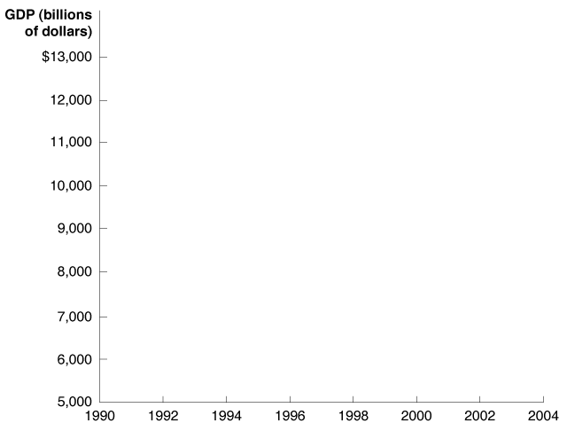
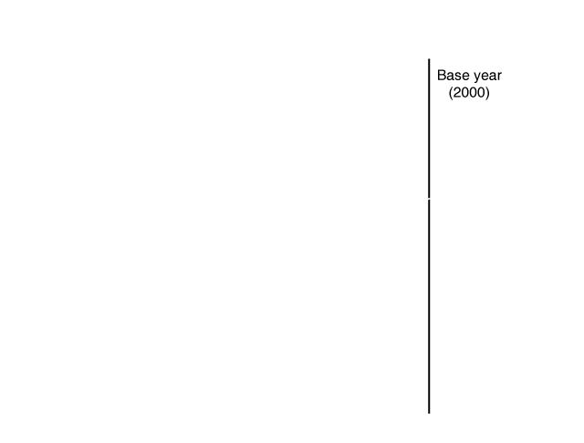
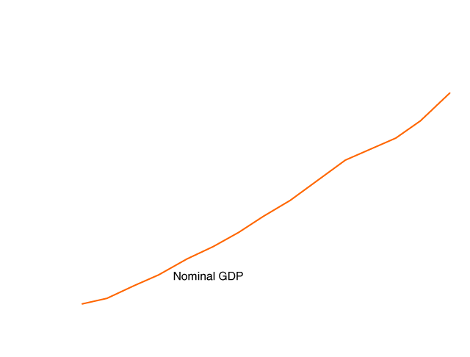
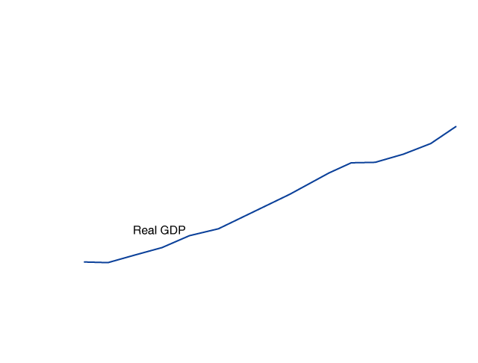
Real GDP versus Nominal GDP
Comparing Real GDP and Nominal GDP
7 - 3
Nominal GDP and Real GDP, 1990-2004

Slide 45

7 - 4
How Freightliner Uses Forecasts of GDP
Freightliner increased hiring and production in 2004 based on forecasts of GDP.

Slide 46
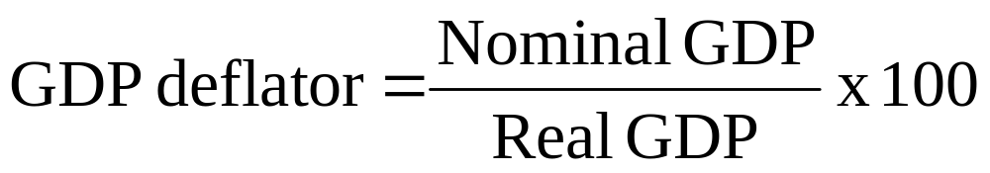
Real GDP versus Nominal GDP
The GDP Deflator
Price level A measure of the average prices of goods and services in the economy.
GDP deflator A measure of the price level, calculated by dividing nominal GDP by real GDP, and multiplying by 100.

Slide 47
Other Measures of Total Production and Total Income
4
LEARNING OBJECTIVE
Gross National Product (GNP)
Net National Product (NNP)
National Income
Personal Income
Disposable Personal Income

Slide 48
1991年以前，美国一直用GNP作为总产出的主要测量值，从1991年起改为GDP。其原因是：GDP是一国经济中就业潜力较好的测量指标；GDP数据与GNP数据相比，相对容易获得；国际贸易水平的相对提高；欧洲国家传统采用GDP。

Slide 49
使用GDP的原因
国际间的比较容易
国外净收入的数据不足
GDP可更好衡量经济的就业能力
GDP

Slide 50
其他数据（MPS与SNA）
2
国内净产值（Net Domestic Product）
  NDP＝GDP－折旧（固定资本的消耗，约GDP 的10%）
  NNP= GNP－折旧
国民收入（National Income）衡量经济中所有人所赚
  NI＝GNP－折旧－间接税
Return
Notes:
After revealing the first bullet point, mention that there are several different measures of the overall price level. Your students are probably familiar with one of them---the Consumer Price Index, which will be covered shortly. For now, though, we learn about a different one <reveal next bullet point>, the GDP deflator.
The GDP deflator is so named because it is used to “deflate” (remove the effects of inflation from) GDP and other economic variables.

Slide 51
国民收入的组成
1.3
工资和其他劳动收入
1、雇员报酬（71%），工人的工资与福利津贴
2、业主收入（8%），非公司企业收入
3、租金收入（2%），房东得到的收入
4、公司利润（12%），公司的收入
5、净利息（7%）国内企业支付的利息减得到的利息，加上从国外获得的。

Slide 52
其他数据
个人收入（PI）=国民收入-公司利润-社会保险税-净利息+红利+政府转移支付+个人利息收入
个人可支配收入（DPI）= PI-个人税收和非税收支出，如抗旱费

Slide 53
衡量方法
收入法
把参加生产过程的所有生产要素的所有者的收入相加得到GDP的数字。不同类型的收入主要有工资、利润、地租、利息收入等。
支出法
把实际经济生活中四大类对最终产品和服务的需求相加得到GDP。四个部分包括消费（C）、投资（I）、政府购买（G）和净出口（NX），即Y=C+I+G+NX。
因为买者的支出必定是卖者的收入，所以收入法和支出法等价。

Slide 54
GDP是好的指标吗？
忽视非市场行为和地下经济
忽略了闲暇和心理
不反映收入分配状况，环境，产品质量等福利性指标
没有考虑孩子的健康、教育或享受游戏的快乐；没有包括诗歌之美和婚姻的稳定；没有衡量我们的勇气和对祖国的热爱。他衡量了一切，除了使我们生活有意义的东西。

Slide 55


产品质量的提高
售价相同，但是质量不同。

Slide 56
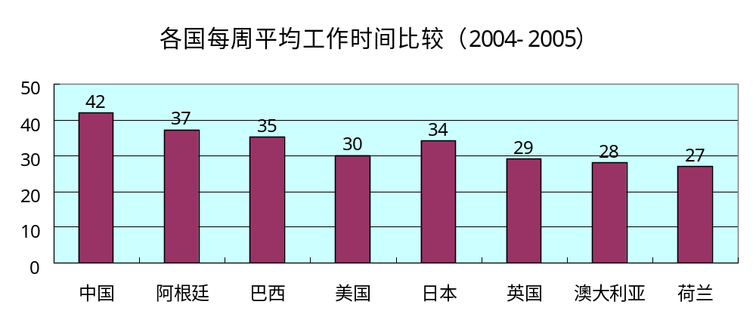
闲暇时间的忽略

Slide 57
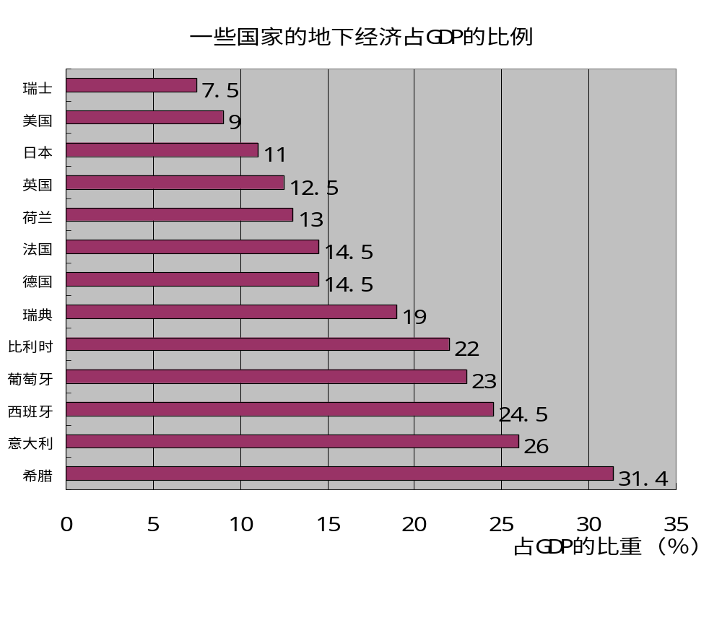
地下经济（underground economy）

Slide 58
地下经济
目前全球地下经济规模高达1.5万亿美元。随着市场经济发展，我国也出现了地下经济，个别地区还很严重。
地下经济被国际社会公认为是“经济黑洞”，它主要由三部分组成：
非法经济———如走私、贩毒、卖淫、拐卖人口、开办地下工厂、制假贩假、贪污贿赂、洗钱、赌博等；
未申报经济———主要表现为经济主体没有取得合法经营资格、无照经营、不缴纳税款和管理费用、不遵守有关规定等经济活动；
未统计经济———它是指政府没有进行统计或遗漏统计的一些经济活动。

Slide 59
Discussion Question:
In your country,
which would you want
to be bigger, GDP or GNP?
Why?
Notes:
This issue is subjective, and the question is intended to get students to think a little deeper about the difference between GNP and GDP. Of course, there is no single correct answer.
Some students offer this response:
It’s better to have GNP > GDP, because it means our nation’s income is greater than the value of what we are producing domestically. If, instead, GDP > GNP, then a portion of the income generated in our country is going to people in other countries, so there’s less income left over for us to enjoy.

Slide 60
地下经济
中国统计局内部调查表明，在10万亿元的经济总量中，“地下经济”约占10%，而学者们认为比例可能高达15%至20%。由于“地下经济”逃避政府管制和税收，其产品成本较合法经济低得多，在竞争中处于有利地位，极不利于市场的公平竞争和资源的优化配置。
西班牙政府估计，目前西班牙从事地下经济的人数约占劳动力的18－20%，地下经济约占国内生产总值的20%。地下经济主要集中在农业和建筑业。

Slide 61
Which of the following do we subtract from GNP to obtain NNP?
a. The production of fixed capital.
b. Consumption.
c. Investment.
d. Depreciation.

Slide 62
Which of the following do we subtract from GNP to obtain NNP?
a. The production of fixed capital.
b. Consumption.
c. Investment.
d. Depreciation.

Slide 63
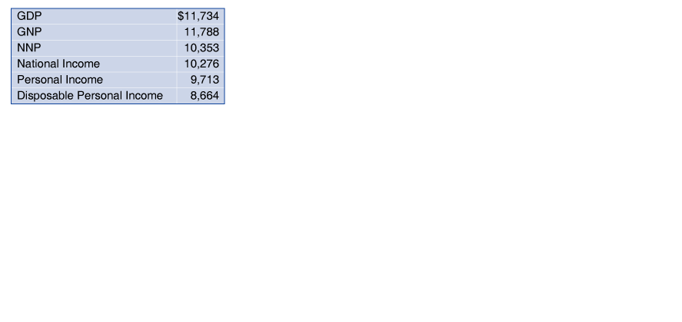
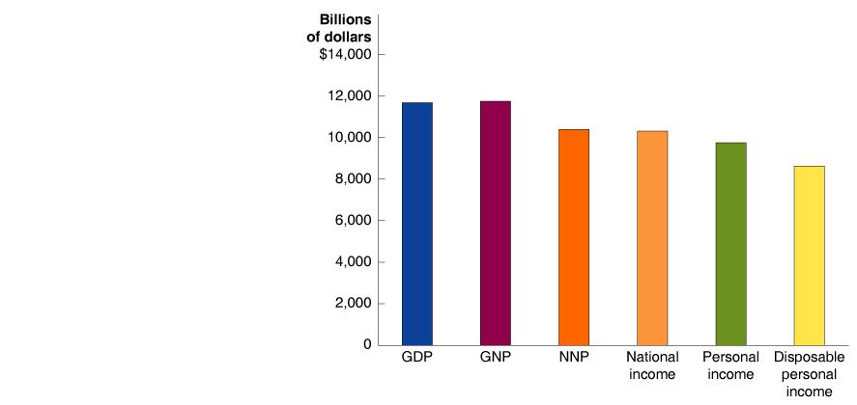
Real GDP versus Nominal GDP
Disposable Personal Income
7 - 4
Measures of Total Production and Total Income, 2004

Slide 64

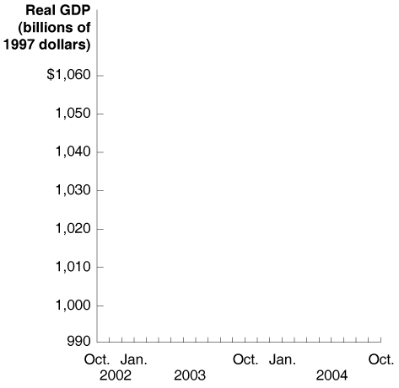

Canadian GDP Was Flat in October
Monthly real GDP for Canada, October 2002 to October 2004.

Slide 65

Business cycle
Consumption
Economic growth
Expansion
Final good or service
GDP deflator
Government purchases
Gross domestic product (GDP)
Inflation rate
Intermediate good or service
Investment
Macroeconomics
Microeconomics
Net exports
Nominal GDP
Price level
Real GDP
Recession
Transfer payments
Underground economy
Value added

