Slide 1
Unemployment and Inflation

Slide 2

Lucent Technologies Deals with Unemployment and Inflation
After studying this chapter, you should be able to:
  Define the unemployment rate and the labor force participation rate, and understand how they are computed.
  Identify the three types of unemployment.
  Explain what factors determine the unemployment rate.
  Define the price level and the inflation rate, and understand how they are computed.
  Use price indexes to adjust for the effects of inflation.
  Distinguish between the nominal interest rate and the real interest rate.
  Discuss the problems caused by inflation.
1
2
3
4
LEARNING OBJECTIVES
5
…, the contract between Lucent and its union workers increased wages by less than the increase in prices expected by the firm and the workers.
6
7

Slide 3
生活中的不幸
一位经济学教授在他的办公室门上写了一条告示：“学习经济学并不能保证你不失业，但等到你失业时，经济学会告诉你为什么会失业。”

Slide 4
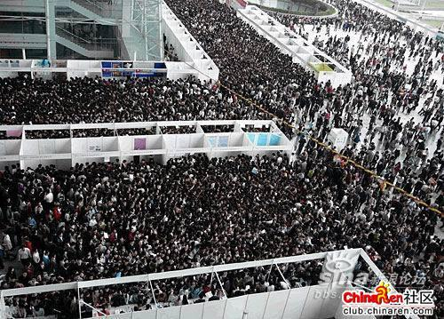
像这样的招聘会已经是司空见惯了！！！

Slide 5
Measuring the Unemployment Rate and the Labor Force Participation Rate
1
LEARNING OBJECTIVE
The Household Survey
Labor force The sum of employed and unemployed workers in the economy.
Unemployment rate The percentage of the labor force that is unemployed.
Discouraged workers People who are available for work, but who have not looked for a job during the previous four weeks because they believe no jobs are available for them.

Slide 6

Which of the following groups is included in the labor force?
a. The unemployed.
b. Retirees, homemakers, and full-time students.
c. People who could have a civilian job but are on active military service, in prison, or in mental hospitals.
d. None of the above.

Slide 7
Which of the following groups is included in the labor force?
a. The unemployed.
b. Retirees, homemakers, and full-time students.
c. People who could have a civilian job but are on active military service, in prison, or in mental hospitals.
d. None of the above.

Slide 8
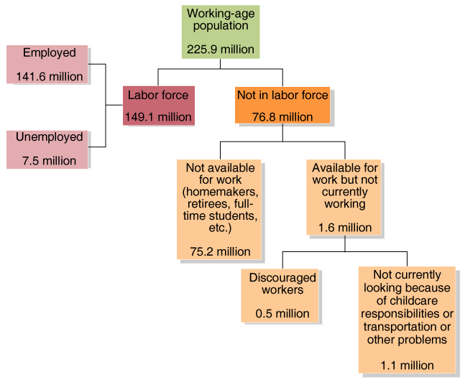
Measuring the Unemployment Rate and the Labor Force Participation Rate
The Household Survey
8 - 1
The Employment Status of the Civilian Working-Age Population, June 2005

Slide 9
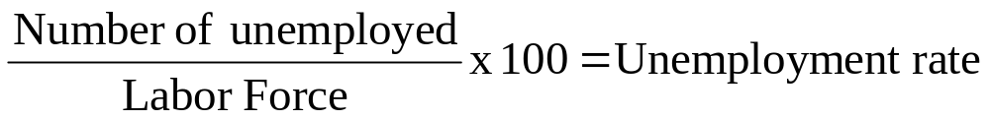
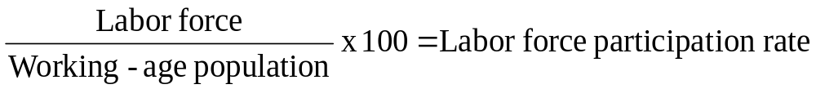
Measuring the Unemployment Rate and the Labor Force Participation Rate
The Household Survey
  The unemployment rate measures the percentage of the labor force that is unemployed:
  The labor force participation rate measures the percentage of the working-age population that is in the labor force:

Slide 10
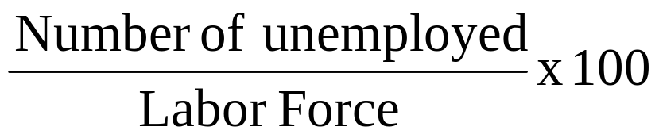
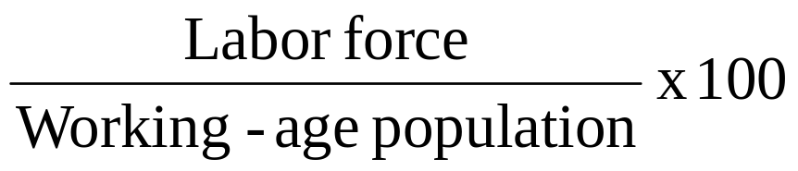
8 - 1
1
LEARNING OBJECTIVE
What Happens If You Include the Military?
People on active military service are not included in the employment, labor force, or working-age population totals compiled in the BLS household survey. Suppose people in the military were included in these statistics.

Slide 11
How would employment statistics be affected if we were to include people in the military?
a. The unemployment rate would decrease.
b. The working-age population would remain the same.
c. The labor force participation rate would remain the same.
d. All of the above.

Slide 12
How would employment statistics be affected if we were to include people in the military?
a. The unemployment rate would decrease.
b. The working-age population would remain the same.
c. The labor force participation rate would remain the same.
d. All of the above.

Slide 13
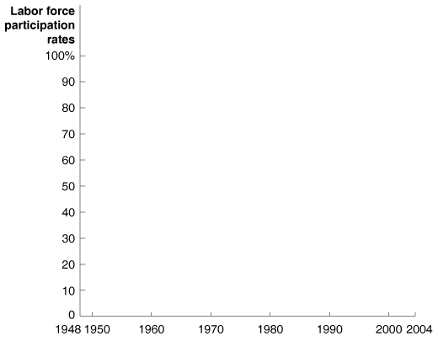
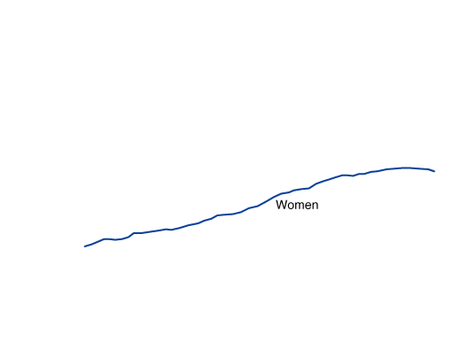
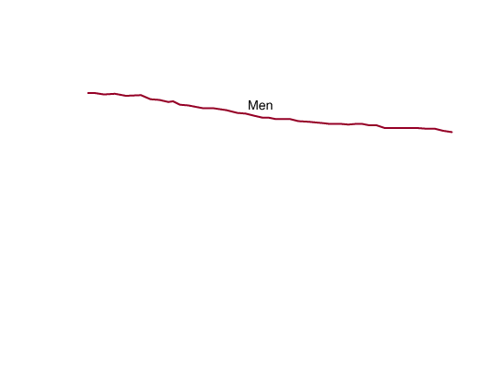
Measuring the Unemployment Rate and the Labor Force Participation Rate
Problems with Measuring the Unemployment Rate
Trends in Labor Force Participation
8 - 2
Trends in the Labor Force
Participation Rates of Adult
Men and Women Since 1948

Slide 14

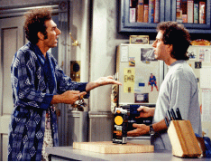
8 - 1
What Explains the Increase in “Kramers?”
Why do more men seem to be adopting Kramer’s lifestyle?

Slide 15
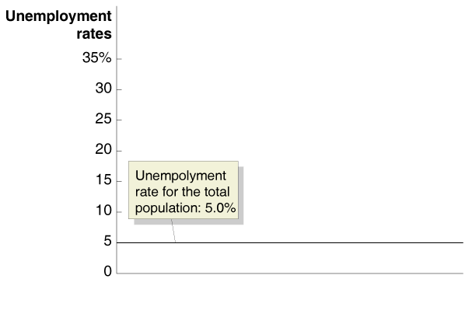
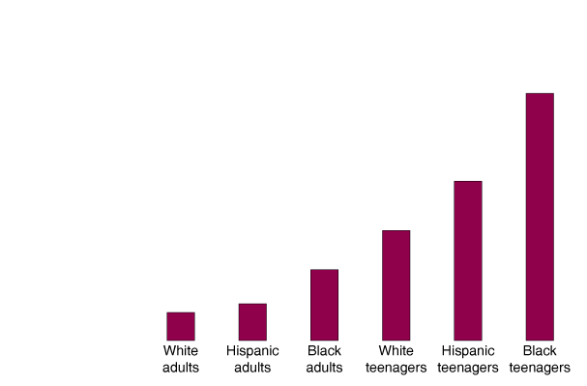
Measuring the Unemployment Rate and the Labor Force Participation Rate
Unemployment Rates for Demographic Groups
8 - 3
Unemployment Rates in the United States
by Demographic Group, June 2005

Slide 16
In June 2005, which of the following demographic groups had a higher rate of unemployment than the unemployment rate for the total population?
a. White adults.
b. Black adults.
c. Hispanic adults.
d. None of the above. The unemployment rates for these groups were all lower than the overall unemployment rate.

Slide 17
In June 2005, which of the following demographic groups had a higher rate of unemployment than the unemployment rate for the total population?
a. White adults.
b. Black adults.
c. Hispanic adults.
d. None of the above. The unemployment rates for these groups were all lower than the overall unemployment rate.

Slide 18
Measuring the Unemployment Rate and the Labor Force Participation Rate
How Long Are People Usually Unemployed?
8 – 1
Duration of Unemployment
LENGTH OF TIME UNEMPLOYED | PERCENTAGE OF TOTAL UNEMPLOYED
Less than 5 weeks | 36.2%
5 to 14 weeks | 31.8
15 to 26 weeks | 14.1
27 weeks or more | 17.8

Slide 19
Measuring the Unemployment Rate and the Labor Force Participation Rate
The Establishment Survey: Another Measure of Employment
8 – 2
Household and Establishment Survey Data for May and June 2005
HOUSEHOLD SURVEY |  |  |  | ESTABLISHMENT SURVEY
 | MAY | JUNE | CHANGE | MAY | JUNE | CHANGE
Employed | 141,475,000 | 141,638,000 | +163,000 | 133,391,000 | 133,537,000 | +146,000
Unemployed | 7,647,000 | 7,486,000 | –161,000
Labor Force | 149,122,000 | 149,123,000 | +1,000
Unemployment Rate | 5.1% | 5.0%

Slide 20
Measuring the Unemployment Rate and the Labor Force Participation Rate
Job Creation and Job Destruction Over Time
8 – 3
Establishments Creating and Eliminating Jobs, September-December 2004
 | NUMBER OF ESTABLISHMENTS |  | NUMBER OF JOBS
ESTABLISHMENTS CREATING JOBS
Existing establishments | 1,530,000 |  | 6,365,000
New establishments | 379,000 |  | 1,716,000
ESTABLISHMENTS ELIMINATING JOBS
Continuing establishments |  | 1,467,000 | 5,727,000
Closing establishments |  | 320,000 | 1,485,000

Slide 21
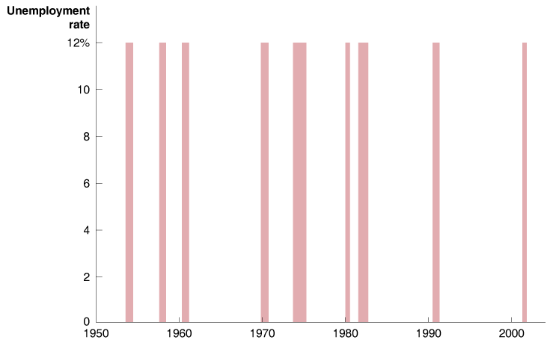
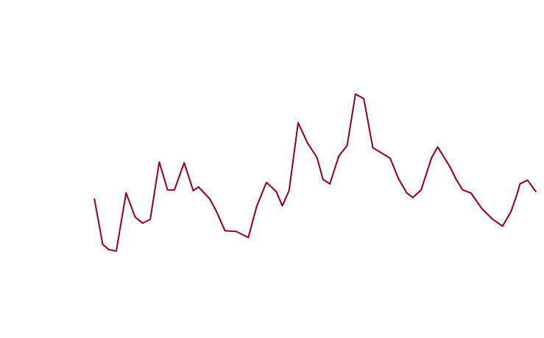
Types of Unemployment
2
LEARNING OBJECTIVE
8 - 4
The Annual Unemployment Rate in the United States, 1950-2004

Slide 22
From 1950 until 2004, the behavior of the annual unemployment rate in the United States demonstrated that:
a. The unemployment rate rises during both recessions and expansions.
b. The unemployment rate falls during both recessions and expansions.
c. The unemployment rate falls during recessions and rises during expansions.
d. The unemployment rate rises during recessions and falls during expansions.

Slide 23
From 1950 until 2004, the behavior of the annual unemployment rate in the United States demonstrated that:
a. The unemployment rate rises during both recessions and expansions.
b. The unemployment rate falls during both recessions and expansions.
c. The unemployment rate falls during recessions and rises during expansions.
d. The unemployment rate rises during recessions and falls during expansions.

Slide 24
Types of Unemployment
Frictional Unemployment and Job Search
Frictional unemployment Short-term unemployment arising from the process of matching workers with jobs.
Structural Unemployment
Structural unemployment Unemployment arising from a persistent mismatch between the skills and characteristics of workers and the requirements of jobs.

Slide 25
Types of Unemployment
Cyclical Unemployment
Cyclical unemployment Unemployment caused by a business cycle recession.
Full Employment
Natural rate of unemployment The normal rate of unemployment, consisting of structural unemployment plus frictional unemployment.

Slide 26

季节性失业
季节性失业是指与天气、旅游或是其他季节性因素变化相关的失业。
季节性失业是一种良性失业：它是一种短期失业，并且可以完全预测得到，工人可以事先从这种季节性性失业中得到补偿。比如：建筑工人的小时工资高于平均水平，部分弥补了他们在冬季的高失业概率。

Slide 27
结构性失业
结构性失业是指工作技能或工人特征与工作要求之间持续的不相匹配所形成的失业。

Slide 28
周期性失业
周期性失业是指经济周期中的衰退或萧条时，因需求下降而造成的失业。这种失业是由整个经济的支出和产出下降造成的。

Slide 29
When the economy is at full employment, which types of unemployment remain?
a. Cyclical and structural.
b. Frictional and structural.
c. Frictional and cyclical.
d. None of the above. Full employment means that there is no unemployment, so the unemployment rate would be zero.

Slide 30
When the economy is at full employment, which types of unemployment remain?
a. Cyclical and structural.
b. Frictional and structural.
c. Frictional and cyclical.
d. None of the above. Full employment means that there is no unemployment, so the unemployment rate would be zero.

Slide 31

8 - 2
How Should We Categorize the Unemployment at Lucent Technologies?
How can we categorize the unemployment at Lucent?

Slide 32
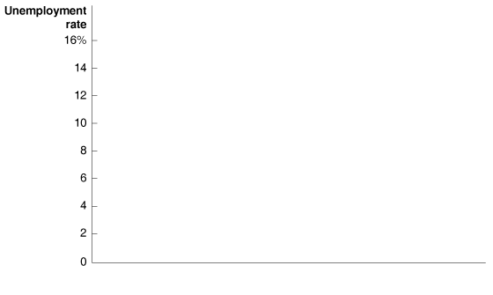
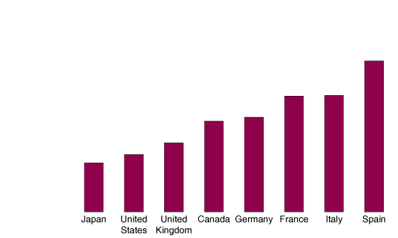
Explaining Unemployment
3
LEARNING OBJECTIVE
Government Policies and the Unemployment Rate
UNEMPLOYMENT INSURANCE AND OTHER PAYMENTS TO THE UNEMPLOYED
INTERNATIONAL COMPARISONS
8 - 5
Average Unemployment Rates
in the United States, Canada,
Japan, and Europe, 1995-2004

Slide 33
Explaining Unemployment
Government Policies and the Unemployment Rate
MINIMUM WAGE LAWS
Labor Unions
Efficiency Wages
Efficiency wage A higher-than-market wage paid by a firm to increase worker productivity.

Slide 34
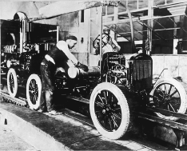
8 - 3
Why Did Henry Ford Pay His Workers Twice As Much As Other Car Manufacturers?
Henry Ford claimed that paying a wage twice as high as his competitors was the finest cost-cutting move he ever made.

Slide 35
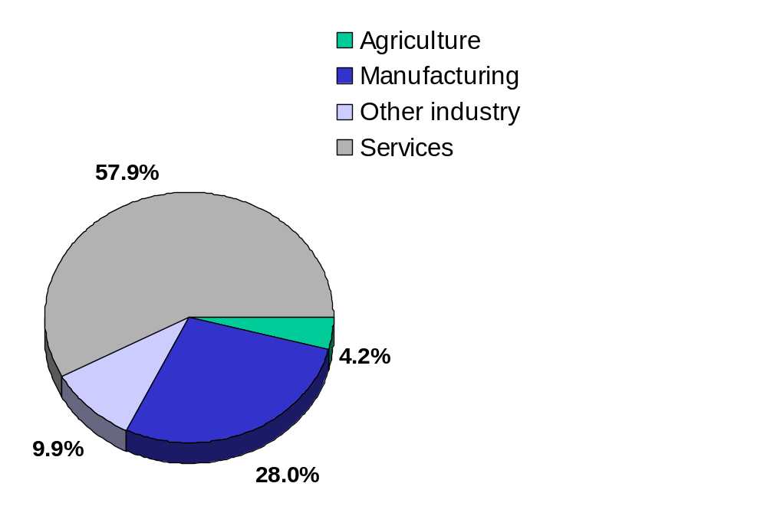
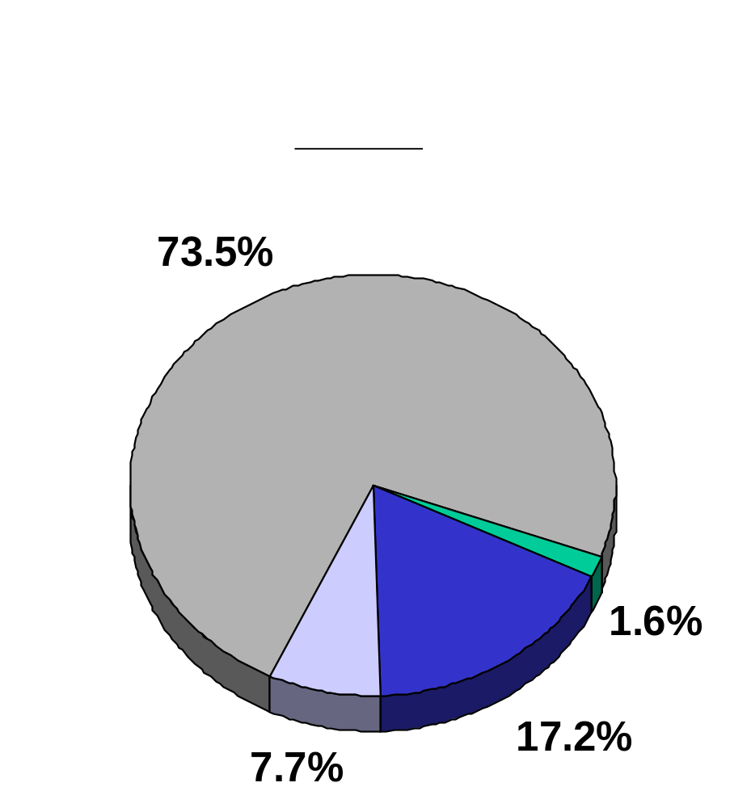
CASE STUDY:
Structural change over the long run
Notes:
All figures are industry shares in U.S. GDP. “Other industry” includes construction, mining, electricity, water, and gas.
From 1960 to 2000, there are huge changes in all four categories.
Manufacturing falls by about a third.
Even the “tiny” category of agriculture drops by nearly two-thirds:
from 4.2% to 1.6% of GDP.
These changes represent HUGE structural shifts, which vastly alter the kinds of jobs in demand.
Source: World Development Indicators, World Bank.

Slide 36
我国GDP中构成比例
20.4
49.5
30.1
1996
年
1997
年
19.1
50.0
30.9
1998
年
18.6
49.3
32.1
1999
年
17.6
49.4
33.0
2000
年
16.4
50.2
33.4
2001
年
15.8
50.1
34.1
2002
年
15.4
51.1
33.5

Slide 37
劳动力及失业特征
剩余劳动力、正规就业、非正规就业、失业（隐形失业、下岗）和社会保障
新中国几十年经济体制演变的基本轨迹，决定了我国当代失业问题具有突出的体制转型相联系的特点。这一特点在标准经济学理论中没有现成解释，与一般发展中国家劳动力供求关系也有重要区别。

Slide 38
我国失业的基本概念
失业人口广义定义：
  包括完全失业、农村剩余劳动力、下岗失业人员、企业内部失业者等。
失业人口狭义定义：
  登记失业人口：
  实际失业人口 = 登记失业人口 +（下岗职工总数 - 已重新就业人员）+ 城镇中农村劳动力失业人数
  下岗职工总数 = 寻找工作人员+等待回岗人员+等待向新单位报到人员+已重新就业人员
  失业率 = 失业人口/（失业人口+就业人口）

Slide 39
中国城镇实际失业人口基本情况
第一、全国下岗失业人员迅速增长，2000年已超过1000万人。
第二、全国城镇实际失业人员大幅度增加，2000年已达到1700万人规模。涉及城镇家庭人口超过5000万人，占城镇人口的九分之一。
第三，“九五” 期间全国在岗职工已减少3649万人，下降了24.5%。
第四、真实失业率大大高于登记失业率。
第五、据官方统计，3.3亿农村劳动力中剩余劳动力人数达1.2—1.5亿人。
解决劳动力问题依然是我国经济发展中的最核心的课题。

Slide 40
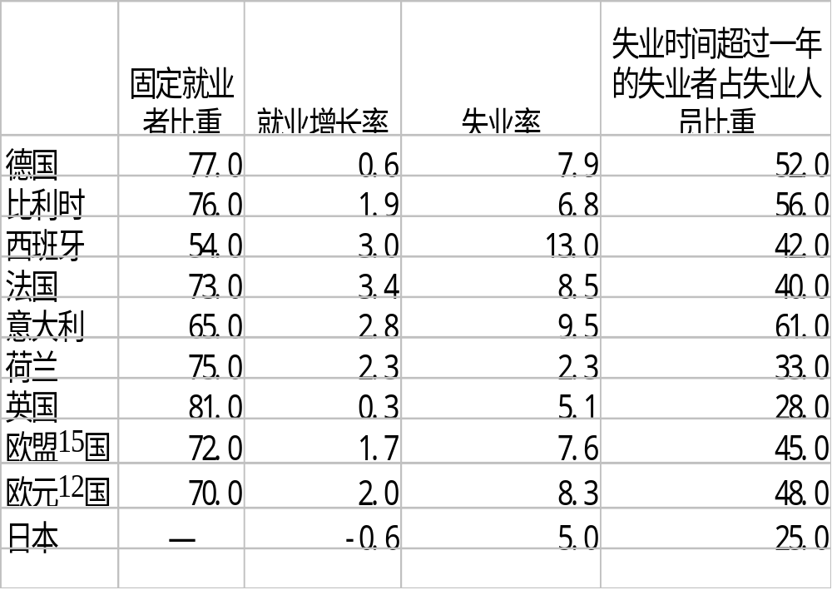
部分发达国家及地区就业和失业状况
（2001年第一季度）（单位：%）

Slide 41
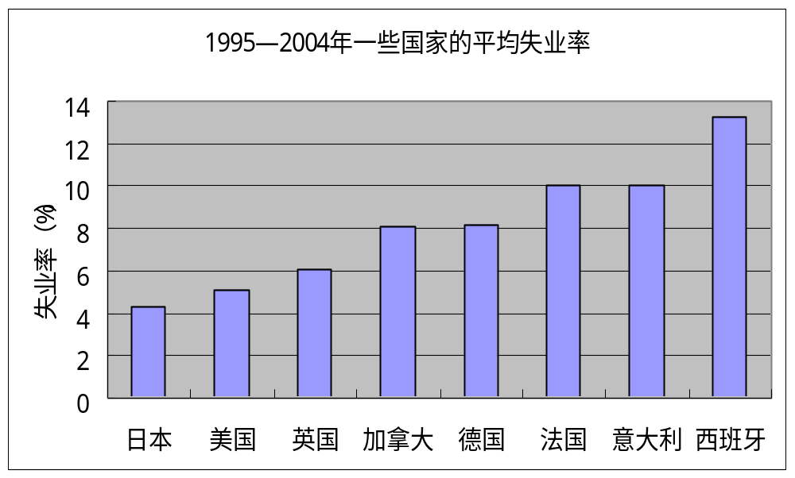
资料来源：Organization for Economic Cooperation and Development

Slide 42
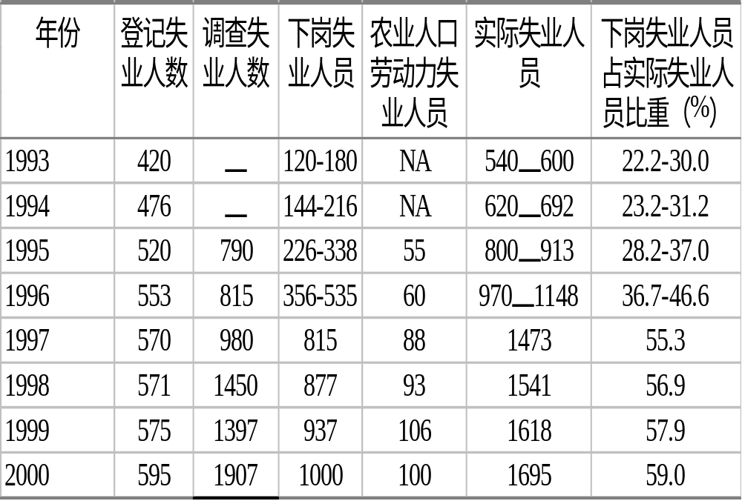
城镇失业人数估计（1993—2000）
（单位：万人）

Slide 43
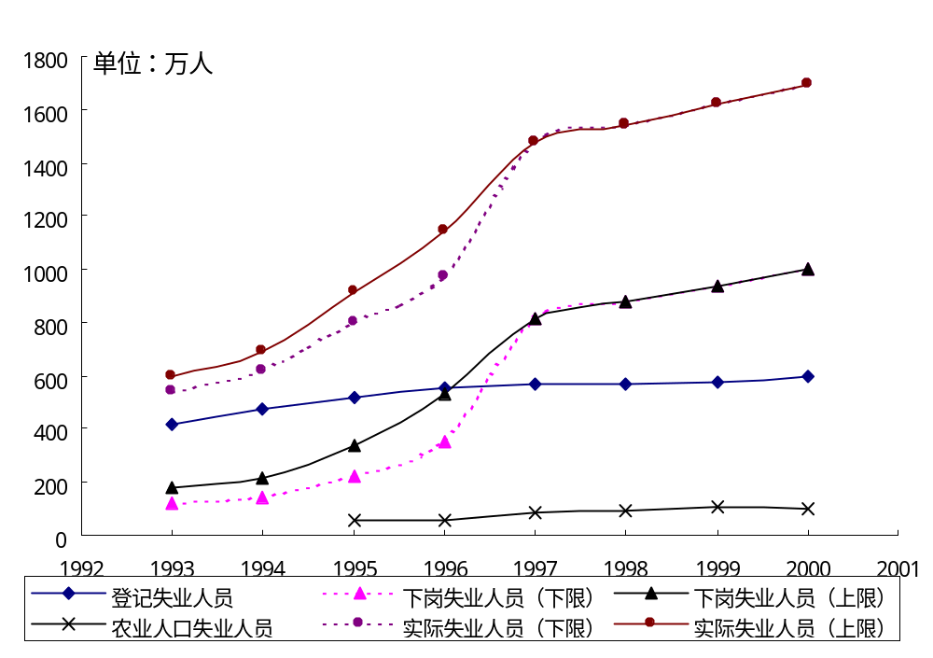
城镇失业人数估计（1993—2000）

Slide 44
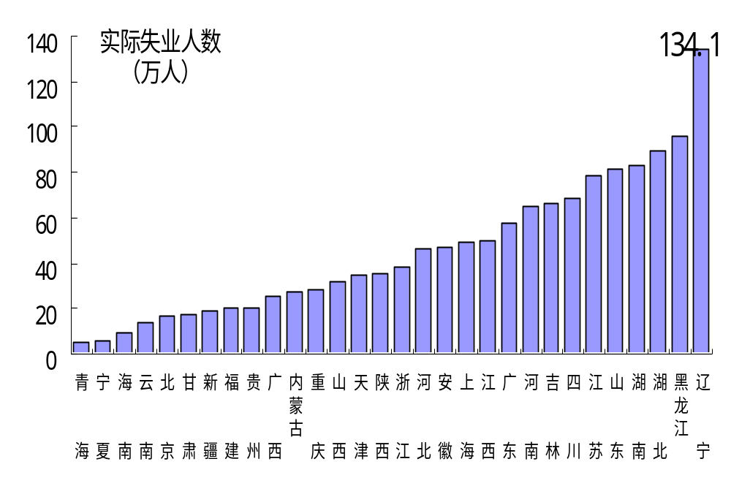
各地区城镇实际失业人数

Slide 45
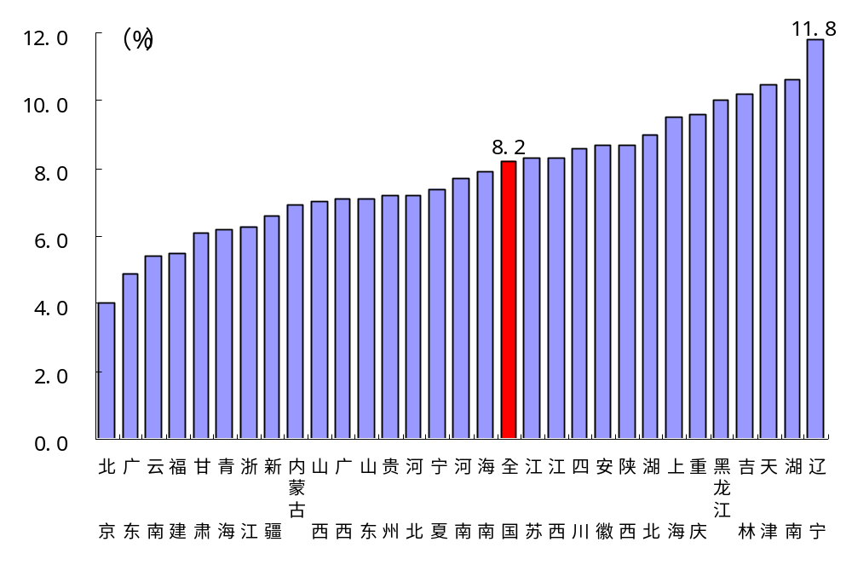
各地区实际失业率估计值（1999年）

Slide 46
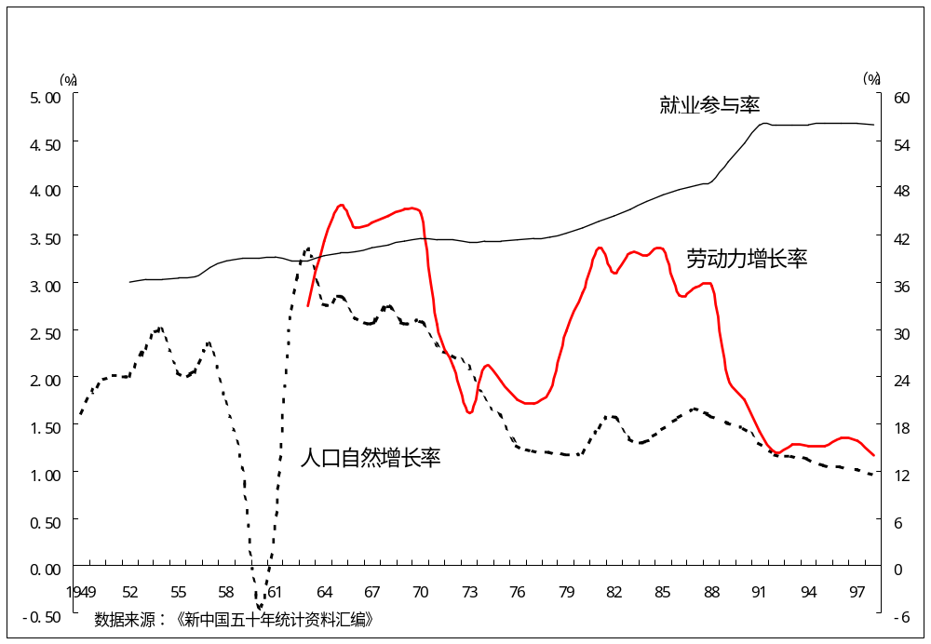
中国的人口增长率和劳动力增长率

Slide 47
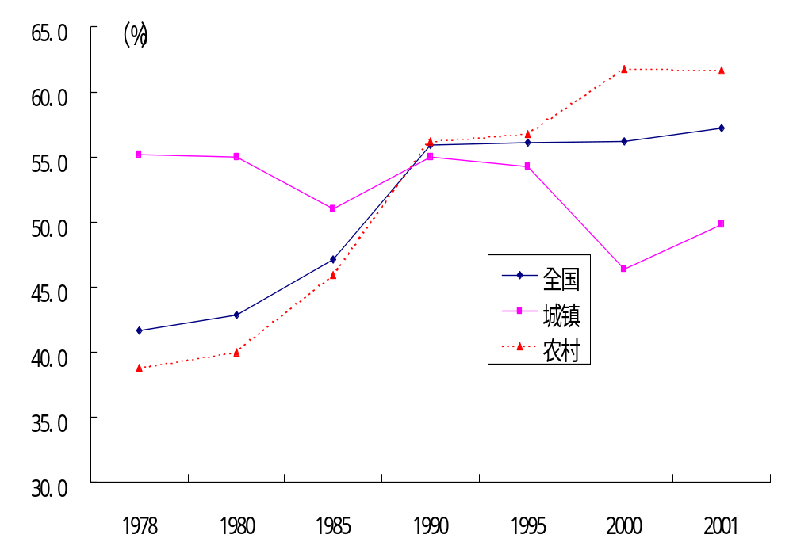
1978—2001年全国、城乡就业率

Slide 48
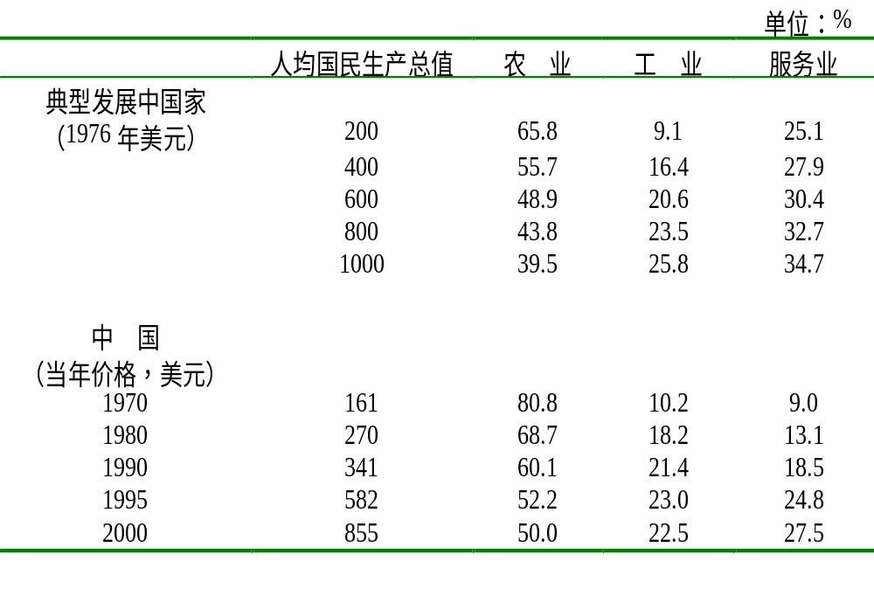
经济发展与分产业就业结构

Slide 49
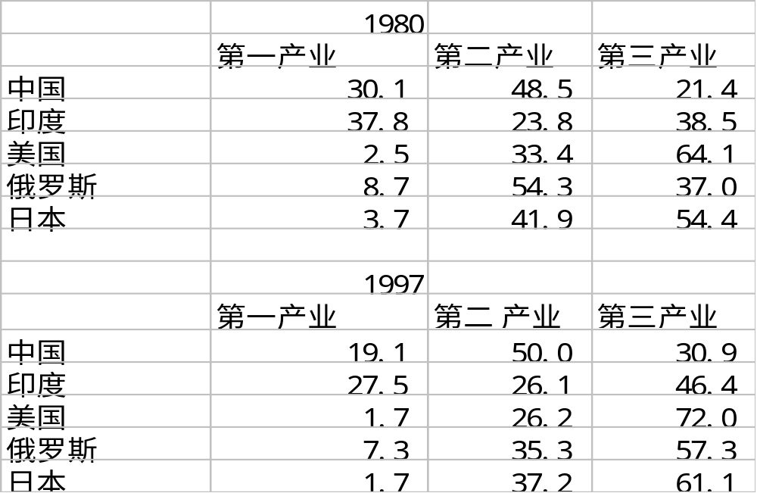
产业结构变化

Slide 50
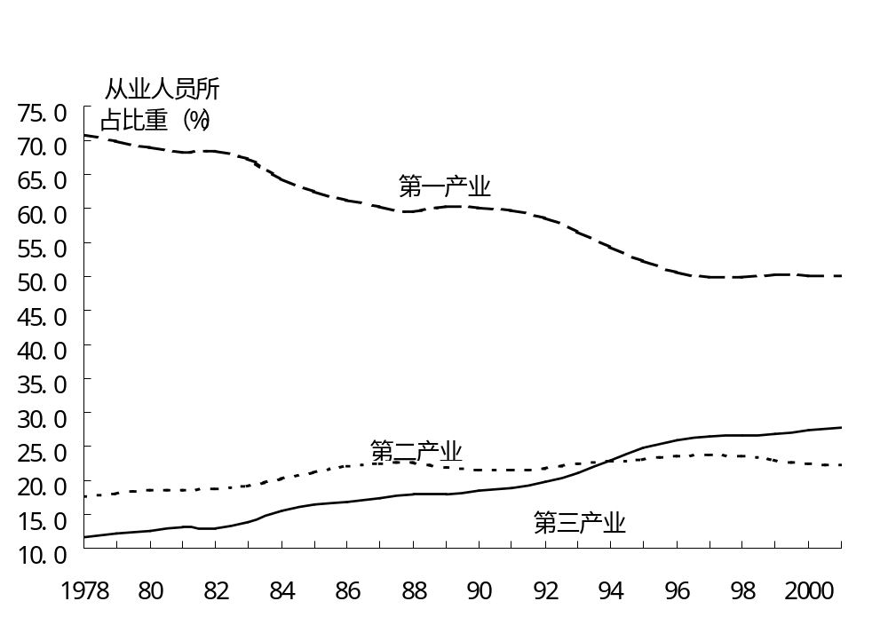
分产业就业结构变化（1978～2001年）

Slide 51
二元经济与发展型失业
美国经济学家刘易斯50年代提出“二元经济（dual economy）”概念，成为解释传统农业经济向现代经济转型的一个概念。
发达国家内部一体化程度很高，劳动力报酬——工资由劳动的边际产品价值决定，要素有效配置规律要求劳动在各个行业边际产品相等，否则很快引起劳动力在各部门之间转移

Slide 52
二元经济与发展型失业
从长期看，收入落差推动农业劳动不断流入现代部门，最终实现经济现代化；但从短期看，现代部门没有能力吸收传统部门所有剩余劳动力；极端意义上可假定相对于现代部门工资水平而言，传统部门存在劳动力无限供给。这类大量农业剩余劳动力，被看作特殊形态的发展型失业。

Slide 53
失业的治理
教育普及和劳动力技能培训，树立现代就业观。
运用宏观调节政策工具降低经济周期不景气阶段需求不足失业。
促进经济持续增长，逐步减少发展型失业和体制转型伴随的失业。
需要建立包括失业保险的现代社会保障制度。

Slide 54
我国就业问题探讨
现状：就业困难-收入增长缓慢-消费不足
发达国家就业模式：自由职业、特小企业（5人以下）、中小企业（300人）占75-85%；而政府、大型企业占25-15%。鼓励发展，不交费；登记容易；对自由职业者不进行注册。
中国：53%为前种模式。
体制问题：个体注册，否则非法；登记审批时间长；费养人；

Slide 55
体制创新
鼓励自由创业
小企业具备规模后再注册
减少审批
税费问题

Slide 56
Measuring Inflation
4
LEARNING OBJECTIVE
Price level A measure of the average prices of goods and services in the economy.
Inflation rate The percentage increase in the price level from one year to the next.

Slide 57
货币与通货膨胀
Inflation is always and everwhere a monetary phenomenon-----Friedman,M.
Public enemy number one ___Ford
The cruelest tax____Reagan

Slide 58
Which of the following is a better measure of the average of the prices of all goods and services included in GDP?
a. The Consumer Price Index.
b. The Producer Price Index.
c. The GDP deflator.
d. The inflation rate.

Slide 59
Which of the following is a better measure of the average of the prices of all goods and services included in GDP?
a. The Consumer Price Index.
b. The Producer Price Index.
c. The GDP deflator.
d. The inflation rate.

Slide 60
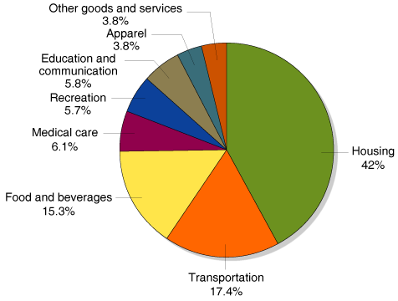
Measuring Inflation
The Consumer Price Index
Consumer price index (CPI) An average of the prices of the goods and services purchased by the typical urban family of four.
8 - 6
The CPI Market Basket,
December 2004

Slide 61
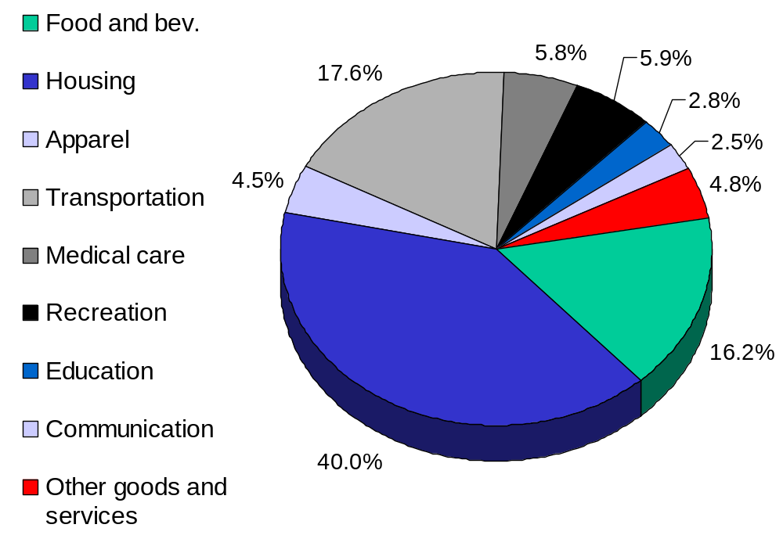
The composition of the CPI’s “basket”
Notes:
Each number is the percent of the “typical” household’s total expenditure.
source: Bureau of Labor Statistics, http://stats.bls.gov/cpihome.htm
Ask students for examples of how the breakdown of their own expenditure differs from that of the typical household shown here. Then, ask students how the typical elderly person’s expenditure might differ from that shown here. (This is relevant because the CPI is used to give Social Security COLAs to the elderly; however, the elderly spend a much larger fraction of their income on medical care, a category in which prices grow much faster than the CPI.)
The website listed above also gives a very fine disaggregation of each category, which enables students to compare their own spending on compact discs, beer, or cell phones to that of the “typical” household.

Slide 62
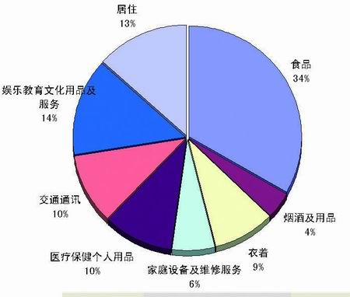
中国的CPI构成

Slide 63
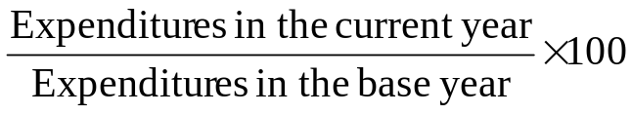
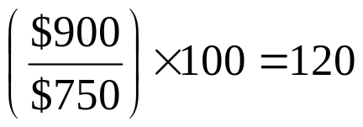
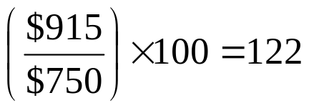

Measuring Inflation
 | BASE YEAR (1999) |  |  | 2006 |  | 2007
PRODUCT | QUANTITY | PRICE | EXPENDITURES | PRICE | EXPENDITURES | PRICE | EXPENDITURES
Eye examinations | 1 | $50.00 | $50.00 | $100.00 | $100.00 | $85.00 | $85.00
Pizzas | 20 | 10.00 | 200.00 | 15.00 | 300.00 | 14.00 | 280.00
Books | 20 | 25.00 | 500.00 | 25.00 | 500.00 | 27.50 | 550.00
Total |  |  | 750.00 |  | 900.00 |  | 915.00
FORMULA | APPLIED TO 2006 | APPLIED TO 2007
CPI =
Don’t Miscalculate the Inflation Rate

Slide 64
Measuring Inflation
Is the CPI Accurate?
  Substitution bias.
  Increase in quality bias.
  New product bias.
  Outlet bias.

Slide 65
Measuring Inflation
The Producer Price Index
Producer price index (PPI) An average of the prices received by producers of goods and services at all stages of the production process.

Slide 66
Which market basket below specifically targets intermediate goods?
a. The basket used by the Consumer Price Index.
b. The basket used by the GDP deflator.
c. The basket used by the Producer Price Index.
d. All of the above.

Slide 67
Which market basket below specifically targets intermediate goods?
a. The basket used by the Consumer Price Index.
b. The basket used by the GDP deflator.
c. The basket used by the Producer Price Index.
d. All of the above.

Slide 68
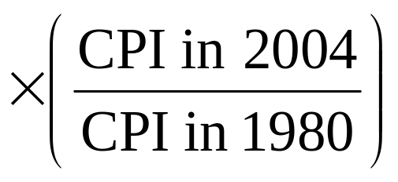
Using Price Indexes to Adjust for the Effects of Inflation
5
LEARNING OBJECTIVE
Value in 2004 dollars = Value in 1980 dollars
Falling Real Wages at Lucent

Slide 69
8 - 2
4
LEARNING OBJECTIVE
Calculating Real Average Hourly Earnings
YEAR | NOMINAL AVERAGE HOURLY EARNINGS | CPI (1982-1984 = 100)
2002 | $14.95 | 179.9
2003 | 15.35 | 184.0
2004 | 15.67 | 188.9
YEAR | NOMINAL AVERAGE HOURLY EARNINGS | CPI (1982-1984 = 100) | REAL AVERAGE HOURLY EARNINGS (1982-1984 DOLLARS)
2002 | $14.95 | 179.9 | $8.31
2003 | 15.35 | 184.0 | 8.34
2004 | 15.67 | 188.9 | 8.30

Slide 70
Real versus Nominal Interest Rates
6
LEARNING OBJECTIVE
Nominal interest rate The stated interest rate on a loan.
Real interest rate The nominal interest rate minus the inflation rate.
Deflation A decline in the price level.

Slide 71
If the inflation rate turns out to be higher than expected, then:
a. Borrowers pay lenders a higher real interest rate than they expected.
b. Borrowers pay lenders a lower real interest rate than they expected.
c. Borrowers pay only a nominal interest rate but not a real interest rate.
d. Borrowers pay only a real interest rate but not a nominal interest rate.

Slide 72
If the inflation rate turns out to be higher than expected, then:
a. Borrowers pay lenders a higher real interest rate than they expected.
b. Borrowers pay lenders a lower real interest rate than they expected.
c. Borrowers pay only a nominal interest rate but not a real interest rate.
d. Borrowers pay only a real interest rate but not a nominal interest rate.

Slide 73
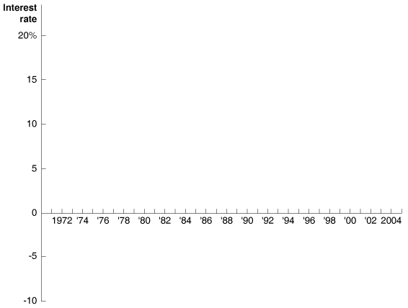
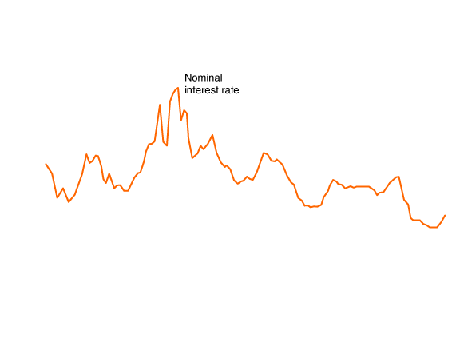
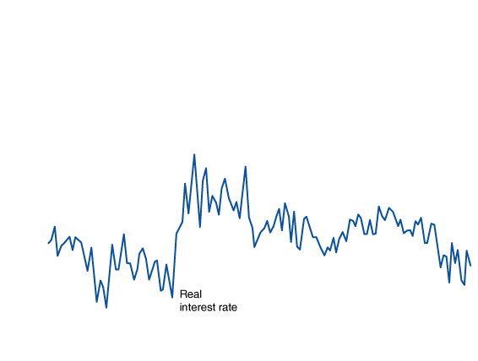
Real versus Nominal Interest Rates
8 - 7
Nominal and Real Interest Rates, 1970-2004

Slide 74
Does Inflation Pose Costs on the Economy?
7
LEARNING OBJECTIVE
Inflation Affects the Distribution of Income
The Problem with Anticipated Inflation
Menu costs The costs to firms of changing prices.
The Problem with Unanticipated Inflation

Slide 75
通货膨胀分类
可以把年度物价上涨幅度不超过10%的通货膨胀称为温和通货膨胀；物价上涨百分比超过两位数的通货膨胀是严重通货膨胀；物价年上涨幅度达到三位数或更高的，称为超速通货膨胀或恶性通货膨胀（hyper-inflation）。
也有经济学家把不会显著改变相对价格和收入分配的通货膨胀称作温和通货膨胀（modest inflation）；把年上涨率超过50%或者100-200%的称为奔腾通货膨胀（galloping inflation），年率超过1000%的称为超速通货膨胀。

Slide 76
What causes hyperinflation?
Hyperinflation is caused by excessive money supply growth:
When the central bank prints money, the price level rises.
If it prints money rapidly enough, the result is hyperinflation.

Slide 77

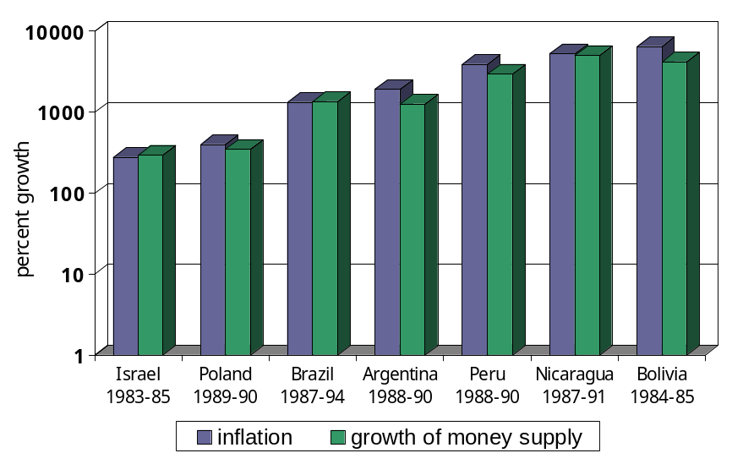
Recent episodes of hyperinflation
slide <number>

Slide 78
通货膨胀
物价水平的持续上升称为通货膨胀。我国80年代以来发生了四次通货膨胀。
价格变动率（%)）
25
20
15
10
5
0
-5
1978
1980
1982
1984
1986
1988
1990
1992
1994
1996
1998
2000
年份

Slide 79

8 - 4
Why a Lower Inflation Rate Is Like a Tax Cut for Lucent’s Bondholders
PRINCIPAL | REAL INTEREST RATE | INFLATION RATE | NOMINAL INTEREST RATE
$1,000 | 4% | 6% | 10%
$1,000 | 4% | 2% | 6%
A lower inflation rate is like a tax cut for investors.
INFLATION RATE | NOMINAL INTEREST PAYMENT | TAX PAYMENT | AFTER-TAX INTEREST PAYMENT | ADJUSTMENT FOR INFLATION | REAL AFTER-TAX INTEREST PAYMENT
6% | $100 | – $25 | = $75 | – $60 | = $15
2% | $60 | – $15 | = $45 | – $20 | = $25

Slide 80

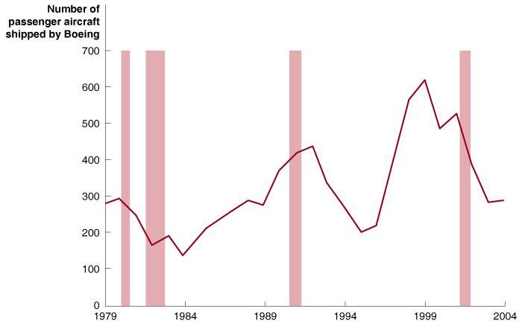
Boeing Offers Unionized Workers in Wichita, Kan., Wage Increases

Slide 81
一句名言
摧毁资本主义最好的办法是破坏通货
-------列宁

Slide 82

Consumer price index (CPI)
Cyclical unemployment
Deflation
Discouraged workers
Efficiency wage
Frictional unemployment
Inflation rate
Labor force
Labor force participation rate
Menu costs
Natural rate of unemployment
Nominal interest rate
Price level
Producer price index (PPI)
Real interest rate
Structural unemployment
Unemployment rate

