Slide 1
Economic Growth, the Financial System, and Business Cycles

Slide 2

Growth and the Business Cycle at the Ford Motor Company
After studying this chapter, you should be able to:
  Discuss the importance of long-run economic growth.
  Discuss the role of the financial system in facilitating long-run economic growth.
  Explain what happens during a business cycle.
1
2
LEARNING OBJECTIVES
In this chapter we will look more closely at long-run growth and at the business cycle, both of which have had important implications for individual firms and for the economy as a whole.
3

Slide 3
经济增长与经济发展
上路比抵达更重要
《吉普赛人的名言》

Slide 4
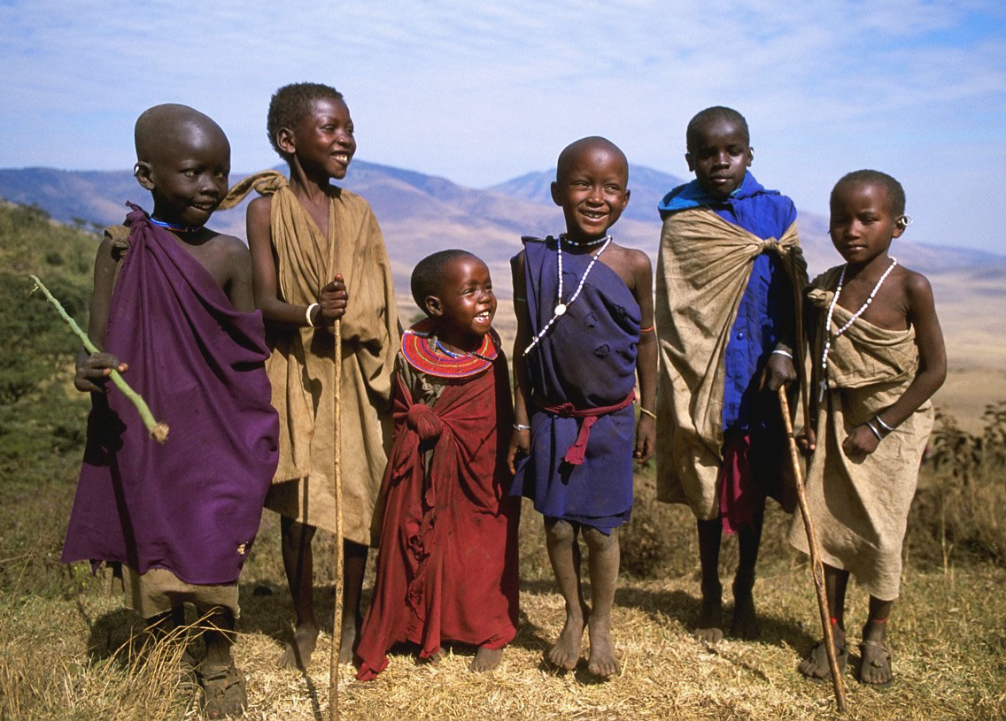
增长理论的研究
…将对千百万人的生活带来正面的不同的影响.
这个经验有助于我们：
  理解为什么穷国很贫穷
  设计促进发展的政策
  了解我们的经济增长率为什么受经济冲击与政府政策的影响

Slide 5
长期经济增长国际比较
从人均GDP数据来看，不同国家存在很大差别。象美国，瑞士等发达国家，按汇率计算的人均GDP比中国，印度这样低收入国家高出几十倍。以购买力平价计算的GDP国际差距有所缩小，但富国与穷国差距也可能达到十倍以上。
收入差异决定了人民物质生活水平高低不同，表现为富国人民能够普遍享受比穷国更多的商品和服务。

Slide 6
长期经济增长国际比较
现实经济发展水平差异存在一些显而易见的直接原因。
例如从纵向时间角度看，现实发展水平与历史增长绩效存在联系，今天的国际差异是历史时期增长水平差异的结果。
穷国与富国经济水平在100多年前的差距较小，然而由于发达国家在近百年长期历史中经济增长率较高，而低收入国家增长率较低，结果导致现阶段的更大差距。因而，现实是历史的展开和结果。

Slide 7
长期经济增长国际比较
国别
时期
期初人均
GDP
（美元）
期末人均
GDP
（美元）
年均增长率（
%
）
日本
1890
-
1990
842
16144
3.00
巴西
1900
-
1987
436
3417
2.39
联邦德国
1870
-
1990
1330
17070
2.15
美国
1870
-
1990
1223
14288
2.07
中国
1900
-
1987
401
1478
1.17
墨西哥
1900
-
1987
649
2667
1.64
英国
1870
-
1990
2693
13589
1.36
阿根廷
1900
-
1
987
1284
3302
1.09
印度尼西亚
1900
-
1987
499
1200
1.01
巴基斯坦
1900
-
1987
413
885
0.88
印度
1900
-
1987
378
662
0.65
孟加拉国
1900
-
1987
349
375
0.08

Slide 8
长期增长的“70”规则
某个变量年增长率为X%，则该变量在70/X年内翻一番，因而称作“70规则”。
从这一规则看，如果甲国经济增长率为1%，它的GDP翻一番需要70年，而乙国经济增长率为3%，翻一番时间仅为70/3或23年。也就是说，即便甲乙两国人均收入起点水平大体相同，2个百分点增长率差别在100年后会导致3-4倍的巨大收入差别。复利式增长可能会在较长时期导致极为惊人的结果。

Slide 9
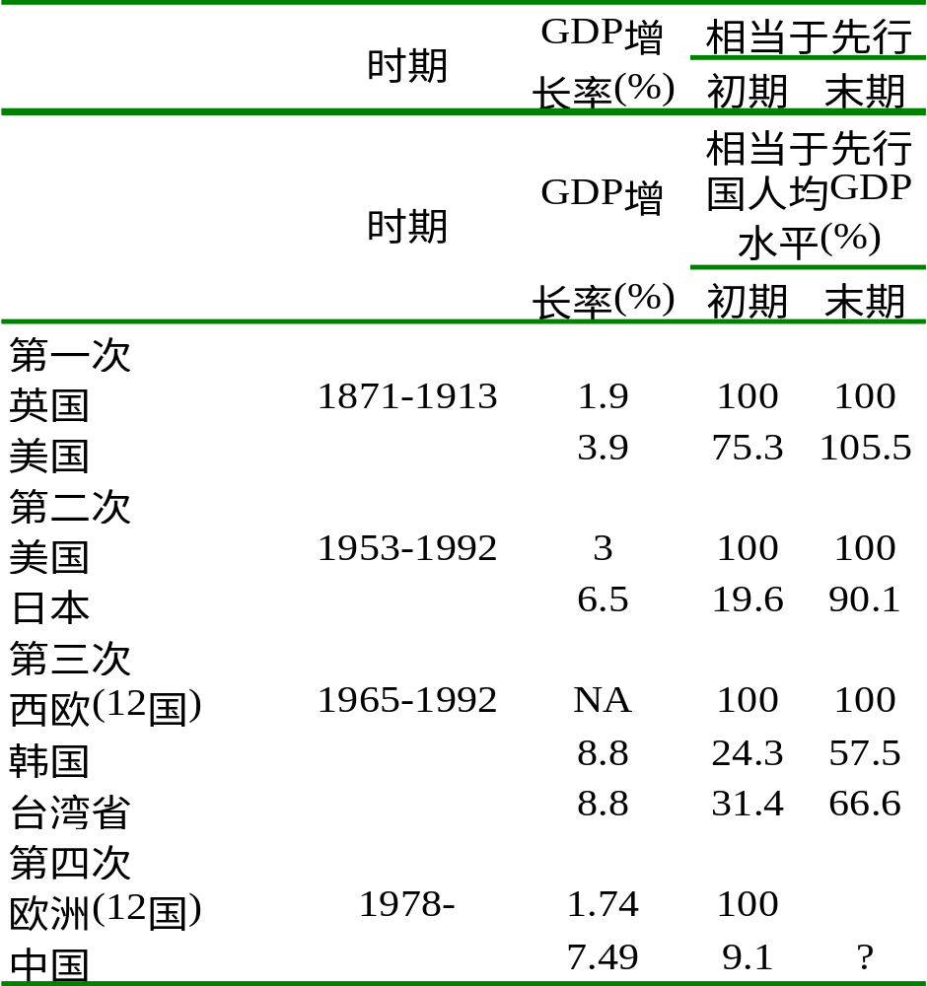
经济发展的追赶(Catch up)

Slide 10
中国经济增长前景
我国改革开放以后人均收入年增长率大体为5-6%，如果能够长期保持5%年增长率，用“70规则”计算，年均增长5%的变量将在大约14年内翻一番，在一百年间翻7番以上。
一国在100年内持续保持5%人均收入增长不大可能。然而经济学家相信，我国有可能在未来30-40年内保持较高增长水平。假定在未来40年间保持人均GDP年均5%增长率，即便不考虑人民币升值可能性，人均GDP则能在本世纪中期达到12，000-13，000美元，达到现在中等发达国家经济水平。

Slide 11
经济发展因素：自然条件
自然资源指自然界提供的作为生产过程投入品的资源，如耕地，河流，森林，矿产资源等等。自然资源分为可再生资源与不可再生资源两类。
丰富的自然资源对于经济发展具有积极作用。例如，美国早期经济发展，相当程度得益于辽阔的疆域和广袤的耕地资源。某些中东国家如科威特，沙特阿拉伯等产油国生活富裕，主要原因是由于这些国家地下幸运地蕴藏了大量石油资源。

Slide 12
经济发展因素：自然条件
地理位置和气候条件：可以观察到，除了很少几个例外，被陆地包围、没有海岸线的国家一般比较贫穷。被陆地包围地区运输成本很高，发展国内市场和参加国际贸易比较困难。
另外，温带国家与热带国家在成为高收入国家的机会上存在悬殊的差异。世界上高收入人口大约99%处于温带地区。
有关地理和气候因素影响经济水平的具体机制还缺少有说服力研究证据，但地理位置与经济增长之间至少存在统计相关性。

Slide 13
经济发展因素：自然条件
自然资源对经济发展的作用是有限的。自然资源匮乏的国家也可能创造很高的生产率并享受富裕生活水平。
吃生鱼片的日本资源极为匮乏，然而由于成功利用国际分工和贸易条件，加上勤奋努力，结果变成富裕国家。相反，无论是温带地区或是拥有海岸线的经济，仍有不少处于相对落后状态。
地理决定论不可取。

Slide 14
经济发展因素：资本积累
通过资本积累提供物质资本。物质资本是用来生产商品和劳务的技术设备及其附属物的存量，又简称资本。
工具，专业化设备等资本条件，能够极大地提高一个社会的生产率。

Slide 15
经济发展因素：资本积累
资本存量是一国经济发展和生活水平的重要因素。发达国家人均资本存量比较高，而不发达国家人均资本存量比较低。
今天资本存量是昨天投资的结果，未来资本存量部分取决于今天投资。
政府可以运用税收，利率经济手段来鼓励本国企业和国民积累与投资，还可以实施开放政策鼓励外国资本进入本国投资，作为解决本国资本不足问题的一个补充措施

Slide 16
经济发展因素：人力资本
人力资本指劳动者通过教育，培训和实际经历获得的知识和技能，它们附着在劳动者个人这一特殊载体上并表现为他们素质差异。
人力资本不象物质资本那样具有可直接观察的实际形态，二者对生产率和经济发展影响具有相似之处。经济学家同样把人力资本看作生产要素，认为它们能够有效地提升一个劳动者或国家生产产品和提供服务的能力或效率。象增加物质资本需要积累和投资一样，增加人力资本也需要投资，并且需要特殊的投入要素。

Slide 17
经济发展因素：对外开放
五六十年代很多发展中国家实行进口替代的内向型政策，试图在避免与外部世界发生不断深化的经济互动前提下提升本国经济发展水平。这些政策通常对于国际贸易进行大量关税和非关税限制，希望由此发展国内民族工业，并赶超发达国家经济
经过对几十年经济发展绩效的分析检验，现在大多数经济学家认为，出口导向的外向型政策比较有助于穷国经济发展。减少对贸易的限制，扩大开放，从参与全球经济体系过程中学习，是经济长期发展的必要条件。

Slide 18
经济发展因素：对外开放
由于出口品通常是比较具有资源优势和生产机会成本比较低的产品，而进口的是产品通常不具有资源优势因而生产机会成本比较高，所以贸易实现的交换通常会提高交换双方的资源配置效率，提升给定资源限制下人们生活水平，促进经济发展。
除了静态福利效果，贸易还具有其它多方面积极“溢出”效应。贸易促进信息交流沟通，使贸易参与国的企业和人民加深对于外部世界的了解，这对经济长期发展具有重要意义。

Slide 19
经济发展因素：技术进步
只有储蓄积累而没有技术进步的经济，由于资本边际收益递减，增长过程存在上限，在某个较高收入水平就会出现停滞。经济持续增长的必要条件是技术升级，技术进步是现代经济长期增长的发动机。
经济发展因素：制度条件
市场机制的健全和有效性，既表现为产权界定和保护的强度和力度，也体现为市场竞争的程度和有效性。

Slide 20
激励作用：市场促进增长作用之一
市场机制的积极功能在于它一方面提供了创新激励，另一方面拓展了创新空间，因而创造了一种激活和鼓励创新的环境。
市场环境下，企业的利润机制，企业家、管理人员和职员个人的收入激励机制，会对个人努力工作和创新发挥极为重要的作用。这个简单的道理，应是我国市场取向的改革取得成就的基本原因之一。

Slide 21
协调作用：市场促进增长作用之二
它所显示的社会资源相对稀缺度，为技术选择，投资选择以及消费行为选择提供了信息参照和协调机制。
通过投资进行资本积累，资本应当投向何方？扩大贸易和吸引外资有助于经济增长，那么应当出口什么和进口什么？外资进来投向什么部门？技术进步是增长的发动机，然而什么技术应当得到广泛运用？所以这些问题，都不能从他们本身涉及的关系中得到回答，而需要用到市场和价格机制协调

Slide 22
经济发展的一般规律
经济发展的一般规律就是自身发展的自我相克过程
低水平经济（贫困）：从传统的农业社会出发→
初始条件（生产力水平和消费水平都很低；死亡率和出生率都很高，发达国家人均GNP在200-500美元之间，日本为74美元，中国为50美元）
经济持续增长的起飞（人均国民收入的大幅度的持续增长的开始；随着工业化的兴起，产业组织形成了大规模生产和分工），经过100—200年的时间人均增长率超过1—2%）→
高水平经济（人均收入达到高水平，实现了工业化和城市化）

Slide 23
经济增长的一个现实
19世纪以前人均增长率低于1%
19世纪的人均增长率为1%—2%
20世纪以后人均增长率高于2%以上
所谓现代经济增长是相对比较现代的现象。而在经济增长的过程中，一般规律是有一个持续增长的起飞过程。又由于经济增长率的加速，经济发展呈追赶的趋势。

Slide 24
规律
所有幸福的家庭都是相似的，而不幸的家庭却有着各自的不幸。
列夫·托尔斯泰《安娜·卡列尼娜》
所有幸福的 “国家” （发达）都是相似的，而不幸的 “国家” （发展中）却有着各自的不幸。

Slide 25
经济发展的结果（1996）
世界148个国家中，只有25个国家为高收入国家，其人均GNP为25,870美元
1970年以来，只有七个国家和地区进入了高收入国家的行列：葡萄牙、西班牙、希腊、韩国、新加坡、香港和台湾
83个低收入国家的人均GNP为490美元

Slide 26
小康社会与科学发展观与和谐社会
经过20多年的改革开放，到2000年实现了人民生活总体上达到小康水平。这是中国历史上了不起的事。但是，我们现在达到的小康还只是低水平的、不全面的、发展很不平衡的小康。
所谓低水平，就是虽然我国经济总量已经达到一定规模，但人均水平还比较低。
所谓不全面，就是目前的小康基本上还处于生存性消费的满足，而发展性消费还没有得到有效满足，社会保障还不健全，环境质量还有待提高。
所谓发展很不平衡，是指地区之间、城乡之间，发展水平差距不平衡。十六大报告提出的全面建设小康社会，就是要针对这些问题，建设一个惠及十几亿人口的更高水平的、更全面的、发展比较均衡的小康社会。

Slide 27
Economic Growth, the Financial
System, and Business Cycles
Business cycle Alternating periods of economic expansion and economic recession.

Slide 28
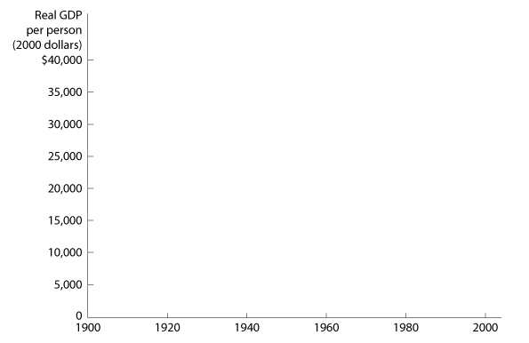
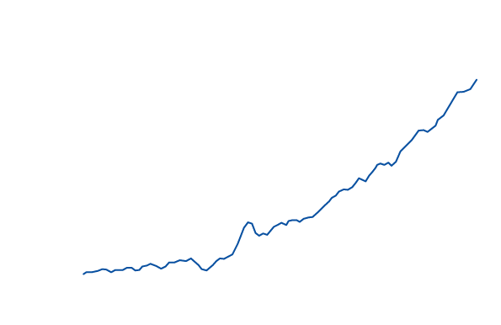
Long-Run Economic
Growth Is the Key to Rising Living Standards
1
LEARNING OBJECTIVE
Long-run economic growth The process by which rising productivity increases the average standard of living.
9 - 1
The Growth in Real GDP per capita, 1900-2004

Slide 29

The most important characteristic of long-run economic growth is:
a. The business cycle.
b. Rising productivity.
c. Steady increases in living standards for everyone each year.
d. All of the above.

Slide 30
The most important characteristic of long-run economic growth is:
a. The business cycle.
b. Rising productivity.
Steady increases in living standards for everyone each year.
d. All of the above.

Slide 31

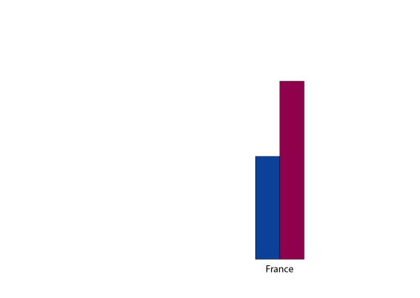
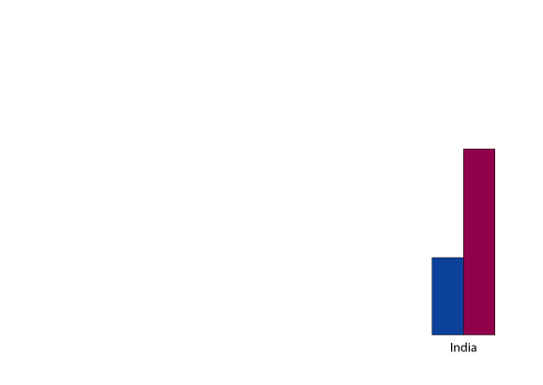
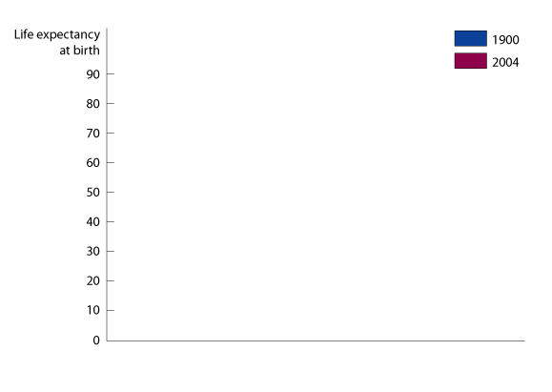
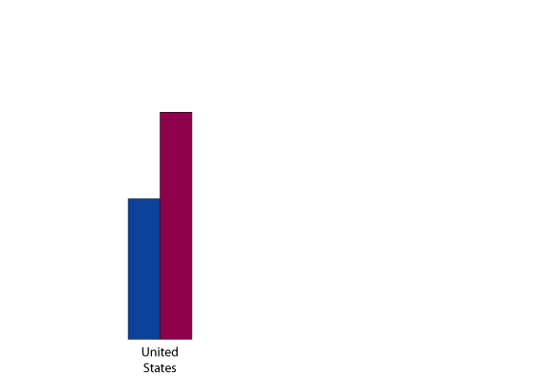
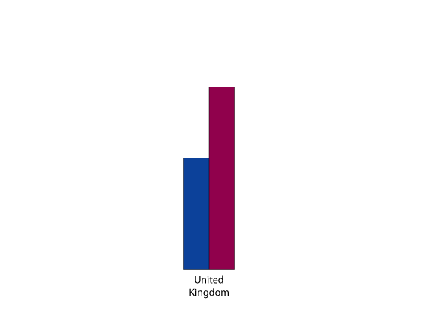
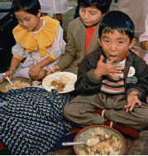
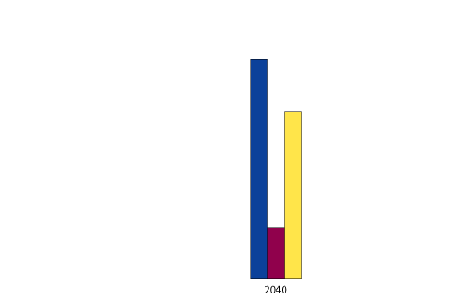
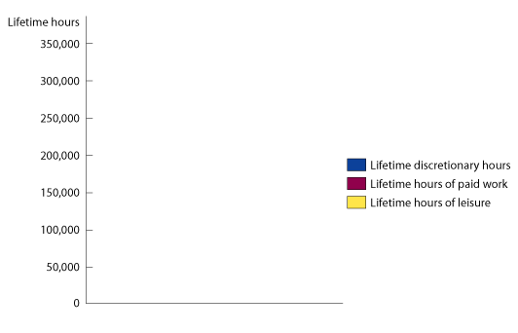
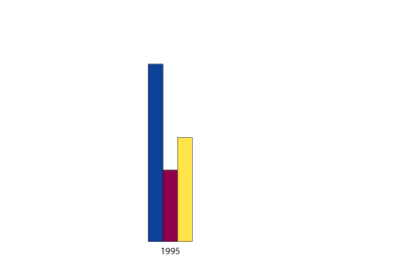
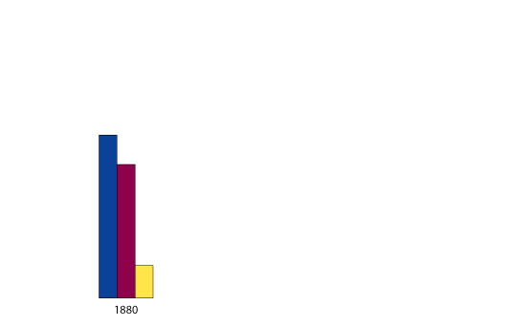
9 - 1
The Connection Between Economic Prosperity and Health
Because of technological advance, these children will live longer, be healthier, and work less than their parents and grandparents.

Slide 32
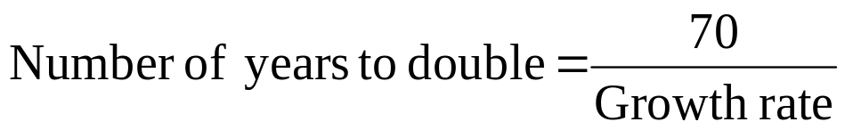
Long-Run Economic
Growth Is the Key to Rising Living Standards
Calculating Growth Rates and the Rule of 70
  One way to judge how rapidly real GDP per person is growing is to calculate the number of years it would take to double.

Slide 33
When it comes to raising the standard of living in a country, how important are growth rates, particularly the growth rate of real GDP?
a. Growth rates are very important. Small differences in growth rates can have large effects over long time periods.
b. The difference in growth rates must be rather substantial before we notice any rise in living standards.
c. The standard of living can increase without any change in the growth rate of real GDP.
d. Economists focus more on social factors than on growth rates of GDP.

Slide 34
When it comes to raising the standard of living in a country, how important are growth rates, particularly the growth rate of real GDP?
a. Growth rates are very important. Small differences in growth rates can have large effects over long time periods.
b. The difference in growth rates must be rather substantial before we notice any rise in living standards.
c. The standard of living can increase without any change in the growth rate of real GDP.
d. Economists focus more on social factors than on growth rates of GDP.

Slide 35
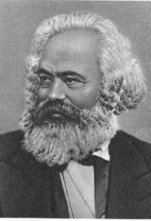
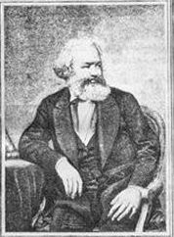
卡尔·马克思（Karl Marx）的发展
1818.5.5-1883.3.14
党的十六大强调，“确定劳动、资本、技术和管理等生产要素按贡 献参与分配的原则，完善按劳分配为主体，多种分配方式并存的分配制 度”，这一精神深化了对劳动价值论的认识，是对我国现阶段分配理论 和分配制度的重大突破。(1)按资本要素分配。(2)按劳动力要素分配。主要是按劳动力价值分配。(3)按技术要素分配。(4)按管理要素分配。(5)按信息要素分配。

Slide 36
Long-Run Economic
Growth Is the Key to Rising Living Standards
What Determines the Rate of Long-Run Growth?
Labor productivity The quantity of goods and services that can be produced by one worker or by one hour of work.
INCREASES IN CAPITAL PER HOUR WORKED
  Capital Manufactured goods that are used to produce other goods and services; examples of capital are computers, factory buildings, machine tools, warehouses, and trucks.
  Human capital The accumulated knowledge and skills that workers acquire from education and training, or from their life experiences.

Slide 37
Long-Run Economic
Growth Is the Key to Rising Living Standards
What Determines the Rate of Long-Run Growth?
INCREASES IN CAPITAL PER HOUR WORKED
Human capital The accumulated knowledge and skills that workers acquire from education and training, or from their life experiences.
TECHNOLOGICAL CHANGE
9-1
1
LEARNING OBJECTIVE
The Role of Technological Change in Growth

Slide 38
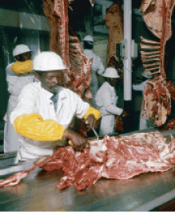






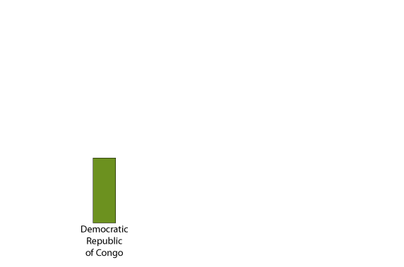
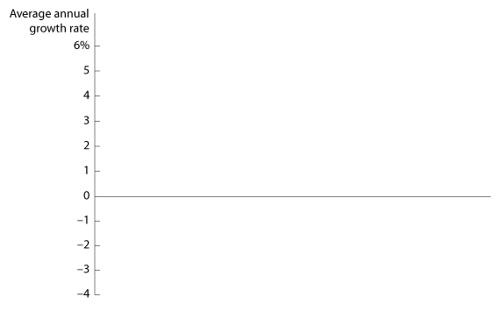
9 - 2
What Explains Rapid Economic Growth in Botswana?
Firms like the Botswana Meat Company benefit from government policies that protect private property.

Slide 39
Which of the following government policies can help economic growth?
a. Ensuring relative political stability and little corruption.
b. Promoting an efficient financial system.
c. Protecting private property rights, allowing freedom of the press, and having a democratic form of government.
d. All of the above.

Slide 40
Which of the following government policies can help economic growth?
a. Ensuring relative political stability and little corruption.
b. Promoting an efficient financial system.
c. Protecting private property rights, allowing freedom of the press, and having a democratic form of government.
d. All of the above.

Slide 41

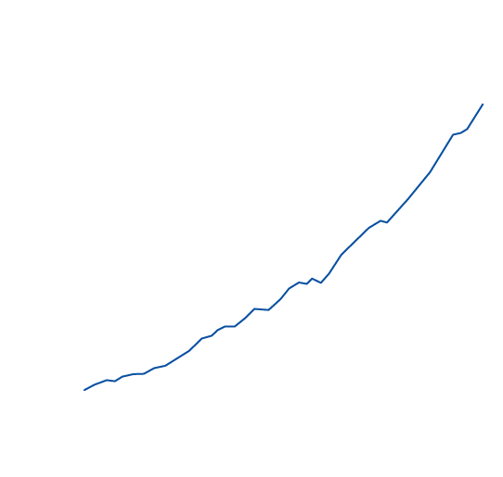
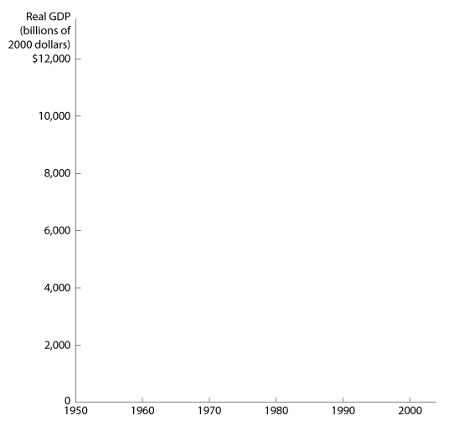
Long-Run Economic
Growth Is the Key to Rising Living Standards
Potential Real GDP
Potential GDP The level of GDP attained when all firms are producing at capacity.
9 - 2
Actual and Potential Real GDP

Slide 42
Saving, Investment, and the Financial System
2
LEARNING OBJECTIVE
Financial system The system of financial markets and financial intermediaries through which firms acquire funds from households.
An Overview of the Financial System
  Stocks are financial securities that represent partial ownership of a firm.
  Bonds are financial securities that represent promises to repay a fixed amount of funds.

Slide 43
Saving, Investment, and the Financial System
An Overview of the Financial System
  Financial intermediaries, such as banks, mutual funds, pension funds, and insurance companies, act as go-betweens for borrowers and lenders.
  In addition to matching households that have excess funds with firms who want to borrow funds, the financial system provides three key services for savers and borrowers:
    risk sharing,
    liquidity, and
    information.

Slide 44
Allowing savers to spread their money among many financial instruments is one of the key services offered by financial intermediaries. What is the name of this service?
a. Risk sharing.
b. Liquidity.
c. Information.
d. Matching.

Slide 45
Allowing savers to spread their money among many financial instruments is one of the key services offered by financial intermediaries. What is the name of this service?
a. Risk sharing.
b. Liquidity.
c. Information.
d. Matching.

Slide 46
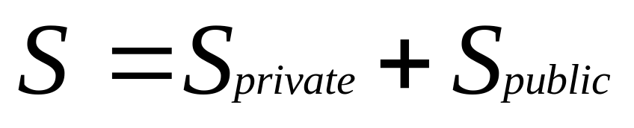
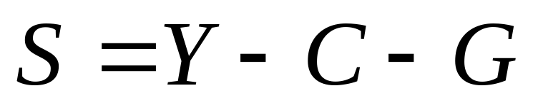
Saving, Investment, and the Financial System
The Macroeconomics of Saving and Investment

Slide 47
What happens when government spending is greater than government tax revenues?
a. There is negative public saving.
b. The national debt rises.
c. The government issues more new bonds than the old bonds it pays off.
d. All of the above.

Slide 48
What happens when government spending is greater than government tax revenues?
a. There is negative public saving.
b. The national debt rises.
c. The government issues more new bonds than the old bonds it pays off.
d. All of the above.

Slide 49
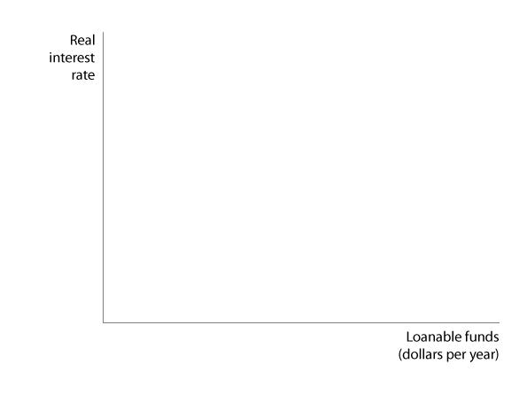
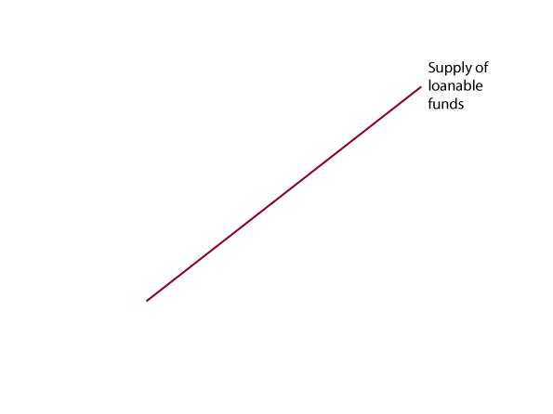
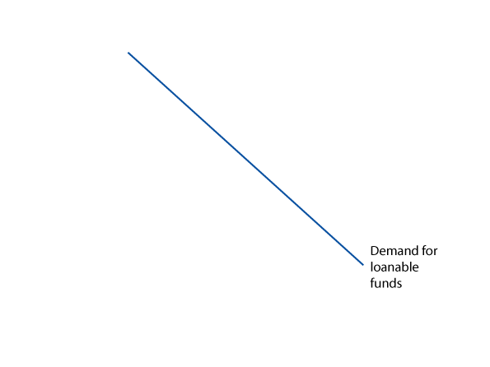
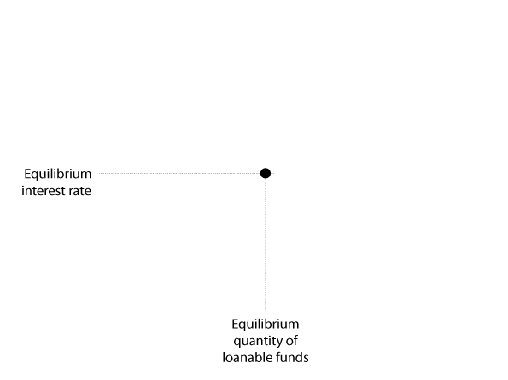
Saving, Investment, and the Financial System
The Market for Loanable Funds
Market for loanable funds The interaction of borrowers and lenders that determines the market interest rate and the quantity of loanable funds exchanged.
21- 3
The Market for Loanable Funds

Slide 50

9 - 3
Ebenezer Scrooge: Accidental Promoter of Economic Growth?
Who was better for economic growth: Scrooge the saver, or Scrooge the spender?

Slide 51
Which of the following determines the supply of loanable funds?
a. The willingness of households and governments to save.
b. The number of financial intermediaries available.
c. Changes in the interest rate, which cause business firms to undertake more or less profitable investment projects.
d. The quantity of stocks and bonds issued by business firms.

Slide 52
Which of the following determines the supply of loanable funds?
a. The willingness of households and governments to save.
b. The number of financial intermediaries available.
c. Changes in the interest rate, which cause business firms to undertake more or less profitable investment projects.
d. The quantity of stocks and bonds issued by business firms.

Slide 53
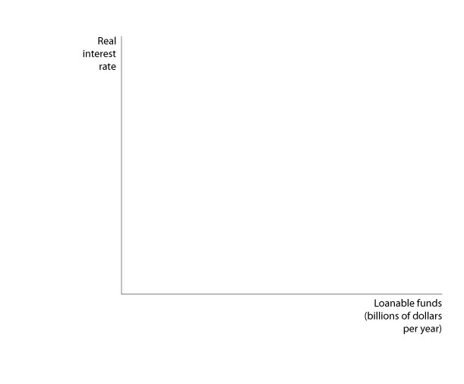
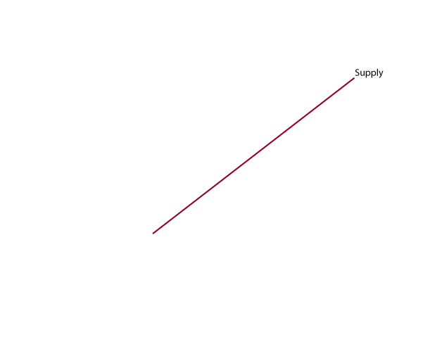


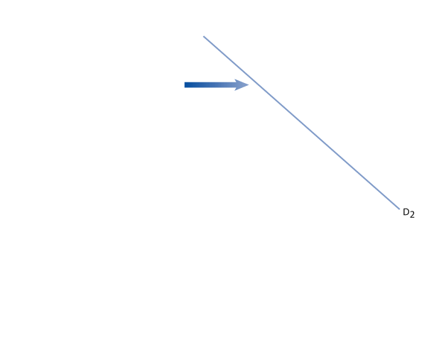

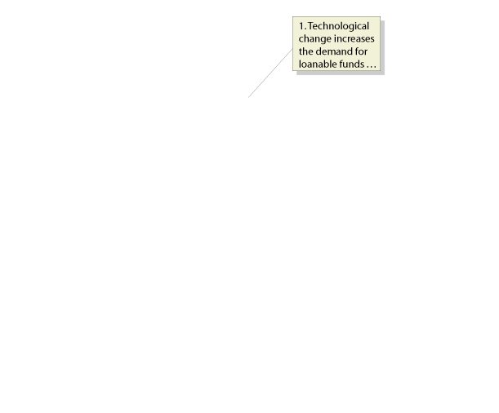
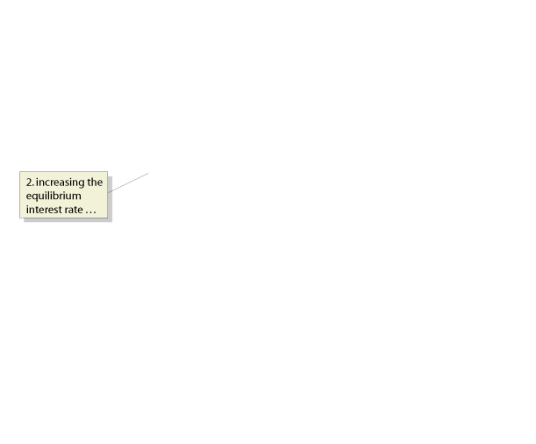

Saving, Investment, and the Financial System
The Market for Loanable Funds
EXPLAINING MOVEMENTS IN SAVING, INVESTMENT, AND INTEREST RATES
9 - 4
An Increase in the Demand for Loanable Funds

Slide 54
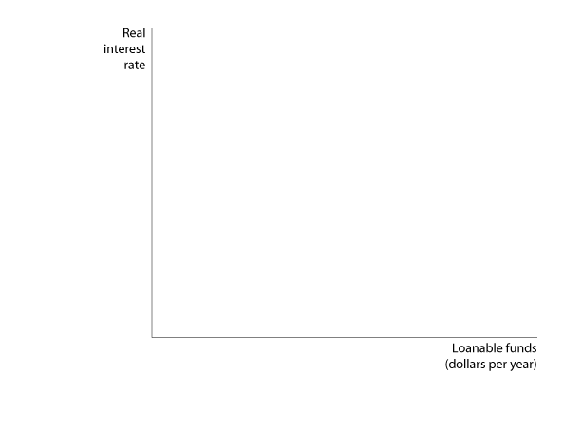
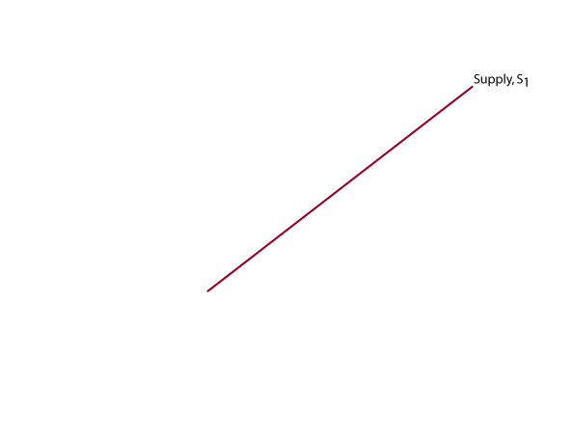
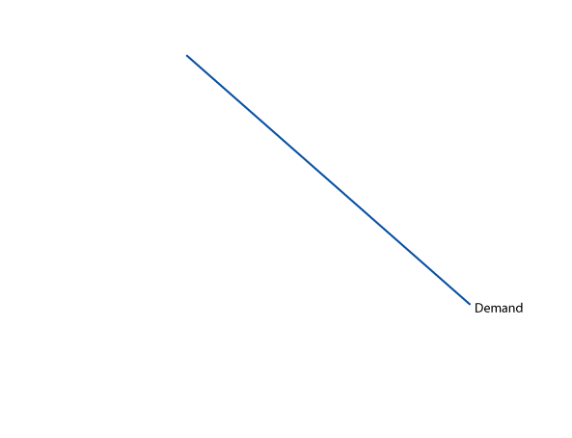

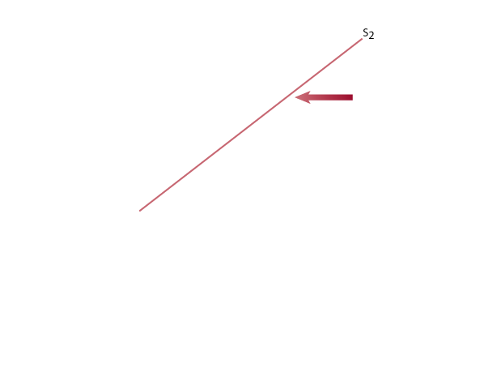
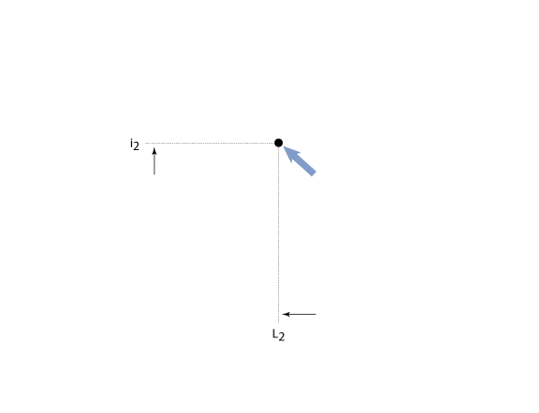
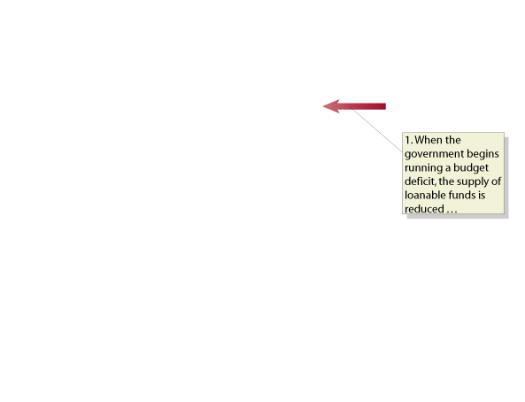

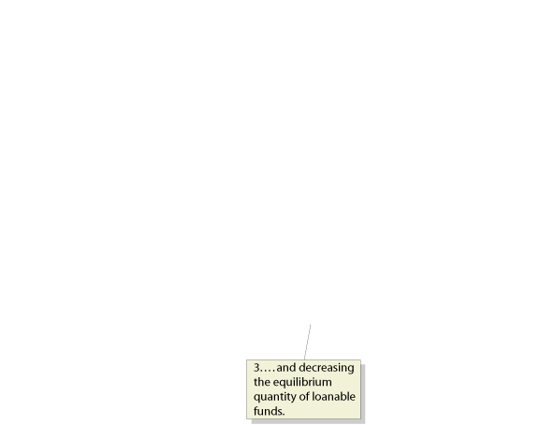
Saving, Investment, and the Financial System
The Market for Loanable Funds
EXPLAINING MOVEMENTS IN SAVING, INVESTMENT, AND INTEREST RATES
9 - 5
The Effect of a Budget Deficit on the Market for Loanable Funds

Slide 55
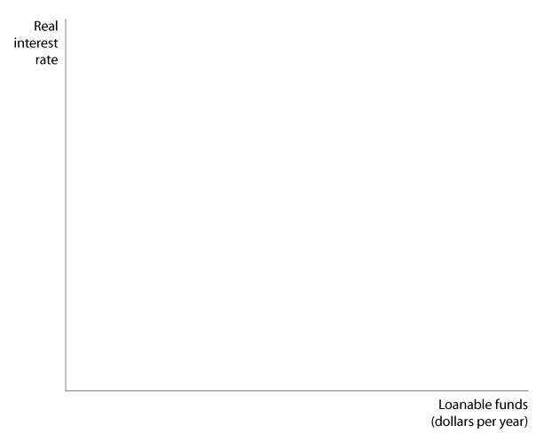
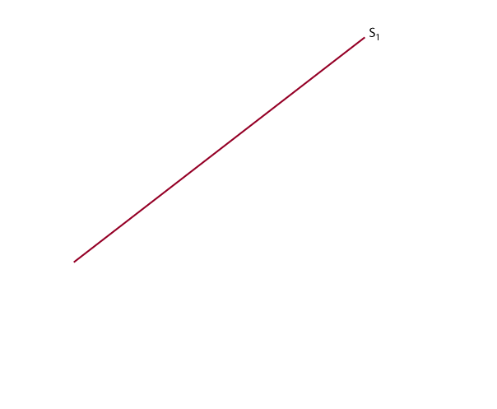

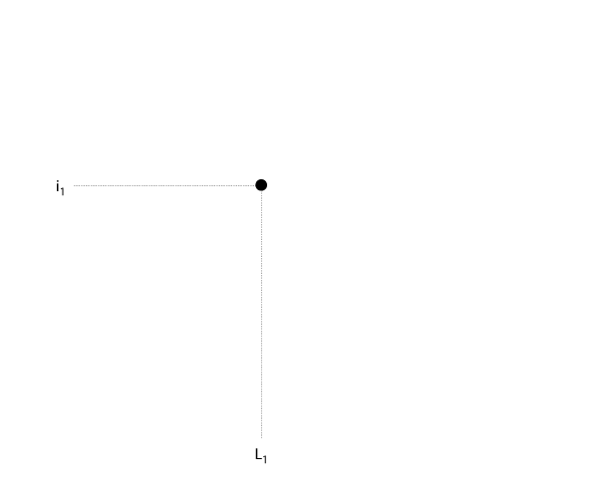
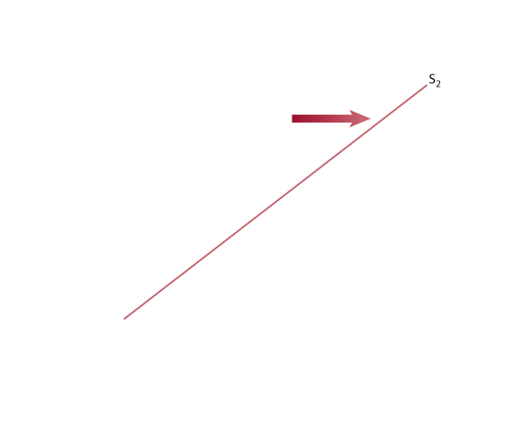
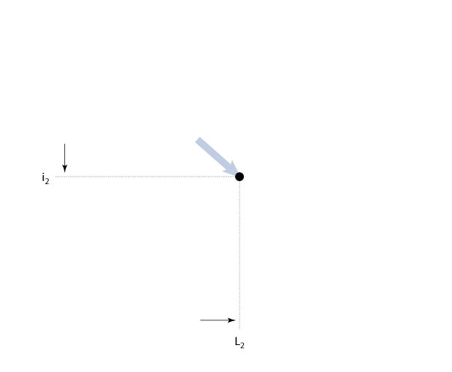
9-2
2
LEARNING OBJECTIVE
How Would a Consumption Tax Affect Saving, Investment, the Interest Rate, and Economic Growth?

Slide 56
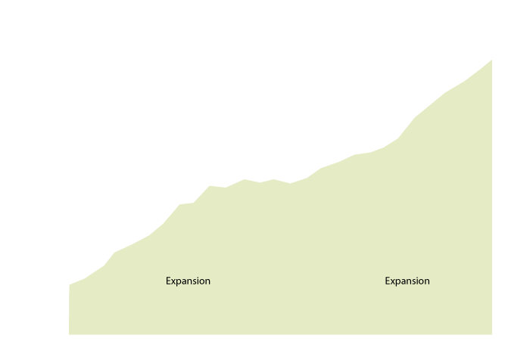
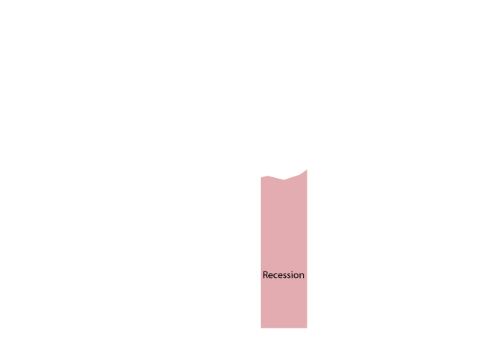


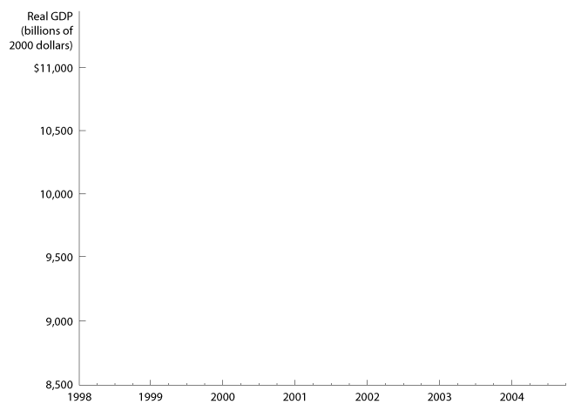
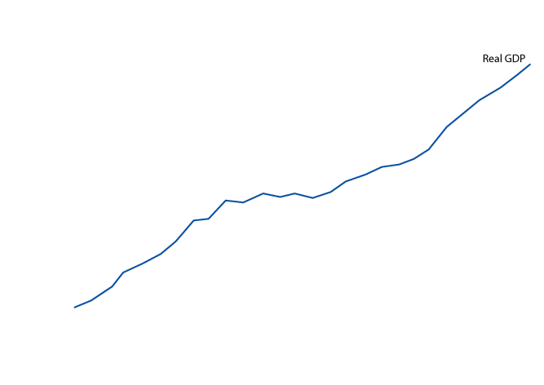
The Business Cycle
3
LEARNING OBJECTIVE
Some Basic Business Cycle Definitions
9 - 6
Movements in Real GDP,
1998-2004

Slide 57

9 - 4
Who Decides If the Economy Is
In a Recession?
PEAK | TROUGH | LENGTH OF RECESSION
July 1953 | May 1954 | 10 months
August 1957 | April 1958 | 8 months
April 1960 | February 1961 | 10 months
December 1969 | November 1970 | 11 months
November 1973 | March 1975 | 16 months
January 1980 | July 1980 | 6 months
July 1981 | November 1982 | 16 months
July 1990 | March 1991 | 8 months
March 2001 | November 2001 | 8 months
The National Bureau of Economic Research determines when recessions begin and end.

Slide 58
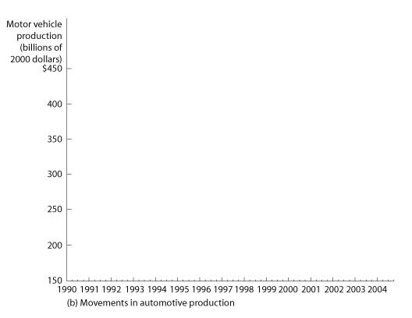







The Business Cycle
What Happens During a Business Cycle?
THE EFFECT OF THE BUSINESS CYCLE ON AUTOMOBILE PRODUCTION
9 - 7
The Effect of the Business Cycle on Automobile Production

Slide 59








The Business Cycle
What Happens During a Business Cycle?
THE EFFECT OF THE BUSINESS CYCLE ON THE INFLATION RATE
9 - 8
The Effect of the 2001 Recession on the Inflation Rate
Don’t Confuse the Price Level and the Inflation Rate

Slide 60
From a trough to a peak, the economy goes through:
a. The recession phase of the business cycle.
b. The expansion phase of the business cycle.
c. A contraction.
d. A depression.

Slide 61
From a trough to a peak, the economy goes through:
a. The recession phase of the business cycle.
b. The expansion phase of the business cycle.
c. A contraction.
d. A depression.

Slide 62



The Business Cycle
What Happens During a Business Cycle?
THE EFFECT OF THE BUSINESS CYCLE ON THE UNEMPLOYMENT RATE
9 - 9
The Impact of Recessions on the Inflation Rate

Slide 63





The Business Cycle
What Happens During a Business Cycle?
THE EFFECT OF THE BUSINESS CYCLE ON THE UNEMPLOYMENT RATE
9 - 10
How the Recession of 2001 Affected the Unemployment Rate

Slide 64
During the early stages of a recovery,
a. Firms usually rush to hire new employees before other firms employ them.
b. Firms are usually reluctant to hire new employees.
c. The rate of unemployment surges dramatically.
d. The rate of unemployment decreases dramatically.

Slide 65
During the early stages of a recovery,
a. Firms usually rush to hire new employees before other firms employ them.
b. Firms are usually reluctant to hire new employees.
c. The rate of unemployment surges dramatically.
d. The rate of unemployment decreases dramatically.

Slide 66



The Business Cycle
What Happens During a Business Cycle?
RECESSIONS HAVE BEEN MILDER AND THE ECONOMY HAS BEEN MORE STABLE SINCE 1950
9 - 11
The Impact of Recessions on the Unemployment Rate

Slide 67


The Business Cycle
What Happens During a Business Cycle?
RECESSIONS HAVE BEEN MILDER AND THE ECONOMY HAS BEEN MORE STABLE SINCE 1950
9 - 12
Fluctuations in Real GDP,
1900-2004

Slide 68
The Business Cycle
What Happens During a Business Cycle?
RECESSIONS HAVE BEEN MILDER AND THE ECONOMY HAS BEEN MORE STABLE SINCE 1950
9 – 1
The Business Cycle Has Become Milder
PERIOD | AVERAGE LENGTH OF EXPANSIONS | AVERAGE LENGTH OF RECESSIONS
1870-1900 | 26 months | 26 months
1900-1950 | 25 months | 19 months
1950-2001 | 61 months | 9 months

Slide 69
Which types of goods are more likely to be affected by the business cycle?
a. Durable goods.
b. Nondurable goods.
c. Services.
d. Both durable and nondurable goods equally.

Slide 70
Which types of goods are more likely to be affected by the business cycle?
a. Durable goods.
b. Nondurable goods.
c. Services.
d. Both durable and nondurable goods equally.

Slide 71
The Business Cycle
Why Is the Economy More Stable?
  The increasing importance of services and the declining importance of goods.
  The establishment of unemployment insurance and other government transfer programs that provide funds to the unemployed.
  Active federal government policies to stabilize the economy.

Slide 72















Here Come Chinese Cars

Slide 73

Business cycle
Capital
Financial system
Human capital
Labor productivity
Long-run economic growth
Market for loanable funds
Potential GDP

