Slide 1
Long-Run Economic Growth:
Sources and Policies

Slide 2

The Chinese Economic Miracle
After studying this chapter, you should be able to:
  Define economic growth, calculate economic growth rates, and describe trends in economic growth.
  Use the economic growth model to explain why growth rates differ across countries.
  Discuss fluctuations in productivity growth in the United States.
  Explain economic catch-up, and discuss why many poor countries have not experienced rapid economic growth.
  Discuss government policies that foster economic growth.
1
2
3
LEARNING OBJECTIVES
4
At the rapid growth rate of recent years, per capita GDP in China will double every eight years.
5

Slide 3
Economic Growth Over Time and Around the World
1
LEARNING OBJECTIVE
Economic Growth from 1,000,000 B.C. to the Present
Industrial Revolution The application of mechanical power to the production of goods, beginning in England around 1750.

Slide 4

Which of the following marks the beginning of significant economic growth?
a. The victory of Mao Zedong and the Communist Party in 1949.
b. The Glorious Revolution of 1688 in England.
c. The Industrial Revolution.
d. The Bolshevik Revolution.

Slide 5
Which of the following marks the beginning of significant economic growth?
a. The victory of Mao Zedong and the Communist Party in 1949.
b. The Glorious Revolution of 1688 in England.
c. The Industrial Revolution.
d. The Bolshevik Revolution.

Slide 6

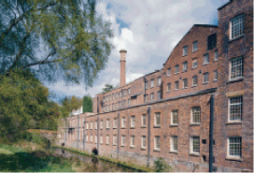
10 - 1
Why was England First?
Why did the Industrial Revolution occur in England?

Slide 7
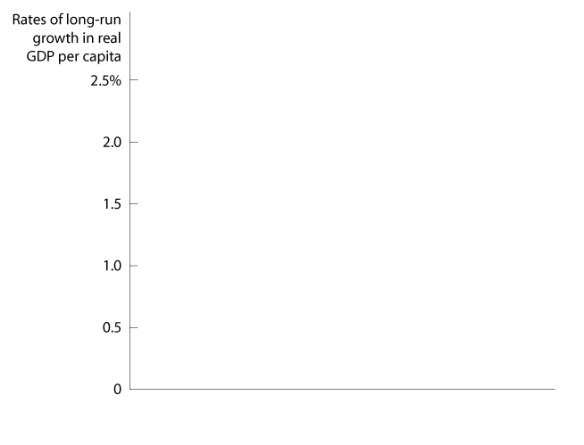
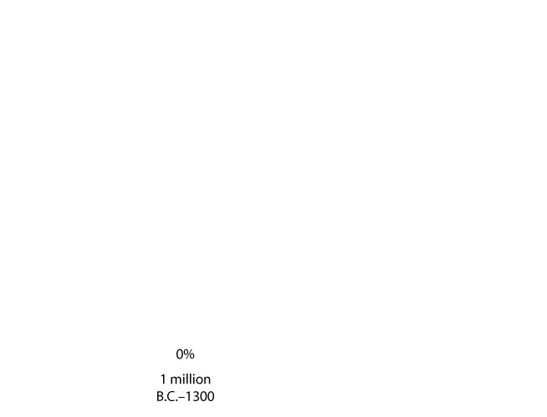

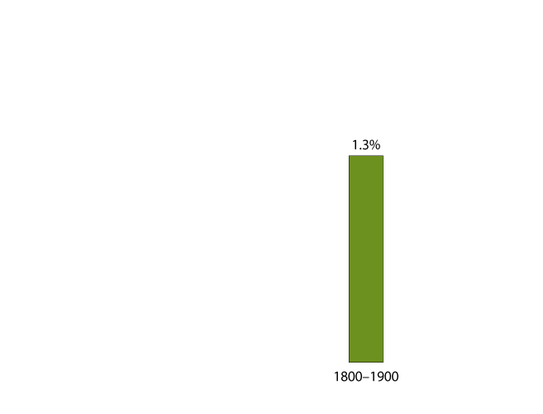

Economic Growth Over Time and Around the World
Small Differences in Growth Rates Are Important
10 - 1
Average Annual Growth Rates for the World Economy

Slide 8
The process known as compounding does the following:
a. It minimizes the differences in interest rates or growth rates over short periods of time.
b. It magnifies even small differences in interest rates or growth rates over long periods of time.
c. It highlights the social characteristics necessary for the phenomenon of growth to occur.
d. It magnifies the importance of large contributions rather than small contributions in order to accumulate wealth over time.

Slide 9
The process known as compounding does the following:
a. It minimizes the differences in interest rates or growth rates over short periods of time.
b. It magnifies even small differences in interest rates or growth rates over long periods of time.
c. It highlights the social characteristics necessary for the phenomenon of growth to occur.
d. It magnifies the importance of large contributions rather than small contributions in order to accumulate wealth over time.

Slide 10

10 - 2
The Benefits of an Earlier Start: Standards of Living in China and Japan
 | CHINA | JAPAN
Life expectancy at birth | 71.5 years | 81.9 years
Infant mortality (per 1,000 live births) | 30 | 3
Percentage of the population surviving on less than $2 per day | 47% | 0%
Percentage of the population with access to treated water | 77% | 100%
Percentage of the population with access to improved sanitation | 44% | 100%
If rapid economic growth continues in China, its standard of living will begin to approach those in the United States and Japan.

Slide 11

Economic Growth Over Time and Around the World
Why Do Growth Rates Matter?
Growth rates matter because an economy that grows too slowly fails to raise living standards.
“The Rich Get Richer and …”
In the 1980s and 1990s, a small group of countries, mostly East Asian countries such as South Korea, Taiwan, and Singapore, experienced high rates of growth and are sometimes referred to as the newly industrializing countries.
Don’t Confuse Average Annual Percentage Change with Total Percentage Change

Slide 12
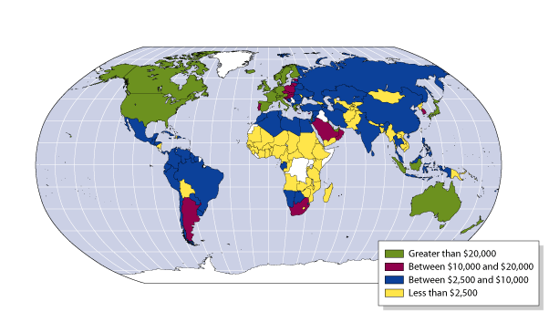
What Determines How Fast Economies Grow?
10 - 2
GDP per Capita, 2004

Slide 13
What Determines How Fast Economies Grow?
2
LEARNING OBJECTIVE
Economic growth model A model that explains changes in real GDP per capita in the long run.
Labor productivity The quantity of goods and services that can be produced by one worker or by one hour of work.
Economists believe two key factors determine labor productivity: the quantity of capital per hour worked and the level of technology.

Slide 14
What Determines How Fast Economies Grow?
Technological change Change in the ability of a firm to produce a given level of output with a given quantity of inputs
There are three main sources of technological change:
  Better machinery and equipment.
  Increases in human capital.
  Better means of organizing and managing production.

Slide 15
What Determines How Fast Economies Grow?
Human capital The accumulated knowledge and skills that workers acquire from education and training, or from their life experiences.
The Per-Worker Production Function
Per-worker production function The relationship between real GDP, or output, per hour worked and capital per hour worked, holding the level of technology constant.

Slide 16
Along the per-worker production function, what happens to real GDP per hour worked as the capital per hour worked increases?
a. It increases at an increasing rate.
b. It increases at a decreasing rate.
c. It decreases at an increasing rate.
d. It decreases at a decreasing rate.

Slide 17
Along the per-worker production function, what happens to real GDP per hour worked as the capital per hour worked increases?
a. It increases at an increasing rate.
b. It increases at a decreasing rate.
c. It decreases at an increasing rate.
d. It decreases at a decreasing rate.

Slide 18
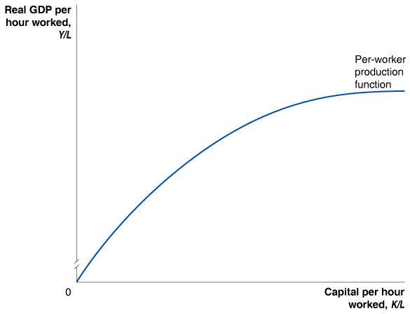
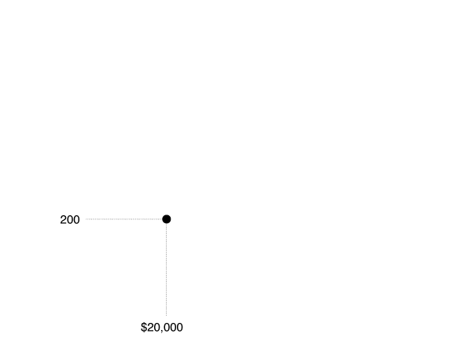
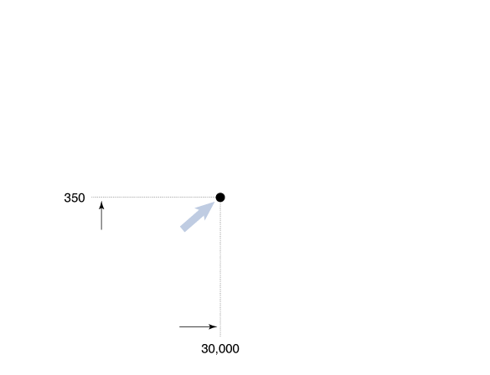
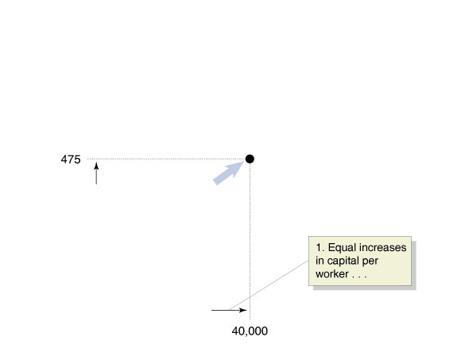
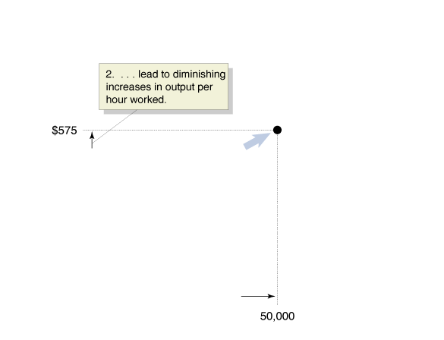
What Determines How Fast Economies Grow?
The Per-Worker Production Function
10 - 3
The Per-Worker Production Function

Slide 19
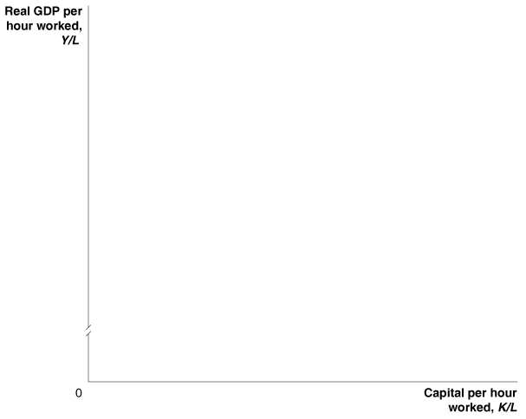
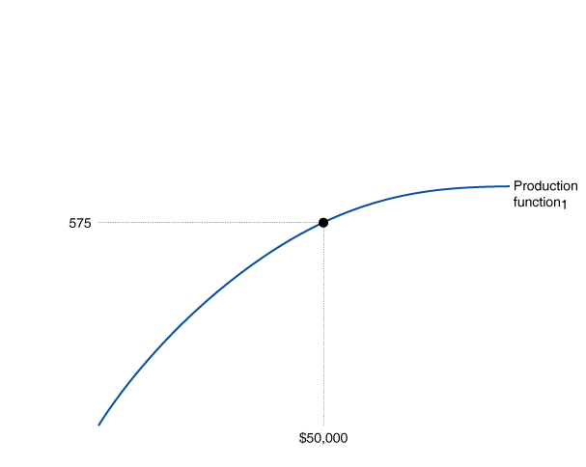
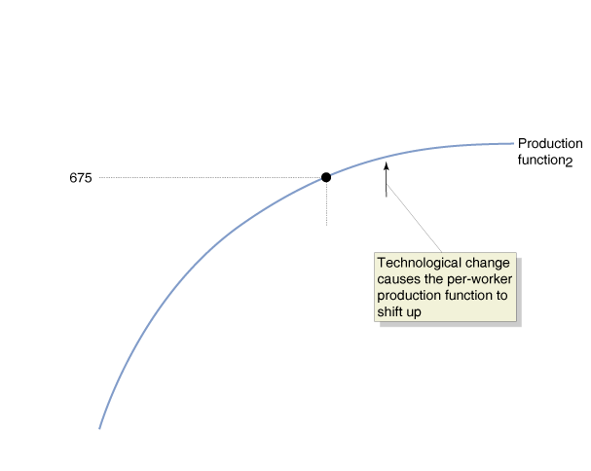
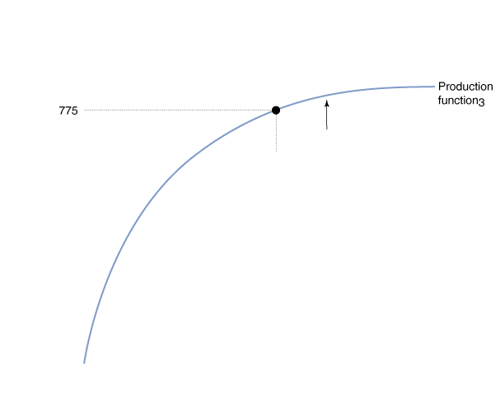
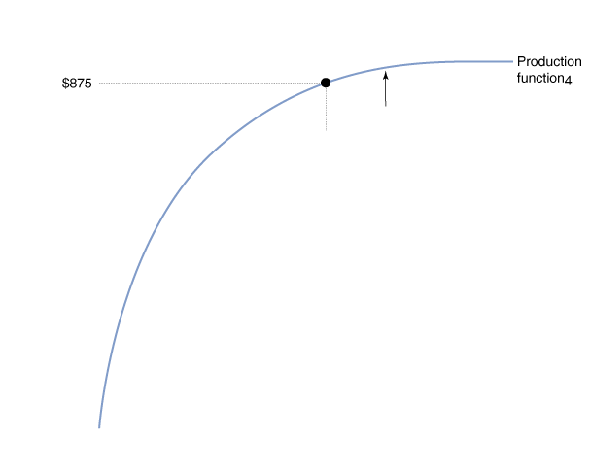
What Determines How Fast Economies Grow?
Which Is More Important for Economic Growth: More Capital or Technological Change?
Technological Change: The Key to Sustaining Economic Growth
10 - 4
Technological Change Increases Output per hour worked

Slide 20

10- 3
Why Did the Soviet Union’s Economy Fail?
He did not bury us.

Slide 21

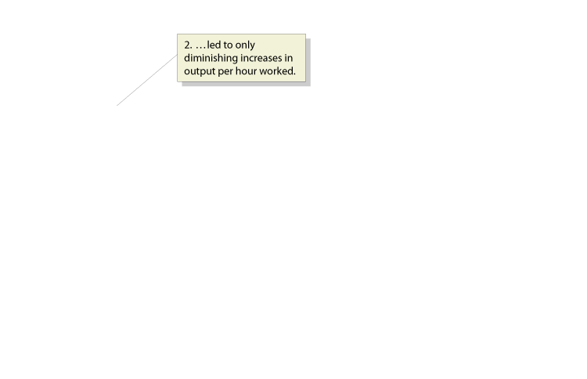
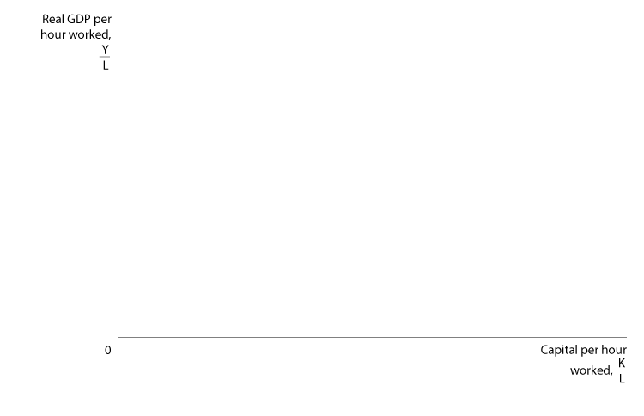
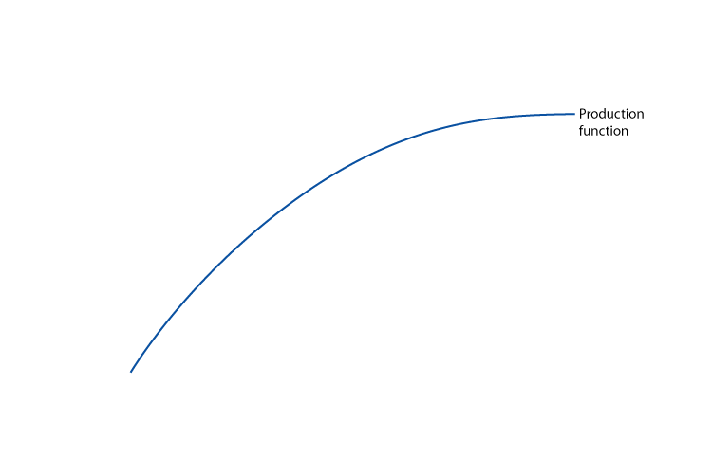
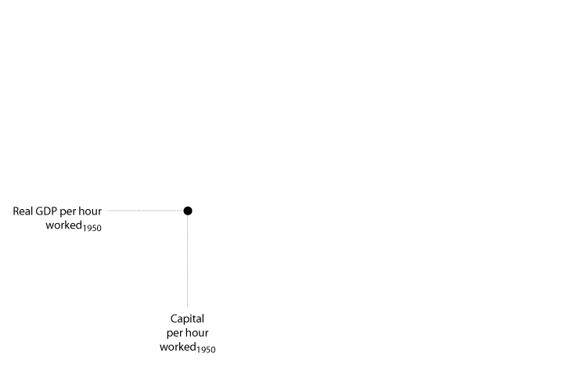
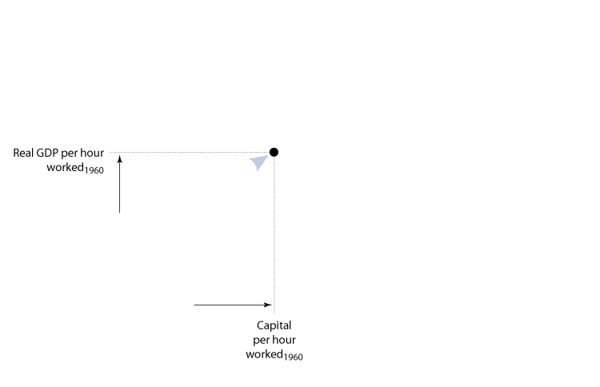
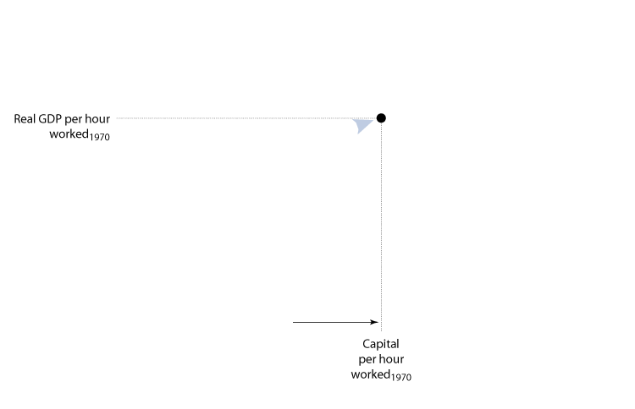
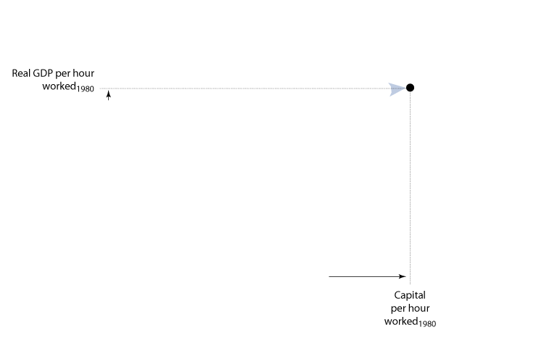
10-1
2
LEARNING OBJECTIVE
Using the Economic Growth Model to Analyze the Failure of the Soviet Union’s Economy

Slide 22
What Determines How Fast Economies Grow?
Endogenous Growth Theory
Endogenous growth theory A model of long-run economic growth that emphasizes that technological change is influenced by economic incentives, and so is determined by the working of the market system.
Patent The exclusive right to a product for a period of 20 years from the date the product was invented.

Slide 23
In which economies is there a greater incentive for technological improvement?
a. In centrally planned economies.
b. In market economies.
c. In Eastern economies.
d. In less developed economies.

Slide 24
In which economies is there a greater incentive for technological improvement?
a. In centrally planned economies.
b. In market economies.
c. In Eastern economies.
d. In less developed economies.

Slide 25
What Determines How Fast Economies Grow?
Government policy can help increase the accumulation of knowledge capital in three ways:
  Protecting intellectual property with patents and copyrights.
  Subsidizing research and development.
  Subsidizing education.

Slide 26
What Determines How Fast Economies Grow?
Joseph Schumpeter and Creative Destruction
To Schumpeter, the entrepreneur is central to economic growth:
The function of entrepreneurs is to reform or revolutionize the pattern of production by exploiting an invention or, more generally, an untried technological possibility for producing new commodities or producing an old one in a new way.

Slide 27

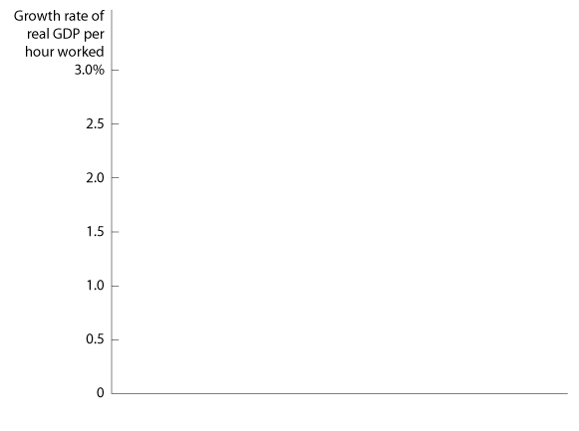
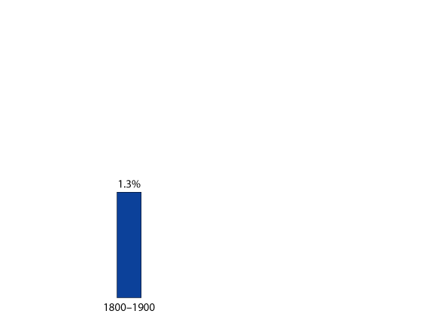
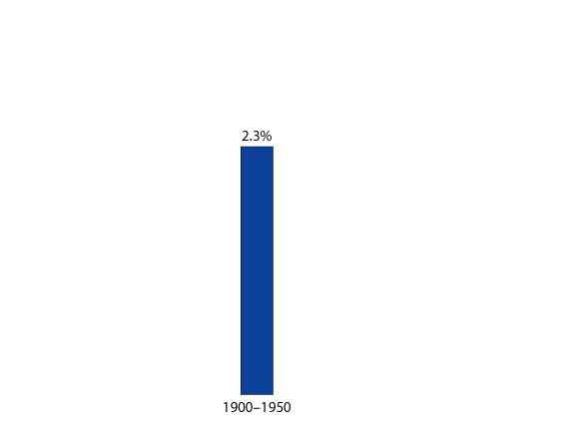
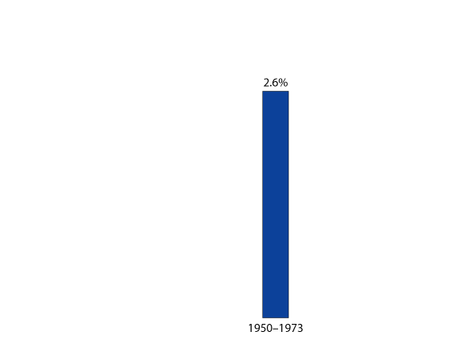
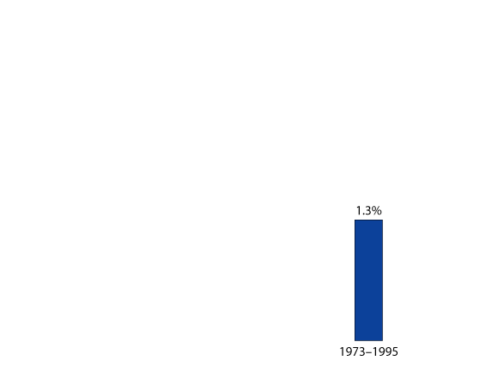
Economic Growth in the United States
3
LEARNING OBJECTIVE
Economic Growth in the United States Since 1950: Fast, Then Slow, Then Fast Again
10 - 5
Average Annual Growth Rates in Real GDP per Hour Worked in the United States

Slide 28
Economic Growth in the United States
What Caused the Productivity Slowdown of 1973-1995?
WAS IT A MEASUREMENT PROBLEM?
WAS IT THE EFFECT OF HIGH OIL PRICES?
WAS IT THE DECLINING QUALITY OF LABOR?
THE PRODUCTIVITY SLOWDOWN AFFECTED ALL INDUSTRIAL COUNTRIES

Slide 29
Which of the following periods in U.S. economic history had the slowest growth rate, as measured by the growth rate of real GDP per hour worked?
a. 1900-1950.
b. 1950-1973.
c. 1973-1995.
d. 1995-2004.

Slide 30
Which of the following periods in U.S. economic history had the slowest growth rate, as measured by the growth rate of real GDP per hour worked?
a. 1900-1950.
b. 1950-1973.
c. 1973-1995.
d. 1995-2004.

Slide 31
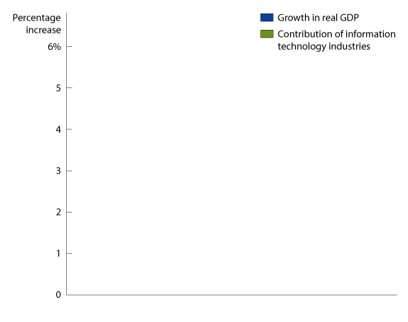
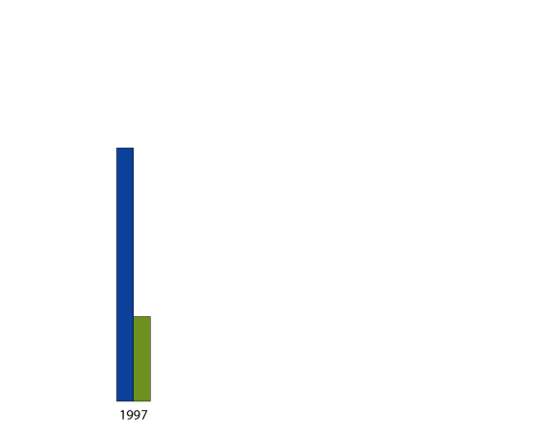
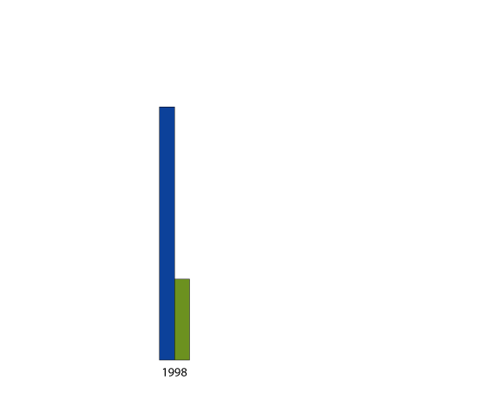
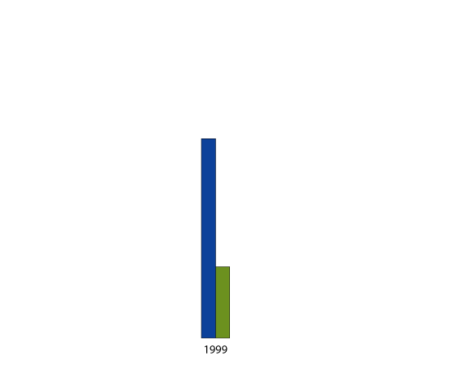
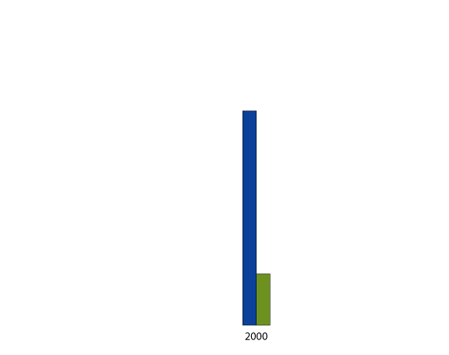

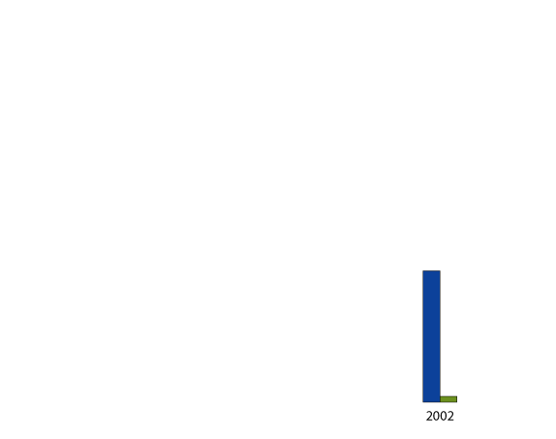

Economic Growth in the United States
The Productivity Boom: Are We in a “New Economy”?
10 - 6
The Contribution of Information Technology to Growth in Real GDP

Slide 32



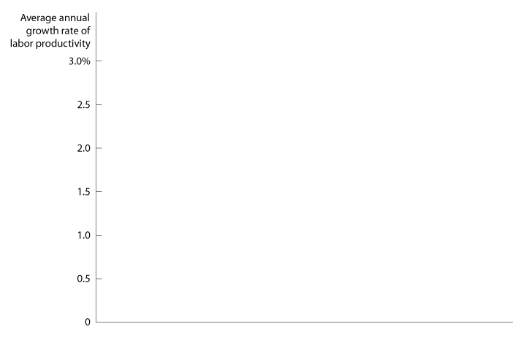

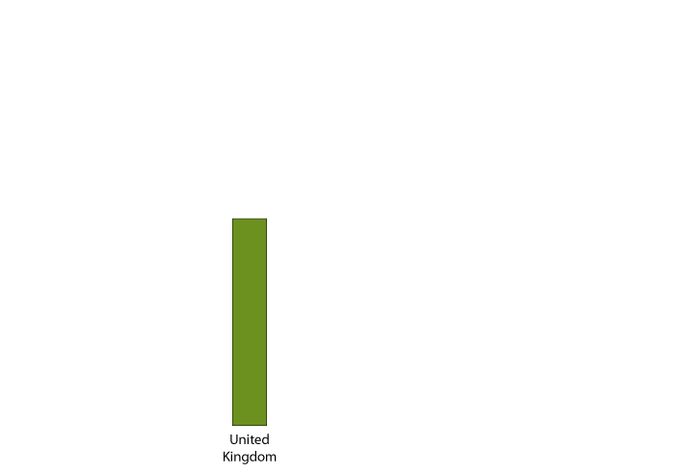
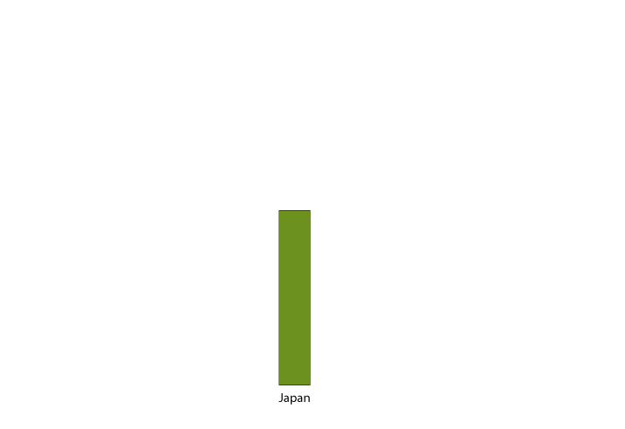

Economic Growth in the United States
Why Has Productivity Growth Been Faster in the United States than in Other Countries?
10 - 7
Productivity Growth in the Leading Industrial Economies, 1996-2004

Slide 33
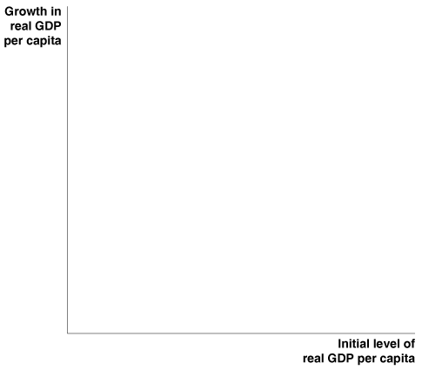

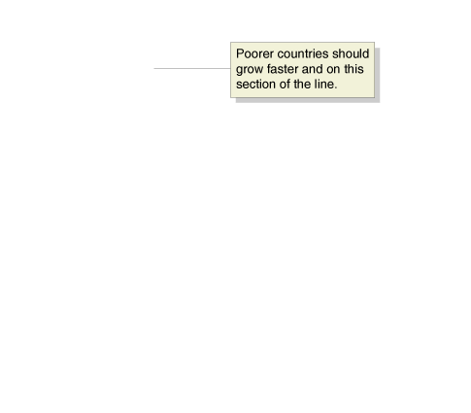

Why Isn’t the Whole World Rich?
4
LEARNING OBJECTIVE
Catch-up The prediction that the level of GDP per capita (or income per capita) in poor countries will grow faster than in rich countries.
Catch-up: Sometimes, But Not Always
10 - 8
The Catch-up Predicted by the Economic Growth Model

Slide 34
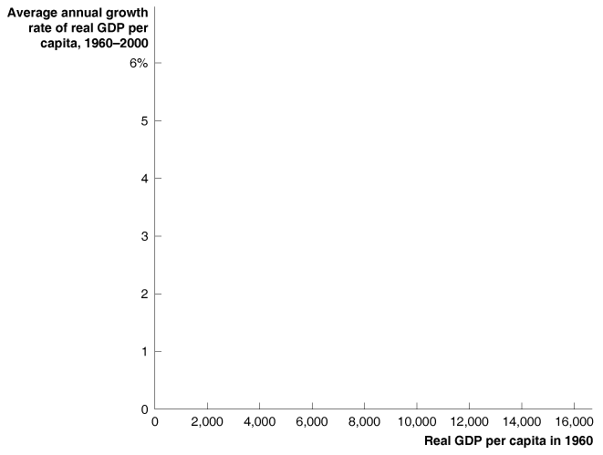
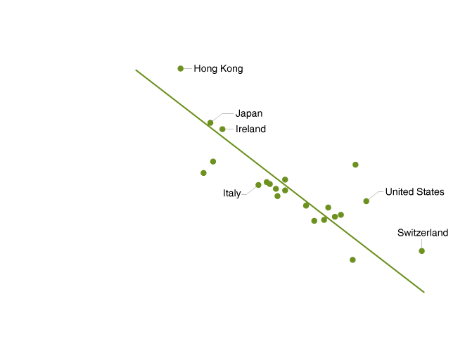
Why Isn’t the Whole World Rich?
Catch-up: Sometimes, But Not Always
CATCH-UP AMONG THE INDUSTRIAL COUNTRIES
10 - 9
There Has Been Catch-up Among Industrial Countries

Slide 35
Why has productivity growth in the United States been more rapid than in the other industrialized countries?
a. Because of the greater flexibility of U.S. labor markets and the greater efficiency of the U.S. financial system.
b. Because the U.S. government has more restrictive but also more effective regulations that make the labor and output markets more efficient.
c. Because the opportunity cost of being unemployed is lower in the United States than in these other countries.
d. All of the above.

Slide 36
Why has productivity growth in the United States been more rapid than in the other industrialized countries?
a. Because of the greater flexibility of U.S. labor markets and the greater efficiency of the U.S. financial system.
b. Because the U.S. government has more restrictive but also more effective regulations that make the labor and output markets more efficient.
c. Because the opportunity cost of being unemployed is lower in the United States than in these other countries.
d. All of the above.

Slide 37
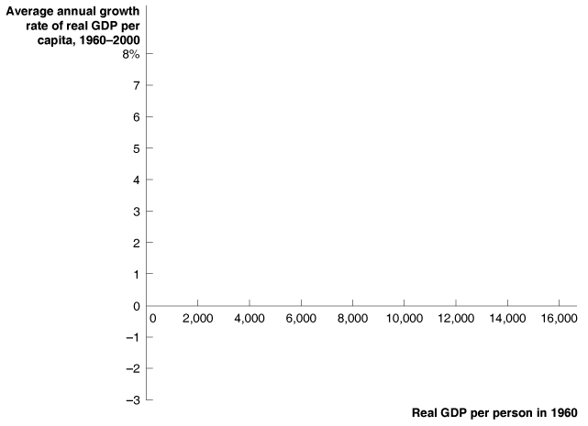
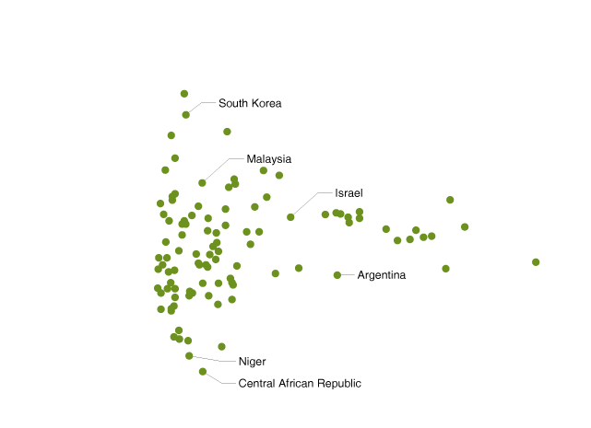
Why Isn’t the Whole World Rich?
Catch-up: Sometimes, But Not Always
ARE THE DEVELOPING COUNTRIES CATCHING UP TO THE INDUSTRIAL COUNTRIES?
10 - 10
Most of the World Hasn’t Been Catching Up

Slide 38
10-2
4
LEARNING OBJECTIVE
The Economic Growth Model’s Predictions of Catch-Up
COUNTRY | REAL GDP PER CAPITA IN 1960 (1996 DOLLARS) | GROWTH IN REAL GDP PER CAPITA, 1960-2000
Botswana | $958 | 5.29%
Thailand | 1,091 | 4.70
Sri Lanka | 1,333 | 2.29
Ecuador | 2,003 | 1.38
Guatemala | 2,344 | 1.29
COUNTRY | REAL GDP PER CAPITA IN 1960 (1996 DOLLARS) | GROWTH IN REAL GDP PER CAPITA, 1960-2000
Japan | $4,544 | 4.32%
Norway | 8,240 | 3.00
The Netherlands | 9,245 | 2.45
United Kingdom | 9,674 | 2.10

Slide 39
Why Isn’t the Whole World Rich?
Why Don’t More Low-Income Countries Experience Rapid Growth?
There is no one answer, but most economists point to four key factors:
  Failure to enforce the rule of law
  Wars and revolutions
  Poor public education and health
  Low rates of saving and investment

Slide 40
Which of the following statements about catch-up is correct?
a. The lower-income industrial countries have been catching up to the higher-income industrial countries.
b. The developing countries as a group have been catching up to the industrial countries as a group.
c. Both of the above.
d. None of the above.

Slide 41
Which of the following statements about catch-up is correct?
a. The lower-income industrial countries have been catching up to the higher-income industrial countries.
b. The developing countries as a group have been catching up to the industrial countries as a group.
c. Both of the above.
d. None of the above.

Slide 42
Why Isn’t the Whole World Rich?
Why Don’t More Low-Income Countries Experience Rapid Growth?
FAILURE TO ENFORCE THE RULE OF LAW
Rule of Law The ability of a government to enforce the laws of the country, particularly with respect to protecting private property and enforcing contracts.

Slide 43
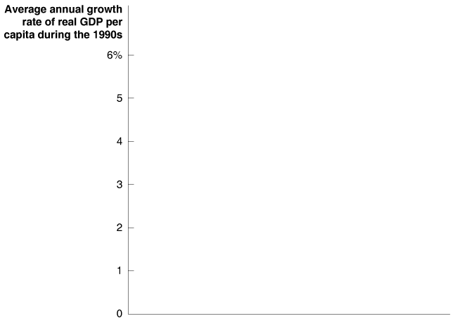

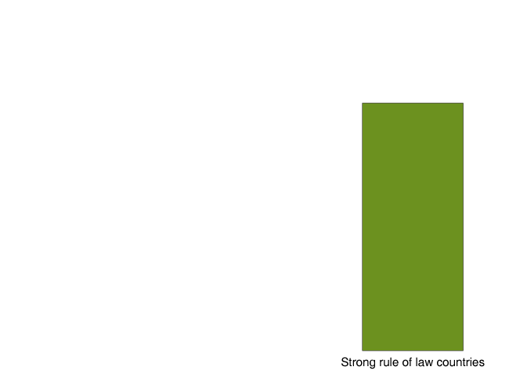
Why Isn’t the Whole World Rich?
Why Don’t More Low-Income Countries Experience Rapid Growth?
WARS AND REVOLUTIONS
10 - 11
The Rule of Law and Growth

Slide 44
Why Isn’t the Whole World Rich?
Why Don’t More Low-Income Countries Experience Rapid Growth?
POOR PUBLIC EDUCATION AND HEALTH
Many low-income countries have weak public school systems, so many workers are unable to read and write.
People who are sick work less and are less productive when they do work.
LOW RATES OF SAVING AND INVESTMENT
The low savings rates in developing countries contribute to a vicious cycle of poverty.

Slide 45
Why Isn’t the Whole World Rich?
The Benefits of Globalization
Foreign direct investment The purchase or building by a corporation of a facility in a foreign country.
Foreign portfolio investment The purchase by an individual or firm of stock or bonds issued in another country.
Globalization The process of countries becoming more open to foreign trade and investment.

Slide 46
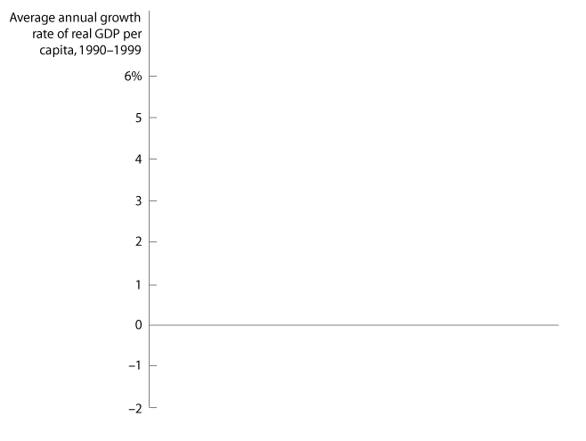

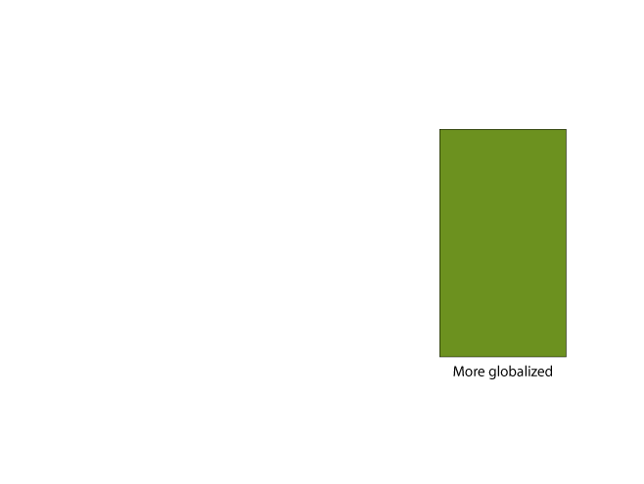
Why Isn’t the Whole World Rich?
The Benefits of Globalization
10 - 12
Globalization and Growth

Slide 47
Which countries have experienced faster economic growth?
a. Countries that have been generally more open to foreign trade and investment.
b. Countries that relied less on foreign trade and more on their own internal sources of saving and investment.
c. Countries that focused on job preservation.
d. Countries that avoided globalization.

Slide 48
Which countries have experienced faster economic growth?
a. Countries that have been generally more open to foreign trade and investment.
b. Countries that relied less on foreign trade and more on their own internal sources of saving and investment.
c. Countries that focused on job preservation.
d. Countries that avoided globalization.

Slide 49
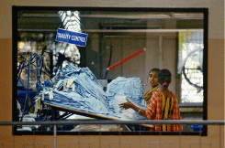
10 - 4
Globalization and the Spread of Technology in Bangladesh
The spread of technology spurred Bangladesh's booming clothing industry.

Slide 50
Growth Policies
5
LEARNING OBJECTIVE
Enhancing Property Rights and the Rule of Law
Improving Health and Education
Policies with Respect to Technology
Policies with Respect to Saving and Investment
Is Economic Growth Good or Bad?

Slide 51

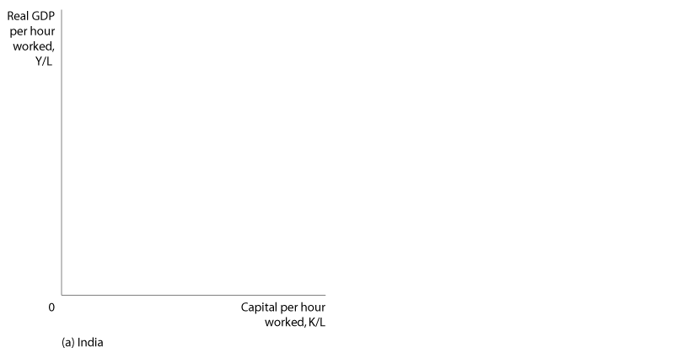




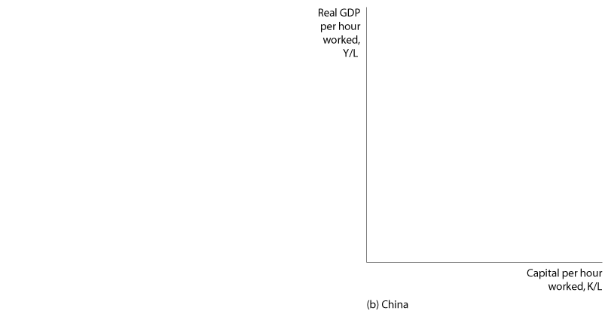



India Comes of Age, As Focus on Returns Lures Foreign Capital

Slide 52

Catch-up
Economic growth model
Endogenous growth theory
Foreign direct investment (FDI)
Foreign portfolio investment
Globalization
Human capital
Industrial Revolution
Labor productivity
Patent
Per-worker production function
Rule of law
Technological change

