Slide 1
Output and Expenditure in the Short Run

Slide 2

Demand Forecasts Backfire at Cisco Systems
After studying this chapter, you should be able to:
  Understand how macroeconomic equilibrium is determined in the aggregate expenditure model.
  Discuss the determinants of the four components of aggregate expenditure and define the marginal propensity to consume and the marginal propensity to save.
  Use a 45-line diagram to illustrate macroeconomic equilibrium.
  Calculate a numerical example of macroeconomic equilibrium.
  Define the multiplier effect and use it to calculate changes in equilibrium GDP.
  Understand the relationship between the aggregate demand curve and aggregate expenditure.
1
2
3
LEARNING OBJECTIVES
4
5
In this chapter, we will focus on exploring the reasons for fluctuations in total spending in the economy.
6

Slide 3
Output and Expenditure in the Short Run
Aggregate expenditure (AE) The total amount of spending in the economy: the sum of consumption, planned investment, government purchases, and net exports.

Slide 4
The Aggregate Expenditure Model
1
LEARNING OBJECTIVE
Aggregate expenditure model A macroeconomic model that focuses on the relationship between total spending and real GDP, assuming the price level is constant.

Slide 5

The key idea of the aggregate expenditures model is that in any particular year, the level of gross domestic product (GDP) is determined mainly by:
a. The economy’s endowment of economic resources and technology.
b. The level of the interest rate for the economy as a whole.
c. The level of aggregate expenditures.
d. The level of government expenditures.

Slide 6
The key idea of the aggregate expenditures model is that in any particular year, the level of gross domestic product (GDP) is determined mainly by:
a. The economy’s endowment of economic resources and technology.
b. The level of the interest rate for the economy as a whole.
c. The level of aggregate expenditures.
d. The level of government expenditures.

Slide 7
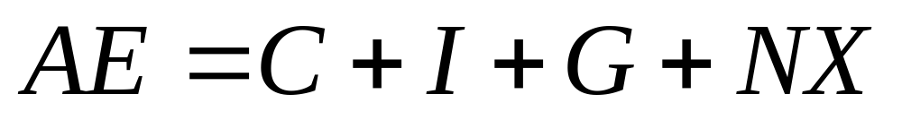
The Aggregate Expenditure Model
Aggregate Expenditure
  Consumption (C)
  Planned Investment (I)
  Government Purchases (G)
  Net Exports (NX)

Slide 8
The Aggregate Expenditure Model
The Difference between Planned Investment and Actual Investment
Inventories Goods that have been produced, but not yet sold.
Macroeconomic Equilibrium
Aggregate Expenditure = GDP

Slide 9
Which of the following statements is correct?
a. Actual investment and planned investment are always the same.
b. Actual investment will equal planned investment only when inventories rise.
c. Actual investment will equal planned investment only when there is no unplanned change in inventories.
d. Actual investment equals planned investment only when inventories decline.

Slide 10
Which of the following statements is correct?
a. Actual investment and planned investment are always the same.
b. Actual investment will equal planned investment only when inventories rise.
c. Actual investment will equal planned investment only when there is no unplanned change in inventories.
d. Actual investment equals planned investment only when inventories decline.

Slide 11
The Aggregate Expenditure Model
Adjustments to Macroeconomic Equilibrium
11 – 1
The Relationship Between Aggregate Expenditure and GDP
IF … | THEN … | AND …
Aggregate expenditure is equal to GDP | inventories are unchanged | the economy is in macroeconomic equilibrium.
Aggregate expenditure is less than GDP | inventories rise | GDP and employment decrease.
Aggregate Expenditure is greater than GDP | inventories fall | GDP and employment increase.

Slide 12
Determining the Level of
Aggregate Expenditure in the Economy
2
LEARNING OBJECTIVE
11 – 2
Components of Aggregate Expenditure, 2004
EXPENDITURE CATEGORY | EXPENDITURE (BILLIONS OF 2000 DOLLARS)
Consumption | $7,589
Investment | 1,810
Government | 1,952
Net Exports | -601

Slide 13
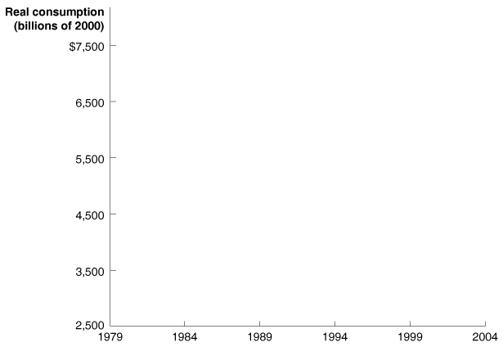
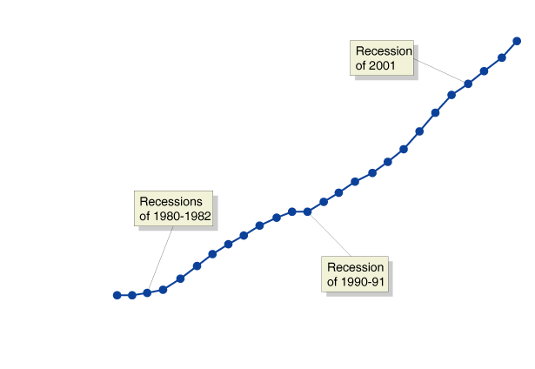
Determining the Level of
Aggregate Expenditure in the Economy
Consumption
11 - 1
Real Consumption, 1979-2004

Slide 14
Determining the Level of
Aggregate Expenditure in the Economy
Consumption
The five most important variables that determine the level of consumption are:
  CURRENT DISPOSABLE INCOME
  HOUSEHOLD WEALTH
  EXPECTED FUTURE INCOME
  THE PRICE LEVEL
  THE INTEREST RATE

Slide 15
The most important determinant of consumption is:
a. Current disposable income.
b. Household wealth.
c. Expected future income.
d. The price level and the interest rate.

Slide 16
The most important determinant of consumption is:
a. Current disposable income.
b. Household wealth.
c. Expected future income.
d. The price level and the interest rate.

Slide 17
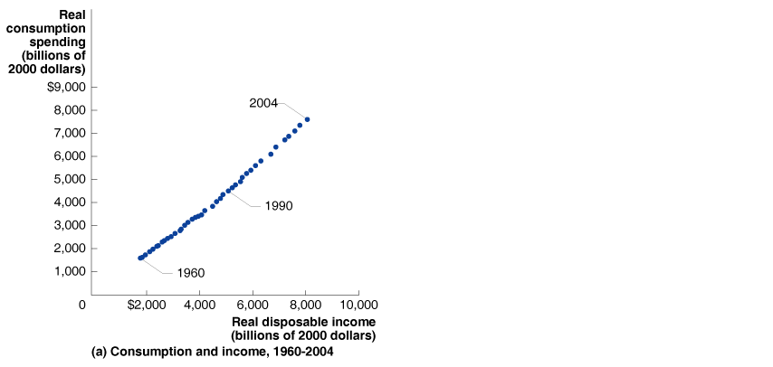
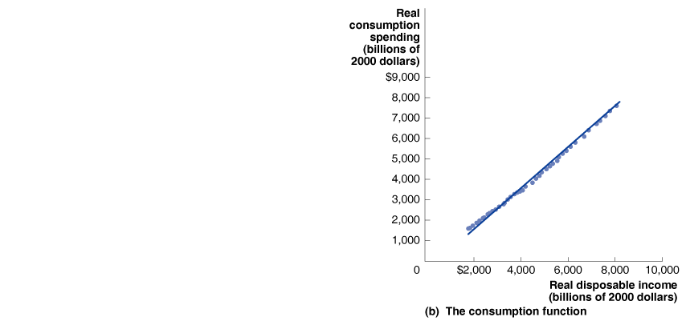
Determining the Level of
Aggregate Expenditure in the Economy
THE CONSUMPTION FUNCTION
11 - 2
The Relationship between Consumption and Income, 1960-2004

Slide 18
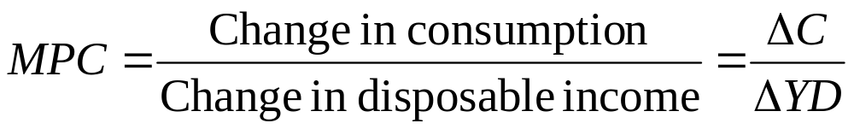
Determining the Level of
Aggregate Expenditure in the Economy
THE CONSUMPTION FUNCTION
Consumption function The relationship between consumption spending and disposable income.
Marginal propensity to consume (MPC) The slope of the consumption function: the amount by which consumption spending increases when disposable income increases.

Slide 19
If the marginal propensity to consume (MPC) is 0.9, how much additional consumption will result from an increase of $80 billion of disposable income?
a. $88.89 billion.
b. $800 billion.
c. $72 billion.
d. None of the above.

Slide 20
If the marginal propensity to consume (MPC) is 0.9, how much additional consumption will result from an increase of $80 billion of disposable income?
a. $88.89 billion.
b. $800 billion.
c. $72 billion.
d. None of the above.

Slide 21
Determining the Level of
Aggregate Expenditure in the Economy
The Relationship between Consumption and National Income
Disposable income = National income – Net taxes
Or, rearranging the equation:
National income = GDP = Disposable income + Net taxes

Slide 22
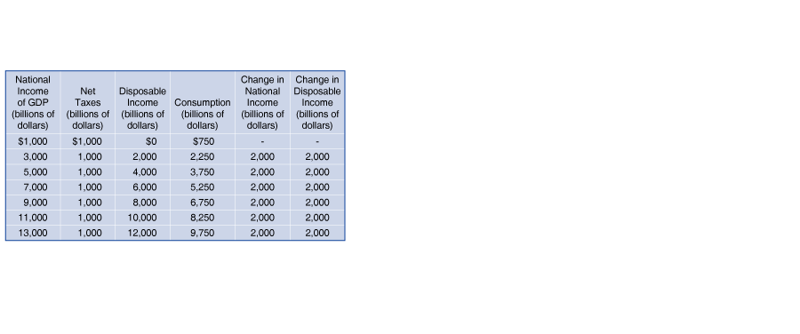
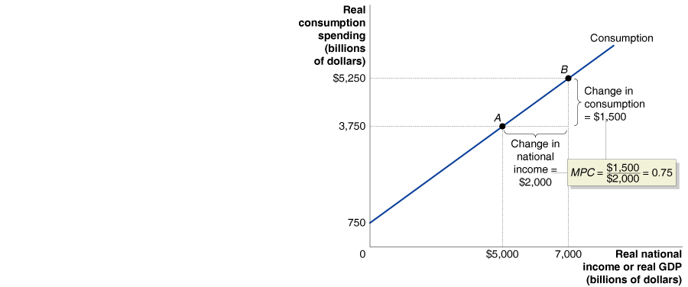
Determining the Level of
Aggregate Expenditure in the Economy
The Relationship between Consumption and National Income
11 - 3
The Relationship between Consumption and National Income

Slide 23
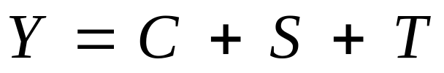
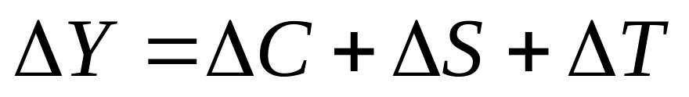
Determining the Level of
Aggregate Expenditure in the Economy
Income, Consumption, and Saving
National income = Consumption + Saving + Taxes
Change in national income = Change in consumption + Change in saving + Change in taxes
Using symbols, where Y represents national income (and GDP), C represents consumption, S represents saving, and T represents taxes, we can write:
and,

Slide 24

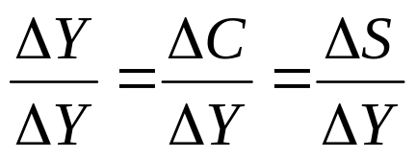
Determining the Level of
Aggregate Expenditure in the Economy
Income, Consumption, and Saving
To simplify, we can assume that taxes are always a constant amount, in which case ΔT = 0, so that:
  Marginal propensity to save (MPS) The change in saving divided by the change in income.
  or,
  1 = MPC + MPS

Slide 25
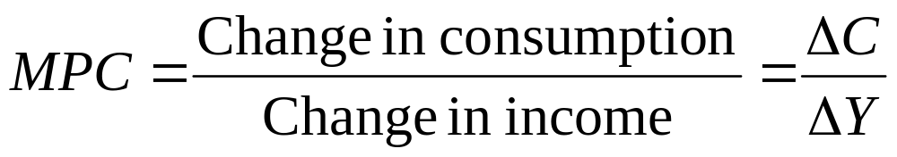
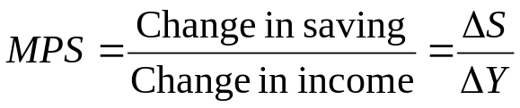
11 - 1
2
LEARNING OBJECTIVE
Calculating the Marginal Propensity to Consume and the Marginal Propensity to Save
NATIONAL INCOME AND REAL GDP (Y) | CONSUMPTION (C) | SAVING (S) | MARGINAL PROPENSITY TO CONSUME (MPC) | MARGINAL PROPENSITY TO SAVE (MPS)
$9,000 | $8,000 |  | — | —
10,000 | $8,600
11,000 | $9,200
12,000 | $9,800
13,000 | $10,400

Slide 26
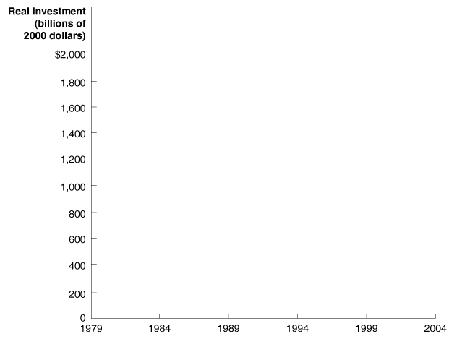
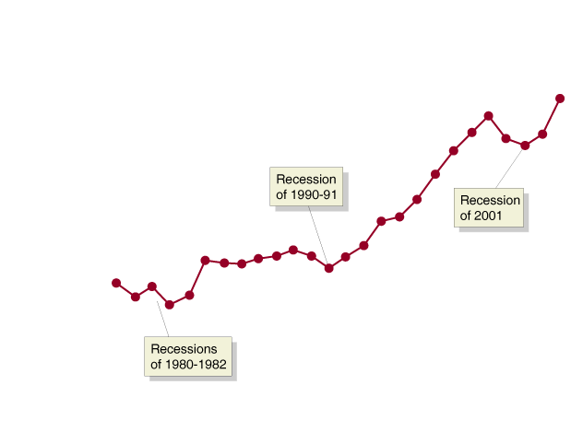
Determining the Level of
Aggregate Expenditure in the Economy
Planned Investment
11 - 4
Real Investment, 1979-2004

Slide 27
The behavior of consumption and investment over time can be described as follows:
a. Investment follows a smooth, upward trend, but consumption is highly volatile.
b. Consumption follows a smooth, upward trend, but investment is subject to significant fluctuations.
c. Both consumption and investment fluctuate significantly over time.
d. Neither consumption nor investment fluctuates significantly over time.

Slide 28
The behavior of consumption and investment over time can be described as follows:
a. Investment follows a smooth, upward trend, but consumption is highly volatile.
b. Consumption follows a smooth, upward trend, but investment is subject to significant fluctuations.
c. Both consumption and investment fluctuate significantly over time.
d. Neither consumption nor investment fluctuates significantly over time.

Slide 29
Determining the Level of
Aggregate Expenditure in the Economy
Planned Investment
The four most important variables that determine the level of investment are:
  EXPECTATIONS OF FUTURE PROFITABILITY
  THE INTEREST RATE
  TAXES
  CASH FLOW
    Cash flow The difference between the cash revenues received by the firm and the cash spending by the firm.

Slide 30


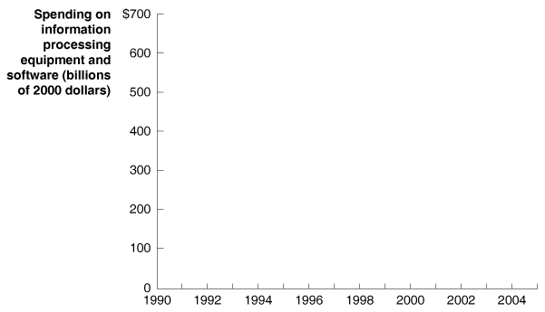
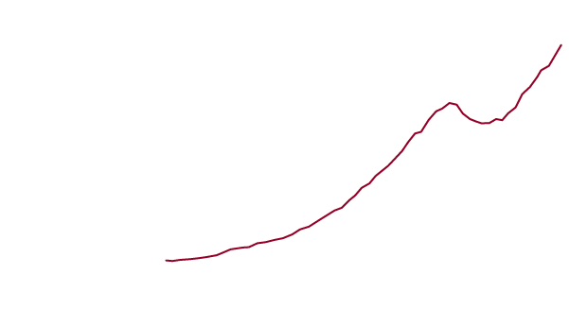
11 - 1
Cisco Rides the Roller Coaster of Information Technology Spending
Cisco Systems has survived the wild Internet boom and bust.

Slide 31
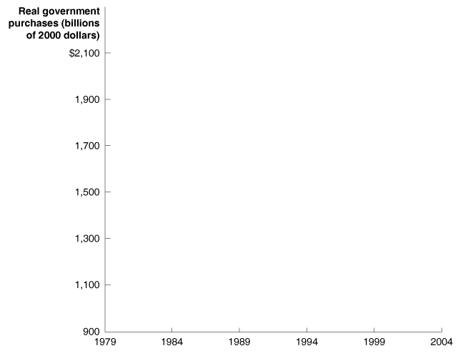
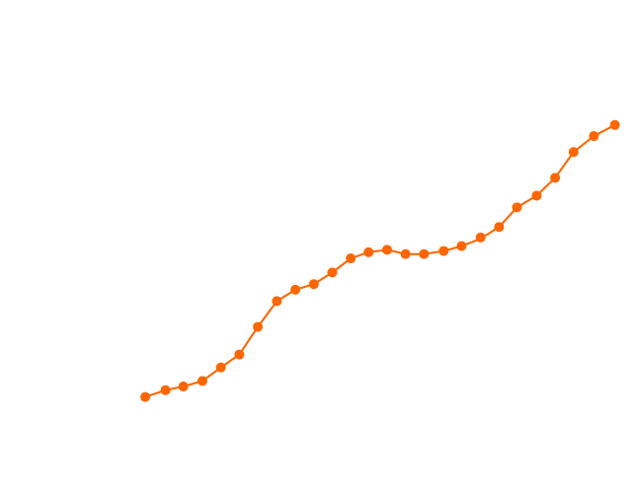
Determining the Level of
Aggregate Expenditure in the Economy
Government Purchases
11 - 5
Real Government Purchases, 1979-2004

Slide 32
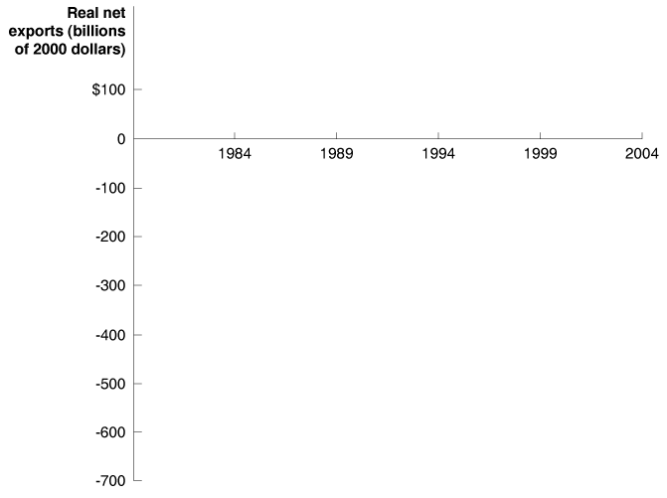
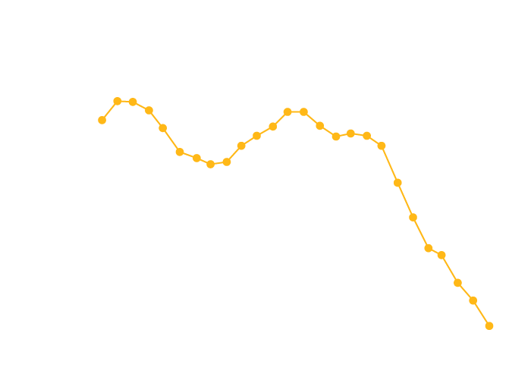
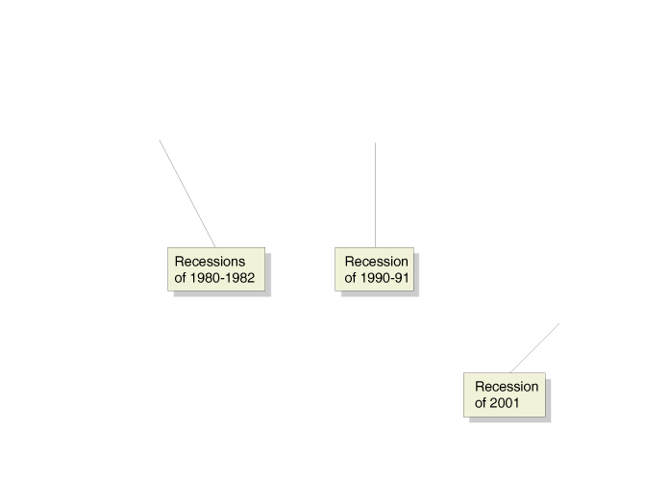
Determining the Level of
Aggregate Expenditure in the Economy
Net Exports
11 - 6
Real Net Exports, 1979-2004

Slide 33
Determining the Level of
Aggregate Expenditure in the Economy
Net Exports
The three most important variables that determine the level of net exports are:
  THE PRICE LEVEL IN THE UNITED STATES RELATIVE TO THE PRICE LEVELS IN OTHER COUNTRIES
  THE GROWTH RATE OF GDP IN THE UNITED STATES RELATIVE TO THE GROWTH RATES OF GDP IN OTHER COUNTRIES
  THE EXCHANGE RATE BETWEEN THE DOLLAR AND OTHER CURRENCIES

Slide 34
If inflation in the United States is lower than inflation in other countries, then U.S. exports ________ and U.S. imports ________, which _________ net exports.
a. increase; increase; decrease
b. increase; decrease; increase
c. decrease; increase; increase
d. decrease; increase; decrease

Slide 35
If inflation in the United States is lower than inflation in other countries, then U.S. exports ________ and U.S. imports ________, which _________ net exports.
a. increase; increase; decrease
b. increase; decrease; increase
c. decrease; increase; increase
d. decrease; increase; decrease

Slide 36
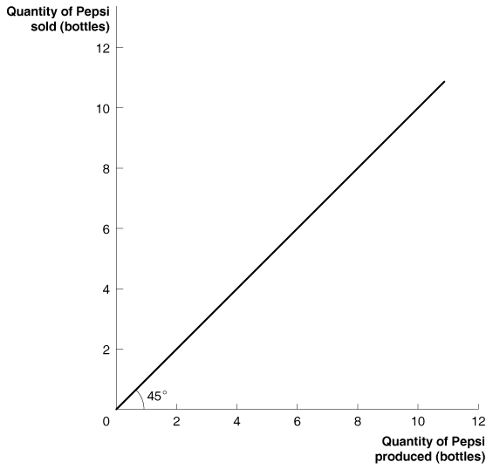
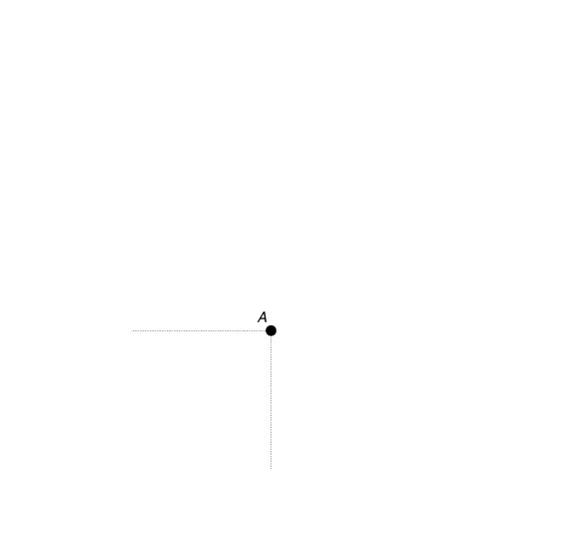
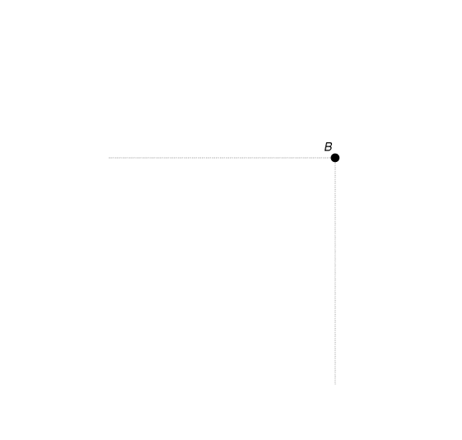
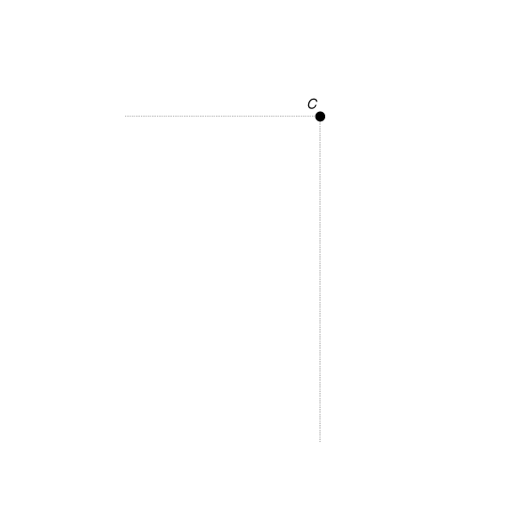

Graphing Macroeconomic Equilibrium
3
LEARNING OBJECTIVE
11 - 7
An Example of a 45- Line Diagram

Slide 37
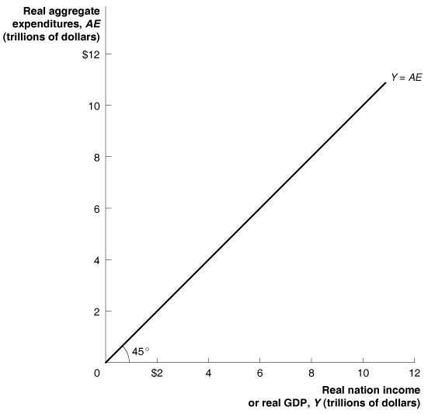
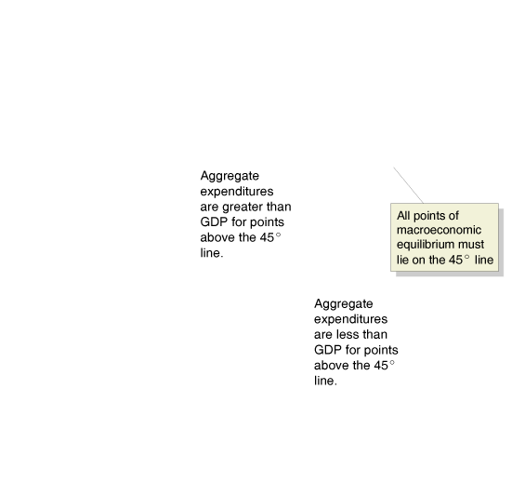
Graphing Macroeconomic Equilibrium
11 - 8
The Relationship between Aggregate Expenditure and GDP on a 45-Line Diagram

Slide 38
At points above the line indicating that aggregate expenditures equal actual output (Y = AE):
a. Aggregate expenditures are greater than GDP.
b. Aggregate expenditures are less than GDP.
c. Aggregate expenditures are equal to GDP.
d. Aggregate expenditures are in equilibrium.

Slide 39
At points above the line indicating that aggregate expenditures equal actual output (Y = AE):
a. Aggregate expenditures are greater than GDP.
b. Aggregate expenditures are less than GDP.
c. Aggregate expenditures are equal to GDP.
d. Aggregate expenditures are in equilibrium.

Slide 40
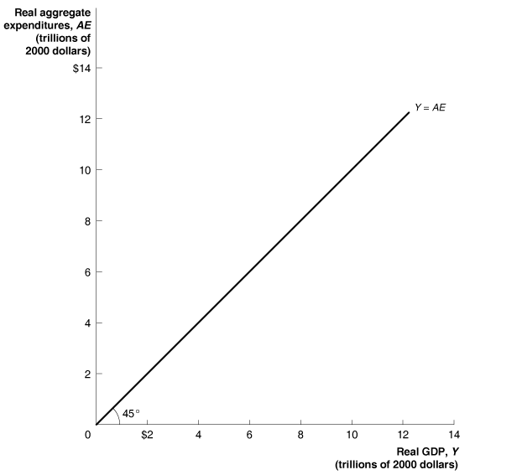
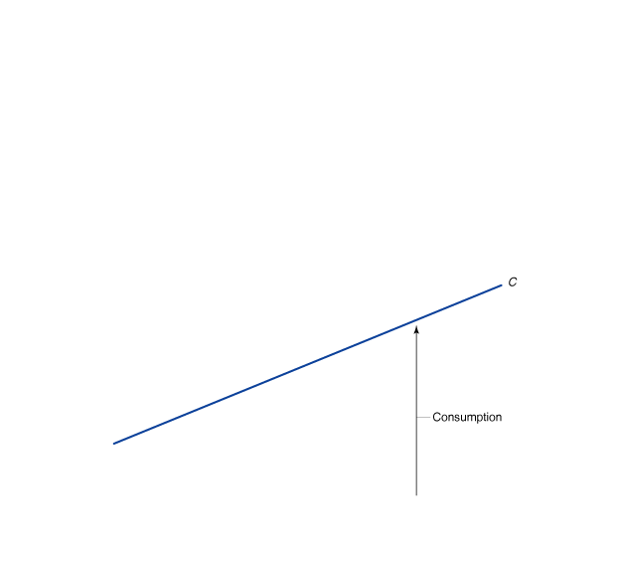
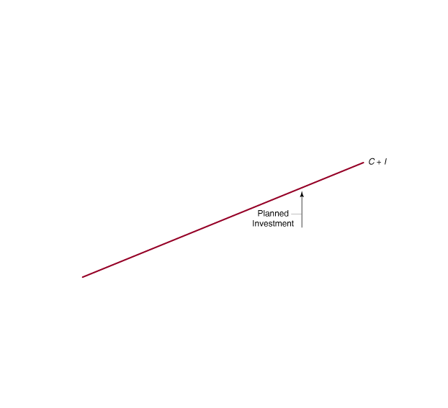
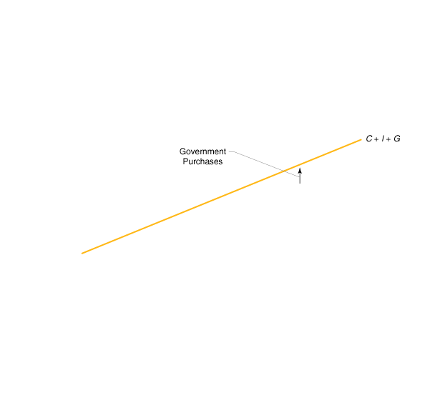
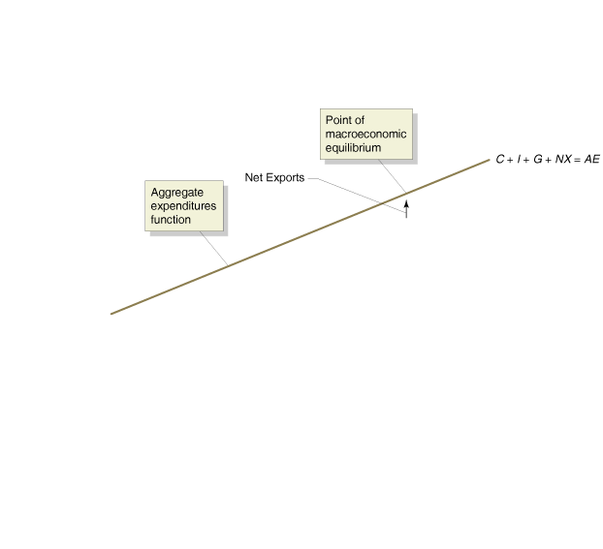
Graphing Macroeconomic Equilibrium
11 - 9
Macroeconomic Equilibrium on the 45-Line Diagram

Slide 41
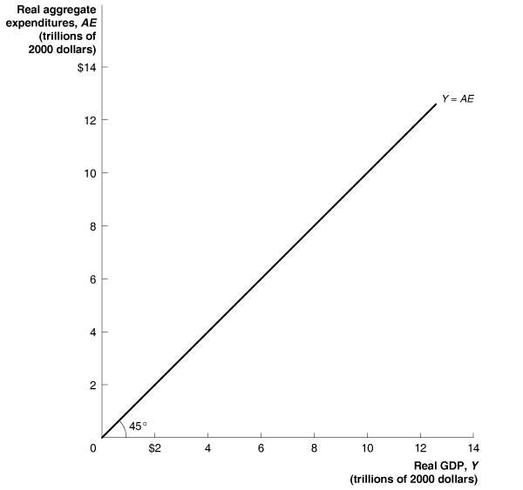
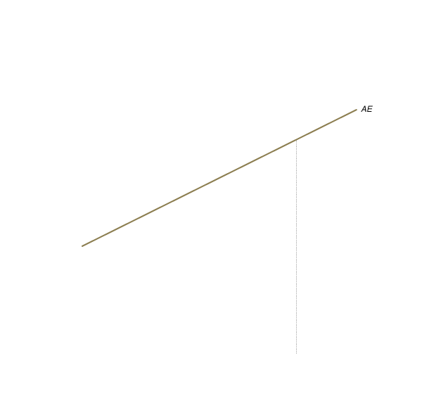
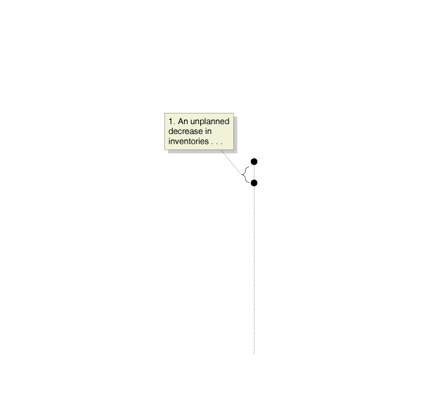
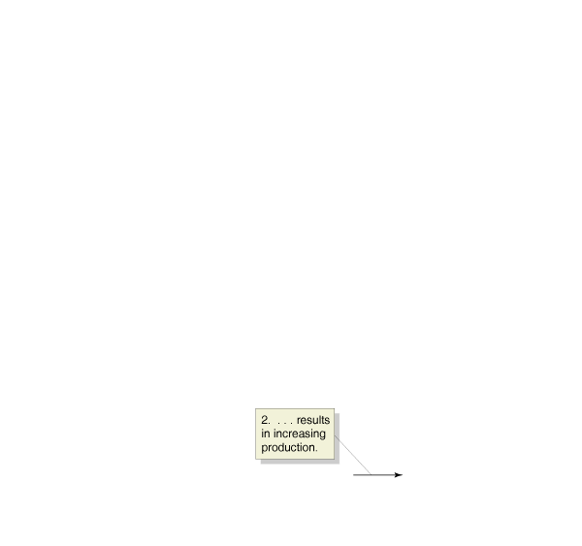
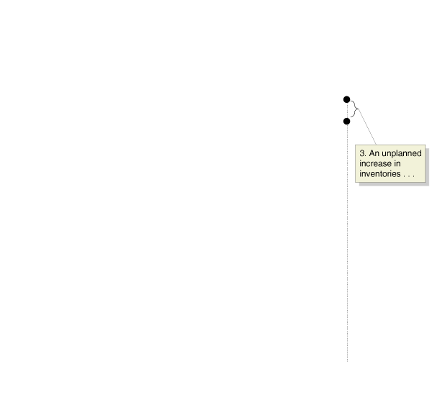
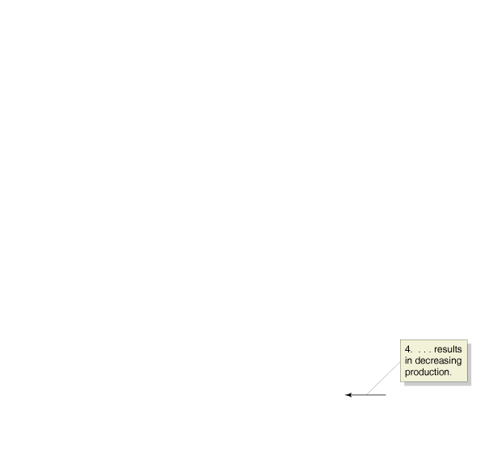
Graphing Macroeconomic Equilibrium
11 - 10
Macroeconomic Equilibrium

Slide 42
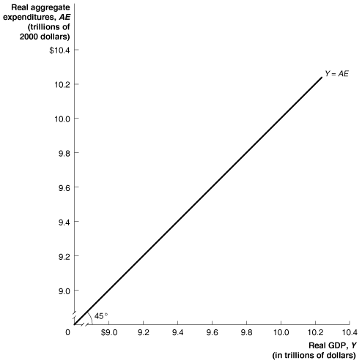

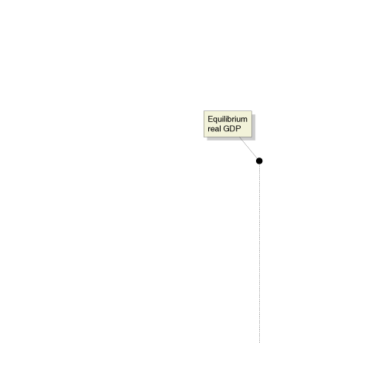
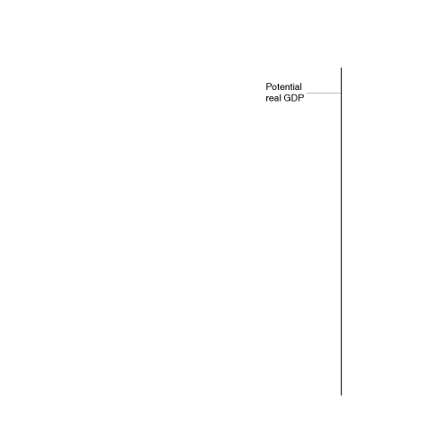
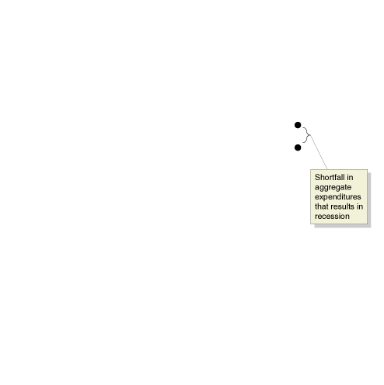
Graphing Macroeconomic Equilibrium
Showing a Recession on the 45-Line Diagram
11 - 11
Showing a Recession on the 45-Line Diagram

Slide 43
When the economy is in a recession, the shortfall in aggregate expenditures is exactly equal to:
a. The value of GDP.
b. The shortfall in aggregate production.
c. The unplanned increase in inventories.
d. All of the above.

Slide 44
When the economy is in a recession, the shortfall in aggregate expenditures is exactly equal to:
a. The value of GDP.
b. The shortfall in aggregate production.
c. The unplanned increase in inventories.
d. All of the above.

Slide 45
Graphing Macroeconomic Equilibrium
The Important Role of Inventories
Whenever aggregate expenditure is less than real GDP, some firms will experience an unplanned increase in inventories.

Slide 46

11 - 2
Business Attempts to Control Inventories, Then … and Now
Dell Computer uses supply chain management to keep its inventories low.

Slide 47

A Numerical Example of Macroeconomic Equilibrium
4
LEARNING OBJECTIVE
11 – 3
Macroeconomic Equilibrium
Real GDP (Y) | Consumption (C) | Planned Investment (I) | Government Purchases (G) | Net Exports (NX) | Planned Aggregate Expenditure (AE) | Unplanned Change in Inventories | Real GDP Will …
$8,000 | $6,200 | $1,500 | $1,500 | $–500 | $8,700 | –$700 | increase
9,000 | 6,850 | 1,500 | 1,500 | –500 | 9,350 | –350 | increase
10,000 | 7,500 | 1,500 | 1,500 | –500 | 10,000 | 0 | be in equilibrium
11,000 | 8,150 | 1,500 | 1,500 | –500 | 10,650 | +350 | decrease
12,000 | 8,800 | 1,500 | 1,500 | –500 | 11,300 | +700 | decrease
Don’t Confuse Aggregate Expenditure with Consumption Spending

Slide 48
11 - 2
4
LEARNING OBJECTIVE
Determining Macroeconomic Equilibrium
Real GDP (Y) | Consumption (C) | Planned Investment (I) | Government Purchases (G) | Net Exports (NX) | Planned Aggregate Expenditure (AE) | Unplanned Change in Inventories
$8,000 | $6,200 | $1,675 | $1,675 | $–500
9,000 | 6,850 | 1,675 | 1,675 | –500
10,000 | 7,500 | 1,675 | 1,675 | –500
11,000 | 8,150 | 1,675 | 1,675 | –500
12,000 | 8,800 | 1,675 | 1,675 | –500

Slide 49
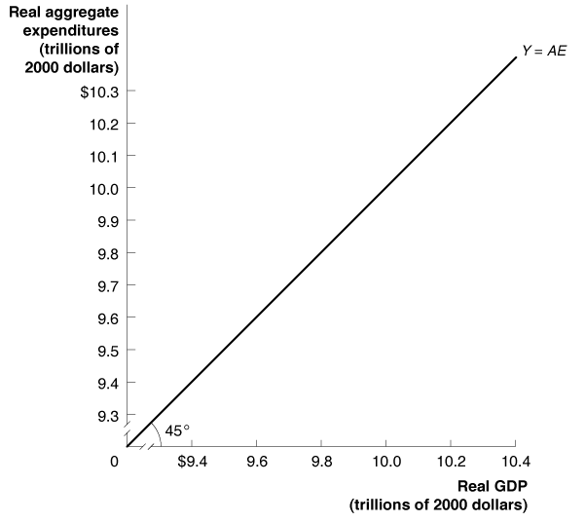
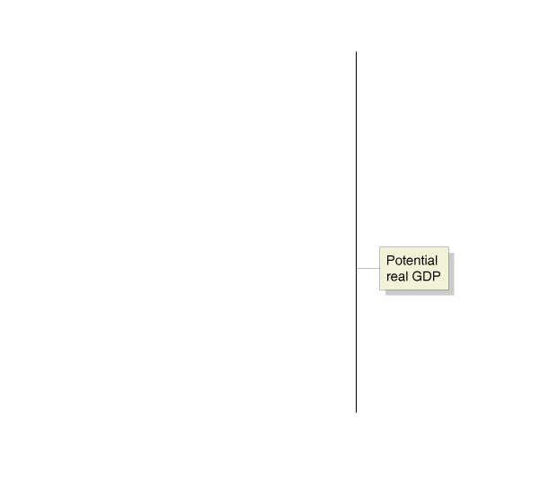


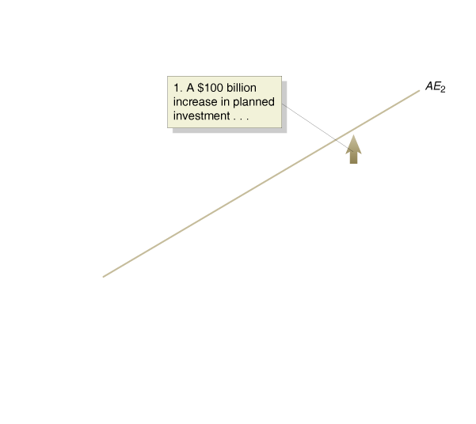
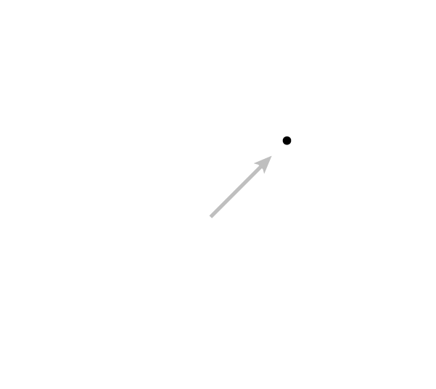
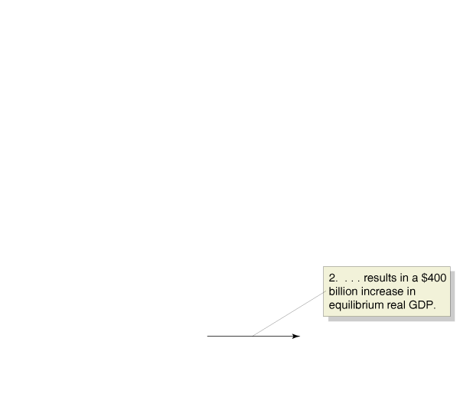
The Multiplier Effect
5
LEARNING OBJECTIVE
11 - 12
The Multiplier Effect

Slide 50
The Multiplier Effect
Autonomous expenditure Expenditure that does not depend on the level of GDP.
Multiplier The increase in equilibrium real GDP divided by the increase in autonomous expenditure.
Multiplier effect The process by which an increase in autonomous expenditure leads to a larger increase in real GDP.

Slide 51
The Multiplier Effect
11 – 4
The Multiplier Effect in Action
 | ADDITIONAL AUTONOMOUS EXPENDITURE (INVESTMENT) | ADDITIONAL INDUCED EXPENDITURE (CONSUMPTION) | TOTAL ADDITIONAL EXPENDITURE = TOTAL ADDITIONAL GDP
Round 1 | $100 billion | $0 | $100 billion
Round 2 | 0 | 75 billion | 175 billion
Round 3 | 0 | 56 billion | 231 billion
Round 4 | 0 | 42 billion | 273 billion
Round 5 | 0 | 32 billion | 305 billion
… | … | … | …
Round 10 | 0 | 8 billion | 377 billion
… | … | … | …
Round 15 | 0 | 2 billion | 395 billion
… | … | … | …
Round 19 | 0 | 1 billion | 398 billion
n | 0 | 0 | $400 billion

Slide 52
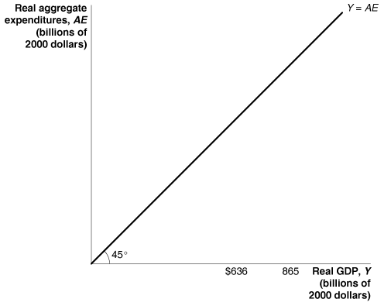
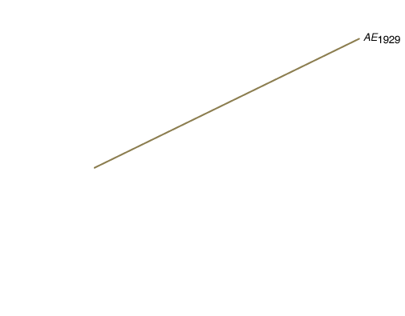



11 - 3
The Multiplier in Reverse: The Great Depression of the 1930s
The multiplier effect contributed to the very high levels of unemployment during the Great Depression.
Year | Consumption | Investment | Net Exports | Real GDP | Unemployment Rate
1929 | $661 billion | $91.3 billion | $9.4illion | $865 billion | 3.2%
1933 | 541 billion | 17.0 billion | -$10.2 billion | 636 billion | 24.9%

Slide 53


The Multiplier Effect
A Formula for the Multiplier

Slide 54

The Multiplier Effect
Summarizing the Multiplier Effect
  The multiplier effect occurs both when autonomous expenditure increases and when it decreases.
  The multiplier effect makes the economy more sensitive to changes in autonomous expenditure than it would otherwise be.
  The larger the MPC, the larger the value of the multiplier.
  The formula for the multiplier, , is oversimplified because it ignores some real world complications, such as the effect that an increasing GDP can have on imports, inflation, and interest rates.

Slide 55

在大萧条时期，乘数效应使失业率恶化。

Slide 56

美国大萧条时期，为了谋求生活，当兵的人供过于求。
Notes:
This chart presents data from Table 11-2 on p.296 of the text. For data sources, see notes accompanying that table.
Note the very strong negative correlation between output and unemployment.

Slide 57
If we account for the impact of higher GDP on imports, inflation, and interest rates, the simple multiplier formula would:
a. Reflect very accurately the true value of the multiplier.
b. Understate the true value of the multiplier.
c. Overstate the true value of the multiplier.
d. Illustrate precisely the opposite of what happens in reality.

Slide 58
If we account for the impact of higher GDP on imports, inflation, and interest rates, the simple multiplier formula would:
a. Reflect very accurately the true value of the multiplier.
b. Understate the true value of the multiplier.
c. Overstate the true value of the multiplier.
d. Illustrate precisely the opposite of what happens in reality.

Slide 59
11 - 3
5
LEARNING OBJECTIVE
Using the Multiplier Formula
REAL GDP (Y) | CONSUMPTION (C) | PLANNED INVESTMENT (I) | GOVERNMENT PURCHASES (G) | NET EXPORTS (NX)
$8,000 | $6,900 | $1,000 | $1,000 | $–500
9,000 | 7,700 | 1,000 | 1,000 | –500
10,000 | 8,500 | 1,000 | 1,000 | –500
11,000 | 9,300 | 1,000 | 1,000 | –500
12,000 | 10,100 | 1,000 | 1,000 | –500

Slide 60
11 - 3
5
LEARNING OBJECTIVE
Using the Multiplier Formula
REALGDP (Y) | CONSUMPTION (C) | PLANNED INVESTMENT (I) | GOVERNMENT PURCHASES (G) | NET EXPORTS (NX) | PLANNED AGGREGATE EXPENDITURE (AE)
$8,000 | $6,900 | $1,000 | $1,000 | $–500 | $8,400
9,000 | 7,700 | 1,000 | 1,000 | –500 | 9,200
10,000 | 8,500 | 1,000 | 1,000 | –500 | 10,000
11,000 | 9,300 | 1,000 | 1,000 | –500 | 10,800
12,000 | 10,100 | 1,000 | 1,000 | –500 | 11,600

Slide 61






The Aggregate Demand Curve
6
LEARNING OBJECTIVE
11 – 13a
The Effect of a Higher Price Level on Real GDP

Slide 62






The Aggregate Demand Curve
11 – 13b
The Effect of a Lower Price Level on Real GDP

Slide 63
The Aggregate Demand Curve
Aggregate demand curve (AD) A curve showing the relationship between the price level and the level of planned aggregate expenditure in the economy, holding constant all other factors that affect aggregate expenditure.

Slide 64





The Aggregate Demand Curve
The Effect of a Decrease in the Price Level on Real GDP
11 - 14
The Aggregate Demand Curve

Slide 65


Japan’s Consumers Show Signs of Life

Slide 66

Aggregate demand curve (AD)
Aggregate expenditure (AE)
Aggregate expenditure model
Autonomous expenditure
Cash flow
Consumption function
Inventories
Marginal propensity to consume (MPC)
Marginal propensity to save (MPS)
Multiplier
Multiplier effect

Slide 67





Appendix 11A:
The Algebra of Macroeconomic Equilibrium
Consumption function
Investment function
Government spending function
Net export function
Equilibrium condition

Slide 68


Appendix 11A:
The Algebra of Macroeconomic Equilibrium
The letters with “bars” represent fixed or autonomous values. So, represents autonomous consumption, which had a value of 1000 in our original example. Now, solving for equilibrium we get:
Or,
Or,
Or,

Slide 69

Appendix 11A:
The Algebra of Macroeconomic Equilibrium
Remember that is the multiplier. Therefore an alternative expression for equilibrium GDP is:
Equilibrium GDP = Autonomous expenditure x multiplier

