Slide 1
Aggregate Demand and
Aggregate Supply Analysis

Slide 2

Caterpillar Recovers Slowly from the 2001 Recession
After studying this chapter, you should be able to:
  Discuss the determinants of aggregate demand, and distinguish between a movement along the aggregate demand curve and a shift of the curve.
  Discuss the determinants of aggregate supply, and distinguish between a movement along the short-run aggregate supply curve and a shift of the curve.
  Use the aggregate demand and aggregate supply model to illustrate the difference between short-run and long-run macroeconomic equilibrium.
  Use the dynamic aggregate demand and aggregate supply model to analyze macroeconomic conditions.
1
2
LEARNING OBJECTIVES
3
Caterpillar is a multinational corporation, so its sales are affected by factors that are unimportant for firms that sell only in the domestic markets.
4

Slide 3
Aggregate Demand
1
LEARNING OBJECTIVE
Aggregate demand and aggregate supply model A model that explains short-run fluctuations in real GDP and the price level.
Aggregate demand curve (AD) A curve showing the relationship between the price level and the quantity of real GDP demanded by households, firms, and the government.
Short-run aggregate supply curve (SRAS) A curve showing the relationship in the short run between the price level and the quantity of real GDP supplied by firms.

Slide 4

The aggregate demand curve shows the relationship between the price level and the quantity of real GDP demanded by:
a. Households.
b. Firms.
c. The government.
d. All of the above.

Slide 5
The aggregate demand curve shows the relationship between the price level and the quantity of real GDP demanded by:
a. Households.
b. Firms.
c. The government.
d. All of the above.

Slide 6
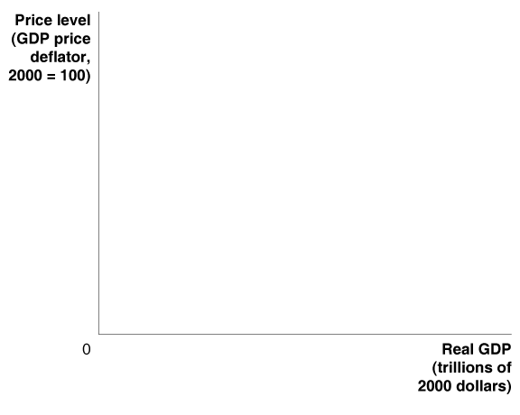
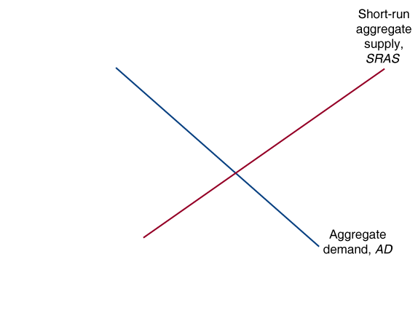
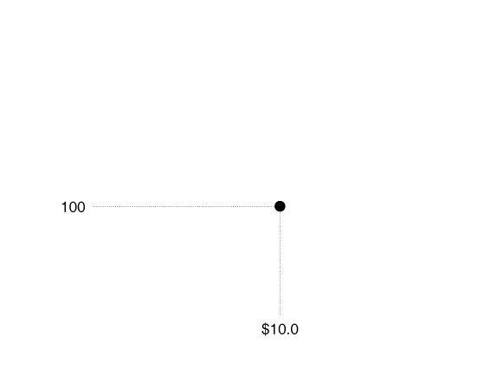
Aggregate Demand
12 - 1
Aggregate Demand and Aggregate Supply

Slide 7

Aggregate Demand
Why is the Aggregate Demand Curve Downward Sloping?
Y = C + I + G + NX
THE WEALTH EFFECT: HOW A CHANGE IN THE PRICE LEVEL AFFECTS CONSUMPTION
THE INTEREST-RATE EFFECT: HOW A CHANGE IN THE PRICE LEVEL AFFECTS INVESTMENT
THE INTERNATIONAL-TRADE EFFECT: HOW A CHANGE IN THE PRICE LEVEL AFFECTS NET EXPORTS
Be Clear Why the Aggregate Demand Curve Is Downward Sloping

Slide 8
Aggregate Demand
Shifts of the Aggregate Demand Curve versus Movements Along It
The Variables That Shift the Aggregate Demand Curve
CHANGES IN GOVERNMENT POLICIES
CHANGES IN THE EXPECTATIONS OF HOUSEHOLDS AND FIRMS
CHANGES IN FOREIGN VARIABLES

Slide 9


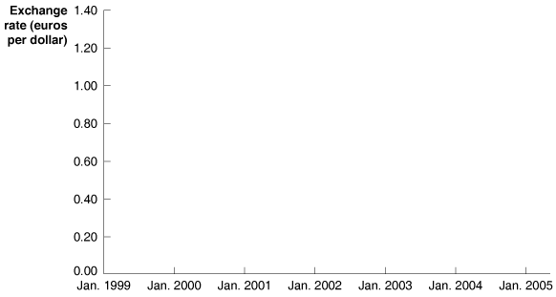
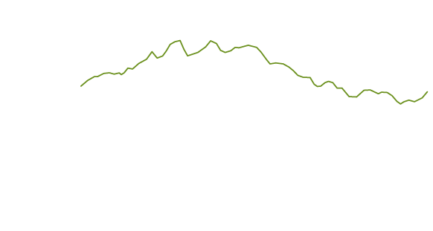
12 - 1
The Effect of Exchange Rates on Caterpillar’s Sales
The falling value of the dollar against the euro helped increase Caterpillar's sales from 2002 to 2004.

Slide 10
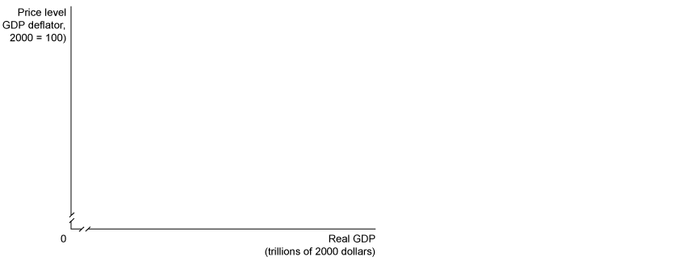
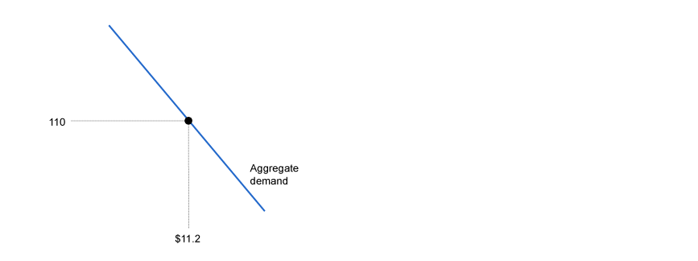
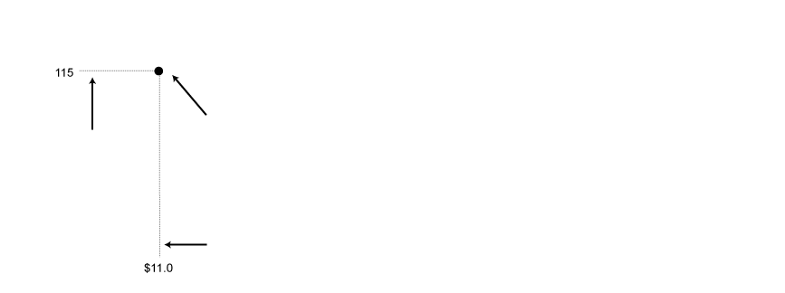
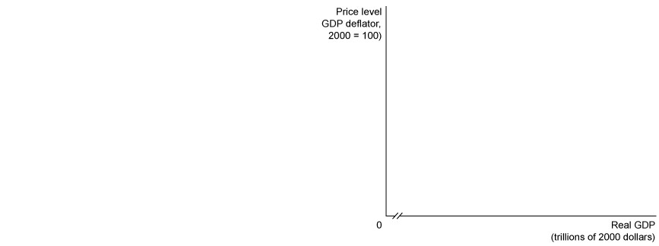
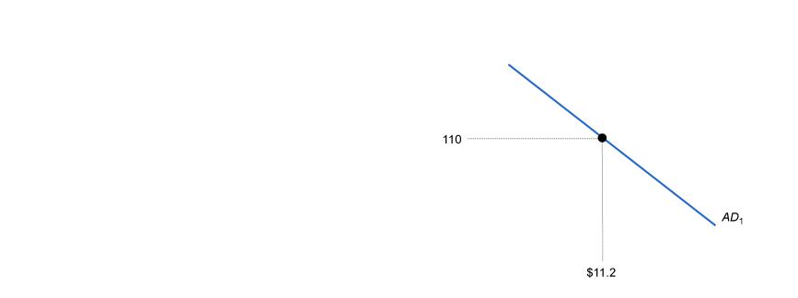
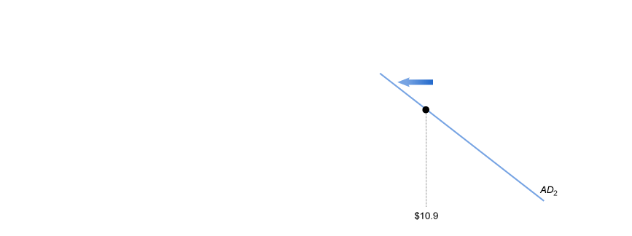
12 - 1
1
LEARNING OBJECTIVE
Movements along the Aggregate Demand Curve versus Shifts of the Aggregate Demand Curve

Slide 11
Which of the following factors does not cause the aggregate demand curve to shift?
a. A change in the price level.
b. A change in government policies.
c. A change in the expectations of households and firms.
d. A change in foreign factors.

Slide 12
Which of the following factors does not cause the aggregate demand curve to shift?
a. A change in the price level.
b. A change in government policies.
c. A change in the expectations of households and firms.
d. A change in foreign factors.

Slide 13
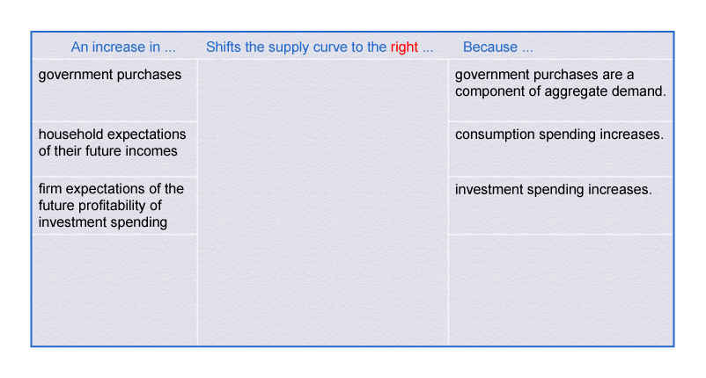
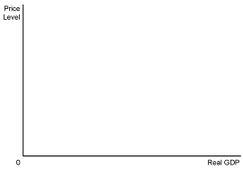
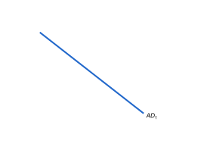
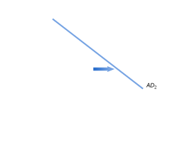
Aggregate Demand
The Variables That Shift the Aggregate Demand Curve
12 – 1
Variables That Shift the Aggregate Demand Curve

Slide 14
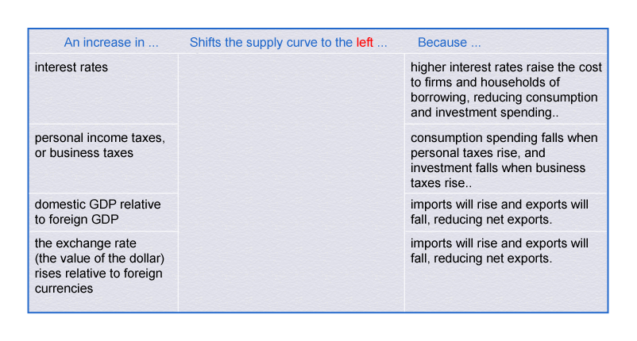

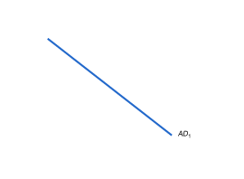
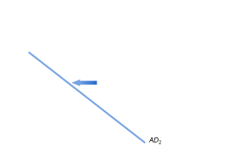
Aggregate Demand
The Variables That Shift the Aggregate Demand Curve
12 – 1
Variables That Shift the Aggregate Demand Curve

Slide 15
How can government policies shift the aggregate demand curve to the right?
a. By increasing personal income taxes.
b. By increasing business taxes.
c. By increasing government purchases.
d. All of the above.

Slide 16
How can government policies shift the aggregate demand curve to the right?
a. By increasing personal income taxes.
b. By increasing business taxes.
c. By increasing government purchases.
d. All of the above.

Slide 17
Aggregate Supply
2
LEARNING OBJECTIVE
The Long-Run Aggregate Supply Curve
Long-run aggregate supply (LRAS) A curve showing the relationship in the long run between the price level and the quantity of real GDP supplied.

Slide 18
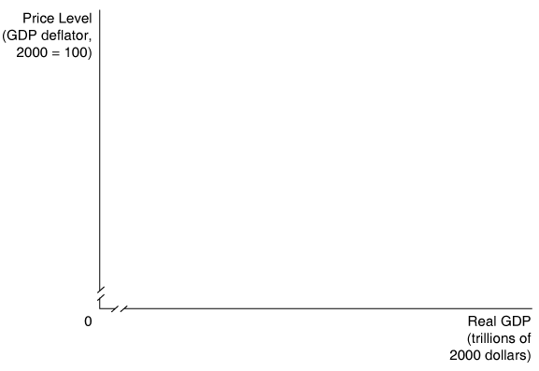
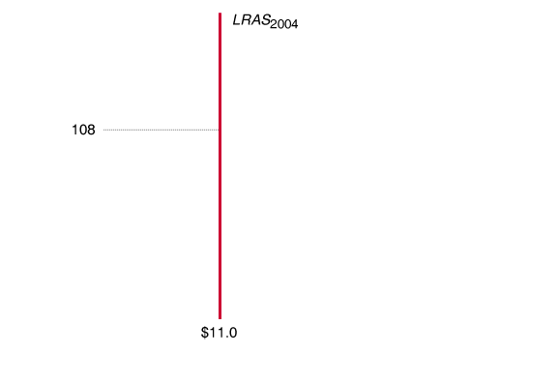
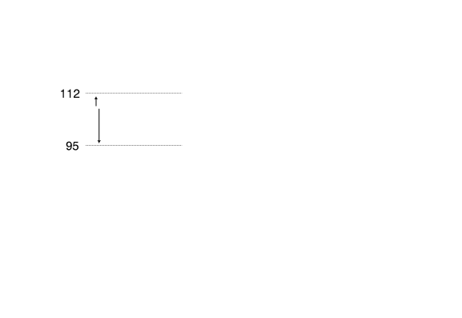
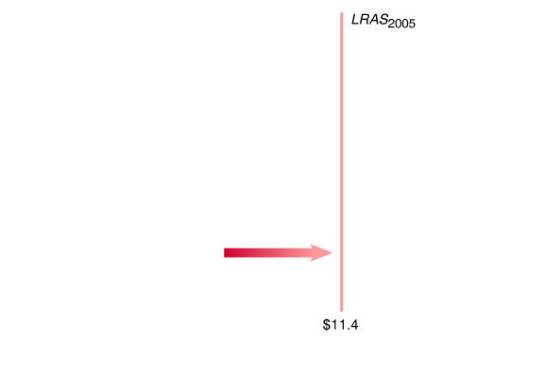
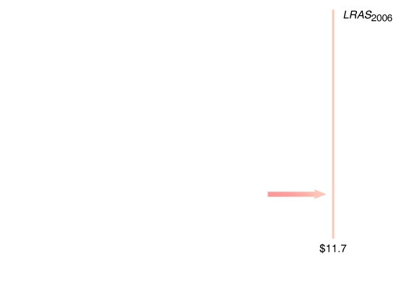
Aggregate Supply
The Long-Run Aggregate Supply Curve
12 - 2
The Long-Run Aggregate Supply Curve

Slide 19
Which of the following statements is true?
a. In the long run, increases in the price level result in an increase in real GDP.
b. In the long run, increases in the price level result in a decrease in real GDP.
c. In the long run, increases in the price level do not affect real GDP.
d. In the long run, increases in the price level may increase or decrease real GDP.

Slide 20
Which of the following statements is true?
a. In the long run, increases in the price level result in an increase in real GDP.
b. In the long run, increases in the price level result in a decrease in real GDP.
c. In the long run, increases in the price level do not affect real GDP.
d. In the long run, increases in the price level may increase or decrease real GDP.

Slide 21
Aggregate Supply
The Short-Run Aggregate Supply Curve
The three most common explanations as to why a short-run aggregate supply curve slopes upward include:
CONTRACTS MAKE SOME WAGES AND PRICES “STICKY”
FIRMS ARE OFTEN SLOW TO ADJUST WAGES
MENU COSTS MAKE SOME PRICES STICKY
  Menu costs The costs to firms of changing prices

Slide 22
Aggregate Supply
Shifts of the Short-Run Aggregate Supply Curve versus Movements Along It
Variables That Shift the Short-Run Aggregate Supply Curve
INCREASES IN THE LABOR FORCE AND IN THE CAPITAL STOCK
TECHNOLOGICAL CHANGE
EXPECTED CHANGES IN THE FUTURE PRICE LEVEL

Slide 23
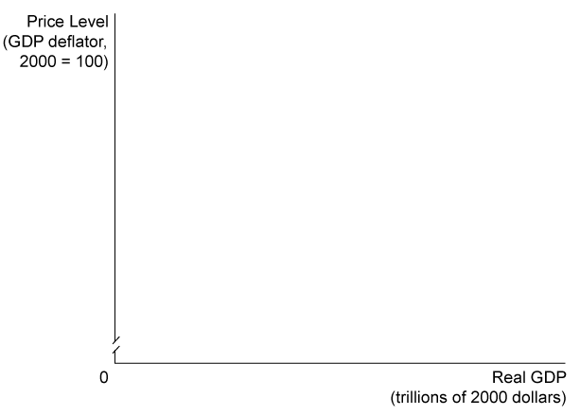
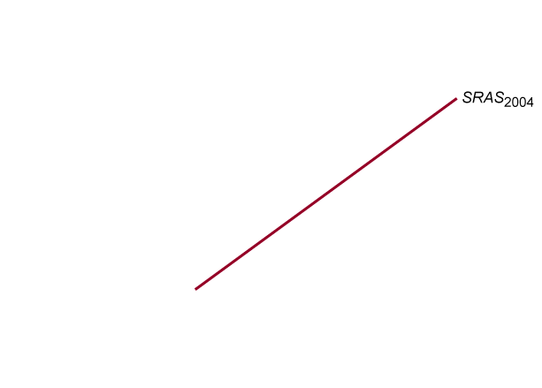
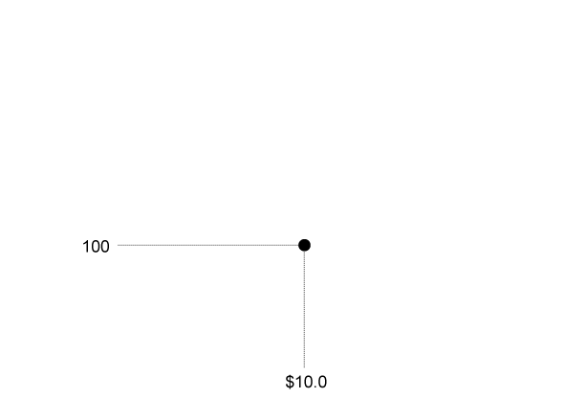
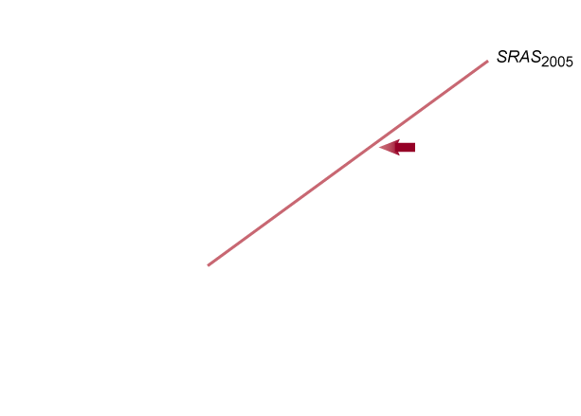
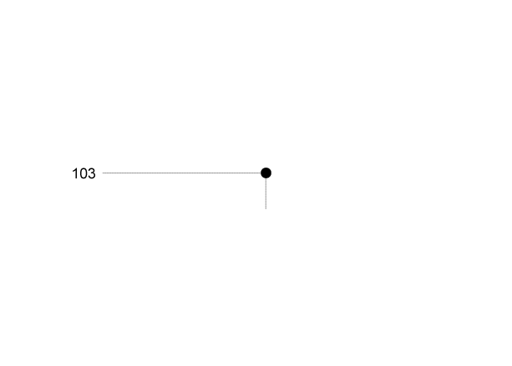
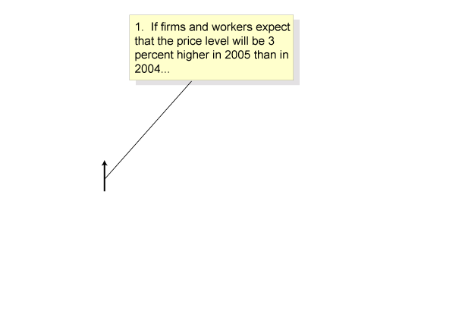
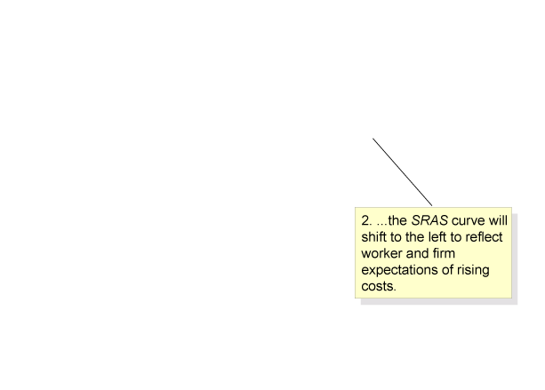
Aggregate Supply
12 - 3
How Expectations of the Future Price Level Affect the Short-Run Aggregate Supply Curve

Slide 24
Aggregate Supply
Variables That Shift the Short-Run Aggregate Supply Curve
ADJUSTMENTS OF WORKERS AND FIRMS TO ERRORS IN PAST EXPECTATIONS ABOUT THE PRICE LEVEL
UNEXPECTED CHANGES IN THE PRICE OF AN IMPORTANT NATURAL RESOURCE
  Supply shock An unexpected event that causes the short-run aggregate supply curve to shift.

Slide 25
If firms and workers could predict the future price level exactly, the short-run aggregate supply curve would be:
a. Downward sloping.
b. Upward sloping.
c. Horizontal.
d. The same as the long-run aggregate supply curve.

Slide 26
If firms and workers could predict the future price level exactly, the short-run aggregate supply curve would be:
a. Downward sloping.
b. Upward sloping.
c. Horizontal.
d. The same as the long-run aggregate supply curve.

Slide 27
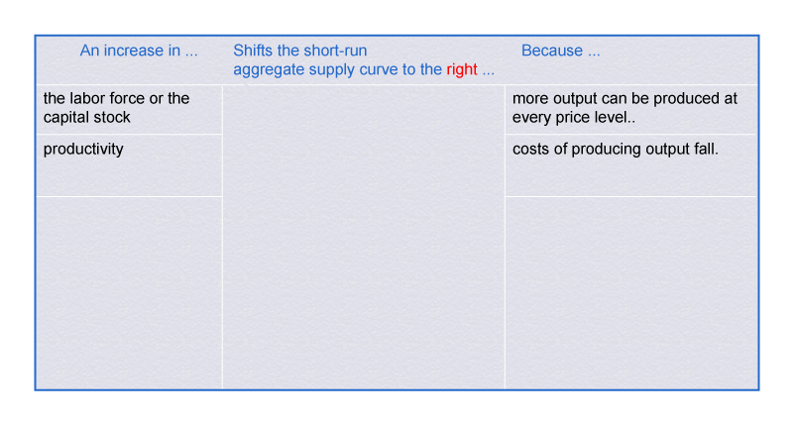
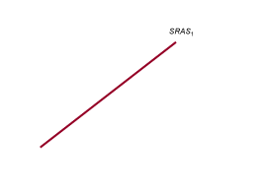
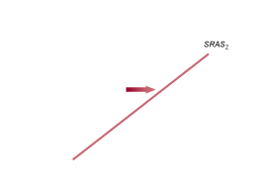
Macroeconomic Equilibrium in the Long Run and the Short Run
3
LEARNING OBJECTIVE
12 – 2
Variables That Shift the Short-Run Aggregate Supply Curve

Slide 28
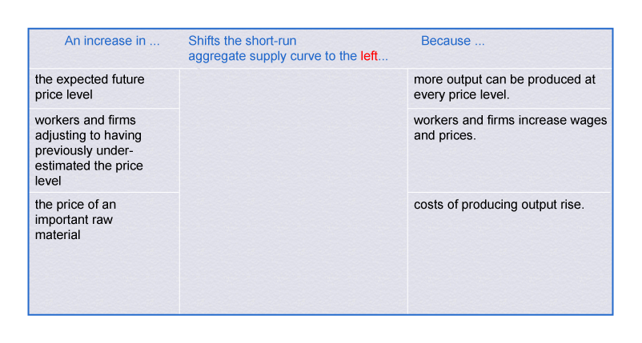
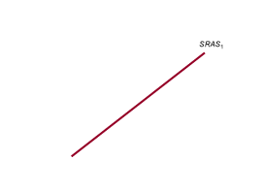
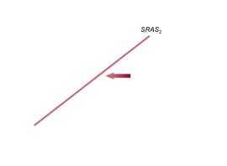
Macroeconomic Equilibrium in the Long Run and the Short Run
12 – 2
Variables That Shift the Short-Run Aggregate Supply Curve

Slide 29
Which of the following will cause the short-run aggregate supply curve to shift to the right?
a. A higher expected future price level.
b. An increase in the actual (or current) price level.
c. A technological improvement.
d. All of the above.

Slide 30
Which of the following will cause the short-run aggregate supply curve to shift to the right?
a. A higher expected future price level.
b. An increase in the actual (or current) price level.
c. A technological improvement.
d. All of the above.

Slide 31
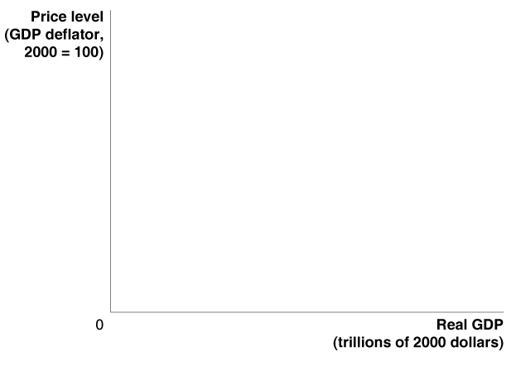
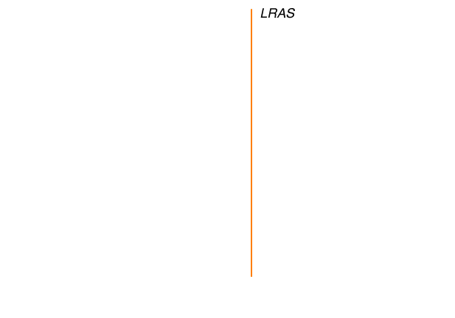
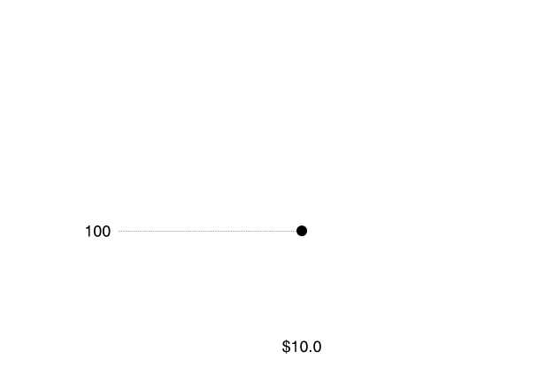
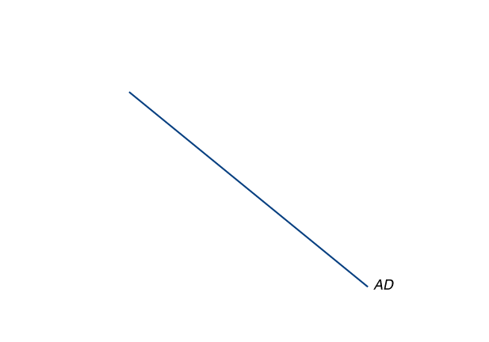
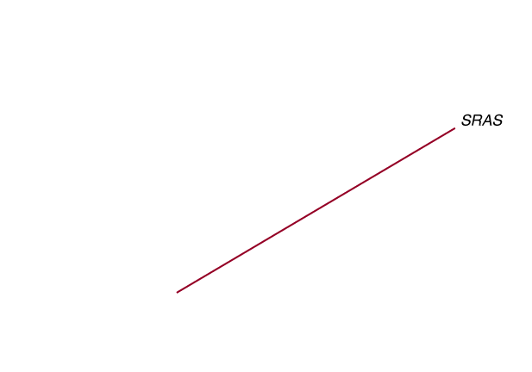
Macroeconomic Equilibrium in the Long Run and the Short Run
12 - 4
Long-Run Macroeconomic Equilibrium

Slide 32
Macroeconomic Equilibrium in the Long Run and the Short Run
Recessions, Expansions, and Supply Shocks
Because the full analysis of the aggregate demand and aggregate supply model can be complicated, we begin with a simplified case, using two assumptions:
The economy has not been experiencing any inflation. The price level is currently 100, and workers and firms expect it to remain at 100 in the future.
The economy is not experiencing any long-run growth. Potential real GDP is $10.0 trillion and will remain at that level in the future.

Slide 33
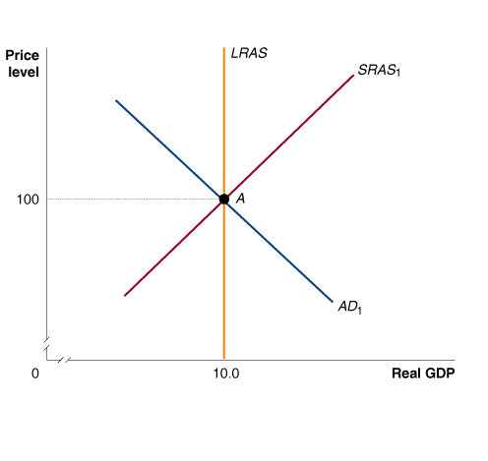
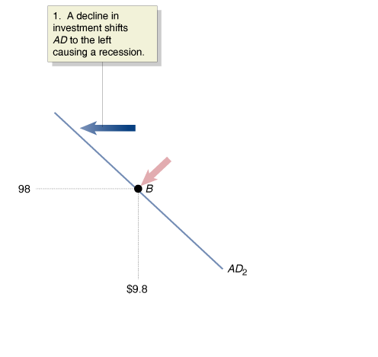
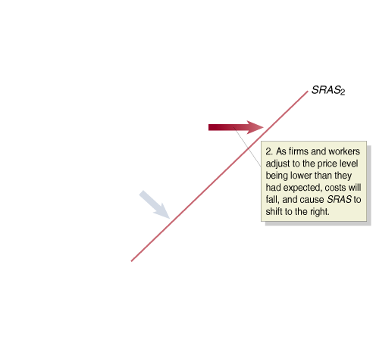
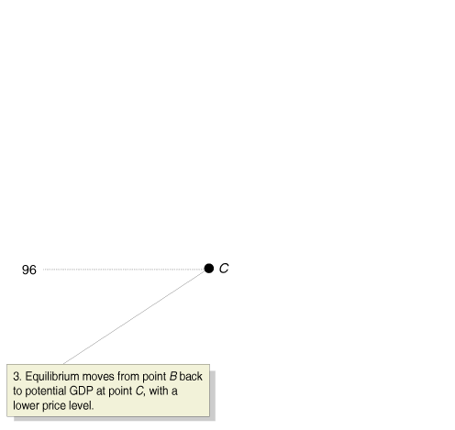
Macroeconomic Equilibrium in the Long Run and the Short Run
Recessions, Expansions, and Supply Shocks
RECESSION
12 - 5
The Short-Run and Long-Run
Effects of a Decrease in
Aggregate Demand

Slide 34
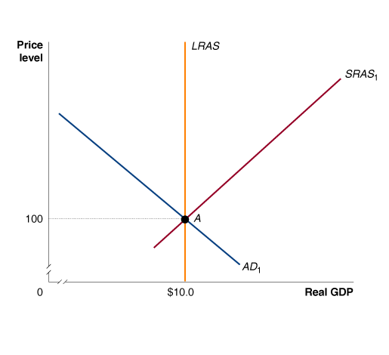
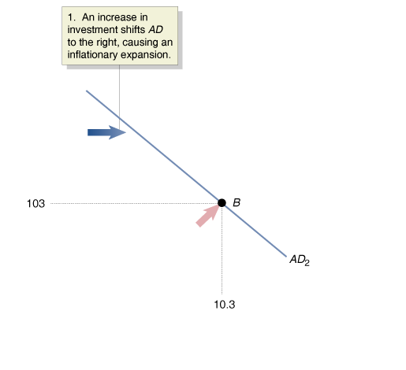
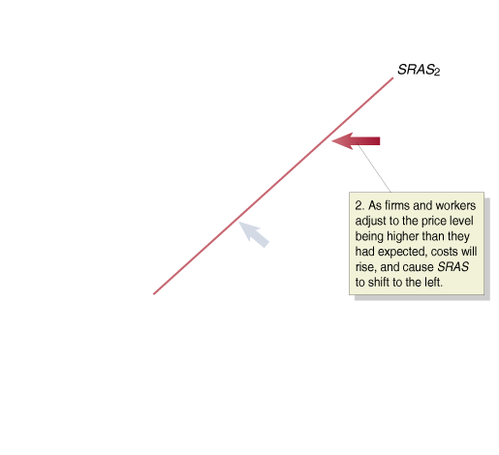
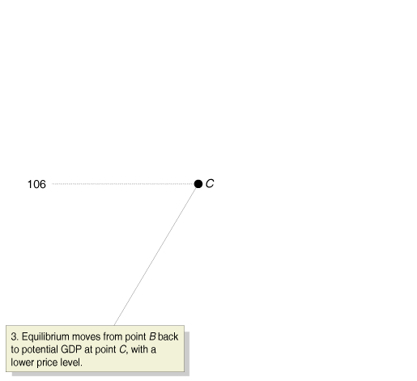
Macroeconomic Equilibrium in the Long Run and the Short Run
Recessions, Expansions, and Supply Shocks
EXPANSION
12 - 6
The Short-Run and Long-Run
Effects of an Increase in
Aggregate Demand

Slide 35
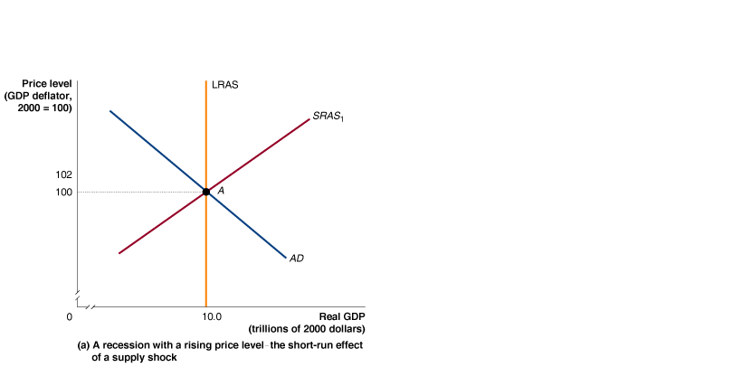





Macroeconomic Equilibrium in the Long Run and the Short Run
Recessions, Expansions, and Supply Shocks
SUPPLY SHOCK
12 - 7
The Short-Run and Long-Run Effects of a Supply Shock

Slide 36
Macroeconomic Equilibrium in the Long Run and the Short Run
Recessions, Expansions, and Supply Shocks
SUPPLY SHOCK
Stagflation A combination of inflation and recession, usually resulting from a supply shock.

Slide 37
Which of the following is usually the cause of stagflation?
a. Reductions in government spending.
b. Increases in investment.
c. Printing money to finance government expenditures.
d. An adverse supply shock.

Slide 38
Which of the following is usually the cause of stagflation?
a. Reductions in government spending.
b. Increases in investment.
c. Printing money to finance government expenditures.
d. An adverse supply shock.

Slide 39
A Dynamic Aggregate Demand and Aggregate Supply Model
4
LEARNING OBJECTIVE
We can create a dynamic aggregate demand and aggregate supply model by making three changes to the basic model:
  Potential real GDP increases continually, shifting the long-run aggregate supply curve (LRAS) to the right.
  During most years, the aggregate demand curve (AD) will be shifting to the right.
  Except during periods when workers and firms expect high rates of inflation, the short-run aggregate supply curve (SRAS) will be shifting to the right.

Slide 40


A Dynamic Aggregate Demand and Aggregate Supply Model
12 - 8
An Increase in Potential Real GDP

Slide 41



A Dynamic Aggregate Demand and Aggregate Supply Model
What Is the Usual Cause of Inflation?
12 - 9
Using Dynamic Aggregate Demand and Aggregate Supply to Understand Inflation

Slide 42
How does the dynamic model of aggregate supply and aggregate demand explain inflation?
a. By showing that productivity increases result in a slower pace of hiring workers and a slow recovery that increases inflation, but only slightly.
b. By showing that productivity increases do not always translate into higher wages but are absorbed instead by higher profits.
c. By showing that if total spending in the economy grows faster than total production, prices will rise.
d. None of the above.

Slide 43
How does the dynamic model of aggregate supply and aggregate demand explain inflation?
a. By showing that productivity increases result in a slower pace of hiring workers and a slow recovery that increases inflation, but only slightly.
b. By showing that productivity increases do not always translate into higher wages but are absorbed instead by higher profits.
c. By showing that if total spending in the economy grows faster than total production, prices will rise.
d. None of the above.

Slide 44
A Dynamic Aggregate Demand and Aggregate Supply Model
The Slow Recovery from the Recession of 2001
The recession of 2001 was caused by a decline in aggregate demand. Several factors contributed to this decline:
    The end of the stock market “bubble.”
    Excessive investment in information technology.
    The terrorist attacks of September 11, 2001.
    The corporate accounting scandals.

Slide 45


A Dynamic Aggregate Demand and Aggregate Supply Model
The Slow Recovery from the Recession of 2001
12 - 10
Using Dynamic Aggregate Demand and Aggregate Supply
to Understand the Recovery from the 2001 Recession

Slide 46





12 - 2
Does Rising Productivity Growth Reduce Employment?
In 2002-2003, companies like Harley-Davidson expanded output without expanding employment.

Slide 47


A Dynamic Aggregate Demand and Aggregate Supply Model
The More Rapid Recovery of 2003-2004
12 - 11
Using Dynamic Aggregate
Demand and Aggregate Supply to Understand the More Rapid Recovery of 2003-2004

Slide 48


12 - 2
1
LEARNING OBJECTIVE
Showing the Oil Shock of 1974-1975 on a Dynamic Aggregate Demand and Aggregate Supply Graph
 | ACTUAL REAL GDP | POTENTIAL REAL GDP | PRICE LEVEL
1974 | $4.32 trillion | $4.35 trillion | 34.7
1975 | $4.31 trillion | $4.50 trillion | 38.0

Slide 49


The Recovery is Still Fragile
Japanese economic expansion during 2003.

Slide 50

Aggregate demand and aggregate supply model
Aggregate demand curve (AD)
Long-run aggregate supply curve (LRAS)
Menu costs
Short-run aggregate supply curve (SRAS)
Stagflation
Supply shock

