Slide 1
Money, Banks, and the Federal Reserve System

Slide 2
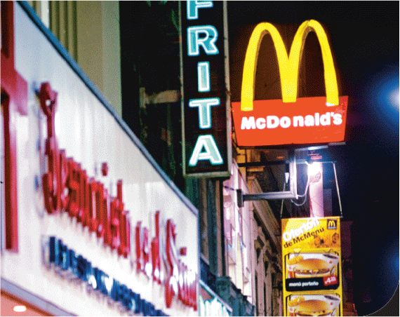
McDonald’s Money Problems in Argentina
After studying this chapter, you should be able to:
  Define money and discuss its four functions.
  Discuss the definitions of the money supply used in the United States today.
  Explain how banks create checking account deposits.
  Discuss the three policy tools the Federal Reserve uses to manage the money supply.
  Explain the quantity theory of money and use it to explain how high rates of inflation occur.
1
2
3
LEARNING OBJECTIVES
4
Confidence and trust cannot be taken for granted. …when households and firms lose faith in an official money, it can harm trade and economic activity in an economy.
5

Slide 3
What Is Money and Why Do We Need It?
1
LEARNING OBJECTIVE
Money Assets that people are generally willing to accept in exchange for goods and services or for payment of debts.
Asset Anything of value owned by a person or a firm.

Slide 4

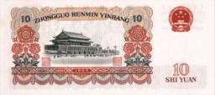
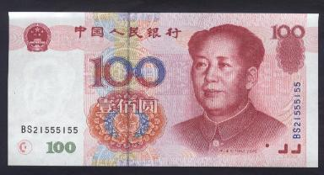
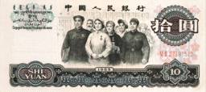
Money: definition
Money is the stock
of assets that can be readily used to make transactions.

Slide 5
什么是货币？
货币是任何一种被普遍接受为交换媒介，并且具有价值储藏和计算单位功能的经济工具。换言之，在购买商品劳务或清偿债务时被广泛接受的任何物品，都可以称作货币。

Slide 6
What Is Money and Why Do We Need It?
Barter and the Invention of Money
Commodity money A good used as money that also has value independent of its use as money.

Slide 7

A double coincidence of wants refers to:
a. the instance in which a good that is used as money also has value independent of its use as money.
b. the fact that for a barter trade to take place between two people, each person must want what the other one has.
c. the idea that a barter economy is more efficient than a monetary economy.
d. the fact that two parties are involved in transactions where money is the medium of exchange.

Slide 8
A double coincidence of wants refers to:
a. the instance in which a good that is used as money also has value independent of its use as money.
b. the fact that for a barter trade to take place between two people, each person must want what the other one has.
c. the idea that a barter economy is more efficient than a monetary economy.
d. the fact that two parties are involved in transactions where money is the medium of exchange.

Slide 9


13 - 1
Money In a World War II Prisoner of War Camp
During World War II, cigarettes were used as money in some prisoner-of-war camps.

Slide 10
If prisoners of war use cigarettes as money, then cigarettes are:
a. token money.
b. fiduciary money.
c. fiat money.
d. commodity money.

Slide 11
If prisoners of war use cigarettes as money, then cigarettes are:
a. token money.
b. fiduciary money.
c. fiat money.
d. commodity money.

Slide 12
What Is Money and Why Do We Need It?
The Functions of Money
Anything used as money – whether a deerskin, a cowrie seashell, or a dollar bill – should fulfill the following four functions:
  MEDIUM OF EXCHANGE
  UNIT OF ACCOUNT
  STORE OF VALUE
  STANDARD OF DEFERRED PAYMENT

Slide 13
Money serves as a unit of account when:
a. sellers are willing to accept it in exchange for goods or services.
b. it can be easily stored and used for transactions in the future.
c. prices of goods and services are stated in the monetary unit.
d. All of the above.

Slide 14
Money serves as a unit of account when:
a. sellers are willing to accept it in exchange for goods or services.
b. it can be easily stored and used for transactions in the future.
c. prices of goods and services are stated in the monetary unit.
d. All of the above.

Slide 15
What Is Money and Why Do We Need It?
What Can Serve As Money?
What makes a good suitable to use as a medium of exchange? There are five criteria:
  The good must be acceptable to (that is, usable by) most traders.
  It should be of standardized quality, so that any two units are identical.
  It should be durable, so that value is not lost by spoilage.
  It should be valuable relative to its weight so that amounts large enough to be useful in trade can be easily transported.
  The medium of exchange should be divisible because different goods are valued differently.

Slide 16
What Is Money and Why Do We Need It?
What Can Serve As Money?
  COMMODITY MONEY
  FIAT MONEY
  Fiat money Money, such as paper currency, that is authorized by a central bank or governmental body and that does not have to be exchanged by the central bank for gold or some other commodity money.

Slide 17
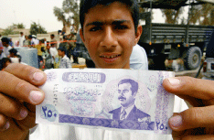
13 - 2
Money without a Government? The Strange Case of the Iraqi Dinar
Many Iraqis continued to use currency with Saddam’s picture on it, even after he was forced from power.

Slide 18
货币形态演变
商品货币：贵金属具有商品货币的天然属性——本身有功用，物理度量标准，坚固耐久，匀质性。
纸币：凸现了交换媒介的职能，容易携带和贮存，改变钞票上印数数字对应不同价值量，利用小数点细分。但本身无价值，需要控制数量保证稀缺性。
支票货币：信用关系发达的现代经济，银行系统提供的支票一定范围内取代了纸币的地位。
电子货币：依托现代信息技术和互联网技术的信用手段，如credit card。未来的电子资金结转系统（electronic funds transfer system: EFTS），更便利地实现不同资产流动性。

Slide 19
Discussion Question
Which of these are money?
a. Currency
b. Checks
c. Deposits in checking accounts
(called demand deposits)
d. Credit cards
e. Certificates of deposit
(called time deposits)
Notes:
You might want to ask students to determine, for each item listed, which of the functions of money it serves.
Answers:
a - yes
b - no, not the checks themselves, but the funds in checking accounts are money.
c - yes (see b)
d - no, credit cards are a means of deferring payment.
e - CDs are a store of value, and they are measured in money units (“Hey, I just bought a $1000 CD, dude!”). They are not readily spendable, though.

Slide 20
货币的种类和度量
M₁，M₂，M₃是依据不同金融资产流动性特点对货币存量提出的范围界定指标。由于不同金融资产可以互相转换，因而具有不同程度流动性即潜在货币功能。
为了更好地观察经济内部货币总量，把货币划分为不同种类或层次，并且用同一符号M（英文货币money第一个字母）加上数字下标，来表示不同外延范围的货币存量

Slide 21
How Do We Measure Money Today?
2
LEARNING OBJECTIVE
M1: The Narrowest Definition of the Money Supply
  M1 The narrowest definition of the money supply: the sum of currency in circulation, checking account balances in banks, and holdings of traveler’s checks.
  It includes:
  1. All the paper money and coins that are in circulation – meaning what is not held by banks or the government.
  2. The value of all checking account balances at banks.
  3. The value of traveler’s checks.

Slide 22
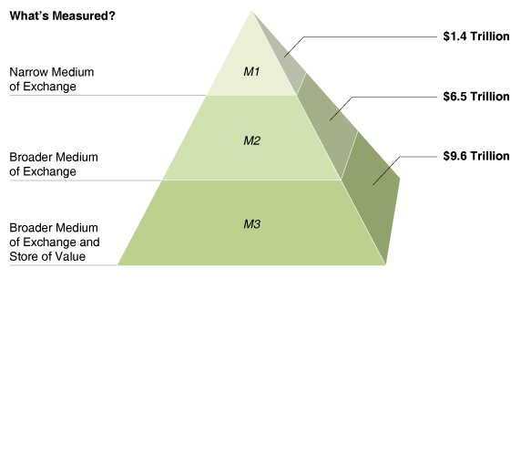
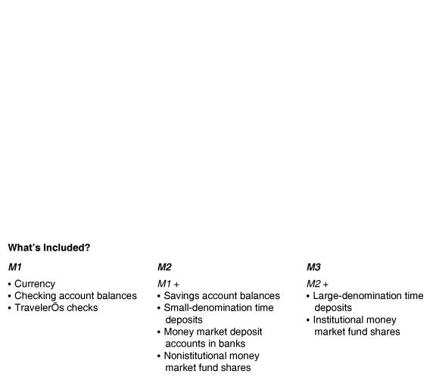
How Do We Measure Money Today?
M1: The Narrowest Definition of the Money Supply
13 - 1
Measuring the Money
Supply, September 2005

Slide 23
How Do We Measure Money Today?
M2: A Broader Definition of Money
  M2 A broader definition of the money supply: M1 plus savings account balances, small-denomination time deposits, balances in money market deposit accounts in banks, and noninstitutional money market fund shares.
  Two key points about the money supply to keep in mind are:
  1. The money supply consists of both currency and balances in checking accounts and traveler’s checks.
  2. Because balances in checking accounts are included in the money supply, banks play an important role in the process by which the money supply increases and decreases.

Slide 24

13 - 1
2
LEARNING OBJECTIVE
The Definitions of M1 and M2
Suppose you decide to withdraw $2,000 from your checking account and use the money to buy a bank certificate of deposit (CD). Briefly explain how this will affect M1 and M2.
How Do We Measure Money Today?
What About Credit Cards and Debit Cards?
Don’t Confuse Money with Income or Wealth

Slide 25
我国货币体系：四个层次
M₀ —— 流通中的现金。
M₁ —— M₀ + 企业活期存款 + 机关团体部队存款 + 农村存款 + 个人持有的信用卡类存款。
M₂ —— M₁ + 城乡居民储蓄存款 + 企业存款中具有定期性质的存款 + 外币存款 + 信托类存款。
M₃ —— M₂ + 金融债券 + 商业票据 + 大额可转让定期存单。

Slide 26
In the definition of the money supply, where do credit cards belong?
a. M1.
b. M2.
c. M3.
d. None of the above.

Slide 27
In the definition of the money supply, where do credit cards belong?
a. M1.
b. M2.
c. M3.
d. None of the above.

Slide 28
How Do Banks Create Money?
3
LEARNING OBJECTIVE
Bank Balance Sheets
  Reserves Deposits that a bank keeps as cash in its vault or on deposit with the Federal Reserve.
  Required reserves Reserves that a bank is legally required to hold, based on its checking account deposits.
  Required reserve ratio The minimum fraction of deposits banks are required by law to keep as reserves.
  Excess reserves Reserves that banks hold over and above the legal requirement.

Slide 29
How Do Banks Create Money?
Bank Balance Sheets
13 - 2
Balance Sheet for Wachovia Bank, December 31, 2004
ASSETS (IN MILLIONS) |  | LIABILITIES AND STOCKHOLDERS’ EQUITY (IN MILLIONS)
Reserves | $34,150 | Deposits | $295,053
Loans | $221,083 | Short-term borrowing | $64,161
Deposits with other banks | $4,441 | Long-term debt | $46,750
Securities | $110,597 | Other liabilities | $37,216
Buildings and equipment | $5,628 | Total Liabilities | $443,189
Other assets | $117,425
 |  | Stockholders’ equity | $50,135
Total Assets | $493,324 | Total Liabilities and Stockholders’ equity | $493,324
Know When a Checking Account Is an Asset and When It Is a Liability

Slide 30
The largest liability for most banks is:
a. deposits.
b. loans.
c. reserves.
d. all of the above.

Slide 31
The largest liability for most banks is:
a. deposits.
b. loans.
c. reserves.
d. all of the above.

Slide 32
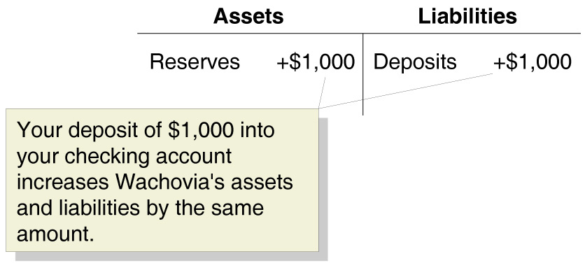
How Do Banks Create Money?
Using T-Accounts to Show How a Bank Can Create Money

Slide 33
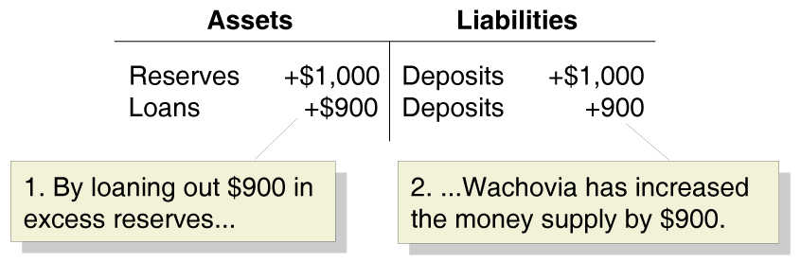
How Do Banks Create Money?
Using T-Accounts to Show How a Bank Can Create Money

Slide 34
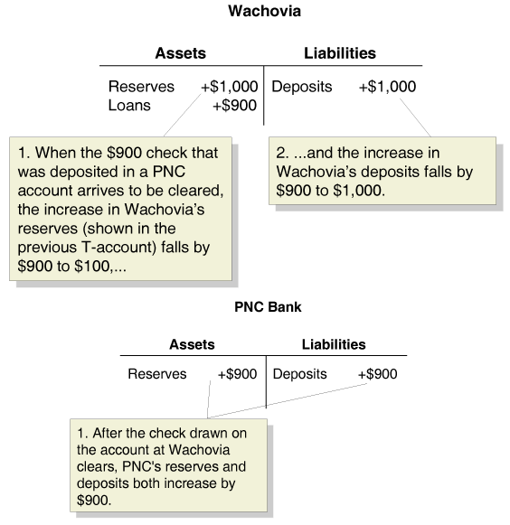
How Do Banks Create Money?
Using T-Accounts to Show How a Bank Can Create Money

Slide 35
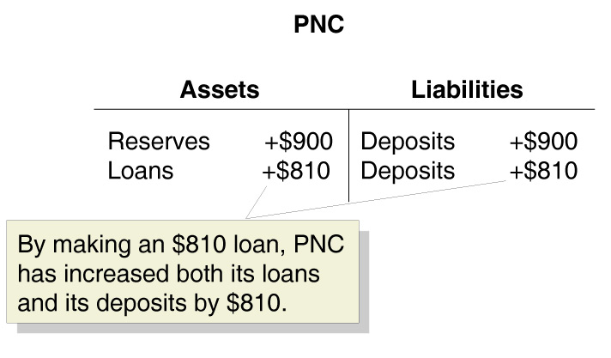
How Do Banks Create Money?
Using T-Accounts to Show How a Bank Can Create Money

Slide 36
How Do Banks Create Money?
Using T-Accounts to Show How a Bank Can Create Money
BANK | INCREASE IN CHECKING ACCOUNT DEPOSITS
Wachovia | $1,000
PNC | $900 | (= 0.9 x $1,000)
Third Bank | $810 | (= 0.9 x $900)
Fourth Bank | $729 | (= 0.9 x $810)
. | .
. | .
. | .
Total Change in Checking Account Deposits | $10,000

Slide 37
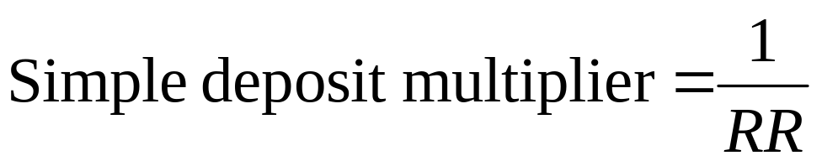
How Do Banks Create Money?
The Simple Deposit Multiplier
  Simple deposit multiplier The ratio of the amount of deposits created by banks to the amount of new reserves.

Slide 38
An increase in the amount of excess reserves that banks keep _________ the value of the simple deposit multiplier.
a. increases
b. decreases
c. leaves unchanged
d. nullifies

Slide 39
An increase in the amount of excess reserves that banks keep _________ the value of the simple deposit multiplier.
a. increases
b. decreases
c. leaves unchanged
d. nullifies

Slide 40
13 - 2
3
LEARNING OBJECTIVE
Showing How Banks Create Money
PNC Bank
Assets |  | Liabilities
Reserves | +$5,000 | Deposits | +$5,000
PNC Bank
Assets |  | Liabilities
Reserves | +$5,000 | Deposits | +$5,000
Loans | +$4,500 | Deposits | +$4,500
PNC Bank
Assets |  | Liabilities
Reserves | +$500 | Deposits | +$5,000
Loans | +$4,500
Wachovia Bank
Assets |  | Liabilities
Reserves | +$4,500 | Deposits | +$4,500

Slide 41
The Federal Reserve System
4
LEARNING OBJECTIVE
  Fractional reserve banking system A banking system in which banks keep less than 100 percent of deposits as reserves.
  Bank run Many depositors simultaneously decide to withdraw money from a bank.
  Bank panic Many banks experiencing runs at the same time.

Slide 42
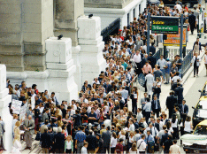
13 - 3
The 2001 Bank Panic in Argentina
The Argentine central bank was unable to stop the bank panic of 2001.

Slide 43
The Federal Reserve System
The Organization of the Federal Reserve System
  Federal Reserve System The central bank of the United States.

Slide 44
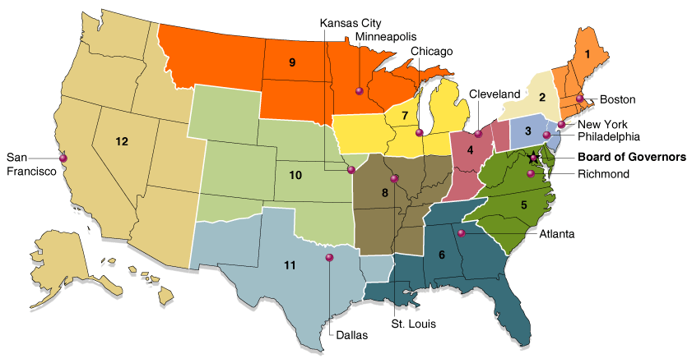
The Federal Reserve System
The Organization of the Federal Reserve System
13 - 3
Federal Reserve Districts

Slide 45
The Federal Reserve System
How the Federal Reserve Manages the Money Supply
  Monetary policy The actions the Federal Reserve takes to manage the money supply and interest rates to pursue economic objectives.
  To manage the money supply, the Fed uses three monetary policy tools:
    Open market operations
    Discount policy
    Reserve requirements

Slide 46
The Federal Reserve System
How the Federal Reserve Manages the Money Supply
OPEN MARKET OPERATIONS
Federal Open Market Committee (FOMC) The Federal Reserve committee responsible for open market operations and managing the money supply.
Open market operations The buying and selling of Treasury securities by the Federal Reserve in order to control the money supply.

Slide 47
To increase the money supply, the FOMC directs the trading desk, located at the Federal Reserve Bank of New York to:
a. buy U.S. Treasury securities from the public.
b. sell U.S. Treasury securities to the public.
c. print U.S. Treasury securities and put them out in circulation.
d. buy U.S. dollars in the foreign exchange market.

Slide 48
To increase the money supply, the FOMC directs the trading desk, located at the Federal Reserve Bank of New York to:
a. buy U.S. Treasury securities from the public.
b. sell U.S. Treasury securities to the public.
c. print U.S. Treasury securities and put them out in circulation.
d. buy U.S. dollars in the foreign exchange market.

Slide 49
The Federal Reserve System
How the Federal Reserve Manages the Money Supply
DISCOUNT POLICY
Discount loans Loans the Federal Reserve
makes to banks.
Discount rate The interest rate the Federal
Reserve charges on discount loans.
RESERVE REQUIREMENTS
Putting It All Together: Decisions of the Nonbank Public, Banks, and the Fed

Slide 50
哪个工具最常使用?
3
公开市场业务:是指中央银行在金融市场上公开买卖有价证券，以此来调节市场货币量的政策行为。
公开市场业务的优越性体现在：主动性强。买卖总能成交。灵活性强。可以根据变化随时调节买卖的数量和方向。调控效果和缓，震动性小。 影响范围广。对商业银行、公众、证券市场都会产生影响。
其局限性是：要求中央银行必须有强大的金融实力；有一个发达、完善的金融市场；还必须有其他金融工具的配合。
使用最频繁.
Notes:
Why not reserve requirements?
Making them too low creates a risk of bank runs. Making them too high makes banking unprofitable.
In addition, banking would be difficult if the Fed changed reserve requirements frequently.

Slide 51
改变法定准备金率:是以法律的形式规定商业银行等金融机构将其吸收存款的一部分上缴中央银行作为准备金的比率。法定存款准备金建立之初的目的，是为了保持银行的流动性，当准备金制度普遍实行，中央银行拥有调整法定准备率的权力之后，就成为中央银行控制货币供应量的政策工具，而且是最猛烈的工具。
其政策效果体现在：通过决定或改变货币乘数影响货币供给；其他货币政策工具都以存款准备金为基础； 限制商业银行体系创造派生存款的能力。
它的局限性在于：效果太强烈，不能作为日常性工具；而且对不同类别的金融机构和存款影响不一致，政策效果不易把握。
最少使用.

Slide 52
改变贴现率:是指中央银行对商业银行持有未到期票据向中央银行申请再贴现时所作的政策性规定。
主要是象征意义; Fed 是最后的支付者;通常并非有求必应地向银行贷款
再贴现政策包括两方面：一是对再贴现率的决定、调整。这种作用主要着眼于短期，调整货币供给量，由于再贴现率在利率体系中的关键作用，这种调整也具有告示效应。另一方面是对申请再贴现的资格的规定。其作用着眼于长期，主要能改变资金流向。
再贴现政策的局限性在于：主动权并非只在中央银行，商业银行对是否申请再贴现有选择权；再贴现率的调节作用是有限度的；再贴现率易于调整，但会引起市场利率的波动。

Slide 53
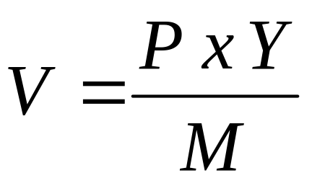
The Quantity Theory of Money
5
LEARNING OBJECTIVE
Connecting Money and Prices: The Quantity Equation
  Velocity of money The average number of times each dollar in the money supply is used to purchase goods and services included in GDP.
  Quantity theory of money A theory of the connection between money and prices that assumes that the velocity of money is constant.

Slide 54
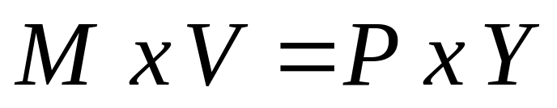
The Quantity Theory of Money
The Quantity Theory Explanation of Inflation
We can transform the quantity equation from:
to:
Growth rate of the money supply + Growth rate of velocity =
Growth rate of the price level (or inflation rate) + Growth rate of real output

Slide 55
The Quantity Theory of Money
The Quantity Theory Explanation of Inflation
The growth rate of the price level is just the inflation rate, so we can rewrite the quantity equation to help us understand the factors that determine inflation:
Inflation rate = Growth rate of the money supply +
Growth rate of velocity – Growth rate of real output
If Irving Fisher was correct that velocity is constant, then the growth rate of velocity will be zero. This allows us to rewrite the equation one last time:
Inflation rate = Growth rate of the money supply –
Growth rate of real output.

Slide 56
The Quantity Theory of Money
The Quantity Theory Explanation of Inflation
This equation leads to the following predictions (recall that deflation is a decline in the price level):
1. If the money supply grows at a faster rate than real GDP, there will be inflation.
2. If the money supply grows at a slower rate than real GDP, there will be deflation.
3. If the money supply grows at the same rate as real GDP, the price level will be stable. There will be neither inflation nor deflation.

Slide 57
Which of the following predictions can be made using the growth rates associated with the quantity equation?
a. If the money supply grows at a faster rate than real GDP, there will be inflation.
b. If the money supply grows at a slower rate than real GDP, there will be inflation.
c. If the money supply grows at the same rate as real GDP, the price level will be fall. There will be deflation.
d. All of the above.

Slide 58
Which of the following predictions can be made using the growth rates associated with the quantity equation?
a. If the money supply grows at a faster rate than real GDP, there will be inflation.
b. If the money supply grows at a slower rate than real GDP, there will be inflation.
c. If the money supply grows at the same rate as real GDP, the price level will be fall. There will be deflation.
d. All of the above.

Slide 59
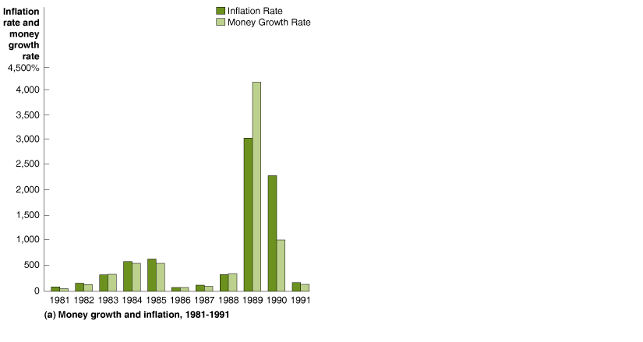
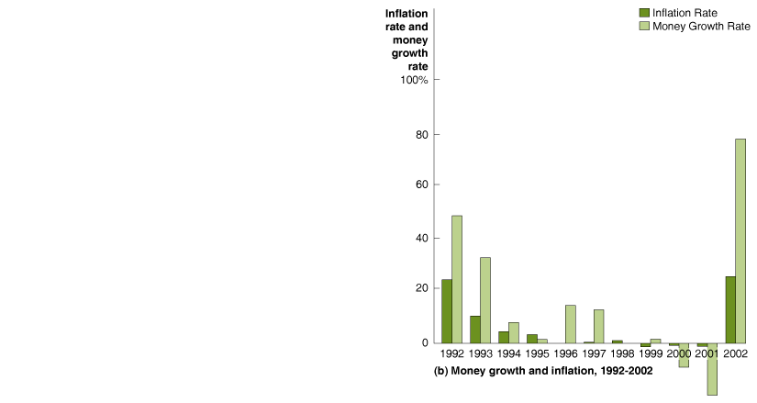
The Quantity Theory of Money
High Rates of Inflation
High Inflation in Argentina
13 - 4
Money Growth and Inflation in Argentina

Slide 60
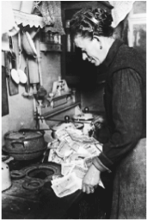
13 - 4
The German Hyperinflation of the Early 1920s
During the hyperinflation of the 1920s, people in Germany used paper currency to light their stoves.

Slide 61

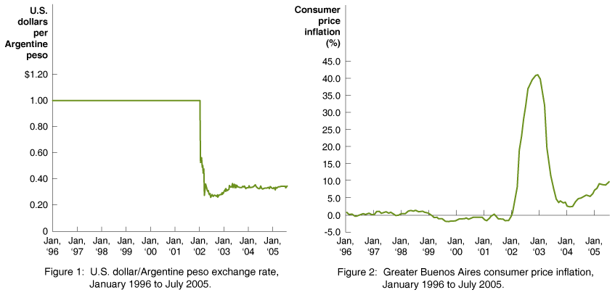
Latin Governments Try to Unseat the Dollar

Slide 62

Asset
Bank panic
Bank run
Commodity money
Discount loans
Discount rate
Excess reserves
Federal Open Market Committee (FOMC)
Federal Reserve System
Fiat money
Fractional reserve banking system
M1
M2
Monetary policy
Money
Open market operations
Quantity theory of money
Required reserve ratio
Required reserves
Reserves
Simple deposit multiplier
Velocity of money

