Slide 1
Monetary Policy

Slide 2

Why Did Homebuilder Toll Brothers, Inc. Prosper during the 2001 Recession?
After studying this chapter, you should be able to:
  Define monetary policy and describe the Federal Reserve’s monetary policy goals.
  Describe the Federal Reserve’s monetary policy targets, and explain how expansionary and contractionary monetary policies affect the interest rate.
  Use aggregate demand and aggregate supply graphs to show the effects of monetary policy on real GDP and the price level.
  Discuss the Fed’s setting of monetary policy targets.
  Assess the arguments for and against the independence of the Federal Reserve.
1
2
3
LEARNING OBJECTIVES
4
By driving down interest rates, the Fed succeeded in heading off what some economists had predicted would be a prolonged and severe recession.
5

Slide 3
What Is Monetary Policy?
1
LEARNING OBJECTIVE
Monetary policy The actions the Federal Reserve takes to manage the money supply and interest rates to pursue its economic objectives.
The Goals of Monetary Policy
The Fed has set four monetary policy goals that are intended to promote a well-functioning economy:
  PRICE STABILITY
  HIGH EMPLOYMENT
  ECONOMIC GROWTH
  STABILITY OF FINANCIAL MARKETS AND INSTITUTIONS

Slide 4

Attempts to ensure that there will be an efficient flow of funds from savers to borrowers is the objective of which monetary policy goal?
a. Price stability.
b. High employment.
c. Economic growth.
d. Stability of financial markets.

Slide 5
Attempts to ensure that there will be an efficient flow of funds from savers to borrowers is the objective of which monetary policy goal?
a. Price stability.
b. High employment.
c. Economic growth.
d. Stability of financial markets.

Slide 6
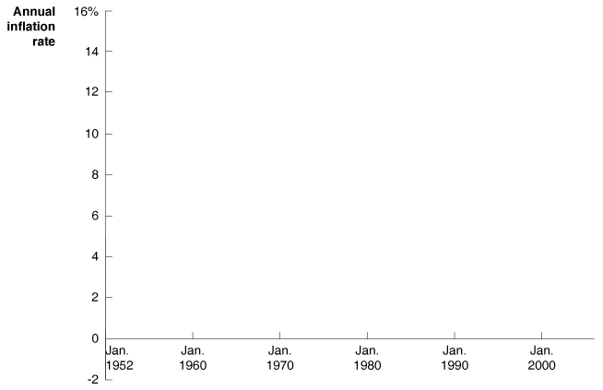
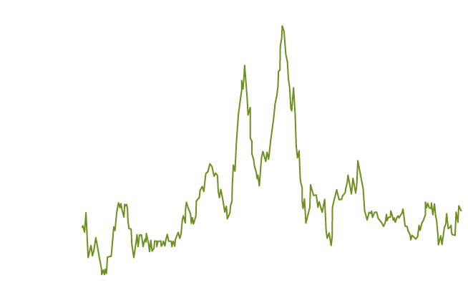
What Is Monetary Policy?
The Goals of Monetary Policy
PRICE STABILITY
14 - 1
The Inflation Rate, 1952-2004

Slide 7
Which of the following periods had the highest inflation rate?
a. The 1950s and 1960s.
b. The 1970s.
c. The 1990s.
d. All of the periods above experienced similar inflation rates.

Slide 8
Which of the following periods had the highest inflation rate?
a. The 1950s and 1960s.
b. The 1970s.
c. The 1990s.
d. All of the periods above experienced similar inflation rates.

Slide 9
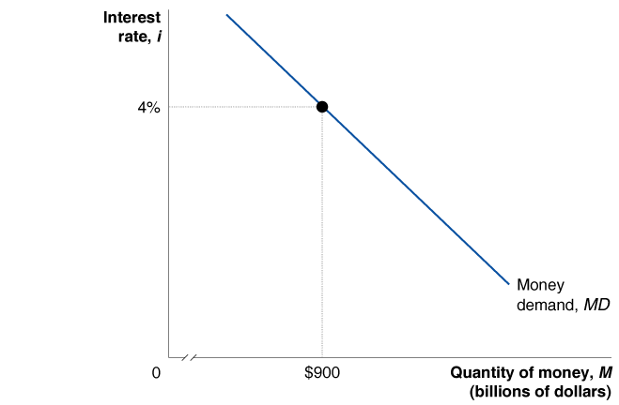
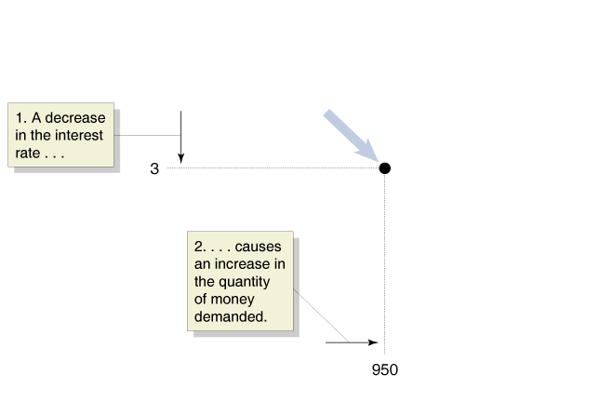
The Money Market and the Fed’s Choice of Targets
2
LEARNING OBJECTIVE
Monetary Policy Targets
The Demand for Money
14 - 2
The Demand for Money

Slide 10
Which of these two variables are the main monetary policy targets of the Fed?
a. Real GDP and the price level.
b. The money supply and the interest rate.
c. Inflation and unemployment.
d. Economic growth and productivity.

Slide 11
Which of these two variables are the main monetary policy targets of the Fed?
a. Real GDP and the price level.
b. The money supply and the interest rate.
c. Inflation and unemployment.
d. Economic growth and productivity.

Slide 12
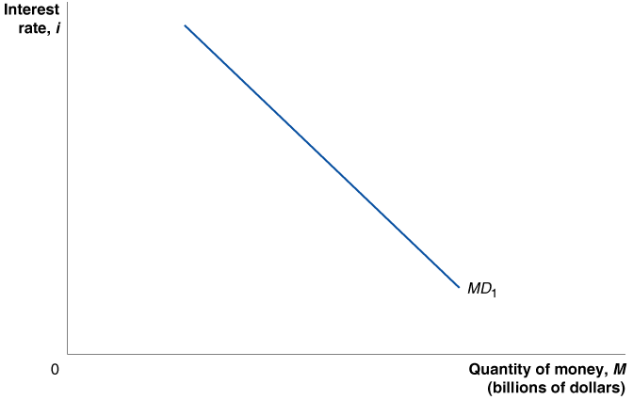
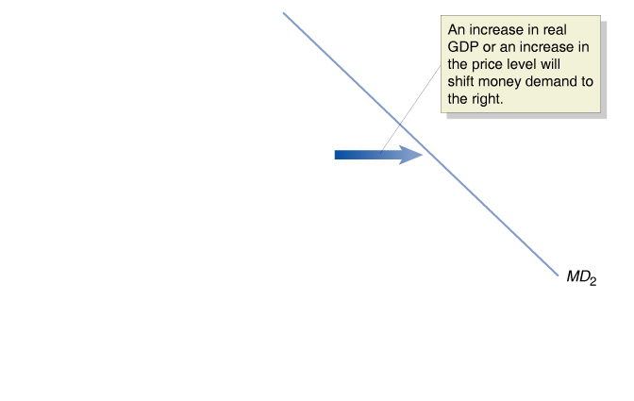
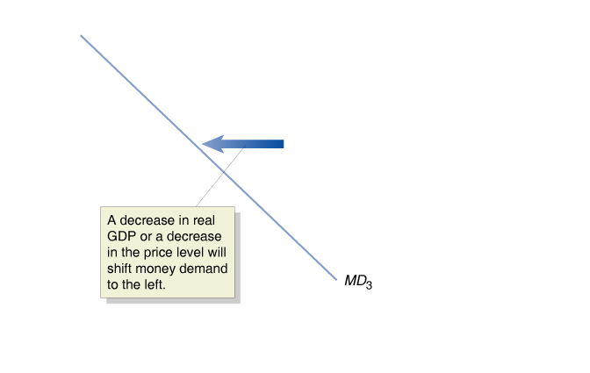
The Money Market and the Fed’s Choice of Targets
Shifts in the Money Demand Curve
14 - 3
Shifts in the Money Demand Curve

Slide 13
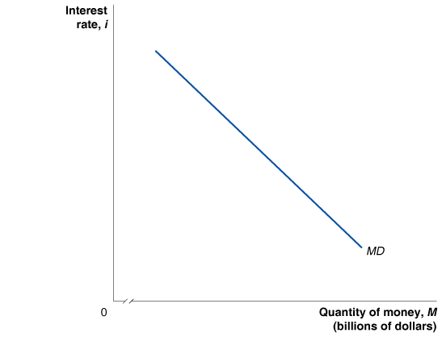
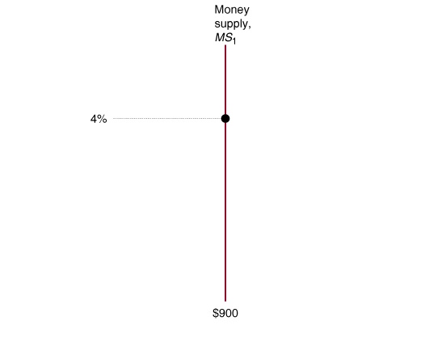
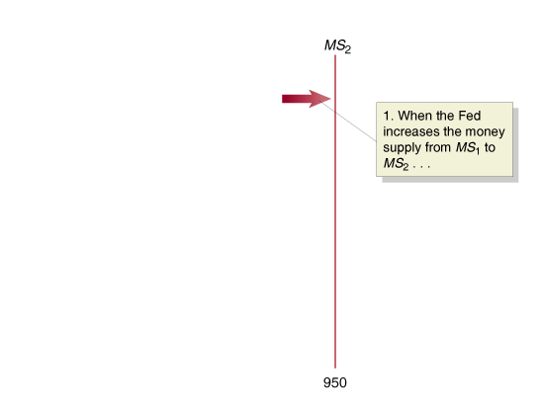
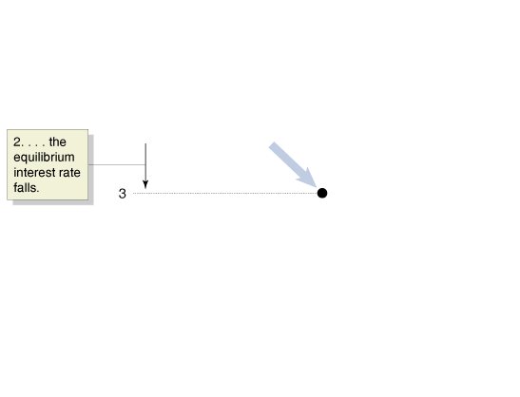
The Money Market and the Fed’s Choice of Targets
How the Fed Manages the Money Supply: A Quick Review
Equilibrium in the Money Market
14 - 4
The Impact on the Interest
Rate When the Fed Increases
the Money Supply

Slide 14
When the interest rate decreases,
a. The money demand curve shifts to the right.
b. The money demand curve shifts to the left.
c. There is a movement downward along a stationary money demand curve.
d. There is a movement upward and to the left along a stationary money demand curve.

Slide 15
When the interest rate decreases,
a. The money demand curve shifts to the right.
b. The money demand curve shifts to the left.
c. There is a movement downward along a stationary money demand curve.
d. There is a movement upward and to the left along a stationary money demand curve.

Slide 16
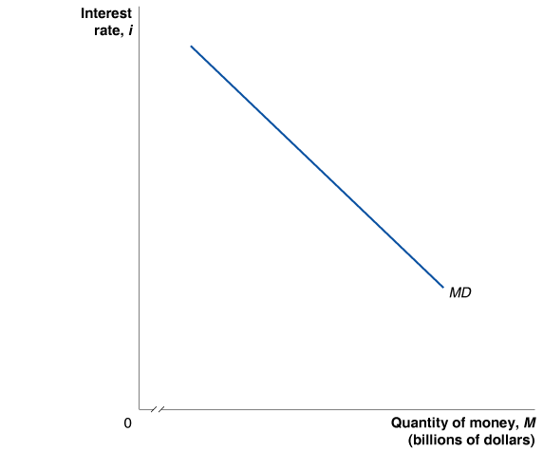
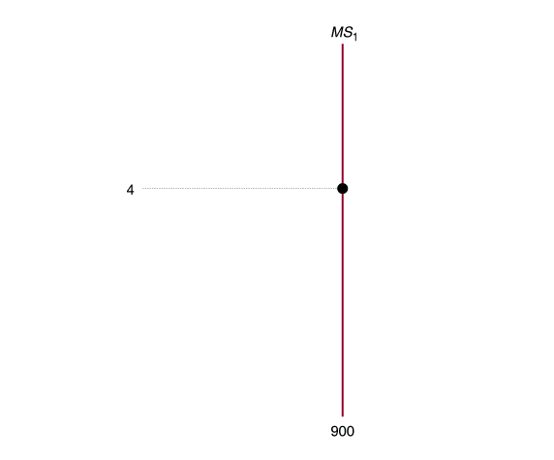
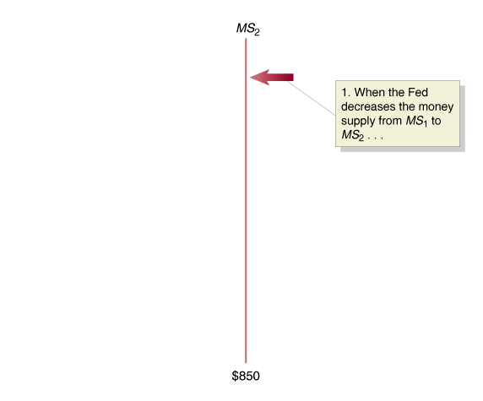
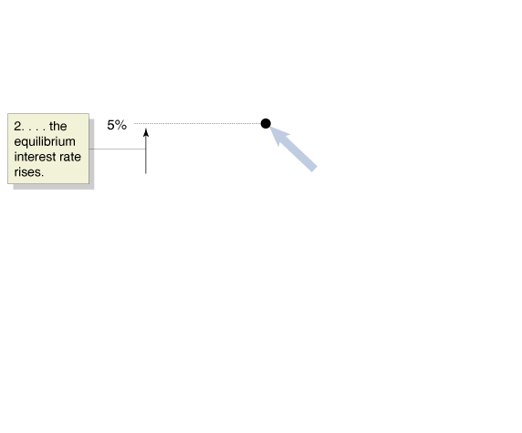
The Money Market and the Fed’s Choice of Targets
Equilibrium in the Money Market
14 - 5
The Impact on Interest Rates When the Fed Decreases
the Money Supply

Slide 17
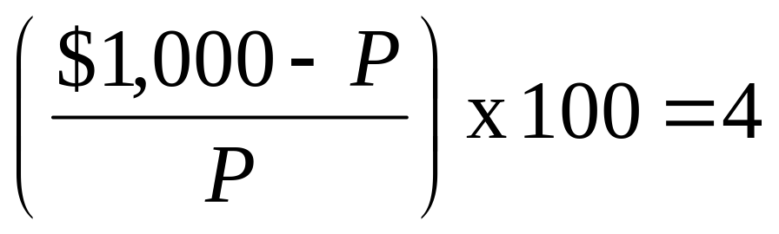
14 - 1
2
LEARNING OBJECTIVE
The Relationship between Treasury Bill Prices and Their Interest Rates
What is the price of a Treasury bill that pays $1,000 in one year, if its interest rate is 4 percent? What is the price of the Treasury bill if its interest rate is 5 percent?

Slide 18
The Money Market and the Fed’s Choice of Targets
A Tale of Two Interest Rates
Choosing a Monetary Policy Target
The Importance of the Federal Funds Rate
Federal funds rate The interest rate banks charge each other for overnight loans.

Slide 19
Suppose you buy a U.S. Treasury bill today for $950 that matures in one year, at which time the Treasury will pay you $1,000. How much interest will you earn on your investment of $950?
a. 4.75%.
b. 5.26%.
c. 19%.
d. 5%.

Slide 20
Suppose you buy a U.S. Treasury bill today for $950 that matures in one year, at which time the Treasury will pay you $1,000. How much interest will you earn on your investment of $950?
a. 4.75%.
b. 5.26%.
c. 19%.
d. 5%.

Slide 21
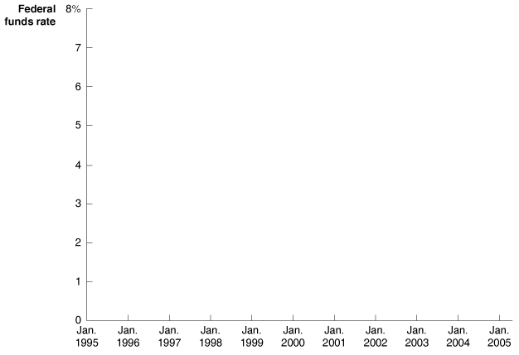
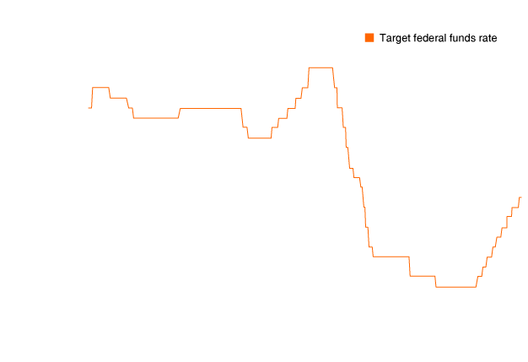
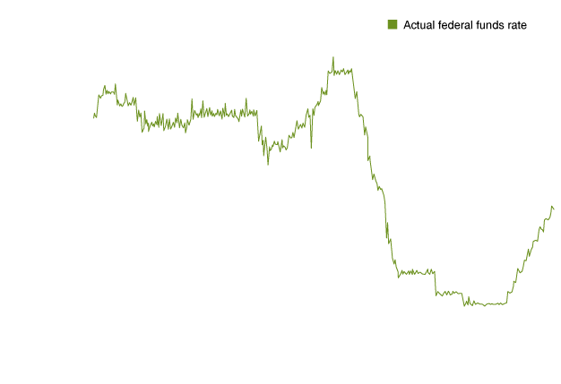
The Money Market and the Fed’s Choice of Targets
The Importance of the Federal Funds Rate
14 - 6
Federal Funds Rate Targeting, January 1995- July 2005

Slide 22
Monetary Policy and Economic Activity
3
LEARNING OBJECTIVE
How Interest Rates Affect Aggregate Demand
Changes in interest rates will not affect government purchases, but they will affect the other three components of aggregate demand in the following ways:
  Consumption
  Investment
  Net exports

Slide 23


14 - 1
Was There a Housing Market “Bubble” in the Early 2000s?
Was there a “bubble” in housing prices in the early 2000s?

Slide 24
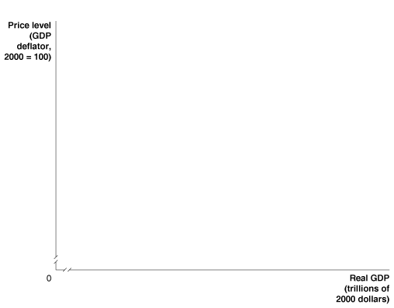
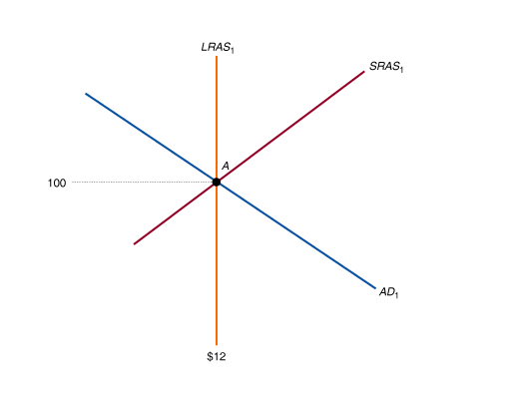
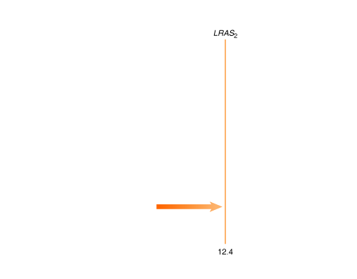
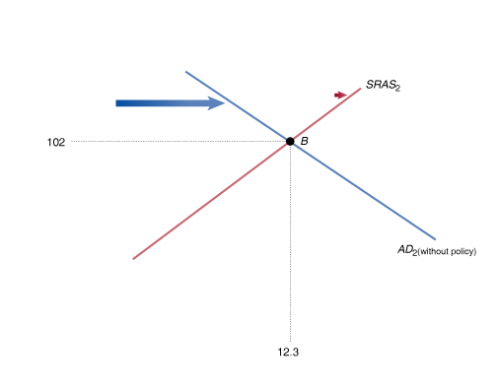
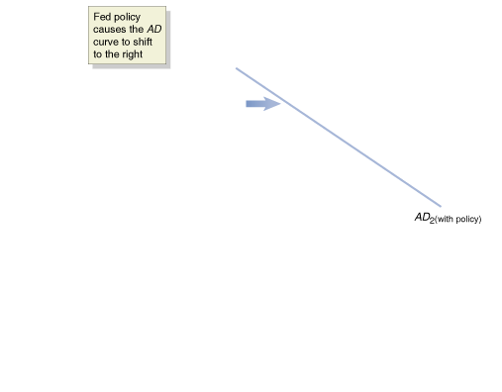
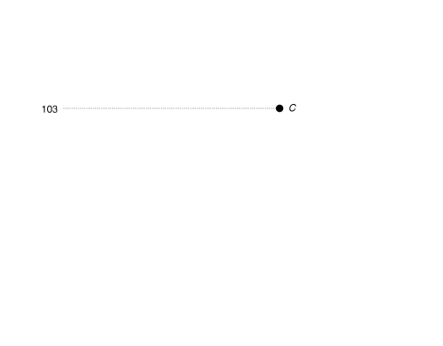
Monetary Policy and Economic Activity
The Effects of Monetary Policy on Real GDP and the Price Level
14 - 7
An Expansionary Monetary Policy

Slide 25
Monetary Policy and Economic Activity
The Effects of Monetary Policy on Real GDP and the Price Level
Expansionary monetary policy The Federal Reserve’s increasing the money supply and decreasing interest rates in order to increase real GDP.
Can the Fed Eliminate Recessions?

Slide 26
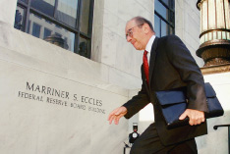
14 - 2
The Fed Responds to the Terrorist Attacks of September 11, 2001
The day after the terrorist attacks of September 11, 2001, the Fed made massive discount loans to banks and succeeded in preventing a financial panic. Alan Greenspan, pictured here, was the chairman of the Fed at the time of the attacks.

Slide 27

14 - 3
Why Was Monetary Policy Ineffective in Japan?
Spending on housing and other types of investment has not been high enough to bring the Japanese economy back to potential GDP.

Slide 28
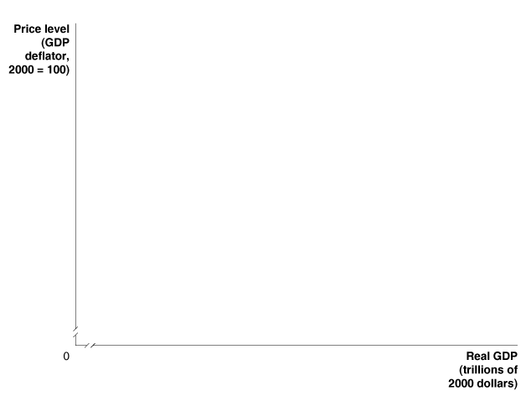
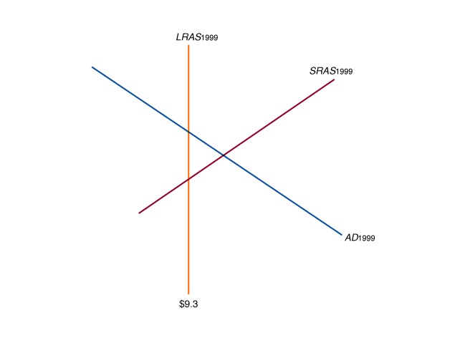
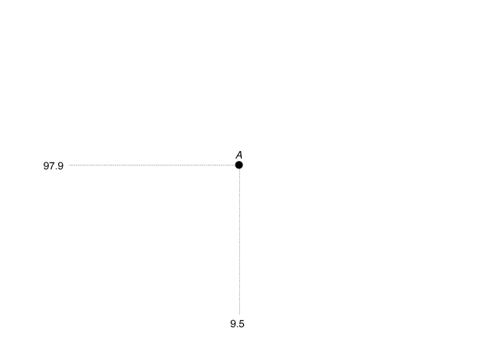
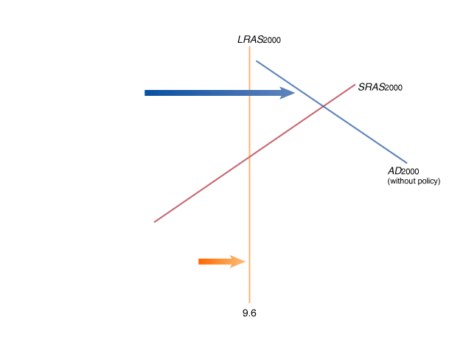
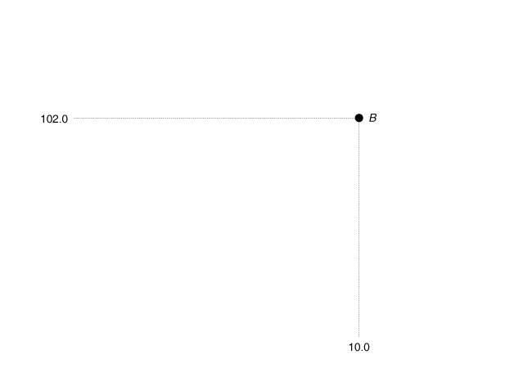
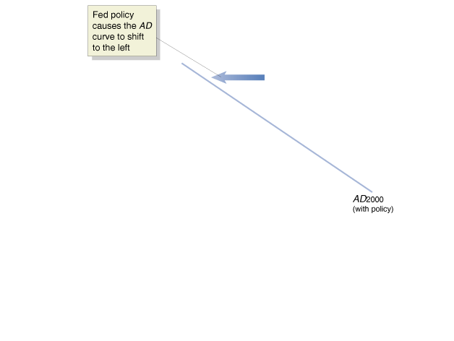
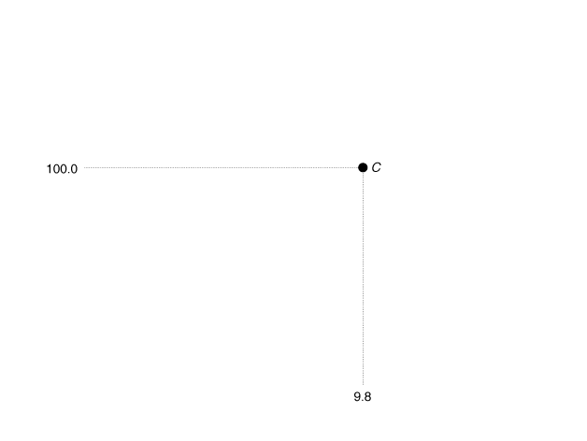
Monetary Policy and Economic Activity
Using Monetary Policy to Fight Inflation
14 - 8
A Contractionary Monetary
Policy in 2000

Slide 29
Monetary Policy and Economic Activity
Using Monetary Policy to Fight Inflation
Contractionary monetary policy The Fed’s adjusting the money supply to increase interest rates to reduce inflation.

Slide 30

14 - 2
3
LEARNING OBJECTIVE
The Effects of Monetary Policy
The hypothetical information in the table shows what the values for real GDP and the price level will be in 2011 if the Fed does not use monetary policy:
YEAR | POTENTIAL REAL GDP | REAL GDP | PRICE LEVEL
2010 | $13.3 trillion | $13.3 trillion | 140
2011 | $13.7 trillion | $13.6 trillion | 142
Remember that with Monetary Policy It’s the Interest Rates – Not the Money – that Counts

Slide 31
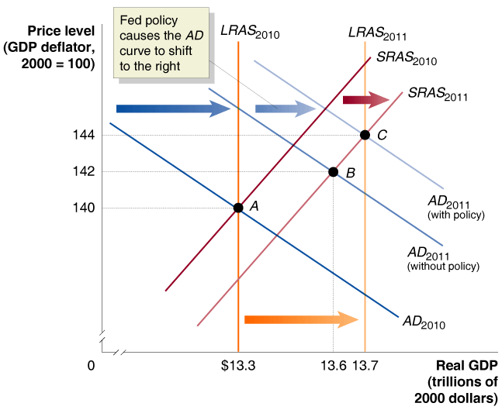
14 - 2
The Effects of Monetary Policy (cont’d.)

Slide 32
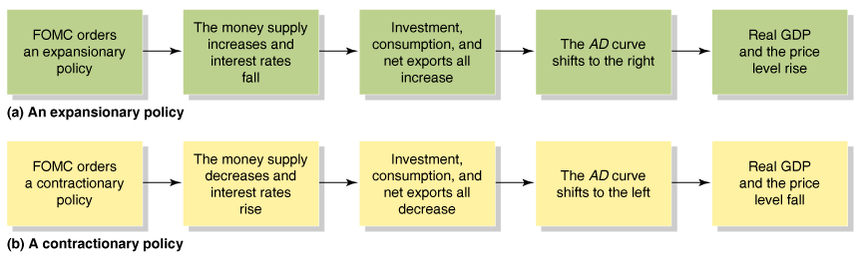
Monetary Policy and Economic Activity
A Summary of How Monetary Policy Works

Slide 33
The Fed’s strategy of increasing the money supply and lowering interest rates in order to increase real GDP is called:
a. Reactionary monetary policy.
b. Contractionary monetary policy.
c. Expansionary monetary policy.
d. Contractionary fiscal policy.

Slide 34
The Fed’s strategy of increasing the money supply and lowering interest rates in order to increase real GDP is called:
a. Reactionary monetary policy.
b. Contractionary monetary policy.
c. Expansionary monetary policy.
d. Contractionary fiscal policy.

Slide 35

14 - 4
Why Does Wall Street Care about Monetary Policy?
The stock market reacts when the Fed either raises or lowers interest rates.

Slide 36
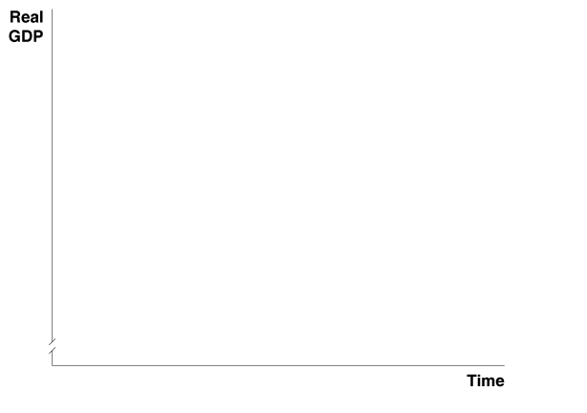
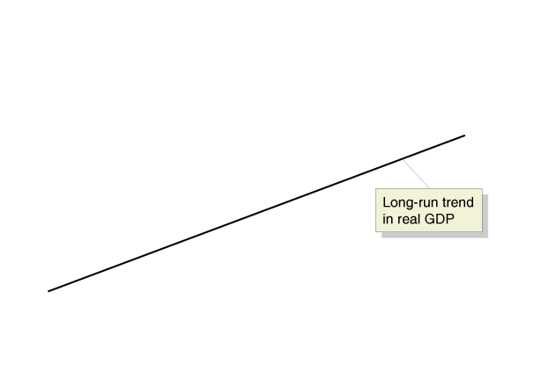
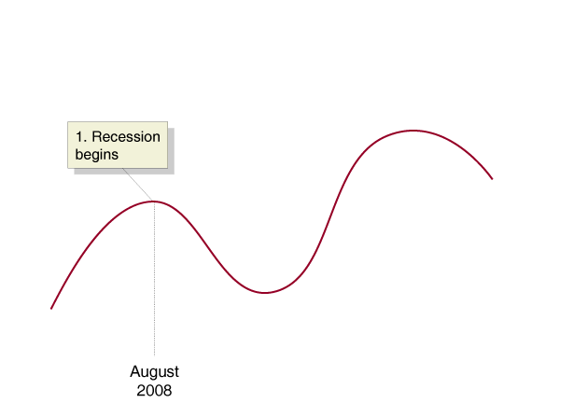
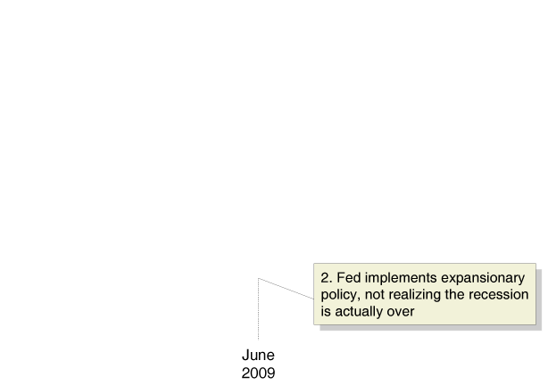
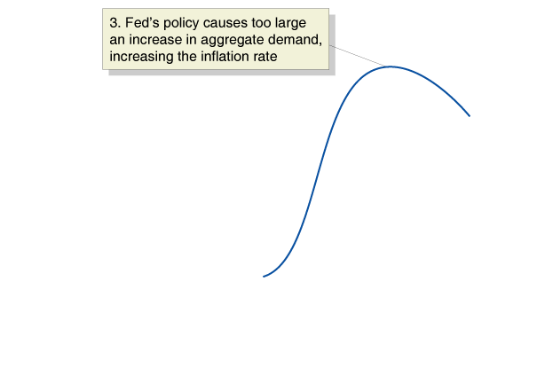
Monetary Policy and Economic Activity
Can the Fed Get the Timing Right?
14 - 9
The Effect of a Poorly Timed Monetary Policy on the Economy

Slide 37
A procyclical policy is one that:
a. Is used to stabilize the economy.
b. Inadvertently increases the severity of the business cycle.
c. Minimizes the cost of economic recessions.
d. Enhances the benefits of economic expansions.

Slide 38
A procyclical policy is one that:
a. Is used to stabilize the economy.
b. Inadvertently increases the severity of the business cycle.
c. Minimizes the cost of economic recessions.
d. Enhances the benefits of economic expansions.

Slide 39
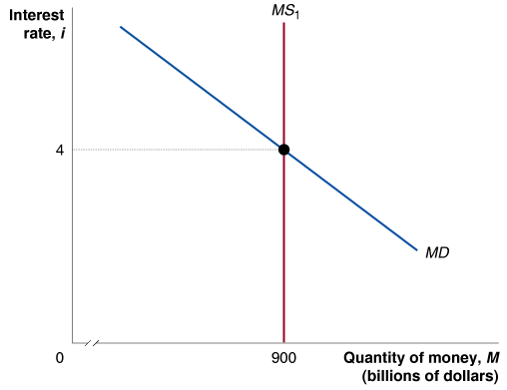
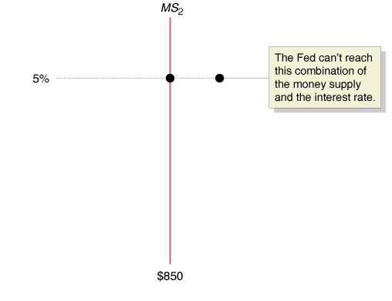
A Closer Look at the Fed’s Setting of Monetary Policy Targets
4
LEARNING OBJECTIVE
Should the Fed Target the Money Supply?
Why Doesn’t the Fed Target Both the Money Supply and the Interest Rate?
14 - 10
The Fed Can’t Target Both
the Money Supply and the
Interest Rate

Slide 40
A Closer Look at the Fed’s
Setting of Monetary Policy Targets
The Taylor Rule
Taylor rule A rule developed by John Taylor that links the Fed’s target for the federal funds rate to economic variables.
Federal funds target rate = Current inflation rate + Real equilibrium federal funds rate + (1/2) x Inflation gap + (1/2) x Output gap

Slide 41
A Closer Look at the Fed’s
Setting of Monetary Policy Targets
Should the Fed Target Inflation?
Inflation targeting Conducting monetary policy so as to commit the central bank to achieving a publicly announced level of inflation.

Slide 42
Which of the following statements is true?
a. The only monetary policy target the Fed can choose is the money supply.
b. The only monetary policy target the Fed can choose is the interest rate.
c. The Fed could simultaneously choose an interest rate and the money supply as its monetary policy targets.
d. The Fed is forced to choose between the interest rate and the money supply as its monetary policy target.

Slide 43
Which of the following statements is true?
a. The only monetary policy target the Fed can choose is the money supply.
b. The only monetary policy target the Fed can choose is the interest rate.
c. The Fed could simultaneously choose an interest rate and the money supply as its monetary policy targets.
d. The Fed is forced to choose between the interest rate and the money supply as its monetary policy target.

Slide 44
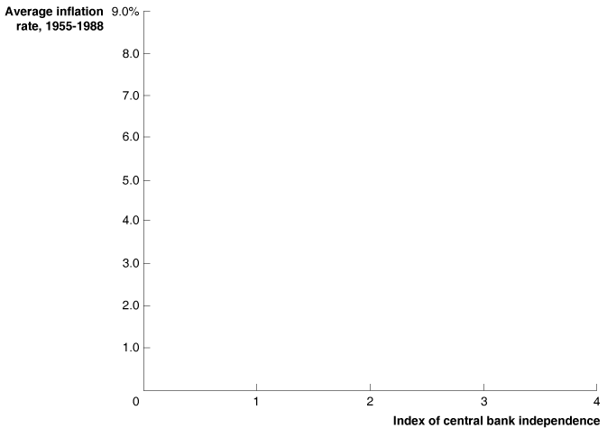
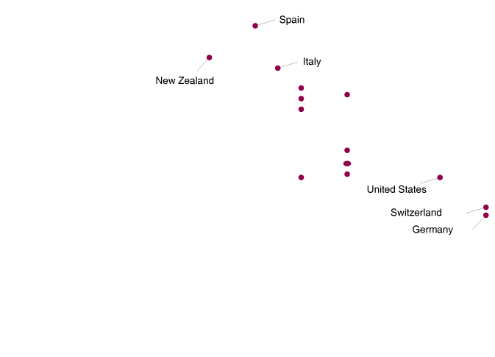
Is the Independence of the
Federal Reserve a Good Idea?
5
LEARNING OBJECTIVE
The Case for Fed Independence
The Case against Fed Independence
14 - 11
The More Independent the Central Bank, the Lower the Inflation Rate

Slide 45

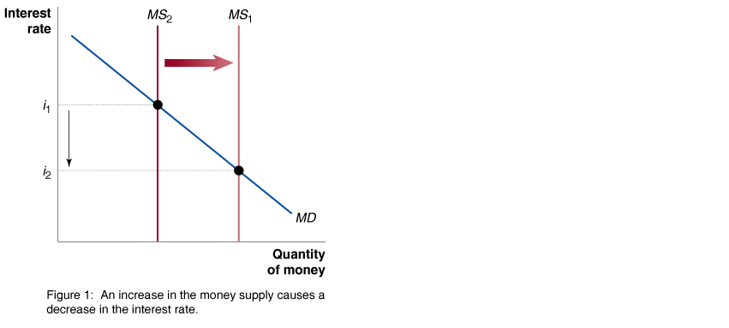
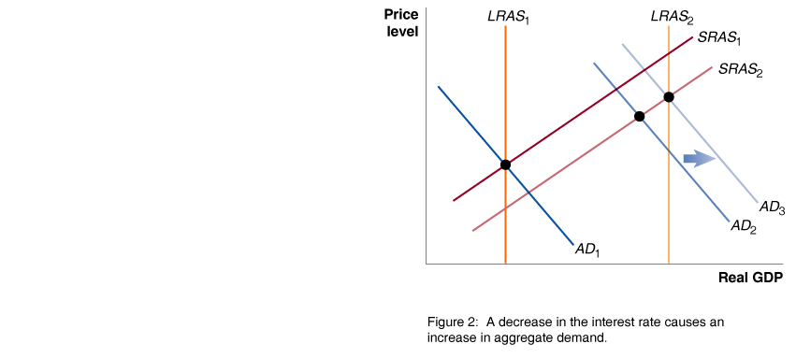
In Treating U.S. After Bubble, Fed Helped Create New Threats

Slide 46

Contractionary monetary policy
Expansionary monetary policy
Federal funds rate
Inflation targeting
Monetary policy
Taylor rule

