Slide 1
Fiscal Policy

Slide 2
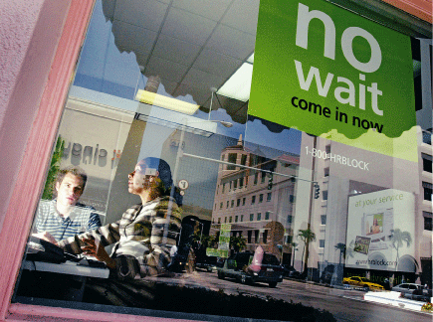
A Boon for H&R Block
After studying this chapter, you should be able to:
  Define fiscal policy.
  Explain how fiscal policy affects aggregate demand and how the government can use fiscal policy to stabilize the economy.
  Explain how the multiplier process works with respect to fiscal policy.
  Discuss the difficulties that can arise in implementing fiscal policy.
  Explain how the federal budget can serve as an automatic stabilizer.
  Discuss the long-run effects of fiscal policy.
1
2
3
LEARNING OBJECTIVES
4
In this chapter, we will explore how the government uses fiscal policy, which involves changes in taxes and changes in government purchases…
5
6

Slide 3
Fiscal Policy
1
LEARNING OBJECTIVE
Fiscal policy Changes in federal taxes and purchases that are intended to achieve macroeconomic policy objectives, such as high employment, price stability, and high rates of economic growth.
What Fiscal Policy Is and What It Isn’t
Automatic Stabilizers versus Discretionary Fiscal Policy
Automatic stabilizers Government spending and taxes that automatically increase or decrease along with the business cycle.

Slide 4

Economists use the term fiscal policy to refer to changes in taxing and spending polices by:
a. Only state and local governments.
b. Only the federal government.
c. All levels of government, federal, state, and local.
d. None of the above.

Slide 5
Economists use the term fiscal policy to refer to changes in taxing and spending polices by:
a. Only state and local governments.
b. Only the federal government.
c. All levels of government, federal, state, and local.
d. None of the above.

Slide 6
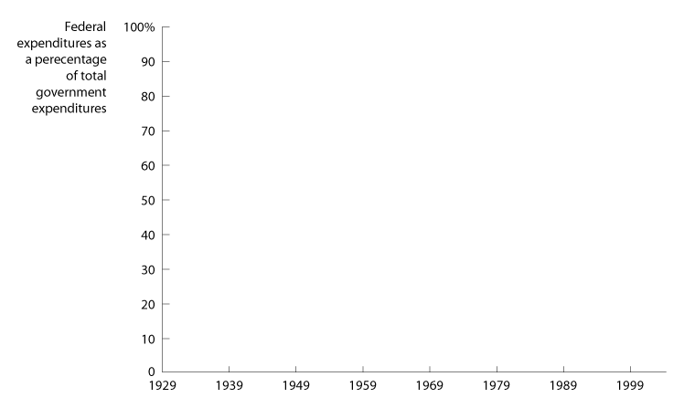
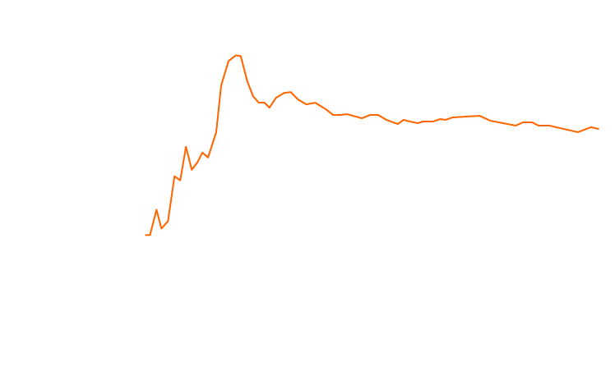


Fiscal Policy
An Overview of Government Spending and Taxes
15 - 1
The Federal Government’s Share of Total Government Expenditures, 1929-2004

Slide 7
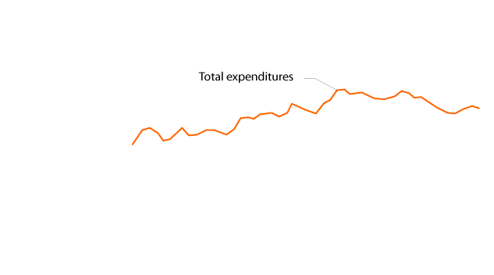
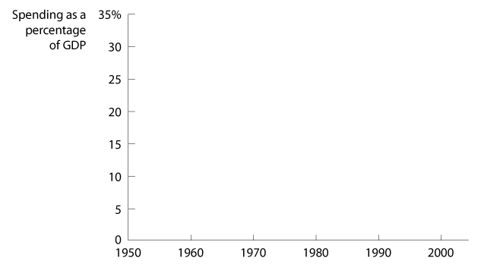
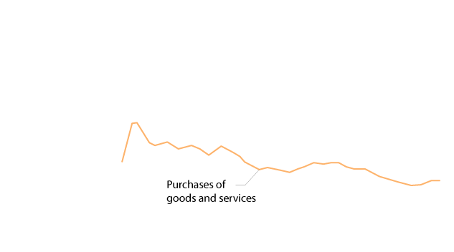
Fiscal Policy
An Overview of Government Spending and Taxes
15 - 2
Federal Purchases and Federal Expenditures as a Percentage of GDP, 1929-2004

Slide 8
What is the relationship between government purchases and government expenditures?
a. Government purchases include government expenditures.
b. Government expenditures include government purchases.
c. Government purchases and government expenditures are the same thing.
d. Government purchases include the totality of government spending, while government expenditures do not.

Slide 9
What is the relationship between government purchases and government expenditures?
a. Government purchases include government expenditures.
b. Government expenditures include government purchases.
c. Government purchases and government expenditures are the same thing.
d. Government purchases include the totality of government spending, while government expenditures do not.

Slide 10

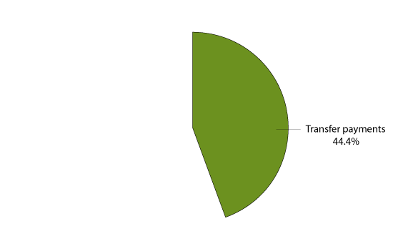
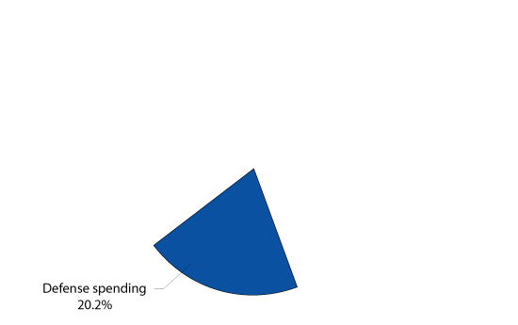
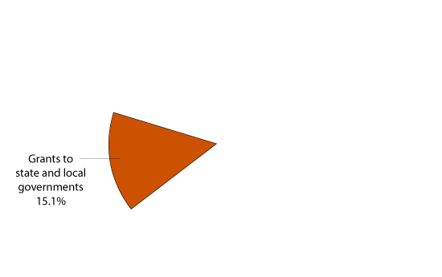
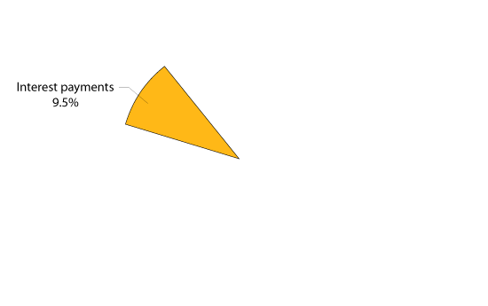
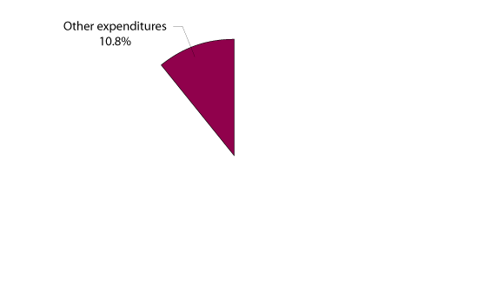
Fiscal Policy
An Overview of Government Spending and Taxes
15 - 3
Federal Government Expenditures, 2004

Slide 11


15 - 1
The Future of Social Security and Medicare
Will the federal government be able to keep the promises made by the Social Security and Medicare programs?

Slide 12
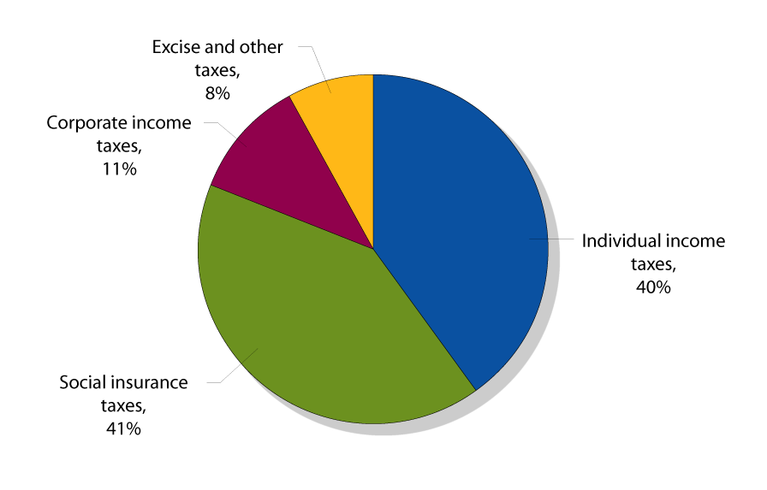
Fiscal Policy
An Overview of Government Spending and Taxes
15 - 4
Federal Government Revenue, 2004

Slide 13
Spending on most of the federal government’s day-to-day activities – including running federal agencies like the Environmental Protection Agency, the FBI, the National Park Service, and the Immigration and Naturalization Service – make up:
a. About 85 percent of federal government expenditures.
b. About 45 percent of federal government expenditures.
c. Less than 11 percent of federal government expenditures.
d. Less than 1 percent of federal government expenditures.

Slide 14
Spending on most of the federal government’s day-to-day activities – including running federal agencies like the Environmental Protection Agency, the FBI, the National Park Service, and the Immigration and Naturalization Service – make up:
a. About 85 percent of federal government expenditures.
b. About 45 percent of federal government expenditures.
c. Less than 11 percent of federal government expenditures.
d. Less than 1 percent of federal government expenditures.

Slide 15
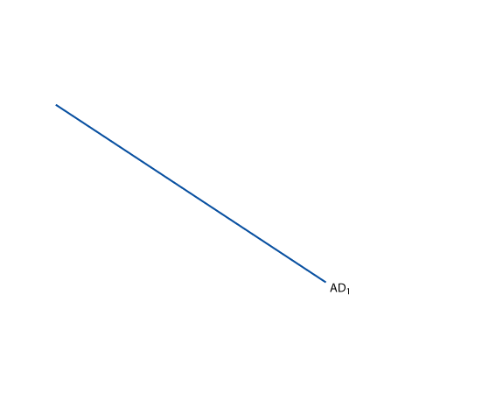
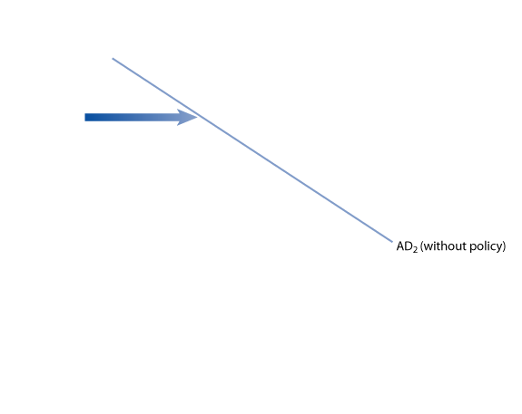
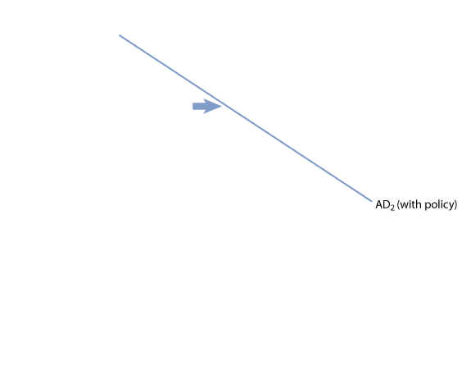
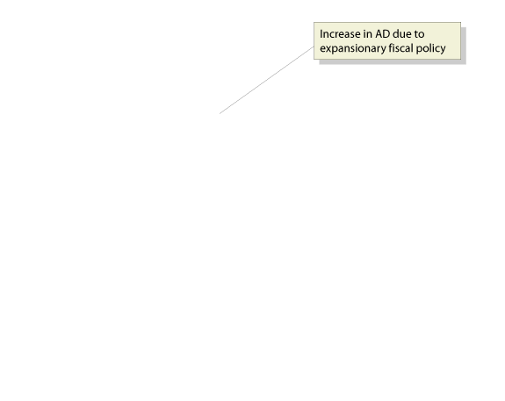
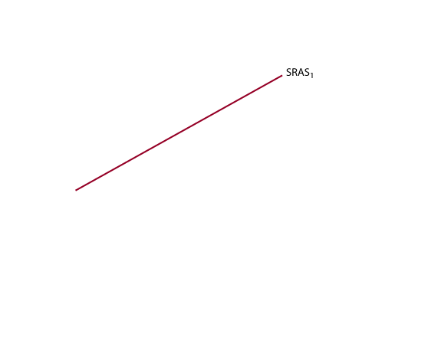
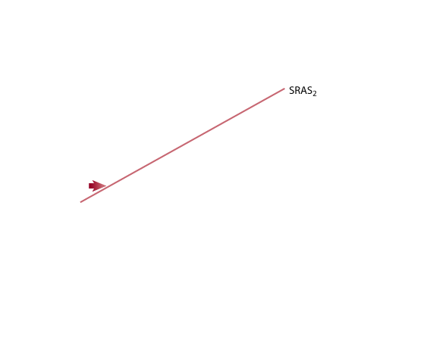
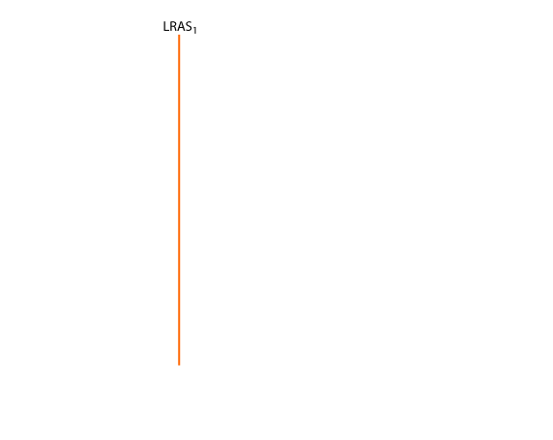
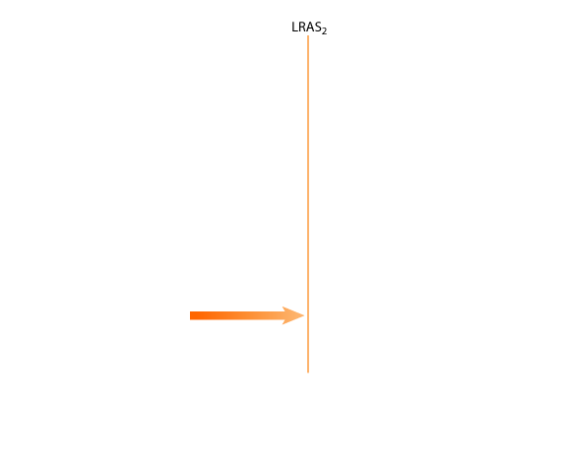
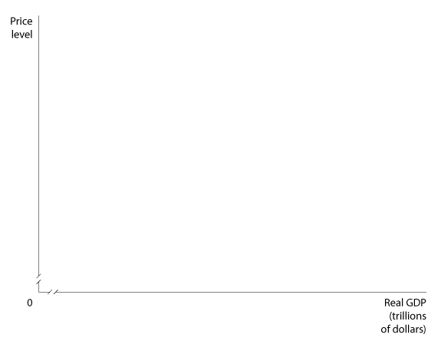
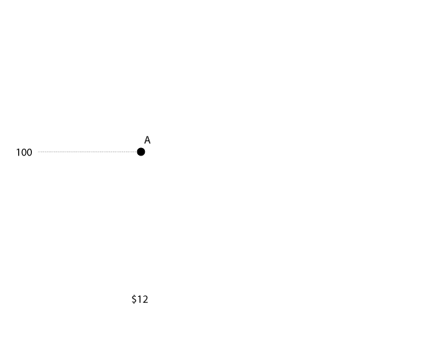
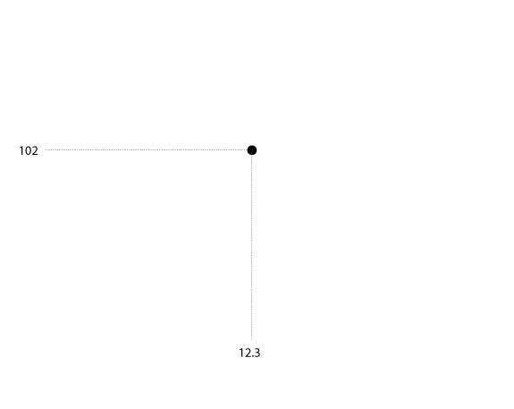
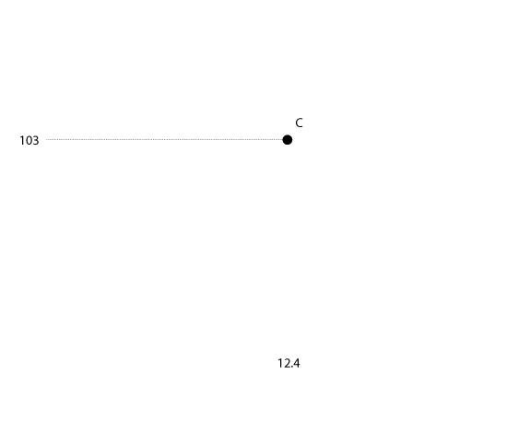
Using Fiscal Policy to Influence Aggregate Demand
2
LEARNING OBJECTIVE
Expansionary Fiscal Policy
15 - 5
An Expansionary Fiscal Policy

Slide 16
When the economy is in a recession, the government can:
a. Reduce expenditures and leave taxes constant in order to stimulate aggregate demand.
b. Increase government purchases or decrease taxes in order to increase aggregate demand.
c. Decrease government purchases or increase taxes in order to decrease aggregate supply.
d. Change spending and taxation but not aggregate demand or aggregate supply.

Slide 17
When the economy is in a recession, the government can:
a. Reduce expenditures and leave taxes constant in order to stimulate aggregate demand.
b. Increase government purchases or decrease taxes in order to increase aggregate demand.
c. Decrease government purchases or increase taxes in order to decrease aggregate supply.
d. Change spending and taxation but not aggregate demand or aggregate supply.

Slide 18
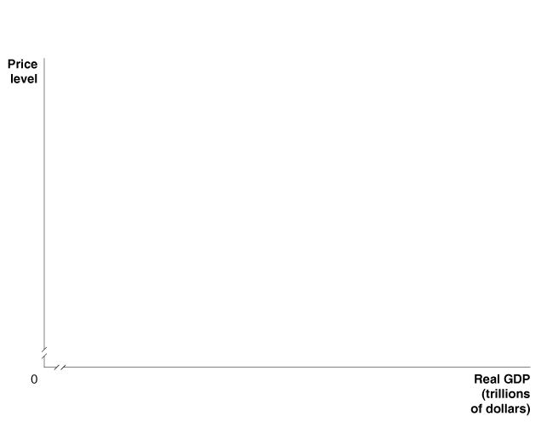
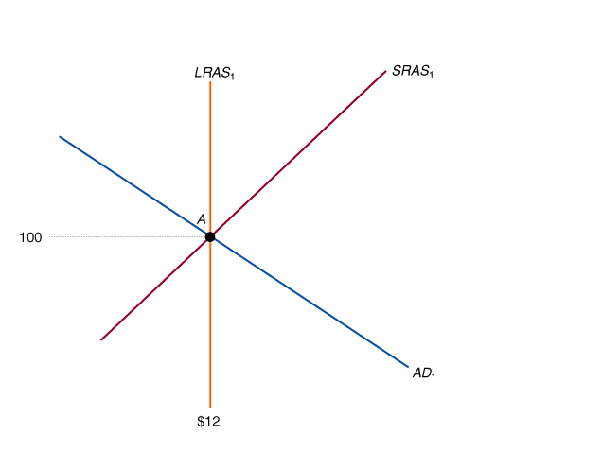
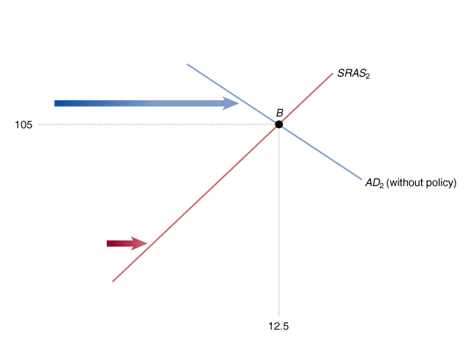
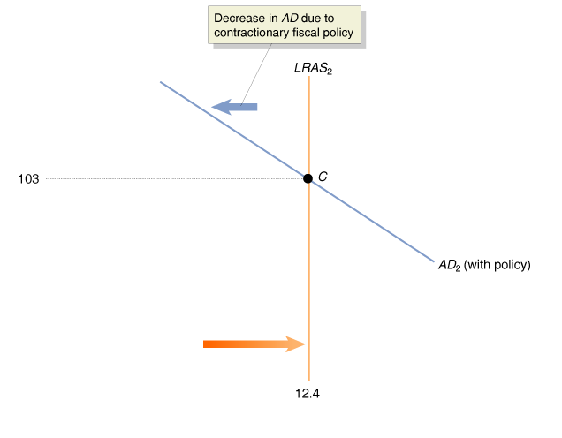
Using Fiscal Policy to Influence Aggregate Demand
Contractionary Fiscal Policy
15 - 6
A Contractionary Fiscal Policy

Slide 19

Using Fiscal Policy to Influence Aggregate Demand
A Summary of How Fiscal Policy Affects Aggregate Demand
15 – 1
Countercyclical Fiscal Policy
PROBLEM | TYPE OF POLICY | ACTIONS BY CONGRESS AND THE PRESIDENT | RESULT
Recession | Expansionary | Increase government spending or cut taxes | Real GDP and the price level rise
Rising Inflation | Contractionary | Decrease government spending or raise taxes | Real GDP and the price level fall
Don’t Confuse Fiscal Policy and Monetary Policy

Slide 20
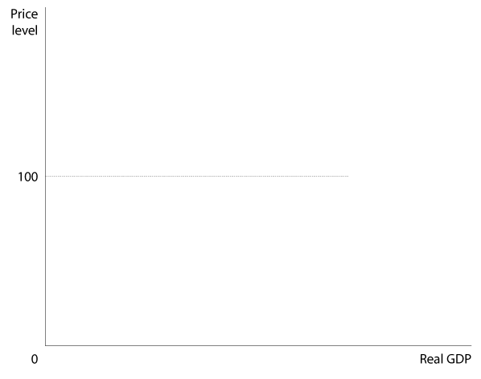
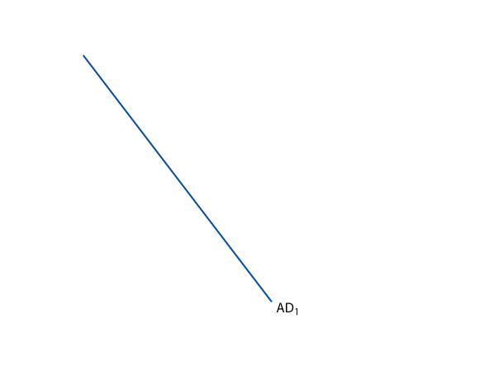
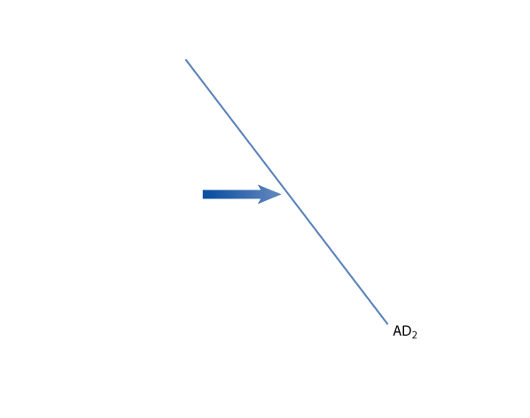
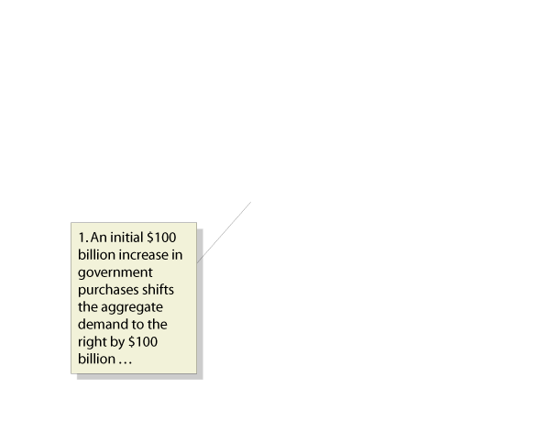
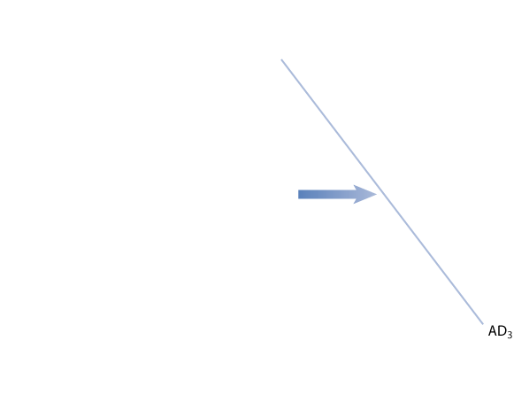
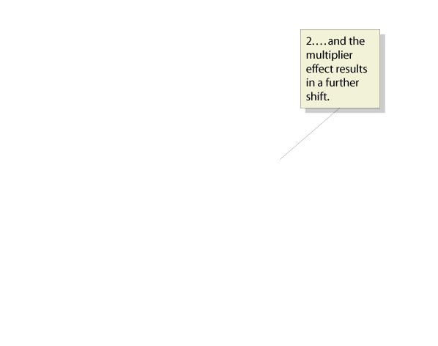
The Government Purchases and Tax Multipliers
3
LEARNING OBJECTIVE
Multiplier effect The series of induced increases in consumption spending that results from an initial increase in autonomous expenditures.
15 - 7
The Multiplier Effect and Aggregate Demand

Slide 21
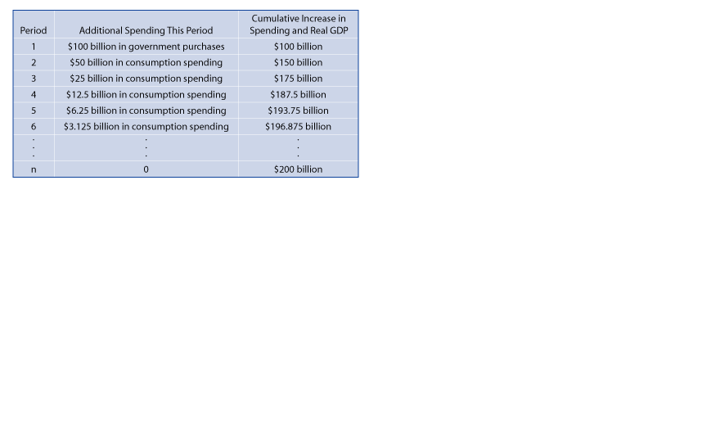
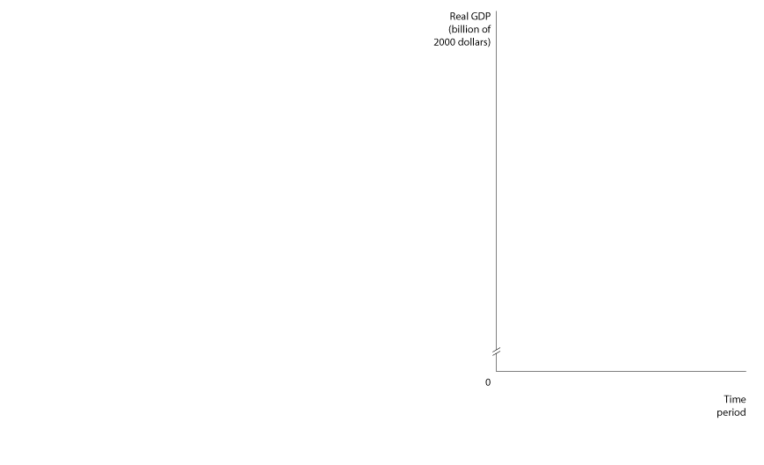
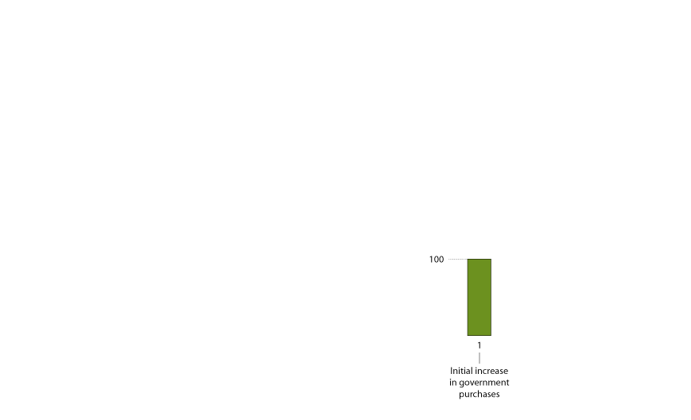
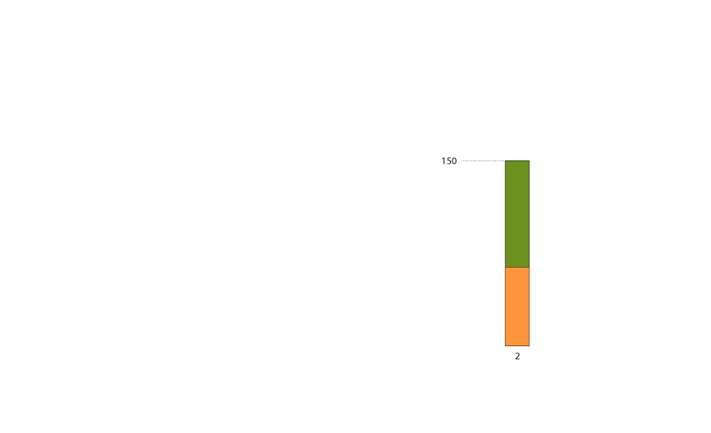
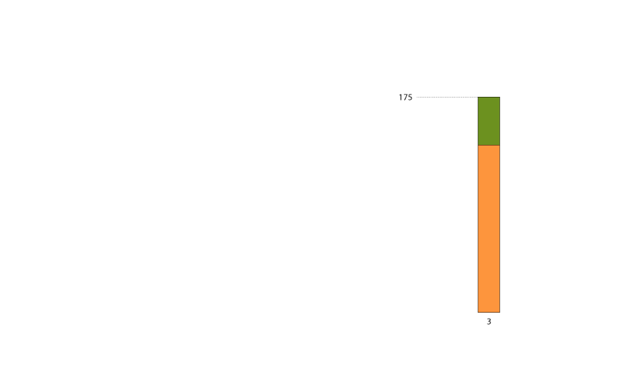
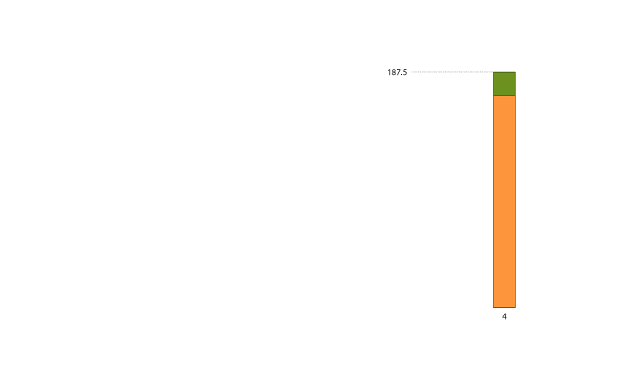
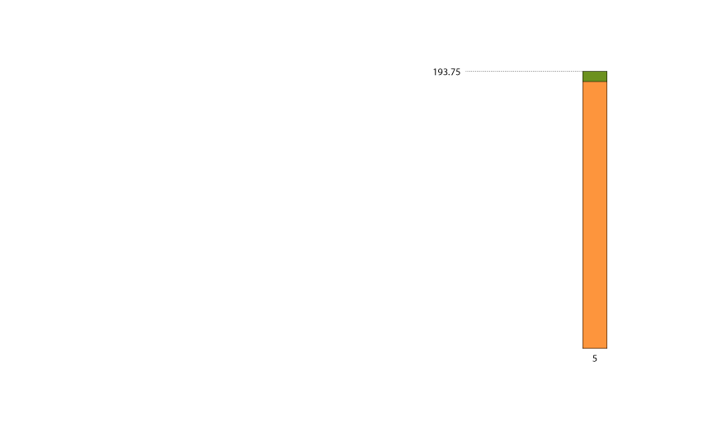
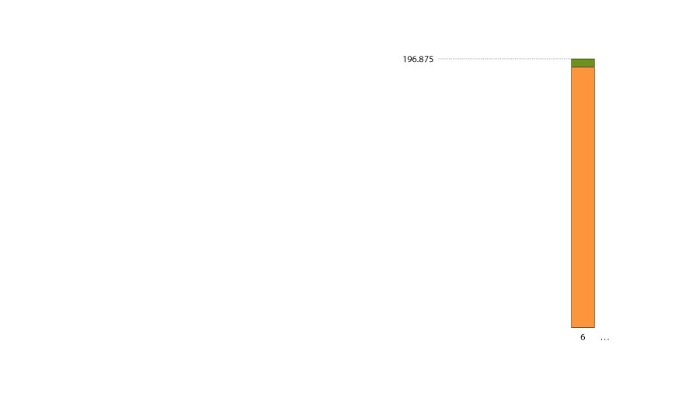
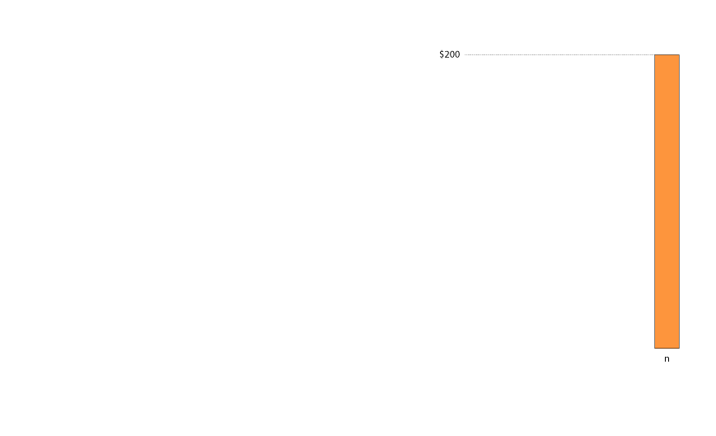
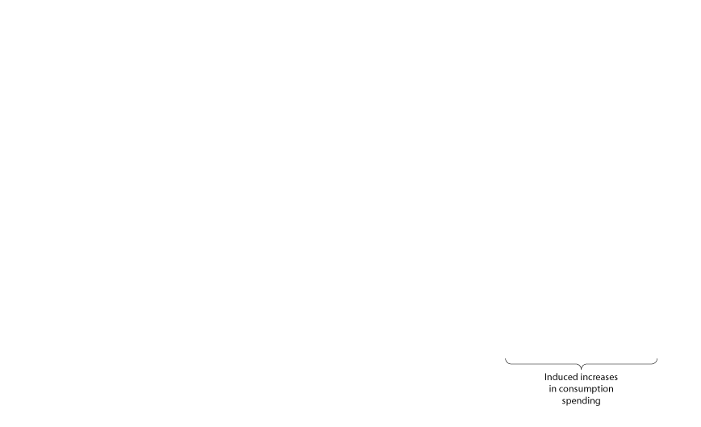
The Government Purchases and Tax Multipliers
15 - 8
The Multiplier Effect of an Increase in Government Purchases

Slide 22
By how much will equilibrium real GDP increase as a result of a $100 billion increase in government purchases?
a. By more than $100 billion.
b. By less than $100 billion.
c. By exactly $100 billion.
d. None of the above. Equilibrium real GDP will not change as a result of an increase in government purchases.

Slide 23
By how much will equilibrium real GDP increase as a result of a $100 billion increase in government purchases?
a. By more than $100 billion.
b. By less than $100 billion.
c. By exactly $100 billion.
d. None of the above. Equilibrium real GDP will not change as a result of an increase in government purchases.

Slide 24
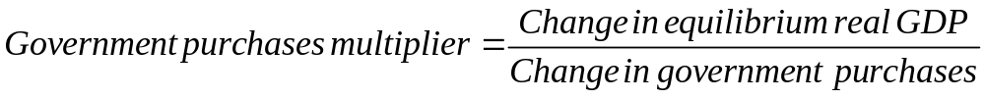
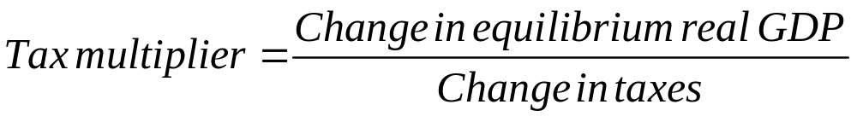
The Government Purchases and Tax Multipliers

Slide 25
We would expect the tax multiplier to be __________ in absolute value than the government purchases multiplier.
a. smaller
b. larger
c. the same
d. None of the above.

Slide 26
We would expect the tax multiplier to be __________ in absolute value than the government purchases multiplier.
a. smaller
b. larger
c. the same
d. None of the above.

Slide 27
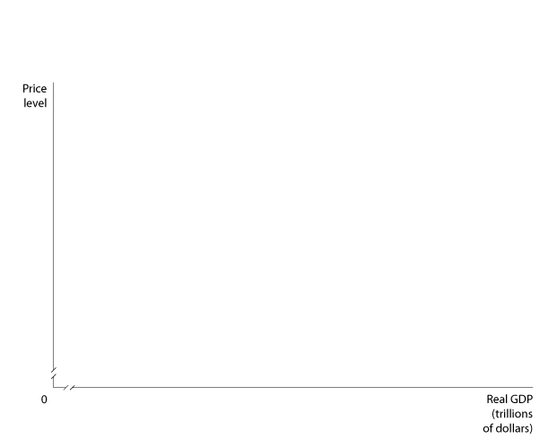
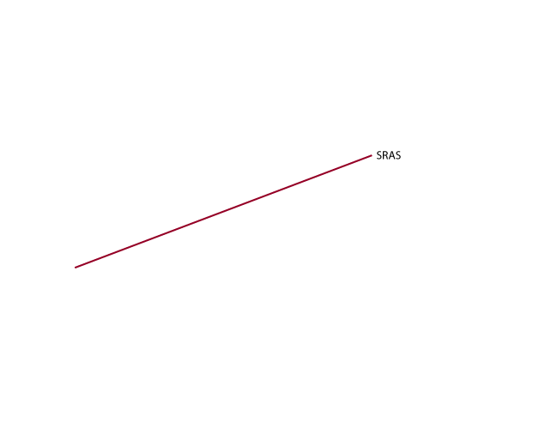
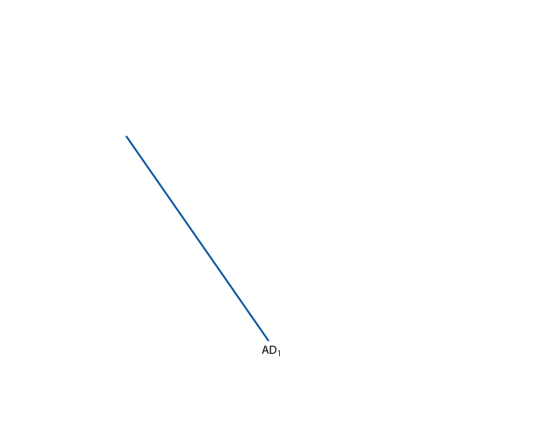
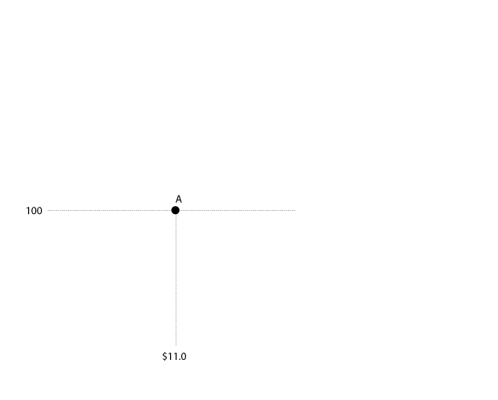







The Government Purchases and Tax Multipliers
The Effect of Changes in Tax Rates
Taking Into Account the Effects of Aggregate Supply
15 - 9
The Multiplier Effect and Aggregate Supply

Slide 28
The Government Purchases and Tax Multipliers
The Multipliers Work in Both Directions
15-1
3
LEARNING OBJECTIVE
Fiscal Policy Multipliers

Slide 29

The Limits of Using Fiscal
Policy to Stabilize the Economy
4
LEARNING OBJECTIVE
15 - 10
How a Bill Becomes Law

Slide 30
Getting the timing right can be more difficult with one of these policies. Which one?
a. Fiscal policy.
b. Monetary policy.
c. Environmental policy.
d. All of the above.

Slide 31
Getting the timing right can be more difficult with one of these policies. Which one?
a. Fiscal policy.
b. Monetary policy.
c. Environmental policy.
d. All of the above.

Slide 32
The Limits of Using Fiscal
Policy to Stabilize the Economy
Does Government Spending Reduce Private Spending?
Crowding out A decline in private expenditures as a result of an increase in government purchases.

Slide 33








The Limits of Using Fiscal
Policy to Stabilize the Economy
Crowding Out in the Short Run
15 - 11
An Expansionary Fiscal Policy Increases Interest Rates

Slide 34












The Limits of Using Fiscal
Policy to Stabilize the Economy
Crowding Out in the Short Run
15 - 12
The Effect of Crowding Out in the Short Run
Crowding Out in the Long Run

Slide 35
Which of the following is true of any permanent increase in government purchases in the long run?
a. Any permanent increase in government purchases can be accommodated by the economy in the long run so as to maintain a steady level of private expenditures.
b. In the long run, any permanent increase in government purchases must come at the expense of private expenditures.
c. In the long run, a permanent increase in government purchases does not affect private expenditures in any way.
d. In the long run, any permanent increase in government purchases is usually accompanied by an increase in private expenditures by the same amount.

Slide 36
Which of the following is true of any permanent increase in government purchases in the long run?
a. Any permanent increase in government purchases can be accommodated by the economy in the long run so as to maintain a steady level of private expenditures.
b. In the long run, any permanent increase in government purchases must come at the expense of private expenditures.
c. In the long run, a permanent increase in government purchases does not affect private expenditures in any way.
d. In the long run, any permanent increase in government purchases is usually accompanied by an increase in private expenditures by the same amount.

Slide 37

15 - 2
Limits to Fiscal Policy: Japan in the Late 1990s
Fiscal policy in Japan has not been effective in expanding real GDP and reducing unemployment.

Slide 38
Deficits, Surpluses, and Federal Government Debt
5
LEARNING OBJECTIVE
Budget deficit The situation in which the government’s spending is greater than its tax revenue.
Budget Surplus The situation in which the government’s expenditures are less than its tax revenue.

Slide 39








Deficits, Surpluses, and Federal Government Debt
How the Federal Budget Can Serve as an Automatic Stabilizer
15 - 13
The Federal Budget Deficit, 1901-2004

Slide 40






Deficits, Surpluses, and Federal Government Debt
How the Federal Budget Can Serve as an Automatic Stabilizer
Cyclically adjusted budget deficit or surplus The deficit or surplus in the federal government’s budget if the economy were at potential GDP.
15 – 14
How the Level of GDP Affects the Cyclically Adjusted Budget Deficit

Slide 41
To obtain a more accurate measure of the effects on the economy of the government’s spending and tax policies, economists prefer to look at:
a. The actual budget deficit or surplus.
b. The cyclically adjusted budget deficit or surplus.
c. The mounting size of the debt.
d. The justifications for increased spending, regardless of revenues.

Slide 42
To obtain a more accurate measure of the effects on the economy of the government’s spending and tax policies, economists prefer to look at:
a. The actual budget deficit or surplus.
b. The cyclically adjusted budget deficit or surplus.
c. The mounting size of the debt.
d. The justifications for increased spending, regardless of revenues.

Slide 43

15 - 3
Did Fiscal Policy Fail During the Great Depression?
 | FEDERAL GOVERNMENT EXPENDITURES (BILLIONS OF DOLLARS | ACTUAL FEDERAL BUDGET DEFICIT OR SURPLUS (BILLIONS OF DOLLARS) | CYCLICALLY ADJUSTED BUDGET DEFICIT OR SURPLUS (BILLIONS OF DOLLARS) | CYCLICALLY ADJUSTED BUDGET DEFICIT OR SURPLUS AS A PERCENTAGE OF GDP
1929 | $2.6 | $1.0 | $1.24 | 1.20%
1930 | 2.7 | 0.2 | 0.81 | 0.89
1931 | 4.0 | -2.1 | -0.41 | -0.54
1932 | 3.0 | -1.3 | 0.50 | 0.85
1933 | 3.4 | -0.9 | 1.06 | 1.88
1934 | 5.5 | -2.2 | 0.09 | 0.14
1935 | 5.6 | -1.9 | 0.54 | 0.74
1936 | 7.8 | -3.2 | 0.47 | 0.56
1937 | 6.4 | 0.2 | 2.55 | 2.77
1938 | 7.3 | -1.3 | 2.47 | 2.87
1939 | 8.4 | -2.1 | 2.00 | 2.17
Although government spending increased during the Great Depression, the cyclically adjusted budget was in surplus most years.

Slide 44
Deficits, Surpluses, and Federal Government Debt
Should the Federal Budget Always Be Balanced?
15-2
5
LEARNING OBJECTIVE
The Effect of Economic Fluctuations on the Budget Deficit

Slide 45





Deficits, Surpluses, and Federal Government Debt
The Federal Government Debt
15 - 15
The Federal Government Debt,
1901-2004
Is the Government Debt a Problem?

Slide 46
Every time the federal government runs a budget deficit, the Treasury must:
a. Buy securities from the Fed in order to increase its reserves.
b. Print money in order to finance the excess expenditures.
c. Borrow funds from savers by selling Treasury securities.
d. Supply funds in the federal funds market.

Slide 47
Every time the federal government runs a budget deficit, the Treasury must:
a. Buy securities from the Fed in order to increase its reserves.
b. Print money in order to finance the excess expenditures.
c. Borrow funds from savers by selling Treasury securities.
d. Supply funds in the federal funds market.

Slide 48
The Effects of Fiscal Policy in the Long Run
6
LEARNING OBJECTIVE
The Long-Run Effects of Tax Policy
Tax wedge The difference between the pre-tax and post-tax return to an economic activity.
We can briefly look at the effects on aggregate supply of cutting each of the following taxes:
  Individual income tax.
  Corporate income tax.
  Taxes on dividends and capital gains.
Tax Simplification

Slide 49
Economists believe that the smaller the tax wedge for any economic activity, such as working, saving, investing, or starting a business,
a. The lower the equilibrium interest rate.
b. The greater the difference between the pre-tax and post-tax return to those activities.
c. The more of that economic activity that will occur.
d. The greater the marginal tax rate.

Slide 50
Economists believe that the smaller the tax wedge for any economic activity, such as working, saving, investing, or starting a business,
a. The lower the equilibrium interest rate.
b. The greater the difference between the pre-tax and post-tax return to those activities.
c. The more of that economic activity that will occur.
d. The greater the marginal tax rate.

Slide 51

15 - 4
Should the United States Adopt the “Flat Tax”?
COUNTRY | FLAT TAX RATE | YEAR FLAT TAX WAS INTRODUCED
Estonia | 26% | 1994
Lithuania | 33 | 1994
Latvia | 25 | 1995
Russia | 13 | 2001
Serbia | 14 | 2003
Ukraine | 13 | 2004
Slovakia | 19 | 2004
Georgia | 12 | 2005
Romania | 16 | 2005
Should the United States simplify the tax code by moving to a flat tax?

Slide 52










The Effects of Fiscal Policy in the Long Run
The Economic Effect of Tax Reform
15 - 15
The Supply-Side Effects
of a Tax Change
How Large Are Supply-Side Effects?

Slide 53









The Not-So-Incredible Shrinking Deficit

Slide 54

Automatic stabilizers
Budget deficit
Budget surplus
Crowding out
Cyclically adjusted budget deficit or surplus
Fiscal policy
Multiplier effect
Tax wedge

Slide 55





Appendix 15: A Closer Look at the Multiplier
An Expression for Equilibrium Real GDP
Consumption function
Planned investment function
Government purchases function
Tax function
Equilibrium condition

Slide 56





Appendix 15: A Closer Look at the Multiplier
An Expression for Equilibrium Real GDP
The letters with “bars” represent fixed or autonomous values that do not depend on the values of other variables. So, represents autonomous consumption, which had a value of 1,000 in our original example. Now, solving for equilibrium we get:
or,
or,
or,

Slide 57



Appendix 15: A Closer Look at the Multiplier
A Formula for the Government Purchases Multiplier
or, the government purchases multiplier

Slide 58


Appendix 15: A Closer Look at the Multiplier
A Formula for the Tax Multiplier

Slide 59

Appendix 15: A Closer Look at the Multiplier
The “Balanced Budget” Multiplier

Slide 60


Appendix 15: A Closer Look at the Multiplier
The Effects of Changes in Tax Rates on the Multiplier

Slide 61


Appendix 15: A Closer Look at the Multiplier
The Multiplier in an Open Economy
We can define the marginal propensity to import (MPI) as the fraction of an increase in income that is spent on imports. So, our expression for imports is:
Imports = MPI x Y.
We can substitute our expressions for exports and imports into the expression we derived earlier for equilibrium real GDP:
where the expression represents net exports.

