Slide 1
Inflation, Unemployment, and
Federal Reserve Policy

Slide 2

Why Does Whirlpool Care About Monetary Policy?
After studying this chapter, you should be able to:
  Describe the Phillips curve and the nature of the short-run tradeoff between inflation and unemployment.
  Explain the relationship between the short-run and long-run Phillips curves.
  Discuss how expectations of the inflation rate affect monetary policy.
  Use a Phillips curve graph to show how the Federal Reserve can permanently lower the inflation rate.
1
2
LEARNING OBJECTIVES
3
In this chapter, we will explore the relationship between inflation and unemployment in both the short run and the long run and discuss what this relationship means for monetary policy.
4

Slide 3
The Discovery of the Short-Run Tradeoff Between Unemployment and Inflation
1
LEARNING OBJECTIVE
Phillips curve A curve showing the short-run relationship between the unemployment rate and the inflation rate.

Slide 4
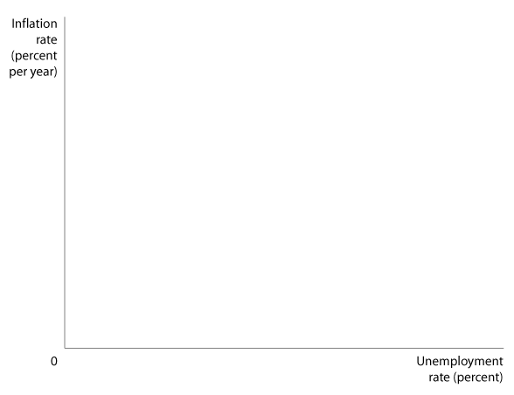

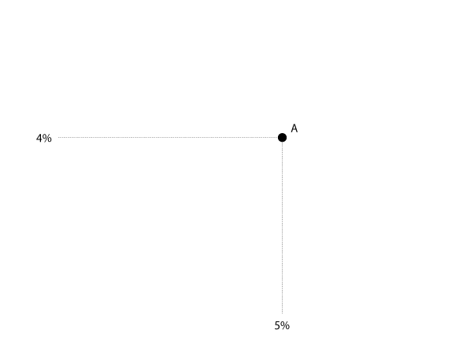
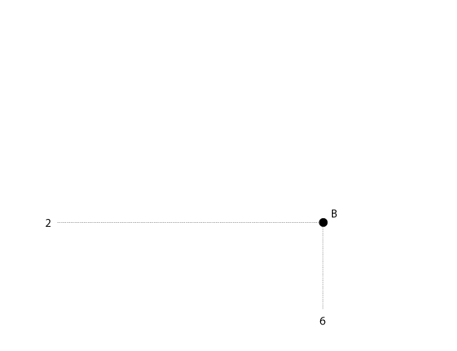
The Discovery of the Short-Run Tradeoff Between Unemployment and Inflation
Explaining the Phillips Curve with Aggregate Demand and Aggregate Supply Curves
16 - 1
The Phillips Curve

Slide 5

A point near the top left segment of the short-run Phillips curve represents:
a. A combination of high unemployment and high inflation.
b. A combination of high unemployment and low inflation.
c. A combination of low unemployment and low inflation.
d. A combination of low unemployment and high inflation.

Slide 6
A point near the top left segment of the short-run Phillips curve represents:
a. A combination of high unemployment and high inflation.
b. A combination of high unemployment and low inflation.
c. A combination of low unemployment and low inflation.
d. A combination of low unemployment and high inflation.

Slide 7
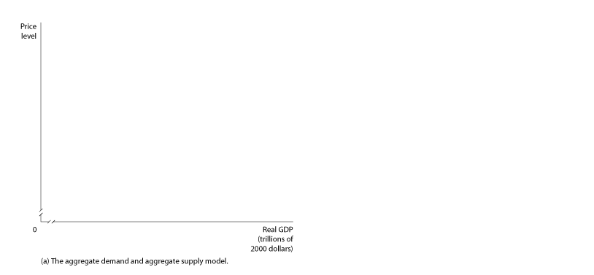
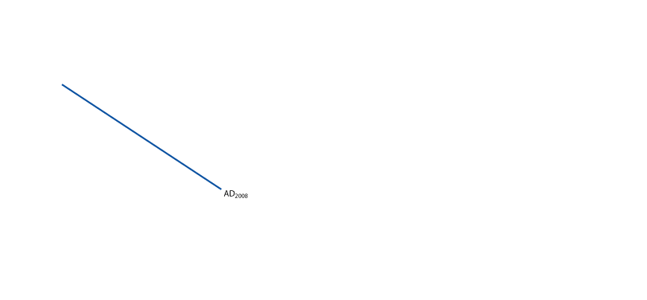
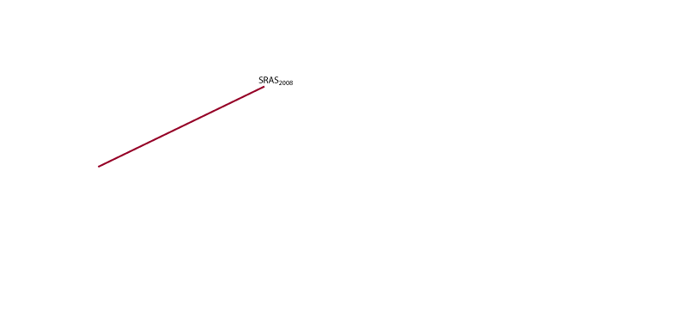
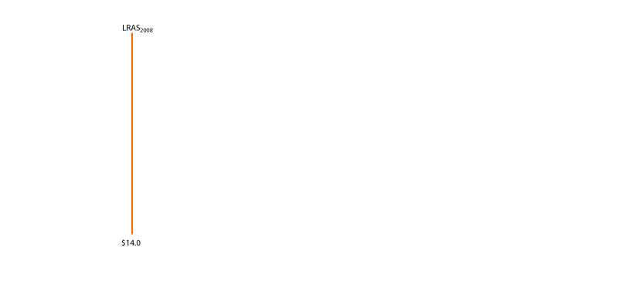
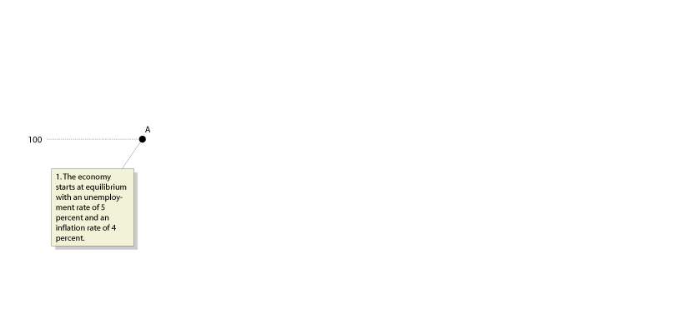
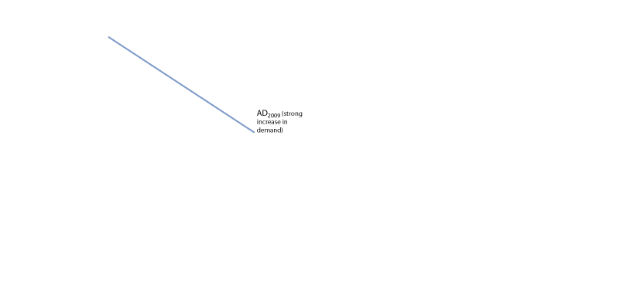
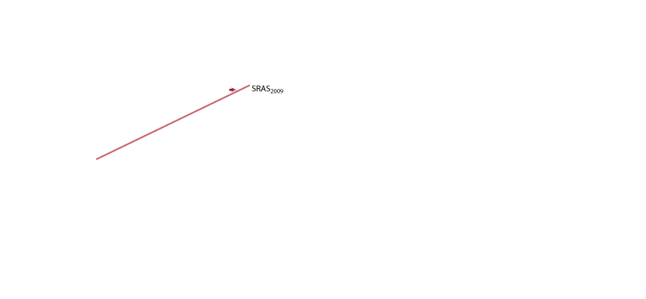
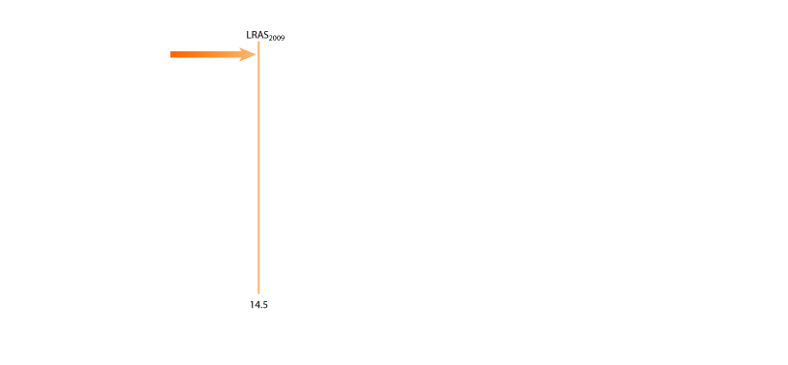
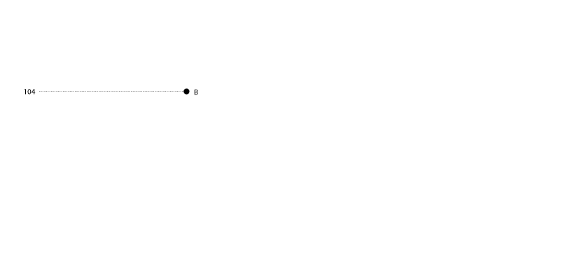
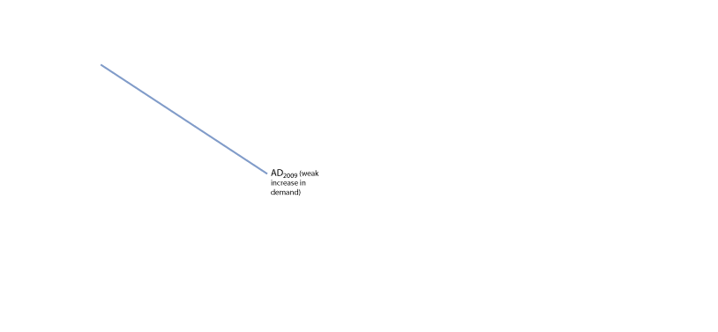
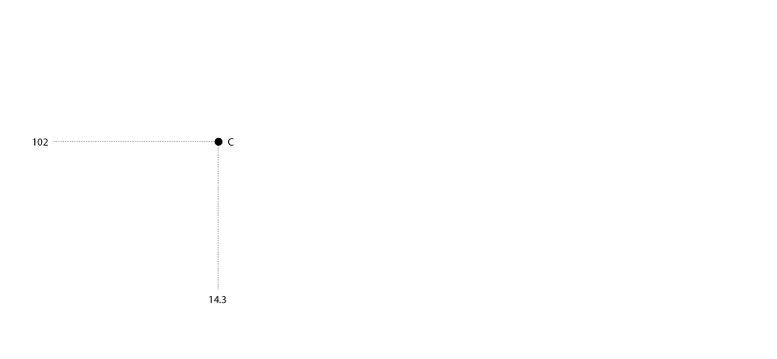

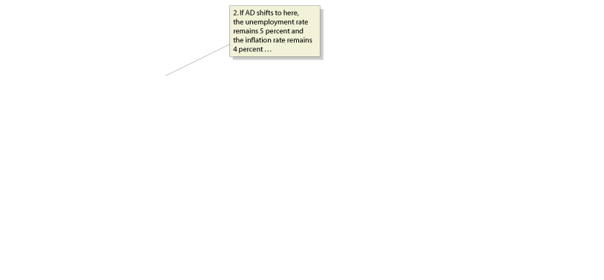

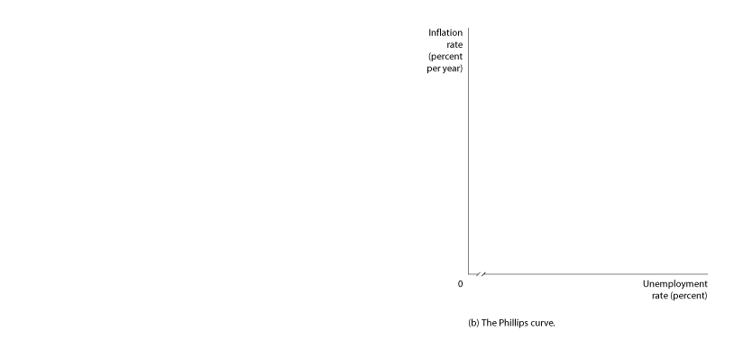

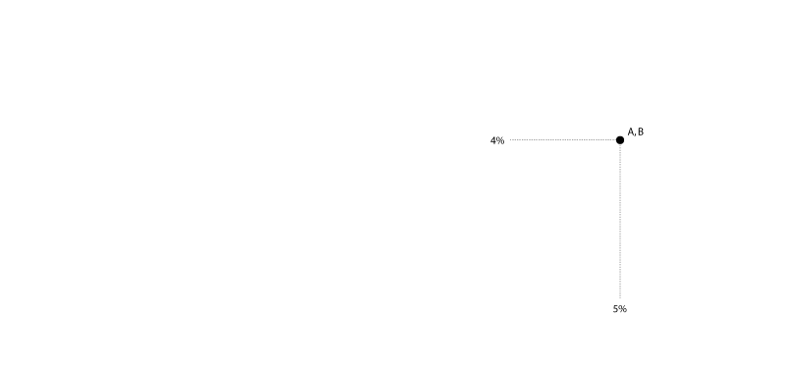
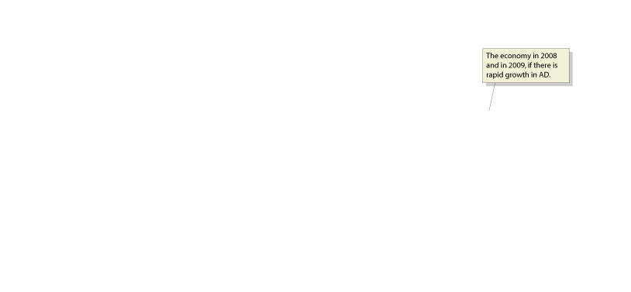
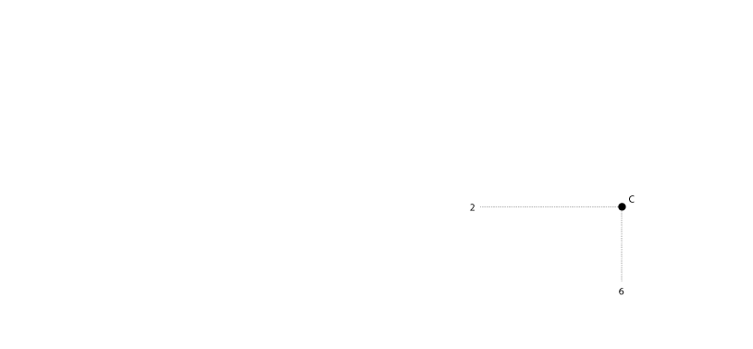
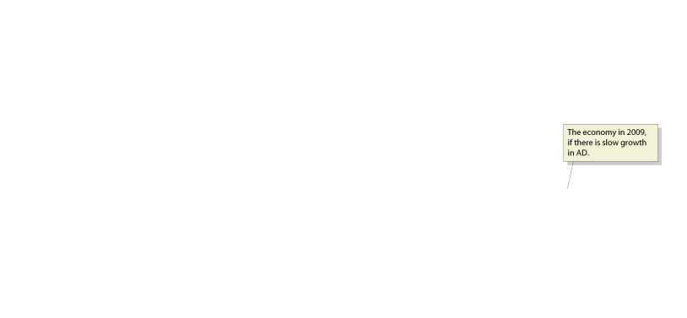
The Discovery of the Short-Run Tradeoff Between Unemployment and Inflation
Explaining the Phillips Curve with Aggregate Demand and Supply Curves
16 - 2
Using Aggregate Demand and Supply to Explain the Phillips Curve

Slide 8
The Discovery of the Short-Run Tradeoff Between Unemployment and Inflation
Is the Phillips Curve a Policy Menu?
Structural relationship A relationship that depends on the basic behavior of consumers and firms and remains unchanged over long periods.
16 - 1
1
LEARNING OBJECTIVE
The Policy Menu View of the Phillips Curve

Slide 9
The Discovery of the Short-Run Tradeoff Between Unemployment and Inflation
Is the Short-Run Phillips Curve Stable?
The Long-Run Phillips Curve
Natural rate of unemployment The unemployment rate that exists when the economy is at potential GDP.

Slide 10
If the long-run aggregate supply curve is vertical, then:
a. The Phillips curve must be horizontal in the short run.
b. The Phillips curve must be vertical in the short run.
c. The Phillips curve cannot be downward sloping in the long run.
d. The Phillips curve must be downward sloping in the long run.

Slide 11
If the long-run aggregate supply curve is vertical, then:
a. The Phillips curve must be horizontal in the short run.
b. The Phillips curve must be vertical in the short run.
c. The Phillips curve cannot be downward sloping in the long run.
d. The Phillips curve must be downward sloping in the long run.

Slide 12
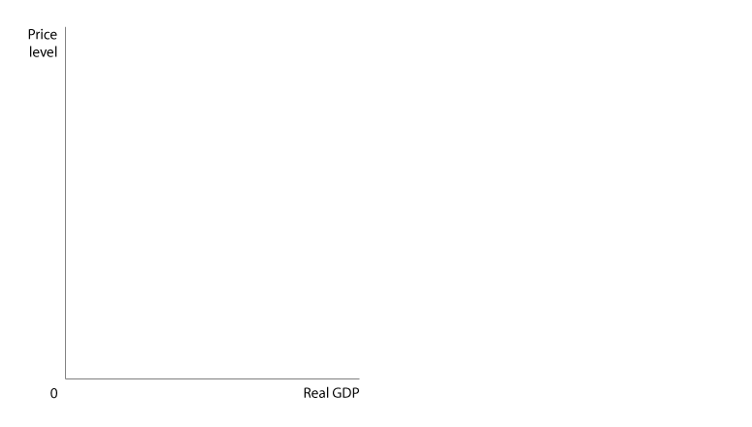
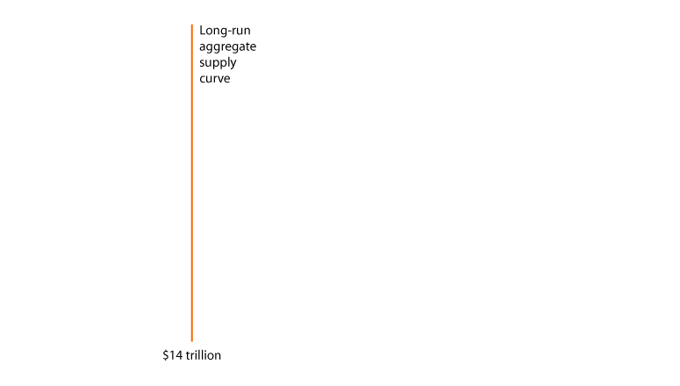

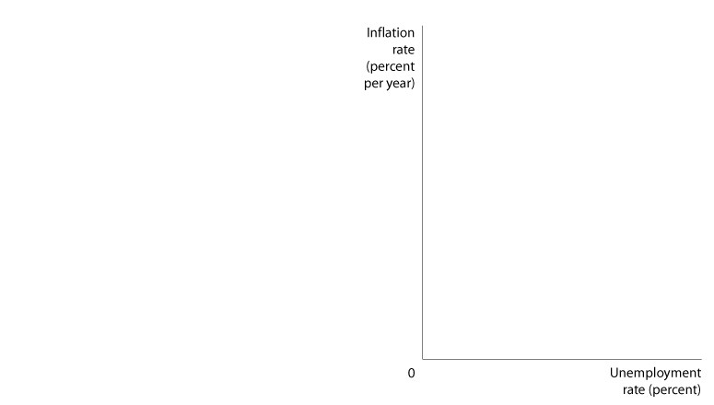
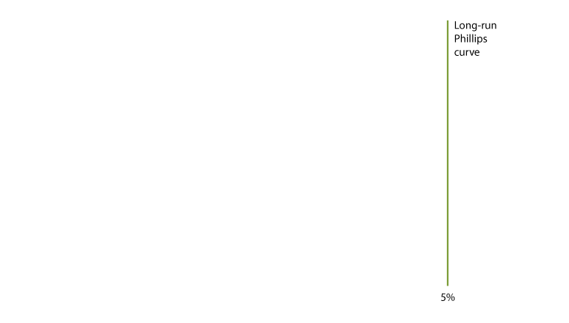

The Discovery of the Short-Run Tradeoff Between Unemployment and Inflation
The Long-Run Phillips Curve
16 - 3
A Vertical Long-Run Aggregate Supply Curve Means a Vertical Long-Run Phillips Curve

Slide 13
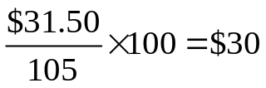
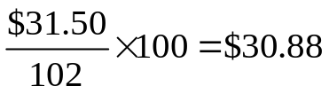
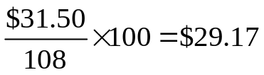
The Discovery of the Short-Run Tradeoff Between Unemployment and Inflation
The Role of Expectations of Future Inflation
16 – 1
The Impact of Unexpected Price Level Changes on the Real Wage
NOMINAL WAGE | EXPECTED REAL WAGE | ACTUAL REAL WAGE | ACTUAL REAL WAGE
 | Expected P₂₀₀₉ = 105 Expected Inflation = 5% | Actual P₂₀₀₉ = 102 Actual Inflation = 2% | Actual P₂₀₀₉ = 108 Actual Inflation = 8%
$31.50
16 – 2
The Basis for the Short-Run Phillips Curve
IF… | THEN… | AND…
actual inflation is greater than expected inflation, | the actual real wage is less than the expected real wage, | the unemployment rate falls.
actual inflation is less than expected inflation, | the actual real wage is greater than the expected real wage, | the unemployment rate rises.

Slide 14
Which change in the inflation rate is more likely to affect the tradeoff between inflation and unemployment?
a. A change in the inflation rate that is expected.
b. A change in the inflation rate that is unexpected.
c. A change in the inflation rate that is exactly equal to the percentage change in the unemployment rate.
d. A change in the inflation rate when the unemployment rate equals the natural rate of unemployment.

Slide 15
Which change in the inflation rate is more likely to affect the tradeoff between inflation and unemployment?
a. A change in the inflation rate that is expected.
b. A change in the inflation rate that is unexpected.
c. A change in the inflation rate that is exactly equal to the percentage change in the unemployment rate.
d. A change in the inflation rate when the unemployment rate equals the natural rate of unemployment.

Slide 16


16 - 1
Do Workers Understand Inflation?
Will her wage increases keep up with inflation?

Slide 17
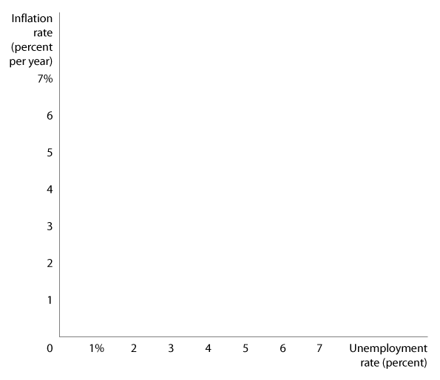
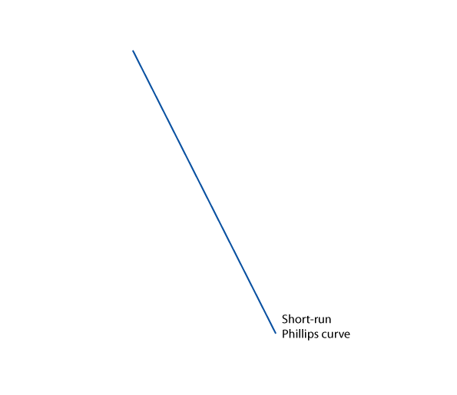
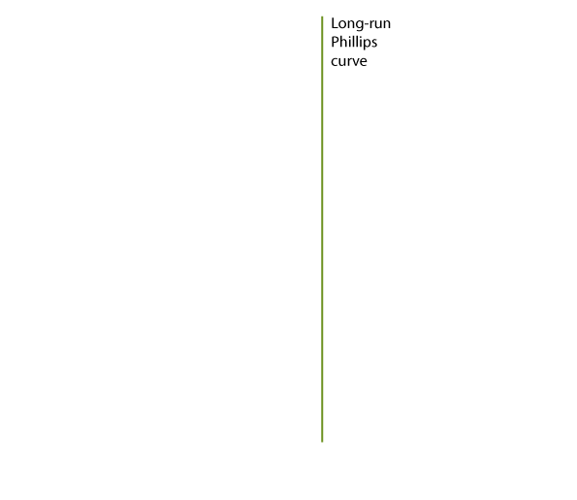

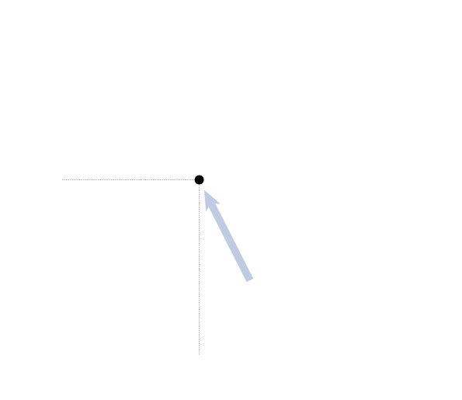
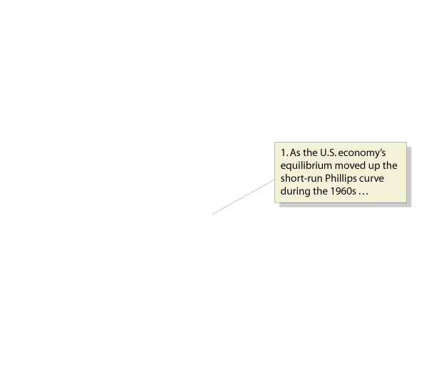
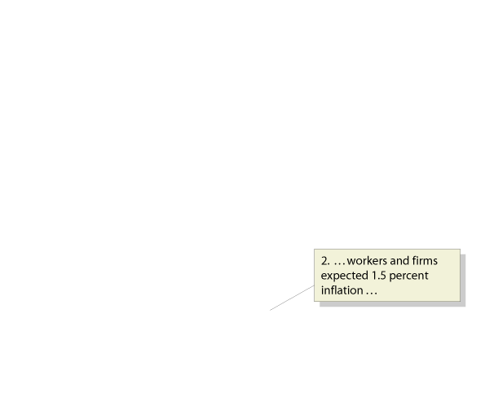
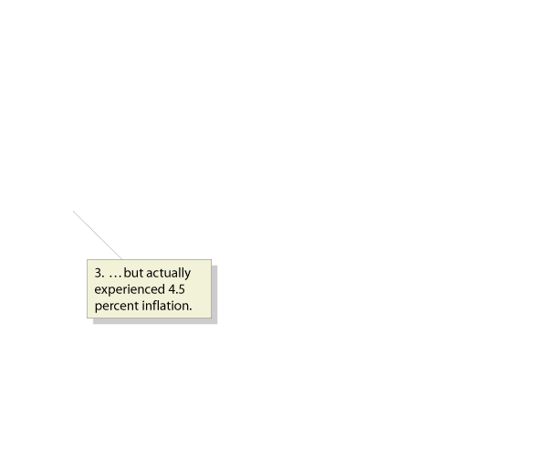
The Short-Run and Long-Run Phillips Curves
2
LEARNING OBJECTIVE
16 - 4
The Short-Run Phillips Curve of the 1960s and the Long-Run Phillips Curve

Slide 18
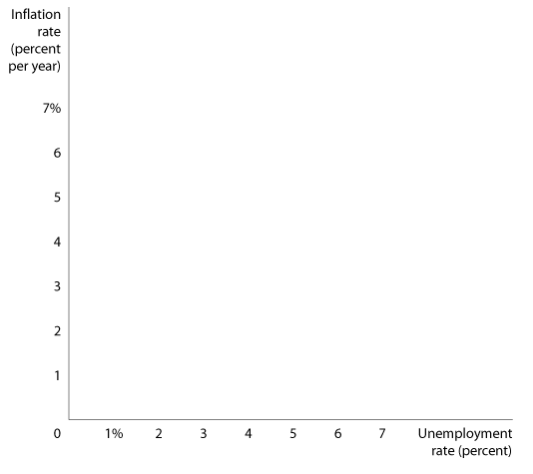
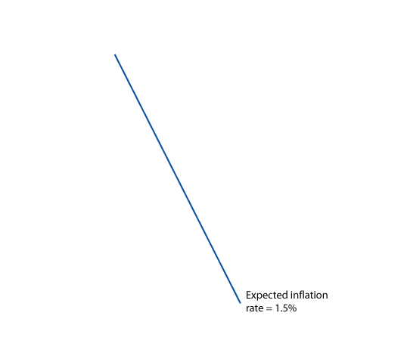
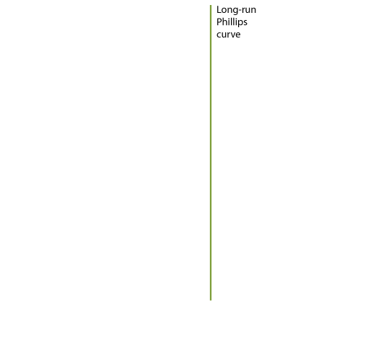
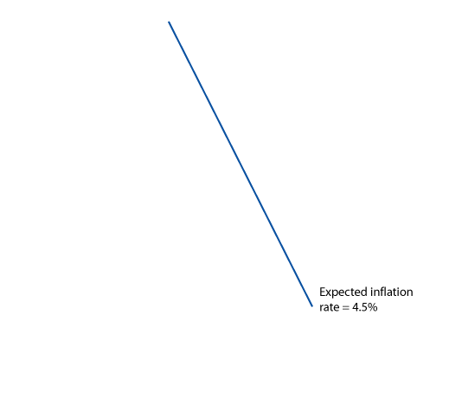
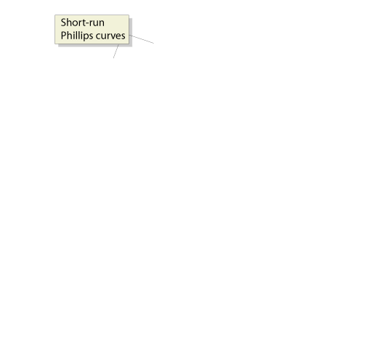
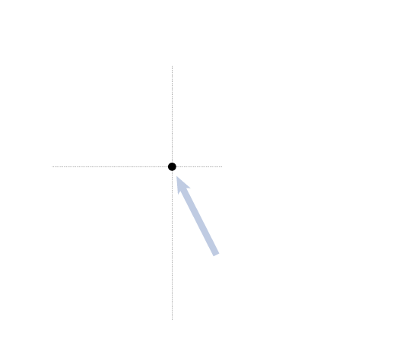

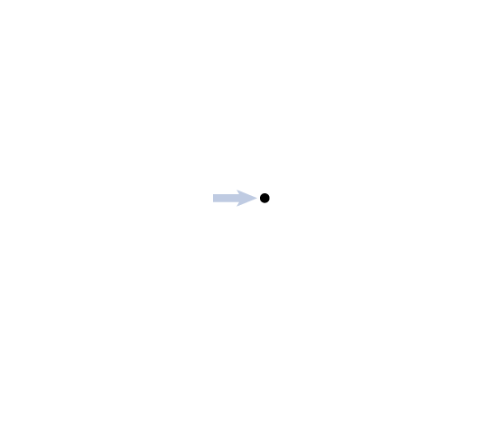
The Short-Run and Long-Run Phillips Curves
Shifts in the Short-Run Phillips Curve
16 - 5
Expectations and the Short-Run Phillips Curve

Slide 19
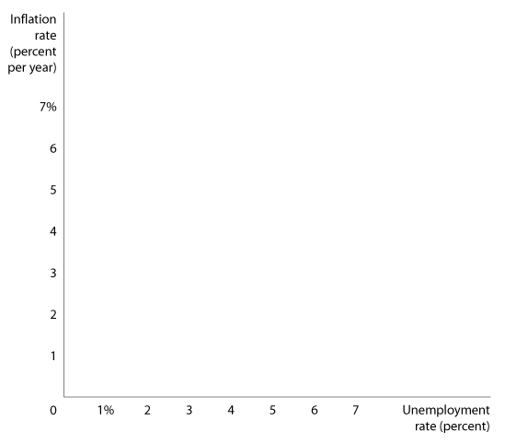
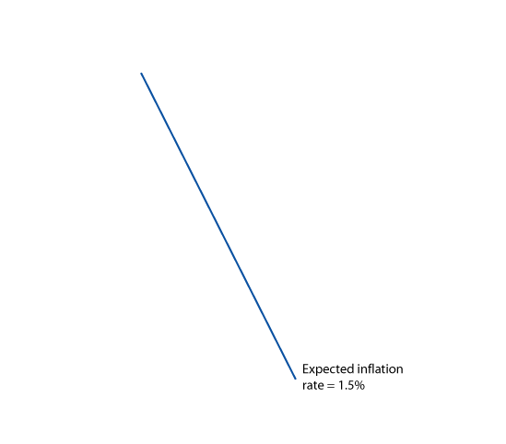
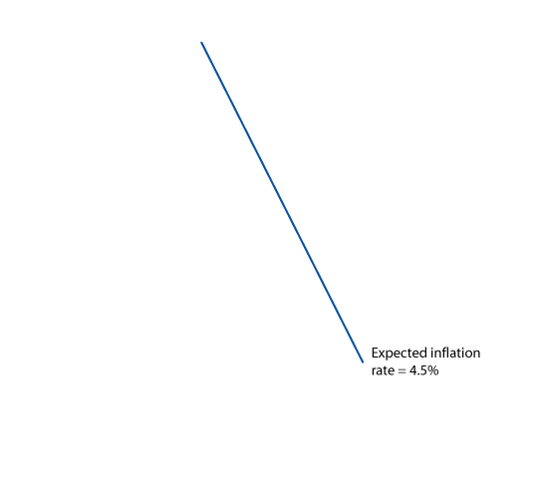
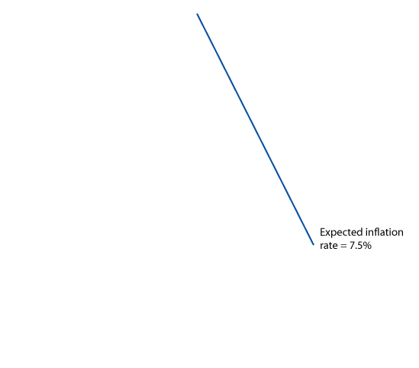
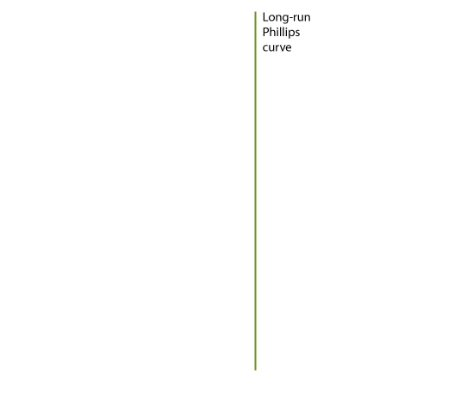

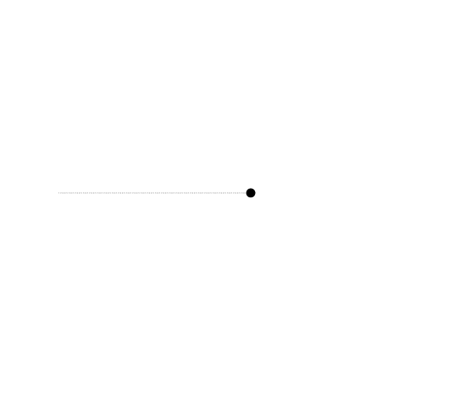

The Short-Run and Long-Run Phillips Curves
Shifts in the Short-Run Phillips Curve
16 - 6
A Short-Run Phillips Curve for Every Expected Inflation Rate

Slide 20
If workers and firms revise their expectations of inflation upward:
a. There will be a movement downward along the short-run Phillips curve.
b. There will be a movement upward along the short-run Phillips curve.
c. The short-run Phillips curve will shift up.
d. The short-run Phillips curve will shift down.

Slide 21
If workers and firms revise their expectations of inflation upward:
a. There will be a movement downward along the short-run Phillips curve.
b. There will be a movement upward along the short-run Phillips curve.
c. The short-run Phillips curve will shift up.
d. The short-run Phillips curve will shift down.

Slide 22
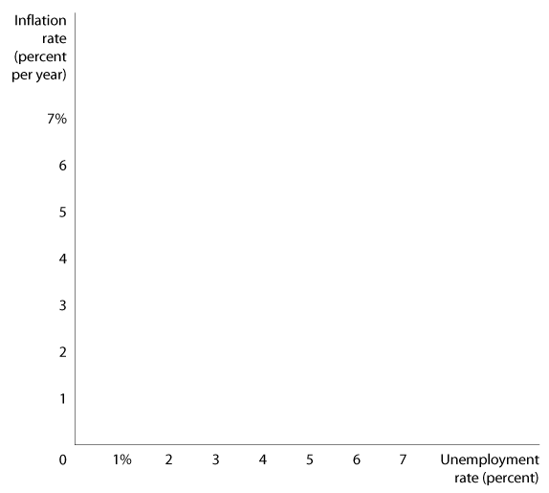
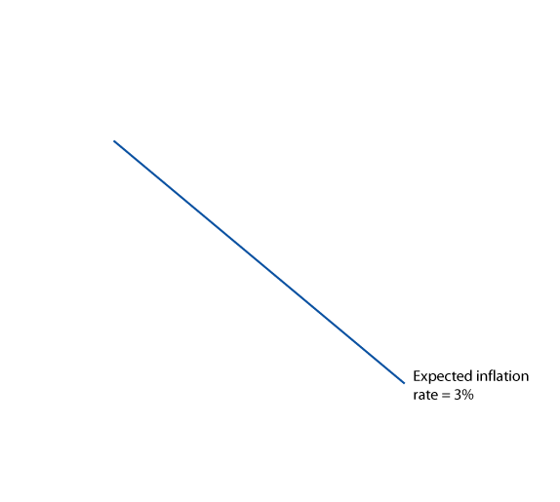
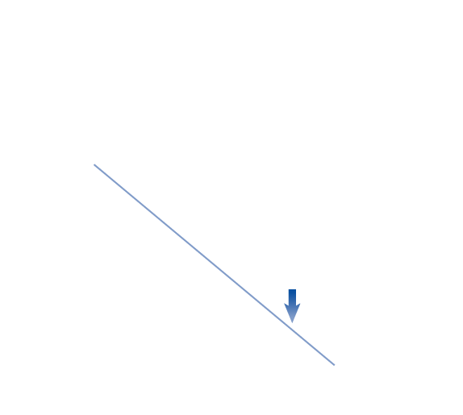






The Short-Run and Long-Run Phillips Curves
How Does a Vertical Long-Run Phillips Curve Affect Monetary Policy?
16 - 7
The Inflation Rate and the Natural Rate of Unemployment in the Long-Run

Slide 23

16 - 2
Does the Natural Rate of Unemployment Ever Change?
Frictional or structural unemployment can change – thereby changing the natural rate – for several reasons:
  Demographic changes.
  Labor market institutions.
  Past high rates of unemployment.
What makes the natural rate of unemployment increase or decrease?
16-2
2
LEARNING OBJECTIVE
Changing Views of the Phillips Curve

Slide 24
There are three types of unemployment. Changes in two of the types will cause a change in the natural rate of unemployment. Which two?
a. Frictional and cyclical unemployment.
b. Structural and cyclical unemployment.
c. Frictional and structural unemployment.
d. Seasonal and cyclical unemployment.

Slide 25
There are three types of unemployment. Changes in two of the types will cause a change in the natural rate of unemployment. Which two?
a. Frictional and cyclical unemployment.
b. Structural and cyclical unemployment.
c. Frictional and structural unemployment.
d. Seasonal and cyclical unemployment.

Slide 26
Expectations of the Inflation Rate
3
LEARNING OBJECTIVE
The experience in the United States over the past 50 years indicates that how workers and firms adjust their expectations of inflation depends on how high the inflation rate is. There are three possibilities:
  Low inflation.
  Moderate, but stable inflation.
  High and unstable inflation.
    Rational expectations Expectations formed by using all available information about an economic variable.

Slide 27
When do workers and firms tend to ignore inflation?
a. When inflation is low.
b. When inflation is moderate.
c. When inflation is high.
d. Never.

Slide 28
When do workers and firms tend to ignore inflation?
a. When inflation is low.
b. When inflation is moderate.
c. When inflation is high.
d. Never.

Slide 29




Expectations of the Inflation Rate
The Effect of Rational Expectations on Monetary Policy
16 - 8
Rational Expectations and the Phillips Curve

Slide 30
If workers and firms have adaptive expectations or if they ignore inflation, what is the effect of an expansionary monetary policy?
a. A move upward along the short-run Phillips curve.
b. A move downward along the short-run Phillips curve.
c. A move upward along the long-run Phillips curve.
d. A move downward along the long-run Phillips curve.

Slide 31
If workers and firms have adaptive expectations or if they ignore inflation, what is the effect of an expansionary monetary policy?
a. A move upward along the short-run Phillips curve.
b. A move downward along the short-run Phillips curve.
c. A move upward along the long-run Phillips curve.
d. A move downward along the long-run Phillips curve.

Slide 32
Expectations of the Inflation Rate
Is the Short-Run Phillips Curve Really Vertical?
Real Business Cycle Models
Real business cycle models Models that focus on real rather than monetary explanations of fluctuations in real GDP.

Slide 33






How the Fed Fights Inflation
4
LEARNING OBJECTIVE
The Effect of a Supply Shock on the Phillips Curve
16 - 9
A Supply Shock Shifts the SRAS and the Short-Run Phillips Curve

Slide 34
In a real business cycle model, which of the following best explains an increase in real GDP above the full-employment level?
a. Adaptive expectations.
b. An increase in the money supply.
c. A positive technology shock.
d. All of the above.

Slide 35
In a real business cycle model, which of the following best explains an increase in real GDP above the full-employment level?
a. Adaptive expectations.
b. An increase in the money supply.
c. A positive technology shock.
d. All of the above.

Slide 36








How the Fed Fights Inflation
Paul Volcker and Disinflation
16 - 10
The Fed Tames Inflation,
1979-1989

Slide 37
After Fed Chairman Paul Volcker decided to fight inflation in 1979, the Fed’s monetary policy resulted in:
a. Lower interest rates.
b. Low unemployment.
c. Lower expectations of future inflation by firms and workers.
d. All of the above.

Slide 38
After Fed Chairman Paul Volcker decided to fight inflation in 1979, the Fed’s monetary policy resulted in:
a. Lower interest rates.
b. Low unemployment.
c. Lower expectations of future inflation by firms and workers.
d. All of the above.

Slide 39

How the Fed Fights Inflation
Paul Volcker and Disinflation
Disinflation A significant reduction in the inflation rate.
Don’t Confuse “Disinflation” with “Deflation”

Slide 40












16 - 3
4
LEARNING OBJECTIVE
Using Monetary Policy to Lower the Inflation Rate

Slide 41
In order to drive down the inflation rate, the unemployment rate will have to rise more if the short-run Phillips curve is:
a. Flatter.
b. Steeper.
c. Vertical.
d. Nonexistent.

Slide 42
In order to drive down the inflation rate, the unemployment rate will have to rise more if the short-run Phillips curve is:
a. Flatter.
b. Steeper.
c. Vertical.
d. Nonexistent.

Slide 43
How the Fed Fights Inflation
Alan Greenspan and the Importance of a Credible Monetary Policy
De-emphasizing the Money Supply
16 – 3
The Record of Fed Chairmen and Inflation
FEDERAL RESERVE CHAIRMAN | TERM | AVERAGE INFLATION RATE DURING TERM
William McChesney Martin | April 1952-January 1970 | 2.0%
Arthur Burns | February 1970-January 1978 | 6.5
G. William Miller | March 1978-August 1979 | 9.2
Paul Volcker | August 1979-August 1987 | 6.2
Alan Greenspan | August 1987-(January 2006) | 3.1

Slide 44
How the Fed Fights Inflation
The Importance of Fed Credibility
Monetary Policy Credibility after Greenspan
A Failure of Credibility at the Bank of Japan
Federal Reserve Policy and Whirlpool’s “Pricing Power”

Slide 45







Keeping Up Is Hard to Do

Slide 46

Disinflation
Natural rate of unemployment
Phillips curve
Rational expectations
Real business cycle models
Structural relationship

