Slide 1
Macroeconomics in an Open Economy

Slide 2
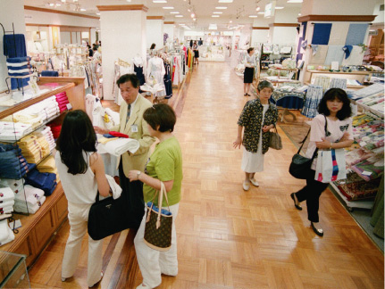
Chinese Towels Invade Japan
After studying this chapter, you should be able to:
  Explain how the balance of payments is calculated.
  Explain how exchange rates are determined and how changes in exchange rates affect the prices of imports and exports.
  Explain the saving and investment equation.
  Explain the effect of a government budget deficit on investment in an open economy.
  Discuss the difference between the effectiveness of monetary and fiscal policy in an open economy and in a closed economy.
1
2
3
LEARNING OBJECTIVES
4
In this chapter, we look more closely at the linkages among countries at the macroeconomic level.
5

Slide 3
The Balance of Payments: Linking the U.S. to the International Economy
1
LEARNING OBJECTIVE
Open economy An economy that has interactions in trade or finance with other economies.
Closed economy An economy that has no interactions in trade or finance with other economies.
Balance of payments The record of a country’s trade with other countries in goods, services, and assets.

Slide 4
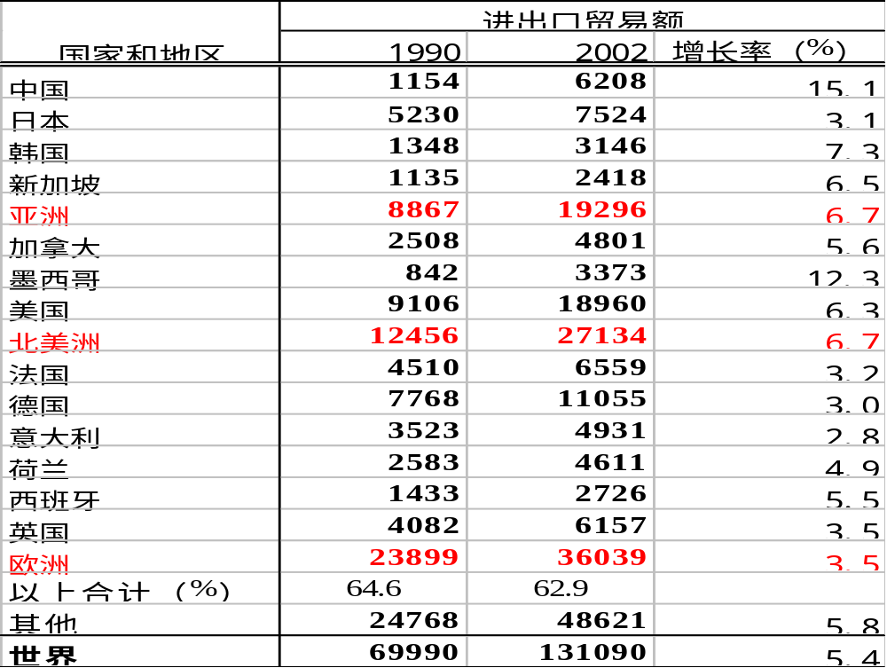
世界贸易额变化（1990-2002年）
（单位：亿美元）

Slide 5
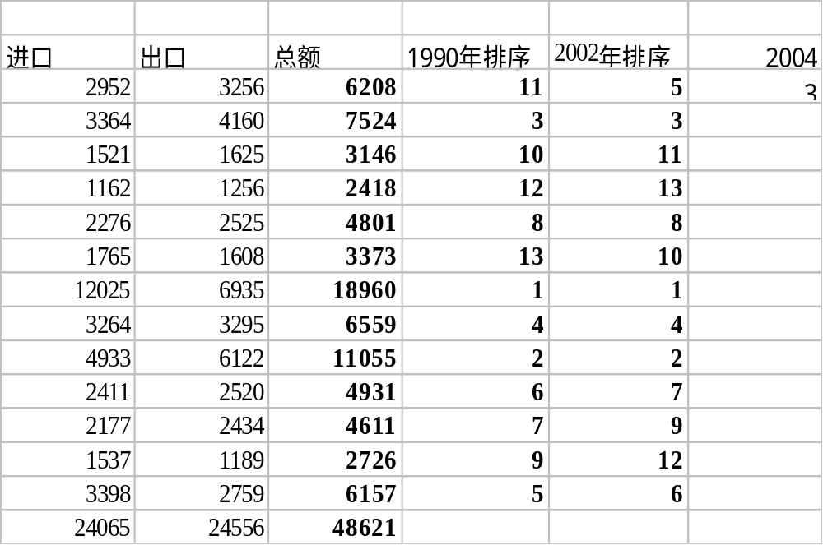
世界贸易额（2002年）（单位：亿美元）

Slide 6
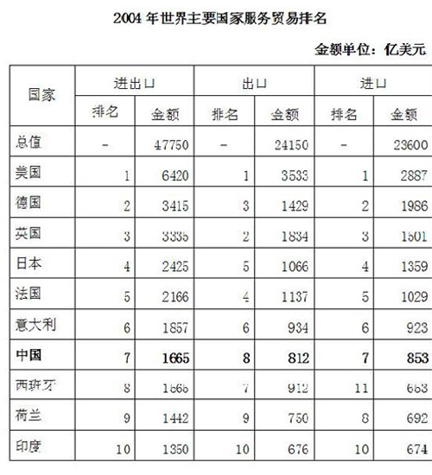

Slide 7
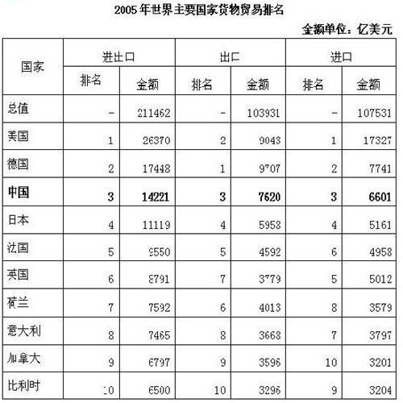

Slide 8
进口与出口占总产出的比例: 2000
1
Percentage
40
of GDP
35
30
25
20
15
10
5
0
Canada
France
Germany
Italy
Japan
U.K.
U.S.
Imports
Exports
Notes:
Figure 5-1 on p.115. While international trade is important for the U.S., it is even more vital for other countries.

Slide 9
WTO统计显示，2008年世界贸易总额为15.775万亿美元，同比增长15%。
其中，德国以1.47万亿美元出口总额跃居首位，中国以1.43万亿美元列第二，美国以1.30万亿美元列第三。
日本、荷兰、法国、意大利、比利时、俄罗斯和英国依次排名第4至10位。
在进口排名名单中，2008年，美国以2.17万亿美元进口总额继续占据首位，德国以1.21万亿美元列第二，中国以1.13万亿美元列第三。日本、法国、英国、荷兰、意大利、比利时和韩国分列第4至10位。

Slide 10
进口与出口占总产出的比例: 2000
1
Percentage
40
of GDP
35
30
25
20
15
10
5
0
Canada
France
Germany
Italy
Japan
U.K.
U.S.
Imports
Exports
Notes:
Figure 5-1 on p.115. While international trade is important for the U.S., it is even more vital for other countries.

Slide 11
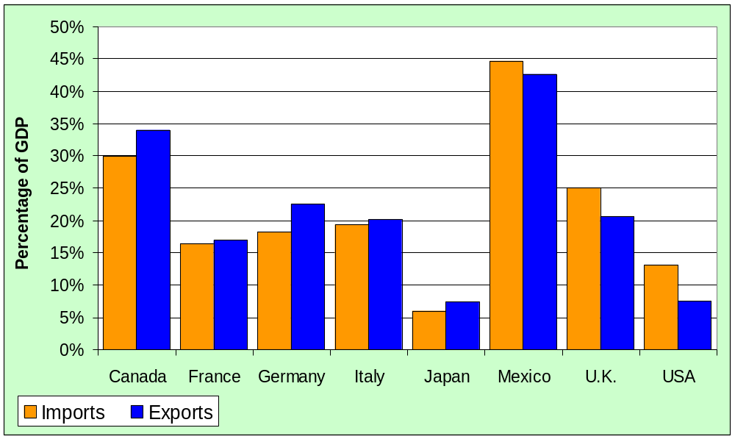
Imports and Exports as a percentage of output: 2002
source: OECD

Slide 12

Nearly all economies of the world are:
a. Open economies.
b. Closed economies.
c. Closed economies about to become open in today’s global economy.
d. Open to trade but closed to investment and finance interactions with other economies.

Slide 13
Nearly all economies of the world are:
a. Open economies.
b. Closed economies.
c. Closed economies about to become open in today’s global economy.
d. Open to trade but closed to investment and finance interactions with other economies.

Slide 14
The Balance of Payments: Linking the U.S. to the International Economy
The Current Account
Current account The part of the balance of payments that records a country’s net exports, net investment income, and net transfers.
THE BALANCE OF TRADE
Balance of trade The difference between the value of the goods a country exports and the value of the goods a country imports.

Slide 15
The Balance of Payments: Linking the U.S. to the International Economy
17 – 1
The Balance of Payments of the United States, 2004 (billions of dollars)
CURRENT ACCOUNT
Exports of Goods | $807
Imports of Goods | –1,473
Balance of Trade |  | –666
Exports of Services | 344
Imports of Services | –296
Balance of Services |  | 48
Income Received on Investments | 380
Income Payments on Investments | –349
Net Income on Investments |  | 31
Net Transfers |  | –81
Balance on Current Account |  | –668

Slide 16
In 2004, the United States ran a _______ _______ with all of its major trading partners and with every region of the world.
a. trade surplus
b. trade deficit
c. trade balance
d. favorable surplus

Slide 17
In 2004, the United States ran a _______ _______ with all of its major trading partners and with every region of the world.
a. trade surplus
b. trade deficit
c. trade balance
d. favorable surplus

Slide 18
The Balance of Payments: Linking the U.S. to the International Economy
17 – 1 cont.
The Balance of Payments of the United States, 2004 (billions of dollars)
FINANCIAL ACCOUNT
Increase in foreign holdings of assets in the United States | $1,440
Increase in U.S. holdings of assets in foreign countries | –856
Balance on Financial Account |  | 584
BALANCE ON CAPITAL ACCOUNT |  |  | -1
Statistical Discrepancy |  | 85
Balance of Payments |  | 0

Slide 19
The Balance of Payments: Linking the U.S. to the International Economy
The Current Account
NET EXPORTS EQUALS THE SUM OF THE BALANCE OF TRADE AND THE BALANCE OF SERVICES

Slide 20
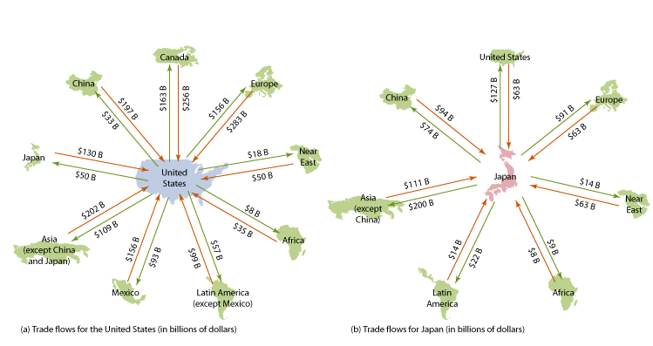
The Balance of Payments: Linking the U.S. to the International Economy
The Financial Account
17 - 1
Trade Flows for the United States and Japan, 2004

Slide 21
The Balance of Payments: Linking the U.S. to the International Economy
The Financial Account
Financial account The part of the balance of payments that records purchases of assets a country has made abroad and foreign purchases of assets in the country.
Net foreign investment The difference between capital outflows from a country and capital inflows, also equal to net foreign direct investment plus net foreign portfolio investment.

Slide 22
When a foreign investor buys a bond issued by either a U.S. firm or the federal government, or when a foreign firm builds a factory in the United States, the transaction is recorded in the balance of payments as:
a. A capital inflow.
b. A capital outflow.
c. Both a capital outflow and a capital inflow.
d. Neither a capital outflow nor a capital inflow.

Slide 23
When a foreign investor buys a bond issued by either a U.S. firm or the federal government, or when a foreign firm builds a factory in the United States, the transaction is recorded in the balance of payments as:
a. A capital inflow.
b. A capital outflow.
c. Both a capital outflow and a capital inflow.
d. Neither a capital outflow nor a capital inflow.

Slide 24

The Balance of Payments: Linking the U.S. to the International Economy
The Capital Account
Capital Account The part of the balance of payments that records relatively minor transactions, such as migrants’ transfers, and sales and purchases of nonproduced, nonfinancial assets.
Why Is the Balance of Payments Always Zero?
17-1
1
LEARNING OBJECTIVE
Understanding the Arithmetic of Open Economies
Don’t Confuse the “Balance of Trade,” the “Current Account Balance,” and the “Balance of Payments”

Slide 25
The Foreign Exchange Market and Exchange Rates
2
LEARNING OBJECTIVE
Nominal exchange rate The value of one country’s currency in terms of another country’s currency.

Slide 26


17 - 1
Exchange Rates in the Financial Pages
EXCHANGE RATE BETWEEN THE DOLLAR AND THE INDICATED CURRENCY
 | UNITS OF FOREIGN CURRENCY PER U.S. DOLLAR | U.S. DOLLAR PER UNIT OF FOREIGN CURRENCY
Canadian dollar | 1.199 | 0.834
Japanese yen | 110.200 | 0.009
Mexican peso | 10.841 | 0.092
British pound | 0.555 | 1.801
Euro | 0.814 | 1.228
The financial pages of most newspapers provide information on exchange rates.

Slide 27
人民币汇率升值带来的利好：
1、有利于中国进口
2、原材料进口依赖型厂商成本下降
3、国内企业对外投资能力增强
4、在华外商投资企业盈利增加
5、有利于人才出国学习和培训
6、外债还本付息压力减轻
7、中国资产出卖更合算
8、中国GDP国际地位提高
9、增加国家税收收入
10、中国百姓国际购买力增强

Slide 28
人民币升值影响的初步分析
汇率波动是一把“双刃剑”，总会从正反两个方面影响一国经济。人民币升值，可能有利于企业“走出去”、扩大国家货物和服务贸易进口以及减缓我国外债偿还压力等，但升值对国内和世界贸易经济所产生的负面影响也不容忽视。
（一）将对我国外贸出口增长产生严重负面影响。人民币升值将提高我出口商品的外币价格，直接削弱我出口的价格竞争优势，影响我在美元贬值期间转移效应和相对比较优势的发挥，加大我开拓国际市场的难度，不利于我国经济的稳定增长。
（二）不利于亚洲和世界贸易经济的稳定增长。在美元贬值期间，亚洲各国的货币保持了相对稳定，若人民币升值，有可能打破亚洲货币的稳定，影响亚洲经济增长格局。

Slide 29
加工贸易在我国对外贸易占有相当比重，2002年就达48．7％。人民币升值对出口负面影响，最终通过加工链条，影响加工贸易进口的增长，这也将不利于世界贸易经济的复苏。
（三）不利于吸引外资和加工贸易产业升级。
第一，人民币升值将减弱我引资力度，可能会减缓外商对华直接投资的增长。
第二，在华外企的经营目前已逐步进入成熟发展期，外资利润汇出的要求也在逐年增大，人民币升值将提高利润的外汇收益，可能加大资本外流规模，对国际收支平衡产生压力。这都将影响外商投资企业投资及利润再投资的规模与产业本地化的进程，不利于我国加工贸易的持续发展和产业升级。
（四）不利于缓解国内就业压力。目前外经贸行业提供的就业机会超过7000万人，很多新增就业机会也是由本国出口企业和外资企业提供的。人民币升值对出口行业和外商直接投资的影响，最终将体现在就业上，势必对当前就业环境的改善产生一定冲击。

Slide 30
（五）将直接导致我外汇净资产的权益受损。2004年底，国家外汇储备为6099亿美元。若人民币升值，势必加重美元实际贬值幅度，进而导致我外汇净资产的严重“缩水”。
可以看出，当前人民币升值的负面影响呈现两大特点，一是范围较为广泛，升值将影响国际贸易、吸引外资、就业、物价以及金融改革的稳定发展；二是力度相对强烈，升值负面影响直接关系国计民生，力度明显强于其正面效应。因此，面对人民币升值的压力，我们更应该保持谨慎，研究周全，并积极加以应对.

Slide 31
世界贸易概况（1998年） （单位：亿美元）
太平洋贸易区
= 5894
北美自由贸易区（NAFTA）
= 5073
日本
东亚
加拿大
墨西哥
1607
2741
美国
3636
2332
1198
1418
1767
1763
488
大西洋贸易区
= 3530
166
中国
200
欧盟
439
资料来源：Direction of Trade Statistics Quarterly, June 1999.

Slide 32
中国贸易
2004年，中国出口占全球出口的比例为6％，是1982年的5倍，当年中国进出口贸易总额突破一万亿美元，成为继美国和德国之后的世界第三大贸易国；同时，截至2004年12月底，全国累计实际使用外资5621亿美元，位居世界第四。中国已跻身国际市场最大开放经济体之一。2004年，中国出口增速为35．4％，出口价格上升了5．3％，而进口价格上涨10．3％，出口价格指数与进口价格指数之比在下降，这说明中国从外贸中得到的国民所得不高，对外贸易还是依靠数量型增长，对国民福利的贡献相对有限。

Slide 33
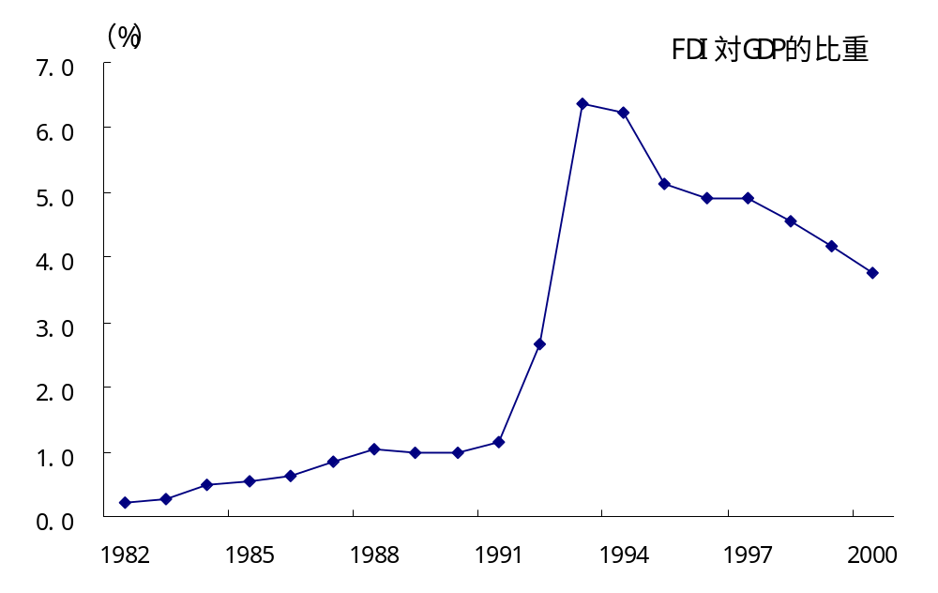
外资依赖度变化（1982—2000)

Slide 34
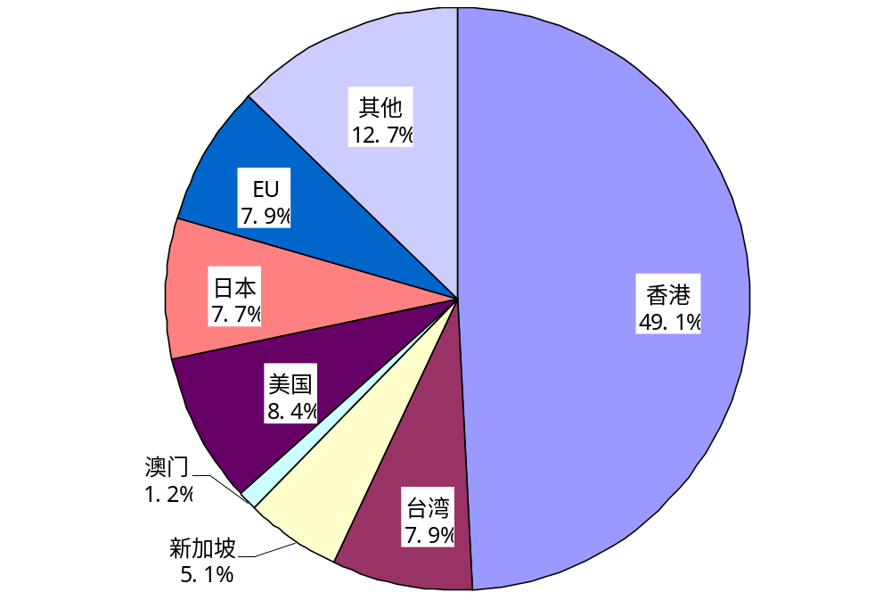
国别以及地域别的外资构成
（1991-2000年合计引进外资3300亿美元）

Slide 35
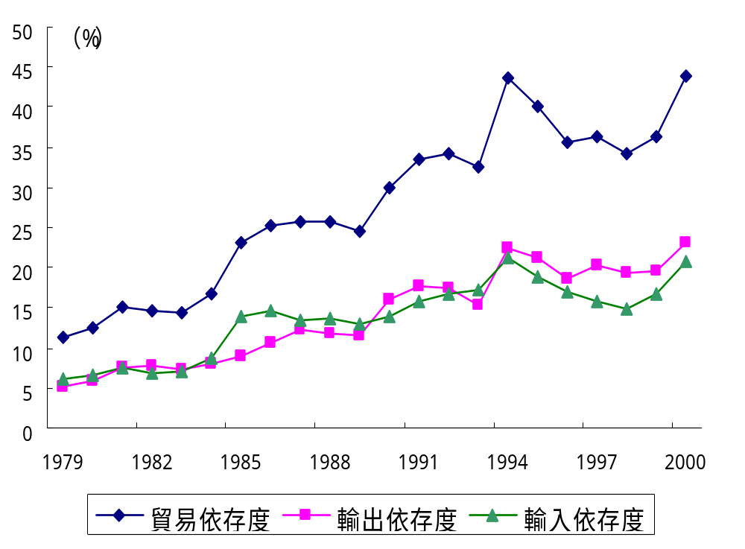
贸易依赖度变化（1979-2000）

Slide 36
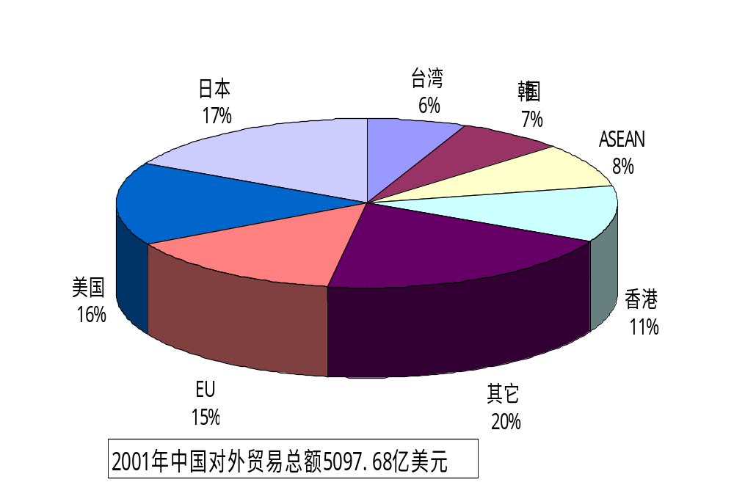
外国/地区对中国贸易的比重（2001年）

Slide 37
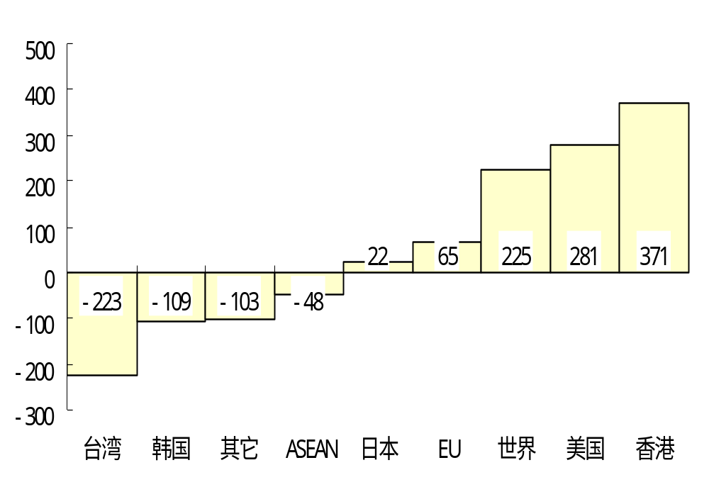
中国和主要国家/地区的贸易差（2001年） （单位：亿美元）

Slide 38
中美、中日贸易总额
（亿美元）
年份 | 1996 | 2003 | 年平均增长率(%)
中美 | 428.4 | 1263.3 | 16.7
中日 | 339.1 | 1335.7 | 21.6

Slide 39
中国的贸易流通机构演变
50年代
60年代
70年代
80年代
90年代
2003年
商业部1952.8
管辖全国的商业流通
商业部
1982年合并
粮食部1952.8
粮食的调配和供应
国内贸易部
1993年合并管辖国内所有商品的流通
中华全国供销合作总社1954.7
农村地域的商品流通以及农产品收购
商务部
国家物资管理总局1962.5（生产资料流通）
国家物资总局1975.11
物资部1988升级
对外贸易部

Slide 40
中美贸易战
中美纺织品争执，中国自然要求世界贸易组织介入裁决，但即使裁决中国获胜，美国对中国的贸易战不会收敛。
随着中国的综合国力提升，类似的贸易纠纷和摩擦只会增加，决不会因中国让步而减少。
关键在于中国的贸易政策的目标和国家发展战略的构筑。

Slide 41
我国面临的贸易摩擦问题
贸易摩擦将会反映在三个方面：一是各国会更多地利用反倾销、特别贸易条款等贸易救济措施对中国商品加以限制并保护其国内产业；二是发达国家将更多地利用非传统的贸易壁垒，如环保标准、劳工标准、社会责任标准等来设置更多的障碍；三是我国面对的知识产权纠纷有增加的趋势。

Slide 42
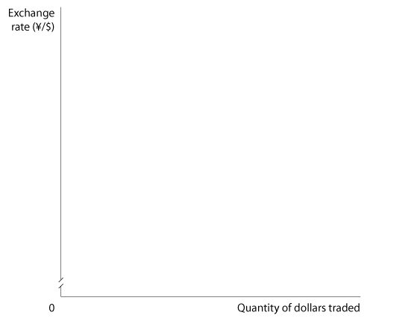
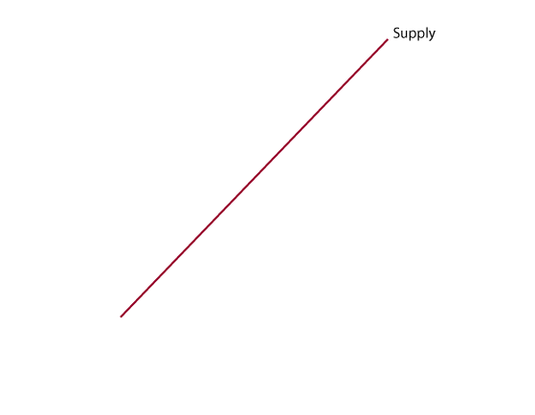
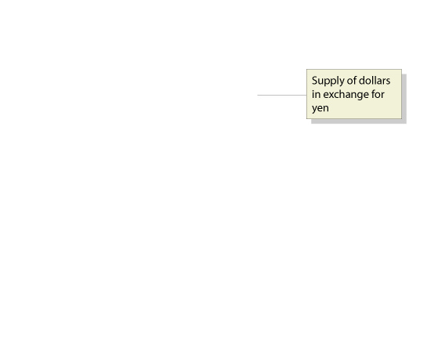
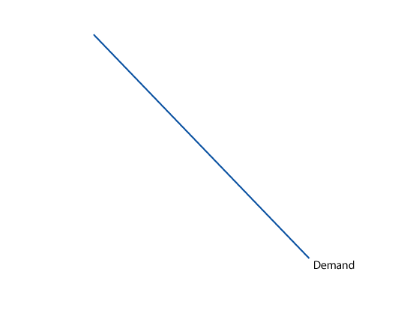
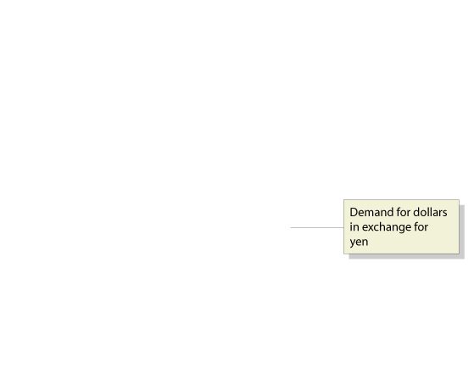
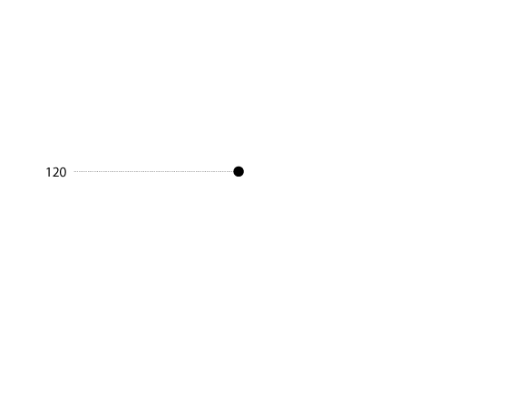
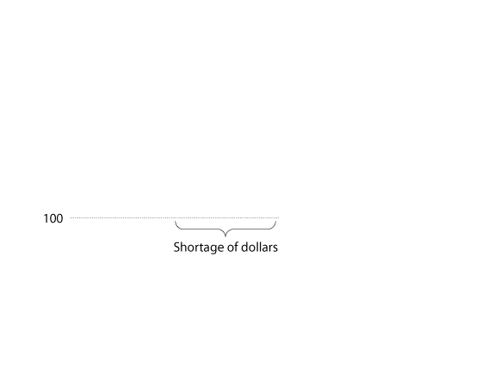
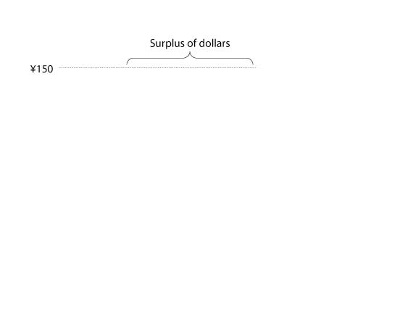
The Foreign Exchange Market and Exchange Rates
Equilibrium in the Market for Foreign Exchange
17 - 2
Equilibrium in the Foreign Exchange Market

Slide 43
Which of the following are sources of foreign demand for U.S. dollars?
a. Foreign firms and consumers who want to buy goods and services produced in the United States.
b. Foreign firms and consumers who want to invest in the United States.
c. Currency traders who believe that the value of the dollar in the future will be greater than its value today.
d. All of the above.

Slide 44
Which of the following are sources of foreign demand for U.S. dollars?
a. Foreign firms and consumers who want to buy goods and services produced in the United States.
b. Foreign firms and consumers who want to invest in the United States.
c. Currency traders who believe that the value of the dollar in the future will be greater than its value today.
d. All of the above.

Slide 45
The Foreign Exchange Market and Exchange Rates
Equilibrium in the Market for Foreign Exchange
Currency appreciation Occurs when the market value of a currency rises relative to another currency.
Currency depreciation Occurs when the market value of a currency falls relative to another currency.
Don’t Confuse What Happens When a Currency Appreciates with What Happens When It Depreciates

Slide 46
The Foreign Exchange Market and Exchange Rates
How Do Shifts in Demand and Supply Affect the Exchange Rate?
Three main factors cause the demand and supply curves in the foreign exchange market to shift:
  Changes in the demand for U.S.-produced goods and services and changes in the demand for foreign-produced goods and services.
  Changes in the desire to invest in the United States and changes in the desire to invest in foreign countries.
  Changes in the expectations of currency traders about the likely future value of the dollar and the likely future value of foreign currencies.

Slide 47
Which of the following factors causes both the supply curve and the demand curve for dollars in the foreign exchange market to shift?
a. Changes in the demand for U.S.-produced goods and services and changes in the demand for foreign-produced goods and services.
b. Changes in the desire to invest in the United States and changes in the desire to invest in foreign countries.
c. Changes in the expectations of currency traders concerning the likely future value of the dollar and the likely future value of foreign currencies.
d. All of the above.

Slide 48
Which of the following factors causes both the supply curve and the demand curve for dollars in the foreign exchange market to shift?
a. Changes in the demand for U.S.-produced goods and services and changes in the demand for foreign-produced goods and services.
b. Changes in the desire to invest in the United States and changes in the desire to invest in foreign countries.
c. Changes in the expectations of currency traders concerning the likely future value of the dollar and the likely future value of foreign currencies.
d. All of the above.

Slide 49
The Foreign Exchange Market and Exchange Rates
How Do Shifts in Demand and Supply Affect the Exchange Rate?
SHIFTS IN THE DEMAND FOR FOREIGN EXCHANGE
Speculators Currency traders who buy and sell foreign exchange in an attempt to profit by changes in exchange rates.
SHIFTS IN THE SUPPLY OF FOREIGN EXCHANGE
ADJUSTMENT TO A NEW EQUILIBRIUM

Slide 50
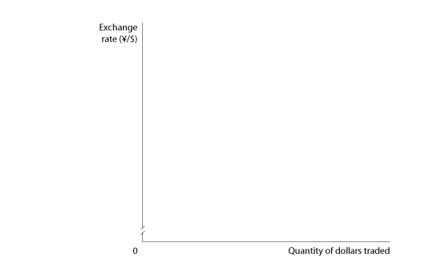
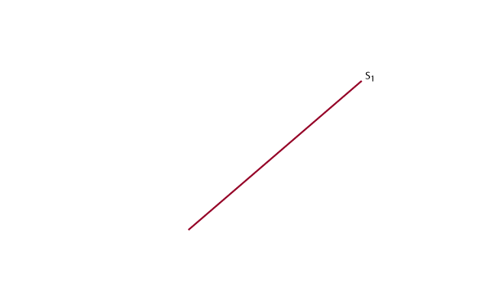
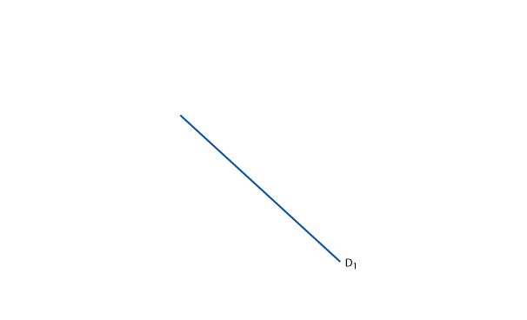
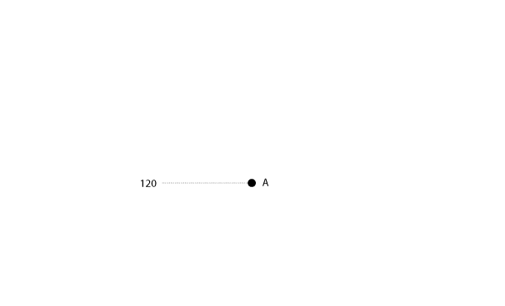
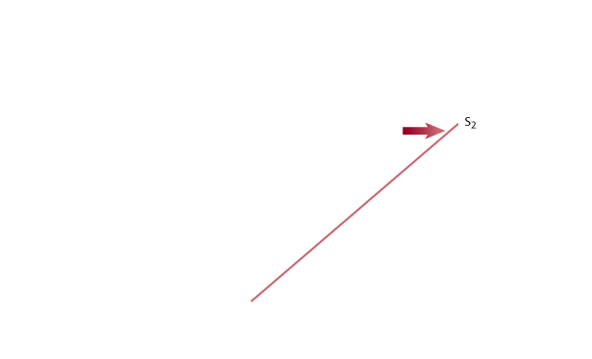
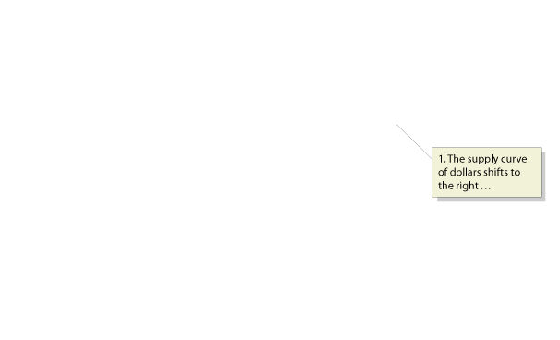
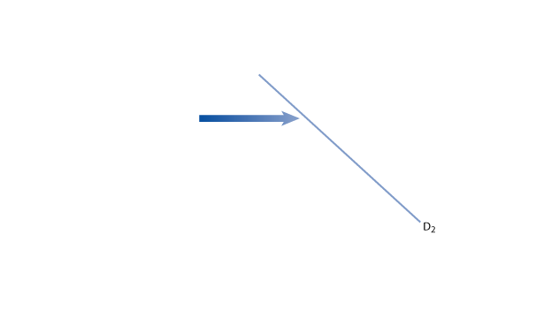
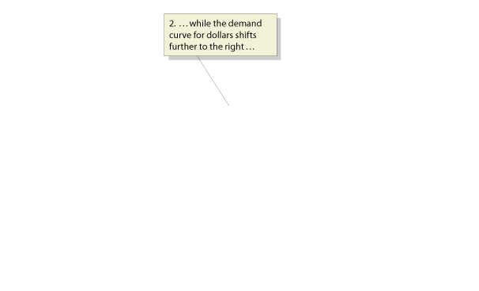
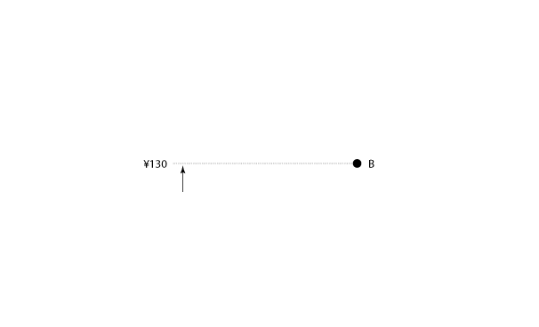
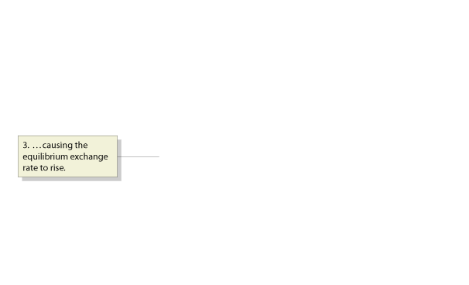
The Foreign Exchange Market and Exchange Rates
How Do Shifts in Demand and Supply Affect the Exchange Rate?
ADJUSTMENT TO A NEW EQUILIBRIUM
17 - 3
Shifts in the Demand and Supply Curve Resulting in a Higher Exchange Rate

Slide 51
When will the demand curve for dollars shift to the right?
a. When incomes in Japan fall.
b. When interest rates in the United States fall.
c. When speculators decide that the value of the dollar will rise relative to the value of the yen.
d. All of the above.

Slide 52
When will the demand curve for dollars shift to the right?
a. When incomes in Japan fall.
b. When interest rates in the United States fall.
c. When speculators decide that the value of the dollar will rise relative to the value of the yen.
d. All of the above.

Slide 53
The Foreign Exchange Market and Exchange Rates
Some Exchange Rates Are Not Determined by the Market
How Movements in the Exchange Rate Affect Exports and Imports
17-2
2
LEARNING OBJECTIVE
Effect of Changing Exchange Rates on the Prices of Imports and Exports

Slide 54
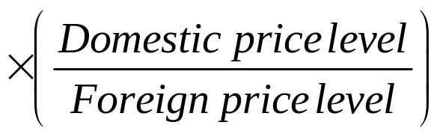
The Foreign Exchange Market and Exchange Rates
The Real Exchange Rate
Real exchange rate The price of domestic goods in terms of foreign goods.
Real exchange rate = Nominal exchange rate

Slide 55
Which two factors do economists combine to establish the real exchange rate between two countries?
a. The balance of payments and whether or not the currency of either country faces a shortage or surplus in the foreign exchange market.
b. The money supply in each country and the fixed exchange rate between the two countries.
c. The relative price levels and the nominal exchange rate between the two countries’ currencies.
d. Net exports and whether there is currency appreciation or depreciation between the two countries.

Slide 56
Which two factors do economists combine to establish the real exchange rate between two countries?
a. The balance of payments and whether or not the currency of either country faces a shortage or surplus in the foreign exchange market.
b. The money supply in each country and the fixed exchange rate between the two countries.
c. The relative price levels and the nominal exchange rate between the two countries’ currencies.
d. Net exports and whether there is currency appreciation or depreciation between the two countries.

Slide 57
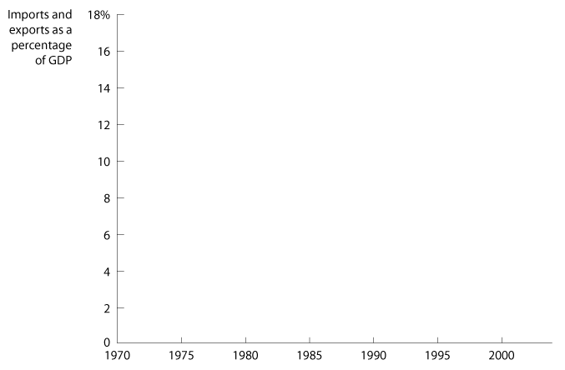
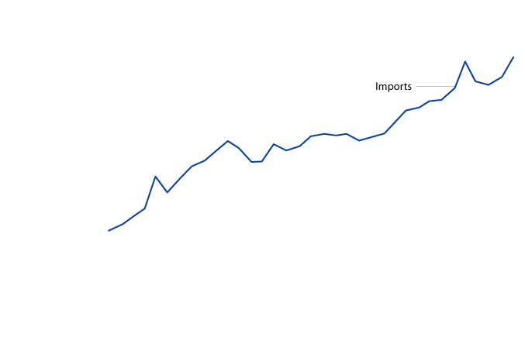
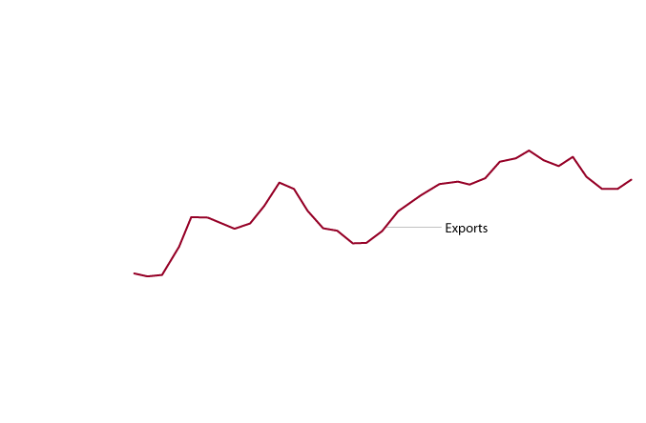
The International Sector and
National Saving and Investment
3
LEARNING OBJECTIVE
Net Exports Equal Net Foreign Investment
17 - 4
U.S. Imports and Exports,
1970-2004

Slide 58
The International Sector and National
Saving and Investment
Net Exports Equal Net Foreign Investment
Current Account Balance + Financial Account Balance = 0
or,
Current Account Balance = -Financial Account Balance
or,
Net Exports = Net Foreign Investment

Slide 59
The International Sector and National
Saving and Investment
Domestic Saving, Domestic Investment, and Net Foreign Investment
National Saving = Private Saving + Public Saving
S = S_{private} + S_{public}
Private Saving = National Income – Consumption - Taxes
S_{private} = Y – C – T
Government Saving = Taxes – Government Spending
S_{public} = T – G

Slide 60
The International Sector and National
Saving and Investment
Domestic Saving, Domestic Investment, and Net Foreign Investment
Remember the basic macroeconomic equation
for GDP or national income:
Y = C + I + G + NX
Saving and investment equation An equation showing that national saving is equal to domestic investment plus net foreign investment.
National Saving = Domestic Investment + Net Foreign Investment
S = I + NFI

Slide 61
In the strict sense of the concept of net foreign investment, a country such as the United States that has negative net foreign investment must be:
a. Investing less than it is saving domestically.
b. Saving less than it is investing domestically.
c. Experiencing positive net exports.
d. A net lender, not a borrower.

Slide 62
In the strict sense of the concept of net foreign investment, a country such as the United States that has negative net foreign investment must be:
a. Investing less than it is saving domestically.
b. Saving less than it is investing domestically.
c. Experiencing positive net exports.
d. A net lender, not a borrower.

Slide 63
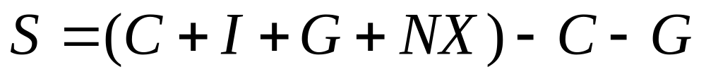
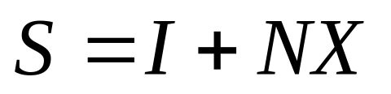
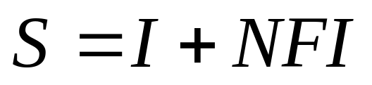
17-3
3
LEARNING OBJECTIVE
Arriving at the Saving and Investment Equation

Slide 64
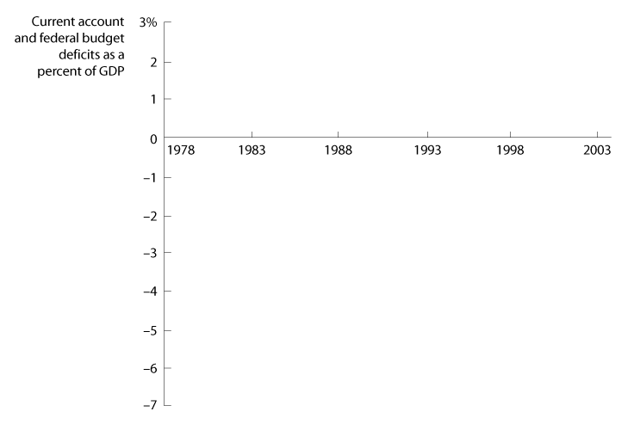
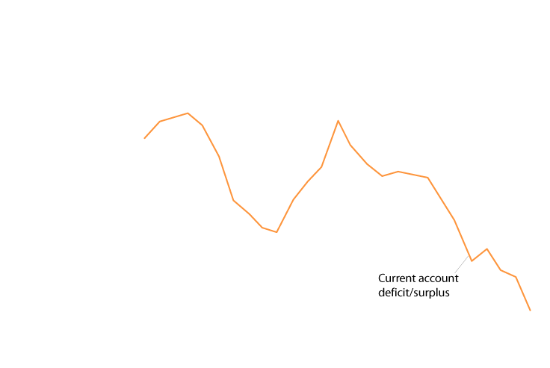
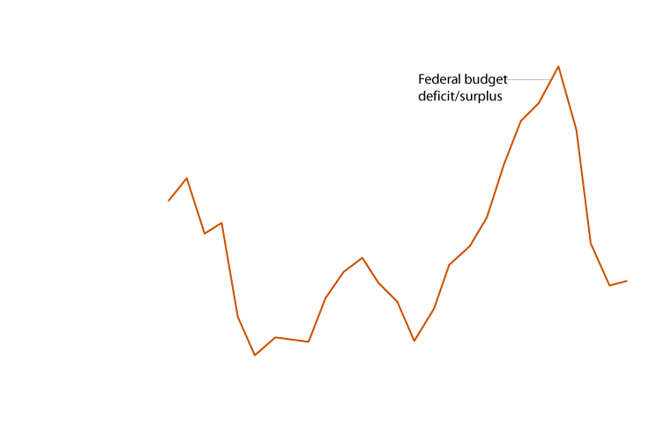
The Effect of a Government Budget Deficit on Investment
4
LEARNING OBJECTIVE
17 - 5
The Twin Deficits, 1978-2004

Slide 65
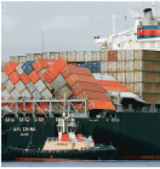
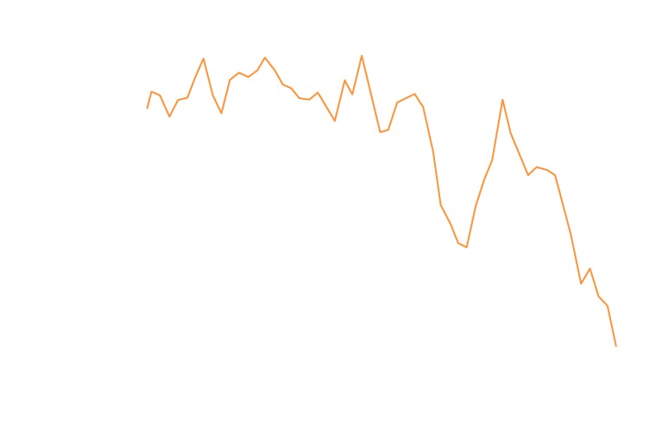
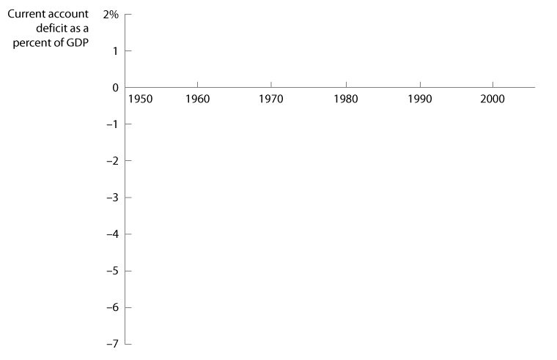
17 - 2
Why Is The United States Called the “World’s Largest Debtor?”
Large current account deficits have resulted in foreign investors purchasing large amounts of U.S. assets.

Slide 66
A country experiences twin deficits when a government budget deficit causes:
a. A trade deficit.
b. A service exports deficit.
c. A current account deficit.
d. A financial account deficit.

Slide 67
A country experiences twin deficits when a government budget deficit causes:
a. A trade deficit.
b. A service exports deficit.
c. A current account deficit.
d. A financial account deficit.

Slide 68
Monetary Policy and Fiscal Policy in an Open Economy
5
LEARNING OBJECTIVE
Monetary Policy in an Open Economy
Fiscal Policy in an Open Economy

Slide 69

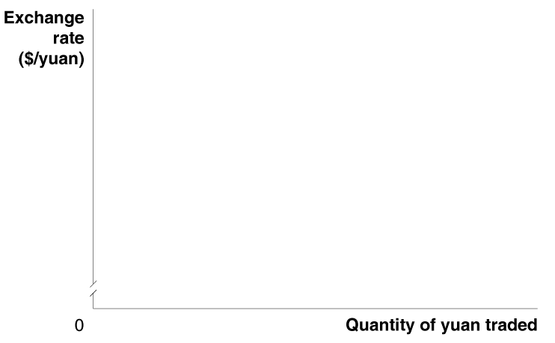
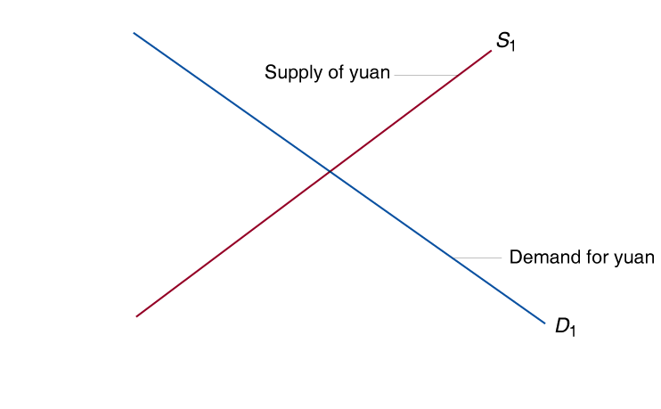
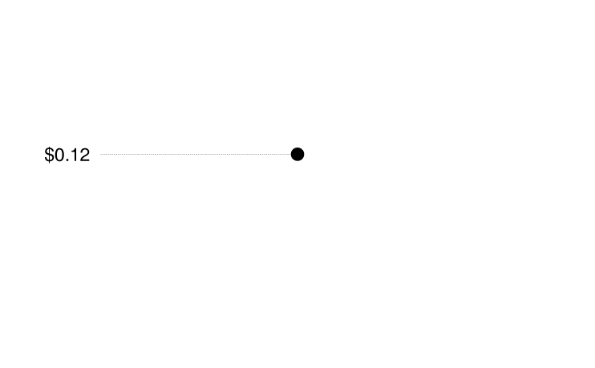
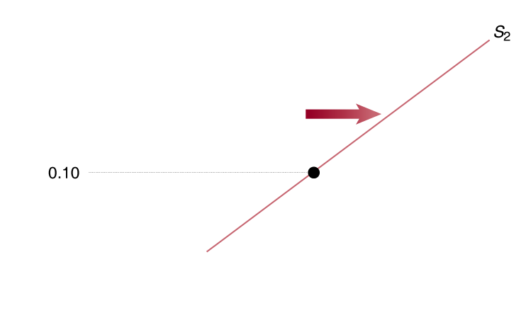
Traffic Lights on the Blink?

Slide 70

Balance of payments
Balance of trade
Capital account
Closed economy
Currency appreciation
Currency depreciation
Current account
Financial account
Net foreign investment
Nominal exchange rate
Open economy
Real exchange rate
Saving and investment equation
Speculators

