Slide 1
The International
Financial System

Slide 2
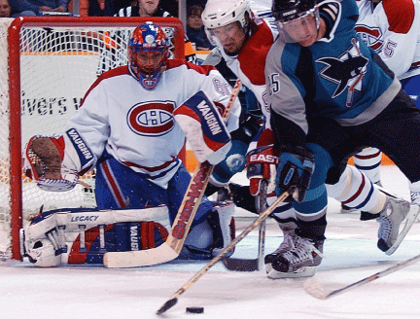
Fluctuating Exchange Rates Cause Molson Breweries to Sell the Canadiens
After studying this chapter, you should be able to:
  Understand how different exchange rate systems operate.
  Discuss the three key aspects of the current exchange rate system.
  Discuss the growth of international capital markets.
1
2
LEARNING OBJECTIVES
3
In this chapter, we look further at the international financial system and at the role central banks play in the system.

Slide 3
Exchange Rate Systems
1
LEARNING OBJECTIVE
Floating currency The outcome of a country allowing its currency’s exchange rate to be determined by demand and supply.
Exchange rate system An agreement among countries on how exchange rates should be determined.

Slide 4

Exchange Rate Systems
Managed float exchange rate system The current exchange rate system under which the value of most currencies is determined by demand and supply, with occasional government intervention.
Fixed exchange rate system A system under which countries agree to keep the exchange rates among their currencies fixed.
Remember That Modern Currencies Are Fiat Money

Slide 5

Which of the following happens in a managed float exchange rate system?
a. Countries agree to keep the value of their currencies constant.
b. Countries agree on how exchange rates should be determined.
c. Countries will occasionally intervene to buy and sell their currency or other currencies in order to affect exchange rates.
d. Countries allow the currency’s exchange rate to be determined by supply and demand.

Slide 6
Which of the following happens in a managed float exchange rate system?
a. Countries agree to keep the value of their currencies constant.
b. Countries agree on how exchange rates should be determined.
c. Countries will occasionally intervene to buy and sell their currency or other currencies in order to affect exchange rates.
d. Countries allow the currency’s exchange rate to be determined by supply and demand.

Slide 7
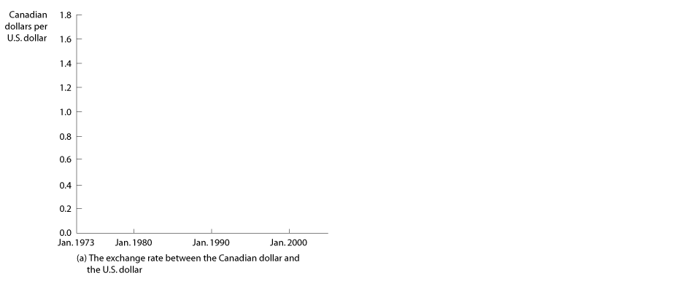
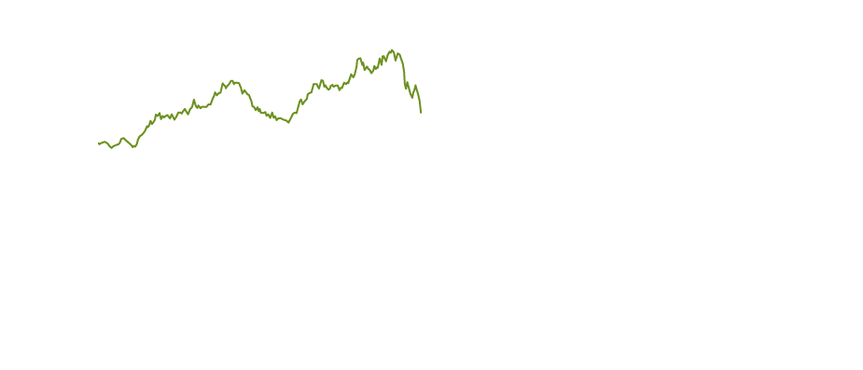
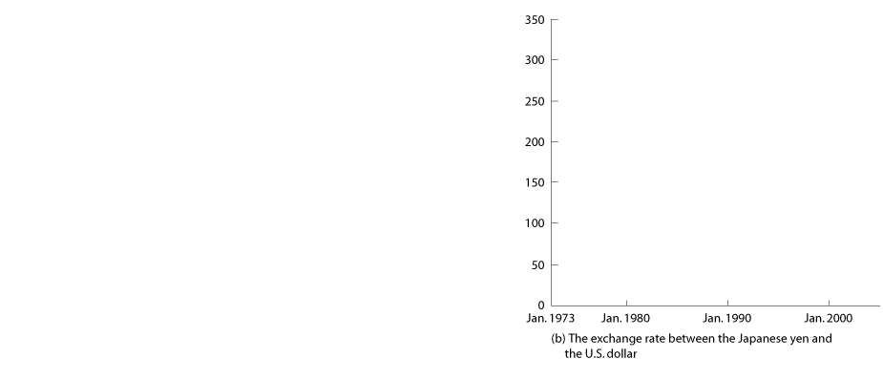
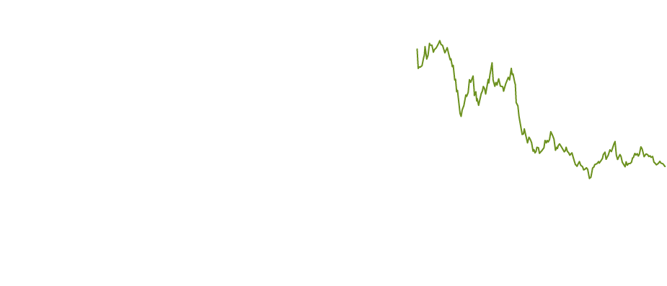
The Current Exchange Rate System
2
LEARNING OBJECTIVE
Euro The common currency of many European countries.
The Floating Dollar
18 - 1
U.S. Dollar-Canadian Dollar and U.S. Dollar-Yen Exchange Rates, 1973-2004

Slide 8

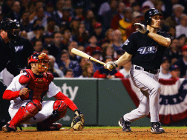
18 - 1
The Toronto Blue Jays Gain from the Rising Value of the Canadian Dollar
The Toronto Blue Jays benefited from the rising value of the Canadian dollar.

Slide 9
The Current Exchange Rate System
What Determines Exchange Rates in the Long Run?
THE THEORY OF PURCHASING POWER PARITY
Purchasing power parity The theory that in the
long run exchange rates move to equalize the purchasing
power of different currencies.
Three real-world complications keep purchasing power parity from being a complete explanation of exchange rates, even in the long run:
  Not all products can be traded internationally.
  Products and consumer preferences are different across countries.
  Countries impose barriers to trade.
  Tariff A tax imposed by a government on imports.
  Quota A limit on the quantity of a good that can be imported.

Slide 10
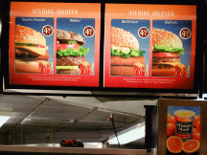
18 - 2
The Big Mac Theory of Exchange Rates
COUNTRY | BIG MAC PRICE | IMPLIED EXCHANGE RATE | ACTUAL EXCHANGE RATE
Argentina | 4.74 pesos | 1.55 pesos per dollar | 2.89 pesos per dollar
Japan | 250 yen | 82 yen per dollar | 107 yen per dollar
Britain | 1.88 pounds | 0.61 pound per dollar | 0.55 pound per dollar
Switzerland | 6.30 Swiss francs | 2.06 Swiss francs per dollar | 1.25 Swiss francs per dollar
Indonesia | 14,599 rupiahs | 4,771 rupiahs per dollar | 9,542 rupiahs per dollar
Canada | 3.27 Canadian dollars | 1.07 Canadian dollars per U.S. dollar | 1.24 Canadian dollars per U.S. dollar
Is the price of a Big Mac in Finland the same as the price of a Big Mac in Chicago?

Slide 11
18-1
2
LEARNING OBJECTIVE
Calculating Purchasing Power Parity Exchange Rates Using Big Macs
COUNTRY | BIG MAC PRICE | IMPLIED EXCHANGE RATE | ACTUAL EXCHANGE RATE
Brazil | 5.91 reals | 1.93 reals per dollar | 2.47 reals per dollar
Poland | 6.49 zlotys | 2.12 zlotys per dollar | 3.31 zlotys per dollar
South Korea | 2,500 won | 817 won per dollar | 1,004 won per dollar
Czech Republic | 56.30 korunas | 18.4 korunas per dollar | 24.5 korunas per dollar

Slide 12
The Current Exchange Rate System
What Determines Exchange Rates in the Long Run?
THE FOUR DETERMINANTS OF EXCHANGE RATES IN THE LONG RUN
There are four main determinants of exchange rates in the long run:
  Relative price levels.
  Relative rates of productivity growth.
  Preferences for domestic and foreign goods.
  Tariffs and quotas.

Slide 13
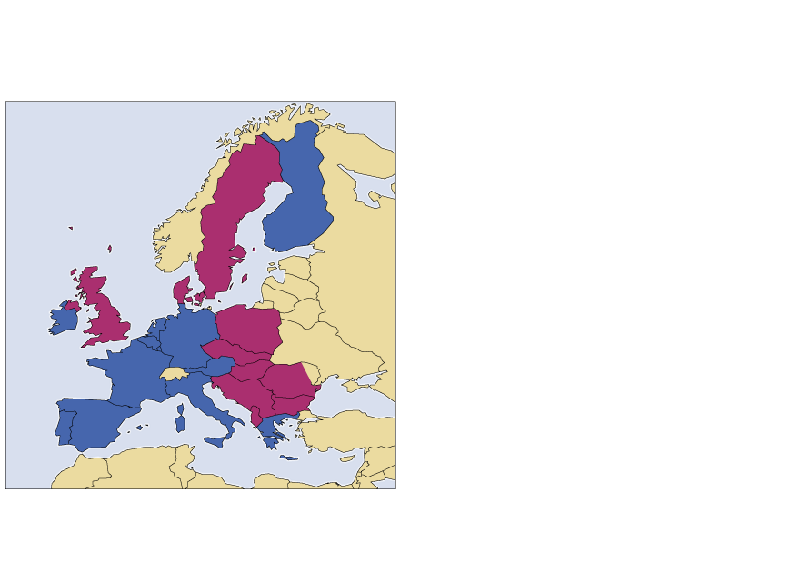
The Current Exchange Rate System
The Euro
18 - 2
Countries Adopting the Euro

Slide 14
Which of the following statements about foreign purchases of U.S. stocks and bonds is correct?
a. Since 1995, there has been a large rise in foreign purchases of bonds issued by U.S. corporations and by the federal government.
b. Falling stock prices in the United States caused a fall in foreign ownership of corporate stocks between 2001 and 2004.
c. Foreign investment in stocks and bonds between 2001 and 2004 was more than twice as great as it was in 1995.
d. All of the above.

Slide 15
Which of the following statements about foreign purchases of U.S. stocks and bonds is correct?
a. Since 1995, there has been a large rise in foreign purchases of bonds issued by U.S. corporations and by the federal government.
b. Falling stock prices in the United States caused a fall in foreign ownership of corporate stocks between 2001 and 2004.
c. Foreign investment in stocks and bonds between 2001 and 2004 was more than twice as great as it was in 1995.
d. All of the above.

Slide 16

18 - 3
The Underground Economy in Europe Surfaces
Smugglers rushed to exchange national currencies for euros before the June 2002 deadline.

Slide 17
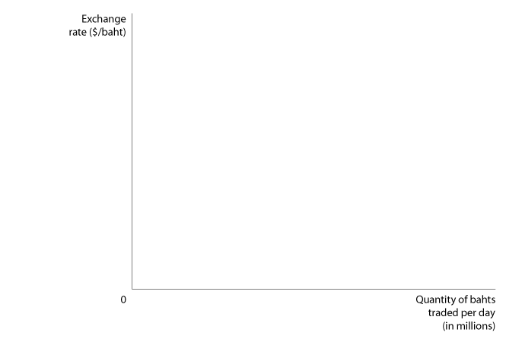
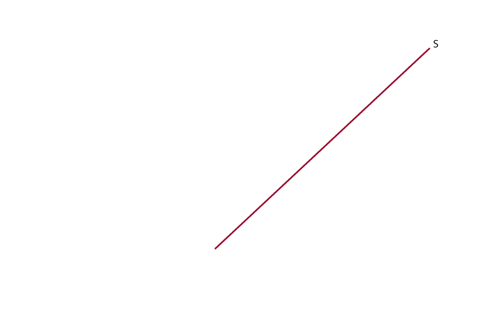

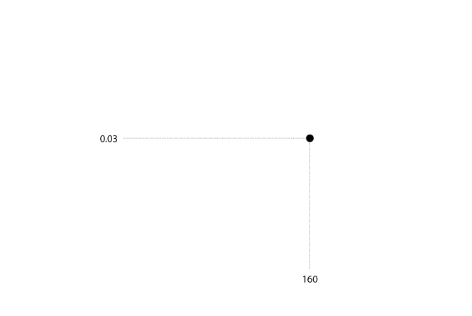
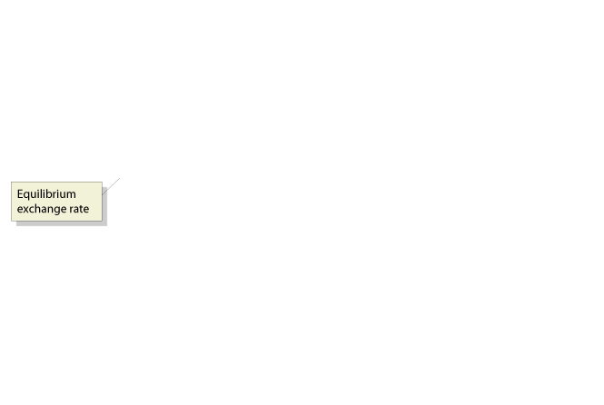
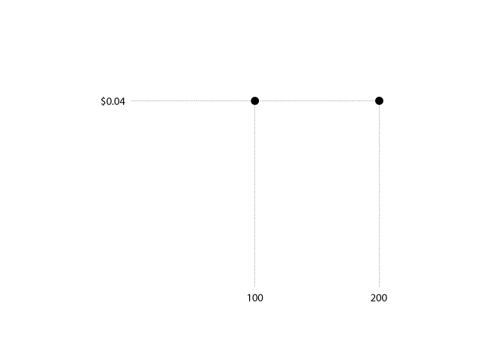
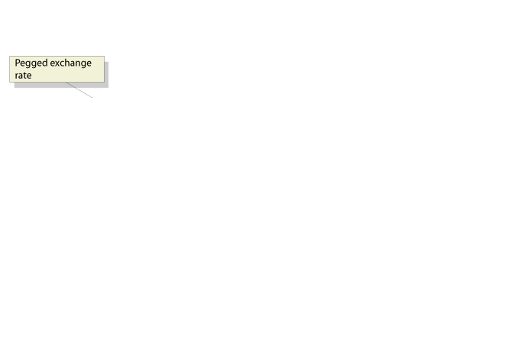
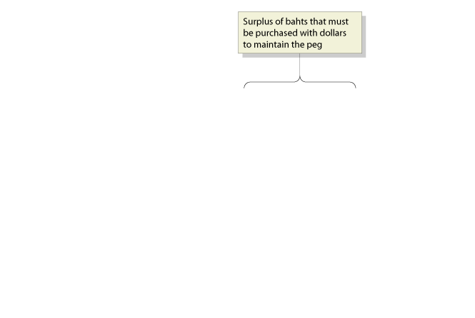
The Current Exchange Rate System
Pegging Against the Dollar
THE EAST ASIAN EXCHANGE RATE CRISIS OF THE LATE 1990s
Pegging The decision by a country to keep the exchange rate fixed between its currency and another currency.
18 - 3
By 1997 the Thai Baht Was
Overvalued Against the Dollar

Slide 18
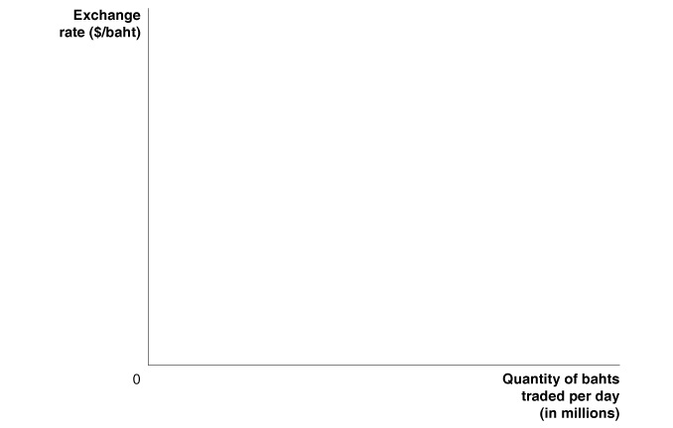
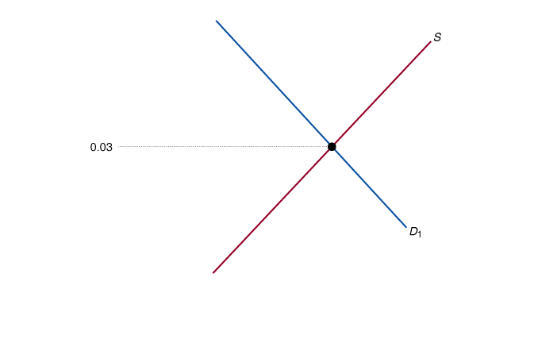
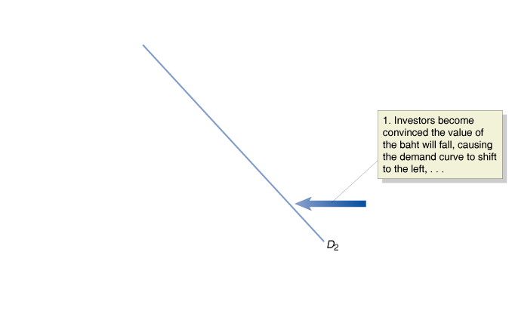
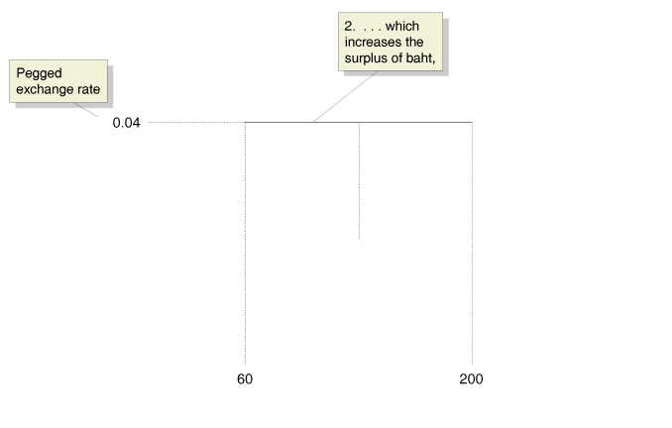
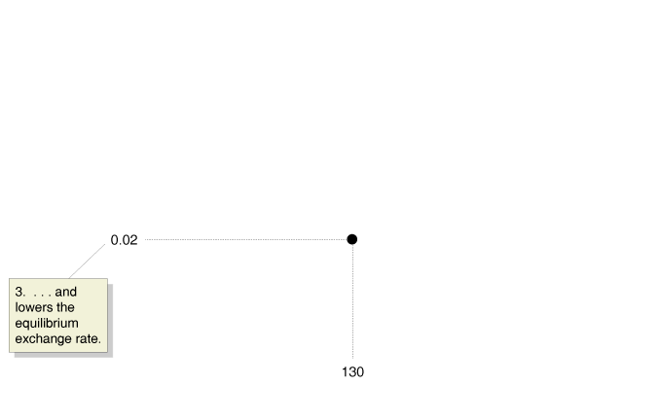
The Current Exchange Rate System
Pegging Against the Dollar
THE EAST ASIAN EXCHANGE RATE CRISIS OF THE LATE 1990s
18 - 4
Destabilizing Speculation
Against the Thai Baht

Slide 19
The Current Exchange Rate System
Pegging Against the Dollar
THE DECLINE IN PEGGING
THE CHINESE EXPERIENCE WITH PEGGING

Slide 20
Among the important aspects of the exchange rate system today is that:
a. The United States allows the dollar to float against other major currencies (with some intervention by central banks).
b. Many countries in Western Europe have adopted a single currency, the euro.
c. Some developing countries have attempted to keep their currency’s exchange rate fixed against the dollar, or against another major currency.
d. All of the above.

Slide 21
Among the important aspects of the exchange rate system today is that:
a. The United States allows the dollar to float against other major currencies (with some intervention by central banks).
b. Many countries in Western Europe have adopted a single currency, the euro.
c. Some developing countries have attempted to keep their currency’s exchange rate fixed against the dollar, or against another major currency.
d. All of the above.

Slide 22
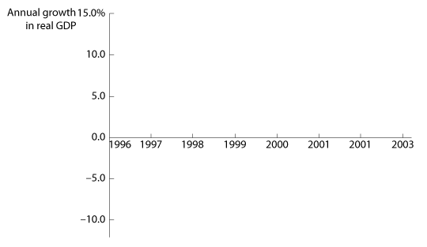
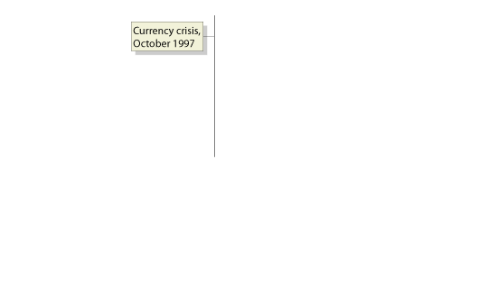
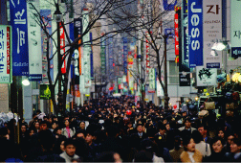
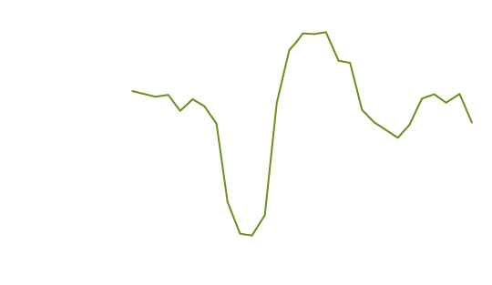
18 - 4
Crisis and Recovery in South Korea
The South Korea economy was able to rapidly recover from the late 1990s currency crisis.

Slide 23
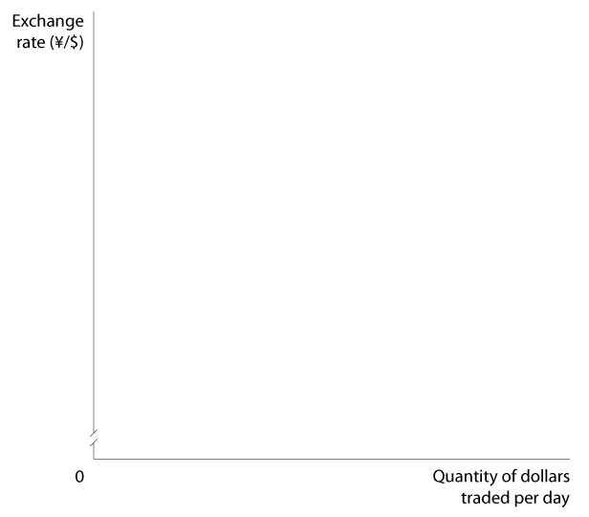
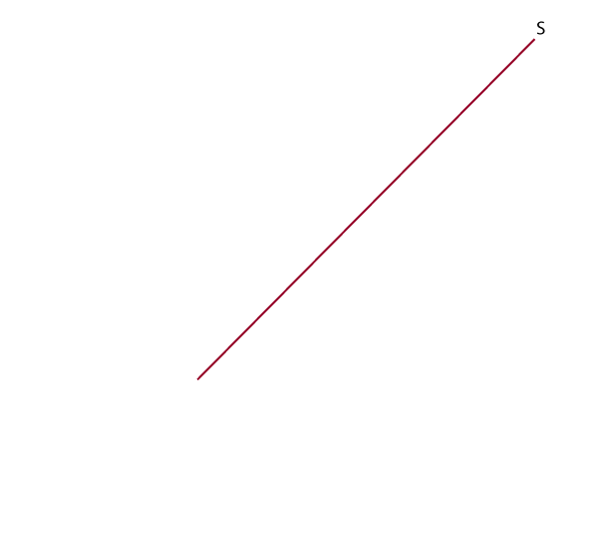
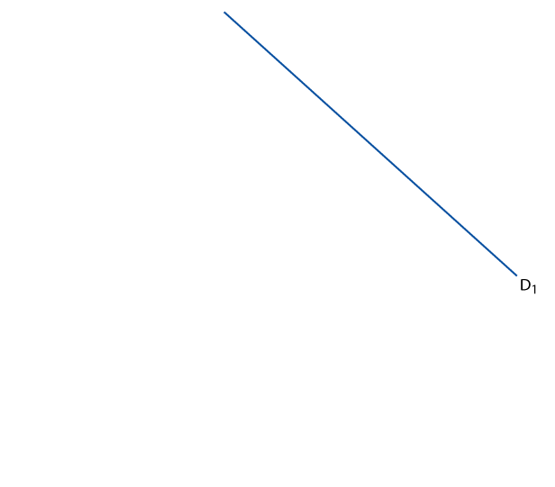
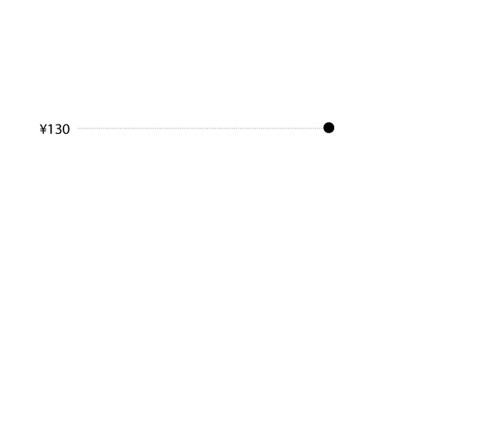
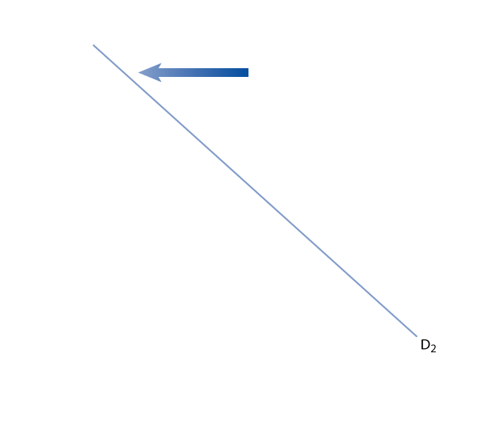
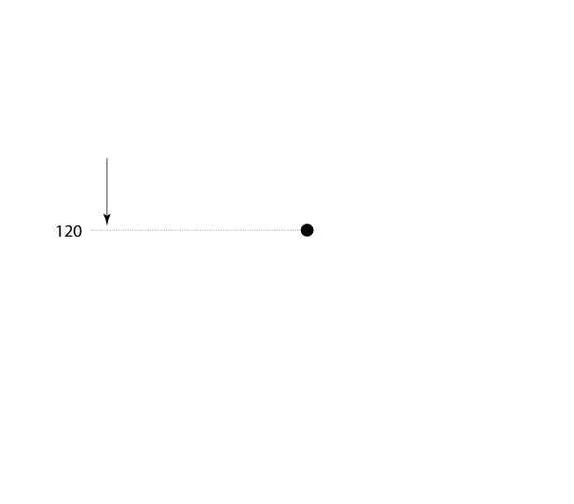
18-2
2
LEARNING OBJECTIVE
Coping with Fluctuations in the Value of the U.S. Dollar

Slide 24
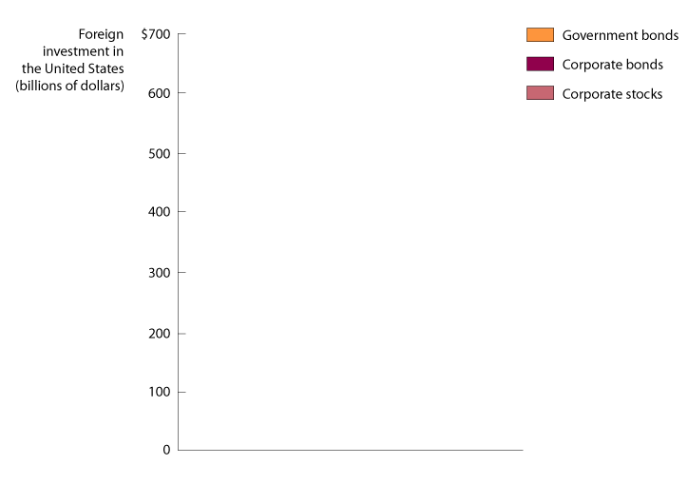
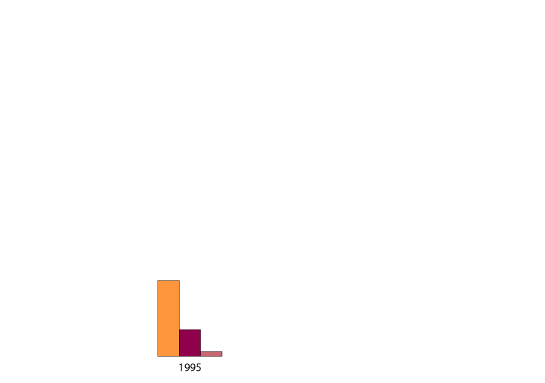
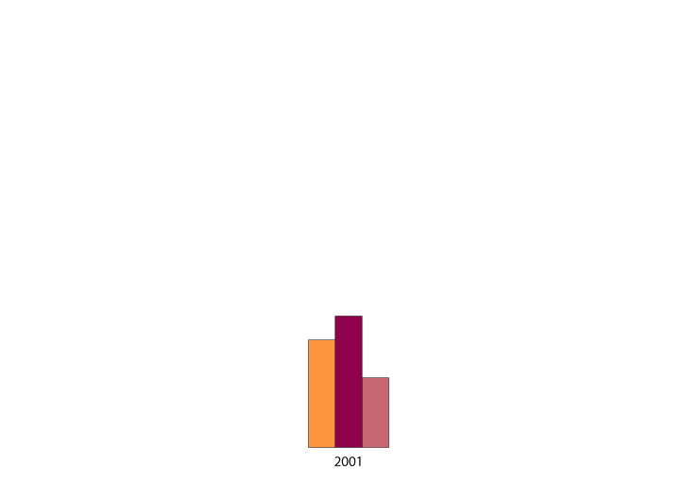
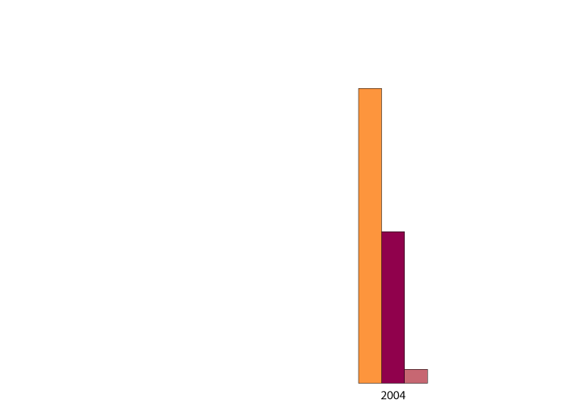
International Capital Markets
3
LEARNING OBJECTIVE
18 - 5
Growth of Foreign Portfolio Investment in the United States

Slide 25
By 2005, corporations, banks, and governments had raised more than __________ in funds on global financial markets.
a. $1 billion
b. $10 billion
c. $100 billion
d. $1 trillion

Slide 26
By 2005, corporations, banks, and governments had raised more than __________ in funds on global financial markets.
a. $1 billion
b. $10 billion
c. $100 billion
d. $1 trillion

Slide 27
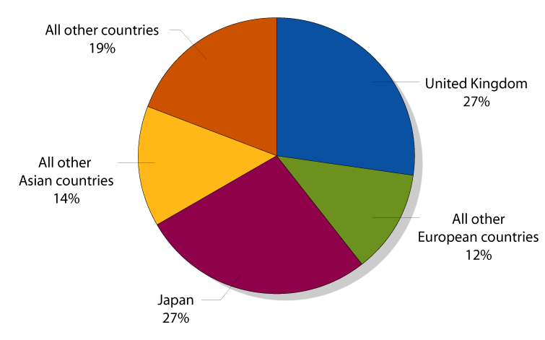
International Capital Markets
18 - 6
The Distribution of Foreign Purchases of U.S. Stocks and Bonds by Country, 2004

Slide 28
The three most important international financial centers today are:
a. Zurich, Paris, and Montreal.
b. New York, London, and Tokyo.
c. Seoul, Moscow, and Buenos Aires.
d. None of the above. All financial centers today are equally important.

Slide 29
The three most important international financial centers today are:
a. Zurich, Paris, and Montreal.
b. New York, London, and Tokyo.
c. Seoul, Moscow, and Buenos Aires.
d. None of the above. All financial centers today are equally important.

Slide 30

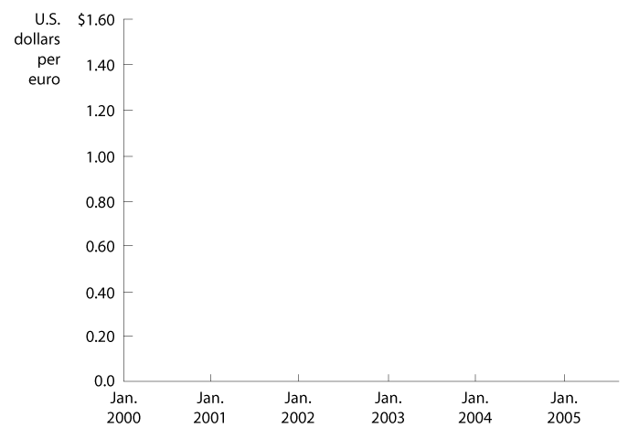
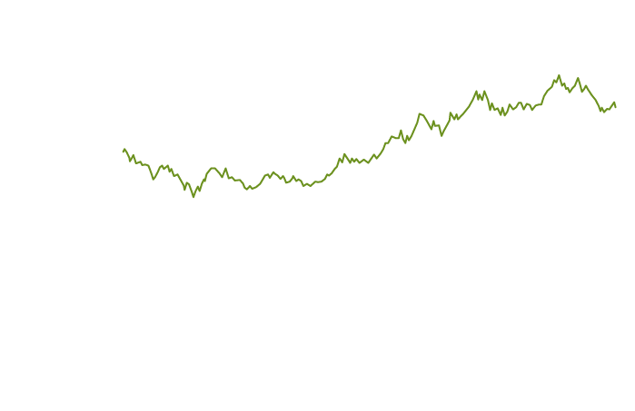
Strong Euro Bedevils EU Firms

Slide 31

Euro
Exchange rate system
Fixed exchange rate system
Floating currency
Managed float exchange rate system
Pegging
Purchasing power parity
Quota
Tariff

Slide 32
Appendix 18: The Gold Standard and
The Bretton Woods System
The Gold Standard
The End of the Gold Standard

Slide 33
Appendix 18: The Gold Standard and
The Bretton Woods System
The Bretton Woods System
Bretton Woods System An exchange rate system that lasted from 1944 to 1971, under which countries pledged to buy and sell their currencies at a fixed rate against the dollar.
International Monetary Fund (IMF) An international organization that provides foreign currency loans to central banks and oversees the operation of the international monetary system.

Slide 34
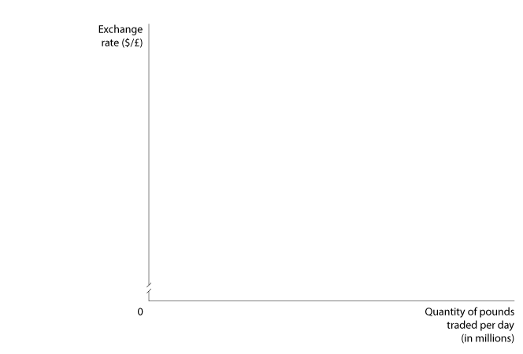
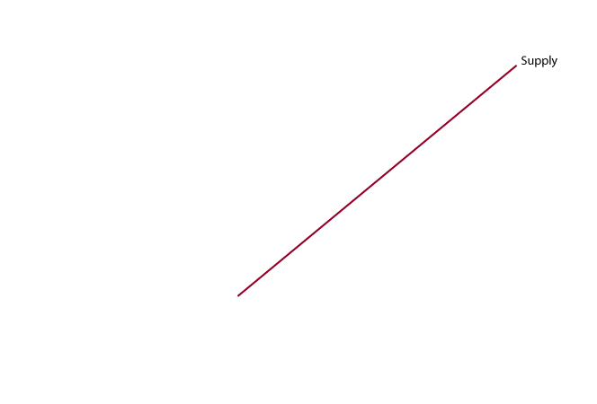
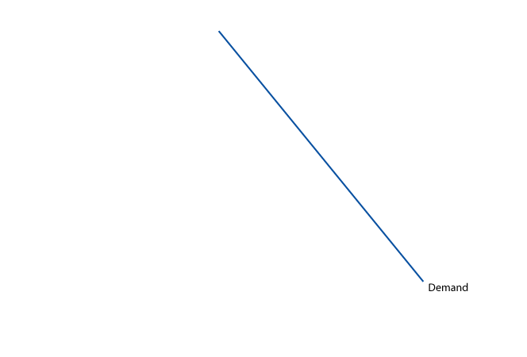
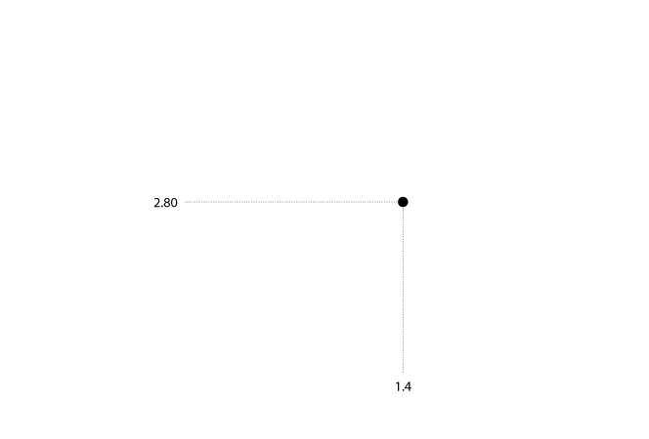
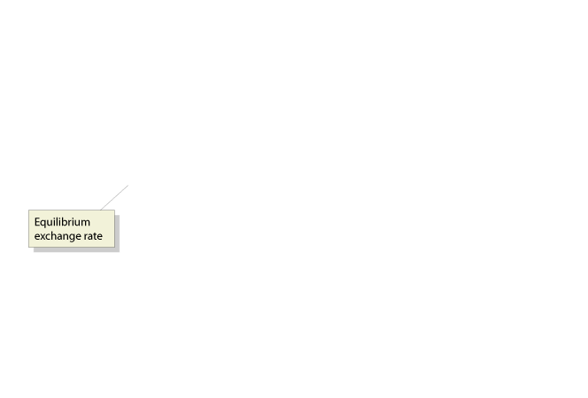
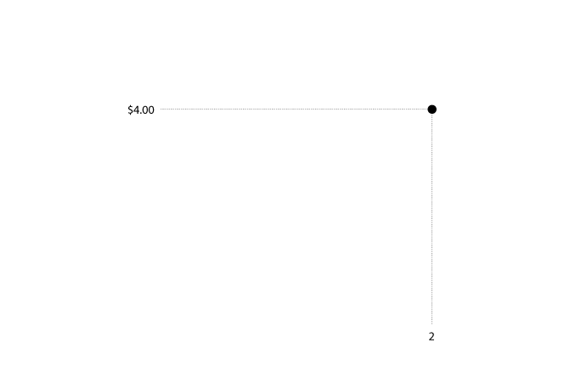
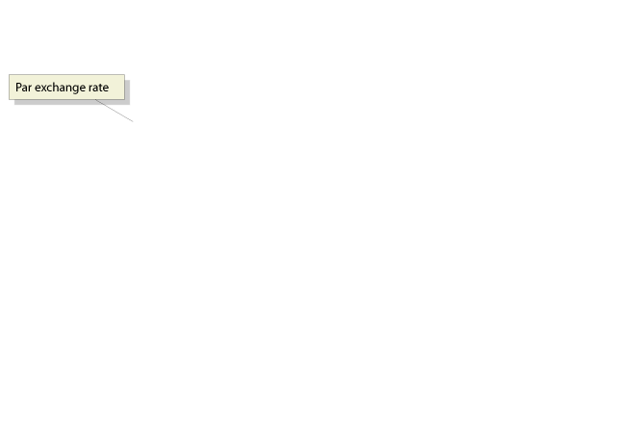
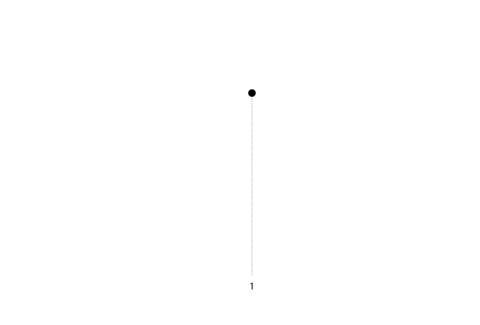
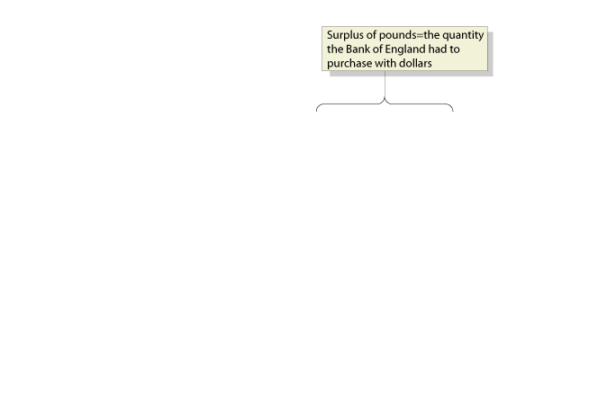
Appendix 18: The Gold Standard and
The Bretton Woods System
The Bretton Woods System
18A - 1
A Fixed Exchange Rate above Equilibrium Results in a Surplus of Pounds

Slide 35
The Bretton Woods System was:
a. An agreement between participating countries to reduce trade barriers.
b. An agreement in which central banks pledged to buy and sell their currencies at a fixed rate against the dollar.
c. An agreement in which the exchange rate between two currencies was automatically determined by the quantity of gold in each currency.
d. An agreement in which countries could go off the gold standard to allow their central banks to expand the money supply and pay for war expenditures.

Slide 36
The Bretton Woods System was:
a. An agreement between participating countries to reduce trade barriers.
b. An agreement in which central banks pledged to buy and sell their currencies at a fixed rate against the dollar.
c. An agreement in which the exchange rate between two currencies was automatically determined by the quantity of gold in each currency.
d. An agreement in which countries could go off the gold standard to allow their central banks to expand the money supply and pay for war expenditures.

Slide 37
Appendix 18: The Gold Standard and
The Bretton Woods System
The Bretton Woods System
Devaluation A reduction in a fixed exchange rate.
Revaluation An increase in a fixed exchange rate.

Slide 38
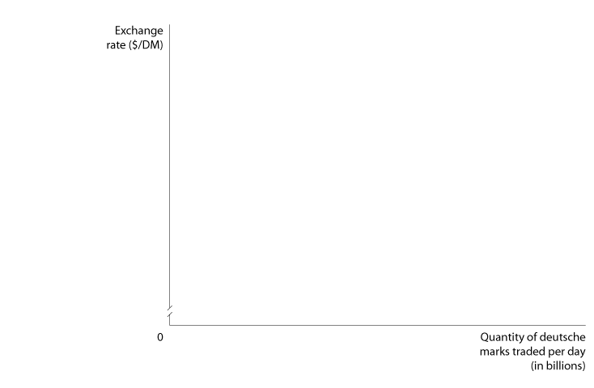
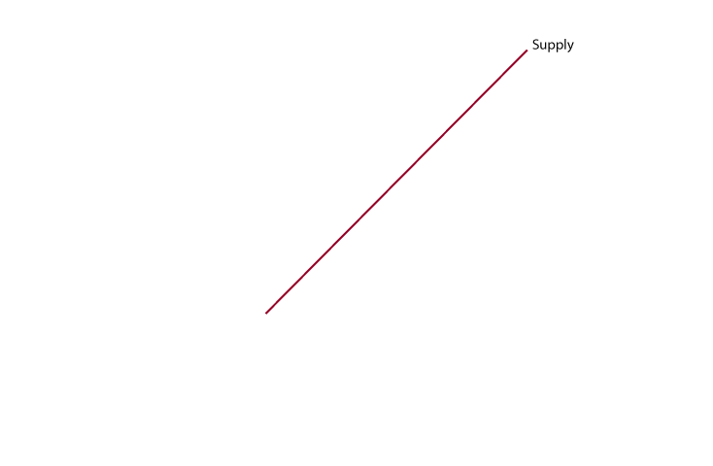
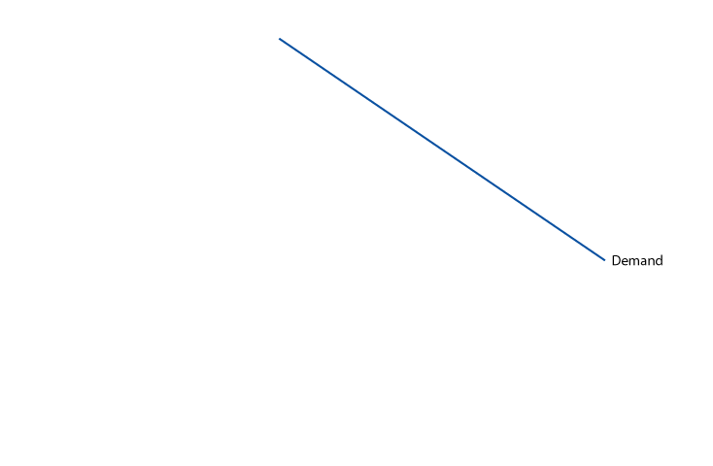
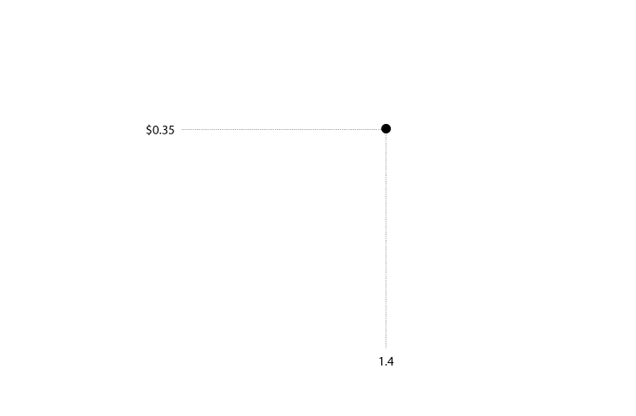





Appendix 18: The Gold Standard and
The Bretton Woods System
The Collapse of the Bretton Woods System
18A - 2
West Germany’s Undervalued Exchange Rate

Slide 39
Which of the following periods marks the collapse of the gold standard?
a. The beginning of the 1930s.
b. The end of the 1930s.
c. The beginning of the 1940s.
d. The period immediately following World War II.

Slide 40
Which of the following periods marks the collapse of the gold standard?
a. The beginning of the 1930s.
b. The end of the 1930s.
c. The beginning of the 1940s.
d. The period immediately following World War II.

Slide 41





Appendix 18: The Gold Standard and
The Bretton Woods System
The Collapse of the Bretton Woods System
Capital controls Limits on the flow of foreign exchange and financial investment across countries.
18A - 3
Destabilizing Speculation against the Deutsche Mark, 1971

Slide 42
Which of the following factors contributed to the collapse of the Bretton Woods system?
a. After 1963, the total number of dollars held by foreign central banks was larger than the gold reserves of the United States.
b. The credibility of the U.S. promise to redeem dollars for gold was called into question.
c. Some countries with undervalued currencies, particularly West Germany, were unwilling to revalue their currencies.
d. All of the above.

Slide 43
Which of the following factors contributed to the collapse of the Bretton Woods system?
a. After 1963, the total number of dollars held by foreign central banks was larger than the gold reserves of the United States.
b. The credibility of the U.S. promise to redeem dollars for gold was called into question.
c. Some countries with undervalued currencies, particularly West Germany, were unwilling to revalue their currencies.
d. All of the above.

Slide 44
Bretton Woods System
Capital controls
Devaluation
International Monetary Funds (IMF)
Revaluation

