Slide 1
Tutorial 2
Creating & Maintaining a Database

Slide 2
Objectives
Guidelines to design a database and Tables
Create/Save a Table
Modify Table structure/Field properties
Add/Delete/Move records/fields
Modify the structure of a table
Copy records from another Access database

Slide 3
Typical Development Steps
Task analysis: Access, Oracle, SQL?
Task flow layout: Sales, Accounting?
Data analysis: Convert, new?
Data design: Add/delete fields?
Prototyping, UI design
Application construction
Testing, reviewing, fine tuning

Slide 4
Designing a Table
Identify all needed fields
Group all related fields into tables
Make sure consist field names in different tables
Determine primary key/field properties
Avoid data redundancy
Field Name
Field Data Type
Field Description

Slide 5
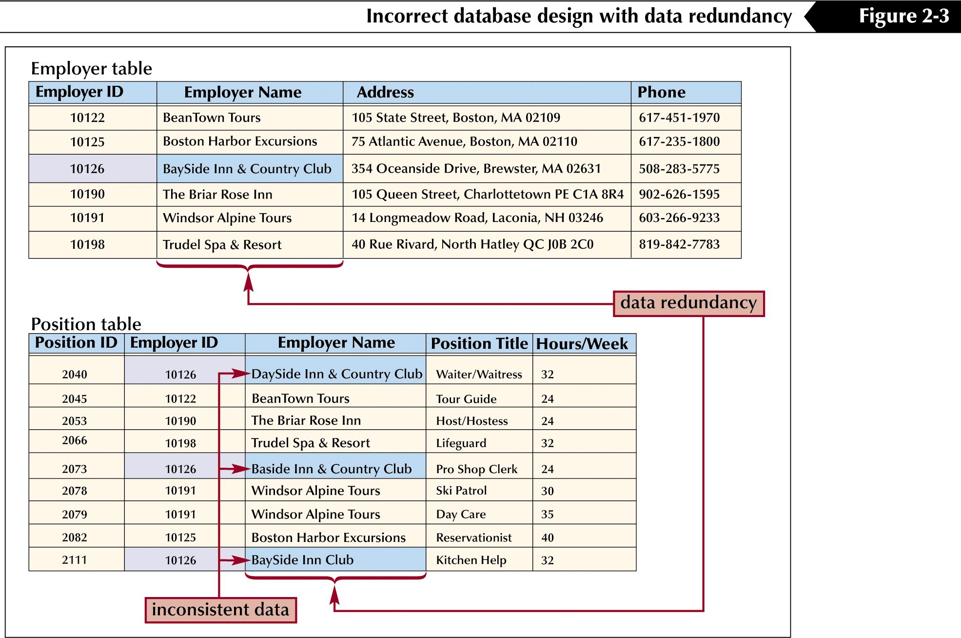
Data redundancy wastes space and can lead to data errors

Slide 6
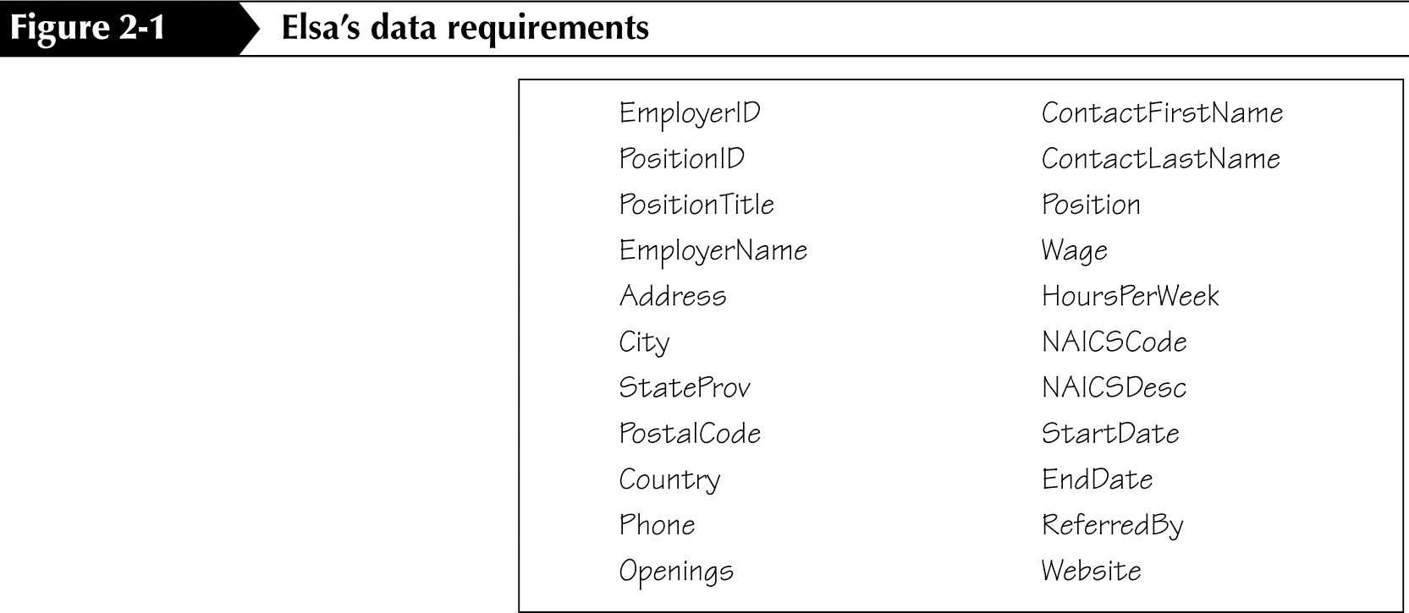
Determining database fields

Slide 7
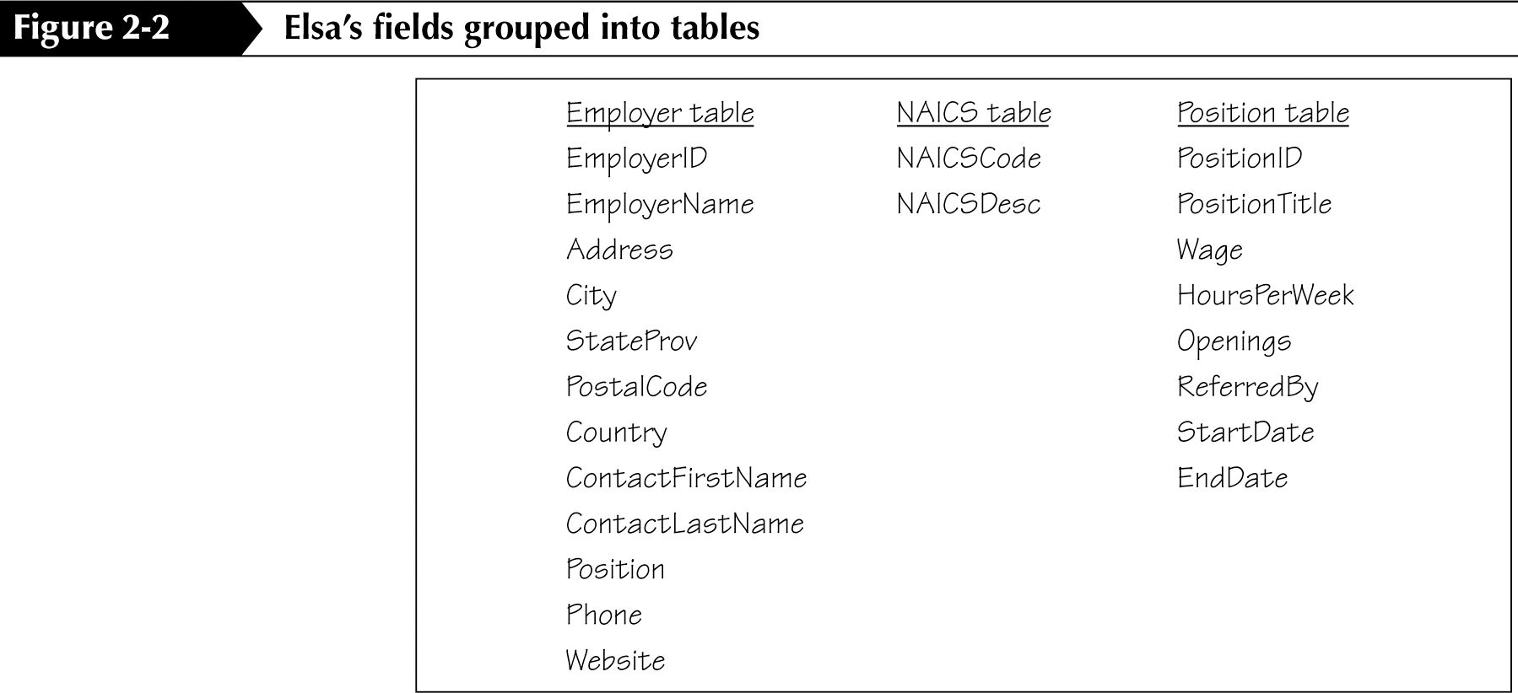
Group the fields into tables

Slide 8
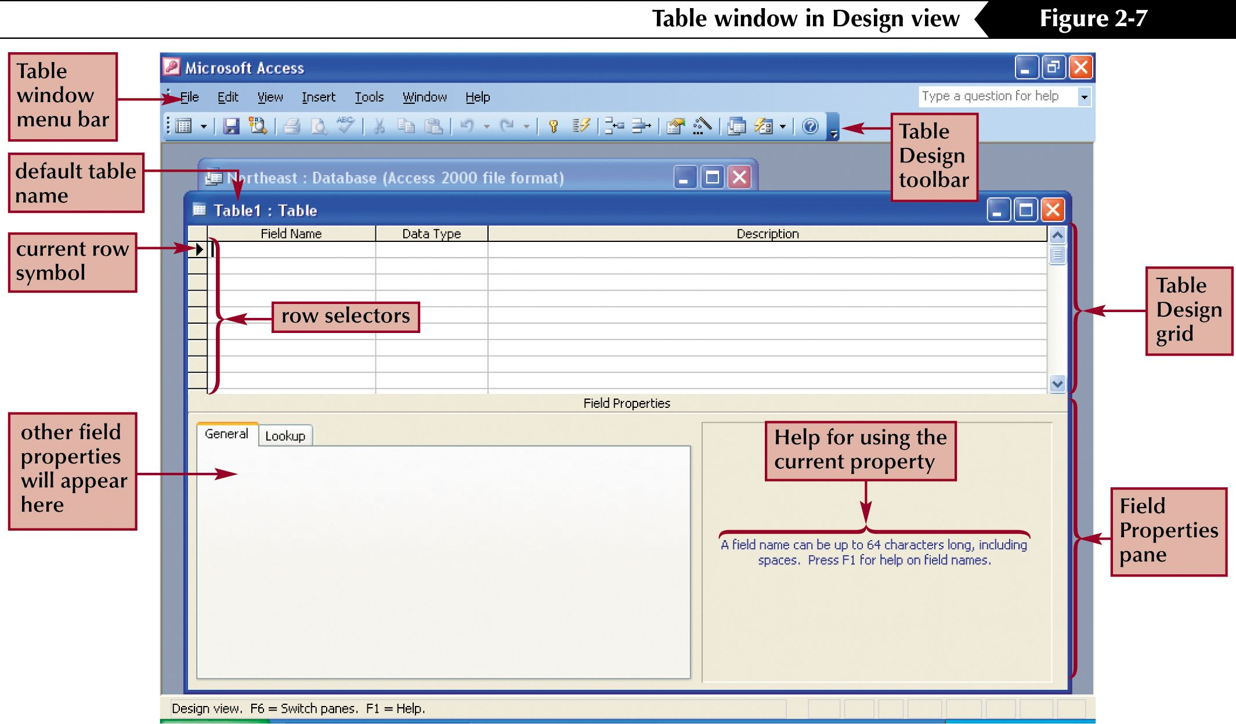
The database Design View window

Slide 9
Name Fields and Objects
Up to 64 characters long
No . ! ‘ [ ]
Not begin with a space
Capitalize the first letter of each word
Standard abbreviations: Qty, Amt, LName
Avoid long name

Slide 10
Field Data Types
Text: 50 characters default, up to 255
Memo: up to 65,535 characters
Number: 1-15 digits, +,-, decimal, commas
Date/Time: 8 digits, long or short
Currency: 15 digits, $
AutoNumber: 9 digits
Yes/No: 1 character
OLE:object linking & embedding, 1Gb max

Slide 11
Field Data Types (cont.)
Hyperlink: help to connect Internet or Intranet
Lookup Wizard: Need to create Tables/Queries first

Slide 12
Field Description
Remarks for field you named
Notes for others about what is in this field

Slide 13
Field Properties
Field size: the size of Text field
Format: the way to display
InputMask: set data input the mask you want, TEL, SS#, ZIP etc.
Caption: the field name will be displayed in OPEN view
DecimalPlaces: only to Number/Currency

Slide 14
Field Properties (2)
DefaultValue: a certain value for each new record you add
ValidationRule: Limit data entered to meet requirement
ValidationText: if data is invalid, display this Text
Required: Enter data or you can not go!
Indexed: for a quick search (see next slide)

Slide 15
Indexes
Setting NO: do not create an index on this field or delete existing index
Setting YES(Duplicates OK): Create an index on this field
Setting YES(No duplicates): Create a Unique index

Slide 16
Primary Key(PK)
Uniquely identifies each record in a Table
No duplicate values in the Primary key field
Force to enter a value
No null value allowed
Dual PK (composite Key)

Slide 17
Work with Records
Enter Record:R-click
Add Record
Delete Record: R-click
Save Record/Database

Slide 18
Work with Fields
Add a Field: R-click
Move a Field: select the row
Delete a Field: R-click
Change Field Property

Slide 19
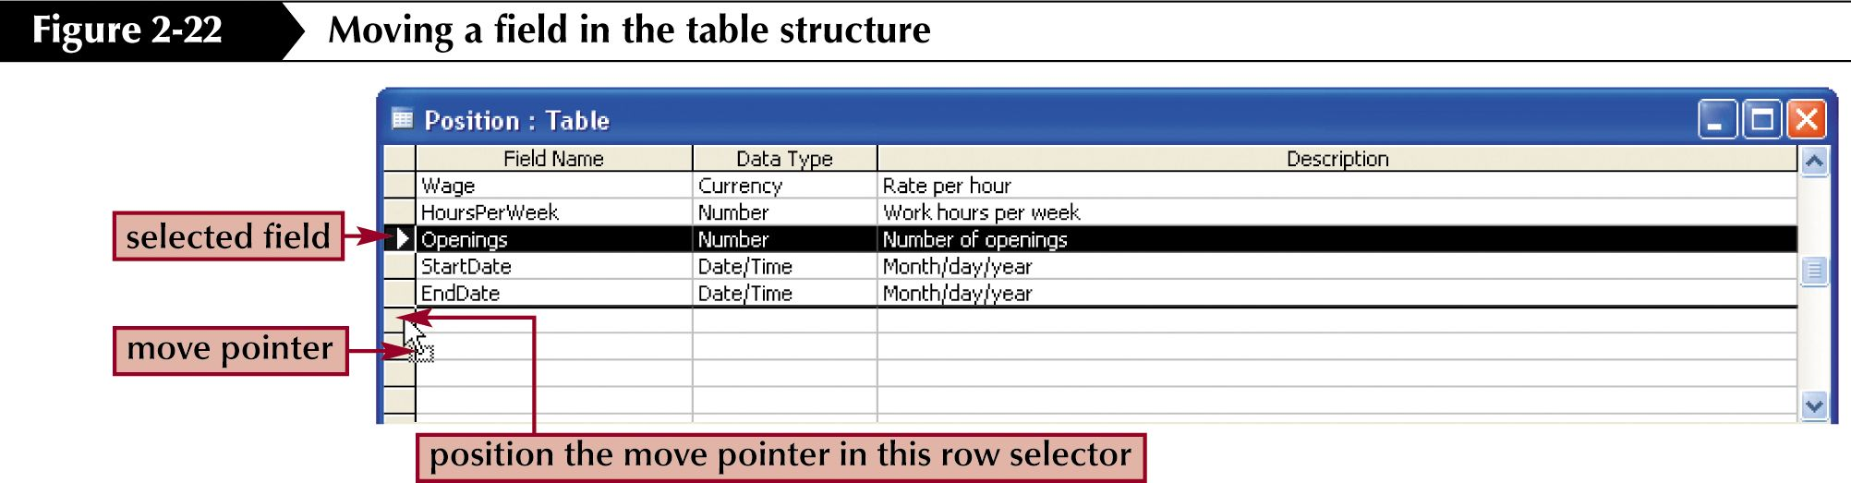
Moving a field in Design View

Slide 20
Copy records from another table/database
Same structure
Source database: select (highlighted) records
  Click upper left corner if copy all records
Copy, close the source database
Open the target database
Click the row selector (available row for new records
Paste

Slide 21
Import a table from another Access database
To import a database table:
  Click the File menu
  Point to Get External Data, and then Import
  Locate and select the database and the table you want to import
This differs from the cut and paste method because you actually import the entire table, its structure, and its data.

Slide 22
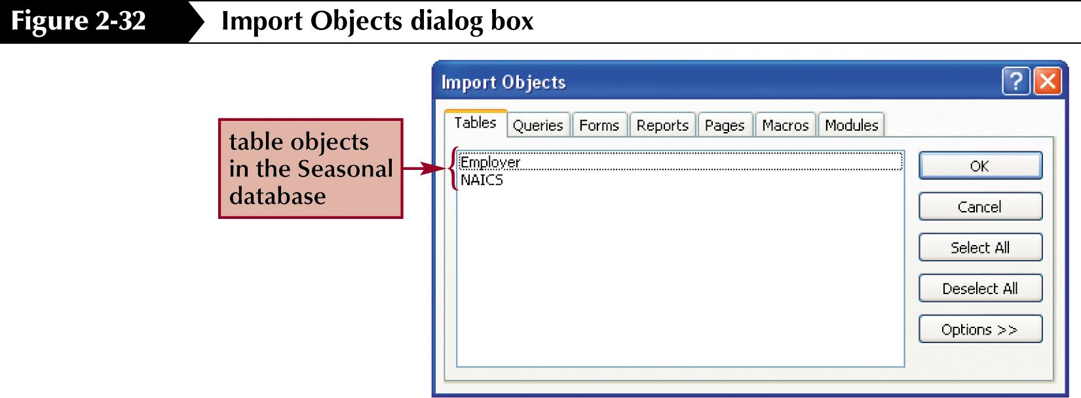
The Import Objects dialog box

Slide 23
Copy and import considerations
If you choose to copy records from one table to another, it is very important that you first determine that the two tables have the exact same data structure.
  If the two data structures differ in any way, the copy will cause an error
When you import, you are importing an entire table, including its data and its structure.
  This is a good way to include a table in your database that was previously designed in a different database

Slide 24
Delete and change records
Once records have been added to a table, they can be deleted or modified:
  In Datasheet view, click the row selector for the record(s) you want to delete and then click the Delete Record button on the toolbar
To change or modify a record:
  Place your cursor on the record and then on the field you want to change
  You can then edit the field's value as you wish by typing in new data
You can switch from navigation mode to editing mode depending on what you want to do at the time.
  When you are editing a record, you are in editing mode, Otherwise you are in navigation mode
  Editing mode is indicated by a pencil symbol in the left margin of the datasheet view

Slide 25
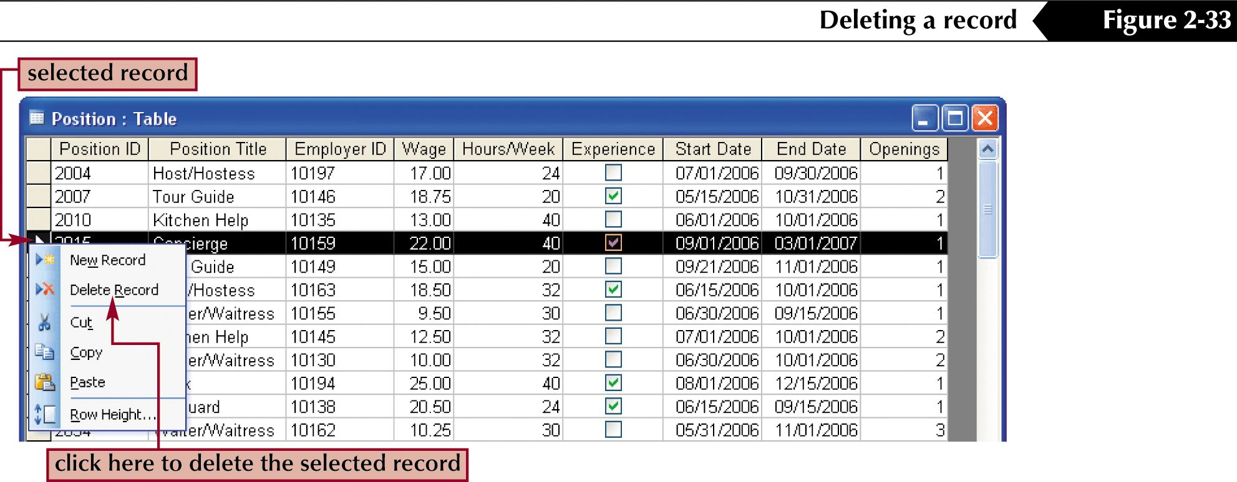
An alternate method for deleting a record

Slide 26
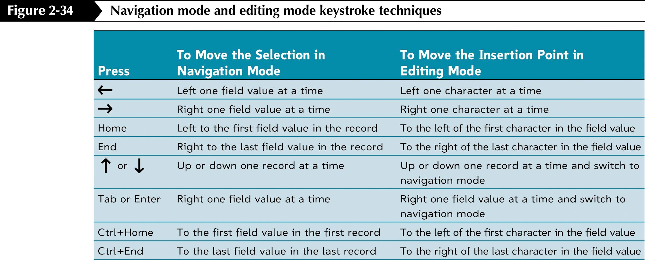
Keystroke techniques for navigation and editing modes

