Slide 1
Tutorial 11
Using and Writing Visual Basic for Applications (VBA) Code

Slide 2
Objectives
Function procedures
Sub procedures
Modules
Create event procedures
Compile, Test procedures

Slide 3
Function procedures,
Sub procedures
Statements are grouped together into procedures, which can be either a function or a Sub procedure.
Function: performs operations, returns values, accepts input values, be used in expressions
Sub procedure: performs operations, accepts input values

Slide 4
Modules
Common procedures are usually stored together into a module.
A module can be a standard module (stored in memory with other database objects) or it can be a class module (stored in association with a particular form or report).
With class modules, the procedures are available by the form or report for which the class module was created.

Slide 5
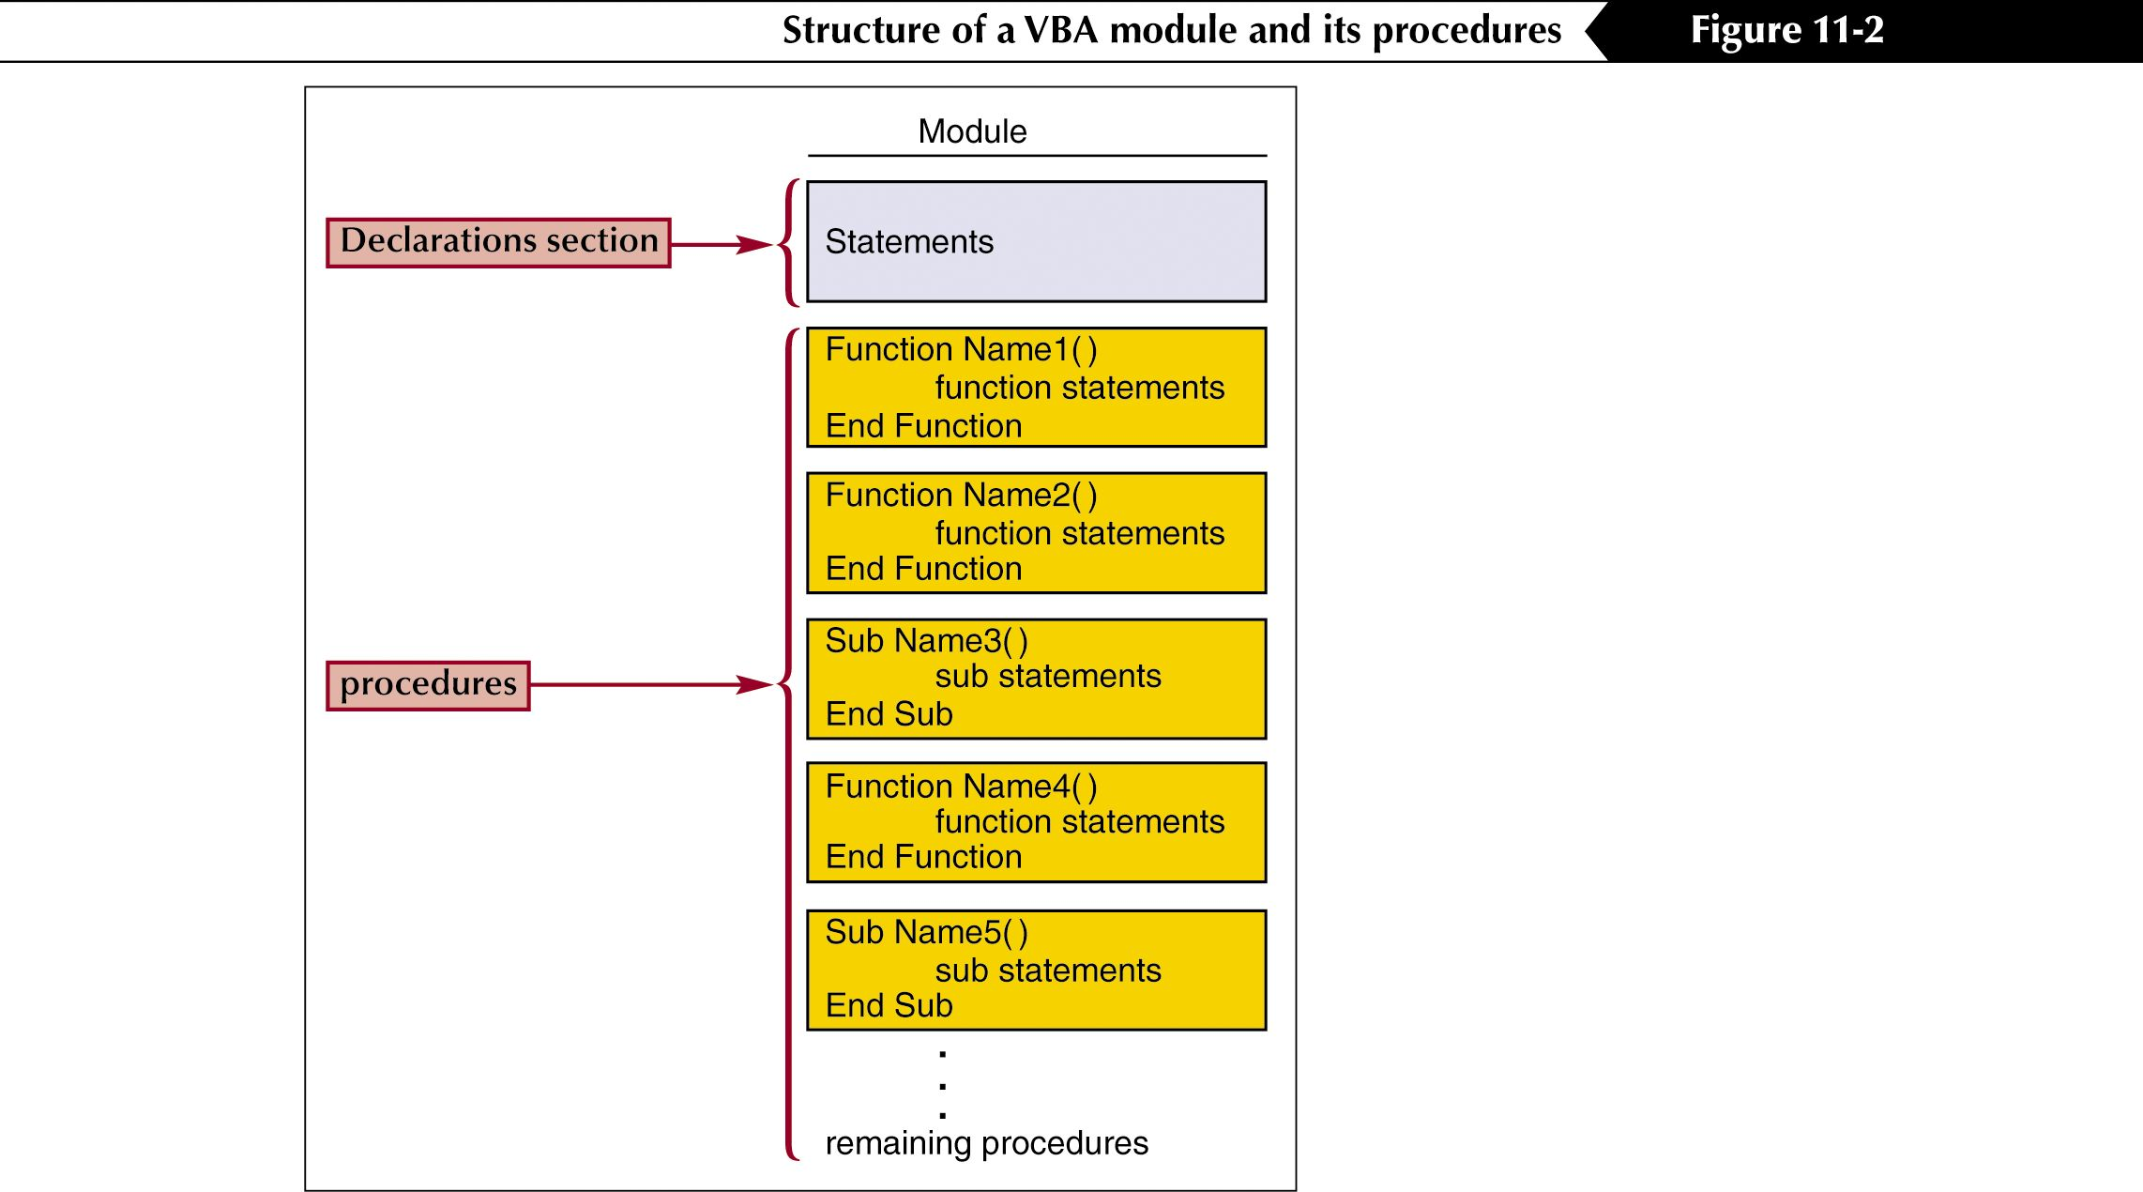
The structure of a VBA module

Slide 6
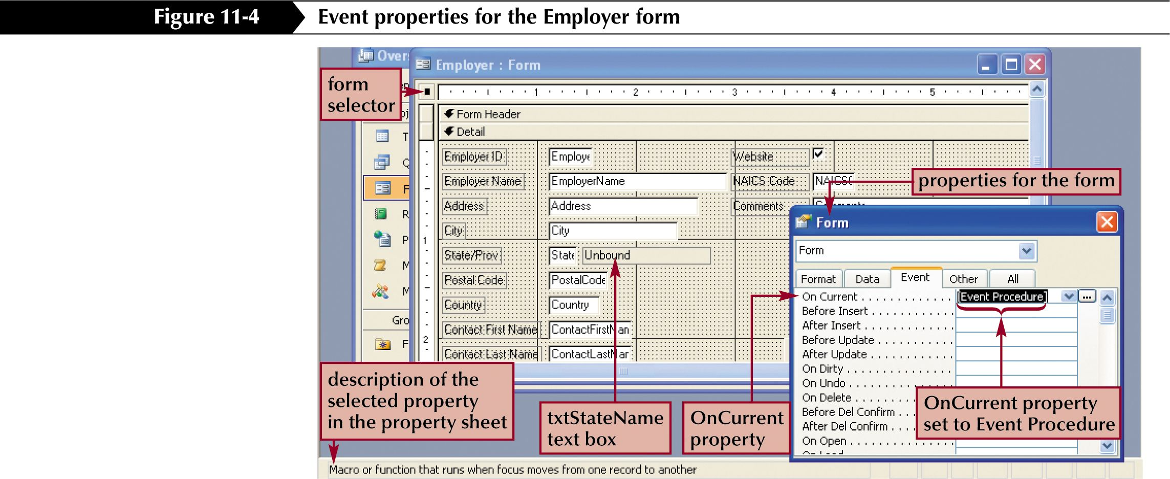
Event properties for a form

Slide 7
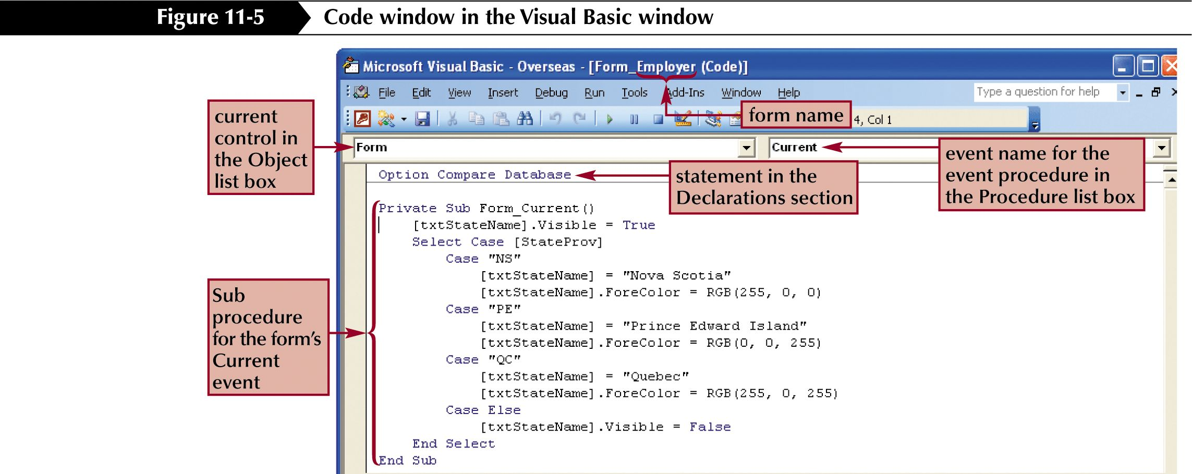
The Visual Basic Code window

Slide 8
Recognize VBA statements
statements that you will recognize:
  The first statement is the Private Sub statement
  The last statement is the End Sub statement
In this sample code, the ForeColor is changed under certain circumstances.
  The code used the RGB function, which will return a specified colored by using combinations of Red, Green, and Blue

Slide 9
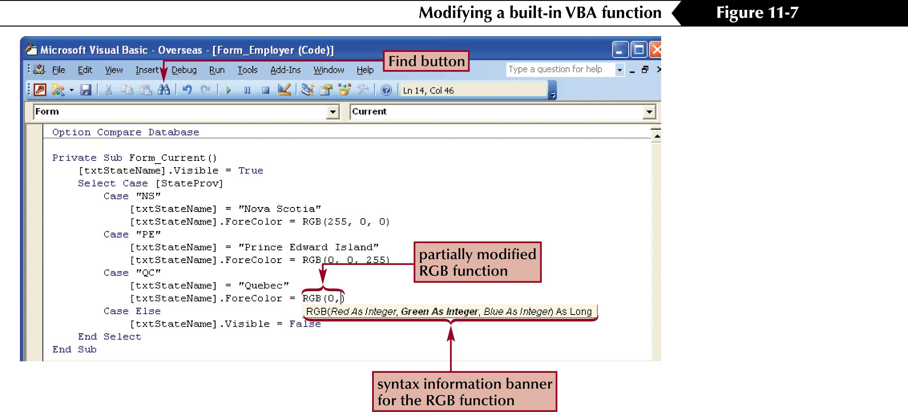
A function that modifies an object’s color

Slide 10
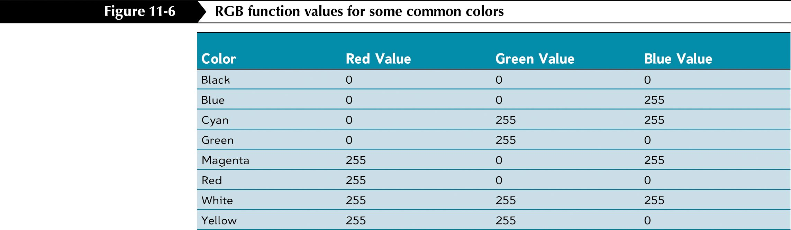
RGB values for some colors

Slide 11
Create Function procedures
To create new procedures click Modules on the objects bar and then click New.
To write a Sub procedure,begin with the Sub statement.
To write a Function procedure, begin with the Function statement.
The Function will end with the End Function statement.

Slide 12
Assign a name to a function
The Function statement is then followed with the name of the function.
If you will be passing values to the Function, the Function name is followed by a Parameter list.
When you pass a value to a Function, it is called an argument.
When naming a Sub procedure or a function, you must follow the rules for naming objects.

Slide 13
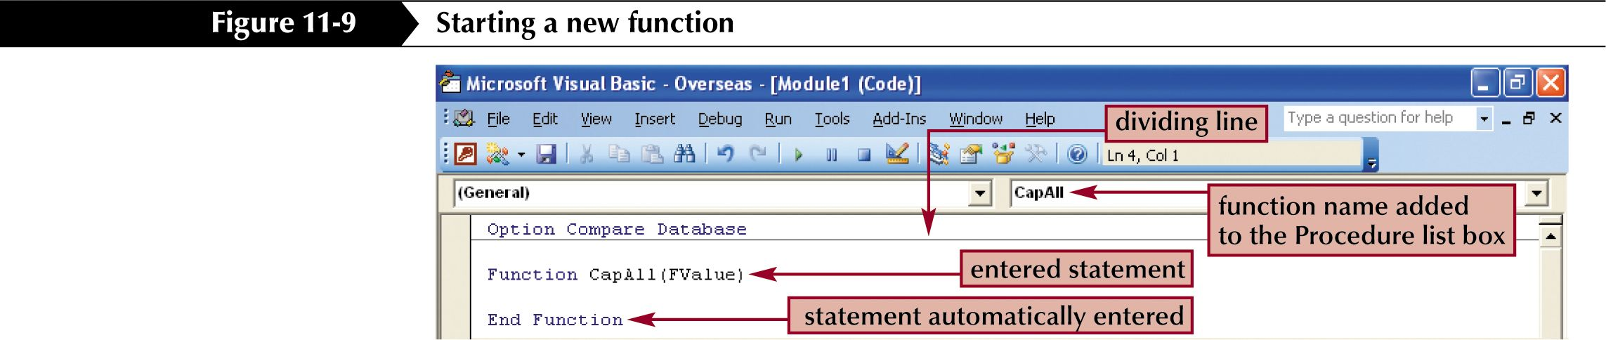
Define a function in the Code window

Slide 14
Name and save your module
When you click the Save button, you will be prompted to supply a name for the module.
Recall that a module will hold a collection of procedures so you will want to name the module something that will indicate what is inside the module.

Slide 15
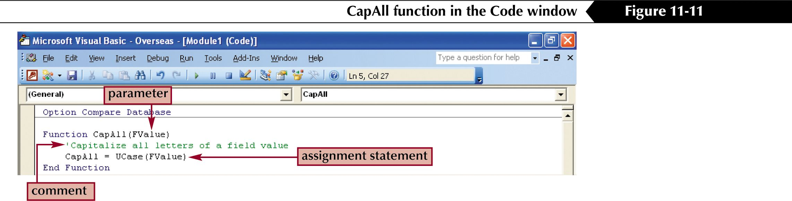
Use comments in your functions

Slide 16
Create event procedures
VBA is an event-driven language, meaning that when events takes place, procedures are triggered.
All event procedures are Sub procedures.
Access will automatically name the event in a standard way, which includes:
  The name of the control
  An underscore
  The event name

Slide 17
Add an event procedure
To add an event procedure to a class module:
  Open the object to which it will be attached
  Open its property sheet
  On the Event tab, select the event that will trigger the function
Before you run your procedure, it must first be compiled.
The process of compilation is the process of converting the code to a format the computer can understand.

Slide 18
Use the If statement
The If statement provides a condition and then if the condition is true, a set of statements is executed; if it is false, a different set of statements is executed.
The If statement created in your tutorial incorporates the IsNull function into it.
The IsNull function returns a True value if the argument is empty (no text) and it returns a False value if the argument is not empty.

Slide 19
IF
IF logical test Then statement if true
Else statement if false
End if
logical test: condition, either true or false
False
True
Logical test
Value if false
Value if true

Slide 20
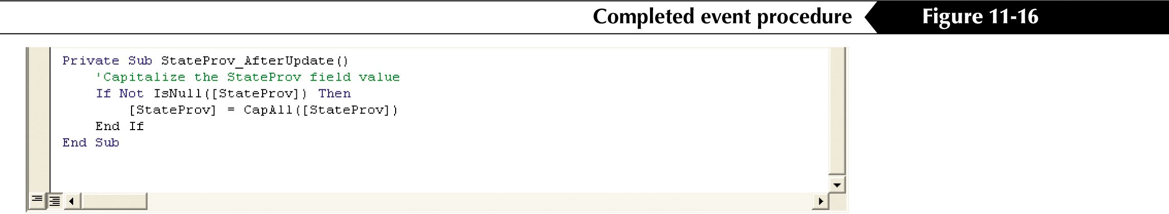
An example of an If statement

Slide 21
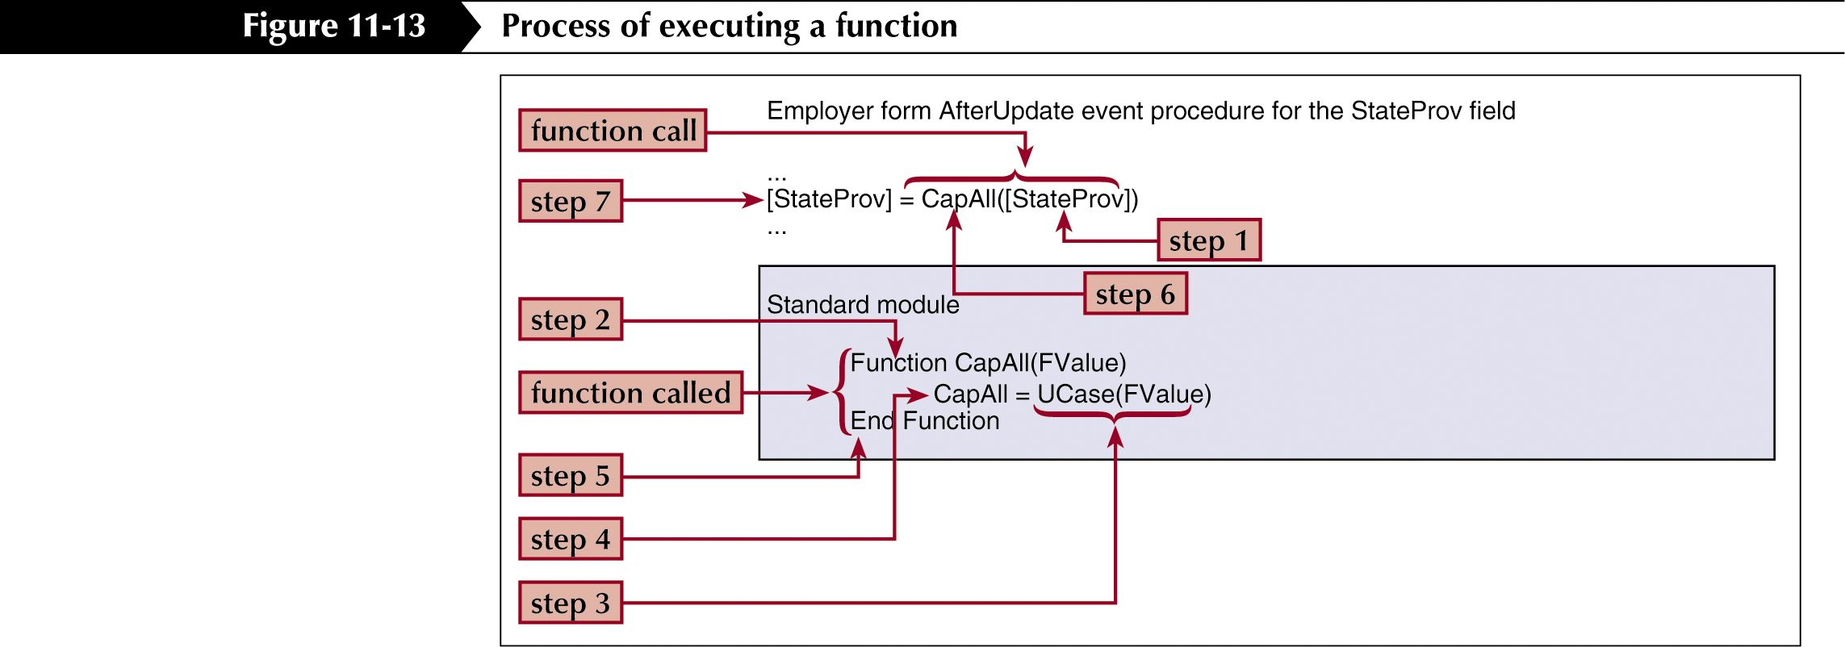
The function execution process

Slide 22
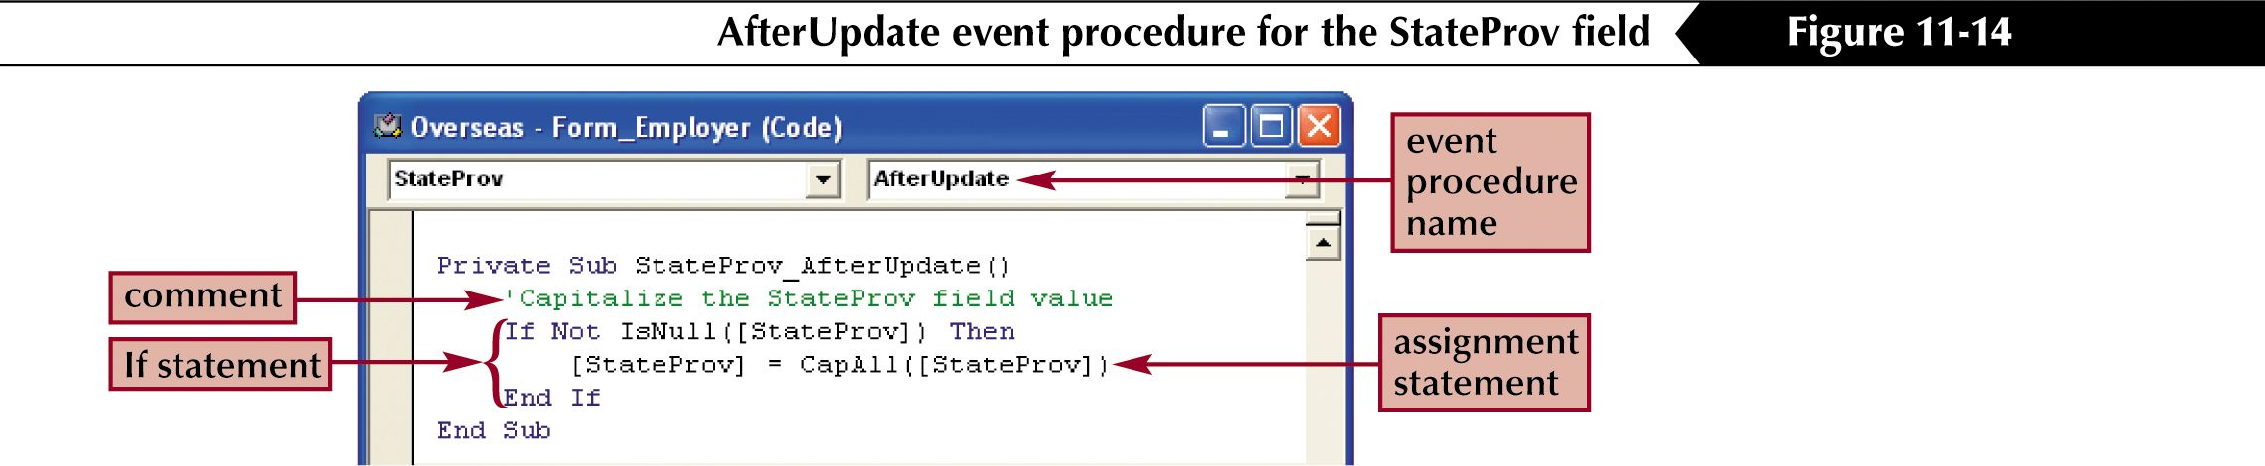
An example of an event procedure

Slide 23
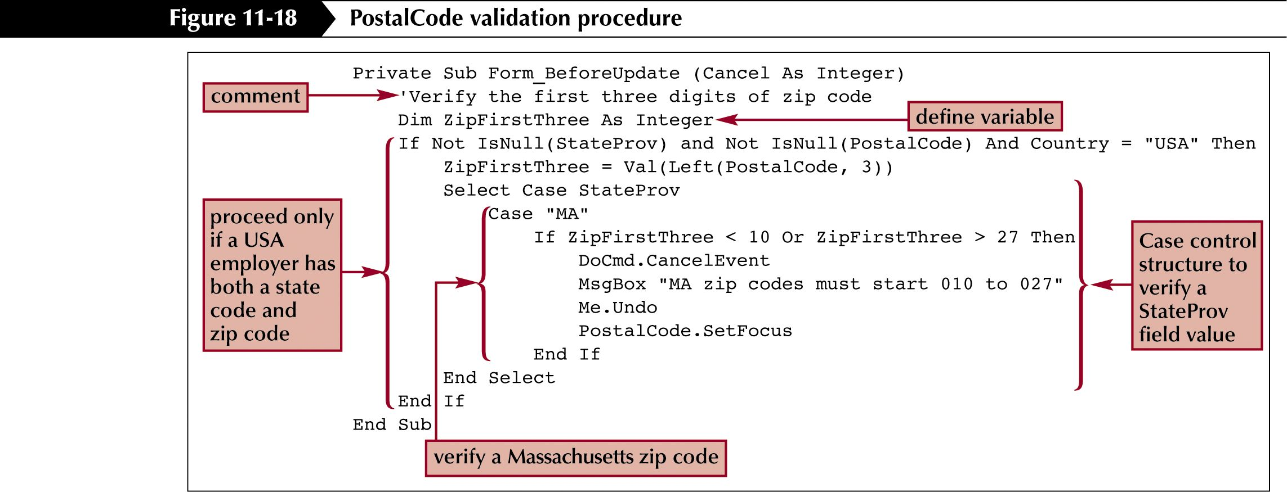
Declare variables in functions and procedures

Slide 24
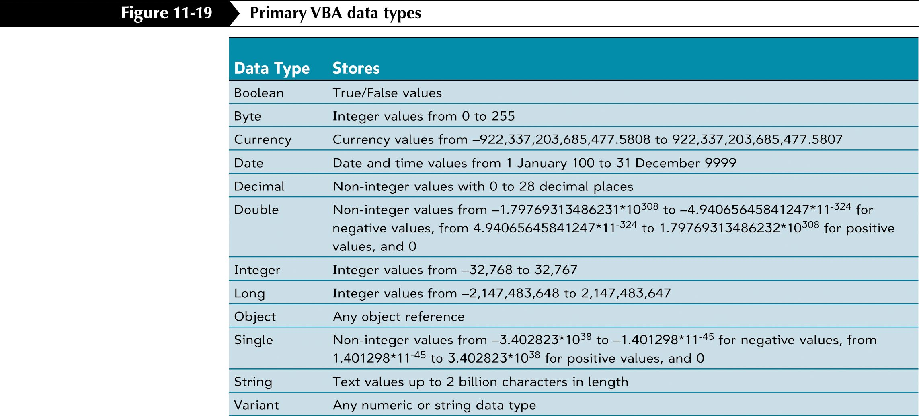
Primary VBA Data Types

Slide 25
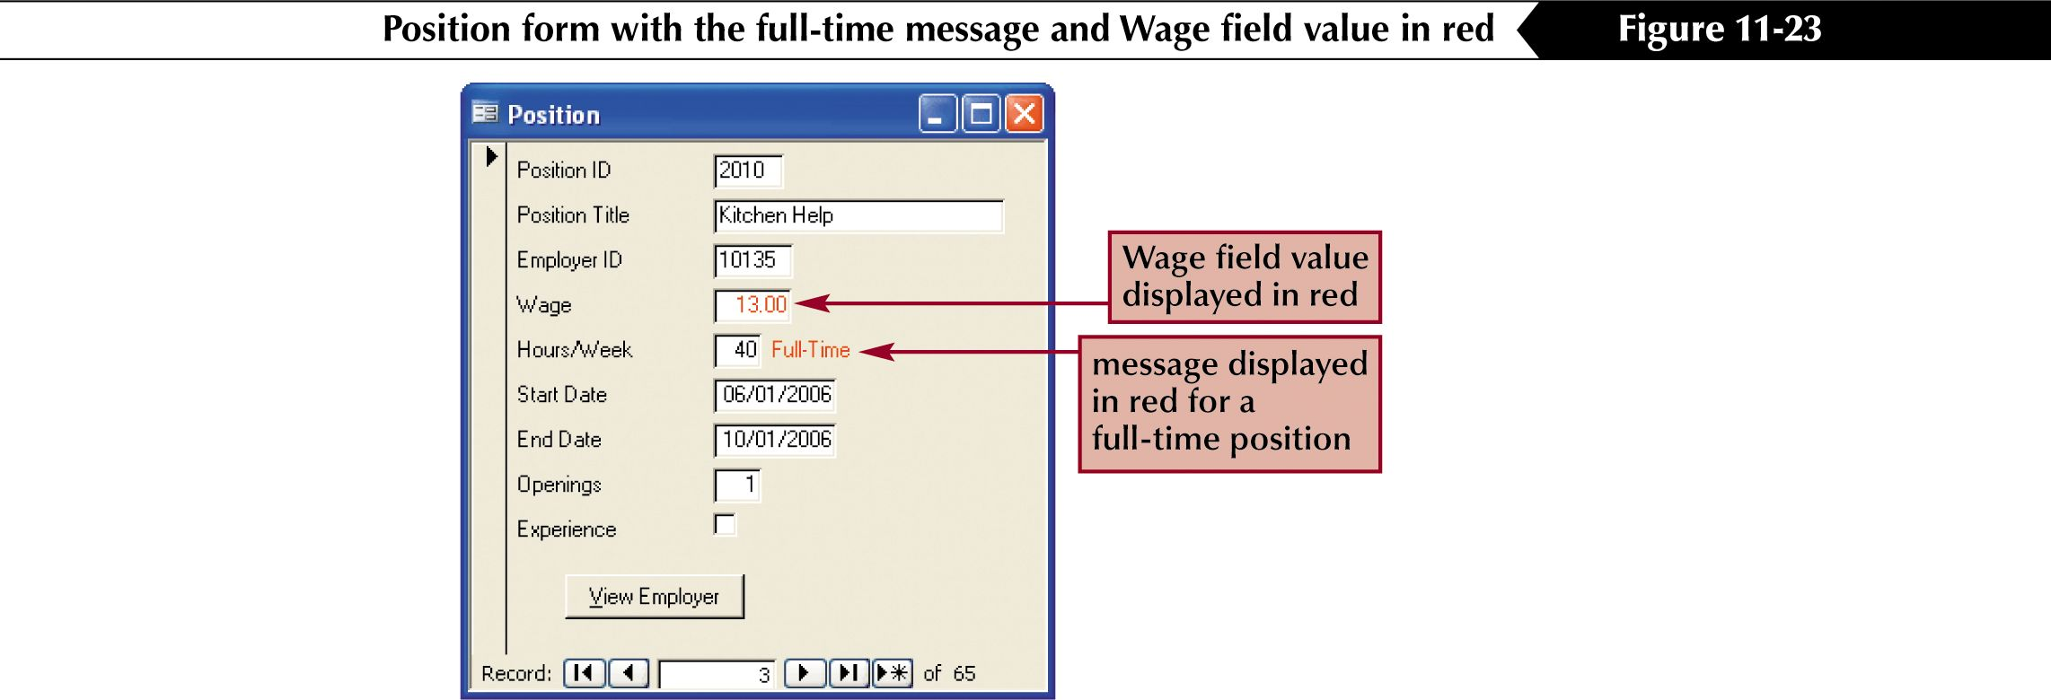
Hiding and Changing Display Colors

Slide 26
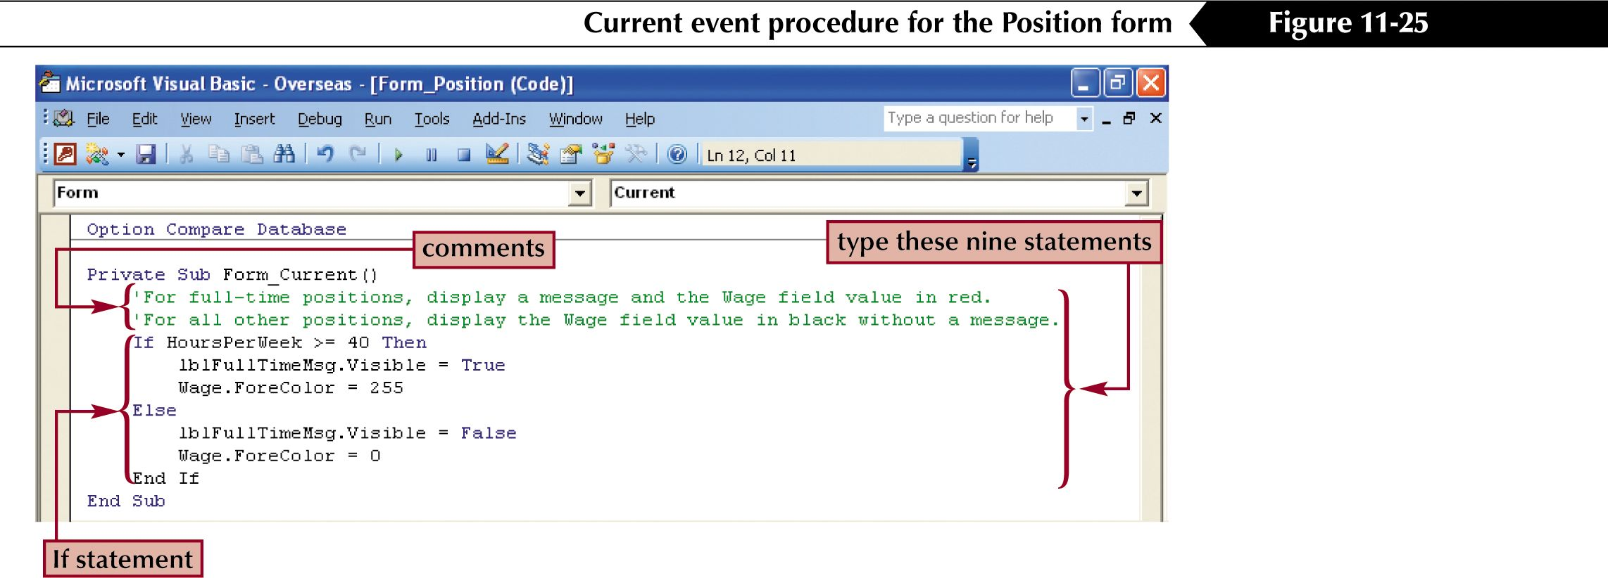
An event procedure to modify properties

Slide 27
UI Design Tips (1)
Avoid to pull too much information on screen
Data entry as Logical as Possible
Use Modal forms for critical data entry
Use Text as an aid
Include useful Hot keys for menus
Set Docking status to avoid custom menu/toolbar loss
Informative graphics on command buttons
Display/hide buttons/fields as needed (visible property)

Slide 28
UI design tips (2)
Check boxes, List boxes
Leave white space around forms
Add help to applications
  Status bar and Control tip help
Minimize unnecessary graphics
Use color wisely
Implement clear/concise error messages

Slide 29
Select…Case….End Select
Select Case SalesGrade
Case 1
Incentive = Commission * .15
Case 2, 3
Incentive = Commission * .12
Case Is >4
Incentive = Commission * .9
Case Else
Incentive = 0
End Select

Slide 30
With statement
DoCmd.OpenTable “tblOrders”
DoCmd.GoToControl “Lastname”
change to
With DoCmd
.OpenTable “tblOrders”
.GoToControl “Lastname”
End With

Slide 31
If….Then….Else
If TypeFilter = 1 Then
txtState.visible= False
Else
txtState.visible = True
End If

Slide 32
Do While….Loop
Run the Loop as long as the test is TRUE
  Do While logical test is TRUE
  Statements
  Loop
  ------------------------------
  Do
  Statements
  Loop While logical test is TRUE
Which one will execute statements at least once ?

Slide 33
Do…Loop until
Run the Loop Until the test becomes TRUE
  Do Until logical test becomes TRUE
  Statement
  Loop
  ------------------------------
  Do
  Statements
  Loop Until logical test becomes TRUE

Slide 34
Do…While example
iCount=1
Do While iCount<3
  Print iCount
  iCount = iCount+1
Loop

Slide 35
Do…Loop Until example
iCount = 1
Do
  Print iCount
  iCount = iCount + 1
Loop Until iCount >= 3

Slide 36
While….Wend
While test-is-true
  Statements
  Wend
  -------------------------------------
  Counter = 1
  While Counter < 10
  Print Counter
  Counter = Counter + 1
  Wend

Slide 37
For…Next Loop
For counter=StartValue To EndValue [Step StepValue]
  Instructions
  Next [counter]
  --------------------------------------------------
  For iCount = 1 To 3 Step 1
  Print iCount
  Next iCount

Slide 38
Customize Menu bar, Toolbar and Shortcut menu
View|Toolbars|Customize… or R-click menu
Toolbars tab: show or hide toolbars by check box
Commands tab: add various commands to existing menus/toolbars, or new command bars
Options: control the size of toolbar etc.

Slide 39
Toolbar
Click New button
Type the new toolbar name
Click Properties to modify the Type property
Click command tab
DnD the commands into this new toolbar
Any change should be in Customize window

Slide 40
Toolbar Properties
Selected Toolbar: name of the toolbar
Toolbar Name: name of the toolbar
Type: Toolbar, Menu Bar, Popup (shortcut menu)
Docking: how use can dock your menu
Show….: appear on the default View|Toolbar
Allow….: you should understand them

Slide 41
Menu
Creating a New Menu
  View|Toolbar|Customize|Command|New Menu
R-click menu: modify name and other properties
Create a submenu (same procedure)
Add separator bars into menu bar
  Property|Begin A Group

Slide 42
Creating a Custom Shortcut Menu
R-click menu
View|Toolbar|Customize|Toolbars tab|New
Click this new menu
  Properties|Type|Popup
  Click Shortcut Menus
  Add commands into Shortcut Menu
  Assign this menu to an object
    In design view|property|shortcut menu to pick the menu

Slide 43
How to delete custom Toolbars, Menu, Shortcut menu ?
Need to be in Customize window
Toolbars: Toolbar tab, select the one you want to delete and click Delete button
Menu bar: Command tab, DnD the menu items into Customize window
Shortcut menu: Toolbar tab|Shortcut menu|Properties|Selected Toolbar|Type-toolbar|same as delete Toolbars

Slide 44
Startup Properties (1)
Tools|Startup
Application Title
Application Icon
Menu Bar
Allow Full Menu
Allow Default Shortcut Menu
Display Form/Page

Slide 45
Startup Properties (2)
Display Database Window
Display Status Bar
Shortcut Menu Bar
Allow Built-in Toolbars
Allow Toolbar/Menu Changes
Use Special Access Keys

Slide 46
Disable Bypass Key
Shift key is the Bypass key
Disable the bypass key: a common method to secure database
VBA code to disable, see Help
Include a transparent command button to enable the Shift key

