Slide 1

CIS 1230
Chapter 1
Introduction to Access
Notes:
In this chapter, you will learn about the Access database program.

Slide 2
Objectives
Navigate among objects in Access database
Understand the difference between working in storage and memory
Practice good database file management
Back up, compact, and repair Access files
Create filters
Notes:
The objectives of this chapter include to:
navigate among objects in Access database.
understand the difference between working in storage and memory.
practice good database file management.
back up, compact, and repair Access files.
create filters.
The list of objectives are continued on the next slide.

Slide 3
Objectives (continued)
Sort table data on one or more fields
Know when to use Access or Excel to manage data
Use Relationships window
Understand relational power
Notes:
The objectives also include to:
sort table data on one or more fields.
know when to use Access or Excel to manage data.
use Relationships window.
understand relational power.

Slide 4
Databases are Everywhere!
The Internet uses databases extensively
Every time you are asked to input data, you’re accessing a database
Examples: Google, Ebay and Abercrombie
Notes:
Most Internet sites that ask you to input data use a database. Whether you’re using Google, Ebay, or Abercrombie, you’re interacting with a database that is storing information about you and your purchases.

Slide 5
Objects
What are objects?
Four most commonly used object types
Tables
Queries
Forms
Reports
Two less commonly used object types
Macros
Modules
Notes:
Now, we’ll explore how Access database objects work with table views and how to save changes to database objects.
Objects are the components that make a database function. The four most commonly used object types include tables, queries, forms and reports.
Tables are the foundation of a database—a collection of related records.
Queries are used to extract information from data. Data is the raw material; whereas information is the meaningful output.
Forms allow users to enter information into tables.
Reports are used to produce meaningful output from related tables or queries. Decisions are made from information produced by queries and reports, rather than the raw data found in tables.
Two less commonly use object types are macros and modules.

Slide 6
Database Components
Objects
Tables
Fields
Records
School Database
Student Table |  |  | Course Table
S-ID | S-FN | S-LN | C-ID | C-Name
S01 | Bob | Woods | C01 | Intro to Microcomputer Applications
S02 | Ted | Trees | C02 | Computer Applications for Business
S03 | Carol | Rose | C03 | Introduction to Computer Science
S04 | Alice | Lilies | C04 | Introduction to Programming
Notes:
Objects are the main components that are created and used to make the database function.
Tables include data and are made up of records and fields about one type of entity. Examples of an entity would be a student, DVD, CD, or a piece of furniture.
Records represent a complete set of all of the data elements (fields) about one particular entity. Examples of entities include a person, a place, an event, or a concept.
Fields are the smallest pieces of data found in a table. Examples of fields include an individual person’s first name, last name, and middle initial.
So, a database consists of one or more tables to store data, one or more forms to enter data into the tables, and one or more reports output the table data as meaningful information.

Slide 7
Navigating in Access
Navigation Pane
Organizes and lists the database objects in an Access database
Access Ribbon
Contains the icons that enable you to perform functions to maintain your database
Notes:
The Navigation Pane organizes and lists the database objects in an Access database. The Navigation Pane holds six types of objects: tables, queries, forms, reports, macros and modules. To view a group associated with an object, click on the visible group name. To hide it, click on the group name again.
The Access Ribbon provides icons that enable you to perform database functions to maintain your database.

Slide 8
Working with Table Views
Datasheet View
Design View
Notes:
Datasheet View allows the user to add, edit, and delete records within a table.
Design View allows the user to create tables, add and delete fields, and modify field properties.
Fields can be assigned data types, such as text (the default), number, currency, etc.
Field properties show the characteristics of the fields in more detail.

Slide 9
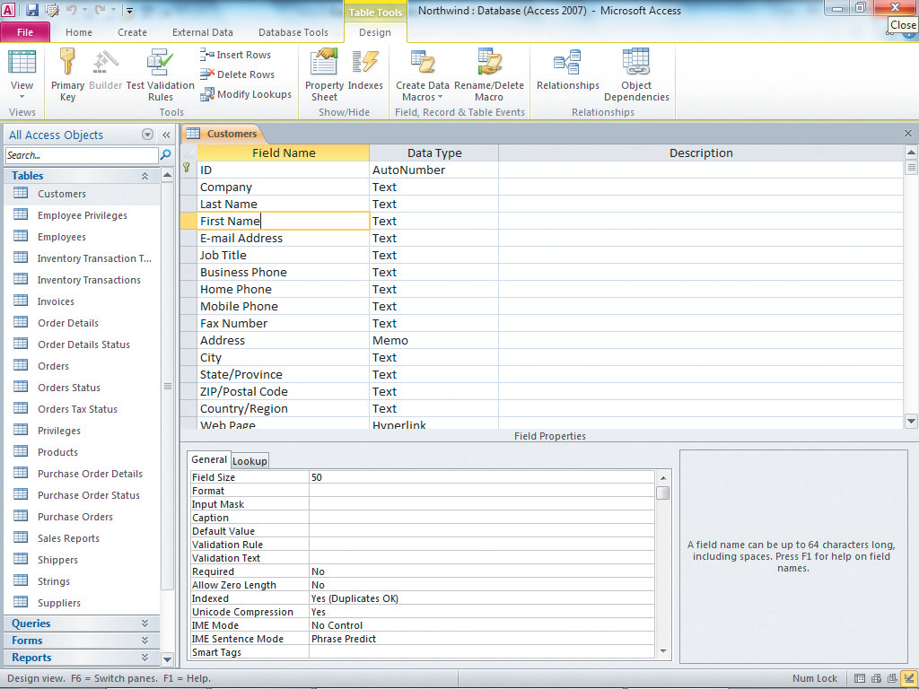
Design View
Notes:
In this figure, the Customers table is displayed in design view. Notice Field Names are along the left side with each field having its own data type. Below the list of field names, you can change attributes of individual fields in the Properties window for each field selected.

Slide 10
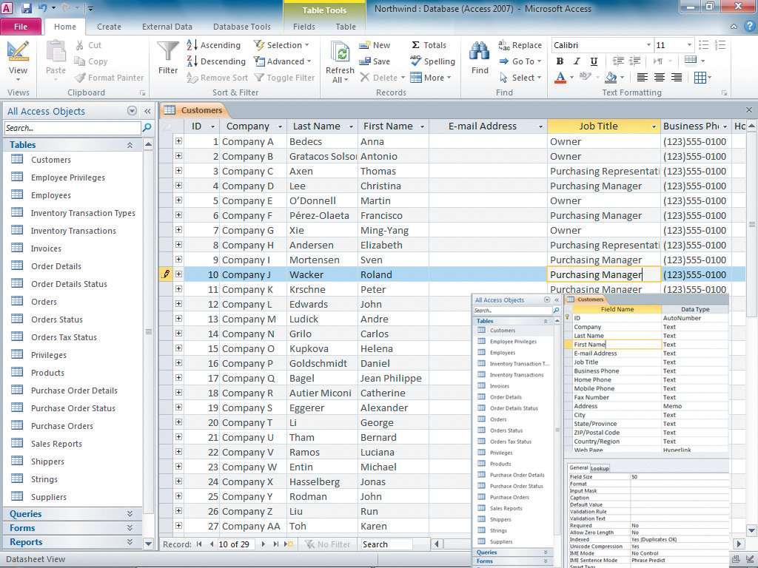
Datasheet View
Notes:
Here, the Customers table is displayed in the datasheet view. Notice that the Field Names are along the top. This is different from Excel where you see the column indicators along the top. Here, the database designer (the user) has created the field names to be used in this particular table.
You can see the data within the table or select an individual record (row) for one particular entity within the table.

Slide 11
Using Forms, Queries and Reports
Tables
Primary Key
Forms
Queries
Criteria
Reports
Notes:
Tables contain the raw data, but forms are objects that enable the user to enter, modify, or delete table data in a more user-friendly view.
A primary key is a field (or combination of fields) that is used to uniquely identify records. The Autonumber data type is often used to create unique values by automatically incrementing the value each time a new record is created. An example of a primary key would be a student’s ID number or a driver’s license number.
A query is a question. Queries allow users to ask questions of the data in the tables of your database. You use criteria to selectively filter data from tables in queries. For example, you might want to know how many customers bought an HDTV during the month of April. Queries are typically created to access information quickly, but they can be created and saved so that they can be used repeatedly, such as for month-end reports.
Reports are used to produce professionally-looking formatted information from one or more underlying tables and/or queries. As an example, create a query showing how many customers purchased an HDTV during the month of April, displaying the first and last names of the customers sorted by last name and the amounts they paid for the TVs. Then, use the query in a report, which can also create a summary of all of the TVs sold.

Slide 12
Tips on Database Management
Database files should be named using meaningful names
Database files should be stored in meaningful folders and subfolders
Back up your files!
Notes:
Here are some tips to help manage your database.
Access database files should be named with meaningful names—something that is meaningful to the content in the database. For example, if you are creating an inventory database for your household belongings, a name like “Household Inventory” would match the database content.
Access files should be stored in meaningful folders and subfolders, so they can easily be located and accessed. Access works best on a local drive or a network drive because those drives provide the quickest access speeds to support the software.
Above all, no matter what type of file you’re working with, backing up is paramount to maintaining the safety of your files. Backup creates a duplicate copy of the database.

Slide 13
Compacting & Repairing a Database
Access databases increase in size over time
Compacting
Avoids loss of data
Recovers unclaimed space
Defragments fragmented databases
Repairs corrupt databases
Notes:
Because databases are the lifeblood of any organization, Access provides two utilities to help protect data within a database. These two utilities are: Backup and Compact and Repair. Compact and Repair reduces the size of the database.
As data is entered, queries created, reports created and run, objects created and deleted and indexes added, Access databases tend to increase in size over time. This growth increases storage requirements and can impact database performance.
By compacting databases regularly, they become less likely to become corrupt, which can cause a loss of data. When the Compact and Repair utility is run, it creates a copy of the database in the background, copying all of the objects from the original database into the new one. As it copies the objects into the new file, Access will remove temporary objects and unclaimed space due to deleted objects, resulting in a smaller database file. Compact and Repair will also defragment a fragmented database file, if needed. When the utility is finished copying the data, it deletes the original file and renames the new one with the same name as the original.
If the database file is corrupt, the utility will also repair the corrupt database and, in most cases, only a small amount of data (usually just the last record modified) will be lost during the repair process. As a result, you should compact your database every day.

Slide 14
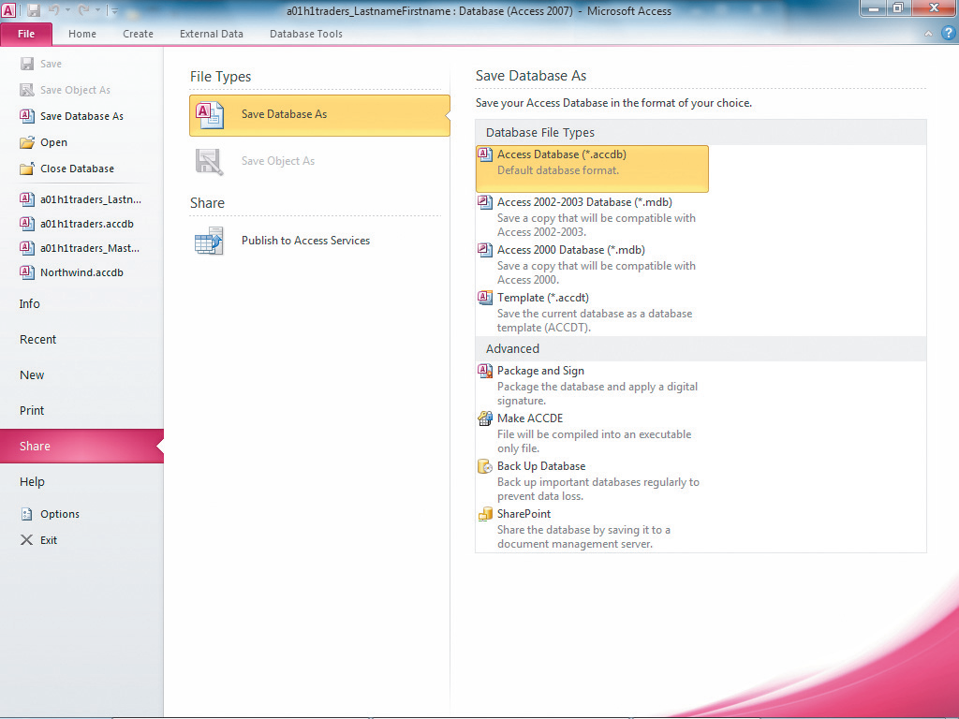
Steps in Compacting & Repairing and Backing-up Your Database
Back Up
Database option
Notes:
This figure shows the Backstage of the Share option off of the File Tab. This includes the Back Up Database option.
You’ll first click on the File tab, which reveals the Backstage view. Then click on Compact & Repair Database, but before running this feature, close any open objects in the database. Then Click the File tab again, click Share, and then click Back Up Database. The Save As dialog box opens, verify the Save in folder is correct before saving.
The backup utility assigns a default name by adding a date to your file name.

Slide 15
Backing Up a Database
Backups are critical to a database
Access provides a default file name, including the original file name and adds on the current date
Default extension for Access databases is accdb
Notes:
As backups are so critical for anyone storing a database, Access makes the process very simple.
To back up files, click the File tab, then click Share from the list of options. From this list of options, click on Back Up database and the Save As dialog box will open. Here, you can designate the folder location and the file name for the backup copy of the database. Access provides a default file name that is the original file name followed by the current date. The default database extension is accdb.

Slide 16
Filters
A filter displays a subset of records based on specified criteria
Will always display the entire record selected based on criteria selected
All data extracted must be contained within a single table
Hides unwanted records, but does not delete them
Notes:
A filter displays a subset of records based on specified criteria. Filters allow you to analyze information very quickly, but a filter only works when all of the information needed is contained in a single table. Filters will always return the entire record, whether you need all of its data or not. They only display records that meet the criteria. When the filter is cleared, all of the records in the table will be displayed.

Slide 17
Types of Filters
Filter by Selection
Filter by Form
Notes:
Two types of Filters are discussed:
Filter by Selection
Filter by Form
Filter by Selection selects only the records that match preselected single criteria.
Filter by Form offers a more versatile way to select a subset of records, including the use of comparison operators.

Slide 18
Filter by Selection
Displays only records that match selected criteria
To implement a Filter by Selection
Click in any cell field that contains the criterion on which you want to filter
Click Filter by Selection in the Sort & Filter group
Select Equals “criterion” from the list of options
Only the records that match the selected criteria will be displayed
Notes:
Filter by Selection displays only records that match selected criteria.
To implement a Filter by Selection:
Click in any cell field that contains the value on which you want to filter.
Click Filter by Selection in the Sort & Filter group.
Select Equals “criterion” from the list of options.
Filter by Selection will display only the records that match the selected criteria. This type requires the user to specify criteria that are equal to an existing value.

Slide 19
Filter by Form
Displays table records based on multiple criteria.
Allows the use of AND and OR conditions
Allows the use of comparison operators
Comparison operators include:
Greater than | > | Less than | <
Greater than or equal to | >= | Less than or equal to | <=
Notes:
Advantages of the Filter by Form include:
1. Displays table records based on multiple criteria.
2. Allows the user to apply AND and OR conditions.
3. Allows the user to use a comparison operator.
Comparison operators evaluate the relationship between two quantities and determine which one is greater than the other. Symbols for the comparison operators are included in the table.
An example of using a comparison operator would be to select students with a GPA greater than 3.0.

Slide 20
Filter using ANDs and ORs
ANDs restrict selection criteria
ORs expand selection criteria
Notes:
You can expand your selection criteria by using the OR condition. Click on the OR tab at the bottom of the Filter by Form window. For example, you can use an OR to look for inventory greater than 30 OR prices less than $20.00. This option will find inventory items that have more than 30 items and any prices less than $20.00, even though the number of inventory items may not be greater than 30.
You can restrict your selection criteria by using the AND condition. Click on the AND tab at the bottom of the Filter by Form window. For example, you can use an AND condition to look for inventory greater than 30 AND prices less than $20.00. This option will find all inventory items that have both more than 30 items and only prices with less than $20.00.

Slide 21
Access or Excel?
It is better to use Excel, if you:
Are more comfortable with its ease of use
Only need one worksheet to handle all of your data
Have mostly numeric data
Require subtotals and totals for worksheet
Want to use “what if” scenarios on data
Need to create complex charts and/or graphs
Notes:
There are a lot of similarities between Access and Excel. They both store data. They can both create formulas to summarize data. They can both sort data and filter data. So, when do you use each one?
Generally, when you have data better suited to two or more tables, Access is preferred. Access is also more appropriate when dealing with large amounts of data.
Excel provides ease of use and most people are already familiar with arithmetic operations, so they adapt to Excel easily. Excel is also best when you’re:
dealing with a minimum number of worksheets, and you don’t need to relate the spreadsheets.
dealing with mostly numeric data where you may require subtotals and/or totals on each spreadsheet.
dealing with the “what if” scenarios on data.
creating complex charts and/or graphs when wanting to explain or clarify data.

Slide 22
Access or Excel? (continued)
It is better to use Access when you:
Need multiple related tables to store data
Have a large amount of data
Need to connect to and retrieve data from external databases (such as Microsoft SQL Server)
Need to group, sort, and total data based on criteria
Need multiple users to have access to application simultaneously
Need built-in tools to help organize data
Ability to create relationships between tables
Notes:
Alternatively, Access is preferred when dealing with multiple tables that store large amounts of data, if the tables are related. Access can be used to:
connect to or retrieve data from external databases.
import data from multiple data sources.
group, sort or total data based on specific criteria.
allow multiple users to access the database at the same time. Remember though that two users may not write data to the same record at the same time—one can view and the other can write, but both users cannot write to the same record at the same time.
Finally, Access provides built-in tools to help organize your data. One of these tools is the ability to create a relational database, which creates relationships between tables.

Slide 23
Relational Databases
Access—a Relational Database Management System (RDBMS)
Allows the user to create relationships between tables
Relationships—the set of rules on how tables will be related
Good database table design is based on normalization
Notes:
Access is known as a Relational Database Management System (RDBMS). Using an RDBMS, you can manage groups of tables and create rules (the relationships) between the tables. When relational databases are designed properly, users can easily combine data from multiple tables to create queries, forms, and reports.
Good database design is based on grouping like data into tables. The process of grouping data into properly designed tables is called normalization. It takes some time to learn how to do this effectively, but it’s well worth the time and effort.

Slide 24
Creating Relationships
A common field—used to relate two tables together
Join lines—allow relationships between two tables to be created on a common field
Three types of relationships used by Access to manage relationships between tables:
Enforce referential integrity
Cascade update related fields (see Chapter 2)
Cascade delete related records (see Chapter 2)
Notes:
A common field is used as a connection between two tables.
When joining two tables, join lines allow the user to create a relationship between two tables using the common field. Once the join lines are there, you can determine what type of relationship you want the two tables to have.
There are three types of relationships to determine how Access will manage the relationship between two tables:
Enforce referential integrity
Cascade update related fields
Cascade delete related records
We’ll cover the first one in this chapter, but the last two will be covered in Chapter 2.

Slide 25
Using the Relationships Window
Relationships should be created after the tables are created, but before any sample data is entered
Relationships between tables are represented by join lines in the Relationships window
Most common method of connecting two tables is using a primary key from the primary table to the foreign key in the related table
Notes:
The Relationships window allows the user to add tables and create relationships between those tables. Relationships should be created after the tables have been created, but before any sample data is entered into the tables. This allows adjustments to be made without having to also adjust the data.
When two tables are joined in the Relationship window, join lines link the tables based on a common field. The most common method of joining two tables is using a primary key from one table to the foreign key in the related table. A foreign key is a field in one table that is also the primary key of another table. For example, StudentID would be the primary key in the Student table, but the foreign key in the Courses table.

Slide 26
Referential Integrity
Ensures that data cannot be entered into a related table unless it first exists in the primary table
Example:
Banks would not want to offer a loan to an individual unless that individual was already established as a customer of the bank.
Thus, the customer has to be entered into the customer table, before a new loan can be made in the loan table with that customer’s ID.
Notes:
One of the most used methods for relationships is enforcing referential integrity. When referential integrity is enforced, you cannot enter a foreign key value in a related table unless the primary key value exists in the primary table. By selecting enforce referential integrity, Access ensures that data cannot be entered into a related table unless it first exists in the primary table.
As an example, a bank would not want to create a new loan record for a customer who does not yet exist in the customer table. A loan not related to a customer does not make sense, so by enforcing referential integrity, the customer must be placed in the Customer table before the loan can be entered into the Loan table. The Loan table uses CustomerID as the foreign key, which links back to the CustomerID in the Customer table.

Slide 27
Using Sample Data
Before entering the real data, populate your tables with sample, yet representative, data in each of your tables
Notes:
One of the biggest mistakes novice database users make is to try to enter all of their data before checking the design of their database to make sure it really works.
This lesson is easily avoided by applying your design first, entering sample data, and then testing your design based on your sample data before entering your actual data. Even this small step can save hours of time in undoing badly designed tables and having to re-enter data.

Slide 28
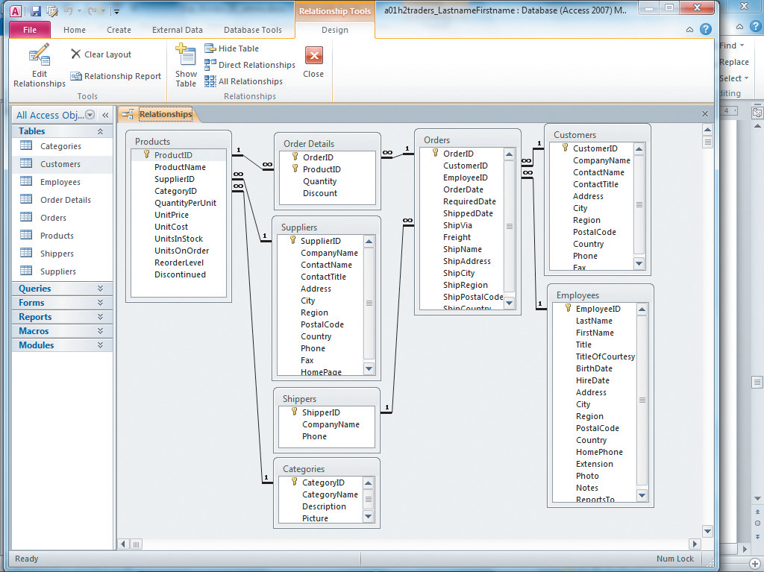
Relationships Window
Notes:
Access gets its power from multiple tables and the relationships between those tables. The diagram in the figure demonstrates the database structure using relationships. Notice that SupplierID (Primary key) in Suppliers table is connected to the Products table as a foreign key. This represents a one-to-many relationship (something you’ll learn more about later). This structure would allow you to query what suppliers provide which products.
Also, notice the Products table is connected to the Orders table through the Order Details table. This represents a link between two many tables (Orders and Products) through the intermediary Order Details table. This represents a many-to-many relationship. (Again, you’ll learn more about these types of relationships later on).

Slide 29
Summary
Access works best for large amounts of data stored in multiple related tables using relationships between tables
Access allows you to sort and filter data
Access allows you to compact and repair and back up your data
Practicing good database file management will improve the quality of your database
Notes:
In this chapter, you learned the distinction between data and information. Access stores data, but by manipulating the tables storing raw data, meaningful information can be displayed.
Access works best for large amounts of data stored in multiple tables, using relationships between tables. Multiple users may need access to the database at the same time.
Access also allows the user to sort and filter data to extract information quickly.
An established routine of compacting and repairing and backing up your database will help to maintain the integrity of your data.
Finally, practicing good database file management techniques will improve the quality of your database. Creating tables before entering sample data will produce a better database design and could help you avoid much time-consuming repairs on an ill-formed database design.

