Slide 1

CIS 1230
Chapter 5
PivotTables and PivotCharts:
Data Mining
Notes:
This chapter discusses the use of PivotTables and PivotCharts in Microsoft Access 2010. For instance, most major grocery stores, bookstores, and retailers collect information based on customers’ shopping habits. Then, they analyze the data stored in their companies’ databases to track customer purchasing trends through membership cards, using a process called data mining.

Slide 2
Objectives
Create a PivotTable
Add aggregate functions to a PivotTable
Modify a PivotTable
Create a PivotChart
Identify chart elements
Modify a PivotChart
Add calculations to a PivotTable
Work with calculations in a PivotTable
Notes:
In this chapter, we learn how to:
Create a PivotTable.
Add aggregate functions to a PivotTable.
Modify a PivotTable.
Create a PivotChart.
Identify chart elements.
Modify a PivotChart.
Add calculations to a PivotTable.
Work with calculations in a PivotTable.

Slide 3
Create a PivotTable
Data mining ─ the process of analyzing large volumes of data to identify patterns and trends
PivotTable ─ a data summarization tool that can sort, filter, and total data in a table or query, and then display the summarized data in a format specified by the user
Notes:
Before we create a PivotTable, we need to understand the definition for several terms commonly associated with PivotTable.
Data mining is the process of analyzing large volumes of data to identify patterns and trends. This process can assist managers in making informed decisions and to help predict future customer purchases. Some data mining software is very sophisticated and can assist the user with drilling into the details of the company data to help analyze the patterns. Access provides a tool to help you perform data mining—PivotTables.
A PivotTable is a data summarization tool that can sort, filter, and total data in a table or query, and then display the summarized data in a format specified by the user. With the ability to collapse and expand groups and perform a range of calculations, PivotTables enable the decision makers to identify patterns and trends in historical data in an attempt to predict the future.

Slide 4
Create a PivotTable (continued)
From a Query:
PivotTable views can be created from either tables or queries
Use an existing query or create a new query based on the tables that contain the fields you want to analyze
Open the query in either Design or Datasheet view, click the View arrow, and then select PivotTable View from the list
Notes:
When analyzing data using PivotTables:
The PivotTable views can be created from either tables or queries.
You can use an existing query or create a new query based on the tables that contain the fields you want to analyze.
Then, you open the query in either Design or Datasheet view, click the View arrow, and then select PivotTable View from the list.

Slide 5
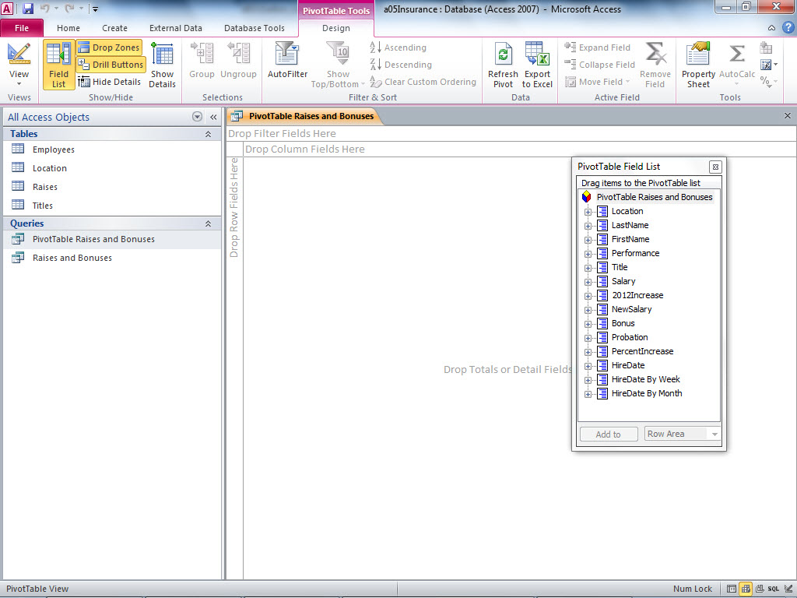
Create a PivotTable (continued)
Drop Zones toggle (On/Off)
Drop Filter Fields Here drop zone
Field List toggle (On/Off)
Drill Buttons toggle (On/Off)
Drop Column Fields Here drop zone
PivotTable Field List
Drop Totals or Detail Fields Here drop zone
Notes:
Figure 5.1 shows that each PivotTable contains four drop zones -- row field, column field, detail field, and filter field. A drop zone is an area in a PivotTable design grid where you drop fields to organize the data for analysis. The first drop zone that we are reviewing is the row field , which is the data source field that you use to group data horizontally into rows. Row fields are generally created by fields containing text, such as states or cities or category.

Slide 6
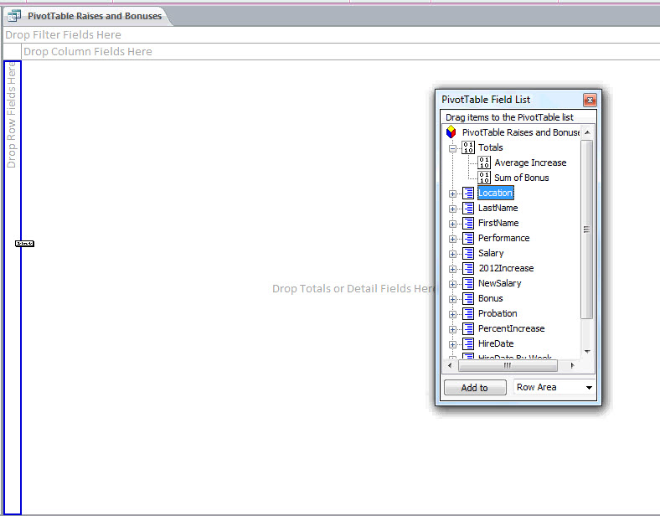
Create a PivotTable (continued)
PivotTable Field List
Blue background indicates
selected field
Blue border appears
when you drop a field onto a drop zone
Notes:
In Figure 5.2, the Location field is dragged from the field list to the Drop Row Fields Here drop zone. The border turns blue when the location field is dropped there.
After you drop the Location field onto the Drop Row Fields Here drop zone, the PivotTable displays an alphabetical list of cities where IBL has offices. Each city is listed only once, regardless of how many times it occurs in the data source.

Slide 7
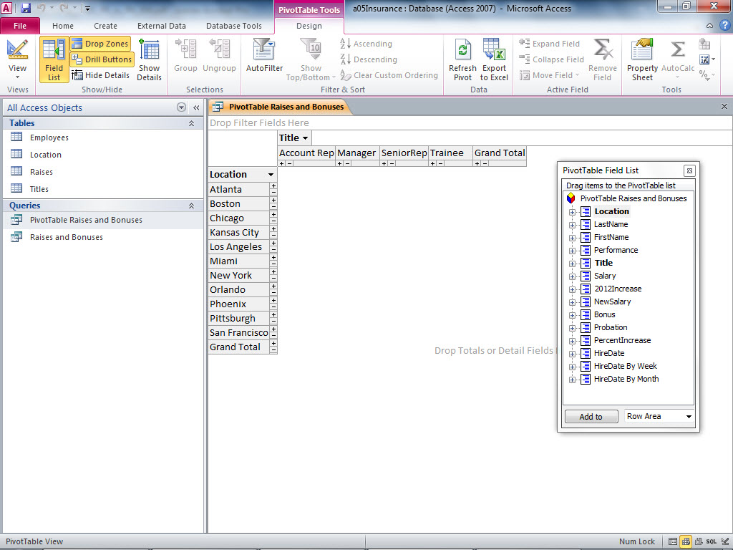
Create a PivotTable (continued)
Title values provide
column data
Location values provide row data
No field was added to Totals yet
Notes:
The second drop zone is the column field , which is the data source field that you use to group data vertically in columns in a PivotTable. An example of a column field would be an employee title.
Figure 5.3 shows that the Title field is dropped into the Drop Column Fields Here drop zone. Each job title is displayed once across the top of the PivotTable grid. When a field is dropped onto the total or detail drop zone, the data will be separated into title columns automatically.

Slide 8
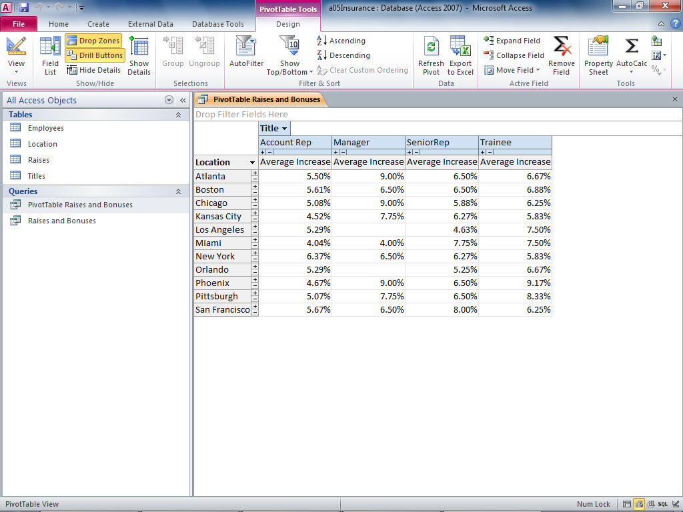
Create a PivotTable (continued)
Average Increase added to Totals drop zone
Trainees in Kansas City earned a 5.83% increase, on average
Managers in Phoenix earned a 9% increase, on average
Notes:
Figure 5.4 shows that the third drop zone, the detail field, is the largest drop zone. It contains the details of the PivotTable and holds the data to be analyzed. In general, the detail field is a field that contains numerical data, such as quantities, monetary values, or percentages. In Figure 5.4, the PercentIncrease field was added to the Drop Totals or Detail Fields Here drop zone. Access will summarize the PercentIncrease field by city, which is the field used to organize data into rows. With the PercentIncrease field, we can analyze the data to see the impact of pay raises across locations and positions. The data from the PercentIncrease field are averaged instead of totaled because the underlying values are percentages. For example, the average increase for Phoenix managers is 9.00%.

Slide 9
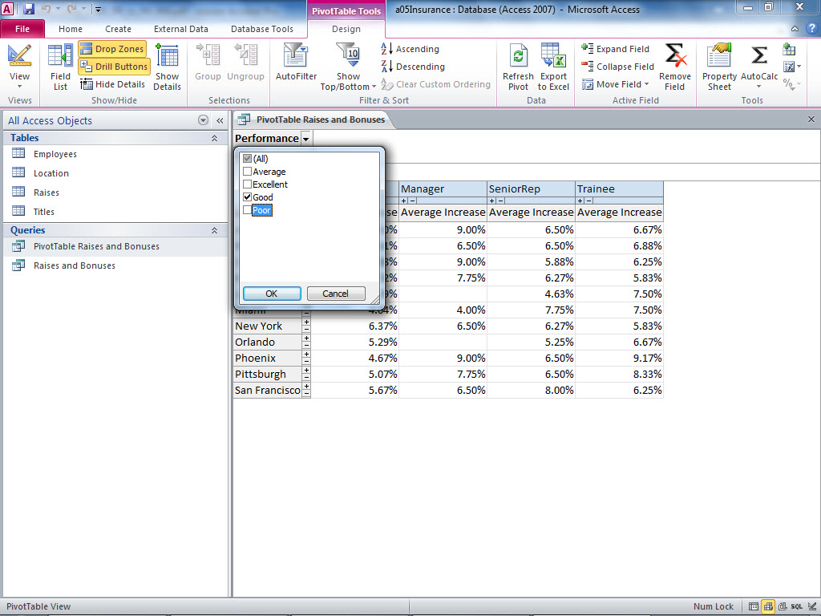
Create a PivotTable (continued)
Performance values provide filter data
Add and remove values to analyze specific data
Notes:
As illustrated in Figure 5.5, the fourth drop zone is the filter field , which is the data source field that you use to create specific criteria to filter data in a PivotTable. You use a filter to analyze data based on just ONE particular condition. For example, using the employee data from the previous examples, you can add the performance rating field to the filter drop zone to only include data for a specific performance rating as shown in Figure 5.5. The filter is set to Good so that you can analyze data for all employees who received a good performance rating. The human resource manager can then examine the results to determine if this year’s salary increases are fair for all of the employees with a good performance rating across locations and position titles. In this case, the raises are very consistent. Managers with a good rating in all locations received at least a 4% increase in their salaries.

Slide 10
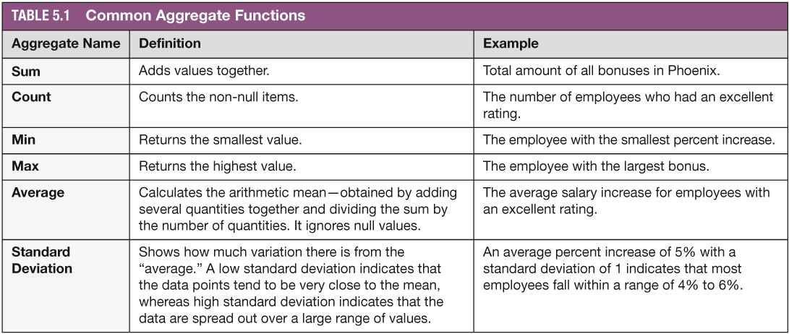
Add Aggregate Functions to a PivotTable
Notes:
After you assemble data in the PivotTable, you can use the same aggregate functions found in queries and reports to help analyze and extract the information. An Aggregate Function provides a summarized view of a set of detail records, and common examples are sum, average, minimum, maximum, and standard deviation. Review Table 5.1 for more details on these aggregate functions.

Slide 11
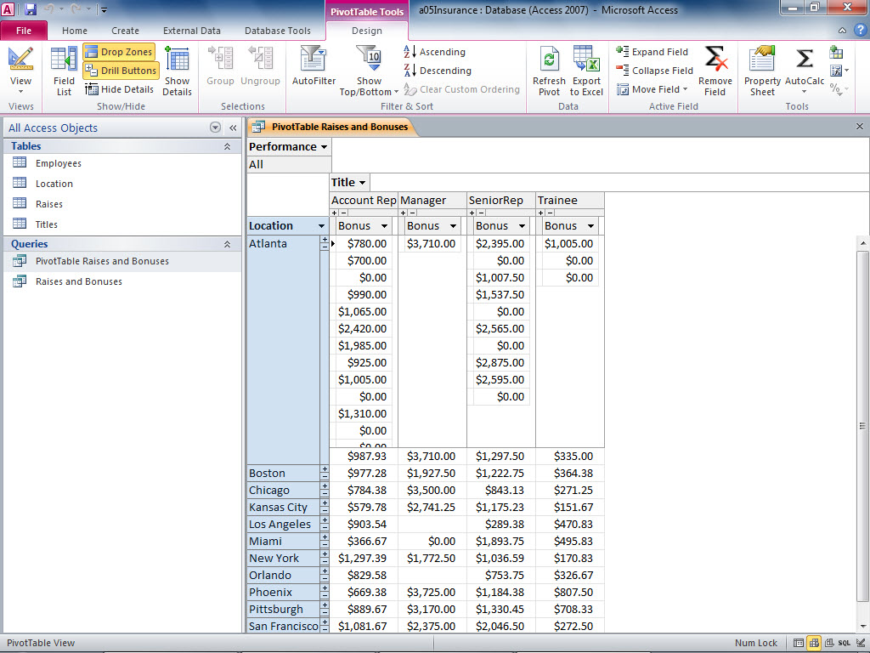
Add Aggregate Functions to a PivotTable (continued)
Show Details toggle On/Off
Hide Details toggle On/Off
Create aggregate formulas using AutoCalc tool
Atlanta shows details and
aggregate data
Average Atlanta bonus
Other cities show only
aggregate data
Notes:
First, you need to select a data value in the Drop Totals or Detail Fields Here drop zone before applying an aggregate function. For numeric fields, you can use sum, count, minimum value, maximum value, average, standard deviation, and others. When the field is a text or a yes/no type, you can only use the count function.
Then you apply an aggregate function to the detail data in a PivotTable, by using the AutoCalc tool.
Figure 5.6 shows the Bonus amount for employees in the Atlanta location. To calculate the average bonus for these employees, click on any data value (e.g., the first record, with a bonus of $780), and then click the AutoCalc tool in the Tools group.

Slide 12
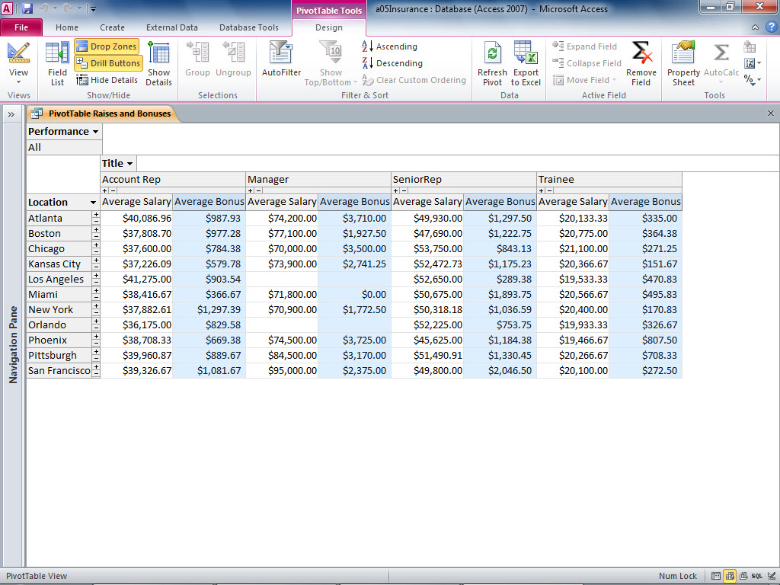
Modify a PivotTable
Show Details toggle On/Off
Use AutoCalc tool to add aggregate data
Average salary added
to detail section
Use Remove Field to remove
aggregate data
Details hidden for all cities
Notes:
After you create a PivotTable, you can modify the structure or format of the PivotTable by rearranging fields from rows to columns, selecting other fields for displaying details, replacing a filter with another field, or changing the format of the PivotTable to make it easier to read.
For example, after the managers examine the percent increase across locations, position titles, and performance rating, they may wish to compare average salary to average bonus. To accomplish this, you can remove the Average Increase field from the PivotTable by selecting it and then clicking Remove Field in the Active Field group OR you can simply drag the column heading of the field off the grid.
You can add the Average Salary and Average Bonus fields by dragging them from the Field list onto the Drop Totals or Detail Fields Here drop zone. Figure 5.7 shows percent increase was removed from the grid and the Average Salary and Average Bonus fields were added to the Totals drop zone.

Slide 13
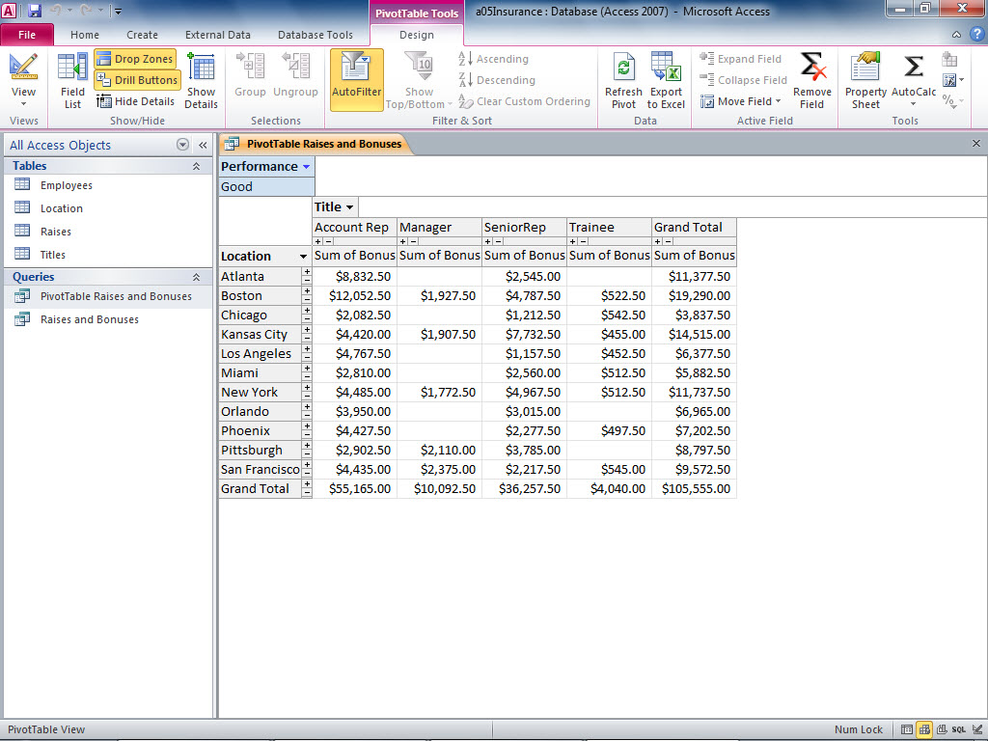
Modify a PivotTable (continued)
Notes:
To add subtotals to a PivotTable, as illustrated in Figure 5.8, we select the column field (e.g., Title in the IBL data), and then click the Subtotal command in the Tools group. A Grand Total column will be added to the end of the row and provide the total of all bonus columns for each city. Similarly, you can click the row field (e.g., Location in the IBL data), and then click Subtotal and the total bonuses for each position. The details still remain, but the Grand Totals have been added.

Slide 14
Modify a PivotTable (continued)
To change a PivotTable’s appearance:
Click Property Sheet in the Tools group
Click Format tab
To edit the appropriate text or cell format:
Background color
Font color
Font size
Click Captions tab
To customize field names
Notes:
Access keeps the properties (font, format, color, etc.) for a PivotTable in the Property Sheet. To change a PivotTable’s appearance, you click on the Property Sheet in the Tools group, then you click the Format tab to edit the appropriate text or cell format, such as Background color, Font color, or Font size.
The Captions tab in the Properties pane helps you customize the field names. Access uses default names for aggregate functions. You can change the way it displays in the PivotTable view by creating a caption. Click the Caption tab, select the type of field you wish to modify using the Select caption box, and then type the name you want to display in the PivotTable.

Slide 15
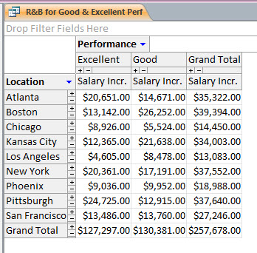
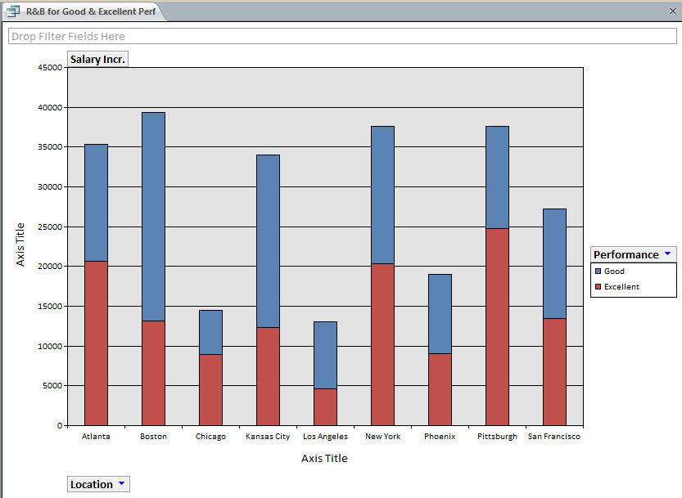
Modify a PivotTable (continued)
Notes:
Figures 5.15 and 5.16 show the PivotTable view and the PivotChart view for the same data source—the total bonuses and salary increases for good and excellent performers, for each location. Because the two views are linked, any changes you make to the chart will affect the table and any changes made to the table will change the chart.

Slide 16
Create a PivotChart
PivotChart ─ provides a visual representation of the data in a PivotTable and is easy to interpret at a glance
Displays bars, columns, or pie slices to represent the data
PivotTable ─ shows numeric data (detail records or summary calculations)
If possible, provide the users with both form of illustrations
Notes:
A PivotChart provides a visual representation of the data in a PivotTable and is easy to interpret at a glance. The PivotTable shows numeric data (detail records or summary calculations). The PivotChart displays bars, columns, or pie slices to represent the data. Many users prefer PivotCharts, since they are easy to interpret at a glance; but, some users may prefer the numeric data found in the PivotTable. If possible, it would be best to provide the users with both form of illustration to help them analyze data.

Slide 17
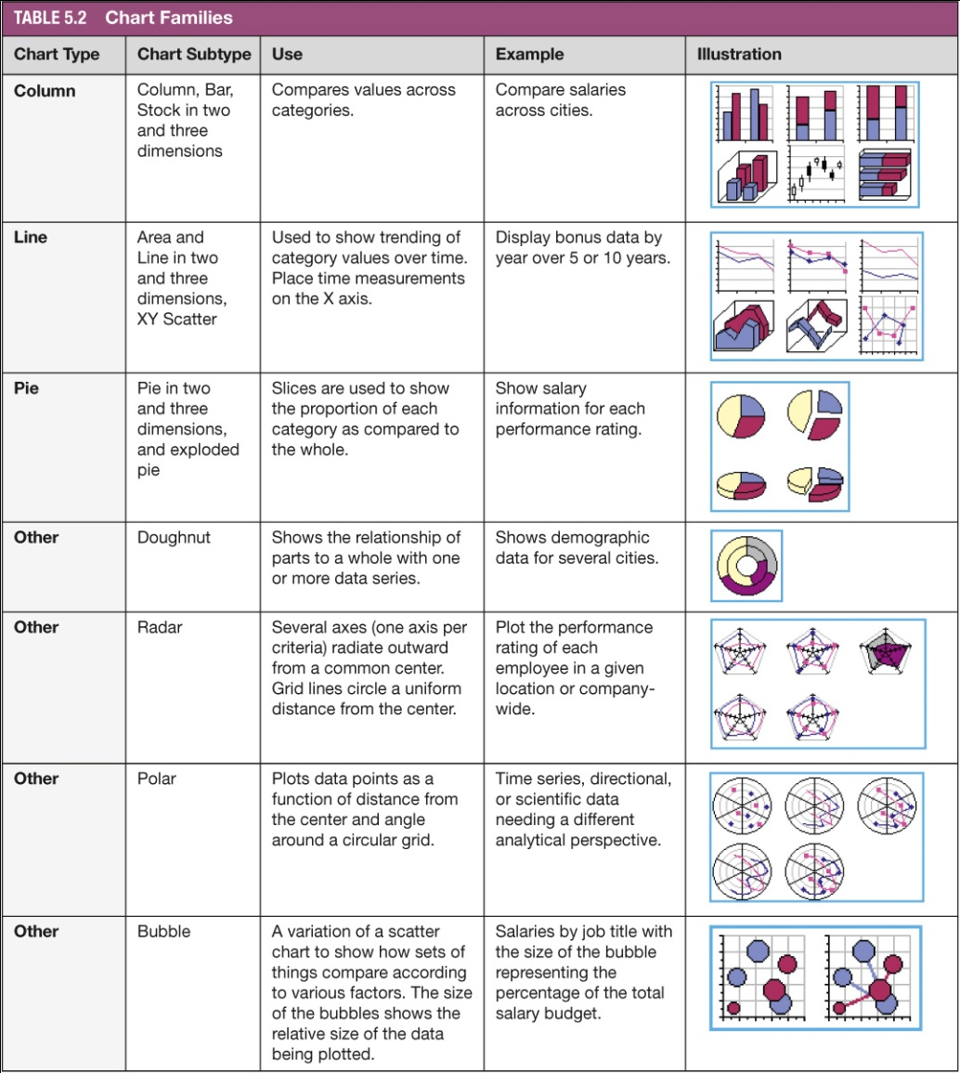
Create a PivotChart (continued)
Notes:
Access can produce a variety of PivotChart types to serve various purposes. The most commonly used PivotChart are column charts, line charts, and pie charts. The PivotChart can easily be changed from one type to another.
Table 5.2 gives a summary of the chart families, which are quite similar to those in Excel. As you work with the different chart types—column, line, pie, etc.—remember that the chart should not only look attractive, it should also convey a clear message.

Slide 18
Create a PivotChart (continued)
Create Column and Bar Charts
Column chart
Displays quantitative data in vertical columns
Compares summarized data across different categories for a particular time frame
Default chart
Bar chart
Displays quantitative data in horizontal bars
Width of bars indicates the relative value of the data as compared to the other bars
Notes:
A Column chart, the default chart, displays quantitative data in vertical columns. It compares summarized data across different categories for a particular time frame. For example:, we could use a column chart to display the total bonuses earned by each city for a certain year. The height of the columns indicates the relative value of the data as compared to the other cities (columns).
A Bar chart displays quantitative data in horizontal bars. The width of bars indicates the relative value of the data as compared to the other bars.

Slide 19
Create a PivotChart (continued)
Create Line, Area, and Scatter Plot, and Smoothline Charts
Line chart
Area chart
Scatter plot chart
Smoothline chart
Notes:
A Line chart displays continuous data over time and is useful for recognizing trends in aggregate data over time. For example, it can be used to show the number of college graduates over the past 15 years at U.S. colleges.
An Area chart is similar to a line chart except that the area below the line is shaded.
A Scatter plot chart uses points plotted on a graph where the “x” and “y” coordinates represent values for two variables in a set of data; for example, to show the # of service calls received by a heating contractor in a month compared to the average monthly temperature.
A Smoothline chart also shows trends over time, but the lines connecting data points are curved rather than straight lines. This is a derivative of the line chart.

Slide 20
Create a PivotChart (continued)
To create Pie and Doughnut Charts
Pie chart
Displays 2 or more data categories as slices of a pie
Values are converted to percentages of the total
Doughnut chart
Shows the parts of a data source in relationship to a whole.
Can display more than one series of data.
Notes:
A Pie chart displays two or more categories in a data source as slices of a pie. Instead of showing actual values, the values are converted to percentages of the total; for example, to show the percent that each product line contributes to the total revenue of a company, or the number of gold medals per country in an Olympic competition.
A Doughnut chart also shows the parts of a data source in relationship to a whole. It can display more than one series of data. An example would be to use one ring to show the proportion of male college students in math and science majors over a given period and a second ring to show the proportion of female college students in math and science majors for the same period.
Other types of charts include radar, polar, bubble, and the stock chart, which plots high, low, and closing stock prices.

Slide 21
Identify Chart Elements
Plot area ─ the rectangular area where the graphical data elements are placed
Axis ─ a vertical or horizontal scale displaying the information to be plotted
Gridline ─ a line that extends across the chart
Each series (or set of data) in a bar chart ─ represented with a different color or pattern
Legend ─ tells which color represents the data for each data series
Chart title ─ displays a name describing the data depicted in a chart
Chart Filter ─ enables the user to temporarily narrow the data source to isolate a portion of the whole
Notes:
We will review the definitions of the following terms which are associated with a chart:
The plot area is the rectangular area where the graphical data elements are placed.
An axis is a vertical or horizontal scale displaying the information to be plotted.
A gridline is a line that extends across the chart.
Each series (or set of data) in a bar chart is represented with a different color or pattern.
The legend tells which color represents the data for each data series.
The chart title displays a name describing the data depicted in a chart.
A Chart Filter enables the user to temporarily narrow the data source to isolate a portion of the whole.

Slide 22
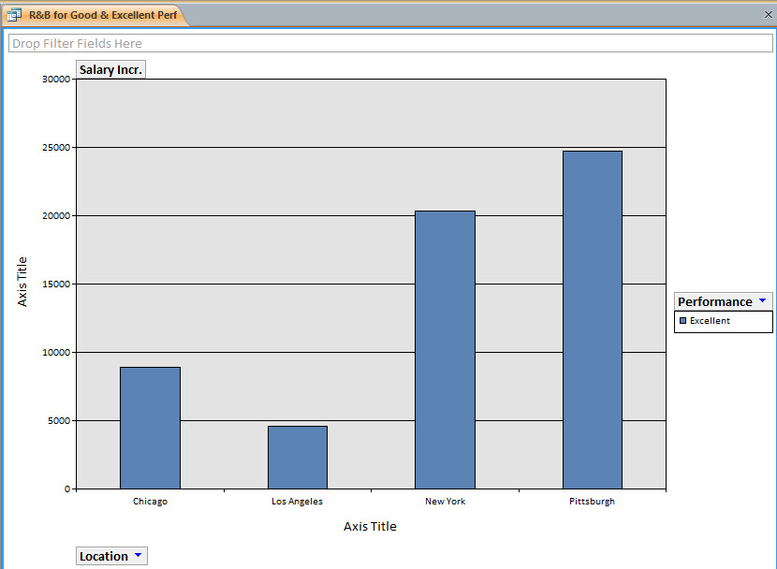
Identify Chart Elements (continued)
Only the excellent performers
Only four locations
are selected
Notes:
Figure 5.17 displays a different view of the same PivotChart shown in Figure 5.16. Here, the Performance filter was used to uncheck Good performance, and only four locations were selected using the Location filter. All of the PivotChart fields contain arrows, as shown in the Location and Performance fields in Figure 5.17. Filters contain checklists of categories that you check or uncheck (to include or exclude) in the current view. Since the PivotTable and PivotChart views are connected to the same data source, changes made to one also change the other. If you uncheck all the cities except four (using the Location field) in the chart, both the PivotTable and PivotChart will change.

Slide 23
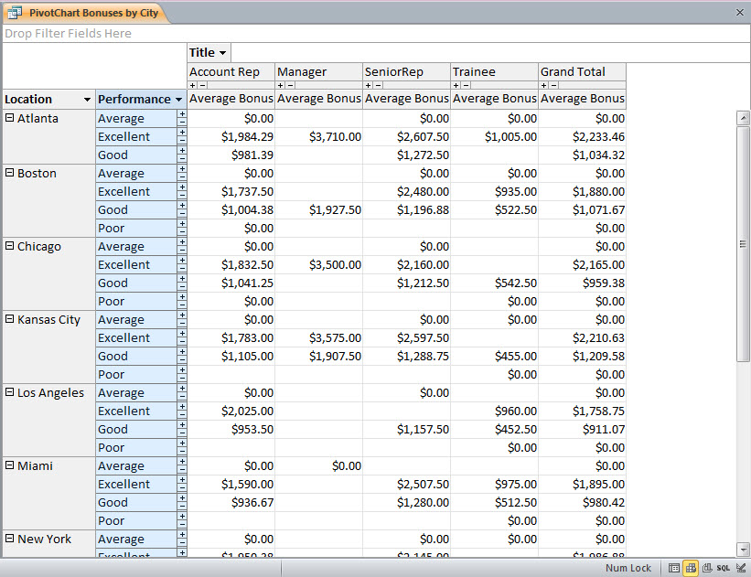
Modify a PivotChart
Title field added to the Drop
Column Fields Here drop zone
Performance field moved to the Drop Row Fields Here drop zone
Notes:
You may need to add or remove fields in a PivotChart. Figures 5.15 and 5.16 show a PivotTable and PivotChart of the same data, Salary Increases for employees with Good and Excellent performance ratings by City. Both the chart and the table convey clear information. In Figures 5.19 and 5.20 (see next slide), the Performance field has been moved to the row drop zone, and the Title field has been added to the column drop zone. Even though this may seem like a small change, the PivotTable data becomes more complex, but remains understandable (see Figure 5.19).

Slide 24
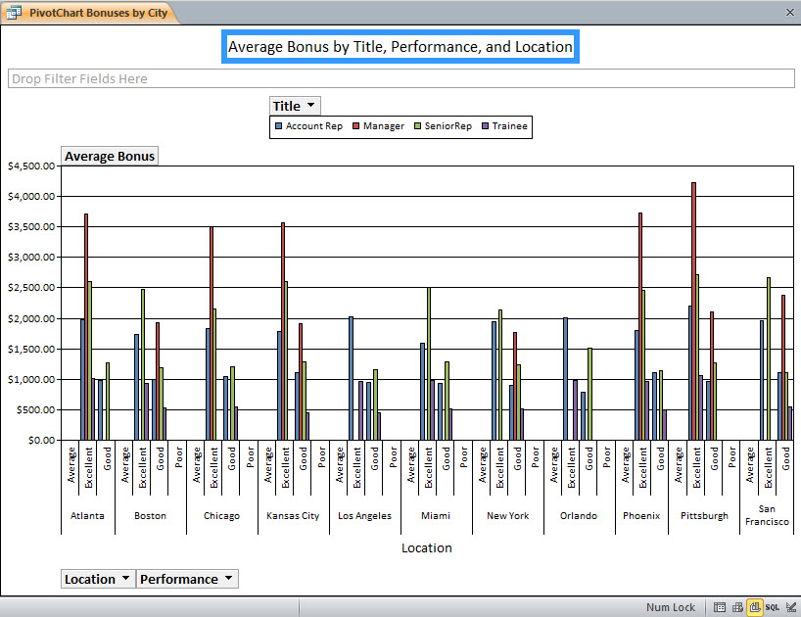
Modify a PivotChart (continued)
Too many fields make the chart difficult to read
Remove or filter a field to make it more readable
Notes:
As you can see, though, this PivotChart has too many variables and too much information. It will most likely confuse the reader.

Slide 25
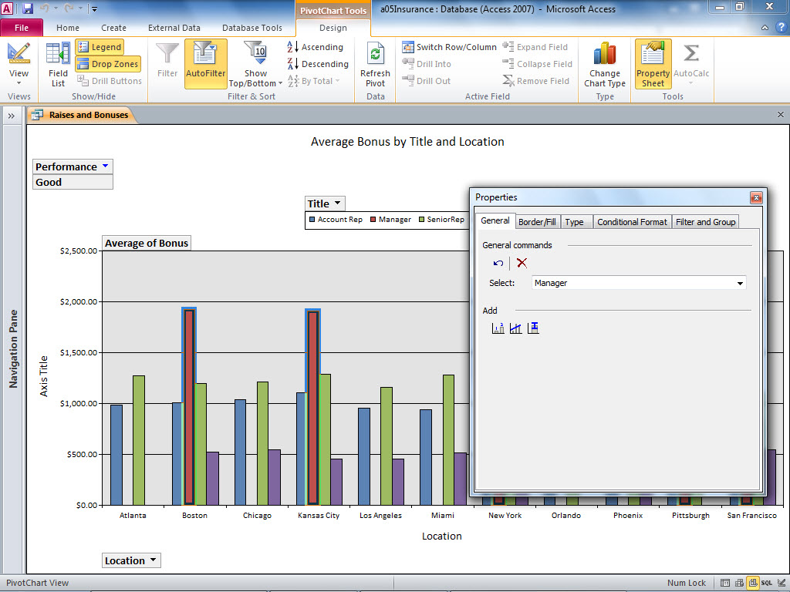
Modify a PivotChart (continued)
Open the Property
Sheet to edit the series
Blue borders indicate Manager series is selected
Manager series selected
Notes:
To change the red bars of the Manager’s series to yellow, you must:
Open the Property dialog box by clicking Property Sheet in the Tools group on the Design tab.
Click the Manager bar twice to select the series.
Click the Border/Fill tab.
Click the Fill Color arrow.
Select the yellow box in the color grid.
Close the Property dialog box to see the effect of the change.

Slide 26
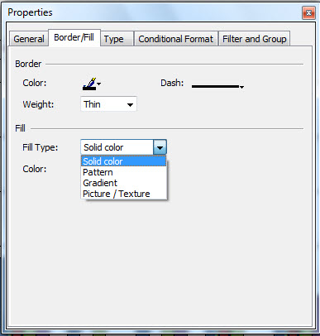
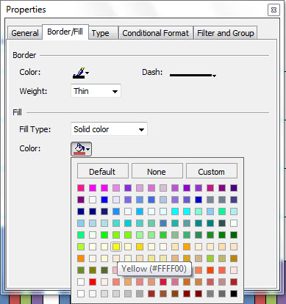
Modify a PivotChart (continued)
Change Border and Fill Properties
Select a Color for the Manager Data Series
Select a Fill Type
Click Fill Color
Click Border/Fill
Choose a Fill Type
Select a color
Notes:
The Border/Fill tab on the Property Sheet contains the properties to change the size and color of the border or line surrounding the chart object. Figure 5.22 shows that you can also define the internal color and pattern of a chart object. You may specify fill types by clicking the Fill Type arrow in the Fill section, and then selecting Solid Color, Pattern, Gradient, or Picture/Texture from the list.
Figure 5.23 shows that you can change the fill color by clicking the Color arrow in the Fill section and selecting a color from the color palette .

Slide 27
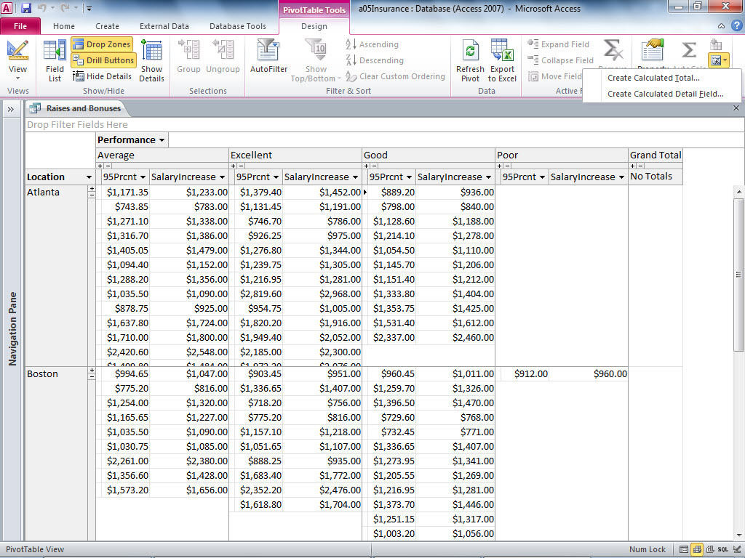
Add Calculations to a PivotTable
New calculated field
Click the Formulas button to create a calculated field
Notes:
You can create a calculated field in a PivotTable by clicking Formulas in the Tools group. You must choose between a calculated detail field and a calculated total. A calculated detail field generates a new field based on the values in the detail records. For example, the IBL PivotTable contains salary information for each employee. Click Show Details to see the individual employee salaries. You could calculate 95% of each employee’s salary increase, to help stay within the company goal of $500,000 in payroll increases. To create the 95% calculated field, you would create the calculated expression SalaryIncrease * .95. The results will be displayed in the Detail section of the PivotChart, in a column to the left of the SalaryIncrease field.
A calculated total field generates a new field based on the values in the aggregate data. In the above example, you may wish to calculate 95% of the total salary increases for each city, rather than each individual employee. In this case, you would create a calculated total field to calculate the total salary increases for each city * .95.
In Figure 5.32, each employee’s salary increase is listed in the Detail section. Next to each salary increase is a calculated detail field showing 95% of each salary increase.

Slide 28
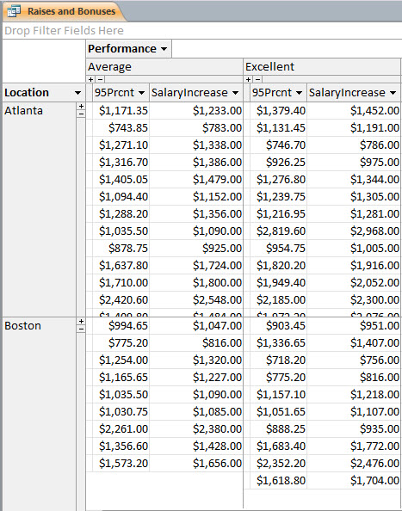
Work with Calculations in a PivotTable
Calculated detail field
Check the math
($1,356.00 * .95 =
$1,288.20)
Notes:
After you create a calculated field, you can format it, move it to a new location, use it as a source for aggregate calculations, and plot it in a PivotChart.
Figure 5.34 shows the calculated salary increase field (95%) added to the Detail Fields drop zone. Select any value in the 95% column, and then use the AutoCalc tool to create the sum of the reduced salary increases. Figure 5.35 shows the results after the Sum function was applied to the 95% column. Figure 5.36 displays only the category totals after Hide Details was clicked.

Slide 29
Summary
In this chapter, you learned to use the PivotTables
and PivotCharts tools to help you analyze large
amounts of data and translate that data into
useful information.
Notes:
In this chapter, you learned to use the PivotTables and PivotCharts tools to help you analyze large amounts of data and translate that data into useful information.

