Slide 1

CIS 1230
Chapter 6 Data Validation Techniques
Notes:
This chapter discusses the application of various data validation techniques using tables, forms, and reports to reduce errors while managing a database in Microsoft Access 2010.

Slide 2
Objectives
Establish data validation
Create an input mask
Create and modify a lookup field
Set the tab order
Create a combo box control
Restrict edits in a form
Compare fields using a data macro
Create a query to display missing data
Create a missing data report
Create an aggregate report
Notes:
In this chapter, we plan to:
Establish data validation.
Create an input mask.
Create and modify a lookup field.
Set the tab order.
Create a combo box control.
Restrict edits in a form.
Compare fields using a data macro.
Create a query to display missing data.
Create a missing data report.
Create an aggregate report.

Slide 3
Establish Data Validation
Data validation ─ a set of constraints or rules that help control how data is entered into a field
Various data validation methods include:
Required
Default value
Validation rule
Validation text
Input Masks
Lookup lists
Notes:
Data validation is a set of constraints or rules that help control how data is entered into a field. In Access, some data validation are provided automatically. For instance, a user cannot enter text into a field that is declared as a number data type. Also, a user cannot add a new record to a table if the value of the primary key of the new record is already in the table.
There are several data validation methods available in Access that could to help minimize the number of data entry errors:
• Required: The Required data validation method sets the Required property of a field to force the user to enter the data. A required field is a field in which the value cannot be left blank when you create a new record. For instance, the primary keys are required fields by definition. However, the default Required setting of the remaining fields is set to No. An example of a required field would be the last name field.
• Default Value: This method specifies a value that is automatically entered into a field. For instance, if most of the company’s customers live in North Carolina, then it would be a good idea to set the default value of the state field to NC. However, the user is allowed to overwrite the default value with a value that is more appropriate to the situation.
• Validation Rule: The validation rule method limits the type of data that a user can enter into a field. For instance, if all of your school’s course numbers are larger than 100, then the database designer can set a validation rule to prohibit values less than 100 to be entered on a course registration form. Another example is to add a validation rule “>=7.25” to the hourly pay rate field to ensure that the hourly employee pay rate is at the federal minimum wage or higher.
• Validation Text: This method provides an error message that will allow the users to know what they did wrong and further provide instructions on what they need to do to fix it. For instance, the validation text for the above rule violation could be, “You have entered an invalid course number. Please recheck the number and enter a value greater than 100.”
• Input Masks: The input masks method forces the users to conform to a specific data entry format for a given field. For instance, all Social Security numbers must be entered in the 123-45-6789 format. In this instance, the two hyphens need not to be typed; they can be optionally stored or not stored with the entered data.
• Lookup Lists: Using the lookup lists method, the field values are limited to a predefined list of values. For example, the list of values for the student classification in a university’s student table would be Freshman, Sophomore, Junior, Senior, Graduate, or Other.

Slide 4
Create an Input Mask
Database designers can control how users enter data into tables by:
Selecting the appropriate data type when adding fields to a table, e.g., Text, Number, Currency, and Date/Time
Creating an input mask to further restrict the data being input into a field by specifying the exact format of the data entry.
Notes:
There are two ways that database designers can control how users enter data into tables.
First, the database designer can select the appropriate data type when adding fields to a table. For instance, examples of common data type are Text, Number, Currency, and Date/Time.
Second, the database designer can create an input mask to further restrict the data being input into a field by specifying the exact format of the data entry. Common fields that normally have an input mask are Social Security number (which uses the 123-45-6789 format) and phone number (which uses the (405) 555-1234 format).

Slide 5
Create an Input Mask (continued)
Two ways to create input masks:
Typing the appropriate characters into the input mask field
Using the Input Mask Wizard to generate an input mask for a field based on responses to a few questions
Notes:
There are two ways to create input masks:
First, the user can enter the input mask manually by typing the appropriate characters into the input mask field.
Second, the user can generate the input mask automatically by using the Input Mask Wizard to generate an input mask for a field based on responses to a few questions.

Slide 6
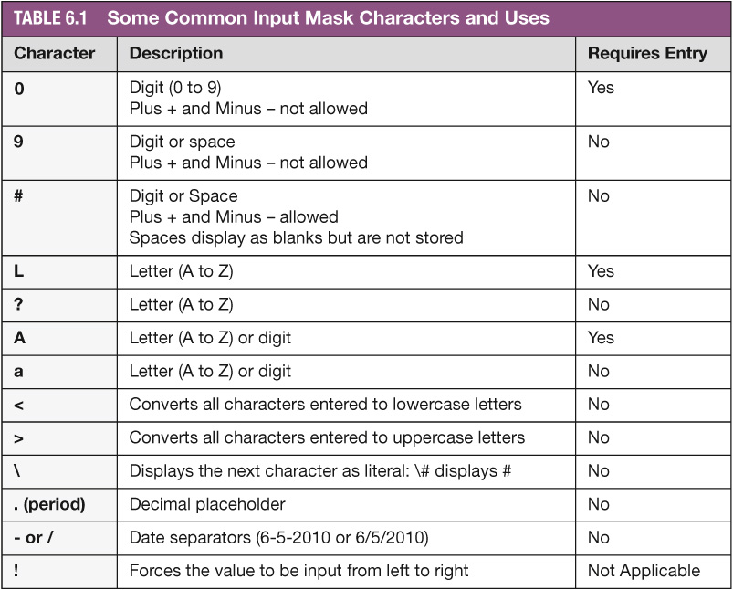
Create an Input Mask (continued)
Notes:
Table 6.1 describes the characters and uses of some commonly used input masks. For instance the character “0“ represents a digit ranging from 0 to 9, plus and minus signs are not allowed, and it requires an entry. However, the character “9” would represent a digit or space, and it does not requires an entry. Also, plus and minus signs are not allowed with the “9” character.

Slide 7
Create and Modify a Lookup Field
Lookup field ─ provides the user with a finite list of values to choose from
Lookup Wizard ─ helps to create the lookup field
Asks you six questions
Uses your answers to create the options list
Notes:
A lookup field provides the user with a finite list of values to choose from. By using a predefined list of values, the user will increase the speed of data entry and also eliminate many data entry errors.
In Access, the Lookup Wizard helps the user to create the lookup field by asking six questions and then using the answers to create the options list. Before launching the Lookup Wizard, it is best to create the new table that will hold the lookup field options.

Slide 8
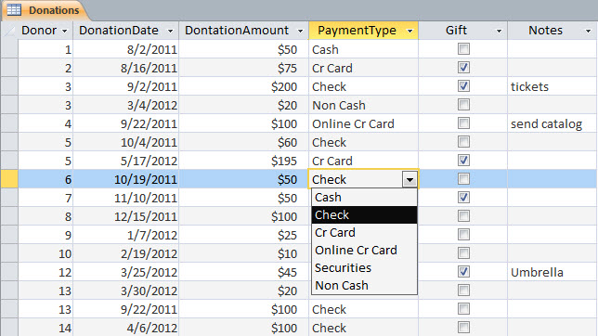
Create and Modify a Lookup Field (continued)
Payment type with
lookup options
Notes:
In Figure 6.5, all the donated items are categorized as Cash, Check, Cr Card, Online Cr Card, Securities, or Non Cash in the PaymentType field. These six values repeat throughout the datasheet in the PaymentType column. It would make life much easier for the data entry person if the options for this field were limited to the six values in a list format, thereby ensuring uniformity and consistency of the data in that field.
Usually, the options in a lookup field are stored in a separate table. For instance, if a PaymentType field has valid options such as Cash, Check, Cr Card, Online Cr Card, Securities, or Non Cash, a Payment Types table would contain six records, one for each option. A separate table will also make it much easier for the end users to update the list. For instance, the end user can easily add a new record, e.g., Estate, to the Payment Types table by entering the information into the Payment Types table.

Slide 9
Set the Tab Order
Tab order ─ the sequential advancing in a form from one field or control to the next when you press Tab
Notes:
The tab order is the sequential advancing in a form from one field or control to the next when you press Tab.
During data entry, when the user presses the Tab key, the cursor will advance from one field to the next in a sequential order. The user cannot enter data out of order unless she or he clicks a field with the mouse. However, the database designer must remember to check the tab order before delivering the form to the end users to enter data because the order in which the fields were created may not be necessarily be in the order that is most useful to the end user.

Slide 10
Set the Tab Order (continued)
To set the tab order in a form:
Switch to Design view
Click Tab Order in the Tools group on the Design tab
Click Auto Order if the form has a Stacked layout and you want to enter data from top to bottom
Click OK to accept the changes
Close the Tab
Notes:
To set the tab order in a form:
Switch to Design view.
Click Tab Order in the Tools group on the Design tab.
Click Auto Order if the form has a Stacked layout and you want to enter data from top to bottom (drag the field to the desired position, if necessary).
Click OK to accept the changes.
Close the Tab.

Slide 11
Set the Tab Order (continued)
Remove a Tab Stop
When you want the tab order to skip a field completely, e.g., a calculated field that does not require data entry
Set the Tab Stop property to No for that field
Remove Tab Stop from Unbound Controls
Unbound controls do not require data entry, e.g., a Close Form command button
Notes:
To remove a Tab Stop, set the Tab Stop property to No for that field. This should occur when you want the tab order to skip a field completely, e.g., a calculated field that does not require data entry.
Unbound controls do not require data entry, e.g., a Close Form command button. So there is no reason for the cursor to stop on this control.

Slide 12
Create a Combo Box Control
Combo box control ─ provides a list of options from which the user can choose a single value
Notes:
If you create a form based on a table with a lookup field, the lookup field will become a combo box control on the new form. A combo box control provides a list of options from which the user can choose a single value.
If the Limit To List property is set to Yes, which is the default, the combo box control will force a user to choose an item from the list.
If the Limit To List property is set to No, then the users is not restricted to the items on the options list.
If you want to force the user to enter a value for the combo box field, set the Required property of the combo box field to Yes.

Slide 13
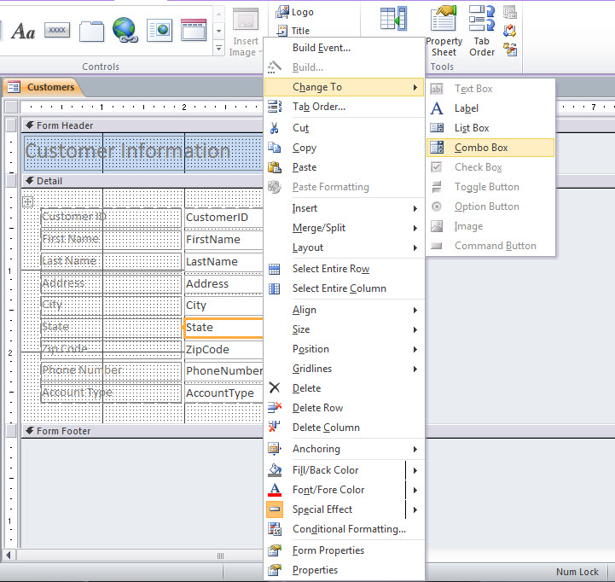
Create a Combo Box Control (continued)
Select Change
To, Combo Box
Right-click State
Notes:
At times, a text box on a form should be converted to a combo box. This can happen when the data you are collecting may not appear to be repeating data at first. As you enter transactions over time, you may realize that a field does have repeating data and that a combo box may be appropriate. For example, the state field will sometimes be overlooked for a combo box. Fifty states and the District of Columbia make up the United States, but the customers that are entered in your database may be located in only a subset of the 50 states. In this case, a combo box would be helpful.
Before you convert a text box to a combo box, you must first create a new table and enter the values for the option list (e.g., States). Then, open the form in Design view, right-click the text box you want to convert, click the Change To option from the shortcut menu, and then select Combo Box as shown in Figure 6.23.

Slide 14
Restrict Edits in a Form
When too many users make changes to the data, the data can become unreliable and difficult to maintain
Protect data in a database by restricting casual users from editing the data
Casual users may need access to customer information or order details, but they may not need permission to add, edit, and delete
Easier to maintain data integrity if only a select group of users is allowed to enter and edit data
Notes:
When too many users make changes to the data, the data can become unreliable and difficult to maintain.
One method of protecting data in a database is to restrict casual users from editing the data. Casual users may need access to the data to look up information such as a person’s address or phone number or to review the details of an order, but they may not need permission to add, edit, and delete. If only a select group of users is allowed to enter and edit data, maintaining the integrity of the data will be much easier.

Slide 15
Restrict Edits in a Form (continued)
Create a Lookup Copy of a Form
When casual users need to look up information without making changes
After you make a copy of the original form, name the copy as Lookup Form
Limit the Lookup Form to only allow viewing data by setting the Allow Edits Property to No
Notes:
When casual users need to look up information without making changes, it is best to create a copy of the original form and then restrict editing on the copy. After you make a copy of the original form, you can name the copy as Lookup Form. Limit the Lookup form to only allow viewing data—no adding, deleting, or editing—by setting the Allow Edits Property to No.

Slide 16
Compare Fields using a Data Macro
Data macro ─ executes a series of actions when a table event occurs or whenever a named macro is executed
Two types of data macros:
Event-driven
Named
Table event ─ occurs naturally as users enter, edit, and delete table data
Notes:
A data macro executes a series of actions when a table event occurs or whenever a named macro is executed. The two main types of data macros are event-driven data macros and named data macros. Event-driven data macros are triggered when a table event occurs, such as After Insert and Before Change, as shown in Figure 6.27 in the next slide. Named data macros can be executed anytime they are needed; they are not dependent on a table event occurring. Named data macros will not be covered further in this chapter.
A table event occurs naturally as users enter, edit, and delete table data. A data macro is triggered when one of these naturally occurring events happens—but only if a data macro has been created for the event.

Slide 17
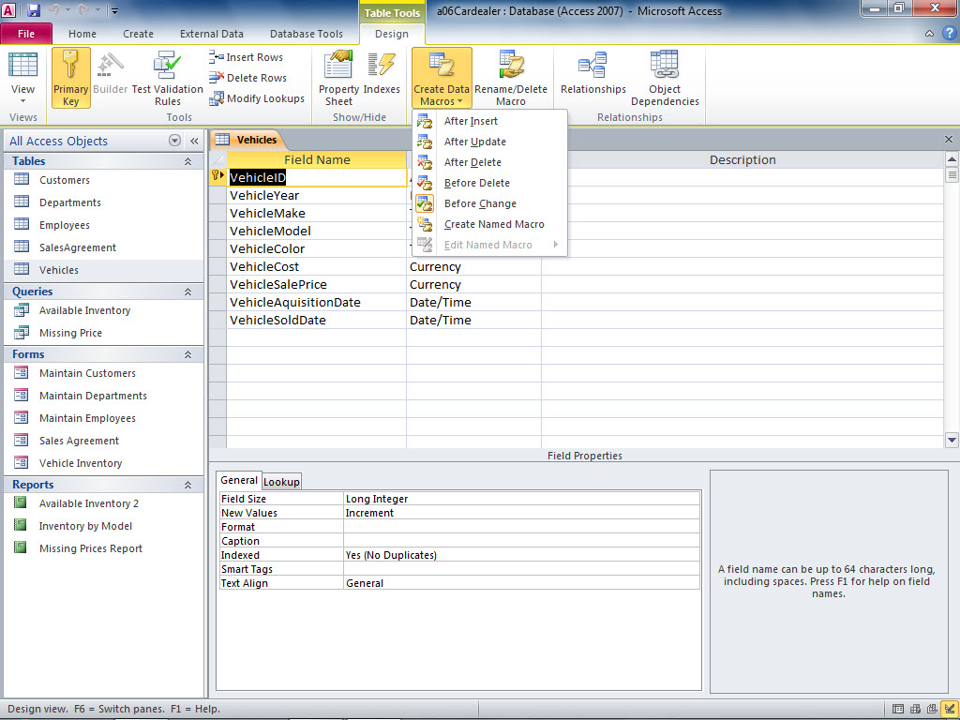
Compare Fields using a Data Macro (continued)
Design view of Vehicles table
Selecting a field is not required
Select an event for the data macro
Notes:
Figure 6.27 shows the users how to create an event-driven data macro in the design view. Always remember that the event-driven data macros are triggered when a table event occurs, such as After Insert and Before Change. Therefore, an event must always be selected in order for the data macro to work.

Slide 18
Create a Query to Display Missing Data
Create a query based on the table that you want to check to display records with missing information
Add criteria to check for missing data in key fields, e.g., Last Name or Order Date.
Checking for missing data in all the fields may become overwhelming because some are blank half the time
Notes:
To display records with missing information, you can create a query based on the table that you want to check. Then, add
criteria to check for missing data in key fields, such as Last Name in a table containing names or Order Date in a table
containing orders.
You could check for missing data in all the fields, but that may become overwhelming because some fields—such as address 2
and shipping address—are blank half the time.

Slide 19
Create a Query to Display Missing Data (continued)
Create a Query to Check for Null Values
Choose the table to use
Add the required fields in Query Design
Add the Is Null criteria to the fields that should not be blank
Make sure that the Is Null criteria for the fields are on separate rows if you want to create the OR condition
Notes:
To create a query to check for Null Values, choose the table to use. Then, add the required fields in Query Design. Add the Is Null criteria to the fields that should not be blank. Make sure that the Is Null criteria for the fields are on separate rows if you want to create the OR condition. This will reveal missing data in one or the other field or both fields.

Slide 20
Creating a Missing Data Report
Use the Report Wizard to Create a Report:
Click Report Wizard in the Reports group on the Create tab
Choose the correct table or query to base the report on (e.g., use the Missing Price Query)
Add the fields you want using the Add One Field (>) button
Click at the remaining prompts until the report is displayed
Notes:
To use the Report Wizard to create a report, click Report Wizard in the Reports group on the Create tab. Then choose the correct table or query to base the report on (e.g., use the Missing Price Query). Add the fields you want using the Add One Field (>) button. Then, click at the remaining prompts until the report is displayed (as shown in Figure 6.36).
The same data appears in the report as in the query, but the report is formatted in a professional manner.

Slide 21
Creating a Missing Data Report (continued)
Revise a Report to Highlight Possible Problems
Modify the title, add and remove fields, add grouping and sorting, and add a theme
To help a user spot a missing price, you could add color to a text box when there is an empty field (conditional formatting)
Notes:
To revise a Report to highlight possible problems, you can:
Modify the title, add and remove fields, add grouping and sorting, and add a theme.
Add color to a text box when there is an empty field (conditional formatting), so that the user can spot a missing price.

Slide 22
Create an Aggregate Report
Steps to create an aggregate report:
Create a query to use as a record source
Create a report based on the query
Notes:
To create an aggregate report:
Create a query to use as a record source.
Create a report based on the query.
Here, as an example, we can consider a vehicle database that holds all the automobiles for sale or being sold at a dealership. First, you would create a query that lists the total units for each model, excluding all the vehicles that have been sold. You would then create a report based on the Available Inventory query. When this report is examined by the dealer’s management team, they will get an immediate picture of the automobiles in the inventory.

Slide 23
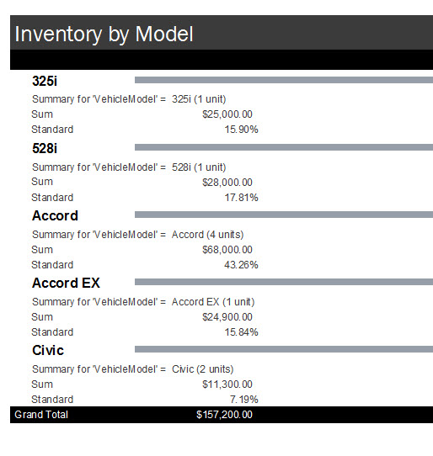
Create an Aggregate Report (continued)
Aggregate data
for each model
Notes:
Aggregate reports are meant to provide the reader with a snapshot of the data in the database, which is the key data that drives the business. Also, an aggregate report can inadvertently alert the managers (and the data entry staff) that a value looks suspicious. For instance, in Figure 6.37, the Inventory by Model Report indicated that the Summary for the VehicleModel for Accords is listed as 4, which could be one of the suspect values. The accounting staff will need to examine the individual records to verify that they are correct. An additional advantage of an aggregate report is to reveal invalid data that could easily be hidden in a huge database.

Slide 24
Summary
In this chapter, you learned how to apply the various data validation techniques using tables, forms, and reports to reduce errors while managing the database.
Notes:
In this chapter, you learned how to apply the various data validation techniques using tables, forms, and reports to reduce errors while managing the database.

