Slide 1

CIS 1230
Chapter 7
Advanced Queries:
Moving Beyond the Select Query
Notes:
This chapter discusses the use of Advanced queries in Microsoft Access 2010. The most common types of queries are typically select queries, but there are many others that exist as well. Among these are action queries, such as the append, delete, make table and update queries, parameter queries, crosstab queries, find duplicate queries, and find unmatched queries.

Slide 2
Objectives
Determine when to use an action query
Update data with an update query
Add records to a table with an append query
Create a table with a make table query
Delete records with a delete query
Create a parameter query to provide flexibility
Summarize data with a crosstab query
Find unmatched records with a query
Find duplicate records with a query
Notes:
In this chapter, we learn how to:
Determine when to use an action query.
Update data with an update query.
Add records to a table with an append query.
Create a table with a make table query.
Delete records with a delete query.
Create a parameter query to provide flexibility.
Summarize data with a crosstab query.
Find unmatched records with a query.
Find duplicate records with a query.

Slide 3
Action Queries
Alternative to the Select query, which fetches information for display
Will perform an action to change data
Start by making Select query, and then change type to:
Update
Append
Make table
Delete
Notes:
Select queries are common in databases. They allow the user to find information on demand. However, there may be times we want to do more than find information, and that is what Action queries will do. Instead of selecting information for display, they will perform an action to add, update, and delete records. We start by creating a new Select query, and then we can change to an Update, Append, Make Table, or Delete query.

Slide 4
Action Queries
Can use criteria just as Select queries can
Often run in the background (not always on command)
Can cause problems with data loss
Notes:
Just as you might find in a Select query, all Action queries can use criteria just as Select queries can. These queries often are run in the background; in other words, they may be triggered to run automatically at certain times or when certain actions are performed in a database. Since these queries are actually changing data, they can cause problems with data loss, and the database should be backed up before running. Otherwise, you may experience catastrophic data loss or corruption.

Slide 5
Action Queries: Examples
Append query — used to copy records to an existing table
Example: Copy graduated students from Students table to Graduated table in a student database
Delete query — used to remove records
Example: Delete graduated students from Students table after they are copied to Graduated table
No “move” query; this is how we simulate a move
Notes:
Two types of Action queries are:
Append queries, which can be used to add records to an existing table. For example, after students have graduated from a college, the Registrar’s Office may wish to have those student records copied from the Students table to the Graduated table.
Delete queries, which can be used to delete records. For example, after we have copied graduated students to the Graduated table, we likely want to remove them from the Student table to avoid duplication.
Note that there is no “move” query, so this is how a move to an existing table is simulated.

Slide 6
Action Queries: Examples
Update query — used to make changes
Example: One customer service rep leaves, and all clients assigned to that rep must be changed to someone else
Make table query — used to copy information to a new table
Example: Move all inactive customers to a new table
Pair with delete query to remove old records
Can help keep Customers table fast and efficient
Queries on smaller tables will be quicker
Notes:
Two more types of Action queries are:
Update queries, which can be used to make changes. For example, when a customer service representative leaves a company, we may need to reassign their clients to someone else. If we wish to do this automatically rather than by hand, an Update query would be our way to do this
Make Table queries, which can be used to copy information to a new table. For example, we may want to move inactive customers to a new table. This would then be paired with a delete query to remove the old records. This can help keep the Customers table fast and efficient, because queries on smaller tables will be quicker.

Slide 7
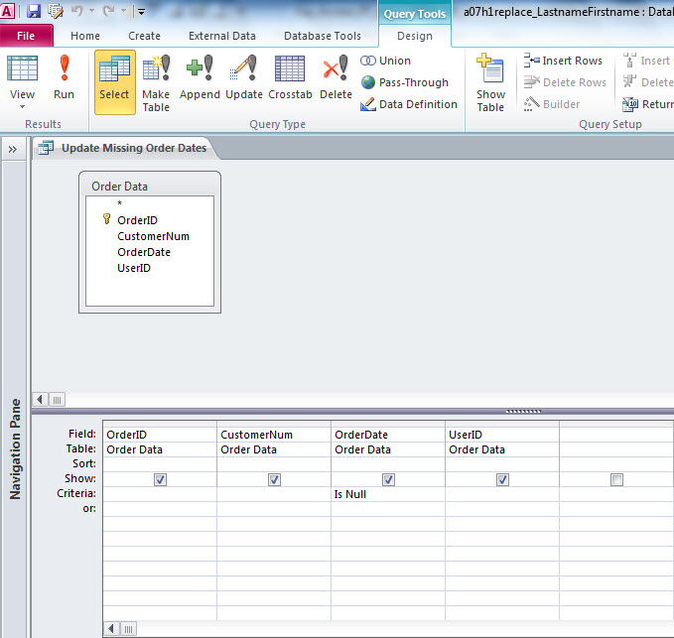
Action Queries: Locations
Locations of Action Queries on Query Tools Design Tab
Make Table
Append
Update
Delete
Notes:
After creating a Select query, you can change query type at any time by clicking on one of the buttons in the Query Tools Design Tab on the Ribbon. You will notice to the right of Select, there is an option to change the query in to a Make Table, Append, Update, and Delete query.

Slide 8
Action Queries: Warnings
Important to backup database first
Can make changes that cause unintended changes
Access prompts with the number of records to change
Ensure number sounds correct
Verify table data afterwards
Did it change what you thought it would change?
Do not re-run
Especially with Update queries, updates that are calculations can cause unintended changes
Notes:
Since Action queries are making changes to a database, there are some precautions that should be taken.
Back up the database before running a query, because it can cause unintended changes to the data.
When Access runs Action queries, it will tell you how many rows will be affected. If this number seems higher than you expected, you may want to check your query.
After you run the query, it is advisable to give the data a quick spot-check for mistakes.
Especially when using Update queries, do not run the query twice in a row. If you were updating salaries by 10% and ran that query twice in a row, it would increase salaries two times and cause unintended changes.

Slide 9
Update Query
Used to automate changes to a database
No need to do by hand
Change the value of one or more fields automatically
Can be based on criteria (single or multiple)
Notes:
Update queries can be used to automate changes to a database. These could be done by hand, but in a large database system, this is impractical. An Update query can change the value of one or more fields automatically, and like a Select query, we can use criteria to narrow down the records that will be changed. We can use a single criteria or multiple criteria to do so.

Slide 10
Update Query: Examples
All athletes with grade point averages greater than 2.5 should have the Eligible field set to Yes
West Paterson, NJ changed their name to Woodland Park
All customers who have a City field of West Paterson and a State of NJ should have the City field changed to Woodland Park
Notes:
Some examples of Update queries:
We want to make sure all athletes that are eligible are listed as such. In order to be eligible, assume an athlete needs a GPA of 2.5 or better. We would create an Update query to change the Eligible field to Yes if the GPA field is greater than 2.5. GPA > 2.5 is our criteria here.
The town of West Paterson, NJ changed the name of the town to Woodland Park. We would use multiple criteria to find these. We need all customers who have a City of West Paterson and a State of NJ. For all those customers, we would use the Update query to change the City field to Woodland Park.

Slide 11
Append Query
Selects records from one or more tables and adds them to existing table
Destination table must exist
If not, use a Make Table query
Notes:
Append queries can be used to copy records from one or more tables to another. Much like Update queries, you can specify criteria. You must append to an existing table. If you want to create a brand new table, use a Make Table query.

Slide 12
Append Query
Must match source fields with destination fields
Data types must match
Cannot append a date field in to a numeric field
Exceptions: Numeric and Date fields can both be appended to a Text field
Notes:
When you create an Append query, you should match fields together. In other words, you must tell Access where to store the results. Data types should generally match. Though there are some exceptions (Numeric fields can be stored as Text fields, as can Date fields), it is generally good practice to ensure the data types are the same to avoid errors.

Slide 13
Append Query
Validation rules in the destination table still apply
Could not duplicate primary key
Any non-required, missing fields will be blank
If you append four fields to a five-field table, fifth field will be blank
Destination table should NOT contain an Autonumber
Notes:
When appending records, also keep in mind validation rules still apply. We could not append a record with a Student ID Number of 012345 if that Student ID Number already exists (assuming that is the primary key of the table). Other rules still apply as well (for example, Start Date must be before End Date). Any non-required fields that are not accounted for will be left blank. If there are five fields in the destination and we append four fields, the fifth field will be left blank. Finally, the destination table should not have an AutoNumber field, because that field can not be appended into.

Slide 14
Make Table Query
Selects records from one or more tables
Uses results to create a new table
Similar to append query, except results go to new table
Avoids issues with having to match data types
If destination table exists, Access will prompt you to delete the existing table
Notes:
A Make Table query will select records from one or more tables and paste them in to a new table. The advantage to this over an Append query is that you do not have to worry about data types, field validation, etc. If the destination table already exists, Access will prompt you to delete this table before proceeding.

Slide 15
Delete Query
Selects records and then removes them from a table
Permanently removes records
Use with caution
Backup database first
May be done after a Make Table or Append query to simulate a move
Notes:
A Delete query will remove records that meet a certain criteria from a table. Delete queries should be run with caution, because records will be permanently deleted from a database. You may want to backup your database before running a Delete query. Delete queries may also be used in conjunction with a Make Table or Append query to simulate a move, since there is no move operation available.

Slide 16
Delete Query
You need to know the following to create a Delete query:
What are the criteria that should be met for to records to be deleted
Notes:
Keep in mind you need to know the criteria that should be met for to records to be deleted when you create a Delete query.

Slide 17
Queries for Special Conditions
Other queries that can help a user make decisions:
Parameter query
Crosstab query
Find Unmatched Records query
Find Duplicate Records query
Notes:
Among the other types of advanced queries in Access are some of the queries that are not necessarily traditional Select queries. These queries can help a user make decisions in a database. Among the types are Parameter queries, Crosstab queries, Find Unmatched Records queries, and Find Duplicate Records queries

Slide 18
Queries for Special Conditions
Parameter query
Will prompt the user for criteria
Example: Prompt user to enter a state, return all customers living in that state
Crosstab query
Similar to PivotTable
Displays aggregate data across two dimensions
Notes:
A Parameter query will prompt a user for criteria, and based on the response, select records. This is basically a more interactive Select query. The user can be prompted for criteria and records will be returned based on user’s input.
A Crosstab query is similar to a PivotTable, without filters. It will display aggregate data across a two dimensional layout.

Slide 19
Queries for Special Conditions
Find Unmatched Records query
Example: Finds child records with no matching parent records
In a one-to-many relationship, the “one” is the parent record and the “many” is the child record
In an Orders database, if one customer places many orders, customer is the parent record and an order is the child record
Notes:
A Find Unmatched Records query will find child records with no matching parent records.
Child records are the “many” in a one-to-many relationship, and the parent records are the “one”. For example, in an Orders database where one customer places many orders, the Customer is the parent record and the order is the child record, as one customer places many orders.

Slide 20
Queries for Special Conditions
Find Duplicate Records query
Can analyze data to find repeated information
Can find accidental replication of data
Example: Customers can sign up for supermarket store cards, to find people who have signed up for two you can find people with the same name, address, etc.
Notes:
A Find Duplicate Records query can analyze data to find repeated information, generally to find accidental repetition of data. For example, let’s say a company has store cards. Customers can sign up for supermarket store cards, but at times people sign up for multiple cards. To find people who have signed up for two, people with the same name, address, etc., you could use a Find Duplicate Records query.

Slide 21
Parameter Query
Create regular Select query
Add prompt to Criteria line, surrounded by brackets
[Instructions]
User will be prompted with your Instructions text and given a dialog box to enter data
If multiple parameters exist, Access will start from the leftmost field and move right
Notes:
A Parameter query is basically a Select query with one simple change. You can prompt the user for more information. In order to do so, you can surround what you want to prompt the user with by left and right brackets. For example, if you want to ask the user to enter a year, the prompt would be:
[Enter a Year]
The user will be prompted for a year in this case. Multiple parameters can be added to a query as well, and Access would prompt the user first for the leftmost parameter and move to the right.

Slide 22
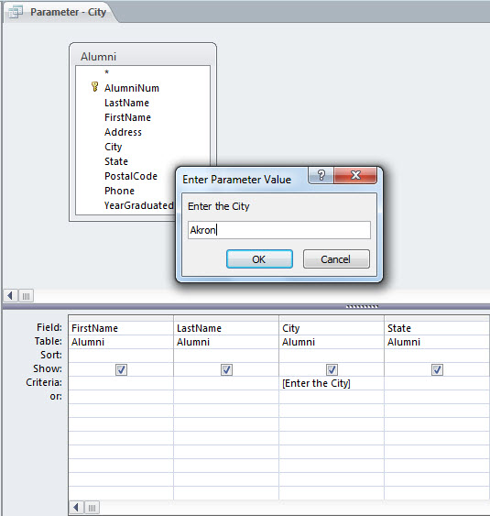
Parameter Query
Access will prompt the user to fill in a value for the parameter in a dialog box when the query is executed.
The parameter in this example is in brackets (as required).
Notes:
Access will prompt the user to fill in a value for the parameter in a dialog box when the query is executed.

Slide 23
Parameter Query
Can be used for partial matches as well
Example: Area Code
Prompt user for an area code
Return all phone numbers in that area code
Enter criteria as
Like [Enter Area Code] & '*'
Results will be all phone numbers starting with entered data
Notes:
Parameter queries can be used to match partial fields as well. For example, let us say we need to pull out all customers in a certain area code. We can prompt the user for an area code, and use the result as part of the criteria, using wildcards. In this case, the bracketed instructions can be added to any criteria string. For example, to find all numbers starting with are code 201, we would type
Like 201*
and it is not much different using parameters. In this case, we would type
Like [Enter Area Code] & '*‘
to simulate this. Note that the & character is just a way for Access to string two sets of characters together.

Slide 24
Parameter Reports
Reports can be based on queries
To create a Parameter Report, create a Parameter query and then base the report on the query
Notes:
Parameter queries can be used as the basis for reports as well. When we do so, these are called Parameter Reports. To do so, we first create a Parameter query (as we have done already) and then create a new report. The source for this new report would be the Parameter query that we just created.

Slide 25
Crosstab Query
Summarizes a data source to a grid of rows and columns
Uses aggregate functions to summarize data (sum, count, average, etc)
Resembles PivotTable without filters
Advantages:
Source can be tables, queries, or a combination of both
Can create many of them and save them
Each table can only have one PivotTable
Notes:
Similar to PivotTables, Crosstab queries summarize a data source into a grid of rows and columns. Much like PivotTables, Crosstab queries use aggregate functions to summarize data (sum, count, average, etc.). Basically, it is a PivotTable without filters. There are two reasons to use a Crosstab query instead of a PivotTable. First, Crosstab queries can be based on one table, multiple tables, queries, or any combination thereof. Secondly, any number of Crosstab queries can be created and saved for future use. Each table can only have one PivotTable.

Slide 26
Crosstab Query
Column headings display field values along the top side
Row headings display field values along the left side
Once completed, it can be edited easily to add fields, change order, etc.
Notes:
In a Crosstab query, the column headings display field values along the top side, and the row headings display field values along the left side of the screen. Once a Crosstab query has been completed, it can easily be edited to add fields, change the order of the fields, and do many other common editing tasks.

Slide 27
Crosstab Query: Example
Example:
We want to summarize the revenue generated by each salesperson
We want to see totals for each month
We also want to see totals for the entire year
Notes:
Example: You may want to summarize the revenue generated by each salesperson for each month and for the year. This is shown on the next slide (or figure 7.33 in your textbook).

Slide 28
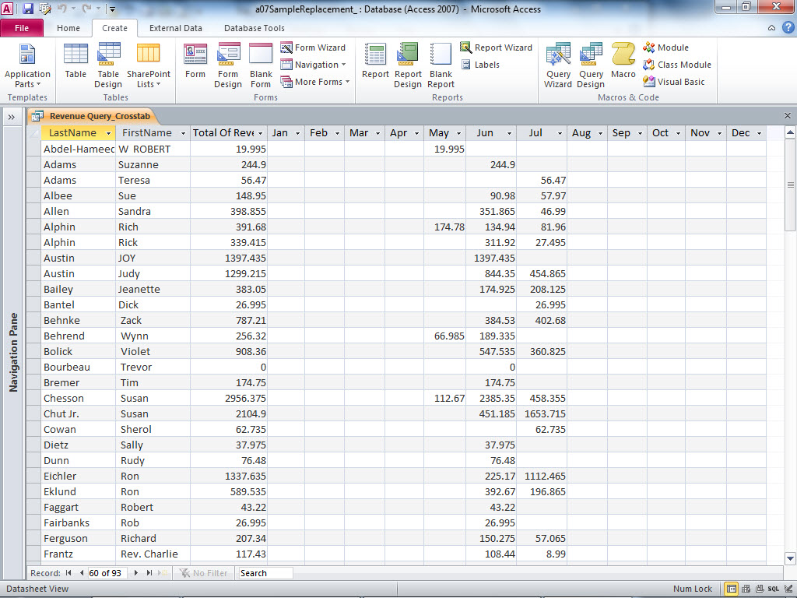
Crosstab Query
The months of the year are the column headings
Two row headings exist: Last Name and First Name
Aggregate function results show here
Notes:
A Crosstab query in the above figure (Figure 7.33 in your text) has two row headings – Last Name and First Name. This query has the months of the year as the column headings. The aggregate function Sum has been used to get monthly and overall totals. As you can see, this resembles a PivotTable.

Slide 29
Find Unmatched Records Query
Compares records in two related tables and displays the records found in one table, but not the other
Requires a common field
Example: Find all applicants to a college (stored in Student table) who have never registered for a class (found in Registration table)
Notes:
If there may be records in one table, but not another, a Find Unmatched Records table may help us to find them. This query will compare records in two related tables and displays the records found in one table, but not the other. It requires a common field in order to compare.
For example, you can find all applicants to a college (stored in Student table) who have never registered for a class (found in Registration table). We would assume in this case the student ID would be a common field, so this query would return all students who exist in the Student table but do not exist in the Registration table, thereby showing students who have never registered.

Slide 30
Find Duplicate Records Query
Useful to find duplicate values in a table
Can be useful if there may be duplication of fields that should not exist
Want to add a primary key field
Duplicates exist, so primary key can not be added
Use query to find these duplicates
Will find duplicates, but it is still up to DBA to review manually
Notes:
The Find Duplicate Records queries is useful to find duplicate values in a table. This is especially useful if you attempt to add a relationship and enforce referential integrity. If there are records that violate referential integrity rules, Access will not allow this relationship to be set up. For example, let’s say there are multiple customers with the same ID number. This can not exist when you attempt to set up a primary key, so a find duplicates query can help. This type of query will find duplicates, but it is still up to DBA to review manually and fix manually as well.

Slide 31
Summary
In this chapter, you learned to go beyond the Select query to automatically add, update, and delete records using other types of queries, and to use special types of queries to help make decisions and increase the flexibility of your database.
Notes:
In this chapter, you learned to go beyond the Select query to automatically add, update, and delete records using other types of queries, and to use special types of queries to help make decisions and increase the flexibility of your database.

