Slide 1

CIS 1230
Chapter 9
Fine-Tuning the Database
INSERT
BOOK
COVER
Notes:
This chapter discusses how you can fine-tune the database by analyzing and improving the performance of the database.

Slide 2
Objectives
Verify First Normal Form
Verify Second Normal Form
Verify Third Normal Form
Use the Database Documenter Tool
Use the Performance Analyzer Tool
Use the Table Analyzer Tool
Use the Database Splitter Tool
Notes:
In Access Chapter 9, we would like to achieve the following learning objectives:
To verify first normal form.
To verify second normal form.
To verify third normal form.
To use the database documenter tool.
To use the performance analyzer tool.
To use the table analyzer tool.
To use the database splitter tool.

Slide 3
Objectives (continued)
Create a menu system
Encrypt and password-protect a database
Digitally sign and publish a database
Save a database as an ACCDE file
Notes:
Other objectives that we would like to achieve in this chapter are:
To create a menu system.
To encrypt and password-protect a database.
To digitally sign and publish a database.
To save a database as an ACCDE file.

Slide 4
Verify First Normal Form
Normalization – the formal process of deciding which fields should be grouped together into which tables
Anomaly – an error or inconsistency that occurs when you add, edit, and delete data
Normal Form – indicates the current state of a table with respect to normalization
First Normal Form (1NF)
Second Normal Form (2NF)
Third Normal Form (3NF)
Notes:
Before, you can normalize a database table, you need to understand the definition for several terms commonly associated with normalization.
Normalization is the formal process of deciding which fields should be grouped together into which tables. There are several reasons why you need to normalize a table. Some of these benefits are:
• To minimization of data redundancy
• To improvement of referential integrity enforcement
• To ease of maintaining data (add, update, delete)
• To accommodation of future growth of a database
An anomaly is an error or inconsistency that occurs when you add, edit, and delete data.
A normal form indicates the current state of a table with respect to normalization. It is always a good practice for database designers to check that all the tables follow the rules of normalization. There are a total of five normal forms, but you will learn the first three rules of normalization in this chapter, and they are known as First Normal Form (1NF), Second Normal Form (2NF), and Third Normal Form (3NF).
A table that meets 1NF criteria is better than a table that does not. Similarly, a table that meets 2NF criteria is better than a table that is in 1NF, and a table that meets 3NF criteria is better than a table that is in 2NF.

Slide 5
Verify First Normal Form (continued)
First Normal Form (1NF) – the first rule to identify and correct
1NF – a table that contains no repeating groups
Repeating groups can also appear in tables as repeating columns, such as Title1, Title2, and Title3
Notes:
First Normal Form is the first rule to identify and correct. First Normal Form (1NF) is defined as a table that contains no repeating groups. Therefore, a table is in 1NF if it contains no repeating groups. Repeating groups can also appear in tables as repeating columns, such as Title1, Title2, and Title3.

Slide 6
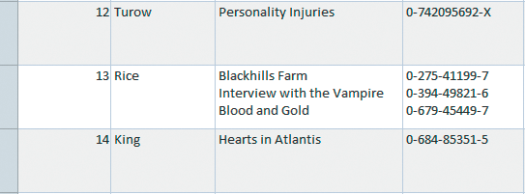
Verify First Normal Form (continued)
Figure 9.2 Access Table with Repeating Groups
Rice is listed as the author
Three titles are shown for Rice
Notes:
Figure 9.2 shows an Access table that has a repeating group. In this example, the author known as Rice is listed once, but the title of the three books that she wrote are all listed in one cell. The titles of her books are known as repeating groups and would not be allowed in a normalized table. Therefore, this table is not in first normal form.

Slide 7
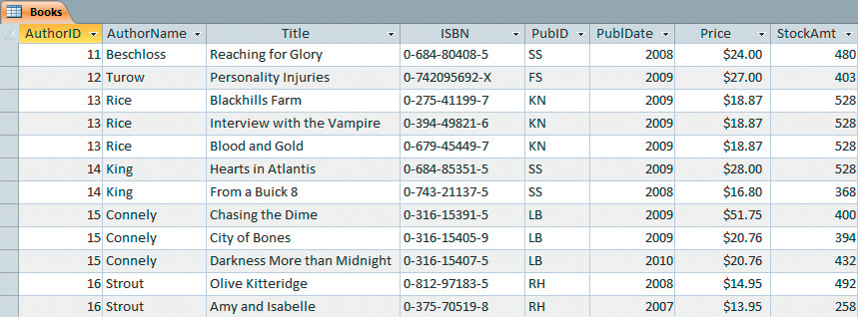
Verify First Normal Form (continued)
Figure 9.4 Access Books Table in 1NF
Rice books are separated
into three records
Notes:
In this example, where the database table has a repeating group, you can remove the repeating group by splitting the cell for Rice’s books into three rows, with each row listing a separate book record. The table as illustrated in Figure 9.4 is now in 1NF.

Slide 8
Verify Second Normal Form
Second Normal Form (2NF) – if the table meets 1NF criteria and all non-key fields are functionally dependent on the primary key
Functional Dependency – occurs when the value of one field is determined by the value of another
Non-key Field – any field that is not part of the primary key
Notes:
A table is in Second Normal Form (2NF) if it meets 1NF criteria and all non-key fields are functionally dependent on the primary key. Functional dependency occurs when the value of one field is determined by the value of another. A non-key field is any field that is not part of the primary key.

Slide 9
Verify Second Normal Form (continued)
Figure 9.4 Access Books Table in 1NF
Primary key
ISBN = 0-275-41199-7
Price and StockAmt not functionally dependent on ISBN
Notes:
As illustrated in Figure 9.4 Access Books Table, ISBN is the primary key, and the title of each book is functionally dependent on this field.
If you look up the ISBN number 0-275-41199-7, the first Rice book, you will always find the same title of the book, Blackhills Farm. Therefore, you can say that the Title field is functionally dependent on the ISBN field. In addition, other fields such as AuthorName, AuthorID, PubID, and PubDate are also functionally dependent on the ISBN field.
But, Price and StockAmt fields are not functionally dependent on the ISBN field. For instance, the price of the book could change at any moment depending on market conditions and the StockAmt will also change whenever a book is sold or replenished. Therefore, Price and StockAmt cannot remain in this table. Consequently, we can conclude that the Books table is not in 2NF.

Slide 10
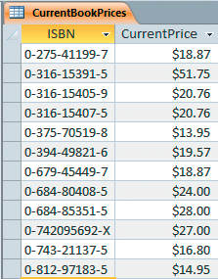
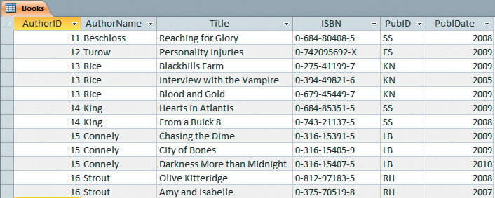
Verify Second Normal Form (continued)
Figure 9.5 New Access Table: CurrentBookPrices
Price and StockAmt
fields removed
Figure 9.6 Books Table in 2NF
Price is entered for each ISBN
Notes:
To convert the table into 2NF, you must move the Price and StockAmt fields to a new table. As illustrated in Figure 9.5, a new table named CurrentBookPrice is created to store the ISBN and CurrentPrice fields. Now you can find the price of a book by looking up the ISBN and then retrieving the current price.
You will remove the StockAmt field from the original table because StockAmt is now calculated based on the values of other tables. The stock amount of a particular book is calculated by choosing a starting quantity (e.g., after a physical inventory), adding any new purchases, and then subtracting any sales. This quantity number will change when there is a purchase or a sale.
Both the Price and StockAmt fields are removed from the Book table, and the resulting Book table illustrated in Figure 9.6 is now in 2NF.

Slide 11
Verify Third Normal Form
Third Normal Form (3NF) – if the table meets 2NF criteria and no transitive dependencies exist
Transitive Dependency – occurs when the value of one non-key field is functionally dependent on the value of another non-key field
Notes:
A table is in Third Normal Form (3NF) if it meets 2NF criteria and no transitive dependencies exist. A transitive dependency occurs when the value of one non-key field is functionally dependent on the value of another non-key field.

Slide 12
Verify Third Normal Form (continued)
Figure 9.6 Books Table in 2NF
AuthorID and AuthorName are functionally dependent on each other
Notes:
In Figure 9.6, AuthorID and AuthorName are functionally dependent on each other. AuthorName is dependent on AuthorID and this is an example of a transitive dependency. Whenever you know the AuthorID, the AuthorName is automatically known. Therefore, the Book table in Figure 9.6 is not in 3NF.

Slide 13
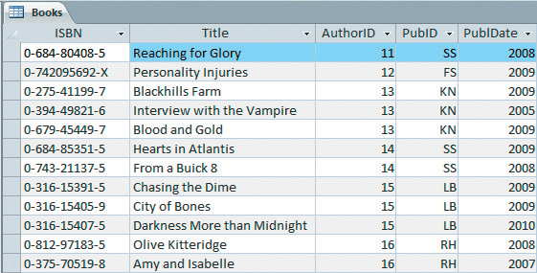
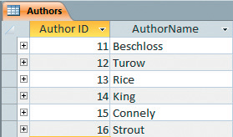
Verify Third Normal Form (continued)
Figure 9.7 New Access Table: Authors
ISBN (Primary Key)
moved to first position
AuthorName removed
from Books table
Each Author is
listed only once
Figure 9.8 Books Table in 3NF
Notes:
To conform the Books table to 3NF, the AuthorName field must be moved to another table. As illustrated in Figure 9.7, a new table named Authors is created, and this table contained two fields: AuthorID and AuthorName. As shown in Figure 9.8, the Book table can now reference the author using the AuthorID field. The Book table is in 3NF since the transitive dependency was removed.

Slide 14
Use the Database Documenter Tool
Database Documenter – creates a report that contains detailed information for each selected object field names, data types, properties, indexes, and permissions
Report for a database with many tables could be very long
Purpose – to verify and update the properties of one object using a printout of the properties of another similar object
Notes:
The Database Documenter creates a report that contains detailed information for each selected object. The detailed information could include the field names, data types, properties, indexes, and permissions. If you run the Documenter for a database with many tables, the report could become very long.
A common use for the Database Documenter is to verify and update the properties of one object using a printout of the properties of another similar object.

Slide 15
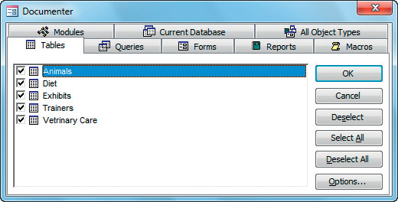
Use the Database Documenter Tool (continued)
Figure 9.13 Database Documenter Dialog Box
Tables tab
All tables are selected
Use Options to
customize the report
Notes:
Access allows the users to specify which items to include or exclude. You can select the items to be included and limit the number of pages to be printed by clicking on the Options button as shown in Figure 9.13.

Slide 16
Use the Performance Analyzer Tool
Performance Analyzer – used to evaluate the design of the database and make recommendations for optimizing the database
The Performance Analyzer lists three kinds of analysis results:
Recommendations
Suggestions
Ideas
Notes:
The Performance Analyzer tool is used to evaluate the design of the database and make recommendations for optimizing the database. The Performance Analyzer lists three kinds of analysis results—Recommendations, Suggestions, and Ideas.

Slide 17
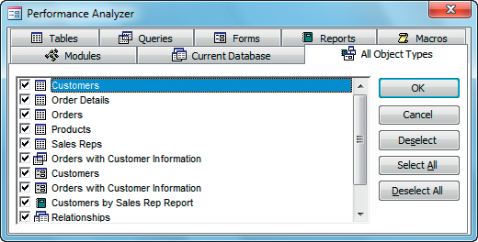
Use the Performance Analyzer Tool (continued)
Figure 9.16 Performance Analyzer Dialog Box
All objects are selected
for analysis
All Object Types tab selected
Notes:
Figure 9.16 displays the Performance Analyzer dialog box. The Tables tab is selected by default. However, if users inform you that the database generally runs slow (e.g., reports take a long time to complete), you might choose to analyze All Object Types in an attempt to improve performance.

Slide 18
Use the Table Analyzer Tool
Table Analyzer – analyzes the tables in a database and then normalize the tables
Use results to:
Rename tables
Split tables
Rearrange fields in tables
Create relationships between tables
Notes:
The Table Analyzer will analyze the tables in a database and then normalize the tables. The Table Analyzer enables you to modify the decisions it makes. You can use the results to rename tables, split tables, rearrange fields in tables, and create relationships between tables. You can modify Table Analyzer decisions during every step of the normalization process.

Slide 19
Use the Database Splitter Tool
Database Splitter – enables you to split a database into two files:
Back-end database
Contains the data tables
Is typically placed on the server
Front-end database
Contains all the other database objects
Placed on each individual user’s computer
Notes:
Splitting the database may improve the speed at which the database processes data and returns results. The Database Splitter enables you to split a database into two files:
a back-end database that contains the data tables and is typically placed on the server.
a front-end database that contains all the other database objects such as queries, forms, and reports, and is placed on each individual user’s computer.
The front-end database will contain links to the tables in the back end.

Slide 20
Create a Menu System
Switchboard – a menu or a series of menus that ties the objects in the database together so that the database is easy to use
Switchboard Manager – an Access utility that prompts you for information about each menu item
Navigation Form – helps users open the forms and reports they need quickly
Notes:
Switchboard is a menu or a series of menus that ties the objects in the database together so that the database is easy to use. Switchboard Manager is an Access utility that prompts you for information about each menu item. Navigation form helps users open the forms and reports they need quickly.

Slide 21
Encrypt and Password-Protect a Database
Access 2010 incorporates encryption methods to help keep your databases secure
Encryption – the process of altering digital information using an algorithm to make it unreadable to anyone except those who possess the key (or secret code)
Open Exclusive – guarantees that you are the only one currently using the database
Notes:
Access 2010 incorporates encryption methods to help keep your databases secure. Encryption is the process of altering digital information using an algorithm to make it unreadable to anyone except those who possess the key (or secret code). Open Exclusive mode guarantees that you are the only one currently using the database.

Slide 22
Digitally Sign and Publish a Database
Digital Signatures – electronic, encryption-based, secure stamps of authentication that confirm who created the file, that the file is valid, and that no changes have been made to the file after its authentication
Certification Authority (CA) – a commercial company, such as VeriSign, that issues and validates identities using digital signatures for a fee.
Notes:
Digital signatures are electronic, encryption-based, secure stamps of authentication that confirm who created the file, that the file is valid, and that no changes have been made to the file after its authentication. A certification authority (CA) is a commercial company, such as VeriSign, that issues and validates identities using digital signatures for a fee. Choose a CA if you need high-level security.

Slide 23
Save a Database as an ACCDE File
Access Database Executable (ACCDE) file
Removes all VBA source code
Prohibits users from making design and name changes to forms or reports
Prohibits users from creating new forms and reports
Notes:
An Access Database Executable (ACCDE) file removes all VBA source code, prohibits users from making design and name changes to forms or reports, and prohibits users from creating new forms and reports. When you save your existing database with the new file extension, Access makes a copy of the last saved edition of your database. When the database has been converted to .accde, it cannot be converted back to its source format (.accdb).

Slide 24
Summary
Majority of database designs only require the first three normal forms
Access provides the following useful tools to improve the performance of a database:
Database Documenter tool
Performance Analyzer tool
Table Analyzer tool
Database Splitter tool
Notes:
In this chapter, you learn that:
The majority of database designs only require the first three normal forms.
Access provides the following useful tools to improve the performance of a database:
the Database Documenter tool
the Performance Analyzer tool
the Table Analyzer tool
the Database Splitter tool

