Slide 1

Exploring Microsoft Office Access 2010
by Robert Grauer, Keith Mast, and Mary Anne Poatsy
Chapter 10
Using Macros and SQL in Access
INSERT
BOOK
COVER
Notes:
This chapter discusses the use of advanced techniques such as macros and SQL in Microsoft Access 2010.

Slide 2
Objectives
Understand the purpose of a macro
Create a stand-alone macro
Use the Macro Builder
Attach an embedded macro to an event
Identify when to use a data macro
Notes:
In Access Chapter 10, we would like to achieve the following learning objectives:
To understand the purpose of a macro
To create a stand-alone macro
To use the Macro Builder
To attach an embedded macro to an event
To identify when to use a data macro
To create an event-driven data macro
To create a named data macro
To understand the fundamentals of SQL
To interpret an SQL Select Statement
To use an SQL Select Statement as a record

Slide 3
Objectives (continued)
Create an event-driven data macro
Create a named data macro
Understand the fundamentals of SQL
Interpret an SQL Select Statement
Use an SQL Select Statement as a record source
Notes:
The following objectives are also covered:
To create an event-driven data macro.
To create a named data macro.
To understand the fundamentals of SQL.
To interpret an SQL Select Statement.
To use an SQL Select Statement as a record.

Slide 4
Understand the Purpose of a Macro
Macro – a series of actions that can be programmed to automate tasks
Event – occurs when a user enters, edits, or deletes data; events can also occur when users open, use, and close forms and reports
Notes:
Before, we create a macro, we need to understand the definition for several terms commonly associated with macros.
A macro is defined as a series of actions that can be programmed to automate tasks.
An event occurs when a user enters, edits, or deletes data; events can also occur when users open, use, and close forms and reports.

Slide 5
Understand the Purpose of a Macro (continued)
Two types of macro:
Stand-alone macro – a database object that you create and use independently of other controls or objects
Embedded macro – a macro that executes when an event attached to a control or object occurs
Notes:
There are two types of macro:
A stand-alone macro is a separate database object in Access that you create and use independently of other controls or objects. A stand-alone macro appears in the Navigation Pane and can be run independently. Stand-alone macros are also available to any control or object in the database.
An embedded macro is a macro that is embedded in a specific object or control and that executes when an event attached to a control or object occurs. An embedded macro does not appear in the Navigation Pane. Use an embedded macro when only one object needs to run the macro.

Slide 6
Understand the Purpose of a Macro (continued)
Two examples of an event attached to a control:
After Update event
Triggered each time you enter (update) data into a field on a form
On Close event
Happens whenever you close a form or a report
When triggered Access will execute the steps stored in the macro
Notes:
Two examples of an event attached to a control:
After Update event is triggered each time you enter (update) data into a field on a form.
On Close event happens whenever you close a form or a report. When an On Close event is triggered, Access will execute the steps stored in the macro.

Slide 7
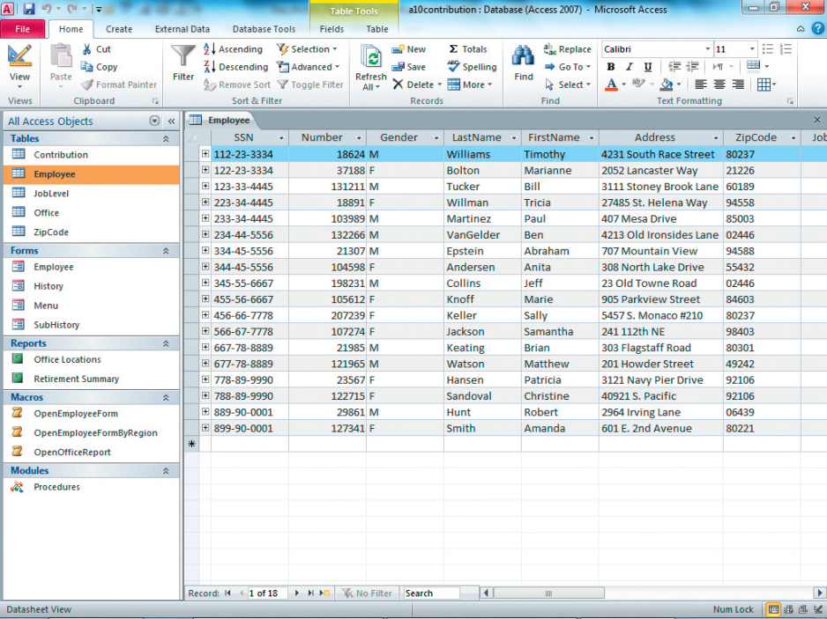
Understand the Purpose of a Macro (continued)
Figure 10.1 Stand-Alone Macro
Stand-alone macros appear
in Navigation Pane
Notes:
Figure 10.1 shows three stand-alone macros that appear as objects in the Navigation Pane of a database.

Slide 8
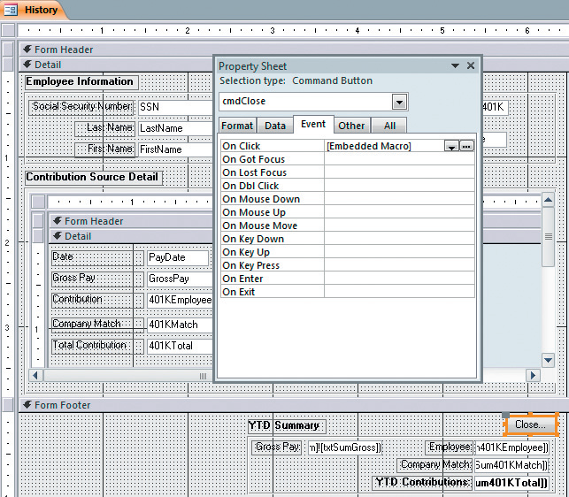
Understand the Purpose of a Macro (continued)
Command Button
Property Sheet
Embedded macro attached
to On Click event
Command button control
Figure 10.2 Embedded Macro
Notes:
Figure 10.2 shows an embedded macro. When you add a macro to an event such as the On Click event of a button, Access embeds a macro in the object or control. The Event tab in the object’s Property Sheet enables you to open and edit the embedded macro.

Slide 9
Understand the Purpose of a Macro (continued)
Two methods to create an embedded macro:
Access wizard
A macro
Notes:
Users can create an embedded macro using either one of the following two methods:
Use an Access wizard, such as the Command Button Wizard, and let Access create the macro for you.
Add a macro to an existing control manually by clicking the Build button in the event box of the control or object you are manipulating.

Slide 10
Create a Stand-Alone Macro
To start the Macro Builder:
Click the Create tab
Click Macro in the Macros & Code group
When you finished building the macro:
Click Save
Type a descriptive name for the macro
To run a stand-alone macro:
Double-click the macro name in the Navigation Pane or select the macro and press Enter
Notes:
We will use the Macro Builder to create a stand-alone macro. In this slide, we will review the steps to creating a stand-alone macro. To start the Macro Builder, you click the Create tab, and then click Macro in the Macros & Code group. When you finished building the macro, you click Save, and then you type a descriptive name for the macro. The macro name will appear in the Navigation Pane. To run a stand-alone macro, you double-click the macro name in the Navigation Pane or select the macro and press Enter.

Slide 11
Create a Stand-Alone Macro (continued)
To edit a macro:
Right-click on the macro name in the Navigation Pane
Select Design View from the shortcut menu
After modifying the macro:
Save
Close the macro
Notes:
To edit a macro, right-click on the macro name in the Navigation Pane, and then select Design View from the shortcut menu. After modifying the macro, save and close the macro.

Slide 12
Use the Macro Builder
Macro Builder – enables you to create and edit macros
Argument – a variable, constant, or expression that is needed to produce the output for an action
Notes:
The Macro Builder enables you to create macros. Remember that an Argument is a variable, constant or expression that is needed to produce output for an action.

Slide 13
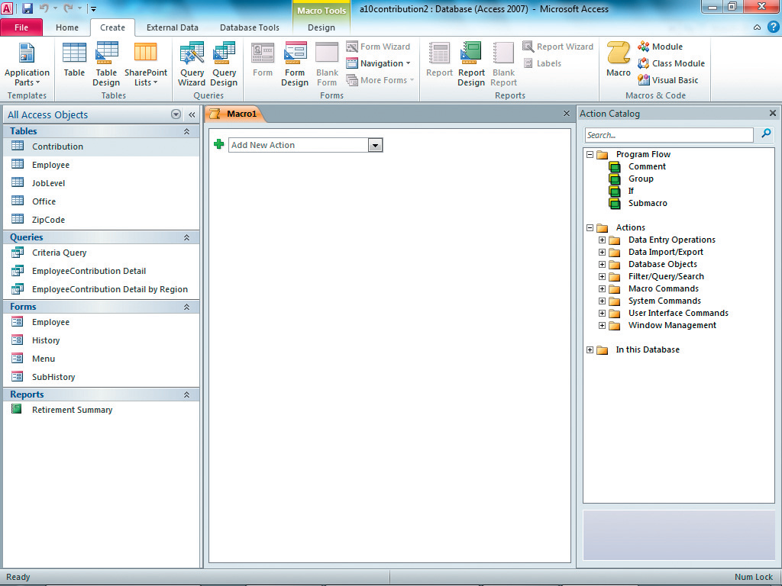
Use the Macro Builder (continued)
Click Macro to open the Macro Builder
Add macro actions here
Use the Action Catalog to find and add actions
Figure 10.3 Macro Builder
Notes:
Figure 10.3 shows the Macro Builder. In this figure, the Navigation pane is on the left, the build-a-macro area is in the middle, and the Action Catalog is on the right. The Action Catalog can be used as a reference as you design a macro. You can also locate an action in the Action Catalog, and double-click it (or drag it) to add it to the macro.

Slide 14
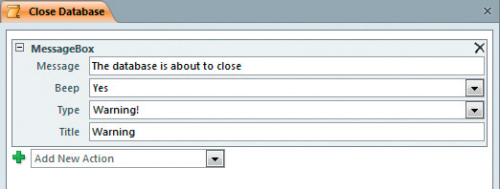
Use the Macro Builder (continued)
Figure 10.4 Macro Action with Arguments
MessageBox action has four arguments: Message, Beep, Type, and Title.
Notes:
Next, you need to specify the arguments for the action you added to the macro. For instance, if you add a MessageBox action to the macro as illustrated in Figure 10.4, the MessageBox action contains four arguments, one of which is required. You can see a short description of each argument by hovering the mouse over the argument box. The MessageBox action contains the following four arguments: Message, Beep, Type, and Title.

Slide 15
Attach an Embedded Macro to an Event
Embedded macros:
Attached to an event of a control on a form or report, or to an event of the form or report object itself
Open in Design view to attach an embedded macro
To attach a macro to an event:
Add a control that automatically creates an embedded macro using the Command Button Wizard
Attach an embedded macro to an event using the Property Sheet
Notes:
Embedded macros are always attached to an event of a control on a form or report, or to an event of the form or report object itself. You must open the form or report in Design view to attach an embedded macro.
You can attach a macro to an event using one of the following two methods:
Add a control that automatically creates an embedded macro using the Command Button Wizard.
Attach an embedded macro to an event using the Property Sheet.

Slide 16
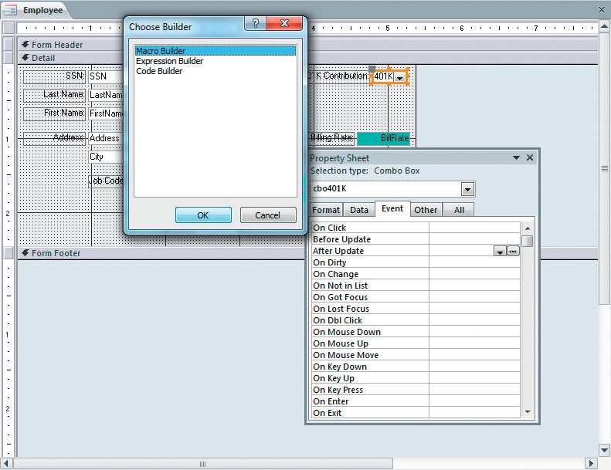
Attach an Embedded Macro to an Event (continued)
Figure 10.6 Create an Embedded Macro
Select the Macro Builder in the Choose Builder dialog box
After Update event is selected
Click Build
Notes:
As illustrated in Figure 10.6, when you click in an event property box, the Build button appears on the right side of the box. You need to click Build, click Macro Builder, and then click OK. The Macro Builder opens and you can add actions using the same methods you used for the stand-alone macro.

Slide 17
Identify When to Use a Data Macro
Data macros are only used with table events and not with other objects
A form based on a table that contains a data macro will inherit the logic of the table
Examples of when to add a data macro to a table:
Verify that a customer has no outstanding invoices
Keep a log of any changes made to a specific table
Send a confirmation email
Notes:
Data macros are only used with table events and you cannot use a data macro with other objects. A form based on a table that contains a data macro will inherit the logic of the table. Examples of when to add a data macro to a table:
To verify that a customer has no outstanding invoices before placing a new order.
To keep a log of any changes made to a specific table.
To send a confirmation email when a contributor makes a donation.

Slide 18
Create an Event-Driven Data Macro
Event-driven Data Macros
Triggered when a table event, such as After Delete or Before Change, occurs
Occur naturally as users enter, edit, and delete table data
Named Data Macros
Can be accessed from anywhere in the database
Can accept parameters
Notes:
There are two main types of data macros:
1. Event-driven data macros are triggered when a table event, such as After Delete or Before Change, occurs. These events occur naturally as users enter, edit, and delete table data.
2. Named data macros can be accessed from anywhere in the database, You can create and edit a named data macro in Design view of the table where you want to apply a rule.

Slide 19
Create a Named Data Macro
Named Data Macro
Created and edited in table Design view
Save the macro with a descriptive name, such as DataMacro-Email
Can be run from within another macro
Notes:
You can create and edit a named data macro in Design view of the table. After you create a named data macro, you save the macro with a descriptive name, such as DataMacro-Email. You can run the data macro from inside another macro using the RunDataMacro action.

Slide 20
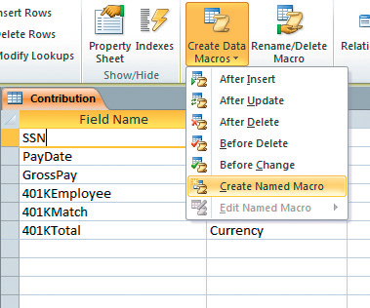
Create a Named Data Macro (continued)
Figure 10.14 Create a Named Data Macro
Create Data Macros
Design view of the Contribution table
Create Named Macro
Notes:
As illustrated in Figure 10.14, when the table is in Design view, click Create Data Macros, and then select Create Named Macro from the list.

Slide 21
Understand the Fundamentals of SQL
Structured Query Language (SQL)
Industry standard language for defining, manipulating, and retrieving the data in a database
Developed at IBM by Donald Chamberlin and Raymond Boyce in the early 1970s
Used to create and modify tables
Microsoft’s own version of SQL for Microsoft Access
Notes:
Structured Query Language (SQL) is the industry standard language for defining, manipulating, and retrieving the data in a database. It was developed at IBM by Donald D. Chamberlin and Raymond F. Boyce in the early 1970s. SQL is used to create and modify tables; this section will be limited to the retrieval of data. Microsoft has developed its own version of SQL for Microsoft Access, which varies slightly from the industry-standard SQL language. All Access queries use an SQL Statement—behind the scenes—to extract data from tables.

Slide 22
Interpret an SQL Select Statement
SQL Select Statement – is used to retrieve data from the tables in a database
SQL Keyword – defines the purpose and the structure of an SQL Statement
Notes:
An SQL Select Statement is used to retrieve data from the tables in a database. An SQL Keyword defines the purpose and the structure of an SQL Statement.

Slide 23
Interpret an SQL Select Statement (continued)
Four basic SQL keywords:
SELECT - Instructs Access to return the specific fields from one or more tables
FROM - Specifies the table(s) that will be searched
WHERE - Specifies the criteria that records must match to be included in the results
ORDER BY - Is used to sort the records by a certain field in either ascending or descending order
Notes:
Four basic SQL keywords:
SELECT - instructs Access to return the specific fields from one or more tables.
FROM - specifies the table (or tables) that will be searched.
WHERE - specifies the criteria that records must match to be included in the results.
ORDER BY - is used to sort the records by a certain field in either ascending or descending order.

Slide 24
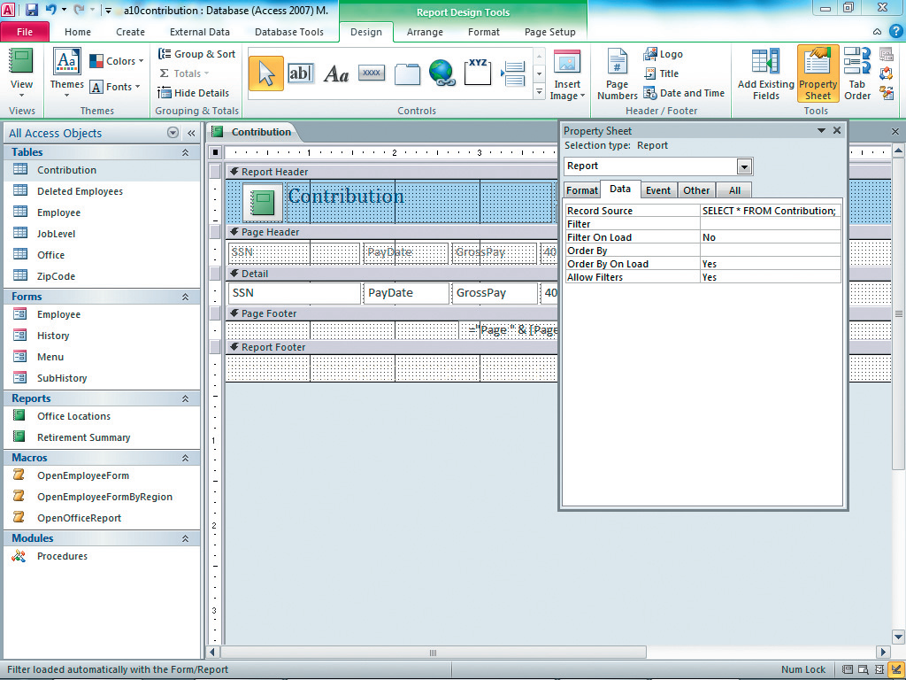
Use an SQL Select Statement as a Record Source
Record source is an SQL statement
FIGURE 10.26 Contribution Report with SQL Record Source
Notes:
You can replace any existing record source with the SQL statement. As illustrated in Figure 10.26, after you open the Property Sheet, you select Report using the Selection arrow at the top of the Property Sheet. You will click the Data tab, and then click in the Record Source property box. In the example mentioned in the textbook, you delete Contribution (which is the name of a table in the database) from the Record Source, and then type SELECT * FROM Contribution; in its place.

Slide 25
Use an SQL Select Statement as a Record Source (continued)
Basic structure of an SQL statement:
SELECT field names
FROM table name
WHERE specified criteria must be met
ORDER BY field name;
Notes:
In this slide, we are going to create an SQL Record Source for a report. The basic structure of an SQL statement is as follows:
SELECT field names
FROM table name
WHERE specified criteria must be met
ORDER BY field name;
We used the four basic SQL keywords that we learned on Slide # 22: Select, From, Where, and Order By.

Slide 26
Use an SQL Select Statement as a Record Source (continued)
Reasons for using an SQL statement for a record source:
Create a form or report without creating a new query
Easier to transfer a form or report to another database
Construct the record source of a report at run-time using VBA
Notes:
There are several reasons for using an SQL statement for a record source:
You can create a form or report without creating a new query (because the record source is contained in the object).
It is easier to transfer a form or report to another database (because the record source is contained in the object).
You can construct the record source of a report at run-time using VBA (based on user input).

Slide 27
Summary
In this chapter, you learned how to use the following advanced techniques in Microsoft Access 2010:
Macros: to verify data entry and automate tasks
SQL statements: to create record sources
Notes:
In this chapter, you learned how to use the following advanced techniques in Microsoft Access 2010:
Macros to verify data entry and automate tasks.
SQL statements to create record sources.

Slide 28
Questions
Notes:
Do you have any questions about what we learned today? Please feel free to email me if you have any other questions later.

Slide 29

Copyright
All rights reserved. No part of this publication may be reproduced, stored in a retrieval system, or transmitted, in any form or by any means, electronic, mechanical, photocopying, recording, or otherwise, without the prior written permission of the publisher. Printed in the United States of America.

