Slide 1
Economics:
Foundations and Models

Slide 2
References
(1)R. Glenn Hubbard; Anthony Patrick O’Brien，Economics，机械工业出版社
(2)Samuelson and Nordhars, Economics,17th Ed.,McGraw-Hill Inc.,New York,2001
(3)微观经济学, 罗伯特·S·平狄克(Robert S.Pindyck)、丹尼尔·L·鲁宾费尔德(Daniel L.Rubinfeld),中国人民大学出版社

Slide 3
Final score
Discussion 10 %
Homework 20 %
Final exam 70 %
100%

Slide 4
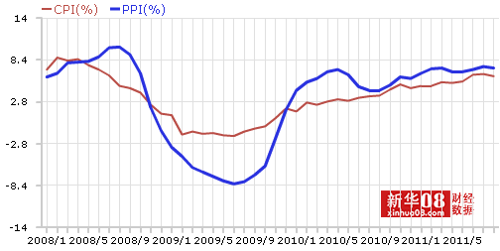
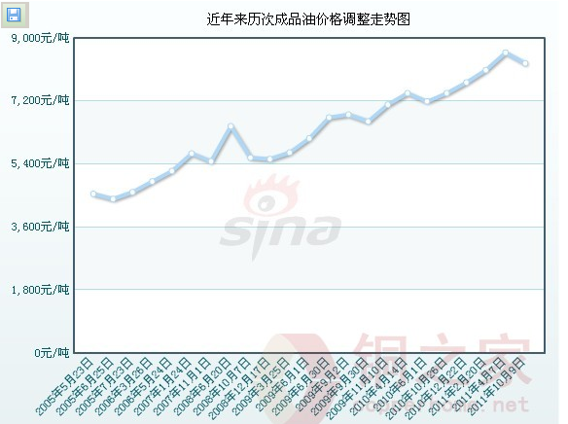
Topics
Gasoline price
Apple and Jobs
Debt crisis of EUR (macro)
CPI and Currency policy (macro)
……

Slide 5
Part 1. Introduction
Chapter 1. Economics: Foundations and Models
Chapter 2. Tradeoffs, Comparative Advantage, and the Market System
Chapter 3. Where Prices Come From: The Interaction of Demand and Supply
Chapter 4. Economic Efficiency, Government Price Setting, and Taxes
Part 2. Markets in Action
Chapter 5. Externalities, Environmental Policy, and Public Goods
Chapter 6. Elasticity: The Responsiveness of Demand and Supply
Part 3. Firms in the Domestic and International Economies
Chapter 7. Firms, the Stock Market, and Corporate Governance
Chapter 8. Comparative Advantage and the Gains from International Trade

Slide 6
Part 4. Microeconomic Foundations: Consumers and Firms
Chapter 9. Consumer Choice and Behavioral Economics
Chapter 10. Production, Technology, and Costs
Part 5. Market Structure and Firm Strategy
Chapter 11. Firms in Perfectly Competitive Markets
Chapter 12. Monopolistic Competition: The Competitive Model in a More Realistic Setting
Chapter 13. Oligopoly: Firms in Less Competitive Markets
Chapter 14. Monopoly and Antitrust Policy
Chapter 15. Pricing Strategy
Part 6. Markets for Factors of Production
Chapter 16. The Markets for Labor and Other Factors of Production
Part 7. Information, Taxes, and the Distribution of Income
Chapter 17. The Economics of Information
Chapter 18. Public Choice, Taxes, and the Distribution of Income

Slide 7
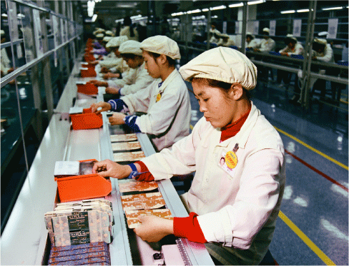
What Happens When U.S. Firms
Move to China?
After studying this chapter, you should be able to:
  Discuss these three important economic ideas: People are rational. People respond to incentives. Optimal decisions are made at the margin.
  Discuss how an economy answers these questions: What goods and services will be produced? How will the goods and services be produced? Who will receive the goods and services?
  Understand the role of models in economic analysis.
  Distinguish between microeconomics and macroeconomics.
  Become familiar with important economic terms.
1
2
LEARNING OBJECTIVES
“Many U.S., Japanese, and European firms have been moving the production of goods and services to other countries.”
3
4
5

Slide 8
Economics: Foundations and Models
In this book, we use economics to answer questions such as the following:
  “How are the prices of goods and services determined?”
  “How does pollution affect the economy, and how should government policy deal with these effects?”
  “Why do firms engage in international trade, and how do government policies affect international trade?”
  “Why does government control the prices of some goods and services, and what are the effects of those controls?”

Slide 9
Economics: Foundations and Models
Scarcity The situation where unlimited wants exceed the limited resources available to fulfill those wants.
Economics The study of the choices people make to attain their goals, given their scarce resources.

Slide 10
Building a Foundation: Economics and Individual Decisions
1
LEARNING OBJECTIVE
Market An arrangement or institution that brings together buyers and sellers of a good or service.
Three important ideas:
  People are rational
  People respond to economic incentives
  Optimal decisions are made at the margin
Marginal analysis Analysis that involves comparing marginal benefits and marginal costs.

Slide 11
1 - 1
1
LEARNING OBJECTIVE
Apple Computer Makes a Decision at the Margin
Should Apple produce an additional 300,000 iPods?
In solving the problem, consider the following:
  Optimal decisions are made at the margin.
  An activity should be continued to the point where the marginal benefit is equal to the marginal cost.
  In this case, the correct decision requires information about additional revenue and additional cost.

Slide 12
The Economic Problem That Every Society Must Solve
2
LEARNING OBJECTIVE
Trade-off The idea that because of scarcity, producing more of one good or service means producing less of another good or service.
Three fundamental questions:
  What goods and services will be produced?
  How will the goods and services be produced?
  Who will receive the goods and services produced?

Slide 13
The Economic Problem That Every Society Must Solve
Centrally Planned Economies versus Market
Economies
Centrally planned economy An economy in which the government decides how economic resources will be allocated.
Market economy An economy in which the decisions of households and firms interacting in markets allocate economic resources.

Slide 14
The Modern “Mixed” Economy
Mixed economy An economy in which most economic decisions result from the interaction of buyers and sellers in markets, but where the government plays a significant role in the allocation of resources.

Slide 15
The Modern “Mixed” Economy
Efficiency and Equity
Productive efficiency Occurs when a good or service is produced at the lowest possible cost.
Allocative efficiency A state of the economy in which production reflects consumer preferences; in particular, every good or service is produced up to the point where the last unit provides a marginal benefit to consumers equal to the marginal cost of producing it.
Voluntary exchange The situation that occurs in markets when both the buyer and seller of a product are made better off by the transaction.
Equity The fair distribution of economic benefits.

Slide 16
Economic Models
3
LEARNING OBJECTIVE
Economic model A simplified version of some aspect of economic life used to analyze an economic issue.
To develop a model, economists generally follow these steps:
  Decide on the assumptions to be used in developing the model.
  Formulate a testable hypothesis.
  Use economic data to test the hypothesis.
  Revise the model if it fails to explain properly the economic data.
  Retain the revised model to help answer similar economic questions in the future.
Economic variable Something measurable that can have different values, such as the wages of software programmers.

Slide 17



Economic Models
Normative and Positive Analysis
Positive analysis Analysis concerned with what is.
Normative analysis Analysis concerned with what ought to be.
Don’t Confuse Positive Analysis with Normative Analysis
When Economists Disagree: A Debate Over Outsourcing
1 - 1
Does outsourcing by U.S. firms raise or lower incomes in the United States?

Slide 18
Microeconomics and Macroeconomics
4
LEARNING OBJECTIVE
Microeconomics The study of how households and businesses make choices, how they interact in markets, and how the government attempts to influence their choices.
Macroeconomics The study of the economy as a whole, including topics such as inflation, unemployment, and economic growth.

Slide 19
A Preview of Important Economic Terms
5
LEARNING OBJECTIVE
Entrepreneur
Innovation
Technology
Firm, company, or business
Goods
Services
Revenue
Opportunity cost
Profit
Household
Factors of production or economic resources
Capital
Human capital

Slide 20


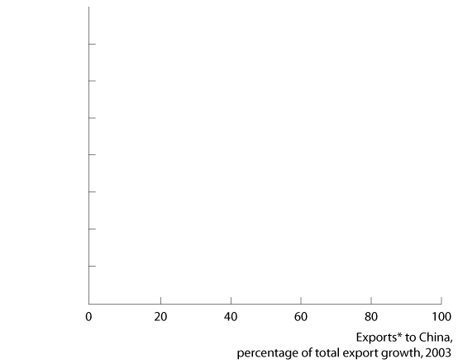








The Halo Effect: How China’s Expansion Will Affect Jobs and Growth Elsewhere
Many countries, including the United States, have experienced rapidly increasing exports to China.

Slide 21

Allocative efficiency
Centrally planned economy
Economic model
Economic variable
Economics
Equity
Macroeconomics
Marginal analysis
Market
Market economy
Microeconomics
Mixed economy
Normative analysis
Positive analysis
Productive efficiency
Scarcity
Trade-off
Voluntary exchange

Slide 22
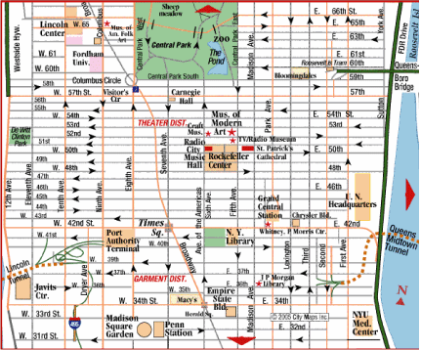
Appendix 1A:
Using Graphs and Formulas
A graph is like a street map—it is a simplified version of reality

Slide 23
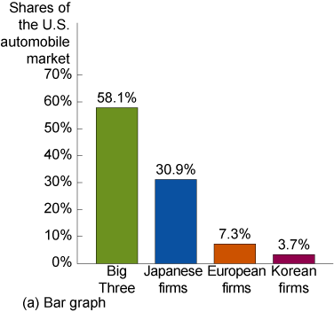
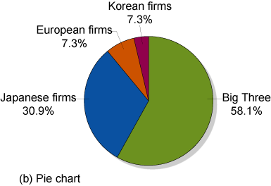
Appendix 1A:
Using Graphs and Formulas
Graphs of One Variable
1A - 1
Market Shares in the U.S.
Automobile Market

Slide 24
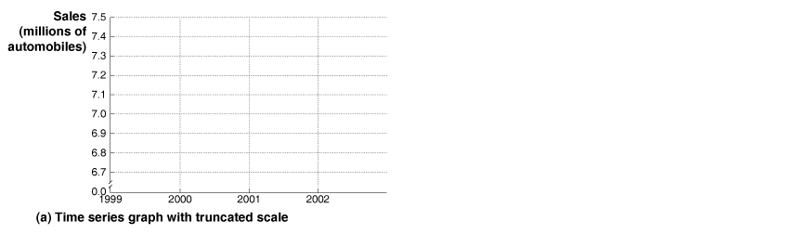

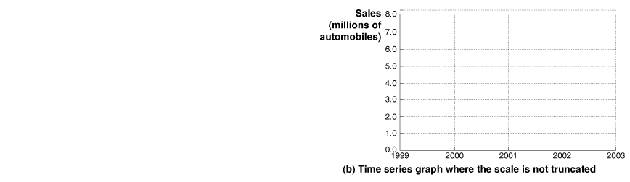

Appendix 1A:
Using Graphs and Formulas
Graphs of One Variable
1A - 2
Time-Series Graphs

Slide 25

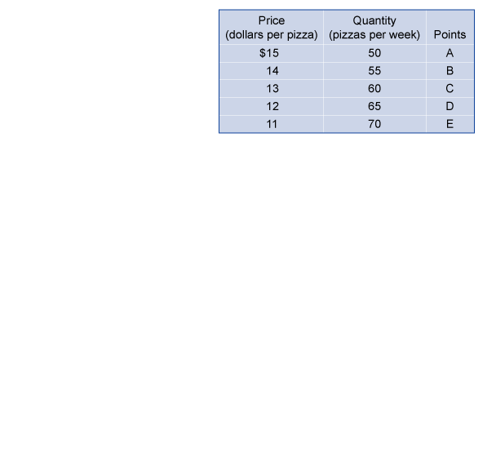
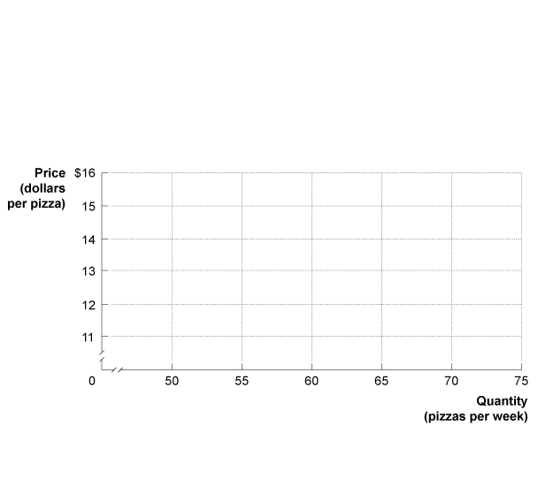
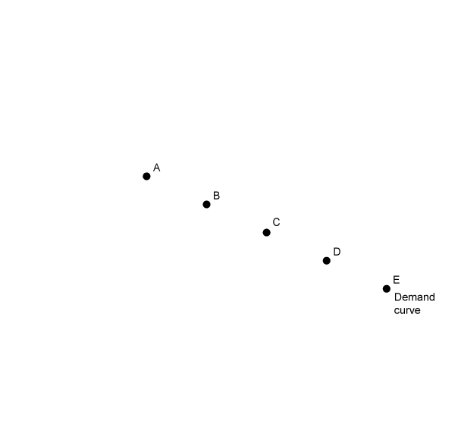
Appendix 1A:
Using Graphs and Formulas
Graphs of Two Variables
1A - 3
Plotting Price and Quantity
Points in a Graph

Slide 26
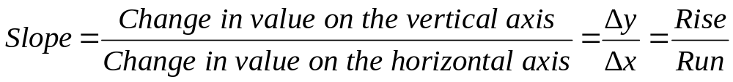
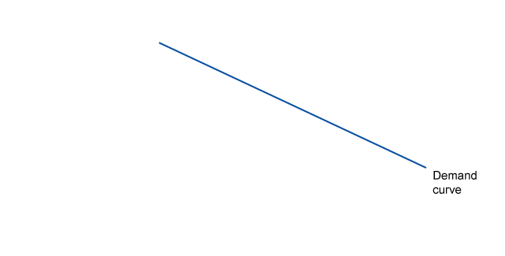
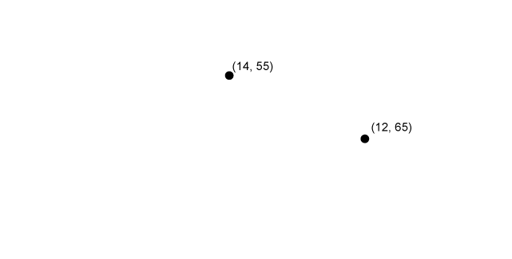
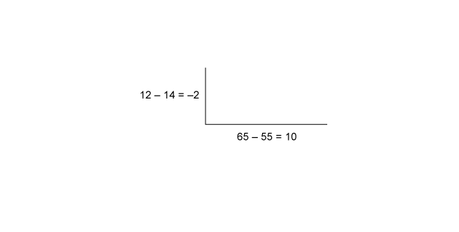
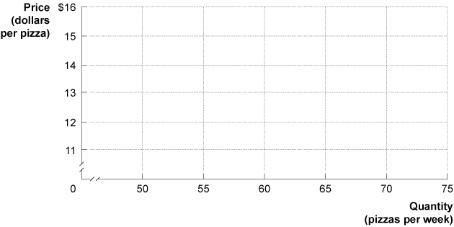
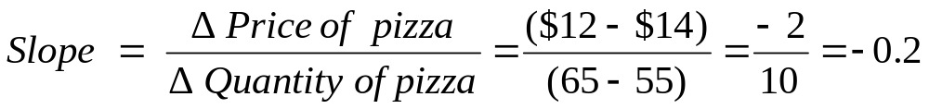
Appendix 1A:
Using Graphs and Formulas
Graphs of Two Variables
Slopes of Lines
1A - 4
Calculating the Slope of a Line

Slide 27
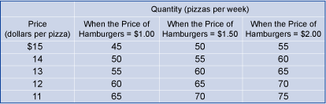
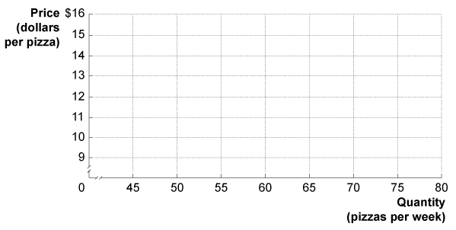
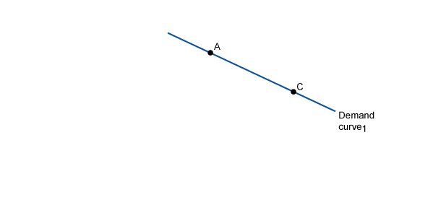
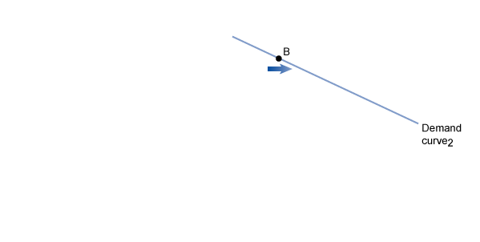
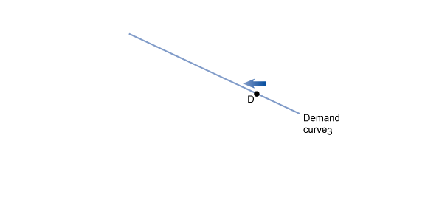
Appendix 1A:
Using Graphs and Formulas
Graphs of Two Variables
Taking Into Account More Than Two Variables on a Graph
1A - 5
Showing Three Variables on a Graph

Slide 28
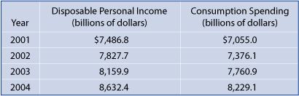

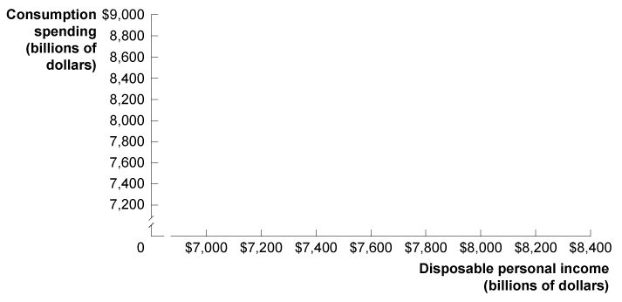
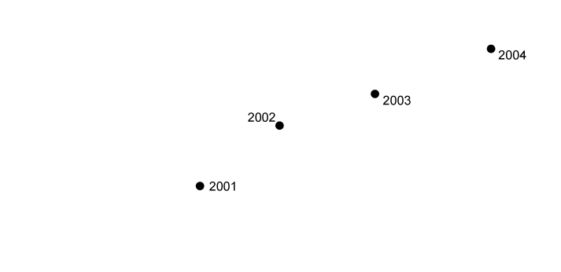
Appendix 1A:
Using Graphs and Formulas
Graphs of Two Variables
Positive and Negative Relationships
1A - 6
Graphing the Direct Relationship between Income and
Consumption Spending

Slide 29
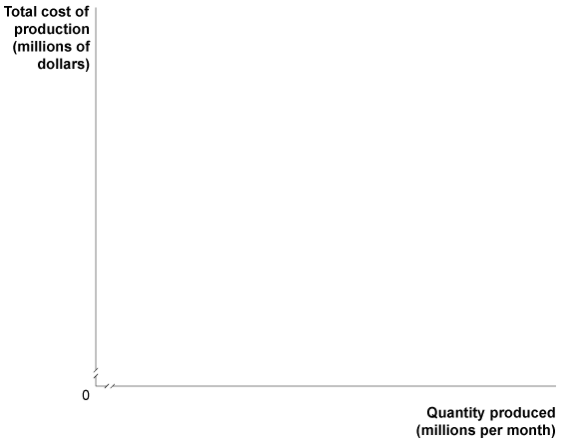
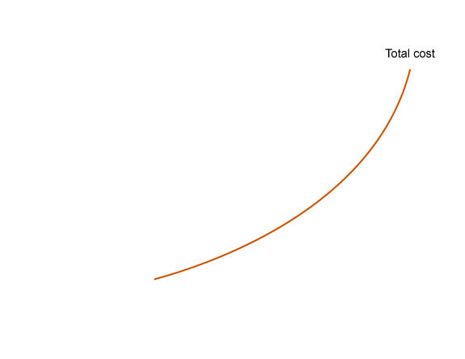
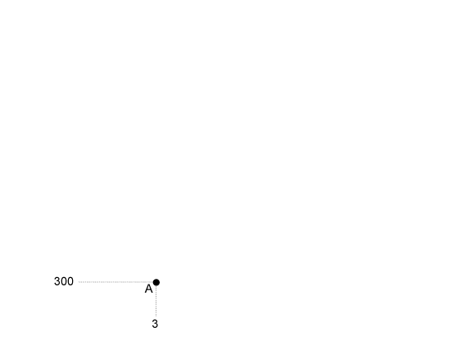
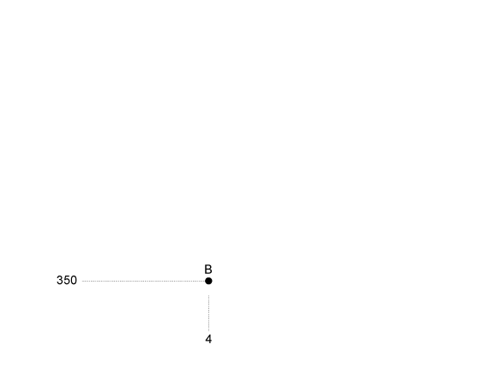
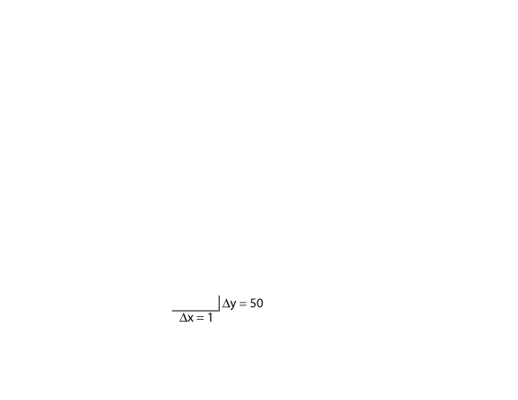
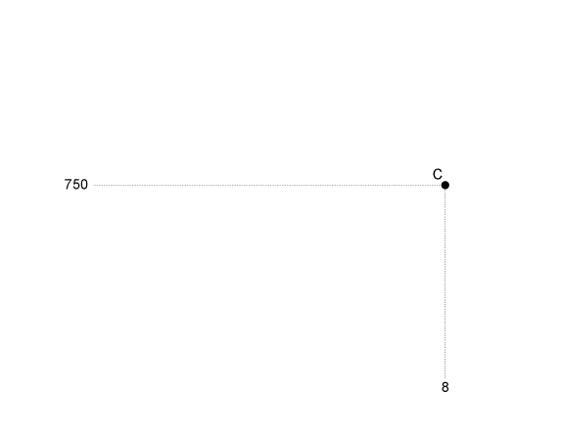
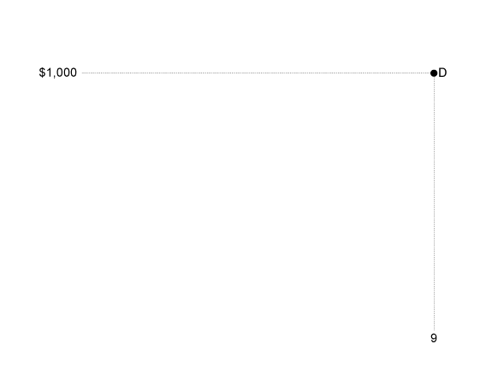
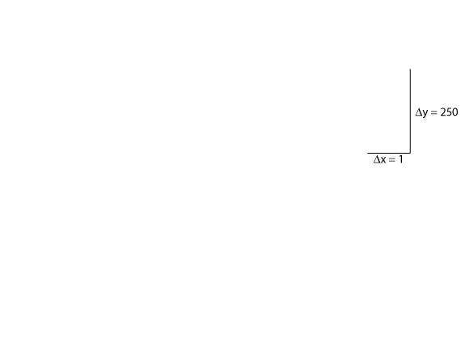
Appendix 1A:
Using Graphs and Formulas
Graphs of Two Variables
Slopes of Nonlinear Curves
1A - 7
The Slope of a Nonlinear Curve

Slide 30
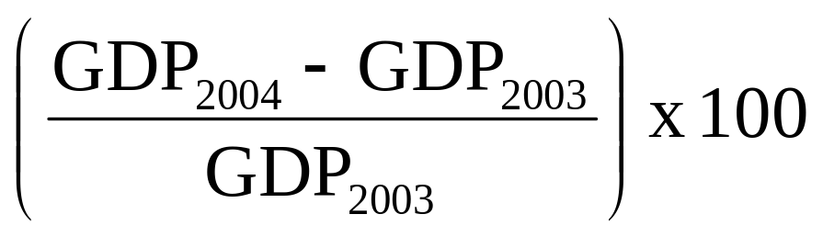
Appendix 1A:
Using Graphs and Formulas
Formulas
Formula for a Percentage Change
Using the growth of Gross Domestic Product (GDP) as an example:

Slide 31
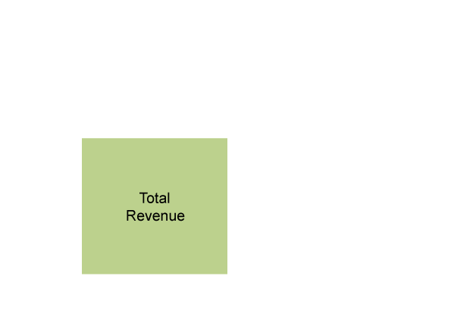
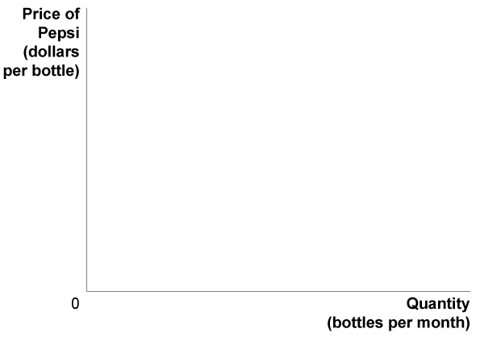
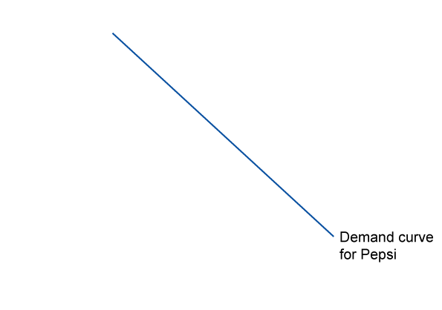
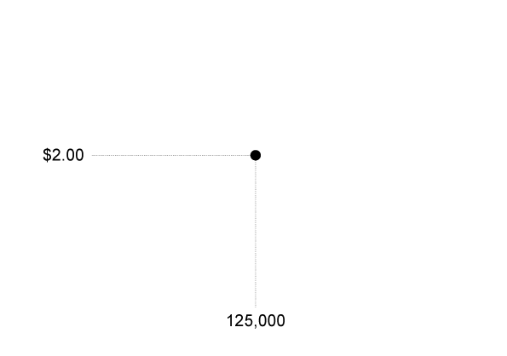
Appendix 1A:
Using Graphs and Formulas
Formulas
Formulas for the Areas of a Rectangle and a Triangle
1A - 8
Showing a Firm’s Total
Revenue on a Graph

Slide 32

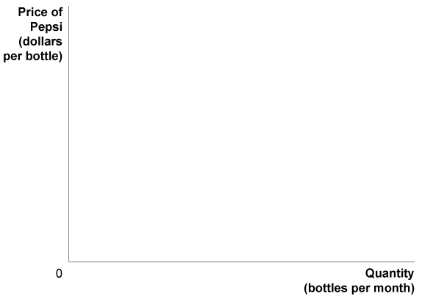
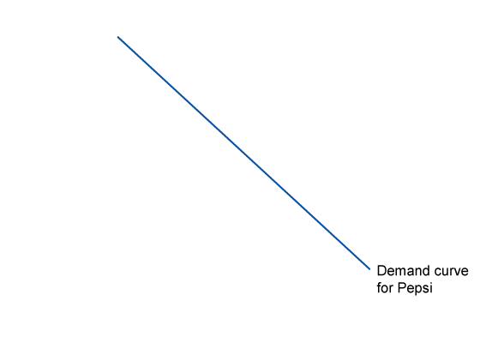
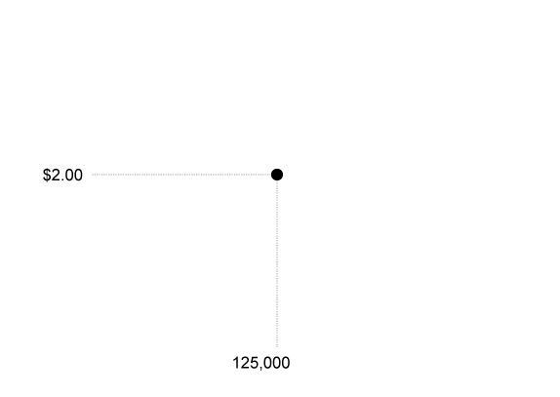
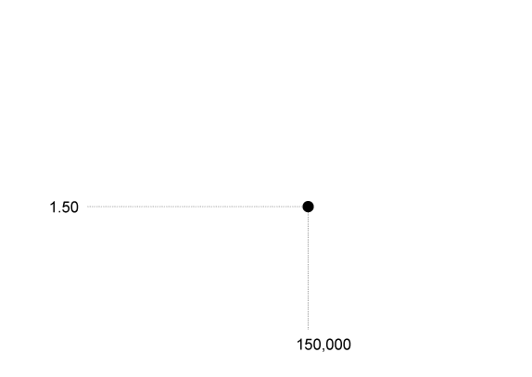
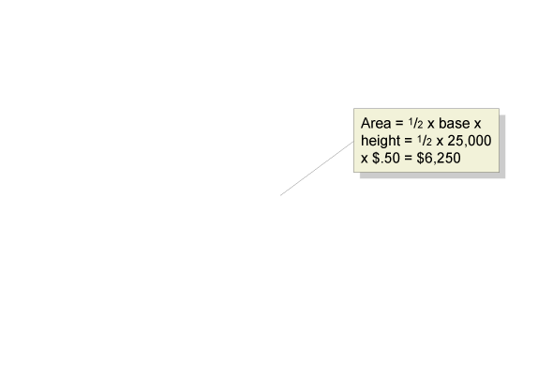
Appendix 1A:
Using Graphs and Formulas
Formulas
Formulas for the Areas of a Rectangle and a Triangle
1A - 9
The Area of a Right Triangle

Slide 33
Appendix 1A:
Using Graphs and Formulas
Formulas
Summary of Using Formulas
Whenever you must use a formula, you should follow these steps:
  Make sure you understand the economic concept that the formula represents.
  Make sure that you are using the correct formula for the problem you are solving.
  Make sure that the number you calculate using the formula is economically reasonable. For example, if you are using a formula to calculate a firm’s revenue and your answer is a negative number, you know you made a mistake somewhere.

