Slide 1
Trade-Offs, Comparative Advantage, and the Market System

Slide 2

Managers Making Choices at BMW
After studying this chapter, you should be able to:
  Use a production possibilities frontier to analyze opportunity cost and trade-offs.
  Understand comparative advantage and explain how it is the basis for trade.
  Explain the basic idea of how a market system works.
1
2
LEARNING OBJECTIVES
… Over the years, BMW’s managers have faced strategic as well as tactical business decisions...
3

Slide 3
Production Possibilities Frontiers and Real-world Trade-offs
1
LEARNING OBJECTIVE
Scarcity The situation in which unlimited wants exceed the limited resources available to fulfill those wants.
Production possibilities frontier A curve showing all the attainable combinations of two products that may be produced with available resources.
Opportunity Cost The highest-valued alternative that must be given up in order to engage in an activity.

Slide 4
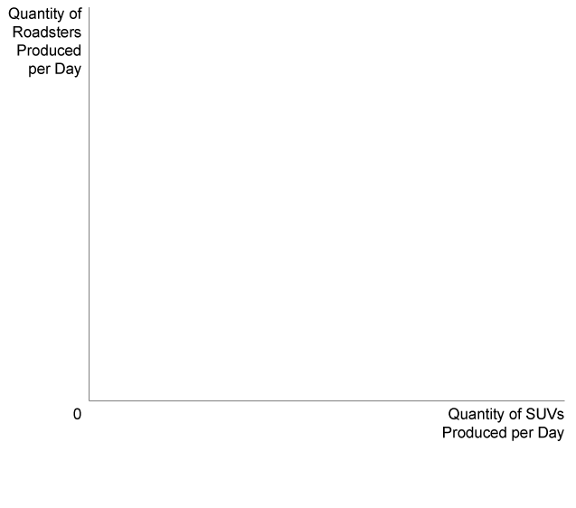

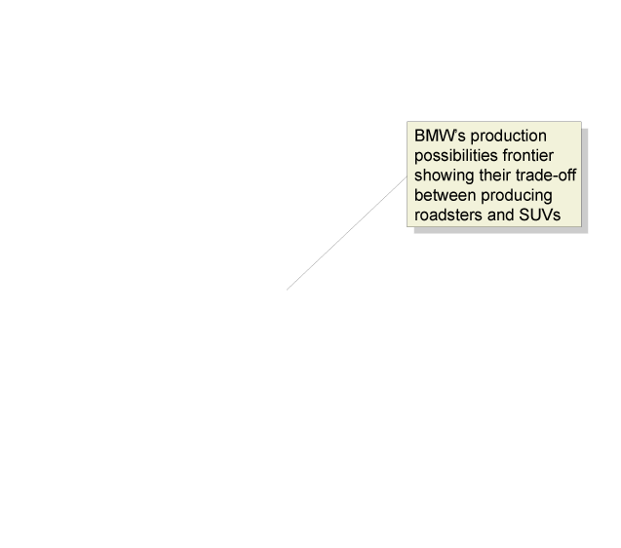

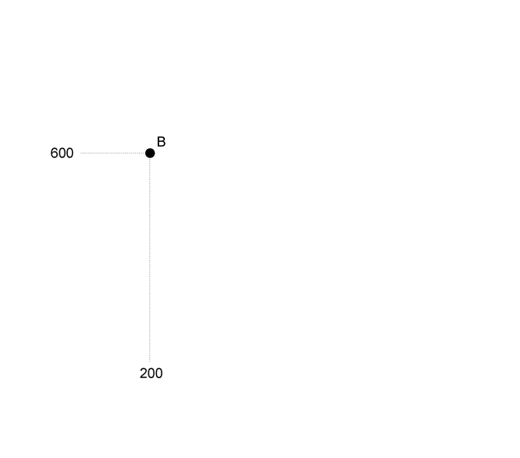
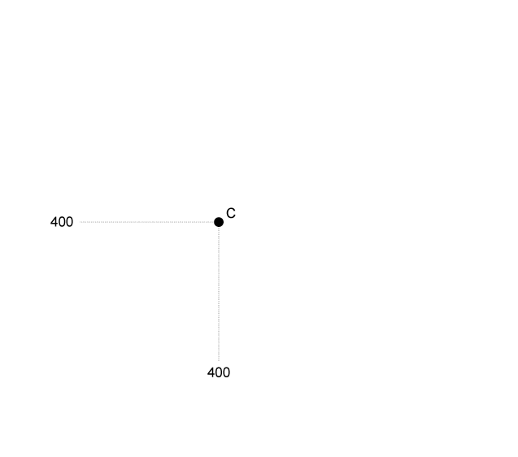
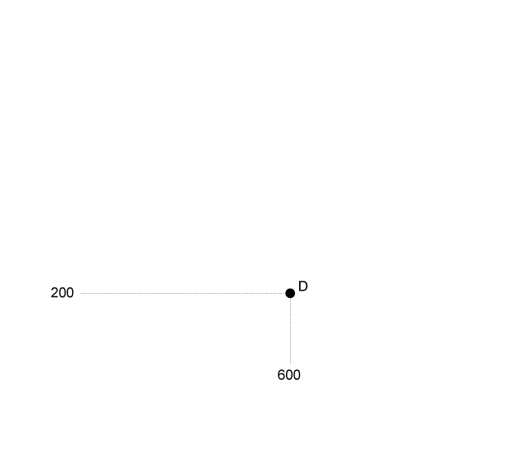

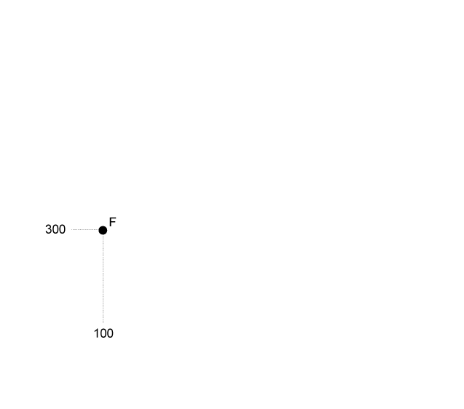
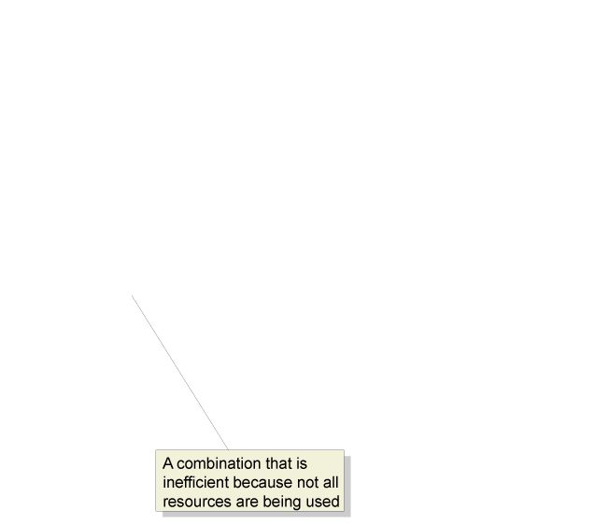
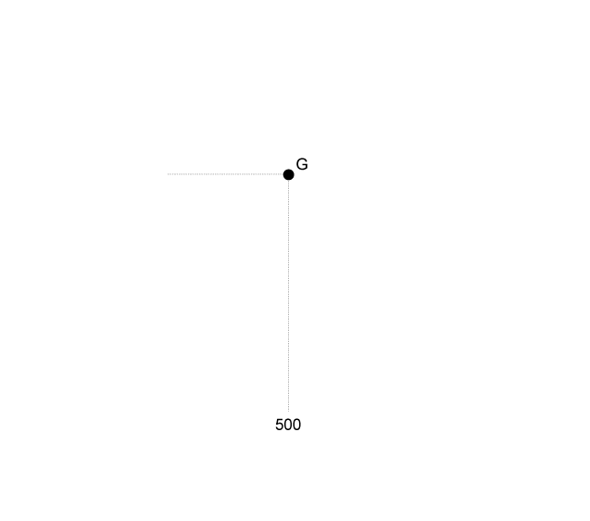
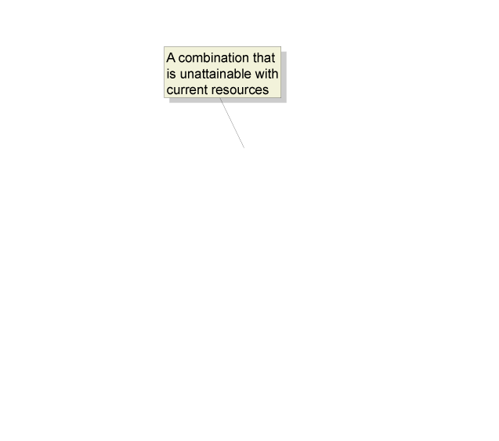
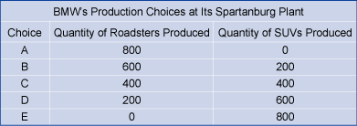
Production Possibilities Frontiers and Real-world Trade-offs
Graphing the Production Possibilities Frontier
2 - 1
BMW’s Production Possibilities Frontier

Slide 5
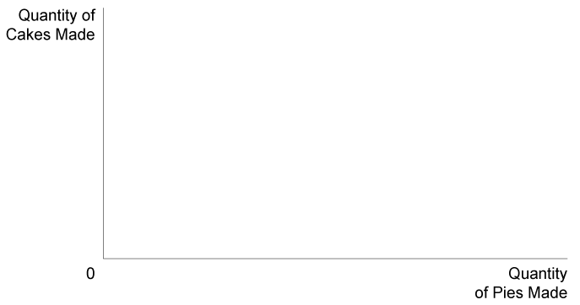
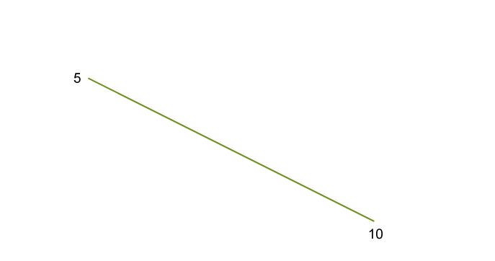
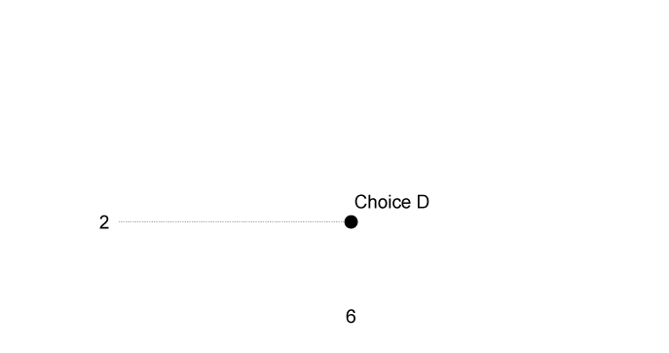
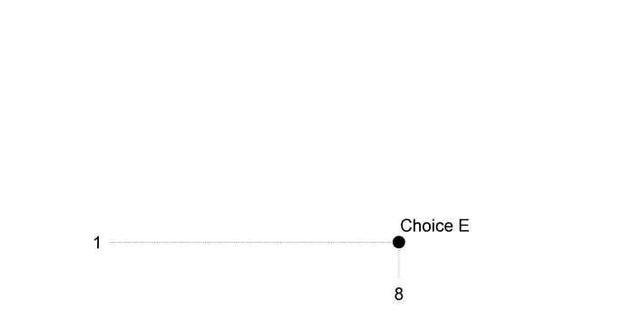
2 - 1
1
LEARNING OBJECTIVE
Drawing a Production Possibilities Frontier for
Rosie’s Boston Bakery
 | Hours Spent Making |  |  |  |  | Quantity Made
Choice |  | Cakes |  |  | Pies | Cakes | Pies
A |  |  | 5 | 0 |  | 5 | 0
B |  |  | 4 | 1 |  | 4 | 2
C |  |  | 3 | 2 |  | 3 | 4
D |  |  | 2 | 3 |  | 2 | 6
E |  |  | 1 | 4 |  | 1 | 8
F |  |  | 0 | 5 |  | 0 | 10

Slide 6
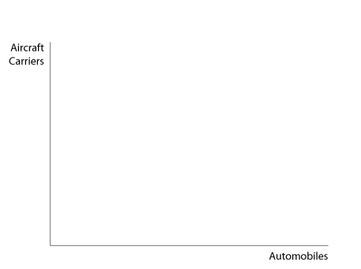
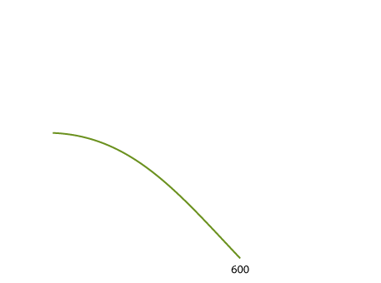

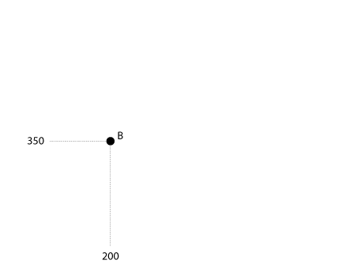
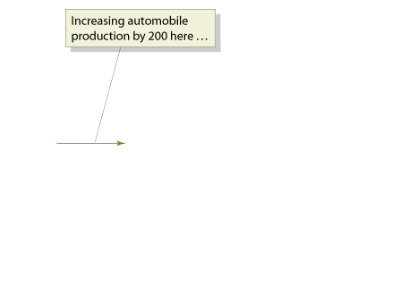
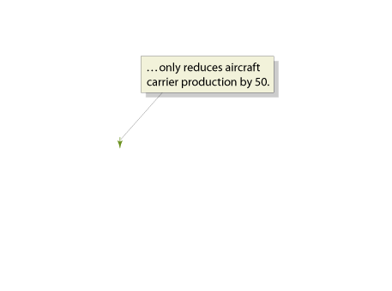
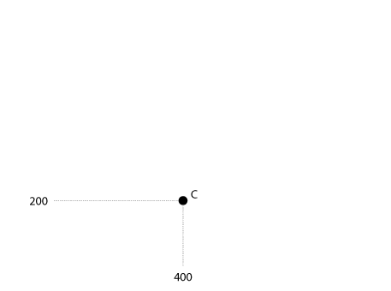
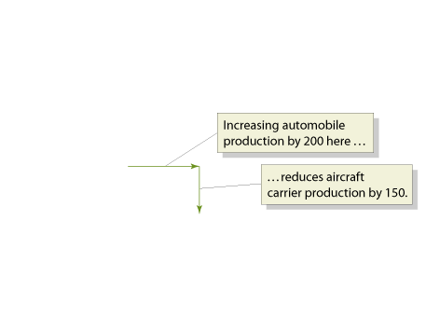


Production Possibilities Frontiers and Real-world Trade-offs
Increasing Marginal Opportunity Costs
2 - 2
As the economy moves down the production possibilities frontier, it experiences increasing marginal opportunity costs because increasing automobile production by a given quantity requires larger and larger decreases in aircraft carrier production.
Trade-offs and Tsunami Relief
2 - 1
More funds for tsunami relief meant less funds for other charities.

Slide 7
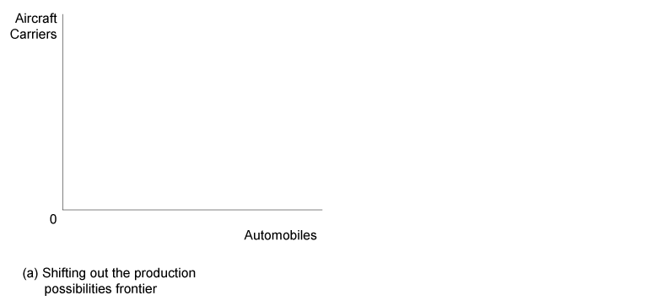




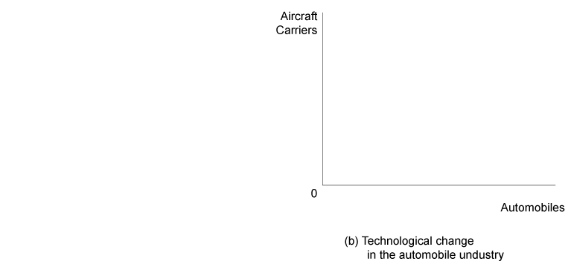


Production Possibilities Frontiers and Real-world Trade-offs
Economic Growth
Economic Growth The ability of the economy to produce increasing quantities of goods and services.
2 - 3
Economic Growth

Slide 8
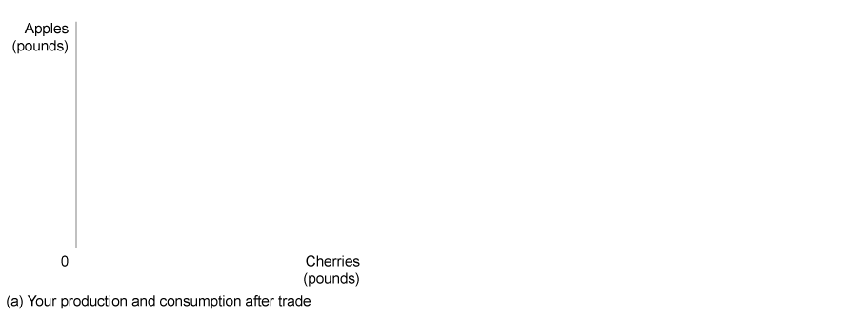

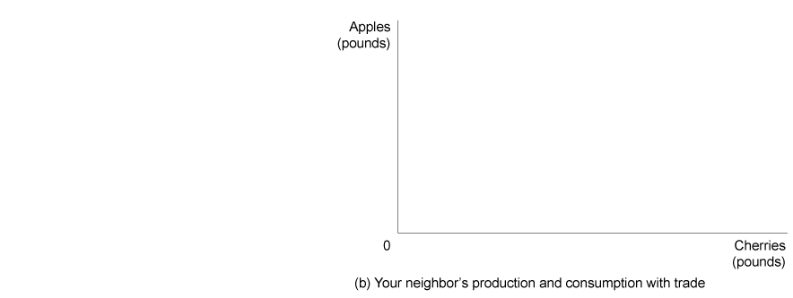


Trade
2
LEARNING OBJECTIVE
Specialization and Gains from Trade
2 - 4
Trade The act of buying or selling.
Production Possibilities for You and Your Neighbor, Without Trade

Slide 9
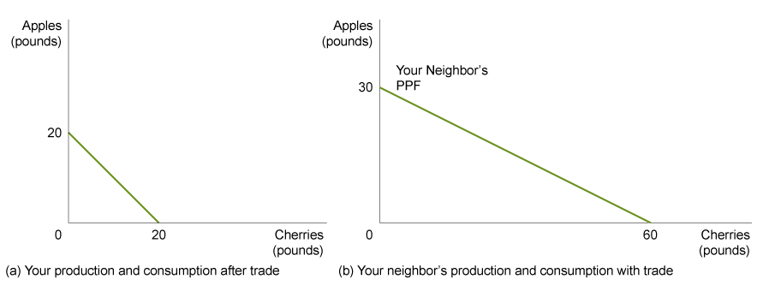

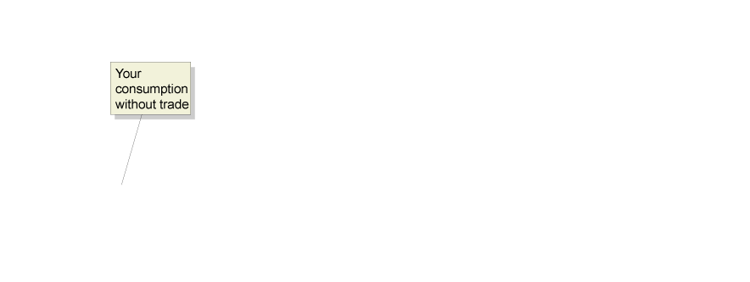
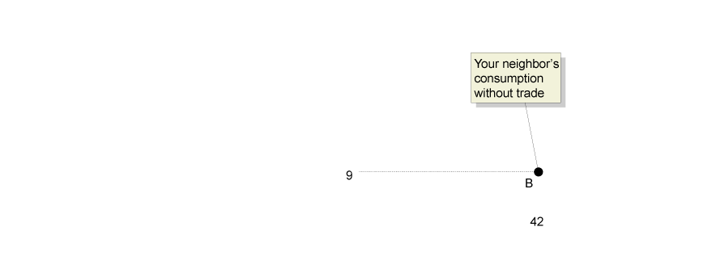

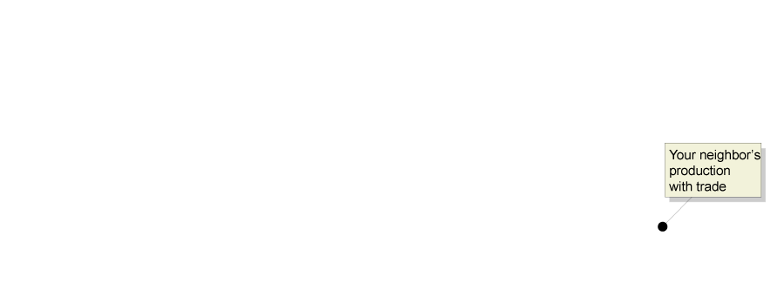
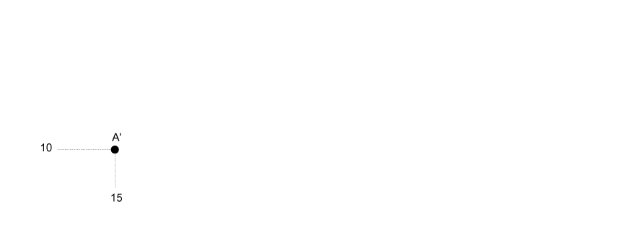
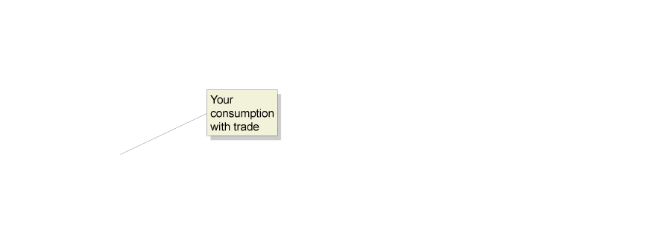
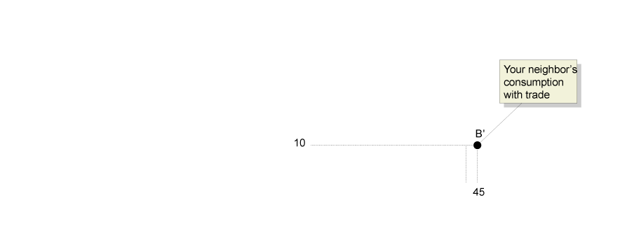
Trade
Specialization and Gains from Trade
2 - 5
Gains from Trade

Slide 10
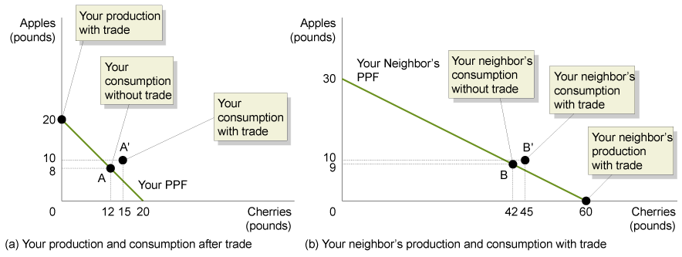
Trade
Specialization and Gains from Trade
2 – 1
A Summary of the Gains from Trade
 | YOU |  | YOUR NEIGHBOR
 | Apples (in pounds) | Cherries (in pounds) | Apples (in pounds) | Cherries (in pounds)
Production and consumption without trade | 8 | 12 | 9 | 42
Production with trade | 20 | 0 | 0 | 60
Consumption with trade | 10 | 15 | 10 | 45
Gains from trade (increased consumption) | 2 | 3 | 1 | 3

Slide 11

Trade
Absolute Advantage Versus Comparative Advantage
Absolute advantage The ability of an individual, firm, or country to produce more of a good or service than competitors using the same amount of resources.
Comparative advantage The ability of an individual, firm, or country to produce a good or service at a lower opportunity cost than other producers.
 | Opportunity cost of picking 1 pound of apples |  | Opportunity cost of picking 1 pound of cherries
You |  | 1 pound of cherries | 1 pound of apples
Your neighbor |  | 2 pounds of cherries | .5 pound of apples
Don’t Confuse Absolute Advantage and Comparative Advantage

Slide 12
Trade
Comparative Advantage and the Gains from Trade
The basis for trade is comparative advantage, not absolute advantage.
A country has a comparative advantage in the production of the good for which it has a lower opportunity cost.
To enjoy the gains from trade, a country should specialize in the production of the good for which it has a comparative advantage.

Slide 13
2 - 2
2
LEARNING OBJECTIVE
Comparative Advantage and the Gains from Trade
CANADA |  | UNITED STATES
Honey (in tons) | Maple syrup (in tons) | Honey (in tons) | Maple syrup (in tons)
0 | 60 | 0 | 50
10 | 45 | 10 | 40
20 | 30 | 20 | 30
30 | 15 | 30 | 20
40 | 0 | 40 | 10
 |  | 50 | 0
 | BEFORE TRADE |  | AFTER TRADE
 | Honey (in tons) | Maple syrup (in tons) | Honey (in tons) | Maple syrup (in tons)
Canada | 30 | 15 | 30 | 20
United States | 10 | 40 | 20 | 40

Slide 14
The Market System
3
LEARNING OBJECTIVE
Market A group of buyers and sellers of a good or service and the institution or arrangement by which they come together to trade.
Product Markets Markets for good—such as computers—and services—such as medical treatment.
Factor markets Markets for the factors of production, such as labor, capital, natural resources, and entrepreneurial ability.

Slide 15

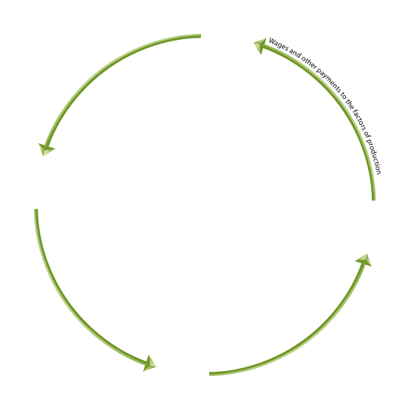
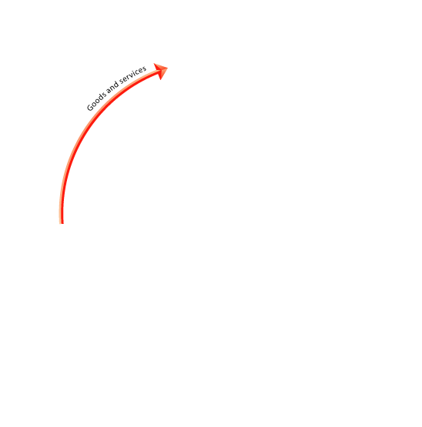
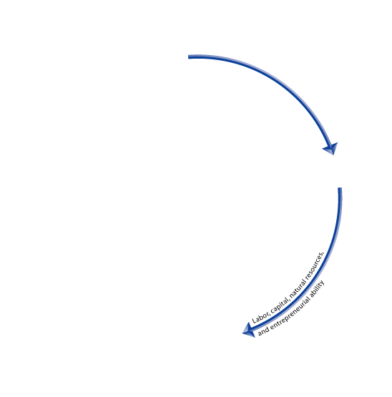




The Market System
The Circular-Flow Diagram
Circular-flow diagram A model that illustrates how participants in markets are linked.
2 - 6
The Circular-Flow Diagram
Households and firms are linked together in a circular flow of production, income, and spending.

Slide 16
The Market System
The Circular Flow Diagram
Two key groups participate in markets:
A household is all the individuals in a home.
Firms are suppliers of goods and services.

Slide 17
The Market System
The Gains from Free Markets
Free market A market with few government restrictions on how a good or service can be produced or sold, or on how a factor of production can be employed.
The Market Mechanism
Individuals usually act in a rational, self-interested way. Adam Smith understood that people’s motives can be complex.
In a famous phrase, Smith said that firms would be led by the “invisible hand” of the market to provide consumers with what they wanted.

Slide 18

The Market System
The Role of the Entrepreneur
Entrepreneur Someone who operates a business, bringing together the factors of production—labor, capital, and natural resources—in order to produce goods and services.
Story of the Market System in Action: “I, Pencil”
2 - 2
The market coordinates the activities of the many people spread around the world who contribute to the making of a pencil.

Slide 19

The Market System
The Legal Basis of a Successful Market System
PROTECTION OF PRIVATE PROPERTY
Property rights The rights individuals or firms have to the exclusive use of their property, including the right to buy or sell it.
Property Right in Cyberspace: Napster, Kazaa, iTunes
2 - 3
Metallica sued to stop copyright infringement of their songs on the Internet.

Slide 20

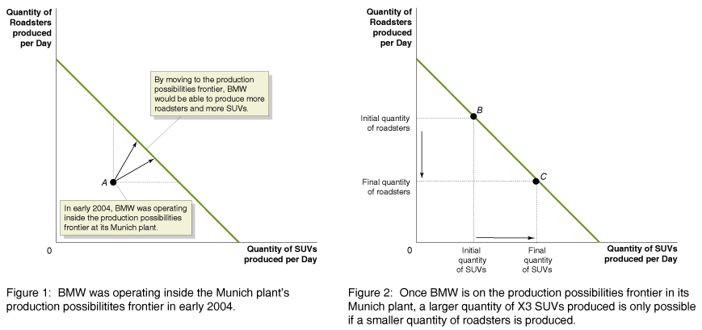
BMW’s Net Profit Rises 2.5% as New Models Benefit Sales

Slide 21

Absolute advantage
Circular-flow diagram
Comparative advantage
Economic growth
Entrepreneur
Factor markets
Market
Opportunity cost
Production possibilities frontier
Product markets
Property rights
Scarcity
Trade

