Slide 1
Externalities, Environmental
Policy, and Public Goods

Slide 2
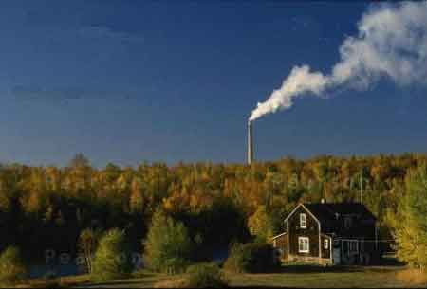
Economic Incentives Spur
Duke Energy Corporation to Reduce Pollution
After studying this chapter, you should be able to:
  Identify examples of positive and negative externalities and use graphs to show how externalities affect economic efficiency.
  Discuss the Coase theorem and explain how private bargaining can lead to economic efficiency in a market with an externality.
  Analyze government policies to achieve economic efficiency in a market with an externality.
  Explain how goods can be categorized on the basis of whether they are rival and excludable.
  Define a public good and a common resource, and use graphs to illustrate the efficient quantities of public goods and common resources.
1
2
3
LEARNING OBJECTIVES
4
Pollution is a part of economic life…
5

Slide 3
Externalities and Efficiency
1
LEARNING OBJECTIVE
Externality A benefit or cost that affects someone who is not directly involved in the production or consumption of a good or service.
The Effect of Externalities
Private cost The cost borne by the producer of a good or service.
Social cost The total cost of producing a good, including both the private cost and any external cost.
Private benefit The benefit received by the consumer of a good or service.
Social benefit The total benefit from consuming a good, including both the private benefit and any external benefit.

Slide 4
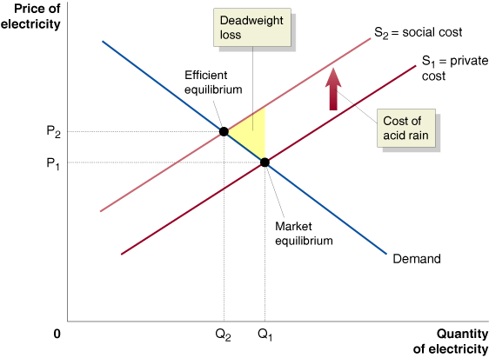
Externalities and Efficiency
HOW A NEGATIVE EXTERNALITY IN PRODUCTION REDUCES ECONOMIC EFFICIENCY
5 - 1
The Effect of Pollution on Economic Efficiency

Slide 5
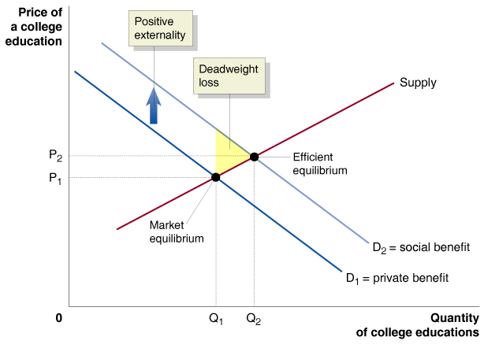
Externalities and Efficiency
HOW A POSITIVE EXTERNALITY IN CONSUMPTION REDUCES ECONOMIC EFFICIENCY
5 - 2
The Effect of a Positive Externality on Efficiency

Slide 6
Externalities and Efficiency
Externalities Can Result in Market Failure
Market failure Situations where the market fails to produce the efficient level of output.
What Causes Externalities?
Property rights The rights individuals or businesses have to the exclusive use of their property, including the right to buy or sell it.

Slide 7
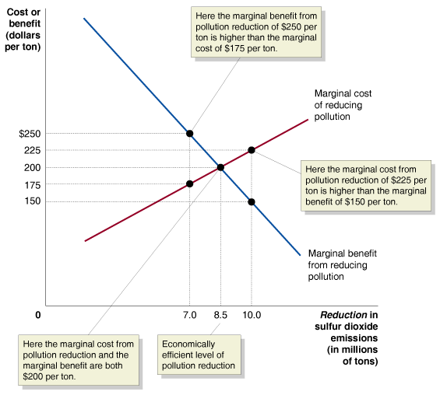
Private Solutions to Externalities: The Coase Theorem
2
LEARNING OBJECTIVE
The Economically Efficient Level of Pollution Reduction
5 - 3
The Marginal Benefit from Pollution Reduction Should
Equal the Marginal Cost

Slide 8


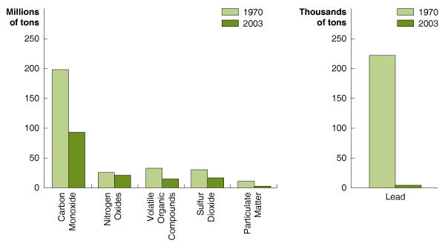

5 - 1
The Reduction in Infant Mortality Due to the Clean Air Act
Reduction in air pollution has been linked to a decline in infant mortality.
Remember that It’s the Net Benefit that Counts

Slide 9
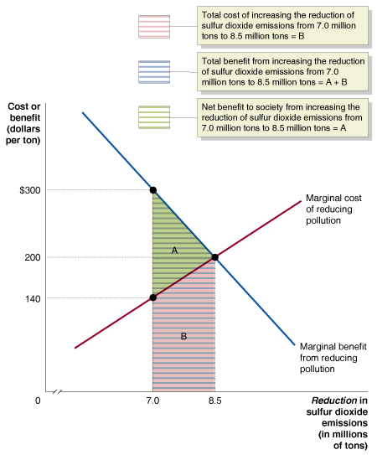
Private Solutions to Externalities: The Coase Theorem
The Basis for Private Solutions to Externalities
5 - 4
The Benefits of Reducing Pollution to the Optimal Level are Greater than the Costs

Slide 10
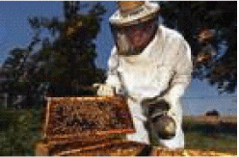
5 - 2
The Fable of the Bees
Some apple growers and beekeepers make private arrangements to arrive at an economically efficient outcome.

Slide 11
Private Solutions to Externalities: The Coase Theorem
The Problem of Transactions Costs
Transactions costs The costs in time and other resources that parties incur in the process of agreeing to and carrying out an exchange of goods or services.
The Coase Theorem
Coase theorem The argument of economist Ronald Coase that if transactions costs are low, private bargaining will result in an efficient solution to the problem of externalities.

Slide 12
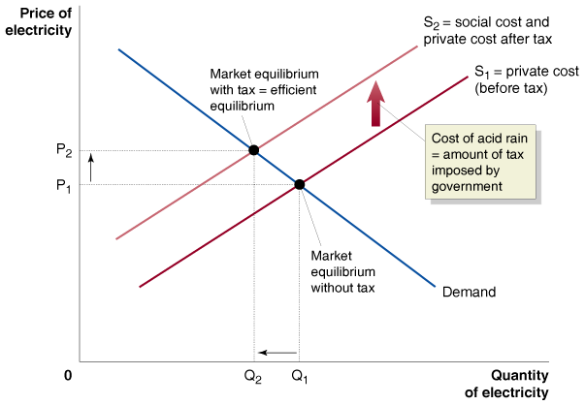
Government Solutions to Externalities
3
LEARNING OBJECTIVE
Government Solutions to Externalities
5 - 5
When There is a Negative Externality, a Tax Can Bring About the Efficient Level of Output

Slide 13
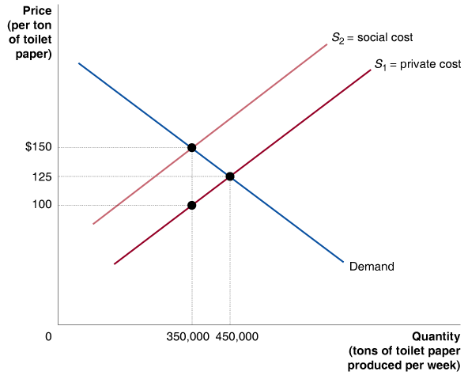
5 - 1
3
LEARNING OBJECTIVE
Using a Tax to Deal with a Negative Externality

Slide 14
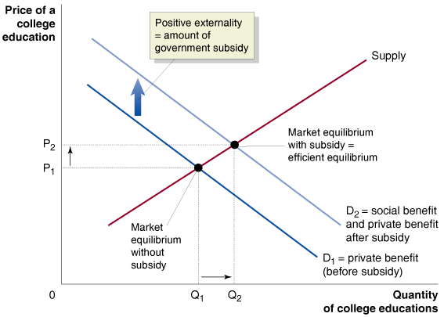
Government Solutions to Externalities
Government Solutions to Externalities
5 - 6
When There is a Positive Externality, a Subsidy Can Bring About the Efficient Level of Output
Pigovian taxes and subsidies Government taxes and subsidies intended to bring about an efficient level of output in the presence of externalities.

Slide 15
Government Solutions to Externalities
Command and Control versus Tradeable Emissions Allowances
Command and control approach Government-imposed quantitative limits on the amount of pollution firms are allowed to generate, or government-required installation by firms of specific pollution control devices.

Slide 16
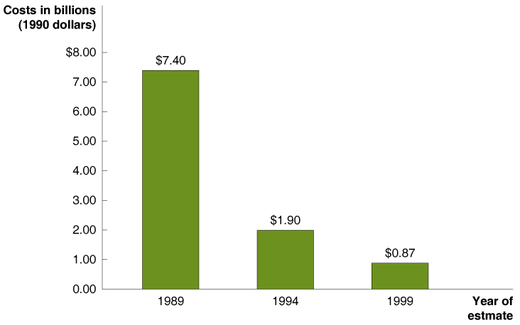
Government Solutions to Externalities
Command and Control versus Tradeable Emissions Allowances
5 - 7
Estimated Cost of the Acid Rain Program in 2010

Slide 17

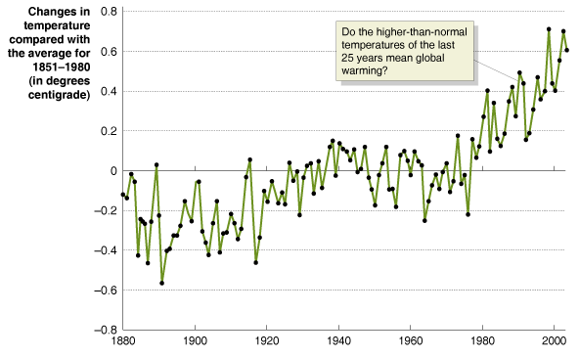
5 - 3
Can Tradeable Permits Reduce Global Warming?
Rapid growth in China has led to rapid increases in CO₂ emissions.

Slide 18
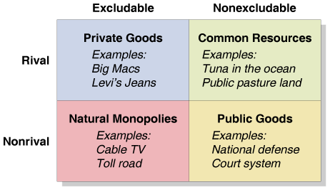
Four Categories of Goods
4
LEARNING OBJECTIVE
Rivalry The situation that occurs when one person’s consuming a unit of a good means no one else can consume it.
Excludability The situation in which anyone who does not pay for a good cannot consume it.
Private good A good that is both rival and excludable.
5 - 8
Four Categories of Goods

Slide 19
Four Categories of Goods
Common resource A good that is rival but not excludable.
Public good A good that is both nonrivalrous and nonexcludable.
Free riding Benefiting from a good without paying for it.

Slide 20

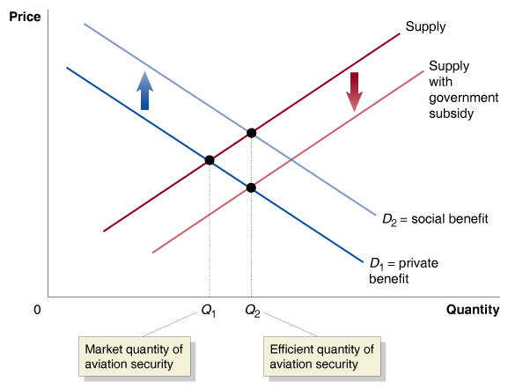
5 - 4
Should the Government or the Airlines Screen Luggage at Airports?
Should the government be responsible for supplying aviation security?

Slide 21
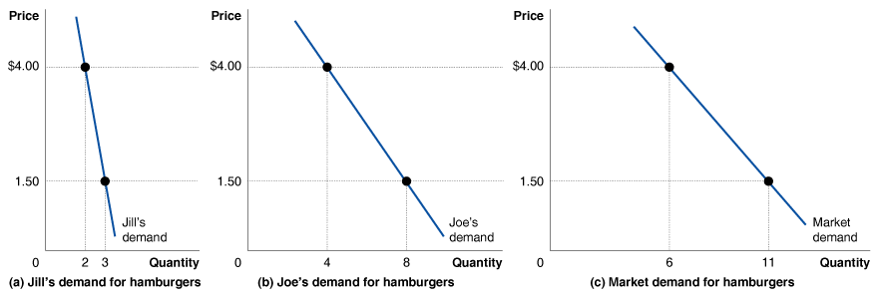
Public Goods and Common Resources
5
LEARNING OBJECTIVE
The Demand for a Private Good
5 - 9
Constructing the Market Demand for a Private Good

Slide 22
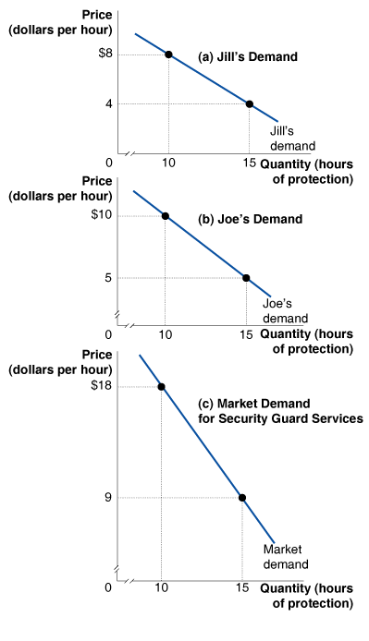
Public Goods and Common Resources
The Demand for a Public Good
5 - 10
Constructing the Market Demand
for a Public Good

Slide 23
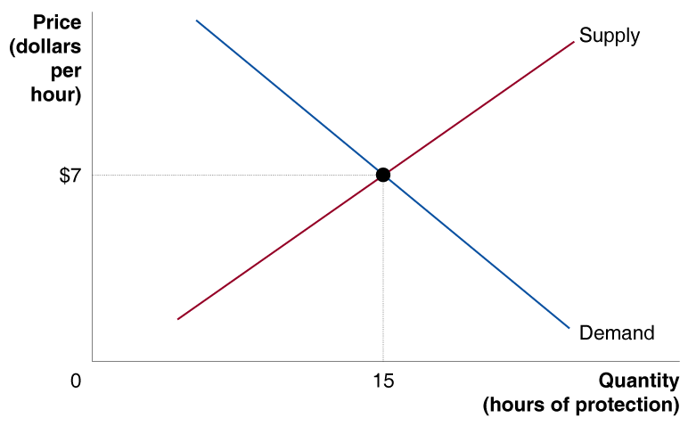
Public Goods and Common Resources
The Optimal Quantity of a Public Good
5 - 11
The Optimal Quantity of a Public Good

Slide 24
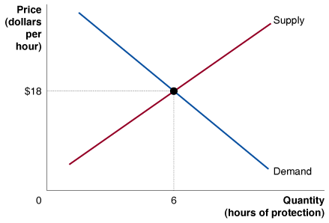
5 - 2
4
LEARNING OBJECTIVE
Determining the Optimal Level of Public Goods
 | Jill
PRICE (DOLLARS PER HOUR) | QUANTITY (HOURS OF PROTECTION)
$20 | 1
$18 | 2
$16 | 3
$14 | 4
$12 | 5
$10 | 6
$8 | 7
$6 | 8
$4 | 9
$2 | 10
Joe
QUANTITY (HOURS OF PROTECTION)
0
1
2
3
4
5
6
7
8
9
Demand
PRICE (DOLLARS PER HOUR) | QUANTITY (HOURS OF PROTECTION)
$38 | 1
$34 | 2
$30 | 3
$26 | 4
$22 | 5
$18 | 6
$14 | 7
$10 | 8
$6 | 9
+
=
Supply
QUANTITY (HOURS OF PROTECTION) | PRICE (DOLLARS PER HOUR)
1 | $8
2 | $10
3 | $12
4 | $14
5 | $16
6 | $18
7 | $20
8 | $22
9 | $24

Slide 25
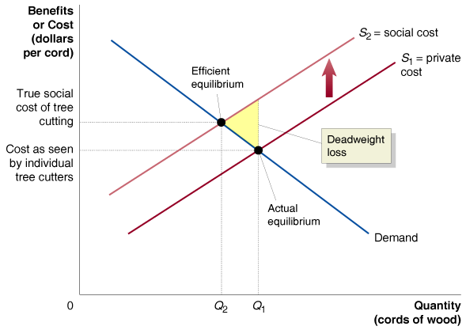
Public Goods and Common Resources
Common Resources
Tragedy of the commons The tendency for a common resource to be overused.
5 - 12
Overuse of a Common Resource

Slide 26

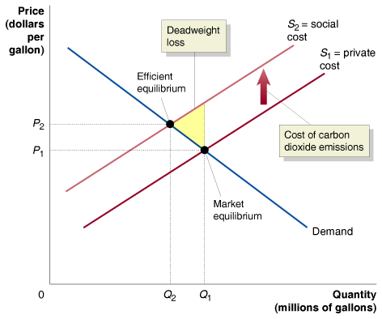
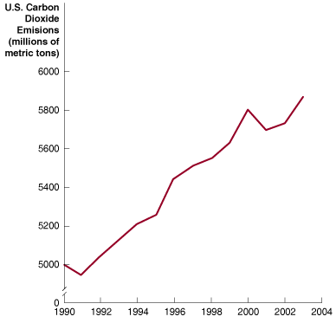
A Hamstrung Market Fights Global Warming

Slide 27

Coase theorem
Command and control approach
Common resource
Excludability
Externality
Free riding
Market failure
Pigovian taxes and subsidies
Private benefit
Private cost
Private good
Property rights
Public good
Rivalry
Social benefit
Social cost
Tragedy of the commons
Transactions costs

