Slide 1
Elasticity: The Responsiveness of
Demand and Supply

Slide 2

Do People Care about the Prices of Books?
After studying this chapter, you should be able to:
  Define the price elasticity of demand and understand how to calculate it.
  Discuss the determinants of the price elasticity of demand.
  Understand the relationship between the price elasticity of demand and total revenue.
  Define the cross-price elasticity of demand and the income elasticity of demand, and understand how they are calculated and what their main determinants are.
  Use price elasticity and income elasticity to analyze economic issues.
  Define the price elasticity of supply, and understand how it is calculated and what its main determinants are.
1
2
3
4
LEARNING OBJECTIVES
In this chapter we will see how to measure the responsiveness of the quantity demanded of a product to changes in its price.
5
6

Slide 3
Elasticity: The Responsiveness of Demand and Supply
Elasticity A measure of how much one economic variable responds to changes in another economic variable.

Slide 4
The Price Elasticity of Demand and Its Measurement
1
LEARNING OBJECTIVE
Price elasticity of demand The responsiveness of the quantity demanded to a change in price, measured by dividing the percentage change in the quantity demanded of a product by the percentage change in the product’s price.
Measuring the Price Elasticity of Demand

Slide 5
The Price Elasticity of Demand and Its Measurement
Elastic Demand and Inelastic Demand
Elastic demand Demand is elastic when the percentage change in quantity demanded is greater than the percentage change in price, so the price elasticity is greater than 1 in absolute value.
Inelastic demand Demand is inelastic when the percentage change in quantity demanded is less than the percentage change in price, so the price elasticity is less than 1 in absolute value.
Unit-elastic demand Demand is unit-elastic when the percentage change in quantity demanded is equal to the percentage change in price, so the price elasticity is equal to –1.

Slide 6
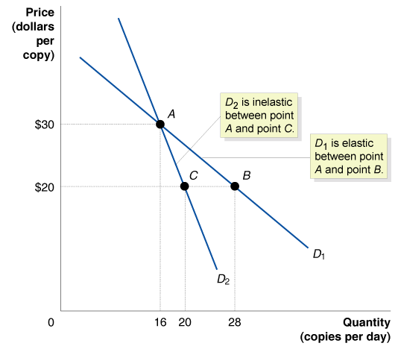
The Price Elasticity of Demand and Its Measurement
An Example of Computing Price Elasticities
6 - 1
Elastic and Inelastic Demand Curves

Slide 7
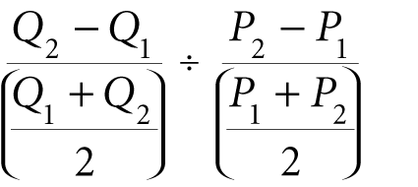
The Price Elasticity of Demand and Its Measurement
The Midpoint Formula
Price elasticity of demand =

Slide 8
6 - 1
1
LEARNING OBJECTIVE
Calculating the Price Elasticity of Demand for Wheat Using the Midpoint Formula
YEAR | PRICE (PER BUSHEL) | QUANTITY (BILLIONS OF BUSHELS)
2010 | $3.00 | 3.0
2011 | $3.60 | 2.8
Verify that the price elasticity of demand is –0.4.

Slide 9
The Price Elasticity of Demand and Its Measurement
Polar Cases of Perfectly Elastic and Perfectly Inelastic Demand
Perfectly inelastic demand Demand is perfectly inelastic when a change in price results in no change in quantity demanded.
Perfectly elastic demand Demand is perfectly elastic when a change in price results in an infinite change in quantity demanded.

Slide 10
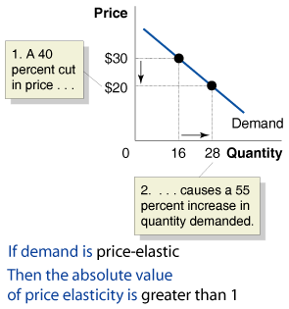
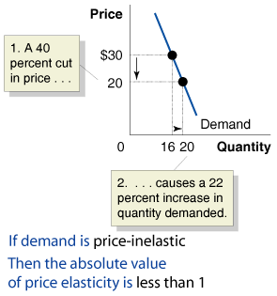
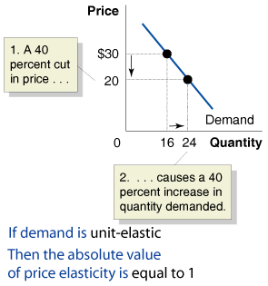
The Price Elasticity of Demand and Its Measurement
6 – 1
The Price Elasticity of Demand

Slide 11
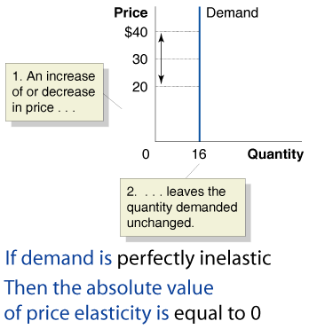
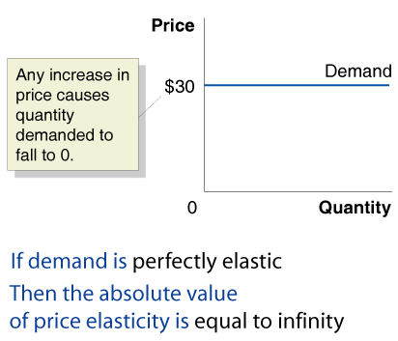

The Price Elasticity of Demand and Its Measurement
6 – 1 (continued)
The Price Elasticity of Demand
Don’t Confuse Inelastic with Perfectly Inelastic

Slide 12
What Determines the Price Elasticity of Demand for a Product?
2
LEARNING OBJECTIVE
The key determinants of price elasticity of demand are as follows:
  Availability of close substitutes
  Passage of time
  Necessities versus luxuries
  Definition of the market
  Share of good in the consumer’s budget

Slide 13


6 - 1
The Price Elasticity of Demand for Breakfast Cereal
CEREAL | PRICE ELASTICITY OF DEMAND
Post Raisin Bran | -2.5
All family breakfast cereals | -1.8
All types of breakfast cereals | -0.9
What happens when the price of cereal rises?

Slide 14
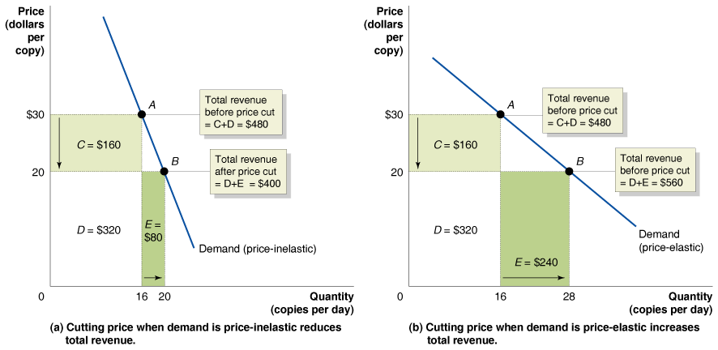
The Relationship Between Price Elasticity and Total Revenue
3
LEARNING OBJECTIVE
Total revenue The total amount of funds received by a seller of a good or service, calculated by multiplying price per unit by the number of units sold.
6 - 2
The Relationship Between Price Elasticity and Total Revenue

Slide 15
The Relationship Between Price Elasticity and Total Revenue
Elasticity and Revenue with a Linear Demand Curve
6 – 2
The Relationship between Price Elasticity and Revenue
IF DEMAND IS . . . | THEN . . . | BECAUSE . . .
elastic | an increase in price reduces revenue | the decrease in quantity demanded is proportionally greater than the increase in price.
elastic | a decrease in price increases revenue | the increase in quantity demanded is proportionally greater than the decrease in price.
inelastic | an increase in price increases revenue | the decrease in quantity demanded is proportionally smaller than the increase in price.
inelastic | a decrease in price reduces revenue | the increase in quantity demanded is proportionally smaller than the decrease in price.
unit-elastic | an increase in price does not affect revenue | the decrease in quantity demanded is proportionally the same as the increase in price.
unit-elastic | a decrease in price does not affect revenue | the increase in quantity demanded is proportionally the same as the decrease in price.

Slide 16
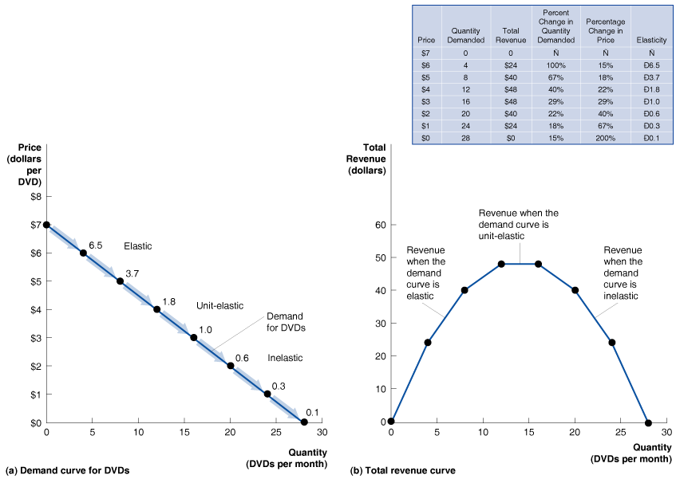
The Relationship Between Price Elasticity and Total Revenue
6 - 3
Elasticity is Not Constant Along a Linear Demand Curve

Slide 17

6 - 2
Determining the Price Elasticity of Demand for DVDs by Market Experiment
FILM | DVD PRICE | VHS PRICE
Rugrats in Paris | $22.46 | $22.99
The Mummy Returns | $26.98 | $22.98
Miss Congeniality | $16.69 | $22.98
The Perfect Storm | $24.98 | $22.99
When DVDs were first introduced, the movie studios were uncertain of their price elasticity of demand.

Slide 18
Other Demand Elasticities
4
LEARNING OBJECTIVE
Cross-Price Elasticity of Demand
Cross-price elasticity of demand The percentage change in quantity demanded of one good divided by the percentage change in the price of another good.
6 – 3
Summary of Cross-Price Elasticity of Demand
IF THE PRODUCTS ARE . . . | THEN THE CROSS-PRICE ELASTICITY OF DEMAND WILL BE . . . | EXAMPLE
Substitutes | Positive | Two brands of printers
Complements | Negative | Printers and toner cartridges
Unrelated | Zero | Printers and peanut butter

Slide 19
Other Demand Elasticities
Income Elasticity of Demand
Income elasticity of demand A measure of the responsiveness of quantity demanded to changes in income, measured by the percentage change in quantity demanded divided by the percentage change in price.
6 – 4
Summary of Income Elasticity of Demand
IF THE INCOME ELASTICITY OF DEMAND IS . . . | THEN THE GOOD IS . . . | EXAMPLE
Positive, but less than 1 | Normal and a necessity | Milk
Positive and greater than 1 | Normal and a luxury | Caviar
Negative | Inferior | High-fat meat

Slide 20

6 - 3
Price Elasticity, Cross-Price Elasticity, and Income Elasticity in the Market for Alcoholic Beverages
Price elasticity of demand for beer | -0.23
Cross-price elasticity of demand between beer and wine | 0.31
Cross-price elasticity of demand between beer and spirits | 0.15
Income elasticity of demand for beer | -0.09
Income elasticity of demand for wine | 5.03
Income elasticity of demand for spirits | 1.21
An “Inferior Good?”

Slide 21
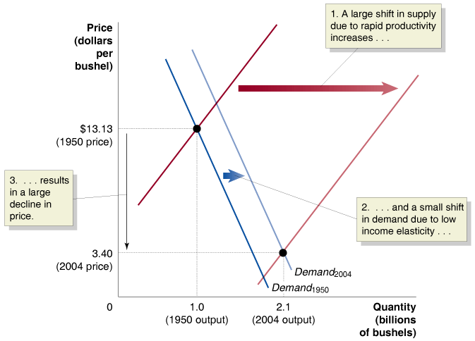
Using Elasticity to Analyze the Disappearing Family Farm
5
LEARNING OBJECTIVE
6 - 4
Elasticity and the Disappearing Farm

Slide 22
6 - 3
5
LEARNING OBJECTIVE
Using Price Elasticity to Analyze the Drug Problem
Verify that the percentage change in quantity demanded is 1.9%.

Slide 23
The Price Elasticity of Supply
6
LEARNING OBJECTIVE
Measuring the Price Elasticity of Supply
Price elasticity of supply The responsiveness of the quantity supplied to a change in price, measured by dividing the percentage change in the quantity supplied of a product by the percentage change in the product’s price.

Slide 24
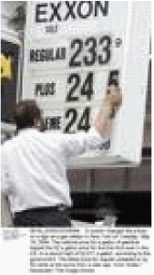
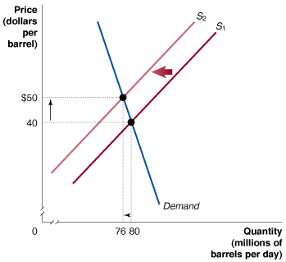
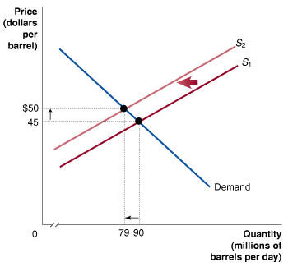
6 - 4
Why Are Oil Prices So Unstable?
Why do oil prices fluctuate so much?

Slide 25
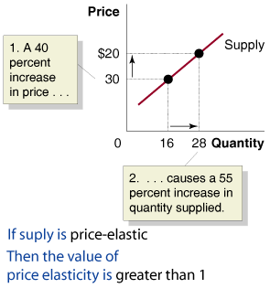
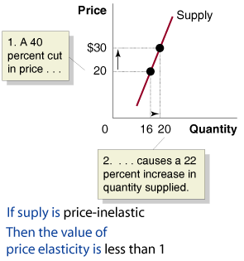
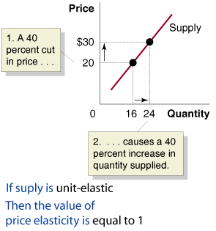
The Price Elasticity of Supply
Polar Cases of Perfectly Elastic and Perfectly Inelastic Supply
6 – 5
The Price Elasticity of Supply

Slide 26
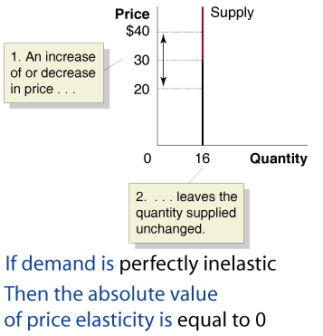
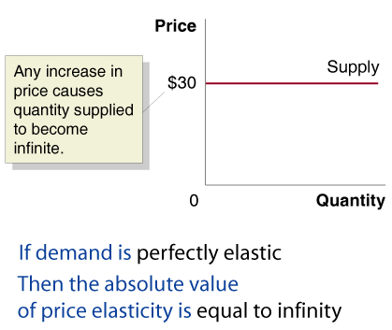
The Price Elasticity of Supply
Polar Cases of Perfectly Elastic and Perfectly Inelastic Supply
6 – 5 (continued)
The Price Elasticity of Supply

Slide 27
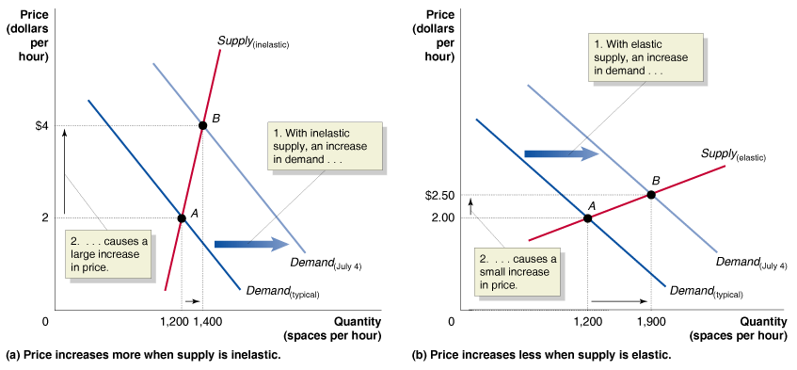
The Price Elasticity of Supply
Using Price Elasticity of Supply to Predict Changes in Price
6 - 5
Changes in Price Depend on the Price Elasticity of Supply

Slide 28

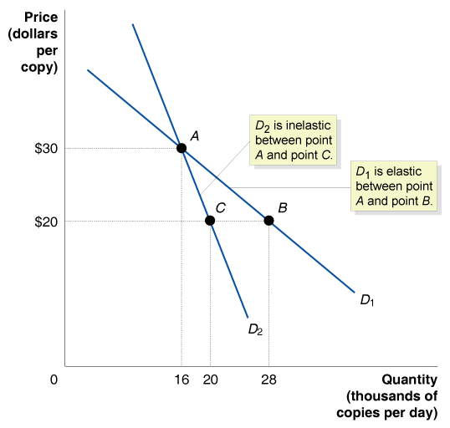
Amazon, Microsoft Earnings Better than Expected

Slide 29

Cross-price elasticity of demand
Elastic demand
Elasticity
Income elasticity of demand
Inelastic demand
Perfectly elastic demand
Perfectly inelastic demand
Price elasticity of demand
Price elasticity of supply
Total revenue
Unit-elastic demand

