Slide 1
Firms, the Stock Market, and
Corporate Governance

Slide 2
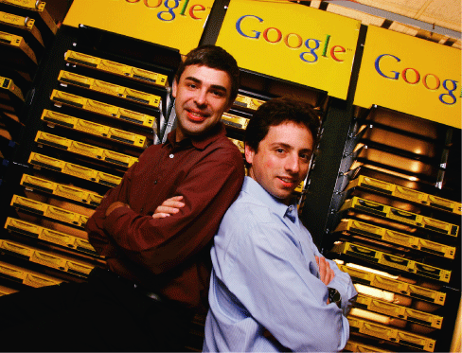
Google: From Dorm Room to Wall Street
After studying this chapter, you should be able to:
  Categorize the major types of business in the United States.
  Describe the typical management structure of corporations and understand the concepts of separation of ownership from control and the principal-agent problem.
  Explain how firms obtain the funds they need to operate and expand.
  Understand the information provided in firms’ financial statements.
  Understand the business accounting scandals of 2002, as well as the role of government in corporate governance.
1
2
3
LEARNING OBJECTIVES
4
Goggle's offering of stock to outside investors provided the firm with a major inflow of funds for growth.
5

Slide 3
Types of Firms
1
LEARNING OBJECTIVE
Sole proprietorship A firm owned by a single individual and not organized as a corporation.
Partnership A firm owned jointly by two or more persons and not organized as a corporation.
Corporation A legal form of business that provides the owners with limited liability.

Slide 4
Types of Firms
Who Is Liable? Limited and Unlimited Liability
Asset Anything of value owned by a person or a firm.
Limited liability The legal provision that shields owners of a corporation from losing more than they have invested in the firm.

Slide 5
Types of Firms
Who Is Liable? Limited and Unlimited Liability
7 – 1
Summary of Cross-Price Elasticity of Demand
 | SOLE PROPRIETORSHIP | PARTNERSHIP | CORPORATION
Advantages | 1. Control by owner 2. No layers of management | 1. Ability to share work 2. Ability to share risks | 1. Limited personal liability 2. Greater ability to raise funds
Disadvantages | 1. Unlimited personal liability 2. Limited ability to raise funds | 1. Unlimited personal liability 2. Limited ability to raise funds | 1. Costly to organize 2. Possible double taxation of income

Slide 6

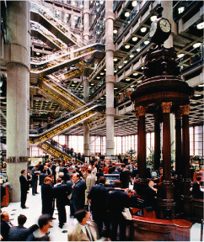
7 - 1
What’s in a “Name"? Lloyd’s of London Learns about Unlimited Liability the Hard Way
Investors in Lloyd’s of London lost billions of dollars during the 1980s and 1990s.

Slide 7
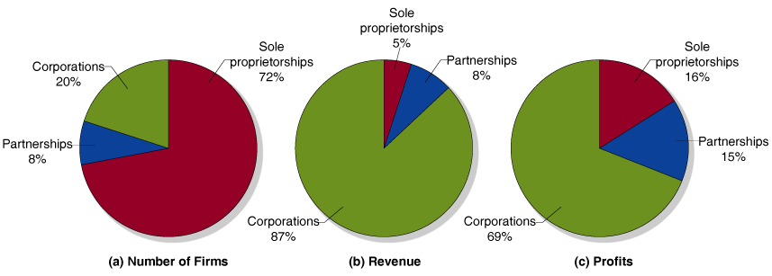
Types of Firms
Corporations Earn the Majority of Revenue and Profits
7 - 1
Business Organizations: Sole Proprietorships, Partnerships, and Corporations

Slide 8
The Structure of Corporations and the Principal-agent Problem
2
LEARNING OBJECTIVE
Corporate governance The way in which corporations are structured and the impact a corporation’s structure has on the firm’s behavior.
Corporate Structure and Corporate Governance
Separation of ownership from control In many large corporations the top management, rather than the shareholders, control day-to-day operations.
Principal-agent problem A problem caused by an agent pursuing his own interests rather than the interests of the principal who hired him.
7 - 1
Does the Principal-Agent Problem Also Apply to the Relationship between Managers and Workers?
2
LEARNING OBJECTIVE

Slide 9
How Firms Raise Funds
3
LEARNING OBJECTIVE
Firms can obtain funds for expansion in three ways:
  Profits that are reinvested in a firm, rather than taken out of a firm and paid to the firm’s owners, are retained earnings.
  You could also obtain funds by taking on one or more partners who would invest in the firm. This arrangement would increase the firm’s financial capital.
  Finally, you could borrow the funds from relatives, friends, or a bank.

Slide 10
How Firms Raise Funds
Sources of External Funds
Indirect finance A flow of funds from savers to borrowers through financial intermediaries such as banks. Intermediaries raise funds from savers to lend to firms (and other borrowers).
Direct finance A flow of funds from savers to firm through financial markets.

Slide 11
How Firms Raise Funds
Sources of External Funds
BONDS
Bond A financial security that represents a promise to repay a fixed amount of funds.
Coupon payment Interest payment on a bond.
Interest rate The cost of borrowing funds, usually expressed as a percentage of the amount borrowed.

Slide 12

How Firms Raise Funds
Sources of External Funds
STOCKS
Stock A financial security that represents partial ownership of a firm.
Dividends Payments by a corporation to its shareholders.
Capital gains Increases in the value of a firm’s shares.
Stock and bond markets provide capital—and information.
When Google Shares Change Hands, Google Doesn’t Get the Money

Slide 13
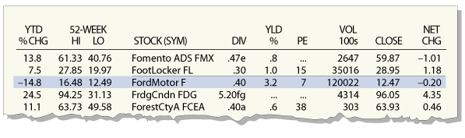

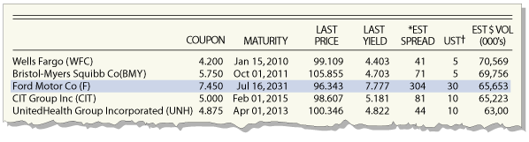
7 - 2
Following Ford’s Stock and Bond Prices in the Financial Pages
Stock and bond tables in local newspapers help investors track a firm’s prospects.

Slide 14

7 - 3
A Bull in China’s Financial Shop
Will China’s weak financial system derail economic growth?

Slide 15
Using Financial Statements to Evaluate a Corporation
4
LEARNING OBJECTIVE
Liability Anything owed by a person or a business.
The Income Statement
Income statement A financial statement that sums up a firm’s revenues, costs, and profit over a period of time.

Slide 16
Using Financial Statements to Evaluate a Corporation
The Income Statement
GETTING TO ACCOUNTING PROFIT
Accounting profit A firm’s net income measured by revenue less operating expenses and taxes paid.
  …AND ECONOMIC PROFIT
Opportunity cost The highest-valued alternative that must be given up in order to engage in an activity.
Explicit cost A cost that involves spending money.
Implicit cost An opportunity cost incurred creating net income.
Economic profit A firm’s revenues minus all of its costs, implicit and explicit.

Slide 17
Using Financial Statements to Evaluate a Corporation
The Balance Sheet
Balance sheet A financial statement that sums up a firm’s financial position on a particular day, usually the end of a quarter or a year.

Slide 18
Understanding the Business Scandals of 2002
In the United States, the landmark Sarbanes-Oxley Act of 2002 requires that corporate directors have a certain level of expertise with financial information and mandates that chief executive officers personally certify the accuracy of financial statements.
Outside of the United States, the European Commission released plans in 2003 to tighten corporate governance rules, and Japan has debated such reforms as well. The challenge of ensuring the accurate reporting of firms’ economic profits is a global one.

Slide 19
7 - 2
5
LEARNING OBJECTIVE
What Makes a Good Board of Directors?
What is an “insider” on a board of directors?
  An insider is a member of top management who also serves on the board of directors.
Why might having too many insiders be a problem?
  Managers may end up controlling the board, rather than the other way around.
Why would having outside directors who are CEOs of large firms be a good thing?
  They have the experience to judge whether top managers are making decisions in the best interest of the firm.
Why would directors not having business ties to the firm be a good thing?
  These directors would not be concerned about having to displease the top managers who may stop doing business with the other firms.

Slide 20

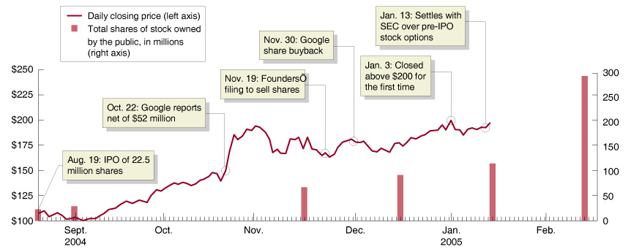
Technology Shares Slip, But Google Passes $200

Slide 21

Accounting profit
Asset
Balance sheet
Bond
Capital gains
Corporation
Corporate governance
Coupon payment
Direct finance
Dividends
Economic profit
Explicit cost
Implicit cost
Income statement
Indirect finance
Interest rate
Liability
Limited liability
Opportunity cost
Partnership
Principal-agent problem
Separation of ownership from control
Sole proprietorship

Slide 22
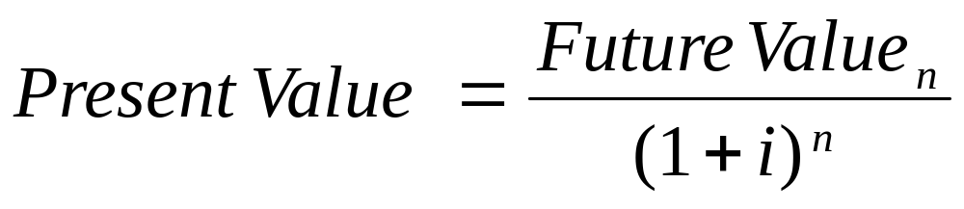
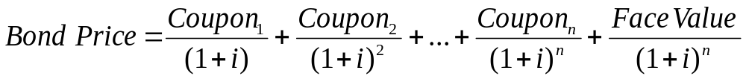
Appendix 7A:
Tools to Analyze Firms’ Financial Information
Using Present Value to Make Investment Decisions
Present value The value in today’s dollars of funds to be paid or received in the future.
Using Present Value to Calculate Bond Prices

Slide 23
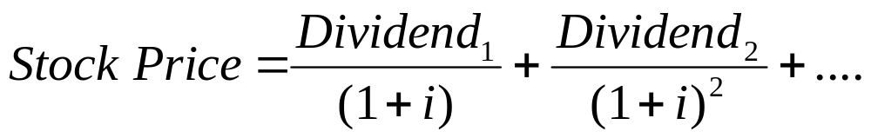
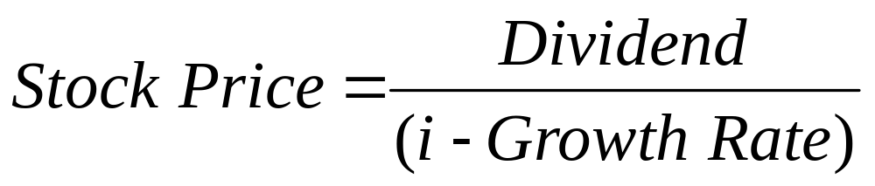
Appendix 7A:
Tools to Analyze Firms’ Financial Information
Using Present Value to Make Investment Decisions
Using Present Value to Calculate Stock Prices
A Simple Formula for Calculating Stock Prices

Slide 24
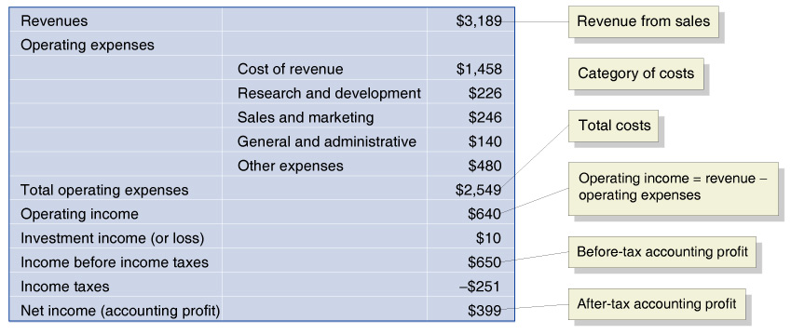
Appendix 7A:
Tools to Analyze Firms’ Financial Information
Going Deeper into Financial Statements
Analyzing Income Statements
7A - 1
Google’s Income Statement for 2004

Slide 25
Appendix 7A:
Tools to Analyze Firms’ Financial Information
Going Deeper into Financial Statements
Analyzing Balance Sheets
Stockholders’ equity The difference between the value of a corporation’s assets and the value of its liabilities; also known as net worth.
or

Slide 26
Appendix 7A:
Tools to Analyze Firms’ Financial Information
Going Deeper into Financial Statements
Analyzing Balance Sheets
7A - 2
Google’s Balance Sheet as of
December 31, 2004
ASSETS |  | LIABILITIES AND STOCKHOLDERS’ EQUITY
Current assets | $2,693 | Current liabilities | $340
Property and Equipment | $379 | Long-term liabilities | $44
Investments | $71 | Total liabilities | $384
Goodwill | $123 | Stockholders’ equity | $2,929
Other long-term assets | $47
Total assets | $3,313 | Total liabilities and Stockholders’ equity | $3,313

Slide 27
Present value
Stockholders’ equity

