Slide 1
Comparative Advantage and the
Gains from International Trade

Slide 2

Sugar Quota Drives U.S. Candy Manufacturers Overseas
After studying this chapter, you should be able to:
  Discuss the increasing importance of international trade to the United States.
  Understand the difference between comparative advantage and absolute advantage.
  Explain how countries gain from international trade.
  Discuss the sources of comparative advantage.
  Analyze the economic effects of government policies that restrict international trade.
  Evaluate the arguments for and against government policies that restrict international trade.
1
2
3
4
LEARNING OBJECTIVES
5
In this chapter, we will explore who wins and who loses from international trade and review the political debate over whether international trade should be restricted.
6

Slide 3
An Overview of International Trade
1
LEARNING OBJECTIVE
Tariff A tax imposed by a government on imports.
Imports Goods and services bought domestically but produced in other countries.
Exports Goods and services produced domestically but sold to other countries.

Slide 4
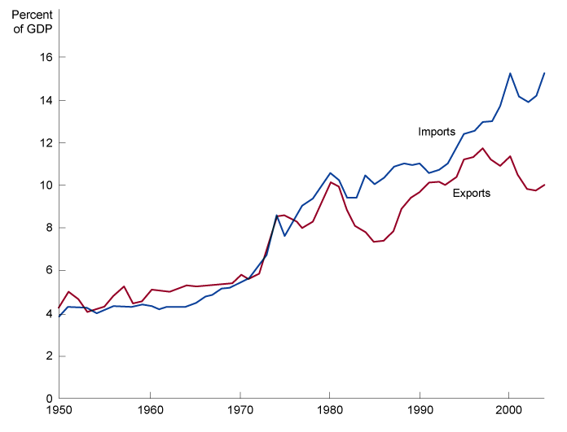
An Overview of International Trade
The Importance of Trade to the U.S. Economy
8 - 1
International Trade Is of Increasing Importance to the United States

Slide 5
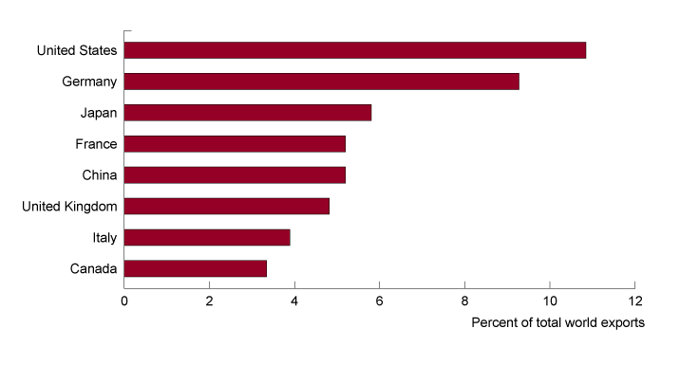
An Overview of International Trade
U.S. International Trade in a World Context
8 - 2
The Eight Leading Exporting Countries

Slide 6
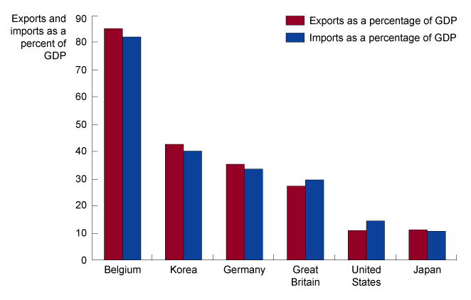
An Overview of International Trade
U.S. International Trade in a World Context
8 - 3
International Trade as a Percent of GDP

Slide 7


8 - 1
Has Outsourcing Hurt the U.S. Economy?
Some companies outsource technical support services to India.

Slide 8
Comparative Advantage: The Basis of All Trade
2
LEARNING OBJECTIVE
A Brief Review of Comparative Advantage
Comparative advantage The ability of an individual, business, or country to produce a good or service at the lowest opportunity cost.
Opportunity Cost The highest-valued alternative that must be given up to engage in an activity.

Slide 9
Comparative Advantage: The Basis of All Trade
Comparative Advantage in International Trade
Absolute advantage The ability to produce more of a good or service than competitors when using the same amount of resources.

Slide 10
Comparative Advantage: The Basis of All Trade
Comparative Advantage in International Trade
8 – 1
OUTPUT PER HOUR OF WORK
 | CELL PHONES | MP3 PLAYERS
Japan United States | 12 2 | 6 4
An Example of Japanese Workers Being More Productive than American Workers
8 –2
OPPORTUNITY COSTS
 | CELL PHONES | MP3 PLAYERS
Japan United States | 0.5 MP3 player 2 MP3 players | 2 cell phones 0.5 cell phone
The Opportunity Costs of Producing Cell Phones and MP3 Players

Slide 11
The Gains from Trade
3
LEARNING OBJECTIVE
Autarky The ability of an individual, business, or country to produce a good or service at the lowest opportunity cost.

Slide 12
The Gains from Trade
Increasing Consumption through Trade
Terms of Trade The ratio at which a country can trade its exports for imports from other countries.
8 –3
Production without Trade
WITHOUT TRADE PRODUCTION AND CONSUMPTION
 | CELL PHONES | MP3 PLAYERS
Japan United States | 9,000 1,500 | 1,500 1,000

Slide 13
The Gains from Trade
Increasing Consumption through Trade
8 –4
The Gains from Trade for Japan and the United States
WITHOUT TRADE
Production and Consumption
 |  | CELL PHONES |  | MP3 PLAYERS
Japan |  | 9,000 |  | 1,500
United States |  | 1,500 |  | 1,000
WITH TRADE
 | Production with Trade |  |  |  |  | Trade |  |  |  |  |  | Consumption with Trade
 | CELL PHONES |  | MP3 PLAYERS |  | CELL PHONES |  |  |  | MP3 PLAYERS |  |  | CELL PHONES |  |  | MP3 PLAYERS
Japan | 12,000 |  | 0 |  | Export 1,500 |  |  |  | Import 1,500 |  |  |  | 10,500 |  | 1,500
United States | 0 |  | 4,000 |  | Import 1,500 |  |  |  | Export 1,500 |  |  |  | 1,500 |  | 2,500
 | With trade, the United States and Japan specialize in the good they have a comparative advantage in producing... |  |  |  |  |  |  |  | ...and export some of that good in exchange for the good the other country has a comparative advantage in producing.
GAINS FROM TRADE
 |  | Increased Consumption
Japan |  | 1,500 Cell Phones |  |  | The increased consumption made possible by trade represents the gains from trade
United States |  | 1,500 MP3 Players

Slide 14
8 - 1
3
LEARNING OBJECTIVE
The Gains from Trade
WITHOUT TRADE PRODUCTION AND CONSUMPTION
 | CLOTH | WINE
Portugal England | 18,000 63,000 | 123,000 18,000
WITH TRADE PRODUCTION WITH TRADE TRADE CONSUMPTION WITH TRADE
 | CLOTH | WINE | CLOTH | WINE | CLOTH | WINE
Portugal England | 0 90,000 | 150,000 0 | Import 18,000 Export 18,000 | Export 18,000 Import 18,000 | 18,000 72,000 | 132,000 18,000
GAINS FROM TRADE INCREASED CONSUMPTION
Portugal England | 9,000 wine 9,000 cloth

Slide 15

The Gains from Trade
Why Don’t We See Complete Specialization?
Not all goods and services are traded internationally.
Production of most goods involves increasing opportunity costs.
Tastes for products differ.
Remember that Trade Creates Both Winners and Losers

Slide 16
Where Does Comparative Advantage Come From?
4
LEARNING OBJECTIVE
Among the main sources of comparative advantage are the following:
  Climate and natural resources
  Relative abundance of labor and capital
  Technology
  External economies
External economies Reductions in a firm’s costs that result from an expansion in the size of an industry.

Slide 17

8 - 2
Why is Dalton, Georgia, the Carpet-Making Capital of the World?
Because Catherine Evans Whitener started making bedspreads by hand in Dalton, Georgia, a hundred years ago, a multibillion-dollar carpet industry is now located there.

Slide 18
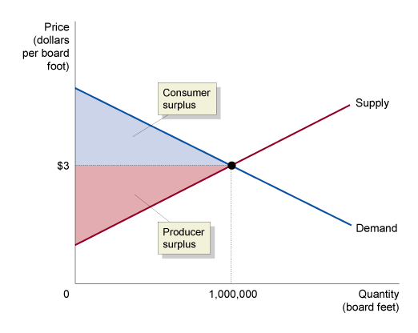
Government Policies That Restrict Trade
5
LEARNING OBJECTIVE
Free Trade Trade between countries that is free from government restrictions.
8 - 4
The U.S. Lumber Industry under Autarky.

Slide 19
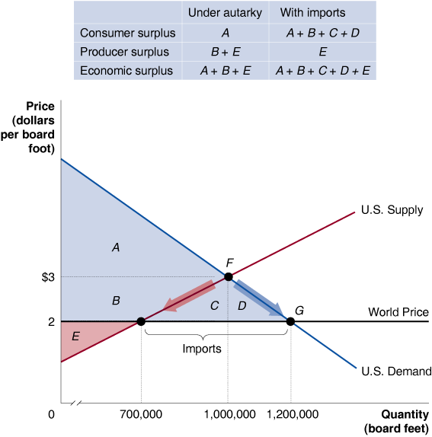
Government Policies That Restrict Trade
8 - 5
The Effect of Imports on the U.S. Lumber Market.

Slide 20
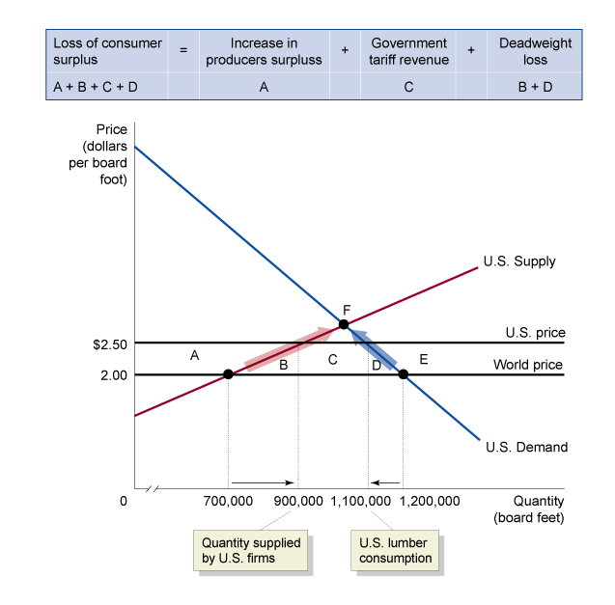
Government Policies That Restrict Trade
Tariffs
8 - 6
The Effects of a Tariff on Lumber

Slide 21
Government Policies That Restrict Trade
Quotas
Quota A numerical limit imposed by the government on the quantity of a good that can be imported into a country.
Voluntary export restraint An agreement negotiated between two countries that places a numerical limit on the quantity of a good that can be imported by one country from the other country.

Slide 22
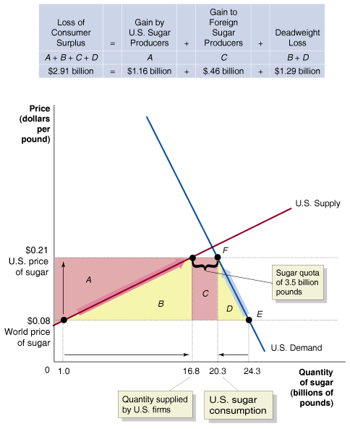
Government Policies That Restrict Trade
Quotas
8 - 7
The Effect of the U.S. Sugar Quota

Slide 23
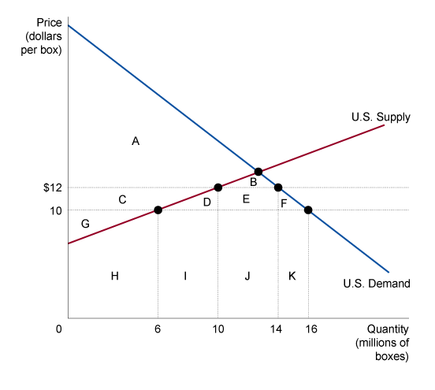
8 - 2
5
LEARNING OBJECTIVE
Measuring the Economic Effect of a Quota
 | WITHOUT QUOTA | WITH QUOTA
World price of apples U.S. price of apples Quantity supplied by U.S. firms Quantity demanded by U.S. consumers Quantity imported Area of consumer surplus Area of producer surplus Area of deadweight loss | $10 $10 6 million boxes 16 million boxes 10 millions boxes A+B+C+D+E+F G No deadweight loss | $10 $12 10 million boxes 14 million boxes 4 million boxes A+B G+C D+F

Slide 24
Government Policies That Restrict Trade
The High Cost of Preserving Jobs with Tariffs and Quotas
8 – 5
Preserving U.S. Jobs with Tariffs and Quotas Is Expensive
PRODUCT | NUMBER OF JOBS SAVED | COST TO CONSUMERS PER YEAR FOR EACH JOB SAVED
Benzenoid chemicals Luggage Softwood lumber Dairy products Frozen orange juice Ball bearings Machine tools Women's handbags Canned tuna | 216 226 605 2,378 609 146 1,556 773 390 | $1,376,435 1,285,078 1,044,271 685,323 635,103 603,368 479,452 263,535 257,640

Slide 25
Government Policies That Restrict Trade
Gains from Unilateral Elimination of Tariffs and Quotas
8 – 6
Preserving Japanese Jobs with Tariffs and Quotas Is Also Expensive
PRODUCT | COST TO CONSUMERS PER YEAROR EACH JOB SAVED
Rice Natural gas Gasoline Paper Beef, pork, and poultry Cosmetics Radio and television sets | $51,233,000 27,987,000 6,329,000 3,813,000 1,933,000 1,778,000 915,000

Slide 26
The Argument over Trade Policies and Globalization
6
LEARNING OBJECTIVE
World Trade Organization (WTO) An international organization that enforces international trade agreements.

Slide 27
The Argument over Trade Policies and Globalization
Why Do Some People Oppose the World Trade Organization?
Globalization The process of countries becoming more open to foreign trade and investment.
ANTI-GLOBALIZATION
Some people believe that free trade and foreign investment destroy the distinctive cultures of many countries. Many governments have resisted globalization proposals.

Slide 28

8 - 3
The Unintended Consequences of Banning Goods Made with Child Labor
Would eliminating child labor in developing countries be a good thing?

Slide 29
The Argument over Trade Policies and Globalization
Why Do Some People Oppose the World Trade Organization?
“OLD-FASHIONED” PROTECTIONISM
Protectionism The use of trade barriers to shield domestic companies from foreign competition.
Protectionism is usually justified on the basis of one of the following arguments:
  Saving jobs
  Protecting high wages
  Protecting infant industries
  Protecting national security

Slide 30

8 - 4
Has NAFTA Helped or Hurt the U.S. Economy?
Despite resistance to NAFTA, time proved that the U.S. economy gained jobs.

Slide 31
The Argument over Trade Policies and Globalization
Dumping
Dumping Selling a product for a price below its cost of production.

Slide 32

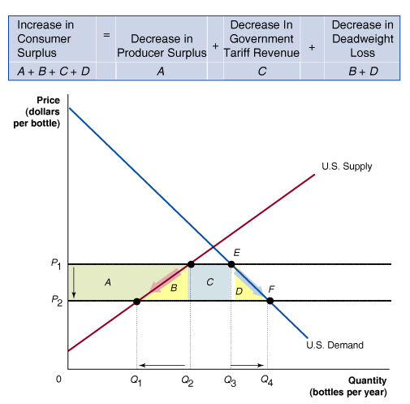
U.S., Australia Commerce to Leap Forward
Figure 1: The market for wine in Australia after the tariff on California wine is eliminated.

Slide 33

Absolute advantage
Autarky
Comparative advantage
Dumping
Exports
External economies
Free Trade
Globalization
Imports
Non-tariff barrier
Opportunity cost
Protectionism
Quota
Tariff
Terms of trade
Voluntary export restraint
World Trade Organization (WTO)

Slide 34
Appendix 8A:
Multinational Firms
Multinational Firms
A Brief History of Multinational Enterprises
Multinational enterprises (MNEs) Firms that conduct operations in more than one country.
Foreign direct investment (FDI) The purchase or building by a domestic firm of a facility in a foreign country.
Foreign portfolio investment The purchase by an individual or firm of stocks or bonds issued in another country.

Slide 35
Appendix 8A:
Multinational Firms
Multinational Firms
A Brief History of Multinational Enterprises
8A – 1
The Top 25 Multinational Corporations, 2004
RANK | CORPORATION | HOME COUNTRY | INDUSTRY
1 2 3 4 5 6 7 8 9 10 11 12 13 | Wal-Mart Stores BP Exxon Mobil Royal Dutch/Shell Group General Motors Ford Motor DaimlerChrysler Toyota Motor General Electric Total Allianz ChevronTexaco Axa | United States Great Britain United States Netherlands/ United Kingdom United States United States Germany Japan United States France Germany United States France | Retailing Petroleum Refining Petroleum Refining Petroleum Refining Motor Vehicles Motor Vehicles Motor Vehicles Motor Vehicles Diversified Financials Petroleum Refining Insurance Petroleum Insurance

Slide 36
Appendix 8A:
Multinational Firms
Multinational Firms
A Brief History of Multinational Enterprises
8A – 1
The Top 25 Multinational Corporations, 2004 (cont’d.)
RANK | CORPORATION | HOME COUNTRY | INDUSTRY
14 15 16 17 18 19 20 21 22 23 24 25 | ConocoPhillips Volkswagen Nippon Telephone and Telegraph ING Group Citigroup International Business Machines American International Group Siemens AG Carrefour Hitachi Hewlett-Packard Honda Motor | United States Germany Japan Netherlands United States United States United States Germany France Japan United States Japan | Petroleum Motor Vehicles Telecommunications Insurance Banking Computers Insurance Electronics Food and Drug Stores Electronics Computers Motor vehicles

Slide 37
Appendix 8A:
Multinational Firms
Multinational Firms
Strategic Factors in Moving from Domestic to Foreign Markets
Firms might expect to increase their profits through overseas operations for five main reasons:
  To avoid tariffs or the threat of tariffs
  To gain access to raw materials
  To gain access to low-cost labor
  To minimize exchange rate risk
  To respond to industry competition

Slide 38

8A - 1
Have Multinational Corporations Reduced Employment and Lowered Wages in the United States?
Many U.S. jobs require technical training.

Slide 39
Foreign direct investment
Foreign portfolio investment
Multinational enterprise

