Slide 1
Technology, Production, and Costs

Slide 2

Sony Uses a Cost Curve to Determine the Price of Radios
After studying this chapter, you should be able to:
  Define technology and give examples of positive and negative technological change.
  Distinguish between the economic short run and the economic long run.
  Understand the relationship between the marginal product of labor and the average product of labor.
  Explain and illustrate the relationship between marginal cost and average total cost.
  Graph average total cost, average variable cost, average fixed cost, and marginal cost.
  Understand how firms use the long-run average cost curve to plan.
1
2
3
LEARNING OBJECTIVES
4
In this chapter, we will focus on the relationship between a firm’s technology and its production costs.
5
6

Slide 3
Technology: An Economic Definition
1
LEARNING OBJECTIVE
Technology The processes a firm uses to turn inputs into outputs of goods and services.
Technological change A change in the ability of a firm to produce a given level of output with a given quantity of inputs.

Slide 4

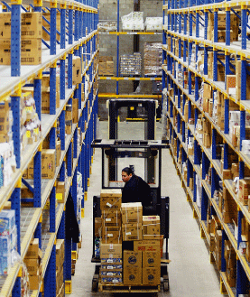
10 - 1
Improving Inventory Control at Wal-Mart
Better inventory controls have helped reduce firms’ costs.

Slide 5
The Short Run and the Long Run
2
LEARNING OBJECTIVE
Short run The period of time during which at least one of the firm’s inputs is fixed.
Long run A period of time long enough to allow a firm to vary all of its inputs, to adopt new technology, and to increase or decrease the size of its physical plant.

Slide 6
The Short Run and the Long Run
The Difference between Fixed Costs and Variable Costs
Total cost The cost of all the inputs a firm uses in production.
Variable costs Costs that change as output changes.
Fixed costs Costs that remain constant as output changes.
Total Cost = Fixed Cost + Variable Cost
TC = FC + VC

Slide 7

10 - 2
Fixed Costs in the Publishing Industry
COST | AMOUNT
Salaries and Benefits Rent Utilities Supplies Postage Travel Subscriptions, etc. Miscellaneous Total | $437,500 $75,000 $20,000 $6,000 $4,000 $8,000 $4,000 $5,000 $559,500
The salaries of editors are considered a fixed cost by publishers.

Slide 8
The Short Run and the Long Run
Implicit versus Explicit Costs
Opportunity cost The highest-valued alternative that must be given up to engage in an activity.
Explicit cost A cost that involves spending money.
Implicit cost A nonmonetary opportunity cost.

Slide 9
The Short Run and the Long Run
10 – 1
Jill Johnson’s Costs per Year
Paper Wages Lease payment for copy machines Electricity Lease payment for store Foregone salary Foregone interest Total | $20,000 $48,000 $10,000 $6,000 $24,000 $30,000 $3,000 $141,000
The Production Function
Production Function The relationship between the inputs employed by the firm and the maximum output it can produce with those inputs.

Slide 10
The Short Run and the Long Run
A First Look at the Relationship Between Production and Cost
10 – 2
Short-Run Production and Cost at Jill Johnson’s Copy Store
QUANTITY OF WORKERS | QUANTITY OF COPY MACHINES | QUANTITY OF COPIES | COST OF COPY MACHINES (FIXED COST) | COST OF WORKERS (VARIABLE COST) | TOTAL COST OF COPIES | COST PER COPY (AVERAGE COST)
0 1 2 3 4 5 6 | 2 2 2 2 2 2 2 | 0 625 1325 2200 2600 2900 3100 | $25 25 25 25 25 25 25 | $0 50 100 150 200 250 300 | $25 75 125 175 225 275 325 | - $0.12 0.09 0.08 0.09 0.10 0.11
Average total cost Total cost divided by the quantity of output produced.

Slide 11
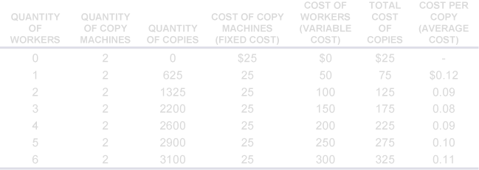
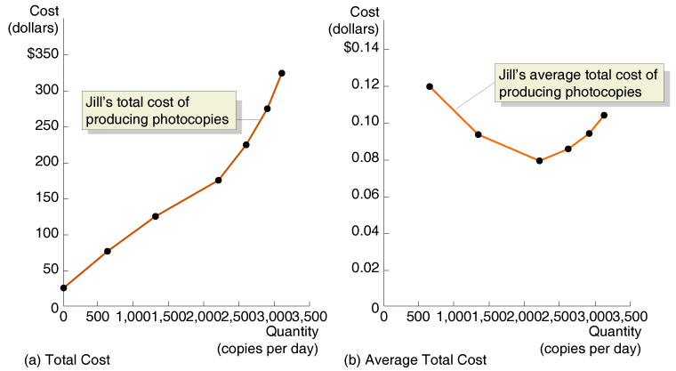
The Short Run and the Long Run
A First Look at the Relationship Between Production and Cost
10 - 1
Graphing Total cost and Average Total Cost at Jill Johnson’s Photocopy Store

Slide 12
The Marginal Product of Labor and the Average Product of Labor
3
LEARNING OBJECTIVE
Marginal product of labor The additional output a firm produces as a result of hiring one more worker.
The Law of Diminishing Returns
Law of diminishing returns The principle that, at some point, adding more of a variable input, such as labor, to the same amount of a fixed input, such as capital, will cause the marginal product of the variable to decline.

Slide 13
The Marginal Product of Labor and the Average Product of Labor
The Law of Diminishing Returns
10 – 3
Marginal and Average Product of Labor at Jill Johnson’s Copy Store
QUANTITY OF WORKERS | QUANTITY OF COPY MACHINES | QUANTITY OF COPIES | MARGINAL PRODUCT OF LABOR
0 1 2 3 4 5 6 | 2 2 2 2 2 2 2 | 0 625 1,325 2,200 2,600 2,900 3,100 | - 625 700 875 400 300 200

Slide 14
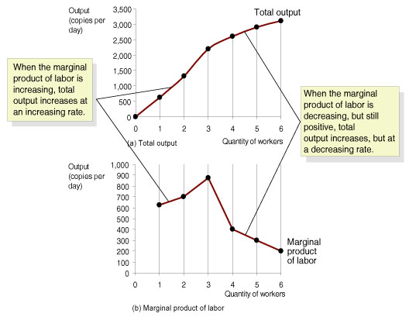
The Marginal Product of Labor and the Average Product of Labor
Graphing Production
10 - 2
Total Output and the Marginal Product of Labor

Slide 15
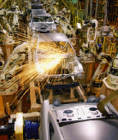
10 - 3
Adam Smith’s Famous Account of the Division of Labor in a Pin Factory
The gains from division of labor and specialization are as important to firms today as they were in the eighteenth century when Adam Smith first discussed them.

Slide 16
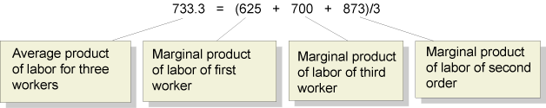
The Marginal Product of Labor and the Average Product of Labor
The Relationship between Marginal and Average Product
Average product of labor The total output produced by a firm divided by the quantity of workers.

Slide 17
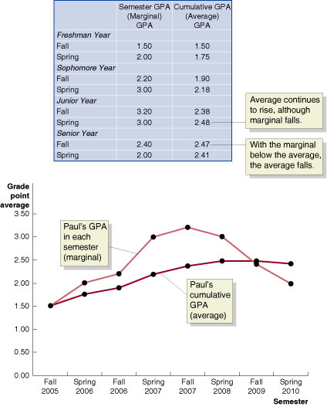
The Marginal Product of Labor and the Average Product of Labor
An Example of Marginal and Average Values: College Grades
10 - 3
Marginal and Average GPAs

Slide 18
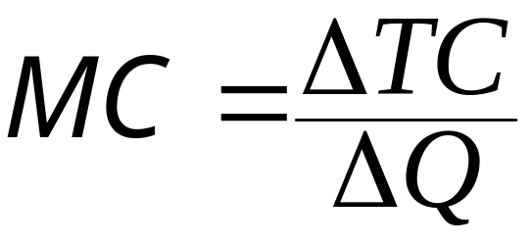
The Relationship Between Short-Run Production and Short-Run Cost
4
LEARNING OBJECTIVE
Marginal Cost
Marginal Cost The change in a firm’s total cost from producing one more unit of a good or service.

Slide 19
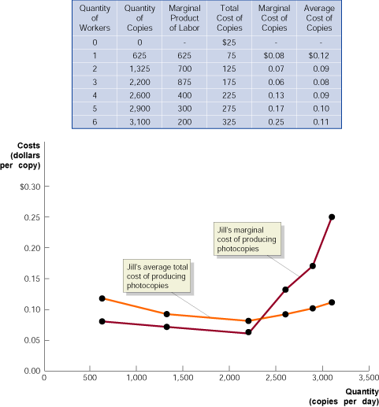
The Relationship Between Short-Run Production and Short-Run Cost
Why Are the Marginal and Average Cost Curves U-Shaped?
10 - 4
Jill Johnson’s Marginal Cost and Average Cost of Producing Copies

Slide 20
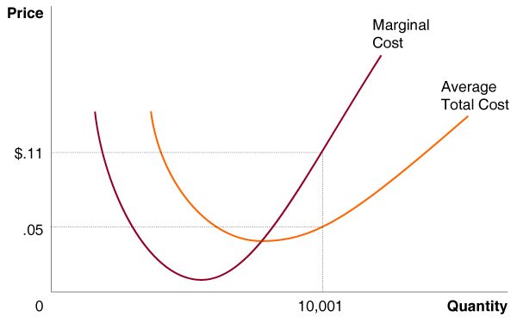
10 - 1
4
LEARNING OBJECTIVE
The Relationship Between Marginal and Average Cost

Slide 21
Graphing Cost Curves
5
LEARNING OBJECTIVE
Average fixed cost Fixed cost divided by the quantity of output produced.
Average variable cost Variable cost divided by the quantity of units produced.
Average total cost = ATC = TC/Q
Average fixed cost = AFC = FC/Q
Average variable cost = AVC = VC/Q
ATC = AFC + AVC

Slide 22
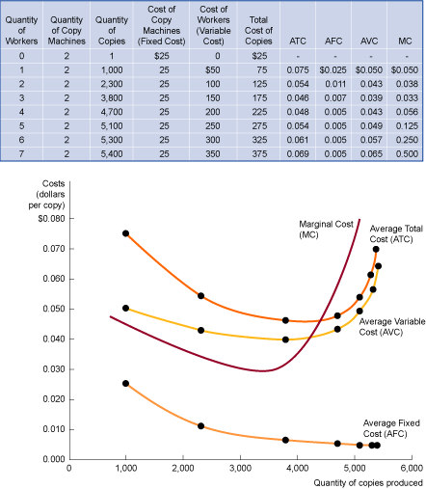
Graphing Cost Curves
10 - 5
Costs at Jill Johnson’s Copy Store

Slide 23
Costs in the Long Run
6
LEARNING OBJECTIVE
Economies of Scale
Long-run average cost curve A curve showing the lowest cost at which the firm is able to produce a given quantity of output in the long run, when no inputs are fixed.
Economies of scale Economies of scale exist when a firm’s long-run average costs fall as it increases output.

Slide 24
Costs in the Long Run
Economies of Scale
Constant returns to scale Constant returns to scale exist when a firm’s long-run average costs remain unchanged as it increases output.
Minimum efficient scale The level of output at which all economies of scale have been exhausted.
Diseconomies of scale Exist when a firm’s long-run average costs rise as it increases output.

Slide 25
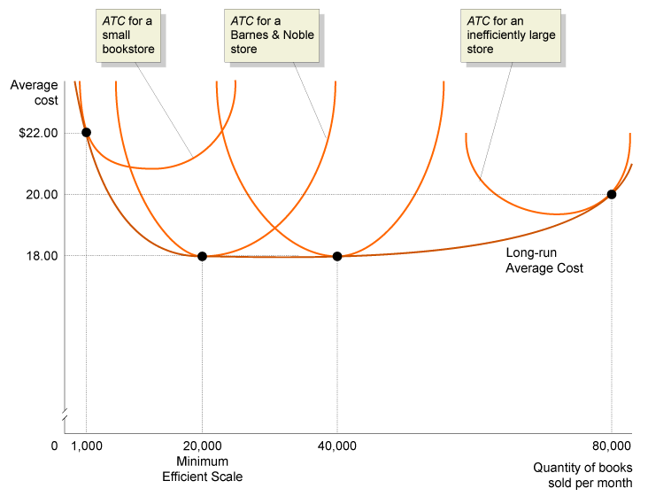
Costs in the Long Run
Long-Run Average Total Cost Curves for Bookstores
10 - 6
The Relationship between Short-Run Average Cost and Long-Run Average Cost

Slide 26
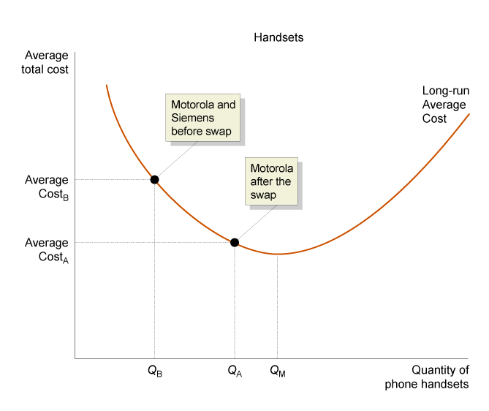
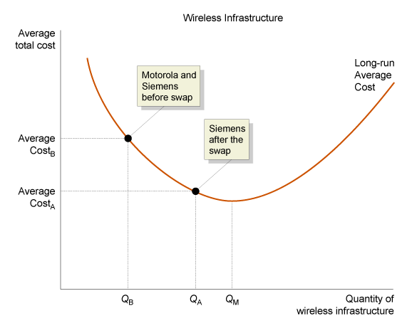
10 - 2
6
LEARNING OBJECTIVE
Using Long-Run Average Cost Curves to Understand Business Strategy

Slide 27
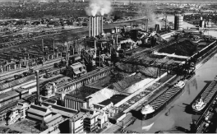
10 - 4
The Colossal River Rouge: Diseconomies of Scale at the Ford Motor Company
Is it possible for a factory to be too big?

Slide 28

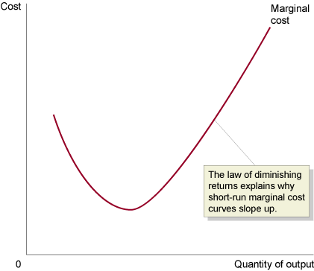
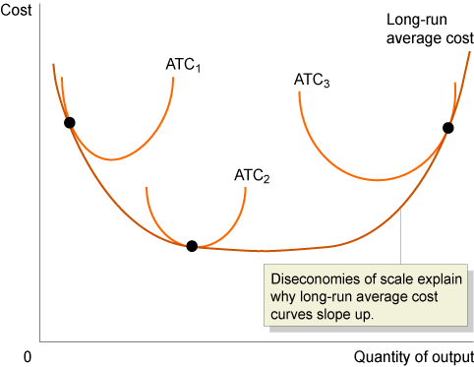
Don’t Confuse Diminishing Returns with Diseconomies of Scale

Slide 29
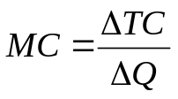
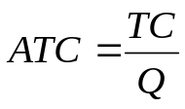
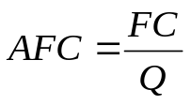
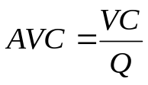
Conclusion
10 – 4
A Summary of Definitions of Cost
TERM | DEFINITION | SYMBOLS AND EQUATIONS
Total cost | The value of all the inputs used by a firm | TC
Fixed cost | Costs that remain constant when a firm’s level of output changes | FC
Variable cost | Costs that change when the firm’s level of output changes | VC
Marginal cost | The increase in total cost resulting from producing another unit of output
Average total cost | Total cost divided by the quantity of units produced
Average fixed cost | Fixed cost divided by the quantity of units produced
Average variable cost | Variable cost divided by the quantity of units produced
Implicit cost | A nonmonetary opportunity cost | -
Explicit cost | A cost that involves spending money | -

Slide 30

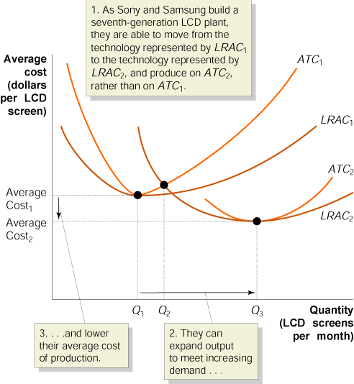
It’s ‘Win-Win’ as Samsung, Sony Join on Flat Screens

Slide 31

Average fixed cost
Average variable cost
Average product of labor
Average total cost
Constant returns to scale
Diseconomies of scale
Economies of scale
Explicit cost
Fixed costs
Implicit cost
Law of diminishing returns
Long run
Long-run average cost curve
Marginal cost
Marginal product of labor
Minimum efficient scale
Opportunity cost
Production function
Short run
Technological change
Technology
Total cost
Variable costs

Slide 32
Appendix 10A: Using Isoquants and
Isocosts to Understand Production and Cost
Isoquants
An Isoquant Graph
Isoquant A curve showing all the combinations of two inputs, such as capital and labor, that will produce the same level of output.

Slide 33
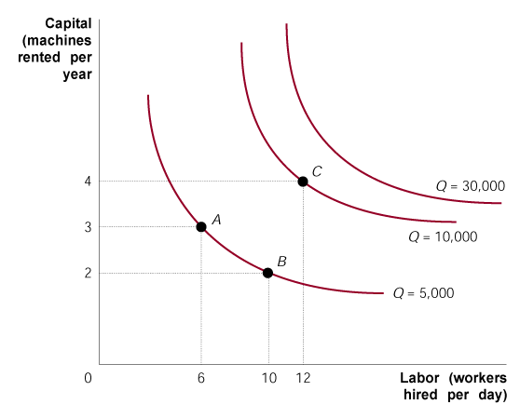
Appendix 10A: Using Isoquants and
Isocosts to Understand Production and Cost
Isoquants
The Slope of an Isoquant
Marginal rate of technical substitution (MRTS) The slope of an isoquant; represents the rate at which a firm is able to substitute one input for another, while keeping the level of output constant.
10A - 1
Isoquants

Slide 34
Appendix 10A: Using Isoquants and
Isocosts to Understand Production and Cost
Isocost Lines
Isocost line All the combinations of two inputs, such as capital and labor, that have the same total cost.

Slide 35
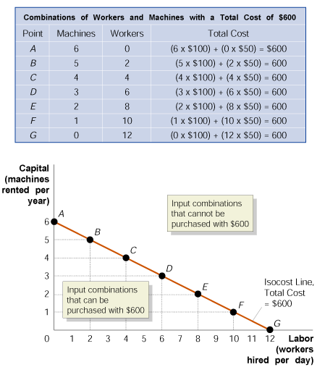
Appendix 10A: Using Isoquants and
Isocosts to Understand Production and Cost
Isocost Lines
The Slope and Position
of the Isocost Line
10A - 2
The Isocost Line

Slide 36
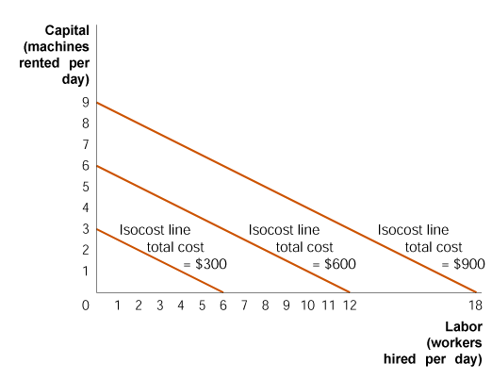
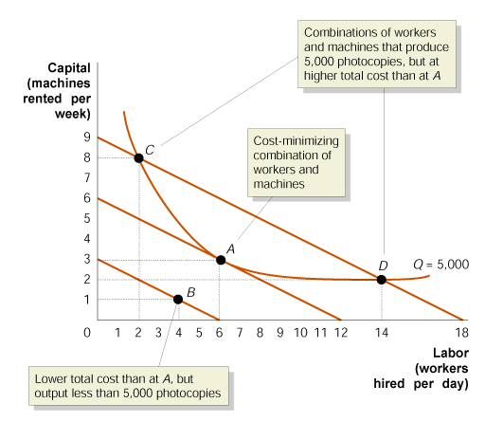
Appendix 10A: Using Isoquants and
Isocosts to Understand Production and Cost
Choosing the Cost-Minimizing Combination of Capital and Labor
10A - 3
The Position of the Isocost Line
10A - 4
Choosing Capital and Labor to Minimize Total Cost

Slide 37
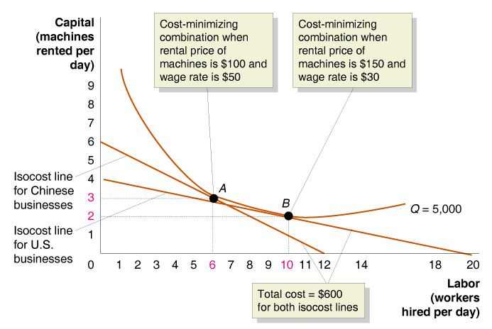
Appendix 10A: Using Isoquants and
Isocosts to Understand Production and Cost
Choosing the Cost-Minimizing Combination of Capital and Labor
Different Input Price Ratios Lead to Different Input Choices
10A - 5
Changing Input Prices Affects the Cost-Minimizing Input Choice

Slide 38

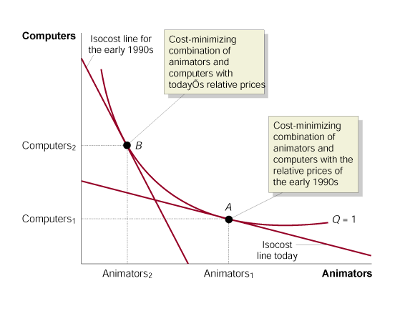
10A - 1
The Changing Input Mix in Film Animation
A change in the price of labor relative to capital in the production of animated films led to a large reduction in the employment of animators.

Slide 39
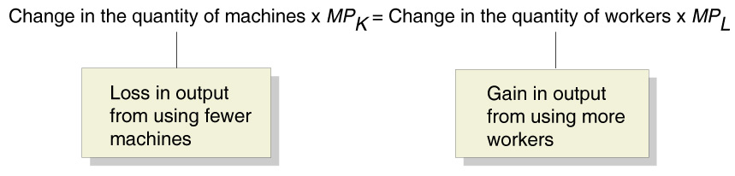
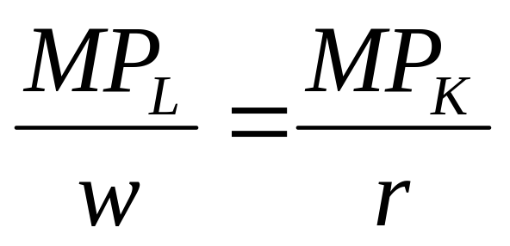
Appendix 10A: Using Isoquants and
Isocosts to Understand Production and Cost
Choosing the Cost-Minimizing Combination of Capital and Labor
Another Look at Cost Minimization

Slide 40
10A -1
Determining the Optimal Combination of Inputs
Marginal Product of Capital Marginal Product of Labor Wage rate Rental price of machines | 3000 copies 100 copies $50 per day $600 per day

Slide 41
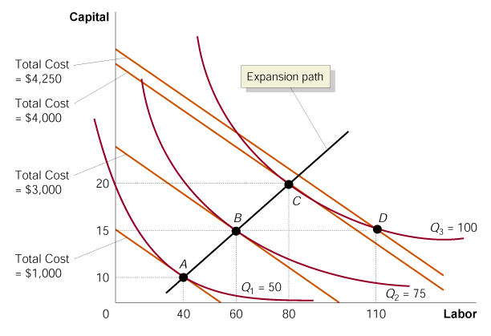
Appendix 10A: Using Isoquants and
Isocosts to Understand Production and Cost
The Expansion Path
Expansion path A curve showing a firm’s cost-minimizing combination of inputs for every level of output.
10A - 6
The Expansion Path

Slide 42
Expansion path
Isocost line
Isoquant
Marginal rate of technical substitution (MRTS)

