Slide 1
Monopoly and Antitrust Policy

Slide 2

Time Warner Rules Manhattan
After studying this chapter, you should be able to:
  Define monopoly.
  Explain the four main reasons monopolies arise.
  Explain how a monopoly chooses price and output.
  Use a graph to illustrate how monopoly affects economic surplus.
  Discuss government policies toward monopoly.
1
2
3
LEARNING OBJECTIVES
In this chapter, we will develop an economic model of monopolies that can help us to analyze their effects on the economy.
4
5

Slide 3
Is Any Firm Ever Really a Monopoly?
1
LEARNING OBJECTIVE
Monopoly The only seller of a good or service that does not have a close substitute.

Slide 4

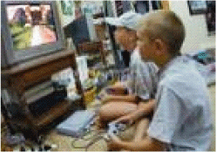
14 - 1
Is Xbox a Close Substitute for
PlayStation 2?
To many gamers, PlayStation 2 is a close substitute for Xbox.

Slide 5
Where Do Monopolies Come From?
2
LEARNING OBJECTIVE
Barriers to entry may be high enough to keep out competing firms for four main reasons:
  Government blocks the entry of more than one firm into a market.
  One firm has control of a key raw material necessary to produce a good.
  There are important network externalities in supplying the good or service.
  Economies of scale are so large that one firm has a natural monopoly.

Slide 6
Where Do Monopolies Come From?
Entry Blocked by Government Action
By granting a patent or copyright to an individual or firm, which gives it the exclusive right to produce a product.
By granting a firm a public franchise, which makes it the exclusive legal provider of a good or service.

Slide 7

14 - 2
The End of the Christmas Plant Monopoly
At one time, the Ecke family had a monopoly on growing poinsettias, but many new firms entered the industry.

Slide 8
Where Do Monopolies Come From?
PATENTS AND COPYRIGHTS
Patent The exclusive right to a product for a period of 20 years from the date the product was invented.
Copyright The legal right of the creator of a book, film, or piece of music to exclusive right to the creation.
PUBLIC FRANCHISES
Public franchise A designation by the government that a firm is the only legal provider of a good or service.
CONTROL OF A KEY RESOURCE
Another way for a firm to become a monopoly is by controlling a key resource. This happens infrequently because most resources are widely available from a variety of suppliers.

Slide 9

14 - 3
Are Diamond (Profits) Forever?
The De Beers Diamond Monopoly
DeBeers promoted the sentimental value of diamonds as a way to maintain its position in the diamond market.

Slide 10
Where Do Monopolies Come From?
Network Externalities
Network externalities Exist when the usefulness of a product increases with the number of consumers who use it.

Slide 11
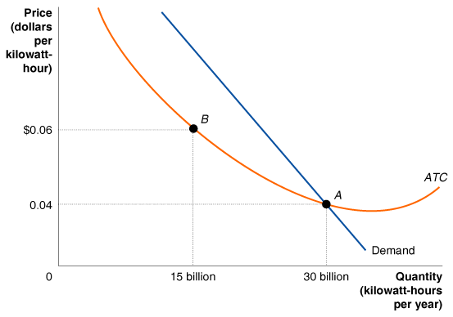
Where Do Monopolies Come From?
Natural Monopoly
Natural monopoly A situation in which economies of scale are so large that one firm can supply the entire market at a lower average total cost than can two or more firms.
14 - 1
Average Total Cost Curve for a Natural Monopoly

Slide 12
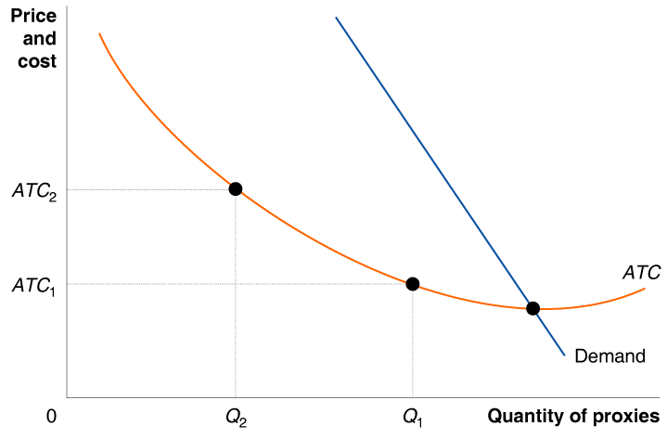
14 - 1
2
LEARNING OBJECTIVE
Is the “Proxy Business” a Natural Monopoly?

Slide 13
How Does a Monopoly Choose Price and Output?
3
LEARNING OBJECTIVE
Marginal Revenue Once Again
Remember that when a firm cuts the price of a product, one good thing and one bad thing happens:
The good thing: It sells more units of the product.
The bad thing: It receives less revenue from each unit than it would have received at the higher price.

Slide 14
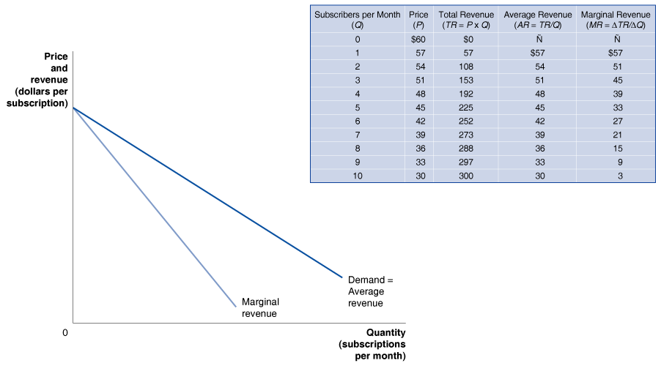
How Does a Monopoly Choose Price and Output?
Marginal Revenue Once Again
14 - 2
Calculating a Monopoly’s Revenue

Slide 15
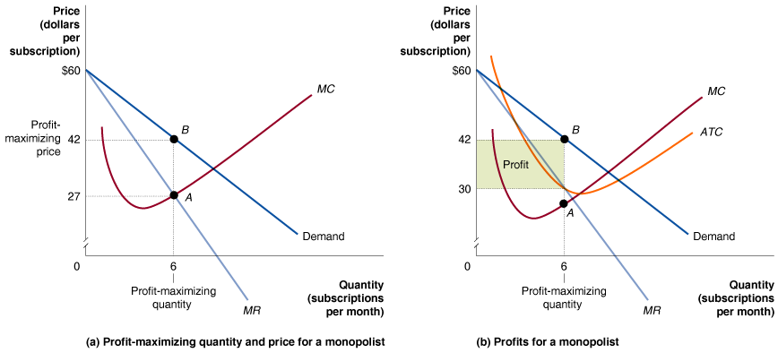
How Does a Monopoly Choose Price and Output?
Profit Maximization For a Monopolist
14 - 3
Profit-Maximizing Price and Output for a Monopoly

Slide 16

14 - 2
3
LEARNING OBJECTIVE
Finding Profit Maximizing Price and Output for a Monopolist
PRICE | QUANTITY | TOTAL REVENUE | MARGINAL REVENUE (MR = ΔTR/ΔQ) | TOTAL COST | MARGINAL COST (MC = ΔTC/ΔQ)
$17 | 3 | $51 | – | $56 | –
$16 | 4 | 64 | $13 | 63 | $7
$15 | 5 | 75 | 11 | 71 | 8
$14 | 6 | 84 | 9 | 80 | 9
$13 | 7 | 91 | 7 | 90 | 10
$12 | 8 | 96 | 5 | 101 | 11
Don’t Assume That Charging a Higher Price Is Always More Profitable For a Monopolist

Slide 17
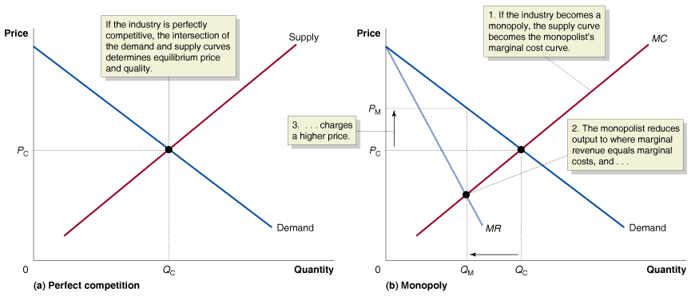
Does Monopoly Reduce Economic Efficiency?
4
LEARNING OBJECTIVE
Comparing Monopoly and Competition
14 - 4
What Happens If a Perfectly Competitive Industry Becomes a Monopoly?

Slide 18
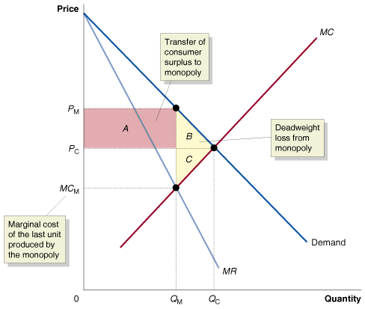
Does Monopoly Reduce Economic Efficiency?
Measuring the Efficiency Losses from Monopoly
14 - 5
The Inefficiency of Monopoly
We can summarize the effects of monopoly as follows:
  Monopoly causes a reduction in consumer surplus.
  Monopoly causes an increase in producer surplus.
  Monopoly causes a deadweight loss, which represents a reduction in economic efficiency.

Slide 19
Does Monopoly Reduce Economic Efficiency?
How Large Are the Efficiency Losses Due to Monopoly?
Market power The ability of a firm to charge a price greater than marginal cost.
Market Power and Technological Change
The introduction of new products requires firms to spend funds on research and development. Because firms with market power are more likely to earn economic profits, they are also more likely to introduce new products.

Slide 20
Government Policy toward Monopoly
5
LEARNING OBJECTIVE
Collusion An agreement among firms to charge the same price, or to otherwise not compete.
Antitrust Laws and Antitrust Enforcement
Antitrust laws Laws aimed at eliminating collusion and promoting competition among firms.

Slide 21
Government Policy toward Monopoly
Antitrust Laws and Antitrust Enforcement
14 – 1
Important U.S. Antitrust Laws
LAW | DATE | PURPOSE
Sherman Act | 1890 | Prohibited “restraint of trade,” including price fixing and collusion. Also outlawed monopolization.
Clayton Act | 1914 | Prohibited firms from buying stock in competitors and from having directors serve on the boards of competing firms.
Federal Trade Commission Act | 1914 | Established the Federal Trade Commission (FTC) to help administer antitrust laws.
Robinson-Patman Act | 1936 | Prohibited charging buyers different prices if the result would reduce competition.
Cellar-Kefauver Act | 1950 | Toughened restrictions on mergers by prohibiting any mergers that would reduce competition.

Slide 22
Government Policy toward Monopoly
Mergers: The Trade-off between Market Power and Efficiency
  Horizontal mergers Mergers between firms in the same industry.
  Vertical mergers Mergers between firms at different stages of production of a good.

Slide 23
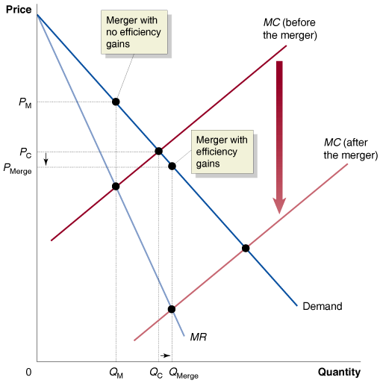
Government Policy toward Monopoly
Mergers: The Trade-Off between Market Power and Efficiency
14 - 6
A Merger That Makes Consumers Better Off

Slide 24
Government Policy toward Monopoly
The Department of Justice and the Federal Trade Commission Merger Guidelines
Market definition
Measure of concentration
Merger standards

Slide 25
Government Policy toward Monopoly
The Department of Justice and the Federal Trade Commission Merger Guidelines
MEASURE OF CONCENTRATION
1 firm, 100% market share (a monopoly): HHI = 100² = 10,000
2 firms, each with a 50% market share: HHI = 50² + 50² = 5,000
4 firms, with market shares of 30%, 30%, 20%, and 20%:
HHI = 30² + 30² + 20² + 20² = 2,600
10 firms, each with market shares of 10%: HHI = 10(10²) = 1,000

Slide 26
Government Policy toward Monopoly
The Department of Justice and the Federal Trade Commission Merger Guidelines
MERGER STANDARDS
Post-Merger HHI Below 1,000. These markets are not concentrated, so mergers in them are not challenged.
Post-Merger HHI Between 1,000 and 1,800. These markets are moderately concentrated. Mergers that raise the HHI by less than 100 will probably not be challenged. Mergers that raise the HHI by more than 100 may be challenged.
Post-Merger HHI Above 1,800. These markets are highly concentrated. Mergers that increase the HHI by less than 50 points will not be challenged. Mergers that increase the HHI by 50 to 100 points may be challenged. Mergers that increase the HHI by more than 100 points will be challenged.

Slide 27

14 - 4
The Antitrust Case Against Microsoft
Software pioneer, monopolist, or both?

Slide 28
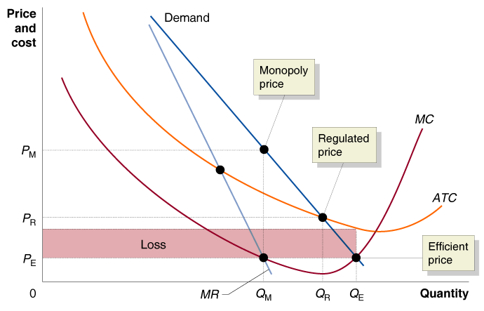
Government Policy toward Monopoly
Regulating Natural Monopolies
14 - 7
Regulating a Natural Monopoly

Slide 29

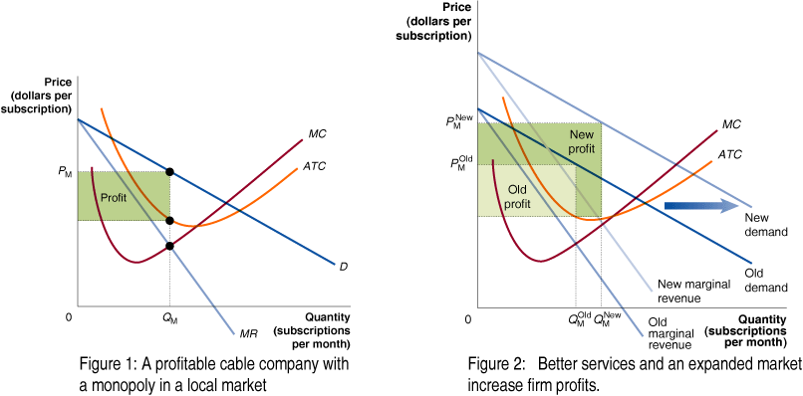
Why I’m Filing Chapter 11

Slide 30

Antitrust laws
Collusion
Copyright
Horizontal mergers
Market power
Monopoly
Natural monopoly
Network externalities
Patent
Public franchise
Vertical mergers

