Slide 1
Pricing Strategy

Slide 2
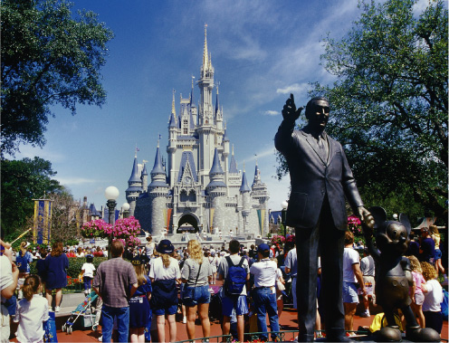
Getting into Walt Disney World: One Price Does Not Fit All
After studying this chapter, you should be able to:
  Define the law of one price and explain the role of arbitrage.
  Explain how a firm can increase its profits through price discrimination.
  Explain how some firms increase their profits through the use of odd pricing, cost-plus pricing, and two-part tariffs.
1
2
LEARNING OBJECTIVES
3
In this chapter, we will study some common pricing strategies, and we will see how Disney and other firms use these strategies to increase their profits.

Slide 3
Pricing Strategy and the Law of One Price
1
LEARNING OBJECTIVE
Arbitrage
Transactions costs The costs in time and other resources that parties incur in the process of agreeing to and carrying out an exchange of goods or services.
15 - 1
2
LEARNING OBJECTIVE
Is Arbitrage Just a Rip-off?
Does eBay serve a useful economic purpose? Economists would say that it does.

Slide 4
Pricing Strategy and the Law of One Price
Why Don’t All Firms Charge the Same Price?
15 – 1
Which Company Would You Buy From?
PRODUCT: HARRY POTTER AND THE HALF-BLOOD PRINCE
COMPANY | PRICE
Amazon.com | $20.95
BarnesandNoble.com | 20.95
WaitForeverForYourOrder.com | 18.50
JustStartedinBusinessLastWednesday.com | 17.75

Slide 5
Price Discrimination: Charging Different Prices for the Same Product
2
LEARNING OBJECTIVE
Price discrimination Charging different prices to different customers for the same product when the price differences are not due to differences in cost.

Slide 6
Price Discrimination: Charging Different Prices for the Same Product
The Requirements for Successful Price Discrimination
  A firm must possess market power.
  Some consumers must have a greater willingness to pay for the product than other consumers, and the firm must be able to know what prices customers are willing to pay.
  The firm must be able to divide up – or segment – the market for the product so that consumers who buy the product at a low price are not able to resell it at a high price. In other words, price discrimination will not work if arbitrage is possible.

Slide 7
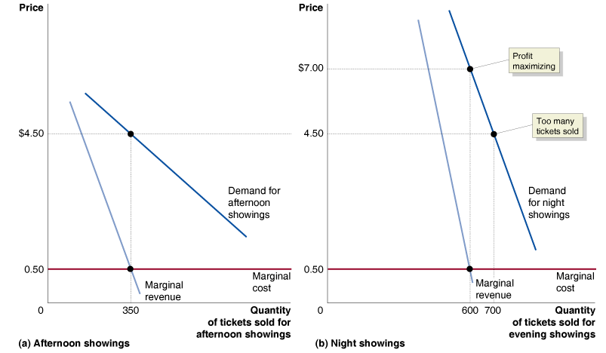
Price Discrimination: Charging Different Prices for the Same Product
The Requirements for Successful Price Discrimination
15 - 1
Price Discrimination by a Movie Theater

Slide 8
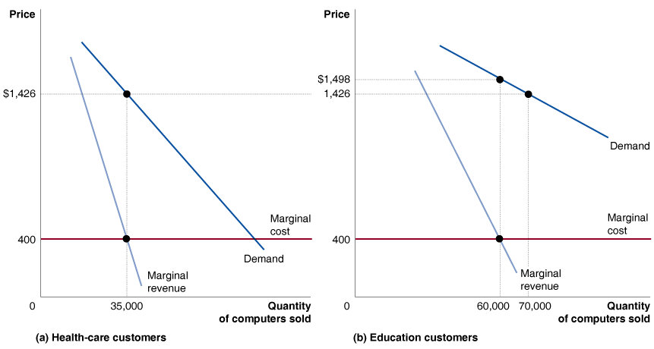
15 - 2
2
LEARNING OBJECTIVE
How Dell Computer Uses Price Discrimination to Increase Profits

Slide 9
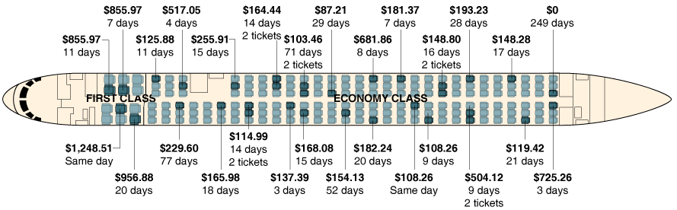
Price Discrimination: Charging Different Prices for the Same Product
Airlines: The Kings of Price Discrimination
15 - 2
33 Customers and 27 Different Prices

Slide 10



15 - 1
How Colleges Use Yield Management
Do colleges practice price discrimination?
Don’t Confuse Price Discrimination with Other Types of Discrimination

Slide 11
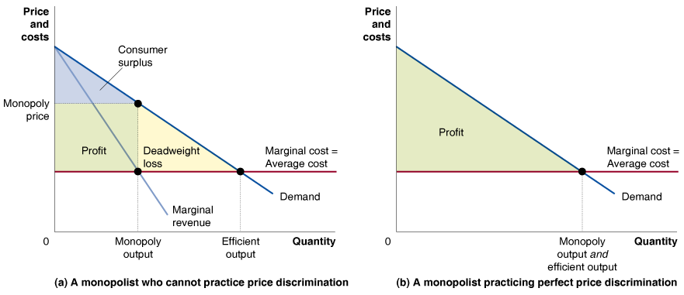
Price Discrimination: Charging Different Prices for the Same Product
Perfect Price Discrimination
15 - 3
Perfect Price Discrimination
Profits increase.
Consumer surplus decreases.

Slide 12
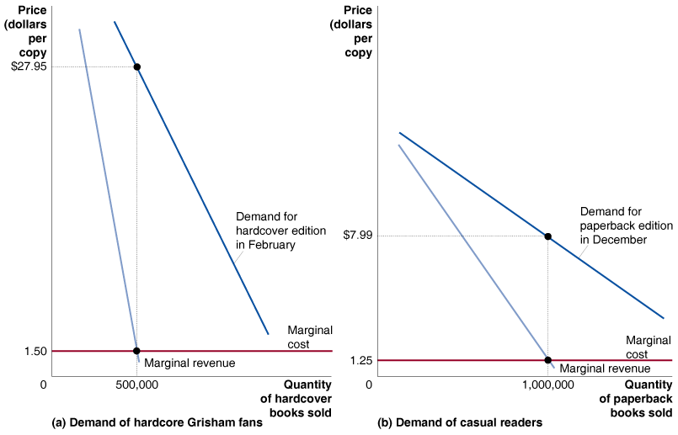
Price Discrimination: Charging Different Prices for the Same Product
Price Discrimination across Time
15 - 4
Price Discrimination across Time

Slide 13
Other Pricing Strategies
3
LEARNING OBJECTIVE
Odd Pricing: Why Is the Price $2.99 Instead of $3.00?
Many firms use what is called odd pricing.
Do consumers have an illusion that a price of $9.99 is significantly cheaper than $10.00?
There is some evidence that using odd prices makes economic sense.

Slide 14
Other Pricing Strategies
Why Do Firms Use Cost-Plus Pricing?
Economists conclude that cost-plus pricing may be the best way to determine the optimal price when:
  Marginal cost and average cost are roughly equal.
  The firm has difficulty estimating its demand curve.
Don’t Confuse Price Discrimination with Other Types of Discrimination

Slide 15

15 - 2
Cost-Plus Pricing in the Publishing Industry
PLANT COST
 | Typesetting | $3,500
 | Other plant costs | 2,000
MANUFACTURING COST
 | Printing | $5,750
 | Paper | 6,250
 | Binding | 5,000
TOTAL PRODUCTION COST
$22,500
How do publishers determine the price of books?

Slide 16
Other Pricing Strategies
Pricing with Two-Part Tariffs
Two-part tariff A situation in which consumers pay one price (or tariff) for the right to buy as much of a related good as they want at a second price.

Slide 17
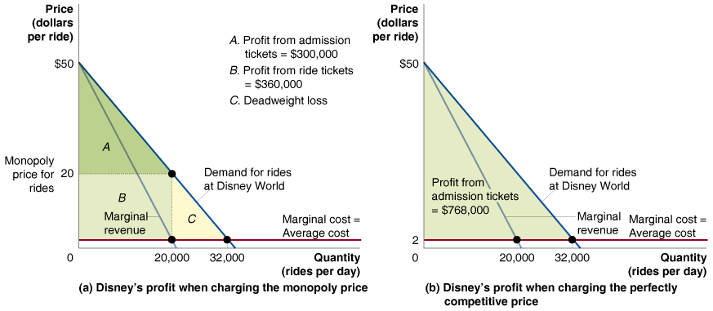
Other Pricing Strategies
Pricing with Two-Part Tariffs
15 - 5
A Two-Part Tariff at Disney World

Slide 18
Other Pricing Strategies
Pricing with Two-Part Tariffs
15 – 2
Profits per Day from Different Pricing Strategies at Disney World
 | MONOPOLY PRICE FOR RIDES | COMPETITIVE PRICE FOR RIDES
Profits from Admission Tickets | $300,000 | $960,000
Profits from Ride Tickets | 360,000 | 0
Total Profit | 660,000 | 960,000
  Because price equals marginal cost at the level of output supplied, the outcome is economically efficient.
  All of consumer surplus is transformed into profit.

Slide 19

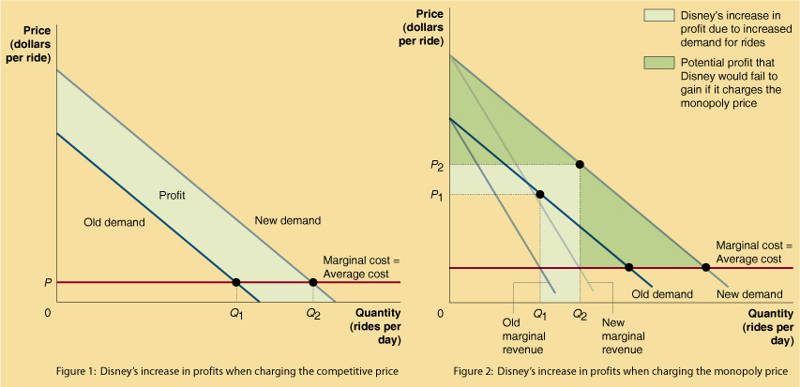
Disney’s Profit Rises 5%, Lifted by TV and Parks

Slide 20

Price discrimination
Transactions costs
Two-part tariff

