Slide 1
The Tax System and the
Distribution of Income

Slide 2

Should the Government Use the
Tax System to Reduce Inequality?
After studying this chapter, you should be able to:
  Understand the tax system in the United States, including the principles of taxation that governments use to create tax policy.
  Understand the effect of price elasticity on tax incidence.
  Discuss the distribution of income in the United States, and understand the extent of income mobility.
1
2
LEARNING OBJECTIVES
3
Tax laws affect economic incentives and economic activity, and can also affect fairness.

Slide 3
The Tax System
1
LEARNING OBJECTIVE
The most widely used taxes are these:
    Individual income taxes.
    Social insurance taxes.
    Sales taxes.
    Property taxes.
    Excise taxes.

Slide 4
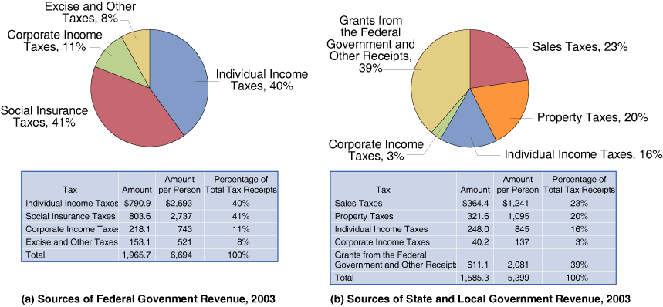
The Tax System
An Overview of the U.S. Tax System
18 - 1
Federal, State, and Local Sources of Revenue, 2004

Slide 5
The Tax System
Progressive and Regressive Taxes
Regressive tax A tax where people with lower incomes pay a higher percentage of their income in tax than do people with higher incomes.
Progressive tax A tax where people with lower incomes pay a lower percentage of their income in tax than do people with higher incomes.

Slide 6
The Tax System
Progressive and Regressive Taxes
18 – 1
INCOME | TAX RATE
0 to $7,300 | 10%
$7,301 to $29,700 | 15
$29,701 to $71,950 | 25
$71,951 to $150,150 | 28
$150,151 to $326,450 | 33
Over $326,451 | 35
Federal Income Tax Brackets and Tax Rates for Single Taxpayers, 2005
18 – 2
ON MATT’S … | MATT PAYS TAX OF …
First $7,300 of income | $730
next $22,400 of income | $3,360
next $42,250 of income | $10,563
last $28,050 of income | $7,854
His total tax payment | $22,507
Federal Income Tax Paid on Taxable Income of $100,000,
2005

Slide 7


18 - 1
Which Groups Pay the Most In Federal Taxes?
INCOME CATEGORY | PERCENTAGE OF TOTAL INCOME EARNED (1) | PERCENTAGE OF TOTAL FEDERAL INDIVIDUAL INCOME TAXES PAID (2) | PERCENTAGE OF TOTAL FEDERAL TAXES PAID (3)
Lowest 20% | 2.6% | –2.3% | 0.3%
Second 20% | 6.7 | –1.8 | 2.6
Third 20% | 11.4 | 4.4 | 8.4
Fourth 20% | 18.8 | 13.8 | 18.1
Highest 20% | 60.7 | 85.8 | 70.5
Total | 100.0 | 100.0 | 100.0
Highest 1% | 20.1 | 37.0 | 23.8
INCOME CATEGORY | FEDERAL INCOME TAXES PAID AS A FRACTION OF INCOME (1) | ALL FEDERAL TAXES PAID AS A FRACTION OF INCOME (2)
Lowest 20% | –6.0% | 4.6%
Second 20% | –0.2 | 10.8
Third 20% | 3.5 | 14.4
Fourth 20% | 6.8 | 18.7
Highest 20% | 15.6 | 26.1
All income categories | 100.0 | 100
Highest 1% | 23.8 | 32.7
Federal taxes
as a whole are progressive.

Slide 8
The Tax System
Marginal and Average Income Tax Rates
Marginal tax rate The fraction of each additional dollar of income that must be paid in taxes.
Average tax rate Total tax paid divided by total income.
The Corporate Income Tax
The federal government taxes the profits earned by corporations under the corporate income tax. Economists debate the costs and benefits of a separate tax on corporate profits.

Slide 9
The Tax System
Evaluating Taxes
  The goal of economic efficiency
  The ability-to-pay principle
  The horizontal-equity principle
  The benefits-received principle
  The goal of attaining social objectives

Slide 10
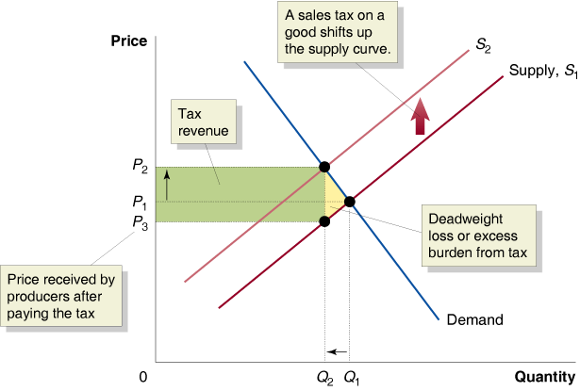
The Tax System
Evaluating Taxes
  THE GOAL OF ECONOMIC EFFICIENCY
18 - 2
The Efficiency Loss from a Sales Tax

Slide 11

The Tax System
Evaluating Taxes
  THE GOAL OF ECONOMIC EFFICIENCY
Excess burden The deadweight loss from a tax.
Should the United States Shift to a Consumption Tax?
18 - 2
Would a consumption tax be more efficient than an income tax?

Slide 12
The Tax System
Other Goals or Principles for Evaluating Taxes
  THE ABILITY-TO-PAY PRINCIPLE
  THE HORIZONTAL-EQUITY PRINCIPLE
  THE BENEFITS RECEIVED PRINCIPLE
  ATTAINING SOCIAL OBJECTIVES

Slide 13
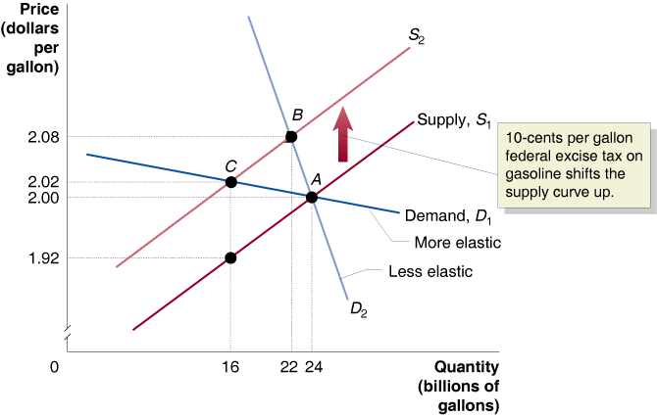
Tax Incidence Revisited: The Effect of Price Elasticity on Who Actually Bears the Burden Of a Tax
2
LEARNING OBJECTIVE
Tax incidence The actual division of the burden of a tax.
18 - 3
The Effect of Elasticity on Tax Incidence

Slide 14
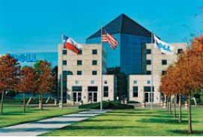

18 - 3
Do Corporations Really Bear the Burden Of the Federal Corporate Income Tax?
Who really bears the burden of the taxes paid by Dell?
Most economists agree that some of the burden of the corporate income tax is passed on to consumers in the form of higher prices.
Remember not to Confuse Who Pays the Tax with Who Bears the Burden of the Tax

Slide 15
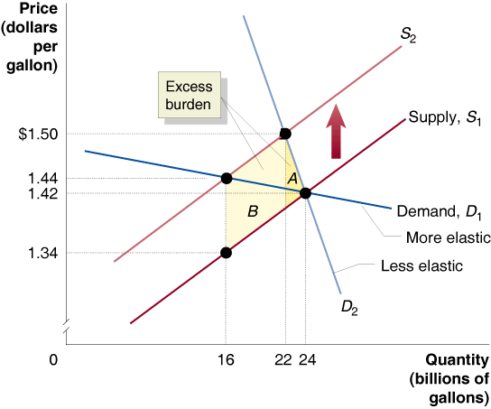
18 - 1
2
LEARNING OBJECTIVE
The Effect of Price Elasticity on the Excess Burden of a Tax

Slide 16
The Distribution of Income
3
LEARNING OBJECTIVE
Measuring the Distribution of Income and Poverty
18 – 3
The Distribution of Household Income in the United States, 2003
ANNUAL INCOME | PERCENTAGE OF ALL HOUSEHOLDS
0 to $14,999 | 15.9%
15,000-24,999 | 13.1
25,000-34,999 | 11.9
35,000-49,999 | 15.0
50,000-74,999 | 18.0
75,000-99,999 | 11.0
100,000 and over | 15.1

Slide 17
The Distribution of Income
Measuring the Distribution of Income and Poverty
18 – 4
How Has the Distribution of Income Changed Over Time?
YEAR | LOWEST 20% | SECOND 20% | THIRD 20% | FOURTH 20% | HIGHEST 20%
2003 | 3.4% | 8.7% | 14.8% | 23.4% | 49.8%
1990 | 3.9 | 9.6 | 15.9 | 24.0 | 46.6
1980 | 4.3 | 10.3 | 16.9 | 24.9 | 43.7
1970 | 4.1 | 10.8 | 17.0 | 24.5 | 43.3
1960 | 3.2 | 10.6 | 17.6 | 24.7 | 44.0
1950 | 3.1 | 10.5 | 17.3 | 24.1 | 45.0
1936 | 4.1 | 9.5 | 15.3 | 22.3 | 51.7

Slide 18
The Distribution of Income
Measuring the Distribution of Income and Poverty
THE POVERTY RATE IN THE UNITED STATES
Poverty line A level of annual income equal to three times the amount necessary to purchase the minimal quantity of food required for adequate nutrition.
Poverty rate The percentage of the population that is poor according to the federal government’s definition.

Slide 19
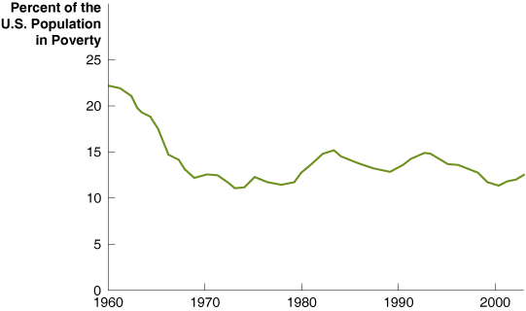
The Distribution of Income
Measuring the Distribution of Income and Poverty
18 - 4
Poverty in the United States, 1960-2003
18 – 5
All people | 12.5%
Female head of family, no husband present (all races) | 28.0
Blacks | 24.4
Hispanics | 22.5
Asians | 11.8
White, not Hispanic | 8.2
Poverty Rates Vary Across Groups, 2003

Slide 20
The Distribution of Income
Explaining Income Inequality
For most people, the most important factor of production they own is their labor. Therefore, the income they earn will depend on how productive they are and on the prices of the goods and services their labor helps to produce.
Many people own other factors of production, such as capital in the form of stock on corporations. Ownership of capital is not equally distributed.
The tax system does not seem to have played a major role in recent changes in income inequality.
Earning an income is also subject to good and bad fortune.

Slide 21
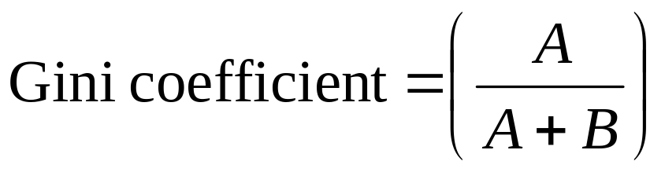
The Distribution of Income
Showing the Income Distribution with a Lorenz Curve
Lorenz curve A curve showing the distribution of income by arraying incomes from lowest to highest on the horizontal axis and indicating the cumulative fraction of income earned by each fraction of households on the vertical axis.

Slide 22
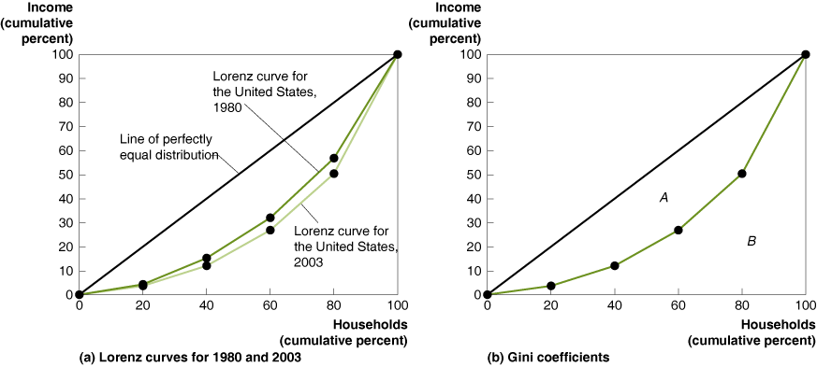
The Distribution of Income
Showing the Income Distribution with a Lorenz Curve
18 - 5
The Lorenz Curves and Gini Coefficients

Slide 23
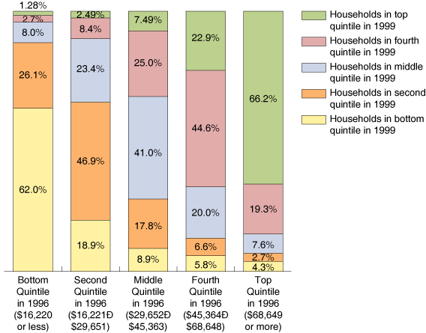
The Distribution of Income
INCOME MOBILITY IN THE UNITED STATES
18 - 6
Income Mobility in the United States, 1996-1999
18 - 2
3
LEARNING OBJECTIVE
Are Many Individuals Stuck in Poverty?

Slide 24
The Distribution of Income
Poverty and the Distribution of Income around the World
18 – 6
Income Inequality around the World
 | LOWEST 20% | HIGHEST 20% | RATIO
South Africa | 2.0% | 66.5% | 33.3
Botswana | 2.2 | 70.3 | 32.0
Mexico | 3.1 | 59.1 | 19.1
Chile | 3.3 | 62.2 | 18.8
United States | 5.4 | 45.8 | 8.5
Thailand | 6.1 | 50.0 | 8.2
United Kingdom | 6.1 | 44.0 | 7.2
Ireland | 7.1 | 43.3 | 6.1
Canada | 7.0 | 40.4 | 5.8
France | 7.2 | 40.2 | 5.6
Germany | 8.5 | 36.9 | 4.3
Norway | 9.6 | 37.2 | 3.9
Japan | 10.6 | 35.7 | 3.4

Slide 25
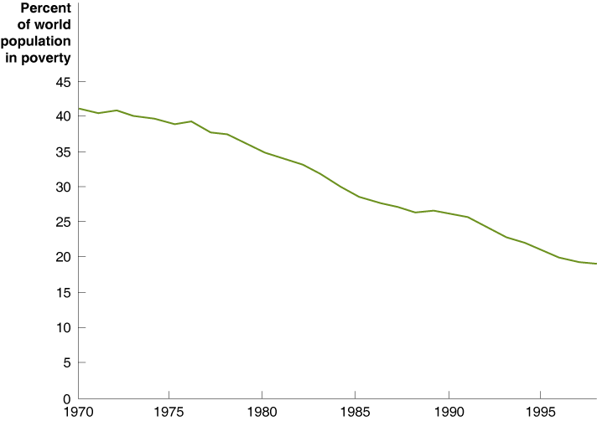
The Distribution of Income
Poverty and the Distribution of Income around the World
18 - 7
Global Poverty Rates

Slide 26
The Distribution of Income
Poverty and the Distribution of Income around the World
18 – 7
Poverty in Africa is Much Greater than Elsewhere in the World
 | PERCENTAGE OF THE POPULATION IN POVERTY
REGION | 1970 | 1998
World | 41.0% | 18.6%
Asia minus China | 49.4 | 13.5
China | 74.4 | 18.7
Latin America | 22.2 | 10.5
Africa | 53.0 | 63.6

Slide 27

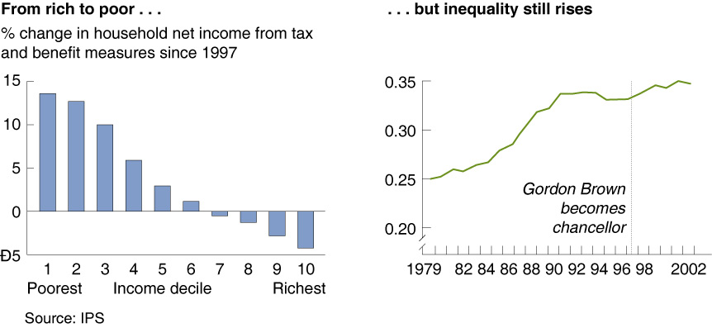
The Chancellor’s Attempts to Emulate Robin Hood Are Not Working

Slide 28

Average tax rate
Excess burden
Lorenz curve
Marginal tax rate
Poverty line
Poverty rate
Progressive tax
Regressive tax
Tax incidence

