Slide 1
Communicating nonverbally

Slide 2
Nonverbal communication behaviors
  Bodily actions and vocal qualities that typically accompany a verbal message
  Works in conjunction with verbal
  Nonverbal and verbal language can contradict one another
  Nonverbal communication is inevitable
  Primary conveyor of our emotions
  Ambiguous

Slide 3
Emoticons
  Types symbols that convey emotional aspects of an online message
Kinesics
  The interpretation of how body motions communicate
Gestures
  Movements of our hands, arms and fingers that we use to describe or to emphasize
Illustrators
  Gestures that augment a verbal massage
  It was this big!
Emblems
  Gestures that can substitute for words
  Waving hello

Slide 4
Eye contact (oculesics)
  We use our eyes to express emotions
  Culture depends on whether we maintain eye contact
  Avoiding eye contact can be a sign of respect or obedience
  We tend to trust people more who maintain eye contact
  What perceptions do we have of people who do not maintain eye contact?
  More eye contact occurs when someone is displaying feminine behavior

Slide 5
Facial expression
  Arrangement of facial muscles to communicate emotional states or reactions to messages
  The face made up of hundreds of muscles
  These muscles tell us a lot about how a person is feeling
Posture
  Position and movement of the body
Body orientation
  Posture in relation to another person

Slide 6
Body language can tell us a lot about a person’s relationship with other people and personality
Direct body orientation
  When two people face one another
  Usually a sign of intimacy
Indirect body orientation
  When two people’s bodies are at angle
  Usually signifies a less casual relationship

Slide 7
Haptics
What and how touch communicates
Culture defines what kind of touching we deem acceptable
Past experiences with touch dictate how we use touch to communicate
Women view touch as as an expressive behavior that demonstrates warmth and affection

Slide 8
Vocalics
Interpretation of a message based on the paralinguistic features
Paralanguage
  Voiced but not verbal part of speech
  Includes pitch, volume, rate, quality, intonation

Slide 9
Pitch
  Highness or lowness of vocal tone
Volume
  Loudness or softness of tone
Rate
  Speed at which a person speaks
Quality
  Sound of a person’s voice that distinguishes it from others
Intonation
  Variety, melody, or infection in one’s voice

Slide 10
Vocalized pauses
  Extraneous sounds or words that interrupt fluent speech
  Interrupters are distracting if they occur often or for a long period of time
  They can complement, supplement or contradict the verbal language being used

Slide 11
Proxemics
Use of space and distance
Personal space
  Distance we try to maintain when interacting with other people
  Protective mechanism
  What is appropriate depends on our individual preference, nature of our relationship to other people, culture
  As relationships become more intimate, we allow less personal space when interacting with that person
  Space can be adjusted depending on noise factors

Slide 12
Public distance
  Anything more than 12 feet
Social distance
  4 to 12 feet
  Impersonal business is conducted
Personal distance
  18 inches-4 feet
  Space in which casual conversation occurs
Intimate distance
  Up to 18 inches
  Appropriate for private conversations
  We are uncomfortable when we feel like someone is violating our intimate space if we feel the relationship doesn’t warrant such closeness

Slide 13
Physical space
  Physical environment over which you exert control
  We manipulate our physical environment to send messages
  Sitting in a seat and put possessions next to us
Artifacts
  Objects and possessions we use to decorate the physical space we control
  These objects communicate meaning to people about what kind of person they are dealing with

Slide 14
Chronemics
Interpretation of a person’s use of time
Western cultures are very time conscious
Other cultures are not so time driven
Monochronic time
  Time orientation that emphasizes doing one thing at a time
Polychronic time
  Time orientation that emphasizes doing multiple things at once

Slide 15
Self-presentation cues
Physical appearance
  People make judgments based on how someone looks
  Body and physical features is one of the first things people notice
Clothing and grooming
  Clothing choices, body art, other personal grooming to communicate who they are and what they stand fpr

Slide 16
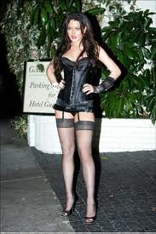
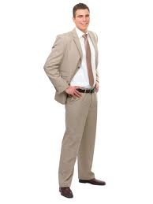
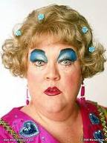
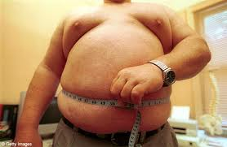

Slide 17
Improving nonverbal communication
Be conscious of the nonverbal behaviors you are displaying
Be purposeful in your use of nonverbal communication
Make sure that your nonverbal cues do not distract from your message
Nonverbal communication should match verbal communication

Slide 18
Interpreting nonverbal messages
Do not assume a particular behavior means the same thing to everyone
Consider nonverbal behaviors as they relate to the context of the message
Pay attention to multiple nonverbal cues being sent and their relationship to the verbal message
Use perception checking
  Describe nonverbal behavior and share your interpretation of it--behavior can be confirmed or contradicted

Slide 19
http://www.youtube.com/watch?v=kTx7RtmZMCg&p=38CEE46CAF2A085B&playnext=1&index=21
http://www.youtube.com/watch?v=BQ7omWSdK50&feature=fvsr
http://www.youtube.com/watch?v=SOQwa73KXbs

