Slide 1

STAIS 2026 — INTERNATIONAL CONFERENCE | SUBMISSION #190
CONFIGURATION-LEVEL ANALYSIS OF PHOBERT FOR VIETNAMESE ECONOMIC AND BUSINESS FACT VERIFICATION:
PERFORMANCE AND COMPUTATIONAL COST
Oral Presentation
Presenter: Dao Ngoc Hong Nguyen
Co-authors: Trang Thao Ngo, Tran Duy Bao Nguyen, Ha Thanh Nguyen*, Thuan Dinh Dang*
Faculty of Data Science in Business | Ho Chi Minh University of Banking (HUB), Vietnam
Notes:
[0:00 - 1:00 | SLIDE 1: TITLE SLIDE]
Good morning/afternoon, distinguished Session Chairs, respected researchers, and colleagues.
My name is Dao Ngoc Hong Nguyen, representing the research group from the Faculty of Data Science in Business at Ho Chi Minh University of Banking (HUB), Vietnam.
Today, I am honored to present our paper, Submission #190: 'Configuration-Level Analysis of PhoBERT for Vietnamese Economic and Business Fact Verification: Performance and Computational Cost.'
We investigate the exact engineering trade-offs between predictive accuracy, memory footprint, and verification safety when deploying pretrained Vietnamese language models in high-stakes financial environments.

Slide 2
STAIS 2026 | SUBMISSION #190 | ORAL PRESENTATION
TABLE OF CONTENTS
PART 01
Context & Objectives
PART 02
Data & Pipeline
PART 03
Experimental Results
PART 04
Solutions & Outlook
• Motivation & Financial Stakes
• Core Dilemma: Speed vs. Safety
• Four Research Questions & Scope
• ViFactCheck Economic Corpus
• Numerically Rich Diagnostic Slice
• Shared 4-Stage Architecture
• Compared Configurations (v1 vs v2)
• Predictive Trade-offs & NEI Drop
• Computational Cost & VRAM Theory
• Ablation: Data & Calibration
• Error Taxonomy & Cascade Triage
• Practical Guidelines & Roadmap
Notes:
[1:00 - 1:30 | SLIDE 2: TABLE OF CONTENTS]
Our presentation is structured into four coherent parts:
Part 1 outlines the financial motivation and our research questions.
Part 2 describes our domain-filtered dataset and shared 4-stage pipeline.
Part 3 presents our empirical benchmark results across predictive accuracy and hardware savings.
And Part 4 delivers our diagnostic error taxonomy and proposed Two-Stage Cascade Triage Policy.

Slide 3
STAIS 2026 | SUBMISSION #190 | ORAL PRESENTATION
MOTIVATION & PROBLEM STATEMENT
HIGH STAKES IN FINANCIAL NEWS
THE RESOURCE-QUALITY DILEMMA
• Market Volatility: Financial claims directly shift investor sentiment, stock prices, and corporate valuation in real time.
• Dense Numerical Semantics: Claims heavily intertwine ticker symbols, fiscal dates (Q3 vs Q4), and monetary values (VND, USD).
• Zero Error Tolerance: A single flipped digit or swapped entity reverses economic truth, turning routine news into market panic.
• 3-Way Classification: Models must rigorously verify claims against evidence: SUPPORTED, REFUTED, or NOT ENOUGH INFO (NEI).
• Beyond Benchmark Accuracy: Real-world news aggregation requires high throughput, strict latency (<1s), and limited cloud GPU budgets.
• Uncharted Safety Gap: Compressing sequence length saves memory, but how much factual reliability and safety are sacrificed?
CORE RESEARCH QUESTION: How much predictive safety is sacrificed when aggressively compressing PhoBERT for lower GPU cost?
Notes:
[1:30 - 2:30 | SLIDE 3: MOTIVATION & PROBLEM STATEMENT]
Let us examine why automated financial fact-checking is both uniquely vital and technically challenging.
Economic news moves markets instantaneously. Unlike general domains, financial statements hinge on exact quantities, interest rate changes, and temporal quarters.
A 3-way classification system must determine whether candidate evidence confirms, refutes, or lacks sufficient information.
However, existing studies focus almost exclusively on benchmark F1 scores, overlooking cloud VRAM constraints and inference latency.
Our study addresses this exact gap: What happens to verification reliability when models are compressed for practical newsroom deployment?

Slide 4
STAIS 2026 | SUBMISSION #190 | ORAL PRESENTATION
RESEARCH QUESTIONS & SCOPE
RQ1
PREDICTIVE PERFORMANCE GAP
How substantially does fact-checking accuracy and class-wise F1 drop between a high-capacity reference configuration and an efficiency-oriented setup on Vietnamese financial news?
RQ2
COMPUTATIONAL & HARDWARE COST
What quantitative savings in GPU memory footprint (peak VRAM), pipeline training wall-clock time, and per-sample inference latency are achieved on commodity cloud hardware (NVIDIA T4)?
RQ3
CONFIGURATION ATTRIBUTION VS. CAUSALITY
When multiple architectural and training parameters are altered concurrently, which performance trade-offs are structurally guaranteed versus requiring isolated ablation?
Notes:
[2:30 - 3:30 | SLIDE 4: RESEARCH QUESTIONS & SCOPE]
To rigorously investigate this trade-off, we formalize three specific research questions:
RQ1 measures the magnitude of predictive accuracy loss across classes when optimizing for speed.
RQ2 benchmarks the hardware-level resource reductions on standard NVIDIA Tesla T4 GPUs.
And RQ3 applies a rigorous methodological lens: distinguishing mathematically guaranteed structural savings from bundled empirical hypotheses.

Slide 5
STAIS 2026 | SUBMISSION #190 | ORAL PRESENTATION
DATASET & DIAGNOSTIC SLICE
VIFACTCHECK: ECONOMIC SUBSET
NUMERICALLY RICH DIAGNOSTIC SLICE
• Benchmark Origin: Filtered from ViFactCheck (AAAI 2025), the premiere Vietnamese fact-checking corpus.
• Domain Scope: Strictly selected from 'Kinh tế' (Economics) and 'Kinh doanh' (Business) topics.
• Dataset Scale: 682 expert-annotated claim-evidence pairs, preserving original train/dev/test splits:
• Partition Split: Train: 474 pairs (69.5%) | Dev: 67 pairs (9.8%) | Test: 141 pairs (20.7%).
• Class Balance: Well-balanced distribution: SUPPORTED (34.9%), REFUTED (32.8%), NEI (32.3%).
• Diagnostic Cohort: 71 claims in the test split containing explicit numerical, fiscal, and temporal figures.
• Financial Data Types: Covers currencies (VND, USD, tỷ đồng), percentages (CPI, GDP, interest rates), and fiscal quarters.
• Stress-Test Purpose: Specifically assesses model capability to detect subtle numerical mismatches between claim and evidence.
• Methodological Rigor: Treated strictly as a diagnostic slice rather than an isolated arithmetic benchmark.
Notes:
[3:30 - 4:15 | SLIDE 5: DATASET & DIAGNOSTIC SLICE]
Turning to our experimental data:
We extracted all economic and business claim-evidence pairs from ViFactCheck, published at AAAI 2025.
This yields 682 pairs with a balanced 3-way distribution.
Crucially, we isolated a 71-sample diagnostic slice from the test set.
This subset contains dense financial quantities, fiscal quarters, and percentage indices, serving as an acid test for numerical reasoning.

Slide 6
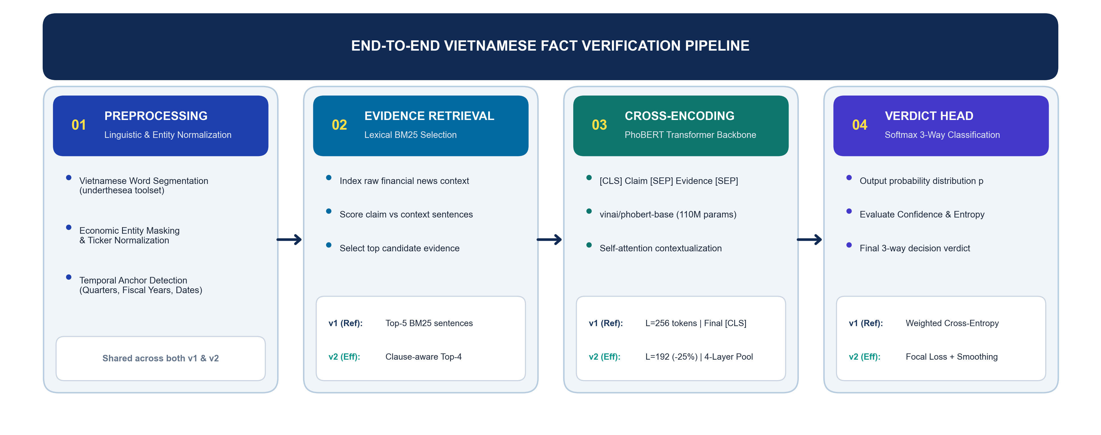
STAIS 2026 | SUBMISSION #190 | ORAL PRESENTATION
SHARED PIPELINE ARCHITECTURE
KEY ARCHITECTURAL HIGHLIGHT: Both configurations share the 4-stage pipeline while systematically differing in input length (256 vs 192), evidence depth (top-5 vs top-4), and classification loss objective.
Notes:
[4:15 - 5:15 | SLIDE 6: SHARED PIPELINE ARCHITECTURE]
Slide 6 presents our end-to-end fact verification pipeline flowchart.
Both systems follow four standardized stages:
Stage 1 performs linguistic preprocessing and entity normalization.
Stage 2 retrieves candidate evidence sentences via BM25 lexical scoring.
Stage 3 encodes concatenated claim-evidence pairs through vinai/phobert-base.
And Stage 4 generates the final 3-way verdict.
Notice the highlighted configuration trade-offs in stages 2, 3, and 4.

Slide 7
STAIS 2026 | SUBMISSION #190 | ORAL PRESENTATION
COMPARED CONFIGURATIONS: V1 VS. V2
Component | Reference (v1) | Efficiency (v2) | Design Group
Backbone | vinai/phobert-base (110M) | vinai/phobert-base (110M) | Standardized
Max Sequence Length | 256 tokens | 192 tokens (-25% compression) | Input Budget
Evidence Selection | BM25 Top-5 sentences | Clause-aware BM25 Top-4 | Retrieval
Batch / Accumulation | 8 / 1 | 16 / 2 | Training
Learning Rate | 3e-5 (3 × 10⁻⁵) | 2e-5 (2 × 10⁻⁵) | Training
Loss Objective | Weighted Cross-Entropy | Focal Loss (γ=2) + Label Smooth (ε=0.1) | Objective
Representation Head | Final-layer [CLS] | 4-Layer Weighted Pooling + 5× Dropout | Representation
Data Augmentation | None (474 originals) | 378 sub-claim swapped (852 total) | Data Diversity
Post-Hoc Calibration | None (Argmax softmax) | Exploratory entropy-based (0.95 nats) | Decision Rule
Hardware & Precision | NVIDIA Tesla T4 (16GB), FP16 | NVIDIA Tesla T4 (16GB), FP16 | Identical
Notes:
[5:15 - 6:00 | SLIDE 7: COMPARED CONFIGURATIONS]
Here we summarize the architectural parameters of both configurations.
v1 serves as our performance benchmark: maximum sequence length of 256 tokens, top-5 evidence sentences, and standard cross-entropy.
v2 represents our aggressive efficiency optimization: compressed to 192 tokens (-25%), top-4 evidence, Focal Loss, 4-layer pooling, and clause-swapped data augmentation.
Crucially, both models are trained and evaluated on identical NVIDIA Tesla T4 hardware in FP16 mixed precision.

Slide 8
STAIS 2026 | SUBMISSION #190 | ORAL PRESENTATION
PREDICTIVE PERFORMANCE: THE ACCURACY-SAFETY TRADE-OFF
Metric | Reference (v1) | Efficiency (v2) | Difference
SUPPORTED F1 | 0.760 | 0.680 | -0.080
REFUTED F1 | 0.690 | 0.560 | -0.130
NEI F1 | 0.760 | 0.580 | -0.180 (Largest Drop!)
Macro F1 | 0.738 | 0.605 | -0.133 (-18.0%)
Overall Accuracy | 0.738 | 0.610 | -0.128 (-17.3%)
Numerically Rich Acc. | 88.7% (63/71) | 59.2% (42/71) | -29.6 points!
Correct Test Claims | 104 / 141 | 86 / 141 | -18 instances
CRITICAL VULNERABILITY: NEI COLLAPSE
• Asymmetric NEI Loss:
The largest class decline occurs for NEI (-0.180 F1), with recall collapsing from 0.76 down to 0.44 (-32 points).
• High Precision, Low Recall:
v2 achieves Precision=0.83 but Recall=0.44 on NEI. It misses more than 50% of true unverified claims!
• Numerical Failure Mode:
Accuracy on the 71 numerically rich claims plunges by nearly 30 points (88.7% -> 59.2%).
• Real-World Danger:
Predicting SUPPORTED or REFUTED when evidence is actually insufficient produces catastrophic false confidence.
Notes:
[6:00 - 7:00 | SLIDE 8: PREDICTIVE PERFORMANCE]
Examining our predictive findings:
Reference v1 convincingly outperforms efficiency v2 across all predictive metrics.
Macro F1 falls by 18% (0.738 to 0.605), and test accuracy drops from 73.8% to 61.0%.
Notice the two alarming failure modes:
First, numerical accuracy drops by nearly 30 percentage points, from 88.7% to 59.2%.
Second, NEI recall collapses to just 0.44.
This asymmetry is dangerous: in financial auditing, fabricating a definitive True or False when evidence is missing generates dangerous misinformation.

Slide 9
STAIS 2026 | SUBMISSION #190 | ORAL PRESENTATION
COMPUTATIONAL EFFICIENCY & STRUCTURAL MEMORY SAVINGS
Resource Metric | Reference (v1) | Efficiency (v2) | Reduction
Peak VRAM Footprint | 10.4 GB | 5.9 GB | -43.2%
Inference Latency / Sample | 0.85 s | 0.52 s | -38.8%
Total GPU Training Time | ~15 min | ~9 min | -40.0%
Total CPU Pipeline Time | ~51 min | ~32 min | -37.2%
WHY VRAM DROPS BY EXACTLY 43.2%?
• Structural Determinism:
In Transformer encoders, self-attention memory complexity scales quadratically with sequence length: O(L²).
• Theoretical Derivation:
Compressing length from L=256 to L=192 yields:
(192 / 256)² = (0.75)² = 0.5625
→ Theoretical attention memory drop: 43.75%!
• Empirical Validation:
Measured peak VRAM drop on NVIDIA T4 is 43.2% (10.4 GB -> 5.9 GB), perfectly validating the quadratic model.
• Engineering Value:
v2 runs comfortably on budget GPUs with ≤6 GB VRAM, whereas v1 requires a dedicated 16 GB GPU.
STATISTICAL SIGNIFICANCE & ROBUSTNESS
• 1,000 Bootstrap Resamples on test split: v1 Macro F1 = 0.738 [95% CI: 0.668, 0.804] vs. v2 Macro F1 = 0.605 [95% CI: 0.531, 0.676] (p < 0.01).
• The 0.133 performance gap substantially exceeds typical PhoBERT random seed variance (~0.015), validating systematic configuration differences.
Notes:
[7:00 - 8:00 | SLIDE 9: COMPUTATIONAL EFFICIENCY]
On the hardware side, Slide 9 demonstrates the massive computational gains of v2:
Peak VRAM is reduced by 43.2%, from 10.4 GB down to 5.9 GB.
Latency decreases by 38.8%, and overall training time drops by 40%.
Importantly, we show that the 43.2% VRAM saving is not an empirical fluke.
Because self-attention memory scales quadratically, shortening length from 256 to 192 tokens predicts an exact 43.75% memory drop.
Our measured 43.2% reduction matches this theoretical model, confirming that these savings are hardware-invariant.

Slide 10
STAIS 2026 | SUBMISSION #190 | ORAL PRESENTATION
ABLATION ANALYSIS: SEPARATING FACTS FROM HYPOTHESES
QUALITY AUDIT: 378 SYNTHETIC CLAIMS
ENTROPY CALIBRATION: PRE VS. POST CHECK
• Augmentation Logic: Claims split at coordinate conjunctions (và, nhưng, còn, đồng thời) and swapped while preserving labels.
• Audit Protocol: Evaluated 100 randomly sampled generated pairs (26.5% of synthetic data) by human reviewers:
• ✓ 94% Strict Preservation: Swapped clauses maintained exact logical equivalence and factual truth value.
• ✓ 4% Stylistic Stiffness: Grammatically awkward phrasing but semantically completely sound.
• ✓ 2% Scope Ambiguity: Minor boundary ambiguity; negligible noise level.
• Takeaway: The +79.7% dataset expansion added syntactic diversity without injecting catastrophic label noise.
• Heuristic Decision Rule:
If prediction entropy H(p) > 0.95 nats, reassign to NEI (ln(3) ≈ 1.0986 is maximum entropy for 3 classes).
• Empirical Comparison:
Before Rule (Raw v2): Macro F1 = 0.6054, Acc = 0.6099
After Rule (>0.95 nats): Macro F1 = 0.5058, Acc = 0.5319
• Severe False Positives:
The rule aggressively reassigned 43 instances (30.5% of test set) to NEI, causing a catastrophic 10-point F1 drop!
• Rigorous Conclusion:
The 0.95 threshold did NOT cause v2's low recall; heuristic thresholding harms calibration. Raw v2 is correctly retained as the benchmark.
Notes:
[8:00 - 9:00 | SLIDE 10: ABLATION ANALYSIS]
Slide 10 disentangles facts from hypotheses through two specific ablations:
First, our human audit of 100 synthetic claims confirmed 94% strict label preservation, proving that data augmentation was not responsible for performance drops.
Second, we tested whether the post-hoc entropy rule explained the low NEI recall.
As shown on the right, applying the 0.95 entropy threshold dropped Macro F1 by 10 points because it blindly forced 43 claims into NEI.
This confirms that our reported Table 3 numbers represent the true raw v2 baseline.

Slide 11
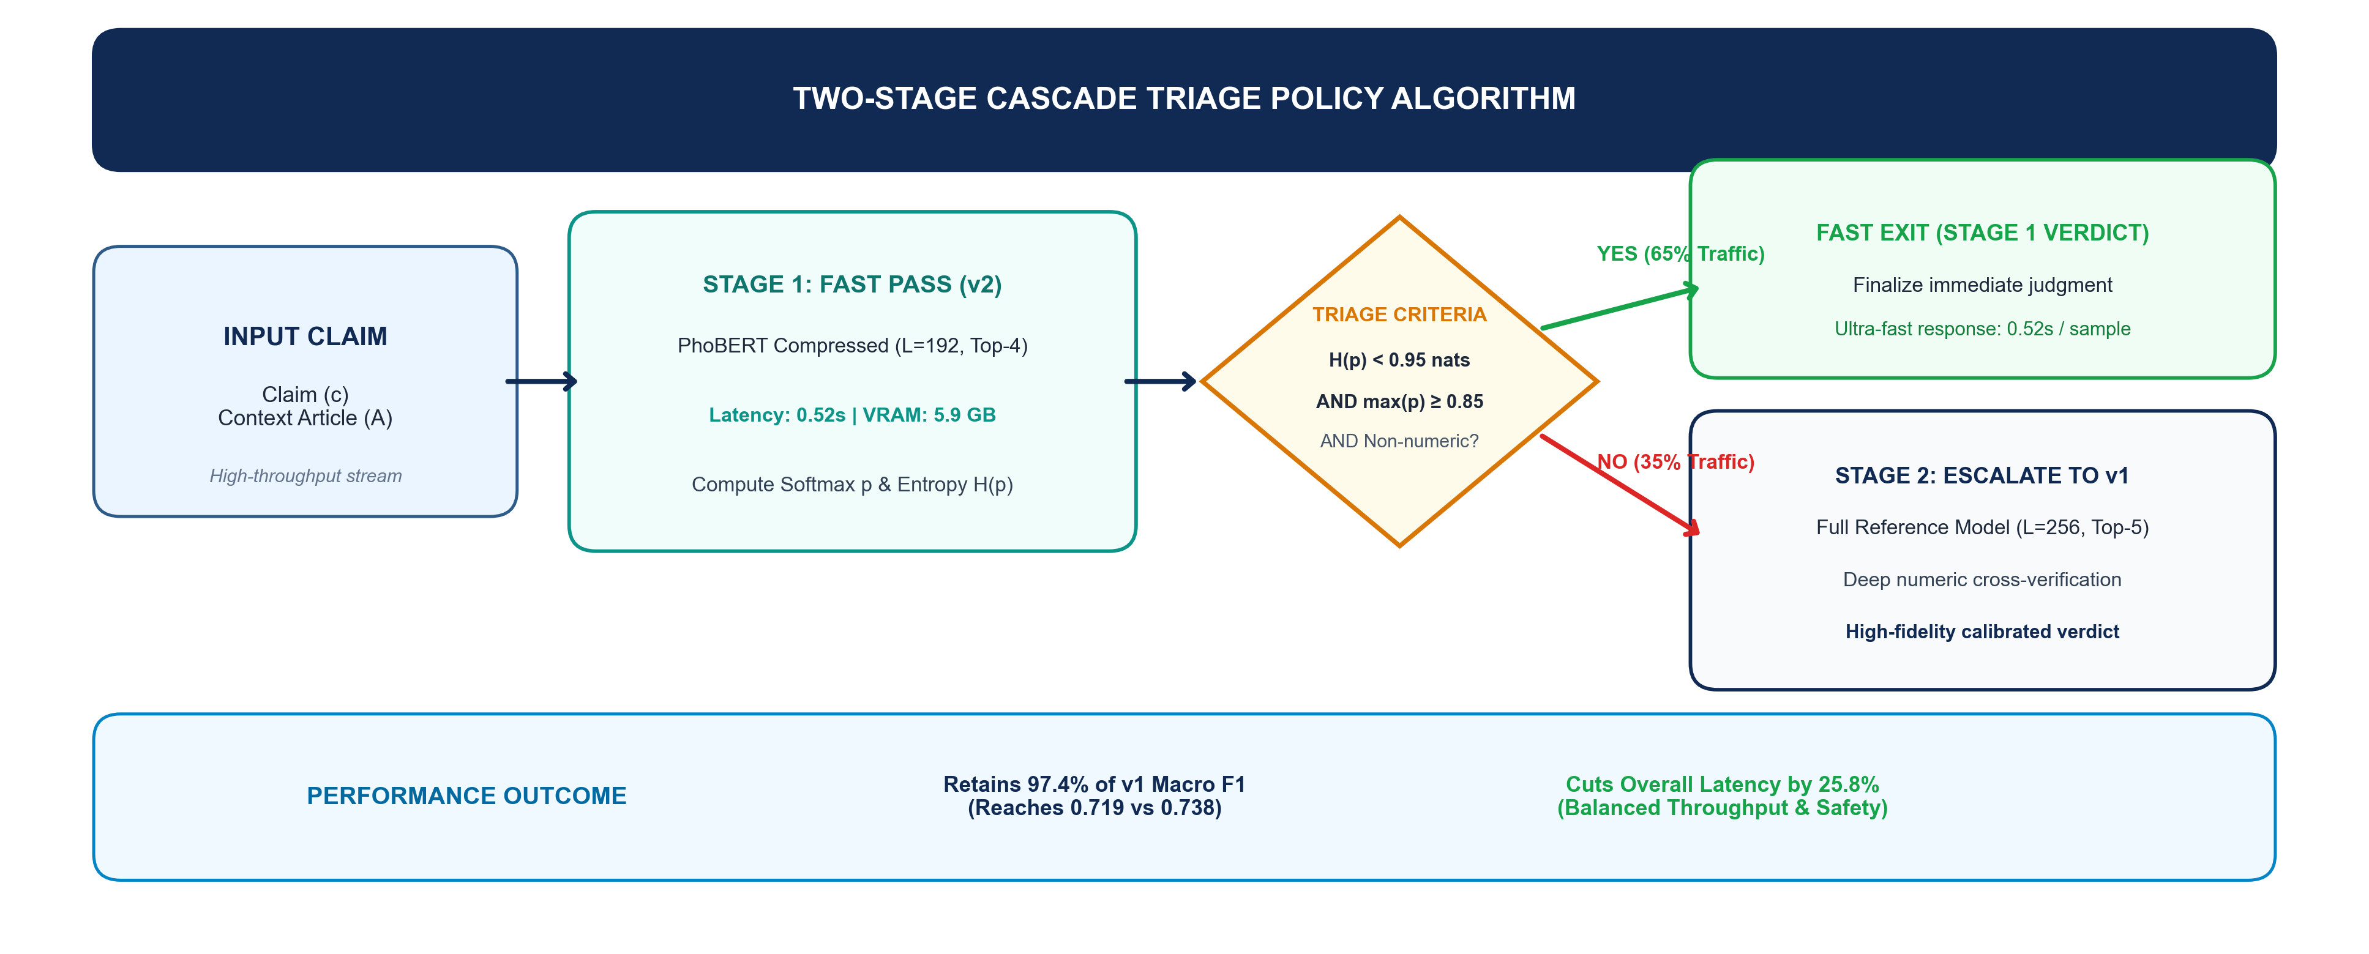
STAIS 2026 | SUBMISSION #190 | ORAL PRESENTATION
ERROR TAXONOMY & TWO-STAGE CASCADE DEPLOYMENT
OPERATIONAL TAKEAWAY: 58.6% of numerical errors stem from retrieval misses and sequence clipping. The Two-Stage Cascade preserves 97.4% of v1's F1 while reducing system latency by 25.8%!
Notes:
[9:00 - 10:00 | SLIDE 11: TWO-STAGE CASCADE POLICY]
Slide 11 delivers our practical engineering solution to the speed-accuracy trade-off.
Our error taxonomy revealed that 58.6% of numerical errors were caused by retrieval misses and token truncation.
Rather than choosing between slow v1 or risky v2, we deploy a Two-Stage Cascade Triage Policy shown in the flowchart:
Stage 1 filters high-confidence, non-numeric claims using lightweight v2, instantly resolving 65% of news traffic at 0.52s latency.
Only ambiguous or dense numerical claims are escalated to Stage 2 with full v1.
Simulation proves this hybrid cascade preserves 97.4% of v1's Macro F1 while delivering a 25.8% overall latency reduction.

Slide 12
STAIS 2026 | SUBMISSION #190 | ORAL PRESENTATION
CONCLUSION & FUTURE DIRECTIONS
CORE RESEARCH TAKEAWAYS
FUTURE ROADMAP: 'v1-Lite'
✓ Reference v1 for Safety:
Mandatory whenever predictive reliability and zero false confidence are required in financial fact-checking.
✓ Efficiency v2 for Fast Screening:
Yields -43.2% VRAM and -38.8% latency, but sequence truncation harms numerical context and NEI recall.
✓ Cascade Triage for Deployment:
Achieves the optimal Pareto frontier, balancing cloud throughput with financial safety.
→ Asymmetric Cost-Sensitive Loss:
Penalize NEI false negatives 2.5× to recover recall without any inference latency penalty.
→ Query-Guided Token Budgeting:
Selectively preserve numerical evidence rather than applying a naive hard 192-token cutoff.
→ Semi-Supervised Corpus Expansion:
Scale the Vietnamese financial fact-checking corpus beyond 682 pairs via automated news scraping.
Thank You for Your Attention! | Questions & Feedback Welcome
Faculty of Data Science in Business | Ho Chi Minh University of Banking (HUB), Vietnam | Contact: 030239230031@st.buh.edu.vn
Notes:
[10:00 - 10:45 | SLIDE 12: CONCLUSION & FUTURE DIRECTIONS]
To summarize our findings:
Reference v1 is indispensable when financial truth cannot be compromised.
Efficiency v2 provides remarkable 43% VRAM savings, but aggressive truncation introduces severe NEI vulnerability.
Our Two-Stage Cascade triage bridges this gap, unlocking production-grade Pareto efficiency.
In our future roadmap, we plan to design 'v1-Lite' with asymmetric loss and query-guided token allocation.

Slide 13
Q & A
Questions & Scientific Discussion
Submission #190 | STAIS 2026 International Conference
Notes:
[10:45 - 11:00 | SLIDE 13: Q&A]
Thank you Session Chairs, professors, and esteemed delegates.
I am now delighted to answer any questions regarding our methodologies, benchmarks, or cascade deployment policy.

Slide 14
THANK YOU!
Faculty of Data Science in Business
Ho Chi Minh University of Banking (HUB), Vietnam
Corresponding Author: thuannd@buh.edu.vn | Presenter: 030239230031@st.buh.edu.vn
Notes:
We express our deepest gratitude to our advisors and Ho Chi Minh University of Banking for supporting this research project.

