Slide 1
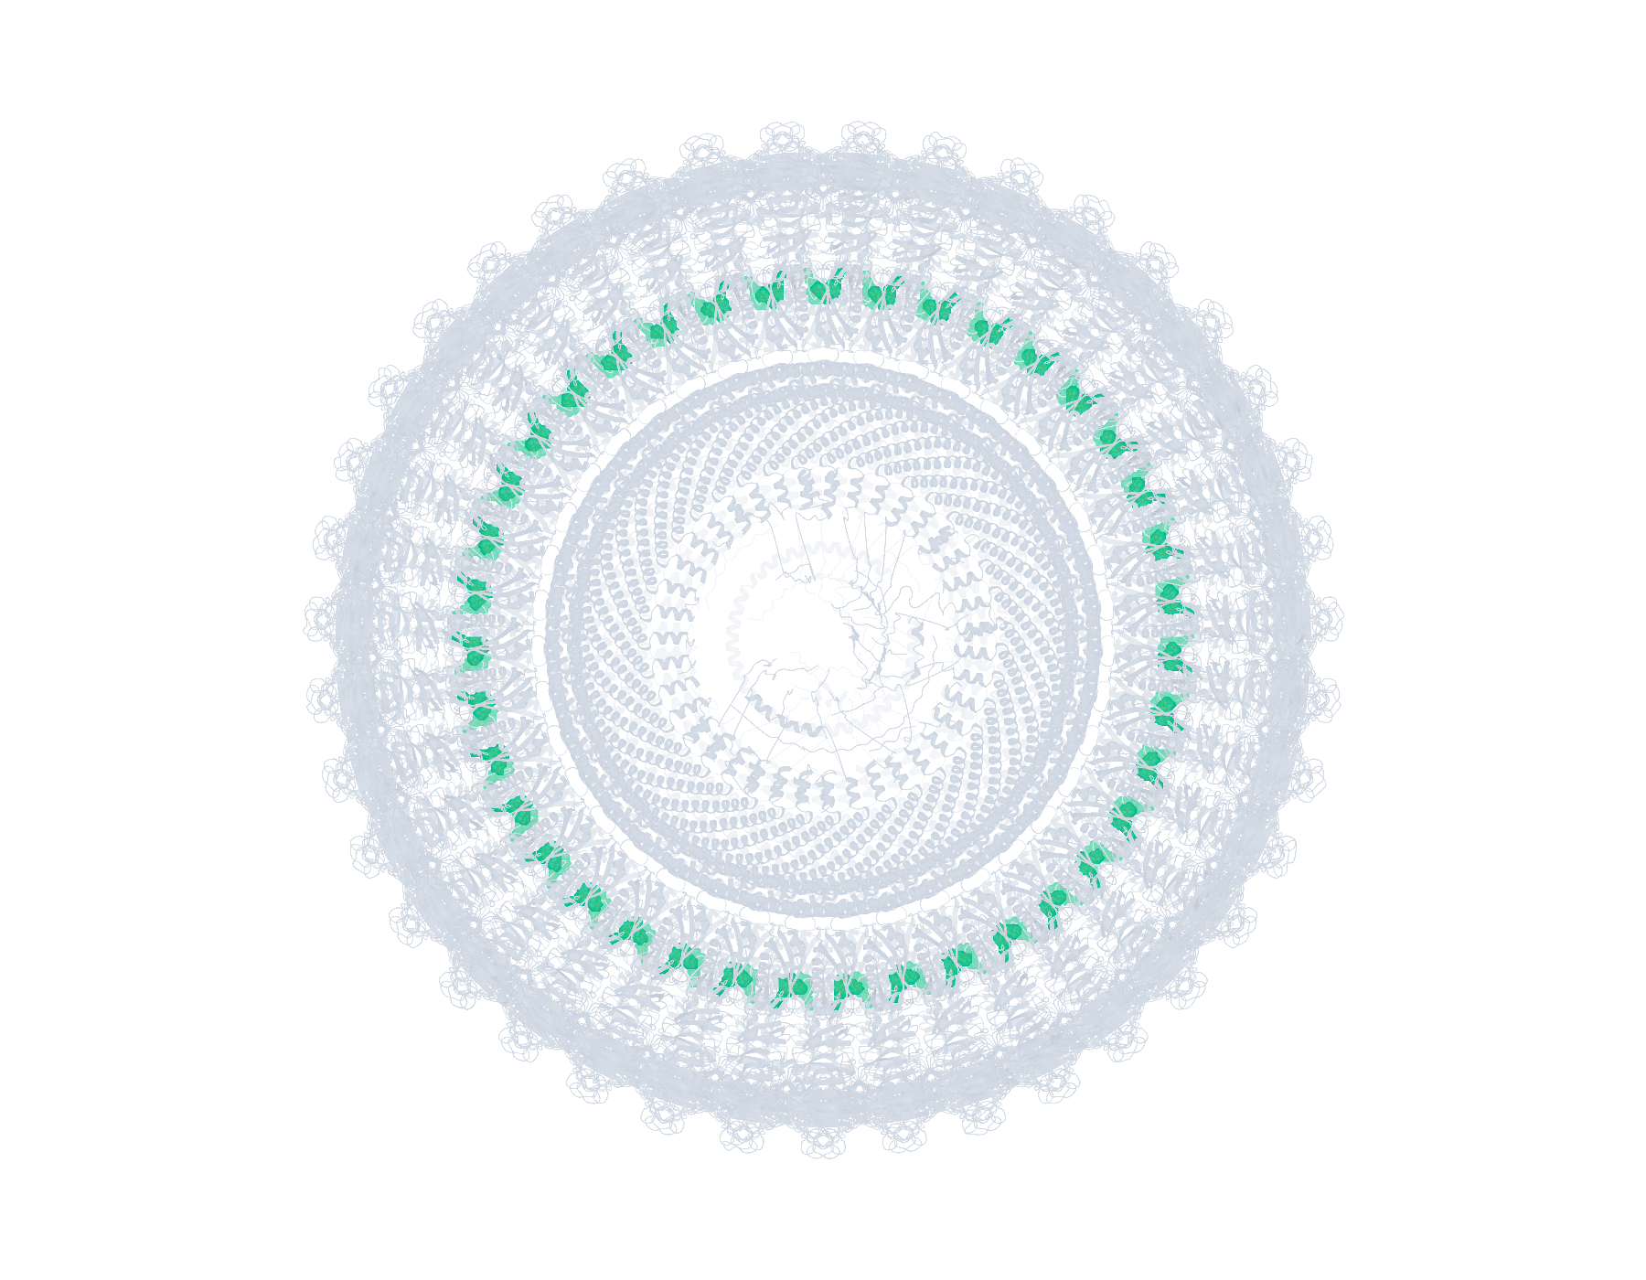
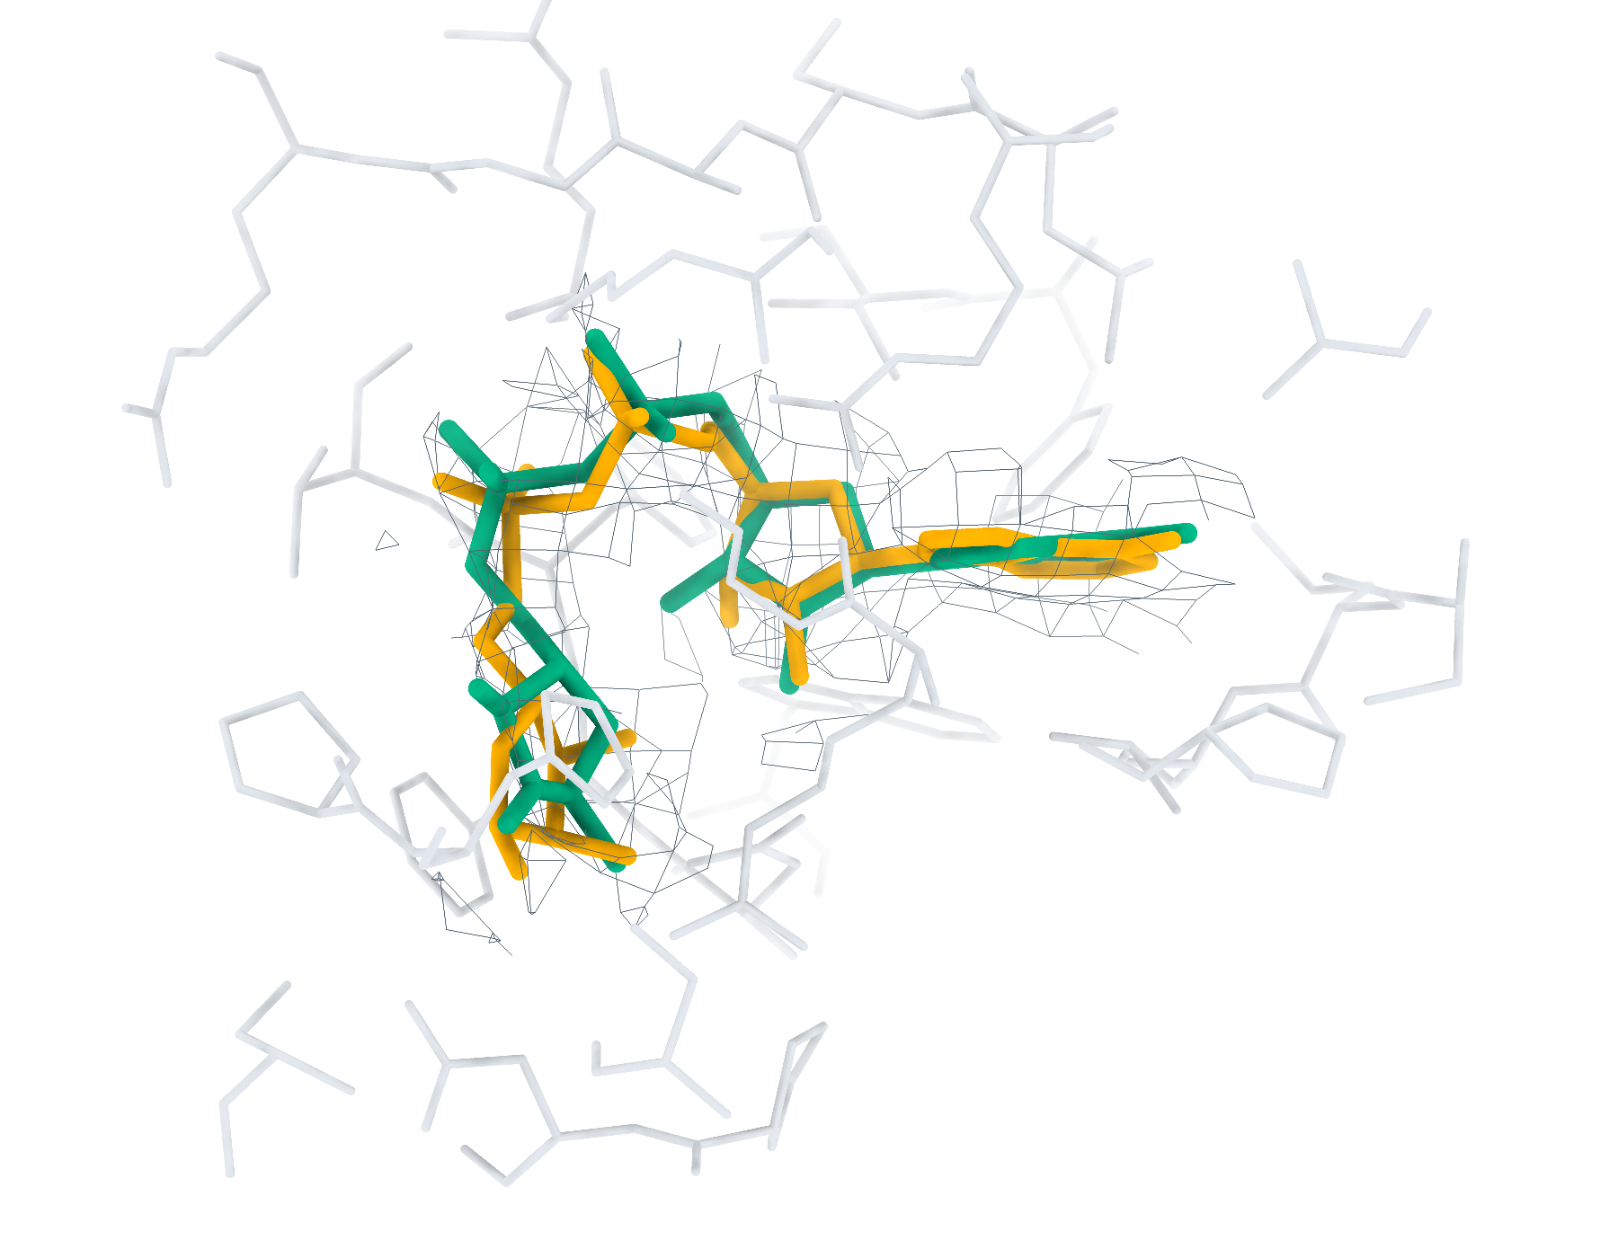
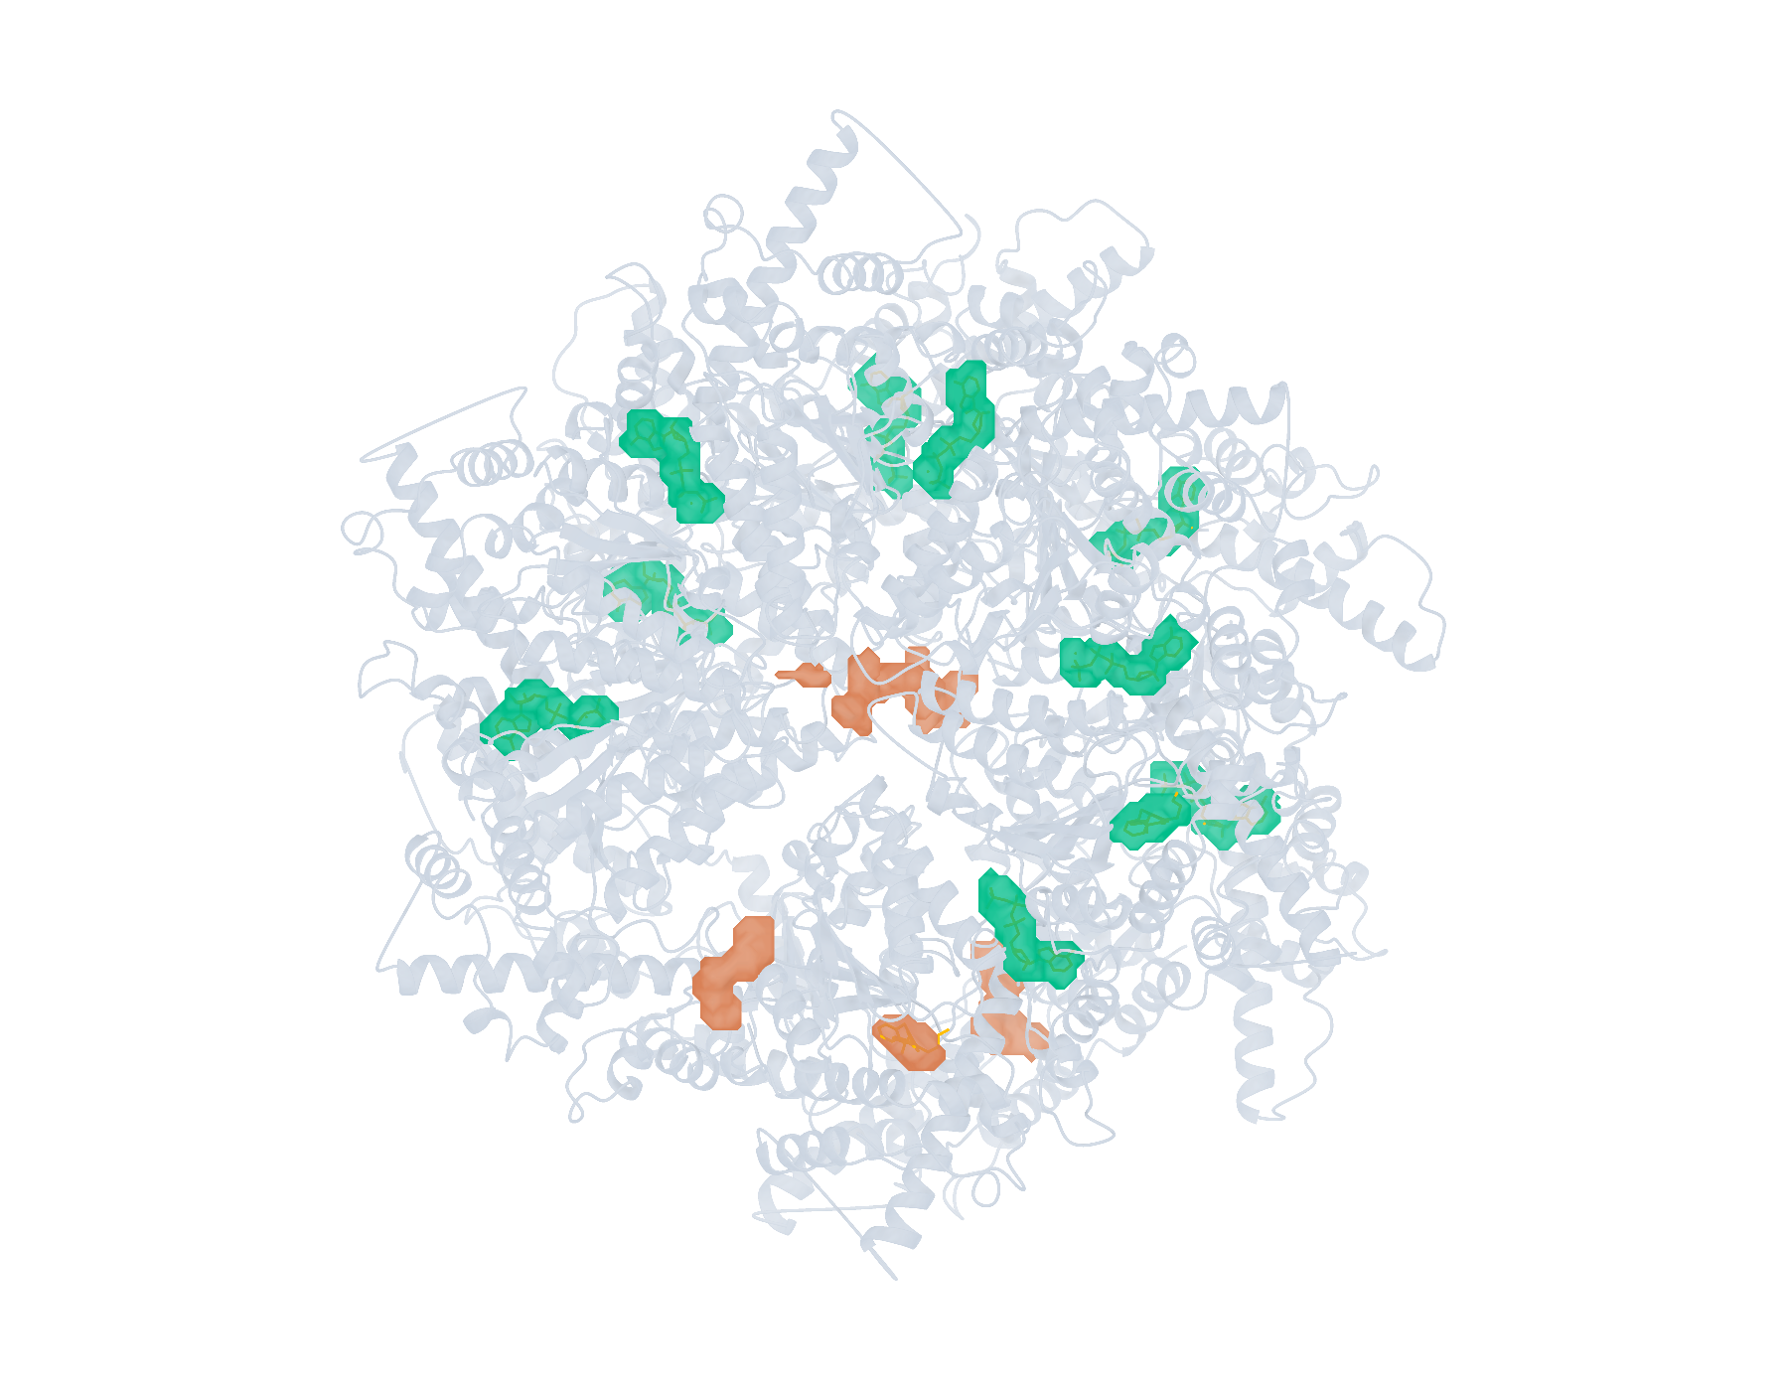
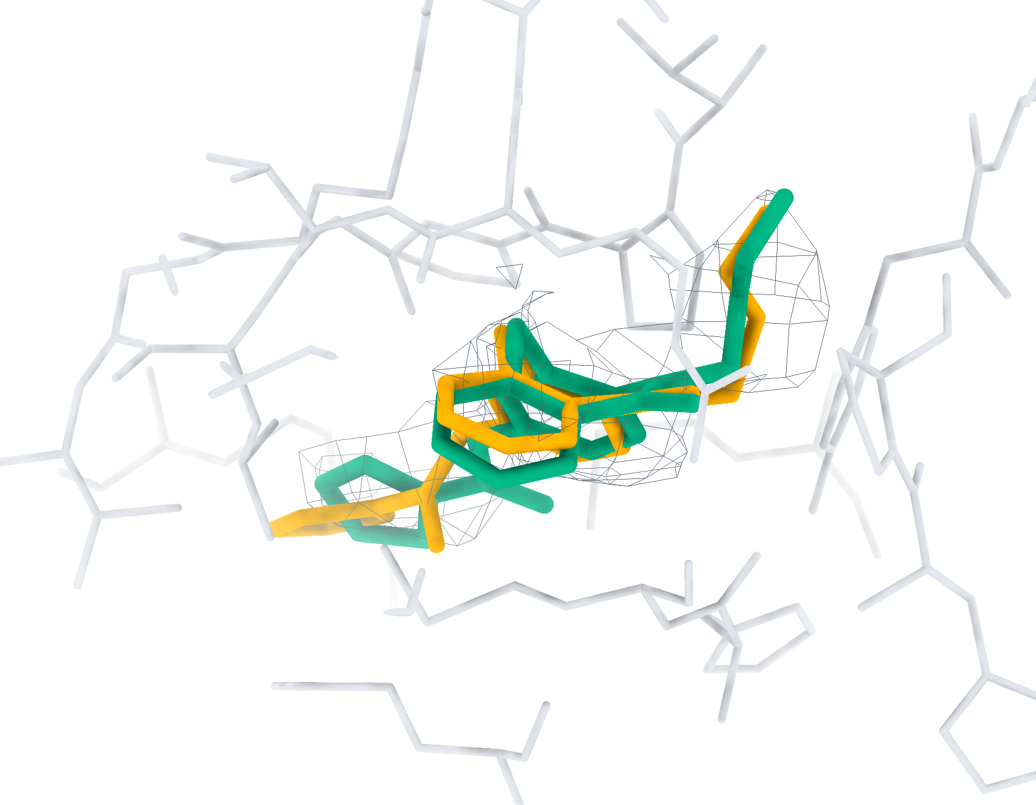
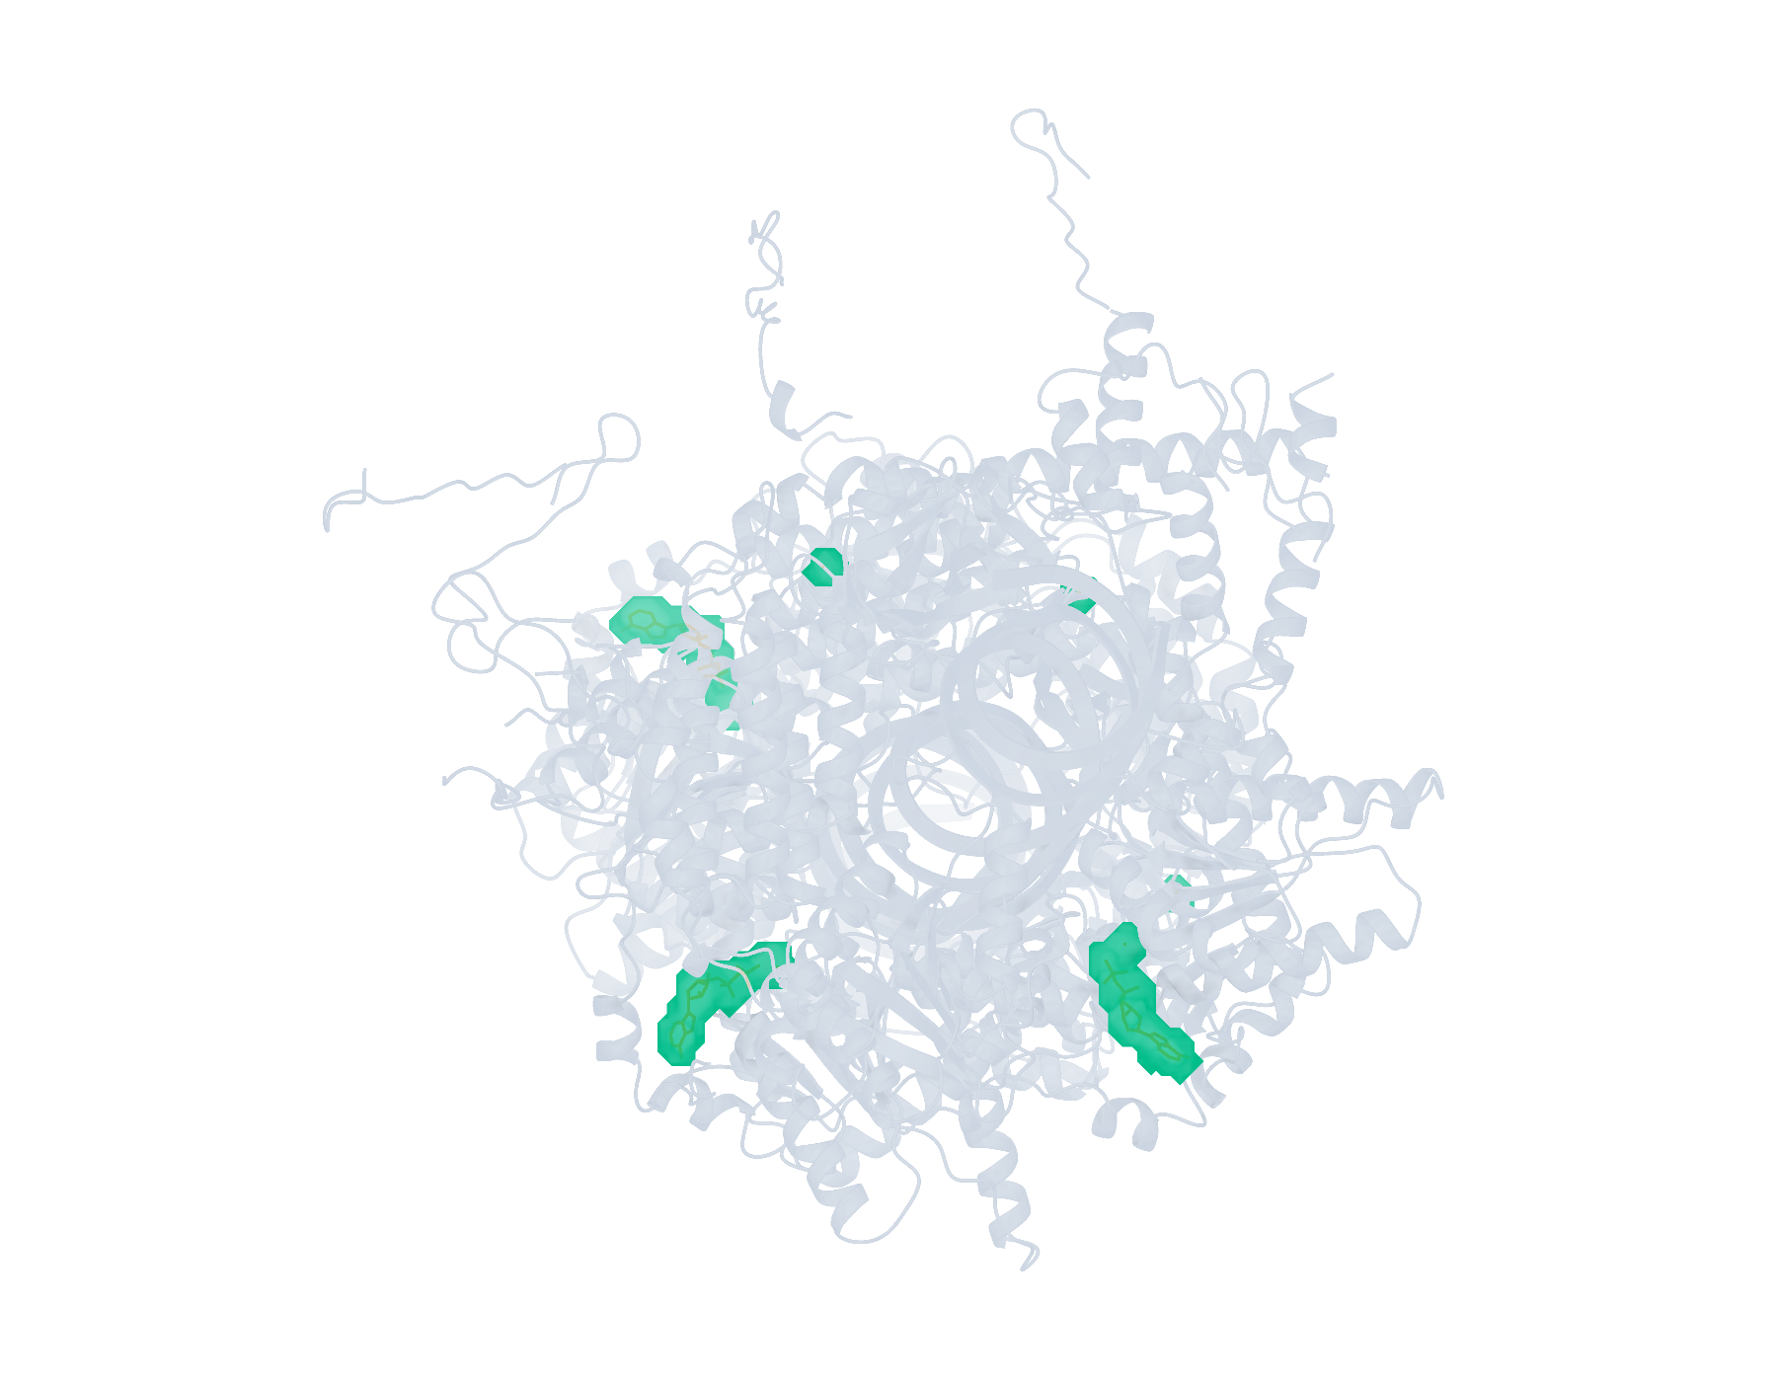
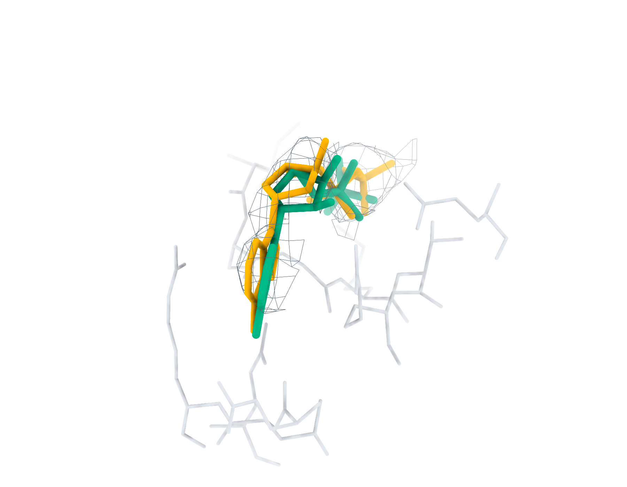
Multi-ligand recognition and modelling
CryoAtom2 receptor, 100% attempt budgets
a
11JB Find+Match 78/78
b
AR6 (f:2001) RMSD 1.46 Å
c
9BJJ Find+Match 10/19
d
A1AP0 (E:1001) RMSD 1.06 Å
e
9LOV Find+Match 6/9
f
ADP (B:1101) RMSD 1.09 Å
Overview: teal, correct identity; brown, other candidates. Local: teal, top-1; orange, reference.
Notes:
LigandSeek的多配体识别与建模。a、c、e，采用CryoAtom2重建受体，分别展示11JB、9BJJ、9LOV中的LigandSeek-Find候选配体区域及LigandSeek-Match身份匹配。青绿色表示前景区域的身份匹配正确，棕色表示其他候选，橙色为沉积配体。标签给出100%尝试预算下完成实例数/目标实例数，预算基数为全部沉积配体实例数。b、d、f，采用PocketXMol-tuned的完整Find–Match–Build流水线首选构象（青绿色）、沉积构象（橙色）、实验冷冻电镜密度（灰色网格）及5 Å内的受体残基。局部图以单残基、无缺失原子、有机的小分子实例数定义100%预算。在该预算下，三个复合物中重原子RMSD低于2 Å的首选构象分别完成76/78、10/11、3/3个合格实例。局部分别展示AR6（f:2001）、A1AP0（E:1001）及ADP（B:1101）。不同复合物总览的显示比例不同。
ENGLISH:
Multi-ligand recognition and modelling by LigandSeek. a,c,e, LigandSeek-Find candidate ligand regions with LigandSeek-Match identity assignments in 11JB, 9BJJ and 9LOV, respectively, using CryoAtom2-reconstructed receptors. Teal denotes a correct identity at a foreground region, brown denotes other candidates and orange shows deposited ligands. The labels give completed/target instance counts at 100% attempt budget, with the attempt limit equal to the number of deposited ligand instances. b,d,f, Selected top-1 poses from the complete Find–Match–Build pipeline using PocketXMol-tuned (teal), overlaid with deposited poses (orange), experimental cryo-EM density (grey mesh) and receptor residues within 5 Å. Local panels use 100% budget relative to the number of single-residue, complete organic small molecules. At this budget, top-1 poses below 2 Å heavy-atom root-mean-square deviation (RMSD) complete 76/78, 10/11 and 3/3 eligible instances in the three complexes, respectively. The local panels show AR6 (f:2001), A1AP0 (E:1001) and ADP (B:1101). Overview scales differ between complexes.

Slide 2
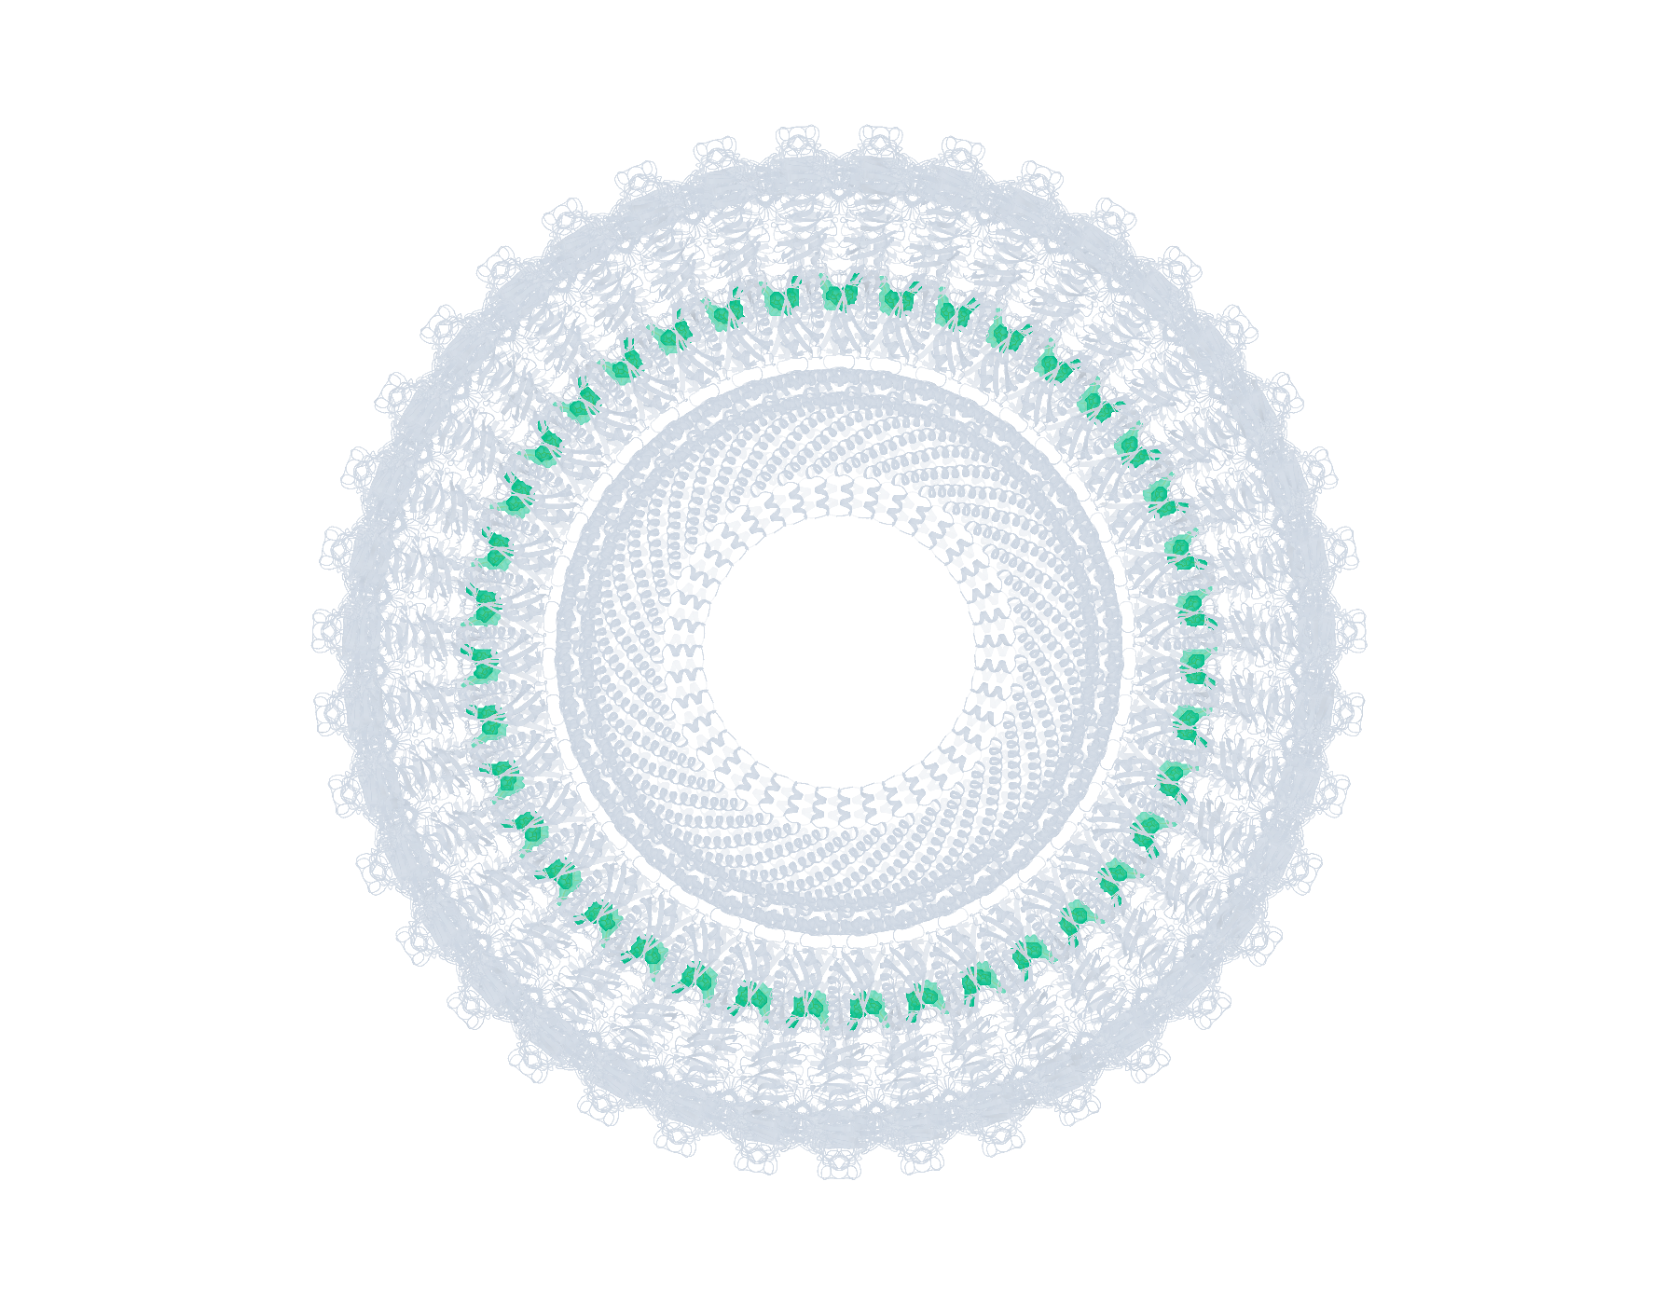
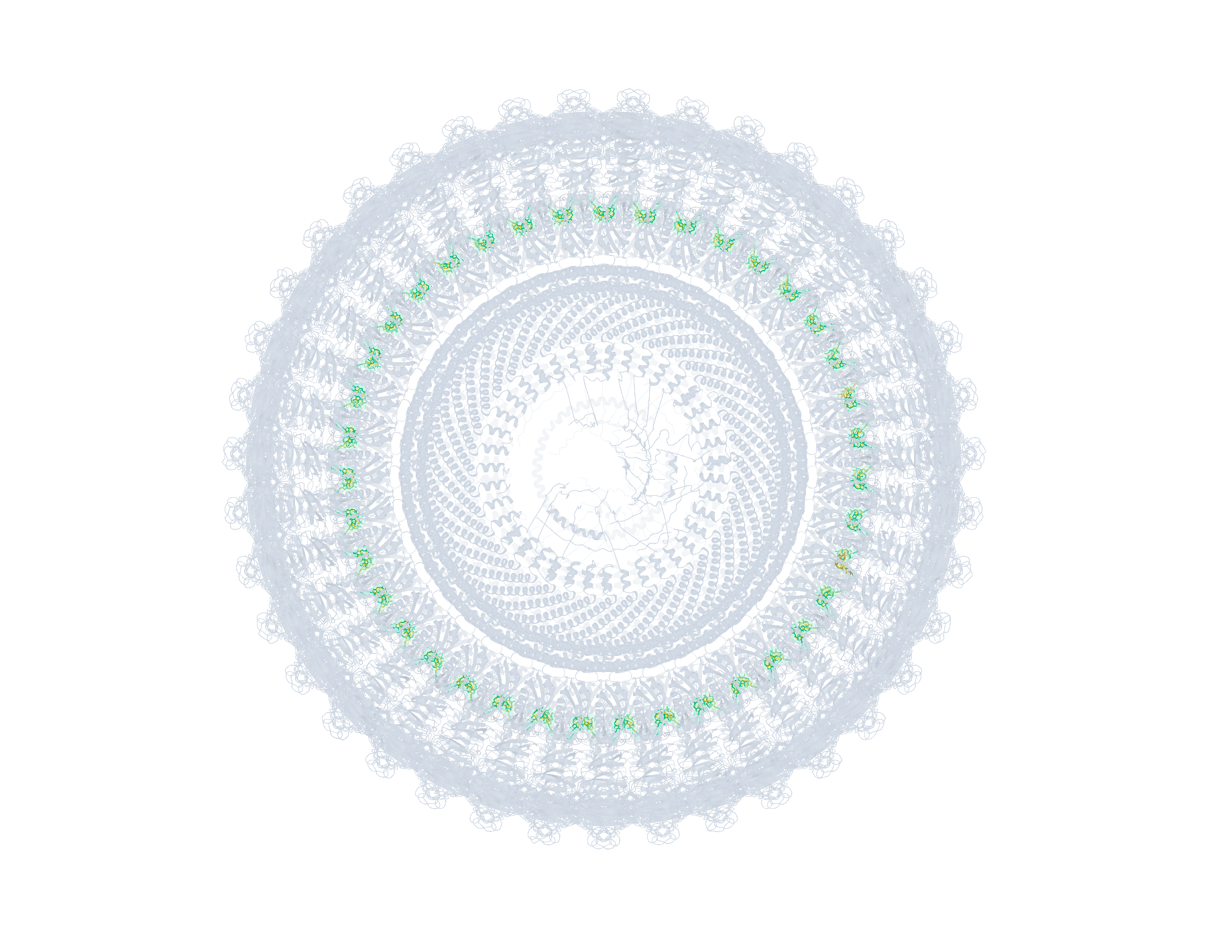
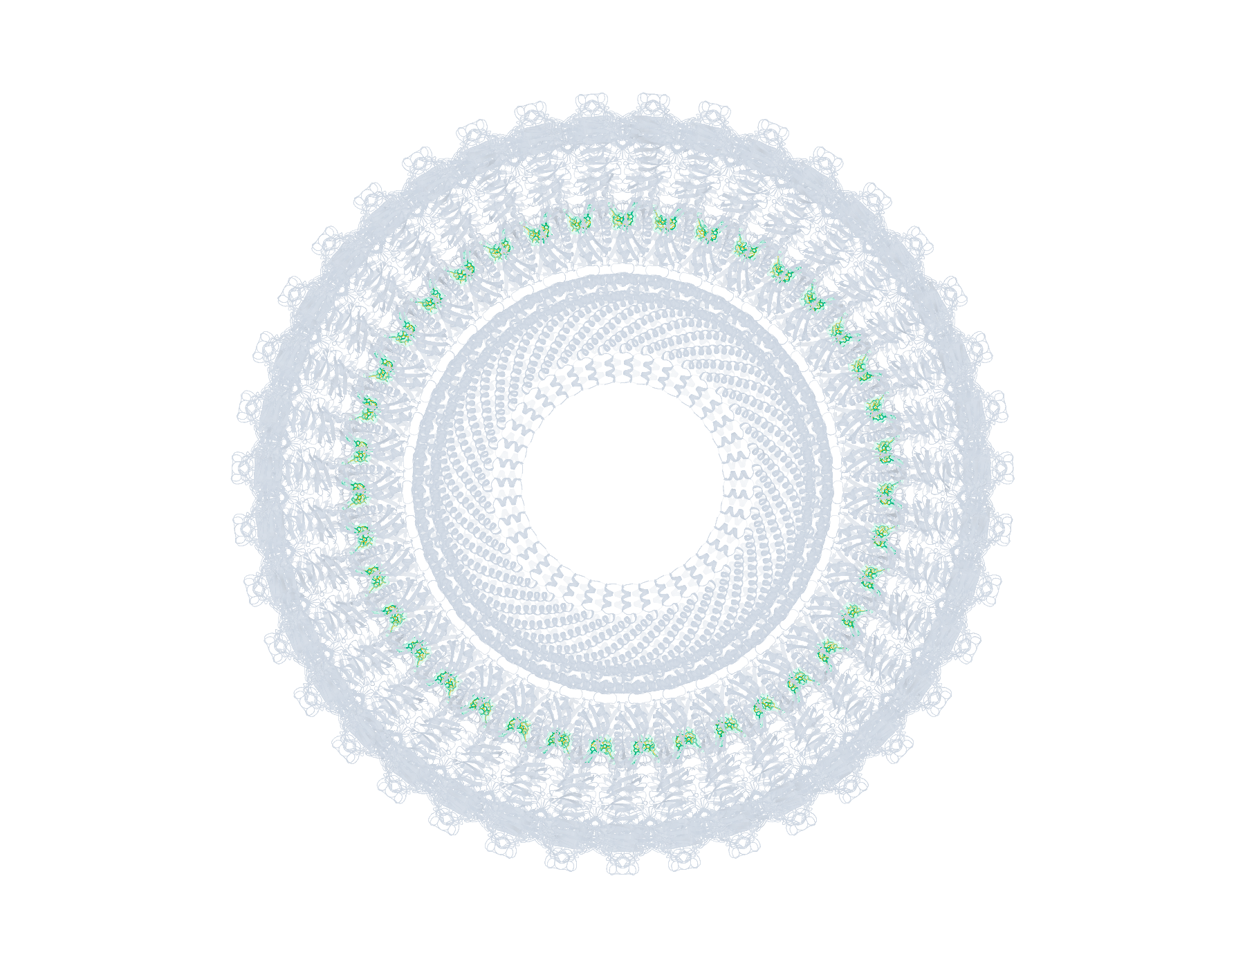
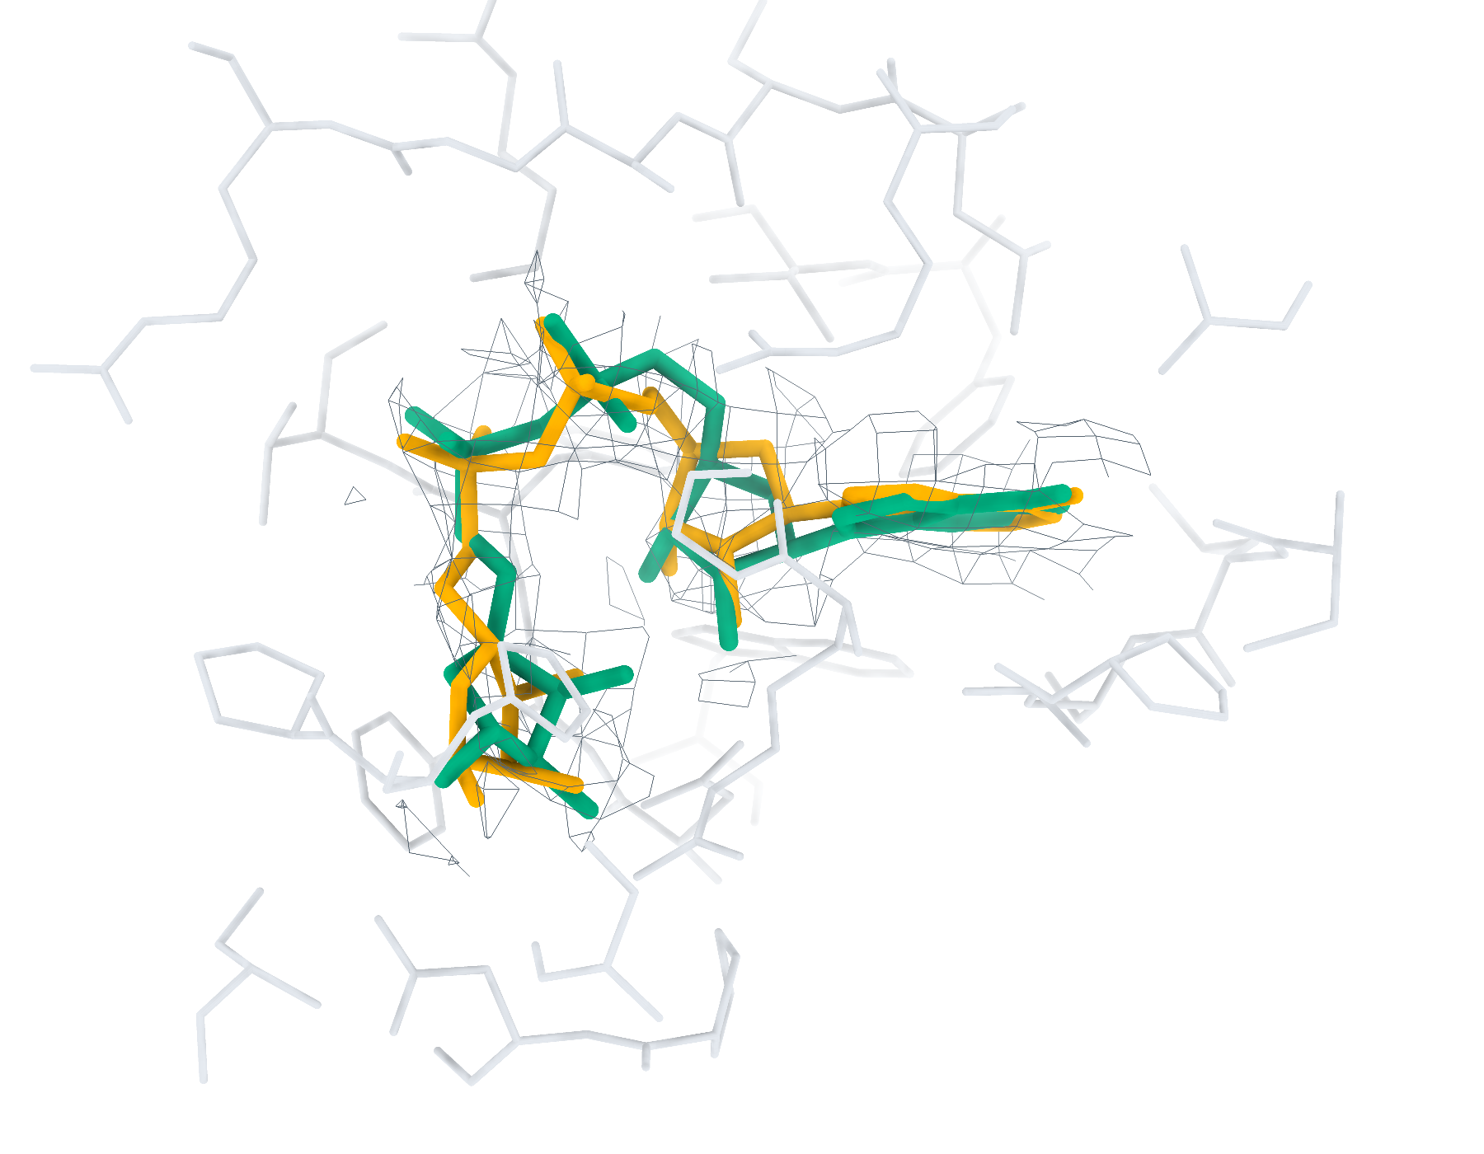
11JB Ligand recognition and modelling
78 deposited ligands, 78 small molecules, 78 eligible for modelling
a
CA2 Find+Match 78/78
b
GT Find+Match 78/78
c
CA2 Pipeline top-1 < 2 Å 76/78
d
GT Pipeline top-1 < 2 Å 78/78
e
CA2 AR6 RMSD 1.46 Å
f
GT AR6 RMSD 0.86 Å
Find+Match: teal, correct identity. Pipeline: teal, RMSD < 2 Å; brown, ≥ 2 Å. Orange, reference.
Notes:
11JB中的多配体识别与建模。复合物含78个沉积配体实例，其中小分子78个，满足单残基、无缺失原子、有机条件的建模实例78个。左、右列分别采用CryoAtom2重建受体（CA2）和沉积受体（GT）。a、b，LigandSeek-Find候选配体区域及LigandSeek-Match身份匹配。青绿色表示前景区域中的身份匹配正确，棕色表示其他候选，橙色为沉积配体。c、d，采用PocketXMol-tuned的LigandSeek Find–Match–Build完整流水线首选构象。青绿色和棕色构象的重原子RMSD分别低于和不低于2 Å。标签列出100%尝试预算下的完成实例数/目标实例数；a、b以全配体实例数为预算基数，c、d以合格小分子实例数为基数。e、f，局部实验密度（灰色网格）、5 Å内的受体残基、沉积构象（橙色）和已有完整流水线首选构象（青绿色）。CA2: AR6 (f:2001), 首选构象RMSD 1.46 Å；GT: AR6 (f:2001), 首选构象RMSD 0.86 Å。局部沿用相同完整流水线预算。不同复合物总览的显示比例不同。
ENGLISH:
Multi-ligand recognition and modelling in 11JB. The complex contains 78 deposited ligand instances, including 78 small molecules and 78 single-residue, complete organic small molecules eligible for modelling. Left and right columns use the CryoAtom2-reconstructed (CA2) and deposited (GT) receptor structures, respectively. a,b, LigandSeek-Find candidate ligand regions with LigandSeek-Match assignments. Teal denotes a correct identity at a foreground region, and brown denotes other candidates. Orange shows deposited ligands. c,d, Top-1 poses from the complete LigandSeek Find–Match–Build pipeline using PocketXMol-tuned. Teal and brown poses have heavy-atom root-mean-square deviation (RMSD) below and at least 2 Å, respectively. The labels give completed/target instance counts at 100% attempt budget. The budget equals the number of all ligand instances in a,b and eligible small-molecule instances in c,d. e,f, Selected local views with experimental density (grey mesh), receptor residues within 5 Å, deposited poses (orange) and available pipeline top-1 poses (teal). CA2: AR6 (f:2001), top-1 RMSD 1.46 Å; GT: AR6 (f:2001), top-1 RMSD 0.86 Å. Local views use the same pipeline budgets. Overview scales differ between complexes.

Slide 3
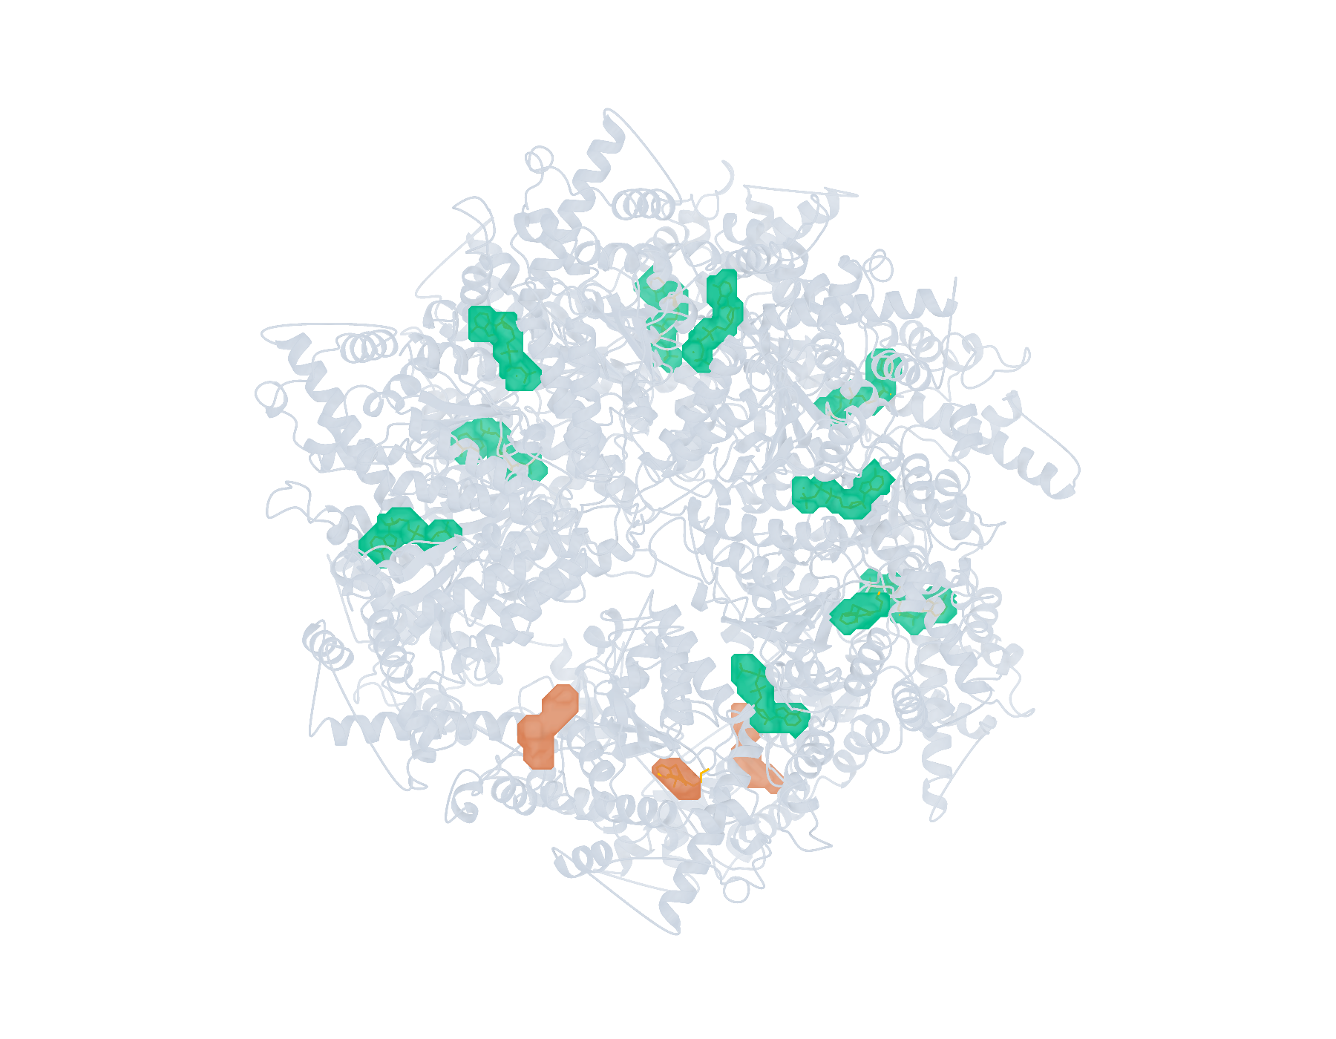
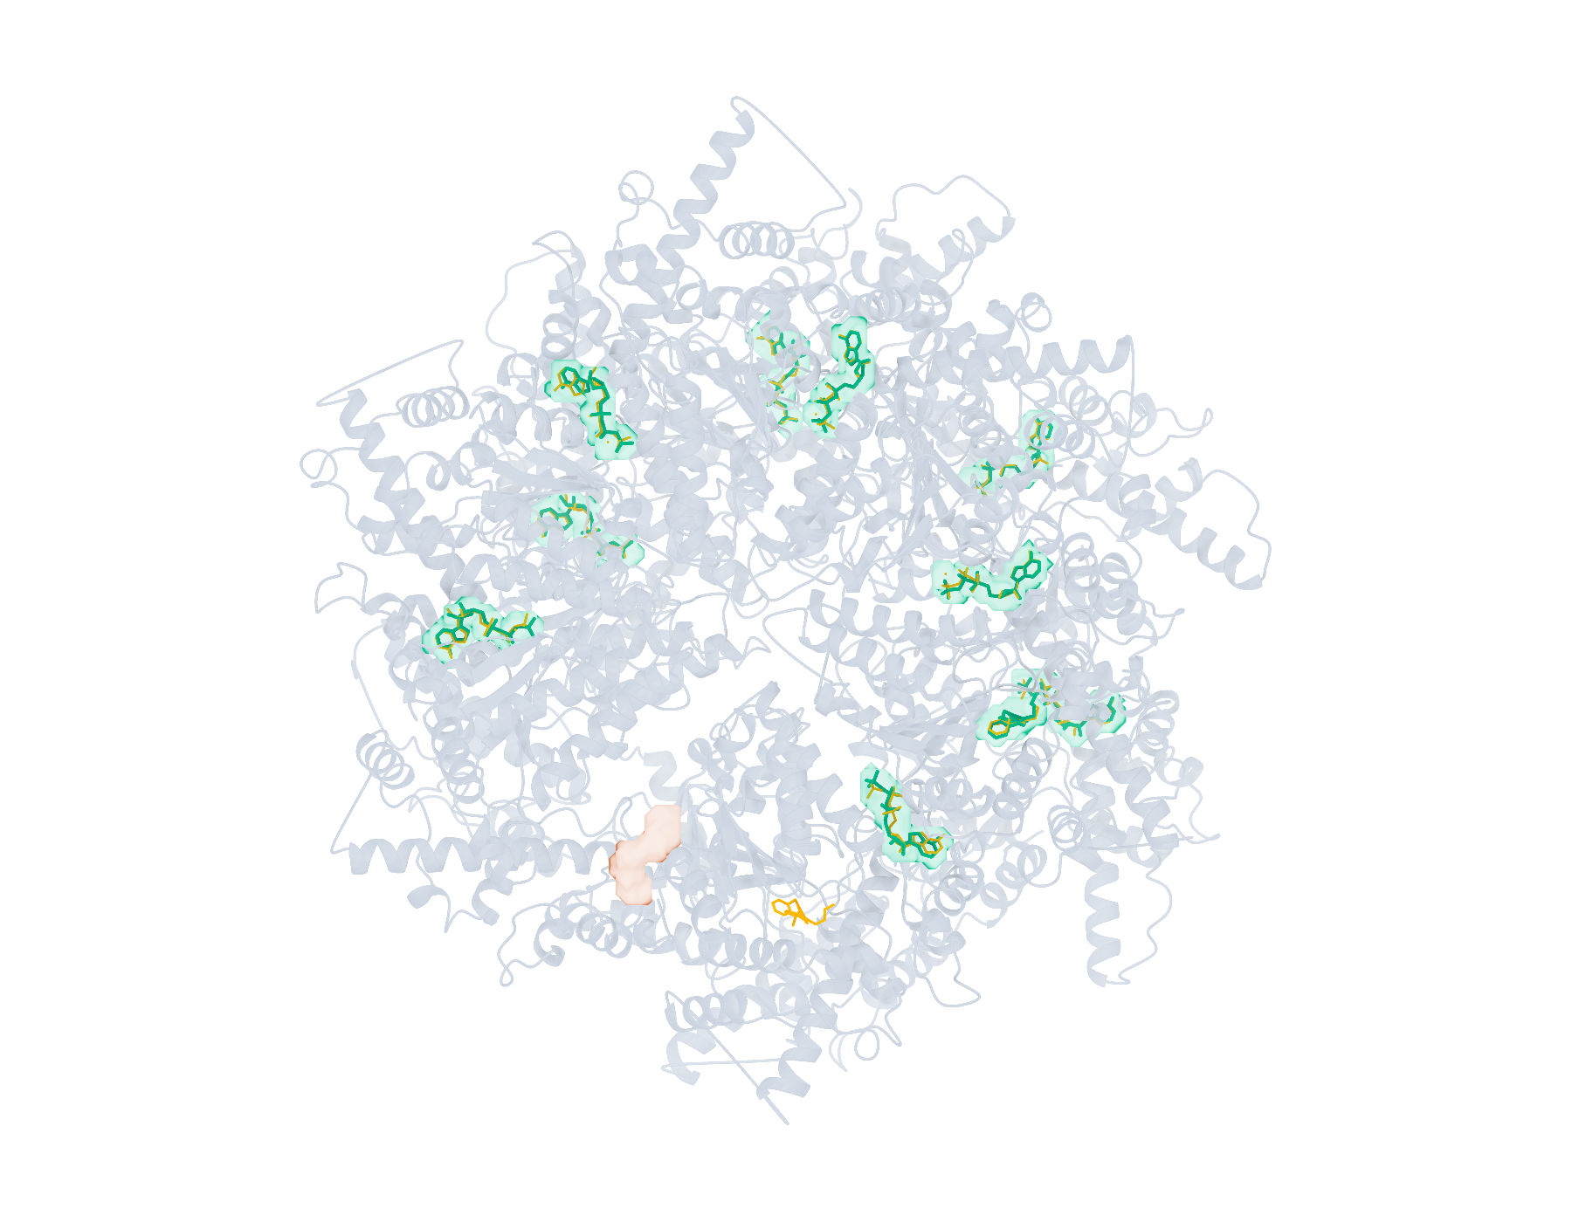
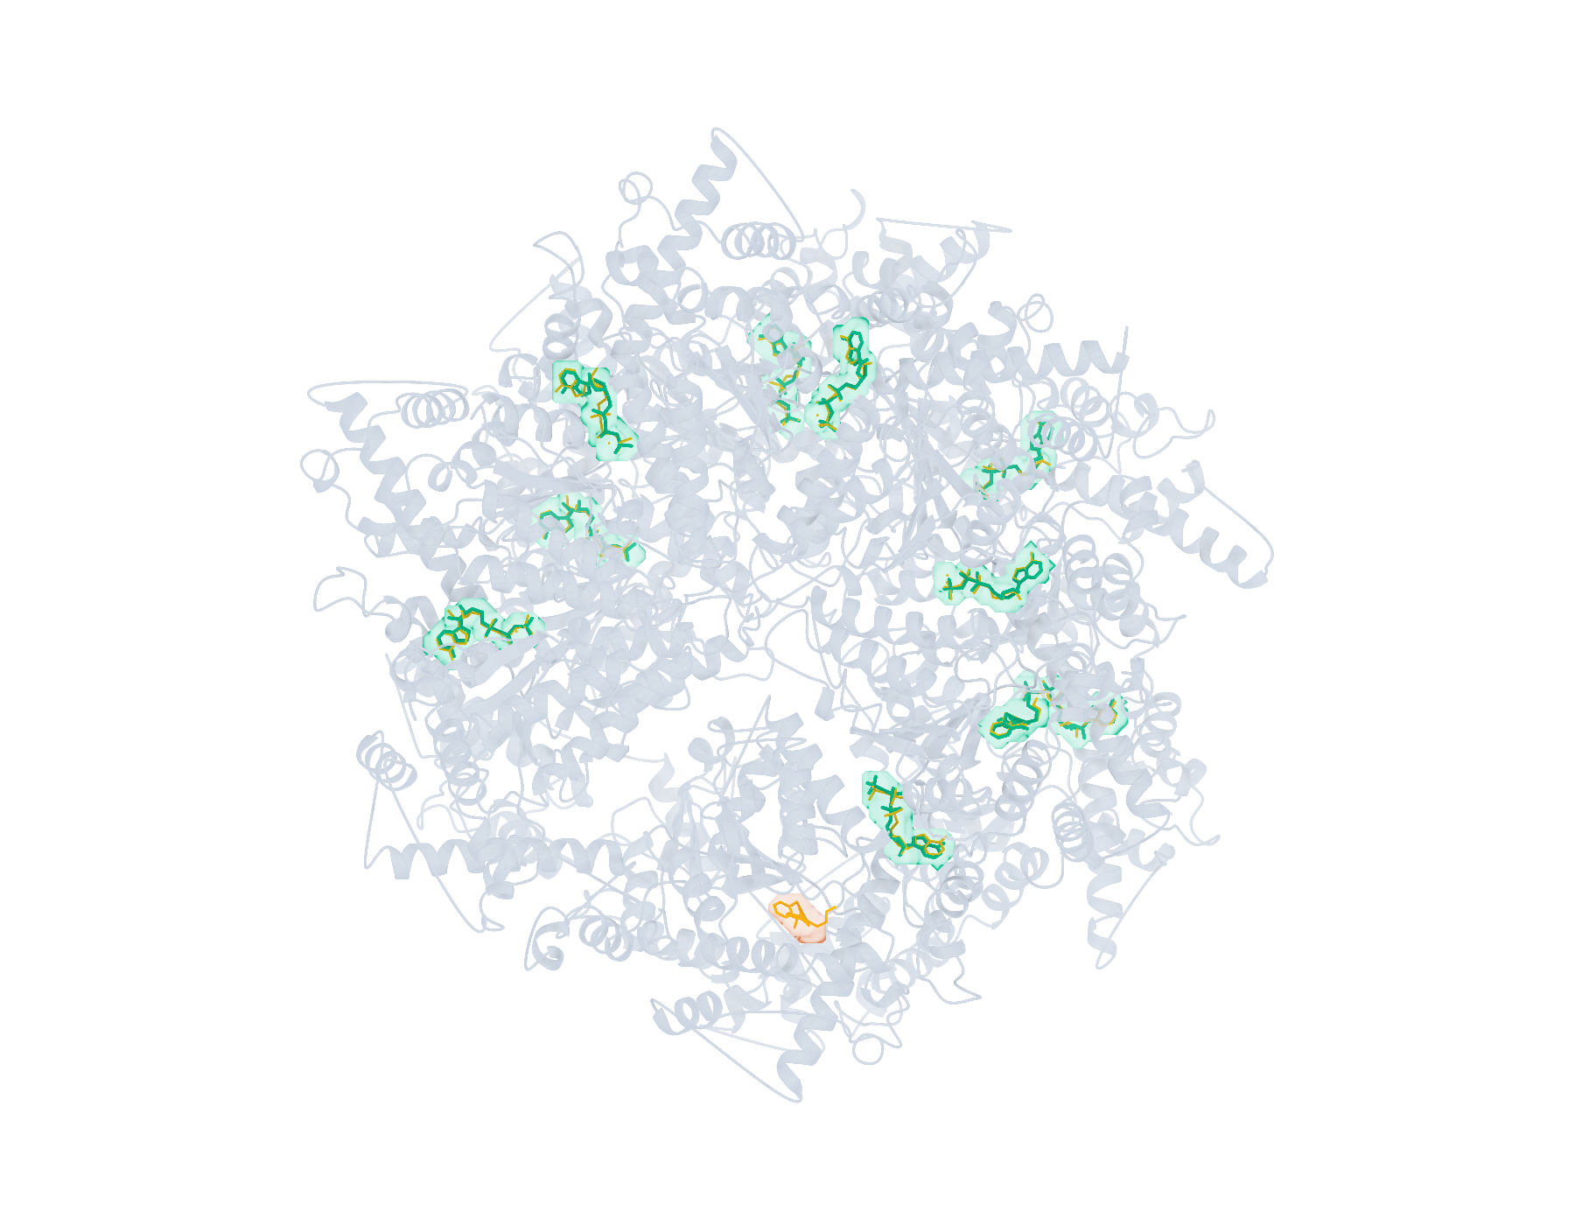
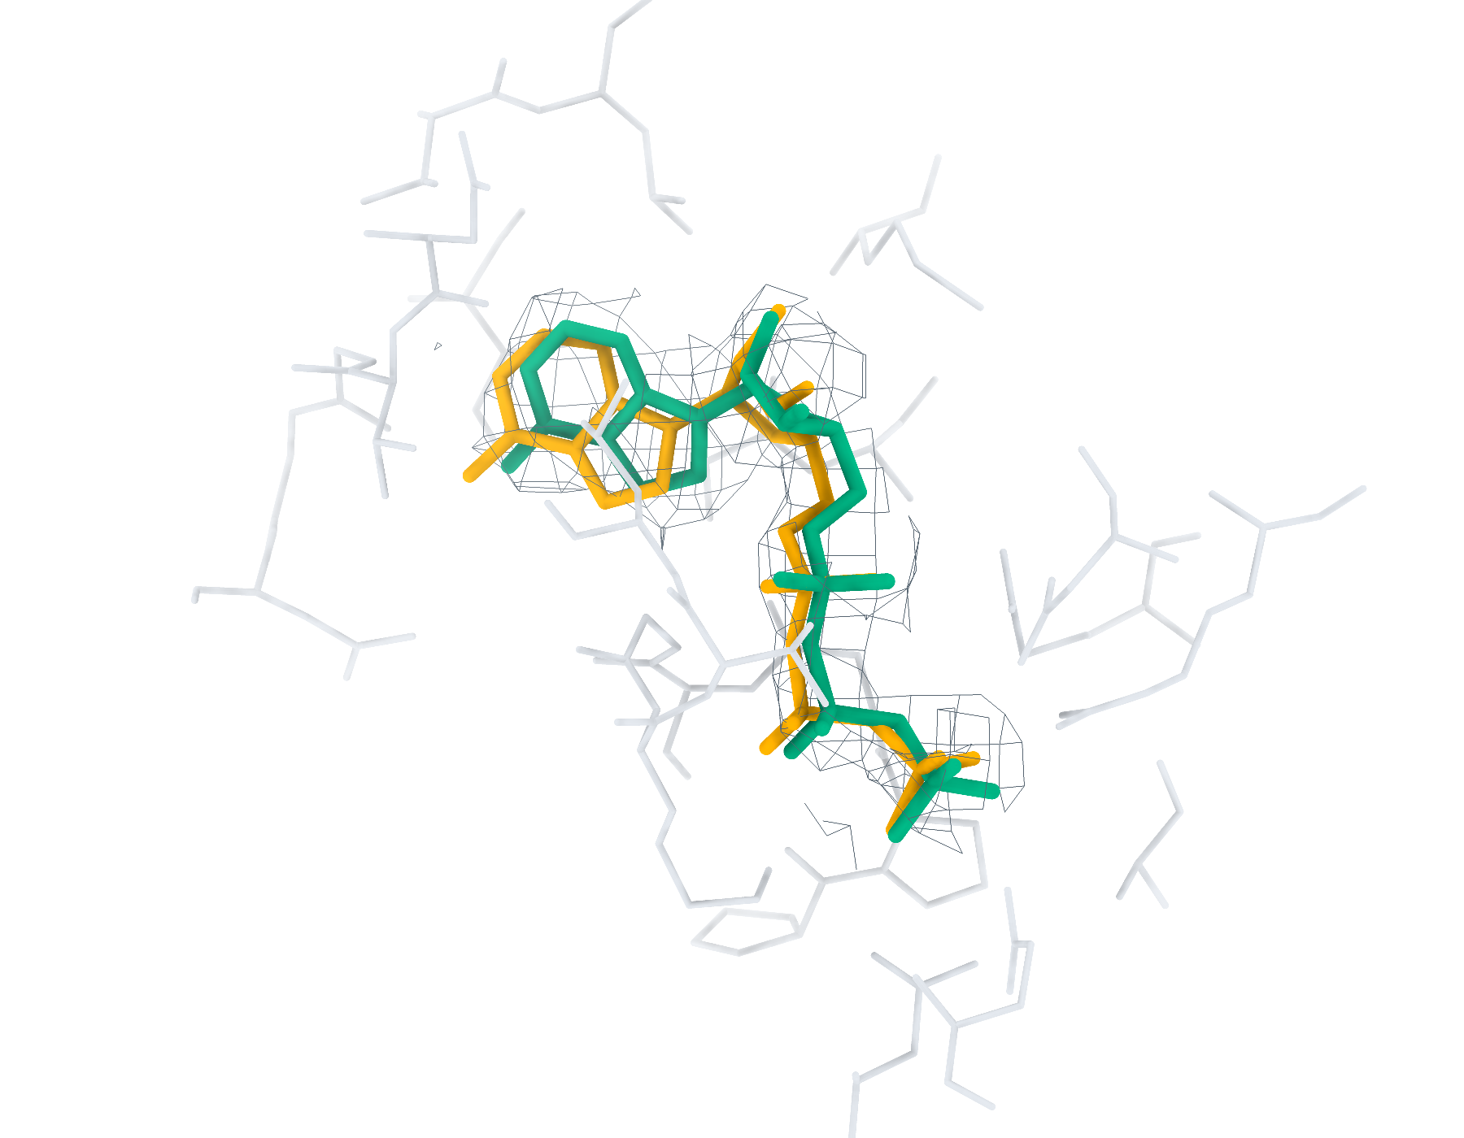
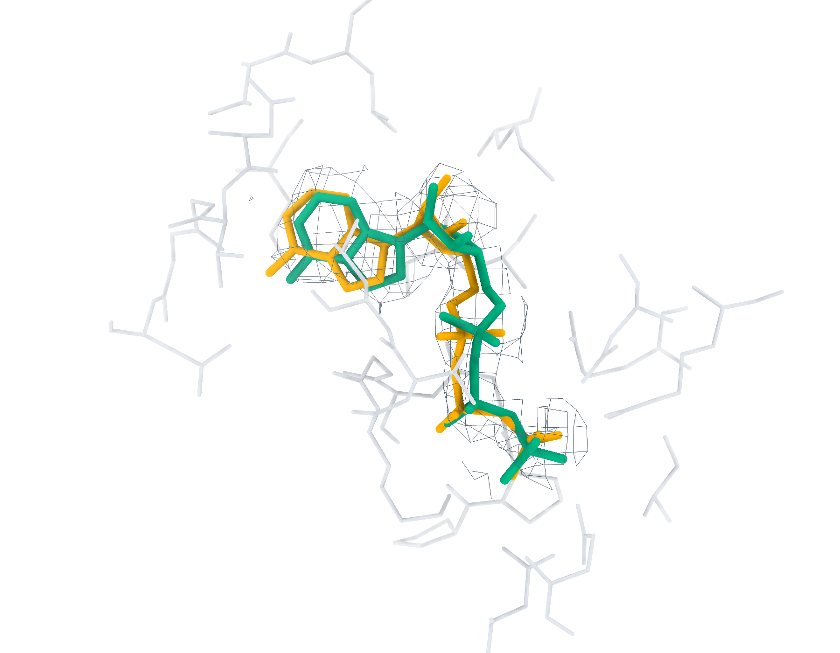
9BJJ Ligand recognition and modelling
19 deposited ligands, 11 small molecules, 11 eligible for modelling
a
CA2 Find+Match 10/19
b
GT Find+Match 10/19
c
CA2 Pipeline top-1 < 2 Å 10/11
d
GT Pipeline top-1 < 2 Å 10/11
e
CA2 ATP RMSD 0.80 Å
f
GT ATP RMSD 0.93 Å
Find+Match: teal, correct identity. Pipeline: teal, RMSD < 2 Å; brown, ≥ 2 Å. Orange, reference.
Notes:
9BJJ中的多配体识别与建模。复合物含19个沉积配体实例，其中小分子11个，满足单残基、无缺失原子、有机条件的建模实例11个。左、右列分别采用CryoAtom2重建受体（CA2）和沉积受体（GT）。a、b，LigandSeek-Find候选配体区域及LigandSeek-Match身份匹配。青绿色表示前景区域中的身份匹配正确，棕色表示其他候选，橙色为沉积配体。c、d，采用PocketXMol-tuned的LigandSeek Find–Match–Build完整流水线首选构象。青绿色和棕色构象的重原子RMSD分别低于和不低于2 Å。标签列出100%尝试预算下的完成实例数/目标实例数；a、b以全配体实例数为预算基数，c、d以合格小分子实例数为基数。e、f，局部实验密度（灰色网格）、5 Å内的受体残基、沉积构象（橙色）和已有完整流水线首选构象（青绿色）。CA2: ATP (B:901), 首选构象RMSD 0.80 Å；GT: ATP (B:901), 首选构象RMSD 0.93 Å。局部沿用相同完整流水线预算。不同复合物总览的显示比例不同。
ENGLISH:
Multi-ligand recognition and modelling in 9BJJ. The complex contains 19 deposited ligand instances, including 11 small molecules and 11 single-residue, complete organic small molecules eligible for modelling. Left and right columns use the CryoAtom2-reconstructed (CA2) and deposited (GT) receptor structures, respectively. a,b, LigandSeek-Find candidate ligand regions with LigandSeek-Match assignments. Teal denotes a correct identity at a foreground region, and brown denotes other candidates. Orange shows deposited ligands. c,d, Top-1 poses from the complete LigandSeek Find–Match–Build pipeline using PocketXMol-tuned. Teal and brown poses have heavy-atom root-mean-square deviation (RMSD) below and at least 2 Å, respectively. The labels give completed/target instance counts at 100% attempt budget. The budget equals the number of all ligand instances in a,b and eligible small-molecule instances in c,d. e,f, Selected local views with experimental density (grey mesh), receptor residues within 5 Å, deposited poses (orange) and available pipeline top-1 poses (teal). CA2: ATP (B:901), top-1 RMSD 0.80 Å; GT: ATP (B:901), top-1 RMSD 0.93 Å. Local views use the same pipeline budgets. Overview scales differ between complexes.

Slide 4
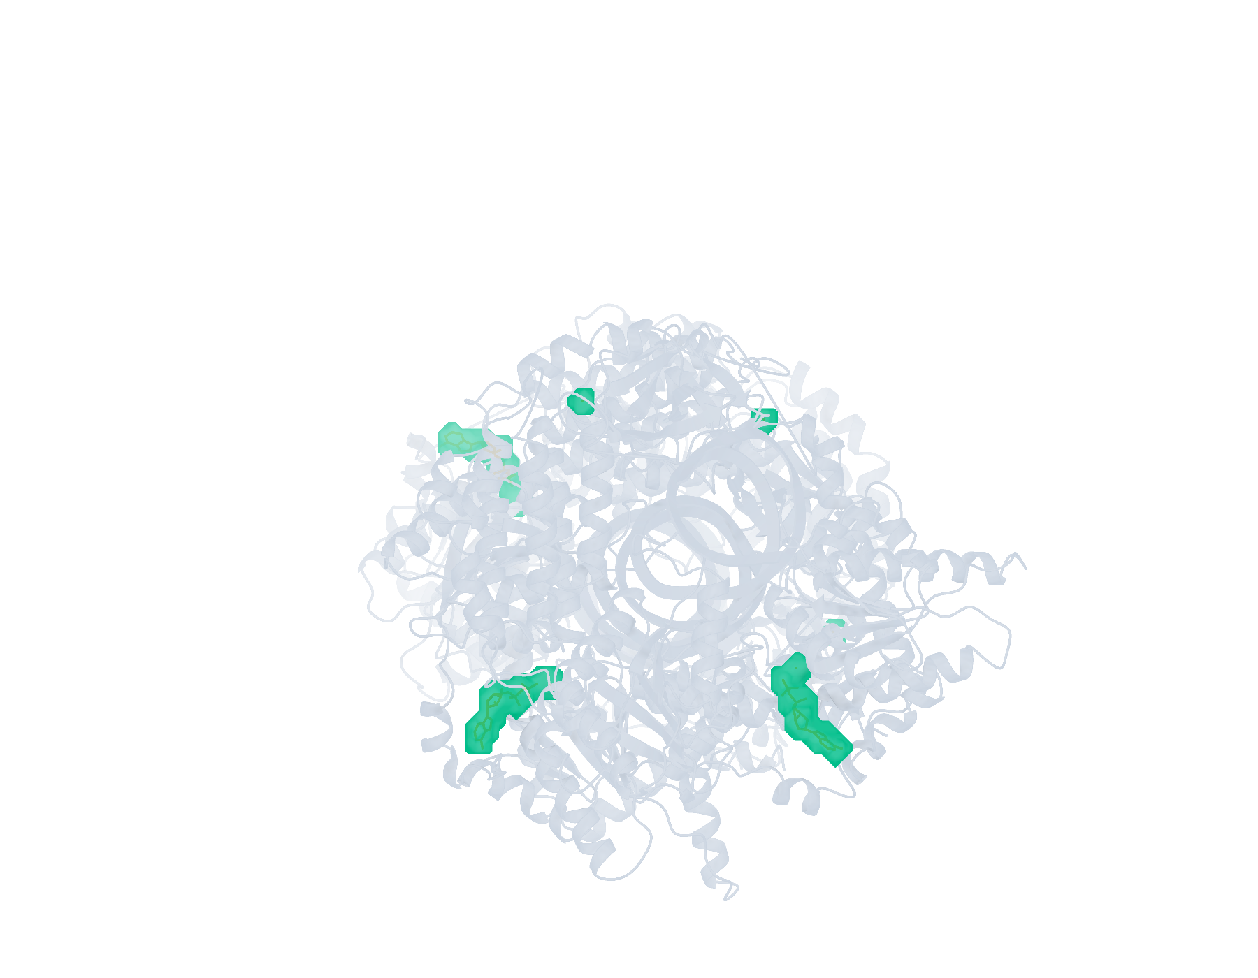
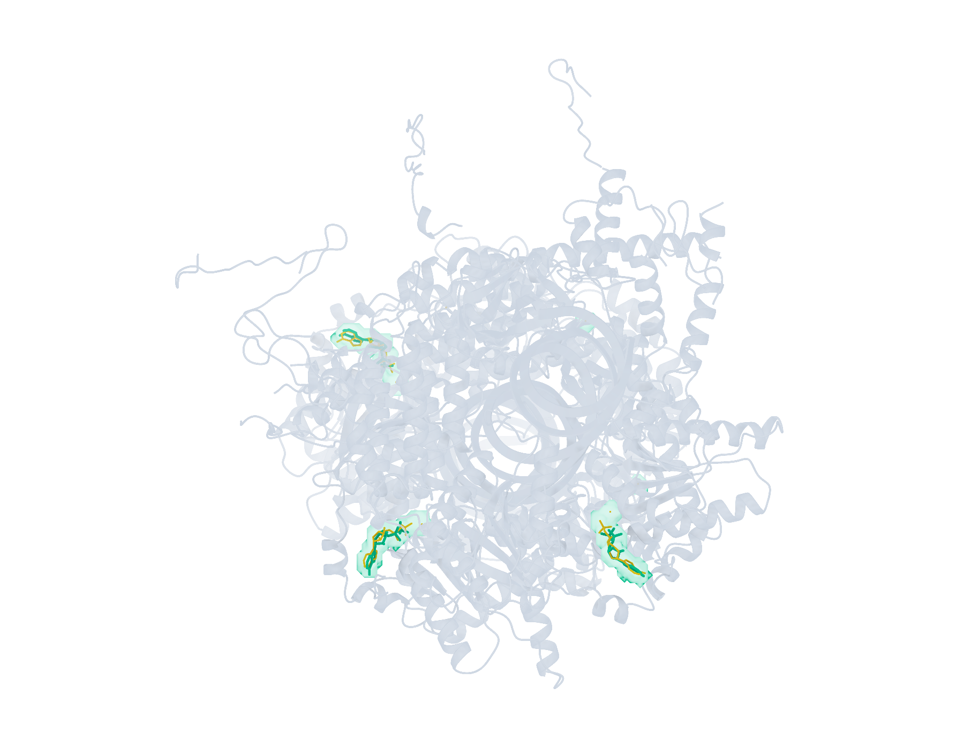
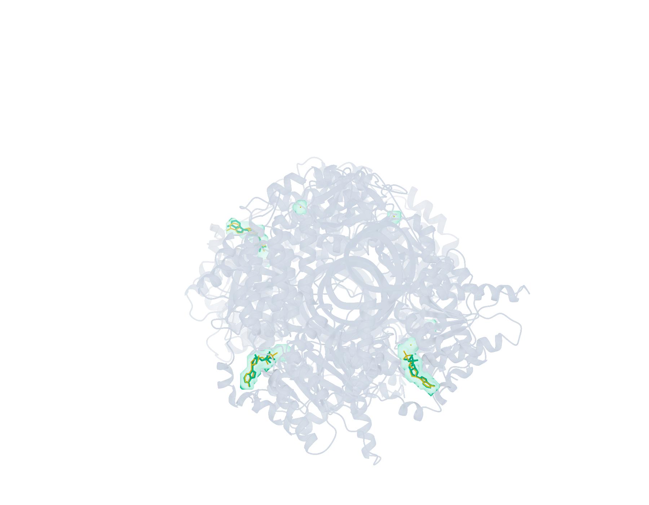
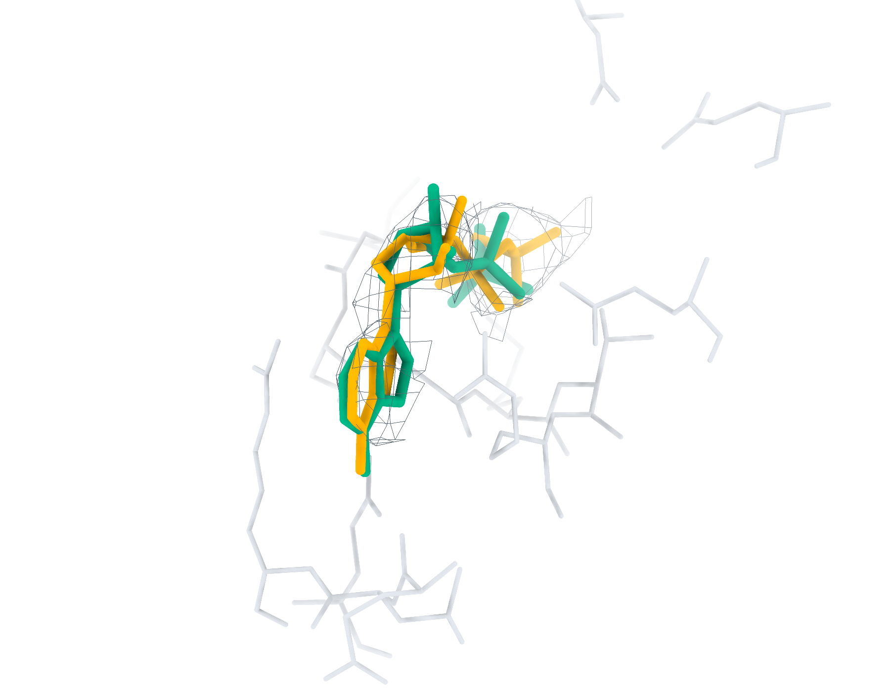
9LOV Ligand recognition and modelling
9 deposited ligands, 3 small molecules, 3 eligible for modelling
a
CA2 Find+Match 6/9
b
GT Find+Match 6/9
c
CA2 Pipeline top-1 < 2 Å 3/3
d
GT Pipeline top-1 < 2 Å 3/3
e
CA2 ADP RMSD 1.09 Å
f
GT ADP RMSD 1.04 Å
Find+Match: teal, correct identity. Pipeline: teal, RMSD < 2 Å; brown, ≥ 2 Å. Orange, reference.
Notes:
9LOV中的多配体识别与建模。复合物含9个沉积配体实例，其中小分子3个，满足单残基、无缺失原子、有机条件的建模实例3个。左、右列分别采用CryoAtom2重建受体（CA2）和沉积受体（GT）。a、b，LigandSeek-Find候选配体区域及LigandSeek-Match身份匹配。青绿色表示前景区域中的身份匹配正确，棕色表示其他候选，橙色为沉积配体。c、d，采用PocketXMol-tuned的LigandSeek Find–Match–Build完整流水线首选构象。青绿色和棕色构象的重原子RMSD分别低于和不低于2 Å。标签列出100%尝试预算下的完成实例数/目标实例数；a、b以全配体实例数为预算基数，c、d以合格小分子实例数为基数。e、f，局部实验密度（灰色网格）、5 Å内的受体残基、沉积构象（橙色）和已有完整流水线首选构象（青绿色）。CA2: ADP (B:1101), 首选构象RMSD 1.09 Å；GT: ADP (B:1101), 首选构象RMSD 1.04 Å。局部沿用相同完整流水线预算。不同复合物总览的显示比例不同。
ENGLISH:
Multi-ligand recognition and modelling in 9LOV. The complex contains 9 deposited ligand instances, including 3 small molecules and 3 single-residue, complete organic small molecules eligible for modelling. Left and right columns use the CryoAtom2-reconstructed (CA2) and deposited (GT) receptor structures, respectively. a,b, LigandSeek-Find candidate ligand regions with LigandSeek-Match assignments. Teal denotes a correct identity at a foreground region, and brown denotes other candidates. Orange shows deposited ligands. c,d, Top-1 poses from the complete LigandSeek Find–Match–Build pipeline using PocketXMol-tuned. Teal and brown poses have heavy-atom root-mean-square deviation (RMSD) below and at least 2 Å, respectively. The labels give completed/target instance counts at 100% attempt budget. The budget equals the number of all ligand instances in a,b and eligible small-molecule instances in c,d. e,f, Selected local views with experimental density (grey mesh), receptor residues within 5 Å, deposited poses (orange) and available pipeline top-1 poses (teal). CA2: ADP (B:1101), top-1 RMSD 1.09 Å; GT: ADP (B:1101), top-1 RMSD 1.04 Å. Local views use the same pipeline budgets. Overview scales differ between complexes.

Slide 5
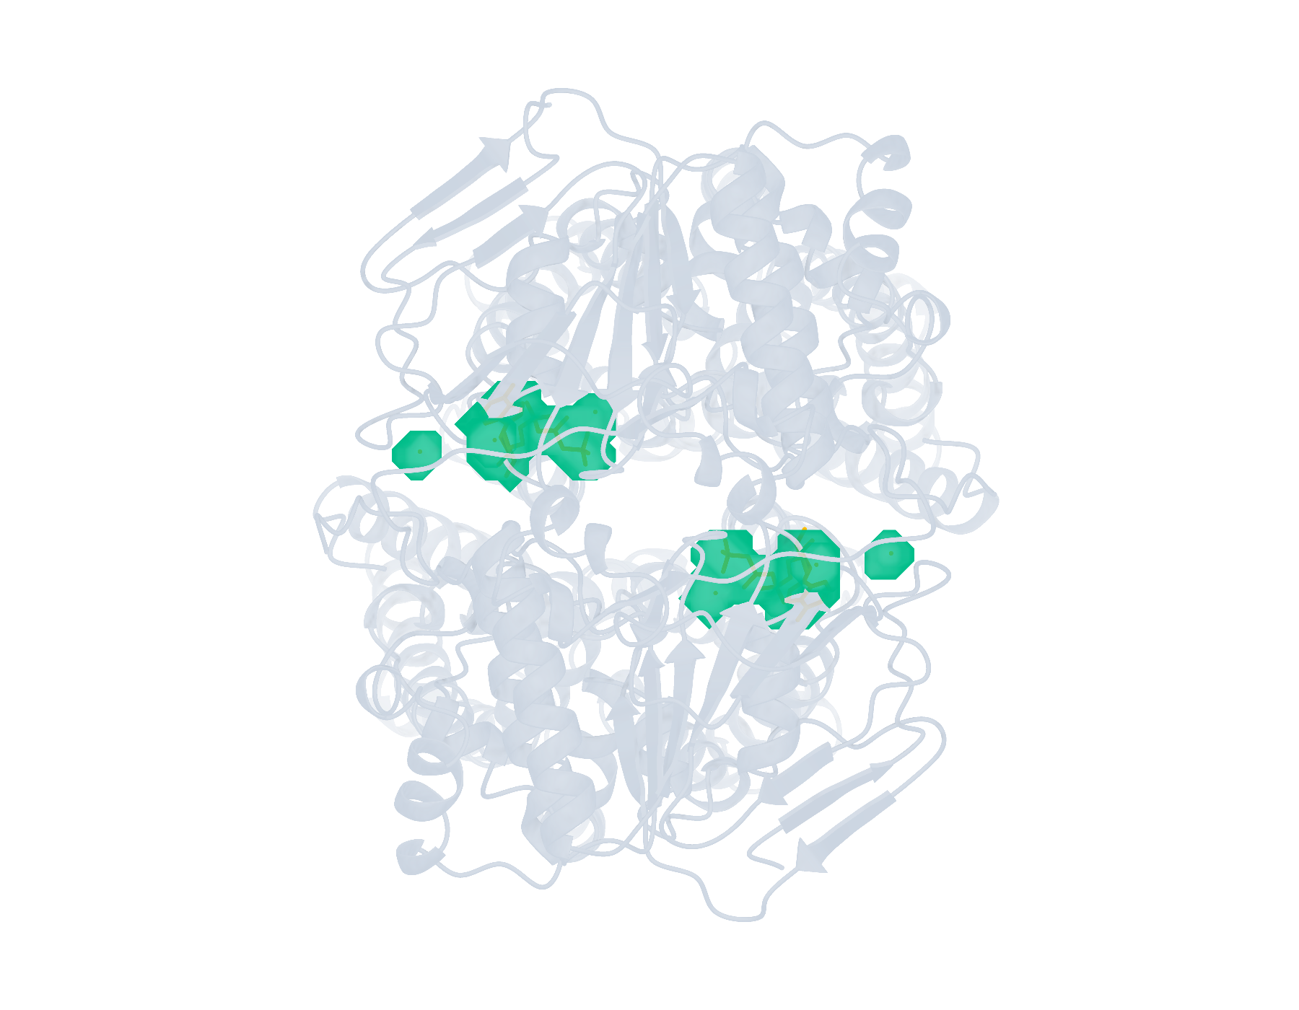
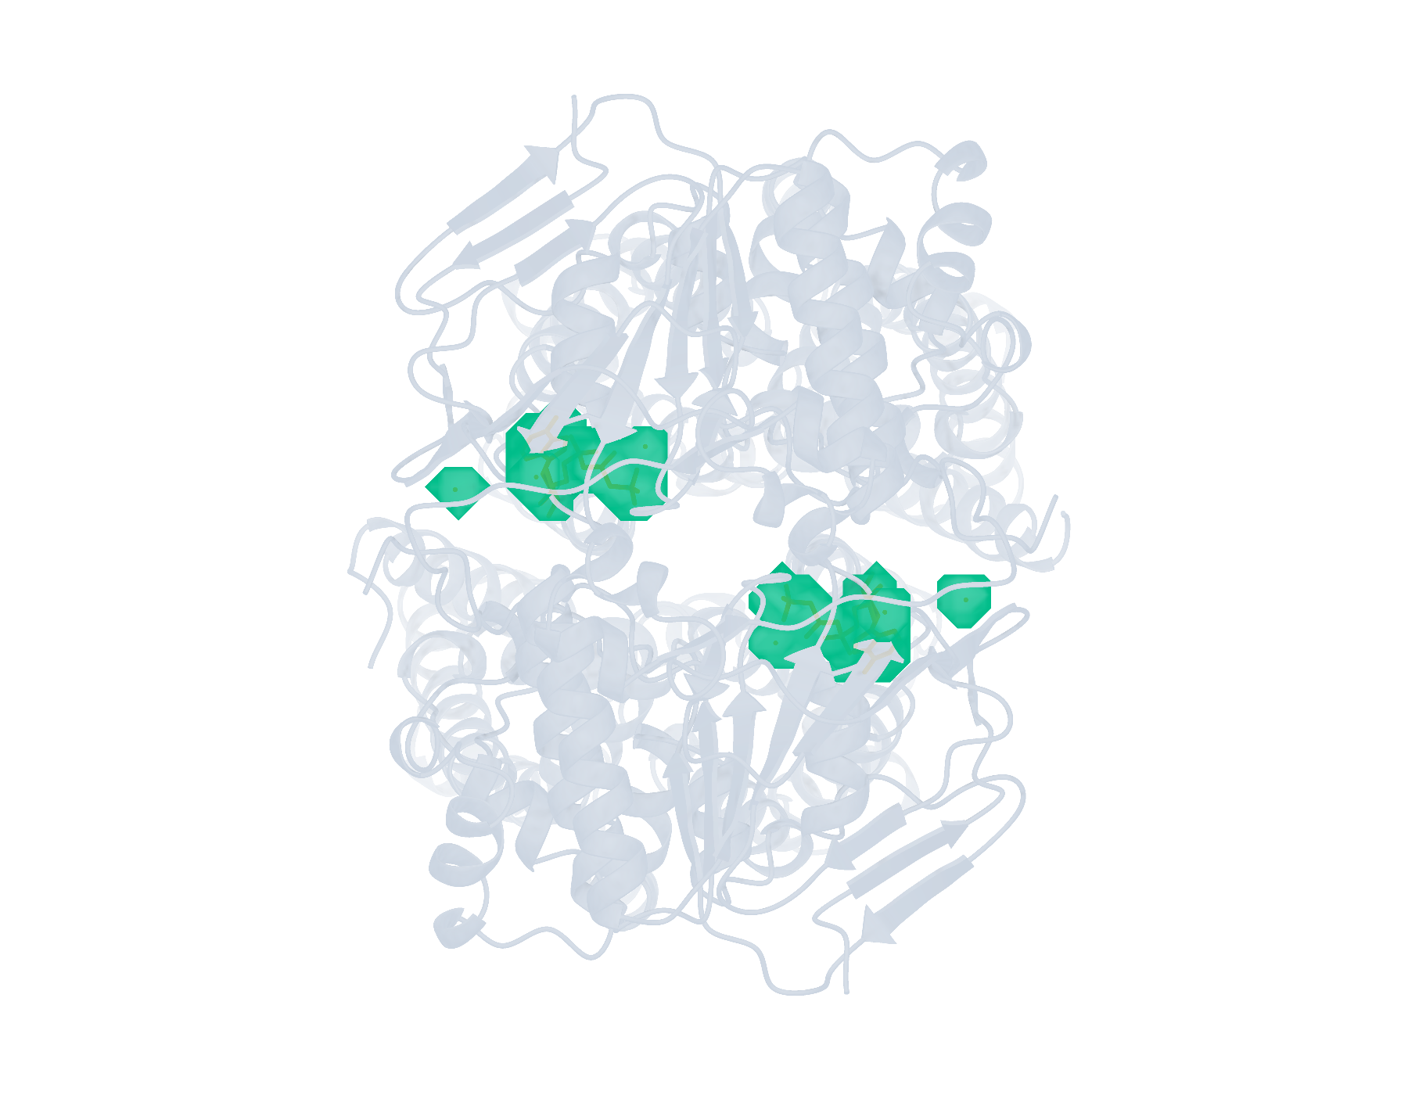
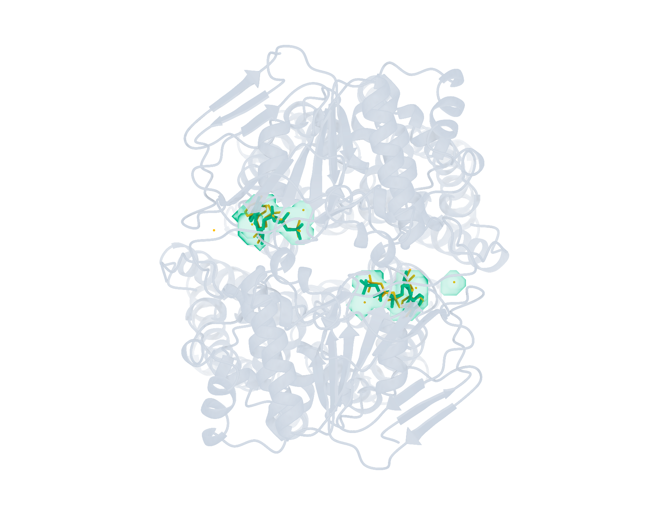
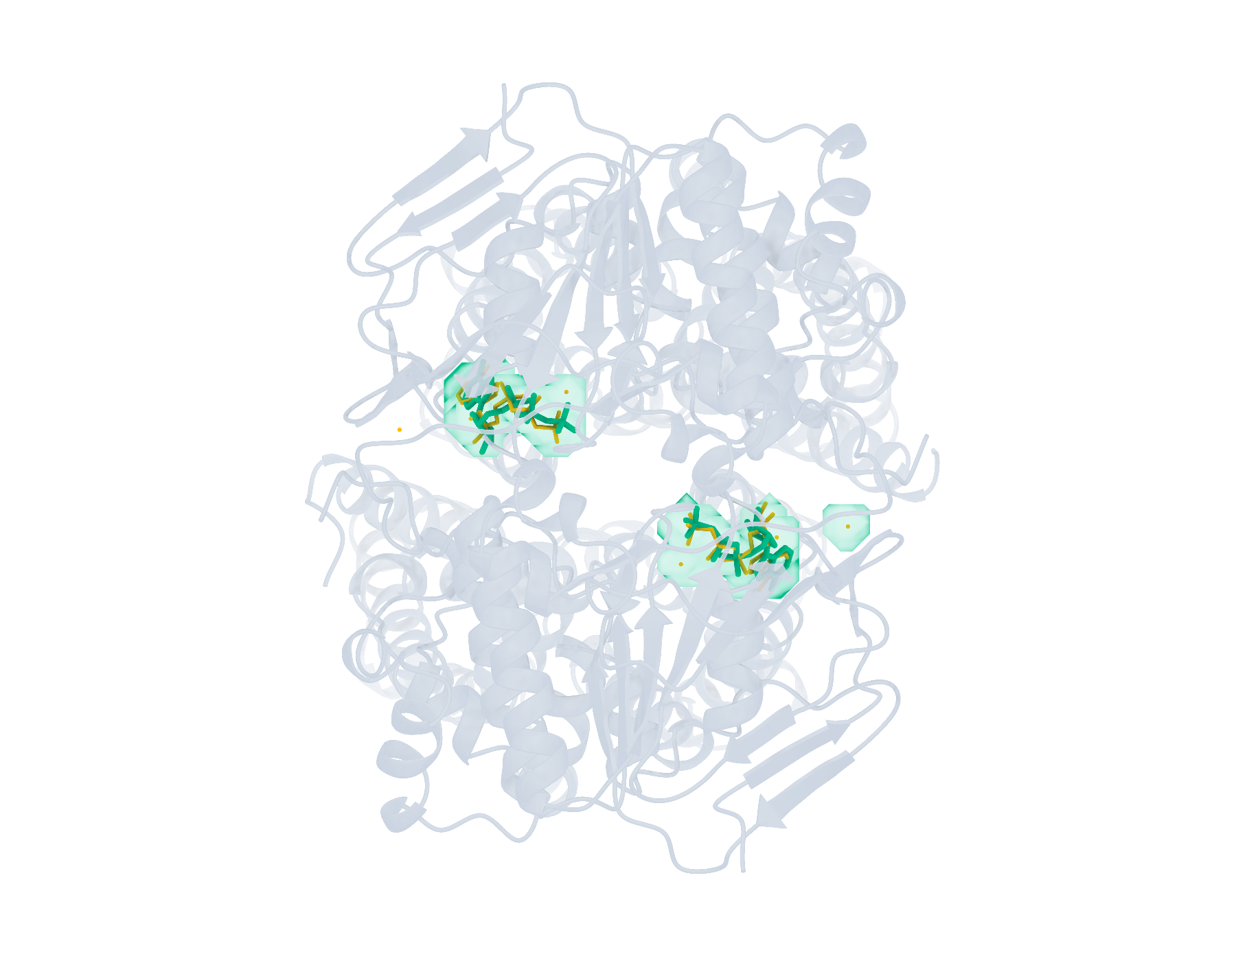
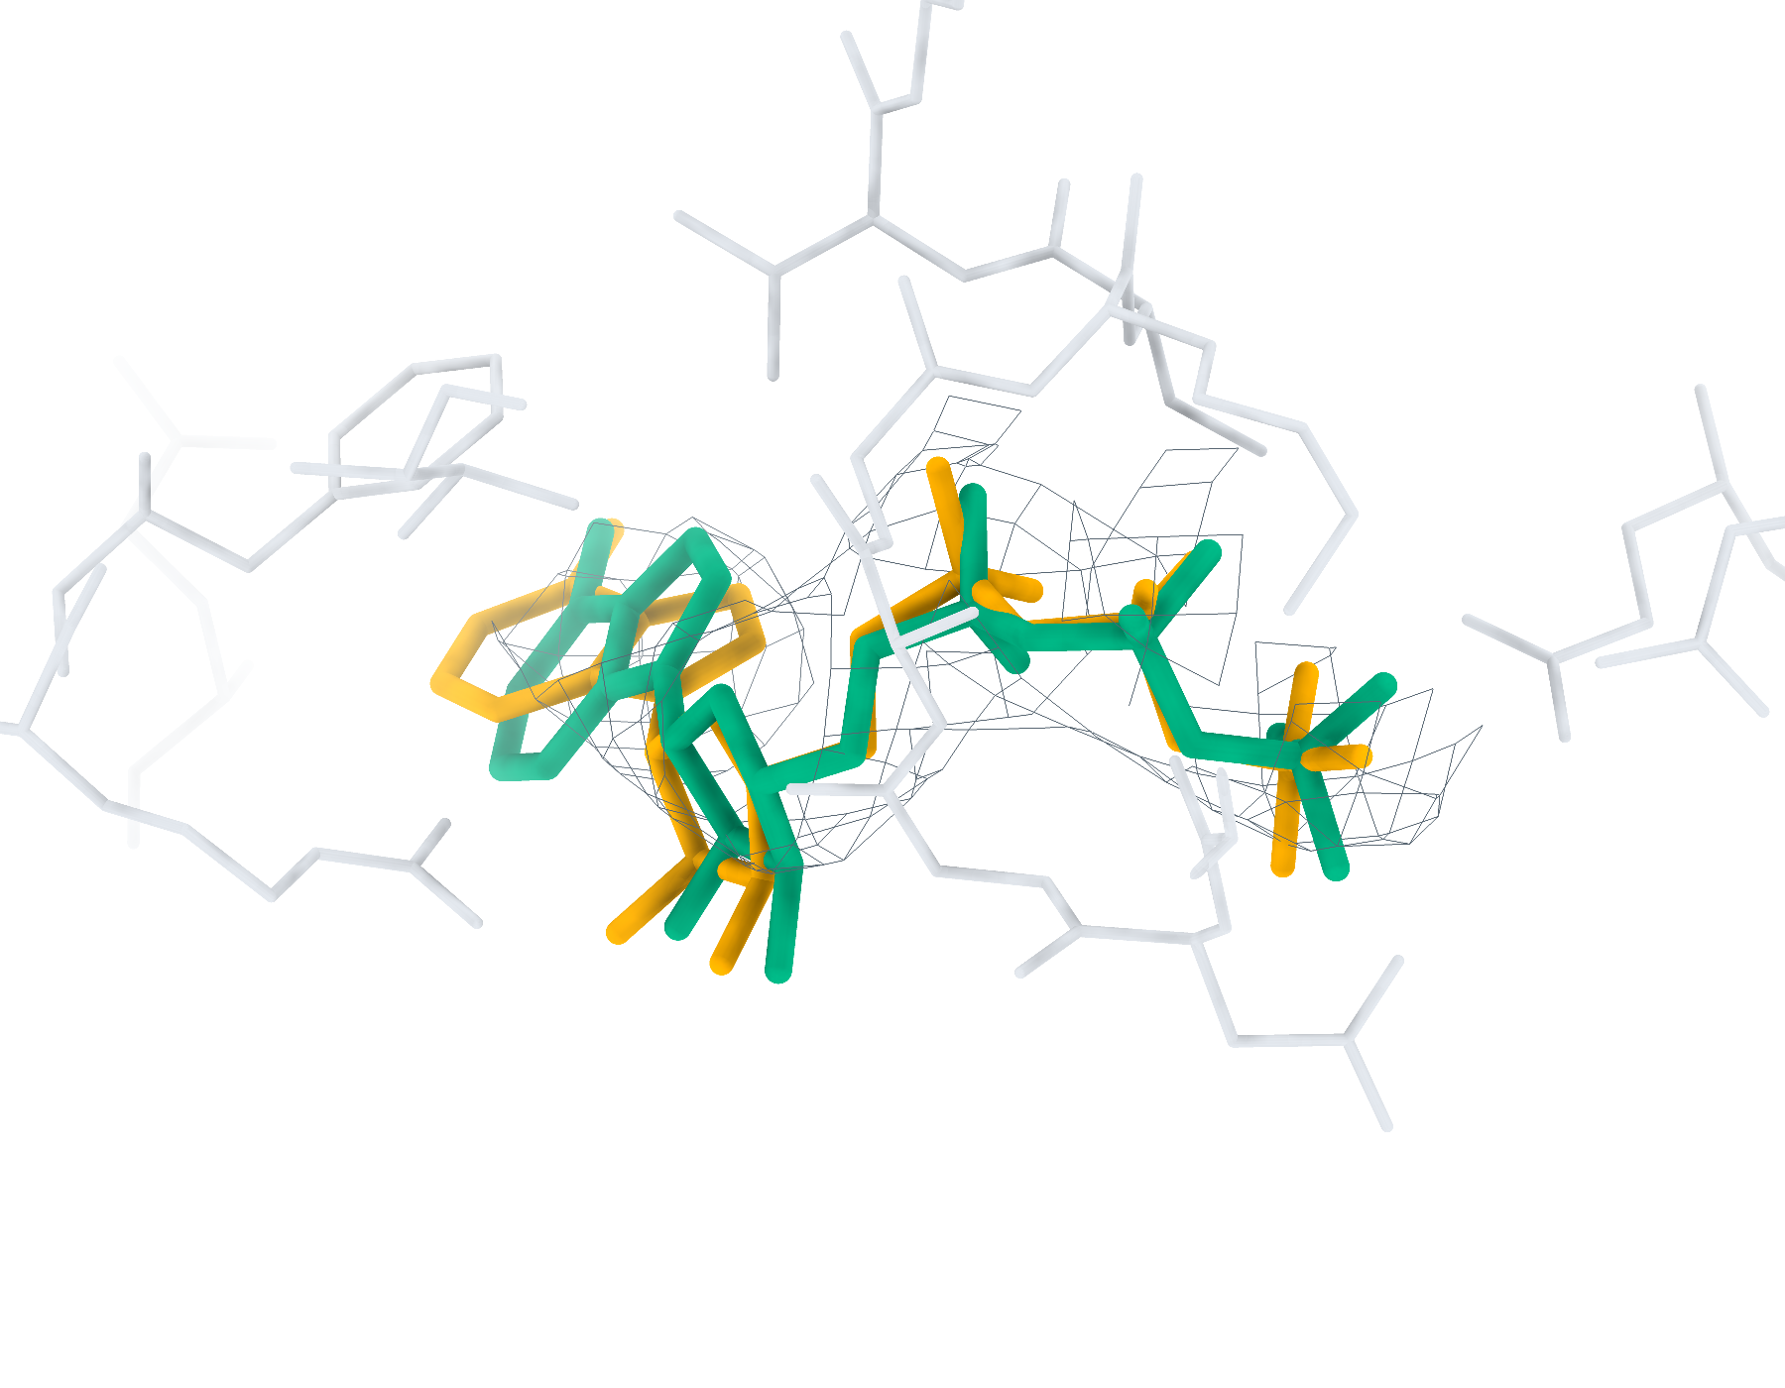
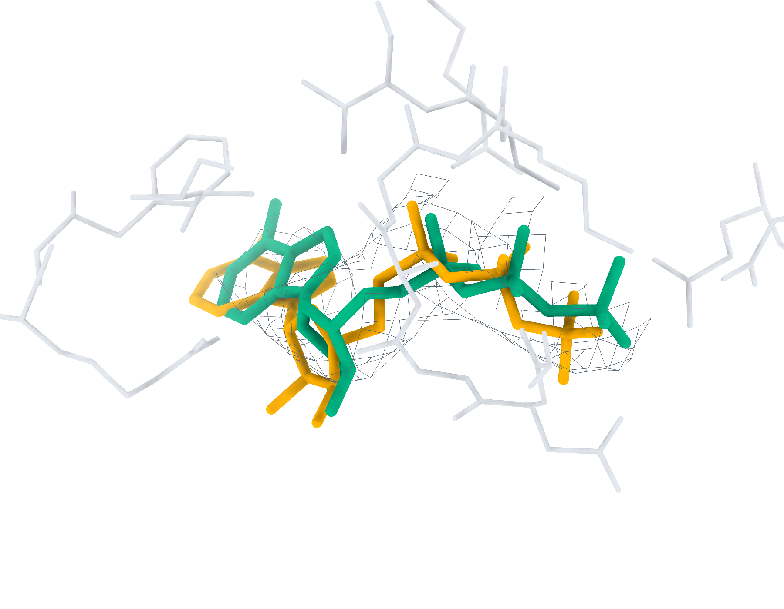
9OKP Ligand recognition and modelling
8 deposited ligands, 2 small molecules, 2 eligible for modelling
a
CA2 Find+Match 6/8
b
GT Find+Match 6/8
c
CA2 Pipeline top-1 < 2 Å 2/2
d
GT Pipeline top-1 < 2 Å 2/2
e
CA2 ATP RMSD 0.89 Å
f
GT ATP RMSD 1.31 Å
Find+Match: teal, correct identity. Pipeline: teal, RMSD < 2 Å; brown, ≥ 2 Å. Orange, reference.
Notes:
9OKP中的多配体识别与建模。复合物含8个沉积配体实例，其中小分子2个，满足单残基、无缺失原子、有机条件的建模实例2个。左、右列分别采用CryoAtom2重建受体（CA2）和沉积受体（GT）。a、b，LigandSeek-Find候选配体区域及LigandSeek-Match身份匹配。青绿色表示前景区域中的身份匹配正确，棕色表示其他候选，橙色为沉积配体。c、d，采用PocketXMol-tuned的LigandSeek Find–Match–Build完整流水线首选构象。青绿色和棕色构象的重原子RMSD分别低于和不低于2 Å。标签列出100%尝试预算下的完成实例数/目标实例数；a、b以全配体实例数为预算基数，c、d以合格小分子实例数为基数。e、f，局部实验密度（灰色网格）、5 Å内的受体残基、沉积构象（橙色）和已有完整流水线首选构象（青绿色）。CA2: ATP (E:301), 首选构象RMSD 0.89 Å；GT: ATP (E:301), 首选构象RMSD 1.31 Å。局部沿用相同完整流水线预算。不同复合物总览的显示比例不同。
ENGLISH:
Multi-ligand recognition and modelling in 9OKP. The complex contains 8 deposited ligand instances, including 2 small molecules and 2 single-residue, complete organic small molecules eligible for modelling. Left and right columns use the CryoAtom2-reconstructed (CA2) and deposited (GT) receptor structures, respectively. a,b, LigandSeek-Find candidate ligand regions with LigandSeek-Match assignments. Teal denotes a correct identity at a foreground region, and brown denotes other candidates. Orange shows deposited ligands. c,d, Top-1 poses from the complete LigandSeek Find–Match–Build pipeline using PocketXMol-tuned. Teal and brown poses have heavy-atom root-mean-square deviation (RMSD) below and at least 2 Å, respectively. The labels give completed/target instance counts at 100% attempt budget. The budget equals the number of all ligand instances in a,b and eligible small-molecule instances in c,d. e,f, Selected local views with experimental density (grey mesh), receptor residues within 5 Å, deposited poses (orange) and available pipeline top-1 poses (teal). CA2: ATP (E:301), top-1 RMSD 0.89 Å; GT: ATP (E:301), top-1 RMSD 1.31 Å. Local views use the same pipeline budgets. Overview scales differ between complexes.

Slide 6
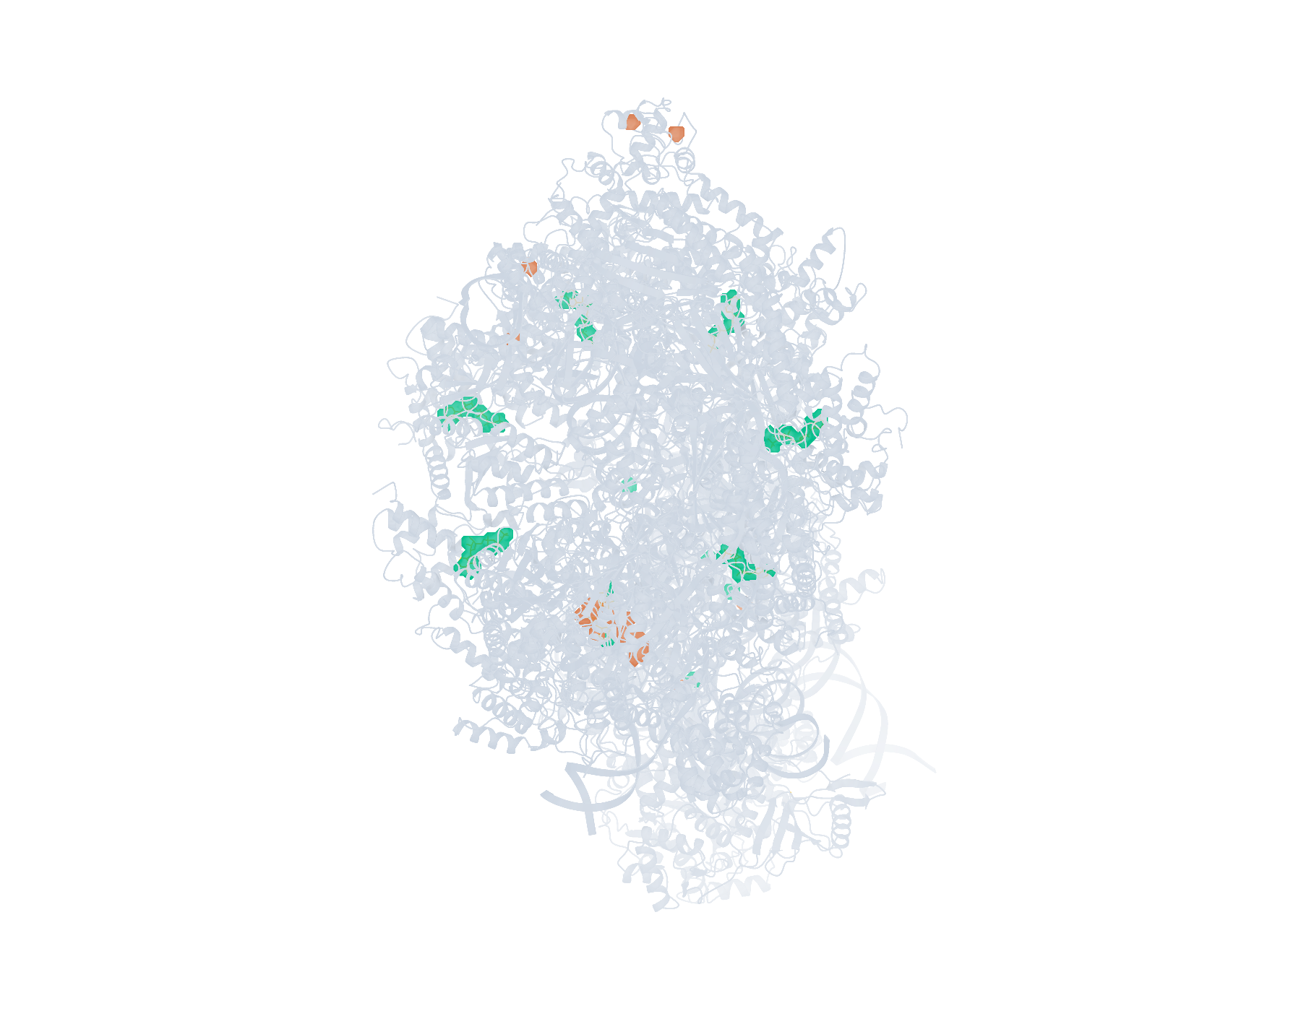
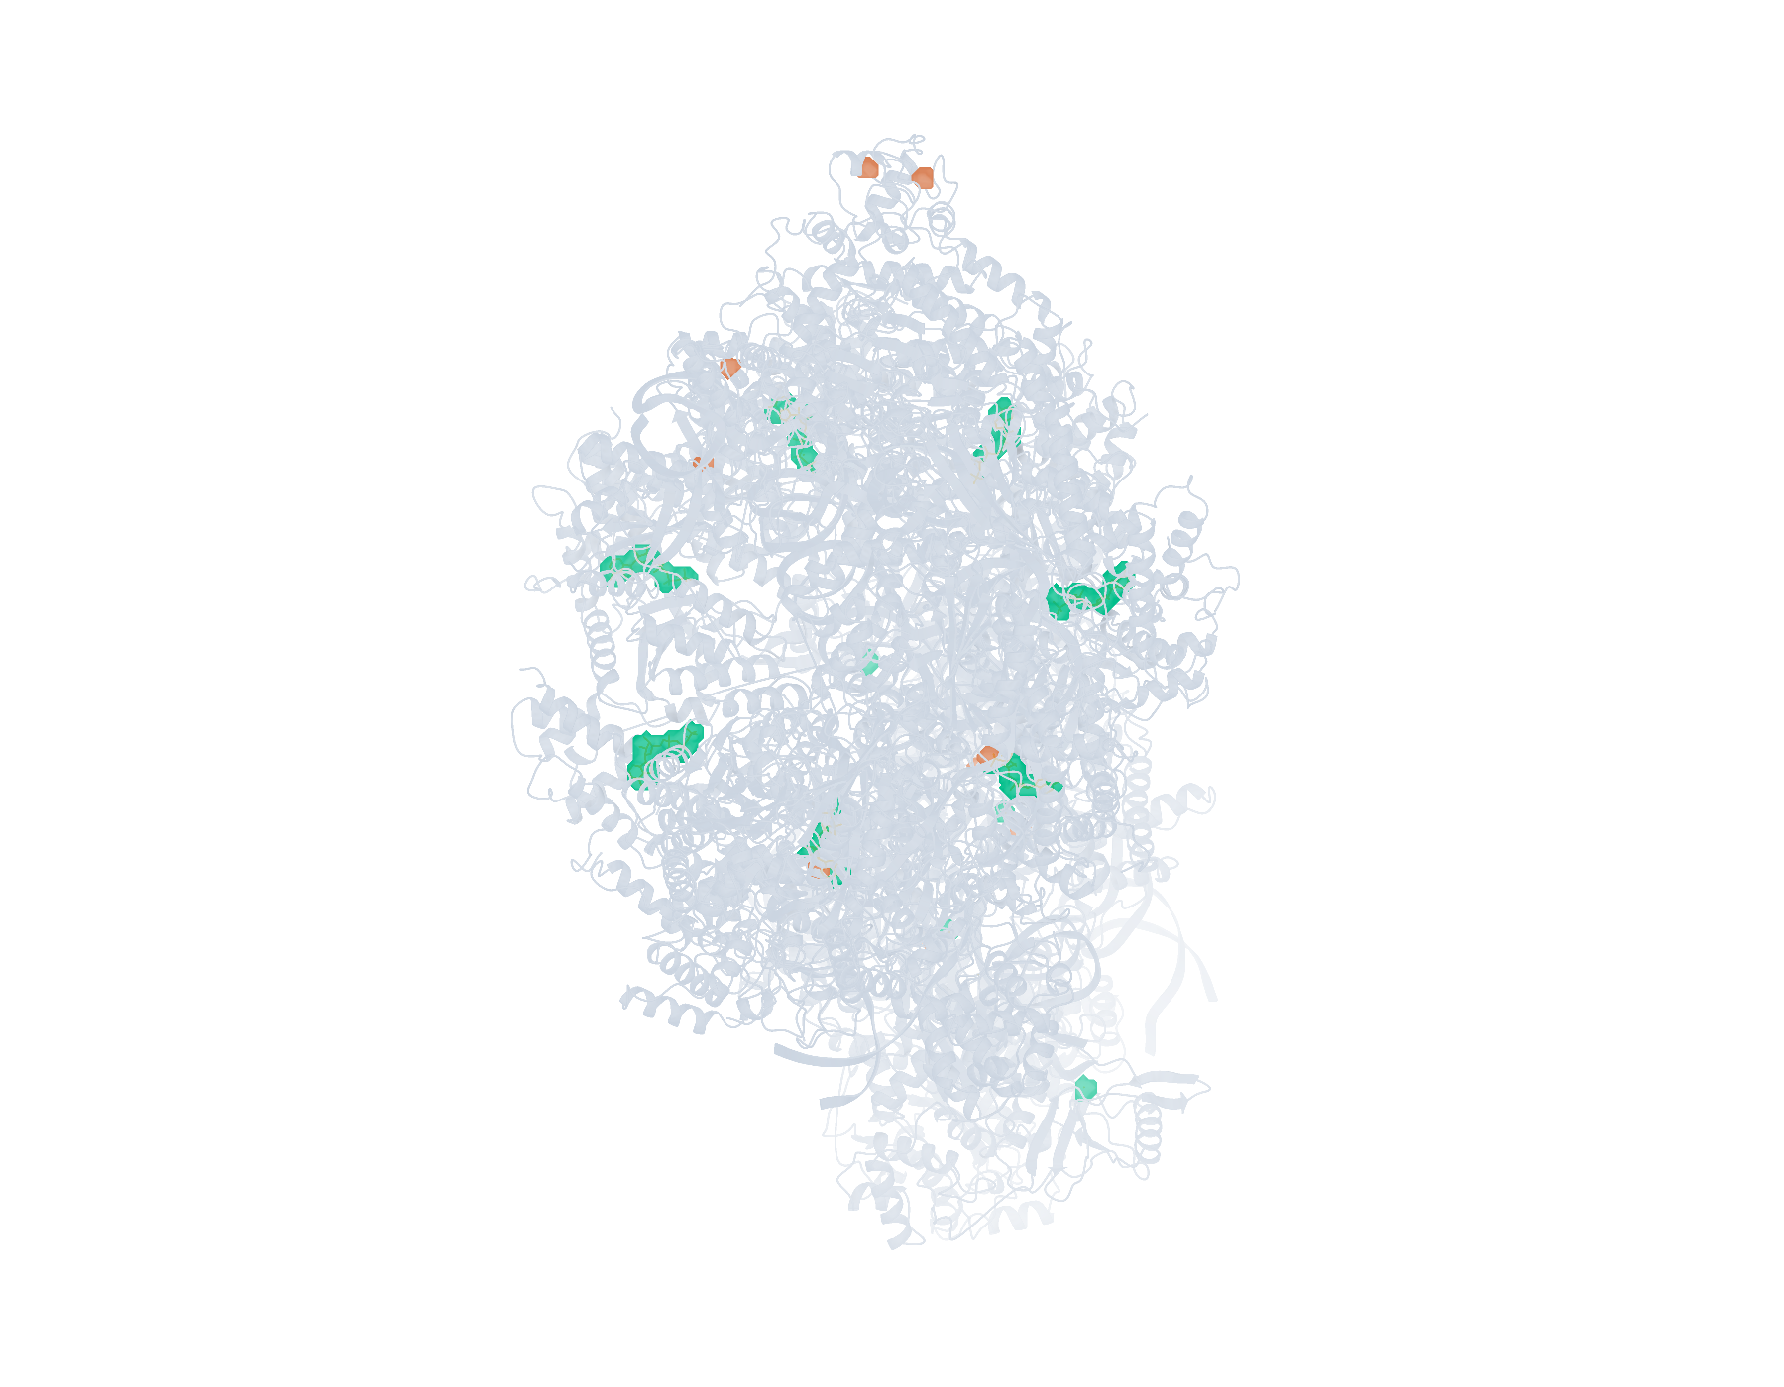
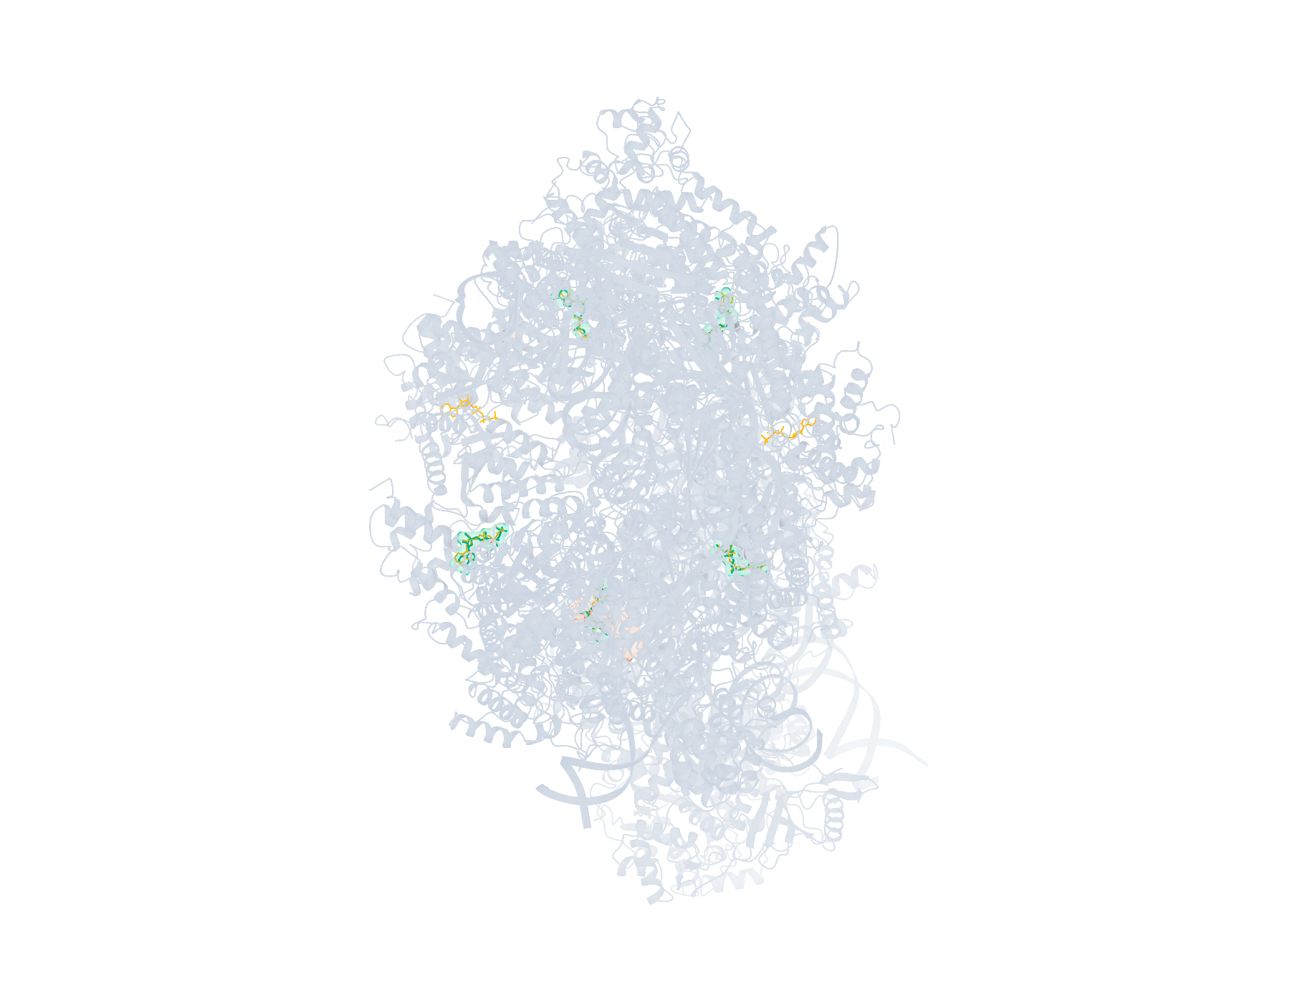
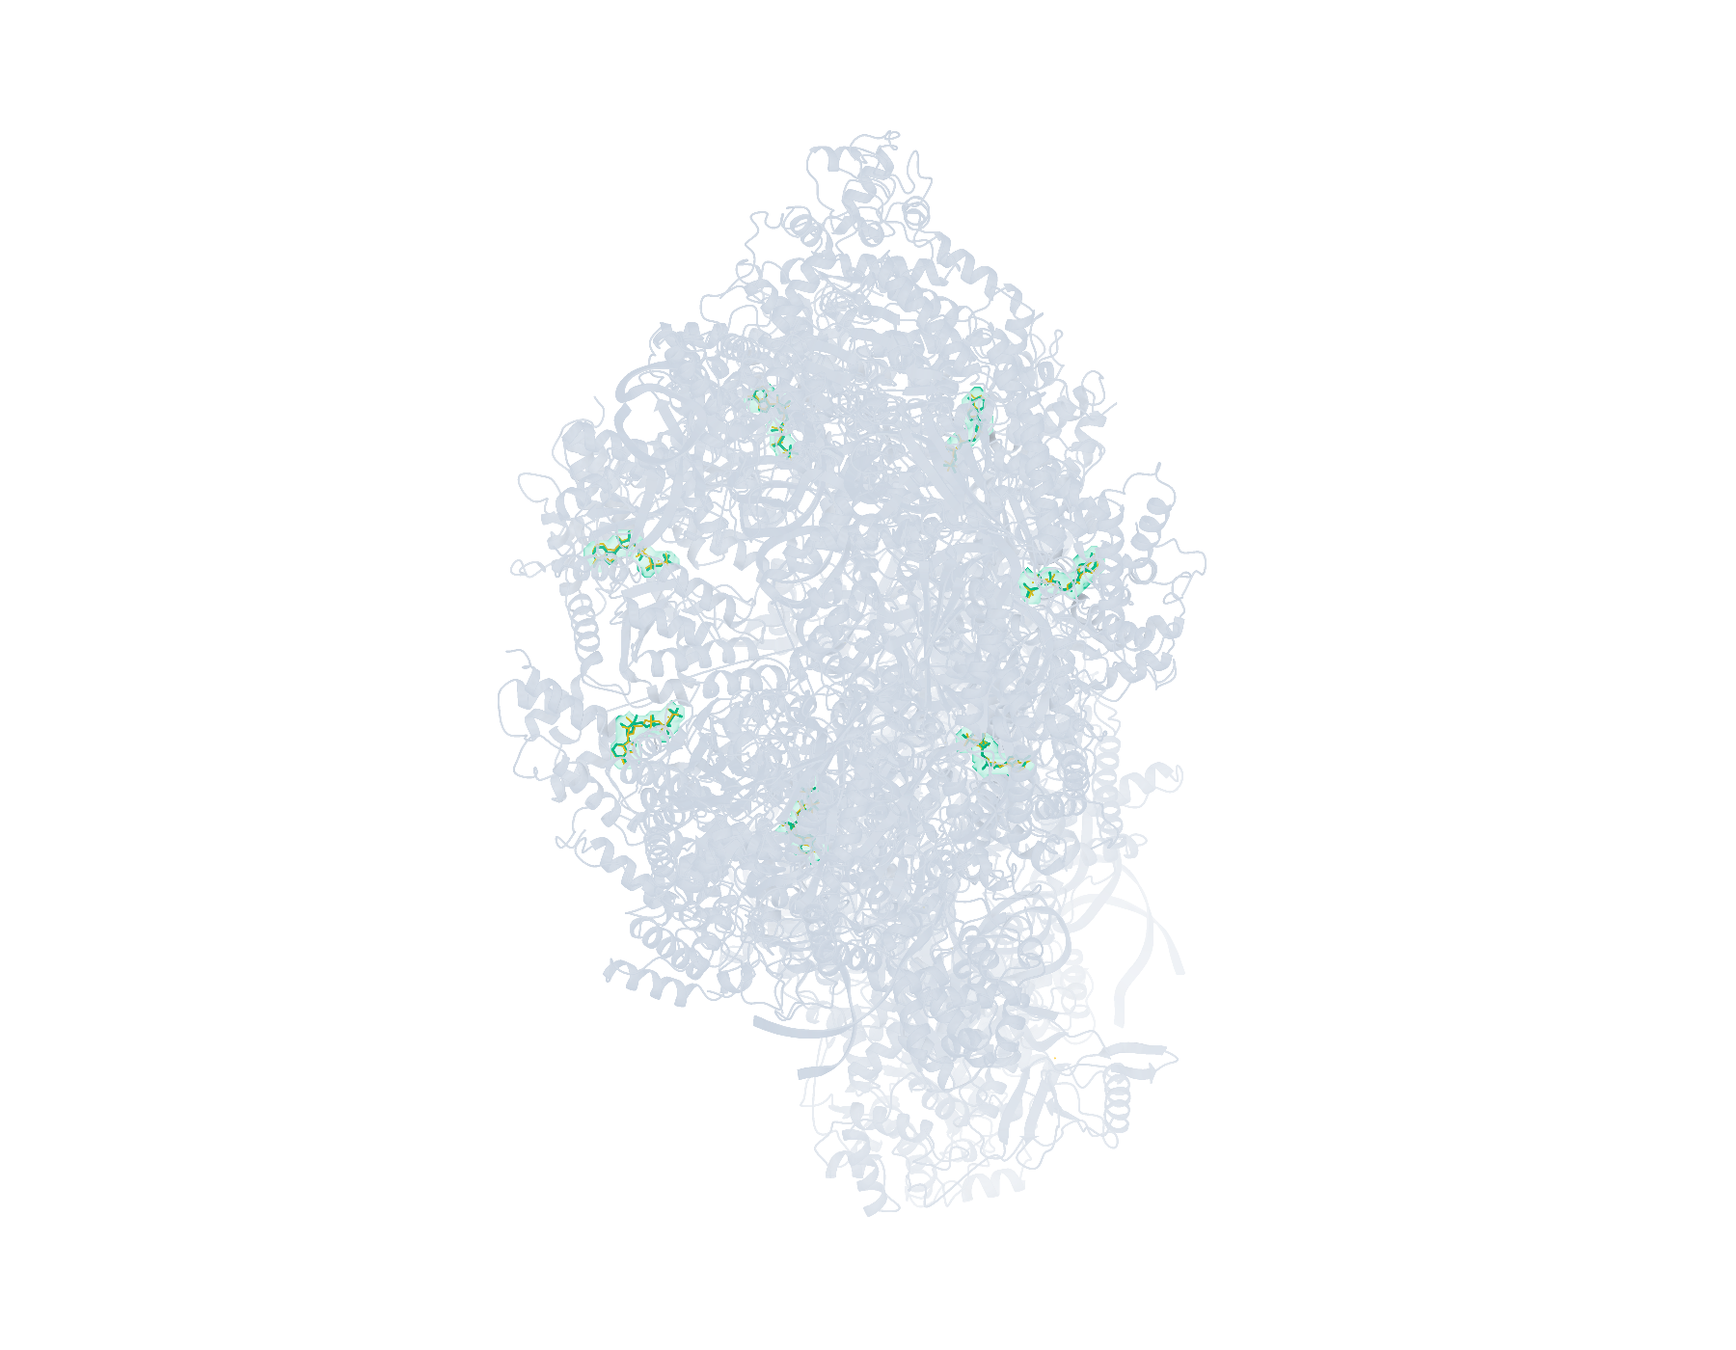
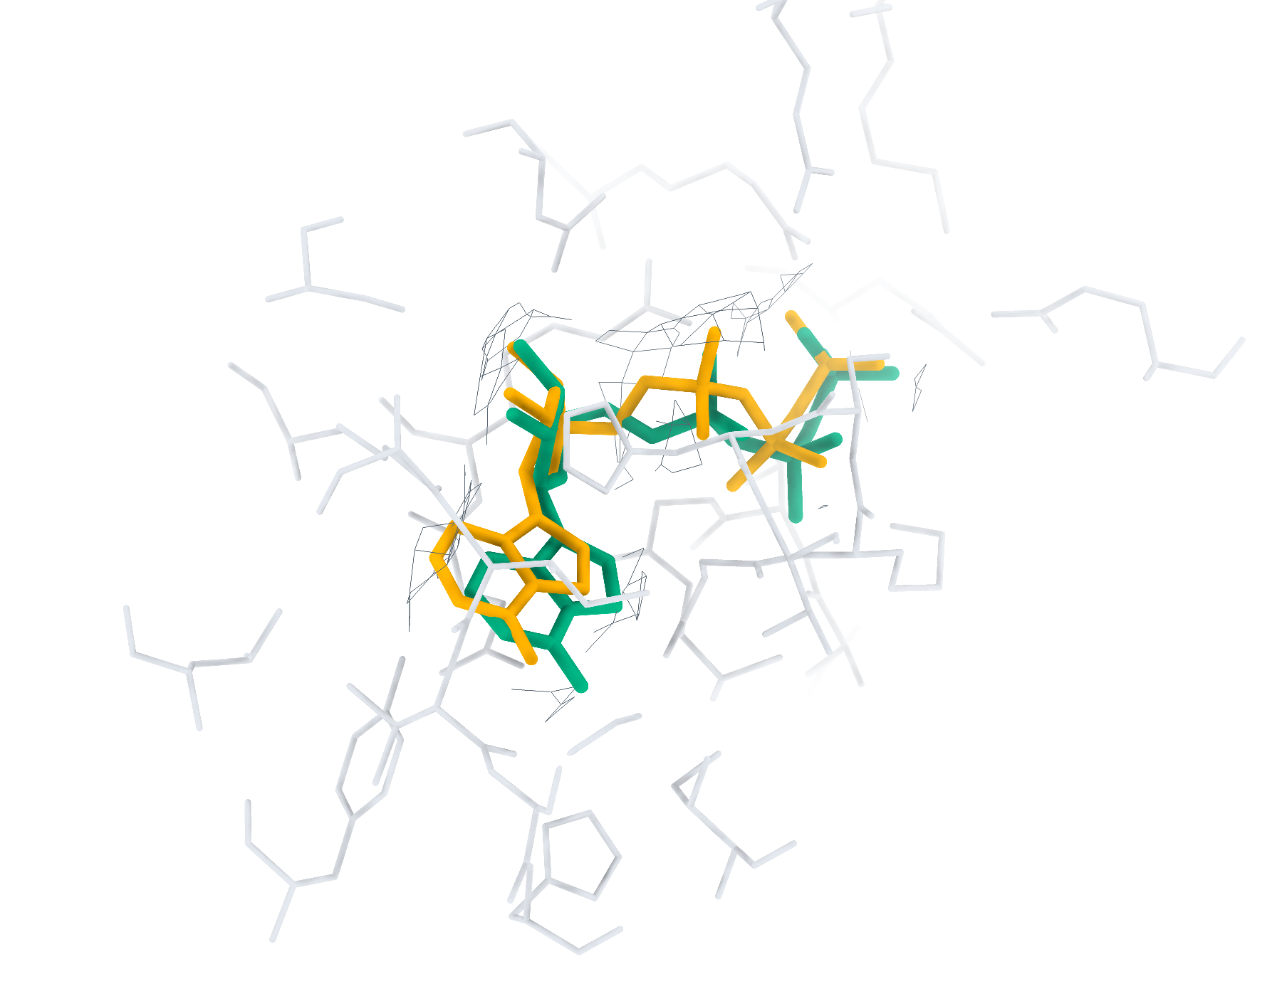
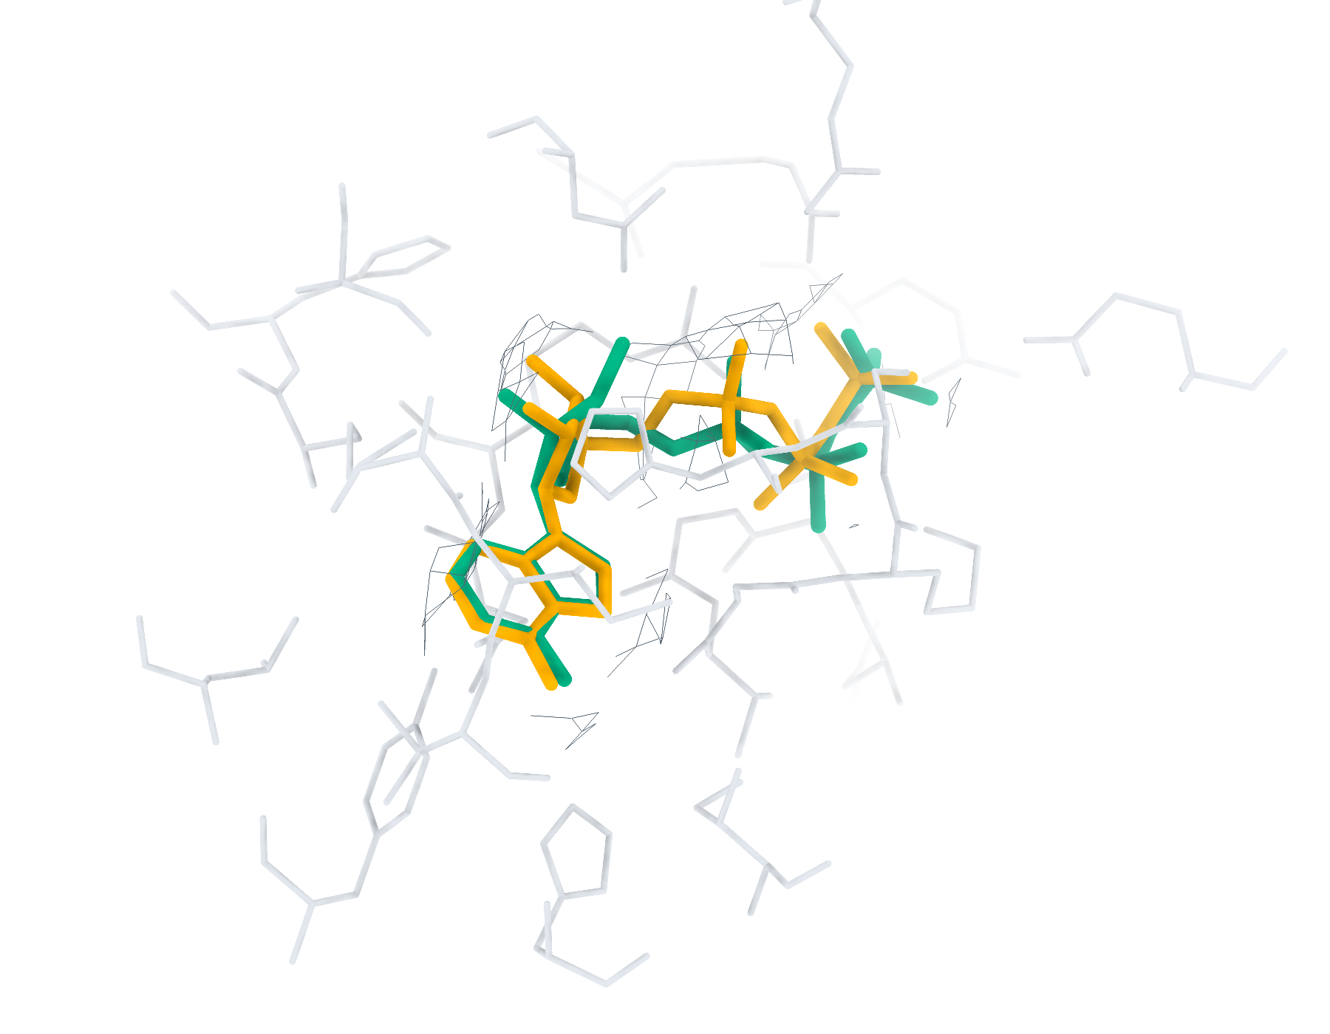
30GA Ligand recognition and modelling
20 deposited ligands, 7 small molecules, 7 eligible for modelling
a
CA2 Find+Match 11/20
b
GT Find+Match 11/20
c
CA2 Pipeline top-1 < 2 Å 5/7
d
GT Pipeline top-1 < 2 Å 7/7
e
CA2 ATP RMSD 1.04 Å
f
GT ATP RMSD 0.84 Å
Find+Match: teal, correct identity. Pipeline: teal, RMSD < 2 Å; brown, ≥ 2 Å. Orange, reference.
Notes:
30GA中的多配体识别与建模。复合物含20个沉积配体实例，其中小分子7个，满足单残基、无缺失原子、有机条件的建模实例7个。左、右列分别采用CryoAtom2重建受体（CA2）和沉积受体（GT）。a、b，LigandSeek-Find候选配体区域及LigandSeek-Match身份匹配。青绿色表示前景区域中的身份匹配正确，棕色表示其他候选，橙色为沉积配体。c、d，采用PocketXMol-tuned的LigandSeek Find–Match–Build完整流水线首选构象。青绿色和棕色构象的重原子RMSD分别低于和不低于2 Å。标签列出100%尝试预算下的完成实例数/目标实例数；a、b以全配体实例数为预算基数，c、d以合格小分子实例数为基数。e、f，局部实验密度（灰色网格）、5 Å内的受体残基、沉积构象（橙色）和已有完整流水线首选构象（青绿色）。CA2: ATP (N:401), 首选构象RMSD 1.04 Å；GT: ATP (N:401), 首选构象RMSD 0.84 Å。局部沿用相同完整流水线预算。不同复合物总览的显示比例不同。
ENGLISH:
Multi-ligand recognition and modelling in 30GA. The complex contains 20 deposited ligand instances, including 7 small molecules and 7 single-residue, complete organic small molecules eligible for modelling. Left and right columns use the CryoAtom2-reconstructed (CA2) and deposited (GT) receptor structures, respectively. a,b, LigandSeek-Find candidate ligand regions with LigandSeek-Match assignments. Teal denotes a correct identity at a foreground region, and brown denotes other candidates. Orange shows deposited ligands. c,d, Top-1 poses from the complete LigandSeek Find–Match–Build pipeline using PocketXMol-tuned. Teal and brown poses have heavy-atom root-mean-square deviation (RMSD) below and at least 2 Å, respectively. The labels give completed/target instance counts at 100% attempt budget. The budget equals the number of all ligand instances in a,b and eligible small-molecule instances in c,d. e,f, Selected local views with experimental density (grey mesh), receptor residues within 5 Å, deposited poses (orange) and available pipeline top-1 poses (teal). CA2: ATP (N:401), top-1 RMSD 1.04 Å; GT: ATP (N:401), top-1 RMSD 0.84 Å. Local views use the same pipeline budgets. Overview scales differ between complexes.

Slide 7
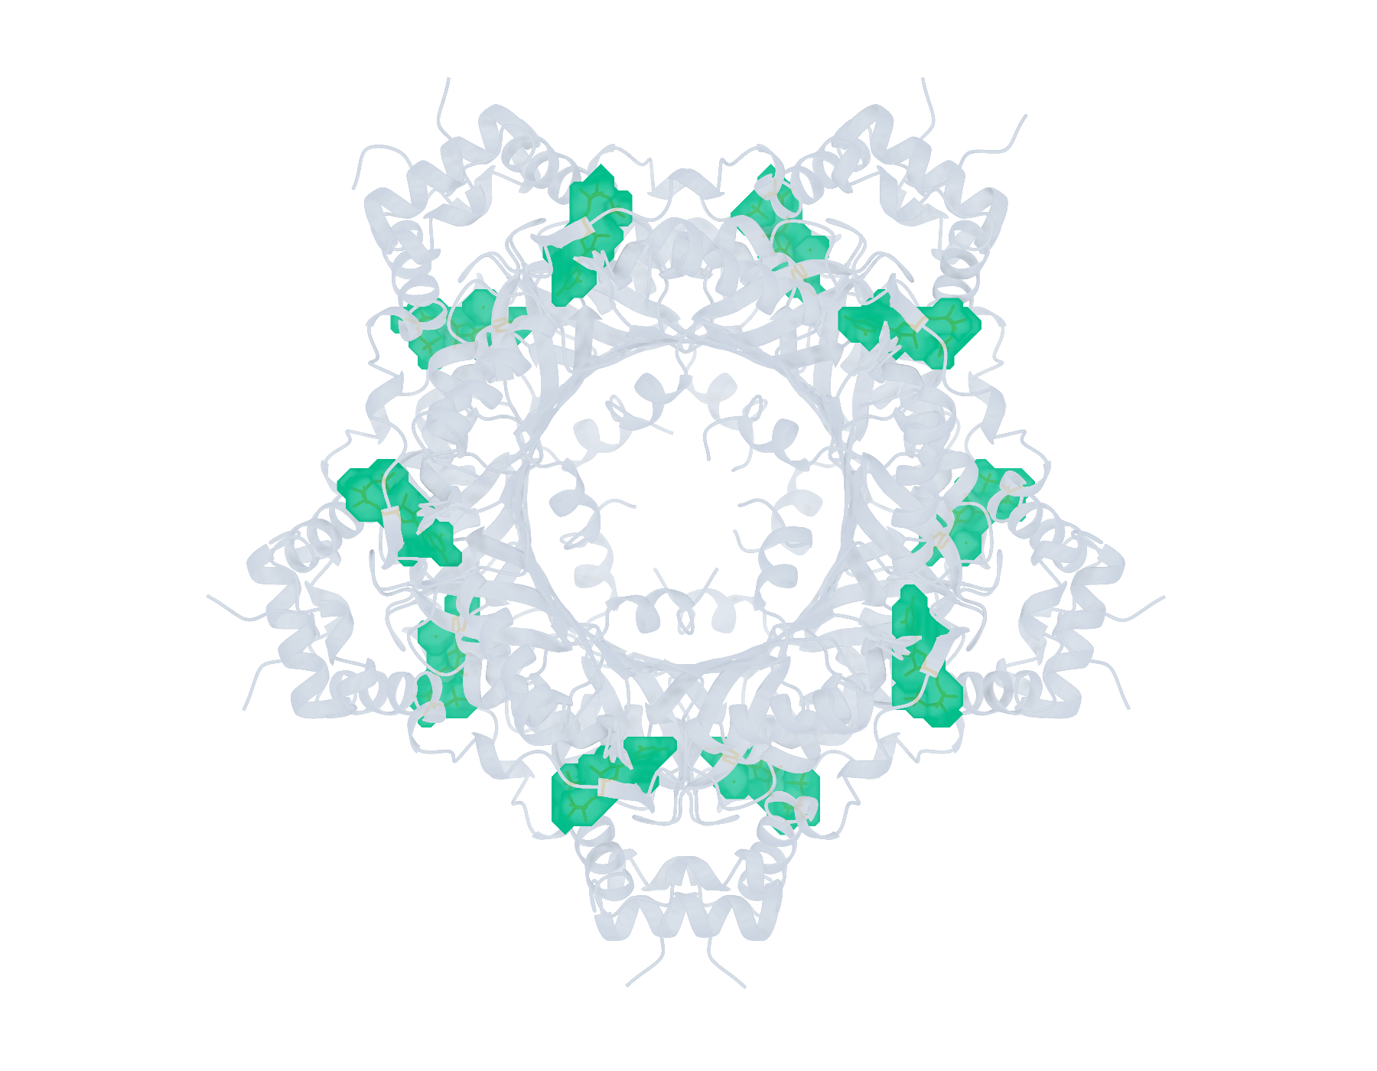
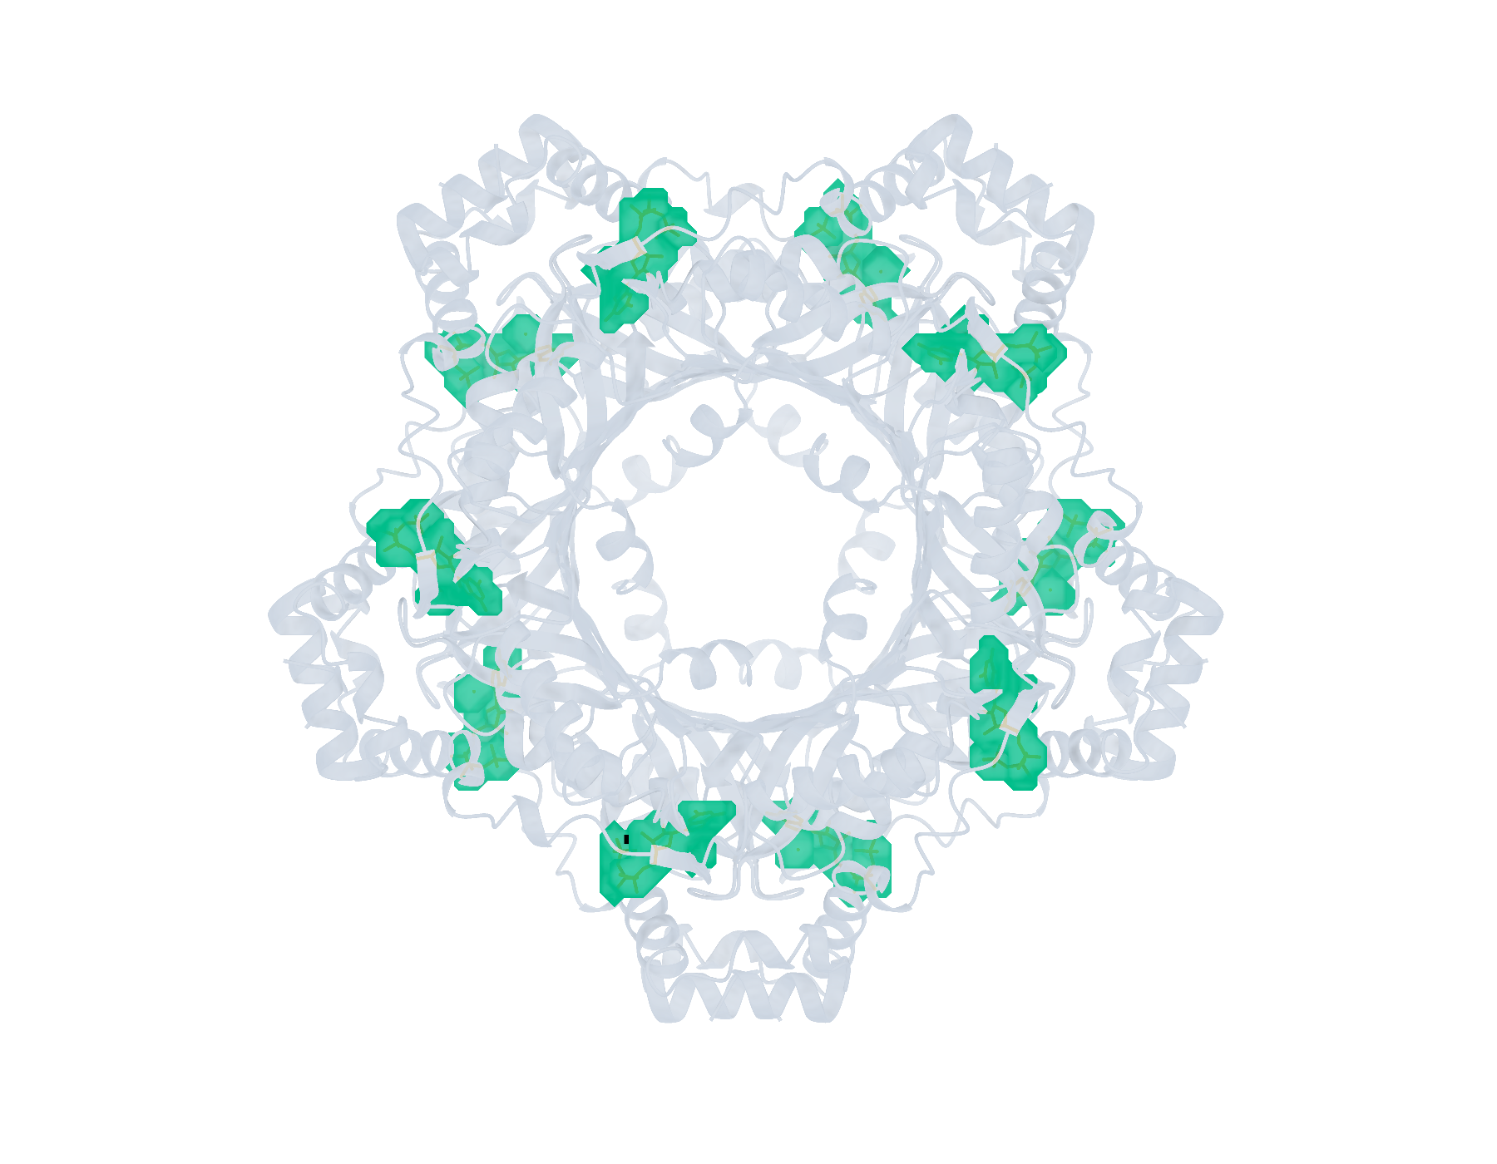
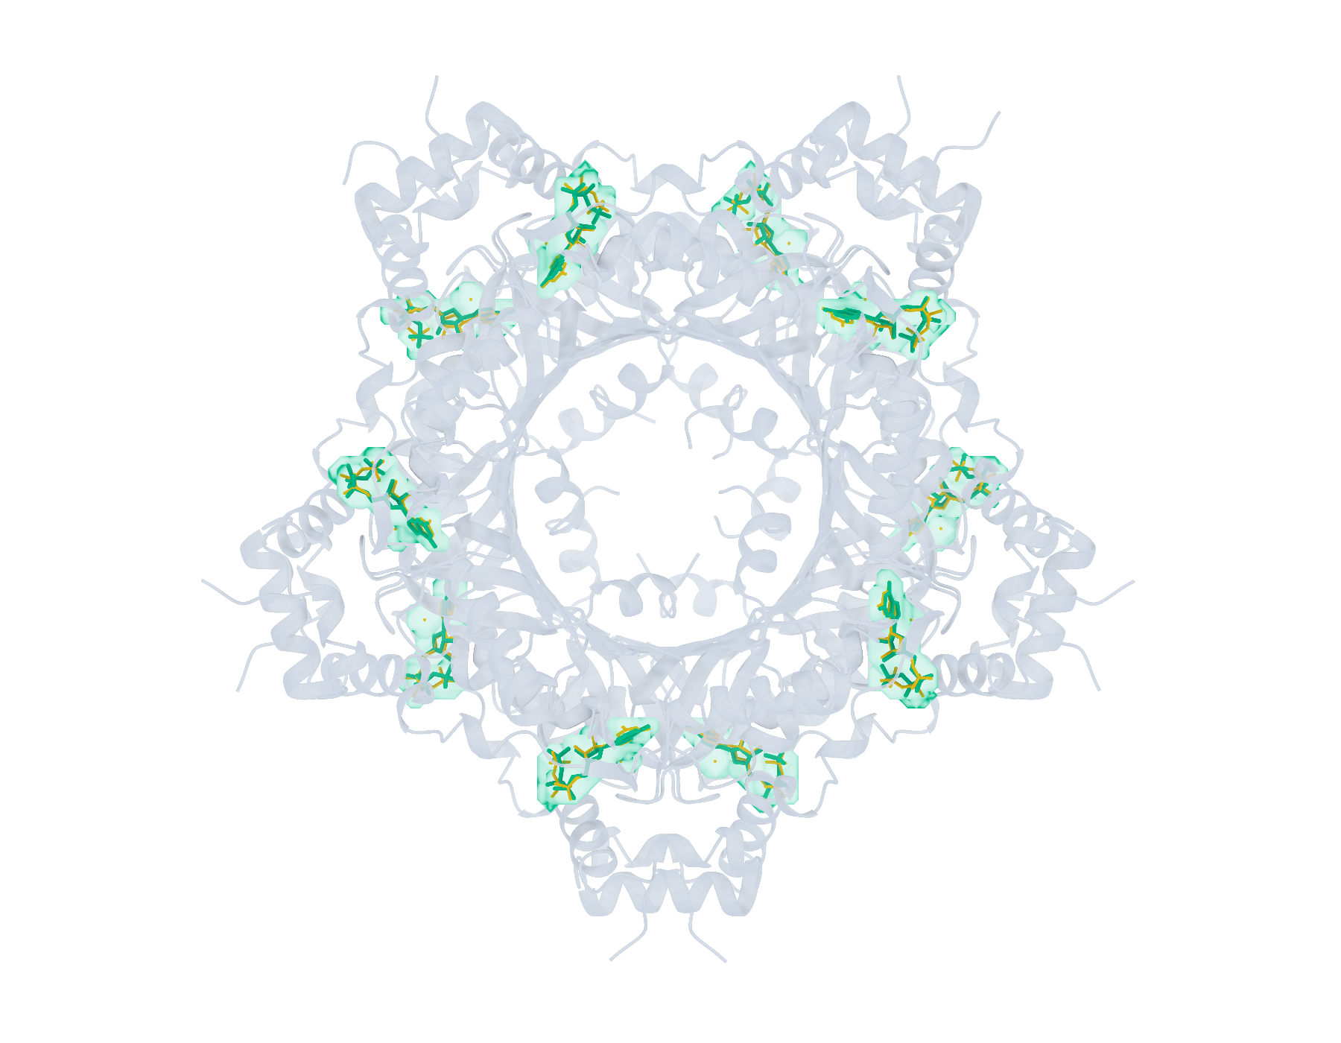
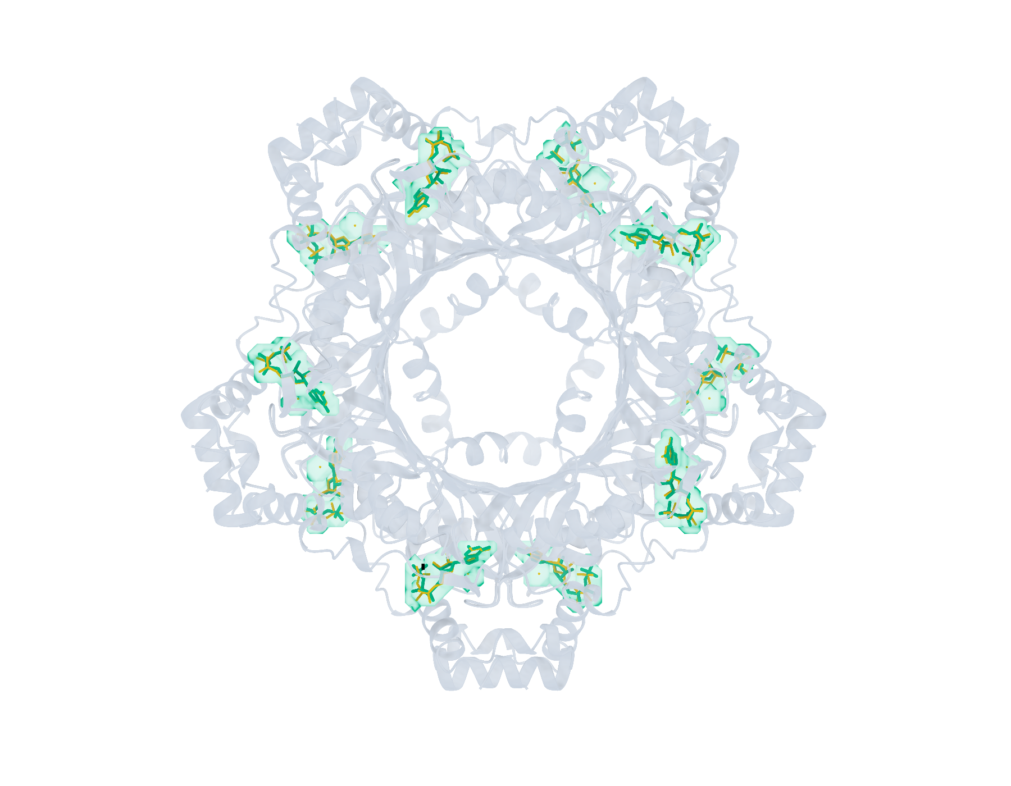
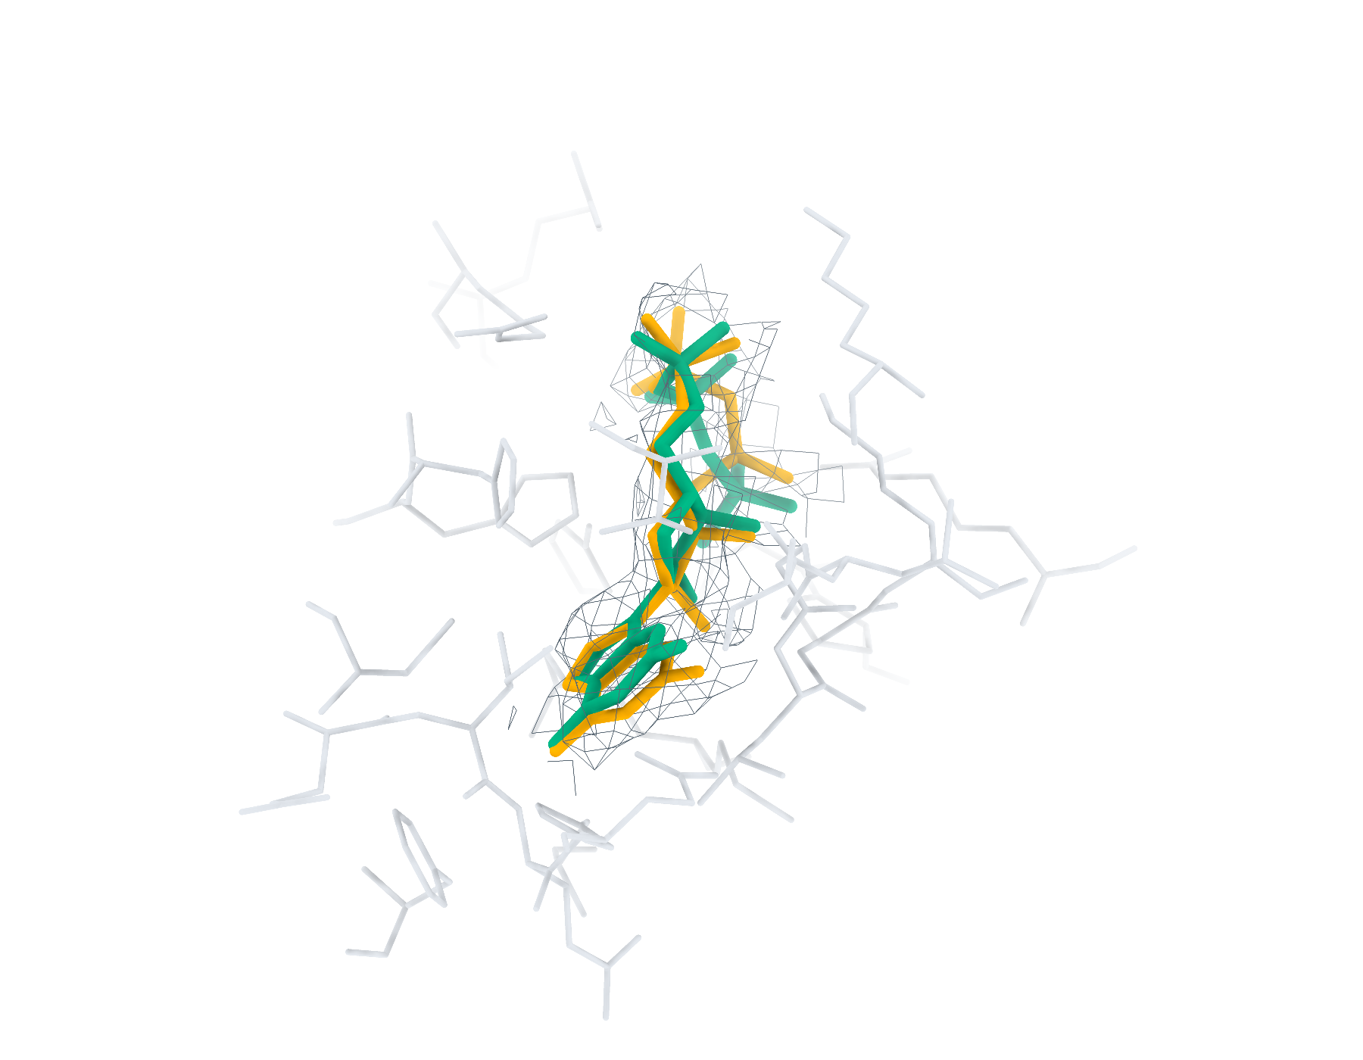
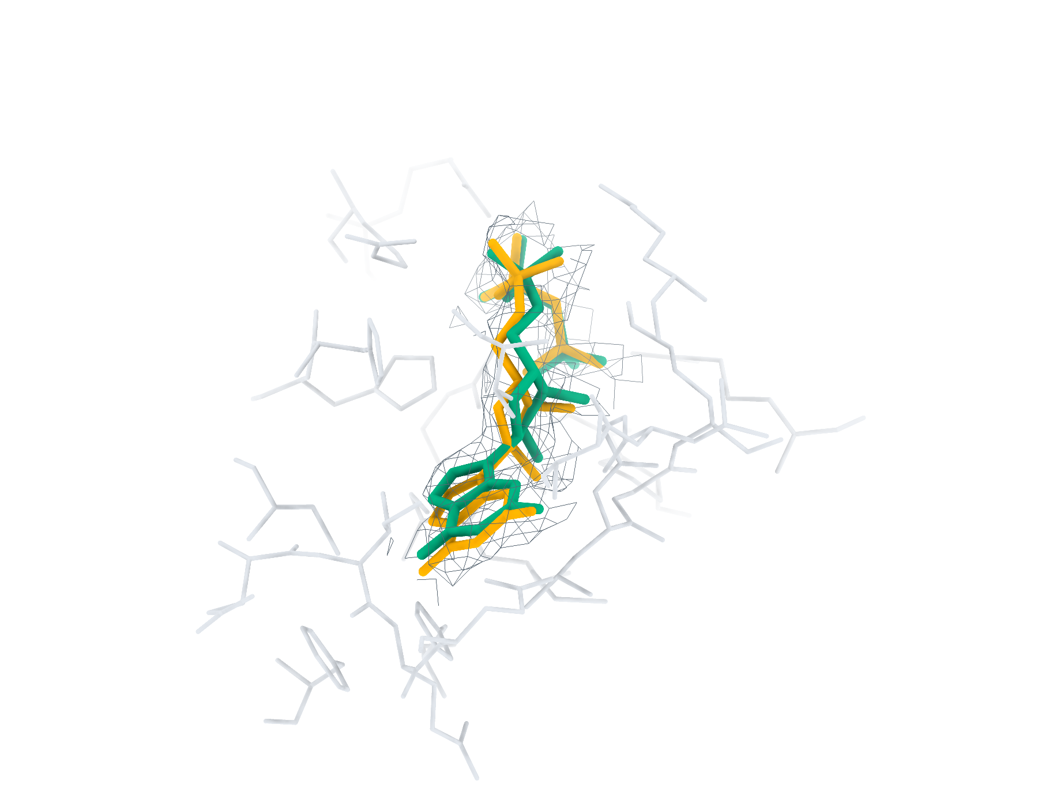
9UJF Ligand recognition and modelling
20 deposited ligands, 10 small molecules, 10 eligible for modelling
a
CA2 Find+Match 10/20
b
GT Find+Match 10/20
c
CA2 Pipeline top-1 < 2 Å 10/10
d
GT Pipeline top-1 < 2 Å 10/10
e
CA2 GTP RMSD 0.71 Å
f
GT GTP RMSD 0.57 Å
Find+Match: teal, correct identity. Pipeline: teal, RMSD < 2 Å; brown, ≥ 2 Å. Orange, reference.
Notes:
9UJF中的多配体识别与建模。复合物含20个沉积配体实例，其中小分子10个，满足单残基、无缺失原子、有机条件的建模实例10个。左、右列分别采用CryoAtom2重建受体（CA2）和沉积受体（GT）。a、b，LigandSeek-Find候选配体区域及LigandSeek-Match身份匹配。青绿色表示前景区域中的身份匹配正确，棕色表示其他候选，橙色为沉积配体。c、d，采用PocketXMol-tuned的LigandSeek Find–Match–Build完整流水线首选构象。青绿色和棕色构象的重原子RMSD分别低于和不低于2 Å。标签列出100%尝试预算下的完成实例数/目标实例数；a、b以全配体实例数为预算基数，c、d以合格小分子实例数为基数。e、f，局部实验密度（灰色网格）、5 Å内的受体残基、沉积构象（橙色）和已有完整流水线首选构象（青绿色）。CA2: GTP (A:202), 首选构象RMSD 0.71 Å；GT: GTP (A:202), 首选构象RMSD 0.57 Å。局部沿用相同完整流水线预算。不同复合物总览的显示比例不同。
ENGLISH:
Multi-ligand recognition and modelling in 9UJF. The complex contains 20 deposited ligand instances, including 10 small molecules and 10 single-residue, complete organic small molecules eligible for modelling. Left and right columns use the CryoAtom2-reconstructed (CA2) and deposited (GT) receptor structures, respectively. a,b, LigandSeek-Find candidate ligand regions with LigandSeek-Match assignments. Teal denotes a correct identity at a foreground region, and brown denotes other candidates. Orange shows deposited ligands. c,d, Top-1 poses from the complete LigandSeek Find–Match–Build pipeline using PocketXMol-tuned. Teal and brown poses have heavy-atom root-mean-square deviation (RMSD) below and at least 2 Å, respectively. The labels give completed/target instance counts at 100% attempt budget. The budget equals the number of all ligand instances in a,b and eligible small-molecule instances in c,d. e,f, Selected local views with experimental density (grey mesh), receptor residues within 5 Å, deposited poses (orange) and available pipeline top-1 poses (teal). CA2: GTP (A:202), top-1 RMSD 0.71 Å; GT: GTP (A:202), top-1 RMSD 0.57 Å. Local views use the same pipeline budgets. Overview scales differ between complexes.

Slide 8
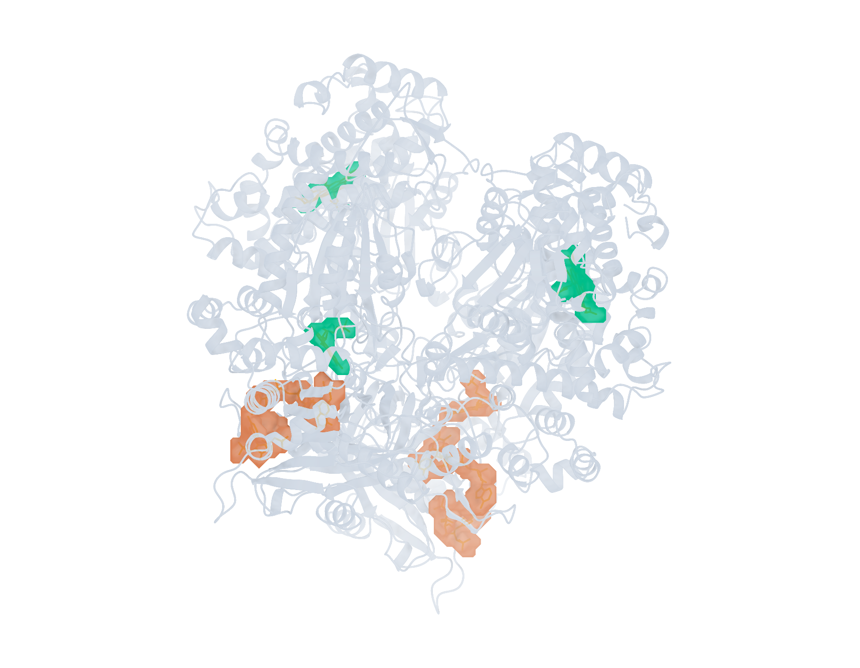
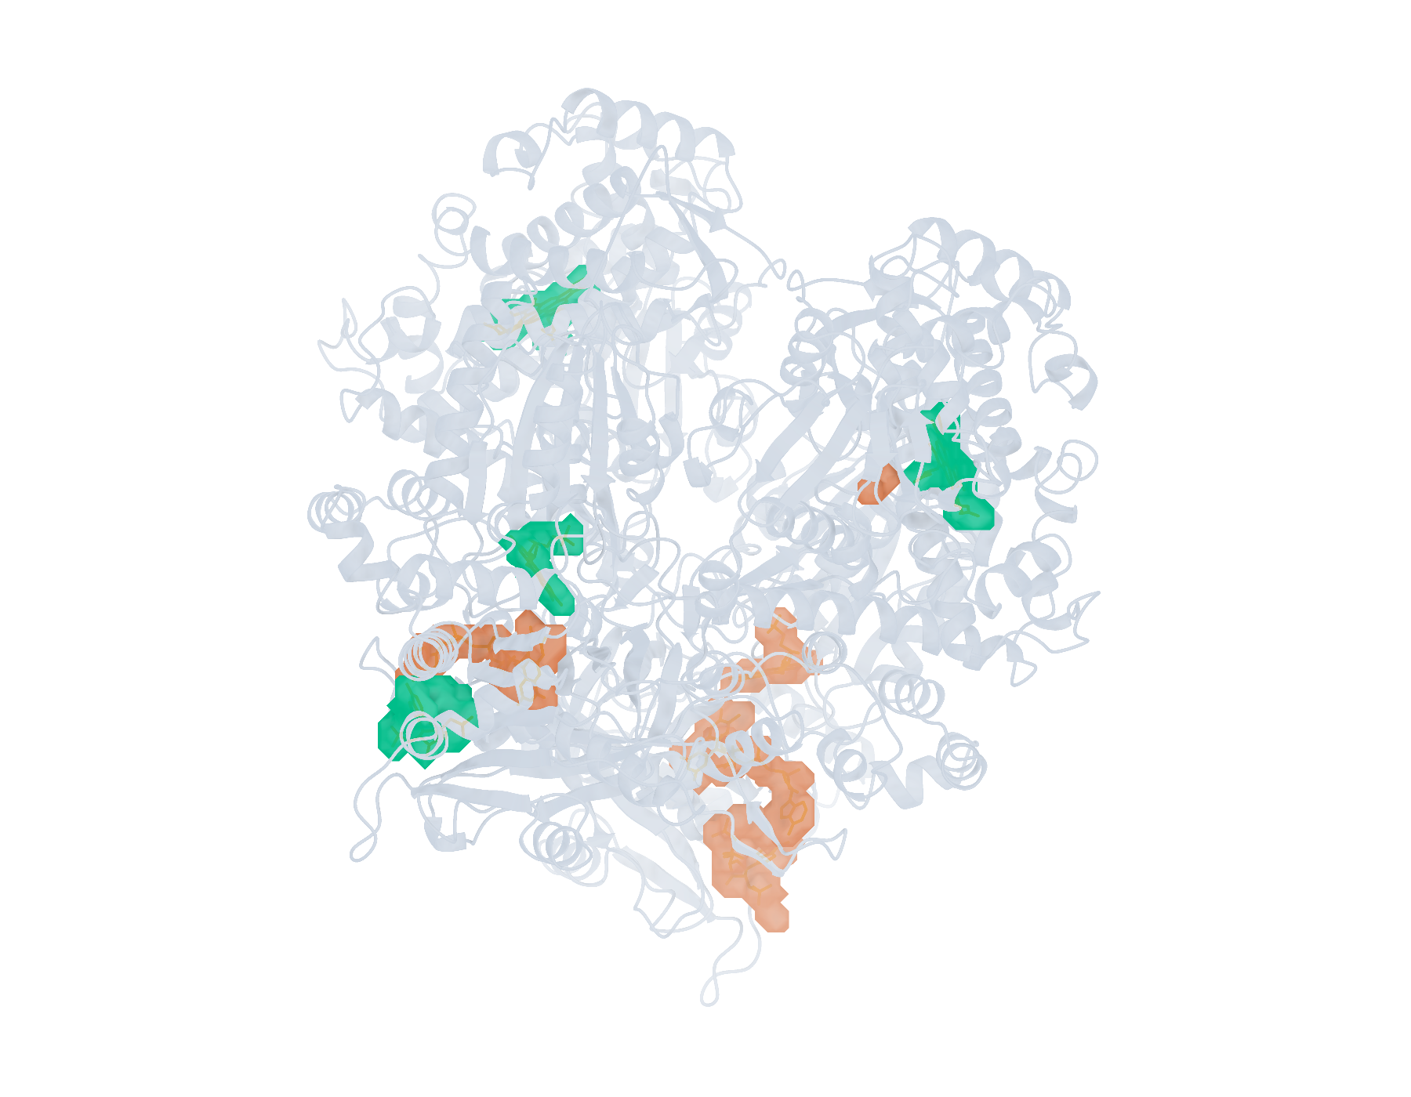
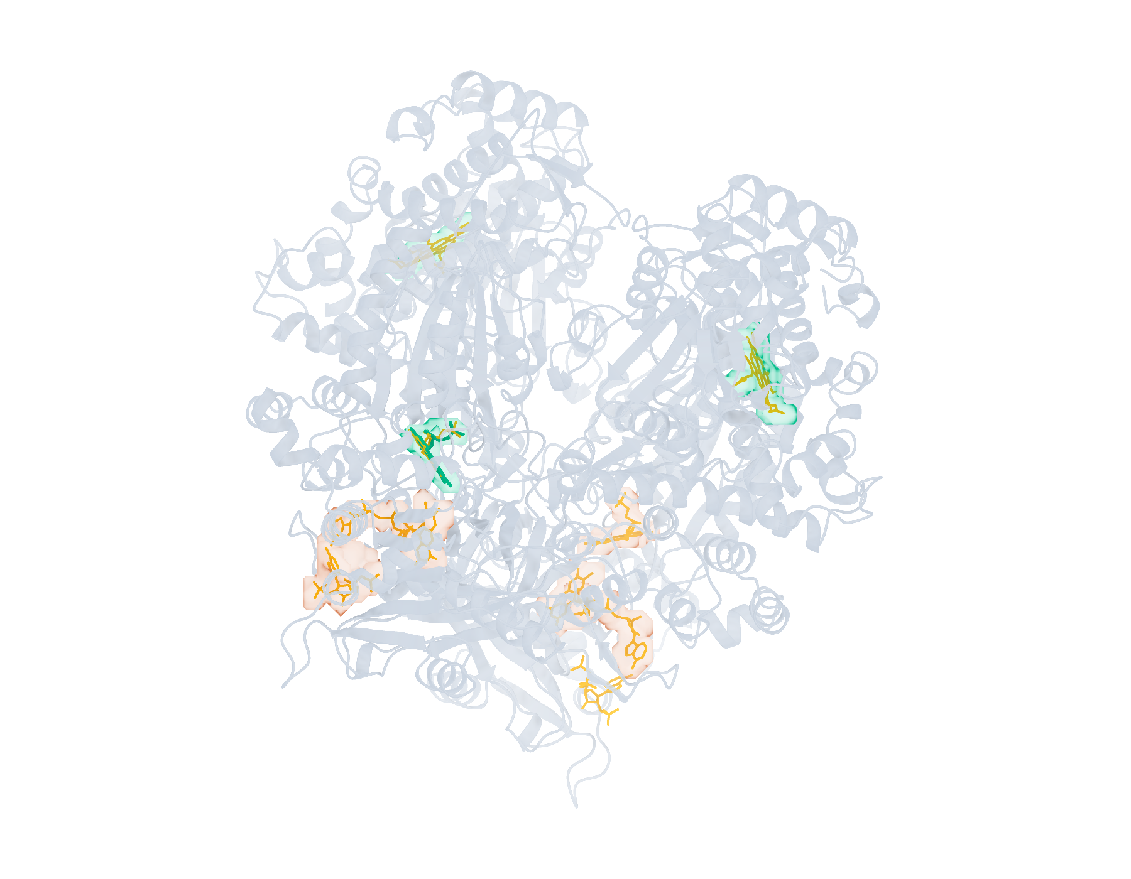
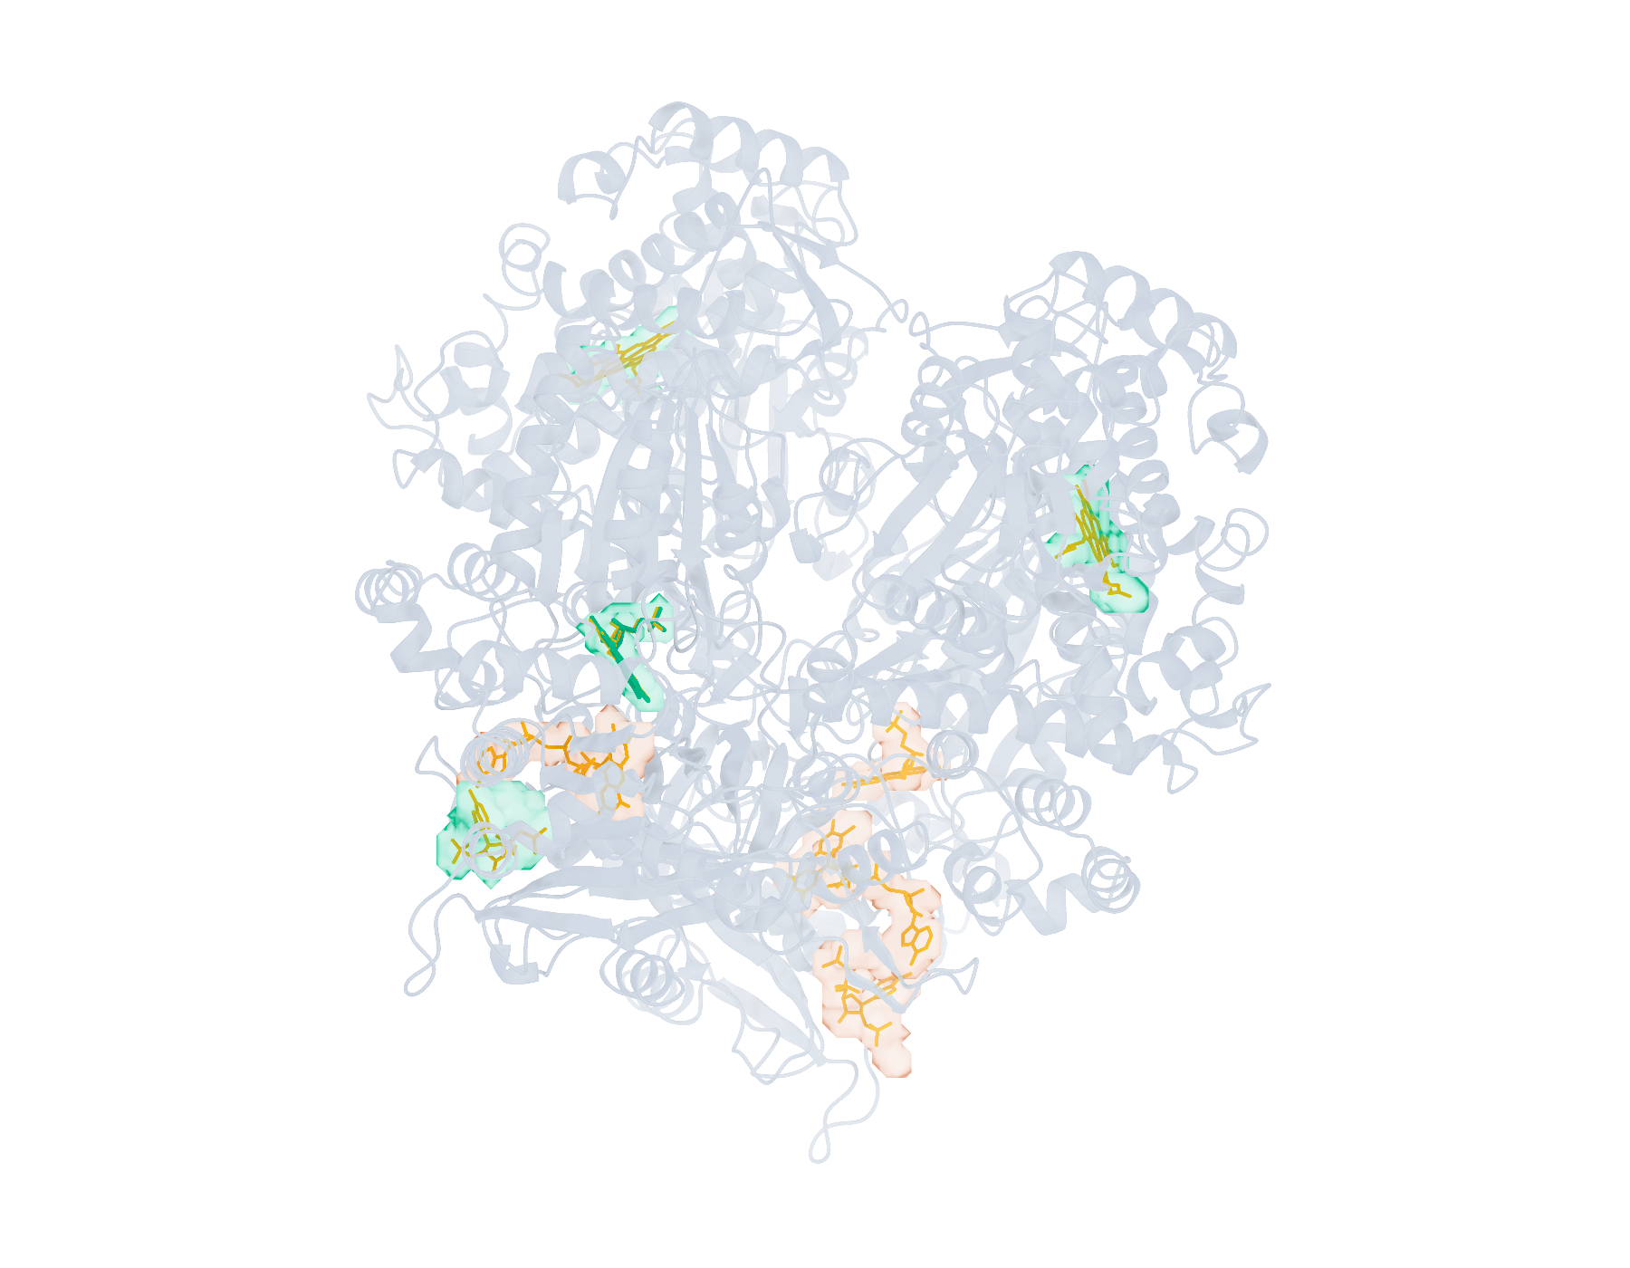
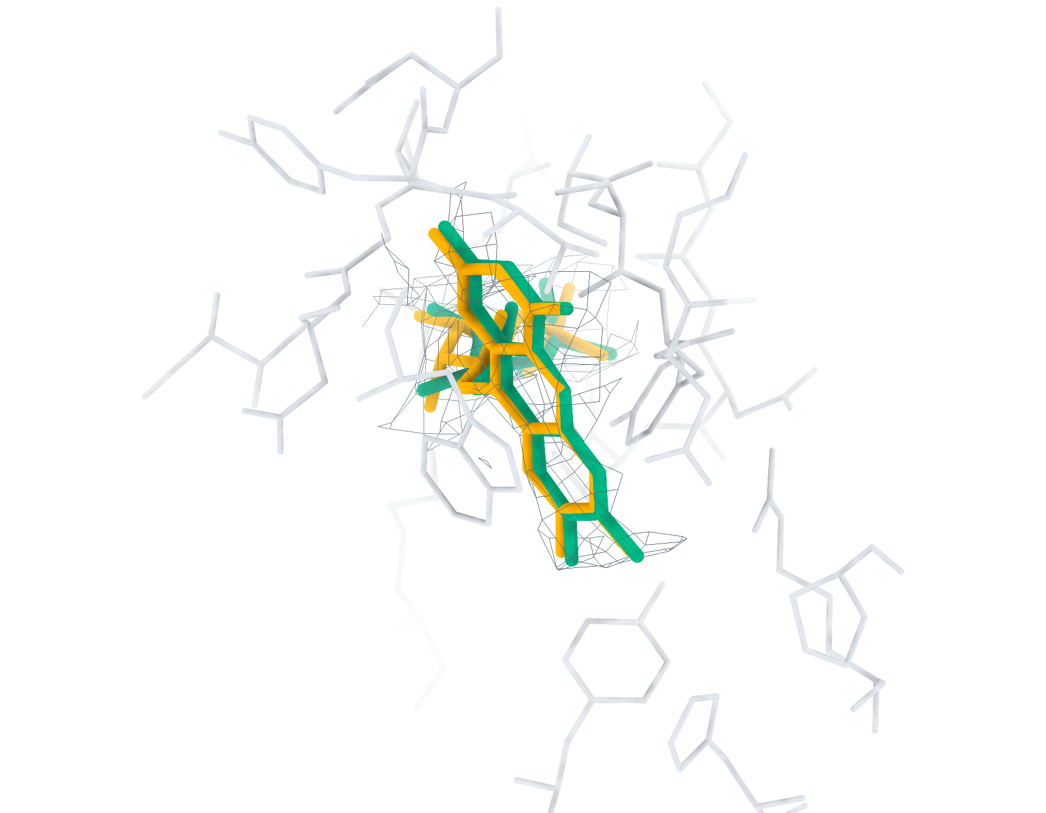
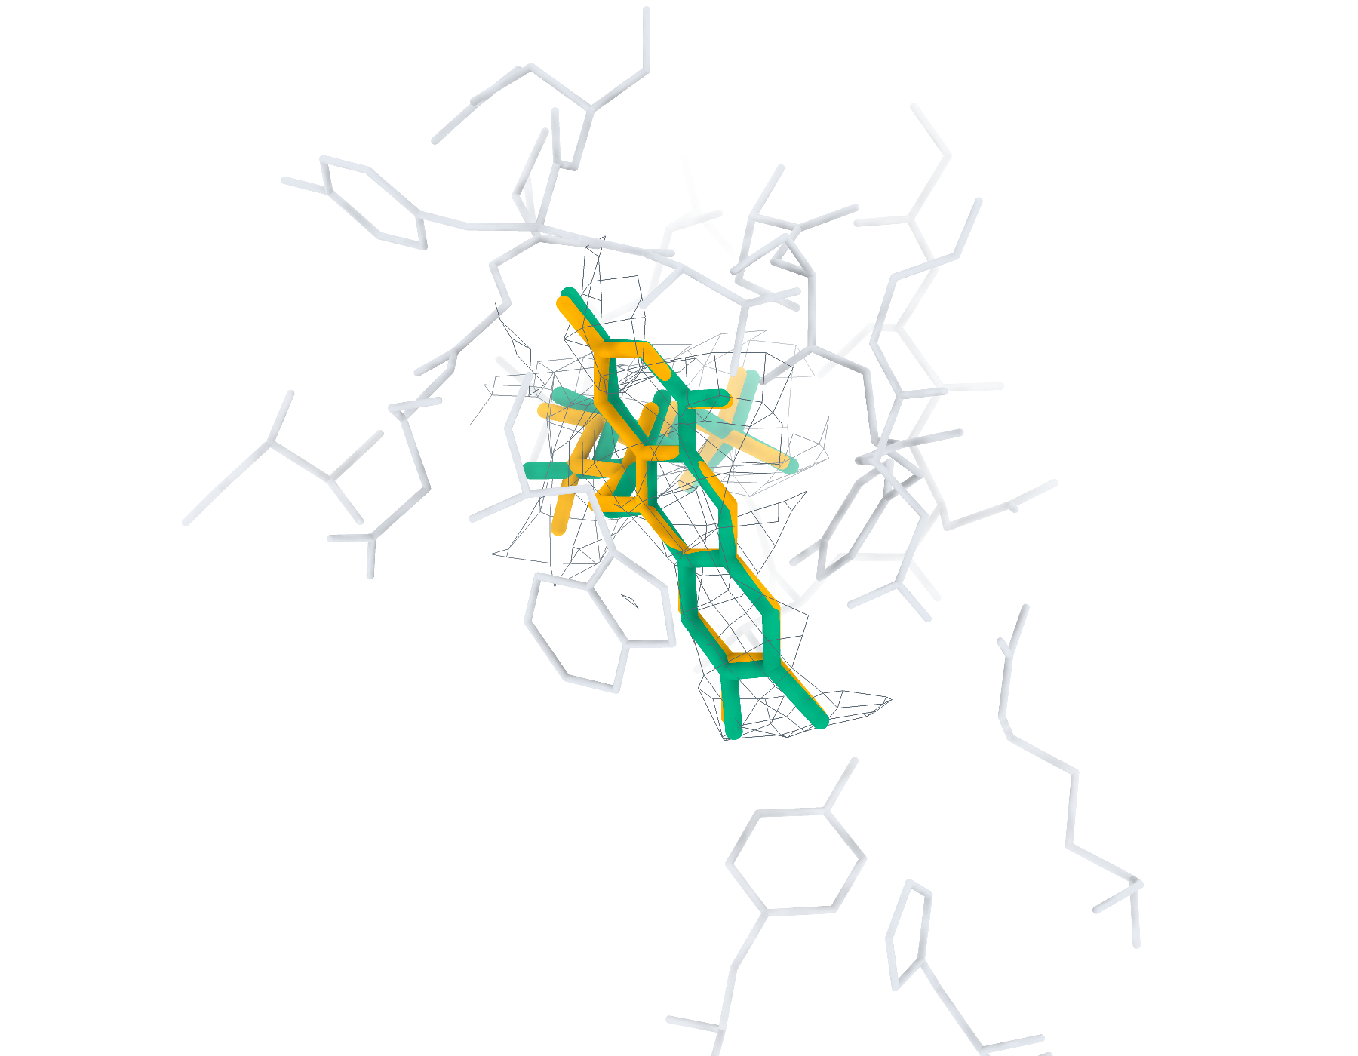
9WUP Ligand recognition and modelling
8 deposited ligands, 8 small molecules, 4 eligible for modelling
a
CA2 Find+Match 3/8
b
GT Find+Match 4/8
c
CA2 Pipeline top-1 < 2 Å 1/4
d
GT Pipeline top-1 < 2 Å 1/4
e
CA2 FMN RMSD 0.52 Å
f
GT FMN RMSD 0.37 Å
Find+Match: teal, correct identity. Pipeline: teal, RMSD < 2 Å; brown, ≥ 2 Å. Orange, reference.
Notes:
9WUP中的多配体识别与建模。复合物含8个沉积配体实例，其中小分子8个，满足单残基、无缺失原子、有机条件的建模实例4个。左、右列分别采用CryoAtom2重建受体（CA2）和沉积受体（GT）。a、b，LigandSeek-Find候选配体区域及LigandSeek-Match身份匹配。青绿色表示前景区域中的身份匹配正确，棕色表示其他候选，橙色为沉积配体。c、d，采用PocketXMol-tuned的LigandSeek Find–Match–Build完整流水线首选构象。青绿色和棕色构象的重原子RMSD分别低于和不低于2 Å。标签列出100%尝试预算下的完成实例数/目标实例数；a、b以全配体实例数为预算基数，c、d以合格小分子实例数为基数。e、f，局部实验密度（灰色网格）、5 Å内的受体残基、沉积构象（橙色）和已有完整流水线首选构象（青绿色）。CA2: FMN (B:1103), 首选构象RMSD 0.52 Å；GT: FMN (B:1103), 首选构象RMSD 0.37 Å。局部沿用相同完整流水线预算。不同复合物总览的显示比例不同。
ENGLISH:
Multi-ligand recognition and modelling in 9WUP. The complex contains 8 deposited ligand instances, including 8 small molecules and 4 single-residue, complete organic small molecules eligible for modelling. Left and right columns use the CryoAtom2-reconstructed (CA2) and deposited (GT) receptor structures, respectively. a,b, LigandSeek-Find candidate ligand regions with LigandSeek-Match assignments. Teal denotes a correct identity at a foreground region, and brown denotes other candidates. Orange shows deposited ligands. c,d, Top-1 poses from the complete LigandSeek Find–Match–Build pipeline using PocketXMol-tuned. Teal and brown poses have heavy-atom root-mean-square deviation (RMSD) below and at least 2 Å, respectively. The labels give completed/target instance counts at 100% attempt budget. The budget equals the number of all ligand instances in a,b and eligible small-molecule instances in c,d. e,f, Selected local views with experimental density (grey mesh), receptor residues within 5 Å, deposited poses (orange) and available pipeline top-1 poses (teal). CA2: FMN (B:1103), top-1 RMSD 0.52 Å; GT: FMN (B:1103), top-1 RMSD 0.37 Å. Local views use the same pipeline budgets. Overview scales differ between complexes.

Slide 9
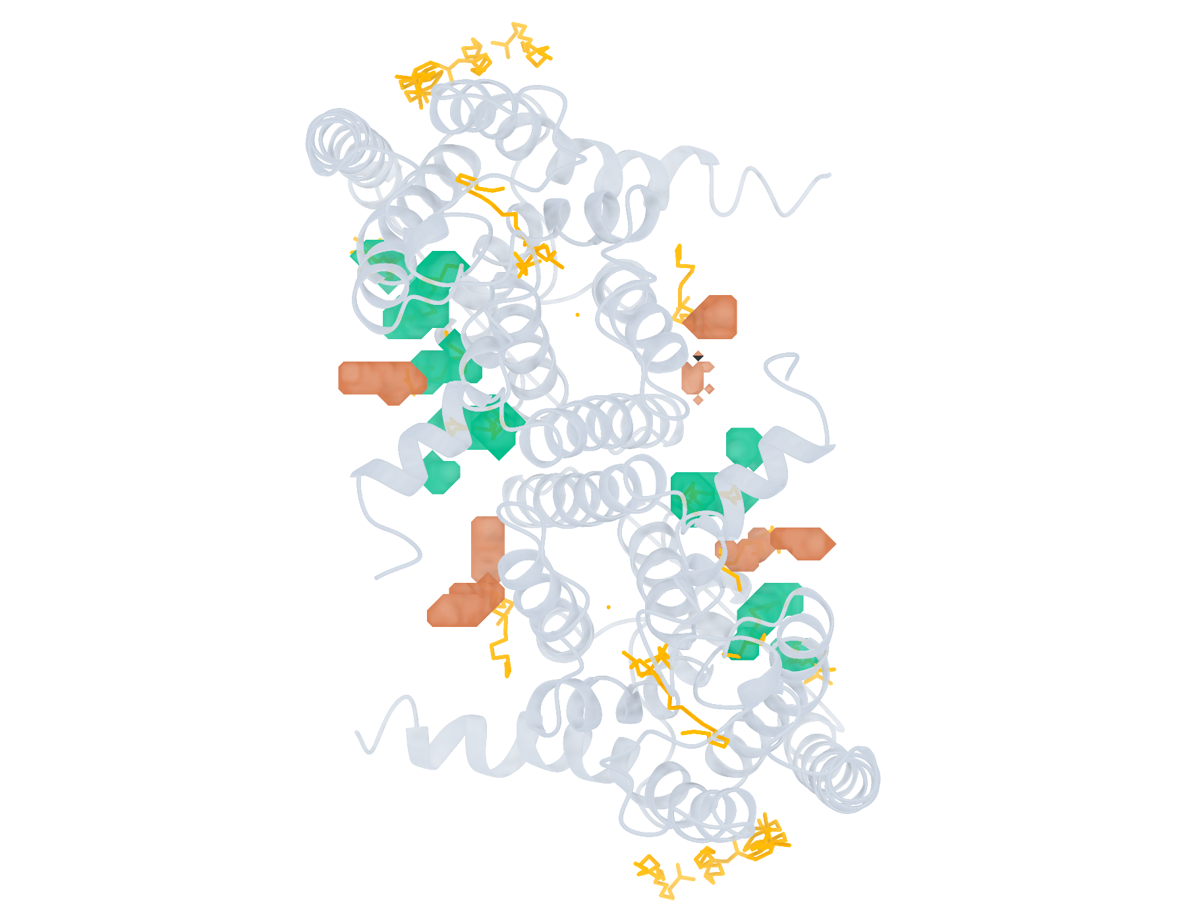
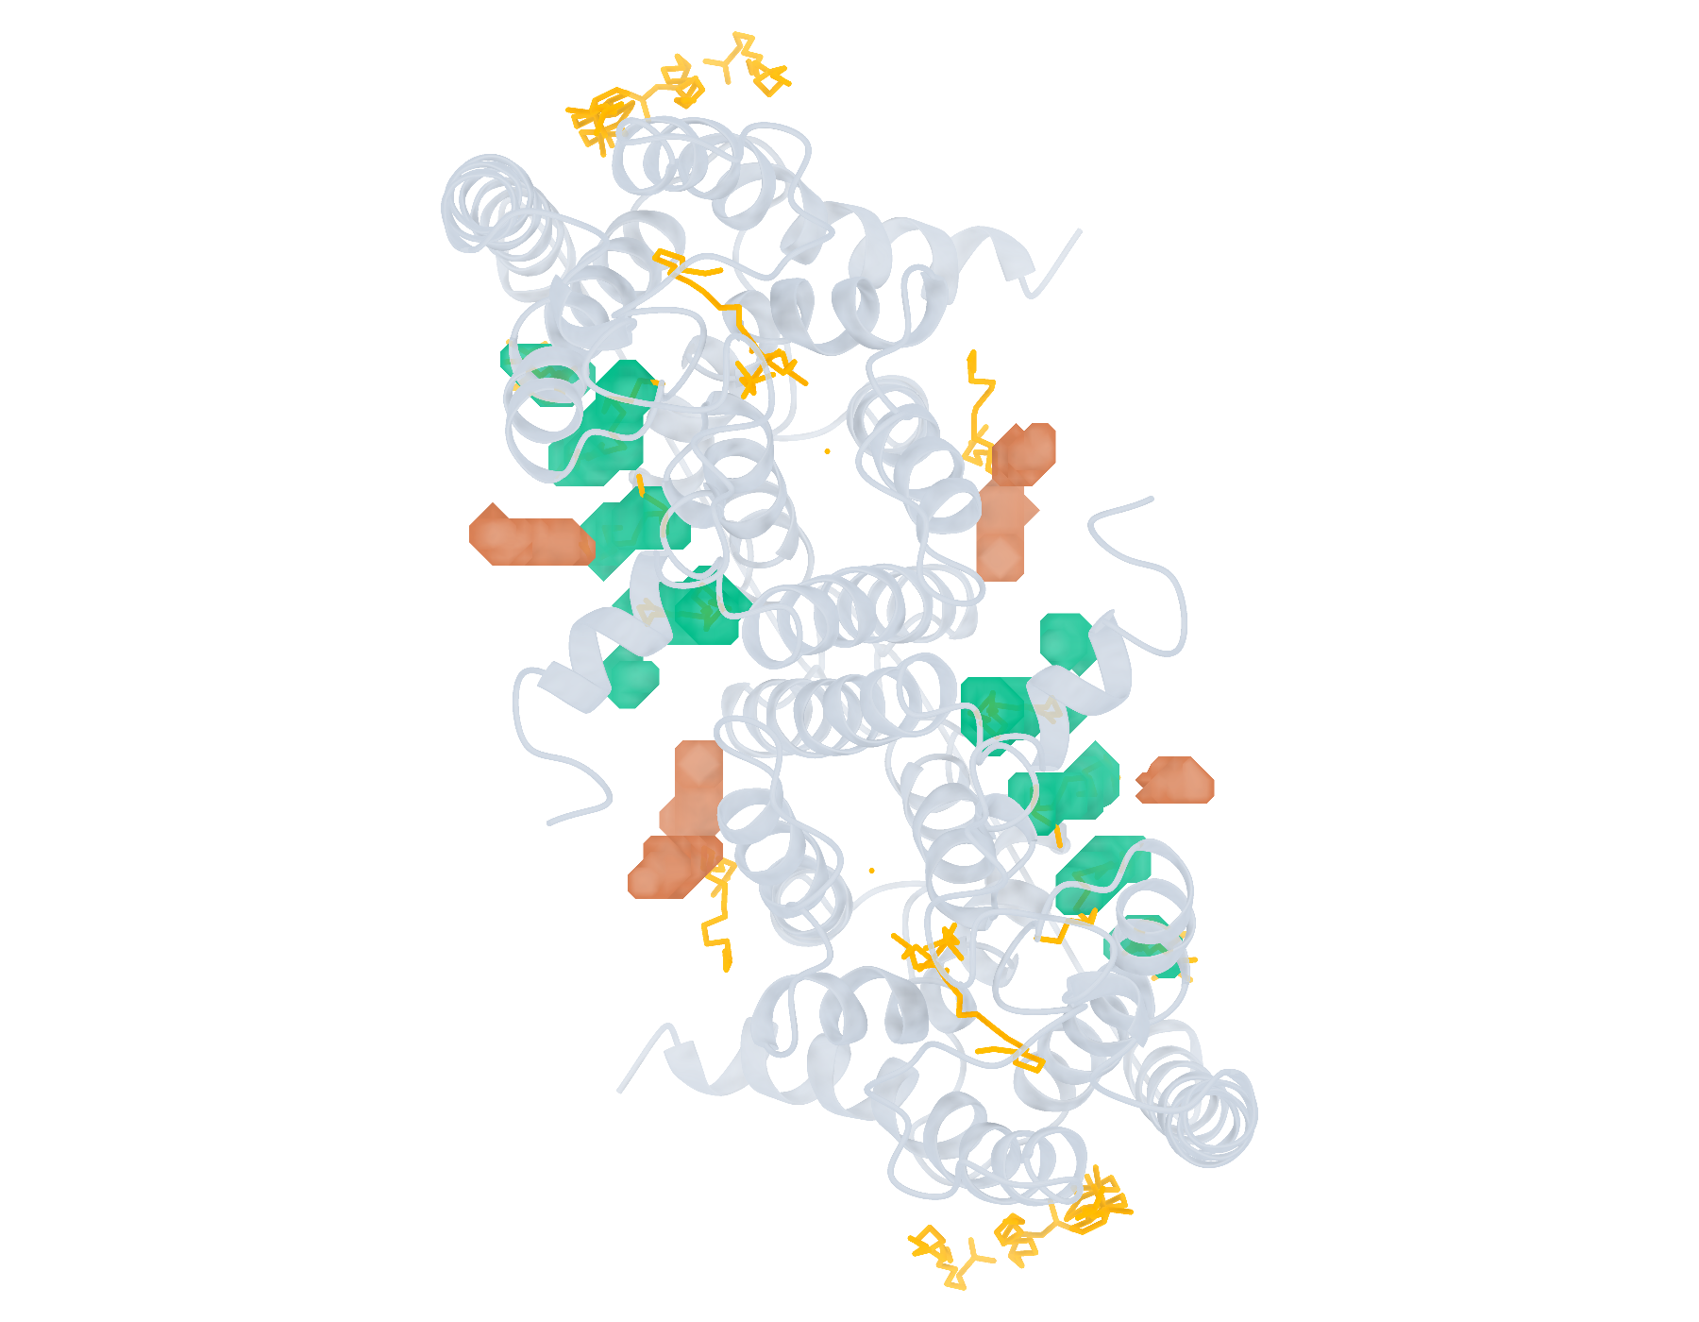
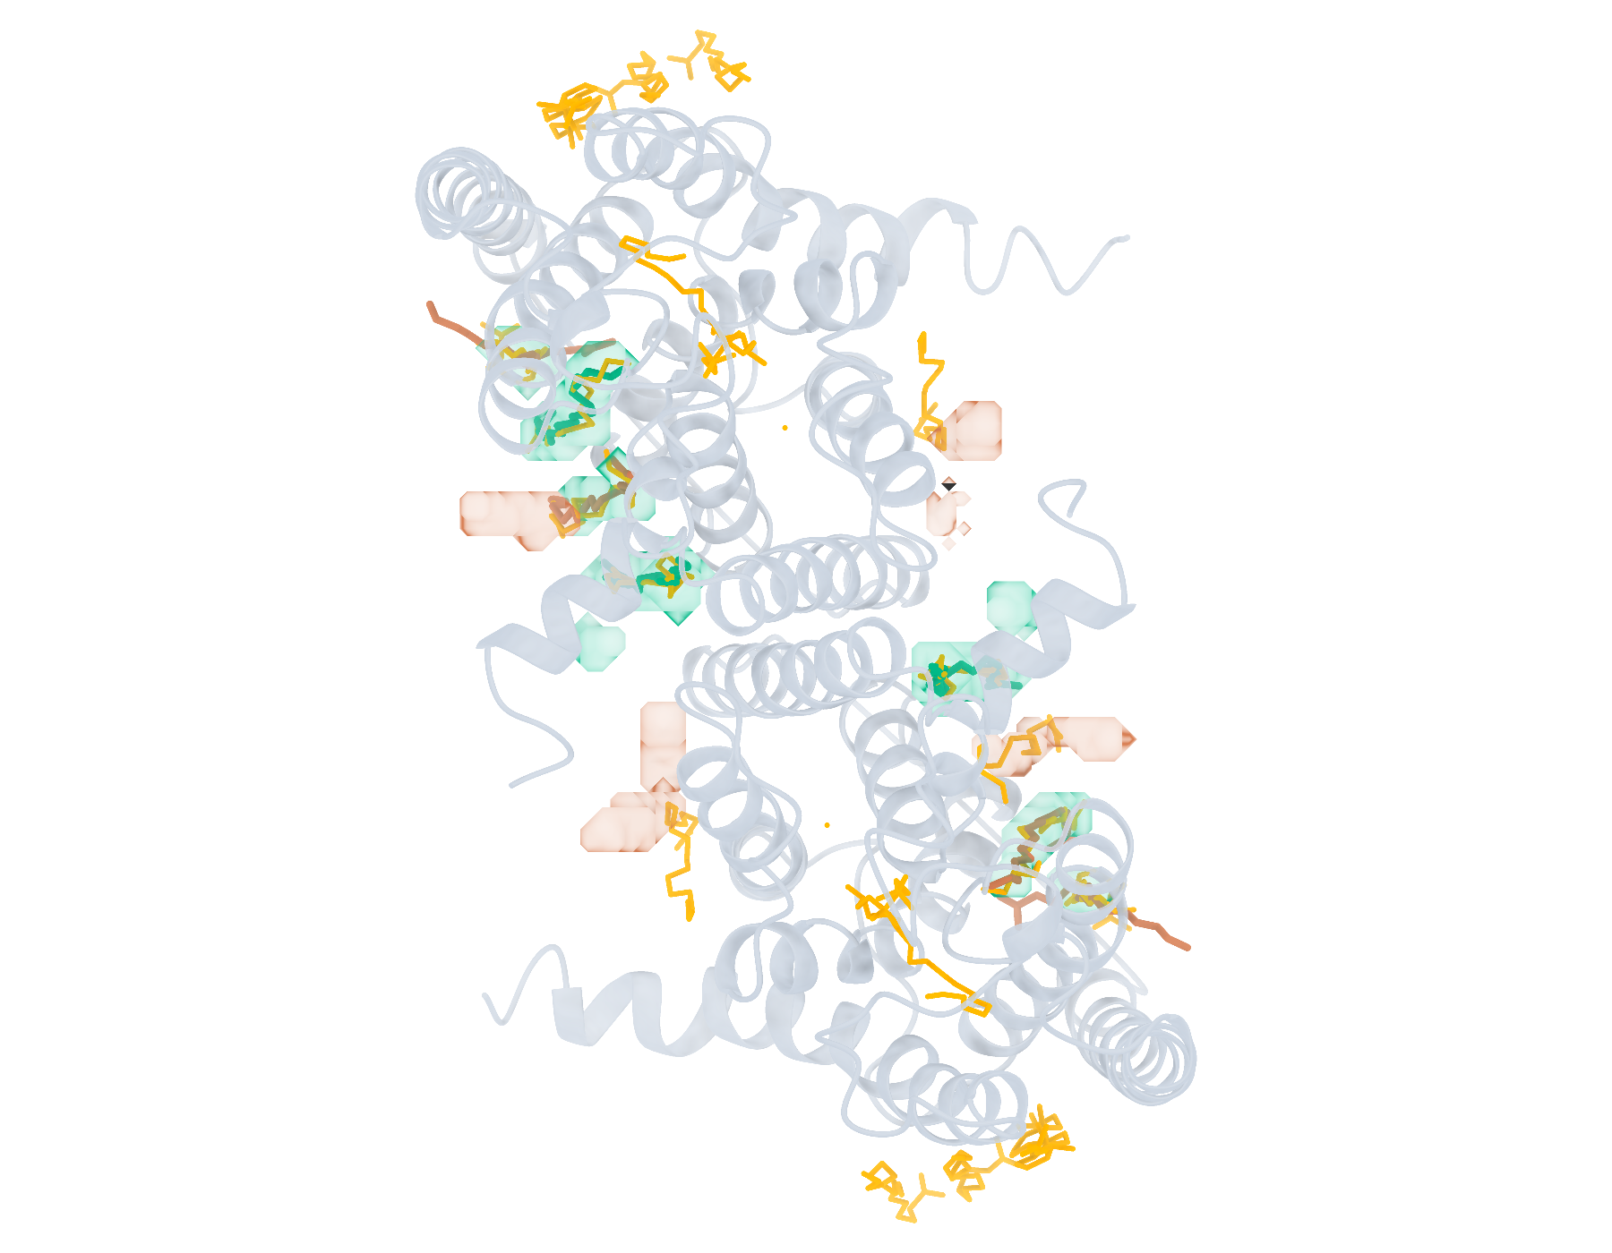
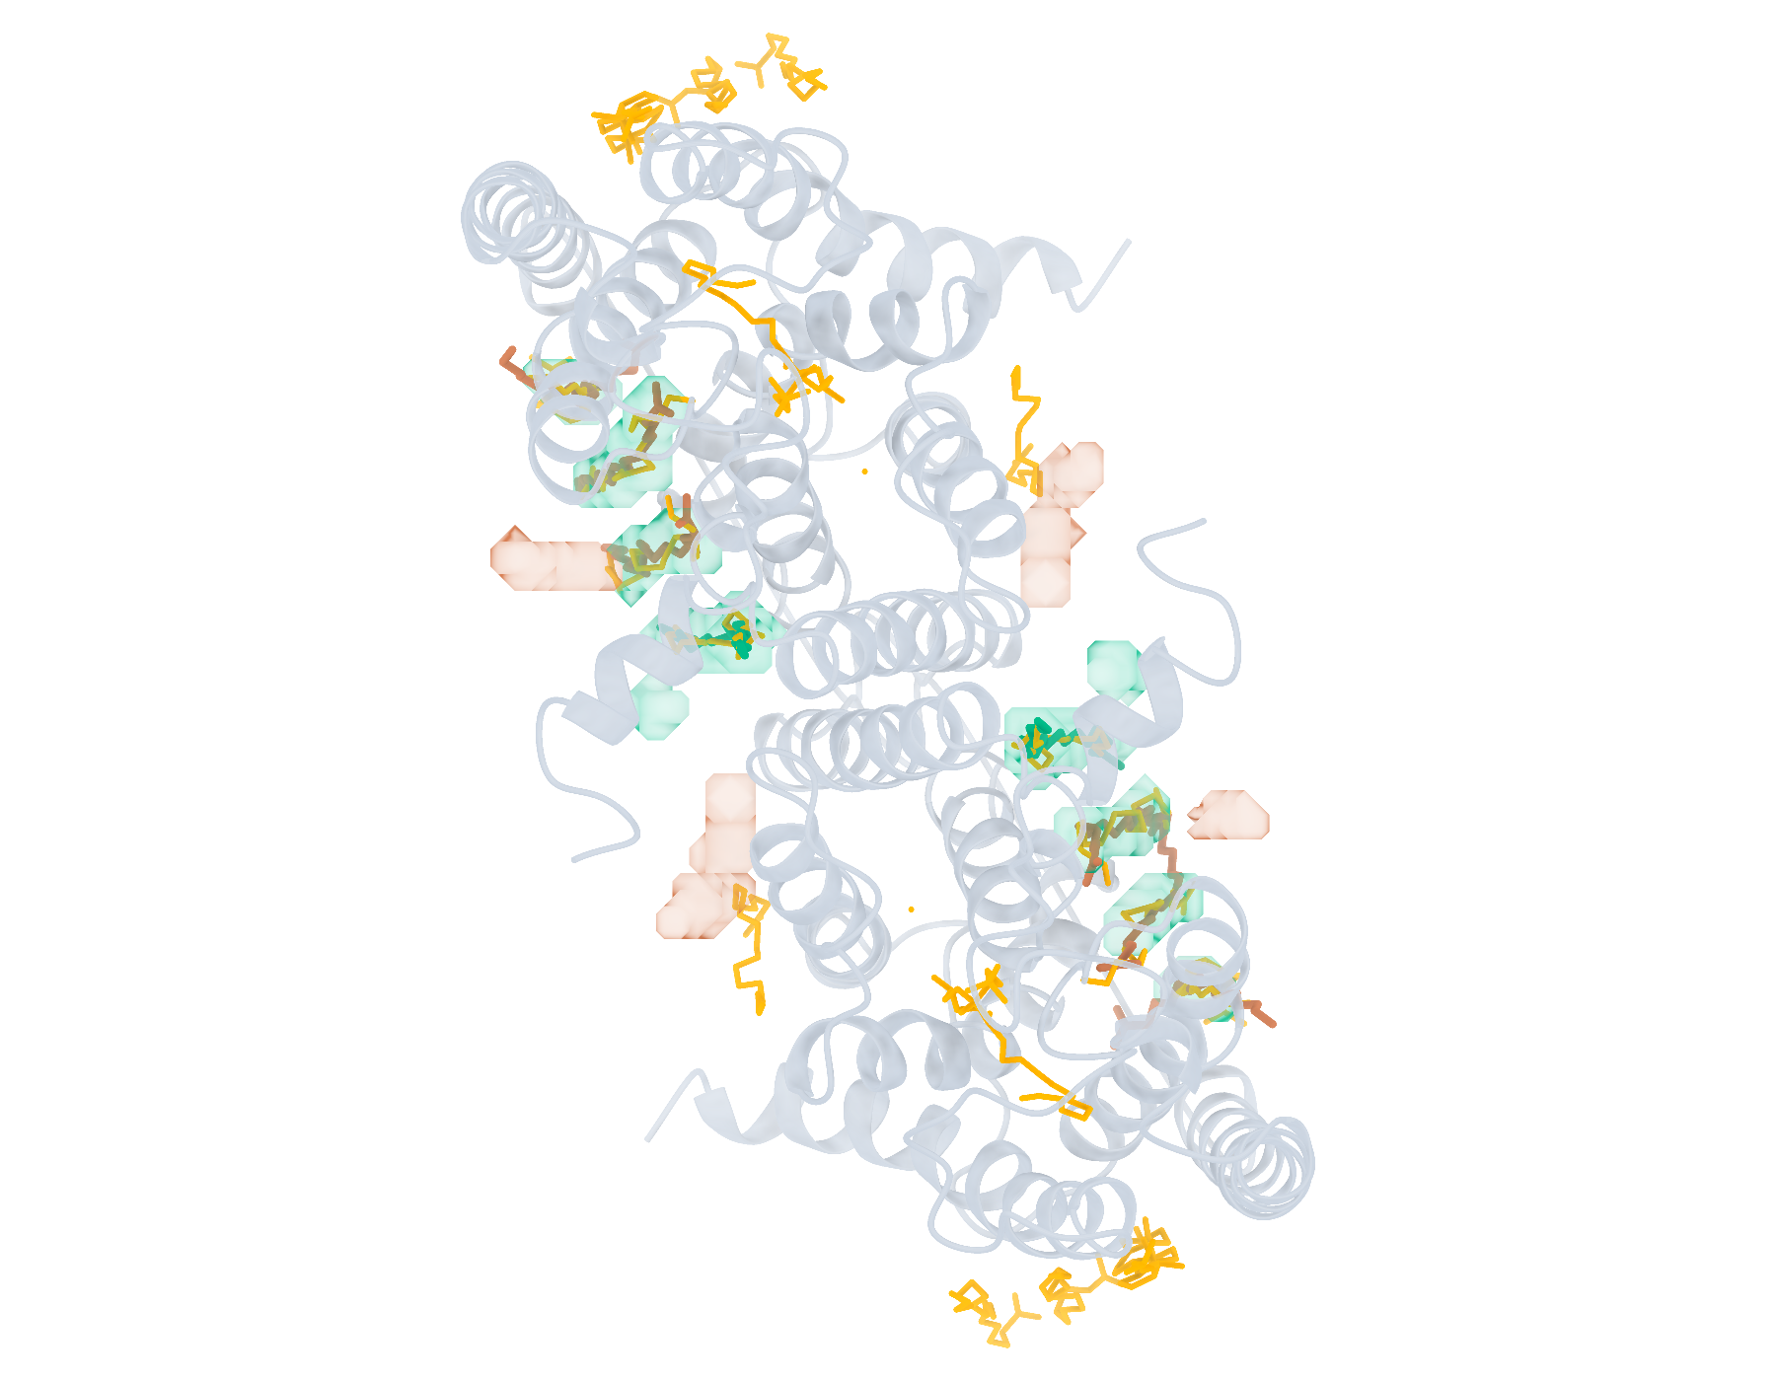
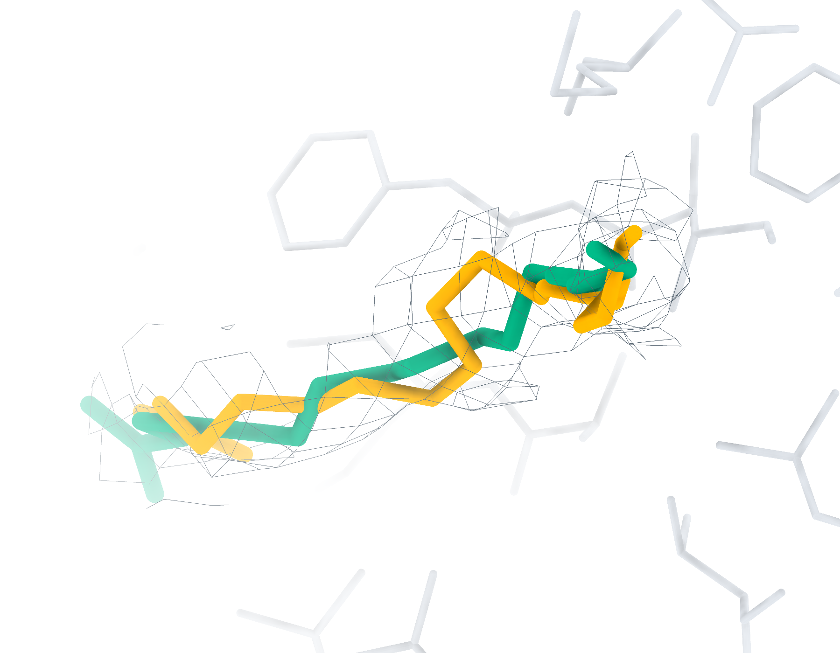
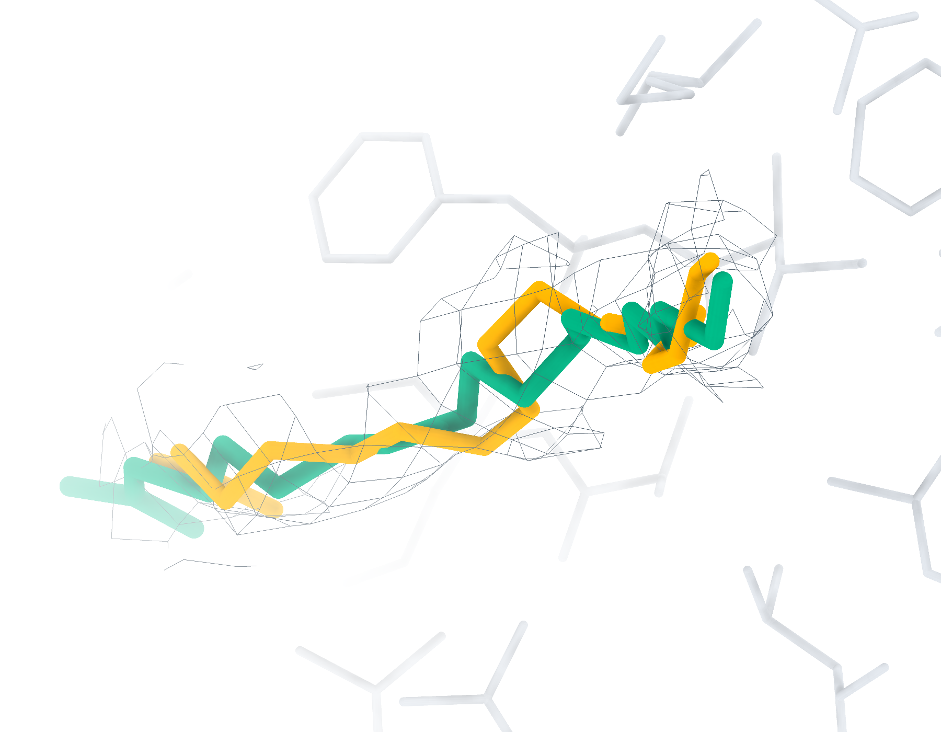
9LW1 Ligand recognition and modelling
20 deposited ligands, 18 small molecules, 18 eligible for modelling
a
CA2 Find+Match 7/20
b
GT Find+Match 8/20
c
CA2 Pipeline top-1 < 2 Å 3/18
d
GT Pipeline top-1 < 2 Å 2/18
e
CA2 4I1 RMSD 1.92 Å
f
GT 4I1 RMSD 1.64 Å
Find+Match: teal, correct identity. Pipeline: teal, RMSD < 2 Å; brown, ≥ 2 Å. Orange, reference.
Notes:
9LW1中的多配体识别与建模。复合物含20个沉积配体实例，其中小分子18个，满足单残基、无缺失原子、有机条件的建模实例18个。左、右列分别采用CryoAtom2重建受体（CA2）和沉积受体（GT）。a、b，LigandSeek-Find候选配体区域及LigandSeek-Match身份匹配。青绿色表示前景区域中的身份匹配正确，棕色表示其他候选，橙色为沉积配体。c、d，采用PocketXMol-tuned的LigandSeek Find–Match–Build完整流水线首选构象。青绿色和棕色构象的重原子RMSD分别低于和不低于2 Å。标签列出100%尝试预算下的完成实例数/目标实例数；a、b以全配体实例数为预算基数，c、d以合格小分子实例数为基数。e、f，局部实验密度（灰色网格）、5 Å内的受体残基、沉积构象（橙色）和已有完整流水线首选构象（青绿色）。CA2: 4I1 (A:307), 首选构象RMSD 1.92 Å；GT: 4I1 (A:307), 首选构象RMSD 1.64 Å。局部沿用相同完整流水线预算。不同复合物总览的显示比例不同。
ENGLISH:
Multi-ligand recognition and modelling in 9LW1. The complex contains 20 deposited ligand instances, including 18 small molecules and 18 single-residue, complete organic small molecules eligible for modelling. Left and right columns use the CryoAtom2-reconstructed (CA2) and deposited (GT) receptor structures, respectively. a,b, LigandSeek-Find candidate ligand regions with LigandSeek-Match assignments. Teal denotes a correct identity at a foreground region, and brown denotes other candidates. Orange shows deposited ligands. c,d, Top-1 poses from the complete LigandSeek Find–Match–Build pipeline using PocketXMol-tuned. Teal and brown poses have heavy-atom root-mean-square deviation (RMSD) below and at least 2 Å, respectively. The labels give completed/target instance counts at 100% attempt budget. The budget equals the number of all ligand instances in a,b and eligible small-molecule instances in c,d. e,f, Selected local views with experimental density (grey mesh), receptor residues within 5 Å, deposited poses (orange) and available pipeline top-1 poses (teal). CA2: 4I1 (A:307), top-1 RMSD 1.92 Å; GT: 4I1 (A:307), top-1 RMSD 1.64 Å. Local views use the same pipeline budgets. Overview scales differ between complexes.

Slide 10
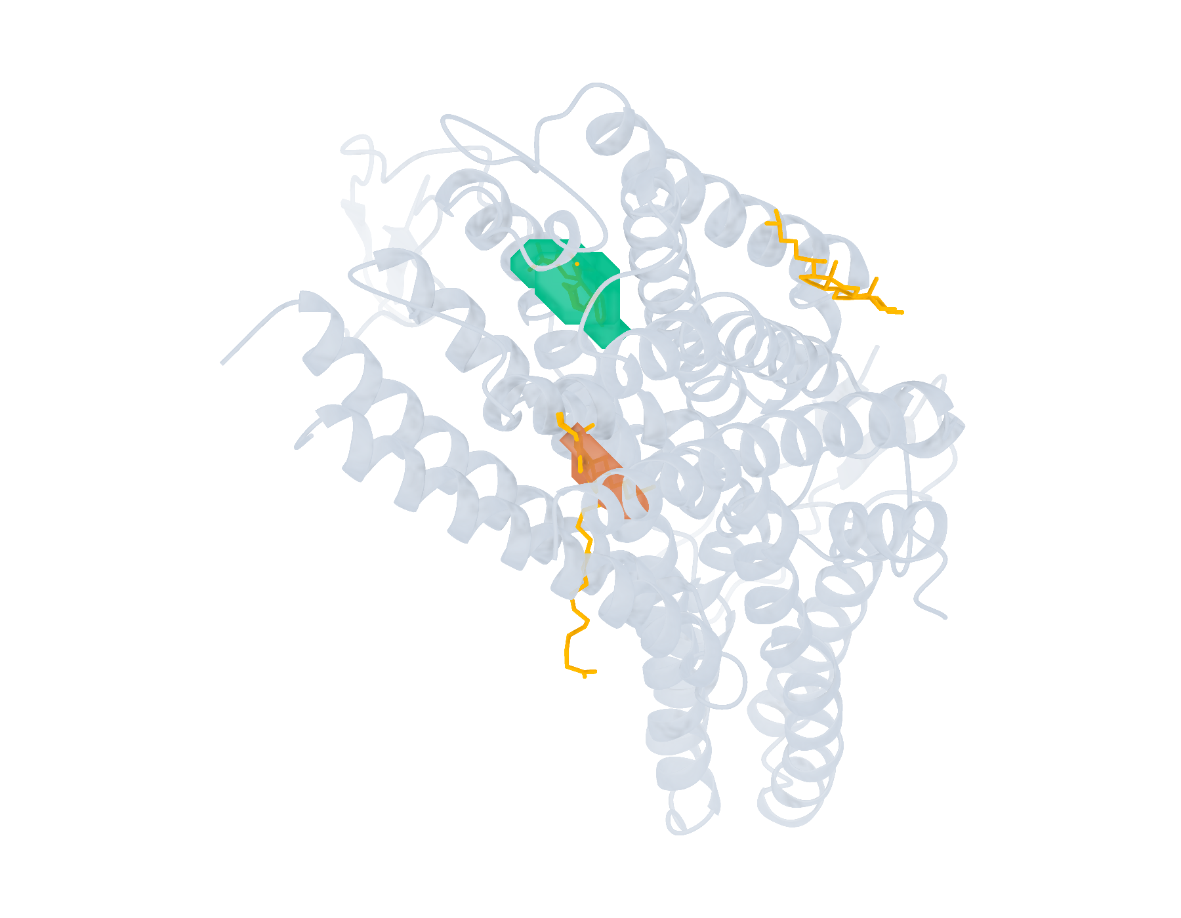





9LLG Ligand recognition and modelling
4 deposited ligands, 4 small molecules, 4 eligible for modelling
a
CA2 Find+Match 1/4
b
GT Find+Match 2/4
c
CA2 Pipeline top-1 < 2 Å 1/4
d
GT Pipeline top-1 < 2 Å 1/4
e
CA2 A1EKL RMSD 0.88 Å
f
GT A1EKL RMSD 0.87 Å
Find+Match: teal, correct identity. Pipeline: teal, RMSD < 2 Å; brown, ≥ 2 Å. Orange, reference.
Notes:
9LLG中的多配体识别与建模。复合物含4个沉积配体实例，其中小分子4个，满足单残基、无缺失原子、有机条件的建模实例4个。左、右列分别采用CryoAtom2重建受体（CA2）和沉积受体（GT）。a、b，LigandSeek-Find候选配体区域及LigandSeek-Match身份匹配。青绿色表示前景区域中的身份匹配正确，棕色表示其他候选，橙色为沉积配体。c、d，采用PocketXMol-tuned的LigandSeek Find–Match–Build完整流水线首选构象。青绿色和棕色构象的重原子RMSD分别低于和不低于2 Å。标签列出100%尝试预算下的完成实例数/目标实例数；a、b以全配体实例数为预算基数，c、d以合格小分子实例数为基数。e、f，局部实验密度（灰色网格）、5 Å内的受体残基、沉积构象（橙色）和已有完整流水线首选构象（青绿色）。CA2: A1EKL (R:602), 首选构象RMSD 0.88 Å；GT: A1EKL (R:602), 首选构象RMSD 0.87 Å。局部沿用相同完整流水线预算。不同复合物总览的显示比例不同。
ENGLISH:
Multi-ligand recognition and modelling in 9LLG. The complex contains 4 deposited ligand instances, including 4 small molecules and 4 single-residue, complete organic small molecules eligible for modelling. Left and right columns use the CryoAtom2-reconstructed (CA2) and deposited (GT) receptor structures, respectively. a,b, LigandSeek-Find candidate ligand regions with LigandSeek-Match assignments. Teal denotes a correct identity at a foreground region, and brown denotes other candidates. Orange shows deposited ligands. c,d, Top-1 poses from the complete LigandSeek Find–Match–Build pipeline using PocketXMol-tuned. Teal and brown poses have heavy-atom root-mean-square deviation (RMSD) below and at least 2 Å, respectively. The labels give completed/target instance counts at 100% attempt budget. The budget equals the number of all ligand instances in a,b and eligible small-molecule instances in c,d. e,f, Selected local views with experimental density (grey mesh), receptor residues within 5 Å, deposited poses (orange) and available pipeline top-1 poses (teal). CA2: A1EKL (R:602), top-1 RMSD 0.88 Å; GT: A1EKL (R:602), top-1 RMSD 0.87 Å. Local views use the same pipeline budgets. Overview scales differ between complexes.

