Slide 1
Overall scores
All ligands
1.0
Score
0.5
0.0
Semantic
One-to-one
One-to-one
Dice
PRAUC, τ = 0.3
PRAUC, τ = 0.5
Find_1 · deposited receptor
Find_1 · CryoAtom2 receptor
Emap2lig
Notes:
全配体，test_0，n=179 个 PDB。Dice、one-to-one PRAUC@0.3 和 PRAUC@0.5；柱高为 PDB 等权均值，点为逐 PDB 结果，误差线为 10,000 次 PDB bootstrap 的均值 95% 区间。Find_1 均使用冻结的 F2–F1 Gaussian 流程，Emap2lig 使用官方 Find/Li 流程。

Slide 2
Overall scores
Small molecules only
1.0
Score
0.5
0.0
Semantic
One-to-one
One-to-one
Dice
PRAUC, τ = 0.3
PRAUC, τ = 0.5
Find_1 · deposited receptor
Find_1 · CryoAtom2 receptor
Emap2lig
Notes:
小分子-only，test_0，n=94 个 PDB。Dice、one-to-one PRAUC@0.3 和 PRAUC@0.5；柱高为 PDB 等权均值，点为逐 PDB 结果，误差线为 10,000 次 PDB bootstrap 的均值 95% 区间。Find_1 均使用冻结的 F2–F1 Gaussian 流程，Emap2lig 使用官方 Find/Li 流程。仅保留含小分子真实实例的 94 个 PDB；按固定归属规则忽略匹配非小分子的候选，未归属候选保留。

Slide 3
One-to-one PRAUC · τ = 0.3
All ligands
1.0
4.0
3.0
Find_1 (CryoAtom2)
Resolution (Å)
0.5
2.0
0.0
1.0
0.0
0.5
1.0
Emap2lig
Notes:
全配体，test_0，n=179 个 PDB。横轴为 Emap2lig，纵轴为 CryoAtom2 受体 Find_1，虚线为等值线，点颜色为实验地图分辨率。Find_1 较高、相等、Emap2lig 较高分别为 112、40、27 个 PDB。Find_1 均使用冻结的 F2–F1 Gaussian 流程，Emap2lig 使用官方 Find/Li 流程。

Slide 4
One-to-one PRAUC · τ = 0.3
Small molecules only
1.0
4.0
3.0
Find_1 (CryoAtom2)
Resolution (Å)
0.5
2.0
0.0
1.0
0.0
0.5
1.0
Emap2lig
Notes:
小分子-only，test_0，n=94 个 PDB。横轴为 Emap2lig，纵轴为 CryoAtom2 受体 Find_1，虚线为等值线，点颜色为实验地图分辨率。Find_1 较高、相等、Emap2lig 较高分别为 40、36、18 个 PDB。Find_1 均使用冻结的 F2–F1 Gaussian 流程，Emap2lig 使用官方 Find/Li 流程。仅保留含小分子真实实例的 94 个 PDB；按固定归属规则忽略匹配非小分子的候选，未归属候选保留。

Slide 5
One-to-one detection · τ = 0.3
All ligands
1.0
Score
0.5
0.0
Precision
Recall
Find_1 · deposited receptor
Find_1 · CryoAtom2 receptor
Emap2lig
Notes:
全配体，test_0，n=179 个 PDB。仅展示 one-to-one@0.3 Precision/Recall。点为逐 PDB 结果，白点为中位数，粗线为四分位范围。Find_1 均使用冻结的 F2–F1 Gaussian 流程，Emap2lig 使用官方 Find/Li 流程。

Slide 6
One-to-one detection · τ = 0.3
Small molecules only
1.0
Score
0.5
0.0
Precision
Recall
Find_1 · deposited receptor
Find_1 · CryoAtom2 receptor
Emap2lig
Notes:
小分子-only，test_0，n=94 个 PDB。仅展示 one-to-one@0.3 Precision/Recall。点为逐 PDB 结果，白点为中位数，粗线为四分位范围。Find_1 均使用冻结的 F2–F1 Gaussian 流程，Emap2lig 使用官方 Find/Li 流程。仅保留含小分子真实实例的 94 个 PDB；按固定归属规则忽略匹配非小分子的候选，未归属候选保留。

Slide 7
1.0
0.8
0.6
PRAUC
0.4
0.2
0.0
Semantic
Coverage
One-to-one
Coverage
One-to-one
τ = 0.3
τ = 0.3
τ = 0.6
τ = 0.6
Notes:
All values use test_0 (179 PDBs). Bar height is the PDB mean. Every dot is one PDB at its true metric value; horizontal jitter only. Whiskers are percentile 95% confidence intervals from 10000 bootstrap replicates, resampling 179 PDBs with replacement with shared indices across all methods and metrics (seed 20260922). These quantify PDB sampling variability, not repeated-training variability. Methods: Find_1 / GT / Gaussian, Find_1 / CryoAtom2 / Gaussian, Emap2lig Basic family: F1-F1. Resolution colour scale: 1.0–4.0 Å.

Slide 8
Semantic PRAUC
1.0
4.0
0.8
3.0
0.6
Find_1 with CryoAtom2 receptor
Resolution (Å)
0.4
2.0
0.2
0.0
1.0
0.0
0.2
0.4
0.6
0.8
1.0
Emap2lig
Find_1 higher: 160 Equal: 7 Emap2lig higher: 12
test_0, n = 179 paired PDBs. Diagonal: equal performance.
Notes:
Each point is one matched PDB. No point jitter or filtering. x = official Emap2lig, y = Find_1 F2–F1–Gaussian with CryoAtom2 receptor. Colour is experimental map resolution in Å, not receptor model accuracy. Higher/equal/lower counts = 160/7/12. Basic family: F1-F1. Resolution colour scale: 1.0–4.0 Å.

Slide 9
One-to-one PRAUC at τ = 0.3
1.0
4.0
0.8
3.0
0.6
Find_1 with CryoAtom2 receptor
Resolution (Å)
0.4
2.0
0.2
0.0
1.0
0.0
0.2
0.4
0.6
0.8
1.0
Emap2lig
Find_1 higher: 112 Equal: 40 Emap2lig higher: 27
test_0, n = 179 paired PDBs. Diagonal: equal performance.
Notes:
Each point is one matched PDB. No point jitter or filtering. x = official Emap2lig, y = Find_1 F2–F1–Gaussian with CryoAtom2 receptor. Colour is experimental map resolution in Å, not receptor model accuracy. Higher/equal/lower counts = 112/40/27. Basic family: F1-F1. Resolution colour scale: 1.0–4.0 Å.

Slide 10
1.0
Semantic · Precision
Semantic · Recall
0.5
0.0
1.0
Coverage, τ = 0.3 · Precision
0.5
0.0
Notes:
Ten panels show all requested semantic, coverage and one-to-one Precision/Recall metrics. White centres indicate medians and thick lines indicate interquartile ranges. All 179 PDBs, including scores 0 and 1, remain visible. Violin contours use reflected Gaussian kernel density estimates clipped to [0,1]. Basic family: F1-F1. Resolution colour scale: 1.0–4.0 Å.

Slide 11
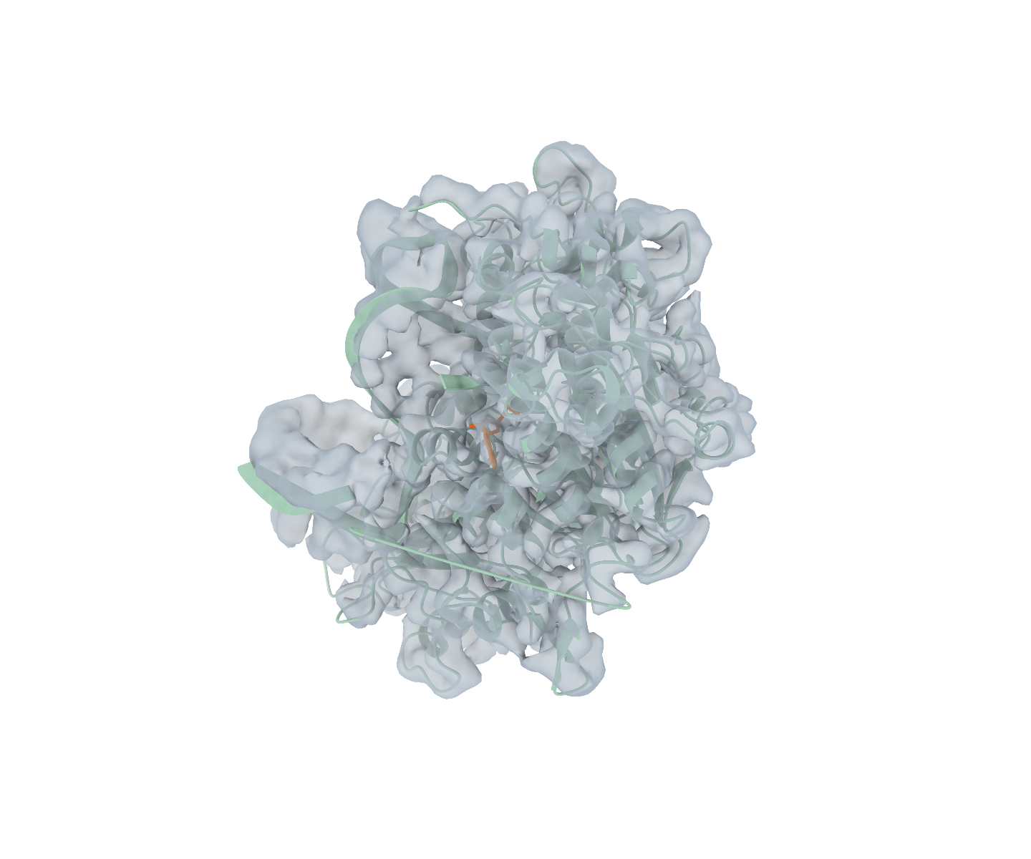
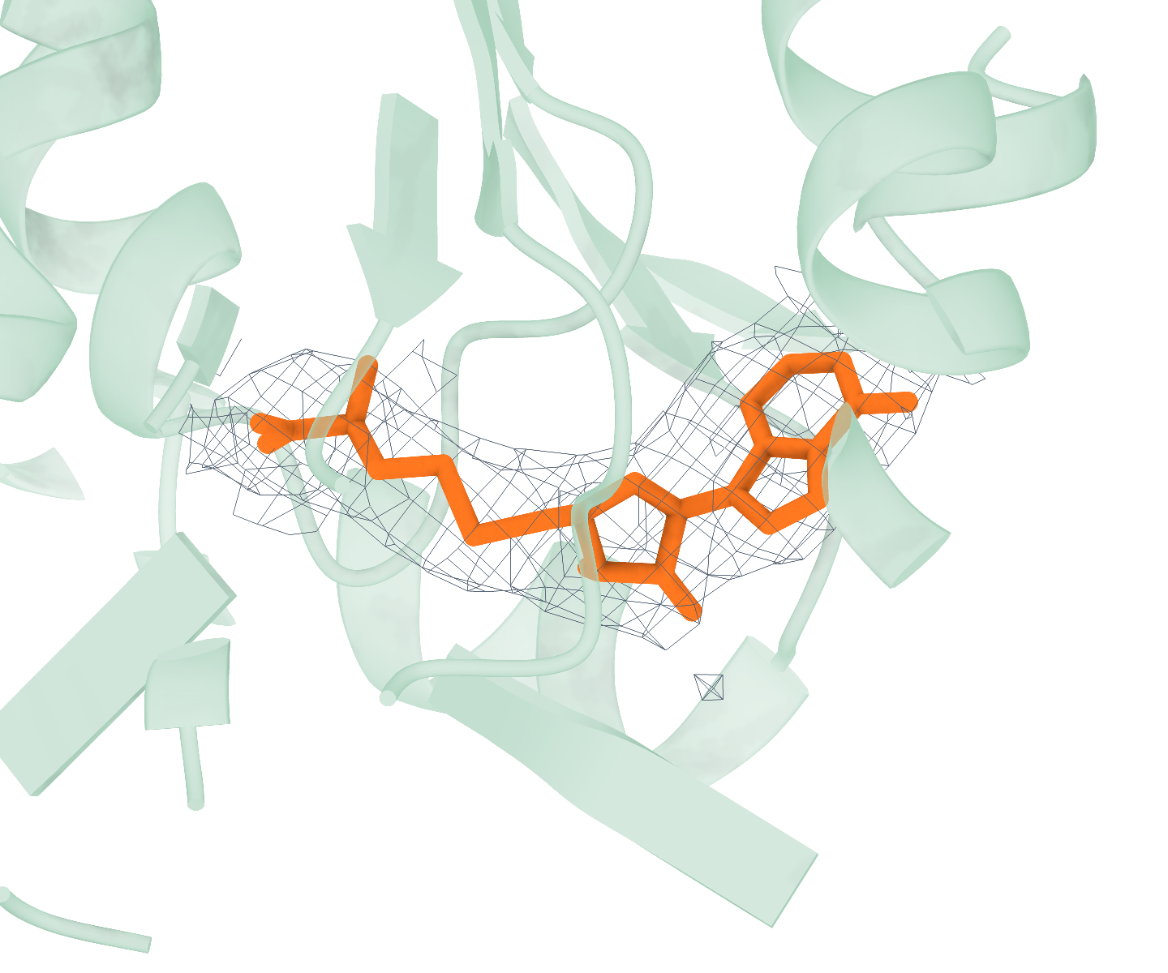
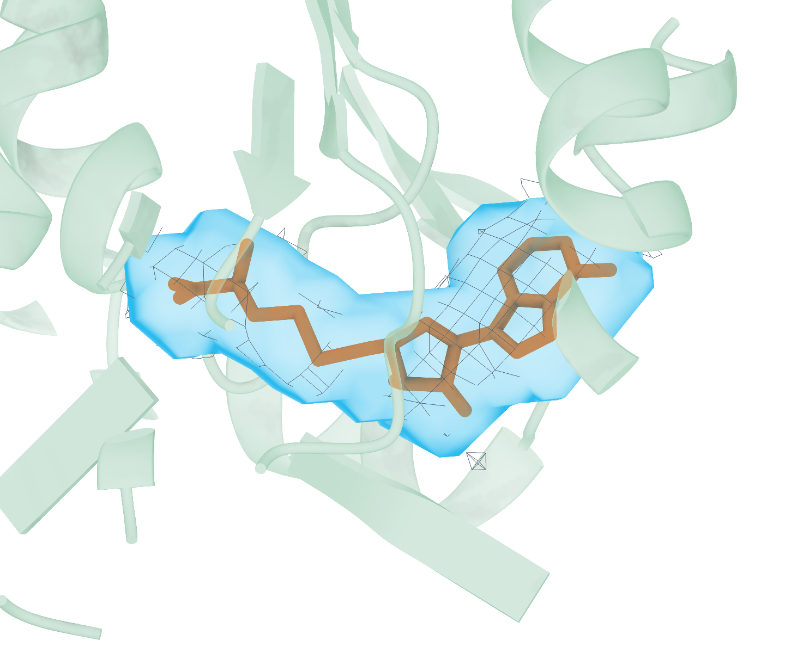
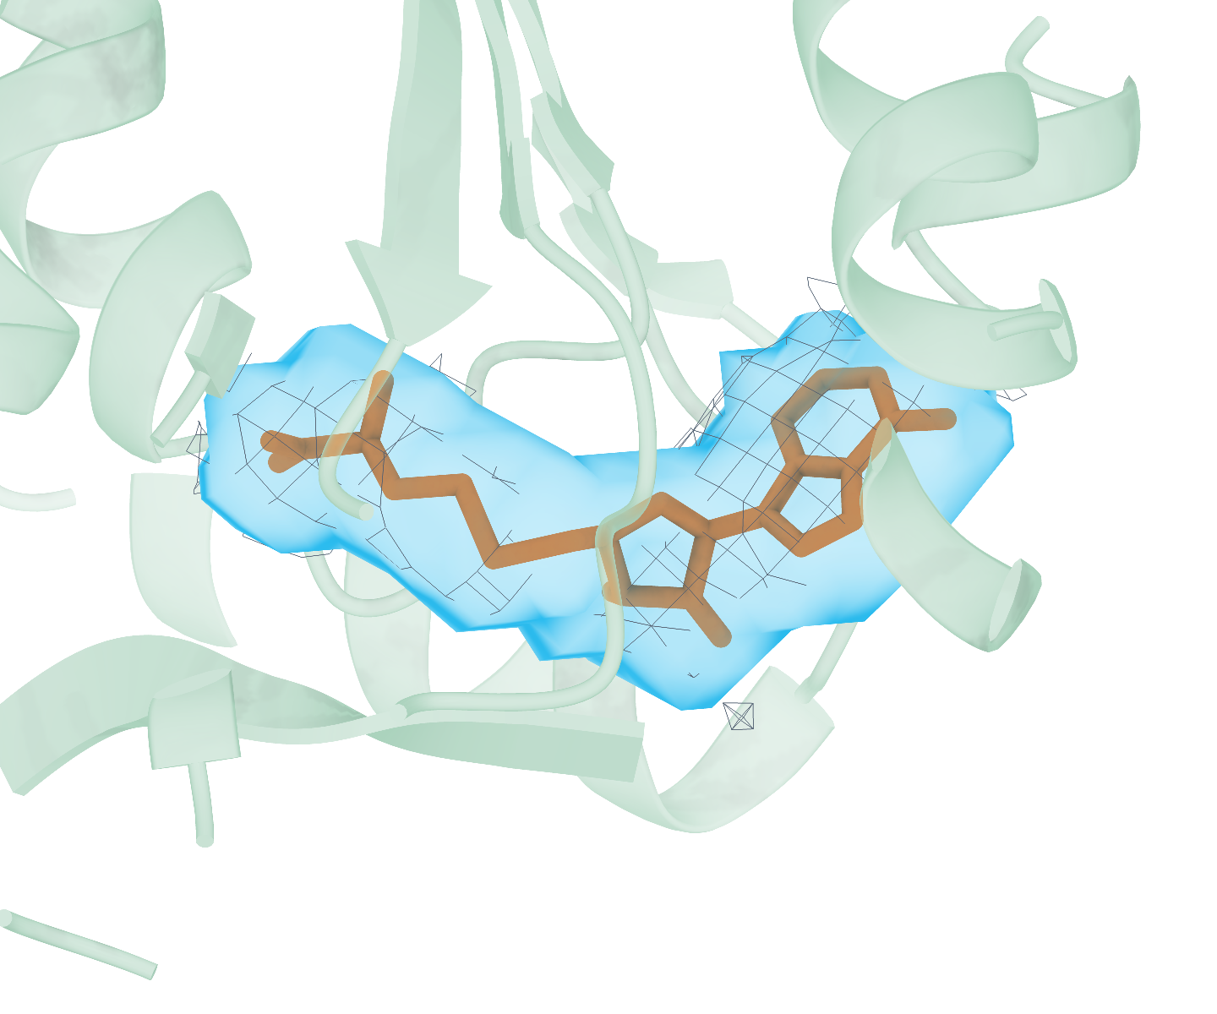
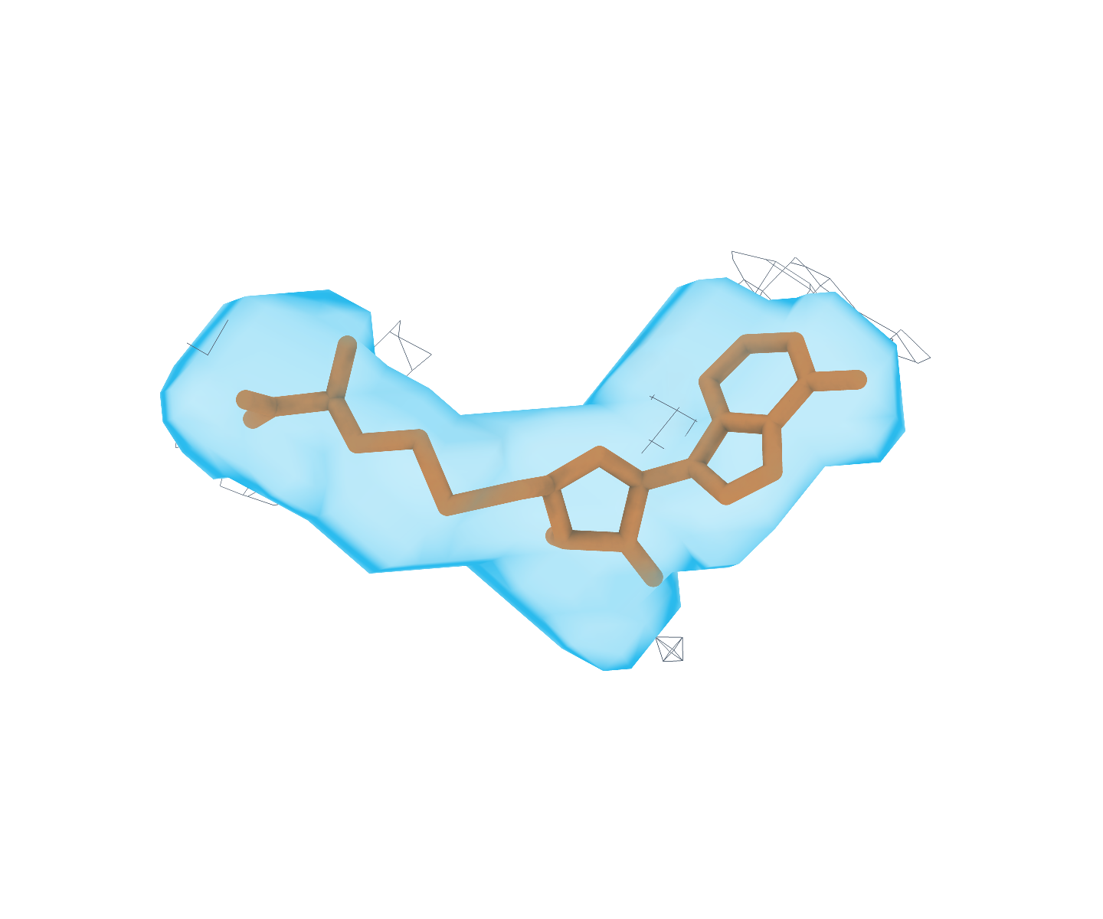
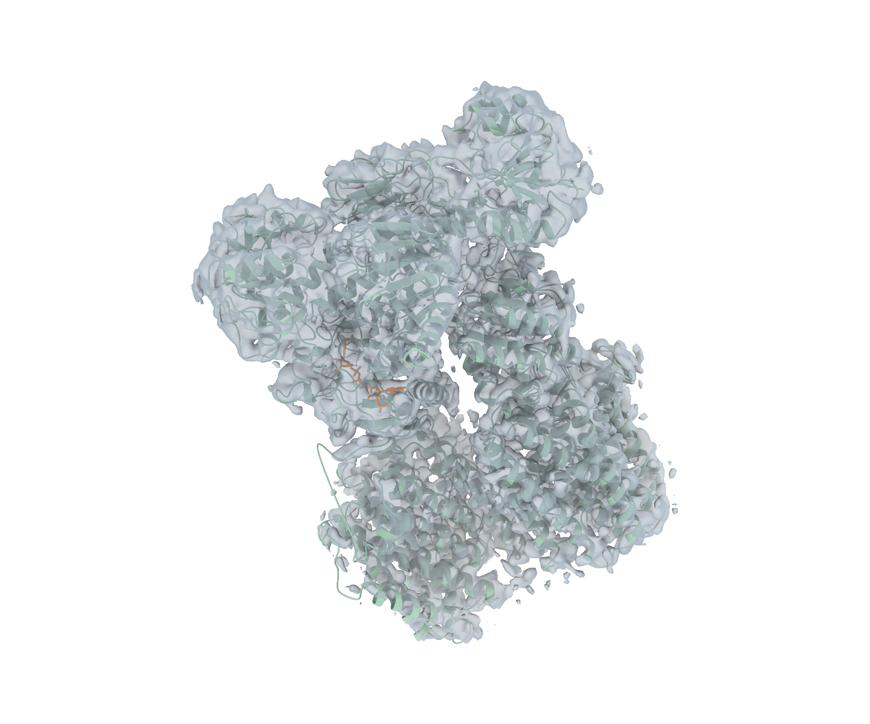
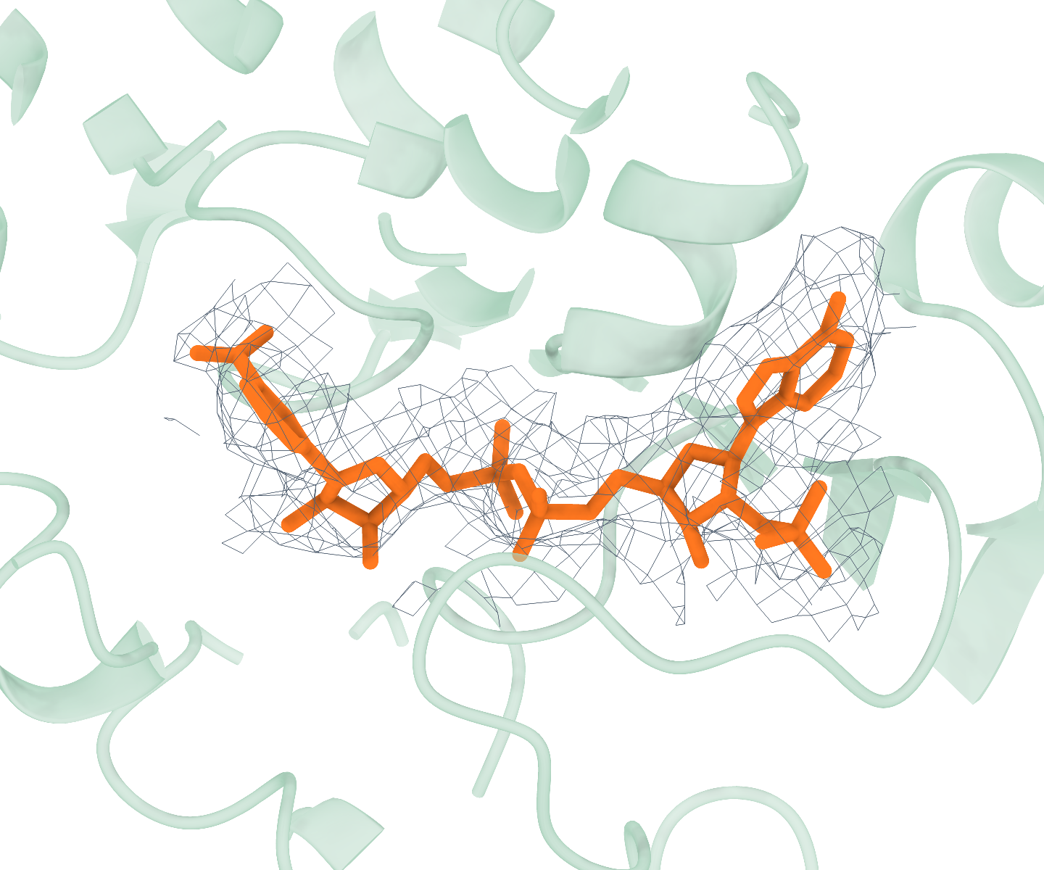
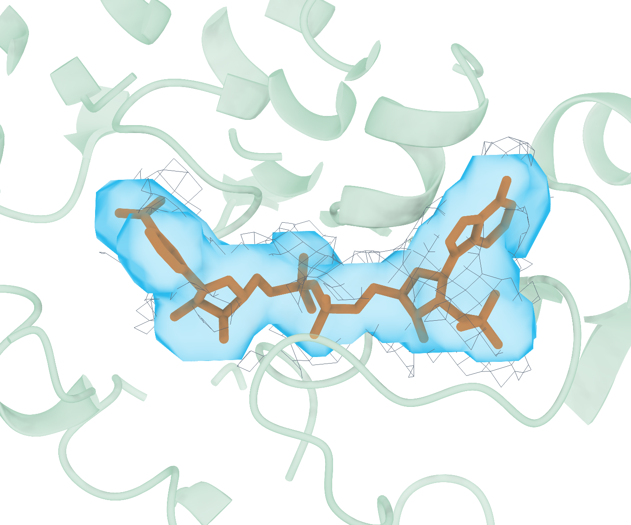
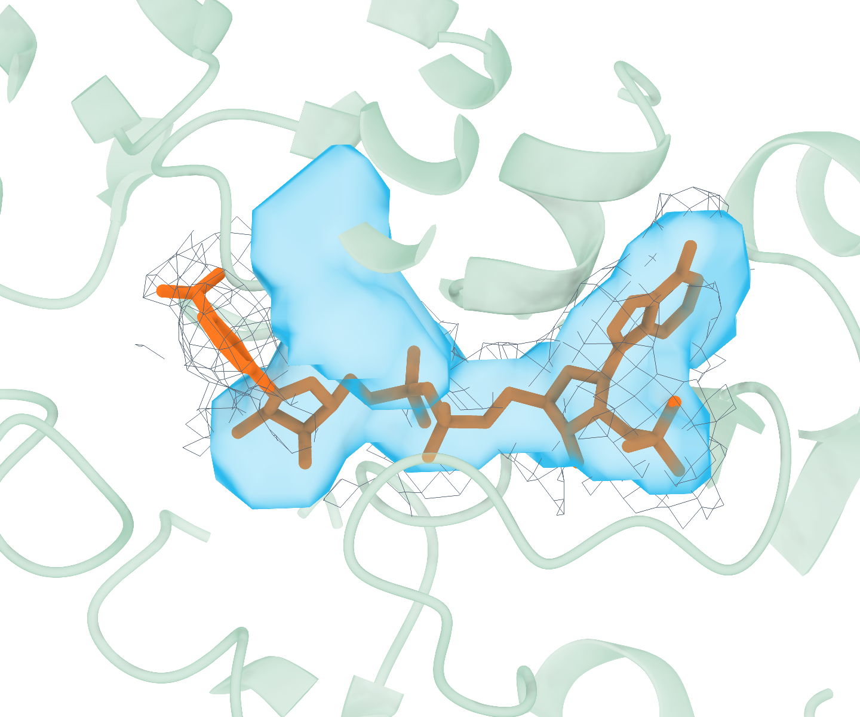
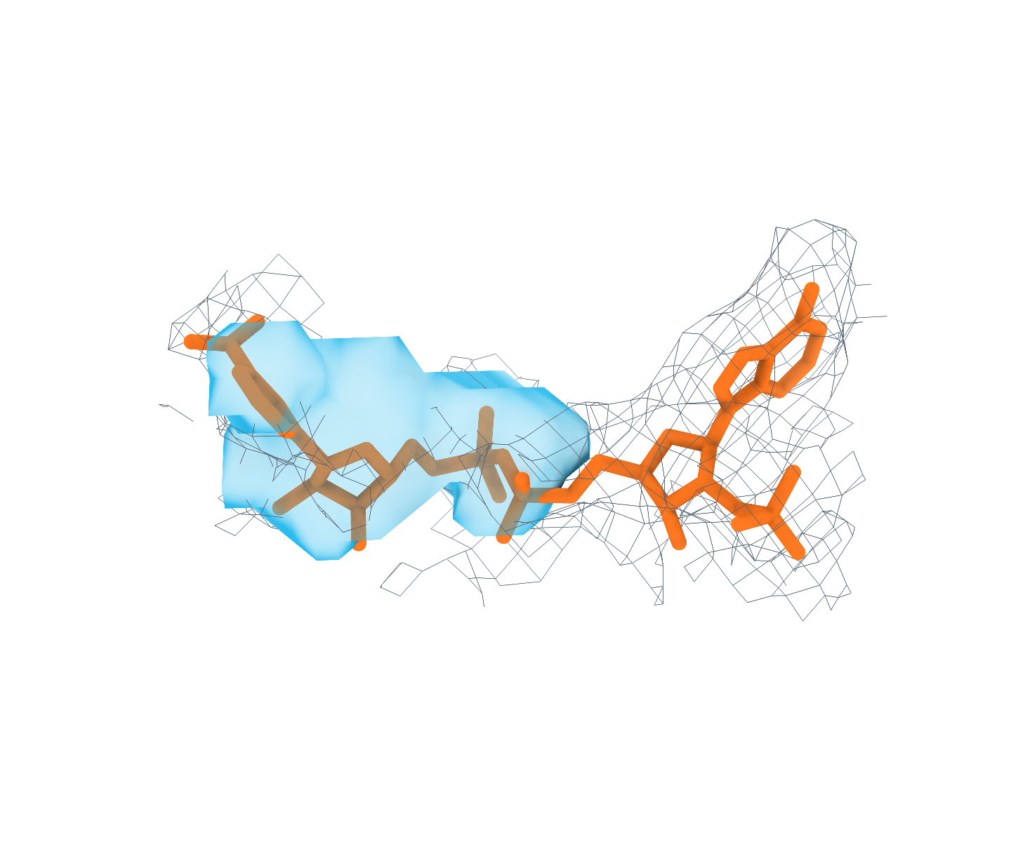
Us-align
Global context
Ligand reference
Find_1
Find_1
Emap2lig
Deposited structure + map
Deposited receptor
Deposited receptor · Gaussian
CryoAtom2 receptor · Gaussian
No receptor input
a
9Z3D | SAH A:801 | EMD-73784 | 2.96 Å
5 Å
5 Å
5 Å
5 Å
Target ligand boxed
Same ligand and local view
Dice 0.885
Dice 0.875
Dice 0.633
P 0.847 R 0.926
P 0.833 R 0.922
P 0.599 R 0.670
b
9HJX | NAP B:500 | EMD-52228 | 3.39 Å
5 Å
5 Å
5 Å
5 Å
Target ligand boxed
Same ligand and local view
Dice 0.845
Dice 0.640
Dice 0.421
P 0.803 R 0.891
P 0.596 R 0.691
P 0.711 R 0.299
GT ligand
Selected target blob
Receptor cartoon
Experimental density (mesh)
GT ligand is a reference only. Each prediction panel shows the selected blob with the largest GT overlap; P, R and Dice are instance-level metrics.
Notes:
图 3｜Stage1 配体区域检测示例。a，9Z3D 的 SAH（A:801）；b，9HJX 的 NAP（B:500）。从左至右为整体定位、真实配体参考、Find_1 真实受体、Find_1 CryoAtom2 受体和 Emap2lig。局部视图比较同一配体及其正式入选预测；其他入选候选保留在三维会话中。Find_1 使用 F2–F1 Gaussian。两例为选定的可视化示例，不代表总体性能。

Slide 12
Semantic segmentation
Method | Dice | Precision | Recall | PRAUC
Find_1 / GT / Gaussian | 0.5845 | 0.5848 | 0.6700 | 0.6226
Find_1 / GT / basic (F1–F1) | 0.5832 | 0.6060 | 0.6455 | 0.6226
Find_1 / CryoAtom2 / Gaussian | 0.4769 | 0.4845 | 0.5735 | 0.4870
Find_1 / CryoAtom2 / basic (F1–F1) | 0.4828 | 0.4996 | 0.5727 | 0.4870
unet_c1 / F1–F1 | 0.3944 | 0.4284 | 0.4730 | 0.4016
Emap2lig | 0.0499 | 0.0372 | 0.3440 | 0.1907
test_0, n = 179 PDBs. Macro averages. Bold: highest value in each column (including ties).
Notes:
Gaussian uses F2–F1; Find_1 and unet_c1 basic use F1–F1. Emap2lig uses its official Find/Li pipeline. All metrics are PDB macro averages. Dice is semantic F1. Precision and recall use final selected candidates. PRAUC scans eligible candidates without the final score threshold. Bidirectional coverage threshold τ is not IoU. Basic family: F1-F1. Resolution colour scale: 1.0–4.0 Å.
Source metrics (read-only server files):
GT_gaussian: /storage/penghongen/AdaLigand_stage1_inference/Find_1/真实受体/artifacts/Find_1/held_out_test_0/evaluation/f2_centered_gaussian_macro_selected.metrics.json
SHA256: f7ef612da12b62a14f2f92de37f966b2dc34807c3122a68084616743a0d73fd6
GT_basic: /storage/penghongen/AdaLigand_stage1_inference/Find_1/真实受体/artifacts/Find_1/held_out_test_0/evaluation/f1_blobs_basic_macro_selected.metrics.json
SHA256: 1288b47f69e2fc66fc217a47d13032343cef6ea92ea96a20888bfede9ff94b80
Cryo_gaussian: /storage/penghongen/AdaLigand_stage1_inference/Find_1/CryoAtom2受体/artifacts/Find_1/held_out_test_0/evaluation/f2_centered_gaussian_macro_selected.metrics.json
SHA256: 0a2c5878640d254efadfadd76e01852514d2200364169bd33f17604759f9b7f3
Cryo_basic: /storage/penghongen/AdaLigand_stage1_inference/Find_1/CryoAtom2受体/artifacts/Find_1/held_out_test_0/evaluation/f1_blobs_basic_macro_selected.metrics.json
SHA256: 3bc148c7035000d685850300ca113d506ca37d38d0f26fa5db47ba4ca31e6924
unet_F1: /storage/penghongen/AdaLigand_stage1_inference/UNET/unet_c1_pdb_centric_v2/artifacts/unet_c1/held_out_test_0/evaluation/f1_blobs_basic_macro_selected.metrics.json
SHA256: 4b216227a8b9d8b528afd8d610ddf48c4bafb95bfdaa71471ec647dedbaf765e
Emap2lig: /storage/penghongen/AdaLigand_stage1_inference/Emap2lig/official_find_li/held_out_test_0/evaluation/official_find_li.metrics.json
SHA256: 19a0bca8380ea2ea708cc0eb1b1867b8d7b4c2c94e6c810bdeed6446a361d100
Source data: source_data_test0_macro.csv. The same unet_c1 baseline is retained in the GT and CryoAtom2 ablation figures.

Slide 13
Instance detection at τ = 0.3
One-to-one
Coverage
Method | P | R | PRAUC | P | R | PRAUC
Find_1 / GT / Gaussian | 0.7628 | 0.6880 | 0.6632 | 0.7628 | 0.7059 | 0.6811
Find_1 / GT / basic (F1–F1) | 0.7299 | 0.6873 | 0.6328 | 0.7299 | 0.7059 | 0.6507
Find_1 / CryoAtom2 / Gaussian | 0.6313 | 0.5942 | 0.5409 | 0.6313 | 0.6075 | 0.5545
Find_1 / CryoAtom2 / basic (F1–F1) | 0.6194 | 0.6172 | 0.5364 | 0.6194 | 0.6313 | 0.5503
unet_c1 / F1–F1 | 0.5720 | 0.4867 | 0.4460 | 0.5720 | 0.4965 | 0.4523
Emap2lig | 0.0368 | 0.3116 | 0.2552 | 0.0368 | 0.3135 | 0.2570
test_0, n = 179 PDBs. Macro averages. Bold: highest value in each column (including ties).
Notes:
Gaussian uses F2–F1; Find_1 and unet_c1 basic use F1–F1. Emap2lig uses its official Find/Li pipeline. All metrics are PDB macro averages. Dice is semantic F1. Precision and recall use final selected candidates. PRAUC scans eligible candidates without the final score threshold. Bidirectional coverage threshold τ is not IoU. Basic family: F1-F1. Resolution colour scale: 1.0–4.0 Å.
Source metrics (read-only server files):
GT_gaussian: /storage/penghongen/AdaLigand_stage1_inference/Find_1/真实受体/artifacts/Find_1/held_out_test_0/evaluation/f2_centered_gaussian_macro_selected.metrics.json
SHA256: f7ef612da12b62a14f2f92de37f966b2dc34807c3122a68084616743a0d73fd6
GT_basic: /storage/penghongen/AdaLigand_stage1_inference/Find_1/真实受体/artifacts/Find_1/held_out_test_0/evaluation/f1_blobs_basic_macro_selected.metrics.json
SHA256: 1288b47f69e2fc66fc217a47d13032343cef6ea92ea96a20888bfede9ff94b80
Cryo_gaussian: /storage/penghongen/AdaLigand_stage1_inference/Find_1/CryoAtom2受体/artifacts/Find_1/held_out_test_0/evaluation/f2_centered_gaussian_macro_selected.metrics.json
SHA256: 0a2c5878640d254efadfadd76e01852514d2200364169bd33f17604759f9b7f3
Cryo_basic: /storage/penghongen/AdaLigand_stage1_inference/Find_1/CryoAtom2受体/artifacts/Find_1/held_out_test_0/evaluation/f1_blobs_basic_macro_selected.metrics.json
SHA256: 3bc148c7035000d685850300ca113d506ca37d38d0f26fa5db47ba4ca31e6924
unet_F1: /storage/penghongen/AdaLigand_stage1_inference/UNET/unet_c1_pdb_centric_v2/artifacts/unet_c1/held_out_test_0/evaluation/f1_blobs_basic_macro_selected.metrics.json
SHA256: 4b216227a8b9d8b528afd8d610ddf48c4bafb95bfdaa71471ec647dedbaf765e
Emap2lig: /storage/penghongen/AdaLigand_stage1_inference/Emap2lig/official_find_li/held_out_test_0/evaluation/official_find_li.metrics.json
SHA256: 19a0bca8380ea2ea708cc0eb1b1867b8d7b4c2c94e6c810bdeed6446a361d100
Source data: source_data_test0_macro.csv. The same unet_c1 baseline is retained in the GT and CryoAtom2 ablation figures.

Slide 14
Instance detection at τ = 0.6
One-to-one
Coverage
Method | P | R | PRAUC | P | R | PRAUC
Find_1 / GT / Gaussian | 0.5737 | 0.5413 | 0.4933 | 0.5737 | 0.5413 | 0.4933
Find_1 / GT / basic (F1–F1) | 0.5525 | 0.5407 | 0.4864 | 0.5525 | 0.5407 | 0.4864
Find_1 / CryoAtom2 / Gaussian | 0.4428 | 0.4374 | 0.3760 | 0.4428 | 0.4374 | 0.3760
Find_1 / CryoAtom2 / basic (F1–F1) | 0.4493 | 0.4635 | 0.3914 | 0.4493 | 0.4635 | 0.3914
unet_c1 / F1–F1 | 0.3228 | 0.2894 | 0.2497 | 0.3228 | 0.2894 | 0.2497
Emap2lig | 0.0051 | 0.0880 | 0.0680 | 0.0051 | 0.0880 | 0.0680
test_0, n = 179 PDBs. Macro averages. Bold: highest value in each column (including ties).
Notes:
Gaussian uses F2–F1; Find_1 and unet_c1 basic use F1–F1. Emap2lig uses its official Find/Li pipeline. All metrics are PDB macro averages. Dice is semantic F1. Precision and recall use final selected candidates. PRAUC scans eligible candidates without the final score threshold. Bidirectional coverage threshold τ is not IoU. Basic family: F1-F1. Resolution colour scale: 1.0–4.0 Å.
Source metrics (read-only server files):
GT_gaussian: /storage/penghongen/AdaLigand_stage1_inference/Find_1/真实受体/artifacts/Find_1/held_out_test_0/evaluation/f2_centered_gaussian_macro_selected.metrics.json
SHA256: f7ef612da12b62a14f2f92de37f966b2dc34807c3122a68084616743a0d73fd6
GT_basic: /storage/penghongen/AdaLigand_stage1_inference/Find_1/真实受体/artifacts/Find_1/held_out_test_0/evaluation/f1_blobs_basic_macro_selected.metrics.json
SHA256: 1288b47f69e2fc66fc217a47d13032343cef6ea92ea96a20888bfede9ff94b80
Cryo_gaussian: /storage/penghongen/AdaLigand_stage1_inference/Find_1/CryoAtom2受体/artifacts/Find_1/held_out_test_0/evaluation/f2_centered_gaussian_macro_selected.metrics.json
SHA256: 0a2c5878640d254efadfadd76e01852514d2200364169bd33f17604759f9b7f3
Cryo_basic: /storage/penghongen/AdaLigand_stage1_inference/Find_1/CryoAtom2受体/artifacts/Find_1/held_out_test_0/evaluation/f1_blobs_basic_macro_selected.metrics.json
SHA256: 3bc148c7035000d685850300ca113d506ca37d38d0f26fa5db47ba4ca31e6924
unet_F1: /storage/penghongen/AdaLigand_stage1_inference/UNET/unet_c1_pdb_centric_v2/artifacts/unet_c1/held_out_test_0/evaluation/f1_blobs_basic_macro_selected.metrics.json
SHA256: 4b216227a8b9d8b528afd8d610ddf48c4bafb95bfdaa71471ec647dedbaf765e
Emap2lig: /storage/penghongen/AdaLigand_stage1_inference/Emap2lig/official_find_li/held_out_test_0/evaluation/official_find_li.metrics.json
SHA256: 19a0bca8380ea2ea708cc0eb1b1867b8d7b4c2c94e6c810bdeed6446a361d100
Source data: source_data_test0_macro.csv. The same unet_c1 baseline is retained in the GT and CryoAtom2 ablation figures.

Slide 15
1.0
0.8
0.6
PRAUC
0.4
0.2
0.0
Semantic
Coverage
One-to-one
Coverage
One-to-one
τ = 0.3
τ = 0.3
τ = 0.6
τ = 0.6
Notes:
All values use test_0 (179 PDBs). Bar height is the PDB mean. Every dot is one PDB at its true metric value; horizontal jitter only. Whiskers are percentile 95% confidence intervals from 10000 bootstrap replicates, resampling 179 PDBs with replacement with shared indices across all methods and metrics (seed 20260922). These quantify PDB sampling variability, not repeated-training variability. Methods: Find_1 / GT / Gaussian, Find_1 / GT / basic (F1–F1), unet_c1 / F1–F1 Basic family: F1-F1. Resolution colour scale: 1.0–4.0 Å.
Source metrics (read-only server files):
GT_gaussian: /storage/penghongen/AdaLigand_stage1_inference/Find_1/真实受体/artifacts/Find_1/held_out_test_0/evaluation/f2_centered_gaussian_macro_selected.metrics.json
SHA256: f7ef612da12b62a14f2f92de37f966b2dc34807c3122a68084616743a0d73fd6
GT_basic: /storage/penghongen/AdaLigand_stage1_inference/Find_1/真实受体/artifacts/Find_1/held_out_test_0/evaluation/f1_blobs_basic_macro_selected.metrics.json
SHA256: 1288b47f69e2fc66fc217a47d13032343cef6ea92ea96a20888bfede9ff94b80
Cryo_gaussian: /storage/penghongen/AdaLigand_stage1_inference/Find_1/CryoAtom2受体/artifacts/Find_1/held_out_test_0/evaluation/f2_centered_gaussian_macro_selected.metrics.json
SHA256: 0a2c5878640d254efadfadd76e01852514d2200364169bd33f17604759f9b7f3
Cryo_basic: /storage/penghongen/AdaLigand_stage1_inference/Find_1/CryoAtom2受体/artifacts/Find_1/held_out_test_0/evaluation/f1_blobs_basic_macro_selected.metrics.json
SHA256: 3bc148c7035000d685850300ca113d506ca37d38d0f26fa5db47ba4ca31e6924
unet_F1: /storage/penghongen/AdaLigand_stage1_inference/UNET/unet_c1_pdb_centric_v2/artifacts/unet_c1/held_out_test_0/evaluation/f1_blobs_basic_macro_selected.metrics.json
SHA256: 4b216227a8b9d8b528afd8d610ddf48c4bafb95bfdaa71471ec647dedbaf765e
Emap2lig: /storage/penghongen/AdaLigand_stage1_inference/Emap2lig/official_find_li/held_out_test_0/evaluation/official_find_li.metrics.json
SHA256: 19a0bca8380ea2ea708cc0eb1b1867b8d7b4c2c94e6c810bdeed6446a361d100
Source data: source_data_test0_macro.csv. The same unet_c1 baseline is retained in the GT and CryoAtom2 ablation figures.

Slide 16
Component profile · GT receptor
Semantic
PRAUC
1.0
0.8
0.6
Coverage
0.4
One-to-one
PRAUC, τ = 0.3
PRAUC, τ = 0.3
0.2
Coverage
One-to-one
PRAUC, τ = 0.6
PRAUC, τ = 0.6
Find_1 · Gaussian
Find_1 · basic (F1–F1)
unet_c1 · basic (F1–F1)
test_0, n = 179 PDBs. Every axis: macro PRAUC, fixed scale 0–1.
Notes:
Five-axis polygon chart with identical [0,1] scales. Values are PDB macro PRAUC. Find_1 Gaussian/basic use the specified receptor condition. The same existing unet_c1 F1–F1 baseline appears in both panels; this is not a separately run CryoAtom2 unet. Read individual axes; polygon area is not a performance metric. Basic family: F1-F1. Resolution colour scale: 1.0–4.0 Å.
Source metrics (read-only server files):
GT_gaussian: /storage/penghongen/AdaLigand_stage1_inference/Find_1/真实受体/artifacts/Find_1/held_out_test_0/evaluation/f2_centered_gaussian_macro_selected.metrics.json
SHA256: f7ef612da12b62a14f2f92de37f966b2dc34807c3122a68084616743a0d73fd6
GT_basic: /storage/penghongen/AdaLigand_stage1_inference/Find_1/真实受体/artifacts/Find_1/held_out_test_0/evaluation/f1_blobs_basic_macro_selected.metrics.json
SHA256: 1288b47f69e2fc66fc217a47d13032343cef6ea92ea96a20888bfede9ff94b80
Cryo_gaussian: /storage/penghongen/AdaLigand_stage1_inference/Find_1/CryoAtom2受体/artifacts/Find_1/held_out_test_0/evaluation/f2_centered_gaussian_macro_selected.metrics.json
SHA256: 0a2c5878640d254efadfadd76e01852514d2200364169bd33f17604759f9b7f3
Cryo_basic: /storage/penghongen/AdaLigand_stage1_inference/Find_1/CryoAtom2受体/artifacts/Find_1/held_out_test_0/evaluation/f1_blobs_basic_macro_selected.metrics.json
SHA256: 3bc148c7035000d685850300ca113d506ca37d38d0f26fa5db47ba4ca31e6924
unet_F1: /storage/penghongen/AdaLigand_stage1_inference/UNET/unet_c1_pdb_centric_v2/artifacts/unet_c1/held_out_test_0/evaluation/f1_blobs_basic_macro_selected.metrics.json
SHA256: 4b216227a8b9d8b528afd8d610ddf48c4bafb95bfdaa71471ec647dedbaf765e
Emap2lig: /storage/penghongen/AdaLigand_stage1_inference/Emap2lig/official_find_li/held_out_test_0/evaluation/official_find_li.metrics.json
SHA256: 19a0bca8380ea2ea708cc0eb1b1867b8d7b4c2c94e6c810bdeed6446a361d100
Source data: source_data_test0_macro.csv. The same unet_c1 baseline is retained in the GT and CryoAtom2 ablation figures.

Slide 17
1.0
0.8
0.6
PRAUC
0.4
0.2
0.0
Semantic
Coverage
One-to-one
Coverage
One-to-one
τ = 0.3
τ = 0.3
τ = 0.6
τ = 0.6
Notes:
All values use test_0 (179 PDBs). Bar height is the PDB mean. Every dot is one PDB at its true metric value; horizontal jitter only. Whiskers are percentile 95% confidence intervals from 10000 bootstrap replicates, resampling 179 PDBs with replacement with shared indices across all methods and metrics (seed 20260922). These quantify PDB sampling variability, not repeated-training variability. Methods: Find_1 / CryoAtom2 / Gaussian, Find_1 / CryoAtom2 / basic (F1–F1), unet_c1 / F1–F1 Basic family: F1-F1. Resolution colour scale: 1.0–4.0 Å.
Source metrics (read-only server files):
GT_gaussian: /storage/penghongen/AdaLigand_stage1_inference/Find_1/真实受体/artifacts/Find_1/held_out_test_0/evaluation/f2_centered_gaussian_macro_selected.metrics.json
SHA256: f7ef612da12b62a14f2f92de37f966b2dc34807c3122a68084616743a0d73fd6
GT_basic: /storage/penghongen/AdaLigand_stage1_inference/Find_1/真实受体/artifacts/Find_1/held_out_test_0/evaluation/f1_blobs_basic_macro_selected.metrics.json
SHA256: 1288b47f69e2fc66fc217a47d13032343cef6ea92ea96a20888bfede9ff94b80
Cryo_gaussian: /storage/penghongen/AdaLigand_stage1_inference/Find_1/CryoAtom2受体/artifacts/Find_1/held_out_test_0/evaluation/f2_centered_gaussian_macro_selected.metrics.json
SHA256: 0a2c5878640d254efadfadd76e01852514d2200364169bd33f17604759f9b7f3
Cryo_basic: /storage/penghongen/AdaLigand_stage1_inference/Find_1/CryoAtom2受体/artifacts/Find_1/held_out_test_0/evaluation/f1_blobs_basic_macro_selected.metrics.json
SHA256: 3bc148c7035000d685850300ca113d506ca37d38d0f26fa5db47ba4ca31e6924
unet_F1: /storage/penghongen/AdaLigand_stage1_inference/UNET/unet_c1_pdb_centric_v2/artifacts/unet_c1/held_out_test_0/evaluation/f1_blobs_basic_macro_selected.metrics.json
SHA256: 4b216227a8b9d8b528afd8d610ddf48c4bafb95bfdaa71471ec647dedbaf765e
Emap2lig: /storage/penghongen/AdaLigand_stage1_inference/Emap2lig/official_find_li/held_out_test_0/evaluation/official_find_li.metrics.json
SHA256: 19a0bca8380ea2ea708cc0eb1b1867b8d7b4c2c94e6c810bdeed6446a361d100
Source data: source_data_test0_macro.csv. The same unet_c1 baseline is retained in the GT and CryoAtom2 ablation figures.

Slide 18
Component profile · CryoAtom2 receptor
Semantic
PRAUC
1.0
0.8
0.6
Coverage
0.4
One-to-one
PRAUC, τ = 0.3
PRAUC, τ = 0.3
0.2
Coverage
One-to-one
PRAUC, τ = 0.6
PRAUC, τ = 0.6
Find_1 · Gaussian
Find_1 · basic (F1–F1)
unet_c1 · basic (F1–F1)
test_0, n = 179 PDBs. Every axis: macro PRAUC, fixed scale 0–1.
Notes:
Five-axis polygon chart with identical [0,1] scales. Values are PDB macro PRAUC. Find_1 Gaussian/basic use the specified receptor condition. The same existing unet_c1 F1–F1 baseline appears in both panels; this is not a separately run CryoAtom2 unet. Read individual axes; polygon area is not a performance metric. Basic family: F1-F1. Resolution colour scale: 1.0–4.0 Å.
Source metrics (read-only server files):
GT_gaussian: /storage/penghongen/AdaLigand_stage1_inference/Find_1/真实受体/artifacts/Find_1/held_out_test_0/evaluation/f2_centered_gaussian_macro_selected.metrics.json
SHA256: f7ef612da12b62a14f2f92de37f966b2dc34807c3122a68084616743a0d73fd6
GT_basic: /storage/penghongen/AdaLigand_stage1_inference/Find_1/真实受体/artifacts/Find_1/held_out_test_0/evaluation/f1_blobs_basic_macro_selected.metrics.json
SHA256: 1288b47f69e2fc66fc217a47d13032343cef6ea92ea96a20888bfede9ff94b80
Cryo_gaussian: /storage/penghongen/AdaLigand_stage1_inference/Find_1/CryoAtom2受体/artifacts/Find_1/held_out_test_0/evaluation/f2_centered_gaussian_macro_selected.metrics.json
SHA256: 0a2c5878640d254efadfadd76e01852514d2200364169bd33f17604759f9b7f3
Cryo_basic: /storage/penghongen/AdaLigand_stage1_inference/Find_1/CryoAtom2受体/artifacts/Find_1/held_out_test_0/evaluation/f1_blobs_basic_macro_selected.metrics.json
SHA256: 3bc148c7035000d685850300ca113d506ca37d38d0f26fa5db47ba4ca31e6924
unet_F1: /storage/penghongen/AdaLigand_stage1_inference/UNET/unet_c1_pdb_centric_v2/artifacts/unet_c1/held_out_test_0/evaluation/f1_blobs_basic_macro_selected.metrics.json
SHA256: 4b216227a8b9d8b528afd8d610ddf48c4bafb95bfdaa71471ec647dedbaf765e
Emap2lig: /storage/penghongen/AdaLigand_stage1_inference/Emap2lig/official_find_li/held_out_test_0/evaluation/official_find_li.metrics.json
SHA256: 19a0bca8380ea2ea708cc0eb1b1867b8d7b4c2c94e6c810bdeed6446a361d100
Source data: source_data_test0_macro.csv. The same unet_c1 baseline is retained in the GT and CryoAtom2 ablation figures.

Slide 19
1.0
Score
0.5
0.0
Semantic
One-to-one
One-to-one
Dice
PRAUC, τ = 0.3
PRAUC, τ = 0.5
1.0
Find_1 (CryoAtom2)
0.5
0.0
0.0
0.5
1.0
Emap2lig
Notes:
图 2｜Stage1 配体区域检测。左列：全配体（179 PDB）；右列：小分子-only（94 PDB，821 实例）。a、b，Dice、one-to-one PRAUC@0.3 和 PRAUC@0.5；柱高为 macro 均值，误差线为 10,000 次 PDB bootstrap 的均值 95% 区间。c、d，one-to-one PRAUC@0.3 配对比较；Find_1 较高/相等/Emap2lig 较高为 112/40/27 和 40/36/18。e、f，同阈值 Precision/Recall；白点和粗线为中位数与四分位范围。各点代表一个 PDB。Find_1 使用 F2–F1 Gaussian。小分子评估排除无小分子 GT 的 PDB，忽略固定归属非小分子的候选，未归属候选仍保留。两列的评价范围不同，均值差不表示性能变化。

